Slide 2
BESS Safety and Reliability Tutorials
Yuliya Preger
SAND2026-21790O

Slide 3
Why are we here?
Can you answer all of these questions now?
How are the gases vented from an LFP cell different from an NMC cell?
What is the standard fire suppression protocol in an ESS?
Are all energy storage systems required to have an emergency response plan?

Slide 4
Schedule
Time | Topic | Presenter
8:20 am - 9:20 am | Topic 1: What causes thermal runaway? (40 min + 20 min Q&A) | Nathan Johnson + Loraine Torres-Castro | SNL Battery Abuse Lab, USABC Battery Safety Testing Manual
9:20 am - 9:35 am | Break
9:35 am - 10:35 am | Topic 2: Taming the Beast: System designs to address cell-level safety concerns (40 min + 20 min Q&A) | Jim McDowall | IEEE Fellow, ESSB standards, ex-ESA director, ex-Saft
10:35am - 10:50 am | Break
10:50 am - 11:50 am | Topic 3: What if systems fail? (40 min + 20 min Q&A) | Matt Paiss | NFPA 800 chair, TC of NFPA855/UL9540/UL1973, ex-SJFD
11:50 am - 12:10 pm | Final Q&A

Slide 5
Learning Objectives
(1) Science of Thermal Runaway
Define what thermal runaway is, and its hazards
Determine chemistry-specific differences in hazards and critically assess safety claims for new chemistries
(2) System Design
Understand the influence of safety incidents on the evolution of ESS system design and safety standards
Learn how ESS vendors are approaching system safety and compliance with codes and standards

Slide 6
Learning Objectives
(3) What if Systems Fail?
Attendees will learn about working with AHJ's, best practices for emergency planning response, and unique decommissioning case studies

Slide 7
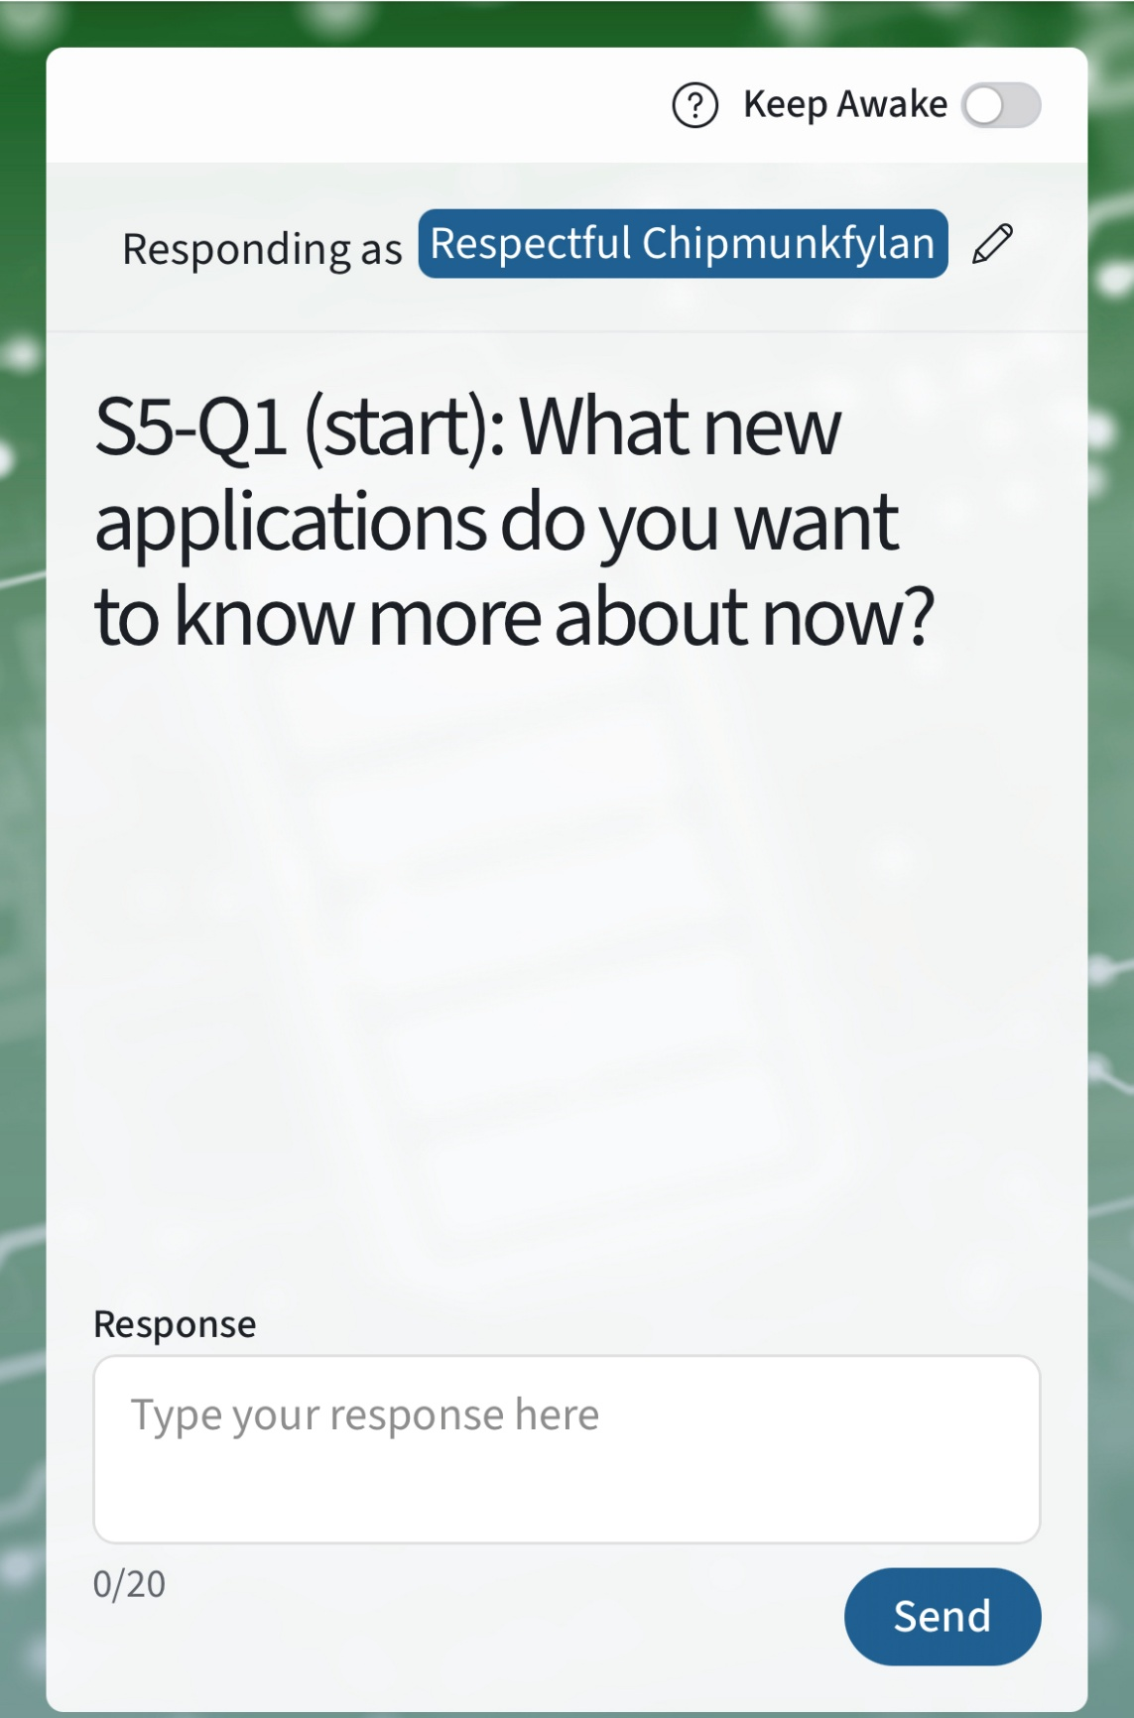
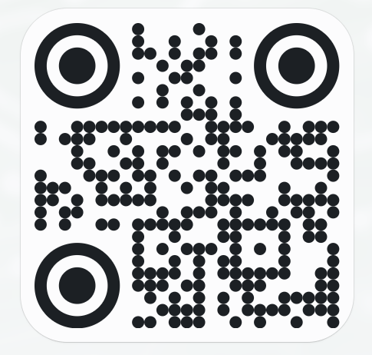

Poll Questions
Please visit Poll Everywhere via the QR code below (mobile) or at pe.app/essrf (laptop). If you would like to add your name, please update with the “pencil” icon. If not, feel free to remain anonymous

Slide 8
Opening Poll:
What group of stakeholders do you consider yourself part of?
ESS industry (manufacturer, installer)
ESS customer/user (utility, EPRI)
Standard development org
ESS AHJ
Research org

Slide 9
Opening Poll:
Where do you currently go for answers if you have energy storage safety questions?

Slide 10
Opening Poll:
What are you most interested in learning more about?

Slide 11
Closing Poll:
What was the most useful thing you learned today?

Slide 12
Closing Poll:
What are you still hoping to learn more about?

