Slide 1
Nantucket Island Energy Storage Assessment
Patrick Balducci, Chief Economist
Pacific Northwest National Laboratory
DOE OE Energy Storage Peer Review
Albuquerque, NM
September 24, 2019
Support from DOE Office of Electricity Delivery & Energy Reliability
ENERGY STORAGE PROGRAM
Other contributing authors: Kendall Mongird, Vanshika Fotedar, Di Wu, Tom McDermott,
Alasdair Crawford, Xu Ma, Bilal Bhatti, Bishnu Bhattarai, and Sumitrra Ganguli

Slide 2
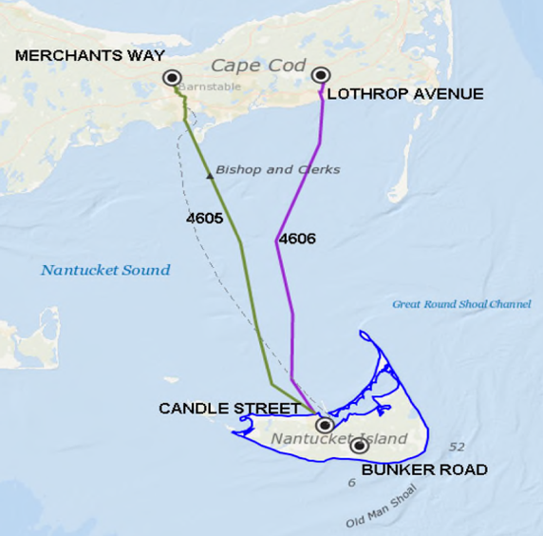
Project Overview
Nantucket Island
Located off the southeast coast of Massachusetts
Small resident population of 11,000
Transmission capacity constraints in summer where population can swell to over 50,000
Project Description
Nantucket Island’s electricity is supplied by two submarine cables with a combined capacity of 71 megawatts (MW) and two small on-island combustion turbine generators (CTGs) with a combined capacity of 6 MW
Rather than deploying a 3rd cable, National Grid is replacing the two CTGs with:
  A single, large CTG with a maximum capacity of 16 MW and
  6 MW / 48 MWh Tesla Li-ion battery energy storage system (BESS).
Nantucket Supply Cables
Project Importance
This study expands our capacity to accurately estimate grid impacts and financial implications of using storage for local and market-based services; study includes cycling limitations, imperfect foresight, market and non-market benefits, accurate market participation under new ISO-NE rules, performance scoring, and 4-second energy neutral signal following
This study highlights a valuable storage project and could also be used to make a case to the Federal Energy Regulatory Commission (FERC) to allow a rate-based asset to participate in wholesale energy markets
The results of this research effort will be used to ensure a more resilient, reliable, flexible and cost effective electricity system on Nantucket Island; lessons applicable to projects across the U.S.

Slide 3



Project Team
Patrick Balducci | Project Manager / Lead Economist
Dr. Jan Alam | Control Strategies Lead
Dr. Tom McDermott | Distribution System Analysis Lead
Vanshika Fotedar | Economic Assessment
Dr. Xu Ma | Modeling / Simulation
Dr. Di Wu | Modeling / Simulation
Kendall Mongird | Economic Assessment
Bishnu Bhattarai | Distribution System Analysis
Alasdair Crawford | Market Price Prediction
Dr. Sumitrra Ganguli | Economic Assessment
Terron Hill | Lead, National Grid Team
Tim Martin | Financial Data/Information
Dave Bianco | Distribution System/Energy Storage Data
Ben Carron | Financial Data/Information
Babak Enayati | Financial Data/Information
Bilal Bhatti | Distribution System Analysis

Slide 4





Project Synopsis and Objectives
Objective
Evaluate the technical and financial (market and non-market) benefits of energy storage on Nantucket Island
Evaluate its impact on the Nantucket Island distribution system
Develop control strategies to maximize financial benefits while achieving resilience goals.
Phases
Phase 1:
Preliminary Economic Analysis
Phase 2: Use Cases / Distribution System Impact Analysis
Phase 3:
Final Assessment & Controls Development
  Preliminary Economic Analysis
  Install Energy Storage Systems (ESS), Document Technical Performance, Perform Distribution Impact Analysis
  Controls Development and Final Evaluation
Team
PNNL: Brings expertise in energy/economics/environment system analysis and modeling
National Grid: Brings deep operational experience and required utility data / test sites
U.S. Department of Energy: Program management
Virginia Tech: Distribution system analytical support

Slide 5
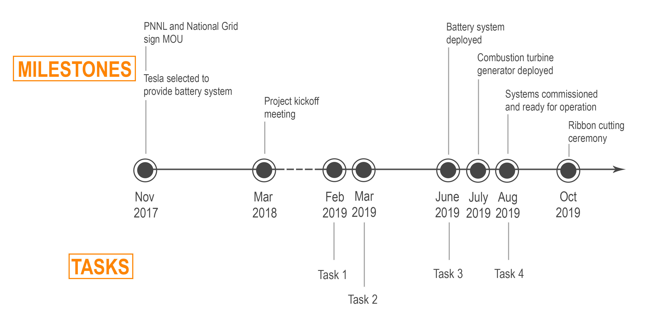
Project Metrics and Milestones
Metrics
Benefits by use case ($)
Return on investment ratio
Value of lost load (VoLL) reductions ($)
Task | Description
1 | Model battery energy storage system (BESS) operation under dynamic reliability needs and determine potential benefits by use case
2 | Model and simulate integration of the Nantucket BESS to Identify and Mitigate Negative System Impacts
3 | Define BESS Control Strategies and Assist with Implementation
4 | Prepare Final Report and Deliver Presentation

Slide 6
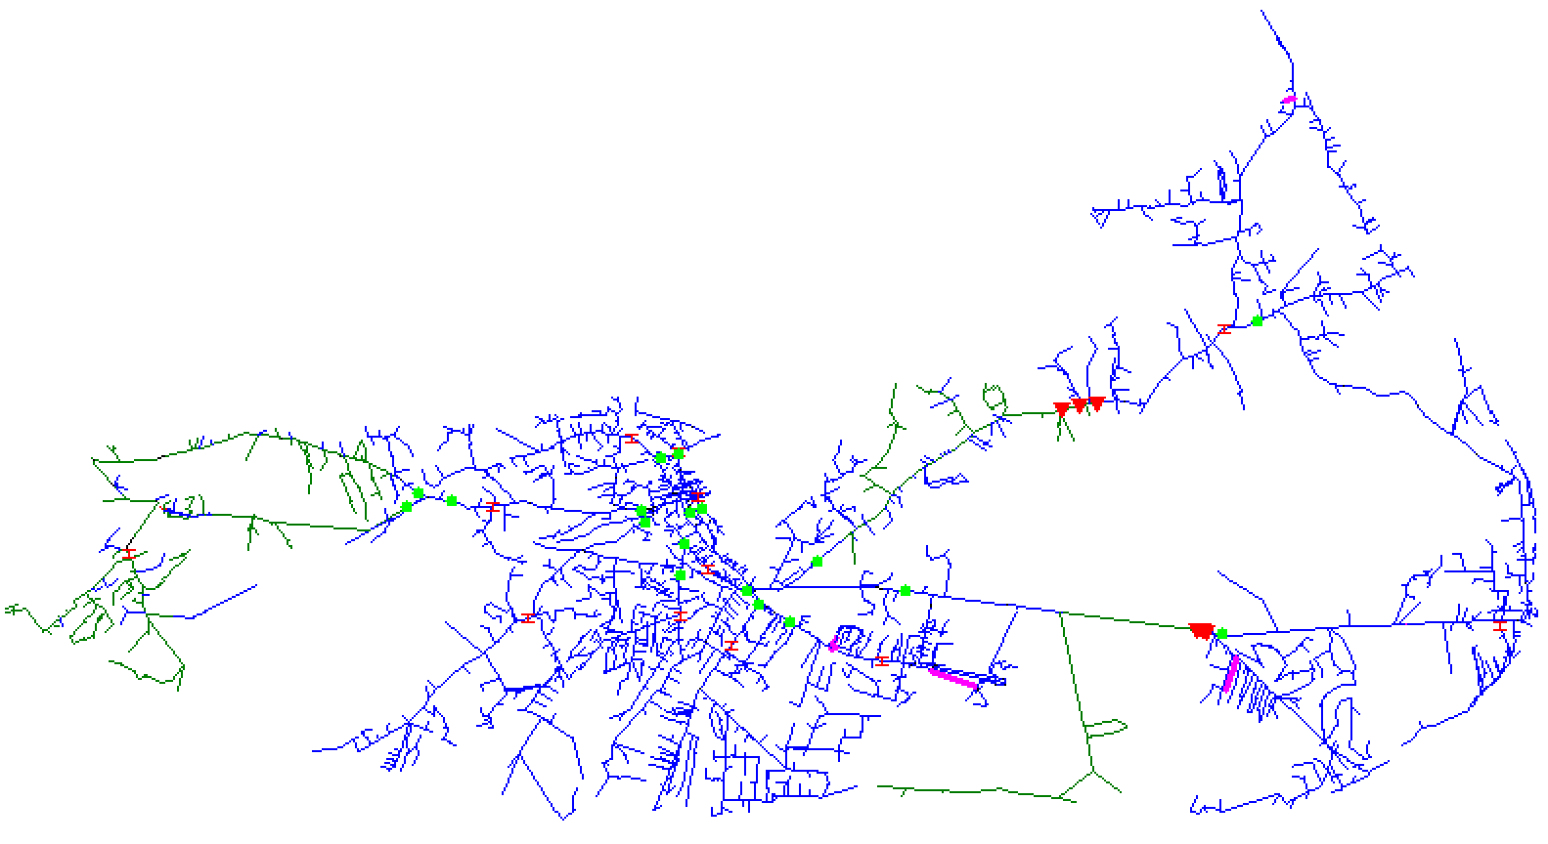
Distribution System Integration
ESSs do not operate in isolation and must therefore be integrated into the existing grid
  Modeled and simulated integration of storage systems to identify and mitigate negative system impacts
  Converted existing data and models to GridLab-D and OpenDSS
  Added battery and inverter controls to the models
  Evaluated battery integration under normal conditions, to include feeder volt/var control, battery SOC management, dispatch requirements with respect to existing DER, and the impact on reliability metrics
  Recommended operating practices and settings as needed, covering the battery, other distributed energy resources, and feeder volt/var equipment
Results woven back into the economic assessment
Nantucket Island Distribution System
Notes:
Four years ago, we weren’t sure how to model the benefits of storage. Today, we have this taxonomy that assigns value at multiple levels of the grid, including transmission, distribution, and customer energy-management benefits.
This framework and associated models is applicable to more than just energy storage – we’re applying it to multiple forms of DERs. The modeling process typically entails conducting a preliminary economic assessment, then testing the battery systems, and
We’ve highlighted the findings of a few of the studies we’ve completed under the CEF to the right.
The red diamond shows costs, so some of the systems made more economic sense than others. However, we found that the benefits driving the outcome differed from one location to the next.
For the PSE Glacier project, it was the ability to island a remote community with poor reliability,
for the Decatur Island project it was the ability to defer investment in a submarine transmission cable.
For Energy NW, demand charge reduction drove the analysis.
For the Avista Turner energy storage project, value was driven by avoiding outages at Schweitzer Engineering Labs in Pullman.

Slide 7
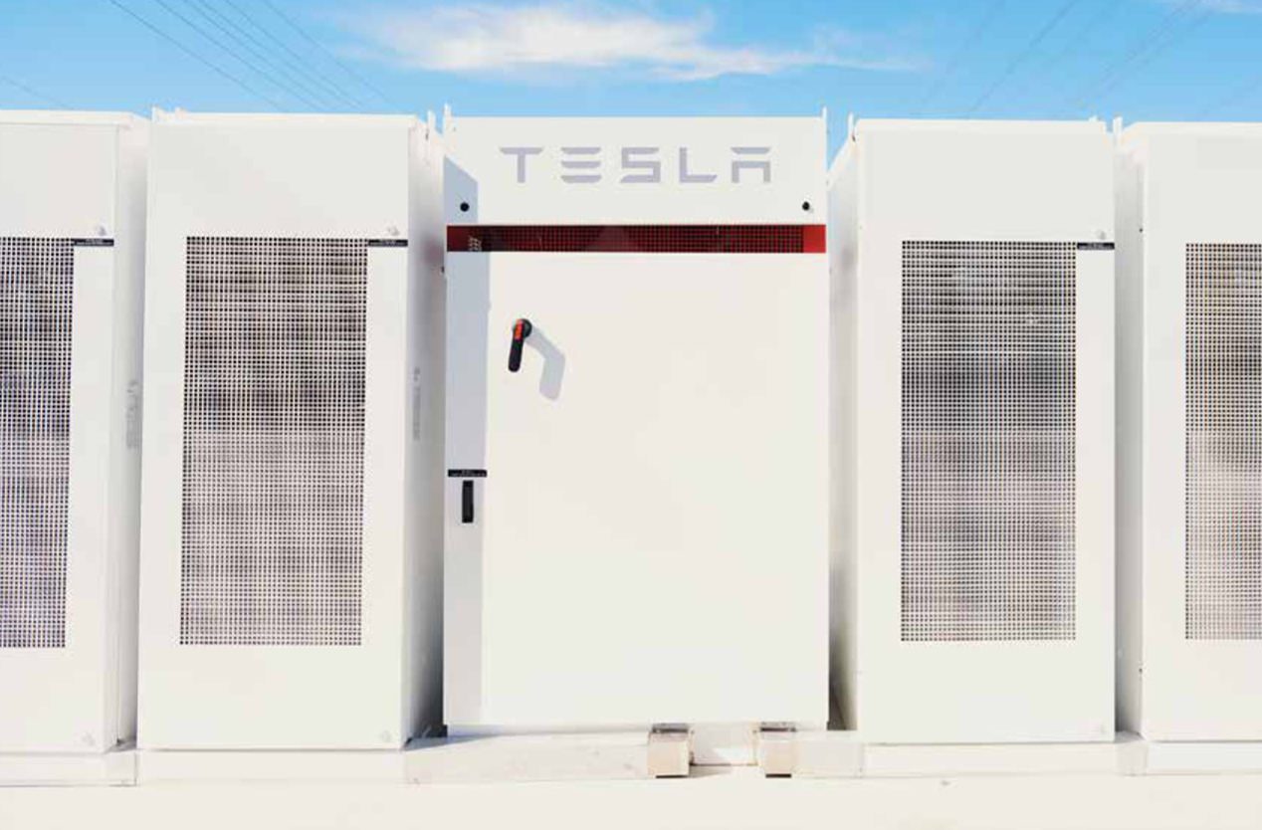

Nantucket Island Use Cases
Use cases evaluated:
  Non-market operations
    Transmission deferral
    Outage mitigation
    Conservation voltage reduction/Volt-VAR optimization
  Market operations
    Forward capacity market
    Arbitrage
    Regulation
    Spinning reserves
Tesla Powerpack 2 Lithium-ion Energy Storage System - Exterior and Interior

Slide 8
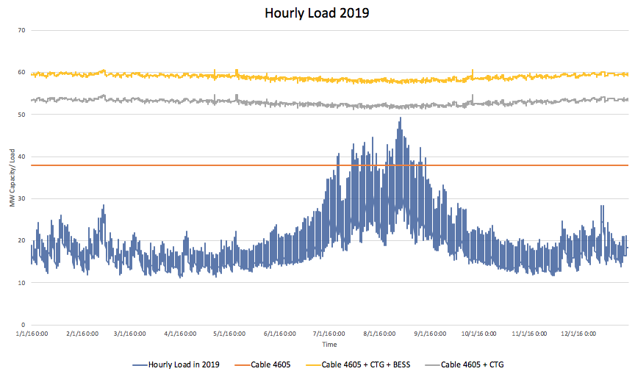
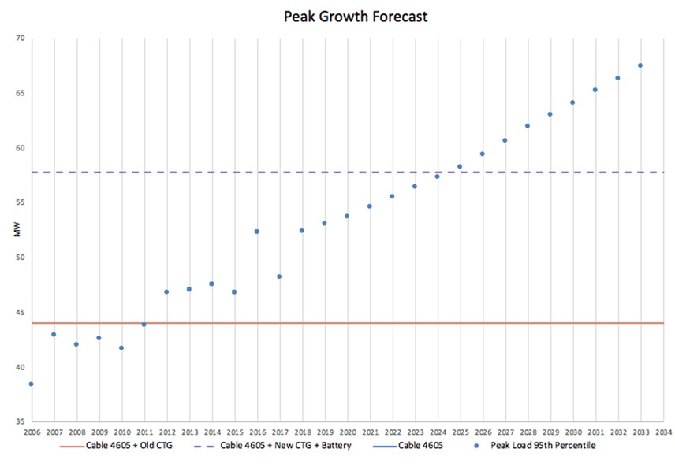
Non-Market: Transmission Deferral
PNNL performed an extensive load analysis in order to define the N-1 contingency window
Historic load data demonstrates that load peaks each year in the July/August period (unique opportunity)
In the event that transmission cable 4606 fails during the peak load season, the island faces a threat of power outage and would not be able to support even current energy demand
Adding the battery and CTG defers the installation of a third cable by 13 years ($109.5 million in net benefits)

Slide 9
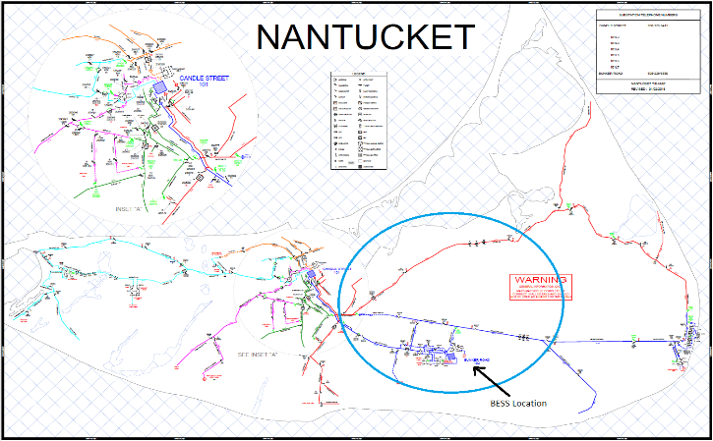
Non-Market: Outage Mitigation
Outage data
  Obtained from National Grid for multiple years - 704 outages over 11 years, averaging 64 annually
  All outages with secondary/service, transformer, and fused branch in the description were eliminated because the BESS could not address them
  Outage start time and duration also collected.
Customer and load information
  Number of customers affected by each outage obtained from utility
  Customer outages sorted into customer classes using utility data and assigned values – 89% of customers on the island are residential.
Annual Savings in Value of Lost Load
Response Time | Without Reconductoring | With Reconductoring
1 Hour | $783,124 | $876,157
5 Minutes | $909,293 | $1,011,754
1 Minute | $920,382 | $1,023,523
Modeled Outage on Nantucket Island
  Outage mitigation evaluated using both historical outages and distribution system model.

Slide 10
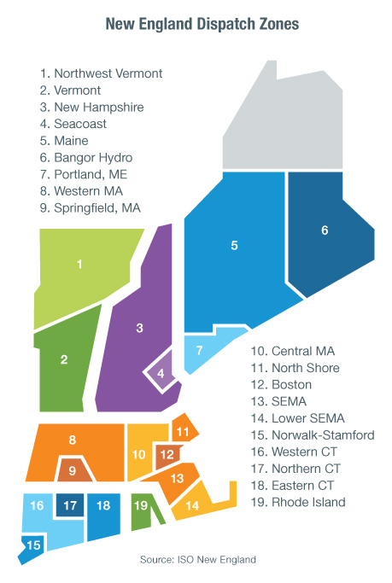
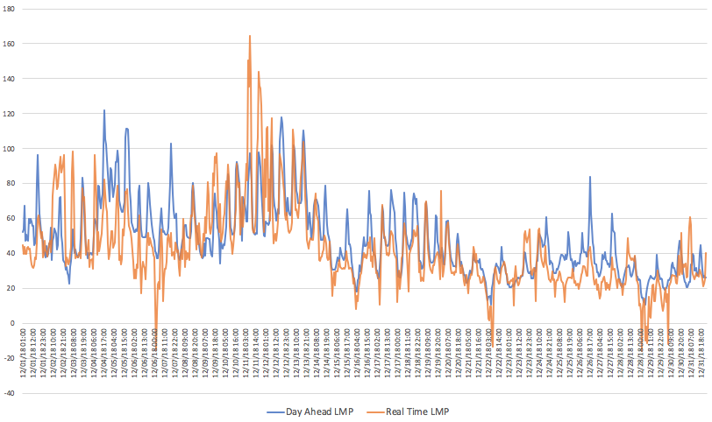
ISONE Market: Energy Arbitrage
Nantucket BESS modeled as a continuous storage facility – forward capacity, spinning reserve, energy arbitrage and frequency regulation (CTG not bid in market due to emissions/noise concerns)
Market rules enable National Grid to adjust price bids based on local opportunity costs – higher prices, economic min/max altered when BESS is required for local operations
For arbitrage, PNNL collected hourly and real-time market data on clearing prices based on supply offers by the energy providers and the demand bids by the load serving entities.
Key Lesson: While one of the first recognized use cases for energy storage, arbitrage typically yields a small value.

Slide 11
ISONE Market: Energy Arbitrage
Daily operation of the BESS is based on forecast prices while revenue results from market clearing prices. Thus, this evaluation does not assume perfect foresight but rather reflects the impacts of prediction error
After testing several models, the two best approaches that were used to generate final predictions for DAM LMP and RTM LMP based on lowest RMSE were ARIMA and GBM. We use the ARIMA-fed GBM method.
GBM - The Gradient Boosting Machine method, or GBM, is a machine learning method where a weak model is iteratively upgraded into a strong one by minimizing the loss function, in this case simply the mean square error.
ARIMA - The ARIMA(p,d,q) models are a general form of time series model capable of modeling autoregressive and integrated time series data, which is also expected to have a moving average over time.
Revenues were higher in the RTM relative to the DAM, even when accounting for forecast error
While the GBM method yielded the most precise estimates statistically, use of the DAM LMP as a predictor of RTM LMPs resulted in the highest revenue because that method was more likely to identify unusually high prices in the next day’s RTM.
Results by Year and Prediction Method for Arbitrage Only ($)
Market/Prediction Method | 2016 | 2017 | 2018 | Average
GBM Prediction of DALMP | 110,058 | 95,585 | 133,560 | 113,068
Yesterday DALMP as Predictor of DALMP | 101,746 | 87,453 | 123,486 | 104,228
GBM Prediction of RTM | 137,519 | 124,620 | 85,866 | 116,002
DALMP Prediction of RTM | 154,096 | 131,988 | 107,506 | 131,197

Slide 12
ISONE Market: Frequency Regulation
The electric power system must maintain a near real-time balance between generation and load. The BESS can provide second-by-second adjustment in output power to maintain grid frequency – value is obtained in terms of capacity and service benefits
Within the ISO-NE market, regulation follows an energy-neutral automatic generation control (AGC) signal; we assume a 95% performance score based on literature review
The Nantucket BESS can simultaneously provide energy, regulation, and reserve services
For this study, regulation prices were obtained from the ISO-NE market database for the time period 2016-2018. Regulation prices represent systemwide regulation pool prices
Regulation provides 78% of total market benefits for the BESS.
Key Lesson: Performance of battery storage in providing frequency regulation is exceptionally high. Batteries represent an efficient resource for providing frequency regulation; however, market prices can be driven downward as a result, undermining the profit potential to storage operators in the process.

Slide 13
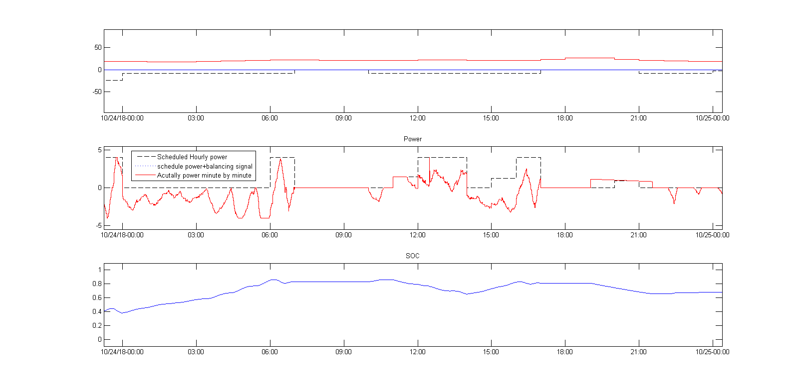
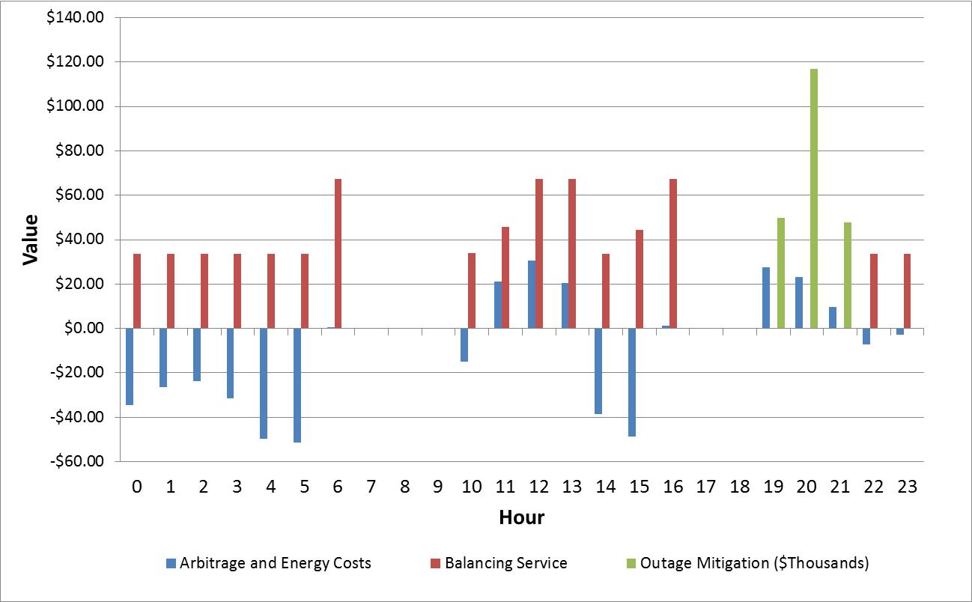
Bundling Services: How To Do It Optimally
Key Lesson: A valuation tool that co-optimizes benefits is required to define technically achievable benefits.
Multi-dimensional co-optimization procedures required to ensure no double counting of benefits
  BESSs are energy limited and cannot serve all services simultaneously
  By using energy in one hour, less is available in the next hour
Energy storage valuation tools are required; we use our battery storage evaluation tool (BEST).

Slide 14
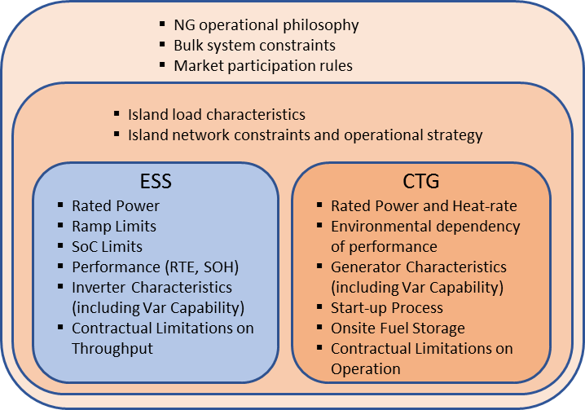
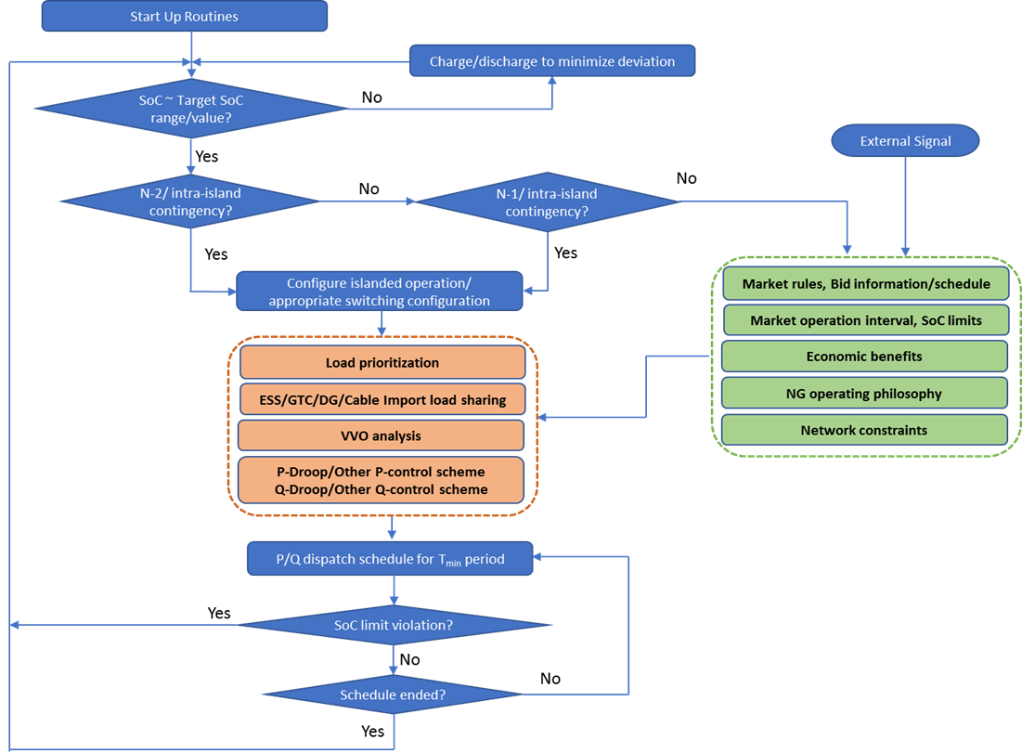
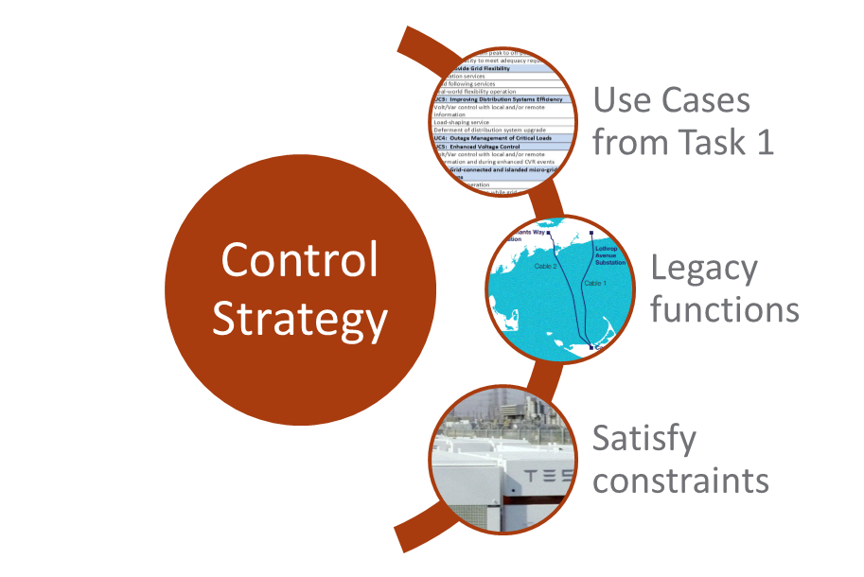
ESS Control Strategy Development
Task Objectives
Design control strategies to implement Use Cases identified in economic evaluation
Meet Use Case objectives while maintaining BESS operational limits
Accommodate existing distribution system improvement functions (e.g., Volt/VAR) with the BESS control scheme
Assist in deploying the strategies.
Control of ESS is not an isolated task – considerations extends from subsystems within ESS to up to the bulk system aspects
An illustrative rule-based control strategy developed for Nantucket Island ESS project
Task Execution
Control strategies were formulated based on economic evaluation outcome, distribution system analysis results, and BESS capabilities/constraints
Rule based strategies were developed for initial and intermediate operation and more optimal control strategies will be developed in the future
Preliminary control strategies were simulated to understand impact on Nantucket island network.

Slide 15
Nantucket Island Base Case Results
The total 20-year present value of BESS and CTG operations at $145.9 million exceed revenue requirements and energy costs at $93.9 million with a benefit-cost ratio (BCR) of 1.55.
Benefits are largely driven by the transmission deferral use case, which provides roughly $109 million in PV terms. This is about 75% of the total benefits.
An additional $18.8 million results from regulation services, which comprise 12.9% of the benefits making it the second largest benefit stream.
Regulation service dominates the application hours, with the BESS engaged in the provision of this service 7,900 hours each year.
Benefits of Local and Market Operations (Base Case) vs. Revenue Requirements

Slide 16
Challenges and Opportunities
  Challenges
    Building a research-oriented distribution system network model
    Obtaining updated and verified network data and planning information
    Validating distribution system model results
    Understanding market rules in a change landscape; defining bidding strategies
    Obtaining verified information on asset capabilities/constraints
    Limited capability of existing systems for coordination with new assets
    Challenges in managing multiple stakeholder constraints
  Innovations/Opportunities
    Monetized benefits in terms of VoLL and costs of specific system upgrades using distribution system network model
    Benefits modeled with imperfect foresight using DAM and RTM data
    Frequency regulation modeled using AGC signals and performance scores
    Expanded capacity to accurately estimate grid impacts and financial implications of using storage for local and market-based services
    Study could also be used to make a case to the Federal Energy Regulatory Commission (FERC) to allow a rate-based asset to participate in wholesale energy markets

Slide 17
Looking Forward
Research Accomplishments
  Final report, Nantucket Island Energy Storage System Assessment (PNNL-28941)
  PNNL has developed a distribution system network model for Nantucket Island.
Next Steps
  PNNL will deliver research findings to the National Grid Leadership Team
  Nantucket Island BESS/CTG ribbon cutting ceremony on October 8th
  PNNL is aiding in development of real-time control systems and has proposed a day-ahead load and price prediction model to assist with day-ahead bidding operations
    National Grid intends to deploy control strategies gradually and in a modular fashion
    Commercially available and highly customizable platforms will be considered
    Additional studies will be performed to support deployment
  PNNL will publish the results of several study elements:
    Findings of the economic assessment
    Transactive system for sustained operation when one or two 46-kV cables are out of service
    Adaptive voltage regulation for storage inverters to avoid limits on real power ramping
  PNNL will continue to assist National Grid with transmission modernization and energy storage-related activities as outlined in our MOU.

Slide 18

Acknowledgments
Dr. Imre Gyuk, DOE ‒ Office of Electricity
Jack Vaz, Joseph Henry, Terron Hill, David Bianco, Ben Carron, Babak Enayati, and Tim Martin of National Grid
Mission ‒ to ensure a resilient, reliable, and flexible electricity system through research, partnerships, facilitation, modeling and analytics, and emergency preparedness.
https://www.energy.gov/oe/activities/technology-development/energy-storage

Slide 19




Q/A and Further Information
Patrick Balducci
PNNL
Patrick.balducci@pnnl.gov
(503) 679-7316
  https://energystorage.pnnl.gov/

