Slide 1
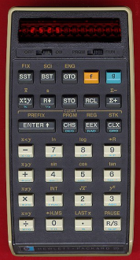
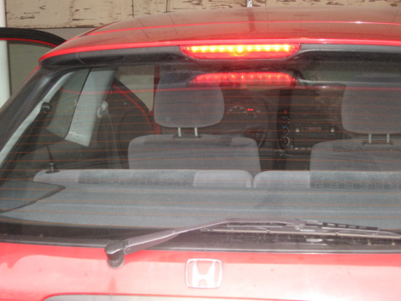
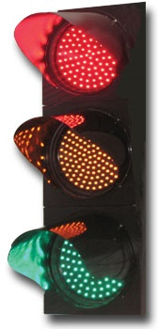
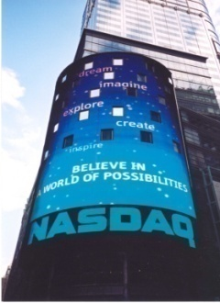
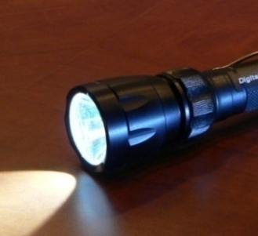
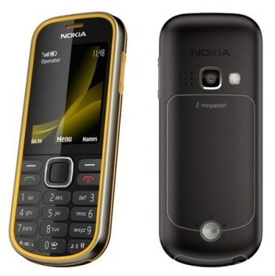
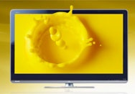
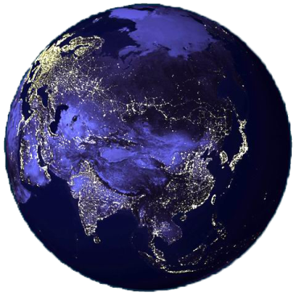
Solid-State Lighting: The III-V Epi “Killer App”
Jeff Tsao ∙ Physical, Chemical and Nano Sciences Center ∙ Sandia National Laboratories
HP calculator.
http://www.hpmuseum.org/32.jpg
Center high-mount stop light (CHMSL).
http://www.honda-tech.com/showthread.php?t=2413558
Traffic light.
http://mksurf8.blogspot.com/2009/11/relasyon.html
NASDAQ’s Giant Video Display in Times Square, New York (Jeff Tsao)
Surefire U2 flashlight. http://en.wikipedia.org/wiki/File:SurefireU2JPG.jpg
Nokia camera phone with LED flash.
http://www.itechnews.net/wp-content/uploads/2009/07/Nokia-3720-Classic-the-most-rugged-mobile-phone.jpg
Sharp QuadPixel RGBY LED-backlit LCD Display. http://www.macworld.com/article/145541/2010/01/sharp_quadpixel.html
http://tan-moneyonline.com/wp-content/uploads/2008/03/earthatnight-asia1.jpg
Earth at Night (courtesy of NASA)
Notes:
HELLO. Good morning. Thank-you, Jerry, for your kind introduction. And thank-you, Raj and the conference organizers for inviting me to speak here today. It’s been ten years since I’ve been to an ICMOVPE conference, so it’s a real pleasure to be here, back amongst you growers who we all know are at the heart of compound semiconductor science and technology. And it’s a real pleasure to be able to talk about the technology that may someday come to be the killer app in compound semiconductor science and technology: solid-state lighting.
STEPPING STONE MARKETS. Now, many of you are familiar with the story of solid-state lighting and the light-emitting diode technology that underlies it. It’s basically what I like to call the story of stepping-stone markets. You penetrate small markets first, using technologies that don’t have very good performance. That gives you revenue that you invest in R&D to improve the technology so that you can penetrate successively bigger markets requiring successively better performance.
COLORED AND WHITE LEDS. For colored LEDs, the most important of these stepping stone markets are illustrated here: the hand-held calculator, the center-high-mount stop light, traffic lights, and large outdoor video displays. For white LEDs, the most important of these stepping stone markets are illustrated here: flashlights, the flashes and backlights for mobile appliances, and now the backlights for larger displays and televisions. In fact, this last market is so big it’s causing, as many of you know, a shortage in LED supply. Because each of these stepping-stone markets valued some feature – like compactness or ruggedness or long-lifetime or efficiency – that was unique to LEDs, LEDs could penetrate these markets even though in some cases their raw economic cost in terms of light output was higher than that of traditional incandescent or fluorescent lamps. The result has been at each stage a steady increase in manufacturing volume and performance, and a steady decrease in cost.
END GAME. The end game of all of this progress, of course, is when solid-state lighting penetrates the market for general illumination. When we get to that end game, the world will be a very different place. Every lamp on earth, from the smallest indicator lamp to the largest stadium-sized flood-lamp, will have become an LED. And the amount of light the world consumes will likely be vastly larger than the amount it consumes now.
OUTLINE. So what I’d like to do in the rest of this talk is two things. First, I’d like to talk about this end game: what might it look like in terms of consumption of light and in terms of the supporting infrastructure, like epiwafers, needed to produce that light. Second, I’d like to talk about some of the economic and technical challenges that we face enroute to that endgame.
WARNING. Oh, and a warning before I start. I tend to go pretty slowly on my viewgraphs. So if it looks like I’m running out of time, don’t worry, I actually don’t have very many viewgraphs.

Slide 2
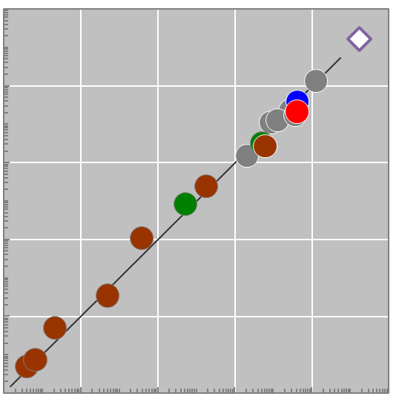
Historical and projected consumption of light
0.0072
β·GDP/CoL (Plmh/yr)
10⁻⁶ 10⁻⁴ 10⁻² 1 10² 10⁴
10⁴
~
/
=
∙
WRLD 2030
10²
WRLD 2005
US 2001
OECD-EU 2005
CN 2006
FSU 2000
CN 2005
CN 1993
JP+KR 2005
1
AU+NZ 2005
UK 2000
Φ (Plmh/yr)
UK 1950
UK 1900
WRLD-NONGRID 1999
10⁻²
10⁻⁴
UK 1800
UK 1850
UK 1750
After JY Tsao, HD Saunders, JR Creighton, ME Coltrin, JA Simmons, “SSL: An Energy Economics Perspective,” J Physics D (submitted).
10⁻⁶
UK 1700
Candles
Gas
Kerosene
HID
Fluorescent
Incandescent
SSL
Notes:
EMPIRICAL HISTORY OF LIGHT CONSUMPTION. Let’s start by talking about the end game. And to understand this end game, let’s start with a history of the consumption of light, so that we can project that history into the future. Here in this plot I show the consumption of light of various nations or groups of nations at various stages of technological development. There’s the UK in 1700, when candles were the dominant lighting technology. There’s the UK in 1850, when gas and kerosene lamps were the dominant lighting technology. And there are various countries in the modern world on grid electricity, where incandescent, fluorescent and high-intensity discharge lamps are the dominant lighting technologies.
Φ = β∙GDP/CoL. The vertical axis of this plot is consumption of light, Phi, in units of Plmh per year. The horizontal axis of the plot is a fixed constant, β, times the ratio between gross domestic product, GDP, and cost of light, CoL. If we use as our units for GDP billions of dollars per year, and for cost of light $/Mlmh, we see that this ratio has the units Plmh/year, the same as the units of the vertical axis. And when the fixed constant, β, is 0.0072, you can see that the empirical data fall very closely along a line of slope unity. This has two implications. The first implication is that, as gross domestic product increases, consumption of light increases. That is, the wealthier we are the more light we consume. The second implication is that as cost of light decreases, consumption of light increases. That is, the cheaper light is the more light we consume.
A FEW DATA POINTS. To put these data points in context, I’ve called out here on the right a few of them. For these data points I list cost of light, which is approximately the cost of energy divided by luminous efficacy. I also list gross domestic product, which is just population in billions of persons times per capita gross domestic product in $ per person year. And I list consumption of light, again in Plmh/yr, as well as per capita consumption of light as Mlmh per person-year.
UNDEVELOPED WORLD. The first data point I’d like to call attention to lies at one extreme: this green point here that represents the undeveloped world in 1999 not on grid electricity. You can see from the plot that this world doesn’t consume much light – on the order of 1/20 of a Plmh/yr, or 2,000 times less than the world as a whole. There are two reasons for this. The first reason is that this world is poor. Its per capita gross domestic product is only about $2,000 per person year. So, even though it has a huge population (about 2 billion people, one third that of the entire world), its gross domestic product is low (about $4.4 trillion compared to a world gross domestic product of $60 trillion). But the most important reason why it doesn’t consume much light is that its lighting technology, kerosene lamps, has a very low luminous efficacy, about a third of a lumen per Watt. Because of that, it has an extremely high cost of light, 600 $/Mlmh, compared to the average world cost of light of only 3.35 $/Mlmh. The result is a ratio between gross domestic product and cost of light that is very low, and hence a consumption of light that is also very low.
UNITED STATES. The second data point I’d like to call attention to lies at the other extreme: this blue point here that represents the United States in 2001. As you can see, the U.S. consumes a ton of light – 42 Plmh/yr, about one third that consumed by the entire world. Partly this is because the US is rich -- its per capita gdp is about 42,000 $/person-year, much higher than that of the world as a whole. But partly this is because of its somewhat lower cost of energy (76 $/MWh instead of the 119 $/MWh for the world as a whole), so its cost of light is lower (2 $/Mlmh instead of 3.35 $/Mlmh for the world). In fact, as you see here in this column, the United States has a much higher per capita lighting consumption than the world, 136 Mlmh/(per-yr) compared to 20 Mlmh/(per-yr). To put that in perspective, 136 Mlmh/(per-yr) is equivalent to the average person in the U.S. being surrounded during his or her waking hours by 17 100W light bulbs!
ENTIRE WORLD IN 2005. The third data point I’d like to call attention to is this grey point here: the world in 2005. This is just the sum over the entire contemporary world, and of course is a pretty big number: 130 Plmh/yr.
ENTIRE WORLD IN 2030. Now, given this history, what would happen if were to project out in time to a world in which solid-state lighting is the dominant lighting technology. To do that, let’s assume that consumption of light will continue to follow this historical beta-times-GDP-divided-by-CoL relationship. We don’t know whether it will or not, of course. And there are many reasons for believing it might not. However, the most reasonable guess would be that the future will follow the past, and that this linear relationship will still hold. So let’s assume that, 20 years from now, in the year 2030, we have reached the end game. Solid-state lighting is dominant, and let’s say it has reached an efficiency of 70% or so, which translates to a luminous efficacy of about 270 lm/W. And let’s take the world’s costs of energy and GDP to be those projected by the US Energy Information Agency: $119/MWh and 140 trillion U.S. dollars per year. If you do that, you come up with a consumption of light in 2030 of about 1,700 Plmh/yr: that’s this purple outlined white diamond here. It may not seem like it’s much different from the consumption of light in 2005. But this is a logarithmic plot with two orders of magnitude per grid label, so this projection is more than 10x the consumption of light in 2005. This is a huge amount of light. Imagine, for example, an earth-at-night photo like this one which is ten times brighter than it is now.

Slide 3
Chip area needed to light the world
Input power density
Luminous efficacy
lm/W
Light
0.0072
Power
Area
Duty cycle
Cost of energy
Luminous efficacy
http://tan-moneyonline.com/wp-content/uploads/2008/03/earthatnight-asia1.jpg
Area
Area Turnover
MOVPE Reactors
137 T$/yr
~0.15 km²/yr
28 football fields/yr
Yield
3/4
~1.3 km²
240 football fields
~ 800
1/4
1/4
Uptime
330 days/yr
119
M$/kWh
300
W/cm²
Life
25 khr
Area of 4” wafer
Wa-
fers per run
12
Runs per day
3
Notes:
DEMAND. OK, so now we have a projection for how much light the world might consume in 2030. Let’s call that the demand for light, and we’ll write it here just as we did before. It’s that constant factor beta, times GDP, divided by the cost of light, where now we rewrite the cost of light as approximately the ratio between the cost of energy and luminous efficacy. That’s the demand side.
SUPPLY. What about the supply side? Well, if all that light is being supplied by semiconductor chips, and if we know the operating characteristics of those chips, then we know how much light those chips would produce. Here we write that as the product of four terms. There’s the power density input to the chip and the area of the chip – that’s just the total power driving the chip. Then there’s the luminous efficacy of the chip, or the lumens out of the chip per unit power driving the chip. Then there’s the duty cycle of the chip – what fraction of the year the chip is powered on. That’s the supply side.
AREA. Now let’s equate demand with supply, and solve for the semiconductor chip area required to satisfy that demand. That’s this equation here in the lower left, and is basically the chip area required to light the world. You’ll notice that luminous efficacy, interestingly, doesn’t appear in the equation. That’s of course because luminous efficacy enters into both demand and supply. If luminous efficacy increases then cost of light decreases and demand for light increases. But if luminous efficacy increases the chip area required to supply that demand decreases, and these two effects exactly cancel each other. Of course, we also have to make some assumptions about GDP, cost of energy, input power density and duty cycle. That’s non-trivial, but let’s go ahead and see what happens if we make some guesses. For GDP and cost of energy let’s use the US Energy Information Agency projections that I mentioned earlier: that’s 137 T$/yr for GDP and 119 $/MWh for cost of energy. For input power density let’s assume something like 1 A into a square millimeter chip, and about a 3V drive voltage – or 300 W/cm2. For a duty cycle let’s assume 1/4 – that is, lamps that are on roughly 6 hours per day, about what is the case for traditional lighting right now. If you make these assumptions, you end up with a semiconductor chip area of 1.3 km2, or about 240 American football fields. So this is an estimate of the chip area that we might need in 2030 to light the world. And now, with this estimate in hand, we can go on to estimate other things.
AREA TURNOVER. For example, we can estimate the chip area turnover required to sustain this area. After all, these chips have a lifetime, and some fraction will need to be replaced every year to maintain a steady-state. That area turnover is just the area you need to maintain divided by the lifetime of the chip. Of course the chip isn’t on all the time, so you have to normalize the life of the chip by the duty cycle. And not every chip made is a good chip, so you have to normalize the area by the yield. Now we have to make some assumptions about these factors, and again that’s non-trivial. But, again, let’s go ahead and make some guesses. If we assume a life of 25,000 hours, the same duty cycle of ¼ we assumed before, and a yield of ¾, then you end up with a semiconductor chip area turnover of about 0.15 km2 per year, or about 28 American football fields per year.
MOVPE REACTORS. From here, we can estimate something that will be of interest to MOVPE reactor manufacturers: the number of MOVPE reactors necessary to sustain this chip area turnover. Here, we write write that number as the chip area turnover divided by the product of the area of a wafer, the number of wafers per run, the runs per day, and the uptime of the reactor. Again, one needs to make a bunch of assumptions. And if we make the assumptions listed here (12 4” wafers per run, 3 runs per day, 330 days of uptime per year), then we end up with something on the order of 800 MOVPE reactors. That’s I think roughly the order of the number of GaN-based MOVPE reactors that are currently in place for applications other than general illumination. So general illumination might ultimately require a doubling of the current number of reactors.
ESTIMATES ONLY. Now, I want to emphasize that these are estimates only, and that they depend on a whole host of assumptions. But they at least frame the order of magnitude. We’re going to need many more MOVPE reactors. Maybe not a factor of ten more. But also not just 10% more.

Slide 4
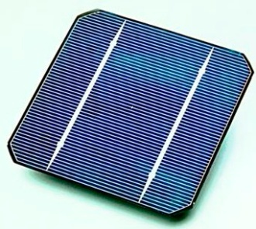
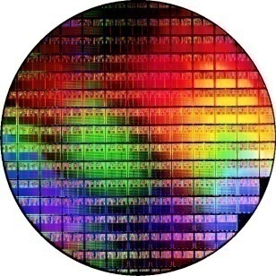

The other electronics “killer apps”
Sharp QuadPixel RGBY LED-backlit LCD Display. http://www.macworld.com/article/145541/2010/01/sharp_quadpixel.html
http://blog.elisehuard.be/wp-content/uploads/2007/12/wafer_200mm_90nm_1024k_dc.jpg
Surefire U2 flashlight. http://en.wikipedia.org/wiki/File:SurefireU2JPG.jpg
http://www.itechnews.net/wp-content/uploads/2009/07/Nokia-3720-Classic-the-most-rugged-mobile-phone.jpg
http://en.wikipedia.org/wiki/File:Solar_cell.png
Market | Liquid crystal displays (2009) | Solar cells (2009) | Si electronics (2009) | GaN solid-state lighting (2030) | GaAs electronics (2009)
Approximate area turnover (km²/year) | 230 | 64 | 4.4 | 0.15 | 0.026
# football fields / year | 43,000 (Lake Tahoe / 2) | 11,800 (Manhattan) | 800 (2 x Monaco) | 28 (Vatican City / 4) | 5
Estimate from Steven S Rosenblum,
Corning, Inc
Assuming 9.6 GW_{p} (http://www.displaybank.com/eng/info/sread.php?id=5730) at 15% efficiency
Estimate from Gartner (http://www.fabtech.org/news/_a/gartner_revises_silicon_wafer_demand_forecast/)
Estimate from A Anwar, Strategy Analytics
Notes:
OTHER KILLER APPS. Now to put these estimates into an even larger perspective, here I show the area turnovers for some other big electronics applications – the ones that in 2009 had the largest area turnovers.
LCDS. The biggest by far is liquid crystal displays. This market is of course growing like crazy, and in 2009 consumed roughly 230 km2 of area, spread over various markets: cell phone displays, computer monitors, televisions. To put that in perspective, that’s about 43,000 American football fields, or about half the size of Lake Tahoe.
SOLAR CELLS. The next biggest is solar cells. This market is also growing like crazy, and in 2009 consumed roughly 64 km2 of area, spread over various technologies: silicon, thin films, etc. To put that in perspective, that’s about 11,800 American football fields, or slightly more than the area of Manhattan.
SI ELECTRONICS. The next biggest is silicon electronics. This market isn’t growing as fast, and in 2009 as we all know went through a slump. Still, it consumed roughly 4.4 km2 of chip area. To put that in perspective, that’s about 800 American football fields, or about twice the country of Monaco.
SSL. Now we come to SSL, which of course seems puny in comparison to these giants. Remember, though 0.15 km2/year is still equivalent to 28 football fields, or about one fourth the size of Vatican City.
GaAs ELECTRONICS. And it is more than five times bigger than the area used for GaAs electronics, which is roughly 0.026 km2/year, or about 5 football fields.
LEDS IN LCDS VS FOR SSL. Looked at in this way, solid-state lighting might possibly be the killer app for the compound semiconductors. But we also need to have some humility. It will very likely be dwarfed by these other much larger killer apps: Si electronics, solar cells, liquid crystal displays.

Slide 5
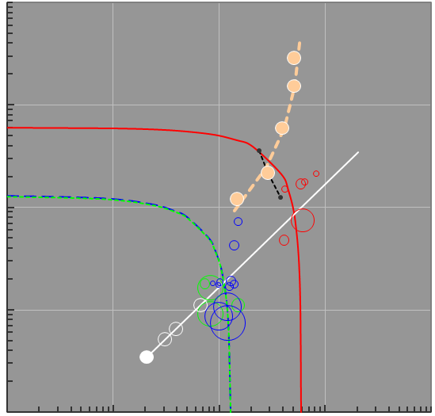
Enroute to the end game: luminous efficacy, cost, functionality
η
η
3.5x
4.6x
100
2004.8
$_{Win}
2005.8
7.1x
10
Incandescent
2007.2
0.35A
1:6 Ratio
2008.5
0.7A
1
Fluorescent
2009.7
CoL_{cap} ~ $_{Win}/[η∙τ] ($/Mlmh)
1.5A
HID
Adapted from
JY Tsao, ME Coltrin, MH Crawford, JA Simmons, “SSL: An Integrated Human Factors, Technology and Economic Perspective,” Proc IEEE (in press).
$_{Win}
0.1
B LED↑
4.9x
Phosphors↑
Perfect
RGB
0.01
0.01 0.1 1 10 100
CoL_{ope} = CoE/η ($/Mlmh)
Notes:
ECONOMIC CHALLENGES. OK, up until now, I’ve talked exclusively about the end game for solid-state lighting. Of course, we aren’t at the end game yet. That’s still another 10-20 years out. And enroute to the end game we know we face a lot of challenges. So what I’d like to in the time I have remaining is talk about some of those challenges. Let’s start, with this viewgraph, by placing those challenges into an economics perspective.
CAPITAL AND OPERATING COSTS OF LIGHT. To do that, here on the left I plot the two important costs of light. The vertical axis is the purchase, or capital, cost of light: the cost of the lamp that converts electricity into light, amortized over the life of the lamp. The horizontal axis is the operating cost of light: the cost of the electricity that is converted into light. Both of these costs have the same units, $ per Mlmh, and the sum of the two costs is the ownership cost of light, the cost of light we talked about earlier.
TRADITIONAL LIGHTING. The various open circles on the plot represent traditional lighting: the red circles represent incandescent lamps, the blue circles fluorescent lamps, and the green circles high-intensity discharge lamps. The sizes of those circles are proportional to the market sizes of the various lamps, and the red, blue and green lines represent contours of constant ownership cost of light. You can see that, very roughly, the circles fall on a line that represents a capital cost of light that is 1/6 the operating cost of light. In other words, the cost structure of traditional lighting is one in which the dominant cost of light is that of the electricity.
SSL PAST. So where is solid-state lighting? Well, here in the filled tan circles I plot solid-state lighting’s progress over the most recent five years. You can see that there has been progress both vertically down (a decrease in the capital cost of lighting), as well as horizontally to the left (a decrease in the operating cost of lighting). One way to understand these cost decreases is to note that the capital cost of light is the cost of a lamp that sinks a certain amount of power (written here as $ per Watt in) divided by luminous efficacy and amortized over tau, the lamp lifetime. So a decrease in lamp cost moves you vertically down on this plot. At the same time, the operating cost of light is the cost of electricity divided by luminous efficacy. Since luminous efficacy is in the denominators of both expressions, as luminous efficacy increases, both capital and operating cost decrease, and one moves diagonally down and to the left on this plot. So, basically, the past five years progress in solid-state lighting can be broken down into two improvements. First, a decrease by 7.1x in the cost of a chip that sinks a certain amount of power, which moves one vertically down. Second, an increase by 3.5x in luminous efficacy, which moves one diagonally downwards and to the left.
SSL FUTURE (PIECEWISE). So what might happen in the future? Well, I think we can anticipate two things, illustrated in the figure on the right. The first thing we can anticipate is that there will be continued pressure on luminous efficacy to increase, moving us diagonally further downwards and to the left on this plot so that the cost of light becomes lower than fluorescent and high-intensity discharge lamps – passing the contours of constant ownership cost of light for these lamps. In fact, if one were to increase luminous efficacy by 4.6x, one would ultimately reach the 70% efficiency we assumed for the endgame in the previous several slides. The second thing we can anticipate is that there will be continued pressure on the cost structure of solid-state lighting to become more and more similar to that of traditional lighting. That is, to to decrease the cost of a lamp that sinks a certain amount of power, so that one moves vertically downwards to this 1:6 capital-to-operating cost ratio line, and so that the cost of light is dominated by its operating cost. In fact, if one were to decrease cost by 4.9x, one would exactly reach that cost structure.
SSL FUTURE (CONTINUOUS). Of course, the improvements won’t occur in the piecewise and serial manner indicated by this dashed white line. They will occur continuously and in parallel, perhaps in a manner similar to the hypothetical trajectory in the dashed black line here. This is a trajectory that is initially weighted towards luminous efficacy increases, then later weighted towards cost decreases. In fact, it is weighted later so heavily towards cost decreases that we are basically imagining an overshoot, where costs decrease so much that the capital cost becomes less than one sixth of the operating cost of light. At that point, there will be may be all sorts of incentives for industry to begin adding functionality – like moving from factory-preset lighting to in-the-field-tunable lighting. That way, industry can use functionality to add cost and stave off commoditization, at least for a while. In the end end game, we can imagine hitting this open white circle here, which corresponds to 70% efficiency and a 1:6 capital-to-operating cost structure.

Slide 6
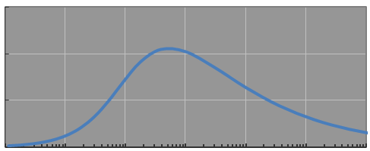
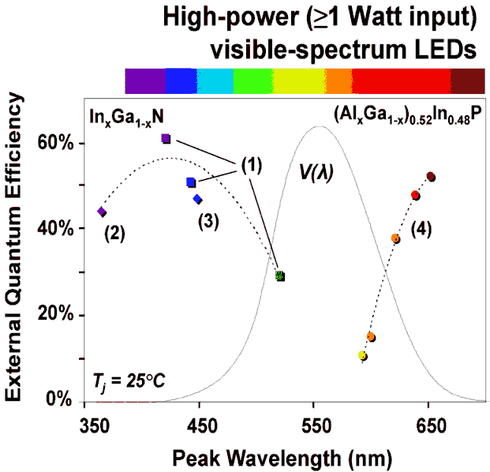
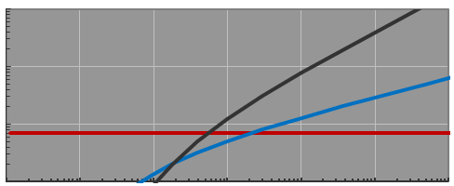
Technology Grand Challenges
1
Luminous Efficacy:
Narrow-linewidth
shallow-red color conversion
2
Cost:
Eliminate blue LED efficiency droop
3
Functionality:
Fill in the red-yellow-green gap and add control loops
Target: 200 A/cm²
0.3
456
614
0.2
456
535
573
614
ε_{IQE}
0.1
Luminous Efficacy (lm/W)
0
Human eye response
1
Auger-like
0.1
Spontaneous Emission
k (ns⁻¹)
Schockley-Read-Hall
State-of-art LED
0.01
0.001
Spectral power distribution (W/nm)
0.1 1.0 10 100 1,000 10,000
J (A/cm²)
1W LEDs
350 mA
Wavelength (nm)
2.8V
0.6Ω
Courtesy of M. Krames, Philips-Lumileds
ε_{Joule}
ε_{IQE}
Notes:
GRAND CHALLENGES FOR LUMINOUS EFFICACY. Finally, in the time I have left, let me just mention some of the technology grand challenges that we face along the hypothetical future trajectory I plotted in the last viewgraph. Here I list what one might call three grand challenges. That isn’t to say that there aren’t a lot of other smaller challenges that, integrated out, wouldn’t equal any one of these grand challenges. But I’ll just mention these three.
CHALLENGE 1. The first challenge is aimed mostly at luminous efficacy, and is basically to find a narrower-linewidth shallow-red color converter. To illustrate why this is important, here I show two spectra. The spectrum at the top is the human eye response. The spectrum at the bottom is that of a state-of-the-art SSL lamp. This short-wavelength hump is due to the blue LED. Then there’s a medium-wavelength hump due to a green phosphor that absorbs the blue and re-emits in the green. Then there’s a long-wavelength hump due to a red phosphor that absorbs the blue and re-emits in the red. I’ve shown that last red hump separated out in the dashed red curve. You can see that it has a long tail in the deep red, where the human eye isn’t very sensitive, and this causes a decrease in luminous efficacy. So the materials challenge is to find a new phosphor, or color converter, with a much sharper line in the orange-red at 614 nm, to eliminate that spill-over into the deep red.
CHALLENGE 2. The second challenge is aimed mostly at cost, and is basically to eliminate blue LED efficiency droop – that is, to maintain high efficiency in the blue at high drive currents. The reason of course is that the more current the device is driven at the lower the cost per lumen of light out, provided you can maintain efficiency. However, this is a challenge -- there is some non-radiative recombination channel that turns on at high carrier densities, and causes this rollover in efficiency. In fact, 2A, when combined with decreases in manufacturing cost, is the drive current that would enable the cost structure for solid-state lighting to approach that of traditional lighting. So that’s a reasonable target for the drive current we would like to achieve, and therefore what we’d like is for this rollover to occur at drive currents higher than 2A per mm2.
CHALLENGE 3. The third challenge is aimed both at luminous efficacy and functionality, and is basically to fill in the so-called red-yellow-green gap, ideally with electroluminescent semiconductor light emitters. The first reason is that you eliminate the Stokes loss associated with phosphors, thereby increasing overall efficiency. The second reason is that if you can have in-the-field control over all colors, you can have in-the-field tailoring of the color content of the white light to best match the illumination circumstances. Filling this red-yellow-green gap will of course be a big challenge. As you all know, the InGaN materials system works reasonably well for the blue, but when you get to the green and yellow, and definitely into the red, efficiencies go way down. The AlInGaP materials system works reasonably well for the deep red, out at 650 nm, but when you get to the orange-red, at 614 nm or so, where the human eye response starts to kick in, again efficiencies go way down. And so the materials challenge is to find new semiconductor materials or to engineer existing semiconductor materials so that they can electroluminesce efficiently in the green, yellow and especially the shallow orange-red.

Slide 7
Sharp QuadPixel RGBY LED-backlit LCD Display. http://www.macworld.com/article/145541/2010/01/sharp_quadpixel.html
http://blog.elisehuard.be/wp-content/uploads/2007/12/wafer_200mm_90nm_1024k_dc.jpg
Surefire U2 flashlight. http://en.wikipedia.org/wiki/File:SurefireU2JPG.jpg
http://www.itechnews.net/wp-content/uploads/2009/07/Nokia-3720-Classic-the-most-rugged-mobile-phone.jpg
http://en.wikipedia.org/wiki/File:Solar_cell.png
Acknowledgements:
Randy Creighton ∙ Mike Coltrin ∙ Roland Haitz ∙ Harry Saunders ∙ Eric Shaner ∙ Jerry Simmons ∙ Paul Waide
Work at Sandia National Laboratories was supported by Sandia’s Solid-State-Lighting Science Energy Frontier Research Center, funded by the U.S. Department of Energy, Office of Basic Energy Sciences. Sandia is a multiprogram laboratory operated by Sandia Corporation, a Lockheed Martin Company, for the U.S. Department of Energy’s National Security Administration under Contract DE-AC04-94AL85000.
Notes:
FULL CIRCLE. With that, let me close by saying that we are truly on the brink of a massive transformation in lighting. Before long, every light on earth will be a solid-state lamp. Now, lighting won’t be the biggest application for electronic materials – those honors will probably be liquid crystal displays, solar cells, silicon electronics. But it is not unlikedly to be the fourth biggest, and the biggest of the compound semiconductor applications, perhaps bigger than the market for GaAs electronics.
ACKNOWLEDGMENTS. Finally, let me acknowledge a number of co-workers who have contributed in various ways to this talk: Randy Creighton, Mike Coltrin, Roland Haitz, Harry Saunders, Eric Shaner, Jerry Simmons, Paul Waide. And I especially want to acknowledge the Department of Energy’s Office of Basic Energy Science for their support through their Energy Frontier Research Center for Solid-State-Lighting Science.
THANKS. With that, thank-you very much for your attention.

