Slide 1
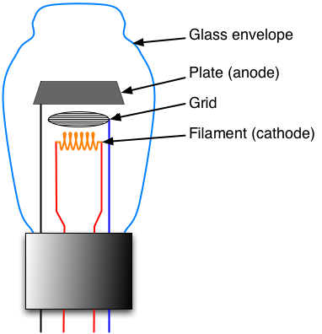
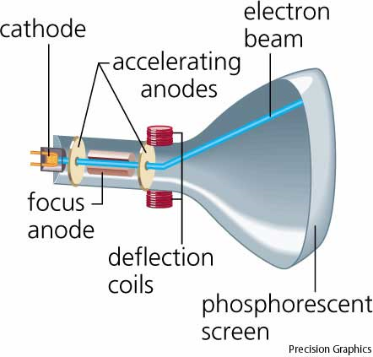
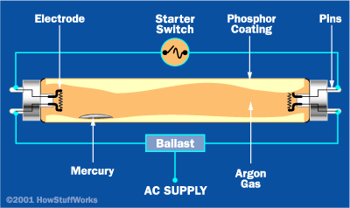
The Next Semiconductor Revolution: This Time It’s Lighting!
Your Grandparents’
Vacuum Triode
Your Parents’
Cathode Ray Tube (CRT)
Your
Fluorescent Tube
Triode vacuum tube. http://commons.wikimedia.org/wiki/File:Triode_vacuum_tube.png
From Dictionary.com. http://dictionary.reference.com/illus/illustration.html/ahd4/cathode-ray%20tube/cathry
How Fluorescent Lamps Work. http://home.howstuffworks.com/fluorescent-lamp4.htm
Earth at Night (courtesy of NASA)
Jeff Tsao ∙ Physical, Chemical & Nano Sciences Center ∙ Sandia National Laboratories
Notes:
HELLO. Good evening. Thank-you, Tom, for your kind introduction. And even though Sue Rzendzian couldn’t be with us tonight, thank-you, Sue, and Jeff, for your invitation to speak here tonight. It’s a pleasure to be here, not just because my son, Eugene, has the good fortune to be a student here at the Academy, but also because it’s an opportunity to tell you a story about a new technology that, literally, will change the way we see (and how often does one get to tell a story like that!). Moreover, it is a story of which only the first few chapters have been written, so you students in the audience will almost certainly see the next few chapters unfold in your lifetimes, and some of you may even have the opportunity to write a few of them!
THE NEXT SEMICONDUCTOR REVOLUTION. Some of us in the field call this story the next semiconductor revolution: this time it’s lighting. We say “next” because it is actually the third in a sequence of three revolutions, each spaced in time by about one human generation, and each displacing a vacuum tube technology of one type or another. Now, almost all of my talk will be about this third revolution. But before I turn to that, I’d like to spend a few minutes on these vacuum tube technologies, because they really are quite amazing, and there is something sad about saying goodbye to them.
VACUUM TRIODES. The first vacuum-tube technology is the vacuum triode, like this one you see here in this old guitar amplifier courtesy of Ian Bannerman and Albuquerque Guitar Works. It’s an amazingly simple and elegant device: basically three electrodes (that’s why it’s called a triode) sealed inside an evacuated glass tube. One electrode is called the cathode – it’s heated so there’s a cloud of electrons that have basically boiled off of the filament. The glow you can perhaps dimly see from this old vacuum tube is coming from that hot cathode. Another electrode is called the anode, and by applying a voltage across the cathode and the anode electrons get accelerated from the one to the other. Finally, there’s a third electrode called a grid that the electrons shoot through on their way from the cathode to the anode. If you apply a voltage to this grid you modulate the number of electrons that make it from the cathode to the anode. In fact, one can arrange for a small voltage change on the grid to control a large current change on the anode, and so you can make an amplifier. In your grandparents’ youth, these amplifiers were the basis for all electronics. But then the semiconductor transistor came along, and as your grandparents got to be middle aged, they turned off their vacuum triodes, and now we’re left with the vacuum triodes in these old antique guitar amplifiers.
CATHODE RAY TUBE. The second vacuum-tube technology is the cathode ray tube, like this old television set, courtesy of Jerry and Carolyn Simmons. It has the same cathode and anode as the simple vacuum triode. But now the anode is coated with a phosphor that lights up when it’s hit by electrons. And, enroute, in addition to passing through a grid the electrons pass through a deflection coil that rasters the beam across the screen so that you can form an image. In your parents’ youth, these CRTs were the basis for all displays. But then the semiconductor-transistor-controlled liquid-cyrstal display came along, and when your parents got to be middle aged, like me, they starting turning off their CRTs, and pretty soon all we’ll be left with are these old antique TV sets.
FLUORESCENT TUBE. That brings us to the third and last vacuum-tube technology, the fluorescent tube, like this one here, or like the compact fluorescent lamp, or CFL equivalent here. It again has a heated cathode, but now instead of the tube being evacuated, the tube has a little bit of mercury in it. Mercury is an interesting metal because it vaporizes relatively easily, and so as the electrons are accelerated from one end of the tube to the other, they occasionally hit and excite a vaporized mercury atom. The mercury atom gets excited, and emits UV light. The UV light then hits the wall of the tube, which is coated with a phosphor. The phosphor absorbs the UV light and re-emits in the visible, and, voila, you end up with a very nice white light. And in your youth, talking to you students, these fluorescent tubes are currently the dominant source of artificial white light for illumination. But, there is a time for all things, and as you yourselves enter the primes of your lives, and eventually even become middle aged, you will someday turn off these fluorescent tubes, in favor of a technology that is just now emerging: a technology called solid-state lighting.
OUTLINE. So the rest of this talk will be devoted to solid-state lighting. I’m going to talk both about what solid-state lighting is like right now as well as what it might be like someday in the future. And I’m going to discuss both non-technical and technical topics, so if I’m getting too technical and you have questions you’d like to ask, please don’t hesitate to ask them. I’m happy for this talk to be very informal and conversational. So, if you have a question, please ask!

Slide 2
Semiconductor Light-Emitting Diode (LED)
-
Ga
N
Ga
N
Ga
N
N
Ga
N
Ga
N
Ga
Ga
N
Si
N
Ga
N
The periodic table, courtesy of BBS. http://www.bbc.co.uk/schools/gcsebitesize/science/edexcel/patterns/periodictablerev1.shtml
N
Ga
N
Ga
N
Ga
Ga
N
Ga
N
Si
N
N
Ga
N
Ga
N
Ga
Ga
N
Ga
N
Ga
N
Photons
N
Mg
N
Ga
N
Ga
Ga
N
Ga
N
Ga
N
N
Ga
N
Mg
N
Ga
Ga
N
Ga
N
Ga
N
N
Ga
N
Ga
N
Ga
+
Notes:
PHYSICS. So let’s talk about solid-state lighting, and let’s start with a little bit of physics. Basically, the foundation of solid-state lighting is a device called a semiconductor light-emitting diode, or an LED.
THE LATTICE. To see how it works, here on the right I’ve drawn a schematic of the atomic lattice of the semiconductor material most widely used today for light-emitting diodes: GaN. As you can see, the lattice is composed of equal parts Ga and N atoms. Each Ga atom is bonded to four N atoms, and each N atom is bonded to four Ga atoms. Because each atom has four bonds, but each bond is shared with another atom, the lattice has basically two bonds per atom.
ELECTRONS. At the same time, each of these atoms is contributing electrons to those bonds. How many electrons? Well, Ga, as you can see here, comes from column 3 of the periodic table, which means it has three electrons in its outer valence shell – that is, three electrons that can participate in bonding. N comes from column 5 of the periodic table, which means it has five electrons in its outer valence shell – five electrons that can participate in bonding. So every atom is contributing, on average, 3 + 5 = 8 divided by 2, or four electrons.
ELECTRONS PER BOND. So the lattice has four electrons and two bonds per atom. That means there are exactly two electrons per bond, as depicted by these blue circles, and, from chemistry, we know that this is a good and stable condition – every electron is accounted for.
DOPING. Now if this were all there were to semiconductors, there wouldn’t be much more one could do with them and the story would end here. But there is something more one can do. One can add impurity atoms which are similar, but not identical, to these Ga and N atoms. Semiconductor physicists call this doping, because, kind of like drugs, it alters the performance of the semiconductor. For example, suppose you take a Ga atom in the lattice and replace it with a Si atom. Then, because Si is in column 4 of the periodic table, it contributes 4 instead of 3 electrons. So there’s an extra electron in the lattice (this extra green dot here) – an electron that can move around relatively freely. Or, for example, suppose you take a Ga atom in the lattice and replace it with a Mg atom. Then, because Mg is in column 2 of the periodic table, it contributes 2 instead of 3 electrons. So there’s a missing electron in the lattice (this red circle here), something semiconductor physicists call a hole.
PHOTONS. So we’ve doped the top half of this semiconductor with Si atoms, and the bottom half with Mg atoms. These two halves basically form two electrodes, which is why this device is called a diode. And if you apply a voltage across the two electrodes, or across the two halves, you can make the electrons move downwards and the holes move upwards, and if the electrons see a hole they’ll fill it. When that happens, the electron moves from a high energy to a low energy state, and energy is released. And if everything works as planned, that energy gets released in the form of a photon of light, which is why this device is called a light-emitting diode.
PHOTON COLOR. What color is the photon that is emitted? Well, it depends on the material, but at this point in time, virtually every color that the human eye can see can now be created. Here’s a demo box courtesy of a company called Philips Lumileds, which shows a range of colors: red, yellow, green and blue. And although this demo box only has these four discrete colors, basically all the colors in between can also be made.

Slide 3
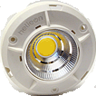
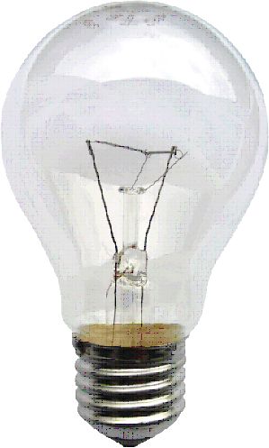
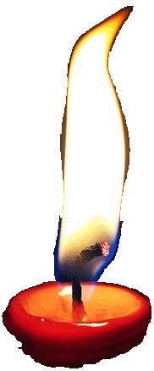
200 Years of Lighting Technology
100
Fluorescent Tube
http://en.wikipedia.org/wiki/File:Leuchtstofflampen-chtaube050409.jpg
Solid-State Lighting
Fluorescence
10
AlInGaP
Bridgelux Helieon Solid-State Lamp.
http://www.bridgelux.com/products/helieon.html
InGaN
Electric bulb from Neloux, courtesy of KMJ. http://commons.wikimedia.org/wiki/File:Gluehlampe_01_KMJ.jpg
Incandescence
AlGaAs
Carbon Filament
Tungsten Filament
GaAsP:N
Color-Filtered Incandescence
1
Efficiency (%)
Gas Mantle
GaP:Zn,O
Fire
0.1
Gas
Kerosene
Oil
Candle burning.
http://en.wikipedia.org/wiki/File:Candleburning.jpg
GaAsP
SiC
0.01
1850 1900 1950 2000 2050
Year
Notes:
CONDENSED HISTORY OF LIGHTING. Indeed, since the early 1990s, progress in light-emitting diode technology has been spectacular. To see that, here I show a condensed history of modern lighting technologies. The bottom axis is time, extending over a 200-yr time span from 1850 to 2050. The left axis is power conversion efficiency, in %. That is, the efficiency with which electrical power is converted into optical power that the human eye can see. Note that this left scale is not linear, it’s logarithmic. That means that equal increments on the axis don’t represent equal additive amounts, but equal multiplicative factors. In this case, each vertical grid spacing represents a factor of 10.
FIRE. At the lower left you see the efficiencies of lighting technologies based on combustion, or fire. A lot of progress was made during the industrial evolution, particularly as the fuel was changed from oil, to kerosene, to gas. You can see that efficiencies increased about ten times from 1850 to 1900. But their efficiencies were still all pretty low: less than one percent.
INCANDESCENCE. Then in the late 19th century came one of the most important inventions of the past couple of centuries: the incandescent light bulb, first with carbon filaments, and then with tungsten filaments. Suddenly lighting was much more efficient (3.5% or so), not to mention safer and cleaner. These old fire-based lighting technologies were considered to be quite a fire hazard in their day. As a side comment, the incandescent light bulb is important not just because of its efficiency, but also because it spurred the development of another invention or development, the electricity grid, itself hailed as one of the most important inventions or developments of the past couple of centuries.
FLUORESCENCE. Then, in the second half of the 20th century came the fluorescent tube that we talked about earlier. This gave us another factor of five increase in efficiency, up to nearly 20-25%! That’s getting pretty good, but of course that still means that 75-80% of your power is being wasted, and not going into light the human eye can see.
SSL. The latest technology, illustrated by the smaller circles on this plot, and developing at a meteoric rate on this 200-yr time scale, is solid-state lighting based on light-emitting diodes. You can see, beginning in the 1960’s with the work of Nick Holonyak and his colleagues at Bell Labs and the University of Illinois, the rise of red LEDs based on a zoo of semiconducting materials like GaAsP, AlGaAs, and AlGaInP. You can also see, beginning in the 1990’s with the work of Isamu Akasaki, Shuji Nakamura and their collaborators in Japan, the even more rapid rise of blue and green LEDs based on GaN and InGaN materials. Finally, you can see the rise of solid-state white lighting, in which blue LEDs are combined with phosphors to create white light. You can see that the efficiency of solid-state white lighting already exceeds that of incandescence, and is poised to exceed the efficiency of fluorescence. Indeed, the ultimate efficiency of these white solid-state lighting lamps may very well reach 50%, maybe even 75%, which would be two to three times more efficient than fluorescence, and ten to twenty times more efficient than incandescence.
WHITE VS COLORED LIGHT. We’re not quite there with white light yet, though, and it will be a few more years before it will be time to switch your fluorescent lamps for solid-state white lighting. Interestingly, though, for colored light, it is already no contest. The reason is that the traditional way of making colored lights is very inefficient. You start with an incandescent lamp and put a filter over it that absorbs the colors you don’t want and transmits only the color you do want. So you start with white light that to begin with wasn’t created very efficiently and you take away the colors you don’t want and make it even less efficient. That’s illustrated by this rainbow-colored line here, which is the approximate efficiency of color-filtered incandescence. Light-emitting diodes, in contrast, create to begin with light of a single wavelength, or a single color, so there’s no color filtering to be done and the light can be used as is. So you can see that colored LEDs are much more efficient than color-filtered incandescence. As a consequence, beginning in the late 1990’s and continuing through the 2000’s, virtually every application for colored light has been migrating to light-emitting diodes.

Slide 4
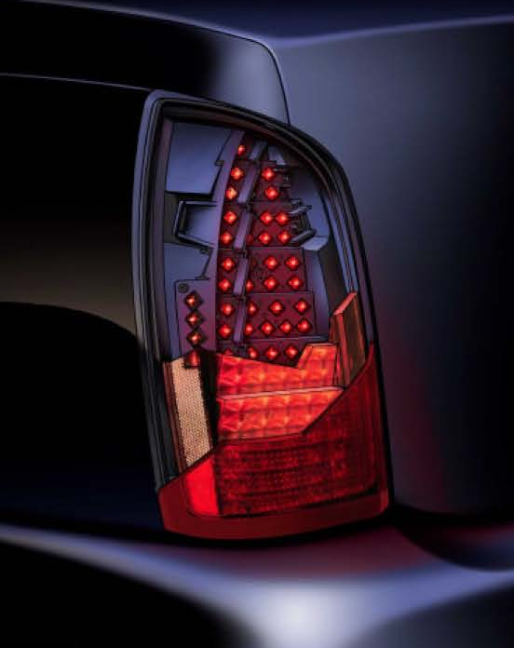
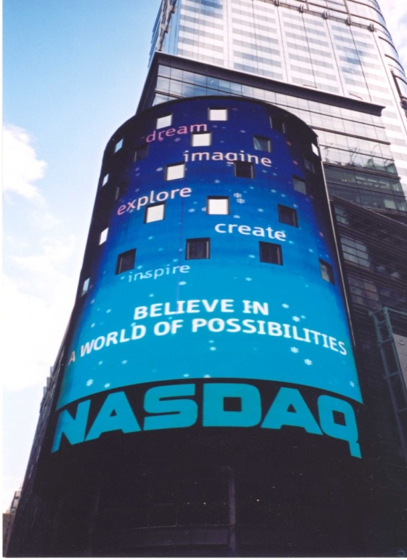

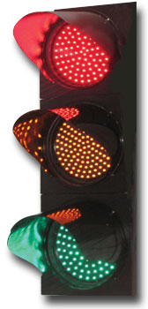
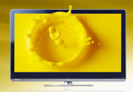
Light-Emitting Diodes and Applications for Colored Light
Rear Combination Lamp (LumiLeds)
Microvision Pico Projector. http://www.microvision.com/pico_projector_displays/application_gallery.html
LED Traffic Light, courtesy of Syafiqshahalam. http://en.wikipedia.org/wiki/File:LED_Traffic_Lights.jpg
NASDAQ’s Giant Video Display in Times Square, New York (Jeff Tsao)
Sharp QuadPixel RGBY LED-backlit LCD Display. http://www.macworld.com/article/145541/2010/01/sharp_quadpixel.html
Notes:
COLORED LIGHT APPLICATIONS. You’re probably pretty familiar with many of these applications for colored light, but here I show some of the more important ones. These are the ones that have provided the LED industry these past two decades with a series of stepping-stone markets that it could use to ramp up production, earn revenue, invest in R&D, continue to improve efficiency and performance, and go after additional markets enabled those improvements in efficiency and performance – the kind of virtuous cycle that characterizes many semiconductor technologies. Let me say a few words about each of these applications, going counter-clockwise starting at the upper left.
AUTOMOTIVE BRAKE LIGHTS. Here you see a photo of a brake light. This was one of the first big applications for LEDs, first for trucks and buses and then for automobiles. Interestingly, one of the reasons this was among the first applications was not so much because of efficiency but because of safety. Incandescent light bulbs are based on a hot filament, and even though the filament is thin and has hardly any thermal mass, it still takes about a quarter of a second for it to warm up and emit light. In that quarter of a second between when you’ve stepped on the brake pedal and your brake light has turned on, a car in back of you moving at 60 mph has moved one or two car lengths. So that’s one or two car lengths of reaction distance that you gain when you use LED brake lights, which switch on instantly.
TRAFFIC LIGHTS. The next big application for LEDs was traffic lights. The primary motivation here was to improve efficiency: at a typical intersection a city can save between $500 and $1,000 per year on electricity costs by switching from incandescent to LED traffic lights. But an important secondary motivation was traffic safety and maintenance. If your traffic light goes out, you not only have a safety hazard, but you have to send a crew to climb up and fix the light. This happens pretty often for incandescent lamps, which typically last about a year in continuous operation, but not nearly as often for LEDs, which last several years or more in continuous operation.
OUTDOOR VIDEO DISPLAYS. Then there are these giant outdoor video displays, like this one in New York City’s Times Square and the ones you see in big cities and sports stadiums all over the world. In fact, the latest controversy, as these kinds of displays get less and less expensive and more and more popular, is whether they should be allowed to replace billboards on the sides of highways. The advantage, of course, is that you can change the billboard in real time, and advertisers can better target their ads to the demographics of who is likely to be driving when. The disadvantage, though, is that it’s yet one more distraction for drivers. We’re already chatting or texting on your cell phones; now we have to keep track of billboard signs as well!
LED-BACKLIT LCD DISPLAYS. Then there is the hottest emerging application for LEDs: the backlighting for liquid-crystal displays. Many of you know that liquid-crystals don’t produce light, they just control whether light can get through them or not. So all liquid-crystal displays rely on some external source of light that they can switch. Up until recently, that external light source was a fluorescent tube. But, increasingly, that external light source is composed of red, green and blue LEDs, and the result is a much more complete palette of colors that can be produced. I just helped my parents buy a new LCD TV, and I was gently steering them towards the cheaper fluorescent-tube backlit technology. But then my Mom, who is 82 years old and has pretty terrible vision, plants herself in front of the more expensive LED-backlit technology and proclaims that this one looks the best. So I sheepishly agreed and we ended up getting the better TV. The latest twist is Sharp’s newest liquid-crystal display, in which they have added yellow. So they’ve basically created an RYGB display, not just an RGB display, and the palette of colors is even wider – especially of course for yellow and bronze colored objects, like brass instruments.
MICRO-PROJECTORS. Finally, up here in the top right you see a bunch of students playing around with an application that is just emerging now. It’s basically a hand-held projector, something that would enable your smart phone, or your digital camera, to project an image or a video onto a wall or even onto the back of someone’s T-shirt. Who knows whether this will catch on or not. But many companies are working on it.
COLORED VS WHITE LIGHT. Now I’ve just spent the last few minutes talking about applications for colored light – applications where LEDs, which are inherently colored, have a natural advantage over incandescent lamps, which are inherently white and have to be filtered to be colored. These applications are almost all ones, like these illustrated here, in which you view the light directly from the source. What about applications for white light, where you don’t view the light directly, but instead use it to illuminate something else, and you view the light after it’s reflected from that something else? This is the domain of lighting for illumination purposes, and now we can see that LEDs actually have a natural disadvantage over incandescent lamps. The problem is LEDs are colored, and to make white you need to have a bunch of colors.
SUNLIGHT. So one big question that comes up is how many colors you might need. At one extreme one might think one would need the equivalent of sunlight, which is basically a continuous spectrum of every visible color. After all, our human color visual system evolved to see objects that were illuminated by the sun.

Slide 5
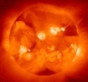
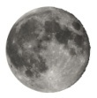

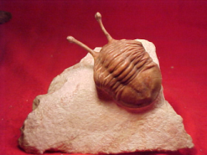
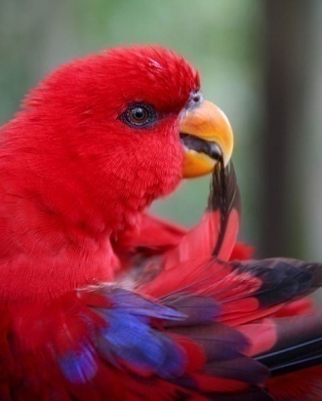



Light from the Sun and Moon: Trilobites, Birds, Mammals, Primates, Humans
Full-disk view of the X-ray Sun and was produced by the Yohkoh solar observatory in 1991. http://en.wikipedia.org/wiki/File:Yohkohimage.gif
Full moon view from Earth in Belgium, courtesy of Luc Viatour. http://en.wikipedia.org/wiki/File:Full_Moon_Luc_Viatour.jpg
Bridgelux Helieon Solid-State Lamp.
http://www.bridgelux.com/products/helieon.html
Asaphus species (Trilobite) picture taken by DanielCD. http://en.wikipedia.org/wiki/File:Asaphus_species_trilobite.jpg
Gray wolf, canis lupus, courtesy of Chris Muiden. http://en.wikipedia.org/wiki/File:Canis_lupus_265b.jpg
Olive baboon in Kenya; courtesy of Ryan Harvey;
http://en.wikipedia.org/wiki/File:Male_Olive_Baboon_2.jpg
A baby wearing many items of winter clothing: headband, cap, fur-lined coat, shawl and sweater. Courtesy of Andrew Vargas, Clovis, United States. http://en.wikipedia.org/wiki/File:Well-clothed_baby.jpg
Red Lory (Eos bornea) upper body preening feathers. http://en.wikipedia.org/wiki/File:Red_Lory_%28Eos_bornea%29-6.jpg
Notes:
INTERACTION BETWEEN THE SUN AND THE EVOLUTION OF COLOR VISION. To illustrate the importance of the interplay between the sun and the evolution of vision, especially color vision, here I sketch a brief history of that interplay, including times when we saw by sunlight and times when we didn’t see by sunlight.
TRILOBITES. Let’s start at the far left, where you see a fossil of a trilobite, one of the first known animals with imaging eyes – eyes that could image objects illuminated by light from the sun. The invention of such an animal eye was a very big deal, and some evolutionary biologists believe that it was this invention that helped fuel the so-called Cambrian explosion, 540 million years or so ago, in which all of the currently known 36 animal phyla appeared in a blink of geological time. Once an animal could see, it could became a predator, other animals could become prey, and the resulting predator-prey arms race could provide a powerful source of evolutionary selection pressure.
BIRDS. As evolutionary time went on, animal eyes began to take advantage of the fact that sunlight is white and contains a spectrum of colors, and evolved the ability to see those colors. Birds are a well known example of a species that sees color extremely well: many of them actually have four kinds of color sensors, not just the three that humans have, so they are tetrachromats, not trichromats. As tetrachromats they can distinguish color differences that our poor trichromat visual system can scarcely imagine. This isn’t so surprising – after all, birds are very colorful, and they use that color for one of the most important of all biological functions: to attract mates! As a side point, some of you may be aware of the recent discovery, just in the past few months, that dinosaurs, which are the ancestors of birds, might also have been relatively colorful. Usually we think of dinosaurs as being pretty much just grey or brown, but actually they might have been very much like modern birds, using color and their excellent color vision to attract mates.
MAMMALS. Mammals, interestingly, are altogether different. As some of you may know, evolutionary biologists believe that the ancestor of mammals was trichromat, but because mammals went through a very long period of evolutionary time when they were nocturnal, and lived under the moon’s light, they lost one kind of color sensor and became dichromat. So this grey wolf, the ancestor of modern dogs, was dichromat, kind of like a color-blind male human who only sees two colors. And this grey wolf’s descendant, the modern dog, is also dichromat.
PRIMATES. Only later, about 50 million years ago or so, when primates (like you and me) came out from the night and became active during the day, did they re-evolve a third kind of color sensor, so that they could more effectively hunt and forage for food. So, you might ask, now that we are trichromats and can see colors better than our mammalian siblings, why aren’t we more colorful? Why are we basically beige? – that is, when we’re not red because we’re blushing or blue because we’re angry! Well, that’s something I’ve been wondering about as well. All I can say is that what we lack in natural coloring we certainly make up for in artificial coloring, like in the clothes we wear, or the make-up we use. Certainly an alien from outer space, not knowing that our clothes weren’t part of our natural biology, would think our color vision was pretty good!
SUNLIGHT. So we see that the sun played a key role in the evolution of our color vision. And so, like I mentioned earlier, it’s natural to think that artificial white light sources should reproduce sunlight if they are going to work well for us, and that they should be composed of many colors. So let’s come back to that question, and ask, how many colors do we actually need to produce a good quality white light – a white light that doesn’t cause us to take a step backwards towards our dichromat mammalian siblings!

Slide 6
Making White Light from Colored Light
Munsell Samples
8
7
6
5
4
3
2
1
9
1
and their spectral reflectances
8
9
0.5
6
7
3
1
2
5
0
4
100%-Efficient SSL
0.1
459
535
573
614
White
Mixing
Optics
Light source spectral power distributions (Watts per nm)
0.01
RYGB
LEDs
16%-Efficient SSL
Early-2010
0.001
615
White
RG
Phosphor
440
538
0.0001
Blue
LED
750
Human eye response
(lumens per Watt)
500
250
0
400 500 600 700 800
Wavelength (nm)
Notes:
CONSIDERATIONS FOR WHITE LIGHT. In fact, color scientists have a tentative answer to this question, and to understand it, this viewgraph illustrates the two main criteria that determine how best to combine colors to create white. Interestingly, the two criteria fight each other – one criterion wants fewer colors concentrated into a narrow wavelength band, while the other criterion wants more colors expanded out into a wider wavelength band.
HUMAN EYE RESPONSE. At the bottom here, I show the first criterion, which is that we want the white light to match the human eye response so that we can maximize the efficiency with which the human eye sees that light. Basically what is being plotted is the sensitivity of the human eye, in lumens of perceived light per Watt of optical power incident on the human eye, as a function of wavelength. To calibrate you, wavelengths around 460 nm are perceived as blue. Wavelengths around 540 nm are percieved as green. Wavelengths around 570 nm are perceived as yellow. And wavelengths around 620 nm or so are pereived as red. Wavelengths that are outside the human eye response we don’t see: like infrared light at wavelengths longer than 650 nm or so, or ultraviolet light at wavelengths shorter than 450 nm or so. So by this first criterion, efficiency, the best light source would be composed of a single color, at a wavelength of 555 nm, right smack in the green, because that’s where the human eye is most sensitive.
COLOR RENDERING. At the top here, I illustrate the second criterion, which is that we want the white light to render well the colors of objects in the world around us, so that we can distinguish between them. The way color scientists do that is based on these color swatches up at the top. These are a subset of the so-called Munsell samples, named after Albert Henry Munsell, a turn-of-the-century American painter. These samples are relatively evenly distributed over the color hues that are present in the world around us. For example, Munsell sample #9 on the far right is red, and Munsell sample #6 over here is blue.
REFLECTANCE SPECTRA. All that can be made quantitative by measuring and plotting the actual reflectance spectra of these samples. You can see that the red Munsell sample #9 does indeed have a high reflectance in the red and low reflectances in the green and blue. And the blue Munsell sample #6 does indeed have a high reflectance in the blue and low reflectances in the green and red.
DISTINGUISHING BETWEEN MUNSELL SAMPLES. So the basic idea is that one wants a white light source that has enough wavelengths in it to render the colors of these swatches well, so the human eye can easily distinguish them from each other. Suppose, e.g., your light had only one wavelength, say, in the yellow here at 573 nm. At this wavelength, the reflectances of the samples separate out into three groups: the first group contains three samples, the second group contains five samples, and the third group contains one sample. This color light can distinguish between these three groups, which is good, but it can’t distinguish between the samples within each group. Suppose we added another wavelength, say, in the green at 535 nm. Then the samples separate out into four groups, one contains two samples, another one sample, another five samples, and the last one sample. But the samples distinguished by the first wavelength are different from the samples distinguished by the second wavelength, so with two colors you can distinguish more samples than you could with just one color. With three colors you can of course do even better, and it turns out that with four colors, provided they are spaced far enough apart, you can do extremely well. In fact, with four colors spaced far enough apart it turns out you can do essentially as well as you could have if you had a continuous spectrum of white light composed of every color. So the tentative answer to our original question, interestingly, is: you don’t need to duplicate the sun’s continuous spectrum, you only need four discrete colors, provided they are spaced far enough apart from each other.
PERFECT COLOR-MIXED WHITE LIGHT. But, now we have another problem. We still have the first criterion to worry about. By spacing the colors far apart we’ve moved our colors away from the 555 nm wavelength at which the human eye is most sensitive. So there is an optimal spacing between the wavelengths that best balances the desire to distinguish between the Munsell samples while also maximizing the response of the human eye. The quantitative result of that balancing is shown by these four white peaks here. These are the magic colors that an ideal white light source would be composed of. And a solid-state source that would produce such an ideal white light is illustrated in this cartoon here. It’s composed of four colored LEDs, red, yellow, green and blue, each 100% efficient, mixed to create white. This is the kind of white light that solid-state lighting might ultimately aspire to.
CURRENT PHOSPHOR-CONVERTED SSL. But what about solid-state lighting right now? Well, we’re actually not yet very close to this ideal white light source. The reason is that, although we can make all these colors, we can’t yet make them all equally efficiently – we can make the blue much more efficiently than we can make the other colors. So industry has adopted an alternative scheme illustrated here. You start with a blue LED, then you put red and green phosphors on top. Some of the blue leaks through, but some gets absorbed by the phosphors and is re-emitted as red and green light. So you end up with a spectral power distribution like this one shown in the black curve. It’s composed of a peak here at 440 nm associated with a blue LED, a very broad peak here at 538 nm associated with the green phosphor, and another very broad peak here at 615 nm associated with the red phosphor. You can see that this spectrum is relatively far from that of the ideal solid-state lamp. But as solid-state lighting continues to improve, we can imagine that it will get closer and closer to this ideal solid-state lamp: its spectrum will become narrower and more centered around these discrete lines.

Slide 7
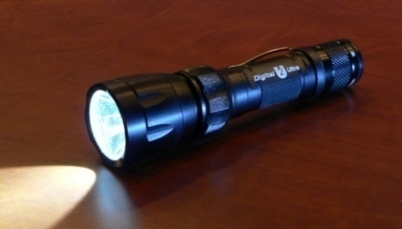
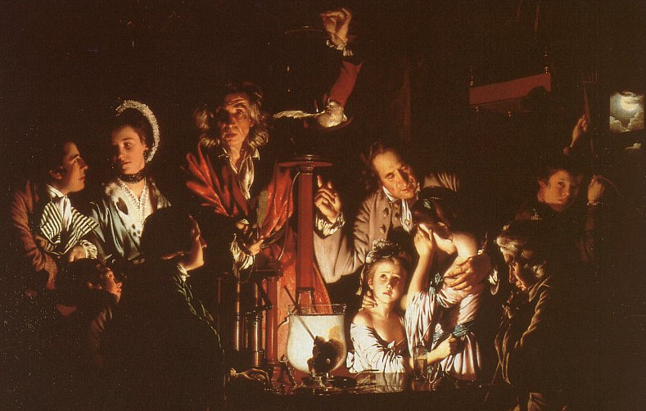
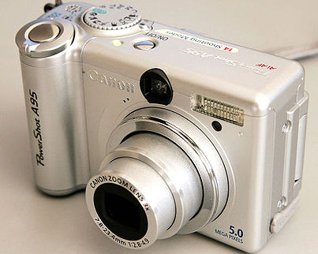
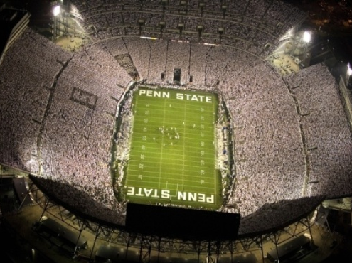
Solid-State Lighting and Applications for White Light
Surefire U2 flashlight. http://en.wikipedia.org/wiki/File:SurefireU2JPG.jpg
Canon PowerShot A95. http://en.wikipedia.org/wiki/File:Canon_PowerShot_A95_-_front_and_back.jpg
Joseph Wright (1768)
“An Experiment on a Bird in the Air Pump“
http://imagearchive.psu.edu/albums/userpics/10003/IMG_5116091707_copy.jpg
Notes:
APPLICATIONS. As it does so, solid-state lighting will gradually make inroads into white lighting applications, with hopefully the same virtuous cycle of stepping stone markets as for colored light, just delayed by about 10 years. Here I show a few, and, again just like with the colored light applications, let me say a few words about each of them.
FLASHLIGHTS. Flashlights were among the first solid-state white lighting applications. Some of you have these small keychain lights that you use to find keyholes in the dark. And many of you have full-fledged flashlights like these that are getting pretty common. In a way, these were the perfect starting point applications for solid-state lighting, because cost was not as important as efficiency and reliability.
CAMERA FLASHES. The flashes for digital cameras were another important stepping stone application. Almost every digital camera, and many cell-phone cameras, have flashes, and nowadays virtually every one of these flashes is a solid-state lamp.
INDOOR ILLUMINATION. The really big application of course will be indoor general illumination: residences, stores, offices. Here I show one of my favorite prototype indoor scenes. It’s actually a 1768 painting by Joseph Wright called “An Experiment on a Bird in the Air Pump.” It depicts a mad scientist showing a family a then-new technology, an air-pump, which he’s going to use to evacuate a glass jar into which he has placed a bird – a white cockatoo. This is of course one of the precursor technologies necessary for the vacuum tubes that we started out by talking about. But that’s not why I’m showing this picture. I’m showing it because it illustrates one of the two ways in which solid-state white lighting for illumination could evolve. One way would be for solid-state lighting to simply replace existing lighting, one-for-one, like this solid-state lamp by Philips that you can now buy at Home Depot. Same functionality and same light quality as this fluorescent lamp, just more efficient and, ultimately, cheaper. That would be OK, but as far as I’m concerned, not the best that we could do. Another way would be for solid-state white lighting technology to continue to evolve so that lighting could be done in entirely new ways.
REAL-TIME CONTROL OVER COLOR AND INTENSITY. For example, suppose your white light were constructed from the four discrete colors as I had mentioned before, and suppose you could change the relative intensities of those colors in real-time. Then, you could change the color hue of the light. You could make it cool and somewhat bluish, as with this flashlight. Or you could make it warm and somewhat reddish, as with the light from the candle in front of these girls. And, as you do so, you could alter people’s emotional response to the scene that’s being illuminated by the light. In this case, the sense of fear and impending death that these girls appear to feel.
REAL-TIME CONTROL OVER PLACEMENT. Or, for example, suppose your white light were fractionated into many separate sources, each of which could be independently steered and focused onto some portion of the scene. After all, semiconductor chips can always be made smaller, with less light output per chip. Then, you could control which parts of a scene were illuminated at any time, and change the relative sense of importance of different parts of that scene. In this case, the sense that these girls are the most important actors in this scene, but that these two people, even though they are off to the side, are also somewhat important.
CELL-PHONE-BASED DIGITAL CONTROL. One could even imagine that real-time control over color and intensity could be combined with real-time control over placement, and that such control would be triggered by the presence or absence of people. In the early days of solid-state lighting, some of us used to joke – but now I think it might someday actually come true – that all of our lights would have IP addresses, just as people like you and me would have IP addresses. Then, when we walked into a room the lights would automatically change to reflect the kind of lighting you and I liked. Of course if multiple people walked into a room together, the system would have to be smart and figure out whether to take an average of everyone’s preferences, or to pick one person’s preferences.
OUTDOOR ILLUMINATION. Finally, I want to mention one last white lighting application, one that one might imagine could grow enormously in the future, and that is outdoor illumination. This football stadium is an example. But as the process of world urbanization continues, particularly in the less developed world, one can speculate that evening lighting of outdoor urban areas where people can socialize, shop and be entertained, might also increase tremendously.

Slide 8
How Fluorescent Lamps Work. http://home.howstuffworks.com/fluorescent-lamp4.htm
Acknowledgements (colleagues):
Roland Haitz, Tom Brennan
Jerry Simmons, Mike Coltrin, Mary Crawford, and Sandia’s Solid-State-Lighting Science Team (http://ssls.sandia.gov/)
Acknowledgements (sponsors):
Work at Sandia National Laboratories was supported by Sandia’s Solid-State-Lighting Science Energy Frontier Research Center, funded by the U.S. Department of Energy, Office of Basic Energy Sciences. Sandia is a multiprogram laboratory operated by Sandia Corporation, a Lockheed Martin Company, for the U.S. Department of Energy’s National Security Administration under Contract DE-AC04-94AL85000.
Notes:
FULL CIRCLE. Well, now we come full circle. I started this talk by saying goodbye to the vacuum triode and the cathode ray tube. In the next few years we will begin to say our goodbyes to the fluorescent tube. We don’t know exactly how at the same time we’ll be saying hello to solid-state lighting. Will it be like this light here, or it will be more sophisticated and digitally controllable? But one thing is for sure. The next few chapters to the story will be exciting, and I do hope that some of you in the audience participate in helping write some of those chapters.
ACKNOWLEDGEMENTS. With that, let me close by acknowledging a few key people. Roland Haitz is one of the early visionaries in solid-state lighting, and was the first to coin the phrase “The Next Semiconductor Revolution: This Time It’s Lighting.” Tom Brennan is an old friend and colleague who first suggested that we do an Academy Lecture on this topic. It’s been a privilege to be associated with a truly outstanding group of scientists on Sandia’s solid-state lighting science team, and I’m especially grateful to Jerry Simmons, Mike Coltrin and Mary Crawford for their friendship and collaborations. And, last but not least, I want to acknowledge the Department of Energy’s Office of Basic Energy Science for their support through their Energy Frontier Research Center for Solid-State-Lighting Science.
THANK-YOU. With that, thank-you.

