Slide 1
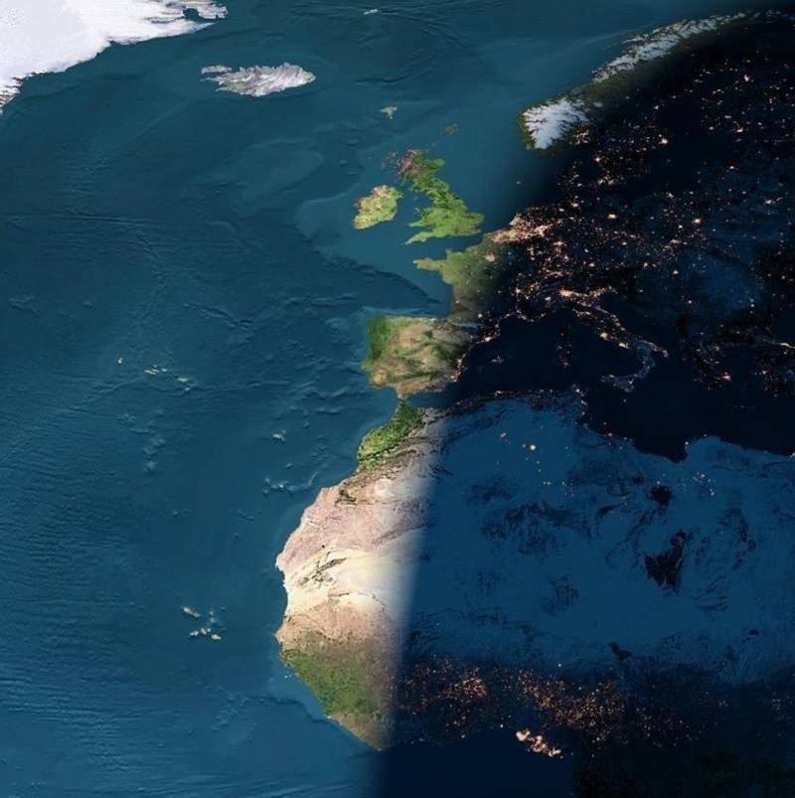
(Lighting and) Solid-State Lighting:
Science, Technology, Economic Perspectives
Jeff Tsao
Physical, Chemical & Nano Sciences Center
Sandia National Laboratories
Acknowledgements
Mike Coltrin
Mary Crawford
Yoshi Ohno
Jerry Simmons
Paul Waide
Jon Wierer
Work at Sandia National Laboratories was supported by Sandia’s Solid-State-Lighting Science Energy Frontier Research Center, funded by the U.S. Department of Energy, Office of Basic Energy Sciences. Sandia is a multiprogram laboratory operated by Sandia Corporation, a Lockheed Martin Company, for the U.S. Department of Energy’s National Security Administration under Contract DE-AC04-94AL85000.
Earth at Night (courtesy of NASA)
Night arrives between Europe and Africa; digital composite of archived images taken by several Earth-orbiting satellites and ocean-faring ships; courtesy of NASA; http://apod.nasa.gov/apod/ap030324.html
Notes:
HELLO. Good afternoon. Thank-you, Fred, for the kind introduction and also for your invitation to speak here today. It’s an honor to be here, and it’s a special honor to be the speaker that follows Shuji Nakamura. Shuji has been responsible for so many tremendous contributions to solid-state lighting and other areas that, again, it’s really just a special honor.
THE DREAM OF SSL. Now, it wasn’t too long ago that the idea that solid-state lighting would someday compete with incandescent or fluorescent lamps in more than just niche applications was just a dream. Today, however, we are truly on the verge of a massive transition in which virtually every lamp on earth, from the smallest indicator lamp to the largest stadium-sized flood-lamp, will someday be a solid-state lamp.
OUTLINE. So what I’d like to do today is give you an overview of this new technology of solid-state lighting. Before I do that, though, I’d like to spend some time putting solid-state lighting in a larger context, and talk about lighting in general. And, throughout, I’ll try to blend various perspectives from science, technology and economics.
IMPORTANCE OF LIGHT. Let’s start with light in general. Here I show a composite photo taken from space depicting night coming to Europe and Africa. I show this photo simply to illustrate how important light, especially artificial light, is to human society. As soon as the sun sets and the natural light from the sun goes away, artificial lights go on. In fact even this photo under-represents the importance of artificial light. We probably consume at least as much artificial lighting during the day as we do during the night, because so many of us spend so many of our waking hours indoors, where we can be more productive sheltered from the environment.

Slide 2
Artificial Lighting and Human Productivity
Efficiency
Consumption
0.72% = US$440B / US$60T
6.5% = 1 TW_{c} / 16 TW_{c}
CoL ($/Mlmh) ≃ CoE/η
10^{1.5}
10⁴
10^{5.4}
10³
CN 2005
CN 2006
100%
Efficiency
JP+KR 2005
WRLD-GRID 2005
OECD-EU 2005
AU+NZ 2005
10²
US 2001
SSL?
FSU 2000
US 2001
JP+KR 2005
WRLD-DEV 2005
UK 2000
FSU 2000
OECD-EU 2005
10³
10¹
CN 2006
Luminous efficacy
η (lm/W_{e})
CN 1993
HID
Fluorescent
Incandescent
UK 1950
CN 2005
10¹
UK 2000
UK 1950
AU+NZ 2005
10⁴
per capita consumption of light
φ [Mlmh/(per-yr)]
CN 1993
1
10^{2.8}
UK 1900
1
UK 1900
WRLD-UNDEV 1999
UK 1850
Gas
Kerosene
10⁻²
10¹
10⁵
UK 1800
UK 1850
10⁻¹
WRLD-NONGRID
1999
UK 1800
Candles
UK 1750
UK 1700
UK 1750
10²
UK 1700
10⁻²
Tsao and Waide, “The World’s Appetite for Light: Empirical Data and Trends Spanning Three Centuries and Six Continents,” to be submitted to LEUKOS
10⁻⁵
Tsao and Waide, “The World’s Appetite for Light: Empirical Data and Trends Spanning Three Centuries and Six Continents,” to be submitted to LEUKOS
10^{4.3}
1 10¹ 10² 10³ 10⁴ 10⁵
10⁻⁵ 10⁻² 10¹ 10⁴
CoE ($/MW_{e}h)
β·gdp/CoL [Mlmh/(per-yr)]
0.0072
$/Mlmh
$/(per-yr)
Notes:
LIGHTING TECHNOLOGY. Because light, especially artificial light, is so important to us, we have invested tremendous amounts of ingenuity and hard work to improve the technology for producing it. To illustrate this, here in the left figure of this viewgraph I plot a three-hundred year history of the efficiency of artificial lighting. The left axis of the plot is luminous efficacy, “eta,” in lm/W, which is basically a measure of the efficiency with which power (Watts) is converted into light (lumens) visible to the human eye. The bottom axis of the plot is the cost of the energy, in units of $/MWh, that is being converted into light. The data points correspond to various nations or groups of nations at various states of technological development over the past three centuries. There’s the UK in 1700, the undeveloped world not on grid electricity in 1999, and various countries in the developed world on grid electricity in the modern world.
Now, the cost of light, in units of $/Mlmh, is approximately the cost of energy divided by luminous efficacy, and so decreases from the lower right to the upper left of this plot: lower cost of energy and higher luminous efficacy mean lower cost of light. To see that, I’ve drawn as these dashed grey lines contours of constant cost of light, spanning a range from 100,000 $/Mlmh to 1 $/Mlmh. From 1700 until now, the cost of light has decreased by an amazing 4.3 orders of magnitude. Of that, 1.5 orders of magnitude has been due to a decrease in the cost of energy. But a much larger 2.8 orders of magnitude has been due to an increase in luminous efficacy, from less than a tenth of a lumen per Watt to nearly 100 lumens per Watt!
Luminous efficacy, of course, is a measure of technological progress, so this plot just quantifies what we all intuitively know: that lighting technology has made enormous historical progress: from candles, to gas and kerosene lamps, and finally to modern incandescent, fluorescent and high-intensity-discharge electric lighting.
CONSUMPTION OF LIGHT. One of the most important consequences of this progress is illustrated on the right side of this viewgraph: as cost of light decreased, we consumed more and more of it. Here I plot a history of the past three centuries of the consumption of light. The left axis of this plot is per capita consumption of light, φ, in units of Mlmh per person year. The bottom axis is a fixed constant, β, times the ratio between per capita gross domestic product, gdp, and cost of light. Since per capita gdp has the units $/(per-yr), and cost of light has the units $/Mlmh, this ratio has the units Mlmh/(per-year), the same as the units of the vertical axis. And when the fixed constant, β, is 0.0072, you can see that the empirical data fall very closely along a line of slope unity. This has two implications.
The first implication is that, over the past few centuries, and even now, the world spends about 0.72% of its gdp on light. This was the case in the UK in 1700, it is the case in the undeveloped world in modern times not on grid electricity in 1999, and is the case for the developed world in modern times using the most advanced lighting technologies. On a 2005 world GDP of 60 T$, this is roughly 440 B$, a huge expenditure. Moreover, because of the energy intensity of lighting, this 0.72% of GDP translates into a much larger percentage, 6.5%, of world primary energy consumption. On a 2005 world primary energy consumption of 16 TW, this is roughly 1 TW!
The second implication is that the income and price elasticity of the consumption of light is roughly unity. In other words, as per capita gdp has increased and cost of light has decreased, per capita consumption of light has increased, linearly. In fact, over three centuries, it’s increased by an astonishing 5.4 orders of magnitude, to the point where, in the U.S. in 2001, with among the highest per capita gdp in the world and among the lowest costs of energy, we consumed about 136 Mlmh/(per-yr). To put that in perspective, that’s the equivalent of the average person in the U.S. being surrounded during his or her waking hours by 17 100W light bulbs!
IMPORTANCE OF LIGHTING AND SOLID-STATE LIGHTING. The message I want to leave you with here is that lighting is very important to us, it makes us productive, we consume tons of it, so the efficiency with which we produce it is very important. With that, let me turn now to solid-state lighting, poised to increase the efficiency of lighting by another perhaps half to three-quarters of an order-of-magnitude or so. This is a big increase, but we should probably be a bit modest about it. It will not be the most important advance in lighting technology of the past few centuries. That distinction belongs to incandescent lamps, which increased lighting efficiency by more than an order of magnitude. Still, half to three-quarters of an order-of-magnitude is nothing to sneeze at, and there is plenty of room for excitement – perhaps even approaching this 100%-efficiency line. So let’s turn now to solid-state lighting, and let’s start by asking: what do we mean by this line at 100% efficiency?

Slide 3
Characteristics of
“100%-Efficient” Lighting
800
Human Eye
Response
(lm/W)
400
100 nm
0
CCT = 3,800K
R₉ = R_{a}/4
90
90
459
nm
535
nm
573
nm
614
nm
CRI 85
Color Rendering Index
(R_{a})
Color Rendering Index
(R_{a})
80
80
70
400 lm/W
70
60
60
300 350 400 450
1.0
0.24
0.23
0.37
Luminous Efficacy (lm/W)
Relative
Power
0.5
0.18
0
All linewidths
1-nm FWHM
Relative
Reflectances Munsell Samples 1-8
0.8
200 nm
7
6
8
0.4
8
5
4
3
1
2
7
J.M. Phillips, et al, “Challenges to Ultra-Efficient SSL”, Laser & Photonics Reviews (2007).
Calculations based on white LED simulator 5-3 (Y. Ohno, NIST).
0
400 500 600 700
Wavelength (nm)
Notes:
100% EFFICIENCY. That is to say, from what we know about the human visual system and the colors of the objects in the world around us, what is the best that solid-state lighting could do? Now, this question has been asked several times over the past decade. Here I show some relatively recent results based on a simulator developed by Yoshi Ohno at NIST. This simulator optimizes the wavelengths and relative powers of four RYGB colors (that together create white) so as to maximize luminous efficacy for a given color temperature and a given color rendering index – basically ability of that light source to faithfully render colors of typical objects in the real world.
WHY FOUR? Why four colors? It’s because most objects in the world around us have relatively broad reflectance spectra, so to distinguish between them we actually don’t need very many wavelengths. Five is overkill. Three is enough for many situations, but four turns out to be safe.
INVERSE RELATIONSHIP BETWEEN LM/W VS CRI. So we use four colors, and if you work through the simulations, what you find is that there is an inverse relationship between luminous efficacy and color rendering index. Luminous efficacy is highest at low color rendering index, and lowest at high color rendering index. The reason is that these two metrics are in competition with each other.
On the one hand, the human eye response peaks at 555 nm, with a FWHM of about 100 nm, so maximizing luminous efficacy means concentrating as much optical power near 555 nm as possible.
On the other hand, objects in the world around us span a range of colors, so maximizing the rendering of those colors means diffusing optical power away from 555 nm. To illustrate this, here I’ve drawn reflectance spectra of the 8 so-called Munsell samples used to calculate the standard color rendering index, Ra. You can see that the wavelengths over which their reflectances vary span a broader, 200-nm-or-so range from 450 nm to 650 nm.
So the result is that as CRI increases, the center wavelengths of the optimal RYGB sources become more widely spaced away from 555 nm and, as a consequence, luminous efficacy decreases.
PERFORMANCE FRONTIER. Now, CRI’s of 70 are common for many SSL white light sources, like flashlights, but they aren’t really good enough for general illumination. CRI’s of 80 to 85 are considered good enough for many general illumination applications, and a CRI of 85 is considered good enough for all but the most demanding of general illumination applications. So, to be on the conservative side, here I’ve drawn a dotted line at a magic CRI of 85. At this CRI it is possible to achieve a luminous efficacy of 400 lm/W. So this is what one might consider to be the performance frontier of SSL. This frontier consists of four RYGB LEDs at the wavelengths 459, 535, 573 and 614 nm, with power fractions of 0.18, 0.24, 0.23 and 0.37.

Slide 4
Efficiencies of Actual Lighting Technologies
600
Human eye response (lm/W)
400
Human eye response (photopic)
200
0
All spectra normalized to 1W wallplug power
100%-Efficient SSL
CCT 3,800K 400 lm/W
21%-Efficient
Fluorescent
CCT 3,500K 85 lm/W
Courtesy of Lauren Rohwer
3.5%-Efficient Incandescent
CCT 3,000K 14 lm/W
14%-Efficient 58 lm/W SSL
Commercial
Late-2009
Warm-White CCT 3,100K
Driven at 0.7A
Notes:
100%-EFFICIENCY. Now, how do current lighting technologies compare with this 100%-efficient light source? Well, here I show the spectral power distributions of a number of lighting technologies. The white curve is the spectral power distribution of the 100%-efficient light source. Its light is concentrated into the four narrow lines we just talked about. Much of the light is within the human eye response, though you can see that the blue and red lines are somewhat in the fringes of that response.
INCANDESCENTS. The red curve is the spectral power distribution of a typical 3.5%-efficient incandescent lamp. The incandescent lamp is of course very efficient at converting electrical power into light, it’s just that most of the light is in the infrared, where the human eye isn’t sensitive.
FLUORESCENTS. The blue curve is the spectral power distribution of a typical 21%-efficient compact fluorescent lamp. These are mercury discharge lamps, where you lose about half of your efficiency in the discharge exciting the mercury, and then you lose another half in the phosphor down-conversion of the mercury line at a wavelength of 254 nm to visible light with wavelengths around 555 nm.
SOLID-STATE LIGHTING. Finally, the black curve is the spectral power distribution of the current generation of solid-state lighting, which is about 14% efficient. Now some of you may be used to seeing efficiencies that are higher than this. The reason is that I’ve chosen a conservative example. It’s a commercial lamp that you can buy, rather than a research laboratory result. It’s a lamp that came out in mid-to-late-2009, as opposed to one that is coming out this month – and in this technology area, a few months can actually make a difference. It’s a warm-white 3,100K lamp, rather than a cool-white lamp, and these tend to have lower efficiencies. And the lamp is driven relatively hard, at 0.7A, a drive current at which efficiencies, as we’ll discuss later, tend to be lower. So we end up with 14%-efficiency.
SPECTRUM. Now, I’ll talk a bit more about this solid-state lamp in just a minute. But for now I want to point out one thing. And that is that its 14% efficiency is better than the 3.5% efficiency of an incandescent lamp, so it is already better to replace your incandescent lamps with solid-state lamps. But its 14% efficiency is not as good as the 21% efficiency of a fluorescent lamp, so it is even better to replace your incandescent lamps with a CFL, which is of course what people are doing right now.

Slide 5
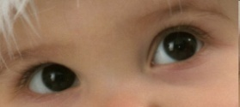
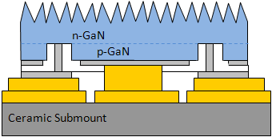
Anatomy of State-of-Art Commercial SSL
ε = 14%
η = 58 lm/W
CRI = 85
CCT = 3,100K
http://bobbymercerbooks.com
Spectral 78%
Phosphor/Package 54%
Internal quantum effic 90%
Stokes deficit 76%
Scattering/absorption 80%
Blue LED 33%
Joule 85%
IQE at low power 70%
Droop at high power 70%
Light extraction 80%
0.7A
Thin-Film Flip Chip (TFFC) schematic courtesy of Jon Wierer
1 mm
Notes:
SOLID-STATE LIGHTING. So let’s talk now in a little more detail about the solid-state lamp. Well, here I show a schematic of a state-of-the-art solid-state lamp. This particular one is a so-called thin-film flip-chip design pioneered by Philips Lumileds. The lamp is basically a blue LED, 1-square-mm in size, driven with 0.7A of current, and coated with green and red phosphors. Some of the blue light leaks through the phosphors. But some is absorbed by the phosphors and is re-emitted as green and red light. The combination of blue, green and red gives a warm-white light that is very pleasing to the human eye and which renders fairly faithfully colors of objects in the environment around us
EFFICIENCY AND TRADE-OFFS. The problem is that, as I just mentioned, the efficiency of this lamp is only around 14%, and that of course is not very high. Of course, you can always back off of some characteristics of the light in order to get higher efficiencies.
You can substitute a yellow phosphor for the green and red phosphors, so you end up with a white light that the human eye is more sensitive to. That’s what manufacturers do for flashlights. But then you end up with a harsher white light that doesn’t render colors very well.
Or you can drive the LED at low currents, where it turns out they run more efficiently. But then you end up with a lamp that doesn’t put out much light, and per lumen of light output is very expensive.
So one of the most important technology challenges right now in solid-state lighting is to improve efficiencies without backing off on any of these characteristics of the light. In fact, if you actually go through the various subefficiencies associated with the various components of this lamp, your find that they aren’t all that bad.
BLUE LED EFFICIENCY. For example, if you consider just the blue LED, the Joule, or resistive, loss is only about 15%, so what remains after that loss is about 85%, which is not too bad. Internal quantum efficiency at low power is about 70%, also not too bad. When you drive the chip at the high powers that are desirable for low cost of light, you lose about 30%, leaving behind about 70% of the light you started with, again not too bad. And light extraction is about 80% efficient. The problem is that these four efficiencies are in series, and so if you multiply them out you end up with a blue LED that is only about 33% efficient. It’s sort of like death by a thousand cuts. Each cut isn’t so significant, but there are a lot of them.
PHOSPHOR & PACKAGE EFFICIENCY. The same goes for the phosphors and the package. The internal quantum efficiency – the probability that the phosphor, having absorbed a blue photon, will re-emit a green or red one -- is pretty high, about 90%. The well-known Stokes deficit – the quantum loss associated with the phosphor absorbing photons at one energy and then re-emitting photons at a lower energy – still leaves behind a good 76% of the power you started with. Now, because these phosphors are basically poly-crystalline grains, they scatter light, both the blue light from the pump as well as the green and red light emitted by those grains, and some of this scattered light can wind up being absorbed by something that isn’t transparent inside the package. Still, even after this scattering and absorption loss you’re left with about 80% of the light you started with. But, again, when you multiply all these efficiencies in series, you end up with an effective phosphor and package efficiency that is only about 54%. So, again, it’s sort of a death by a thousand cuts.
SPECTRAL EFFICIENCY. And, finally, because of the particular characteristics of the phosphors that are used now, there is a mismatch between the spectrum of white light that this source puts out and the spectrum that is ideal for the human visual system. The phosphors emit a little too far into the deep red, where the human eye isn’t as sensitive, and they absorb better in the deep blue so you end up using a blue pump that’s a little too far in the deep blue, where again the human eye isn’t as sensitive. So you end up with a spectrum that is about 78% efficient.
TOTAL EFFICIENCY. Still if you look at these numbers, it doesn’t seem horribly bad – 33%, 54%, 78%. But, again, when you multiply them all up, 33% times 54% times 78%, you’re left with this low efficiency of 14%. So the billion dollar question is: how do we get from 14% to something that’s much closer to 100%? Actually, that’s a 440 B$/yr because that’s how much we spend on light. Or, you could think of it as a 1 TW question, since that’s what how much energy we consume for light.

Slide 6
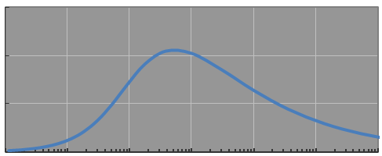
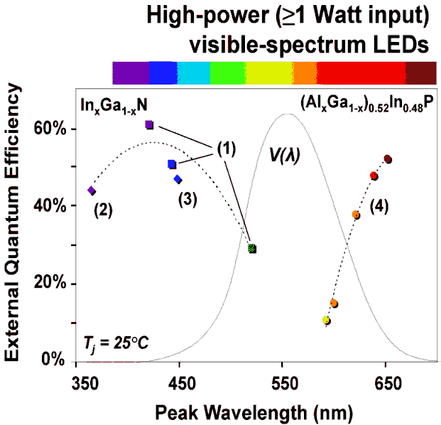
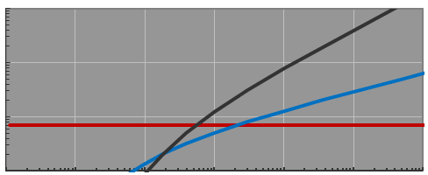
Technology Grand Challenges for Luminous Efficacy
1
Eliminate blue LED droop
2
Narrow-linewidth
shallow-red color conversion
3
Fill in the red-yellow-green gap
Target: 200 A/cm²
0.3
ε_{IQE}
0.2
456
535
573
614
0.1
456
614
0
1
Luminous Efficacy (lm/W)
0.1
Auger-like
k (ns⁻¹)
Spontaneous Emission
Human eye response
0.01
Schockley-Read-Hall
0.001
State-of-art LED
0.1 1.0 10 100 1,000 10,000
J (A/cm²)
Spectral power distribution (W/nm)
1W LEDs
350 mA
Shockley-Read-Hall
Spontaneous Emission
Auger-like
Wavelength (nm)
Courtesy of M. Krames, Philips-Lumileds
Rate constants for 510nm LED, after UT Schwarz, “Emission of biased green quantum wells in time and wavelength domain,” SPIE Proc 7216, 7216U-1 (2009).
Notes:
GRAND CHALLENGES FOR LUMINOUS EFFICACY. So what are some of the technology grand challenges that would enable us to improve efficiencies? Here I list what one might call three grand challenges. That isn’t to say that there aren’t a lot of other smaller challenges, that, integrated out, wouldn’t equal any one of these grand challenges. But I’ll just mention these three.
CHALLENGE 1. The first challenge is to eliminate efficiency droop – that is, to maintain high efficiency in the blue at high drive currents. This is a challenge that many groups are working on right now. It all comes about because there is some non-radiative recombination channel that turns on at high carrier densities, and causes this rollover in efficiency. In fact, as I’ll discuss in just a minute, 2A is the drive current that would enable the cost structure for solid-state lighting to approach that of traditional lighting. So that’s a reasonable target for the drive current we would like to achieve, and therefore what we’d like is for this rollover to occur at drive currents higher than 2A per mm2.
CHALLENGE 2. The second challenge is to find a narrower-linewidth shallow-red color converter. Right now it’s a phosphor, but it could be something else, like quantum dots.
To illustrate this a little more clearly, here I show again the spectrum of the state-of-the-art SSL lamp we discussed earlier. This long-wavelength hump over here is due to the red phosphor, which I’ve shown separated out in the dashed red curve. You can see that it has a long tail into the deep red, where the human eye isn’t very sensitive, and this causes a decrease in luminous efficacy.
So the materials challenge is to find a new phosphor, or color converter, with a sharp line in the orange-red at 614 nm.
CHALLENGE 3. The third challenge is to fill in the so-called red-yellow-green gap not with phosphors, but with electroluminescent semiconductor light emitters.
Phosphors, after all, are used in the current generation of solid-state lighting mainly because blue LEDs are the only reasonably efficient visible LEDs. The InGaN materials system works reasonably well for the blue, but when you get to the green and yellow, and definitely into the red, efficiencies go way down. The AlInGaP materials system works reasonably well for the deep red, out at 650 nm, but when you get to the orange-red, at 614 nm or so, where the human eye response starts to kick in, again efficiencies go way down.
And so the materials challenge is to find new semiconductor materials or to engineer existing semiconductor materials so that they can electroluminesce efficiently in the green, yellow and especially the orange-red. I almost can’t overemphasize the importance of this shallow orange-red for solid-state lighting.

Slide 7
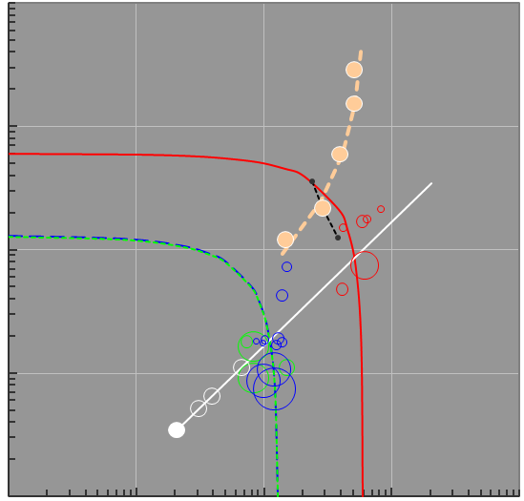
What about Cost of Light?
CoL_{cap} is already ~CoL_{ope}/6,
so η is the key
2012 may be the beginning of “the transition”
100
100
2004.8
2011.8
2005.8
SSL
2008.3
2011.8
10
Incandescent
2007.2
0.35A
1:6 Ratio
10
2008.5
0.7A
Incandescent
1
Fluorescent
2009.7
CoL_{cap} = $_{Win}/[η∙τ] ($/Mlmh)
1.5A
CoL = CoL_{cap} + CoL_{ope} ($/Mlmh)
HID
Fluorescent
1
HID
0.1
B LED↑
Phosphors↑
Adapted from
Navigant, “U.S. Lighting Market Characterization,” U.S. DOE (2002);
and from
JY Tsao, ME Coltrin, MH Crawford, JA Simmons, “SSL: An Integrated Human Factors, Technology and Economic Perspective,” Proc IEEE (to be published).
RGB
Adapted from JY Tsao, ME Coltrin, MH Crawford, JA Simmons, “SSL: An Integrated Human Factors, Technology and Economic Perspective,” Proc IEEE (to be published).
Perfect
“Perfect” SSL
0.01
0.1
0.01 0.1 1 10 100
2000 2005 2010 2015 2020
CoL_{ope} = CoE/η ($/Mlmh)
Year
Notes:
COST OF LIGHT. Up until now, I’ve talked exclusively about luminous efficacy. But what about cost? It’s often said that it’s the high cost of solid-state lighting that is keeping it from being commercially successful. In fact, that’s not quite true.
CAPITAL AND OPERATING COSTS OF LIGHT. To see that, here on the left I plot the two important costs of light. On the left axis is the purchase, or capital, cost of light: the cost of the lamp that converts electricity into light (amortized over the life of the lamp). On the bottom axis is the operating cost of light: the cost of the electricity that is converted into light. Both of these costs have the same units, $ per Mlmh.
TRADITIONAL LIGHTING. The red circles represent incandescent lamps, the blue circles fluorescent lamps, and the green circles high-intensity discharge lamps. You can see that, very roughly, the circles fall on a line that represents a capital cost of light that is 1/6 the operating cost of light. In other words, the cost structure of traditional lighting is one in which the dominant cost of light is that of the electricity.
SSL. In fact, if solid-state lighting could reach the same cost structure, then there would be no need to reduce its capital cost by much more, since its dominant cost would also then be its operating cost. To see where solid-state lighting actually is, and its recent evolution, here in the filled tan circles I plot its most recent five years. You can see that much of the progress has been vertically down, that is, a decrease in the capital cost of lighting. In fact, as I’ve sketched here in black for the mid-2008 SSL chips, if it had been driven hard, at 1.5A, the capital cost of light would have ben very close to being 1/6 of the operating cost of light. And if had been able to drive it even a little bit harder – say, at 2A – we’d be right on the 1/6 line, and we’d be done in terms of cost.
LUMINOUS EFFICACY. The main remaining improvement would therefore be luminous efficacy. To see this more clearly, note that the capital cost of light is the cost of a chip that sinks a certain amount of power (written here as $ per Watt in) divided by luminous efficacy and amortized over tau, the lamp lifetime. At the same time, the operating cost of light is the cost of electricity divided by luminous efficacy. Since luminous efficacy is in the denominators of both expressions, as luminous efficacy increases, one moves diagonally down and to the left on this plot. So once you’ve reached the 1:6 line, through increases in current drive to, say, 1.5 to 2 A, further increases in luminous efficacy will keep you on that line, until eventually you hit the cost of light associated with fluorescent and HID lamps.
COST OF LIGHT. So what does this all mean for the ownership cost of light, which is the sum of the capital and operating costs of light? Well, here on the right I’ve replotted these same five data points as ownership cost of light versus time. What you see is that there has been continuous progress downwards and to the right, to the point where in 2008 solid-state lighting just dipped below incandescent lamps in ownership cost of light. And, if the previous five years of progress continue at about the same rate, 2012 is the magic year in which solid-state lighting will just dip below fluorescent and HID lamps in ownership cost of light.

Slide 8
Earth at Night (courtesy of NASA)
Notes:
FULL CIRCLE. So, in a way, we’ve now come full circle. I started out by saying that we are on the verge of a massive transition from traditional lighting to solid-state lighting. Now we know aproximately when that will begin: 2012. That’s not to say that the transition will be fast. There is a huge infrastructure of luminaires and sockets that are filled with traditional lamps, and so it won’t happen right away, but it will begin very soon.
Of course, even after that transition has begun, it doesn’t mean that solid-state lighting will then be done. Remember, beating fluorescent and high-intensity discharge lighting only requires getting to efficiencies of 25% or so. So I think one of the challenges for the solid-state lighting community is not to get too distracted by the huge amount of money that is going to be made during the transition, and to continue solid-state lighting’s progress so that we can as close to 100% efficiencies as possible!
With that, thank-you very much for your attention.

