Slide 1
Directions for Becoming an AEA Supplier
AEA Certification Process
International Export and Trade Compliance Office
Contact us: eico@sandia.gov or 1-505-845-7000
Revised 04/10/23
SAND2023-01851O

Slide 2
Sandia’s Home Page
To become an AEA Supplier, you first must have an approved iSupplier Account. If you are not registered in Sandia’s iSupplier Portal, please see the Supplier Registration page for details to register.
To navigate to the iSupplier Portal, go to www.sandia.gov.
From the Sandia home page, click on “Partnerships.”
Next, from the Working with Sandia page click on “Current Suppliers.”
Disclaimers:
Each AEA Supplier will be reviewed and approved based on their individual company responses. Completion of the AEA Certification does not guarantee your company will be granted approval as an AEA Supplier.
There is an annual AEA Certification renewal requirement for AEA Suppliers.
Supplier will send written notification to Sandia disclosing any change of facts set forth in their certification within five (5) business days.

Slide 3
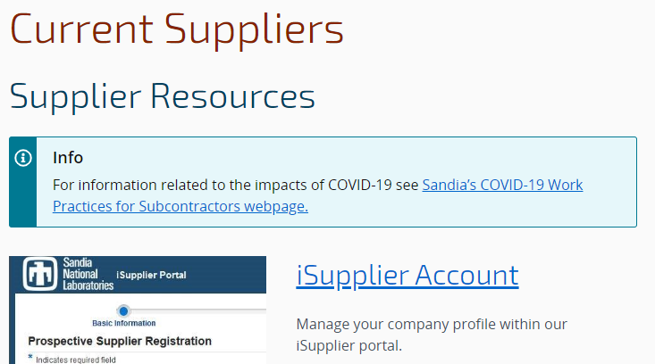
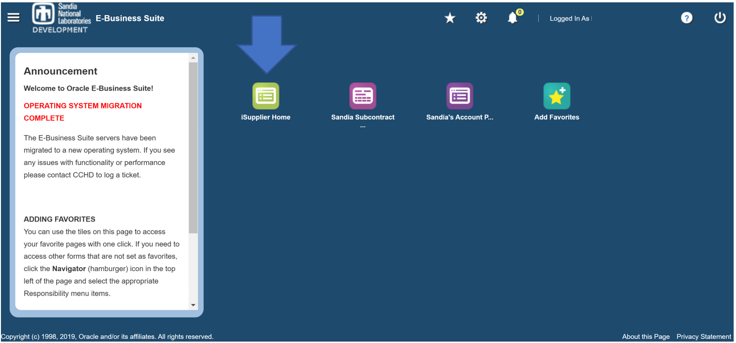
iSupplier Portal
iSupplier Portal Account Login
On the Current Suppliers page, click the “iSupplier Account” link to open the iSupplier Portal login page.
If you are logging in for the first time, and or having issues logging in, please refer to the following resources.
iSupplier MFA Help guide
iSupplier FAQ page
Sandia’s Supplier Data Management Help Desk is also available for assistance at supreg@sandia.gov.
iSupplier Portal – E-Business Suite
Once logged into the iSupplier Portal - E-Business Suite:
Click on “iSupplier Home”

Slide 4
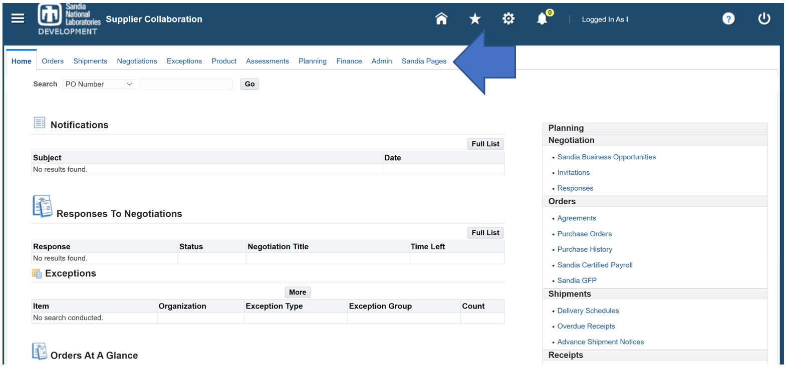
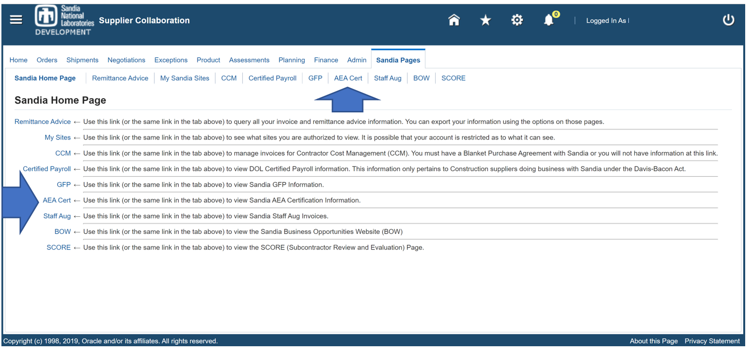
Sandia Pages
You will now be on the Supplier Collaboration Home page:
Click on Sandia Pages.
On the Sandia Pages:
Click on AEA Cert.

Slide 5
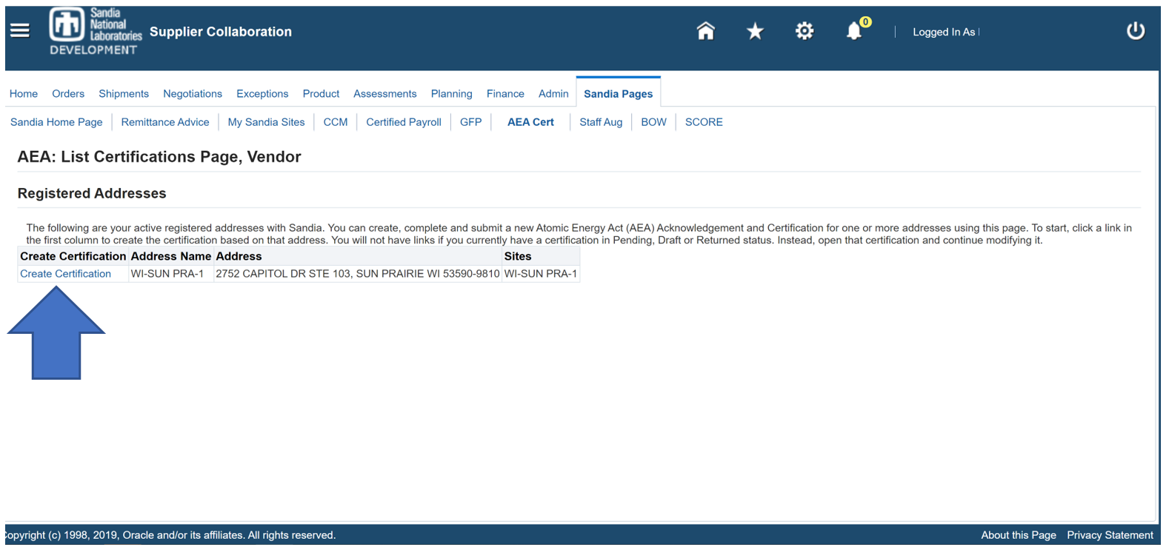
AEA Certification
You will now be on the AEA Cert page:
Under Status, if there is a “Draft” or “Returned” status, click on it to complete the AEA Cert.
Otherwise, click on “Create Certification” next to one of the Registered Addresses.

Slide 6
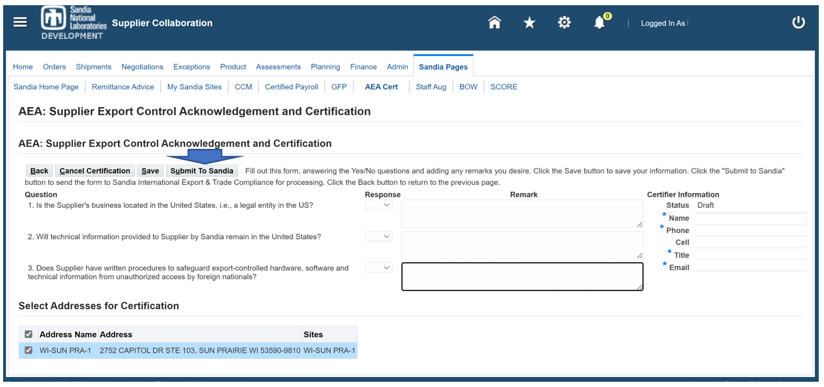
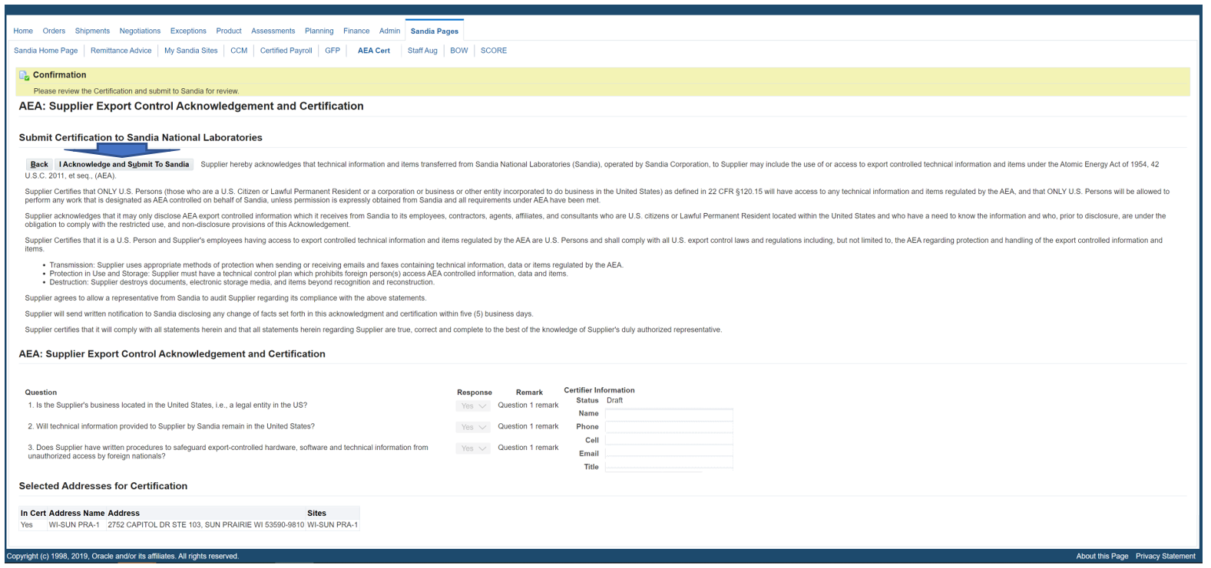
AEA Cert
Complete AEA Questions
Enter the following Information:
Complete AEA Certification questions by using the drop down arrow to indicate YES/NO responses.
Provide any relevant “Remarks” as necessary to support the YES/NO response.
NOTE: If more that one address is available to certify, check all addresses that apply to this Cert.
Click “Submit to Sandia”
Acknowledge and Submit to Sandia
Review the Acknowledgeable Statement and responses to the AEA questions
Click “I Acknowledge and Submit to Sandia”

Slide 7
Requirements of Being an AEA Approved Supplier
ONLY U.S. Persons (those who are a U.S. Citizen or Lawful Permanent Resident or a corporation or business or other entity incorporated to do business in the United States) as defined in 22 CFR 120.15 will have access to any technical information and items regulated by the AEA.
ONLY U.S. Persons will be allowed to perform any work that is designated as AEA controlled on behalf of Sandia, unless permission is expressly obtained from Sandia and all requirements under AEA have been met.
U.S. Person and Supplier’s employees having access to export controlled technical information and items regulated by the AEA are U.S. Persons and shall comply with all U.S. export control laws and regulations including, but not limited to, the AEA regarding protection and handling of the export controlled information and items.
Transmission: Supplier uses appropriate methods of protection when sending or receiving emails and faxes containing technical information, data or items regulated by the AEA.
Protection in Use and Storage: Supplier must have a technical control plan which prohibits foreign person(s) access AEA controlled information, data and items.
Destruction: Supplier destroys documents, electronic storage media, and items beyond recognition and reconstruction.

