Slide 1

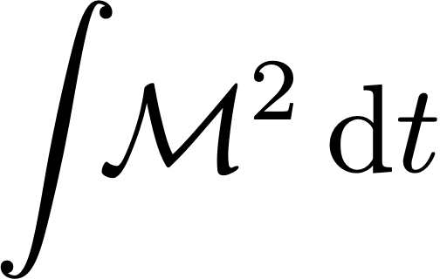




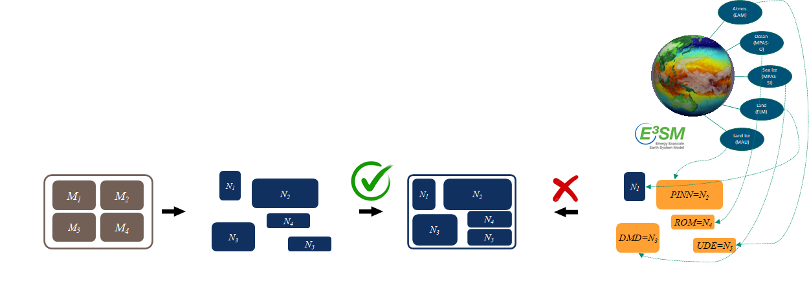
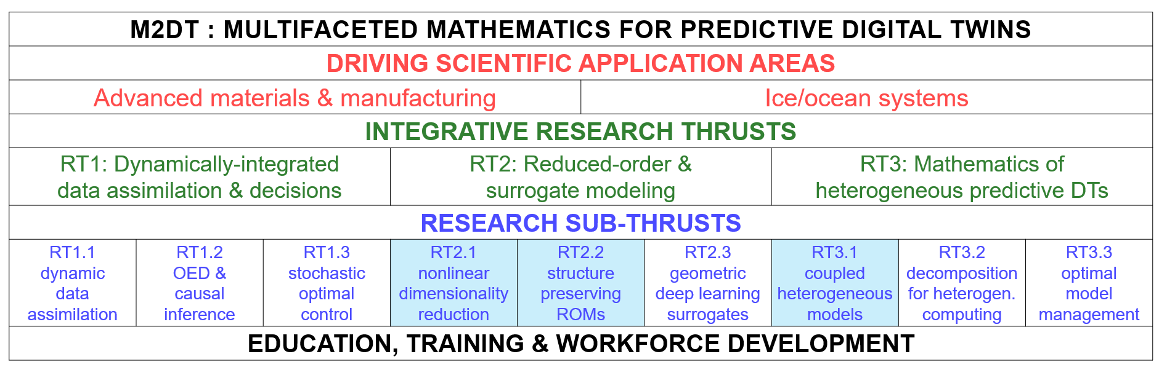
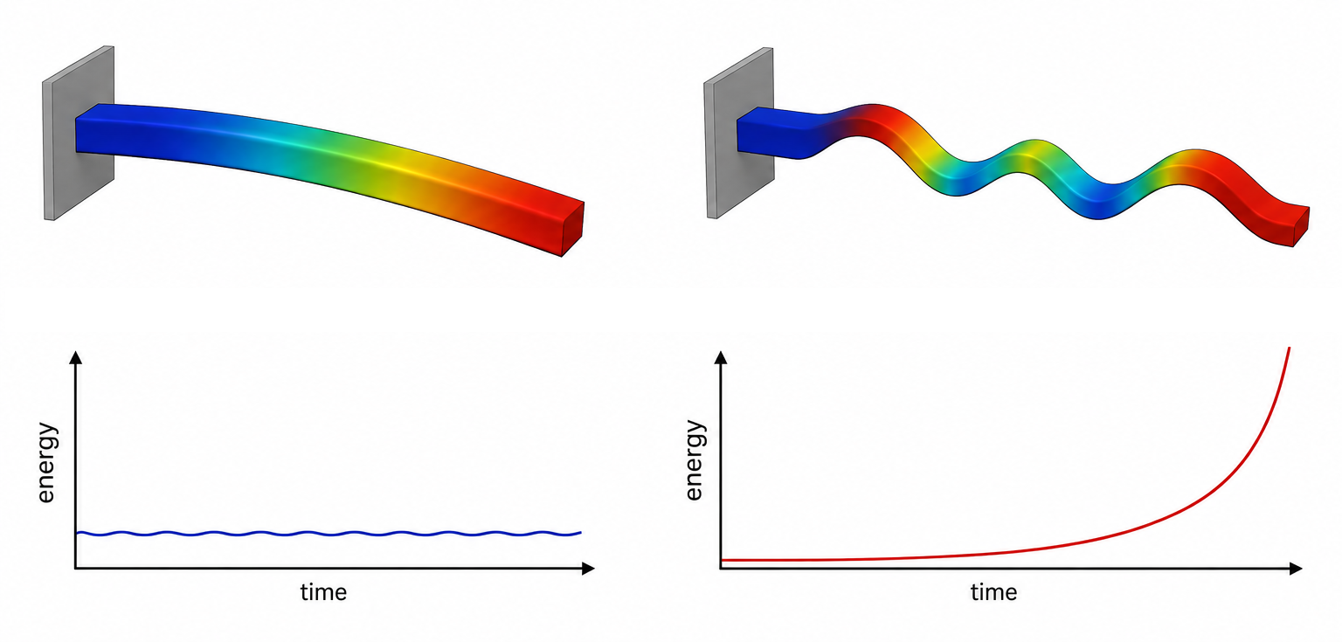
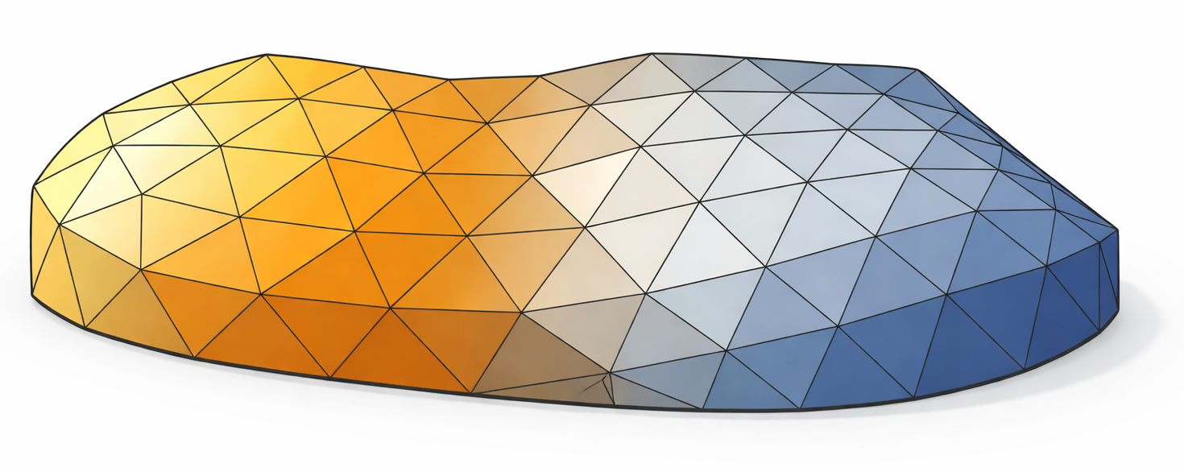
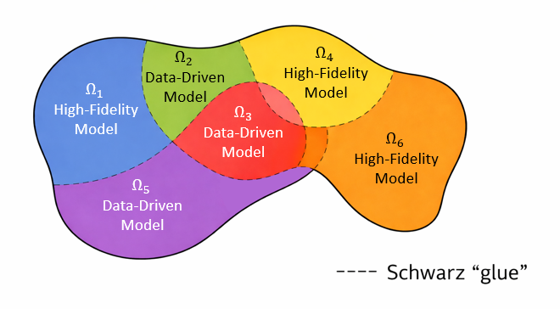

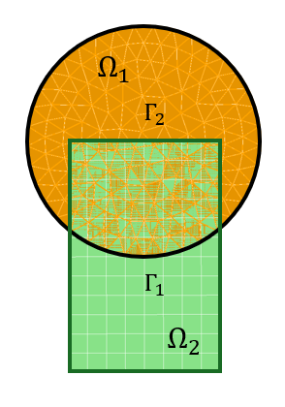
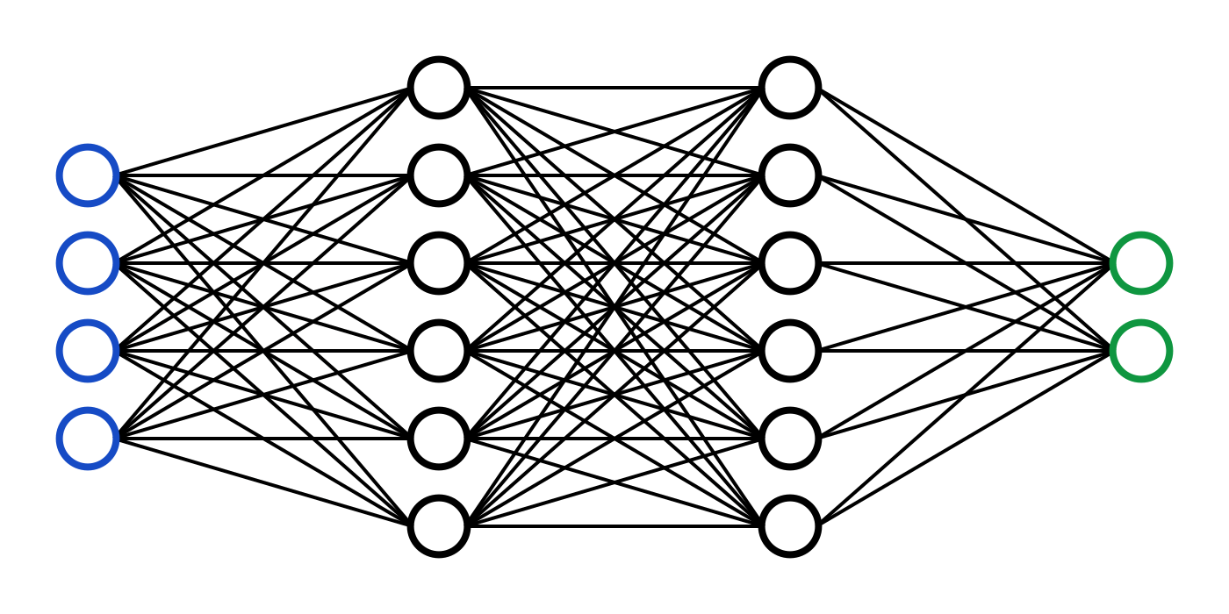
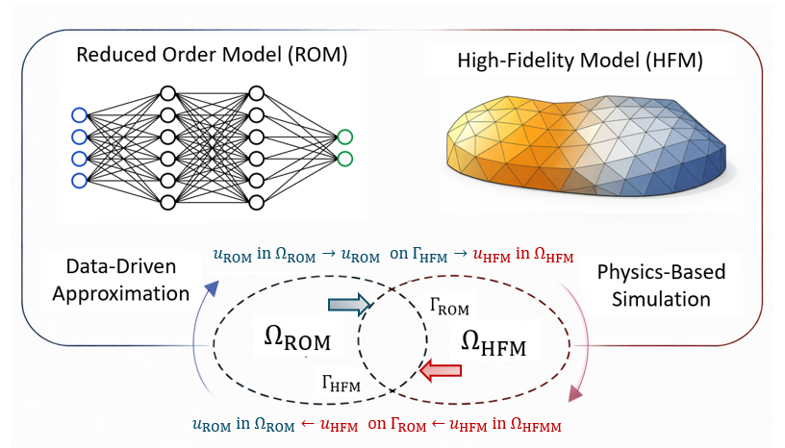
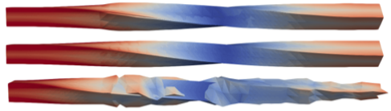
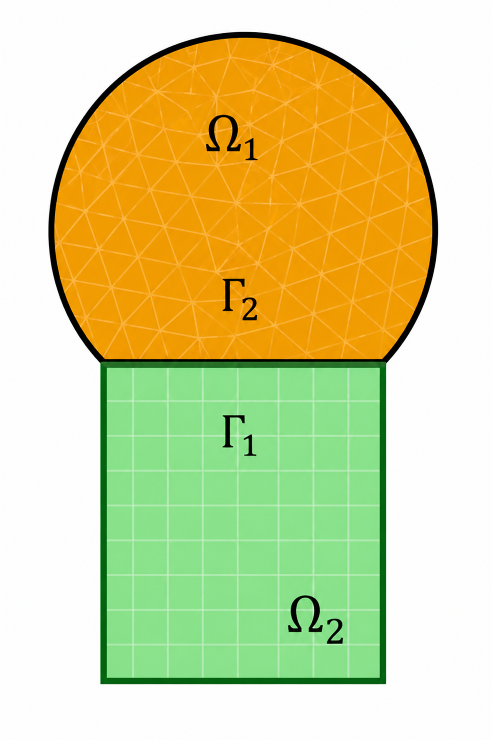
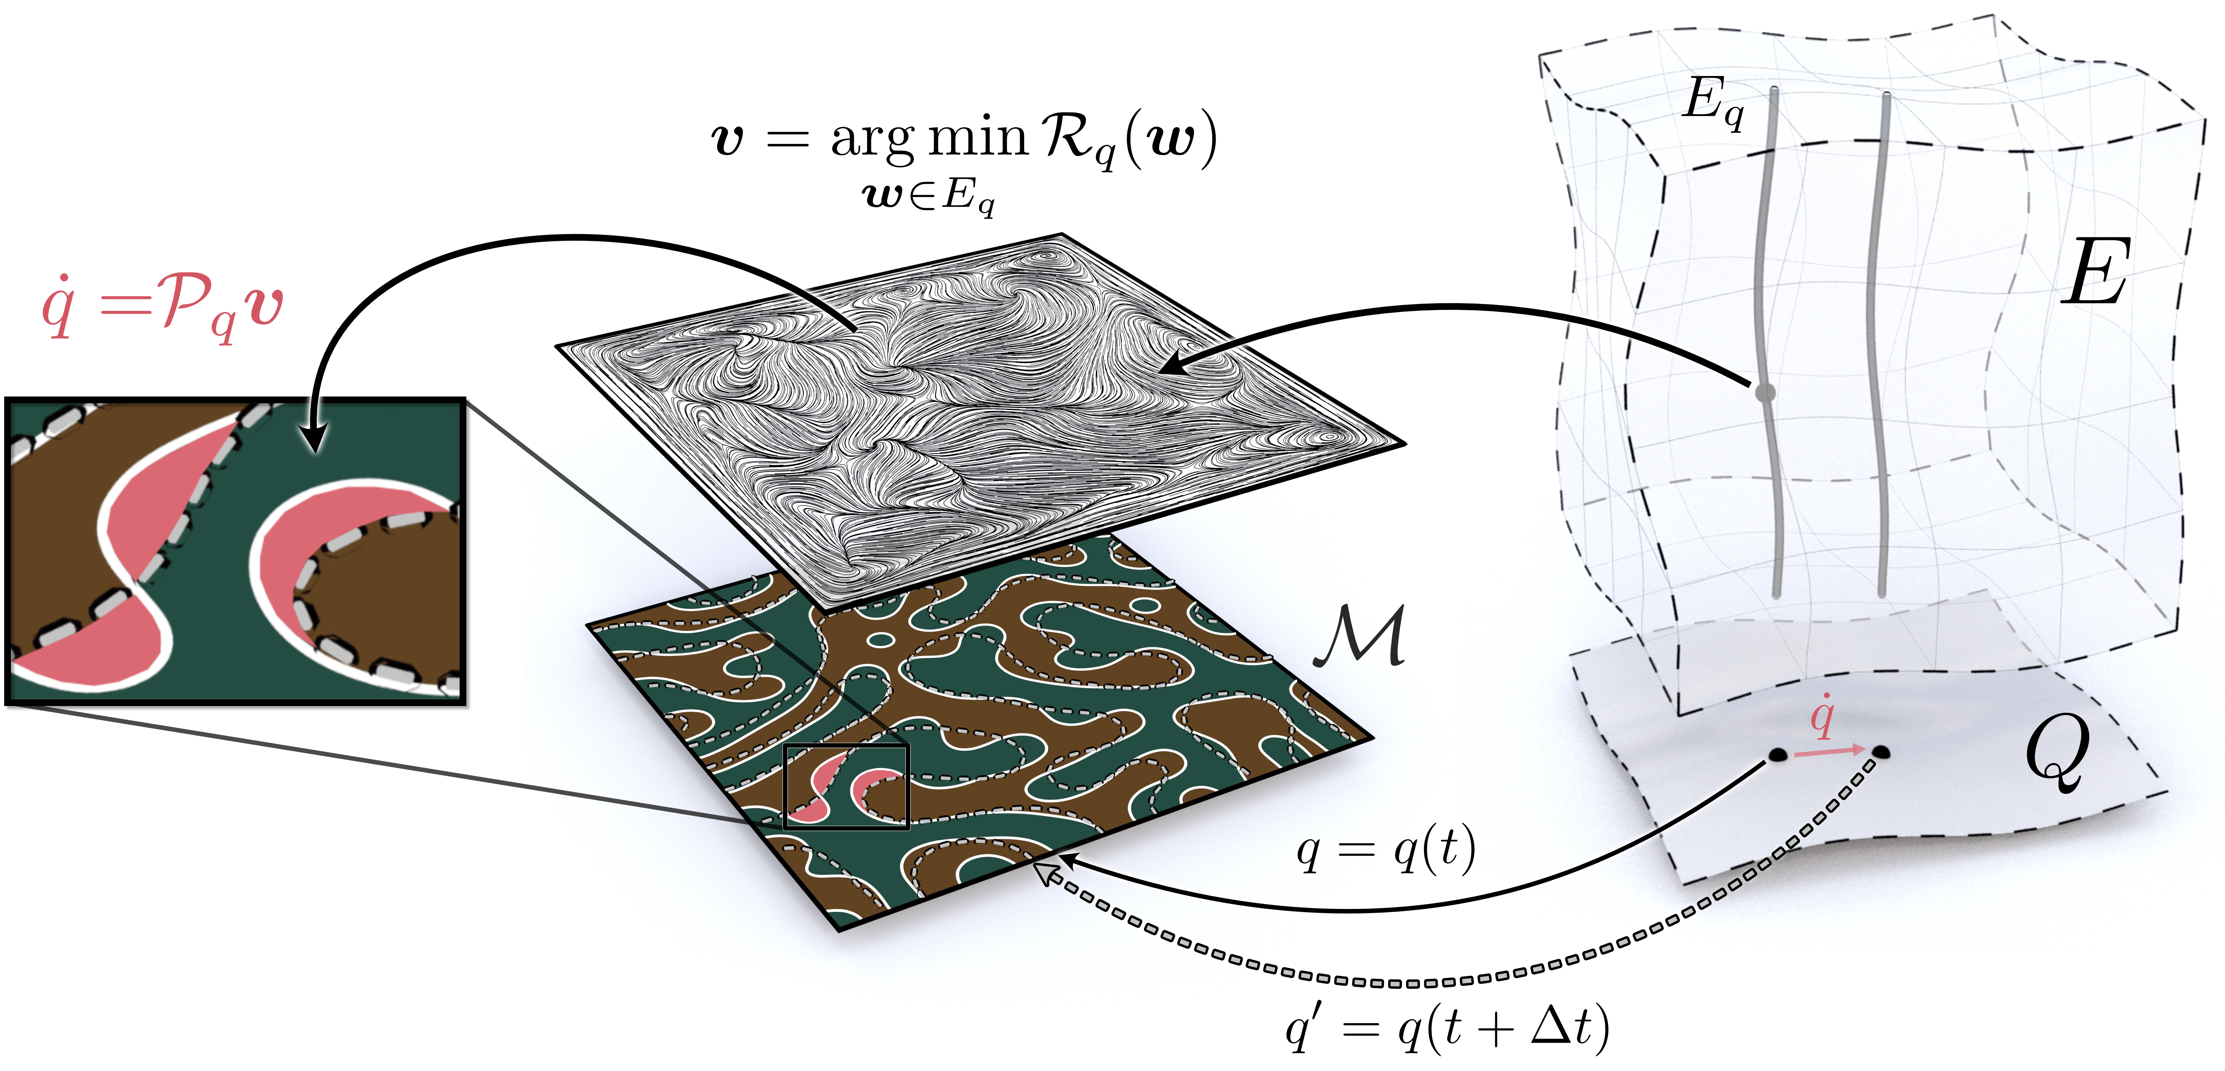





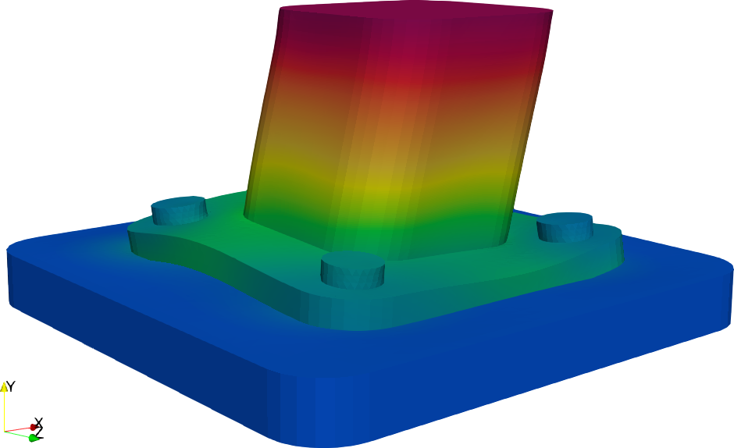
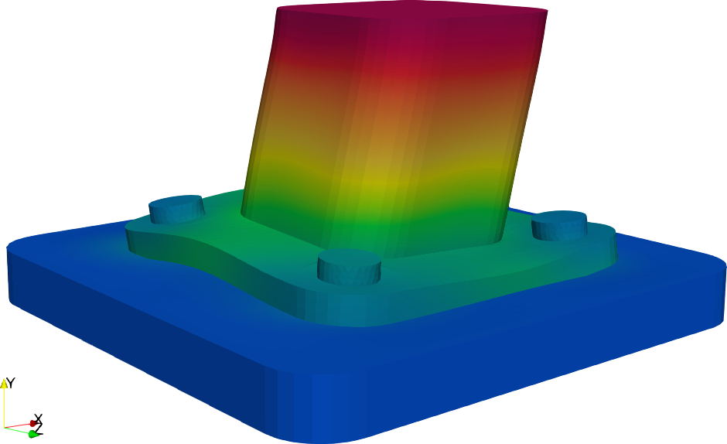

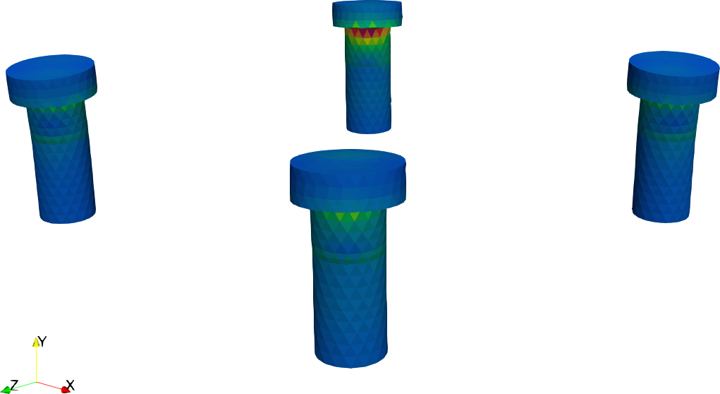
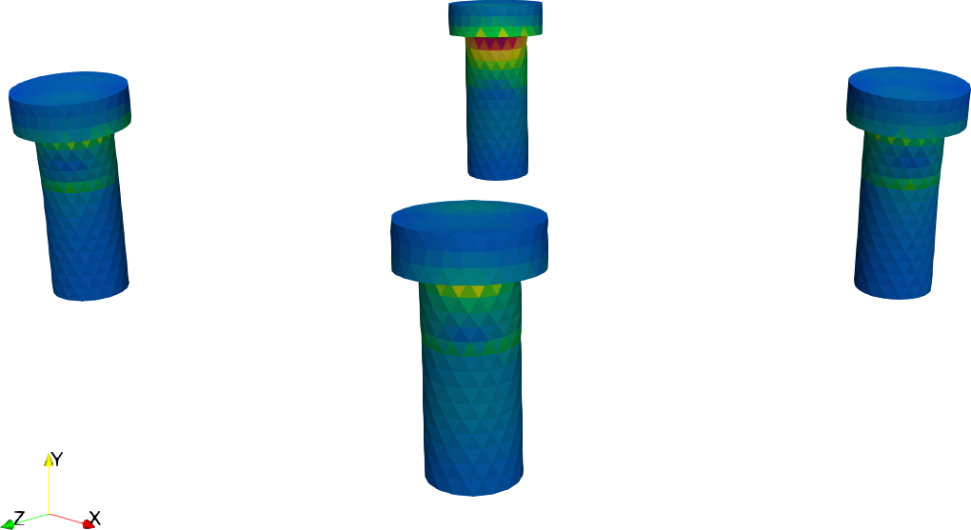
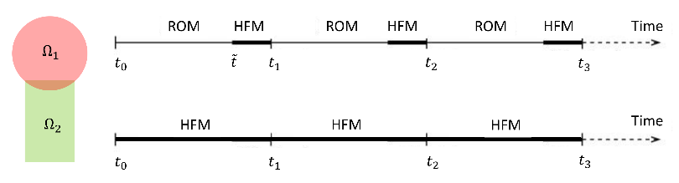


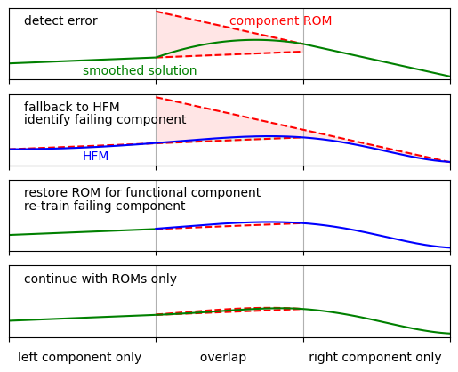

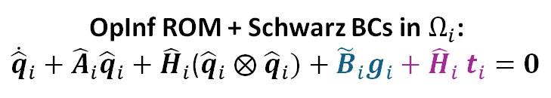


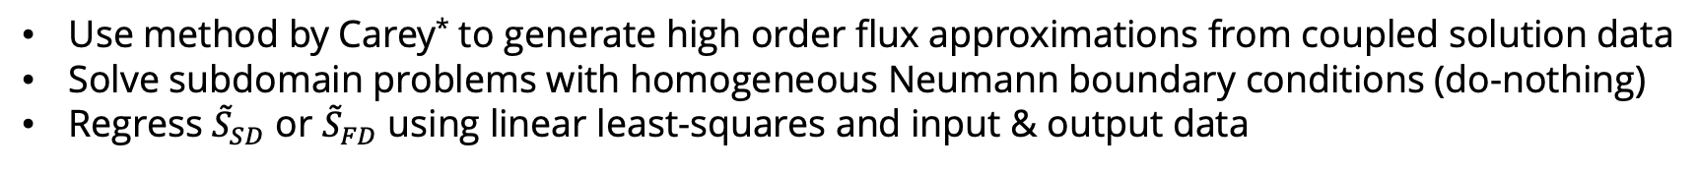

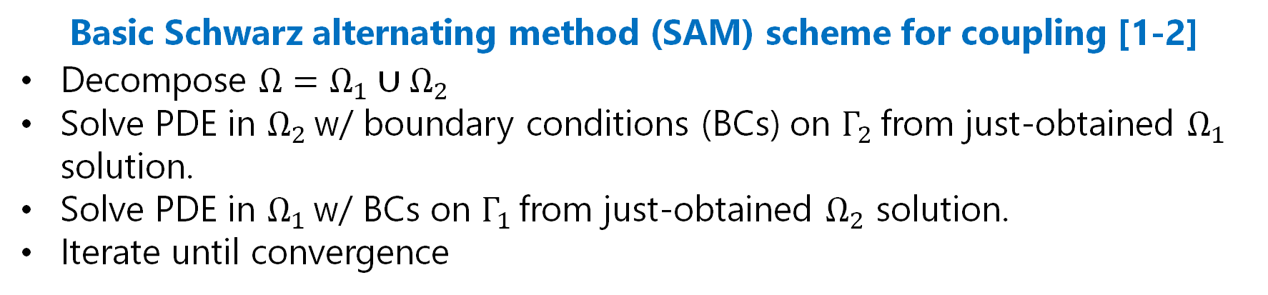




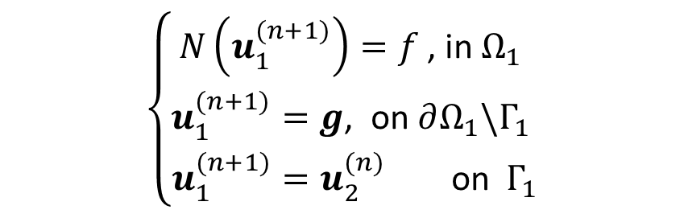
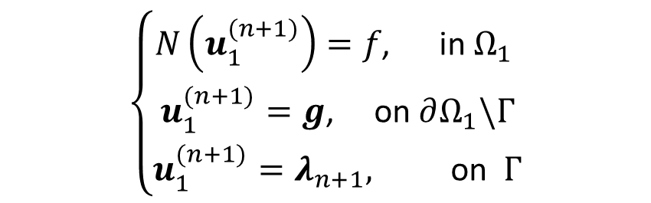
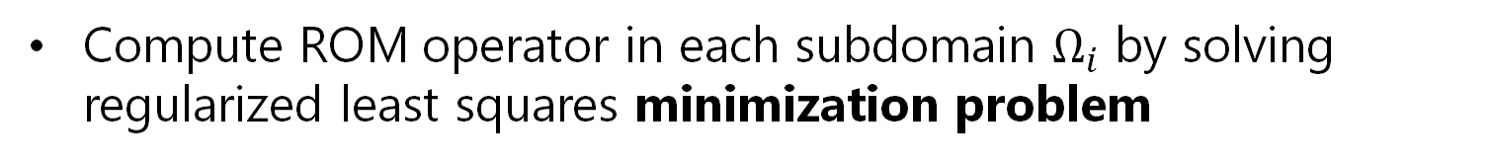





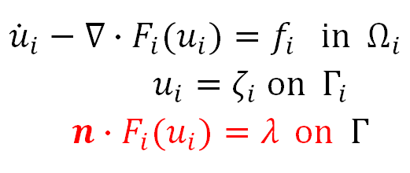

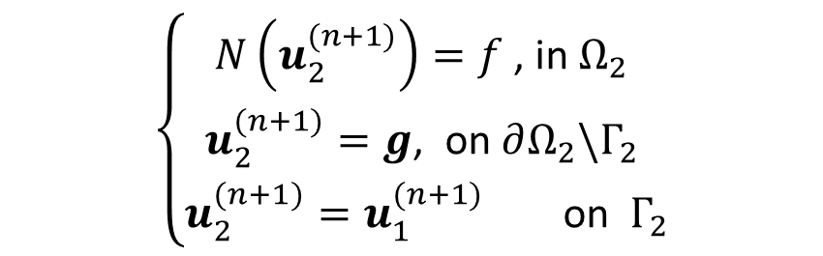
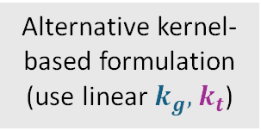
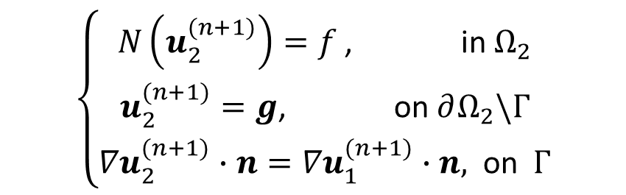






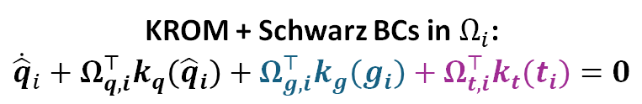
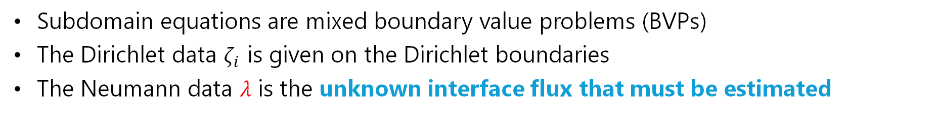
M2dt: Multifaceted Mathematics for Predictive Digital Twins
Data-Driven Coupling and Structure Preservation for Predictive Digital Twins
I. Tezaur¹, P. Bochev¹, P. Kuberry¹, A. Gruber¹, C. Eldred¹, A. Diaz¹, P. Blonigan¹,
N. Urban², N. Aretz³, K. Willcox³
¹Sandia National Laboratories. ²Brookhaven National Laboratory. ³University of Texas at Austin
Motivation for Coupling
Motivation for Structure Preservation
Multi-scale and multi-physics problems are ubiquitous and require rigorous coupling frameworks
In order to be reliable predictive tools within digital twin workflows, reduced order models (ROMs) and surrogates must preserve the key properties of underlying PDEs
Most existing coupling frameworks are based on traditional discretization methods, i.e., high-fidelity models (HFMs)
ROMs in general do NOT automatically inherit these properties!
Objective (RT2.2 of M2dt): develop new structure preserving (SP) model reduction methods to mirror properties of established compatible discretizations for HFMs
Objective (RT3.1 of M2dt): discover the mathematical principles guiding the assembly of HFMs and data-driven models in stable, accurate and physically consistent ways.
HFM
ROM
Interface Flux Surrogates for Coupling
Schwarz Alternating Method (SAM) for Coupling
SP Neural Network OpInf ROMs
Subdomains are decoupled by using interface flux
Goal: create non-intrusive fully non-linear OpInf ROMs that enable structure preservation (SP).
${\dot{u}}_{i}−∇∙F_{i}(u_{i})=f_{i}$ in $Ω_{i}$
$u_{i}=ζ_{i}$ on $Γ_{i}$
$n∙F_{i}(u_{i})=λ$ on $Γ$
$$Ω_{2}$$
$$Γ_{2}$$
Basic Schwarz alternating method (SAM) scheme for coupling [1-2]
Decompose $Ω=Ω_{1}∪$ $Ω_{2}$
Solve PDE in $Ω_{2}$ w/ boundary conditions (BCs) on $Γ_{2}$ from just-obtained $Ω_{1}$ solution.
Solve PDE in $Ω_{1}$ w/ BCs on $Γ_{1}$ from just-obtained $Ω_{2}$ solution.
Iterate until convergence
NNOpInf Assumed Form [9]
Example SP Parameterizations [9]
$ℱ_{2}(u_{1}$,$u_{2})$
$$Γ$$
$ℱ_{1}(u_{1}$,$u_{2})$
$$\dot{\dot{\hat{u}}\left(t,μ\right)=\sum_{r=1}^{M}{N_{r}(\hat{u},μ;θ_{r})}}$$
Matrix:
$$N_{r}\left(\hat{u},μ;θ_{r}\right)=A\left(\hat{u},μ;θ_{r}\right)\hat{u}$$
Symmetrix positive semi-definite (SPSD):
$N_{r}\left(\hat{u},μ;θ_{r}\right)=$ $L\left(\hat{u},μ;θ_{r}\right){L\left(\hat{u},μ;θ_{r}\right)}^{T}\hat{u}$
Skew:
$N_{r}\left(\hat{u},μ;θ_{r}\right)=$ $\left(L\left(\hat{u},μ;θ_{r}\right)−{L\left(\hat{u},μ;θ_{r}\right)}^{T}\right)\hat{u}$
Potential:
$$N_{r}\left(\hat{u},μ;θ_{r}\right)=∇_{\hat{u}}ℒ_{θ}(\hat{u},μ)$$
$$Γ_{1}$$
$$Ω_{1}$$
NNOpInf parameterizes PDE with sum of neural network (NN) operators.
Each NN is constrained to satisfy target problem-specific algebraic structure
Subdomain equations are mixed boundary value problems (BVPs)
The Dirichlet data $ζ_{i}$ is given on the Dirichlet boundaries
The Neumann data $λ$ is the unknown interface flux that must be estimated
SAM enables the seamless plug-and-play coupling of disparate meshes, solvers, time-steppers and models (ROM+HFM) [1-6].
Overlapping Schwarz Alternating Method (O-SAM)
Approximation of Schur Complement-based Coupling Operators
$$\left\{\begin{aligned}N\left(u_{1}^{(n+1)}\right)=f \text{, }\text{in} Ω_{1} \\ u_{1}^{(n+1)}=g\text{, }\text{o}\text{n} ∂Ω_{1}\backslash Γ_{1} \\ u_{1}^{(n+1)}=u_{2}^{(n)} \text{on} Γ_{1}\end{aligned}\right.$$
$$\left\{\begin{aligned}N\left(u_{2}^{(n+1)}\right)=f \text{, }\text{in} Ω_{2} \\ u_{2}^{(n+1)}=g\text{, }\text{o}\text{n} ∂Ω_{2}\backslash Γ_{2} \\ u_{2}^{(n+1)}=u_{1}^{(n+1)} \text{on} Γ_{2}\end{aligned}\right.$$
Generates approximation of Lagrange multiplier-based Schur complement from Lagrange multiplier-based coupling method-inspired input-output data pairs [8]
SAM-based ROM-HFM Coupling Workflow
SP-NNOpInf Results: 3D Hyperelastic Torsion [9]
(SD)
O-SAM is convergent with Dirichlet-Dirichlet boundary conditions (BCs)
HFM has Lagrangian structure:
$$M\ddot{u}=f\left(u\right), L\left(u,\dot{u}\right)=T\left(\dot{u}\right)−V(u)$$
NNOpInf-SPSD-Potential model used:
$\hat{f}\left(\hat{u},μ\right)=$ $∇_{\hat{u}}({\hat{u}}^{T}L_{θ}\left(\left(\hat{u},μ\right){L_{θ}\left(\hat{u},μ\right)}^{T}\hat{u}\right)$
HFM
Non-Overlapping Schwarz Alternating Method (NO-SAM)
SP-NNOpINf
$$\left\{\begin{aligned}N\left(u_{1}^{(n+1)}\right)=f\text{, } \text{in} Ω_{1} \\ u_{1}^{(n+1)}=g\text{, } \text{on} ∂Ω_{1}\backslash Γ \\ u_{1}^{(n+1)}=λ_{n+1}, \text{on} Γ\end{aligned}\right.$$
$$\left\{\begin{aligned}N\left(u_{2}^{(n+1)}\right)=f \text{, } \text{in} Ω_{2} \\ u_{2}^{(n+1)}=g\text{, } \text{on} ∂Ω_{2}\backslash Γ \\ {∇u}_{2}^{(n+1)}∙n={∇u}_{1}^{(n+1)}∙n\text{, }\text{on} Γ\end{aligned}\right.$$
POpInf
Lagrangian structure-preserving NN-OpInf ROMs maintain stability and robustness during future state prediction
(FD) with BDF2
$$λ_{n+1}=θu_{2}^{(n)}+\left(1−θ\right)λ_{n}, on Γ, for n≥1$$
Non-Intrusive ROMs
Define ROM model form in each subdomain:
$$\dot{\hat{q}}+\hat{F}\left(\hat{q}\right)=0$$
ROM model forms:
  Polynomial Operator Inference (POpInf) [4-5]:
  $\hat{F}\left(\hat{q}\right)=\hat{A}\hat{q}+\hat{H}\left(\hat{q}⨂\hat{q}\right)+\hat{G}(\hat{q}⨂\hat{q}⨂\hat{q})$
  Neural Network Operator Interence (NNOpInf) [9]:
  $\hat{F}(\hat{q}) =K\left(\hat{q};w\right)\hat{q}$
  $→$enables structure preservation (SP)
  Kernel Manifold ROM (KROM) [7]:
  $$\hat{F}(\hat{q}) =Ω^{⊤}k(\hat{q})$$
Infer operators from HFM data by solving regularized optimization problem
NO-SAM requires relaxed alternating Dirichlet-Neumann or Robin-Robin BCs
Dynamics Discovery with Onsager’s Variational Principle (OVP)
SAM-based Coupling Algorithm for Non-Intrusive ROMs
Offline stage:
Offline stage:
Create DD of $Ω$ into $d$ subdomains $Ω_{i}$
Perform a SAM-coupled all-HFM simulation on $\bigcup_{i}{Ω_{i}}$
Compute POD basis $Φ_{i}$on each $Ω_{i}$
Assume a functional form for your ROM in $Ω_{i}$, informed by the functional form of the corresponding HFM
  Transmission conditions enter through learned source terms added to the ROM dynamical system
Goal: learn functional-level corrections to dissipation-dominated systems within a structure-preserving variational integrator
Use method by Carey* to generate high order flux approximations from coupled solution data
Solve subdomain problems with homogeneous Neumann boundary conditions (do-nothing)
Regress ${\overset{˜}{S}}_{SD}$ or ${\overset{˜}{S}}_{FD}$ using linear least-squares and input & output data
Online stage:
$λ={\overset{˜}{S}}^{−1}⋅input data$
Solve subdomain problems with homogeneous Neumann boundary conditions (do-nothing)
Solve approximate ${\overset{˜}{S}}_{SD}$ or ${\overset{˜}{S}}_{FD}$ approximates against input data, providing an estimate for $λ$
* G. Carey, S.S. Chow, M.K. Seager, Approximate boundary-flux calculations, Comput. Meth. Appl. Mech. Engng, 50, 1985
KROM + Schwarz BCs in $Ω_{i}$:
$${\dot{\hat{q}}}_{i}+Ω_{q, i}^{⊤}k_{q}\left({\hat{q}}_{i}\right)+Ω_{g,i}^{⊤}k_{g}\left(g_{i}\right)+Ω_{t, i}^{⊤}k_{t}\left(t_{i}\right)=0$$
DD-Schur(IVR)
OpInf ROM + Schwarz BCs in $Ω_{i}$:
${\dot{\hat{q}}}_{i}+{\hat{A}}_{i}{\hat{q}}_{i}+$ ${\hat{H}}_{i}$(${\hat{q}}_{i} ⨂{ \hat{q}}_{i})+{{\tilde{B}}_{i}g}_{i}{+ \hat{H}}_{i}t_{i}=0$
Linear
Patch Test
Results
OpInf-OpInf and OpInf-HFM Results [4]
Motivated by BC implementation in FEM
Schwarz Dirichlet BC term
Schwarz Neumann BC term
Alternative kernel-based formulation (use linear $k_{g}, k_{t}$)
Schwarz Dirichlet BC term
Schwarz Neumann BC term
Bolted Joint
Tension Specimen
Compute ROM operator in each subdomain $Ω_{i}$ by solving regularized least squares minimization problem
OVP strategy [10]:
Discretize a Rayleighan functional comprised of thermodynamic free energy and dissipation potential
  OVP at discrete level → variational time-stepping scheme
  conserving mass and dissipating free energy by construction
Unknown/uncertain terms incorporated into discrete free energy functional and learned from data
  OVP ensures physics remain preserved independent of training process
DD-Schur(IFR)
All hybrid models correctly predict the location of maximum von Mises stress (failure) even in predictive regime
HFM-HFM
Online stage:
Apply Schwarz iteration procedure, with Schwarz BC transfer via pre-learned boundary contributions
POpInf-POpInf
POpInf-POpInf
Heterogeneous
Manufactured Solution
(Verification)
(competing method, Farcas et al., 2024 gives incorrect solution)
Towards Adaptive On-the-Fly ROM-HFM Switching
POpInf-POpInf TET10-HEX8 couplings achieve impressive 106$×$ speedup while maintaining O(0.1%) errors in predictive regime
Motivation: ROMs may fail at run-time!
HFM-HFM
POpInf-HFM
ROMs are generally only as expressive as their training data
Non-intrusive ROMs are particularly susceptible to overfitting and may not generalize well beyond the training data
If the system encounters unforeseen dynamics at runtime,
it becomes necessary to switch to the HFM to avoid collapse
OVP results [10]:
Block co-polymer models have uncertain bulk free energy density within the Ginzburg-Landau free energy
  Learned from data with, e.g., polynomial or neural network model
OVP ensures physics preservation despite 10x extrapolatory rollout
References
NORMA.JL
[1] A. Mota, I. Tezaur, C. Alleman. “The Schwarz alternating method in solid mechanics”, Comput. Meth. Appl. Mech. Engng. 319 19-51, 2017.
[2] A. Mota, I. Tezaur, G. Phlipot. “The Schwarz alternating method for dynamic solid mechanics”, Int. J. Numer. Meth. Engng. 123 (21) 5036-5071, 2022.
[3] C. Wentland, F. Rizzi, J. Barnett, I. Tezaur. “The role of interface boundary conditions and sampling strategies for Schwarz-based coupling of projection-based reduced order models”, J. Comput. Appl. Math., 465 116584, 2025.
[4] I. Tezaur, E. Parish, A. Gruber, I. Moore, C. Wentland, A. Mota. “Hybrid coupling with OpInf and the SAM”, submitted to IJNME. https://arxiv.org/abs/2511.20687
[5] C. Rodriguez, I. Tezaur, A. Mota, A. Gruber, E. Parish, C. Wentland. “Transmission Conditions for the Non-Overlapping Schwarz Coupling of Full Order and Operator Inference Models”, CSRI Summer Proceedings 2025, Sandia National Laboratories, Albuquerque, NM & Livermore, CA (2025).
[6] G. Sambataro, I. Tezaur. “On the role of relaxation and acceleration in the non-overlapping SAM for coupling”, submitted to JCAM. https://arxiv.org/abs/2603.17143
[7] A. Diaz, S. McQuarrie, J. Tencer, P. Blonigan. Interpretable and flexible non-intrusive reduced-order models using reproducing Hilbert spaces, Comput. Meth. Appl. Mech. Engng, 452(A) 118734, 2026.
[8] A. de Castro, P. Kuberry, Minimally Intrusive Data-Driven Approximation of Schur Complement-based Coupling Operators for Heterogeneous Numerical Methods, submitted to NMPDE.
[9] E. Parish, A. Gruber, P. Blonigan, I. Tezaur. “NN-OpInf: an OpInf approach using structure-preserving composable NNs”, submitted to JCP. https://arxiv.org/abs/2603.08488
[10] A. Gruber, R. Roy-Chowdhury, I. Tezaur, N. Urban. “Flexible and stable dynamics discovery with Onsager’s principle”, submitted to Physica D. https://arxiv.org/abs/2606.24106
KROM-KROM and KROM-HFM Results [7]
ROM-HFM switching workflow:
Evaluate at runtime if a ROM is still accurately predicting the dynamics
Switch failing ROM-components to the HFM
Re-train ROMs on the new data for future predictions
Top: HFM-HFM,
Bottom: HFM-KROM, $r_{2}=10$, inverse-multiquadric
Predictive O-SAM Torsion
KROMs have lower errors than QOpInf for $r≥4$ for both ROM-ROM and HFM-ROM
Sandia National Laboratories is a multimission laboratory managed and operated by National Technology & Engineering Solutions of Sandia, LLC, a wholly owned subsidiary of Honeywell International Inc., for the U.S. DOE’s National Nuclear Security Administration under contract DE-NA0003525. SAND#2026-XXXXX
M2dt is a DOE Mathematics Multifaceted Integrated Capability Center (MMICC)
Notes:
This is set to be a 4ft x 4ft poster.

