Slide 1
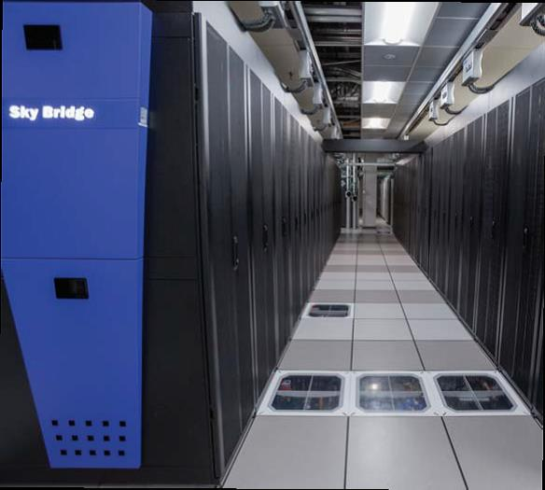
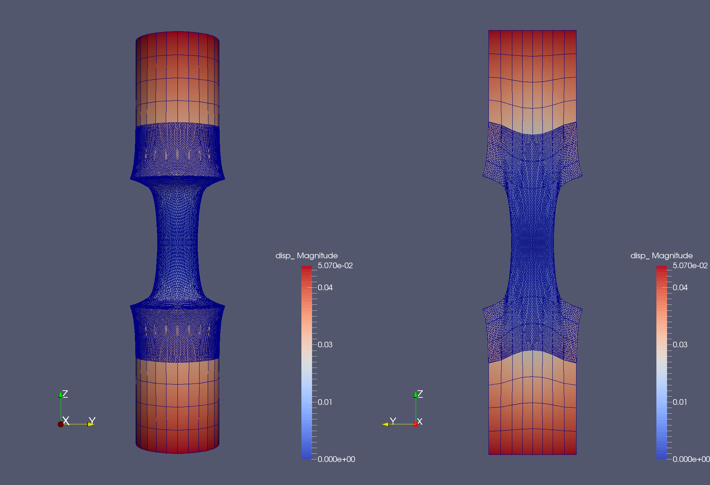
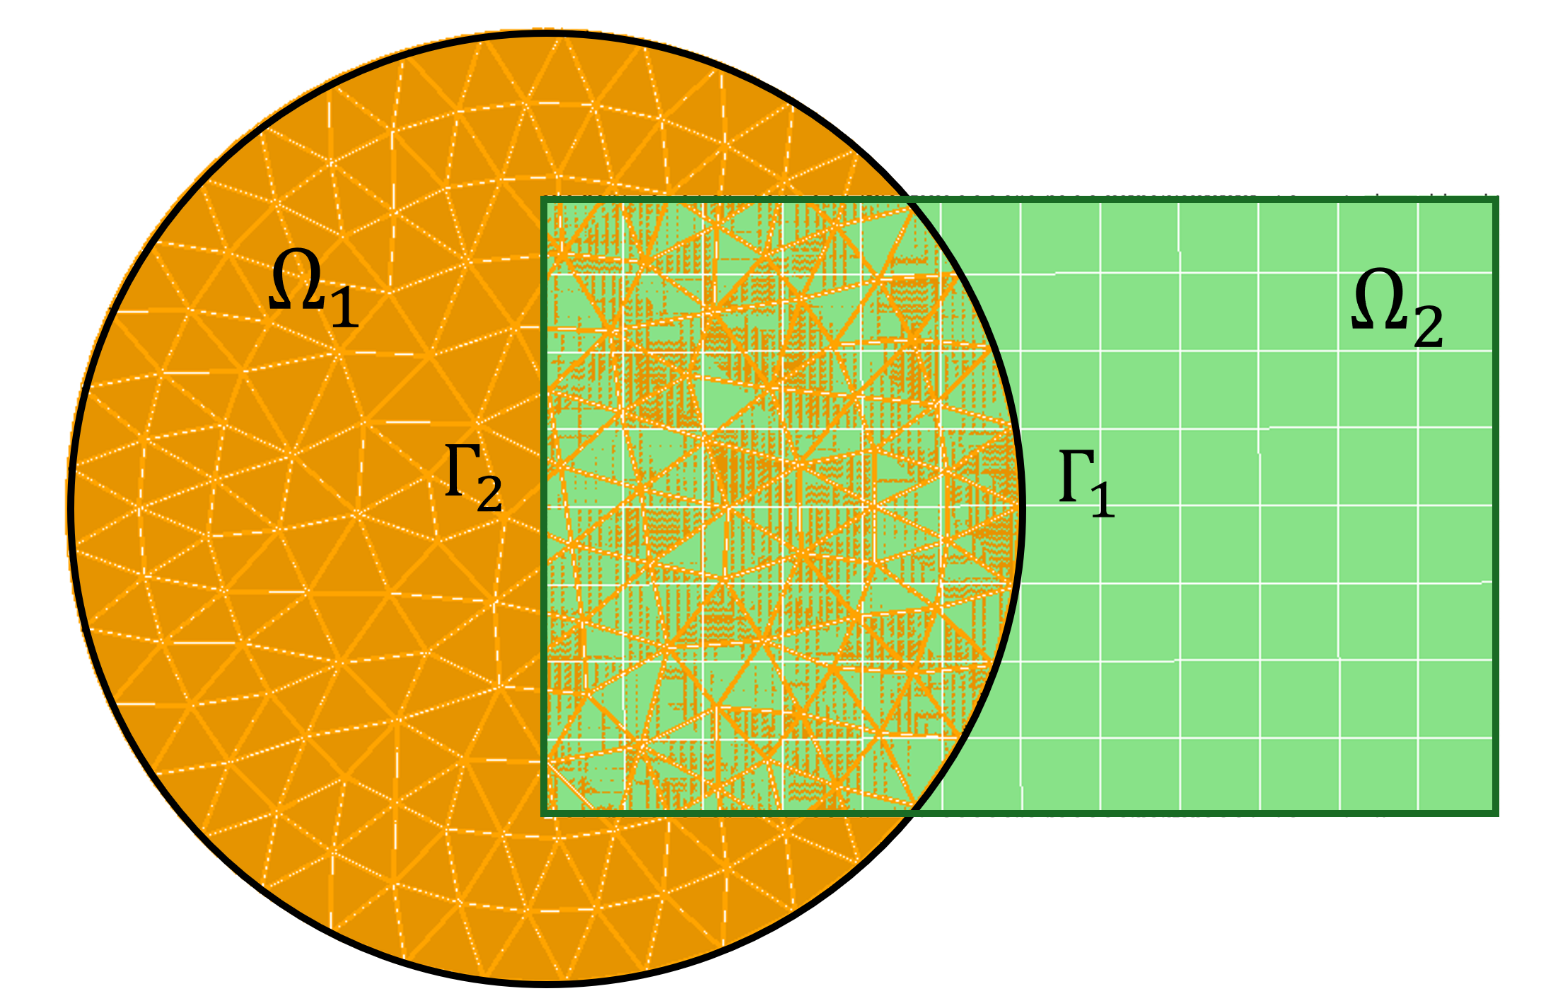
(Towards) Adaptive Hybrid Domain Decomposition-Based Modeling via Operator Inference and the Schwarz Alternating Method
I. Tezaur¹, E. Parish¹, A. Gruber¹, I. Moore^{1,2},
C. Wentland¹, C. Rodriguez³, A. Diaz¹, T. Mondal⁴, A. Mota¹
¹Sandia National Laboratories, USA. ²Rice University, USA. ³Columbia University, USA, ⁴Worcester Polytech Institute, USA
WCCM-ECCOMAS 2026 July 19-24, 2026 Munich, Germany
SAND2026-23089PE

Slide 2
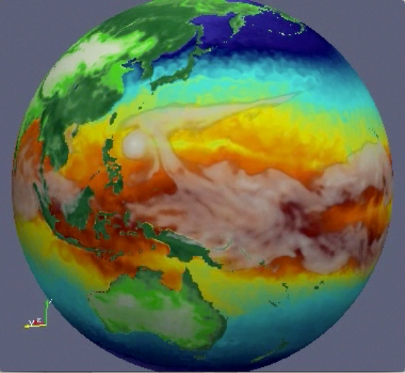

Motivation: Multiscale & Multiphysics Coupling for Predictive Digital Twins
Atmos.
(EAM)
Ocean
(MPAS-O)
☺
There exist established rigorous mathematical theories for coupling multiscale/multiphysics components based on traditional discretization methods (FOMs/HFMs).
Sea Ice
(MPAS-SI)
Land
(ELM)
Multiphysics
Land Ice
(MALI)
N₁
N₂
N₁
N₂
N₁
PINN=N₂
M₁
M₂
M₃
M₄
N₄
N₃
N₄
ROM=N₄
N₃
N₅
DMD=N₃
N₅
UDE=N₅
Complex System Model
Traditional Methods
Coupled Numerical Model
Traditional + Data-Driven Methods
PDEs, ODEs
Nonlocal integral
Classical DFT
Atomistic, …
Mesh-based (FE, FV, FD)
Meshless (SPH, MLS)
Implicit, explicit
Eulerian, Lagrangian, …
Monolithic (Lagrange multipliers)
Partitioned (loose) coupling
Iterative (Schwarz, optimization)
PINNs
Neural ODEs
Projection-based ROMs, …

Slide 3
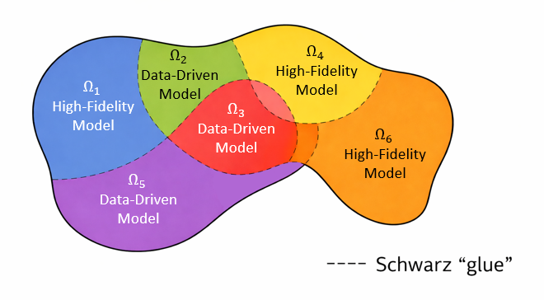
Motivation: Multiscale & Multiphysics Coupling for Predictive Digital Twins
☺
There exist established rigorous mathematical theories for coupling multiscale/multiphysics components based on traditional discretization methods (FOMs/HFMs).
N₁
N₂
N₁
N₂
N₁
PINN=N₂
Multiscale
M₁
M₂
M₃
M₄
N₄
N₃
N₄
ROM=N₄
N₃
N₅
DMD=N₃
N₅
UDE=N₅
Complex System Model
Traditional Methods
Coupled Numerical Model
Traditional + Data-Driven Methods
PDEs, ODEs
Nonlocal integral
Classical DFT
Atomistic, …
Mesh-based (FE, FV, FD)
Meshless (SPH, MLS)
Implicit, explicit
Eulerian, Lagrangian, …
Monolithic (Lagrange multipliers)
Partitioned (loose) coupling
Iterative (Schwarz, optimization)
PINNs
Neural ODEs
Projection-based ROMs, …
Deficiencies of data-driven models and couplings involving them:
  Existing coupling methods for high-fidelity models may not work out-of-the-box when including data-driven models
  ROMs can suffer from lack of robustness, stability and accuracy, and cannot be easily refined to achieve a specified accuracy
☹

Slide 4
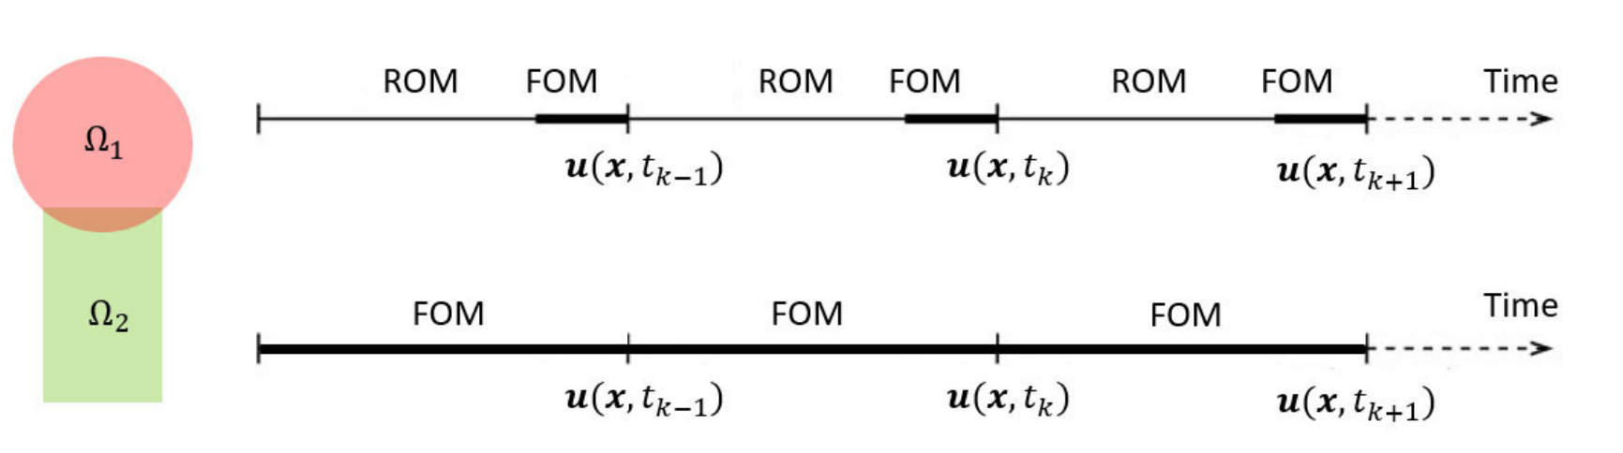
Motivation: Multiscale & Multiphysics Coupling for Predictive Digital Twins
☺
There exist established rigorous mathematical theories for coupling multiscale/multiphysics components based on traditional discretization methods (FOMs/HFMs).
N₁
N₂
N₁
N₂
N₁
PINN=N₂
Multiscale
M₁
M₂
M₃
M₄
N₄
N₃
N₄
ROM=N₄
N₃
N₅
DMD=N₃
N₅
UDE=N₅
Complex System Model
Traditional Methods
Coupled Numerical Model
Traditional + Data-Driven Methods
PDEs, ODEs
Nonlocal integral
Classical DFT
Atomistic, …
Mesh-based (FE, FV, FD)
Meshless (SPH, MLS)
Implicit, explicit
Eulerian, Lagrangian, …
Monolithic (Lagrange multipliers)
Partitioned (loose) coupling
Iterative (Schwarz, optimization)
PINNs
Neural ODEs
Projection-based ROMs, …
Proposed solution: domain decomposition- (DD-) based coupling via the Schwarz alternating method & online model switching
Deficiencies of data-driven models and couplings involving them:
  Existing coupling methods for high-fidelity models may not work out-of-the-box when including data-driven models
  ROMs can suffer from lack of robustness, stability and accuracy, and cannot be easily refined to achieve a specified accuracy
☹

Slide 5
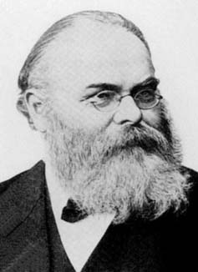
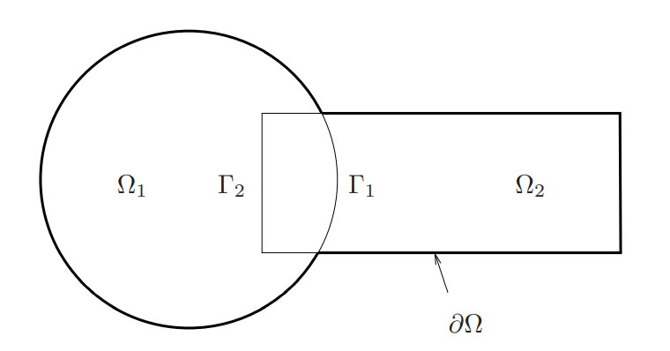
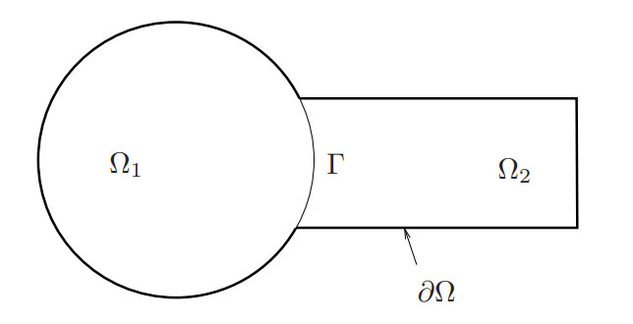
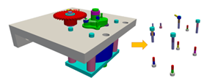
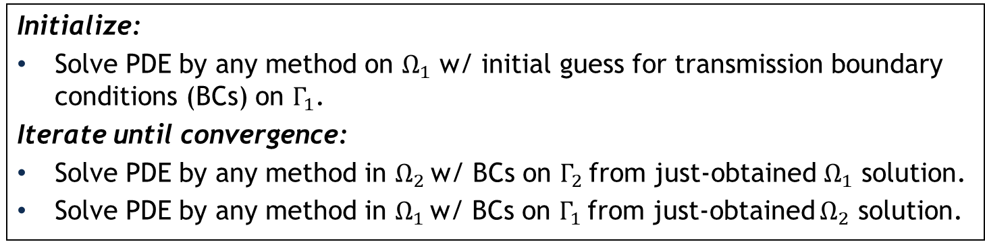
Schwarz Alternating Method (SAM)
Proposed in 1870 by H. Schwarz for solving Laplace PDE on irregular domains.
Crux of Method: if the solution is known in regularly shaped domains, use those as pieces to iteratively build a solution for the more complex domain.
H. Schwarz
overlapping
Basic Schwarz Algorithm
Initialize:
Solve PDE by any method on $Ω_{1}$ w/ initial guess for transmission boundary conditions (BCs) on $Γ_{1}$.
Iterate until convergence:
Solve PDE by any method in $Ω_{2}$ w/ BCs on $Γ_{2}$ from just-obtained $Ω_{1}$ solution.
Solve PDE by any method in $Ω_{1}$ w/ BCs on $Γ_{1}$ from just-obtained $Ω_{2}$ solution.
non-overlapping
SAM most commonly used as a preconditioner for linear solvers.
Idea behind this work: using SAM as a discretization/ coupling method for solving multiscale PDEs.
²Lions, 1990. ³Zanolli et al., 1987.
*Mota et al., 2017; Mota et al., 2022.

Slide 6

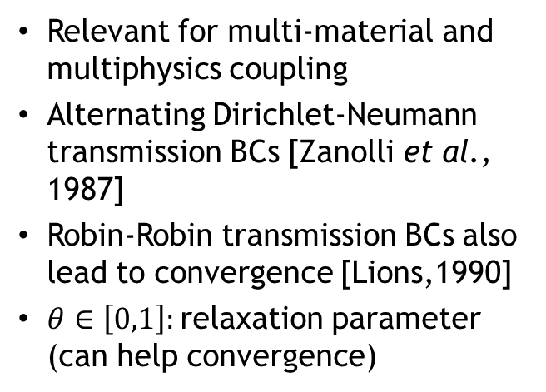




Domain Decomposition (DD)-based Coupling via SAM
Overlapping Domain Decomposition
Model PDE:
$$\left\{\begin{aligned}Div P_{1}^{(n+1)}+ρB(t_{i})=0 \text{, }\text{in} Ω_{1} \\ φ_{1}^{(n+1)}=χ\text{, }\text{on} ∂Ω_{1}\backslash Γ_{1} \\ φ_{1}^{(n+1)}=φ_{2}^{(n)} \text{on} Γ_{2}\end{aligned}\right.$$
Easier implementation and faster convergence
$$\left\{\begin{aligned}Div P+ρB=0 \text{, }\text{in} Ω \\ φ=χ, \text{on} ∂Ω\end{aligned}\right.$$
$$\left\{\begin{aligned}Div P_{2}^{(n+1)}+ρB(t_{i})=0 \text{, }\text{in}{ Ω}_{2} \\ φ_{2}^{(n+1)}=χ\text{, }\text{on} ∂Ω_{2}\backslash Γ_{2} \\ φ_{2}^{(n+1)}=φ_{1}^{(n+1)} \text{on} Γ_{2}\end{aligned}\right.$$
Dirichlet-Dirichlet transmission BCs [Schwarz, 1870; Lions, 1988]
Non-overlapping Domain Decomposition
$$\left\{\begin{aligned}Div{ P}_{1}^{(n+1)}+ρB(t_{i})=0 \text{, }\text{in} Ω_{1} \\ φ_{1}^{(n+1)}=χ\text{, }\text{on} ∂Ω_{1}\backslash Γ \\ φ_{1}^{(n+1)}=λ_{n+1} \text{on} Γ\end{aligned}\right.$$
More flexible but slower to converge
Relevant for multi-material and multiphysics coupling
Alternating Dirichlet-Neumann transmission BCs [Zanolli et al., 1987]
Robin-Robin transmission BCs also lead to convergence [Lions,1990]
$θ∈\left[0,1\right]:$relaxation parameter (can help convergence)
$$\left\{\begin{aligned}Div P_{2}^{(n+1)}+ρB(t_{i})=0 \text{, }\text{in}{ Ω}_{2} \\ φ_{2}^{(n+1)}=χ\text{, }\text{on} ∂Ω_{2}\backslash Γ \\ P_{2}^{(n+1)}n=P_{1}^{(n+1)}n\text{, }\text{on} Γ\end{aligned}\right.$$
$$λ_{n+1}=θφ_{2}^{(n)}+\left(1−θ\right)λ_{n}, on Γ, for n≥1$$
Notes:
TODO: rework this slide to have generic DN and RR formulation

Slide 7
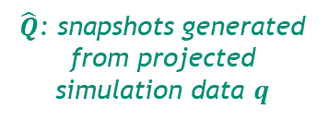
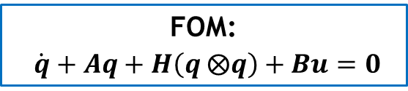
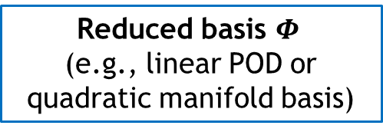
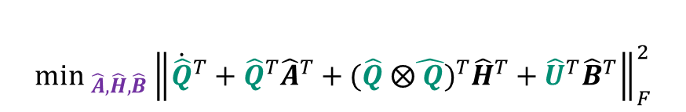

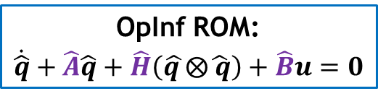
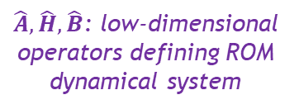
Non-Intrusive Model Order Reduction via Operator Inference (OpInf)*
7
Key Idea Behind OpInf: circumvent the burden of implementing intrusive ROMs in HPC codes by combining projection-based ROM and machine learning (ML).
FOM:
$\dot{q}+Aq+H\left(q ⨂q\right)+Bu=0$
* [Peherstorfer & Willcox, 2016] + many subsequent refs
snapshots of $q$
Nuances:
OpInf can be applied to nonlinear problems by transforming the nonlinear PDEs into PDEs with a polynomial functional form (“lifting” [Qian et al., 2019]) or assuming a polynomial functional form for the ROM
The OpInf least-squares (LS) minimization problem often requires regularization to be solvable, e.g., Tikhonov regularization
Structure preservation (e.g., symmetry constraints) can be incorporated into the OpInf LS minimization problem
Reduced basis $Φ$
(e.g., linear POD or quadratic manifold basis)
$\hat{Q}$: snapshots generated from projected simulation data $q$
$$\min_{\hat{A},\hat{H},\hat{B}}{\left\|{\dot{\hat{Q}}}^{T}+{\hat{Q}}^{T}{\hat{A}}^{T}+{(\hat{Q} ⨂\hat{ Q})}^{T}{\hat{H}}^{T}+{\hat{U}}^{T}{\hat{B}}^{T}\right\|}_{F}^{2}$$
$$+ γ\left({\left\|\hat{A}\right\|}_{F}+{\left\|\hat{H}\right\|}_{F}+{\left\|\hat{B}\right\|}_{F}\right)$$
$\hat{A},\hat{H},\hat{B}$: low-dimensional operators defining ROM dynamical system
OpInf ROM:
$\dot{\hat{q}}+\hat{A}\hat{q}+\hat{H}\left(\hat{q }⨂\hat{ q}\right)+\hat{B}u=0$

Slide 8
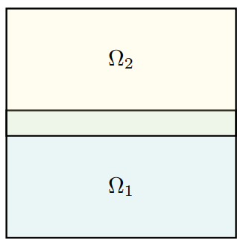
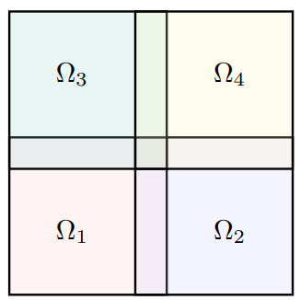
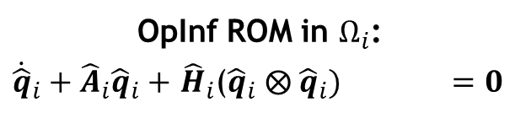
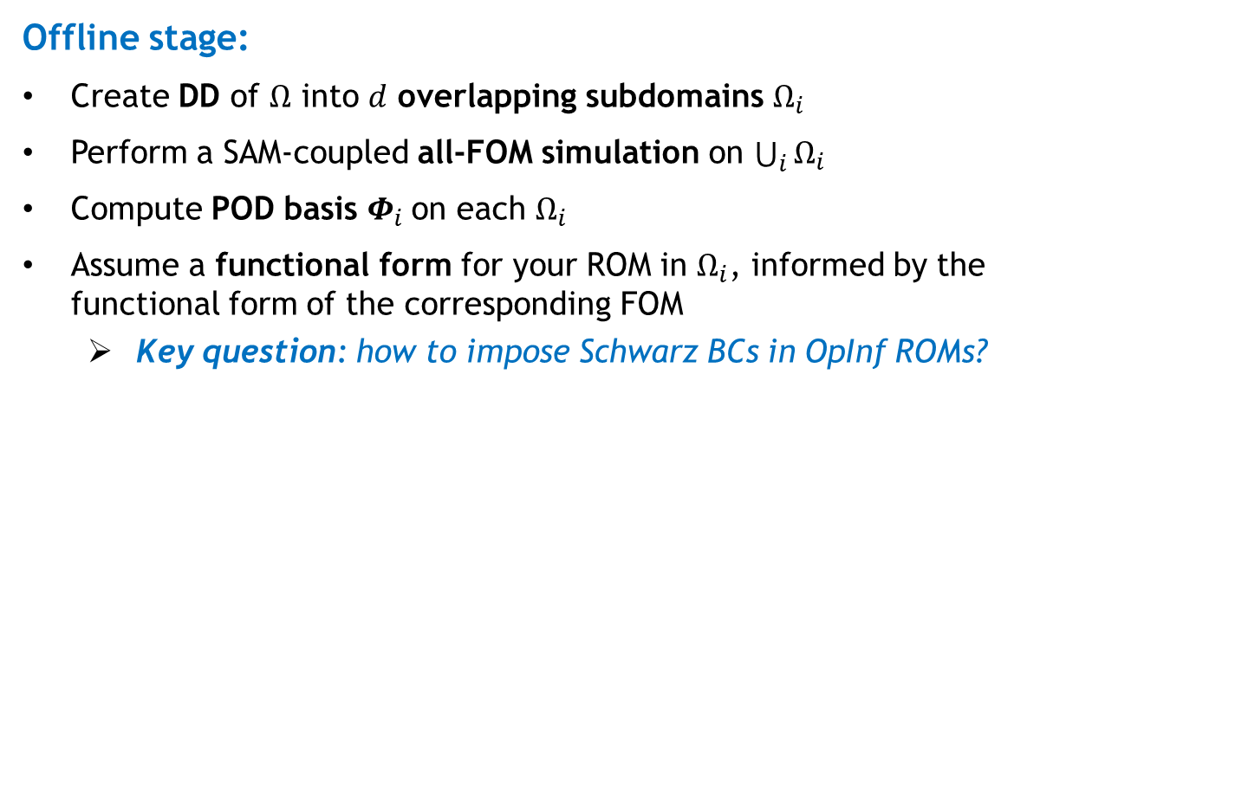
Overlapping SAM-based Coupling for Non-Intrusive OpInf ROMs
8
Offline stage:
Create DD of $Ω$ into $d$ overlapping subdomains $Ω_{i}$
Perform a SAM-coupled all-FOM simulation on $\bigcup_{i}{Ω_{i}}$
Compute POD basis $Φ_{i}$on each $Ω_{i}$
Assume a functional form for your ROM in $Ω_{i}$, informed by the functional form of the corresponding FOM
  Key question: how to impose Schwarz BCs in OpInf ROMs?
OpInf ROM in $Ω_{i}$:
${\dot{\hat{q}}}_{i}+{\hat{A}}_{i}{\hat{q}}_{i}+$ ${\hat{H}}_{i}$(${\hat{q}}_{i} ⨂{ \hat{q}}_{i})+{\hat{B}}_{i}g_{i}=0$
Notes:
The proposed approach is most similar to the recent work by Farcas et al. [9], which develops a DD-based coupling of subdomain-local OpInf ROMs by learning appropriate reduced operators responsible for the coupling, and demonstrates the method on a formidable three-dimensional (3D) combustion problem. In this approach, each subdomain problem is solved once rather than by performing an iteration to convergence as done within our Schwarz framework. As a result, the subdomain-local solutions must be extended to the full domain and smoothly combined to achieve a continuous solution

Slide 9
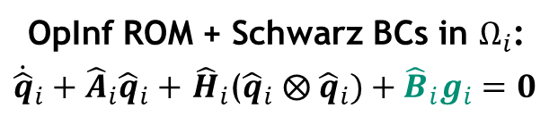
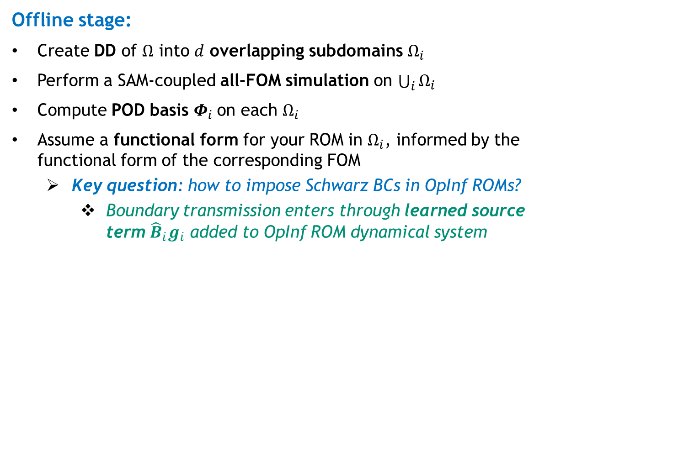
Overlapping SAM-based Coupling for Non-Intrusive OpInf ROMs
9
Offline stage:
Create DD of $Ω$ into $d$ overlapping subdomains $Ω_{i}$
Perform a SAM-coupled all-FOM simulation on $\bigcup_{i}{Ω_{i}}$
Compute POD basis $Φ_{i}$on each $Ω_{i}$
Assume a functional form for your ROM in $Ω_{i}$, informed by the functional form of the corresponding FOM
  Key question: how to impose Schwarz BCs in OpInf ROMs?
    Boundary transmission enters through learned source term ${\hat{B}}_{i}g_{i}$ added to OpInf ROM dynamical system
OpInf ROM + Schwarz BCs in $Ω_{i}$:
${\dot{\hat{q}}}_{i}+{\hat{A}}_{i}{\hat{q}}_{i}+$ ${\hat{H}}_{i}$(${\hat{q}}_{i} ⨂{ \hat{q}}_{i})+{\hat{B}}_{i}g_{i}=0$
Motivated by implementation of Dirichlet BCs in FEM
Schwarz Dirichlet BC term
Notes:
The proposed approach is most similar to the recent work by Farcas et al. [9], which develops a DD-based coupling of subdomain-local OpInf ROMs by learning appropriate reduced operators responsible for the coupling, and demonstrates the method on a formidable three-dimensional (3D) combustion problem. In this approach, each subdomain problem is solved once rather than by performing an iteration to convergence as done within our Schwarz framework. As a result, the subdomain-local solutions must be extended to the full domain and smoothly combined to achieve a continuous solution

Slide 10
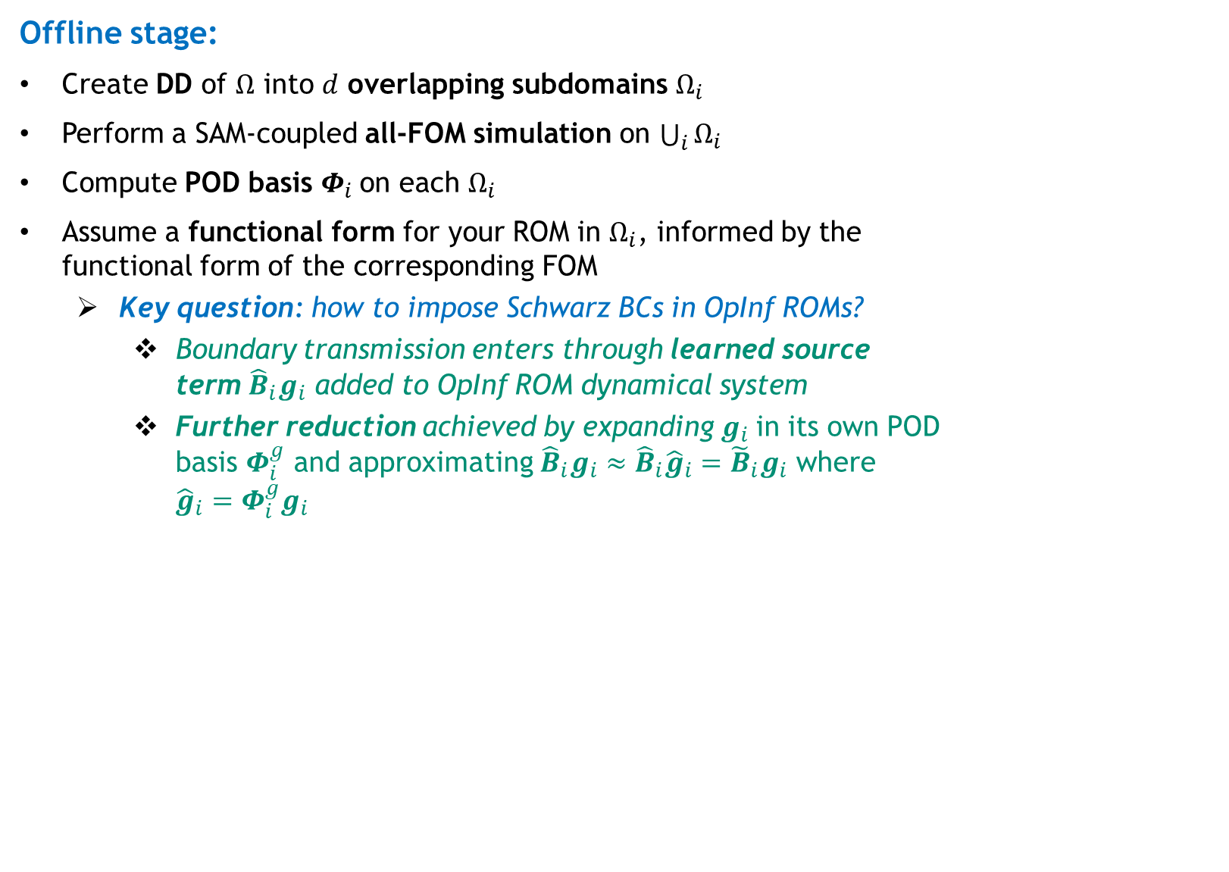

Overlapping SAM-based Coupling for Non-Intrusive OpInf ROMs
10
Offline stage:
Create DD of $Ω$ into $d$ overlapping subdomains $Ω_{i}$
Perform a SAM-coupled all-FOM simulation on $\bigcup_{i}{Ω_{i}}$
Compute POD basis $Φ_{i}$on each $Ω_{i}$
Assume a functional form for your ROM in $Ω_{i}$, informed by the functional form of the corresponding FOM
  Key question: how to impose Schwarz BCs in OpInf ROMs?
    Boundary transmission enters through learned source term ${\hat{B}}_{i}g_{i}$ added to OpInf ROM dynamical system
    Further reduction achieved by expanding $g_{i}$in its own POD basis $Φ_{i}^{g}$ and approximating ${\hat{B}}_{i}g_{i}≈{\hat{B}}_{i}{\hat{g}}_{i}={{\tilde{B}}_{i}g}_{i}$ where ${\hat{g}}_{i}=$ $Φ_{i}^{g}g_{i}$
OpInf ROM + Schwarz BCs in $Ω_{i}$:
${\dot{\hat{q}}}_{i}+{\hat{A}}_{i}{\hat{q}}_{i}+$ ${\hat{H}}_{i}$(${\hat{q}}_{i} ⨂{ \hat{q}}_{i})+{{\tilde{B}}_{i}g}_{i}=0$
Motivated by implementation of Dirichlet BCs in FEM
Schwarz Dirichlet BC term
Notes:
The proposed approach is most similar to the recent work by Farcas et al. [9], which develops a DD-based coupling of subdomain-local OpInf ROMs by learning appropriate reduced operators responsible for the coupling, and demonstrates the method on a formidable three-dimensional (3D) combustion problem. In this approach, each subdomain problem is solved once rather than by performing an iteration to convergence as done within our Schwarz framework. As a result, the subdomain-local solutions must be extended to the full domain and smoothly combined to achieve a continuous solution

Slide 11
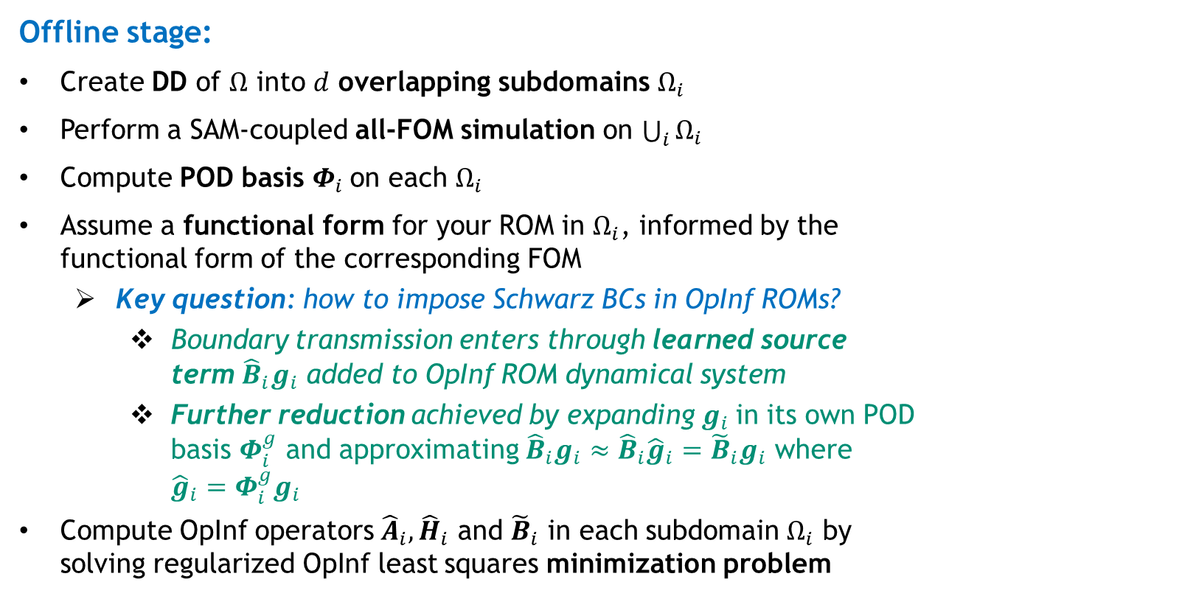
Overlapping SAM-based Coupling for Non-Intrusive OpInf ROMs
11
Offline stage:
Create DD of $Ω$ into $d$ overlapping subdomains $Ω_{i}$
Perform a SAM-coupled all-FOM simulation on $\bigcup_{i}{Ω_{i}}$
Compute POD basis $Φ_{i}$on each $Ω_{i}$
Assume a functional form for your ROM in $Ω_{i}$, informed by the functional form of the corresponding FOM
  Key question: how to impose Schwarz BCs in OpInf ROMs?
    Boundary transmission enters through learned source term ${\hat{B}}_{i}g_{i}$ added to OpInf ROM dynamical system
    Further reduction achieved by expanding $g_{i}$in its own POD basis $Φ_{i}^{g}$ and approximating ${\hat{B}}_{i}g_{i}≈{\hat{B}}_{i}{\hat{g}}_{i}={{\tilde{B}}_{i}g}_{i}$ where ${\hat{g}}_{i}=$ $Φ_{i}^{g}g_{i}$
Compute OpInf operators ${\hat{A}}_{i},{\hat{H}}_{i}$ and ${\tilde{B}}_{i}$ in each subdomain $Ω_{i}$ by solving regularized OpInf least squares minimization problem
OpInf ROM + Schwarz BCs in $Ω_{i}$:
${\dot{\hat{q}}}_{i}+{\hat{A}}_{i}{\hat{q}}_{i}+$ ${\hat{H}}_{i}$(${\hat{q}}_{i} ⨂{ \hat{q}}_{i})+{{\tilde{B}}_{i}g}_{i}=0$
Motivated by implementation of Dirichlet BCs in FEM
Schwarz Dirichlet BC term
Notes:
The proposed approach is most similar to the recent work by Farcas et al. [9], which develops a DD-based coupling of subdomain-local OpInf ROMs by learning appropriate reduced operators responsible for the coupling, and demonstrates the method on a formidable three-dimensional (3D) combustion problem. In this approach, each subdomain problem is solved once rather than by performing an iteration to convergence as done within our Schwarz framework. As a result, the subdomain-local solutions must be extended to the full domain and smoothly combined to achieve a continuous solution

Slide 12
Overlapping SAM-based Coupling for Non-Intrusive OpInf ROMs
12
Offline stage:
Create DD of $Ω$ into $d$ overlapping subdomains $Ω_{i}$
Perform a SAM-coupled all-FOM simulation on $\bigcup_{i}{Ω_{i}}$
Compute POD basis $Φ_{i}$on each $Ω_{i}$
Assume a functional form for your ROM in $Ω_{i}$, informed by the functional form of the corresponding FOM
  Key question: how to impose Schwarz BCs in OpInf ROMs?
    Boundary transmission enters through learned source term ${\hat{B}}_{i}g_{i}$ added to OpInf ROM dynamical system
    Further reduction achieved by expanding $g_{i}$in its own POD basis $Φ_{i}^{g}$ and approximating ${\hat{B}}_{i}g_{i}≈{\hat{B}}_{i}{\hat{g}}_{i}={{\tilde{B}}_{i}g}_{i}$ where ${\hat{g}}_{i}=$ $Φ_{i}^{g}g_{i}$
Compute OpInf operators ${\hat{A}}_{i},{\hat{H}}_{i}$ and ${\tilde{B}}_{i}$ in each subdomain $Ω_{i}$ by solving regularized OpInf least squares minimization problem
OpInf ROM + Schwarz BCs in $Ω_{i}$:
${\dot{\hat{q}}}_{i}+{\hat{A}}_{i}{\hat{q}}_{i}+$ ${\hat{H}}_{i}$(${\hat{q}}_{i} ⨂{ \hat{q}}_{i})+{{\tilde{B}}_{i}g}_{i}=0$
Motivated by implementation of Dirichlet BCs in FEM
Schwarz Dirichlet BC term
Online stage:
Apply Schwarz iteration procedure, with Schwarz BC transfer via pre-learned boundary contributions${{ \tilde{B}}_{i}g}_{i}$
Notes:
The proposed approach is most similar to the recent work by Farcas et al. [9], which develops a DD-based coupling of subdomain-local OpInf ROMs by learning appropriate reduced operators responsible for the coupling, and demonstrates the method on a formidable three-dimensional (3D) combustion problem. In this approach, each subdomain problem is solved once rather than by performing an iteration to convergence as done within our Schwarz framework. As a result, the subdomain-local solutions must be extended to the full domain and smoothly combined to achieve a continuous solution

Slide 13
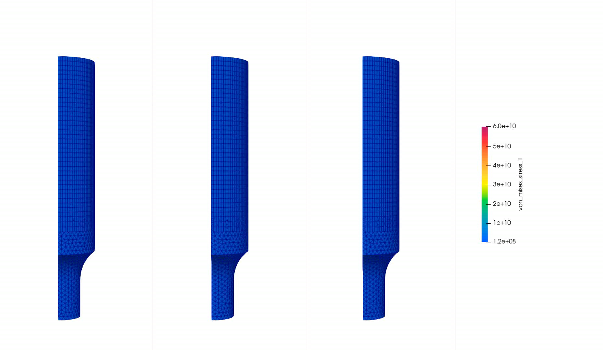
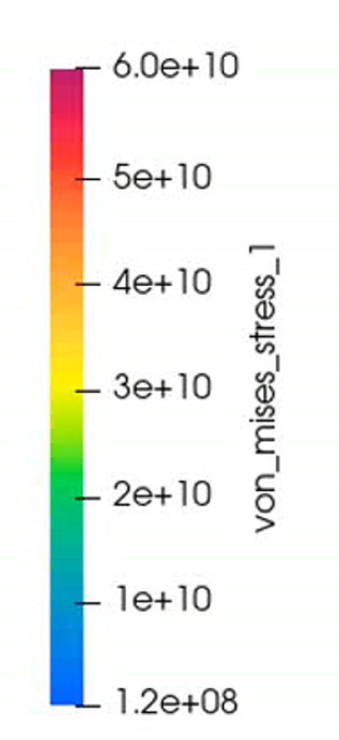
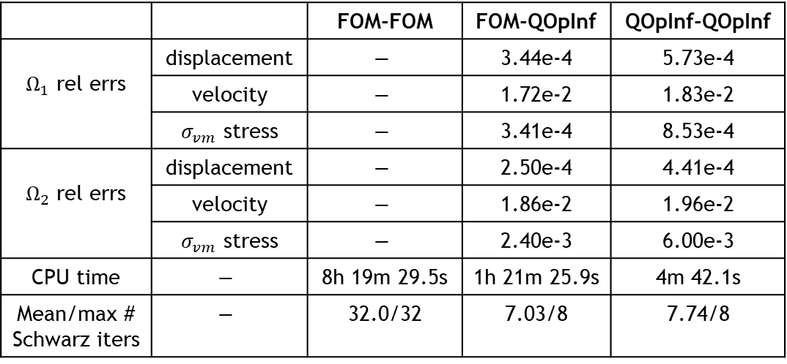

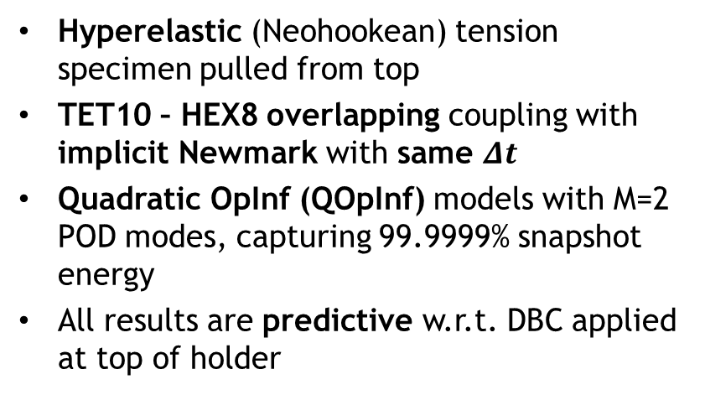
Tension Specimen (Overlapping SAM, Predictive)
13
Hyperelastic (Neohookean) tension specimen pulled from top
TET10 – HEX8 overlapping coupling with implicit Newmark with same $Δt$
Quadratic OpInf (QOpInf) models with M=2 POD modes, capturing 99.9999% snapshot energy
All results are predictive w.r.t. DBC applied at top of holder
 |  | FOM-FOM | FOM-QOpInf | QOpInf-QOpInf
$Ω_{1}$ rel errs | displacement | $$−$$ | 3.44e-4 | 5.73e-4
 | velocity | $$−$$ | 1.72e-2 | 1.83e-2
 | $σ_{vm}$ stress | $$−$$ | 3.41e-4 | 8.53e-4
$Ω_{2}$ rel errs | displacement | $$−$$ | 2.50e-4 | 4.41e-4
 | velocity | $$−$$ | 1.86e-2 | 1.96e-2
 | $σ_{vm}$ stress | $$−$$ | 2.40e-3 | 6.00e-3
CPU time | $$−$$ | 8h 19m 29.5s | 1h 21m 25.9s | 4m 42.1s
Mean/max # Schwarz iters | $$−$$ | 32.0/32 | 7.03/8 | 7.74/8
von Mises stress $σ_{vm}$
QOpInf = Quadratic OpInf
FOM-FOM
FOM-QOpInf
NORMA.JL
Notes:
TODO: add movies!

Slide 14
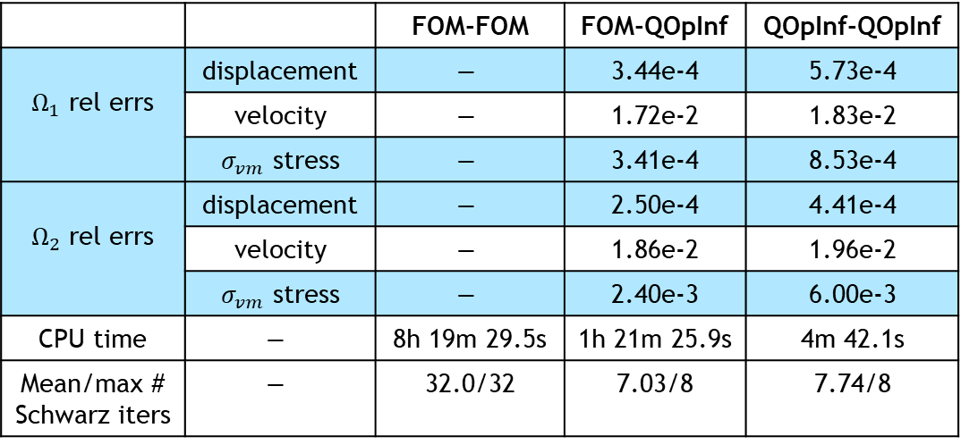
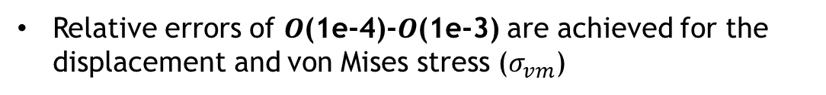
Tension Specimen (Overlapping SAM, Predictive)
14
Hyperelastic (Neohookean) tension specimen pulled from top
TET10 – HEX8 overlapping coupling with implicit Newmark with same $Δt$
Quadratic OpInf (QOpInf) models with M=2 POD modes, capturing 99.9999% snapshot energy
All results are predictive w.r.t. DBC applied at top of holder
 |  | FOM-FOM | FOM-QOpInf | QOpInf-QOpInf
$Ω_{1}$ rel errs | displacement | $$−$$ | 3.44e-4 | 5.73e-4
 | velocity | $$−$$ | 1.72e-2 | 1.83e-2
 | $σ_{vm}$ stress | $$−$$ | 3.41e-4 | 8.53e-4
$Ω_{2}$ rel errs | displacement | $$−$$ | 2.50e-4 | 4.41e-4
 | velocity | $$−$$ | 1.86e-2 | 1.96e-2
 | $σ_{vm}$ stress | $$−$$ | 2.40e-3 | 6.00e-3
CPU time | $$−$$ | 8h 19m 29.5s | 1h 21m 25.9s | 4m 42.1s
Mean/max # Schwarz iters | $$−$$ | 32.0/32 | 7.03/8 | 7.74/8
Relative errors of $O$(1e-4)-$O$(1e-3) are achieved for the displacement and von Mises stress ($σ_{vm}$)
von Mises stress $σ_{vm}$
von Mises stress $σ_{vm}$
QOpInf = Quadratic OpInf
FOM-FOM
FOM-QOpInf
NORMA.JL
Notes:
TODO: add movies!

Slide 15
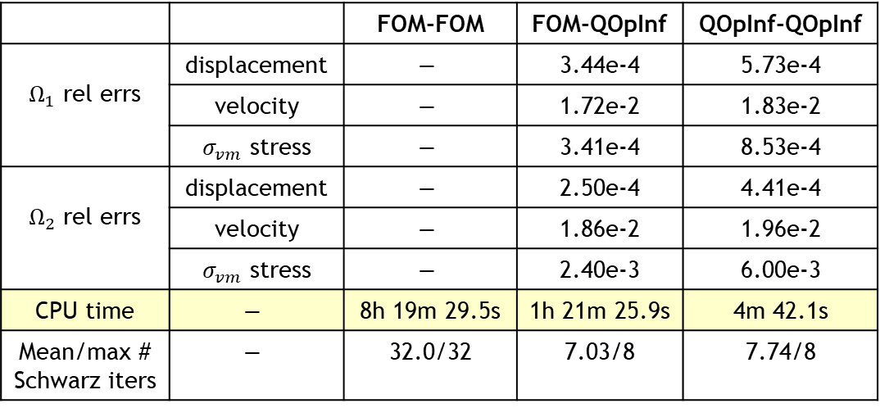
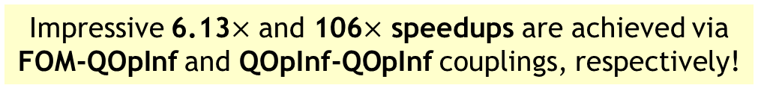
Tension Specimen (Overlapping SAM, Predictive)
15
Hyperelastic (Neohookean) tension specimen pulled from top
TET10 – HEX8 overlapping coupling with implicit Newmark with same $Δt$
Quadratic OpInf (QOpInf) models with M=2 POD modes, capturing 99.9999% snapshot energy
All results are predictive w.r.t. DBC applied at top of holder
 |  | FOM-FOM | FOM-QOpInf | QOpInf-QOpInf
$Ω_{1}$ rel errs | displacement | $$−$$ | 3.44e-4 | 5.73e-4
 | velocity | $$−$$ | 1.72e-2 | 1.83e-2
 | $σ_{vm}$ stress | $$−$$ | 3.41e-4 | 8.53e-4
$Ω_{2}$ rel errs | displacement | $$−$$ | 2.50e-4 | 4.41e-4
 | velocity | $$−$$ | 1.86e-2 | 1.96e-2
 | $σ_{vm}$ stress | $$−$$ | 2.40e-3 | 6.00e-3
CPU time | $$−$$ | 8h 19m 29.5s | 1h 21m 25.9s | 4m 42.1s
Mean/max # Schwarz iters | $$−$$ | 32.0/32 | 7.03/8 | 7.74/8
Relative errors of $O$(1e-4)-$O$(1e-3) are achieved for the displacement and von Mises stress ($σ_{vm}$)
Impressive 6.13$×$ and 106$×$ speedups are achieved via FOM-QOpInf and QOpInf-QOpInf couplings, respectively!
von Mises stress $σ_{vm}$
QOpInf = Quadratic OpInf
FOM-FOM
FOM-QOpInf
NORMA.JL
Notes:
TODO: add movies!

Slide 16
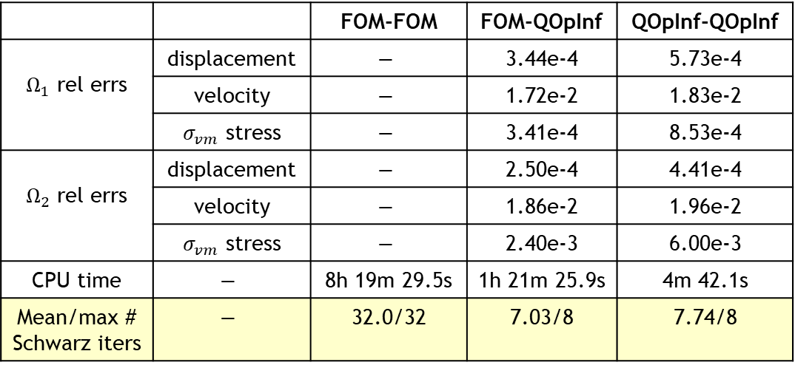
Tension Specimen (Overlapping SAM, Predictive)
16
Hyperelastic (Neohookean) tension specimen pulled from top
TET10 – HEX8 overlapping coupling with implicit Newmark with same $Δt$
Quadratic OpInf (QOpInf) models with M=2 POD modes, capturing 99.9999% snapshot energy
All results are predictive w.r.t. DBC applied at top of holder
 |  | FOM-FOM | FOM-QOpInf | QOpInf-QOpInf
$Ω_{1}$ rel errs | displacement | $$−$$ | 3.44e-4 | 5.73e-4
 | velocity | $$−$$ | 1.72e-2 | 1.83e-2
 | $σ_{vm}$ stress | $$−$$ | 3.41e-4 | 8.53e-4
$Ω_{2}$ rel errs | displacement | $$−$$ | 2.50e-4 | 4.41e-4
 | velocity | $$−$$ | 1.86e-2 | 1.96e-2
 | $σ_{vm}$ stress | $$−$$ | 2.40e-3 | 6.00e-3
CPU time | $$−$$ | 8h 19m 29.5s | 1h 21m 25.9s | 4m 42.1s
Mean/max # Schwarz iters | $$−$$ | 32.0/32 | 7.03/8 | 7.74/8
Relative errors of $O$(1e-4)-$O$(1e-3) are achieved for the displacement and von Mises stress ($σ_{vm}$)
Impressive 6.13$×$ and 106$×$ speedups are achieved via FOM-QOpInf and QOpInf-QOpInf couplings, respectively!
von Mises stress $σ_{vm}$
Speedup largely due to huge reduction in # Schwarz iterations
QOpInf = Quadratic OpInf
FOM-FOM
FOM-QOpInf
NORMA.JL
Notes:
TODO: add movies!

Slide 17
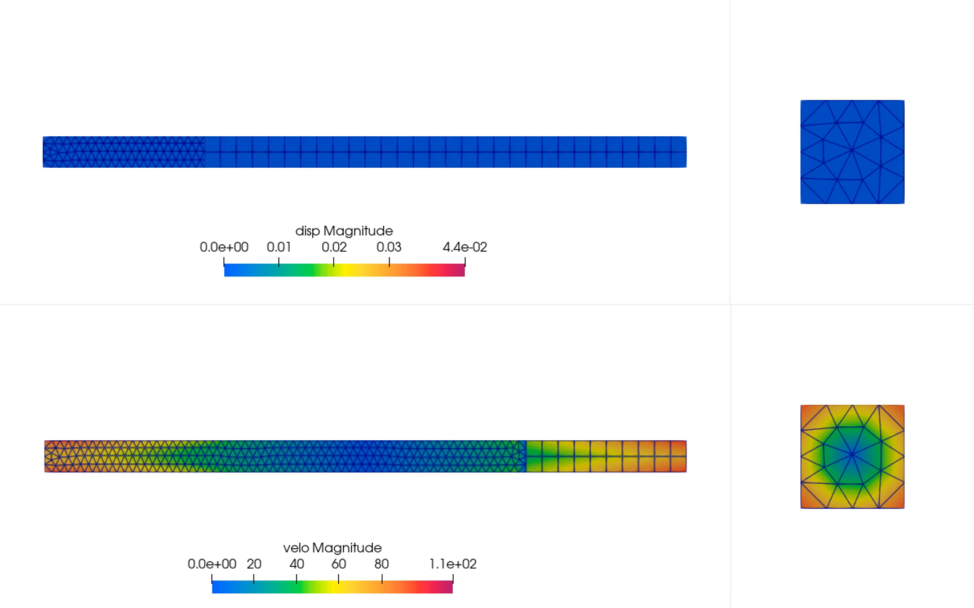
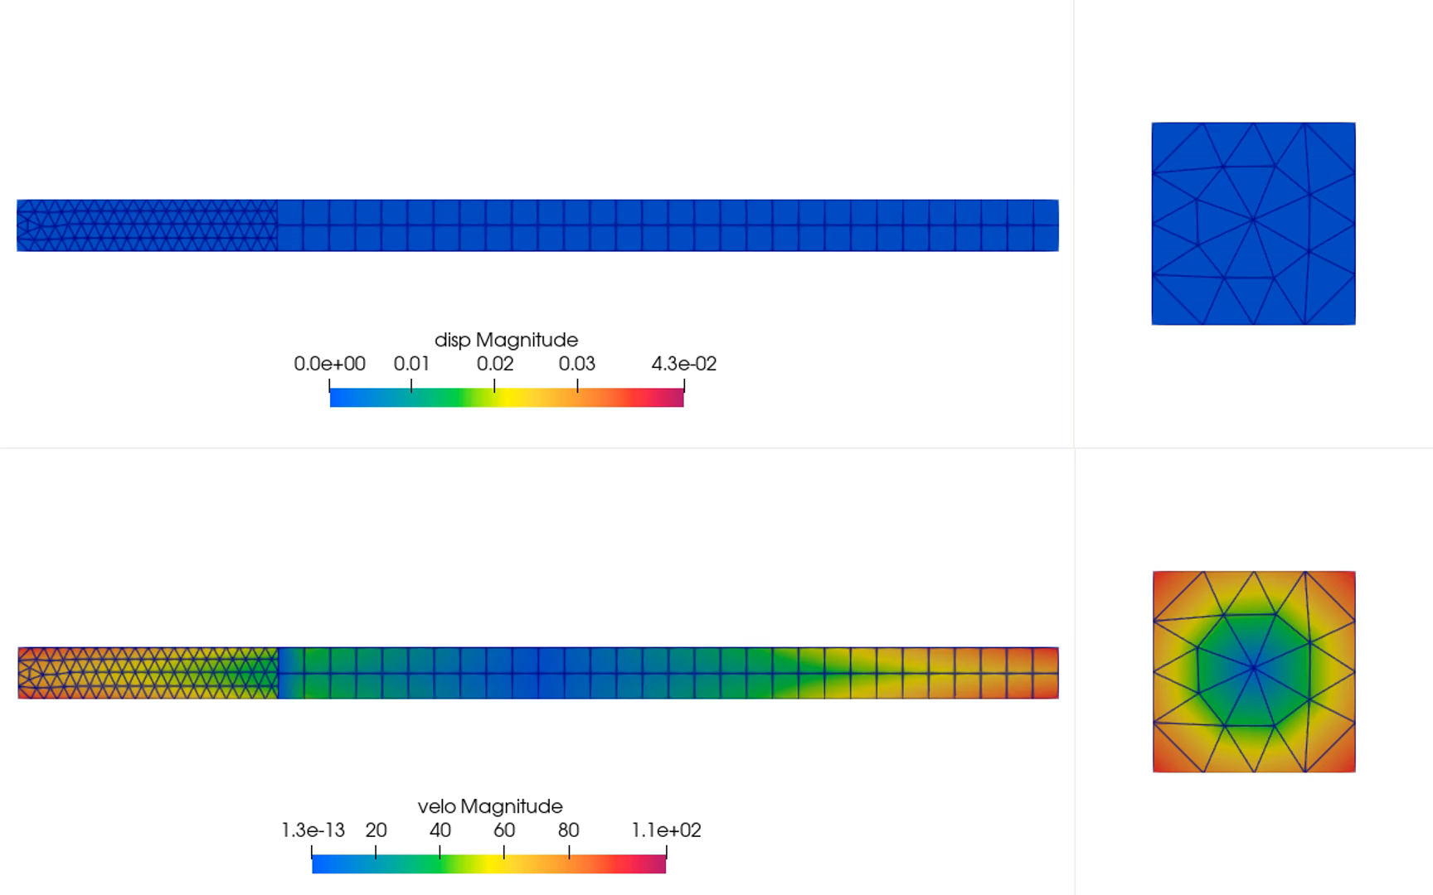
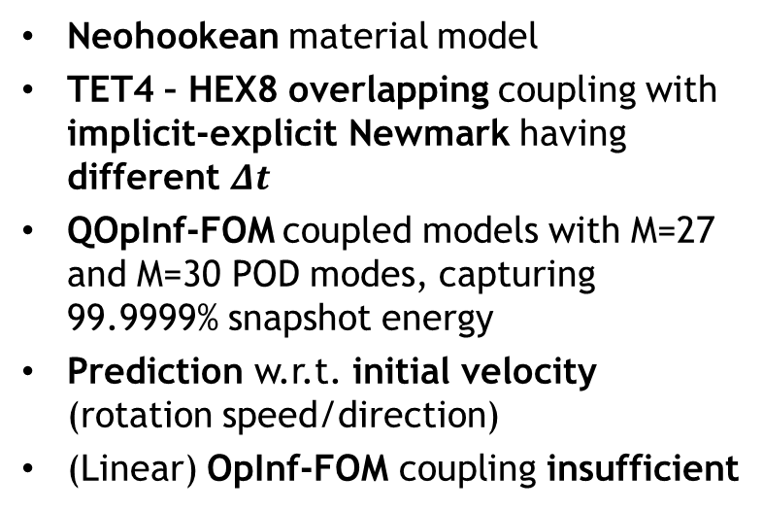
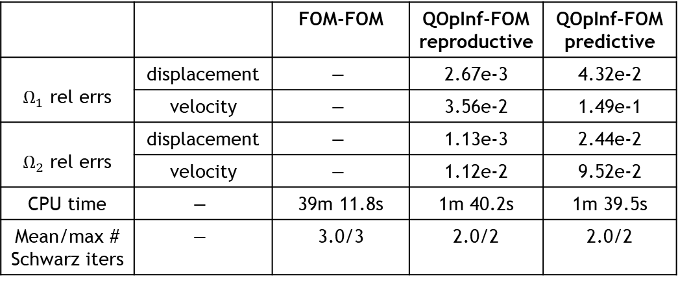
Torsion (Overlapping SAM, Reproductive & Predictive)
 |  | FOM-FOM | QOpInf-FOM reproductive | QOpInf-FOM predictive
$Ω_{1}$ rel errs | displacement | $$−$$ | 2.67e-3 | 4.32e-2
 | velocity | $$−$$ | 3.56e-2 | 1.49e-1
$Ω_{2}$ rel errs | displacement | $$−$$ | 1.13e-3 | 2.44e-2
 | velocity | $$−$$ | 1.12e-2 | 9.52e-2
CPU time | $$−$$ | 39m 11.8s | 1m 40.2s | 1m 39.5s
Mean/max # Schwarz iters | $$−$$ | 3.0/3 | 2.0/2 | 2.0/2
17
Neohookean material model
TET4 – HEX8 overlapping coupling with implicit-explicit Newmark having different $Δt$
QOpInf-FOM coupled models with M=27 and M=30 POD modes, capturing 99.9999% snapshot energy
Prediction w.r.t. initial velocity (rotation speed/direction)
(Linear) OpInf-FOM coupling insufficient
FOM-FOM
QOpInf-FOM
QOpInf = Quadratic OpInf
NORMA.JL
Notes:
TODO: add movies

Slide 18
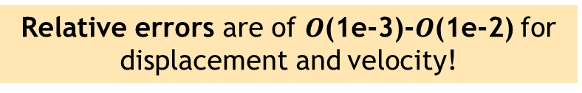
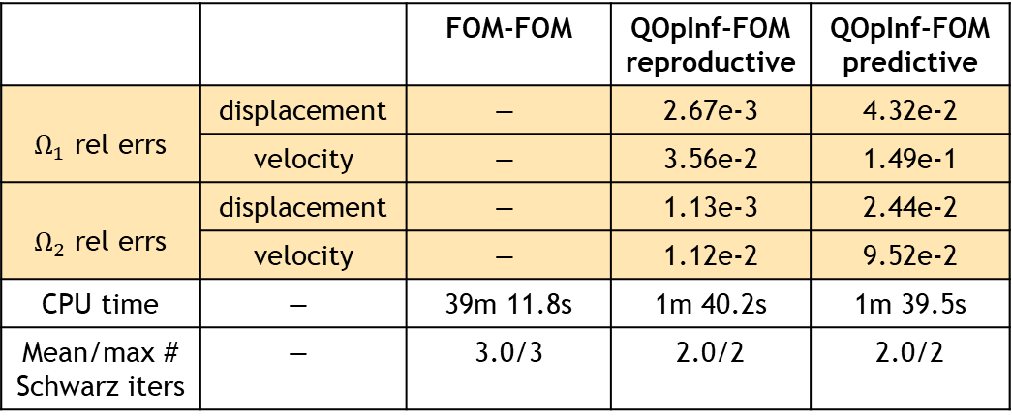
Torsion (Overlapping SAM, Reproductive & Predictive)
 |  | FOM-FOM | QOpInf-FOM reproductive | QOpInf-FOM predictive
$Ω_{1}$ rel errs | displacement | $$−$$ | 2.67e-3 | 4.32e-2
 | velocity | $$−$$ | 3.56e-2 | 1.49e-1
$Ω_{2}$ rel errs | displacement | $$−$$ | 1.13e-3 | 2.44e-2
 | velocity | $$−$$ | 1.12e-2 | 9.52e-2
CPU time | $$−$$ | 39m 11.8s | 1m 40.2s | 1m 39.5s
Mean/max # Schwarz iters | $$−$$ | 3.0/3 | 2.0/2 | 2.0/2
18
Neohookean material model
TET4 – HEX8 overlapping coupling with implicit-explicit Newmark having different $Δt$
QOpInf-FOM coupled models with M=27 and M=30 POD modes, capturing 99.9999% snapshot energy
Prediction w.r.t. initial velocity (rotation speed/direction)
(Linear) OpInf-FOM coupling insufficient
Relative errors are of $O$(1e-3)-$O$(1e-2) for displacement and velocity!
FOM-FOM
QOpInf-FOM
QOpInf = Quadratic OpInf
NORMA.JL
Notes:
TODO: add movies

Slide 19
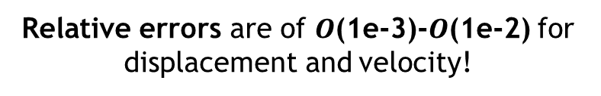
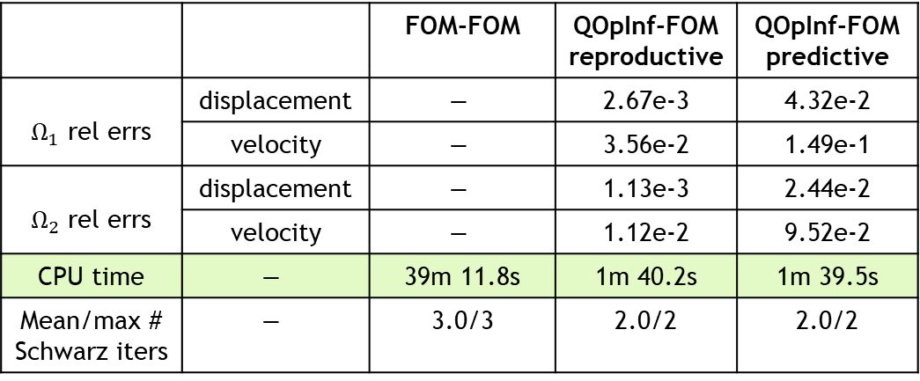
Torsion (Overlapping SAM, Reproductive & Predictive)
 |  | FOM-FOM | QOpInf-FOM reproductive | QOpInf-FOM predictive
$Ω_{1}$ rel errs | displacement | $$−$$ | 2.67e-3 | 4.32e-2
 | velocity | $$−$$ | 3.56e-2 | 1.49e-1
$Ω_{2}$ rel errs | displacement | $$−$$ | 1.13e-3 | 2.44e-2
 | velocity | $$−$$ | 1.12e-2 | 9.52e-2
CPU time | $$−$$ | 39m 11.8s | 1m 40.2s | 1m 39.5s
Mean/max # Schwarz iters | $$−$$ | 3.0/3 | 2.0/2 | 2.0/2
19
Neohookean material model
TET4 – HEX8 overlapping coupling with implicit-explicit Newmark having different $Δt$
QOpInf-FOM coupled models with M=27 and M=30 POD modes, capturing 99.9999% snapshot energy
Prediction w.r.t. initial velocity (rotation speed/direction)
(Linear) OpInf-FOM coupling insufficient
Relative errors are of $O$(1e-3)-$O$(1e-2) for displacement and velocity!
~23.5$×$ speedups are achieved via QOpInf-FOM couplings
FOM-FOM
QOpInf-FOM
QOpInf = Quadratic OpInf
NORMA.JL
Notes:
TODO: add movies

Slide 20
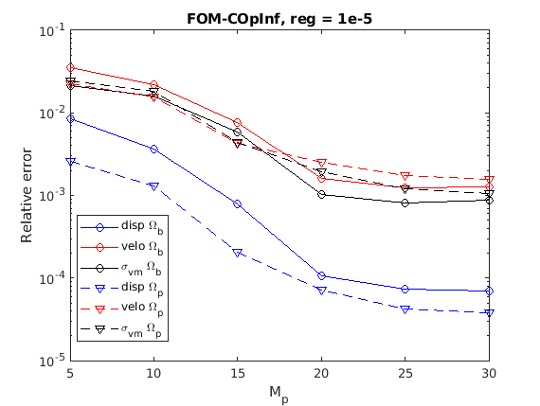
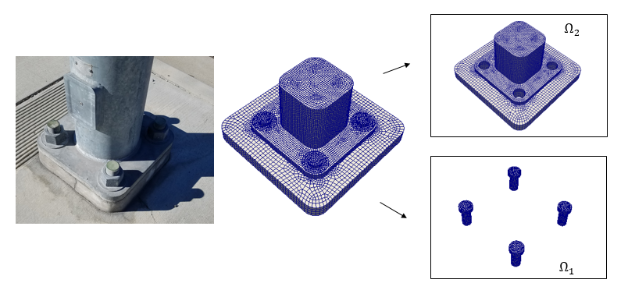
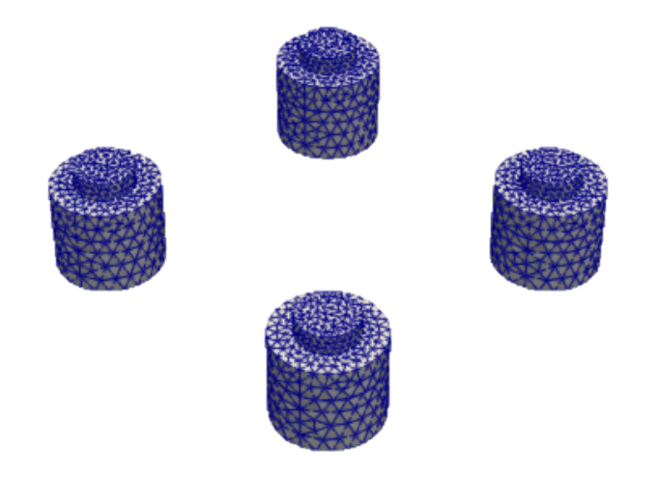
Bolted Joint (Overlapping SAM, Reproductive)
20
Hyper-elastic (Saint-Venant Kirchhoff) problem with TET10 – HEX8 meshes
Loading is applied to top part of bolted join
Cubic OpInf (COpInf) coupled models
Hybrid couplings require fewer Schwarz iterations to converge
Convergence w.r.t. basis size is observed for reproductive FOM-QOpInf couplings (right)
Figure above: convergence w.r.t. basis size for reproductive FOM-COpInf coupling
NORMA.JL

Slide 21
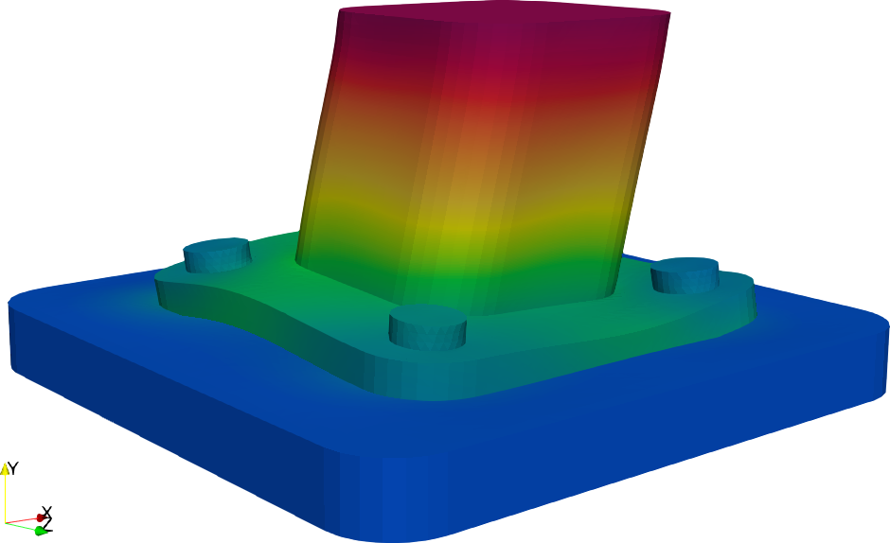
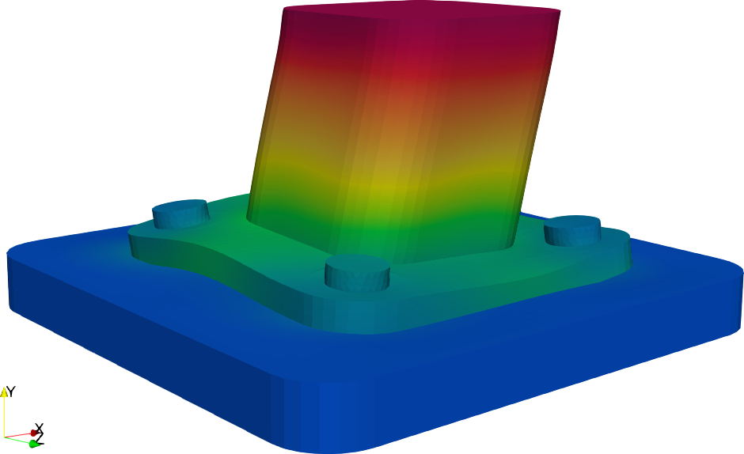


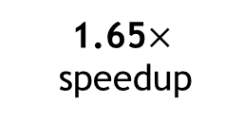
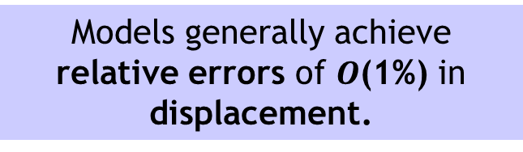

Bolted Joint (Overlapping SAM, Predictive): Displacements
21
COpInf = Cubic OpInf
1.65$×$speedup
FOM-COpInf
0.69% rel err (parts)
3.51% rel err (bolts)
FOM-FOM
Models generally achieve relative errors of $O$(1%) in displacement.
6.12$×$speedup
COpInf-COpInf (best)
0.98% rel err (parts)
4.41% rel err (bolts)
COpInf-COpInf (worst)
12.9% rel err (parts)
12.5% rel err (bolts)
NORMA.JL

Slide 22






Bolted Joint (Overlapping SAM, Predictive): von Mises Stresses
22
COpInf = Cubic OpInf
1.65$×$speedup
All models correctly predict locations of maximum von Mises stress (failure).
FOM-COpInf
7.74% rel err
FOM-FOM
6.12$×$speedup
COpInf-COpInf (best)
12.4% rel error
High errors do not necessarily mean result cannot be informative.
COpInf-COpInf (worst)
30.9% rel error
NORMA.JL
Notes:
.

Slide 23



Non-overlapping SAM-based Coupling for Non-Intrusive OpInf ROMs
23
Alternating Dirichlet-Neumann non-overlapping SAM (dynamic linear elastic problem)
$$\left\{\begin{aligned}Div{ P}_{1}^{(n+1)}=ρ{\ddot{φ}}_{1}^{(n+1)}\text{,} \text{in} Ω_{1} \\ φ_{1}^{(n+1)}=χ\text{, }\text{on} ∂Ω_{1}\backslash Γ \\ φ_{1}^{(n+1)}=φ_{2}^{(n)}\text{, }\text{on} Γ\end{aligned}\right.$$
$$\left\{\begin{aligned}Div P_{2}^{(n+1)}=ρ{\ddot{φ}}_{2}^{(n+1)}\text{, } \text{in}{ Ω}_{2} \\ φ_{2}^{(n+1)}=χ\text{, }\text{on} ∂Ω_{2}\backslash Γ \\ P_{2}^{(n+1)}n=P_{1}^{(n+1)}n\text{, }\text{on} Γ\end{aligned}\right.$$

Slide 24


Non-overlapping SAM-based Coupling for Non-Intrusive OpInf ROMs
24
Alternating Dirichlet-Neumann non-overlapping SAM (dynamic linear elastic problem)
$$\left\{\begin{aligned}Div{ P}_{1}^{(n+1)}=ρ{\ddot{φ}}_{1}^{(n+1)}\text{,} \text{in} Ω_{1} \\ φ_{1}^{(n+1)}=χ\text{, }\text{on} ∂Ω_{1}\backslash Γ \\ φ_{1}^{(n+1)}=φ_{2}^{(n)}\text{, }\text{on} Γ\end{aligned}\right.$$
$$\left\{\begin{aligned}Div P_{2}^{(n+1)}=ρ{\ddot{φ}}_{2}^{(n+1)}\text{, } \text{in}{ Ω}_{2} \\ φ_{2}^{(n+1)}=χ\text{, }\text{on} ∂Ω_{2}\backslash Γ \\ P_{2}^{(n+1)}n=P_{1}^{(n+1)}n\text{, }\text{on} Γ\end{aligned}\right.$$
$$\int_{I}{\left[\int_{Ω_{1}}{\left(ρ{\ddot{φ}}_{1}^{(n+1)}∙ξ+{ P}_{1}^{\left(n+1\right)}:∇ξ\right)dΩ}\right]dt=0}$$
$$\int_{I}{\left[\int_{Ω_{2}}{\left(ρ{\ddot{φ}}_{2}^{(n+1)}∙ξ+{ P}_{2}^{\left(n+1\right)}:∇ξ\right)dΩ − }\int_{Γ}{\left(P_{1}^{(n+1)}n\right)}∙ξdS\right]dt=0}$$

Slide 25




Non-overlapping SAM-based Coupling for Non-Intrusive OpInf ROMs
25
Alternating Dirichlet-Neumann non-overlapping SAM (dynamic linear elastic problem)
$$\left\{\begin{aligned}Div{ P}_{1}^{(n+1)}=ρ{\ddot{φ}}_{1}^{(n+1)}\text{,} \text{in} Ω_{1} \\ φ_{1}^{(n+1)}=χ\text{, }\text{on} ∂Ω_{1}\backslash Γ \\ φ_{1}^{(n+1)}=φ_{2}^{(n)}\text{, }\text{on} Γ\end{aligned}\right.$$
$$\left\{\begin{aligned}Div P_{2}^{(n+1)}=ρ{\ddot{φ}}_{2}^{(n+1)}\text{, } \text{in}{ Ω}_{2} \\ φ_{2}^{(n+1)}=χ\text{, }\text{on} ∂Ω_{2}\backslash Γ \\ P_{2}^{(n+1)}n=P_{1}^{(n+1)}n\text{, }\text{on} Γ\end{aligned}\right.$$
$$\int_{I}{\left[\int_{Ω_{1}}{\left(ρ{\ddot{φ}}_{1}^{(n+1)}∙ξ+{ P}_{1}^{\left(n+1\right)}:∇ξ\right)dΩ}\right]dt=0}$$
$$\int_{I}{\left[\int_{Ω_{2}}{\left(ρ{\ddot{φ}}_{2}^{(n+1)}∙ξ+{ P}_{2}^{\left(n+1\right)}:∇ξ\right)dΩ − }\int_{Γ}{\left(P_{1}^{(n+1)}n\right)}∙ξdS\right]dt=0}$$
${{\hat{M}}_{1}\ddot{\hat{q}}}_{1}+{\hat{K}}_{1}{\hat{q}}_{1}+$ ${\hat{B}}_{1}g_{1}=0$
$${{\hat{M}}_{2}\ddot{\hat{q}}}_{2}+{\hat{K}}_{2}{\hat{q}}_{2}+{\hat{B}}_{2}g_{2}+{\hat{H}}_{2}t_{2}=0$$
OpInf ROMs
Dirichlet problem: learn ${\hat{M}}_{1}$, ${\hat{K}}_{1}$, ${\hat{B}}_{1}$
Use snapshots of displacement, acceleration and Dirichlet data to train ROM
Neumann problem: learn ${\hat{M}}_{2}$, ${\hat{K}}_{2}$, ${\hat{B}}_{2}$, ${\hat{H}}_{2}$
Use snapshots of displacement, acceleration, Dirichlet data and tractions to train ROM

Slide 26







Torsion problem (Non-Overlapping SAM, Predictive & Reproductive)
26
3D Neohookean torsion problem w/ parameterized initial velocity
Test non-overlapping SAM w/ 2 subdomains discretized with conformal HEX8 meshes, implicit-explicit Newmark with different $Δt$
Requires per-operator regularization parameters:
FOM-FOM
$$\min_{\hat{A},\hat{H},\hat{B}}{\left\|{\dot{\hat{Q}}}^{T}+{\hat{Q}}^{T}{\hat{A}}^{T}+{(\hat{Q} ⨂\hat{ Q})}^{T}{\hat{H}}^{T}+{\hat{U}}^{T}{\hat{B}}^{T}\right\|}_{F}^{2}$$
$$+ γ_{A}{\left\|\hat{A}\right\|}_{F}+γ_{H}{\left\|\hat{H}\right\|}_{F}+{γ_{B}\left\|\hat{B}\right\|}_{F}$$
FOM-ROM (predictive, $r_{2}=16$)
Good accuracy is achieved for QOpInf-QOpInf and QOpInf-FOM couplings in both the reproductive and predictive regime with speedup up to 2.16$×$.
Reproductive
Predictive
Model | $$r_{1}/r_{2}$$ | Domain 1 disp. error | Domain 2 disp. error | Max Iterations | CPU time
FOM-FOM | -/- | - | - | 2 | 10m 30.99s
QOpInf-FOM QOpInf-QOpInf | 5/- 5/5 | 4.6867e-2 6.9680e-2 | 5.7994e-2 1.7522e-1 | 2 2 | 9m 21.32s 7m 2.13s
QOpInf-FOM QOpInf-QOpInf | 15/- 15/16 | 4.7315e-2 4.6309e-2 | 4.4132e-2 8.4510e-2 | 2 1 | 9m 20.10s 6m 19.62s
Model | $$r_{1}/r_{2}$$ | Domain 1 disp. error | Domain 2 disp. error | Max Iterations | CPU time
FOM-FOM | -/- | - | - | 2 | 10m 30.99s
QOpInf-FOM QOpInf-QOpInf | 5/- 5/5 | 1.8201e-1 1.3647e-1 | 9.8893e-2 5.4770e-2 | 2 1 | 5m 57.66s 4m 43.67s
QOpInf-FOM QOpInf-QOpInf | 15/- 15/16 | 1.3262e-1 8.5193e-2 | 7.7476e-2 1.4832e-2 | 2 1 | 6m 1.60s 4m 52.07s

Slide 27







Towards adaptive SAM-based coupling
27
Goal: on-the-fly model switching/mesh adaptation if inaccuracies are detected within the SAM workflow.
Work in progress: reinforcement learning (RL) approach to model switching
Result: RL algorithm applied to 1D advection-diffusion problem with shock
State: down-sampled solution field (200 dimensions)
Action: for 3 overlapping subdomains, we have a discrete action of size 8 that selects FOM/ROM combinations
  Model combos: {FFF, FRF, FFR, …, RRR}
  OpInf ROMs for all configurations pre-trained and stored in library
Reward: $r_{k}=−{cost}_{k}−λe_{k}−μnflip$
Episode structure: full rollout over $[0,T]$, 32 $Δt$s/episode with resets
Architecture: Deep Q-Network
Train on several initial conditions, infer on unseen initial condition
$$Ω_{1}$$
$$Ω_{2}$$
$$Ω_{3}$$
Notes:
"The final direction I'd like to mention is making the Schwarz framework adaptive. Rather than fixing which subdomains use FOMs or ROMs ahead of time, we'd like the algorithm to decide this automatically during the simulation.
Here we're exploring reinforcement learning. The physics models themselves are not being learned—the FOMs and OpInf ROMs are all pre-trained offline and stored in a library. The RL agent simply learns which combination of models to activate.
At each decision point, the current solution snapshot forms the state. The action is one of four possible model assignments for the two subdomains: FOM–FOM, FOM–ROM, ROM–FOM, or ROM–ROM.
We then run the Schwarz solve using that choice, compute a reward that balances accuracy against computational cost, and repeat this over many full simulation rollouts. By training on a variety of initial conditions, the agent learns a policy that generalizes to previously unseen cases.
The example on the right shows preliminary results for a one-dimensional advection–diffusion problem, where the agent learns when it is worthwhile to switch to more accurate FOMs near sharp solution features while using ROMs elsewhere."

Slide 28

Ongoing & Future Work
Performance improvements
Acceleration of Schwarz via optimized Robin-Robin TCs
Acceleration of Schwarz via Aitken and Anderson Acceleration
Asynchronous additive Schwarz on GPUs
Automated & adaptive Schwarz
Automated optimization of meshes/DD with multiple constraints
Automated criteria to determine appropriate use of less refined or reduced-order models w/o sacrificing accuracy
Fully non-intrusive adaptive ROM-FOM coupling (w/ K. Willcox & N. Aretz, UT Austin and L. Gkimisis, MPI)
Schwarz for ROM/Data-Driven Model Coupling
Schwarz + Deep NN-OpInf ROMs
Schwarz + kernel-based ROMs (w/ I. Farcas, Virginia Tech)
Schwarz + numerical-informed NNs (w/ B. Riviere, Virginia Tech)
On-the-fly switching between ROMs and FOMs
Implementation in Sandia’s production code, SIERRA/SM
Schwarz + multiphysics coupling

Slide 29












References on SAM for FOM-ROM and ROM-ROM Coupling
Schwarz Couplings Involving Non-Intrusive OpInf ROMs:
I. Tezaur, E. Parish, A. Gruber, I. Moore, C. Wentland, A. Mota. “Hybrid coupling with operator inference and the overlapping Schwarz alternating method”. ArXiv pre-print, 2025. https://arxiv.org/abs/2511.20687
  Implementation: Norma.jl Julia code (https://github.com/sandialabs/Norma.jl)
C. Rodriguez, I. Tezaur, A. Mota, A. Gruber, E. Parish, C. Wentland. “Transmission Conditions for the Non-Overlapping Schwarz Coupling of Full Order and Operator Inference Models”, CSRI Summer Proceedings 2025, Sandia National Laboratories. https://arxiv.org/abs/2509.12228
  First application of non-overlapping Schwarz to OpInf-FOM and OpInf-OpInf coupling that we are aware of
NORMA.JL
Contact: Irina Tezaur (ikalash@sandia.gov)
I. Tezaur J. Barnett I. Moore E. Parish C. Wentland A. Gruber C. Rodriguez A. Diaz T. Mondal
Notes:
TODO: add Alejandro D.!

Slide 30









Contact
NORMA.JL
$$Ω_{1}$$
$$Ω_{2}$$
ikalash@sandia.gov
www.sandia.gov/~ikalash

Slide 31






Other References on SAM for FOM-ROM and ROM-ROM Coupling
Schwarz Couplings Involving Intrusive Projection-Based ROMs:
J. Barnett, I. Tezaur, A. Mota. “The Schwarz alternating method for the seamless coupling of nonlinear reduced order models and full order models”, CSRI Summer Proceedings 2023, Sandia National Laboratories. https://arxiv.org/abs/2210.12551
C. Wentland, F. Rizzi, J. Barnett, I. Tezaur. “The role of interface boundary conditions and sampling strategies for Schwarz-based coupling of projection-based reduced order models”, J. Comput. Appl. Math., 465 116584, 2025
Schwarz Couplings Involving Physics-Informed Neural Networks (PINNs):
W. Snyder, I. Tezaur, C. Wentland. “Domain decomposition-based coupling of PINNs via the Schwarz alternating method”, CSRI Summer Proceedings 2023, Sandia National Laboratories. https://arxiv.org/abs/2311.00224
I. Tezaur J. Barnett I. Moore E. Parish C. Wentland A. Gruber C. Rodriguez W. Snyder G. Sambataro
Notes:
TODO: add new paper to be submitted. Add QR codes.

Slide 32
Start of Backup Slides

Slide 33

Requirements for Multiscale Coupling Method
Coupling is concurrent (two-way)
“Plug-and-play” framework: simplifies task of meshing complex geometries
  Ability to couple regions with different non-conformal meshes, different element types and different levels of refinement
  Ability to use different solvers/time-integrators in different regions
  Ability to mix-and-match conventional and data-driven models in different regions
Ease of implementation into existing massively-parallel HPC codes
Scalable, fast, robust (we target real engineering problems, e.g., analyses involving failure of bolted components!)
Coupling does not introduce nonphysical artifacts
Theoretical convergence properties/ guarantees
A great method theoretically may not make it if it is too difficult to implement in production codes.
Figure above: schematic of difficult-to-mesh ratcheting mechanism with multiple threaded fasteners. From Parish et al., 2024.

Slide 34
Requirements for Multiscale Coupling Method
Coupling is concurrent (two-way)
“Plug-and-play” framework: simplifies task of meshing complex geometries
  Ability to couple regions with different non-conformal meshes, different element types and different levels of refinement
  Ability to use different solvers/time-integrators in different regions
  Ability to mix-and-match conventional and data-driven models in different regions
Ease of implementation into existing massively-parallel HPC codes
Scalable, fast, robust (we target real engineering problems, e.g., analyses involving failure of bolted components!)
Coupling does not introduce nonphysical artifacts
Theoretical convergence properties/ guarantees
Creating a high-quality mesh can take weeks or longer, making it “the single biggest bottleneck in [mod/sim] analyses” [Sandia Lab News, 2020]
Above: schematic of difficult-to-mesh ratcheting mechanism with multiple threaded fasteners. From Parish et al., 2024.

Slide 35

Projects on Coupling for Predictive Hybrid Models
Three projects:
FHNM: Flexible Heterogeneous Numerical Methods [LDRD, FY22-FY24]
M2dt: Multi-faceted Mathematics for Predictive Digital Twins [ASCR, FY23-FY27]
AHEAD: Adaptive Hybrid modEls via domAin Decomposition [LDRD, FY25-FY27]
Principal research objective:
Develop rigorous methods to enable the “plug-and-play” coupling of standard and data-driven models from the following classes
  Class A: intrusive projection-based ROMs
  Class B: machine-learned models
  Class C: flow map approximation models, i.e., dynamic model decomposition (DMD)
  Class D: non-intrusive operator inference (OpInf) ROMs
Three classes of coupling methods:
Alternating Schwarz-based coupling [FHNM, M2dt, AHEAD]
Optimization-based coupling [FHNM, M2dt]
Coupling via generalized mortar methods [FHNM, M2dt]

Slide 36

Projects on Coupling for Predictive Hybrid Models
Three projects:
FHNM: Flexible Heterogeneous Numerical Methods [LDRD, FY22-FY24]
M2dt: Multi-faceted Mathematics for Predictive Digital Twins [ASCR, FY23-FY27]
AHEAD: Adaptive Hybrid modEls via domAin Decomposition [LDRD, FY25-FY27]
Principal research objective:
Develop rigorous methods to enable the “plug-and-play” coupling of standard and data-driven models from the following classes
  Class A: intrusive projection-based ROMs
  Class B: machine-learned models
  Class C: flow map approximation models, i.e., dynamic model decomposition (DMD)
  Class D: non-intrusive operator inference (OpInf) ROMs $→$ this talk
Three classes of coupling methods:
Alternating Schwarz-based coupling [FHNM, M2dt, AHEAD] $→$ this talk
Optimization-based coupling [FHNM, M2dt]
Coupling via generalized mortar methods [FHNM, M2dt]
Why? Less intrusive to integrate into production codes.

Slide 37







Time-Advancement within the Schwarz Framework
$T_{0}$ $T_{1}$
Controller time stepper
$$Γ_{2}$$
Time integrator in $Ω_{1}$
Time integrator in $Ω_{2}$
Step 0: Initialize $i=0 \text{(}\text{controller} \text{time} \text{index}\text{).}$
Model PDE:
$$\left\{\begin{matrix}M\ddot{u}+f_{int}\left(u,\dot{u}\right)=f_{ext} \\ u\left(x,0\right)=u_{0}\end{matrix}\right.$$

Slide 38


Time-Advancement within the Schwarz Framework
$T_{0}$ $T_{1}$
Controller time stepper
$$Γ_{2}$$
Integrate using ${Δt}_{1}$
Time integrator in $Ω_{1}$
Time integrator in $Ω_{2}$
Step 0: Initialize $i=0 \text{(}\text{controller} \text{time} \text{index}\text{).}$
Step 1: Advance $Ω_{1}$ solution from time $T_{i}$ to time $T_{i+1}$ using time-stepper in $Ω_{1}$ with time-step ${Δt}_{1},$using solution in $Ω_{2}$ interpolated to $Γ_{1}$ at times $T_{i}+n{Δt}_{1}.$
Model PDE:
$$\left\{\begin{matrix}M\ddot{u}+f_{int}\left(u,\dot{u}\right)=f_{ext} \\ u\left(x,0\right)=u_{0}\end{matrix}\right.$$

Slide 39



Time-Advancement within the Schwarz Framework
$T_{0}$ $T_{1}$
Controller time stepper
$$Γ_{2}$$
Time integrator in $Ω_{1}$
Interpolate from $Ω_{1}$ to $Γ_{2}$
Time integrator in $Ω_{2}$
Integrate using ${Δt}_{2}$
Step 0: Initialize $i=0 \text{(}\text{controller} \text{time} \text{index}\text{).}$
Step 1: Advance $Ω_{1}$ solution from time $T_{i}$ to time $T_{i+1}$ using time-stepper in $Ω_{1}$ with time-step ${Δt}_{1},$using solution in $Ω_{2}$ interpolated to $Γ_{1}$ at times $T_{i}+n{Δt}_{1}.$
Step 2: Advance $Ω_{2}$ solution from time $T_{i}$ to time $T_{i+1}$ using time-stepper in $Ω_{2}$ with time-step ${Δt}_{2},$using solution in $Ω_{1}$ interpolated to $Γ_{2}$ at times $T_{i}+n{Δt}_{2}$.
.
Model PDE:
$$\left\{\begin{matrix}M\ddot{u}+f_{int}\left(u,\dot{u}\right)=f_{ext} \\ u\left(x,0\right)=u_{0}\end{matrix}\right.$$

Slide 40

Time-Advancement within the Schwarz Framework
$T_{0}$ $T_{1}$
Controller time stepper
$$Γ_{2}$$
Time integrator in $Ω_{1}$
Time integrator in $Ω_{2}$
Step 0: Initialize $i=0 \text{(}\text{controller} \text{time} \text{index}\text{).}$
Step 1: Advance $Ω_{1}$ solution from time $T_{i}$ to time $T_{i+1}$ using time-stepper in $Ω_{1}$ with time-step ${Δt}_{1},$using solution in $Ω_{2}$ interpolated to $Γ_{1}$ at times $T_{i}+n{Δt}_{1}.$
Step 2: Advance $Ω_{2}$ solution from time $T_{i}$ to time $T_{i+1}$ using time-stepper in $Ω_{2}$ with time-step ${Δt}_{2},$using solution in $Ω_{1}$ interpolated to $Γ_{2}$ at times $T_{i}+n{Δt}_{2}$.
Step 3: Check for convergence at time $T_{i+1}$.
Model PDE:
$$\left\{\begin{matrix}M\ddot{u}+f_{int}\left(u,\dot{u}\right)=f_{ext} \\ u\left(x,0\right)=u_{0}\end{matrix}\right.$$

Slide 41


Time-Advancement within the Schwarz Framework
$T_{0}$ $T_{1}$
Controller time stepper
$$Γ_{2}$$
Integrate using ${Δt}_{1}$
Time integrator in $Ω_{1}$
Interpolate from $Ω_{2}$ to $Γ_{1}$
Time integrator in $Ω_{2}$
Step 0: Initialize $i=0 \text{(}\text{controller} \text{time} \text{index}\text{).}$
Step 1: Advance $Ω_{1}$ solution from time $T_{i}$ to time $T_{i+1}$ using time-stepper in $Ω_{1}$ with time-step ${Δt}_{1},$using solution in $Ω_{2}$ interpolated to $Γ_{1}$ at times $T_{i}+n{Δt}_{1}.$
Step 2: Advance $Ω_{2}$ solution from time $T_{i}$ to time $T_{i+1}$ using time-stepper in $Ω_{2}$ with time-step ${Δt}_{2},$using solution in $Ω_{1}$ interpolated to $Γ_{2}$ at times $T_{i}+n{Δt}_{2}$.
Step 3: Check for convergence at time $T_{i+1}$.
If unconverged, return to Step 1.
Model PDE:
$$\left\{\begin{matrix}M\ddot{u}+f_{int}\left(u,\dot{u}\right)=f_{ext} \\ u\left(x,0\right)=u_{0}\end{matrix}\right.$$

Slide 42



Time-Advancement within the Schwarz Framework
$T_{0}$ $T_{1}$
Can use different integrators with different time steps within each domain!
Controller time stepper
$$Γ_{2}$$
Integrate using ${Δt}_{1}$
Time integrator in $Ω_{1}$
Time-stepping procedure is equivalent to doing Schwarz on space-time domain [Mota, IT, et al. 2022].
Interpolate from $Ω_{2}$ to $Γ_{1}$
Time integrator in $Ω_{2}$
Step 0: Initialize $i=0 \text{(}\text{controller} \text{time} \text{index}\text{).}$
Step 1: Advance $Ω_{1}$ solution from time $T_{i}$ to time $T_{i+1}$ using time-stepper in $Ω_{1}$ with time-step ${Δt}_{1},$using solution in $Ω_{2}$ interpolated to $Γ_{1}$ at times $T_{i}+n{Δt}_{1}.$
Step 2: Advance $Ω_{2}$ solution from time $T_{i}$ to time $T_{i+1}$ using time-stepper in $Ω_{2}$ with time-step ${Δt}_{2},$using solution in $Ω_{1}$ interpolated to $Γ_{2}$ at times $T_{i}+n{Δt}_{2}$.
Step 3: Check for convergence at time $T_{i+1}$.
If unconverged, return to Step 1.
If converged, set $i= i+1$and return to Step 1.
Model PDE:
$$\left\{\begin{matrix}M\ddot{u}+f_{int}\left(u,\dot{u}\right)=f_{ext} \\ u\left(x,0\right)=u_{0}\end{matrix}\right.$$

Slide 43















Projection-Based Model Order Reduction via the POD/Galerkin Method
43
Full Order Model (FOM): $M\frac{d^{2}u}{dt^{2}}+f_{int}\left(u\right)=f_{ext}$
1. Acquisition
3. Projection-Based Reduction
Number of time steps
Reduce the number of unknowns
$$u\left(t\right)≈\tilde{u}\left(t\right)=Φ\hat{u}(t)$$
Number of State Variables
Solve ODE at different design points
Save solution data
Perform Galerkin projection
$Φ^{T}MΦ\frac{d^{2}\hat{u}}{dt^{2}}$ + $Φ^{T}f_{int}\left(Φ\hat{u}\right)=Φ^{T}f_{ext}$
2. Learning
Disadvantage: intrusive!
Proper Orthogonal Decomposition (POD):
Hyper-reduce nonlinear terms
$$f_{int}\left(Φ\hat{u}\right)≈ A f_{int}\left(Φ\hat{u}\right)$$
Hyper-reduction/sample mesh
ROM = projection-based Reduced Order Model HROM = Hyper-reduced ROM

Slide 44

Bolted Joint (Overlapping SAM, Predictive): Animations
44
COpInf = Cubic OpInf
FOM-FOM
~53m
COpInf-COpInf
~8.5m

Slide 45





Linear Elastic Wave Propagation (Non-Overlapping SAM, Reproductive)
45
1D linear elastic clamped beam with Gaussian initial condition for the displacement.
Simple problem with analytical exact solution but very stringent test for discretization methods.
Test non-overlapping SAM w/ 2 subdomains: $Ω_{1}= \left(0,0.6\right),Ω_{2}=\left(0.6,1\right).$
Above: representative OpInf-FOM coupling result
Good accuracy and moderate speedups over FOM-FOM coupling are possible. Larger speedups expected in multi-D.
Notes:
.TODO: cut this slide in favor of Alejandro D’s results.

Slide 46





Work in Progress: Accelerating Non-Overlapping SAM via Transmission Condition Design
C. Rodriguez (Columbia U)
46
Risk: non-overlapping Schwarz can be slow to converge w/ Dirichlet-Neumann TCs.
Mitigation: explore optimized Robin-Robin transmission conditions (TCs).
$α_{ij}, β_{ij}:$ tuning parameters
Automatic tuning of $α_{ij}, β_{ij}$ possible using Bayesian optimization via GPTune.
Non-overlapping SAM with optimized Robin-Robin TCs can give to faster convergence (29% less Schwarz iterations), lower errors (by up to 25%), and more stable/accurate time-predictive ROMs than non-overlapping SAM with Dirichlet-Neumann TCs.
Notes:
.

Slide 47
References on SAM for FOM-ROM and ROM-ROM Coupling (cont’d)
Schwarz Couplings Involving Intrusive Projection-Based ROMs:
J. Barnett, I. Tezaur, A. Mota. “The Schwarz alternating method for the seamless coupling of nonlinear reduced order models and full order models”, CSRI Summer Proceedings 2023, Sandia National Laboratories. https://arxiv.org/abs/2210.12551
C. Wentland, F. Rizzi, J. Barnett, I. Tezaur. “The role of interface boundary conditions and sampling strategies for Schwarz-based coupling of projection-based reduced order models”, J. Comput. Appl. Math., 465 116584, 2025
Schwarz Couplings Involving Physics-Informed Neural Networks (PINNs):
W. Snyder, I. Tezaur, C. Wentland. “Domain decomposition-based coupling of PINNs via the Schwarz alternating method”, CSRI Summer Proceedings 2023, Sandia National Laboratories. https://arxiv.org/abs/2311.00224
I. Tezaur J. Barnett I. Moore E. Parish C. Wentland A. Gruber C. Rodriguez W. Snyder G. Sambataro
Notes:
TODO: add new paper to be submitted. Add QR codes.

Slide 48


Current Research Directions
Production Applications
4-way multiscale coupling in salt caverns for Strategic Petroleum Reserve (SPR)
Schwarz coupling for J-integral around crack front on pressure vessel
Multiscale coupling for stronglinks
Schwarz multiphysics coupling for electronics package survivability
Performance Improvements
Acceleration of Schwarz
Asynchronous additive Schwarz on GPUs
Schwarz for salt cavern coupling.
Courtesy of T. Ross.
Automated & Adaptive Schwarz
Automated optimization of meshes/DD with multiple constraints
Automated criteria to determine appropriate use of less refined or reduced-order models w/o sacrificing accuracy
Schwarz for ROM/Data-Driven Model Coupling
Non-overlapping Schwarz + OpInf
Schwarz + Deep NN-based ROMs
Schwarz + kernel-based ROMs
Fully non-intrusive ROM-FOM coupling (w/ K. Willcox & N. Aretz, UT Austin)
On-the-fly switching between ROMs and FOMs
Implementation in SIERRA/SM
Notes:
Q for Alejandro: what is SPR?

Slide 49

How We Use the Schwarz Alternating Method
49
AS A PRECONDITIONER FOR THE LINEARIZED SYSTEM
AS A SOLVER FOR THE COUPLED
FULLY NONLINEAR PROBLEM

Slide 50







Theoretical Foundation
Using the Schwarz alternating as a discretization method for PDEs is natural idea with a sound theoretical foundation.
S.L. Sobolev (1936): posed Schwarz method for linear elasticity in variational form and proved method’s convergence by proposing a convergent sequence of energy functionals.
S.G. Mikhlin (1951): proved convergence of Schwarz method for general linear elliptic PDEs.
P.-L. Lions (1988): studied convergence of Schwarz for nonlinear monotone elliptic problems using max principle.
A. Mota, I. Tezaur, C. Alleman (2017): proved convergence of the alternating Schwarz method for finite deformation quasi-static nonlinear PDEs (with energy functional $Φ[φ]$) with a geometric convergence rate.
S.L. Sobolev (1908 – 1989)
S.G. Mikhlin
(1908 – 1990)
P.- L. Lions (1956-)
$$Φ\left[φ\right]= \int_{B}{A\left(F,Z\right) dV−}\int_{B}{B∙φ dV}$$
$$∇∙P+B=0$$
A. Mota, I. Tezaur, C. Alleman
Notes:
A(F,Z) = Helmholtz free-energy density, Z = collection of internal variables, F = grad(phi) = deformation gradient, B = body force, T = traction on boundary
P = \partial A/\partial F = first Piola-Kirchoff stress
2nd equation is Euler-Lagrange equation

Slide 51


Theory: Overlapping SAM for Quasistatic Multiscale Coupling*
* Mota, IT, et al., 2017.
Notes:
The proof effectively constructs a sequence of solutions phi^n and demonstrates that this sequence converges to the unique minimizer of the energy functional \Phi defining the single-domain problem, and combines concepts used in the analysis of Sobolev, Lions, and others, in studying the convergence of the Schwarz method.

Slide 52




Theory: Overlapping SAM for Dynamic Multiscale Coupling*
Like for quasistatics, dynamic alternating Schwarz method converges provided each single-domain problem is well-posed and overlap region is non-empty, under some conditions on $Δt$.
Well-posedness for the dynamic problem requires that action functional $S\left[φ\right]≔\int_{I}{\int_{Ω}{L}\left(φ,\dot{φ}\right)dVdt}$ be strictly convex or strictly concave, where $L\left(φ,\dot{φ}\right)≔$ $T\left(\dot{φ}\right)+V\left(φ\right)$is the Lagrangian.
  This is studied by looking at its second variation $δ^{2}S\text{[}φ_{h}\text{]}$
We can show assuming a Newmark time-integration scheme that for the fully-discrete problem:
$$δ^{2}S\text{[}φ_{h}\text{]=}x^{T}\left[\frac{γ^{2}}{{(βΔt)}^{2}}M−K\right]x$$
$δ^{2}S\text{[}φ_{h}\text{]}$ can always be made positive by choosing a sufficiently small $Δt$
Numerical experiments reveal that $Δt$ requirements for stability/accuracy typically lead to automatic satisfaction of this bound.
* Mota, IT, et al., 2022.

Slide 53





Additional Parallelism via Additive Schwarz
This talk
Model PDE:
Multiplicative Overlapping Schwarz
Additive Overlapping Schwarz
$$\left\{\begin{aligned}Div P+ρB=0 \text{, }\text{in} Ω \\ φ=χ, \text{on} ∂Ω\end{aligned}\right.$$
$$\left\{\begin{aligned}Div P_{1}^{(n+1)}+ρB(t_{i})=0 \text{, }\text{in} Ω_{1} \\ φ_{1}^{(n+1)}=χ\text{, }\text{on} ∂Ω_{1}\backslash Γ_{1} \\ φ_{1}^{(n+1)}=φ_{2}^{(n)} \text{on} Γ_{2}\end{aligned}\right.$$
$$\left\{\begin{aligned}Div P_{1}^{(n+1)}+ρB(t_{i})=0 \text{, }\text{in} Ω_{1} \\ φ_{1}^{(n+1)}=χ\text{, }\text{on} ∂Ω_{1}\backslash Γ_{1} \\ φ_{1}^{(n+1)}=φ_{2}^{(n)} \text{on} Γ_{2}\end{aligned}\right.$$
$$\left\{\begin{aligned}Div P_{2}^{(n+1)}+ρB(t_{i})=0 \text{, }\text{in}{ Ω}_{2} \\ φ_{2}^{(n+1)}=χ\text{, }\text{on} ∂Ω_{2}\backslash Γ_{2} \\ φ_{2}^{(n+1)}=φ_{1}^{(n+1)} \text{on} Γ_{2}\end{aligned}\right.$$
$$\left\{\begin{aligned}Div P_{2}^{(n+1)}+ρB(t_{i})=0 \text{, }\text{in}{ Ω}_{2} \\ φ_{2}^{(n+1)}=χ\text{, }\text{on} ∂Ω_{2}\backslash Γ_{2} \\ φ_{2}^{(n+1)}=φ_{1}^{(n)} \text{on} Γ_{2}\end{aligned}\right.$$
Multiplicative Schwarz: solves subdomain problems sequentially (in serial)
Additive Schwarz: advance subdomains in parallel, communicate boundary condition data later
  Typically requires a few more Schwarz iterations, but does not degrade accuracy
  Parallelism helps balance additional cost due to Schwarz iterations
  Applicable to both overlapping and non-overlapping Schwarz
Notes:
Chris observed ~3x speedup with additive.

Slide 54


How to Apply Schwarz to Dynamics?
In the literature the Schwarz method is applied to dynamics by using space-time discretizations.
Pro ☺: Can use non-matching meshes and time-steps (see right figure).
Con ☹: Unfeasible given the design of our current codes and size of simulations.
Ease of implementation is a very important requirement!
Overlapping non-matching meshes and time steps in dynamics.

Slide 55




Scaling with Respect to the Number of Subdomains
2 subdomains
4 subdomains
8 subdomains
Overlapping SAM scaling study from 2 to 8 subdomains
Linear elastic cuboid problem, pulled from top at rate of $0.5−0.5\cos\left(πt\right)$
Overlap size varied: 0.4, 0.2 (above) and 0.1
Same mesh resolution of 0.1 in all subdomains
Linear convergence observed w.r.t. # subdomains
Generally, we do not target cases with >5-6 subdomains

Slide 56
Schwarz Extensions to FOM-ROM and ROM-ROM Couplings
56
Choice of domain decomposition
Overlapping vs. non-overlapping domain decomposition?
  Non-overlapping more flexible but typically requires more Schwarz iterations
FOM vs. ROM subdomain assignment?
  Do not assign ROM to subdomains where they have no hope of approximating solution
Snapshot collection and reduced basis construction
Are subdomains simulated independently in each subdomains or together?
Enforcement of boundary conditions (BCs) in ROM at Schwarz boundaries
Strong vs. weak BC enforcement?
  Strong BC enforcement difficult for some models (e.g., cell-centered finite volume, PINNs)
Optimizing parameters in Schwarz BCs for non-overlapping Schwarz?
Choice of hyper-reduction
What hyper-reduction method to use?
  Application may require particular method (e.g., ECSW for solid mechanics problems)
How to sample Schwarz boundaries in applying hyper-reduction?
  Need to have enough sample mesh points at Schwarz boundaries to apply Schwarz

Slide 57







3D Linear Elastic Notched Cylinder Problem
57
Geometry is linear elastic notched cylinder pulled from top dynamically to time $T_{max}=1.5$ at rate of $0.0064t$with $∆t=0.005$
Demonstration of SAM’s ability to couple disparate meshes, element types and models: TET10 + FOM (notched region) and HEX8 + Linear OpInf with $M=30$modes (top region)
Linear OpInf trained on $301$ snapshots in time
Reproductive problem for now
$Ω_{1}$ (TET10 + FOM)
$Ω_{2}$ (HEX8 + OpInf)
Key result: regularization parameter $γ$influences accuracy & convergence. Coupled models are remarkably accurate! Schwarz is not introducing coupling error/artifacts.
 | Mean/max # Schwarz iters | Max $z$-disp rel error $Ω_{1}$ | Max $z$-disp rel error $Ω_{2}$
FOM-FOM | 5.83/9 | $$−$$ | $$−$$
FOM-OpInf ($γ=1×{10}^{−6}$) | 5.09/8 | 2.9e-3 | 4.2e-3
FOM-OpInf ($γ=1×{10}^{−7}$) | 5.48/9 | 3.8e-4 | 4.3e-4
FOM-OpInf ($γ=1×{10}^{−8}$) | 5.54/9 | 1.3e-4 | 2.2e-4
FOM-OpInf ($γ=1×{10}^{−9}$) | 5.52/9 | 3.1e-5 | 3.6e-5
FOM-FOM
FOM-OpInf
Movies above: $z$-displacement solutions for FOM-FOM and FOM-OpInf ($M=30$, $γ=1×{10}^{−6}$)
Notes:
TODO: make movie faster! Try predictive?

Slide 58


Slide 59


Slide 60


Slide 61










Work in Progress: Accelerating Non-Overlapping Schwarz
Risk: non-overlapping Schwarz can be slow to converge w/ Dirichlet-Neumann TCs.
Mitigation: explore accelerating Dirichlet-Neumann Schwarz via Aitken and Anderson acceleration.
G. Sambataro
Non-overlapping Dirichlet-Neumann Schwarz
$$\left\{\begin{aligned}Div{ P}_{1}^{(n+1)}+ρB(t_{i})=0 \text{, }\text{in} Ω_{1} \\ φ_{1}^{(n+1)}=χ\text{, }\text{on} ∂Ω_{1}\backslash Γ \\ φ_{1}^{(n+1)}=λ_{n+1} \text{on} Γ\end{aligned}\right.$$
Aitken acceleration can reduce the # of Schwarz iterations by 3$×$ and has virtually no tuning knobs.
Relax
Aitken
Anderson $m$=1
Anderson $m$=2
Anderson $m$=3
$$θ^{(0)}=0.2$$
$$\left\{\begin{aligned}Div P_{2}^{(n+1)}+ρB(t_{i})=0 \text{, }\text{in}{ Ω}_{2} \\ φ_{2}^{(n+1)}=χ\text{, }\text{on} ∂Ω_{2}\backslash Γ \\ P_{2}^{(n+1)}n=P_{2}^{(n+1)}n\text{, }\text{on} Γ\end{aligned}\right.$$
Minimal tuning knobs improves usability.
Classical relaxation: $λ_{n+1}=θφ_{2}^{(n)}+\left(1−θ\right)λ_{n}, on Γ, for n≥1$
Aitken acceleration: $λ_{n+1}=$ $φ_{1}^{(n)}+θ^{\left(n−1\right)}\left(φ_{2}^{\left(n−1\right)}−φ_{1}^{\left(n−1\right)}\right)$
Relax
Aitken
Anderson $m$=1
Anderson $m$=2
Anderson $m$=3
$θ^{(0)}=0.$5
$$θ^{(n)}=−\frac{\left(φ_{2}^{(n)}−φ_{1}^{\left(n\right)}−φ_{2}^{\left(n−1\right)}−φ_{1}^{(n−1)}\right)∙\left(φ_{1}^{\left(n\right)}−φ_{1}^{(n−1)}\right)}{{\left\|φ_{2}^{(n)}−φ_{1}^{\left(n\right)}−φ_{2}^{\left(n−1\right)}−φ_{1}^{(n−1)}\right\|}^{2}}$$
Anderson acceleration: $λ_{n+1}=\sum_{j=0}^{m}{θ^{\left(n\right)}T\left(λ_{k−m+j}\right), }$
$θ^{\left(n\right)}$ from optimization problem
Notes:
TODO: fill in this slide with Giulia’s results.

Slide 62




Work in Progress: SAM-based Coupling for Non- Intrusive NN-based Models
62
Motivation: finite deformation mechanics does not admit a polynomial structure
Limits capacity of polynomial-based OpInf models
Approach: Develop a neural-network-based OpInf model-reduction strategy
Can represent general nonlinearities
Enforces structure by designing NN operators to parameterize a positive definite stiffness matrix
Fully differentiable ML software enables standard and dynamics-constrained training
Pros: Enables accurate models for strong nonlinearities
Cons: Higher offline cost
E. Parish A. Gruber
NN modeling strategy
$${\ddot{\hat{q}}}^{NN}+\hat{K}\left({\hat{q}}^{NN};w_{K}\right)−\hat{B}\left(u_{i},{\hat{q}}^{NN};w_{B}\right)=0$$
$\hat{K}$, $\hat{B}$: NN models for stiffness and boundary forcings
$w_{K}$, $w_{B}$ : Learnable parameters
Structure is enforced via SPD parameterization of stiffness:
$$\hat{K}=\hat{L}\hat{D}{\hat{L}}^{T}$$
Enforced structure significantly improves performance
Future work: Hamiltonian parameterizations
Training paradigms
Offline (traditional) training
$\min_{w_{K},w_{B} }$ $\sum_{i=1}^{N}{({\ddot{\hat{q}}}_{i}+\hat{K}\left({\hat{q}}_{i};w_{K}\right)−\hat{B}\left(u_{i},{\hat{q}}_{i};w_{B}\right))2}$
FOM-SP NN
FOM-FOM
Dynamics-constrained training (rollout)
$\min_{w_{K},w_{B}}$ $\sum_{i=1}^{N}{(\hat{q}\left(t_{i}\right)−{\hat{q}}^{NN}(t_{i}))2}$
s.t. ${\ddot{\hat{q}}}^{NN}+\hat{K}\left({\hat{q}}^{NN};w_{K}\right)−\hat{B}\left(u_{i},{\hat{q}}^{NN};w_{B}\right)=0$
FOM-QOpInf
Notes:
Most mechanics problems do not admit polynomial structure, which limits the capacity of linear/quadratic OpInf
We’re developing an NN-based OpInf strategy to overcome these limitations
We’re enforcing structure in the inferred operators by learning structured parameterizations of, e.g., the stiffness matrix. This in general gives far superior accuracy to just using a standard feed forward neural network.
With modern ML software, we can do both a standard training approach as well as an ODE-constrained approach (Ben P.’s group calls this rollouts)
Pros are higher accuracy for complex nonlinear problems, and cons are higher offline training cost.

Slide 63
Summary
The Schwarz alternating method has been developed for concurrent multiscale coupling of conventional and data-driven models.
☺
Coupling is concurrent (two-way).
Ease of implementation into existing massively-parallel HPC codes.
“Plug-and-play” framework: simplifies task of meshing complex geometries!
  Ability to couple regions with different non-conformal meshes, different element types and different levels of refinement.
  Ability to use different solvers (including ROM/FOM) and time-integrators in different regions.
Scalable, fast, robust on real engineering problems
Coupling does not introduce nonphysical artifacts.
Theoretical convergence properties/guarantees.
☺
☺
☺
☺
☺
☺
☺

