Slide 1
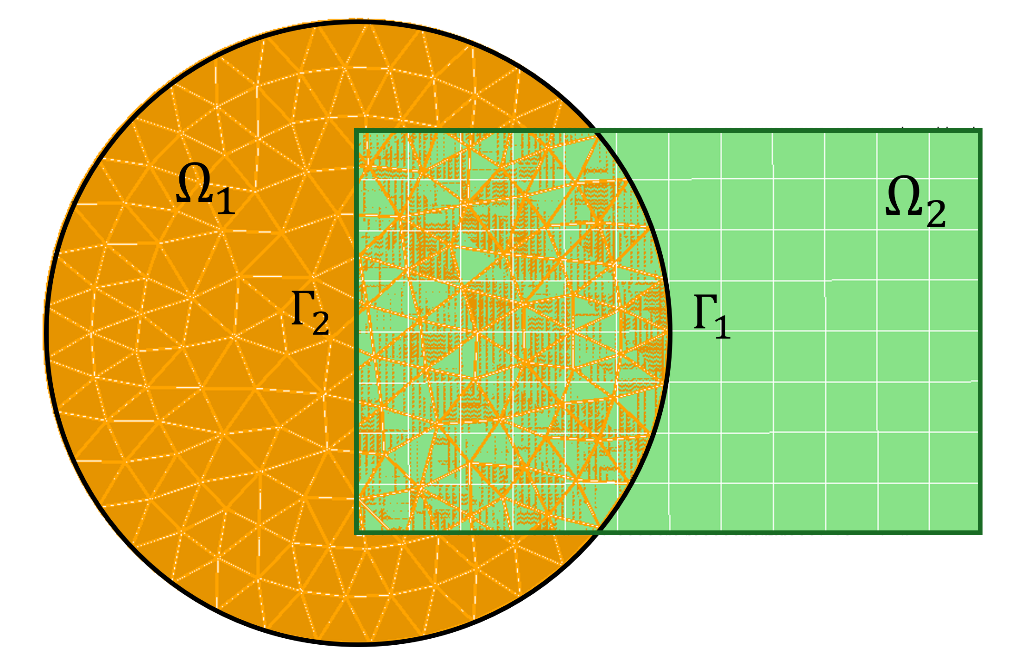
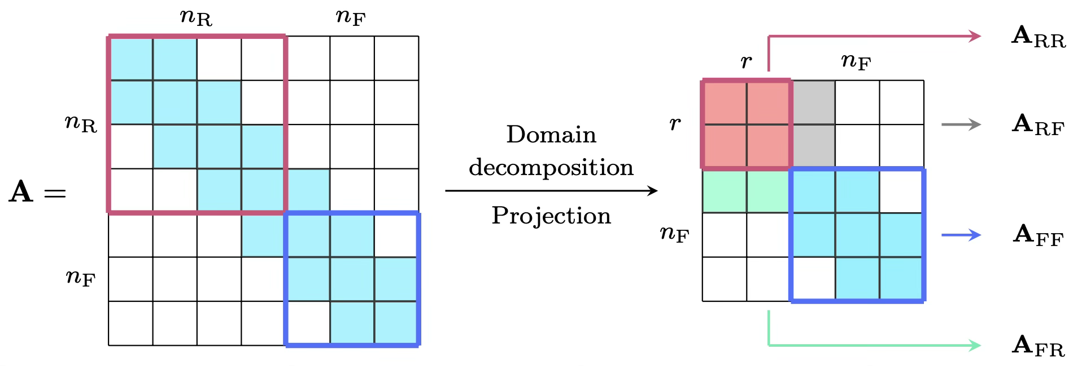
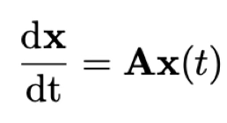
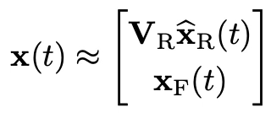
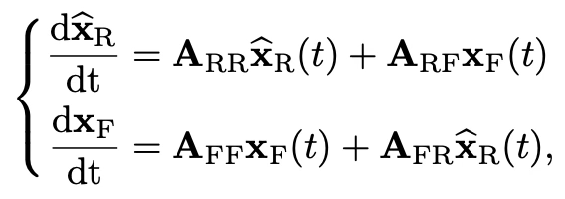
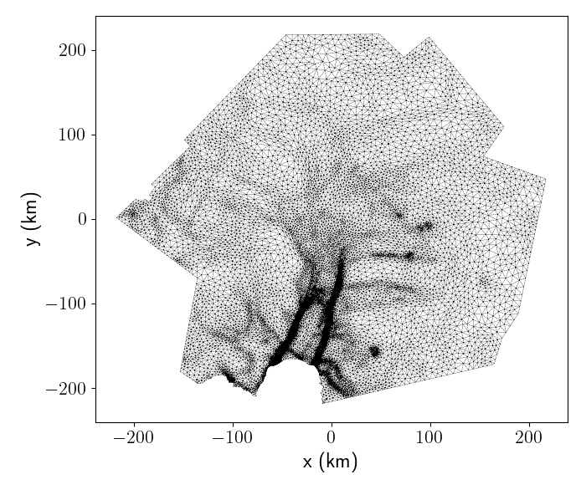
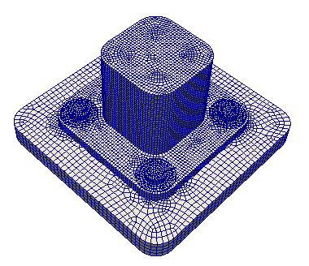
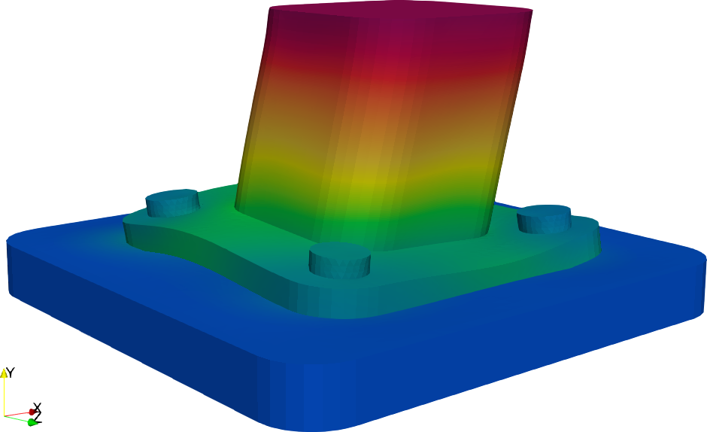
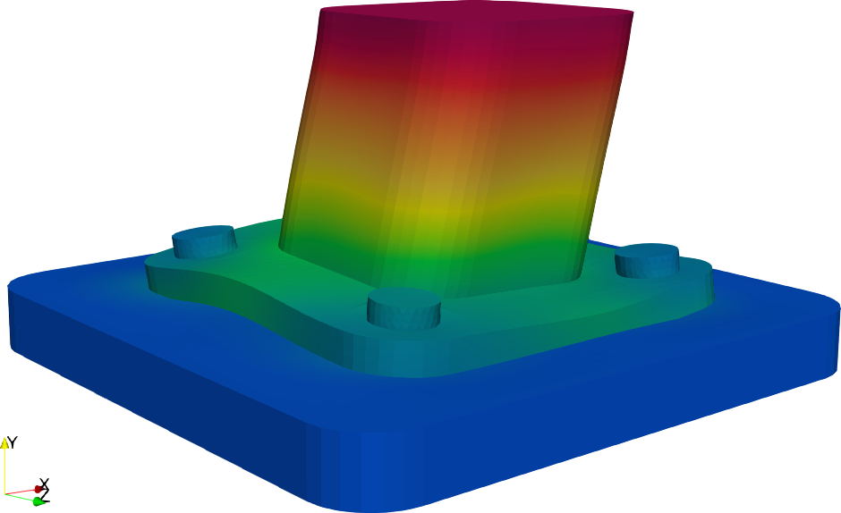

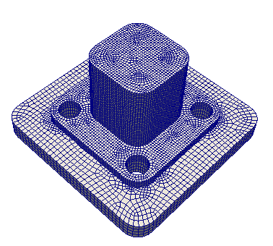
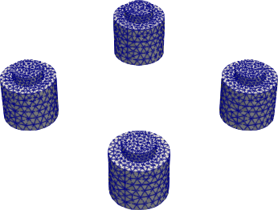
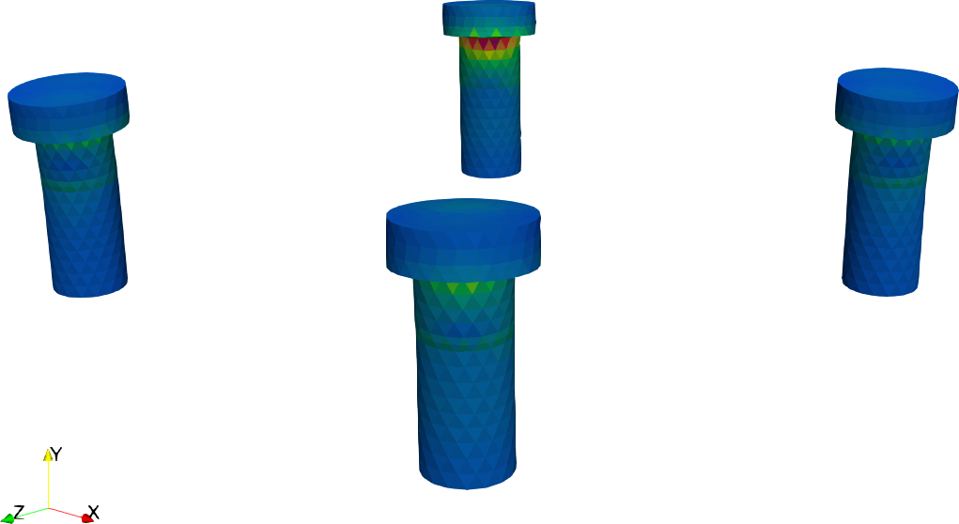
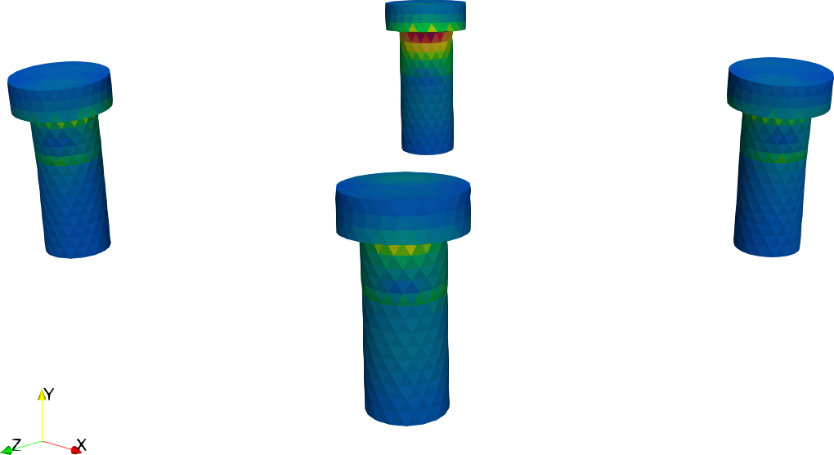
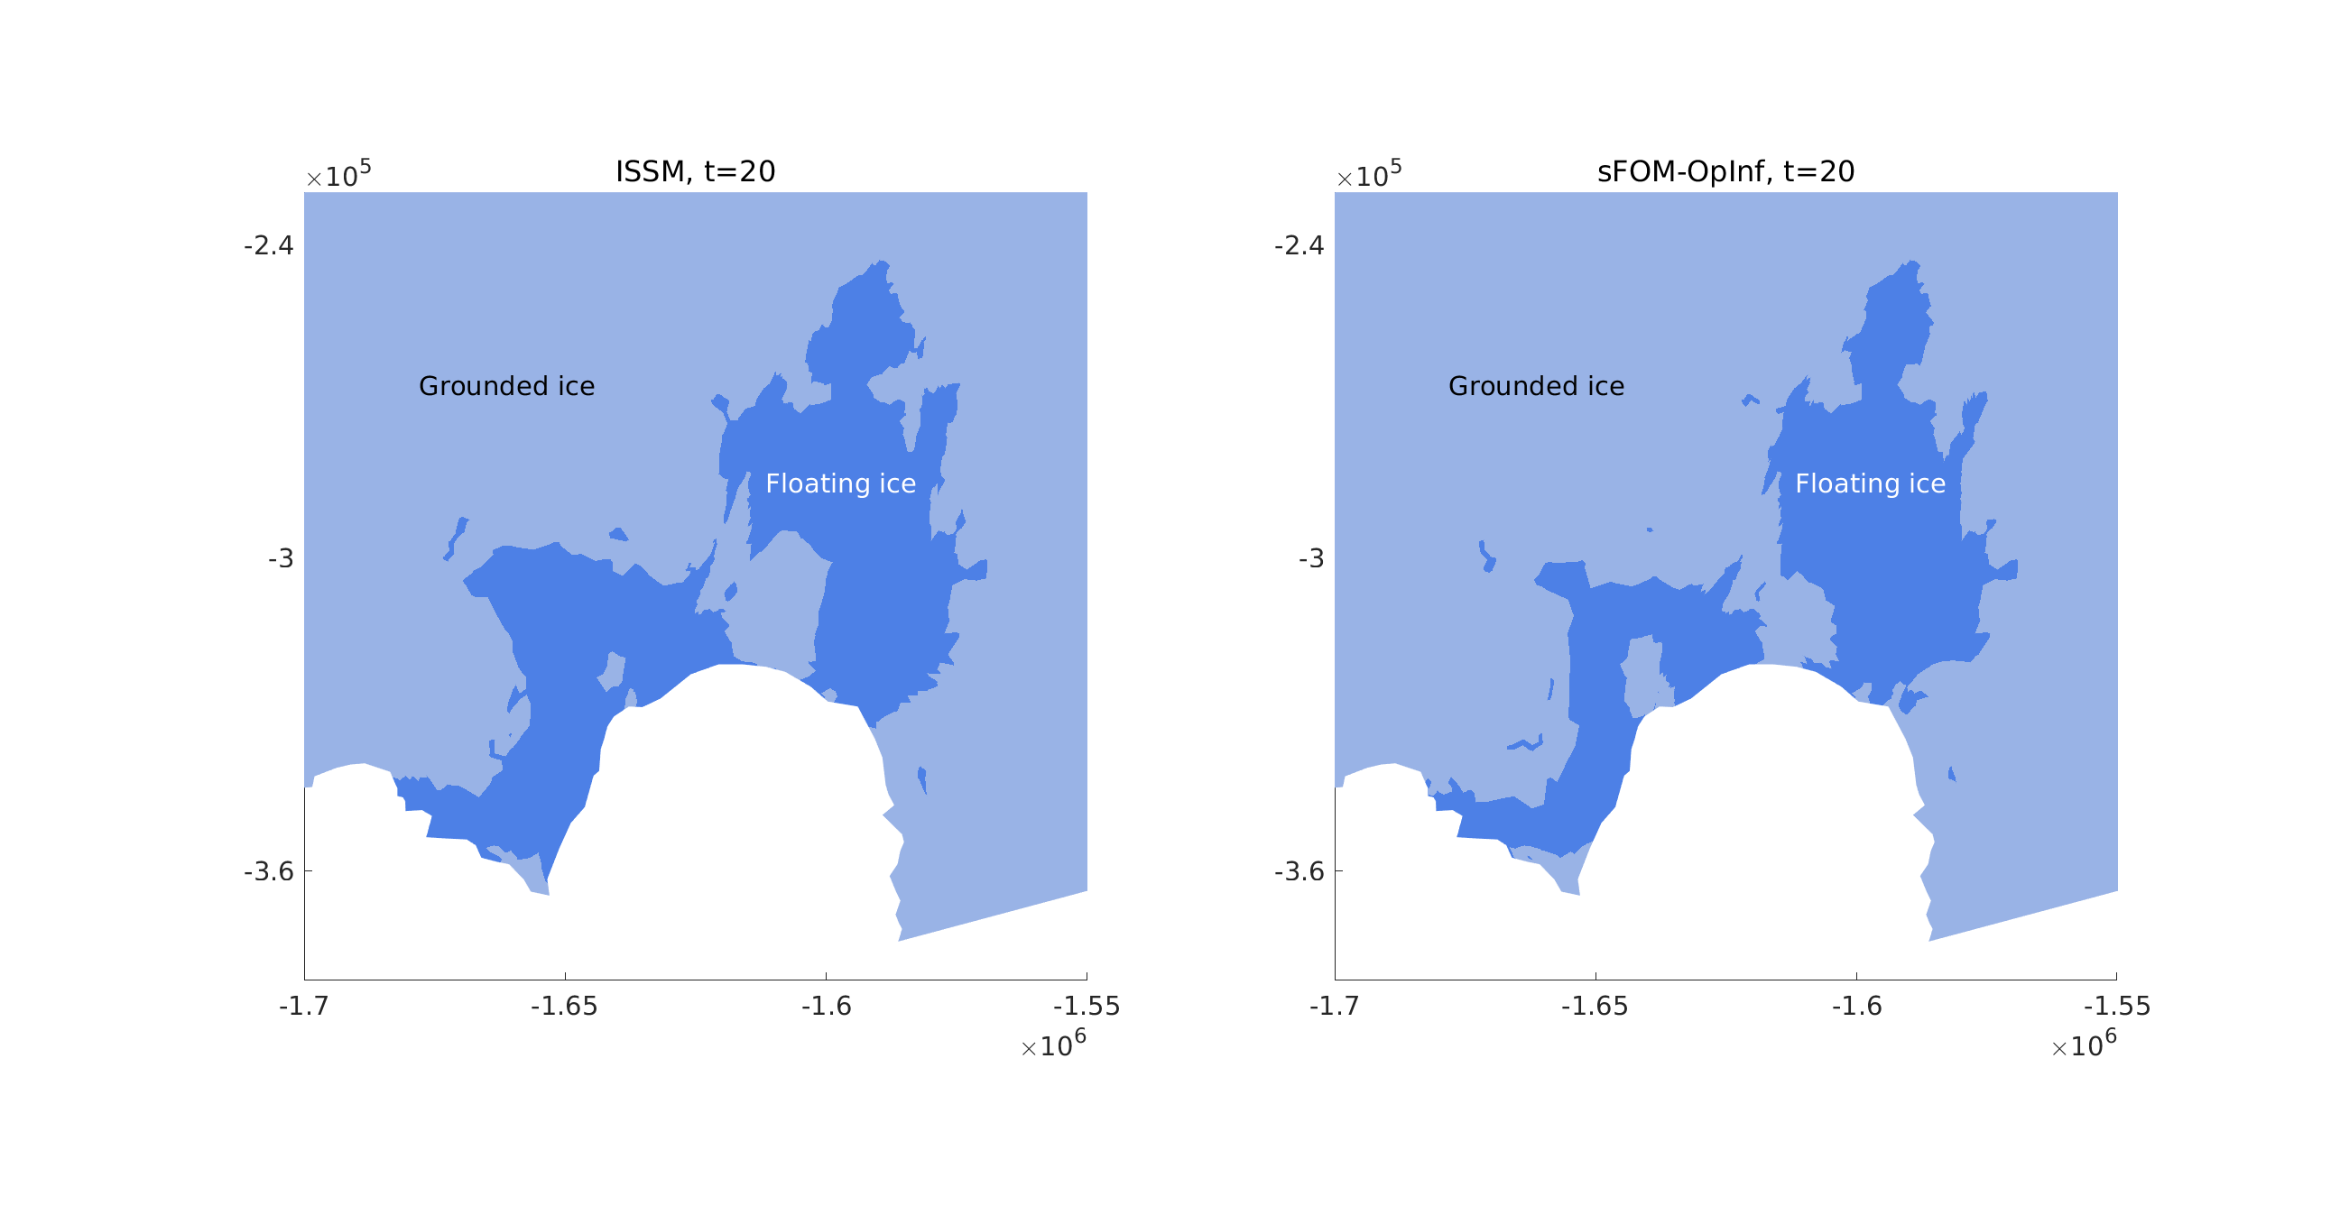
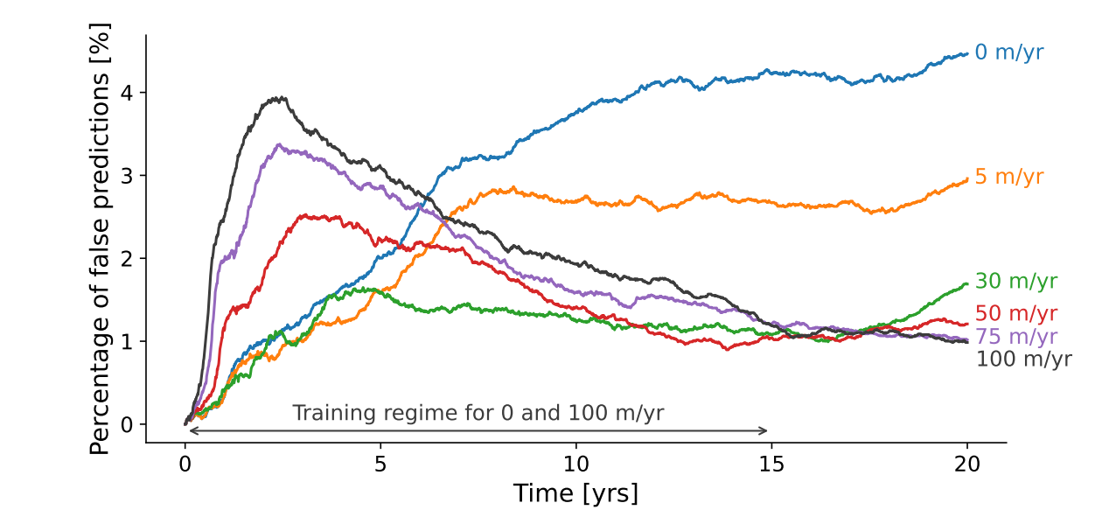


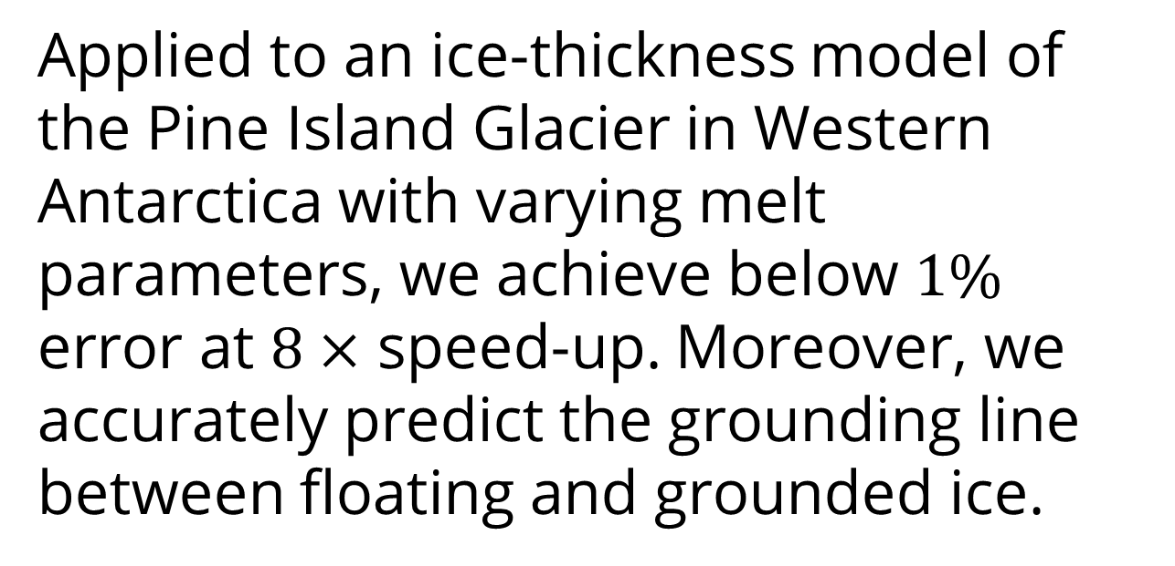

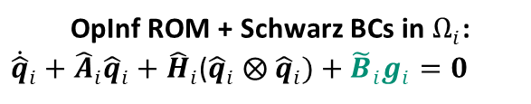

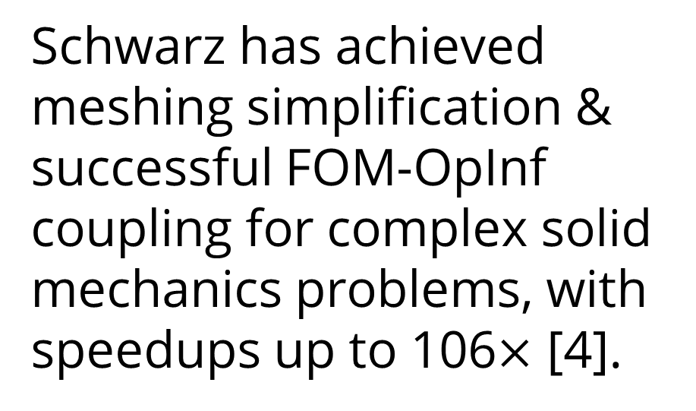
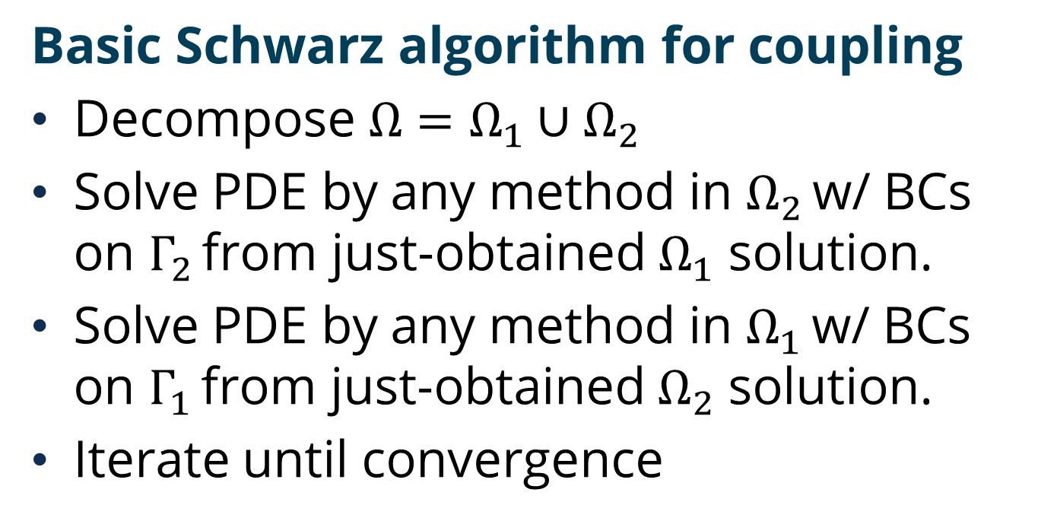
Non-intrusive coupling of reduced-order and full-order models with adaptive domain decomposition
2
Nicole Aretz, Karen Willcox, Irina Tezaur
Oden Institute for Computational Engineering and Sciences, University of Texas at Austin
Sandia National Laboratories
1
1
1
2
MOTIVATION for ROM-FOM coupling
Reduced-order models [ROMs] achieve significant computational speed-up through projection onto low-dimensional reduced spaces but are only as expressive as their reduced spaces. Meanwhile, full-order models [FOMs] are highly expressive but computationally slow.
Objective: Attain computational efficiency at the target accuracy through adaptive, local ROM-FOM coupling.
NON-INTRUSIVE COUPLING OF OPINF AND sFOM MODELS
Operator Inference [OpInf, 1] learns a ROM on a chosen low-dimensional subspace by leveraging the structure of the
governing equations.
Sparse FOM inference [sFOM, 2] imposes a sparsity pattern to learn full-order dynamics.
In [3] we combine both
approaches to
approximate dynamical
systems with spatially
localized features.
SCHWARZ ALTERNATING METHOD FOR OPINF COUPLING
Basic Schwarz algorithm for coupling
Decompose $Ω=Ω_{1}∪$ $Ω_{2}$
Solve PDE by any method in $Ω_{2}$ w/ BCs on $Γ_{2}$ from just-obtained $Ω_{1}$ solution.
Solve PDE by any method in $Ω_{1}$ w/ BCs on $Γ_{1}$ from just-obtained $Ω_{2}$ solution.
Iterate until convergence
OpInf ROM + Schwarz BCs in $Ω_{i}$:
${\dot{\hat{q}}}_{i}+{\hat{A}}_{i}{\hat{q}}_{i}+$ ${\hat{H}}_{i}$(${\hat{q}}_{i} ⨂{ \hat{q}}_{i})+{{\tilde{B}}_{i}g}_{i}=0$
OpInf BC implementation is motivated Dirichlet BC treatment in FEM
Learned Schwarz Dirichlet BC term
${\hat{A}}_{i},{\hat{H}}_{i}$, ${\tilde{B}}_{i}$: learned operators, ${\hat{q}}_{i}$: OpInf solution
Schwarz enables the seamless coupling of disparate models (FOM, OpInf), meshes, solvers and time-steppers.
RESEARCH GOALS
ROM-FOM coupling with adaptive subdomains:
Use ROM for computational speed-up
Use local FOM for under-resolved features
Retrain ROM on generated FOM data online to improve resolution
Adjust the FOM subdomain for comp. speed-up
Non-intrusive ROMs for modular components:
Offline: Train bubble-ROM for reference components
  Train on individual or assembled systems
Online: Assemble complex geometry via ports
Keep everything non-intrusive
Provide error guarantees if possible
Schwarz has achieved meshing simplification & successful FOM-OpInf coupling for complex solid mechanics problems, with speedups up to 106$×$ [4].
Applied to an ice-thickness model of the Pine Island Glacier in Western Antarctica with varying melt parameters, we achieve below $1\%$ error at $8×$ speed-up. Moreover, we accurately predict the grounding line between floating and grounded ice.
OpInf ROM
$$Ω_{1}$$
$$Ω_{2}$$
FOM-FOM
FOM-OpInf
sFOM
FOM
OpInf
REFERENCES
[1] Peherstorfer, Willcox (2016). Data-driven operator inference for nonintrusive projection-based model reduction.
[2] Gkimisis, Richter, Benner (2024). Adjacency-based, non-intrusive model reduction for vortex-induced vibrations.
[3] Gkimisis, Aretz, Tezzele, Richter, Benner, Willcox (2025). Non-intrusive reduced-order modeling for dynamical systems with spatially localized features.
[4] Tezaur, Parish, Gruber, Moore, Wentland, Mota (2026, submitted). Hybrid coupling with operator inference and the Schwarz alternating method.
Sandia National Laboratories is a multimission laboratory managed and operated by National Technology & Engineering Solutions of Sandia, LLC, a wholly owned subsidiary of Honeywell International Inc., for the U.S. Department of Energy’s National Nuclear Security Administration under contract DE-NA0003525.
Click to add SAND XXXX-XXXX P

