Slide 1
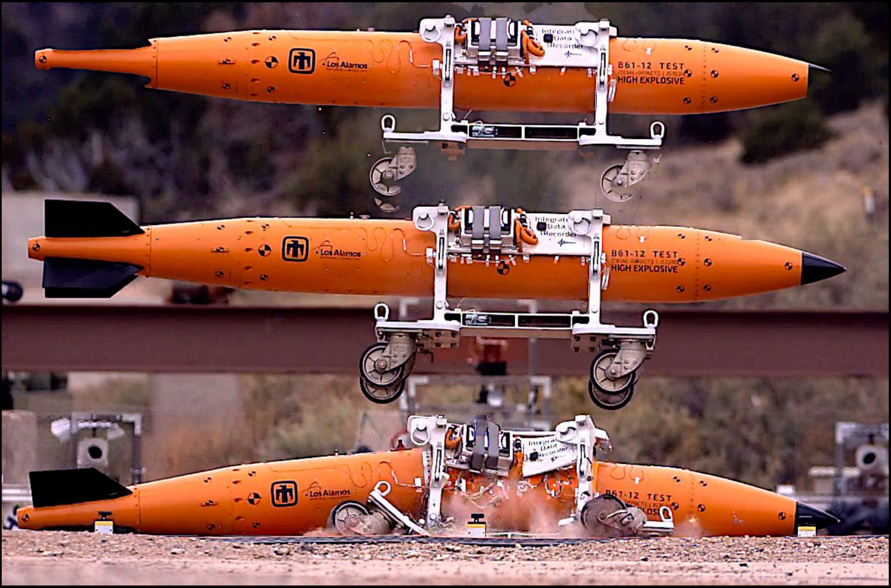
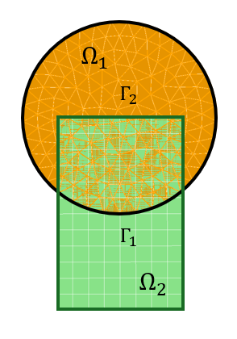

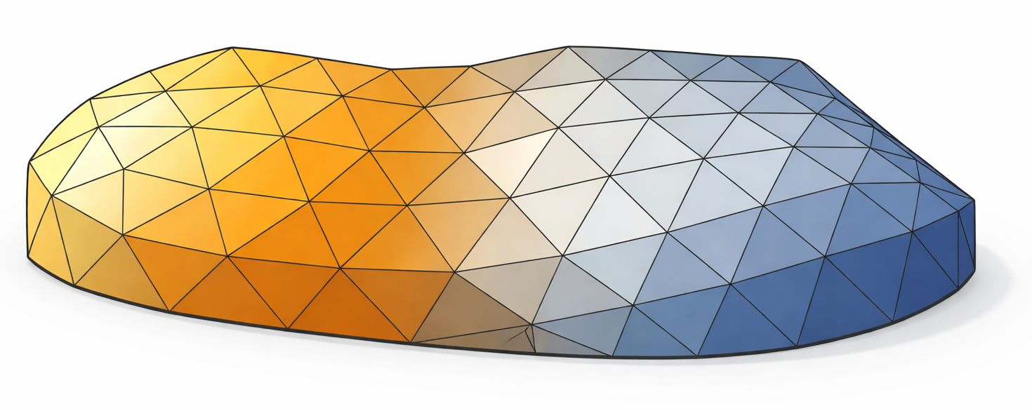
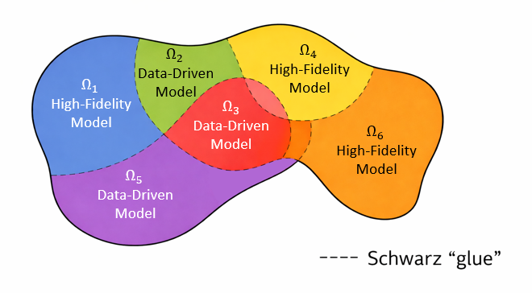
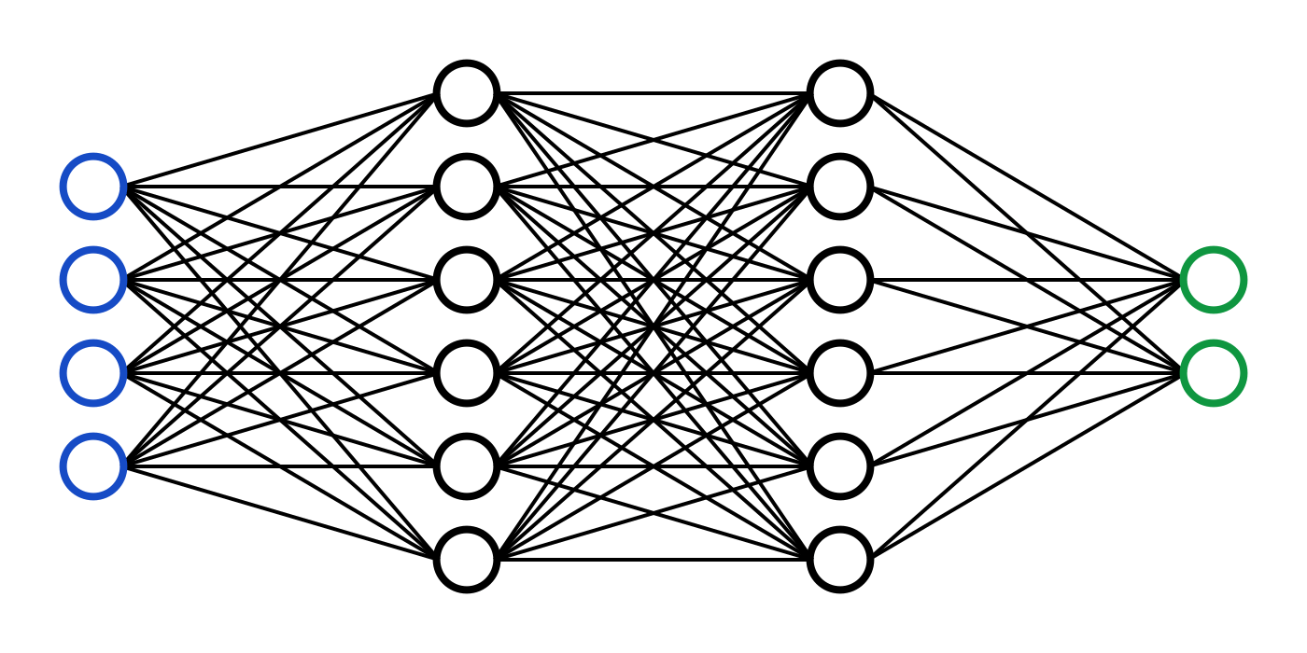
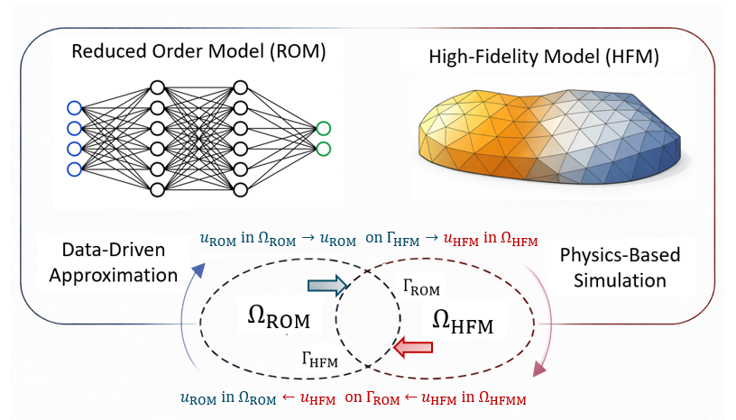
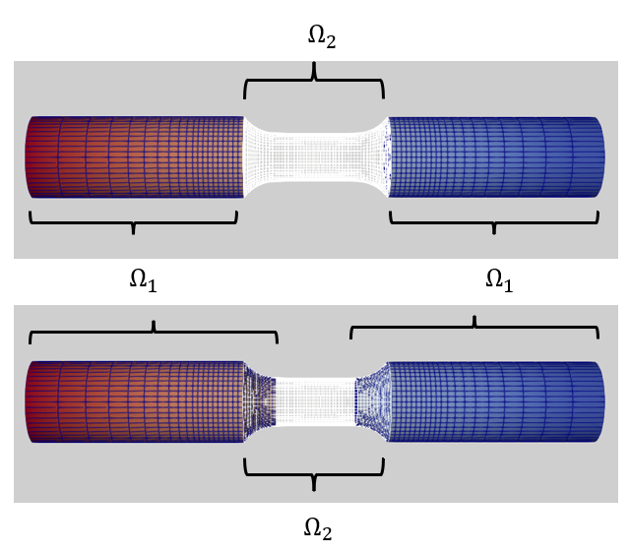
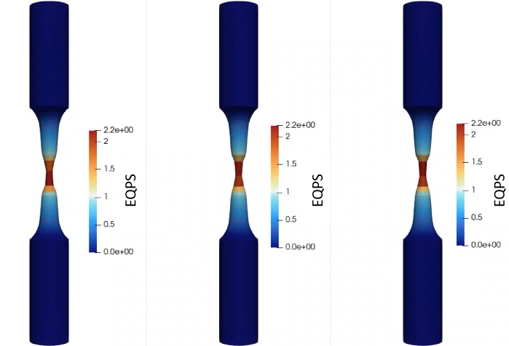
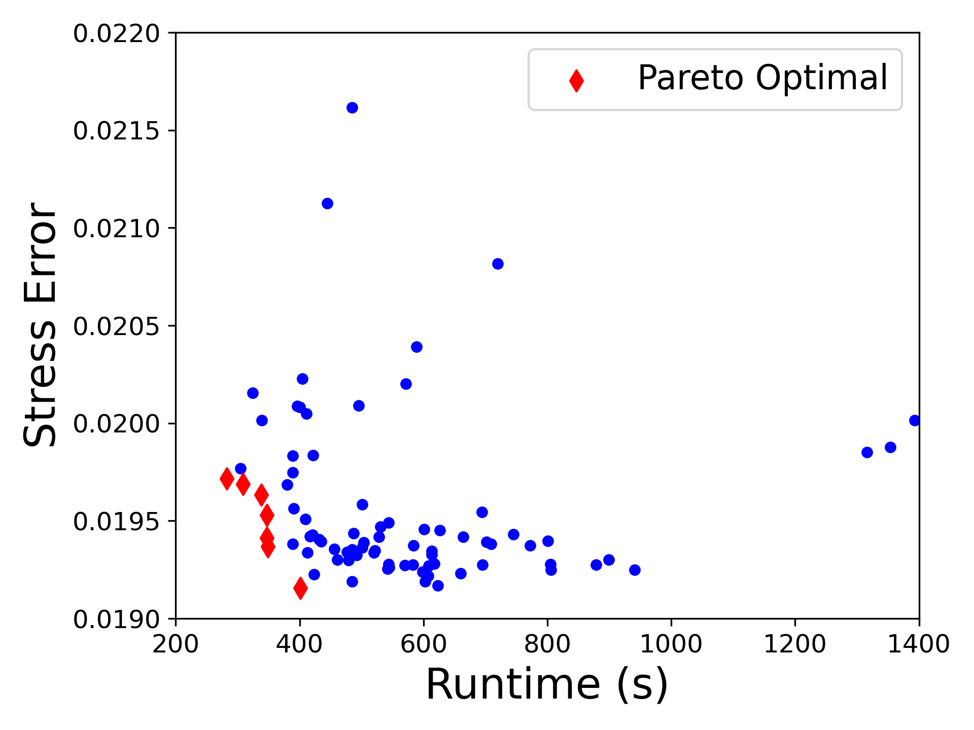

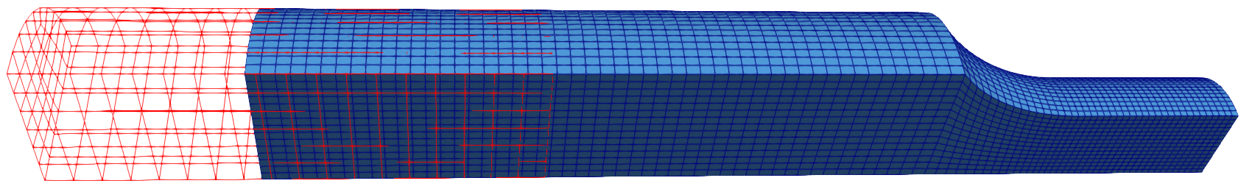


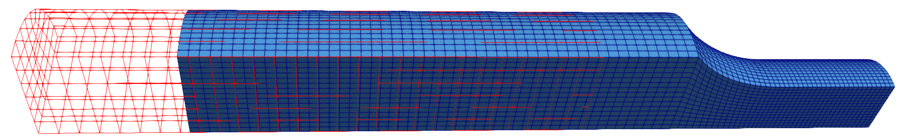
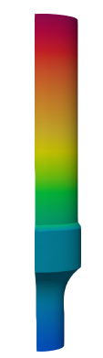
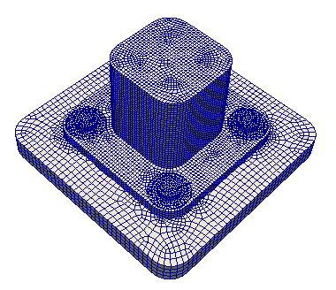
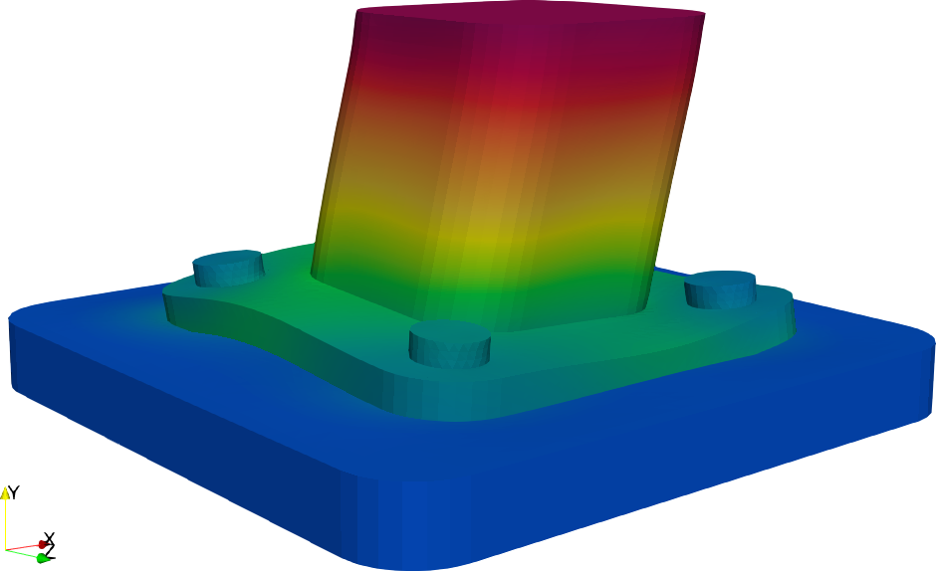
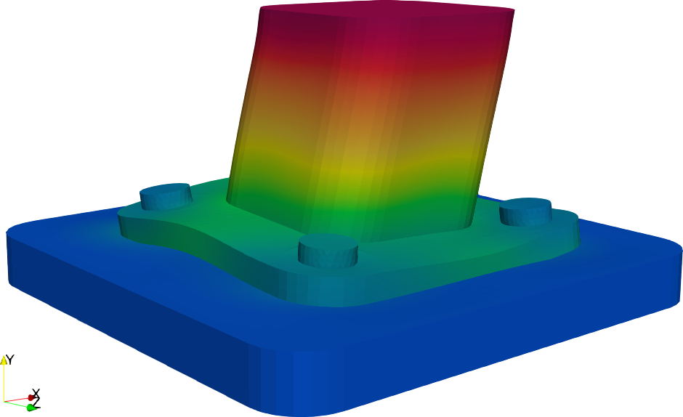
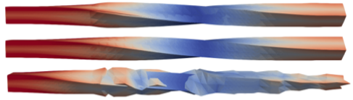
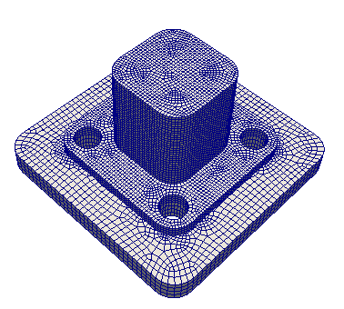
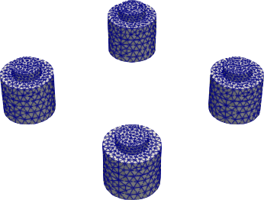
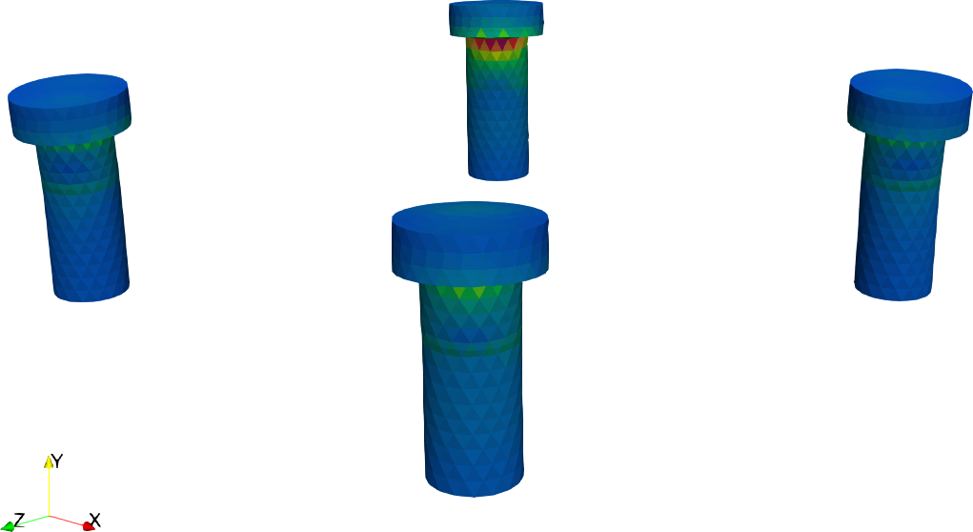
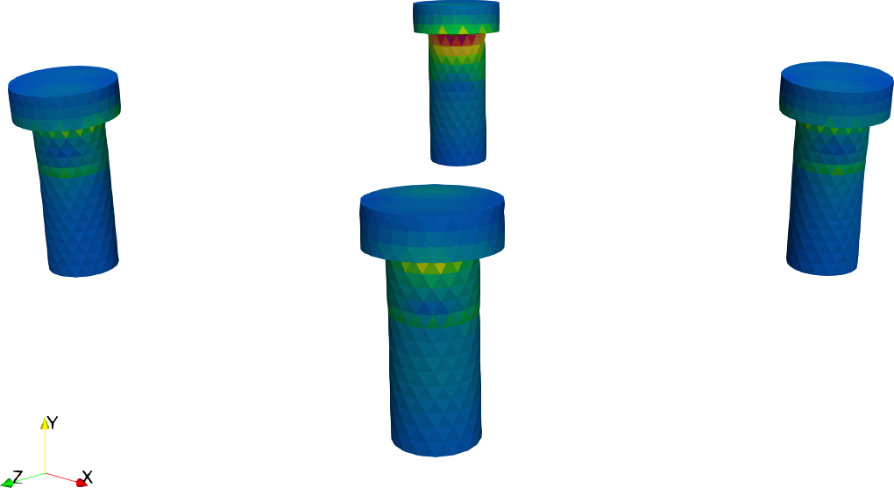
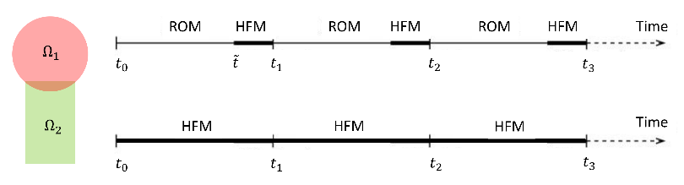
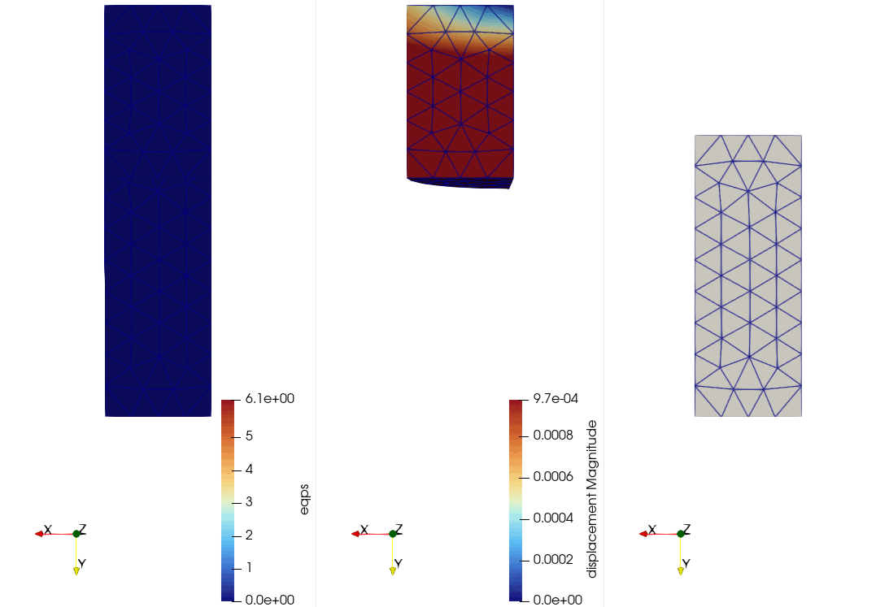
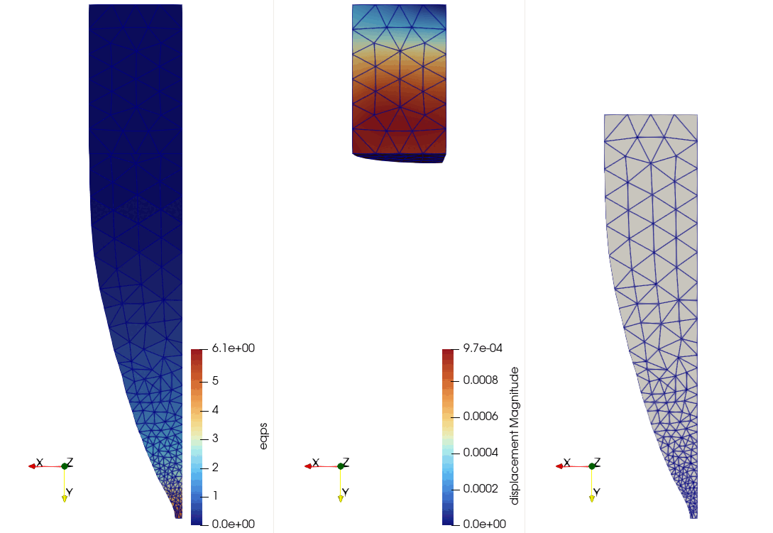
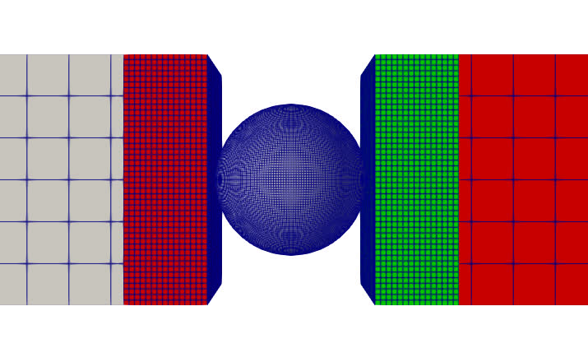
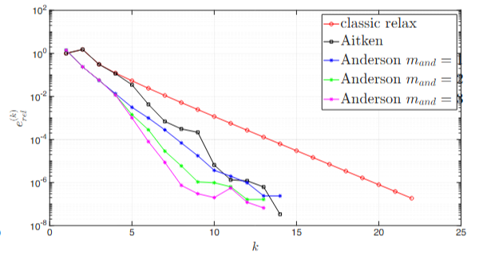
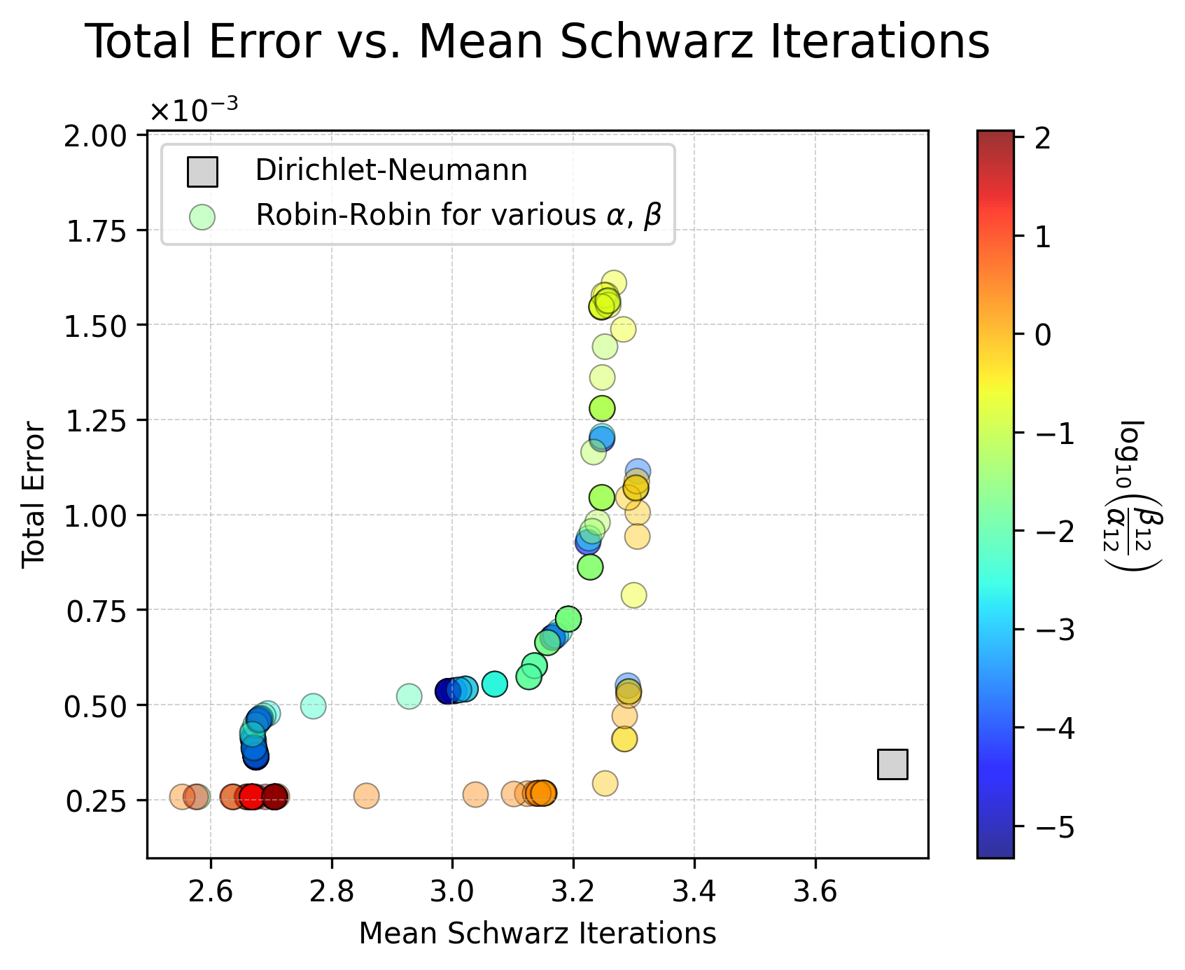
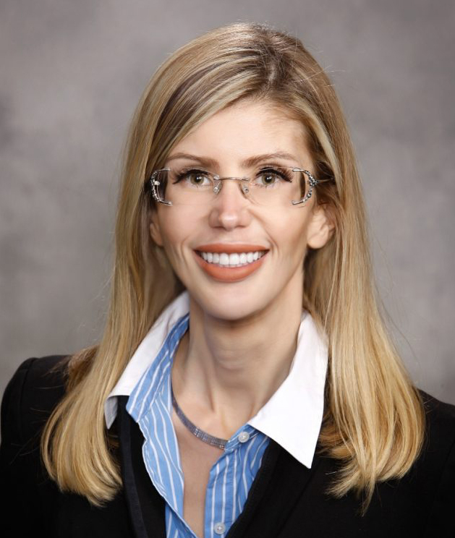


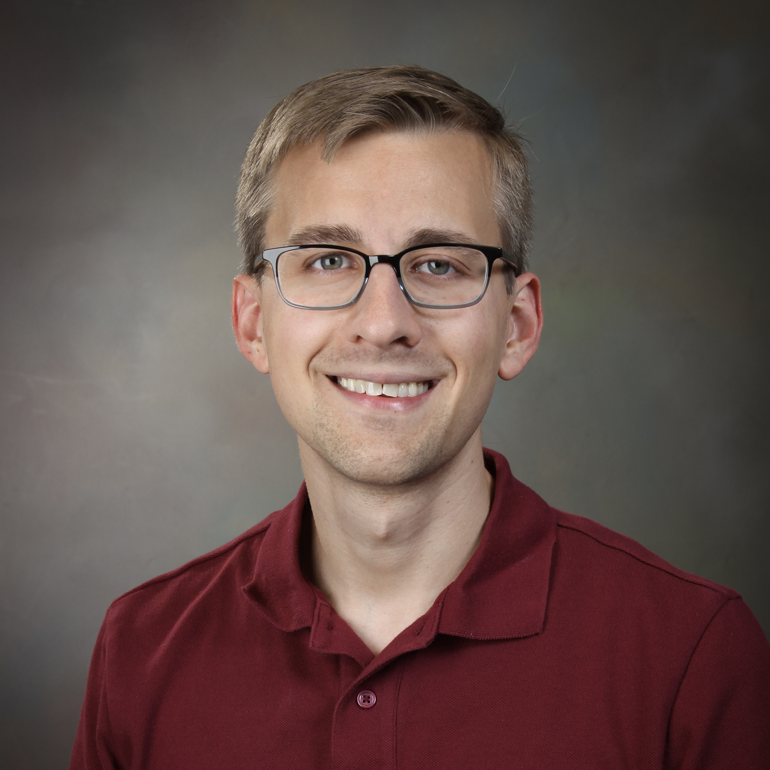
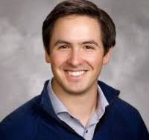

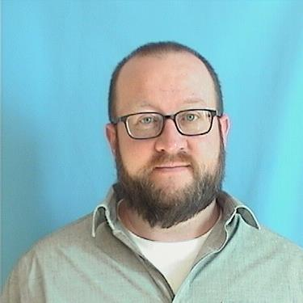

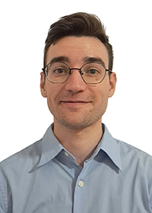
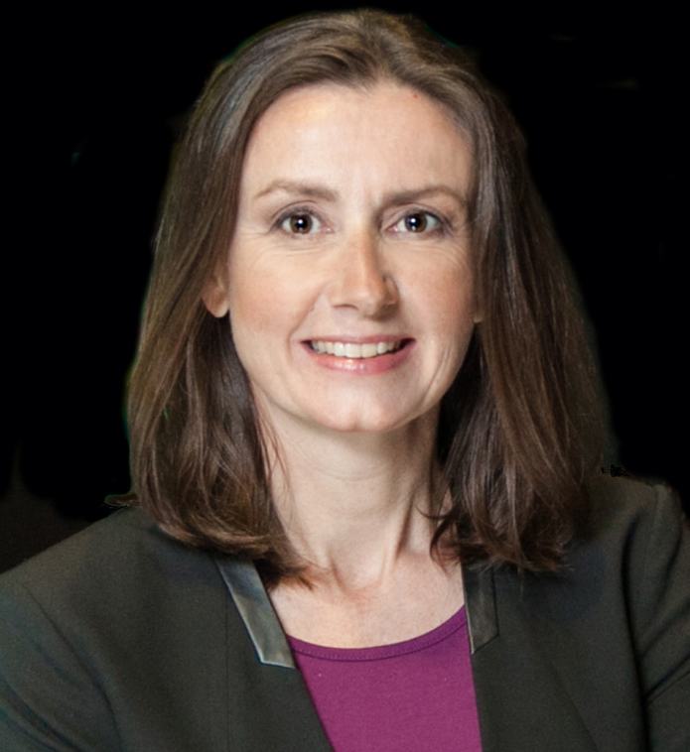

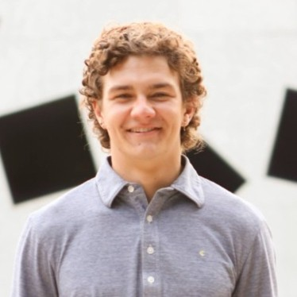




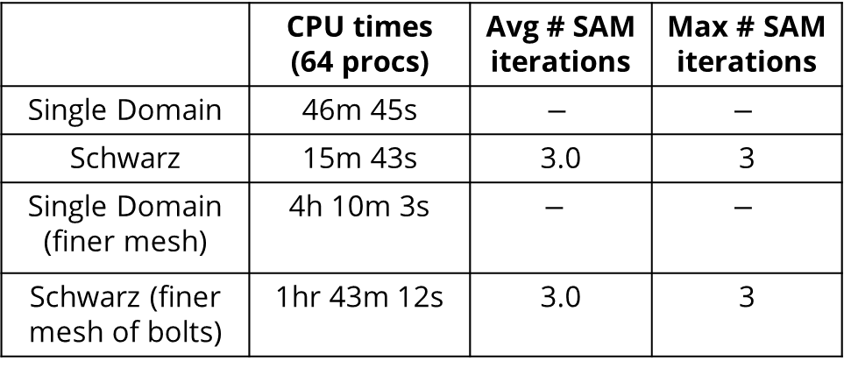

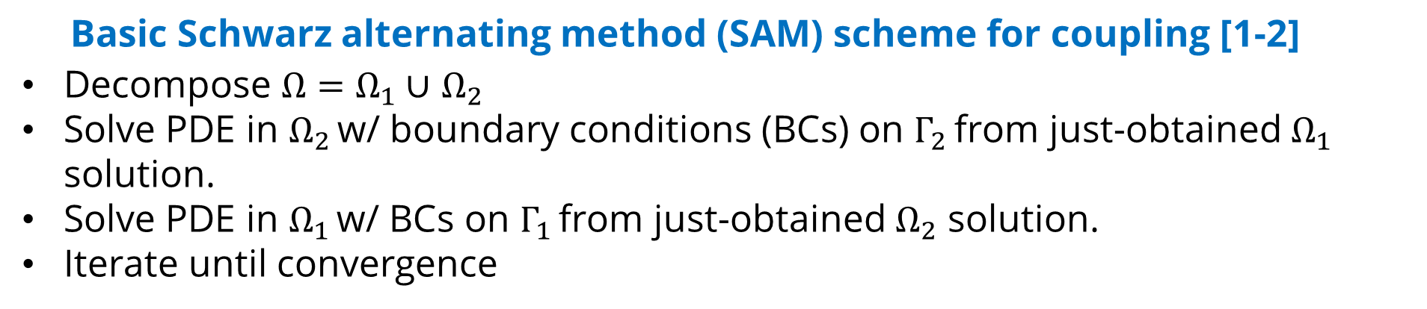
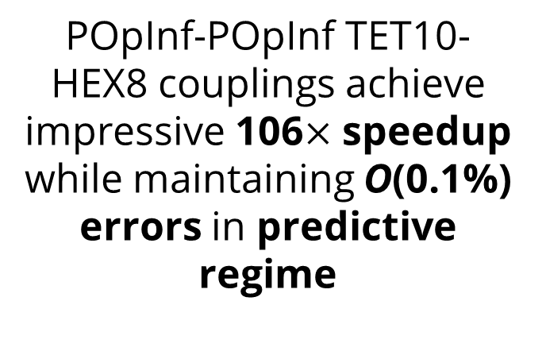
Accelerating the analyst workflow: adaptive hybrid models via domain decomposition (AHeaD)
ESRF LDRD Project, Year 2 out of 3
I. Tezaur (PI), A. mota, A. gruber, E. Parish, C. Wentland, I. Moore, T. Shelton, M. Merewether. SUPN (UT Austin): K. Willcox, N. Aretz, K. Watts.
Motivation
Technical Approach
Analyses involving high-fidelity models (HFMs) and codes can be prohibitive due to:
(i) mesh generation challenges, and
(ii) long runtime requirements
Data-driven reduced order models (ROMs) promise to mitigate challenge (ii) but:
Basic Schwarz alternating method (SAM) scheme for coupling [1-2]
Decompose $Ω=Ω_{1}∪$ $Ω_{2}$
Solve PDE in $Ω_{2}$ w/ boundary conditions (BCs) on $Γ_{2}$ from just-obtained $Ω_{1}$ solution.
Solve PDE in $Ω_{1}$ w/ BCs on $Γ_{1}$ from just-obtained $Ω_{2}$ solution.
Iterate until convergence
Suffer from lack of stability/accuracy for predictions
Cannot be easily refined to achieve a specified level of accuracy like conventional discretizations
SAM enables the seamless plug-and-play coupling of disparate meshes, solvers, time-steppers and models (ROM+HFM) [1-7].
B61-12 guided drop test. SAND 2018-13067M,
New R&D under AHEAD
Non-overlapping SAM for better flexibility [3,6-7]
SAM for the rigorous coupling of non-intrusive Operator Inference (OpInf) ROMs [5-6]
Online mesh/model switching and refinement based on rational, automated criteria
Goal of AHEAD: mitigate above challenges through hybrid (ROM + high-fidelity) models based on optimal domain decomposition (DD) and the Schwarz alternating method (SAM)
Ratcheting mechanism with multiple threaded fasteners. From Parish et al., 2024.
Reduced Order Model (ROM) Coupling
High-Fidelity Model (HFM) Coupling
SAM-based ROM-HFM Coupling Workflow
Non-intrusive OpInf ROMs
Define ROM model form in each subdomain:$\dot{\hat{q}}+\hat{F}\left(\hat{q}\right)=0$
ROM model forms:
  Polynomial (P): $\hat{F}\left(\hat{q}\right)=\hat{A}\hat{q}+\hat{H}\left(\hat{q}⨂\hat{q}\right)+\hat{G}(\hat{q}⨂\hat{q}⨂\hat{q})$ [5-6]
  Neural Network (NN): $\hat{F}(\hat{q}) =K\left(\hat{q};w\right)\hat{q}$ $→$enables structure preservation (SP) [8]
Infer operators from HFM data by solving optimization problem
Tension Specimen
Non-overlapping and overlapping SAM in SIERRA/SM can correctly predict necking in cylindrical tensile specimen geometry with errors < 0.1%.
Non-overlapping DD
Overlapping DD
Single domain Overlapping Non-overlapping
NORMA.JL
Risk: manual SAM DD tuning is often expert-driven, trial-and-error, costly and tedious.
Mitigation: multi-objective optimization of DD using GPTune
Optimal: 405 s
Bolted Joint
Tension Specimen
Torsion
grip_lower_y
All hybrid models correctly predict the location of maximum von Mises stress (failure) even in predictive regime
HFM-HFM
Couplings involving Lagrangian structure-preserving NN-OpInf ROMs can maintain stability and robustness in predicting future state
Naïve: 735 s
POpInf-PQOpInf
Bolted Joint
POpInf-POpInf
 | CPU times (64 procs) | Avg # SAM iterations | Max # SAM iterations
Single Domain | 46m 45s | $$−$$ | $$−$$
Schwarz | 15m 43s | 3.0 | 3
Single Domain (finer mesh) | 4h 10m 3s | $$−$$ | $$−$$
Schwarz (finer mesh of bolts) | 1hr 43m 12s | 3.0 | 3
Benefit: SAM significantly simplifies meshing and transforms hard multiscale problem in $Ω$ into easier monoscale problems in $Ω_{i}$
(competing method, Farcas et al., 2024 gives incorrect solution)
POpInf-POpInf TET10-HEX8 couplings achieve impressive 106$×$ speedup while maintaining O(0.1%) errors in predictive regime
$$Ω_{1}$$
$$Ω_{2}$$
HFM-HFM
POpInf-HFM
Top: HFM-HFM
Middle: HFM-NNOpInf with SP
Bottom: HFM-POpInf
Overlapping DD
Despite its iterative nature, SAM can be faster than comparable single domain run!
Strategic Alignment
Ongoing & Future Work
Improve analyst output by reducing meshing time by at least an order of magnitude
Provide credible mechanism to integrate data-driven ROMs into mod/sim workflows while maintaining desired level of accuracy and achieving speedups
Enable heterogeneous multi-scale and multi-physics simulations involving different types of models with different fidelities
Develop a rational way to determine when and where to use more refined model on-the-fly, providing analysists with smart, hands-off workflow to inform design decisions
ROM implementation in SIERRA/SM
Online ROM-HFM switching
SAM + in-core remeshing in SIERRA/SM
v
SAM acceleration strategies: Aitken and Anderson acceleration [7], inexact Schwarz, Robin-Robin non-overlapping Schwarz [6]
Team
SAM + contact in SIERRA/SM
SAM + Craig-Bampton Reduction (super-elements) in SIERRA/SM and comparison to SAM + OpInf
I. Tezaur (PI) A. Mota E. Parish A. Gruber C. Wentland M. Merewether T. Shelton I. Moore C. Rodriguez K. Willcox (PI) N. Aretz K. Watts
Sandia Team
UT Austin SUPN Team
Outcomes
References
Journal articles: 2 published, 3 submitted; Proceedings papers: 2 published
12 invited conference presentations/university seminars, including 1 invited plenary presentation at CILAMCE 2025; 5 internal presentations
4 open-source code releases
1 post doc converted to staff
Obtained funding for synergistic project under DOE+DOW Joint Munitions Program
[1] A. Mota, I. Tezaur, C. Alleman. “The Schwarz alternating method in solid mechanics”, Comput. Meth. Appl. Mech. Engng. 319 19-51, 2017.
[2] A. Mota, I. Tezaur, G. Phlipot. “The Schwarz alternating method for dynamic solid mechanics”, Int. J. Numer. Meth. Engng. 123 (21) 5036-5071, 2022.
[3] A. Mota, D. Koliesnikova, I. Tezaur, J. Hoy. “A Fundamentally New Coupled Approach to Contact Mechanics via the Dirichlet-Neumann Schwarz Alternating Method”, Int. J. Numer. Meth. Engng., 126(9) e70039, 2025.
[4] C. Wentland, F. Rizzi, J. Barnett, I. Tezaur. “The role of interface boundary conditions and sampling strategies for Schwarz-based coupling of projection-based reduced order models”, J. Comput. Appl. Math., 465 116584, 2025.
[5] I. Tezaur, E. Parish, A. Gruber, I. Moore, C. Wentland, A. Mota. “Hybrid coupling with OpInf and the SAM”, submitted to IJNME.
[6] C. Rodriguez, I. Tezaur, A. Mota, A. Gruber, E. Parish, C. Wentland. “Transmission Conditions for the Non-Overlapping Schwarz Coupling of Full Order and Operator Inference Models”, CSRI Summer Proceedings 2025, Sandia National Laboratories, Albuquerque, NM & Livermore, CA (2025).
[7] G. Sambataro, I. Tezaur. “On the role of relaxation and acceleration in the non-overlapping SAM for coupling”, submitted to JCAM.
[8] E. Parish, A. Gruber, P. Blonigan, I. Tezaur. “NN-OpInf: an OpInf approach using structure-preserving composable NNs”, submitted to JCP.
SAND2026-20484PE
UncontrolLEd unlimited release

