Slide 1
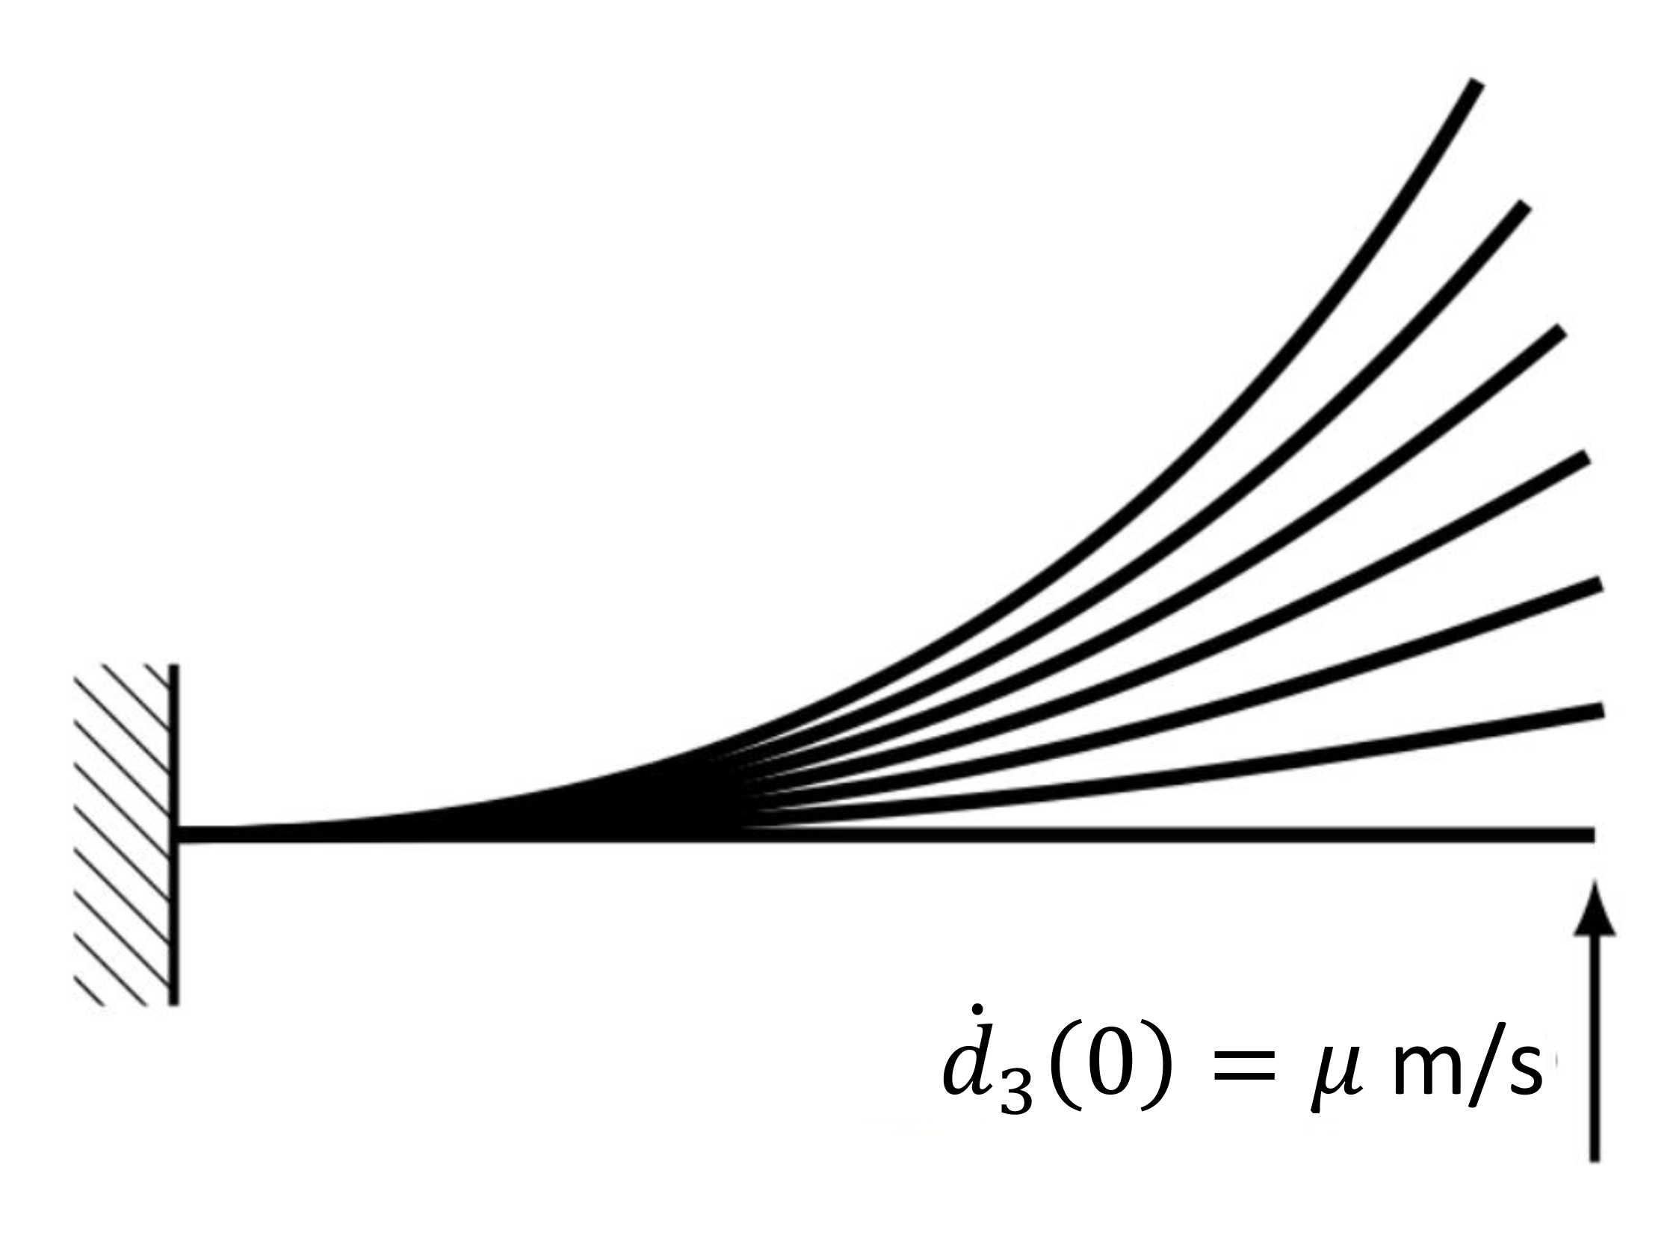
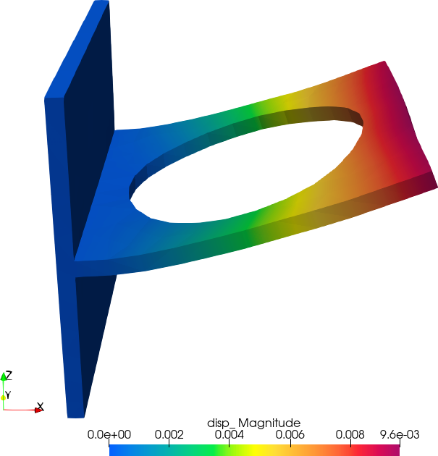
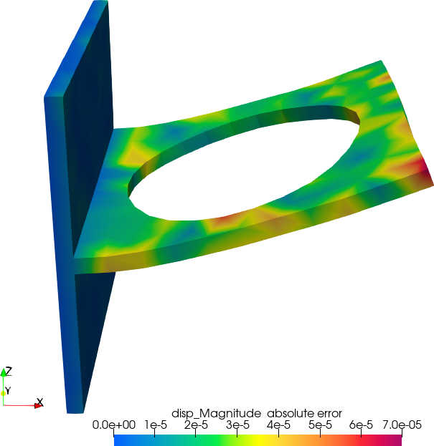
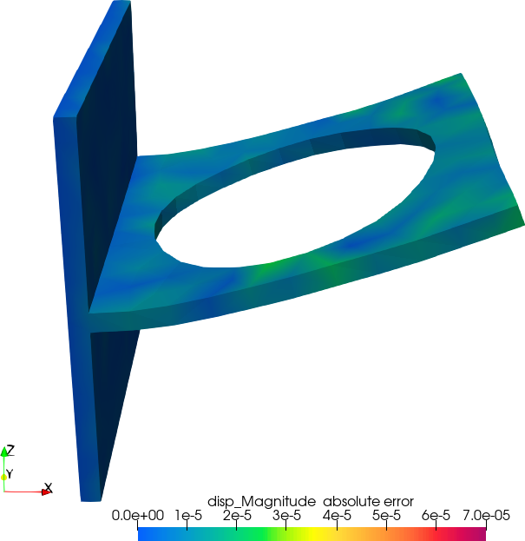
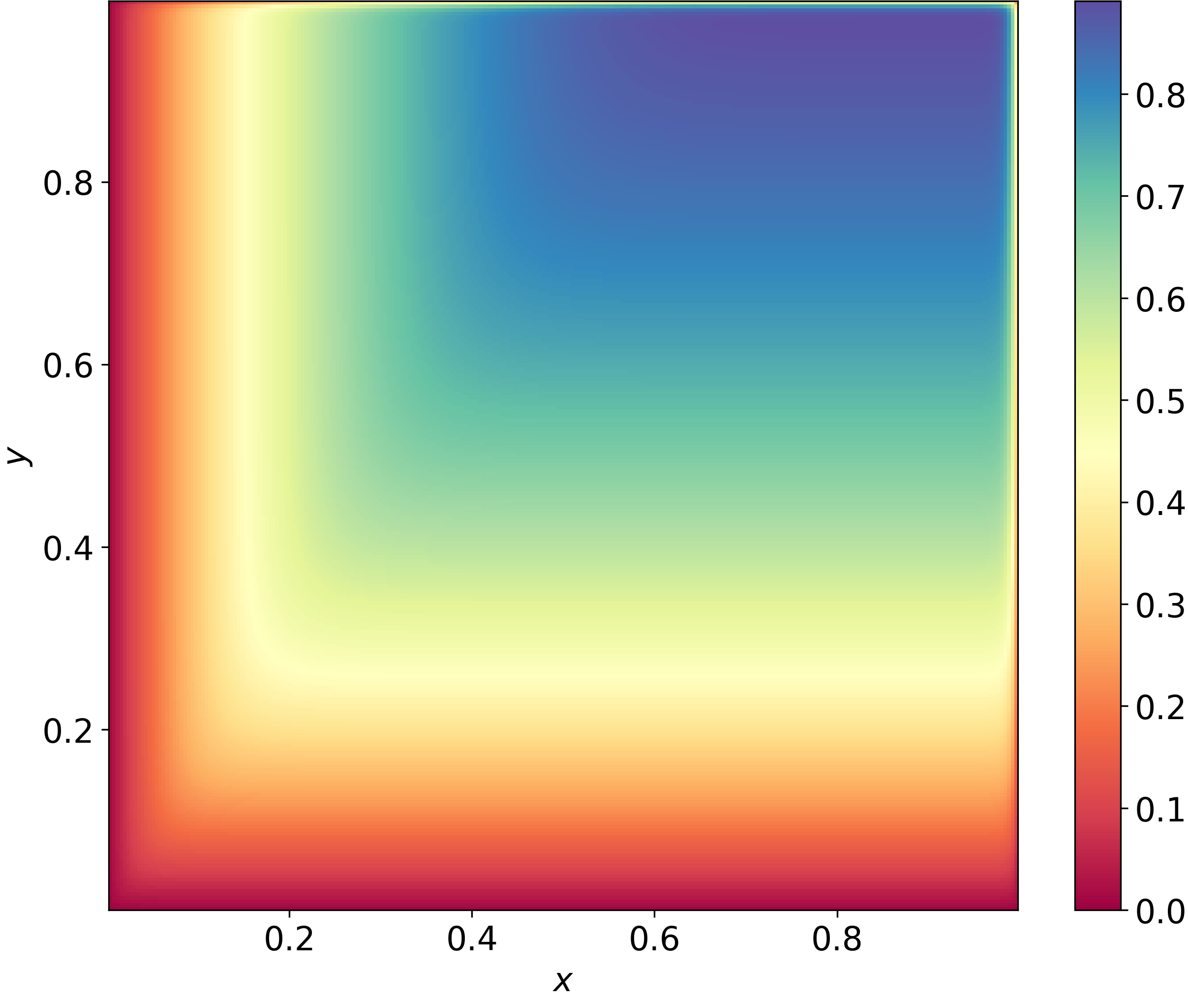
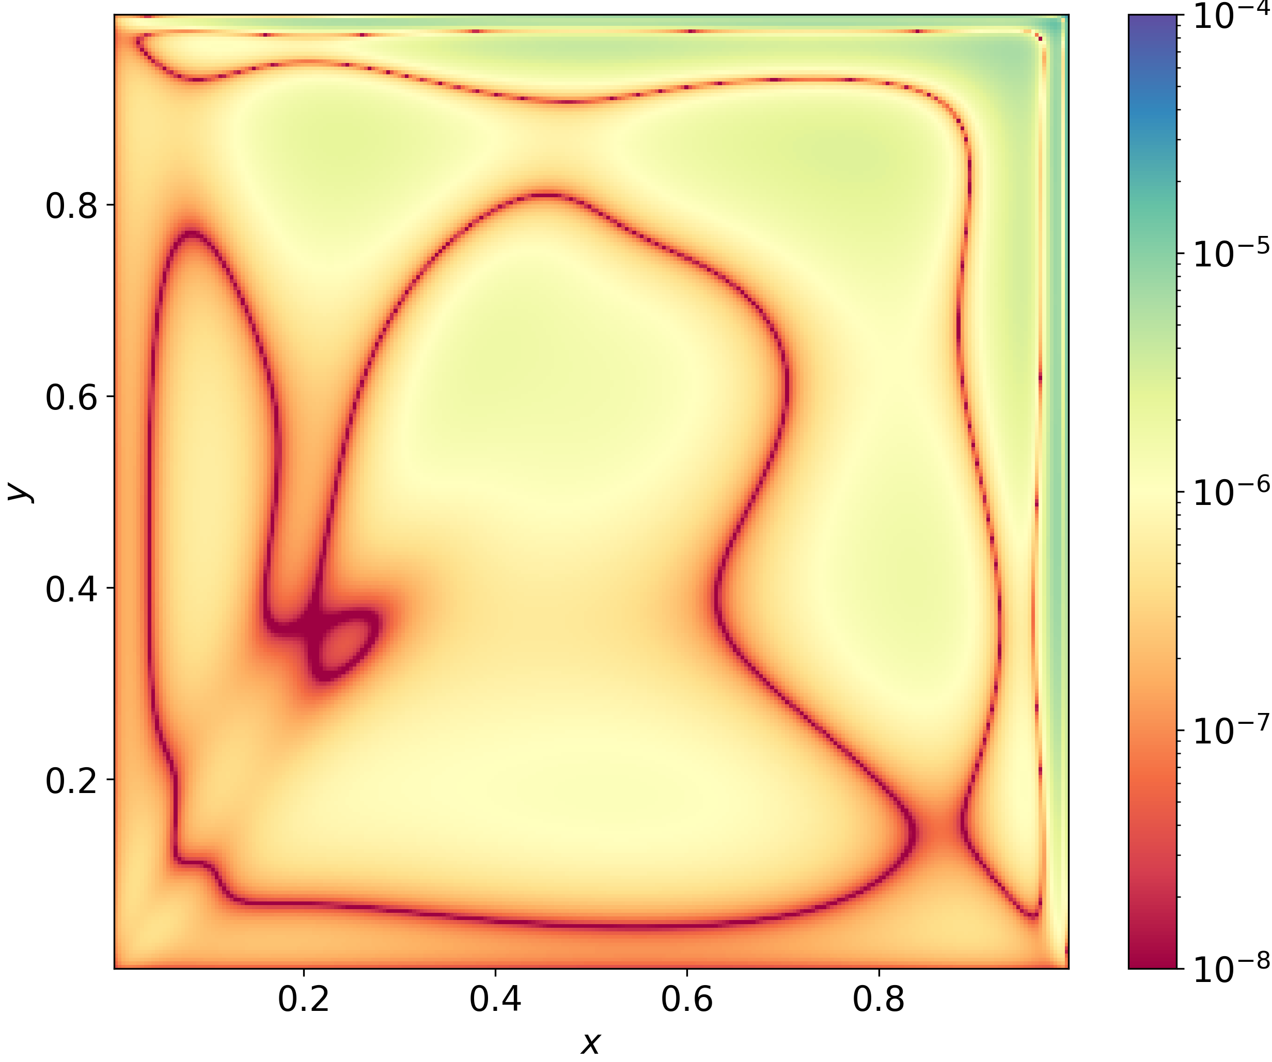
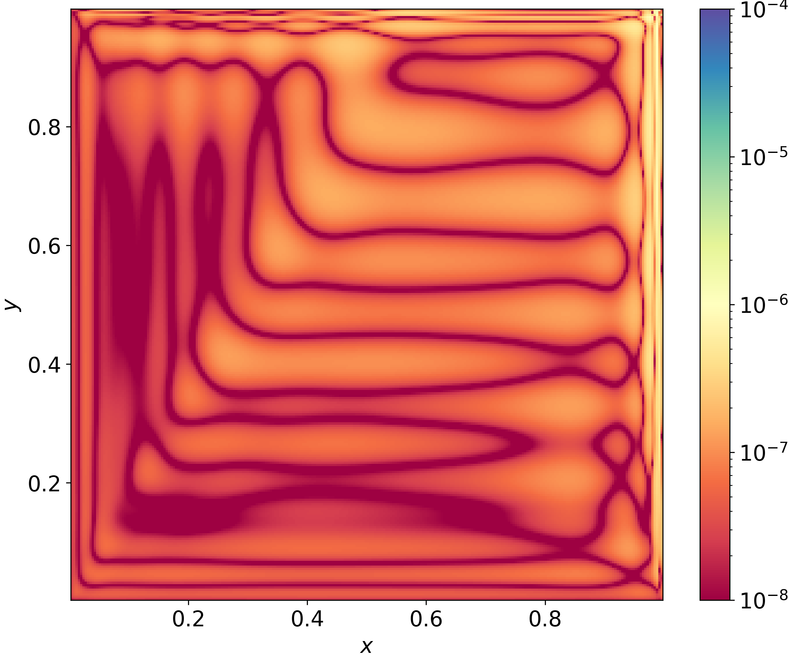
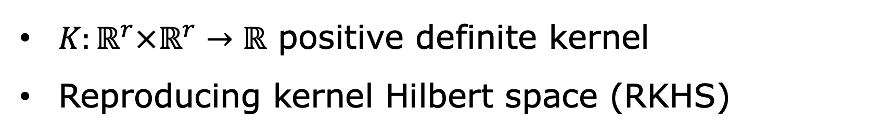

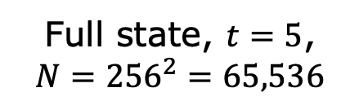
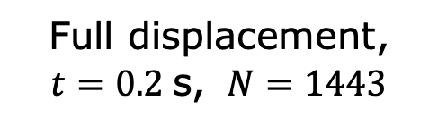
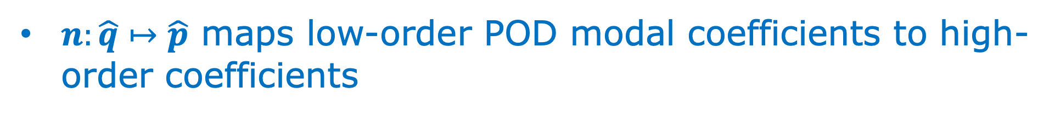
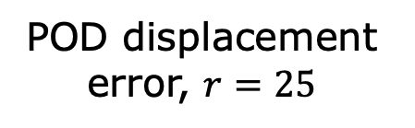
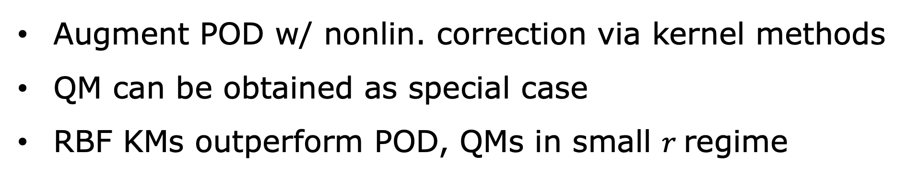
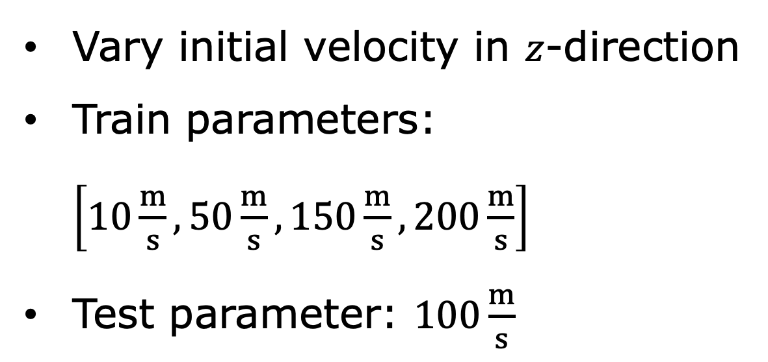

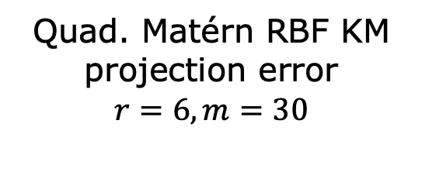
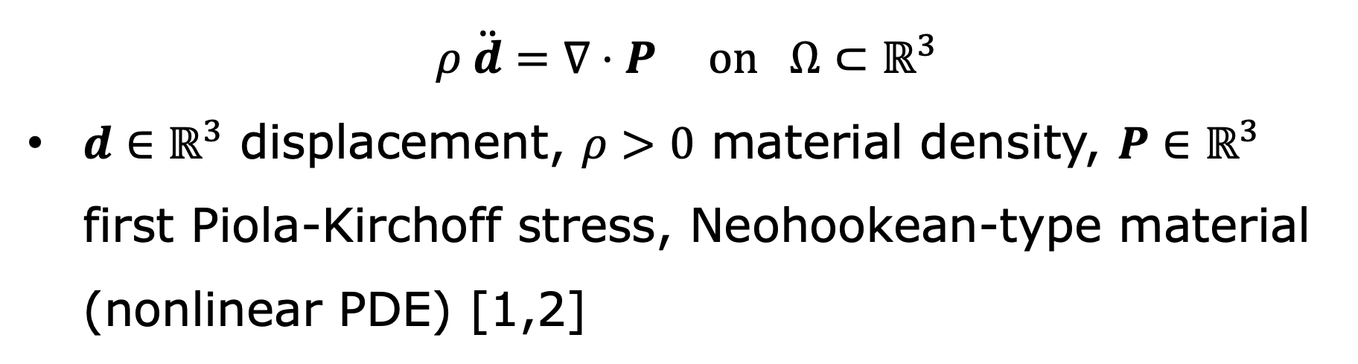
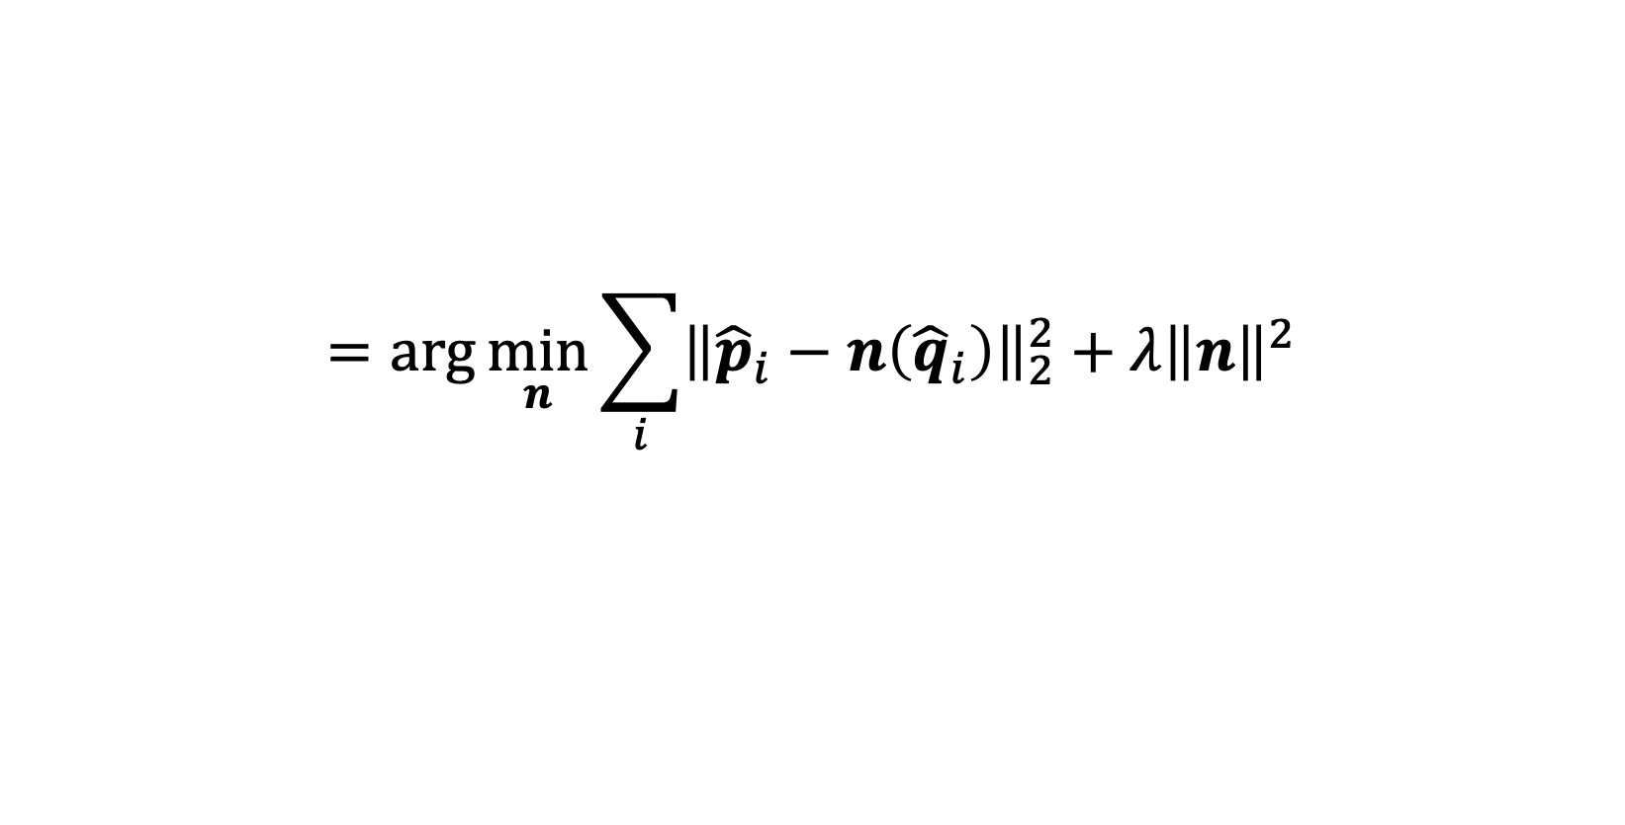
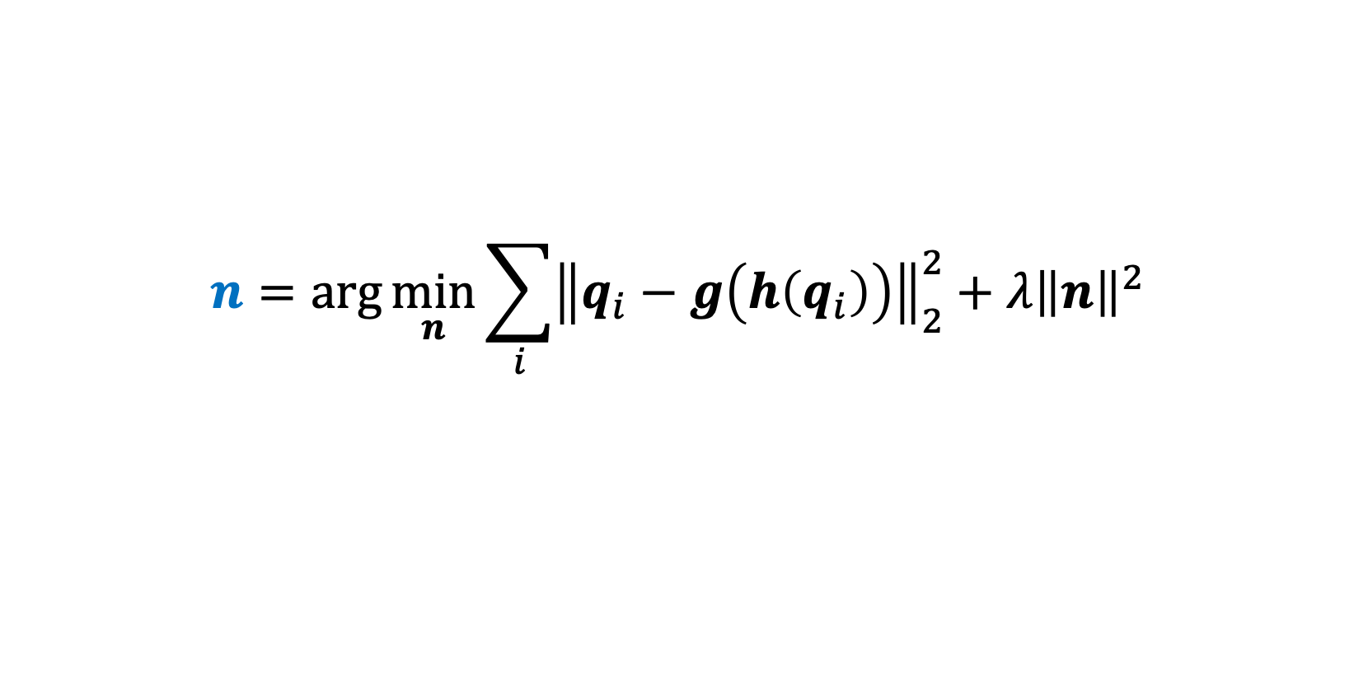
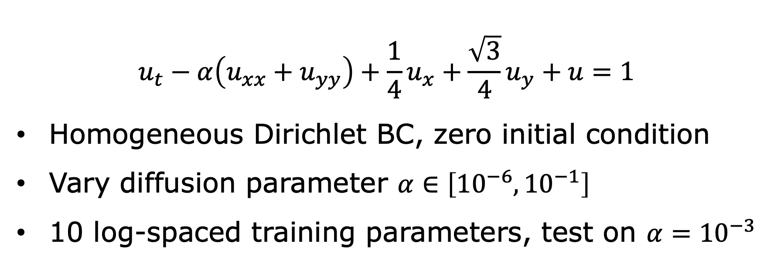
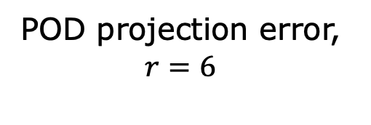
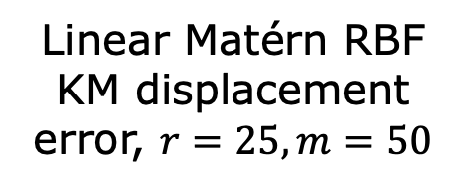
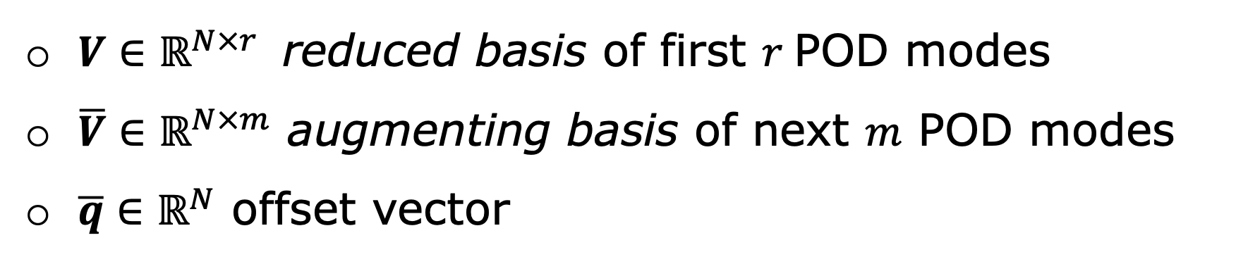
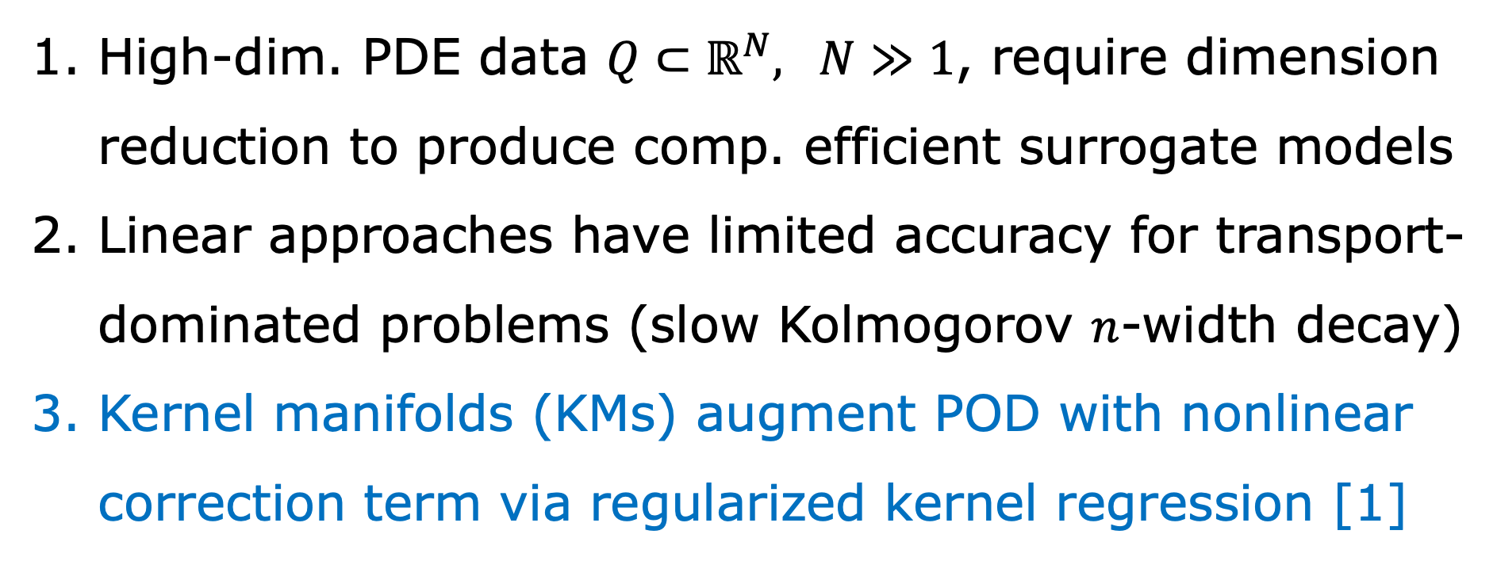
Kernel manifolds: nonlinear-augmentation dimensionality reduction using reproducing kernel Hilbert spaces
Alejandro N. Diaz¹, Jacob Needels¹, Irina K. Tezaur¹, Patrick J. Blonigan¹
Motivation
Kernel-based nonlinear augmentations
Solid mechanics – 3D flexible bracket
High-dim. PDE data $Q⊂ℝ^{N}, N≫1$, require dimension reduction to produce comp. efficient surrogate models
Linear approaches have limited accuracy for transport-dominated problems (slow Kolmogorov $n$-width decay)
Kernel manifolds (KMs) augment POD with nonlinear correction term via regularized kernel regression [1]
$K:ℝ^{r}×ℝ^{r}→ℝ$ positive definite kernel
Reproducing kernel Hilbert space (RKHS)
$$ρ \ddot{d}=∇⋅P on Ω⊂ℝ^{3}$$
$d∈ℝ^{3}$ displacement, $ρ>0$ material density, $P∈ℝ^{3}$ first Piola-Kirchoff stress, Neohookean-type material (nonlinear PDE) [1,2]
$$H_{K}=\overline{\left\{f:ℝ^{r}→ℝ \right| f\left(x\right)=Σ_{i=1}^{n}w_{i}K(x_{i}, x)\}}$$
Compute optimal $n∈H_{K}^{m}=H_{K}×…×H_{K}$ via representer theorem [3]:
Vary initial velocity in $z$-direction
Train parameters: $\left[10\frac{m}{s}, 50\frac{m}{s}, 150\frac{m}{s}, 200\frac{m}{s}\right]$
Test parameter: $100\frac{m}{s}$
Nonlinear-augmentation manifolds (general)
$$n=Ω^{T}K\left(\hat{Q}, \hat{q}\right), \left(K\left(\hat{Q},\hat{Q}\right)+λI\right)Ω={\hat{P}}^{T},$$
$$\hat{Q}=\left[{\hat{q}}_{1},…, {\hat{q}}_{M}\right]∈ℝ^{r×M}, \hat{P}=\left[{\hat{p}}_{1},…, {\hat{p}}_{M}\right]∈ℝ^{m×M}$$
Want encoder $h:Q→\hat{Q}⊂ℝ^{r}, r≪N$, decoder $g:\hat{Q}→Q$ s.t.
Options for $K$ include:
$$g\left(h\left(q\right)\right)≈q ∀ q∈Q$$
RBFs: $K\left(x, y\right)=φ(ε‖x−y‖)$ (e.g, Gaussian, Matérn)
Feature map kernels: $K\left(x, y\right)=φ{\left(x\right)}^{T}Gφ(y)$
Augment POD with nonlinear correction term
$φ\left(x\right)=x⊗x→$ quadratic manifold (QM)
$$h\left(q\right)=V^{T}\left(q−\overline{q}\right), g\left(\hat{q}\right)=\overline{q}+V \hat{q}+\overline{V}n(\hat{q})$$
2D Advection-diffusion-reaction – boundary layer
$$u_{t}−α\left(u_{xx}+u_{yy}\right)+\frac{1}{4}u_{x}+\frac{\sqrt{3}}{4}u_{y}+u=1$$
Homogeneous Dirichlet BC, zero initial condition
Vary diffusion parameter $α∈\left[{10}^{−6}, {10}^{−1}\right]$
10 log-spaced training parameters, test on $α={10}^{−3}$
$V∈ℝ^{N×r }$ reduced basis of first $r$POD modes
$\overline{V}∈ℝ^{N×m}$ augmenting basis of next $m$ POD modes
$\overline{q}∈ℝ^{N}$ offset vector
Compute $n :ℝ^{r}→ℝ^{m}$by solving regression problem
$$n=\arg{\min_{n}{\sum_{i}{{\left\|q_{i}−g\left(h\left(q_{i}\right)\right)\right\|}_{2}^{2}+λ{\left\|n\right\|}^{2}}}}$$
$$=\arg{\min_{n}{\sum_{i}{{\left\|{\hat{p}}_{i}−n\left({\hat{q}}_{i}\right)\right\|}_{2}^{2}+λ{\left\|n\right\|}^{2}}}}$$
where ${\hat{p}}_{i}= {\overline{V}}^{T}\left(q_{i}−\overline{q}\right), {\hat{q}}_{i}=V^{T} \left(q_{i}−\overline{q}\right), λ≥0$
Full displacement,
$t=0.2$s, $N=1443$
POD displacement error, $r=25$
Linear Matérn RBF KM displacement error, $r=25, m=50$
$n:\hat{q}↦\hat{p}$ maps low-order POD modal coefficients to high-order coefficients
Conclusion
References
A.N. Diaz, J. Needels, I.K. Tezaur, and P.J. Blonigan. Kernel Manifolds: nonlinear-augmentation dimensionality reduction using reproducing kernel Hilbert spaces. 2025.
A. Mota. Norma.jl.
G. Santin. Approximation with kernel methods, 2018. Lecture Notes WS 2017/18, Department of mathematics, University of Stuttgart, Germany.
Augment POD w/ nonlin. correction via kernel methods
QM can be obtained as special case
RBF KMs outperform POD, QMs in small $r$regime
Full state, $t=5$,
$$N={256}^{2}=65,536$$
POD projection error,
$$r=6$$
Quad. Matérn RBF KM projection error
$$r=6, m=30$$
¹Sandia National Laboratories, U.S.A

