Slide 1

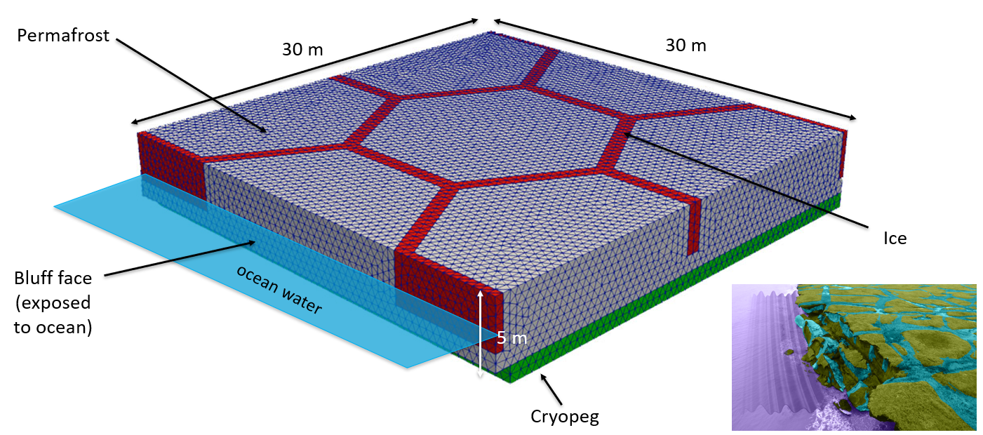
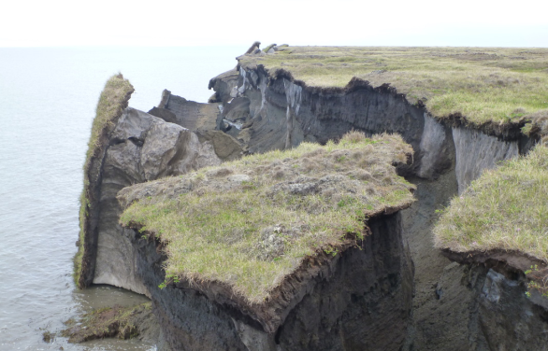
Assessing permafrost erosion and infrastructure using the Arctic Coastal Erosion (ACE) coupled thermo-mechanical model
Elyce Bayat, Jenn Frederick, Alejandro Mota, Irina Tezaur, Diana Bull
Sandia National Laboratories, USA
Villasimius, Italy
SAND2025-05255C
May 26-28, 2025

Slide 2
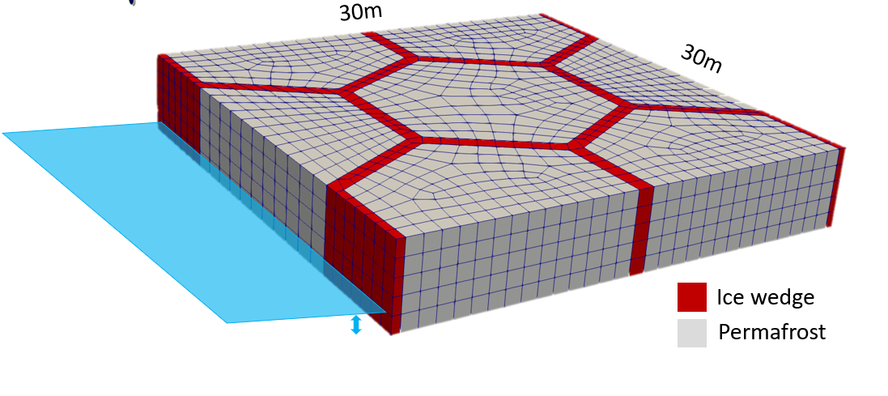
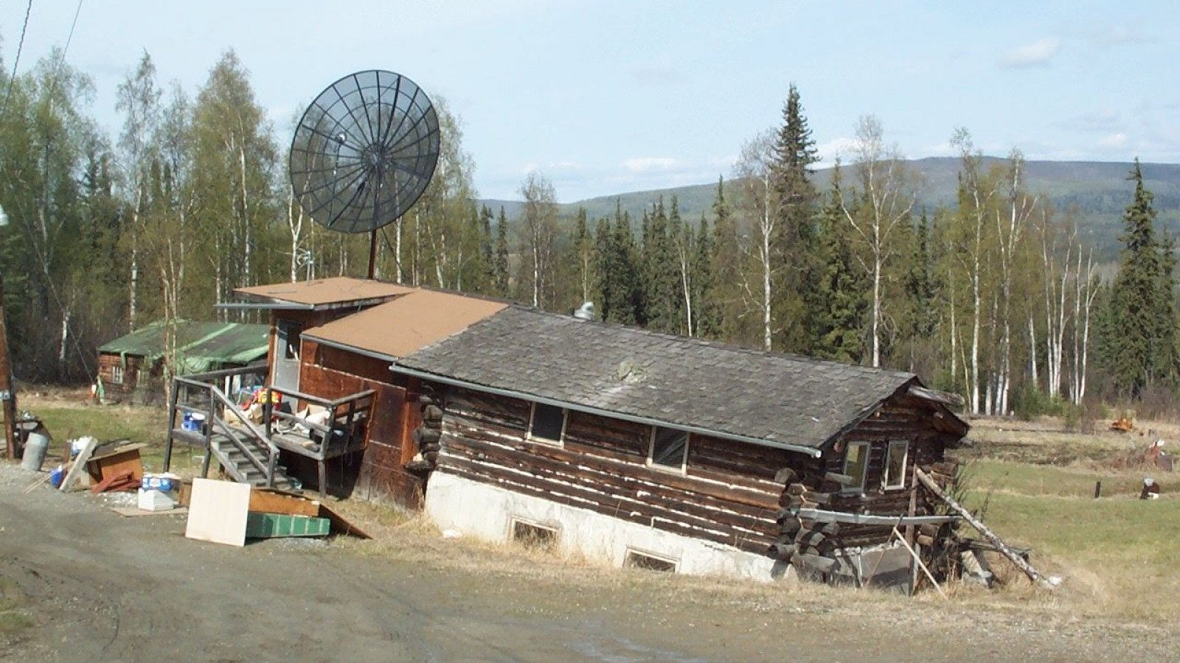
Outline
Motivation and background
The Arctic Coastal Erosion (ACE) model
  The coupled thermo-mechanical FEM terrestrial model in ACE
  Numerical results: calibration/validation of thermo-mechanical coupling for pseudo-realistic 2.5D slice problem
From Arctic Coastal Erosion to Arctic Critical Infrastructure (ACI)
  The ACI project
  Numerical results: Paulatuk peninsula airstrip
Summary
Current and future work
From newsweek.com.

Slide 3
Outline
Motivation and background
The Arctic Coastal Erosion (ACE) model
  The coupled thermo-mechanical FEM terrestrial model in ACE
  Numerical results: calibration/validation of thermo-mechanical coupling for pseudo-realistic 2.5D slice problem
From Arctic Coastal Erosion to Arctic Critical Infrastructure (ACI)
  The ACI project
  Numerical results: Paulatuk peninsula airstrip
Summary
Current and future work
From newsweek.com.

Slide 4
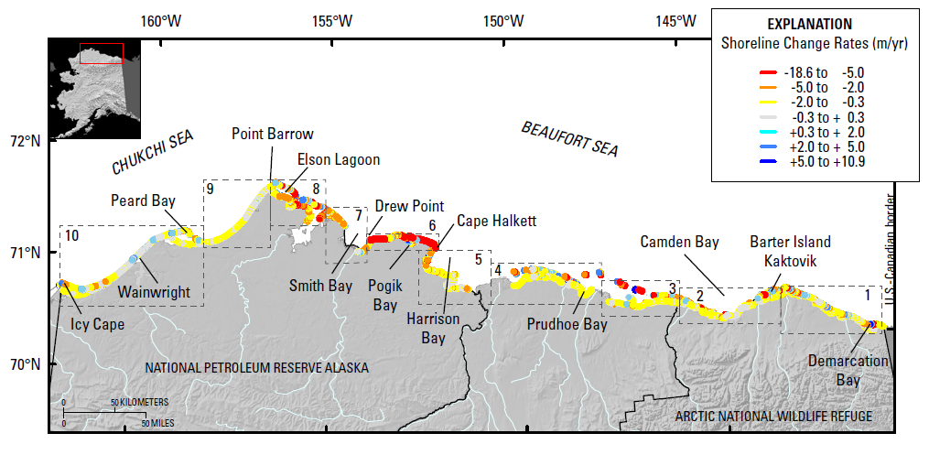
Motivation
The Arctic is warming at 4 times the rate of the global average resulting in accelerated rates of coastal erosion!
Certain locations lost >250 m (~2 football fields in length) b/w 2007-2019!
Primary culprit is loss of Arctic sea ice: since 1979 sea ice has lost 51% in area and 75% in volume
  Increasing ice-free season
  Increasing wave energy and storm surge
  Increasing sea water temperatures
Erosion is threatening:
Coastal communities: threatened with displacement
Coastal infrastructure: active DoD sites, including toxic waste sites, in northern Alaska
Global carbon balance: permafrost stores greenhouse gases (CO₂, CH₄, NO₂).
Active DOD sites
Barrow
Wainwright
Oliktok
Barter Island
Bullen Point
Gibbs & Richmond, 2015.
Notes:
The Arctic is a rapidly changing place.
We now recognize it is warming 4 times the rate as the rest of the globe!
Sea ice is diminishing, creating a longer ice-free season with greater fetch and larger waves.
As a result, the Arctic coastline is experiencing high erosion rates.

Slide 5
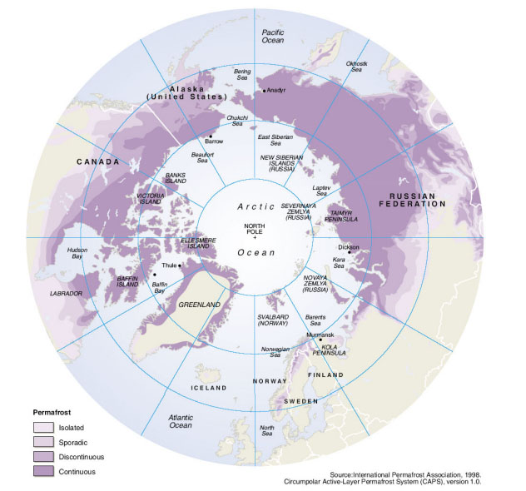
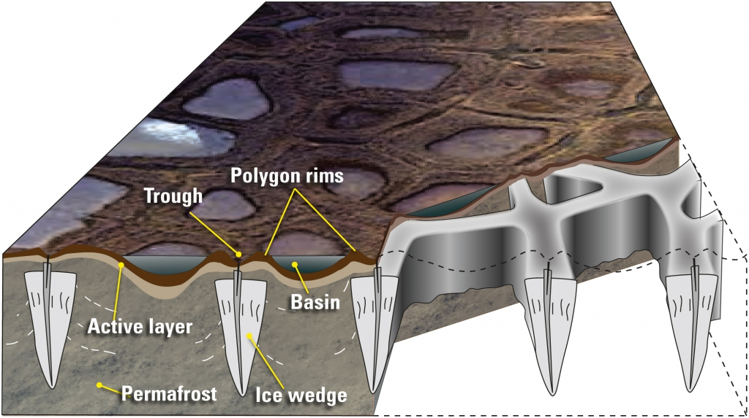
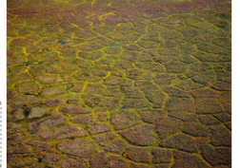
Permafrost thaw & erosion
What is permafrost?
Ground (soil, rock, silt, clay, sand) held together by ice that remains frozen for 2+ consecutive years.
24% of ice-free land area in Northern Hemisphere and 85% of Alaska, Greenland, Canada and Siberia contains permafrost.
34% of global coastline is permafrost.
Left: schematic illustrating formation of ice wedges and ice-wedge polygon landscapes. Right: map of permafrost distribution in Arctic
Polar Media Archive
Brown et al. 1998.
Unique coastal permafrost erosion process in Arctic:
Predominant geomorphology: ice-wedge polygons
  Ice acts to bind unconsolidated soils in permafrost.
  Ice wedges grow/expand up to 10s meters wide and deep.
  Permafrost thaw can cause subsidence, slumping, weakening.
Martin et al. 2009.
Notes:
Many of you here already are familiar with permafrost, so I won’t go into much detail, except to point out that much of the permafrost along the eroding coasts has polygonal geomorphology. . . .

Slide 6
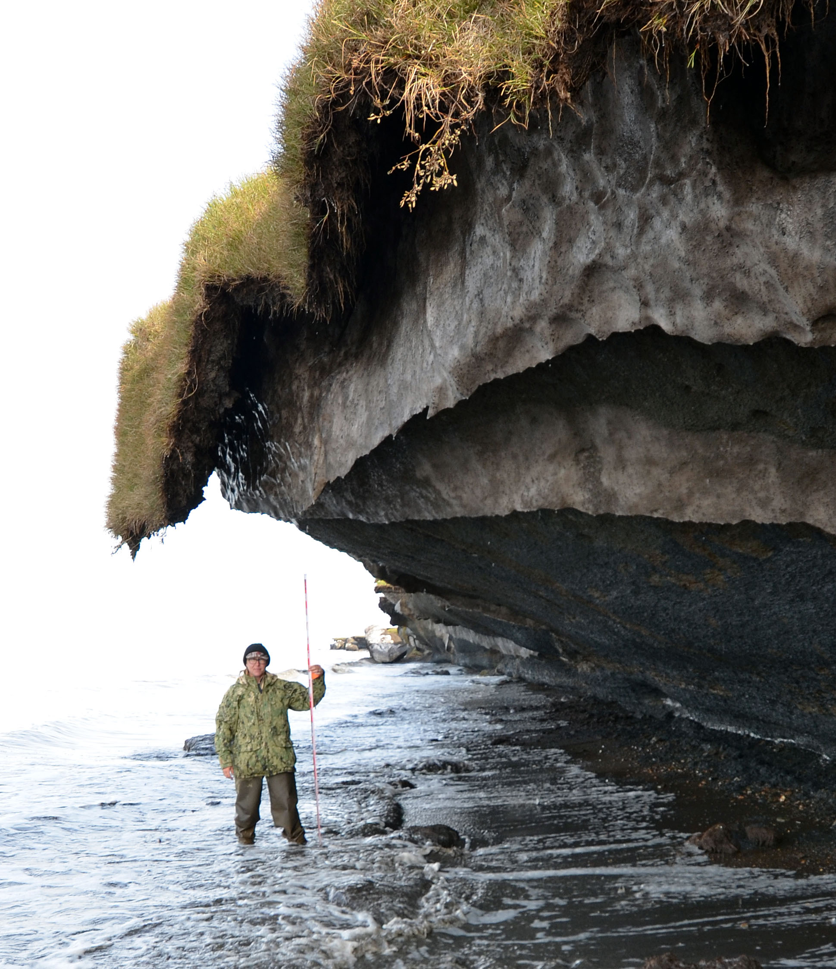
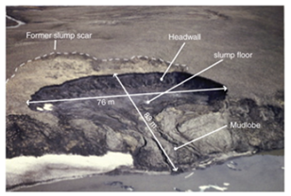
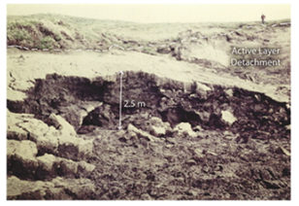
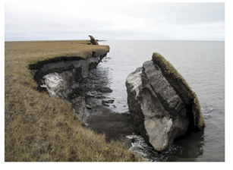
Coastal permafrost failure mechanisms
Retrogressive thaw slumping: a slope failure characterized by thaw of exposed ground ice and slumping of thawed soil, typically caused by thermo-denudation¹.
Active layer detachment: failures are translational landslides that occur in summer in thawing soil overlying permafrost, typically caused by thermo-denudation¹.
Block failure: a niche (recess at bluff base) progresses landward until the overhanging material fails in a shearing or toppling mode known as block failure, caused by thermo-abrasion².
  Fallen blocks can disintegrate in the near-shore environment within 1-2 weeks!
This study
Lantuit et al. 2008
Lantuit et al. 2008
Ravens et al. 2012
Retrogressive thaw slumping
Active layer detachment
Block failure
¹Thawing of permafrost bluffs that proceeds under the influence of gravity. ²Undercutting of permafrost bluff by warming ocean.
6
Notes:
Not all erosion mechanisms are the same, and there can be several types of erosion going on along the same stretch of coast.
The types of erosion are often categorized into these 3 types. . .

Slide 7
Coastal permafrost failure mechanisms
Retrogressive thaw slumping: a slope failure characterized by thaw of exposed ground ice and slumping of thawed soil, typically caused by thermo-denudation¹.
Active layer detachment: failures are translational landslides that occur in summer in thawing soil overlying permafrost, typically caused by thermo-denudation¹.
Block failure: a niche (recess at bluff base) progresses landward until the overhanging material fails in a shearing or toppling mode known as block failure, caused by thermo-abrasion².
  Fallen blocks can disintegrate in the near-shore environment within 1-2 weeks!
This study
Dominant failure mechanism in northern Alaska
Lantuit et al. 2008
Lantuit et al. 2008
Ravens et al. 2012
Retrogressive thaw slumping
Active layer detachment
Block failure
¹Thawing of permafrost bluffs that proceeds under the influence of gravity. ²Undercutting of permafrost bluff by warming ocean.
7

Slide 8
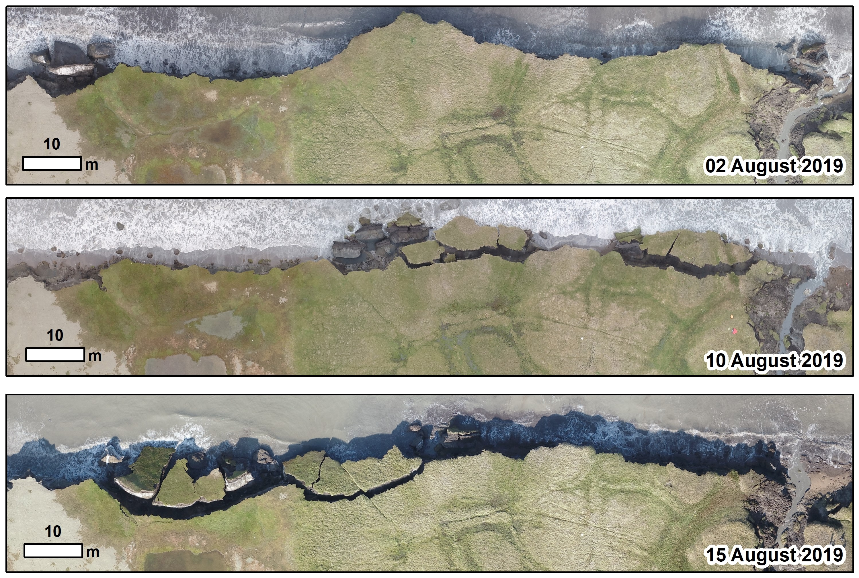
Example of bluff erosion during 2019 UAV surveys*
  Fallen blocks can disintegrate in near-shore environment within 1-2 weeks!
*Images courtesy of Ben Jones, UAF
8
Notes:
Here was can see three consecutive images from a UAV survey in 2019 over a stretch of coastline at Drew Point.
In a matter of just 2 weeks, you can see large blocks fall off and disintegrate.

Slide 9
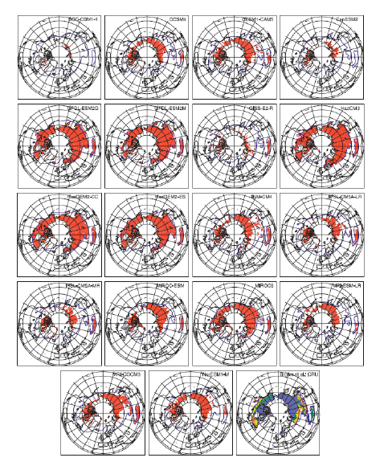
State-of-the-art in permafrost modeling
Most existing permafrost models* (including Earth System Model-, or ESM-, coupled models) are fairly primitive!
  Most models were based on trend projection and/or empirical relationships
  Limited PDE-based models: primarily thermal models, e.g., 1D steady state heat flow (no mechanics/deformation)
  Most models assumed a particular type of erosion (e.g., block failure)
  Models did not include realistic boundary conditions and did not account for permafrost geomorphologies or geophysics.
Premise behind ACE: an accurate, predictive Arctic coastal erosion model must couple the influences of evolving wave dynamics, thermodynamics and mechanics.
Koven et al. 2013
* See [Frederick et al. 2016], Chapter 5, for extensive overview.

Slide 10
Outline
Motivation and background
The Arctic Coastal Erosion (ACE) model
  The coupled thermo-mechanical FEM terrestrial model in ACE
  Numerical results: calibration/validation of thermo-mechanical coupling for pseudo-realistic 2.5D slice problem
From Arctic Coastal Erosion to Arctic Critical Infrastructure (ACI)
  The ACI project
  Numerical results: Paulatuk peninsula airstrip
Summary
Current and future work
From newsweek.com.

Slide 11

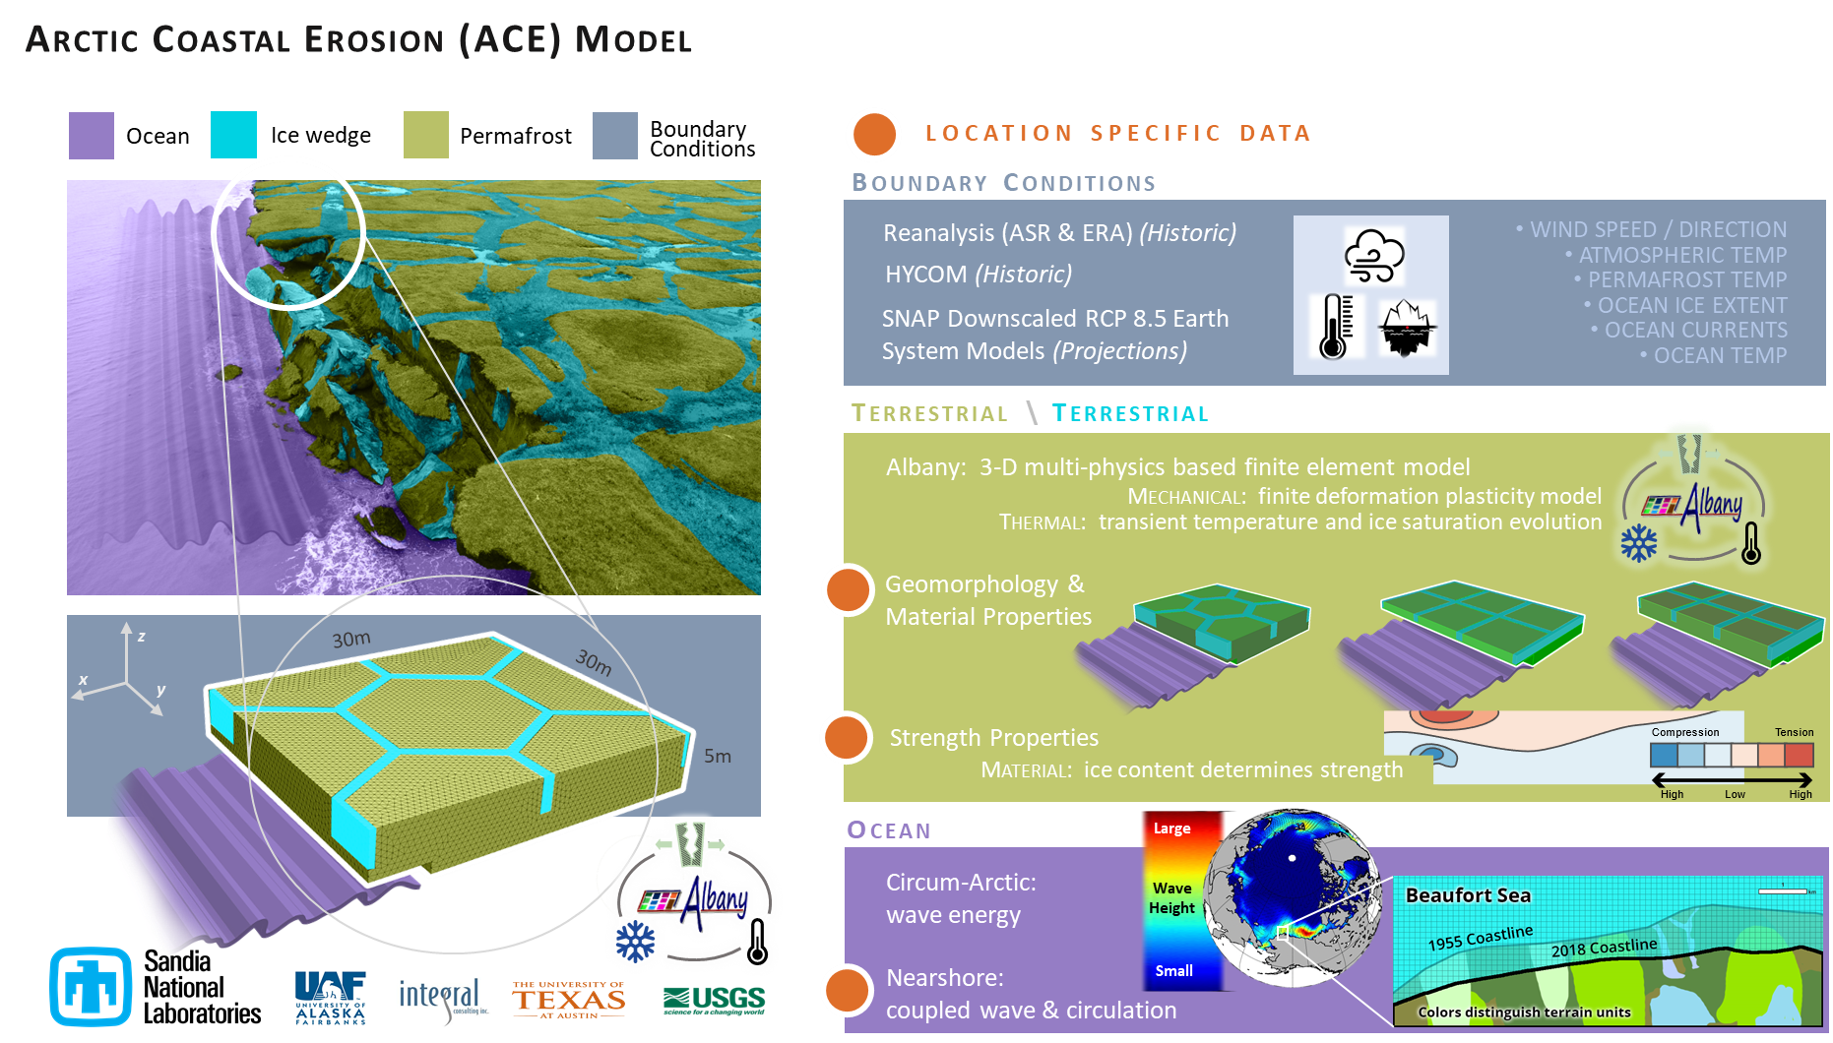
Arctic Coastal Erosion (ACE) model
Notes:
At Sandia, we have created a tool to try and study what the dominant factors are control erosion mechanisms along these permafrost coastal bluffs.
It is a numerical model that has several pieces to it, with the main pieces being the terrestrial and ocean components.

Slide 12
Arctic Coastal Erosion (ACE) model
This talk
12
Notes:
Near-shore ocean model: WWWIII-SWAN-DELFT3D model

Slide 13
Outline
Motivation and background
The Arctic Coastal Erosion (ACE) model
  The coupled thermo-mechanical FEM terrestrial model in ACE
  Numerical results: calibration/validation of thermo-mechanical coupling for pseudo-realistic 2.5D slice problem
From Arctic Coastal Erosion to Arctic Critical Infrastructure (ACI)
  The ACI project
  Numerical results: Paulatuk peninsula airstrip
Summary
Current and future work
From newsweek.com.

Slide 14
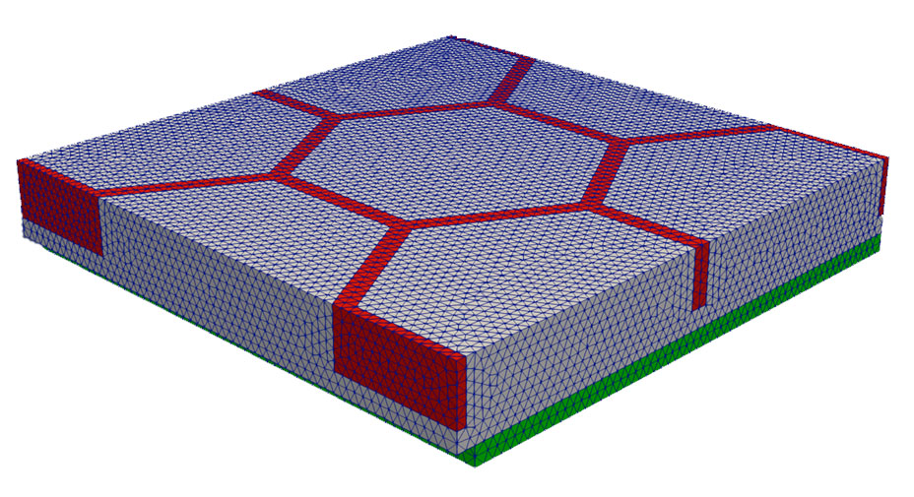
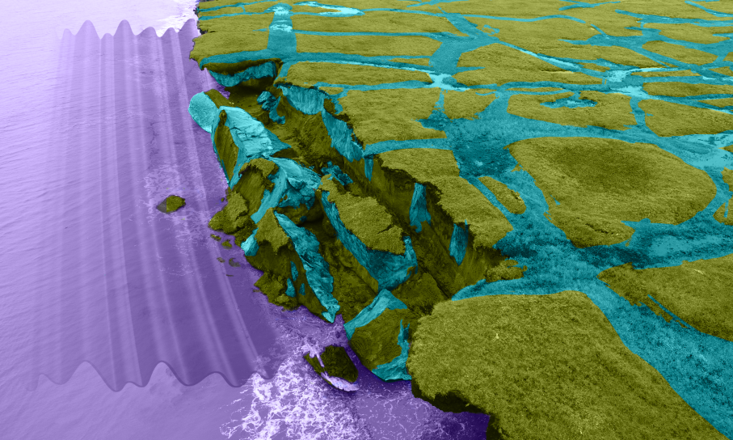
Anatomy of a canonical computational domain
Permafrost
30 m
30 m
Ice
Bluff face (exposed to ocean)
ocean water
5 m
Unique capability of ACE: elements are removed from the computational domain based on failure criteria.
Cryopeg*
* Layer of unfrozen ground that is perennially cryotic (forming part of the permafrost) in which freezing is prevented.

Slide 15
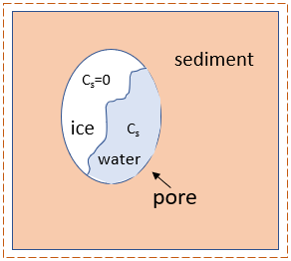
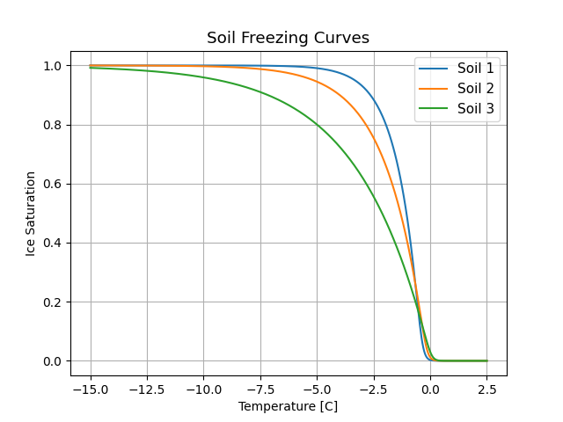

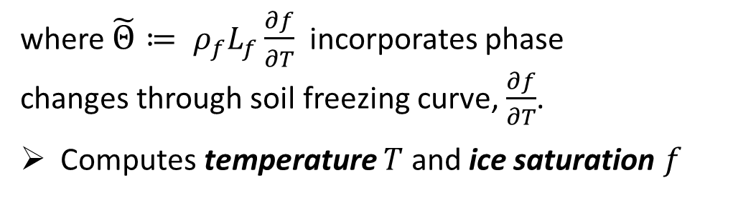
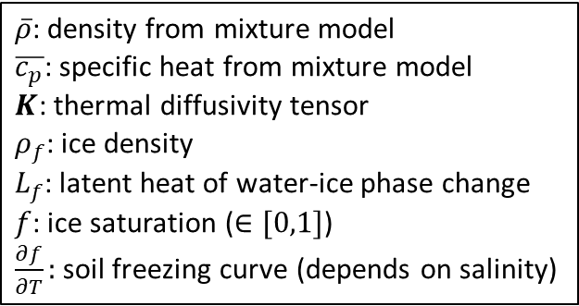
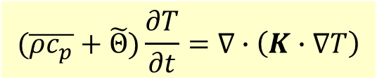
Thermal model
Transient heat conduction in a non-homogeneous porous media with water-ice phase change:
$\overline{ρ}$: density from mixture model
$\overline{c_{p}}$: specific heat from mixture model
$K$: thermal diffusivity tensor
$ρ_{f}$: ice density
$L_{f}$: latent heat of water-ice phase change
$f$: ice saturation ($∈[0,1]$)
$\frac{∂f}{∂T}:$soil freezing curve (depends on salinity)
$$(\overline{ρc_{p}}+\tilde{Θ})\frac{∂T}{∂t}=∇∙\left(K∙∇T\right)$$
where $\tilde{Θ}≔ ρ_{f}L_{f}\frac{∂f}{∂T}$ incorporates phase changes through soil freezing curve, $\frac{∂f}{∂T}$.
Computes temperature $T$ and ice saturation $f$
Permafrost control volume
Above
Soil freezing curve $\frac{∂f}{∂T}≠0$ only during phase change, which occurs in narrow temp zone where the width depends on soil components.
Boundary conditions (from wave model/data)
  Local geothermal heat flux from below
  Air temp* from above
  Air/ocean temp at bluff face
  Ocean salinity at bluff face**
Ice Saturation
water
Bluff face
Below
Temperature [C]
* Or, alternatively surface ground temperature (if available). ** Used to modify melting temperature of ice.
Notes:
Q: ocean salinity is not “true” BC, right?
From Jenn: That is correct. It is not a true BC because there is no governing equation that solves for the salinity. The integration points that are associated with an erodible surface and are below the sea level, have their salinity value modified. This allows the melting temperature to change for those integration points.

Slide 16
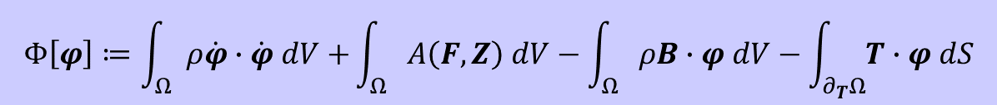
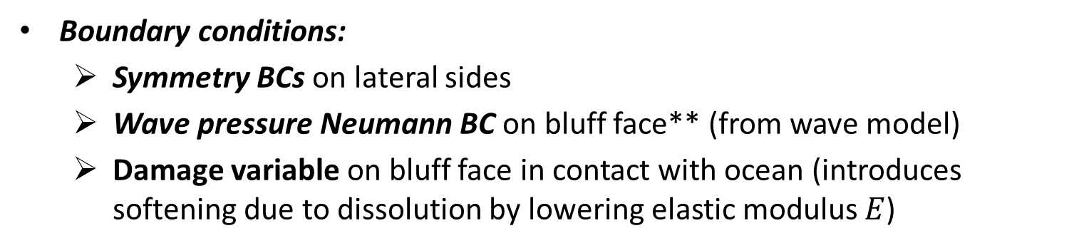
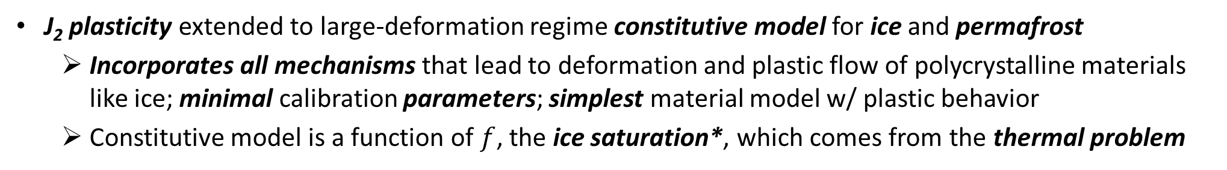
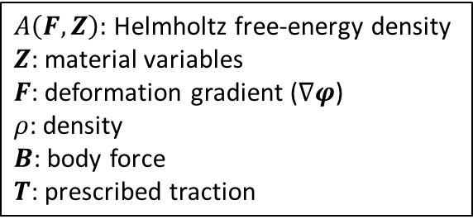
Mechanical model
Finite deformation time-dependent variational formulation for solid mechanics problem obtained by minimizing the energy functional:
$A\left(F,Z\right):$ Helmholtz free-energy density
$Z$: material variables
$F$: deformation gradient ($∇φ$)
$ρ$: density
$B$: body force
$T$: prescribed traction
$$Φ\left[φ\right]≔\int_{Ω}{ρ\dot{φ}∙\dot{φ} dV+}\int_{Ω}{A\left(F,Z\right) dV−\int_{Ω}{ρB∙φ dV−\int_{∂_{T}Ω}{T∙φ dS}}}$$
Computes displacements and new computational geometry (following erosion)
J₂ plasticity extended to large-deformation regime constitutive model for ice and permafrost
  Incorporates all mechanisms that lead to deformation and plastic flow of polycrystalline materials like ice; minimal calibration parameters; simplest material model w/ plastic behavior
  Constitutive model is a function of $f$, the ice saturation*, which comes from the thermal problem
Boundary conditions:
  Symmetry BCs on lateral sides
  Wave pressure Neumann BC on bluff face** (from wave model)
  Damage variable on bluff face in contact with ocean (introduces softening due to dissolution by lowering elastic modulus $E$)
Symmetry BCs
Bluff face
Symmetry BCs
* Young’s modulus $E$ and yield stress $σ$are functions of temp and ice saturation. ** Holthuijsen 2007.
Notes:
Q: damage variable is not really BC, right?
From Jenn: Yes, the damage variable is the by which the residual elastic modulus is divided by if the integration point is associated with an erodible surface and below the sea level. This decreases the residual elastic modulus and makes the material softer or more compliant.

Slide 17
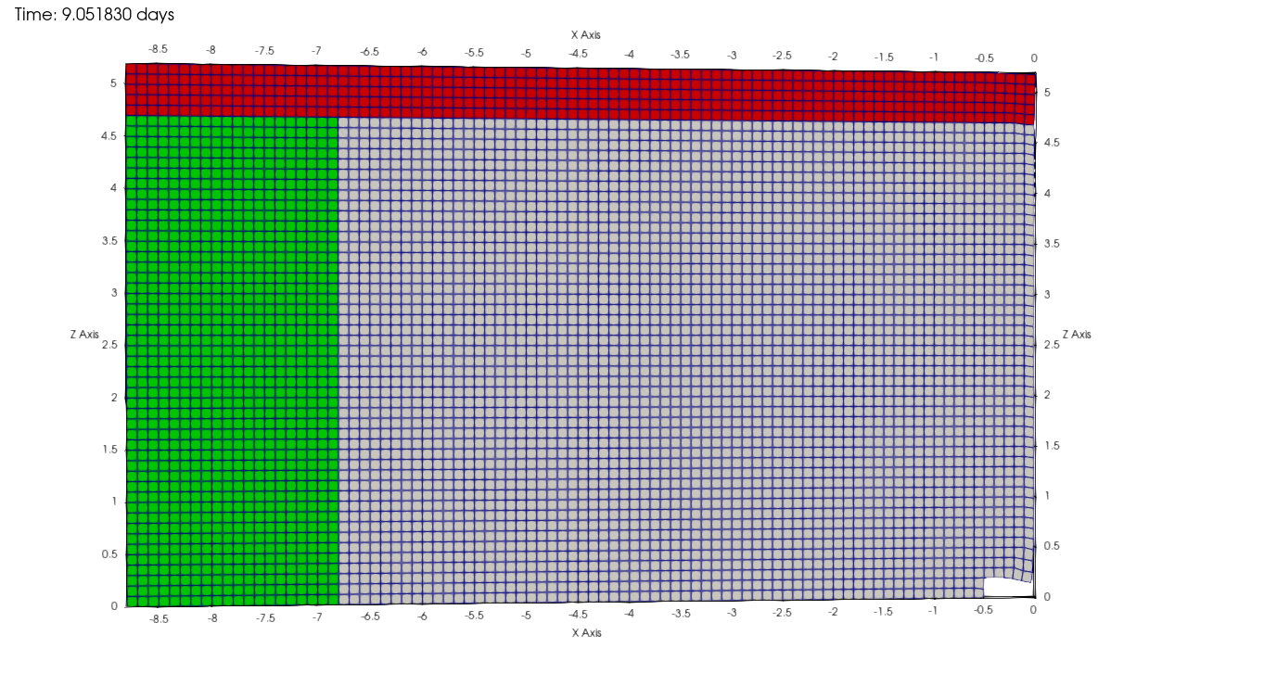
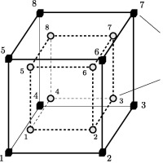
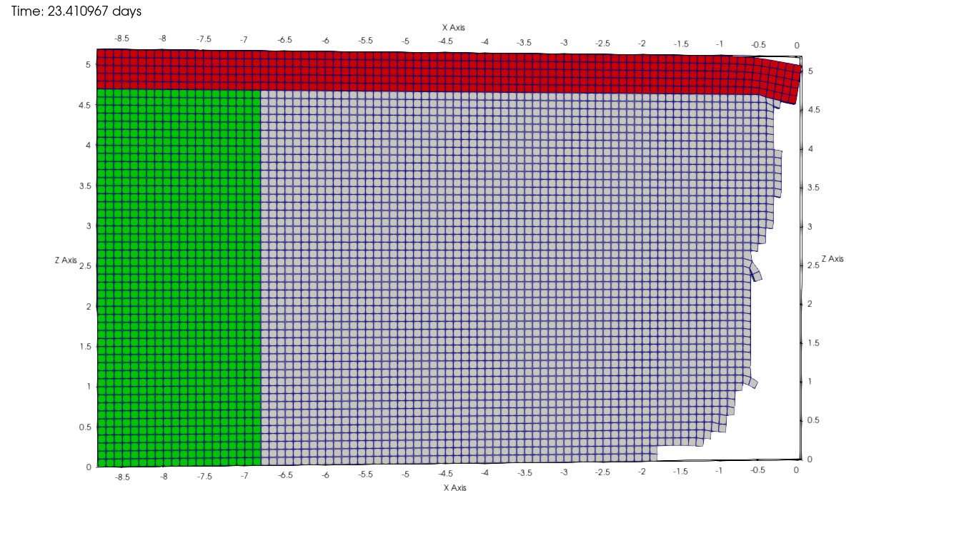
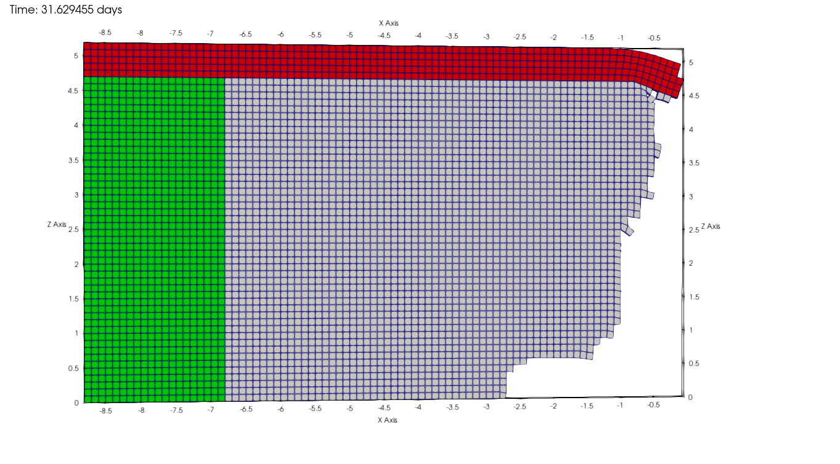
Erosion failure criteria
Stress criterion: when material reaches a critical value of the stress in tension or compression.
Strain criterion: when material reaches a critical strain limit defined as a function of peat content (distortion).
Kinematic criterion: when material has tilted excessively, or exceeded a maximum physical displacement, it is assumed to have fallen as part of block erosion.
element
nodes
element
integration
points
When any of the failure criteria are reached for all integration points within an element, “failed” elements are removed from mesh.

Slide 18
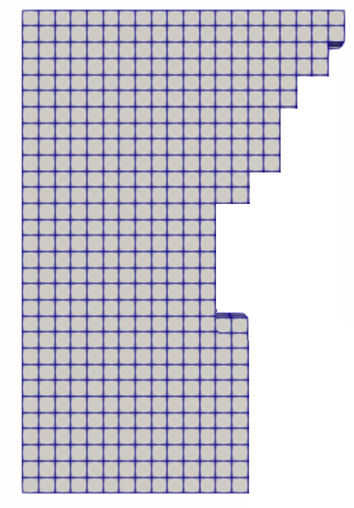

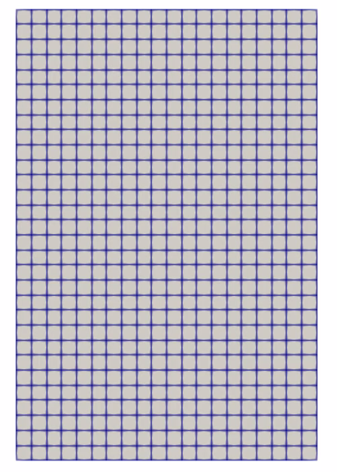
Coupled thermo-mechanical formulation
Potential key advantages:
Failure modes develop from constitutive relationships in FEM model (no empirical relationships!)
Elements are actually removed from the mesh based on failure criteria
Thermal and mechanical problems can be advanced using different time-steppers (e.g., implicit-explicit coupling)
Thermal:
Inputs: geometry, sediment type,
porosity, salinity
Outputs: temperature field, ice saturation
Eroded geometry
Ice saturation
Mechanical:
Inputs: ice saturation, mechanical parameter relationships as function of sediment type and ice saturation
Outputs: displacements, eroded geometry
Coupled mechanical + thermal states
Unique characteristic of coupled model: coupling happens at the level of material model

Slide 19

Finite element implementation in Albany-LCM
The thermo-mechanical Arctic Coastal Erosion (ACE) model is implemented within the LCM project in Sandia’s open-source parallel, C++, multi-physics, finite element code, Albany.
Component-based design for rapid development.
Contains a wide variety of constitutive models.
Extensive use of libraries from the open-source Trilinos project.
  Use of the Phalanx package to decompose complex problem into simpler problems with managed dependencies.
  Use of the Sacado package for automatic differentiation.
All software available on GitHub.
https://github.com/sandialabs/LCM
https://github.com/trilinos/trilinos

Slide 20
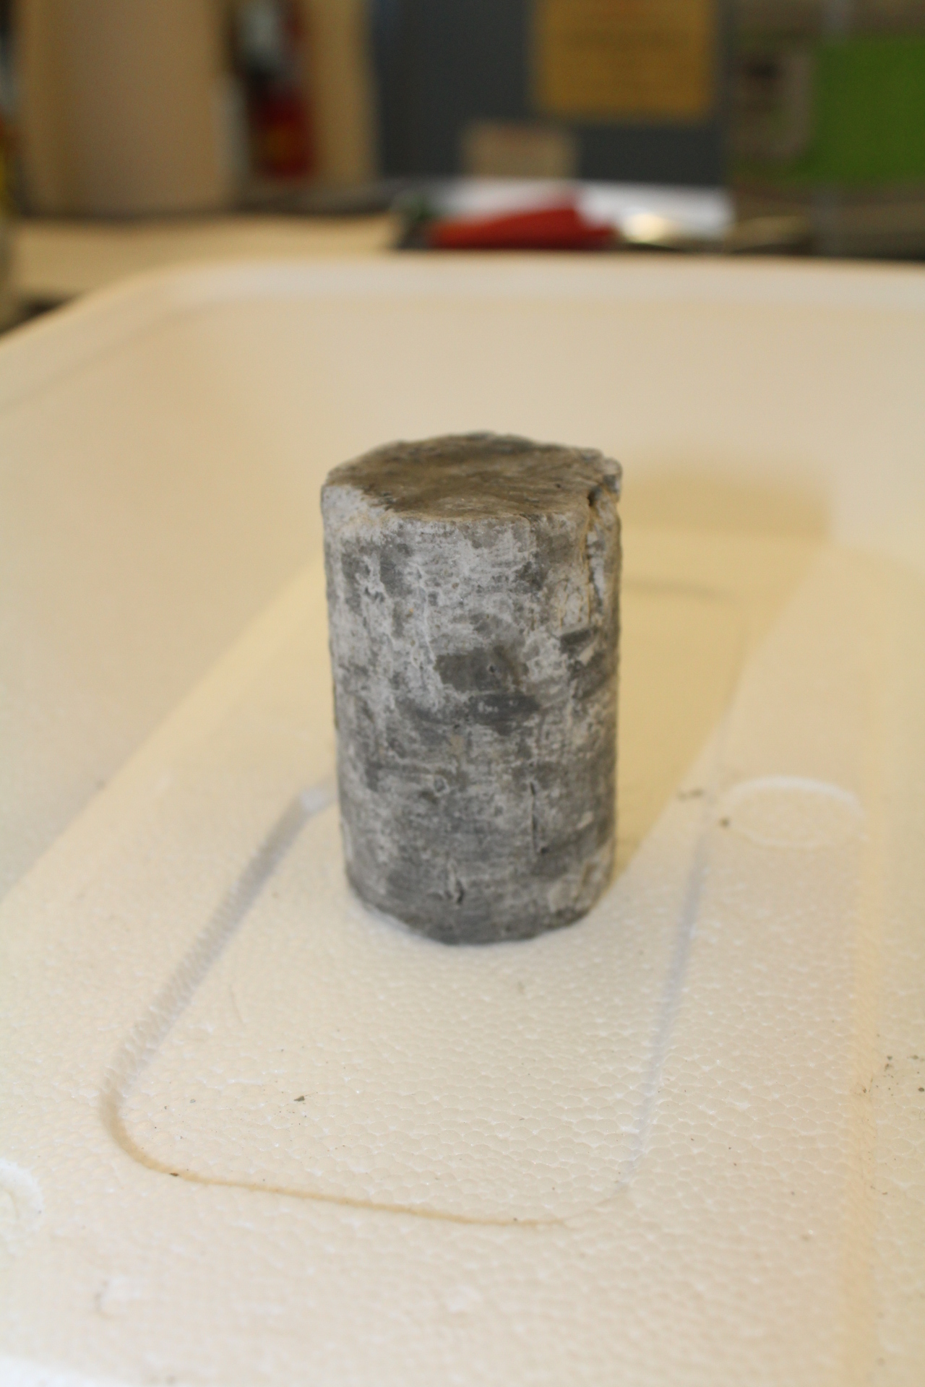
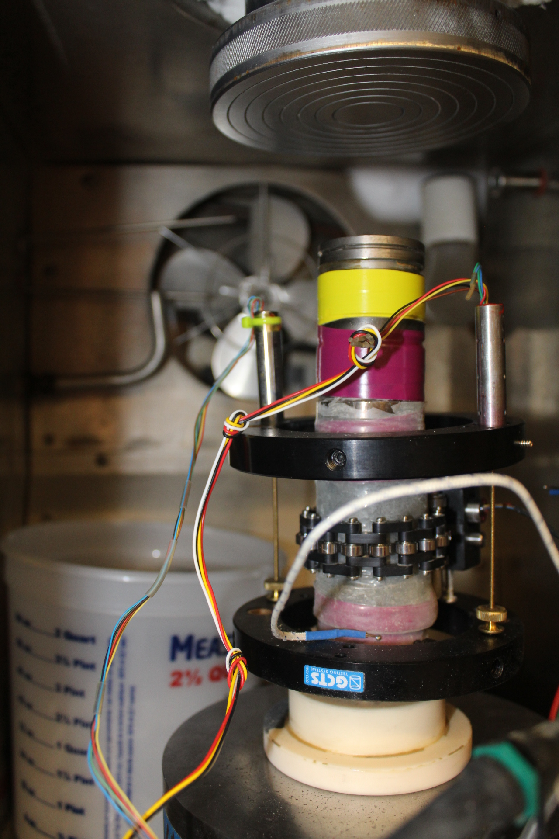
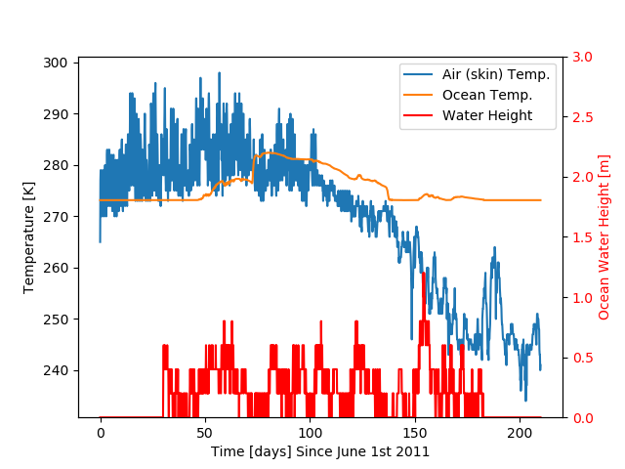
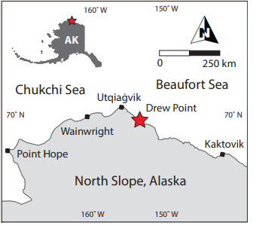
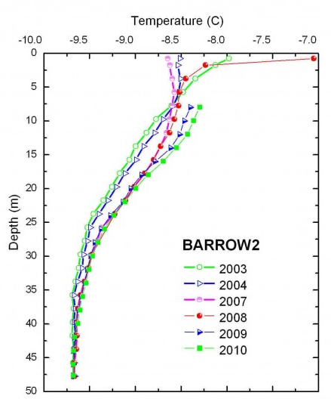
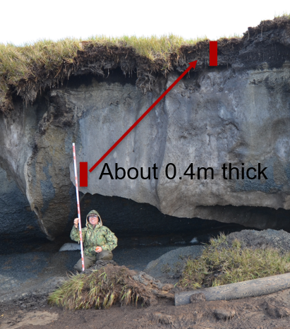

Parameters & inputs
Parameters estimated from core lab experiments:
Elastic modulus, Poisson’s ratio, yield stress
Sand/silt/clay/peat fractions with depth
Porosity with depth
Salinity with depth
Parameters from literature:
Ice/water/sediment densities, thermal conductivities, heat capacities
Freezing curve/width as function of sediment type
BC Data for Drew Point
Parameters estimated from observational data at Drew Point, AK:
Air temp w/ time, initial bluff temp (USGS weather station data)
Geothermal heat flux (borehole at Barrow, AK)
Polygon dimension, ice wedge thickness and depth, bluff height, organic layer (peat) thickness (Aug. 2019 field campaign)
Parameters from wave model (WW3+SWAN+Delft3D):
Ocean temperature, salinity and sea-level w/ time (for thermal and wave pressure mechanical BCs)
Deep borehole

Slide 21
Outline
Motivation and background
The Arctic Coastal Erosion (ACE) model
  The coupled thermo-mechanical FEM terrestrial model in ACE
  Numerical results: calibration/validation of thermo-mechanical coupling for pseudo-realistic 2.5D slice problem
From Arctic Coastal Erosion to Arctic Critical Infrastructure (ACI)
  The ACI project
  Numerical results: Paulatuk peninsula airstrip
Summary
Current and future work
From newsweek.com.

Slide 22
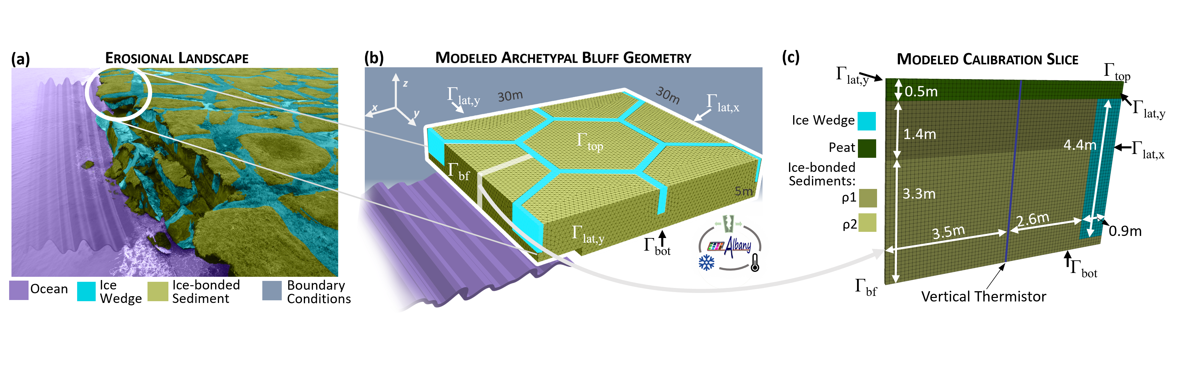
Numerical results: Drew Point 2.5D slice
Computational domain is 2.5D cross-section of archetypal 3D bluff geometry discretized using a uniform hex grid
Pseudo-realistic problem with realistic oceanic and atmospheric forcing BCs from Drew Point, AK in summer 2018.
Initial temperature field obtained from vertical thermistor string placed into DP1-1 ice core at Drew Point
2.5 month simulation starting July 1, 2018 with baseline time-step of 900 s. Thermal uses forward Euler, mechanical uses implicit Newmark.
Goal: determine if ACE can simulate block failure event that occurred on Sept. 1, 2018.
* E. Bayat et al., “The Arctic coastal erosion model: overview, developments and calibration at Drew Point, Alaska”, JAMES (under review).
Notes:
From Jenn: We calibrated the model by choosing parameter values for the damage variable (E weakening factor described above) and the residual elastic modulus that goes into the material model fit for elastic modulus. The E weakening factor controls niche growth and the residual elastic modulus controls the thermal denudation rate. We used the sediment mixture model to determine the freezing curves and the thermal parameters like conductivity, density, and specific heat capacity. Sediment mixtures were not varied (the values came from the field work core samples). We used the vertical thermistor data to give us an idea of the niche geometry and timing of niche growth, and the camera data to give us plausible thermal denudation rates and the date/time of the block collapse. We call the model “calibrated” if the denudation, niche growth and day/time of collapse match what was observed.

Slide 23
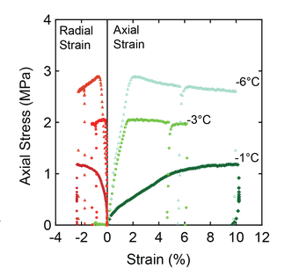
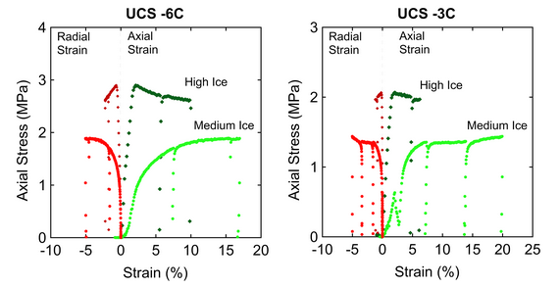
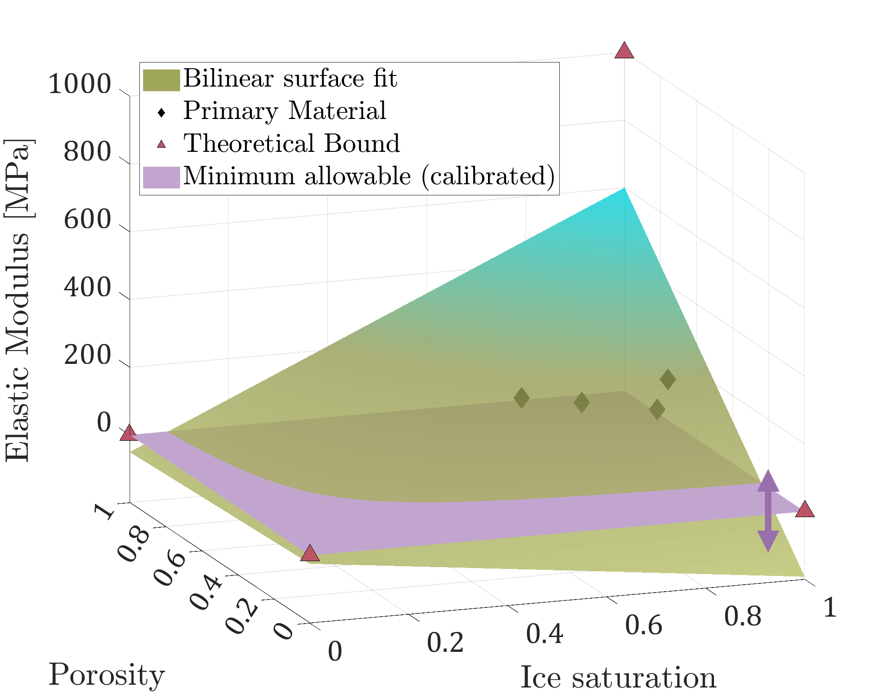
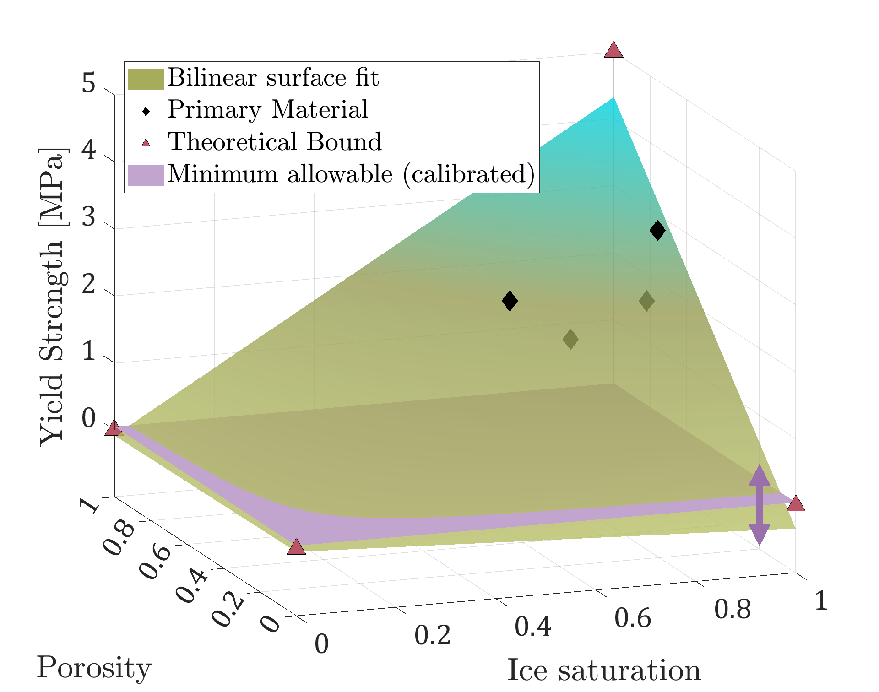



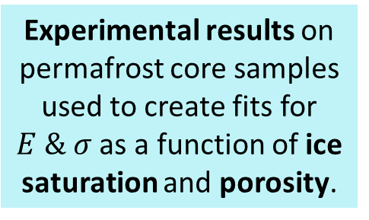
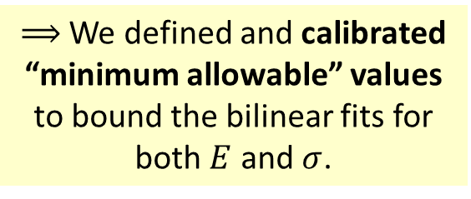

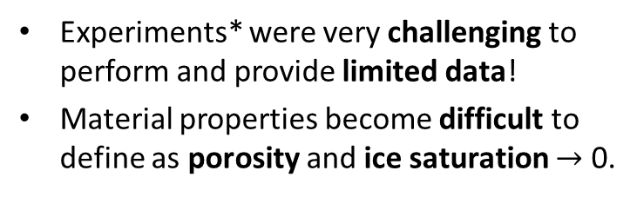
Material model calibration to experimental data
$$σ$$
Experimental results on permafrost core samples used to create fits for $E \& σ$ as a function of ice saturation and porosity.
$$E$$
K
fully frozen
fully frozen
Experiments* were very challenging to perform and provide limited data!
Material properties become difficult to define as porosity and ice saturation $→$ 0.
$σ$
$E$
Young’s modulus
Yield stress
water
$⟹$ We defined and calibrated “minimum allowable” values to bound the bilinear fits for both $E$ and $σ$.
water
sediment
sediment
* From 4 unconfined compressive stress (UCS) experiments
23
Notes:
Asymmetric treatment of yield stress under compression and tension.
Q: does this need updating??
Q: is point that the fits are not great, and this is why we are doing sens. Studies? What are theoretical points?
Black points = BCs. Strongly applied BCs.
Red points = experimental points – change shape as a result of these.
If use just data fits with experiments, at edges would get something nonphysical. Also not getting good responses w/ just experimental data.
From Jenn: The black theoretical points are values for pure ice (porosity=1), pure water (porosity=1), and pure rock (porosity=0). These are used in the fits in addition to the experimental values (red stars). The surface that is slightly transparent is the fit that is used in ACE. It’s a best fit for the data as a function of porosity and ice saturation, but the r^2 values are not shown on this slide. You are correct in your observation that the fits don’t contain the red stars. The red stars are close (meaning, the red stars were used to determine the equation for the surface fits, but the r^2 value is not perfect). I think you can talk about these fits exactly as you suggested.
4 unconfined compressive stress (UCS) experimental results were used to calibrate the material model.
Sigma (yield strength) is the value of the stress where the sample fails (where the slope changes).
E (elastic modulus) is the slope of the axial strain curves before reaching the point of failure, where the slope changes.
K (hardening modulus) is the slope of the axial strain after reaching the point of failure.
The equations for the fits are given above the bilinear surfaces, along with the r^2 values.

Slide 24
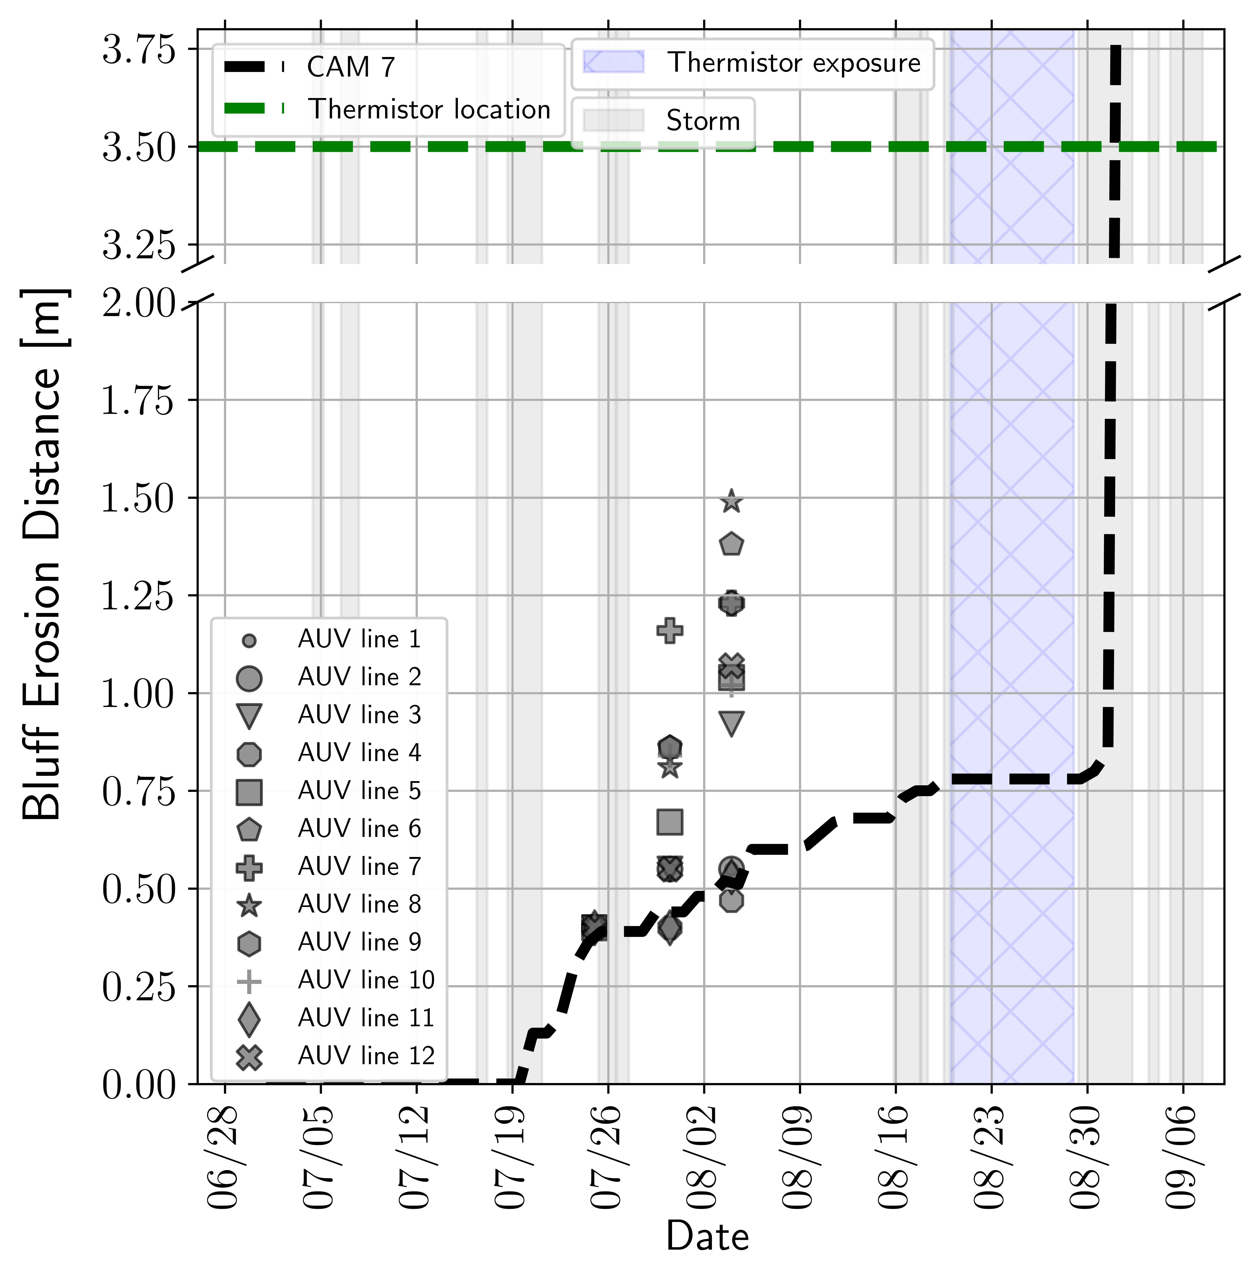
Calibration of minimum allowable $E$ to observations
High-quality observational data provides targets for both upper bluff erosion and niche formation.
Change to ocean temperature implies formation of a niche
Time-lapse camera and UAV surveys provide daily measurements of bluff erosion
Vertical thermistor string 3.5 m back from bluff face enabled detection of timing/shape of niche formation

Slide 25
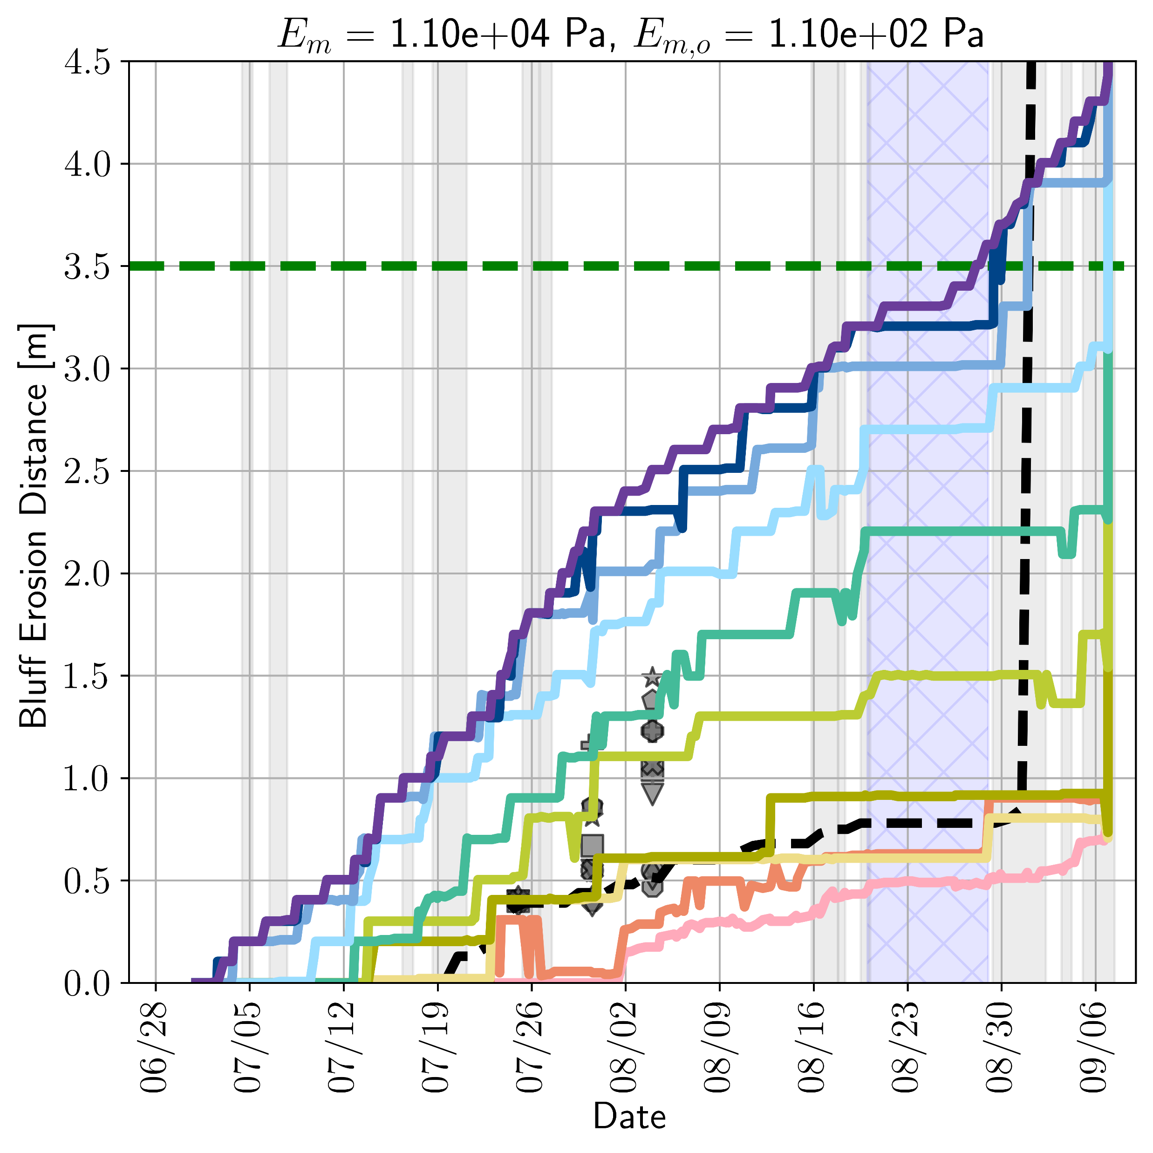















Calibration of minimum allowable $E$ to observations
Calibrated
Legend
Same $E_{m}$ as calibrated
$Em$ increasing
Neighborhood of $E_{m}$, $E_{m,o}$ near calibrated
Same $E_{m,o}$ as calibrated
Minimum allowable elastic moduli hand-calibrated through sensitivity studies s.t. upper bluff denudation, niche growth and day/time of collapse match observations
General, $E_{m}$ (residual elastic modulus): lowest value the elastic modulus, $E = f($ice saturation, porosity$)$, can take
Represents softening of material as it thaws
Increasing value $→$ less deformation/unit stress
Decreasing value $→$ more deformation/unit stress $→$ material more likely to fail in strain
Plays strong role in rate of denudation
Ocean-contacted material, $E_{m, o}$ ($E$ weakening factor): distinct and lowered elastic modulus for material in contact with ocean
Accounts for permafrost transitioning into a slurry-like state when in contact with ocean
Reflects localized adjustment in material properties from material dissolution due to ocean-bluff contact
Decreasing value $→$ more deformation/unit stress $→$ material more likely to fail in strain
Plays strong role in niche formation
$E_{m, o}$ increasing
There is interaction in choice of $E_{m}$ and $E_{m,o}$ as erosion in upper and lower bluff can affect one another!
Notes:
As discussed in slide 23, mechanical material properties are hard to define as ice saturation -> 0. As a result, we need to define a minimum allowable elastic modulus to bound the material property fit in this regime. This value is highly active at the bluff face in general, because at the bluff face the ice saturation is typically very close to zero. This leads to this minimum allowable value having a significant impact on the modeled erosion. As such, we proposed to define two different values:
The general min allowable elastic modulus, called Em -> this takes effect generally, and represents the softening of material as it thaws
The min allowable elastic modulus for ocean-contacted material, called Emo -> the material adopts this value when material is actually in contact with the ocean. This is a modeling decision made to reflect the following: When in contact with ocean water, permafrost transitions into a state of unconsolidated slurry. As such, a distinct and lowered min allowable elastic modulus is applied to reflect this slurry-like state for which the material will experience much larger deformations for a given applied stress.
There is interaction in choice of $E_{m}$ and $E_{m,o}$ as erosion in upper and lower bluff can affect one another!

Slide 26

Simulated 2.5D slice: July 1 - Sept 3
Thermal drivers (ground temp, ocean temp & salinity, etc.)
Mechanical material property fits
Erosion
criteria
Freezing curve
Mechanical state (stress/strain)
Temperature
Ice saturation
Erosion
Strain failure occurs at upper bluff (thaw-dominant softening) and in niche (ocean-dominant, material weakening).
Notes:
I’ve added an animation of the temperature, ice saturation, and tensile + strain failure indicators to this slide, along with some text that sort of highlights how each component of the terrestrial model is linked together. I often like to think about/talk about it this way.

Slide 27


Simulated 2.5D slice: simulated block collapse event (Sept. 3)
Failure in tensile stress leads to block collapse.
Calibrated ACE model capable of simulating block collapse event at Drew Point within 2 days of observation!
Notes:
Q: why are we still doing calibration? What is wrong here?
From Jenn: The thing we are not matching very well is the temperature evolution in the bluff (which we know what it was from the vertical thermistor data). The thermistor data shows a temperature evolution that is more consistent with an ice-filled hole that might even have some water convecting in it (based on the estimates of the thermal diffusivity backed out from the data). The temperature in the undisturbed permafrost would occur much slower. The model temperatures are warming in response to the summer air temperatures much slower than the thermistor data shows.
Elyce is re-running the parameter sensitivity study for the E weakening factor and the residual elastic modulus.

Slide 28


Main takeaways from Drew Point 2.5D slice study
The calibrated ACE model matches total magnitudes of erosion w.r.t. camera measurements:
  12.5% error for thermo-denudation
  5.06% error for block failure
The temporal evolution also matched camera measurements:
  A daily RMSE of 0.16 m was achieved for denudation $→$ shows that ACE correctly predicts erosion rate, not just total erosion at end of summer
  Block failure occurred within 2 days of the observed
ACE predicted reasonable agreement between modeled and observed ground temperatures, with highest deviations between 1.5-2 K
*
*
Results suggest that the calibrated ACE model possesses sufficient physics such that it is capable of predicting permafrost erosion rates.
* https://essopenarchive.org/doi/full/10.22541/essoar.174086594.45589925/v1
28
Notes:
TODO: add slide that is quantitative.
Q: what are errors w.r.t?
Elyce: the errors are with respect to the camera measurement.
The amount of erosion due to thermo-denudation was taken as the amount eroded prior to observed collapse, and the amount due to block collapse was taken as amount eroded during the block collapse event.
The RMSE was calculated by comparing daily simulated erosion amounts averaged from the elevations z=3.5, 4.0, and 4.5 m against the daily camera measurement of erosion amount. This RMSE is a big deal because it shows that we get the rate of erosion pretty well, not just the total amount at the end of the summer.
Q: is Fig. 17 from paper worth including? Thermal validation. Results sort of not great. Elyce: I would stay away from it… that whole discussion is not just a can of worms, but a bucket … that section of the paper took a ton of time for us to write and it still didn’t sit great at the end. Feel free to ask me for more details if you’re interested!
Q: can we put figure here? Elyce: hmm. I wish we could, but honestly I think this may just have to stand as is.

Slide 29
Outline
Motivation and background
The Arctic Coastal Erosion (ACE) model
  The coupled thermo-mechanical FEM terrestrial model in ACE
  Numerical results: calibration/validation of thermo-mechanical coupling for pseudo-realistic 2.5D slice problem
From Arctic Coastal Erosion to Arctic Critical Infrastructure (ACI)
  The ACI project
  Numerical results: Paulatuk peninsula airstrip
Summary
Current and future work
From newsweek.com.

Slide 30

The Arctic Critical Infrastructure (ACI) project
Motivation: “Nearly 4 million people and 70% of current infrastructure” [Hjort, 2018] situated on Arctic permafrost is at risk as permafrost continues to thaw!
Goals of ACI project:
Introduce a novel computational framework based on the ACE thermo-mechanical terrestrial model to estimate and predict risk to Arctic infrastructure.
  Since ACE is a FEM code, it is straightforward to put infrastructure on top of permafrost in simulation (bottom right)
  Easier than ACE: not targeting infrastructure right on coast, so no block failure, only subsidence
Explore a variety of infrastructure-permafrost combinations, their failure mechanisms and possible solutions to decrease risk
From newsweek.com.

Slide 31
Outline
Motivation and background
The Arctic Coastal Erosion (ACE) model
  The coupled thermo-mechanical FEM terrestrial model in ACE
  Numerical results: calibration/validation of thermo-mechanical coupling for pseudo-realistic 2.5D slice problem
From Arctic Coastal Erosion to Arctic Critical Infrastructure (ACI)
  The ACI project
  Numerical results: Paulatuk peninsula airstrip
Summary
Current and future work
From newsweek.com.

Slide 32






ACI demonstration: Paulatuk peninsula airstrip
Tanguy, R. et al. (2023) Permafrost degradation in the ice-wedge tundra terrace of Paulatuk Peninsula (Darnley
Bay, Canada), Geomorphology, 435, 108754.
Paulatuk
Photograph of Paulatuky airstrip (R. Tanguy et al.)
Located within the Inuvialuit Settlement Region of the Amundsen Gulf, south Darnley Bay, in northern Canada.
  Permafrost characteristics are similar to those from Drew Point, Alaska.
Airstrip is 1.3 km long and 55 m wide, with a mean altitude of 4.2 m, artificially installed over a ~2 m thick gravel pad overlying the tundra and numerous ice-wedge troughs.
Airstrip slopes towards a depression with a maximum angle of 0.37$°$, suggesting that subsidence is occurring
  Snow accumulation at side of airstrip acts as insulator and prevents ground from cooling $⇒$ melting of snow causes thaw-ponds, which retain heat from solar radiation $⇒$ downward heat diffusion from ponds induces permafrost degradation and subsidence [Allard et al., 2020].
Notes:
The model is currently running. However, the forthcoming results will show the level of permafrost degradation and subsidence along the runway, including the level of stress, deformation, and damage to the runway on top of the permafrost.
As is occurring in other hamlets in the north, snow is most likely accumulating at the side of the airstrip embankment contact, leading to a larger volume of water during summer, enhancing thaw pond formation. Similar observations have been made at the Tasiujaq airstrip in Quebec (Allard et al., 2012). There, the snow cover was thicker along the embankment foot due to the dominant winds, acting as an isolator and preventing the cooling of the ground surface. Snow accumulation and poor water drainage result in water retention along the runways. Thaw pond water retains heat from solar radiation and participates in downward heat diffusion inducing permafrost degradation and subsidence (Allard et al., 2020). Once the degradation has begun, the new soil surface conditions reinforce the degradation phenomena.
The Albany model can capture the processes of snow accumulation and poor drainage which induce permafrost degradation and subsidence.

Slide 33




Geometry of the airstrip cross-section
Ice wedge parallel to runway
Ice wedge perpendicular to runway
Runway subbase (gravel)
Runway subbase (gravel)
Runway base (compacted fine-grain sand)
Runway base (compacted fine-grain sand)
snow
snow
snow
snow
Ice wedge
Permafrost
Permafrost
J₂ plasticity model employed for all materials.
Ice wedge
Ice wedge
Mesh has 22K nodes, 19K hex elements. Time-step: 8 hrs
Notes:
Run on 36 procs, 2-2.5 weeks to run each case.
Subbase = gravel
Base = compacted sand. Very fine grain.
Everything J2. Yield stress

Slide 34




Simulation setup
¹http://gtnpdatabase.org/boreholes/view/365
² https://climate-change.canada.ca/climate-data/#/daily-climate-data
Initial thermal state: -6.2$°$ Celsius based on mean annual ground temp 2008-2009 from borehole data¹
Hindcast: (2003 – 2014)
Daily mean air temperature and precipitation from weather station 2203058 in Paulatuk²
Snow depth calculated from air temp and precipitation data
Uneven snow depth applied on east and west sides of runway
Forecast: (2024 – 2035)
Daily mean air temperature and precipitation from E3SM w/ RCP 3.7*
Snow depth calculated from air temp and precipitation data
Uneven snow depth applied on east and west sides of runway
* Representative Concentration Pathway 3.7, the 3rd highest projected emissions considered in climate analyses.
Notes:
TODO: materials/properties should be added. Is J2 being used for all materials?
Q for Alejandro/Elyce: what RCP scenario was being considered for forecast?
Side note – when I was going through the bad frames, I remembered that another part of why we see that artificially high deformation in those areas is because that’s the snow layer, and in the mechanical material input deck I think I put something super low for the elastic modulus of snow, which resulted in really (probably unreasonably) high deformation in the snow layer. We didn’t think too hard about this since we weren’t interested in modeling the deformation of the snow, it was really only there to provide thermal insulation (we were modifying the thermal conductivity in the snow layer depending on given snow depth, which changed how the thermal boundary condition got propagated through the solution).
Another note on that too – we purposefully applied uneven snow depth (higher on one side of the runway compared to the other) so that we could see what effect that might have. That’s why we see an asymmetrical thermal solution. (You likely already know this but figured it’d be good to throw in here just in case someone asks about it!)

Slide 35


Hindcast: ice wedge parallel to runway direction
ACI model predicts $\sim 5$ mm settlement.
Arrows show permafrost deformation vectors
Notes:
TODO: ask Alejandro about main takeaways, significant of arrows. Has any kind of comparison to observational data been done?
Q for Elyce: can movies be made to be faster? More fps?
Uneven snow depth => asymmetric temperature profile.
Increase in temp for forecast not much to see much change.

Slide 36


Hindcast: ice wedge perpendicular to runway direction
ACI model predicts $\sim 18$ mm settlement.
Arrows show permafrost deformation vectors

Slide 37


Forecast: ice wedge parallel to runway direction
ACI model predicts $\sim 6$ mm settlement.
Arrows show permafrost deformation vectors

Slide 38


Forecast: ice wedge perpendicular to runway direction
ACI model predicts $\sim 20$ mm settlement.
Arrows show permafrost deformation vectors

Slide 39


Main takeaways from Paulatuk airstrip study
$>3×m$ore settling occurs when ice wedge is perpendicular (vs. parallel) to the runway direction.
Slightly more settling occurs in forecast runs than hindcast
  Prescribed warming is intermediate (RCP 3.7)
  More settling expected for higher warming/emissions scenario, RCP 8.5.
ACE model is well-poised to simulate permafrost & infrastructure interaction, as material mechanical model is responsive to permafrost thermal state and weather drivers (e.g., atmospheric temperature)
* https://www.sandia.gov/app/uploads/sites/127/2024/09/ACI-LDRD-report-SAND2024-12315R.pdf
39
Notes:
The good: we highlighted that we are close to being well-poised to simulate such applications (permafrost & infrastructure interaction) – we have a material mechanical model that is responsive to the thermal state of the permafrost, and weather drivers like atmospheric temperature. We were able to incorporate other materials (like concrete) on top of the permafrost.
The less good: we really need to be able to model plastic deformation to have any real shot at modeling meaningful subsidence.
If I had to guess I’d say we did not match what happened to the runway due to the whole “no plastic deformation” thing, because without plastic deformation we were not able to model any kind of subsidence that accumulated past one season of one year (which is super unrealistic… as cumulative subsidence over many years is what we were really hoping to model in the first place, and would likely be the eventual cause of runway demise). Please feel free to double check what I’m saying with Jenn though to be sure.
SSP5-8.5: An update of RCP8.5, combining it with socioeconomic factors.
SSP5-8.5: The upper boundary of the range of scenarios, representing high emissions and radiative forcing.

Slide 40
Outline
Motivation and background
The Arctic Coastal Erosion (ACE) model
  The coupled thermo-mechanical FEM terrestrial model in ACE
  Numerical results: calibration/validation of thermo-mechanical coupling for pseudo-realistic 2.5D slice problem
From Arctic Coastal Erosion to Arctic Critical Infrastructure (ACI)
  The ACI project
  Numerical results: Paulatuk peninsula airstrip
Summary
Current and future work
From newsweek.com.

Slide 41

Summary
We have developed a thermo-mechanical coupled FEM model, ACE, that can simulate transient niche development and permafrost erosion within Albany-LCM.
The model was calibrated using data from a series of experiments on frozen soil samples and observational data collected from Drew Point, Alaska
The model incorporates boundary conditions from the WW3+SWAN+Delft3D wave models and observational data from field campaigns at Drew Point.
We have validated ACE using observational data from Drew Point collected in summer 2018.
We have started to use the ACE terrestrial model to perform assessments of critical infrastructure situated on top of permafrost.
30m
30m
5m
z
x
y

Slide 42
Outline
Motivation and background
The Arctic Coastal Erosion (ACE) model
  The coupled thermo-mechanical FEM terrestrial model in ACE
  Numerical results: calibration/validation of thermo-mechanical coupling for pseudo-realistic 2.5D slice problem
From Arctic Coastal Erosion to Arctic Critical Infrastructure (ACI)
  The ACI project
  Numerical results: Paulatuk peninsula airstrip
Summary
Current and future work
From newsweek.com.

Slide 43




Current and future work
  InterFACE project: upscale ACE terrestrial model to meso/macro scales for E3SM* integration
    Upscaling will be performed from “catalog” of 6-7 ACE runs for different terrestrial configurations/locations in northern Alaska
    Proposal submitted to develop universal constitutive model using synthetic permafrost samples
Micro-scale (ACE) model
10s of m, storm duration
Meso-scale model
10s of km, monthly duration
Macro-scale model
100s of km, annual+ duration
  Arctic Critical Infrastructure (ACI) project:
    Use ACE/ACI to study alternate permafrost-infrastructure configurations (tanks, pilons, etc.)
    Develop/integrate finite deformation cap plasticity model into ACE (with Prof. R. Regueiro, UC Boulder)
      Incorporates volumetric (or pressure-sensitive) plasticity
Nimbus Horizon
* Energy Exascale Earth System Model, the U.S. Department of Energy’s flagship climate model.
Notes:
Cap plasticity:
For J2: can only have plastic deformation induced by deviatoric stresses – good for metals. Lattices slip, where you have permanent deformation.
Geomaterials: can have deviatoric flavor but also can compress b/c a lot of porosity. Can compress in permanent fashion. Volumetric or pressure-sensitive plasticity.
Rich: J2 is OK at top layers. If deep underground where there is pressure, J2 assumption is garbage.

Slide 44
References from our group
www.sandia.gov/~ikalash
ikalash@sandia.gov
[1] J. Frederick, M. Thomas, D. Bull, C. Jones, J. Roberts. “The Arctic Coastal Erosion Problem”. Sandia National Laboratories Report, SAND2016-9762, 2016.
[2] M. Thomas, A. Mota, B. Jones, C. Choens, J. Frederick, D. Bull. “Bluff geometry and material properties influence stress rates relevant to coastal permafrost block failure”. Frontiers in Earth Science 8, 2020.
[3] J. Frederick, A. Mota, D. Bull, I. Tezaur. “Thermo-chemo-mechanical coupling for Arctic Coastal Erosion”, J. Comput. Appl. Math. 397 113533, 2021.
[4] D. Bull, C. Flanary, C. Jones, J. Frederick, A. Mota, I. Tezaur, J. Kasper, E. Brown, B. Jones, M. Jones, E. Bristol, C. Choens, C. Connoly, J. McClelland. "Arctic Coastal Erosion: Modeling and Experimentation". Sandia National Laboratories report, SAND2020-10223, 2020.
[5] E. Bayat, D. Bull, J. Frederick, A. Mota, B. Jones, I. Tezaur, C. Flanary, E. Bristol, M. Ward Jones, C. Choens, C. Jones. “The Arctic Coastal Erosion Model: Overview, Developments and Calibration at Drew Point, Alaska”, submitted to Journal of Advances in Modeling Earth Systems.
[6] E. Bayat, D. Bull, J. Frederick, A. Mota, I. Tezaur. “Arctic Critical Infrastructure. Assessing and Predicting the Risk to Critical Permafrost Infrastructure from Climate Change: A New Thermomechanical Approach”, Sandia National Laboratories Report, SAND2024,-12315R, 2024.
This talk.

Slide 45
Start of Backup Slides

Slide 46
Other references
[6] A. Gibbs, B. Richmond. “National assessment of shoreline change – historical shoreline change along the north coast of Alaska, U.S.-Canadian border to Icy Cape”. U.S. Geological Survey Open-File Report, 2015-1048, 2015.
[7] P. Martin et al. “Wildlife response to environmental Arctic change: predicting future habitats of Arctic Alaska”. Report to WildREACH: Predicting Future Habitats of Arctic Alaska Workshop, Farbanks, Alaska, 2008.
[8] J. Brown and O. Ferrians and J. Heginbottom, E. Melnikov. “Circum-Arctic map of permafrost and ground conditions. Boulder, CO: National Snow and Ice Data Center, Digital Media, 1998.
[9] H. Lantuit, W. Pollard. Fifty years of coastal erosion and retrogressive thaw slump activity on Herschel Island, southern Beaufort Sea, Yukon Territory, Canada. Geomorphology, 95, 84-102, 2008.
[10] T. Ravens, B. Jones, J. Zhang, C. Arp, J. Schmutz. “Process-based coastal erosion modeling for Drew Point, North Slope, Alaska”. Journal of Waterway, Port, Coastal, and Ocean Engineering, 138, 2, 122-130, 2012.
[11] C. Koven, J. Riley, A. Stern. “Analysis of permafrost thermal dynamics and response to climate change in the CMPI5 Earth system models”. J Climate, 26, 1877-2900, 2009.

