Slide 1
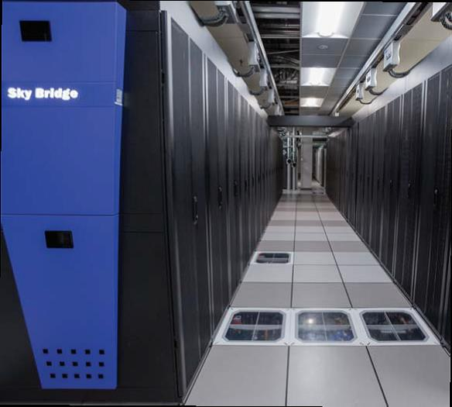
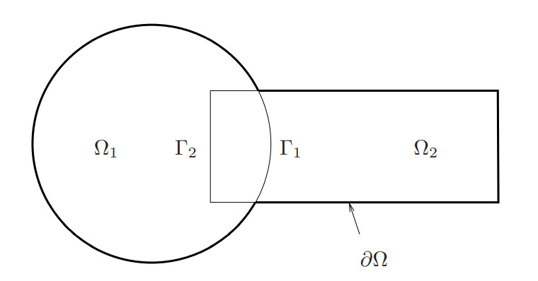
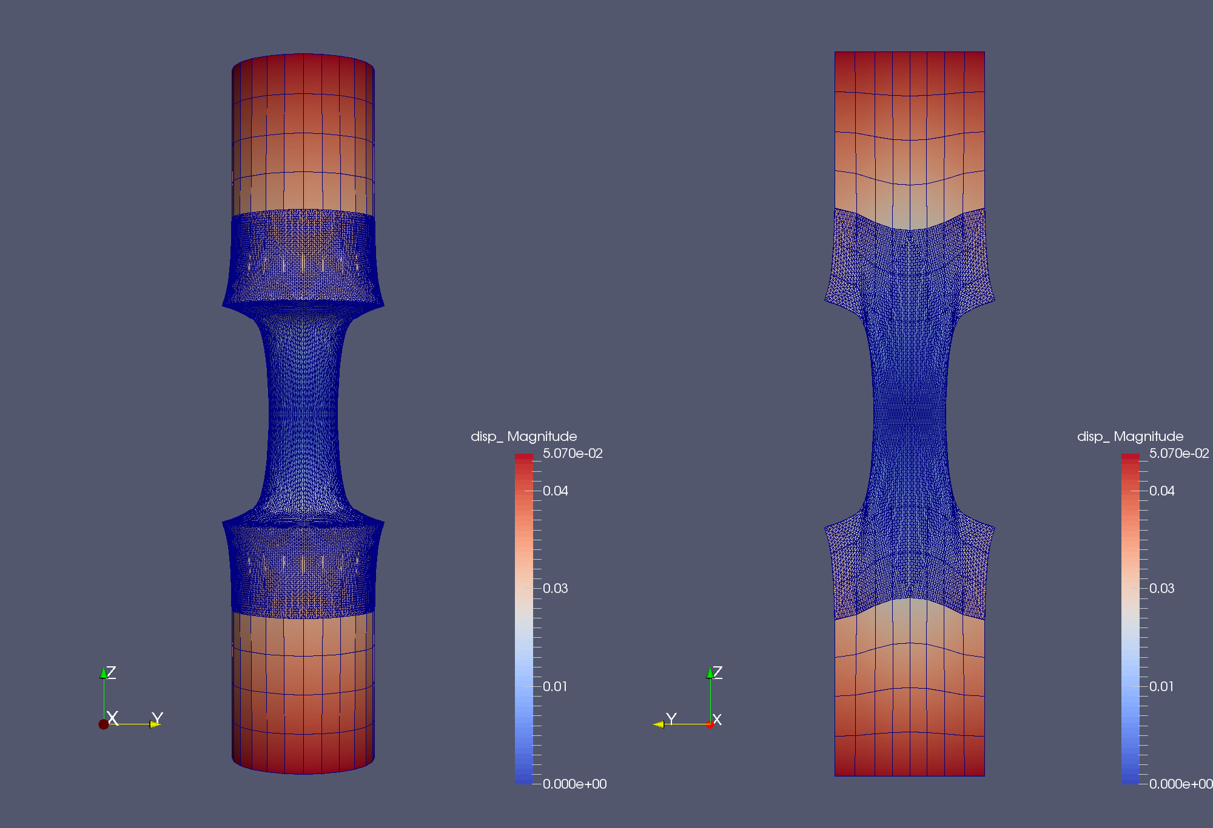
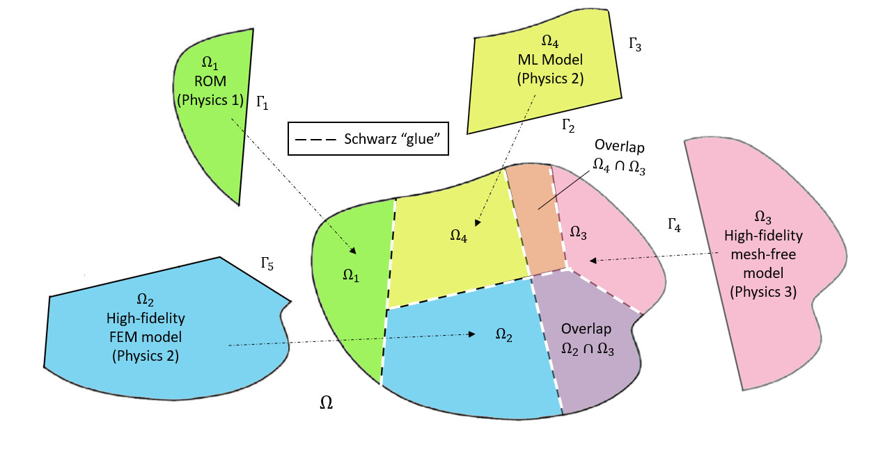
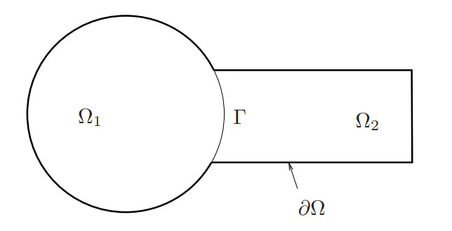
Accelerating mod/sim workflows through hybrid domain decomposition-based models and the Schwarz alternating method
Irina Tezaur¹, Alejandro Mota¹, Coleman Alleman¹, Greg Phlipot², Chris Wentland¹, Francesco Rizzi³, Joshua Barnett⁴
¹Sandia National Laboratories, ²MSC Software, ³NexGen Analytics, ⁴Cadence Design Systems
SAND2024-06735C
ESCO 2024 June 10-14, 2024

Slide 2
Outline
Schwarz Alternating Method for Coupling of Full Order Models (FOMs) in Solid Mechanics
  Motivation & Background
  Quasistatic Formulation
    Numerical Examples
  Extension to Dynamics
    Numerical Examples
Schwarz Alternating Method for FOM-ROM* and ROM-ROM Coupling
  Motivation & Background
  Formulation
  Numerical Examples
Summary and Future Work
* Projection-based Reduced Order Model

Slide 3
Outline
Schwarz Alternating Method for Coupling of Full Order Models (FOMs) in Solid Mechanics
  Motivation & Background
  Quasistatic Formulation
    Numerical Examples
  Extension to Dynamics
    Numerical Examples
Schwarz Alternating Method for FOM-ROM* and ROM-ROM Coupling
  Motivation & Background
  Formulation
  Numerical Examples
Summary and Future Work
* Projection-based Reduced Order Model

Slide 4
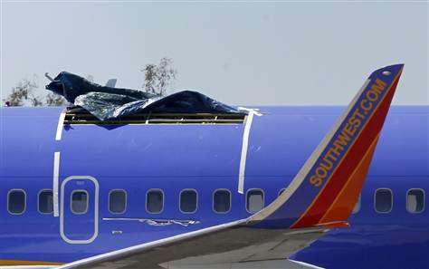
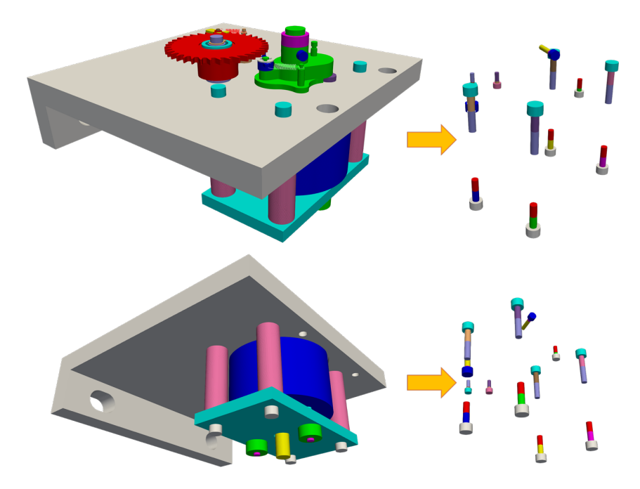
Motivation for Coupling in Solid Mechanics
Concurrent multiscale coupling for predicting failure
Large scale structural failure frequently originates from small scale phenomena such as defects, microcracks, inhomogeneities and more, which grow quickly in unstable manner
Failure occurs due to tightly coupled interaction between small scale (stress concentrations, material instabilities, cracks, etc.) and large scale (vibration, impact, high loads and other perturbations)
Concurrent multiscale methods are essential for understanding and prediction of behavior of engineering systems when a small scale failure determines the performance of the entire system
Simplification of mesh generation
Creating a high-quality mesh for a single component can take weeks, making it “the single biggest bottleneck in analyses” [Sandia Lab News, 2020]!
Roof failure of Boeing 737 aircraft due to fatigue cracks. From imechanica.org
Goal: develop a concurrent multiscale coupling method that is minimally-intrusive to implement into large HPC codes and can simplify the task of meshing complex geometries.
Schematic of difficult-to-mesh ratcheting mechanism with multiple threaded fasteners. From Parish et al., 2024.
Notes:
TODO: what is ratcheting mechanism?

Slide 5
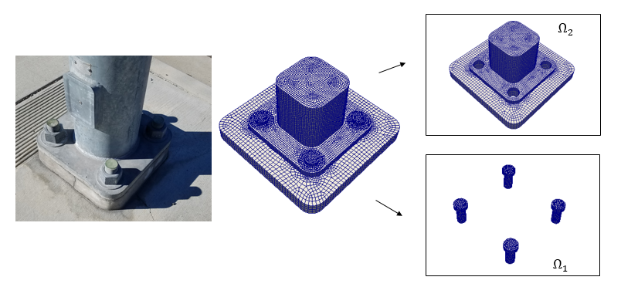
Requirements for Multiscale Coupling Method
Coupling is concurrent (two-way)
Ease of implementation into existing massively-parallel HPC codes
“Plug-and-play” framework: simplifies task of meshing complex geometries
  Ability to couple regions with different non-conformal meshes, different element types and different levels of refinement
  Ability to use different solvers/time-integrators in different regions
Scalable, fast, robust (we target real engineering problems, e.g., analyses involving failure of bolted components!)
Coupling does not introduce nonphysical artifacts
Theoretical convergence properties/ guarantees

Slide 6
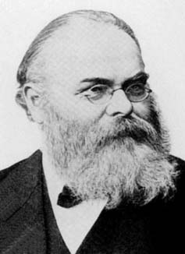
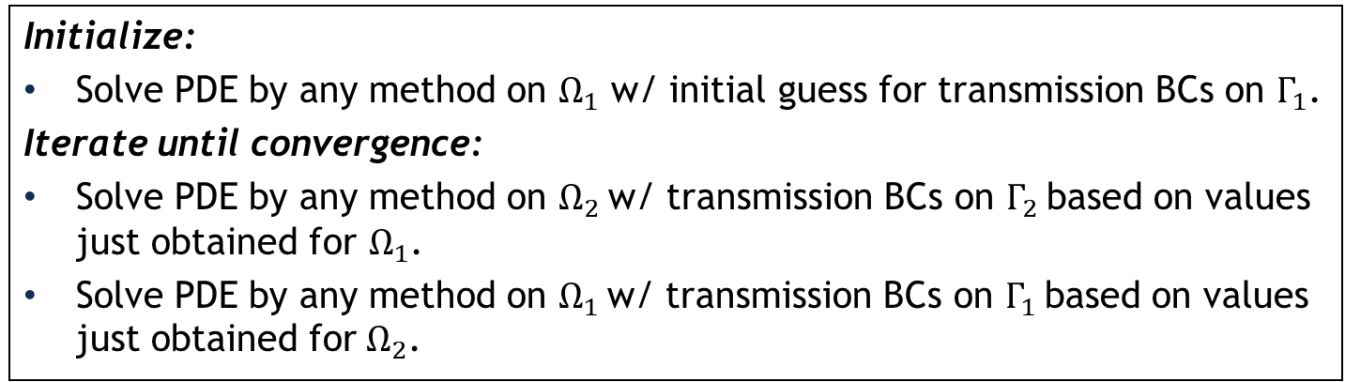
Schwarz Alternating Method for Domain Decomposition
Proposed in 1870 by H. Schwarz for solving Laplace PDE on irregular domains.
Crux of Method: if the solution is known in regularly shaped domains, use those as pieces to iteratively build a solution for the more complex domain.
H. Schwarz (1843–1921)
Basic Schwarz Algorithm
overlapping
Initialize:
Solve PDE by any method on $Ω_{1}$ w/ initial guess for transmission BCs on $Γ_{1}$.
Iterate until convergence:
Solve PDE by any method on $Ω_{2}$ w/ transmission BCs on $Γ_{2}$ based on values just obtained for $Ω_{1}$.
Solve PDE by any method on $Ω_{1}$ w/ transmission BCs on $Γ_{1}$ based on values just obtained for $Ω_{2}$.
non-overlapping
Schwarz alternating method most commonly used as a preconditioner for Krylov iterative methods to solve linear algebraic equations.
Idea behind this work: using the Schwarz alternating method as a discretization method for solving multi-scale or multi-physics partial differential equations (PDEs).
²Lions, 1990. ³Zanolli et al., 1987.

Slide 7
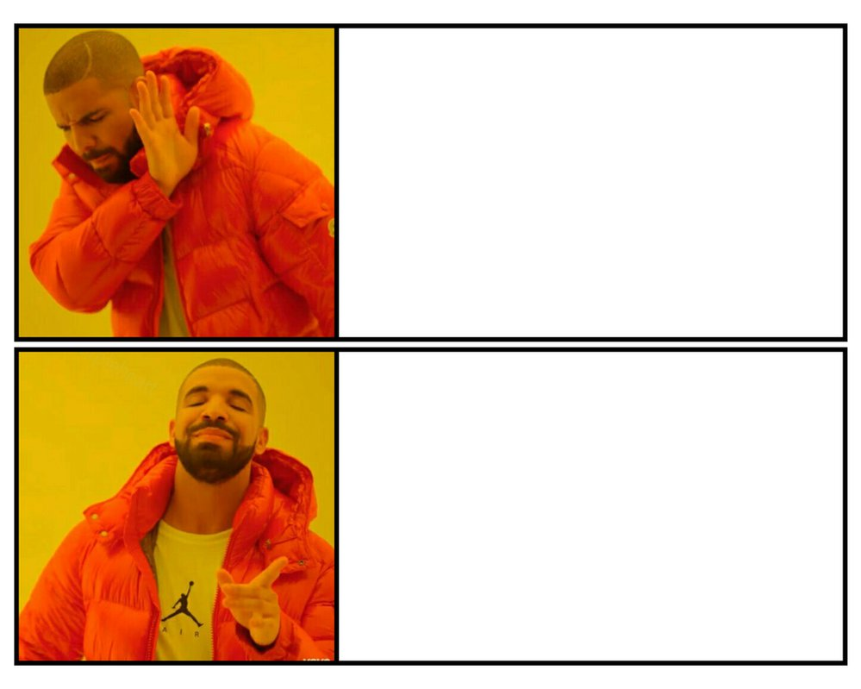
How We Use the Schwarz Alternating Method
7
AS A PRECONDITIONER FOR THE LINEARIZED SYSTEM
AS A SOLVER FOR THE COUPLED
FULLY NONLINEAR PROBLEM

Slide 8
Outline
Schwarz Alternating Method for Coupling of Full Order Models (FOMs) in Solid Mechanics
  Motivation & Background
  Quasistatic Formulation
    Numerical Examples
  Extension to Dynamics
    Numerical Examples
Schwarz Alternating Method for FOM-ROM* and ROM-ROM Coupling
  Motivation & Background
  Formulation
  Numerical Examples
Summary and Future Work
* Projection-based Reduced Order Model

Slide 9
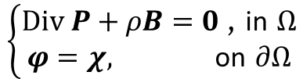
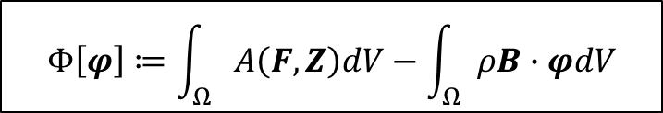
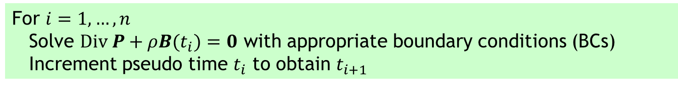
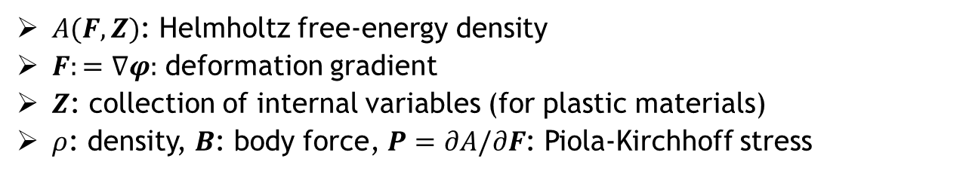
Quasistatic Solid Mechanics Formulation
Energy functional defining weak form of the governing PDEs
$$Φ\left[φ\right]≔\int_{Ω}{A\left(F,Z\right)dV−\int_{Ω}{ρB∙φdV}}$$
$A(F,Z)$: Helmholtz free-energy density
$F:=∇φ:$ deformation gradient
$Z$: collection of internal variables (for plastic materials)
$ρ$: density, $B$: body force, $P=∂A/∂F$: Piola-Kirchhoff stress
Euler-Lagrange equations, obtained by minimizing $Φ\left[φ\right]$:
$$\left\{\begin{aligned}Div P+ρB=0 \text{, }\text{in} Ω \\ φ=χ, \text{on} ∂Ω\end{aligned}\right.$$
Quasistatics solves sequence of problems in which loading (body force) $B$ is incremented quasistatically w.r.t. pseudo time $t_{i}$:
For $i=1, …, n$
Solve $Div P+ρB(t_{i})=0$ with appropriate boundary conditions (BCs)
Increment pseudo time $t_{i}$ to obtain $t_{i+1}$

Slide 10

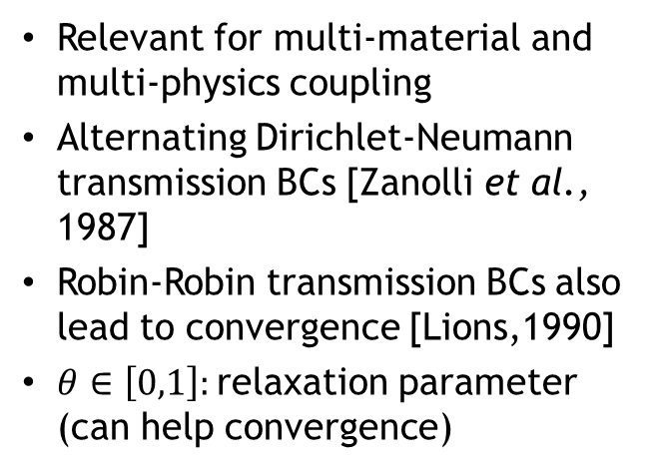




Spatial Coupling via (Multiplicative) Alternating Schwarz
Overlapping Domain Decomposition
Model PDE:
$$\left\{\begin{aligned}Div P_{1}^{(n+1)}+ρB(t_{i})=0 \text{, }\text{in} Ω_{1} \\ φ_{1}^{(n+1)}=χ\text{, }\text{on} ∂Ω_{1}\backslash Γ_{1} \\ φ_{1}^{(n+1)}=φ_{2}^{(n)} \text{on} Γ_{2}\end{aligned}\right.$$
$$\left\{\begin{aligned}Div P+ρB=0 \text{, }\text{in} Ω \\ φ=χ, \text{on} ∂Ω\end{aligned}\right.$$
Dirichlet-Dirichlet transmission BCs [Schwarz, 1870; Lions, 1988]
$$\left\{\begin{aligned}Div P_{2}^{(n+1)}+ρB(t_{i})=0 \text{, }\text{in}{ Ω}_{2} \\ φ_{2}^{(n+1)}=χ\text{, }\text{on} ∂Ω_{2}\backslash Γ_{2} \\ φ_{2}^{(n+1)}=φ_{1}^{(n+1)} \text{on} Γ_{2}\end{aligned}\right.$$
Non-overlapping Domain Decomposition
$$\left\{\begin{aligned}Div{ P}_{1}^{(n+1)}+ρB(t_{i})=0 \text{, }\text{in} Ω_{1} \\ φ_{1}^{(n+1)}=χ\text{, }\text{on} ∂Ω_{1}\backslash Γ \\ φ_{1}^{(n+1)}=λ_{n+1} \text{on} Γ\end{aligned}\right.$$
Relevant for multi-material and multi-physics coupling
Alternating Dirichlet-Neumann transmission BCs [Zanolli et al., 1987]
Robin-Robin transmission BCs also lead to convergence [Lions,1990]
$θ∈\left[0,1\right]:$relaxation parameter (can help convergence)
$$\left\{\begin{aligned}Div P_{2}^{(n+1)}+ρB(t_{i})=0 \text{, }\text{in}{ Ω}_{2} \\ φ_{2}^{(n+1)}=χ\text{, }\text{on} ∂Ω_{2}\backslash Γ \\ P_{2}^{(n+1)}n=P_{2}^{(n+1)}n\text{, }\text{on} Γ\end{aligned}\right.$$
$$λ_{n+1}=θφ_{2}^{(n)}+\left(1−θ\right)λ_{n}, on Γ, for n≥1$$

Slide 11
Spatial Coupling via (Multiplicative) Alternating Schwarz
Overlapping Domain Decomposition
Model PDE:
$$\left\{\begin{aligned}Div P_{1}^{(n+1)}+ρB(t_{i})=0 \text{, }\text{in} Ω_{1} \\ φ_{1}^{(n+1)}=χ\text{, }\text{on} ∂Ω_{1}\backslash Γ_{1} \\ φ_{1}^{(n+1)}=φ_{2}^{(n)} \text{on} Γ_{2}\end{aligned}\right.$$
$$\left\{\begin{aligned}Div P+ρB=0 \text{, }\text{in} Ω \\ φ=χ, \text{on} ∂Ω\end{aligned}\right.$$
Dirichlet-Dirichlet transmission BCs [Schwarz, 1870; Lions, 1988]
$$\left\{\begin{aligned}Div P_{2}^{(n+1)}+ρB(t_{i})=0 \text{, }\text{in}{ Ω}_{2} \\ φ_{2}^{(n+1)}=χ\text{, }\text{on} ∂Ω_{2}\backslash Γ_{2} \\ φ_{2}^{(n+1)}=φ_{1}^{(n+1)} \text{on} Γ_{2}\end{aligned}\right.$$
Part 1 of talk
Non-overlapping Domain Decomposition
Part 2 of talk
$$\left\{\begin{aligned}Div{ P}_{1}^{(n+1)}+ρB(t_{i})=0 \text{, }\text{in} Ω_{1} \\ φ_{1}^{(n+1)}=χ\text{, }\text{on} ∂Ω_{1}\backslash Γ \\ φ_{1}^{(n+1)}=λ_{n+1} \text{on} Γ\end{aligned}\right.$$
Relevant for multi-material and multi-physics coupling
Alternating Dirichlet-Neumann transmission BCs [Zanolli et al., 1987]
Robin-Robin transmission BCs also lead to convergence [Lions,1990]
$θ∈\left[0,1\right]:$relaxation parameter (can help convergence)
$$\left\{\begin{aligned}Div P_{2}^{(n+1)}+ρB(t_{i})=0 \text{, }\text{in}{ Ω}_{2} \\ φ_{2}^{(n+1)}=χ\text{, }\text{on} ∂Ω_{2}\backslash Γ \\ P_{2}^{(n+1)}n=P_{2}^{(n+1)}n\text{, }\text{on} Γ\end{aligned}\right.$$
$$λ_{n+1}=θφ_{2}^{(n)}+\left(1−θ\right)λ_{n}, on Γ, for n≥1$$

Slide 12

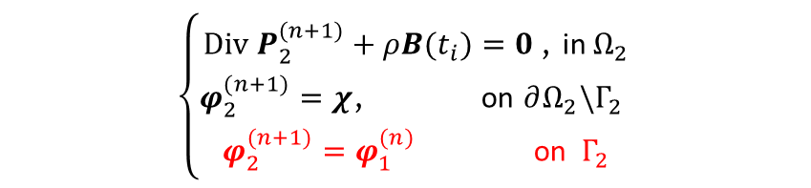
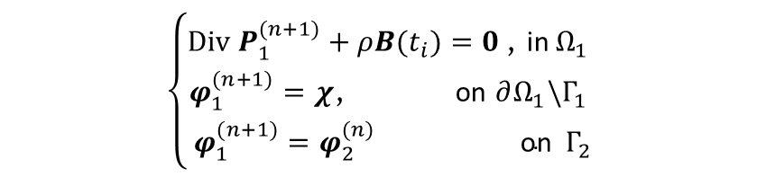
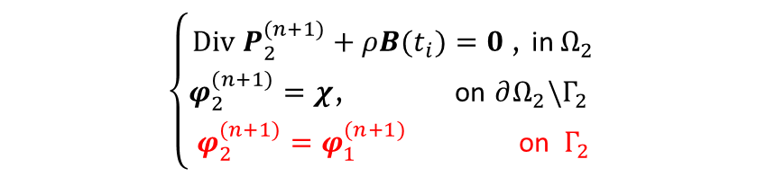
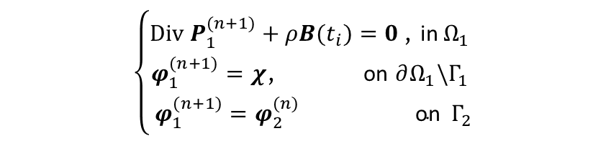
Additional Parallelism via Additive Schwarz
Model PDE:
Multiplicative Overlapping Schwarz
Additive Overlapping Schwarz
$$\left\{\begin{aligned}Div P+ρB=0 \text{, }\text{in} Ω \\ φ=χ, \text{on} ∂Ω\end{aligned}\right.$$
$$\left\{\begin{aligned}Div P_{1}^{(n+1)}+ρB(t_{i})=0 \text{, }\text{in} Ω_{1} \\ φ_{1}^{(n+1)}=χ\text{, }\text{on} ∂Ω_{1}\backslash Γ_{1} \\ φ_{1}^{(n+1)}=φ_{2}^{(n)} \text{on} Γ_{2}\end{aligned}\right.$$
$$\left\{\begin{aligned}Div P_{1}^{(n+1)}+ρB(t_{i})=0 \text{, }\text{in} Ω_{1} \\ φ_{1}^{(n+1)}=χ\text{, }\text{on} ∂Ω_{1}\backslash Γ_{1} \\ φ_{1}^{(n+1)}=φ_{2}^{(n)} \text{on} Γ_{2}\end{aligned}\right.$$
$$\left\{\begin{aligned}Div P_{2}^{(n+1)}+ρB(t_{i})=0 \text{, }\text{in}{ Ω}_{2} \\ φ_{2}^{(n+1)}=χ\text{, }\text{on} ∂Ω_{2}\backslash Γ_{2} \\ φ_{2}^{(n+1)}=φ_{1}^{(n+1)} \text{on} Γ_{2}\end{aligned}\right.$$
$$\left\{\begin{aligned}Div P_{2}^{(n+1)}+ρB(t_{i})=0 \text{, }\text{in}{ Ω}_{2} \\ φ_{2}^{(n+1)}=χ\text{, }\text{on} ∂Ω_{2}\backslash Γ_{2} \\ φ_{2}^{(n+1)}=φ_{1}^{(n)} \text{on} Γ_{2}\end{aligned}\right.$$
Multiplicative Schwarz: solves subdomain problems sequentially (in serial)
Additive Schwarz: advance subdomains in parallel, communicate boundary condition data later
  Typically requires a few more Schwarz iterations, but does not degrade accuracy
  Parallelism helps balance additional cost due to Schwarz iterations
  Applicable to both overlapping and non-overlapping Schwarz

Slide 13
Additional Parallelism via Additive Schwarz
Part 1 of talk
Part 2 of talk
Model PDE:
Multiplicative Overlapping Schwarz
Additive Overlapping Schwarz
$$\left\{\begin{aligned}Div P+ρB=0 \text{, }\text{in} Ω \\ φ=χ, \text{on} ∂Ω\end{aligned}\right.$$
$$\left\{\begin{aligned}Div P_{1}^{(n+1)}+ρB(t_{i})=0 \text{, }\text{in} Ω_{1} \\ φ_{1}^{(n+1)}=χ\text{, }\text{on} ∂Ω_{1}\backslash Γ_{1} \\ φ_{1}^{(n+1)}=φ_{2}^{(n)} \text{on} Γ_{2}\end{aligned}\right.$$
$$\left\{\begin{aligned}Div P_{1}^{(n+1)}+ρB(t_{i})=0 \text{, }\text{in} Ω_{1} \\ φ_{1}^{(n+1)}=χ\text{, }\text{on} ∂Ω_{1}\backslash Γ_{1} \\ φ_{1}^{(n+1)}=φ_{2}^{(n)} \text{on} Γ_{2}\end{aligned}\right.$$
$$\left\{\begin{aligned}Div P_{2}^{(n+1)}+ρB(t_{i})=0 \text{, }\text{in}{ Ω}_{2} \\ φ_{2}^{(n+1)}=χ\text{, }\text{on} ∂Ω_{2}\backslash Γ_{2} \\ φ_{2}^{(n+1)}=φ_{1}^{(n+1)} \text{on} Γ_{2}\end{aligned}\right.$$
$$\left\{\begin{aligned}Div P_{2}^{(n+1)}+ρB(t_{i})=0 \text{, }\text{in}{ Ω}_{2} \\ φ_{2}^{(n+1)}=χ\text{, }\text{on} ∂Ω_{2}\backslash Γ_{2} \\ φ_{2}^{(n+1)}=φ_{1}^{(n)} \text{on} Γ_{2}\end{aligned}\right.$$
Multiplicative Schwarz: solves subdomain problems sequentially (in serial)
Additive Schwarz: advance subdomains in parallel, communicate boundary condition data later
  Typically requires a few more Schwarz iterations, but does not degrade accuracy
  Parallelism helps balance additional cost due to Schwarz iterations
  Applicable to both overlapping and non-overlapping Schwarz

Slide 14
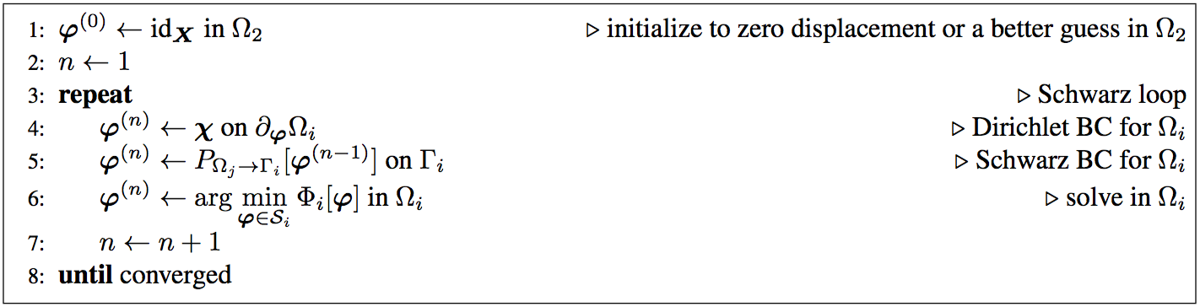
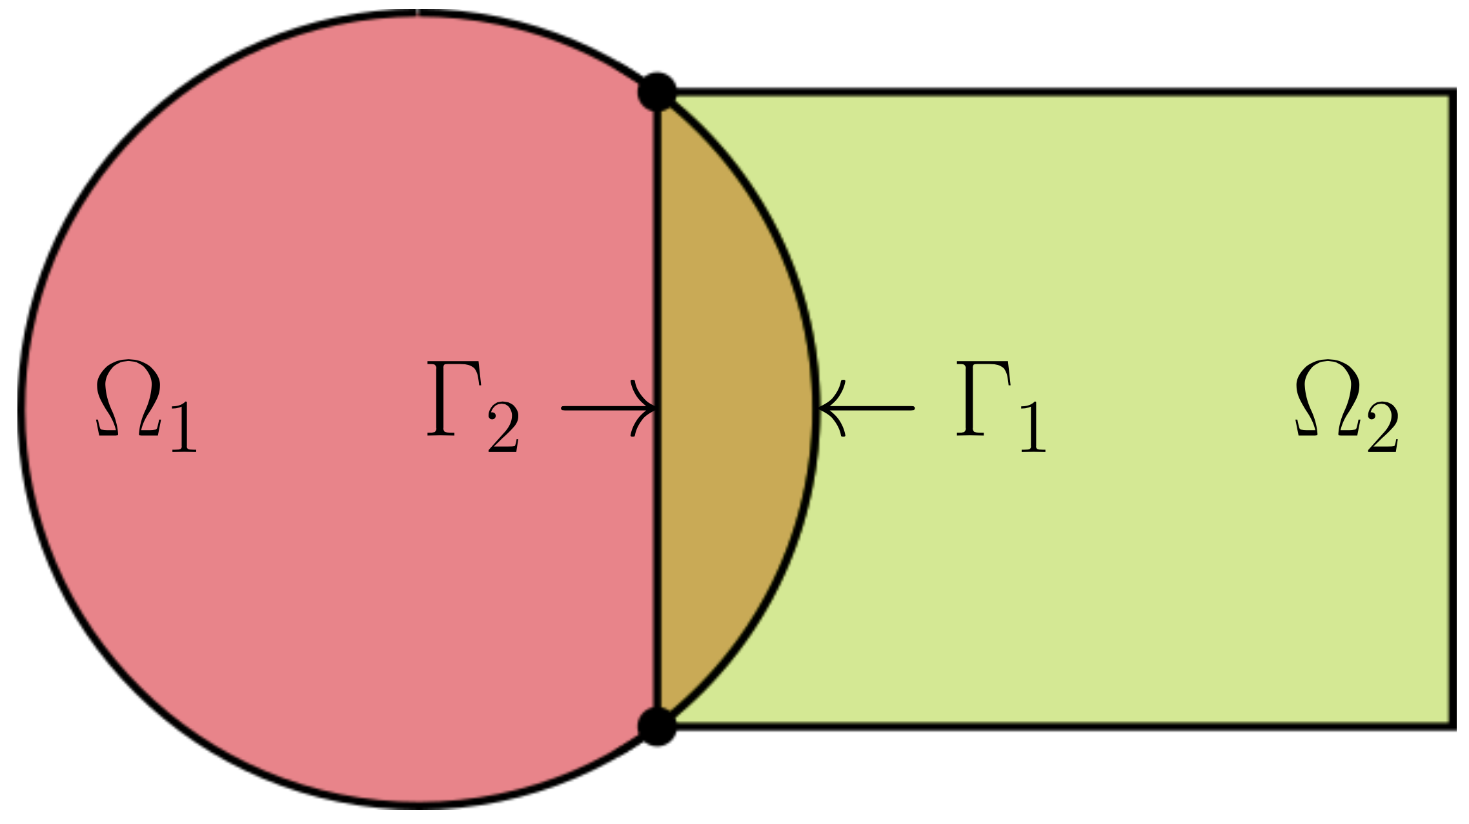
Overlapping Schwarz Coupling in Quasistatics
outer quasistatic loop
Advantages:
Conceptually very simple.
Allows the coupling of regions with different non-conforming meshes, different element types, and different levels of refinement.
Information is exchanged among two or more regions, making coupling concurrent.
Different solvers can be used for the different regions.
Different material models can be coupled if they are compatible in the overlap region.
Simplifies the task of meshing complex geometries for the different scales.

Slide 15
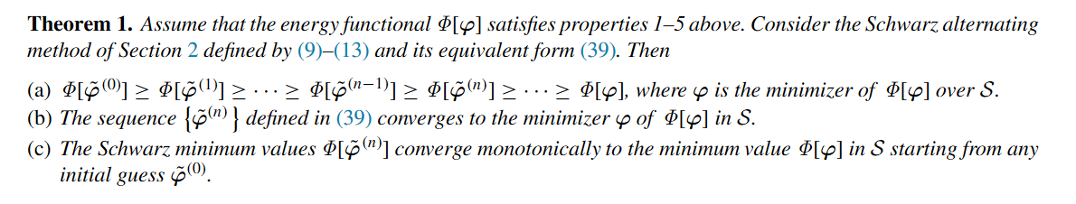
Convergence Proof*
*A. Mota, I. Tezaur, C. Alleman. "The Schwarz Alternating Method in Solid Mechanics", CMAME 319 (2017), 19-51.
Notes:
The proof effectively constructs a sequence of solutions phi^n and demonstrates that this sequence converges to the unique minimizer of the energy functional \Phi defining the single-domain problem, and combines concepts used in the analysis of Sobolev, Lions, and others, in studying the convergence of the Schwarz method.

Slide 16

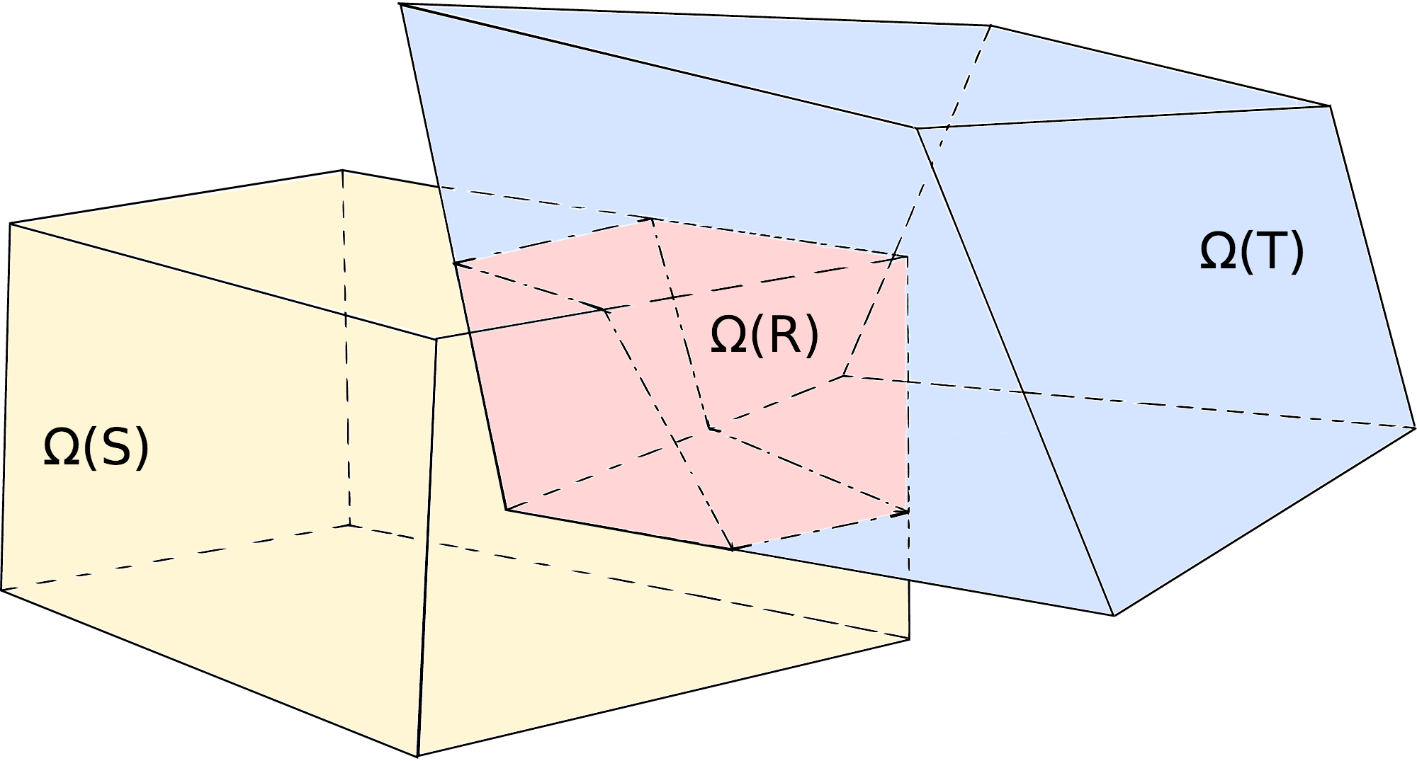
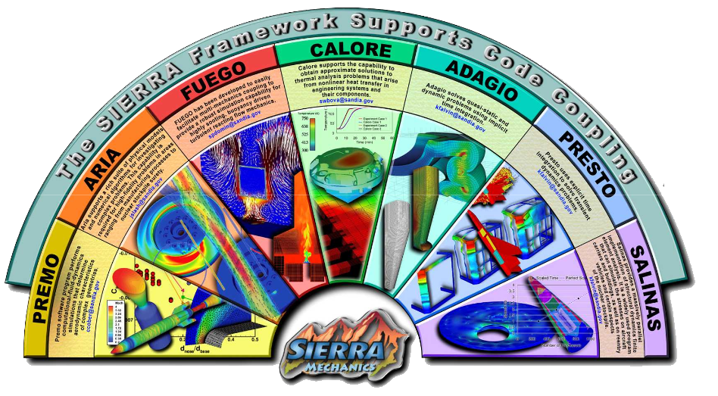
Implementation in Albany-LCM and Sierra/SM HPC Codes
The overlapping Schwarz alternating method has been implemented in two Sandia HPC codes: Albany-LCM and Sierra/SM
Albany-LCM¹
Open-source parallel, C++, multi-physics, finite element code that relies heavily on Trilinos² libraries
Parallel implementation of Schwarz alternating method uses the Data Transfer Kit (DTK)³
Sierra/Solid Mechanics (Sierra/SM)
Sandia proprietary production Lagrangian 3D code for finite element analysis of solids & structures
Schwarz alternating method was “implemented” in Sierra/SM using Arpeggio iterative coupling framework
Data Transfer Kit (DTK)
We did not have to write any code in Sierra/SM to implement Schwarz!
¹https://github.com/sandialabs/LCM.git. ²http://github.com/trilinos/Trilinos.git. ³https://github.com/ORNL-CEES/DataTransferKit.
Notes:
TODO: fill in slide.

Slide 17
Outline
Schwarz Alternating Method for Coupling of Full Order Models (FOMs) in Solid Mechanics
  Motivation & Background
  Quasistatic Formulation
    Numerical Examples
  Extension to Dynamics
    Numerical Examples
Schwarz Alternating Method for FOM-ROM* and ROM-ROM Coupling
  Motivation & Background
  Formulation
  Numerical Examples
Summary and Future Work
* Projection-based Reduced Order Model

Slide 18
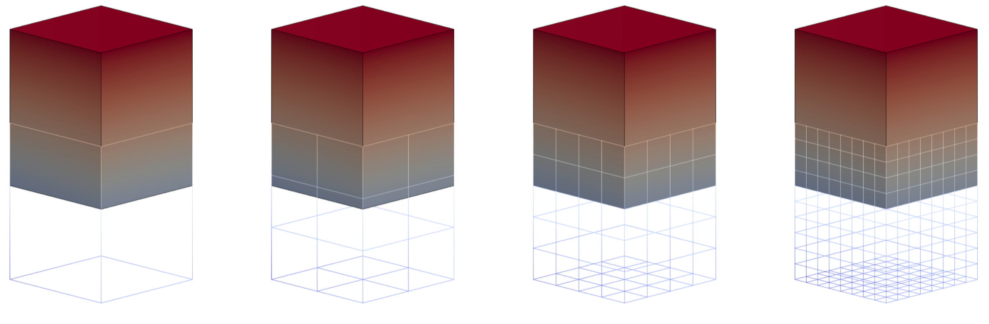

Cuboid Problem
Coupling of two cuboids with square base (above).
Neohookean-type material model.
Schwarz Iteration

Slide 19
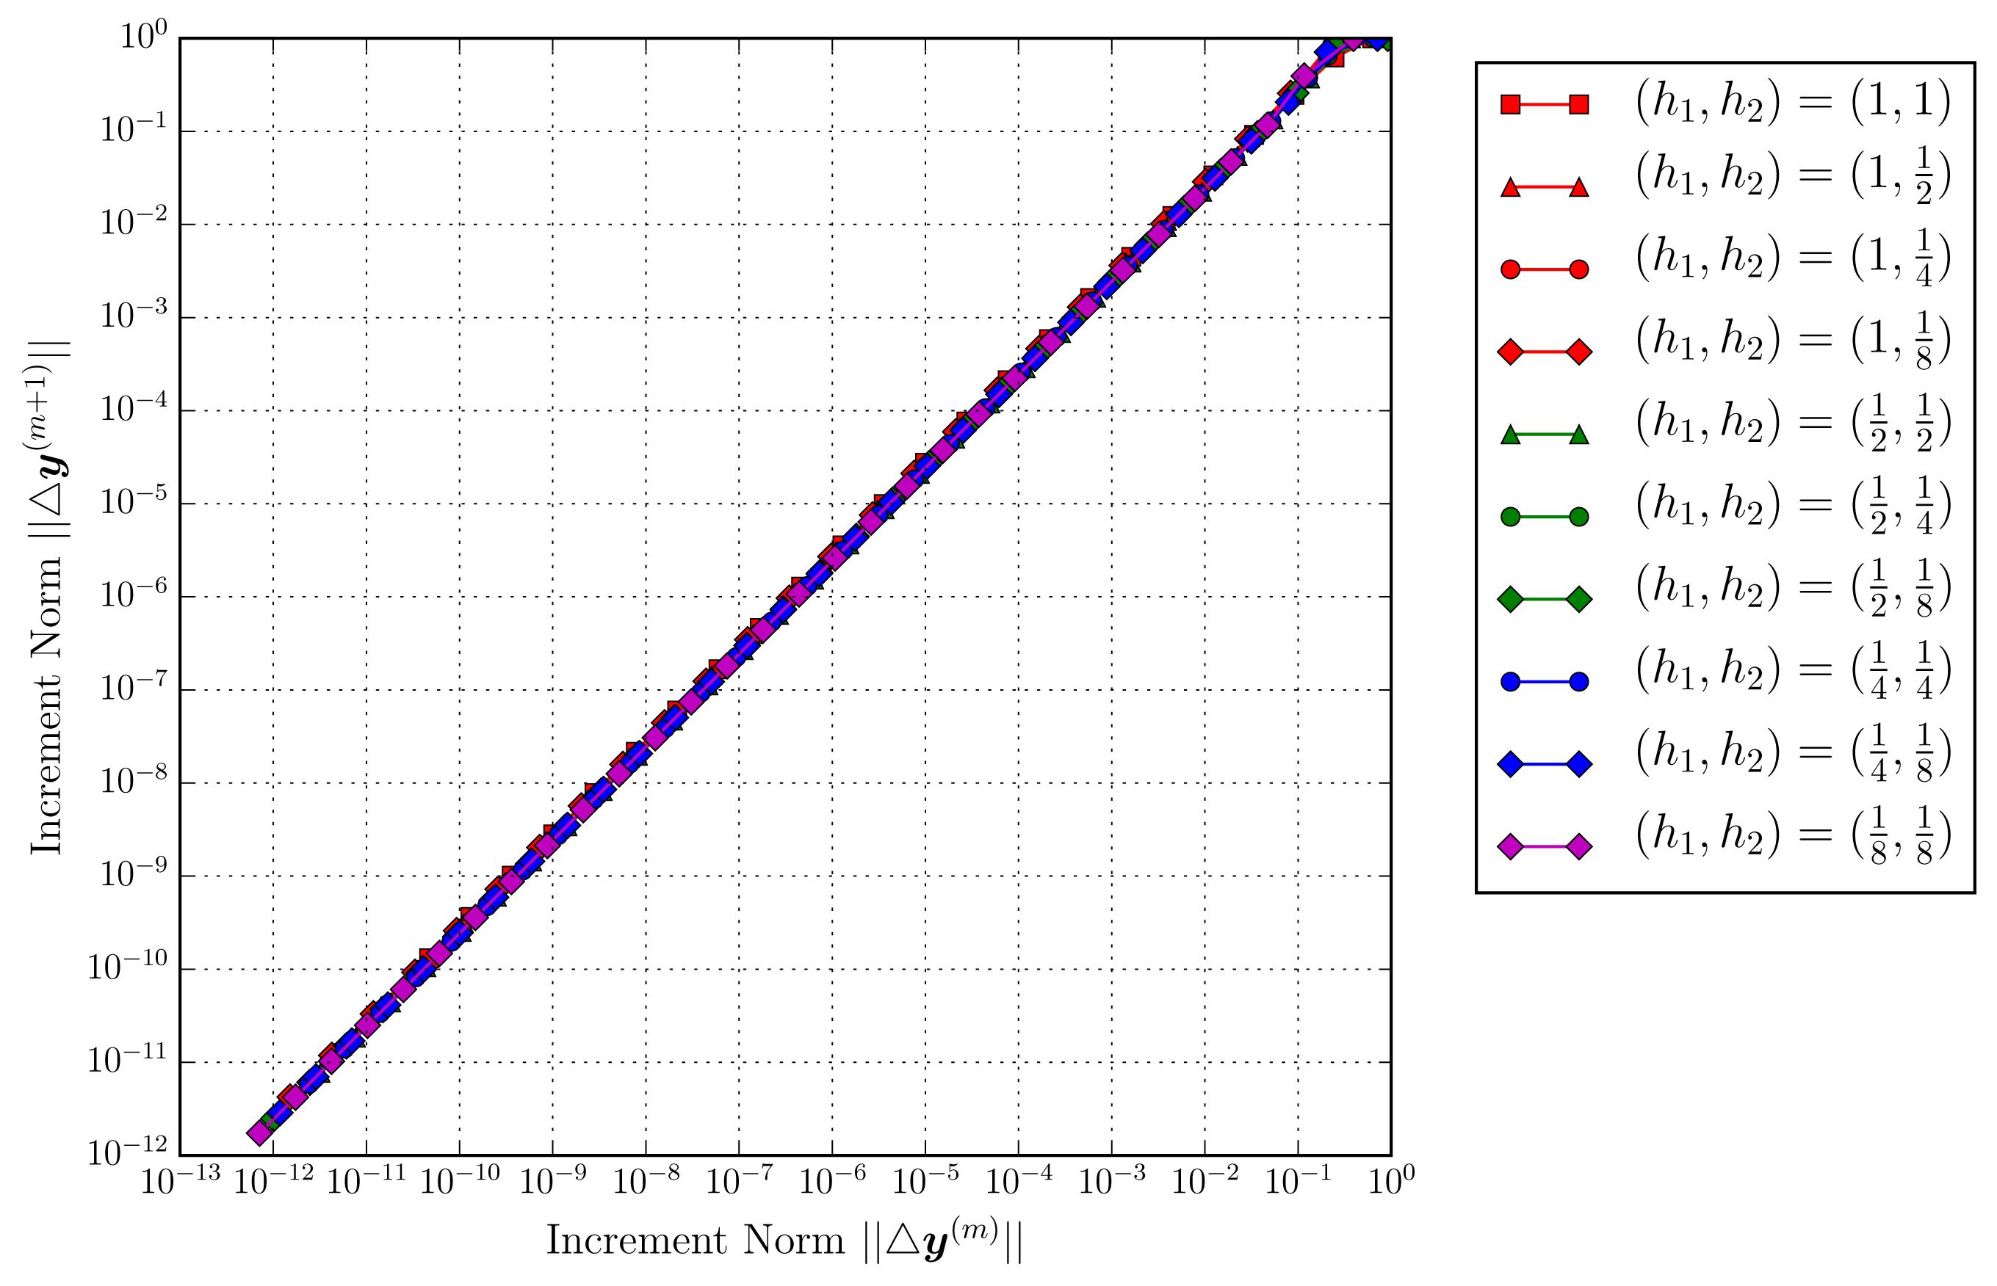
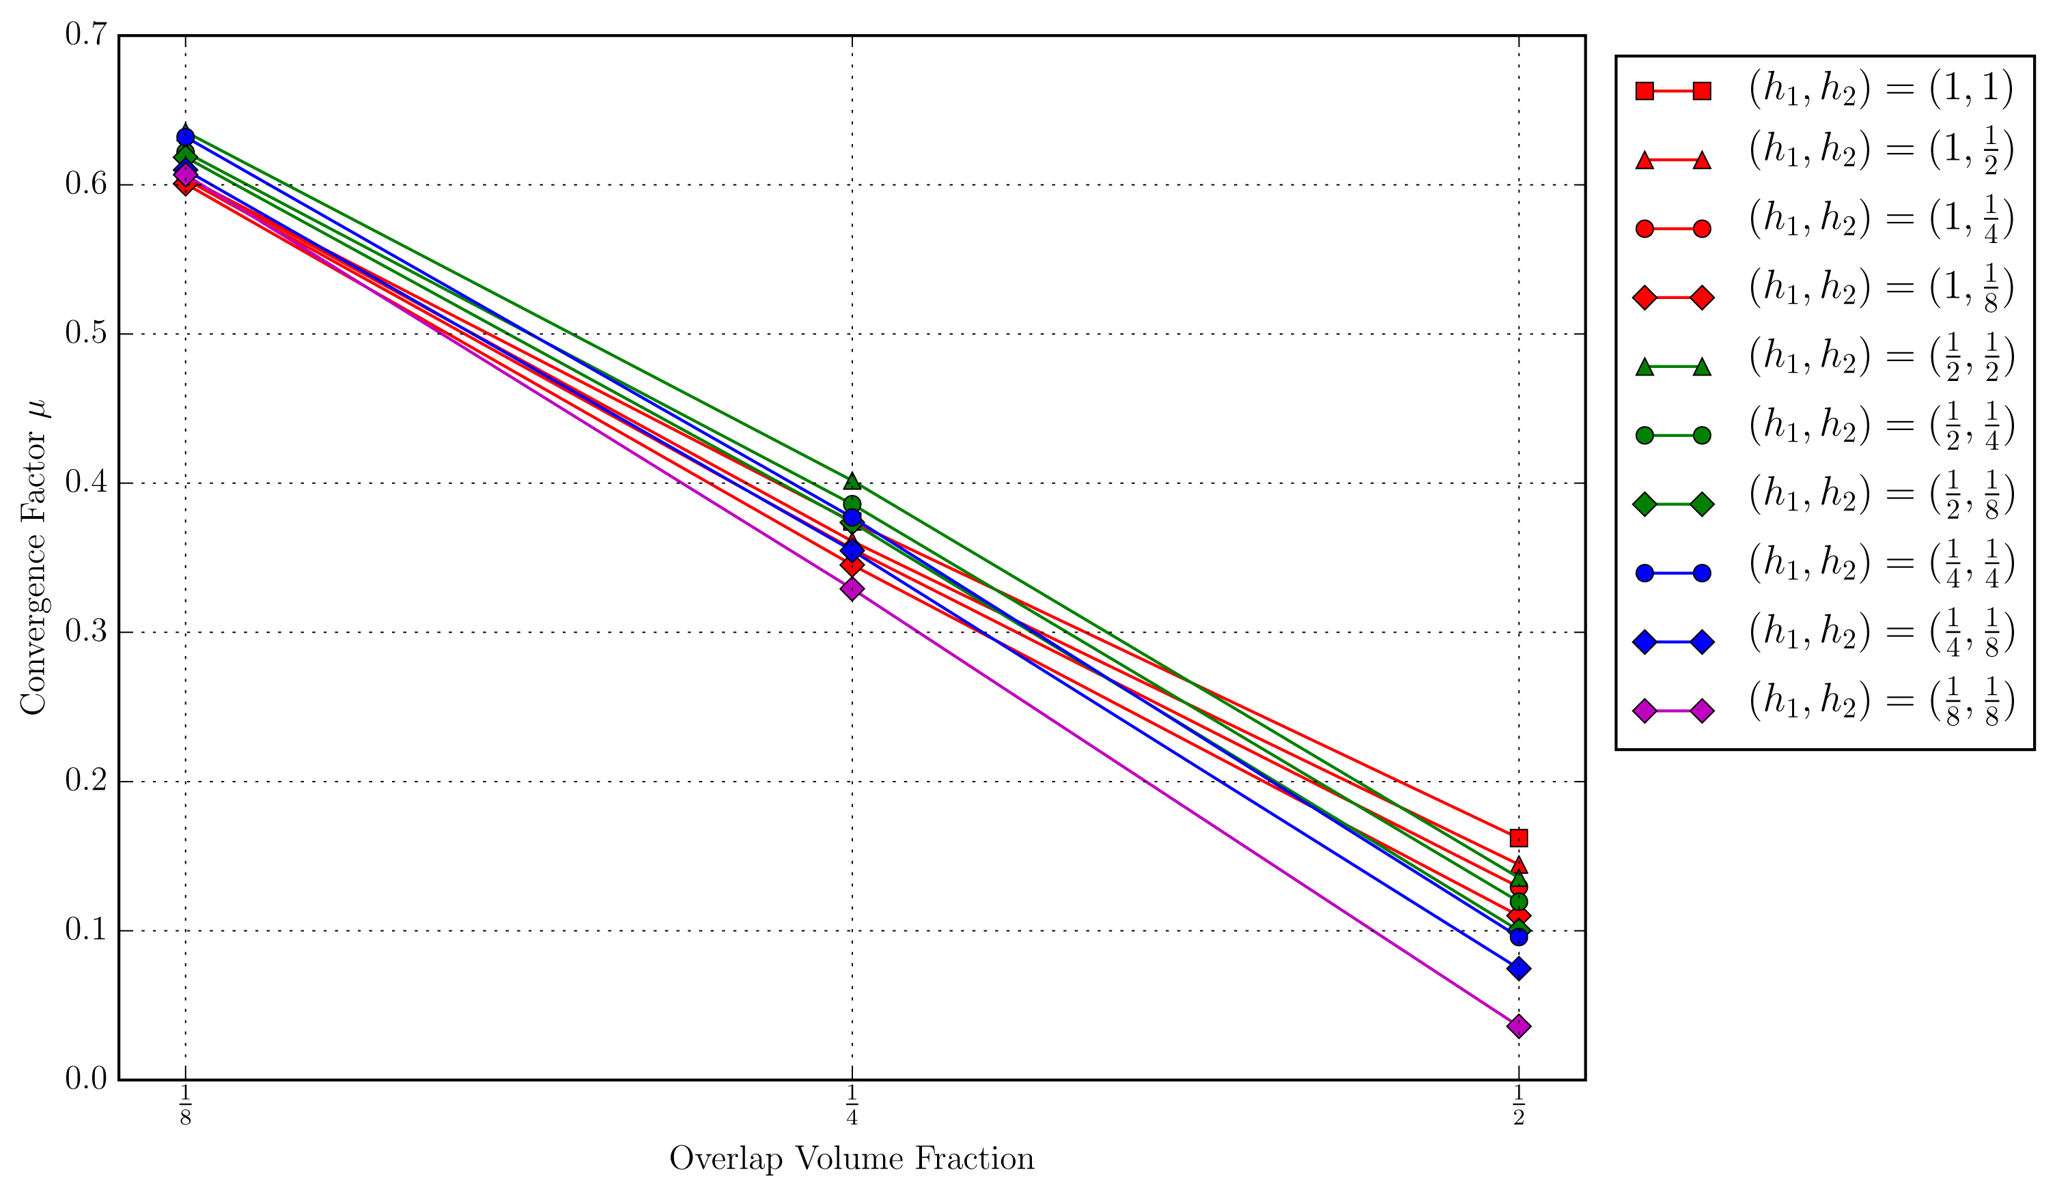
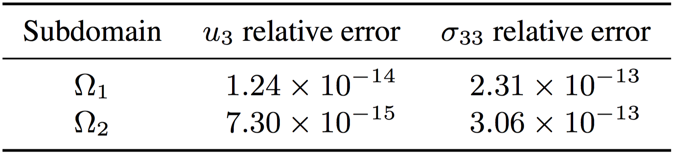
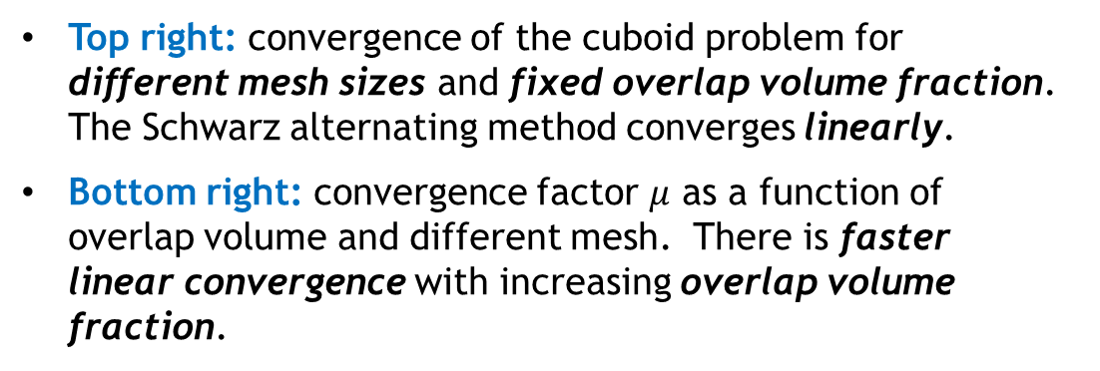

Cuboid Problem: Convergence and Accuracy
Top right: convergence of the cuboid problem for different mesh sizes and fixed overlap volume fraction. The Schwarz alternating method converges linearly.
Bottom right: convergence factor $μ$ as a function of overlap volume and different mesh. There is faster linear convergence with increasing overlap volume fraction.
$$∆y^{(m+1)}≤μ∆y^{(m)}$$
Below: relative errors in displacement and stress w.r.t. single-domain reference solution. Errors are on the order of machine precision.

Slide 20
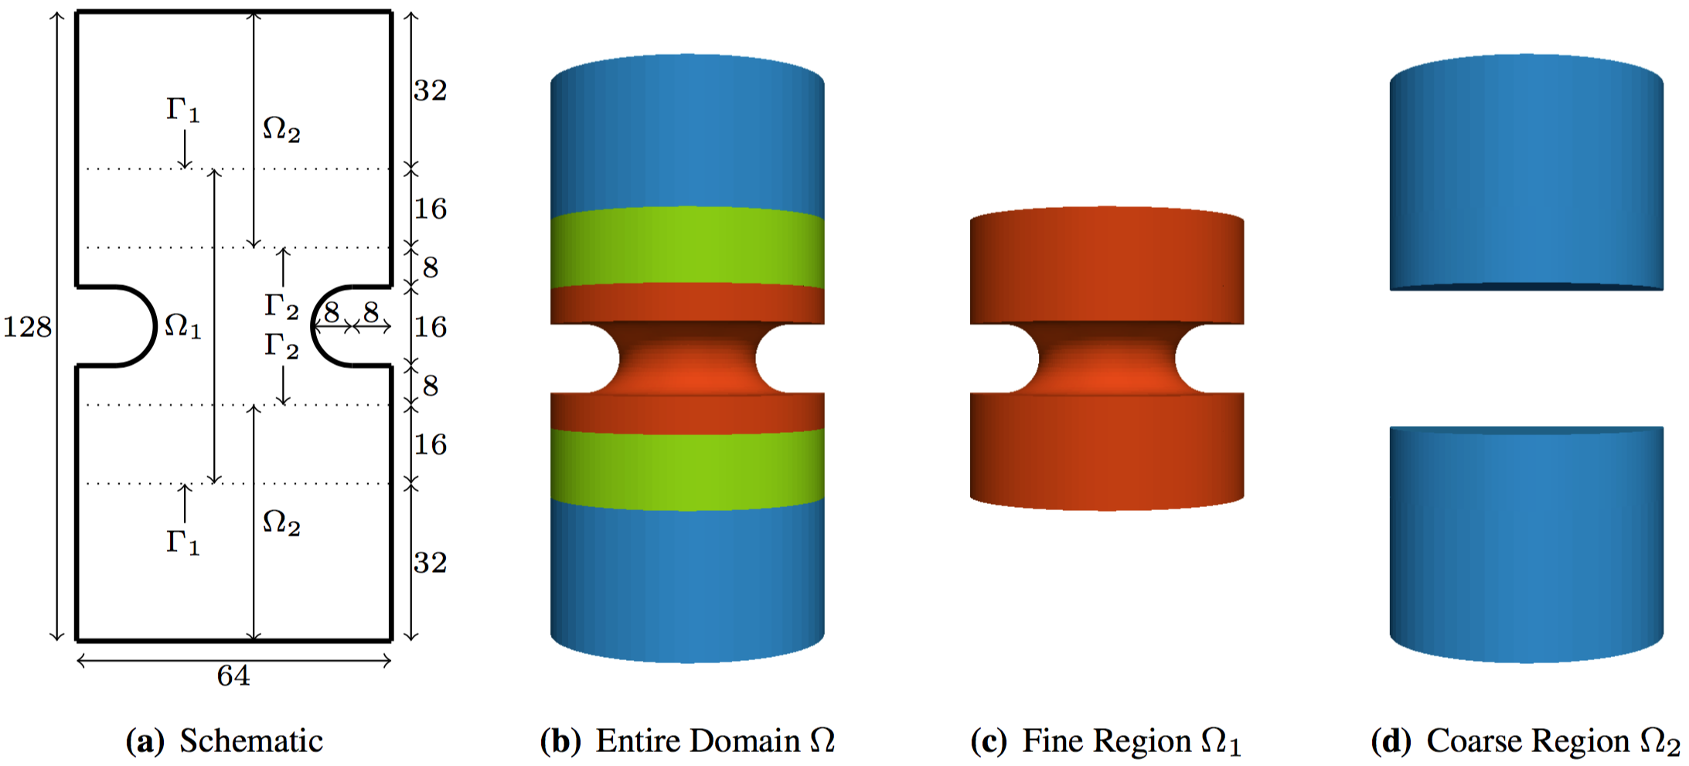
Notched Cylinder
Notched cylinder that is stretched along its axial direction.
Domain decomposed into two subdomains.
Neohookean-type material model.

Slide 21
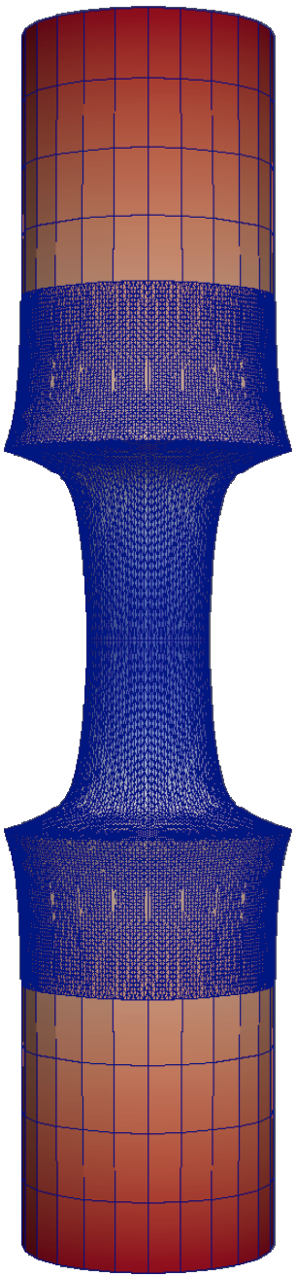
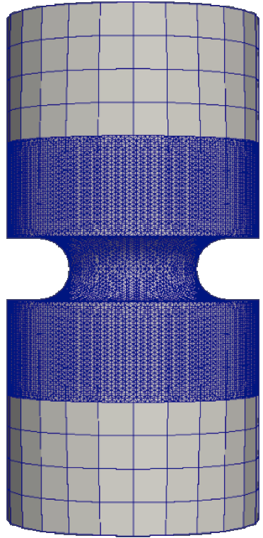
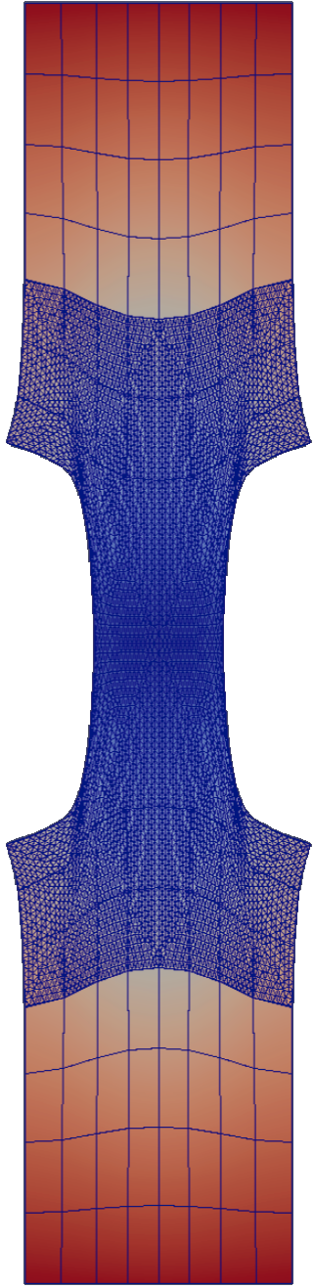
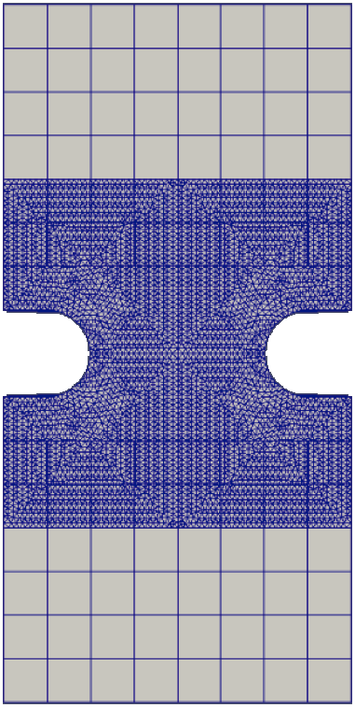
Notched Cylinder: TET - HEX Coupling
The Schwarz alternating method is capable of coupling different mesh topologies.
The notched region, where stress concentrations are expected, is finely meshed with tetrahedral elements.
The top and bottom regions, presumably of less interest, are meshed with coarser hexahedral elements.

Slide 22
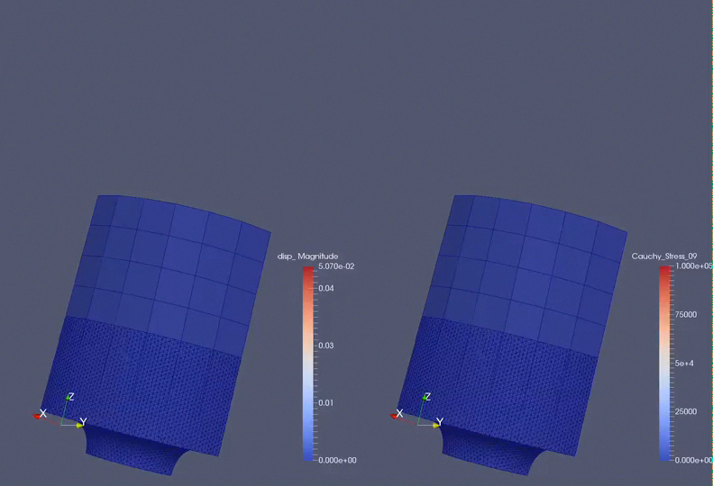
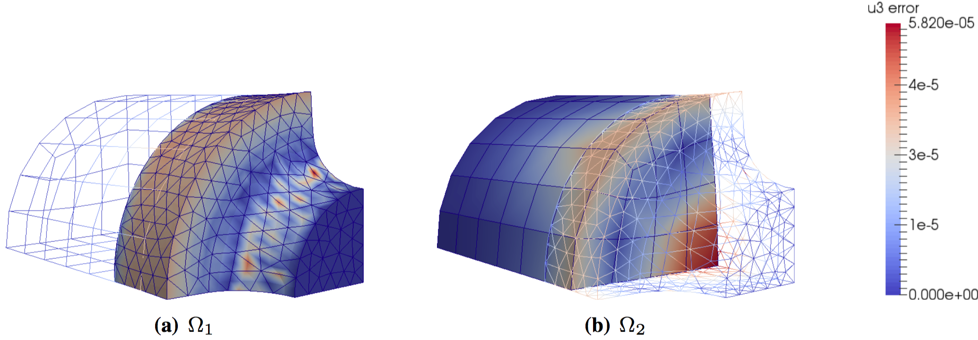
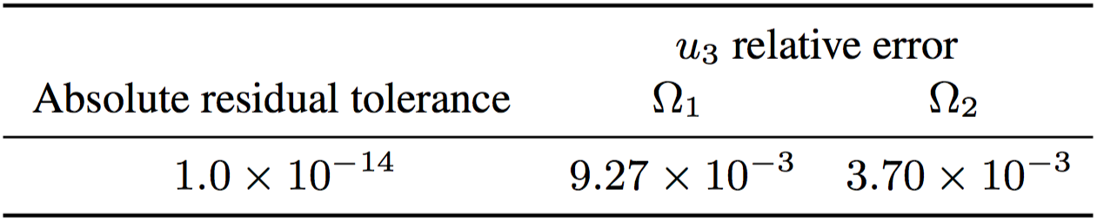
Notched Cylinder: TET - HEX Coupling
Relative errors in displacement w.r.t. single-domain reference solution are dominated by geometric (rather than coupling) error.

Slide 23
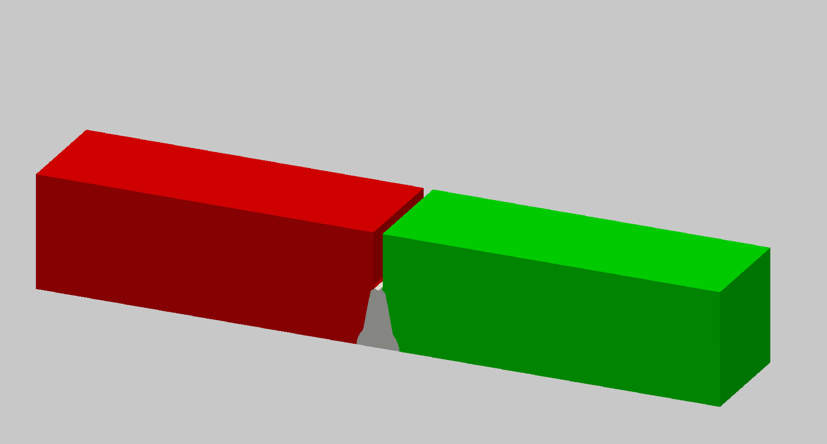
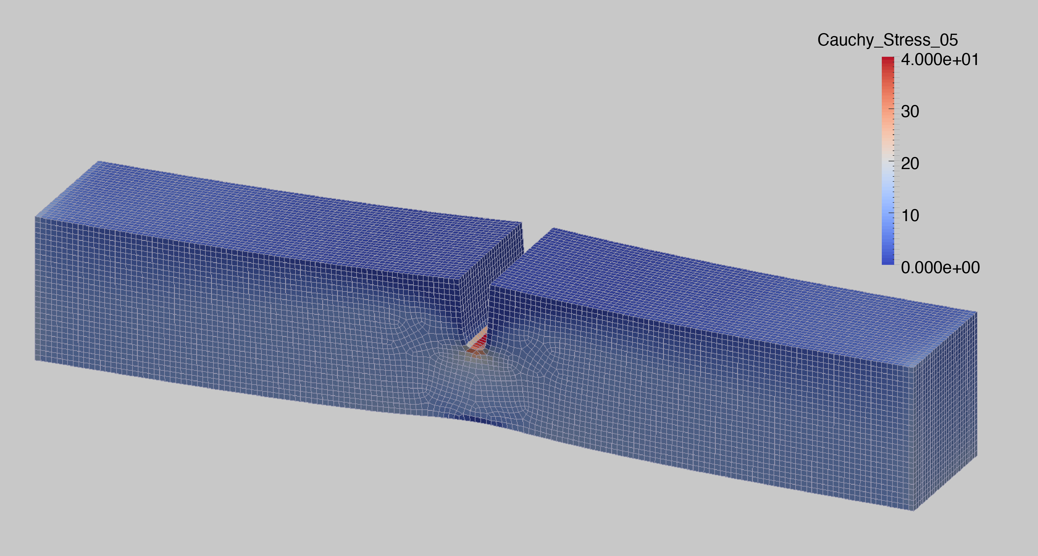
Laser Weld (Albany/LCM)
Laser weld specimen
Single domain discretization
Coupled Schwarz discretization
(50% reduction in model size)
Problem of practical scale.
Isotropic elasticity and J₂ plasticity with linear isotropic hardening.
Identical parameters for weld and base materials for proof of concept, to become independent models.
Notes:
~200K dofs

Slide 24
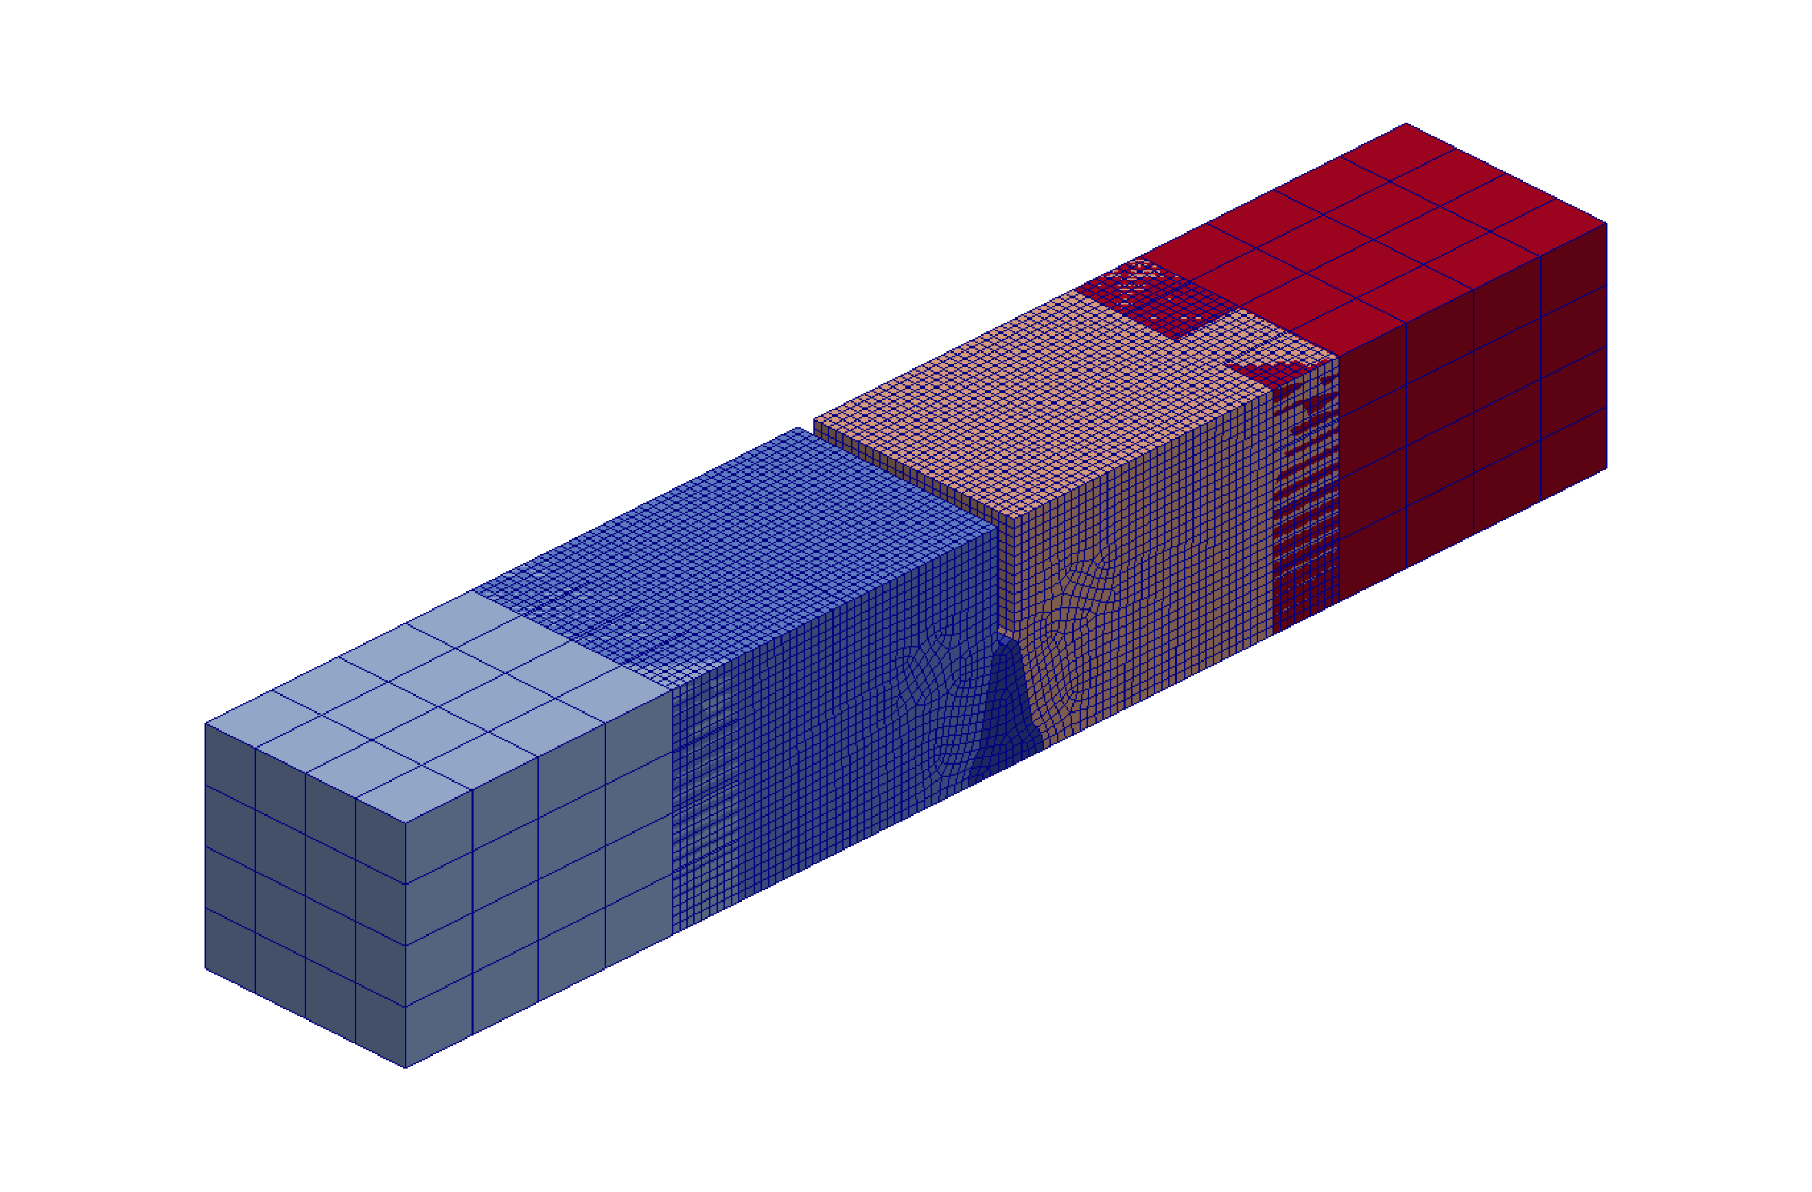
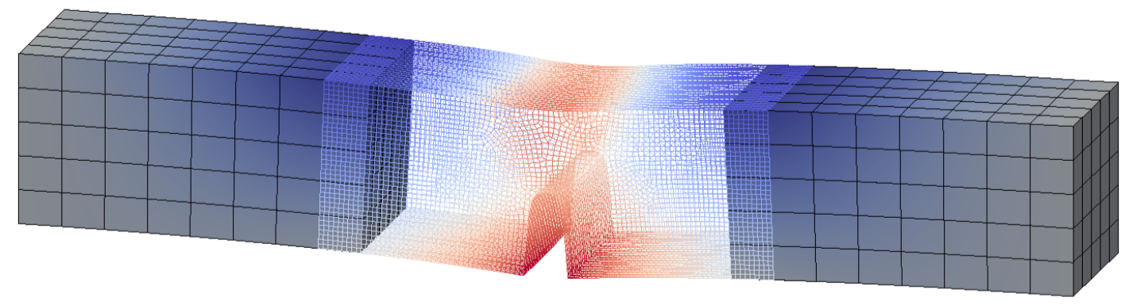
Laser Weld (Albany/LCM): Strong Scalability of Parallel Schwarz with DTK
Near-ideal linear speedup (64-1024 cores).
Data Transfer Kit (DTK)

Slide 25
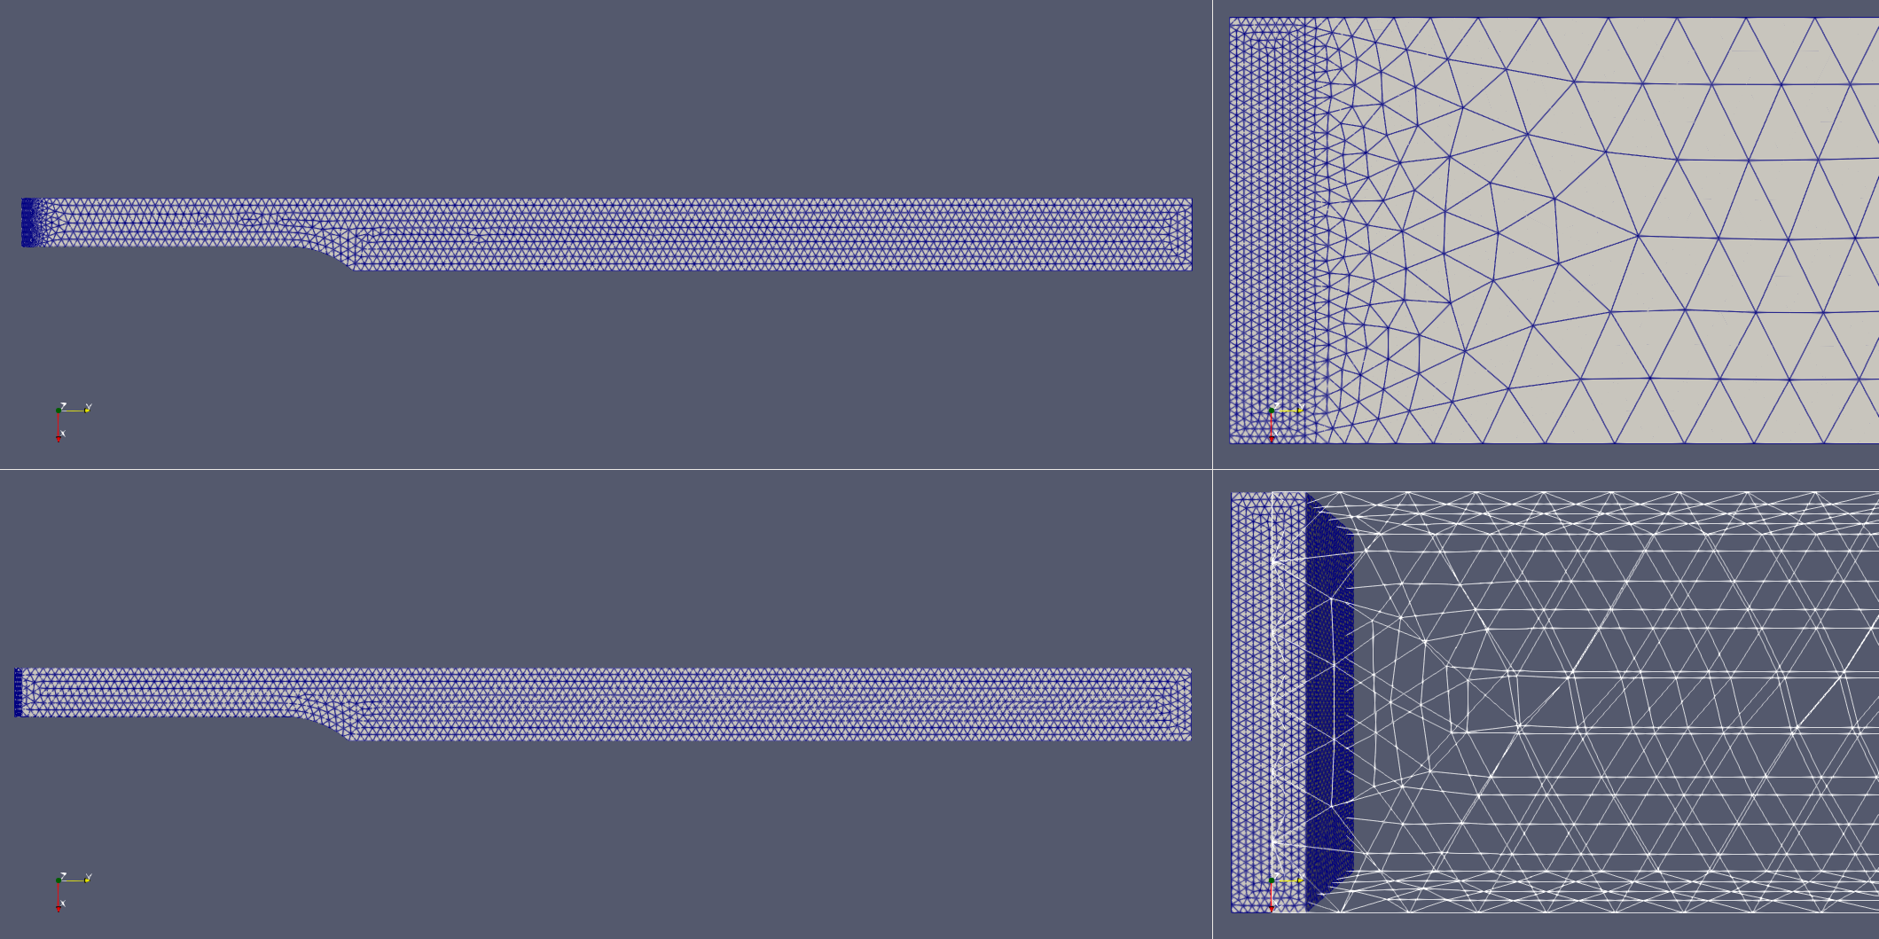
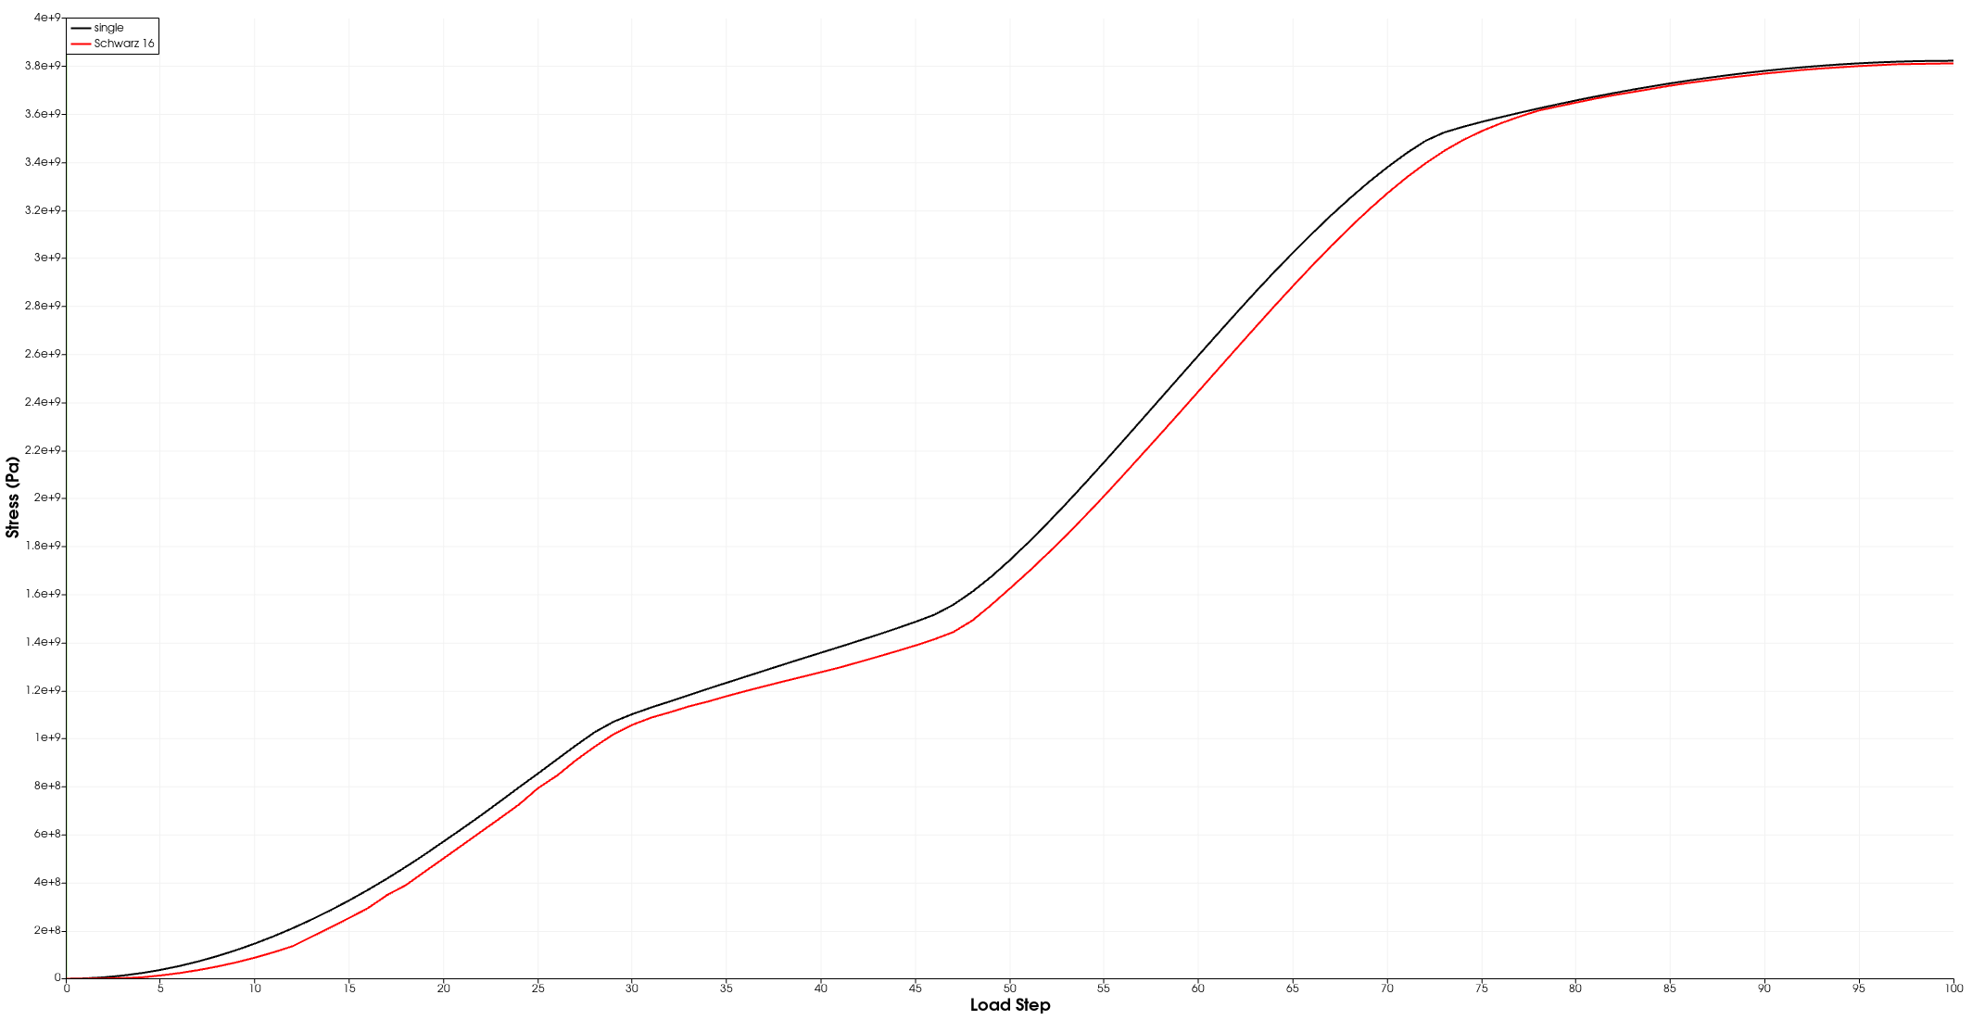


Laser Weld (Sierra/SM): Uniaxial Tension-Test Models
Single domain:
123,425 elements
$−$ single domain
$−$ Schwarz (16 iters)
Stress (Pa)
Overlapping Schwarz:
29,254 coarse, 78,549 fine elements
Load step
The domains for Schwarz coupling are meshed independently
This provides the ability to try different meshing schemes for each subdomain
No need to re-mesh entire domain
Schwarz gives accurate prediction of stress states if tight enough Schwarz tolerance is used
  Tight Schwarz tolerance needed due to large disparity between element sizes
For now, Schwarz is slower on this problem, but we are optimizing this

Slide 26
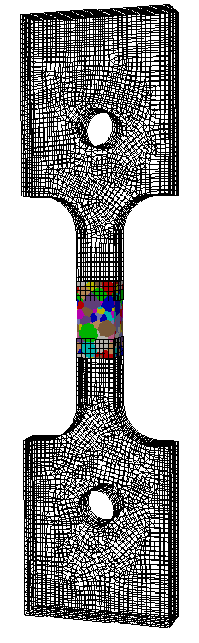
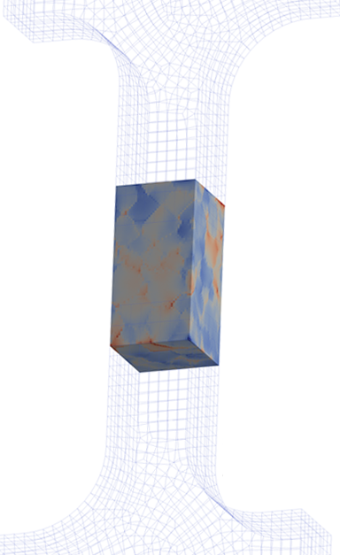
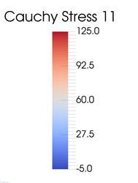
Tensile Bar
The alternating Schwarz method can be used as part of a homogenization (upscaling) process to bridge gap b/w microscopic and macroscopic regions
  Goal: study strain localization in microstructure.
  Microstructure embedded in ASTM tensile geometry (right).
  Fix microstructure, investigate ensemble of uniaxial loads.
  Fit flow curves with a macroscale J₂ plasticity model (below).
macro-scale
micro-structure
macro-scale
Work by C. Alleman, J. Foulk,
D. Littlewood, G. Bergel
Notes:
The last quasistatic example is another production-type problem known as the tensile bar problem and is courtesy of my colleagues Coleman Alleman, Jay Foulk, Dave Littlewood and Guy Bergel. This problem illustrates an interesting use of the Schwarz alternating method, in particular, that the method can be used as a part of a homogenization or upscaling process to bridge the gap between microscopic and macroscopic regions. Here, Coleman and his collaborators took a tensile geometry and embedded in it a microstructure, shown in the middle, with the goal of studying strain localization in the microstructure. The crystal plasticity microscale model in the microstructure was coupled to a J2 plasticity macroscale model in the rest of the domain using Schwarz, and a set of calculations were performed under an ensemble of uniaxial loads. Upscaling was performed by fitting flow curves to this set of ensembles using the J2 plasticity macroscale model.

Slide 27
Outline
Schwarz Alternating Method for Coupling of Full Order Models (FOMs) in Solid Mechanics
  Motivation & Background
  Quasistatic Formulation
    Numerical Examples
  Extension to Dynamics
    Numerical Examples
Schwarz Alternating Method for FOM-ROM* and ROM-ROM Coupling
  Motivation & Background
  Formulation
  Numerical Examples
Summary and Future Work
* Projection-based Reduced Order Model

Slide 28

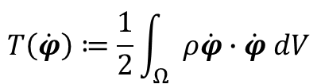
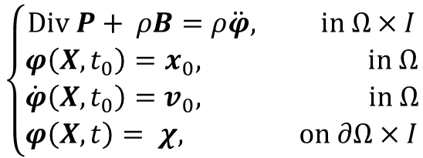
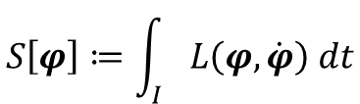

Solid Dynamics Formulation
$$T\left(\dot{φ}\right)≔\frac{1}{2}\int_{Ω}{ρ\dot{φ}∙\dot{φ} dV}$$
Kinetic energy:
$$V\left(φ\right)≔\int_{Ω}{A\left(F,Z\right)dV − \int_{Ω}{ρB∙φ dV}}$$
Potential energy:
$$L\left(φ,\dot{φ}\right)≔T\left(\dot{φ}\right)−V(φ)$$
Lagrangian:
$$S\left[φ\right]≔\int_{I}{L\left(φ,\dot{φ}\right) dt}$$
Action functional:
Euler-Lagrange equations:
$$\left\{\begin{aligned}Div P+ ρB=ρ\ddot{φ}, in Ω×I \\ φ\left(X,t_{0}\right)=x_{0}, in Ω \\ \dot{φ}\left(X,t_{0}\right)=v_{0}, in Ω \\ φ\left(X,t\right)= χ, on ∂Ω×I\end{aligned}\right.$$
Semi-discrete problem following FEM discretization in space:
$$M\ddot{u}+f_{int}\left(u,\dot{u}\right)=f_{ext}$$

Slide 29






Time-Advancement Within the Schwarz Framework
$$T_{0}$$
$$T_{1}$$
Controller time stepper
Time integrator for Ω₁
Time integrator for Ω₂
Step 0: Initialize $i=0 \text{(}\text{controller} \text{time} \text{index}\text{).}$
Model PDE:
$$\left\{\begin{matrix}M\ddot{u}+f_{int}\left(u,\dot{u}\right)=f_{ext} \\ u\left(x,0\right)=u_{0}\end{matrix}\right.$$

Slide 30


Time-Advancement Within the Schwarz Framework
$$T_{0}$$
$$T_{1}$$
Controller time stepper
Time integrator for Ω₁
Time integrator for Ω₂
Integrate using ${Δt}_{1}$
Step 0: Initialize $i=0 \text{(}\text{controller} \text{time} \text{index}\text{).}$
Step 1: Advance $Ω_{1}$ solution from time $T_{i}$ to time $T_{i+1}$ using time-stepper in $Ω_{1}$ with time-step ${Δt}_{1},$using solution in $Ω_{2}$ interpolated to $Γ_{1}$ at times $T_{i}+n{Δt}_{1}.$
Model PDE:
$$\left\{\begin{matrix}M\ddot{u}+f_{int}\left(u,\dot{u}\right)=f_{ext} \\ u\left(x,0\right)=u_{0}\end{matrix}\right.$$

Slide 31



Time-Advancement Within the Schwarz Framework
$$T_{0}$$
$$T_{1}$$
Controller time stepper
Time integrator for Ω₁
Time integrator for Ω₂
Interpolate from $Ω_{1}$ to $Γ_{2}$
Integrate using ${Δt}_{2}$
Step 0: Initialize $i=0 \text{(}\text{controller} \text{time} \text{index}\text{).}$
Step 1: Advance $Ω_{1}$ solution from time $T_{i}$ to time $T_{i+1}$ using time-stepper in $Ω_{1}$ with time-step ${Δt}_{1},$using solution in $Ω_{2}$ interpolated to $Γ_{1}$ at times $T_{i}+n{Δt}_{1}.$
Step 2: Advance $Ω_{2}$ solution from time $T_{i}$ to time $T_{i+1}$ using time-stepper in $Ω_{2}$ with time-step ${Δt}_{2},$using solution in $Ω_{1}$ interpolated to $Γ_{2}$ at times $T_{i}+n{Δt}_{2}$.
Model PDE:
$$\left\{\begin{matrix}M\ddot{u}+f_{int}\left(u,\dot{u}\right)=f_{ext} \\ u\left(x,0\right)=u_{0}\end{matrix}\right.$$

Slide 32

Time-Advancement Within the Schwarz Framework
$$T_{0}$$
$$T_{1}$$
Controller time stepper
Time integrator for Ω₁
Time integrator for Ω₂
Step 0: Initialize $i=0 \text{(}\text{controller} \text{time} \text{index}\text{).}$
Step 1: Advance $Ω_{1}$ solution from time $T_{i}$ to time $T_{i+1}$ using time-stepper in $Ω_{1}$ with time-step ${Δt}_{1},$using solution in $Ω_{2}$ interpolated to $Γ_{1}$ at times $T_{i}+n{Δt}_{1}.$
Step 2: Advance $Ω_{2}$ solution from time $T_{i}$ to time $T_{i+1}$ using time-stepper in $Ω_{2}$ with time-step ${Δt}_{2},$using solution in $Ω_{1}$ interpolated to $Γ_{2}$ at times $T_{i}+n{Δt}_{2}$.
Step 3: Check for convergence at time $T_{i+1}$.
Model PDE:
$$\left\{\begin{matrix}M\ddot{u}+f_{int}\left(u,\dot{u}\right)=f_{ext} \\ u\left(x,0\right)=u_{0}\end{matrix}\right.$$

Slide 33


Time-Advancement Within the Schwarz Framework
$$T_{0}$$
$$T_{1}$$
Controller time stepper
Time integrator for Ω₁
Time integrator for Ω₂
Integrate using ${Δt}_{1}$
Interpolate from $Ω_{2}$ to $Γ_{1}$
Step 0: Initialize $i=0 \text{(}\text{controller} \text{time} \text{index}\text{).}$
Step 1: Advance $Ω_{1}$ solution from time $T_{i}$ to time $T_{i+1}$ using time-stepper in $Ω_{1}$ with time-step ${Δt}_{1},$using solution in $Ω_{2}$ interpolated to $Γ_{1}$ at times $T_{i}+n{Δt}_{1}.$
Step 2: Advance $Ω_{2}$ solution from time $T_{i}$ to time $T_{i+1}$ using time-stepper in $Ω_{2}$ with time-step ${Δt}_{2},$using solution in $Ω_{1}$ interpolated to $Γ_{2}$ at times $T_{i}+n{Δt}_{2}$.
Step 3: Check for convergence at time $T_{i+1}$.
If unconverged, return to Step 1.
Model PDE:
$$\left\{\begin{matrix}M\ddot{u}+f_{int}\left(u,\dot{u}\right)=f_{ext} \\ u\left(x,0\right)=u_{0}\end{matrix}\right.$$

Slide 34



Time-Advancement Within the Schwarz Framework
$$T_{0}$$
$$T_{1}$$
$$T_{2}$$
Controller time stepper
Time integrator for Ω₁
Time integrator for Ω₂
Integrate using ${Δt}_{1}$
Interpolate from $Ω_{2}$ to $Γ_{1}$
Can use different integrators with different time steps within each domain!
Step 0: Initialize $i=0 \text{(}\text{controller} \text{time} \text{index}\text{).}$
Step 1: Advance $Ω_{1}$ solution from time $T_{i}$ to time $T_{i+1}$ using time-stepper in $Ω_{1}$ with time-step ${Δt}_{1},$using solution in $Ω_{2}$ interpolated to $Γ_{1}$ at times $T_{i}+n{Δt}_{1}.$
Step 2: Advance $Ω_{2}$ solution from time $T_{i}$ to time $T_{i+1}$ using time-stepper in $Ω_{2}$ with time-step ${Δt}_{2},$using solution in $Ω_{1}$ interpolated to $Γ_{2}$ at times $T_{i}+n{Δt}_{2}$.
Step 3: Check for convergence at time $T_{i+1}$.
If unconverged, return to Step 1.
If converged, set $i= i+1$and return to Step 1.
Model PDE:
$$\left\{\begin{matrix}M\ddot{u}+f_{int}\left(u,\dot{u}\right)=f_{ext} \\ u\left(x,0\right)=u_{0}\end{matrix}\right.$$

Slide 35
Time-Advancement Within the Schwarz Framework
$$T_{0}$$
$$T_{1}$$
$$T_{2}$$
Controller time stepper
Time integrator for Ω₁
Time integrator for Ω₂
Integrate using ${Δt}_{1}$
Interpolate from $Ω_{2}$ to $Γ_{1}$
Time-stepping procedure is equivalent to doing Schwarz on space-time domain [Mota et al. 2022].
Step 0: Initialize $i=0 \text{(}\text{controller} \text{time} \text{index}\text{).}$
Step 1: Advance $Ω_{1}$ solution from time $T_{i}$ to time $T_{i+1}$ using time-stepper in $Ω_{1}$ with time-step ${Δt}_{1},$using solution in $Ω_{2}$ interpolated to $Γ_{1}$ at times $T_{i}+n{Δt}_{1}.$
Step 2: Advance $Ω_{2}$ solution from time $T_{i}$ to time $T_{i+1}$ using time-stepper in $Ω_{2}$ with time-step ${Δt}_{2},$using solution in $Ω_{1}$ interpolated to $Γ_{2}$ at times $T_{i}+n{Δt}_{2}$.
Step 3: Check for convergence at time $T_{i+1}$.
If unconverged, return to Step 1.
If converged, set $i= i+1$and return to Step 1.
Model PDE:
$$\left\{\begin{matrix}M\ddot{u}+f_{int}\left(u,\dot{u}\right)=f_{ext} \\ u\left(x,0\right)=u_{0}\end{matrix}\right.$$

Slide 36



Schwarz Alternating Method for Dynamic Multiscale Coupling: Theory
Like for quasistatics, dynamic alternating Schwarz method converges provided each single-domain problem is well-posed and overlap region is non-empty, under some conditions on $Δt$.
Well-posedness for the dynamic problem requires that action functional $S\left[φ\right]≔\int_{I}{\int_{Ω}{L}\left(φ,\dot{φ}\right)dVdt}$ be strictly convex or strictly concave, where $L\left(φ,\dot{φ}\right)≔$ $T\left(\dot{φ}\right)+V\left(φ\right)$is the Lagrangian.
  This is studied by looking at its second variation $δ^{2}S\text{[}φ_{h}\text{]}$
We can show assuming a Newmark time-integration scheme that for the fully-discrete problem:
$$δ^{2}S\text{[}φ_{h}\text{]=}x^{T}\left[\frac{γ^{2}}{{(βΔt)}^{2}}M−K\right]x$$
$δ^{2}S\text{[}φ_{h}\text{]}$ can always be made positive by choosing a sufficiently small $Δt$
Numerical experiments reveal that $Δt$ requirements for stability/accuracy typically lead to automatic satisfaction of this bound.
*A. Mota, I. Tezaur, G. Phlipot. "The Schwarz alternating method for dynamic solid mechanics", IJNME, 2022.

Slide 37
Outline
Schwarz Alternating Method for Coupling of Full Order Models (FOMs) in Solid Mechanics
  Motivation & Background
  Quasistatic Formulation
    Numerical Examples
  Extension to Dynamics
    Numerical Examples
Schwarz Alternating Method for FOM-ROM* and ROM-ROM Coupling
  Motivation & Background
  Formulation
  Numerical Examples
Summary and Future Work
* Projection-based Reduced Order Model

Slide 38




Elastic Wave Propagation
Linear elastic clamped beam with Gaussian initial condition for the 𝑧-displacement.
Simple problem with analytical exact solution but very stringent test for discretization methods.
Test Schwarz with 2 subdomains: $Ω_{0}=\left(0,0.001\right)×\left(0,0.001\right)×\left(0,0.75\right),Ω_{1}=\left(0,0.001\right)×\left(0,0.001\right)×\left(0.25,1\right)$.
Left: Initial condition (blue) and final solution (red). Wave profile is negative of initial profile at time T = 1.0e-3.
Time-discretizations: Newmark (implicit, explicit)$.$
Meshes: HEX, TET

Slide 39


Elastic Wave: Different Integrators, Same $∆t$s
Dynamic Schwarz coupling introduces no dynamic artifacts that are pervasive in other coupling methods!
z-displacement
z-velocity
Table 1: Averaged (over times + domains) relative errors in z–displacement (blue) and z-velocity (green) for several different Schwarz couplings, 50% overlap volume fraction
 | Implicit-Implicit |  | Explicit(CM)-Implicit |  | Explicit(LM)-Implicit
Conformal HEX - HEX | 2.79e-3 | 7.32e-3 | 3.53e-3 | 8.70e-3 | 4.72e-3 | 1.19e-2
Nonconformal HEX - HEX | 2.90e-3 | 7.10e-3 | 2.82e-3 | 7.29e-3 | 2.84e-3 | 7.33e-3
TET - HEX | 2.79e-3 | 7.58e-3 | 3.52e-3 | 8.92e-3 | 4.72e-3 | 1.19e-2
LM = Lumped Mass, CM = Consistent Mass

Slide 40




Elastic Wave: Different Integrators, Different $∆t$s
Displacement
Velocity
Acceleration
Figures above: Plots of displacement, velocity and acceleration for the elastic wave propagation problem using different time integrators (implicit and explicit) and different time steps (1e-2s and 2e-7s) for each subdomain, superimposed over the analytic single domain solution.
The analytic solution is indistinguishable from Schwarz solutions (hidden behind the solutions for $Ω_{0}$ (red) and $Ω_{1}$ (green))!

Slide 41






Tension Specimen
$$Ω_{0}$$
Uniaxial aluminum cylindrical tensile specimen with inelastic J₂ material model.
Domain decomposition into two subdomains (right): $Ω_{0}$ = ends,${ Ω}_{1}$ = gauge.
Nonconformal HEX + composite TET10 coupling via Schwarz.
Implicit Newmark time-integration with adaptive time-stepping algorithm employed in both subdomains.
Slight imperfection introduced at center of gauge to force necking upon pulling in vertical direction.
$$Ω_{1}$$
+

Slide 42

Tension Specimen: Expected Result

Slide 43


Tension Specimen: Displacement & EQPS*
y-displacement
EQPS*
Average of $\sim$3 Schwarz iterations/time step required for convergence to Schwarz tolerance of 1e-6.
*EQPS = Equivalent Plastic Strain
Notes:
So, lets see what happens. The plots are showing the y-displacement and the nodal equivalent plastic strain in the specimen. You see a nice smooth transition of the solution between the two subdomains, and the method is able to simulate the necking behavior in the middle. It takes on average 3 Schwarz iterations/time step to achieve a relatively tight convergence tolerance of 1e-6.

Slide 44







Bolted Joint Problem
Problem of practical scale.
$$Ω_{2}$$
Schwarz solution compared to single-domain solution on composite TET10 mesh.
BC: x-disp = 0.02 at T = 1.0e-3 on top of parts.
Run until T = 5.0e-4 w/ dt = 1e-5 + implicit Newmark with analytic mass matrix for composite tet 10s.
$Ω_{1}=$ bolts (Composite TET10), $Ω_{2}=$ parts (HEX).
Inelastic J₂ material model in both subdomains.
  $Ω_{1}:$ steel
  $Ω_{2}:$ steel component, aluminum (bottom) plate
$$Ω_{1}$$

Slide 45




Bolted Joint Problem: Displacement
Single $Ω$
Schwarz

Slide 46


Bolted Joint Problem: Equivalent Plastic Strain (EQPS)
Single $Ω$
Schwarz

Slide 47

Bolted Joint Problem: Convergence Rate
Linear convergence rate is observed for dynamic Schwarz algorithm, as for the quasistatic Schwarz algorithm.
Figure above: Convergence behavior of the dynamic Schwarz algorithm for the bolted joint problem

Slide 48

Bolted Joint Problem: Performance
 | CPU times (64 procs*) | Avg # Schwarz iters | Max # Schwarz iters
Single Domain | 3h 34m | $$−$$ | $$−$$
Schwarz | 2h 42m | 3.22 | 4
Single Domain (finer) | 17h 00m | $$−$$ | $$−$$
Schwarz (finer mesh of bolts) | 29h 29m | 3.28 | 4
* On SNL ascicgpu15, 16, 17 machines (Intel Skylake CPU processor), Schwarz tol = 1e-6.
* On SNL ascicgpu15, 16, 17 machines (Intel Skylake CPU processor), Schwarz tol = 1e-6.
48

Slide 49

Bolted Joint Problem: Performance
 | CPU times (64 procs*) | Avg # Schwarz iters | Max # Schwarz iters
Single Domain | 3h 34m | $$−$$ | $$−$$
Schwarz | 2h 42m | 3.22 | 4
Single Domain (finer) | 17h 00m | $$−$$ | $$−$$
Schwarz (finer mesh of bolts) | 29h 29m | 3.28 | 4
Despite its iterative nature, Schwarz can actually be faster than single domain run for discretizations having comparable # of elements in the bolts.
* On SNL ascicgpu15, 16, 17 machines (Intel Skylake CPU processor), Schwarz tol = 1e-6.
* On SNL ascicgpu15, 16, 17 machines (Intel Skylake CPU processor), Schwarz tol = 1e-6.
49

Slide 50

Bolted Joint Problem: Performance
 | CPU times (64 procs*) | Avg # Schwarz iters | Max # Schwarz iters
Single Domain | 3h 34m | $$−$$ | $$−$$
Schwarz | 2h 42m | 3.22 | 4
Single Domain (finer) | 17h 00m | $$−$$ | $$−$$
Schwarz (finer mesh of bolts) | 29h 29m | 3.28 | 4
Despite its iterative nature, Schwarz can actually be faster than single domain run for discretizations having comparable # of elements in the bolts.
  Even if the method is more computationally expensive for some resolutions, it may be preferred for its ability to rapidly change and evaluate a variety of engineering designs (our typical use case).
* On SNL ascicgpu15, 16, 17 machines (Intel Skylake CPU processor), Schwarz tol = 1e-6.
* On SNL ascicgpu15, 16, 17 machines (Intel Skylake CPU processor), Schwarz tol = 1e-6.

Slide 51


Bolted Joint Problem: Performance
 | CPU times (64 procs*) | Avg # Schwarz iters | Max # Schwarz iters
Single Domain | 3h 34m | $$−$$ | $$−$$
Schwarz | 2h 42m | 3.22 | 4
Single Domain (finer) | 17h 00m | $$−$$ | $$−$$
Schwarz (finer mesh of bolts) | 29h 29m | 3.28 | 4
Despite its iterative nature, Schwarz can actually be faster than single domain run for discretizations having comparable # of elements in the bolts.
  Even if the method is more computationally expensive for some resolutions, it may be preferred for its ability to rapidly change and evaluate a variety of engineering designs (our typical use case).
Dynamic Schwarz converges in between 2-4 Schwarz iterations per time-step despite the overlap region being very small for this problem.
overlap region
* On SNL ascicgpu15, 16, 17 machines (Intel Skylake CPU processor), Schwarz tol = 1e-6.

Slide 52
Outline
Schwarz Alternating Method for Coupling of Full Order Models (FOMs) in Solid Mechanics
  Motivation & Background
  Quasistatic Formulation
    Numerical Examples
  Extension to Dynamics
    Numerical Examples
Schwarz Alternating Method for FOM-ROM* and ROM-ROM Coupling
  Motivation & Background
  Formulation
  Numerical Examples
Summary and Future Work
* Projection-based Reduced Order Model

Slide 53


Motivation for ROM-ROM/ROM-FOM Couplings
Atmos.
(EAM)
Ocean
(MPAS-O)
The past decades have seen tremendous investment in simulation frameworks for coupled multi-scale and multi-physics problems.
Sea Ice
(MPAS-SI)
Frameworks rely on established mathematical theories to couple physics components.
Most existing coupling frameworks are based on traditional discretization methods.
Land
(ELM)
Land Ice
(MALI)
N₁
N₂
N₁
N₂
M₁
M₂
M₃
M₄
N₄
N₃
N₄
N₃
N₅
N₅
Complex System Model
Traditional Methods
Coupled Numerical Model
PDEs, ODEs
Nonlocal integral
Classical DFT
Atomistic, …
Mesh-based (FE, FV, FD)
Meshless (SPH, MLS)
Implicit, explicit
Eulerian, Lagrangian…
Monolithic (Lagrange multipliers)
Partitioned (loose) coupling
Iterative (Schwarz, optimization)
Notes:
The past decades have seen a tremendous amount of investment in the development of simulation frameworks for coupled multi-scale and multi-physics problems. These frameworks rely on established mathematical theories to couple physics components discretized using so-called traditional discretization methods such as finite elements, finite volumes and finite differences. A prime example is the DOE’s global climate model, the Energy Exascale Earth System Model (E3SM), which couples 5 physics components (atmosphere, ocean, sea ice, land ice and land). Each component is developed separately according to the relevant physics, dynamics and numerical methods, and the components are coupled in a way that ensures stability, accuracy and conservation.

Slide 54
Motivation for ROM-ROM/ROM-FOM Couplings
Atmos.
(EAM)
Ocean
(MPAS-O)
The past decades have seen tremendous investment in simulation frameworks for coupled multi-scale and multi-physics problems.
Sea Ice
(MPAS-SI)
Frameworks rely on established mathematical theories to couple physics components.
Most existing coupling frameworks are based on traditional discretization methods.
Land
(ELM)
Land Ice
(MALI)
N₁
N₂
N₁
N₂
N₁
PINN=N₂
M₁
M₂
M₃
M₄
N₄
N₃
N₄
ROM=N₄
N₃
N₅
DMD=N₃
N₅
UDE=N₅
Complex System Model
Traditional Methods
Coupled Numerical Model
Traditional + Data-Driven Methods
PDEs, ODEs
Nonlocal integral
Classical DFT
Atomistic, …
Mesh-based (FE, FV, FD)
Meshless (SPH, MLS)
Implicit, explicit
Eulerian, Lagrangian, …
Monolithic (Lagrange multipliers)
Partitioned (loose) coupling
Iterative (Schwarz, optimization)
PINNs
Neural ODEs
Projection-based ROMs, …
There is currently a big push to integrate data-driven methods into modeling & simulation toolchains.
Unfortunately, existing algorithmic and software infrastructures are ill-equipped to handle plug-and-play integration of non-traditional, data-driven models!

Slide 55

Flexible Heterogeneous Numerical Methods (fHNM) Project
Principal research objective:
Discover mathematical principles guiding the assembly of standard and data-driven numerical models in stable, accurate and physically consistent ways.
Principal research challenges: we lack mathematical and algorithmic understanding of how to
“Mix-and-match” standard and data-driven models from three-classes
  Class A: projection-based reduced order models (ROMs)
  Class B: machine-learned models, i.e., Physics-Informed Neural Networks (PINNs)
  Class C: flow map approximation models, i.e., dynamic model decomposition (DMD) models
This talk.
Ensure well-posedness & physical consistency of resulting heterogeneous models.
Solve such heterogeneous models efficiently.
Three coupling methods:
Alternating Schwarz-based coupling
Optimization-based coupling
Coupling via generalized mortar methods
This talk.

Slide 56
















Projection-Based Model Order Reduction via the POD/LSPG* Method
56
Full Order Model (FOM): $\frac{∂q}{∂t}=f(q,t;μ)$
*Least-Squares Petrov-Galerkin
1. Data Acquisition
3. Projection-Based Reduction
Number of time steps
$$\dot{q}=f(q,t;μ)$$
Discretize FOM in time
Number of State Variables
$r^{n}\left(q^{n};μ\right)=0,$ $n=1, …, T$
Reduce the number of unknowns
$$q\left(t\right)≈\tilde{q}\left(t\right)=Φ\hat{q}(t)$$
Solve ODE at different design points
Save solution data
2. Learning of Reduced Basis
Proper Orthogonal Decomposition (POD):
Apply hyper-reduction and minimize residual
$${minimize}_{\hat{v}} {|| A{ r}^{n}\left(Φ\hat{v};μ\right)||}_{2}$$
Hyper-reduction/sample mesh
ROM = projection-based Reduced Order Model HROM = Hyper-reduced ROM

Slide 57
Outline
Schwarz Alternating Method for Coupling of Full Order Models (FOMs) in Solid Mechanics
  Motivation & Background
  Quasistatic Formulation
    Numerical Examples
  Extension to Dynamics
    Numerical Examples
Schwarz Alternating Method for FOM-ROM* and ROM-ROM Coupling
  Motivation & Background
  Formulation
  Numerical Examples
Summary and Future Work
* Projection-based Reduced Order Model

Slide 58
Schwarz Extensions to FOM-ROM and ROM-ROM Couplings
58
Choice of domain decomposition
Overlapping vs. non-overlapping domain decomposition?
  Non-overlapping more flexible but typically requires more Schwarz iterations
FOM vs. ROM subdomain assignment?
  Do not assign ROM to subdomains where they have no hope of approximating solution
Snapshot collection and reduced basis construction
Are subdomains simulated independently in each subdomains or together?
Enforcement of boundary conditions (BCs) in ROM at Schwarz boundaries
Strong vs. weak BC enforcement?
  Strong BC enforcement difficult for some models (e.g., cell-centered finite volume, PINNs)
Optimizing parameters in Schwarz BCs for non-overlapping Schwarz?
Choice of hyper-reduction
What hyper-reduction method to use?
  Application may require particular method (e.g., ECSW for solid mechanics problems)
How to sample Schwarz boundaries in applying hyper-reduction?
  Need to have enough sample mesh points at Schwarz boundaries to apply Schwarz

Slide 59
Outline
Schwarz Alternating Method for Coupling of Full Order Models (FOMs) in Solid Mechanics
  Motivation & Background
  Quasistatic Formulation
    Numerical Examples
  Extension to Dynamics
    Numerical Examples
Schwarz Alternating Method for FOM-ROM* and ROM-ROM Coupling
  Motivation & Background
  Formulation
  Numerical Examples
Summary and Future Work
* Projection-based Reduced Order Model

Slide 60





2D Inviscid Burgers Equation
Popular analog for fluid problems where shocks are possible, and particularly difficult for conventional projection-based ROMs
$$\frac{∂u}{∂t}+\frac{1}{2}\left(\frac{∂(u^{2})}{∂x}+\frac{∂(uv)}{∂y}\right)=0.02\exp\left(μ_{2}x\right)$$
$$\frac{∂v}{∂t}+\frac{1}{2}\left(\frac{∂(vu)}{∂x}+\frac{∂(v^{2})}{∂y}\right)=0$$
$$u\left(0,y,t;μ\right)=μ_{1}$$
$$u\left(x,y,0\right)=v\left(x,y,0\right)=1$$
0
$$x$$
100
0
$$Ω_{1}$$
$$y$$
100
Problem setup:
$Ω={(0,100)}^{2},$ $t∈\left[0, 25\right]$
Two parameters $μ=(μ_{1},μ_{2})$. Training: uniform sampling of $=\left[4.25, 5.50\right]×[0.015, 0.03]$ by a $3×3$grid. Testing: query unsampled point $μ=[4.75, 0.02]$
FOM discretization:
Spatial discretization given by a Godunov-type scheme with $N = 250$elements in each dimension
Implicit trapezoidal method with fixed $∆t = 0.05$
Figure above: solution of $u$ component at various times
Notes:
TODO: say something about how BCs implemented?

Slide 61








Schwarz Coupling Details
61
Choice of domain decomposition
Overlapping DD of $Ω$into 4 subdomains coupled via multiplicative Schwarz
Solution in $Ω_{1}$is most difficult to capture by ROM
Snapshot collection and reduced basis construction
Single-domain FOM on $Ω$ used to generate snapshots/POD modes
Enforcement of boundary conditions (BCs) in ROM at Schwarz boundaries
BCs imposed strongly using Method 1 of [Gunzburger et al., 2007] at indices $i_{Dir}$
$$q(t)≈\overline{q}+Φ\hat{q}(t)$$
  POD modes made to satisfy homogeneous DBCs: $Φ\left(i_{Dir}, :\right)=0$
  BCs imposed by modifying $\overline{q}$: $\overline{q}\left(i_{Dir}\right)←χ_{q}$
Choice of hyper-reduction
Energy Conserving Sampling & Weighting (ECSW) method for hyper-reduction
All points on Schwarz boundaries are included in the sample mesh
0
$$x$$
100
0
$$Ω_{1}$$
$$Ω_{2}$$
$$y$$
$$Ω_{4}$$
$$Ω_{3}$$
100
Notes:
TODO: say how possible to do strong BC impl in FV method.
TODO: double check about all points on Schwarz boundaries being included in sample mesh with Joshua/Chris.

Slide 62












FOM-HROM-HROM-HROM Coupling
Subdomains | 99% SV Energy
 | $$M$$ | MSE (%) | CPU time (s)
$$Ω_{1}$$ | $$−$$ | 0.0 | 95
$$Ω_{2}$$ | 120 | 0.26 | 26
$$Ω_{3}$$ | 60 | 0.43 | 17
$$Ω_{4}$$ | 66 | 0.34 | 21
Total |  |  | 159
$$Ω_{1}$$
$$Ω_{2}$$
$$Ω_{3}$$
$$Ω_{4}$$
1 SD
FOM in $Ω_{1}$ as this is “hardest” subdomain for ROM
HROMs in $Ω_{2}$, $Ω_{3}$, $Ω_{4}$ capture 99% snapshot energy
Method converges in 3 Schwarz iterations per controller time-step
Errors O(0.1%) with 0 error in $Ω_{1}$
2.26$×$ speedup achieved over all-FOM coupling
0
$$x$$
100
0
$$Ω_{1}$$
$$Ω_{2}$$
$$y$$
$$Ω_{4}$$
$$Ω_{3}$$
100
Further speedups possible via code optimizations, additive Schwarz and reduction of # sample mesh points.
Notes:
360: all-FOM case
Not possible for subdomain 2->4 to pollute 1 b/c of direction of propagation

Slide 63







2D Shallow Water Equations (SWE)
Hyperbolic PDEs modeling wave propagation below a pressure surface in a fluid (e.g., atmosphere, ocean).
$$\frac{∂h}{∂t}+\frac{∂(hu)}{∂x}+\frac{∂(hv)}{∂y}=0$$
$$\frac{∂(hu)}{∂t}+\frac{∂}{∂x}\left(hu^{2}+\frac{1}{2}gh^{2}\right)+\frac{∂}{∂y}\left(huv\right)=−μv$$
$$\frac{∂(hv)}{∂t}+\frac{∂}{∂x}\left(huv\right)+\frac{∂}{∂y}\left(hv^{2}+\frac{1}{2}gh^{2}\right)=μu$$
Problem setup:
$Ω={(−5,5)}^{2},$ $t∈\left[0, 10\right]$, Gaussian initial condition
Coriolis parameter$μ∈\left\{−4,−3,−2,−1,0\right\}$ for training, and $μ∈\left\{−3.5,−2.5,−1.5,−0.5\right\}$for testing
Figure above: FOM solutions to SWE for $μ=−0.5$ (left) and $μ=−3.5$ (right).
FOM discretization:
Spatial discretization given by a first-order cell-centered finite volume discretization with $N =300$elements in each dimension
Implicit first order temporal discretization: backward Euler with fixed $∆t = 0.01$
Implemented in Pressio-demoapps (https://github.com/Pressio/pressio-demoapps)
Notes:
TODO: ask Chris re: temporal discretization

Slide 64



Schwarz Coupling Details
64
Green: different from Burgers’ problem
Choice of domain decomposition
Non-overlapping DD of $Ω$into 4 subdomains coupled via additive Schwarz
  OpenMP parallelism with 1 thread/subdomain
All-ROM or All-HROM coupling via Pressio*
Snapshot collection and reduced basis construction
Single-domain FOM on $Ω$ used to generate snapshots/POD modes
Enforcement of boundary conditions (BCs) in ROM at Schwarz boundaries
BCs are imposed approximately by fictitious ghost cell states
  Implementing Neumann and Robin BCs is challenging
Ghost cells introduce some overlap even with non-overlapping DD
  $⇒$ Dirichlet-Dirichlet non-overlapping Schwarz is stable/convergent!
Choice of hyper-reduction
Collocation for hyper-reduction: min residual at small subset DOFs
Assume fixed budget of sample mesh points at Schwarz boundaries
Figure right: non-overlapping DD w/ ghost cells creating overlap
Ghost cells
Figure above: sample mesh (yellow) and stencil (white) cells
*https://github.com/Pressio/pressio-demoapps
Notes:
TODO: ask Chris what hyper-reduction is used now.

Slide 65







Schwarz All-ROM Domain Overlap Study
65
Study of Schwarz convergence for all-ROM coupling as a function of $N_{o}$ := cell width of overlap region (not including ghost cells).
Dirichlet-Dirichlet coupling with no-overlap ${(N}_{o}=0)$ performs well with no convergence issues (movie, left) and errors comparable to Dirichlet-Dirichlet coupling with overlap (figure below, left)
Movie above: FOM (left), 4 subdomain ROM coupled via non-overlapping Schwarz (middle), and 4 subdomain ROM coupled via overlapping Schwarz (right) for predictive SWE problem with $μ=−0.5$. All ROMs have $K=80$POD modes.
Schwarz iterations decrease (very roughly) with $N_{o}^{0.25}$ (figure, right) whereas evaluating $r(q)$ scales with $N_{o}^{2}$
  $⇒$ there is no reason not to do non-overlapping coupling for this problem
Figures above: relative error and average # Schwarz iterations as a function of $μ$ and $N_{o}.$ Black $μ$: training, red $μ$: testing.
Notes:
Q: Is it true that 80 POD modes/subdomain? Had K = 80 in Chris’s slides.

Slide 66




Schwarz Boundary Sampling for All-HROM Coupling
66
Key question: how many Schwarz boundary points need to be included in sample mesh when performing HROM coupling?
Naïve/sparsely-sampled Schwarz boundary results in failure to transmit coupling information during Schwarz
Movie above: FOM (left), all HROM with $N_{b}=5\%$ (middle) and all HROM with $N_{b}=10\%$ (left). ROMs have $K=100$modes and $N_{s}=0.5\%N$ sample mesh points.
Figure above: example sample mesh with sampling rate $N_{b}=10\%$
Including too many Schwarz boundary points ($N_{b}$) in sample mesh given fixed budget of $N_{s}$ sample mesh points may lead to too few sample mesh points in interior
For SWE problem, we can get away with $\sim$10% boundary sampling (movie above, right-most frame)
Notes:
To clarify the sampling rate Nb, the value of Nb = 0 just means that there is no deliberate sampling at the interface; there is still roughly N * X% points sampled at the interface given a random sampling scheme. Nb is a fixed rate of sampling at the interface, regardless of the overall sampling rate. Nb = 10 means every tenth cell at the interface is sampled, or 10% of all interface cells (Nb = 5 is 20% of all interface cells, etc). The use of an integer for Nb was just stylistic, since N and Ns are also integers.
hris.

Slide 67




Coupled HROM Performance
67
Solid: ${ N}_{s}=0.5\%N$
Dashed: $N_{s}=1\%N$
For a fixed ROM dimension, Schwarz delivers lower error and comparable cost!
There are noticeable cost savings relative to monolithic FOM!
Accuracy similar for predictive $μ$ (red) and non-predictive $μ$ (black) cases.
Notes:
To clarify the sampling rate Nb, the value of Nb = 0 just means that there is no deliberate sampling at the interface; there is still roughly N * X% points sampled at the interface given a random sampling scheme. Nb is a fixed rate of sampling at the interface, regardless of the overall sampling rate. Nb = 10 means every tenth cell at the interface is sampled, or 10% of all interface cells (Nb = 5 is 20% of all interface cells, etc). The use of an integer for Nb was just stylistic, since N and Ns are also integers.
hris.

Slide 68

Teaser: 2D Euler Equations Riemann Problem
$\frac{∂}{∂t}\left(\begin{matrix}ρ \\ ρu \\ \begin{aligned}ρv \\ ρE\end{aligned}\end{matrix}\right)+\frac{∂}{∂x}\left(\begin{matrix}ρu \\ ρu^{2}+p \\ \begin{aligned}ρuv \\ \left(E+p\right)u\end{aligned}\end{matrix}\right)$+ $\frac{∂}{∂y}\left(\begin{matrix}ρv \\ ρuv \\ \begin{aligned}ρv^{2}+p \\ \left(E+p\right)v\end{aligned}\end{matrix}\right)=0$
$$p=(γ−1)\left(ρE−\frac{1}{2}ρ(u^{2}+v^{2})\right)$$
Problem setup:
$Ω={(0,1)}^{2},$ $t∈\left[0, 0.8\right]$, homogeneous Neumann BCs
Fix $ρ_{1}=1.5$, $u_{1}=v_{1}=0$, $p_{3}=0.029$
Vary $p_{1}$; IC from compatibility conditions*
  Training: $p_{1}∈\left[1.0, 1.25,1.5,1.75,2.0\right]$
  Testing: $p_{1}∈\left[1.125, 1.375,1.625,1.875\right]$
Preliminary results:
Schwarz can stabilize unstable monolithic ROM for fixed dimension $K$ (above)
Since shock traverses all parts of domain, achieving speedups with Schwarz is more difficult
FOM discretization:
Spatial discretization given by a first-order cell-centered finite volume discretization with $N = 300$or $N =N =100$elements in each dimension
Implicit first order temporal discretization: backward Euler with fixed $∆t = 0.005$
Implemented in Pressio-demoapps (https://github.com/Pressio/pressio-demoapps)
*Schulz-Rinne, 1993.
Notes:
TODO: ask Chris re: spatial discretization.

Slide 69
Outline
Schwarz Alternating Method for Coupling of Full Order Models (FOMs) in Solid Mechanics
  Motivation & Background
  Quasistatic Formulation
    Numerical Examples
  Extension to Dynamics
    Numerical Examples
Schwarz Alternating Method for FOM-ROM* and ROM-ROM Coupling
  Motivation & Background
  Formulation
  Numerical Examples
Summary and Future Work
* Projection-based Reduced Order Model

Slide 70
Summary
The Schwarz alternating method has been developed for concurrent multi-scale coupling of conventional and data-driven models.
☺
Coupling is concurrent (two-way).
Ease of implementation into existing massively-parallel HPC codes.
“Plug-and-play” framework: simplifies task of meshing complex geometries!
  Ability to couple regions with different non-conformal meshes, different element types and different levels of refinement.
  Ability to use different solvers (including ROM/FOM) and time-integrators in different regions.
Scalable, fast, robust on real engineering problems
Coupling does not introduce nonphysical artifacts.
Theoretical convergence properties/guarantees.
☺
☺
☺
☺
☺
☺
☺

Slide 71










Ongoing & Future Work
Contact boundaries $Γ^{1}$ and $Γ^{2}$
71
$$P$$
Development fundamentally new approach for simulating multi-scale mechanical contact using the Dirichlet-Neumann Schwarz alternating method
  Contact constraints are replaced with boundary conditions applied iteratively at contact boundaries
Implementation of non-overlapping Schwarz in Sierra/SM
Working with analysts to apply Schwarz to problems of interest to Sandia missions
  Laser welds
  Fastener modeling for joints
  Salt caverns for oil storage
Rigorous analysis of why Dirichlet-Dirichlet BC “work” when employing non-overlapping Schwarz with discretizations that employ ghost cells
Extension to coupling of non-intrusive ROMs (dynamic mode decomposition, operator inference, neural networks)
Development of automated criteria to determine appropriate use of less refined or reduced-order models w/o sacrificing accuracy, enabling real-time transitions between different model fidelities
Impact of two 3D beams having different meshes with Schwarz contact method. From [Mota et al., 2023].
From Murugesan et al., 2020.
Notes:
TODO: fill in!

Slide 72







Team & Acknowledgments
72
Irina Tezaur
Joshua Barnett
Alejandro Mota
Chris Wentland
Francesco Rizzi
Coleman Alleman
Greg Phlipot
Notes:
TODO: update team.

Slide 73
References
[1] A. Mota, I. Tezaur, C. Alleman. “The Schwarz Alternating Method in Solid Mechanics", Comput. Meth. Appl. Mech. Engng. 319 (2017), 19-51.
[2] A. Mota, I. Tezaur, G. Phlipot. “The Schwarz Alternating Method for Dynamic Solid Mechanics”, Comput. Meth. Appl. Mech. Engng. 121 (21) (2022) 5036-5071.
[3] J. Barnett, I. Tezaur, A. Mota. “The Schwarz alternating method for the seamless coupling of nonlinear reduced order models and full order models”, ArXiv pre-print, 2022. https://arxiv.org/abs/2210.12551
[4] W. Snyder, I. Tezaur, C. Wentland. “Domain decomposition-based coupling of physics-informed neural networks via the Schwarz alternating method”, ArXiv pre-print, 2023. https://arxiv.org/abs/2311.00224
[5] A. Mota, D. Koliesnikova, I. Tezaur. “A Fundamentally New Coupled Approach to Contact Mechanics via the Dirichlet-Neumann Schwarz Alternating Method”, ArXiv pre-print, 2023. https://arxiv.org/abs/2311.05643
Email: ikalash@sandia.gov
URL: www.sandia.gov/~ikalash

Slide 74
Start of Backup Slides

Slide 75





Theoretical Foundation
Using the Schwarz alternating as a discretization method for PDEs is natural idea with a sound theoretical foundation.
S.L. Sobolev (1936): posed Schwarz method for linear elasticity in variational form and proved method’s convergence by proposing a convergent sequence of energy functionals.
S.G. Mikhlin (1951): proved convergence of Schwarz method for general linear elliptic PDEs.
P.-L. Lions (1988): studied convergence of Schwarz for nonlinear monotone elliptic problems using max principle.
A. Mota, I. Tezaur, C. Alleman (2017): proved convergence of the alternating Schwarz method for finite deformation quasi-static nonlinear PDEs (with energy functional $Φ[φ]$) with a geometric convergence rate.
S.L. Sobolev (1908 – 1989)
S.G. Mikhlin
(1908 – 1990)
P.- L. Lions (1956-)
$$Φ\left[φ\right]= \int_{B}{A\left(F,Z\right) dV−}\int_{B}{B∙φ dV}$$
$$∇∙P+B=0$$
A. Mota, I. Tezaur, C. Alleman
Notes:
A(F,Z) = Helmholtz free-energy density, Z = collection of internal variables, F = grad(phi) = deformation gradient, B = body force, T = traction on boundary
P = \partial A/\partial F = first Piola-Kirchoff stress
2nd equation is Euler-Lagrange equation

Slide 76

Notched Cylinder: Coupling Different Materials
The Schwarz method is capable of coupling regions with different material models.
Notched cylinder subjected to tensile load with an elastic and J2 elasto-plastic regions.
Coarse region is elastic and fine region is elasto-plastic.
The overlap region in the first mesh is nearer the notch, where plastic behavior is expected.
Overlap far from notch.
Overlap near notch.
Coupled regions
Coarse, elastic region
Fine, elasto-plastic region

Slide 77

Notched Cylinder: Coupling Different Materials
Need to be careful to do domain decomposition so that material models are consistent in overlap region.
When the overlap region is far from the notch, no plastic deformation exists in it: the coarse and fine regions predict the same behavior.
When the overlap region is near the notch, plastic deformation spills onto it and the two models predict different behavior, affecting convergence adversely.
Overlap far from notch.
Overlap near notch.

Slide 78






Single Domain Predictive ROM
100
0
$$x$$
0
$$Ω_{1}$$
Uniform sampling of $𝒟=\left[4.25, 5.50\right]×[0.015, 0.03]$ by a $3×3$grid ⇒ 9 training parameters characterized by $Δμ_{1}=0.625,$ $Δμ_{2}=0.0075$
  $>200$ POD modes required to capture $99$% snapshot energy
Queried but unsampled parameter point $μ=[4.75, 0.02]$
Reduced mesh resulting from solving non-negative least squares problem defining ECSW gives $n_{e}=5,689$ elements (9.1% of $N_{e}=62,500$ elements).
$$y$$
100
% SV Energy | $$M$$ | MSE* (%) | CPU time* (s)
95 | 69 | 1.1 | 138
99 | 177 | 0.17 | 447
* Numbers in table are w/o hyper-reduction
Figure above: Reduced mesh of single domain HROM
Figure above: HROM and FOM results at various time steps
Notes:
Table shows ROM CPU times (no hyper-reduction)

Slide 79










All-ROM Coupling
95% Singular Value (SV) Energy Retention
99% Singular Value (SV) Energy Retention
$$Ω_{1}$$
$$Ω_{2}$$
$$Ω_{3}$$
$$Ω_{4}$$
1 SD
Method converges in only 3 Schwarz iterations per controller time-step
Errors O(1%) or less
1.47$×$ speedup over all-FOM coupling for 95% SV energy retention case
Subdomains | 95% SV Energy |  |  | 99% SV Energy
 | $$M$$ | MSE (%) | CPU time (s) | $$M$$ | MSE (%) | CPU time (s)
$$Ω_{1}$$ | 57 | 1.1 | 85 | 146 | 0.18 | 295
$$Ω_{2}$$ | 44 | 1.2 | 56 | 120 | 0.18 | 216
$$Ω_{3}$$ | 24 | 1.4 | 43 | 60 | 0.16 | 89
$$Ω_{4}$$ | 32 | 1.9 | 61 | 66 | 0.25 | 100
Total |  |  | 245 |  |  | 700
0
$$x$$
100
0
$$Ω_{1}$$
$$Ω_{2}$$
$$y$$
$$Ω_{4}$$
$$Ω_{3}$$
100
Notes:
Q for Joshua:
- What are dx and dt in each subdomain? Are they the same or diff?
What is going on with last frame in movie??
Solutions look discontinuous at certain times…
Subdomain 1: 75.38 s 0.94 s
Subdomain 2: 61.52 s 0.91 s
Subdomain 3: 61.54 s 0.91 s
Subdomain 4: 77.02 s 0.93 s

Slide 80
Schwarz Boundary Sampling for All-HROM Coupling
80
Key question: how many Schwarz boundary points need to be included in sample mesh when performing HROM coupling?

Slide 81



Schwarz Boundary Sampling for All-HROM Coupling
81
Key question: how many Schwarz boundary points need to be included in sample mesh when performing HROM coupling?
Naïve/sparsely-sampled Schwarz boundary results in failure to transmit coupling information during Schwarz
Movie above: FOM (left) and all HROM with $N_{b}=5$% (right). ROMs have $K=100$modes and $N_{s}=0.5\%N$ sample mesh points.
Figure above: example sample mesh with sampling rate $N_{b}=5\%.$
Notes:
To clarify the sampling rate Nb, the value of Nb = 0 just means that there is no deliberate sampling at the interface; there is still roughly N * X% points sampled at the interface given a random sampling scheme. Nb is a fixed rate of sampling at the interface, regardless of the overall sampling rate. Nb = 10 means every tenth cell at the interface is sampled, or 10% of all interface cells (Nb = 5 is 20% of all interface cells, etc). The use of an integer for Nb was just stylistic, since N and Ns are also integers.
hris.

Slide 82



Schwarz Boundary Sampling for All-HROM Coupling
82
Key question: how many Schwarz boundary points need to be included in sample mesh when performing HROM coupling?
Naïve/sparsely-sampled Schwarz boundary results in failure to transmit coupling information during Schwarz
Movie above: FOM (left) and all HROM with $N_{b}=5$% (right). ROMs have $K=100$modes and $N_{s}=0.5\%N$ sample mesh points.
Figure above: example sample mesh with sampling rate $N_{b}=0.$
Including too many Schwarz boundary points ($N_{b}$) in sample mesh given fixed budget of $N_{s}$ sample mesh points may lead to too few sample mesh points in interior

Slide 83

Schwarz Boundary Sampling for All-HROM Coupling
83
Key question: how many Schwarz boundary points need to be included in sample mesh when performing HROM coupling?
Naïve/sparsely-sampled Schwarz boundary results in failure to transmit coupling information during Schwarz
Movie above: FOM (left) and all HROM with $N_{b}=5\%$ (right). ROMs have $K=100$modes and $N_{s}=0.5\%N$ sample mesh points.
Figure above: example sample mesh with sampling rate $N_{b}=5\%.$
Including too many Schwarz boundary points ($N_{b}$) in sample mesh given fixed budget of $N_{s}$ sample mesh points may lead to too few sample mesh points in interior

Slide 84

Schwarz Boundary Sampling for All-HROM Coupling
84
Key question: how many Schwarz boundary points need to be included in sample mesh when performing HROM coupling?
Naïve/sparsely-sampled Schwarz boundary results in failure to transmit coupling information during Schwarz
Movie above: FOM (left) and all HROM with $N_{b}=5\%$ (right). ROMs have $K=100$modes and $N_{s}=0.5\%N$ sample mesh points.
Figure above: example sample mesh with sampling rate $N_{b}=10\%.$
Including too many Schwarz boundary points ($N_{b}$) in sample mesh given fixed budget of $N_{s}$ sample mesh points may lead to too few sample mesh points in interior

Slide 85


Schwarz Boundary Sampling for All-HROM Coupling
85
Key question: how many Schwarz boundary points need to be included in sample mesh when performing HROM coupling?
Naïve/sparsely-sampled Schwarz boundary results in failure to transmit coupling information during Schwarz
Movie above: FOM (left) and all HROM with $N_{b}=5$% (right). ROMs have $K=100$modes and $N_{s}=0.5\%N$ sample mesh points.
Figure above: example sample mesh with sampling rate $N_{b}=15\%.$
Including too many Schwarz boundary points ($N_{b}$) in sample mesh given fixed budget of $N_{s}$ sample mesh points may lead to too few sample mesh points in interior

Slide 86






Model Problem 3: 2D Euler Equations Riemann Problem
$\frac{∂}{∂t}\left(\begin{matrix}ρ \\ ρu \\ \begin{aligned}ρv \\ ρE\end{aligned}\end{matrix}\right)+\frac{∂}{∂x}\left(\begin{matrix}ρu \\ ρu^{2}+p \\ \begin{aligned}ρuv \\ \left(E+p\right)u\end{aligned}\end{matrix}\right)$+ $\frac{∂}{∂y}\left(\begin{matrix}ρv \\ ρuv \\ \begin{aligned}ρv^{2}+p \\ \left(E+p\right)v\end{aligned}\end{matrix}\right)=0$
$$p=(γ−1)\left(ρE−\frac{1}{2}ρ(u^{2}+v^{2})\right)$$
Problem setup:
$Ω={(0,1)}^{2},$ $t∈\left[0, 0.8\right]$, homogeneous Neumann BCs
Fix $ρ_{1}=1.5$, $u_{1}=v_{1}=0$, $p_{3}=0.029$
Vary $p_{1}$; IC from compatibility conditions*
  Training: $p_{1}∈\left[1.0, 1.25,1.5,1.75,2.0\right]$
  Testing: $p_{1}∈\left[1.125, 1.375,1.625,1.875\right]$
Figure above: FOM solutions to Euler Riemann problem for $p_{1}=0.875$ (left) and$p_{1}=1.5$ (right).
Preliminary results (WIP)
FOM discretization:
Spatial discretization given by a first-order cell-centered finite volume discretization with $N = 300$or$N =N =100$elements in each dimension
Implicit first order temporal discretization: backward Euler with fixed $∆t = 0.005$
Implemented in Pressio-demoapps (https://github.com/Pressio/pressio-demoapps)
*Schulz-Rinne, 1993.
Notes:
TODO: ask Chris re: spatial discretization.

Slide 87




Schwarz Coupling Details
87
Choice of domain decomposition
Overlapping and non-overlapping DD of $Ω$into 4 subdomains coupled via additive/multiplicative Schwarz
All-ROM or All-HROM coupling via Pressio*
Snapshot collection and reduced basis construction
Single-domain FOM on $Ω$ used to generate snapshots/POD modes
Enforcement of boundary conditions (BCs) in ROM at Schwarz boundaries
BCs are imposed approximately by fictitious ghost cell states
Dirichlet-Dirichlet BCs for both overlapping and non-overlapping
Choice of hyper-reduction
Collocation and gappy POD for hyper-reduction
Assume fixed budget of sample mesh points at Schwarz boundaries
Figure above: DD of $Ω$into 4 subdomains
Figure above: Slow decay of POD energy for Euler problem
*https://github.com/Pressio/pressio-demoapps
Notes:
TODO: ask Chris what hyper-reduction is used now.

Slide 88




Model Problem 3: All-ROM Coupling + Overlapping Schwarz
For smaller basis sizes and larger $p_{1}$, monolithic ROM is unstable whereas Schwarz ROM gives accurate solution!
Increased overlap degrades accuracy (top right)
Shock transmission error significantly increases with overlap
$\sim$4.4 average # Schwarz iterations with additive Schwarz vs. $\sim$3.6 for multiplicative Schwarz
With additive Schwarz, can achieve lower error than monolithic ROM for same CPU time (bottom right)
Movie above: FOM (left), $K=50$monolithic ROM (middle), and $K=50$overlapping Schwarz ROM with $N_{o}=4$ (left) for $p_{1} =1.875.$
Notes:
TODO: split into 2 slides – All-ROM and All-HROM.

Slide 89



Model Problem 3: All-HROM Coupling + Non-Overlapping Schwarz
Hyper-reduction via collocation works better than gappy POD
Schwarz can give improved accuracy relative to monolithic ROM
Achieving cost-savings w.r.t. monolithic FOM is WIP
Figure above: collocation and gappy POD relative errors for K=200, 1% sampling rate.
Movie above: FOM (left), HROM (middle) and Schwarz All-HROM (right) solution. HROMs have 5% sampling rate and 200 POD modes.
Preliminary results (WIP)
Figure above: monolithic vs. decomposed HROM errors with 5% sampling rate no overlap.
Notes:
TODO: split into 2 slides – All-ROM and All-HROM.

Slide 90


Energy-Conserving Sampling and Weighting (ECSW)
Project-then-approximate paradigm (as opposed to approximate-then-project)
$$r_{k}\left(q_{k},t\right)=W^{T}r\left(\tilde{u}, t\right) \\ =\sum_{e∈ℰ}{W^{T}L_{e}^{T}r_{e}(L_{e^{+}}\tilde{u},t)}$$
$L_{e}∈{\left\{0,1\right\}}^{d_{e}×N}$ where $d_{e}$ is the number of degrees of freedom associated with each mesh element (this is in the context of meshes used in first-order hyperbolic problems where there are $N_{e}$ mesh elements)
$L_{e^{+}}∈{\left\{0,1\right\}}^{d_{e}×N}$ selects degrees of freedom necessary for flux reconstruction
Equality can be relaxed

Slide 91

ECSW: Generating the Reduced Mesh and Weights
Using a subset of the same snapshots $u_{i}, i∈1,…, n_{h}$ used to generate the state basis $V$, we can train the reduced mesh
Snapshots are first projected onto their associated basis and then reconstructed
$$c_{se}=W^{T}L_{e}^{T}r_{e}\left(L_{e^{+}}\left(u_{ref}+V V^{T}\left(u_{s}−u_{ref}\right)\right),t\right)∈ℝ^{n} \\ d_{s} =r_{k}\left(\tilde{u}, t\right)∈ℝ^{n}, s=1, …,n_{h}$$
We can then form the system
$$C=\left(\begin{matrix}c_{11} & … & c_{1N_{e}} \\ ⋮ & ⋱ & ⋮ \\ c_{n_{h}1} & … & c_{n_{h}N_{e}}\end{matrix}\right), d=\left(\begin{matrix}d_{1} \\ ⋮ \\ d_{n_{h}}\end{matrix}\right)$$
Where $Cξ=d, ξ∈ℝ^{N_{e}}$, $ξ=1$ must be the solution
Further relax the equality to yield non-negative least-squares problem:
$ξ={arg min}_{x∈ℝ^{n}}{||Cx−d||}_{2}$ subject to $x≥0$
Solve the above optimization problem using a non-negative least squares solver with an early termination condition to promote sparsity of the vector $ξ$

