Slide 1
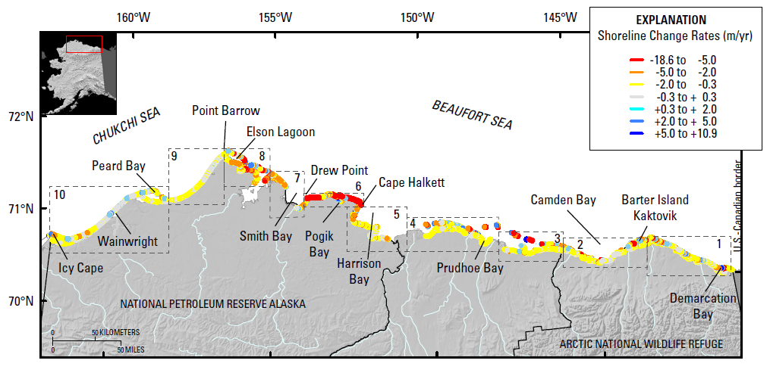
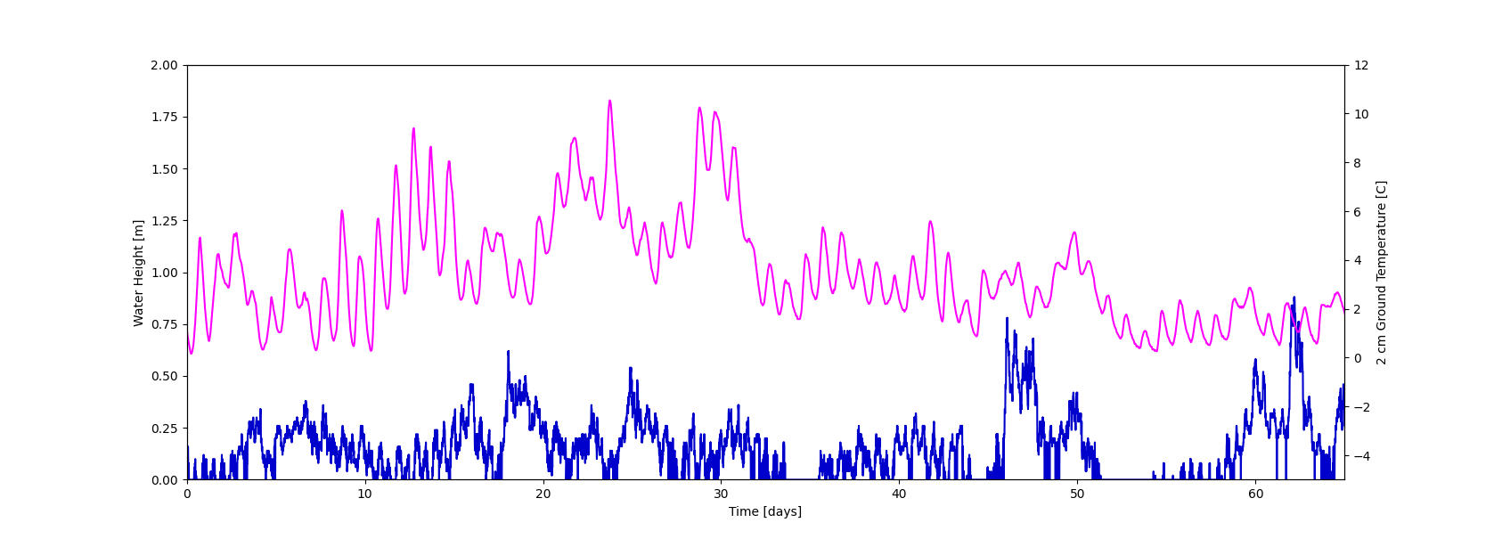
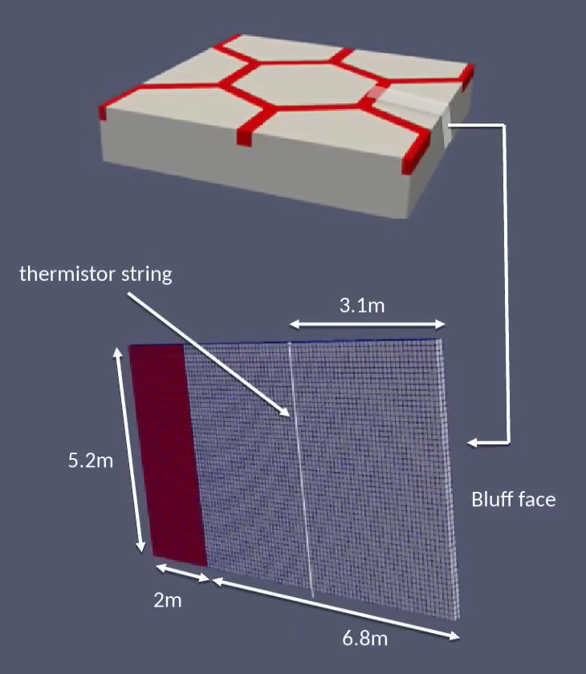
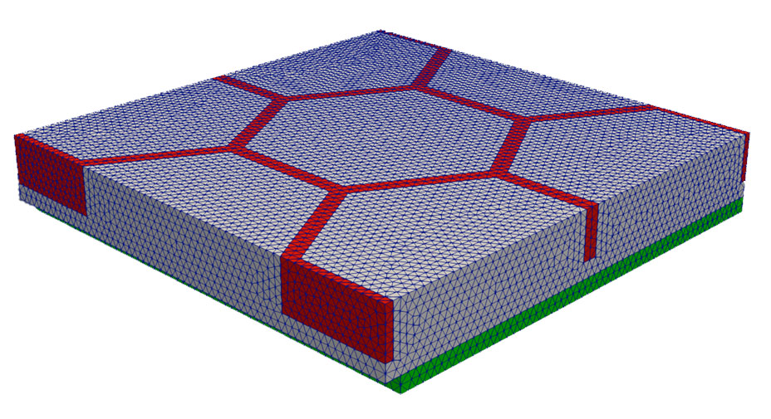

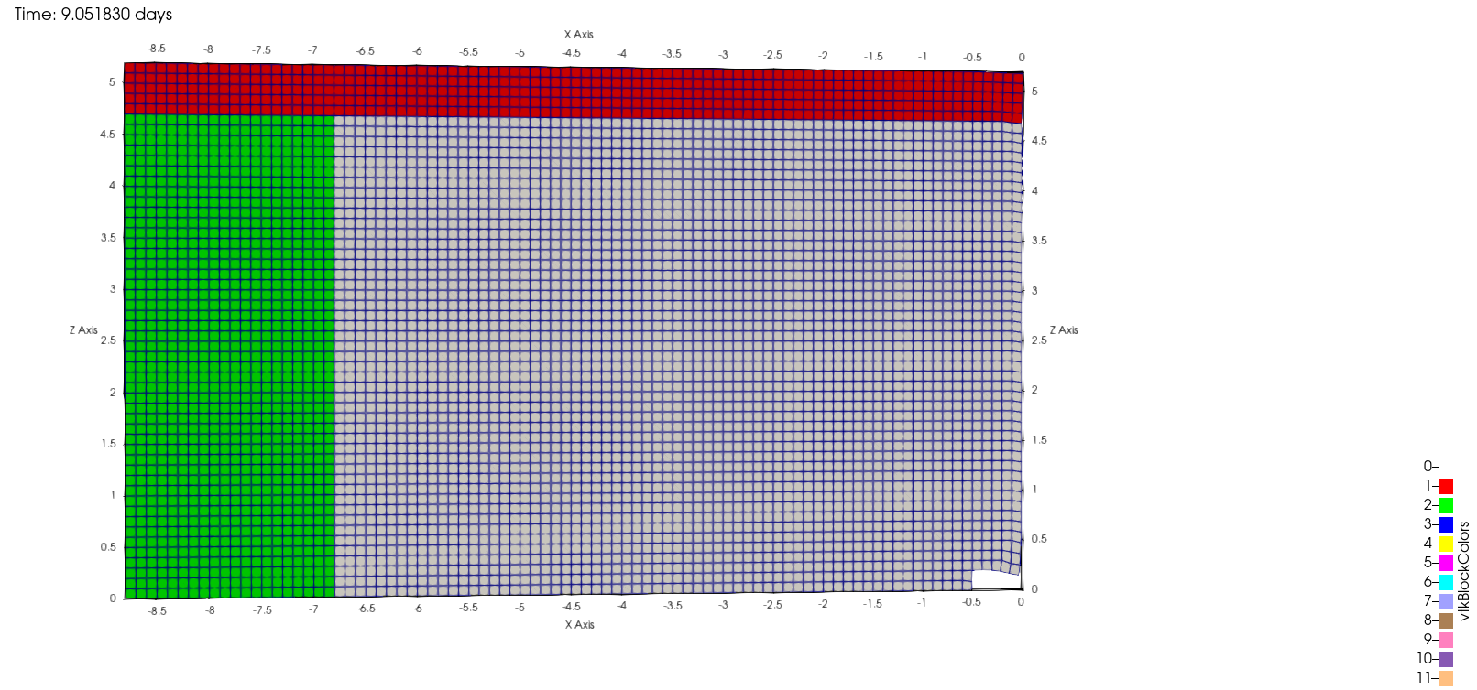
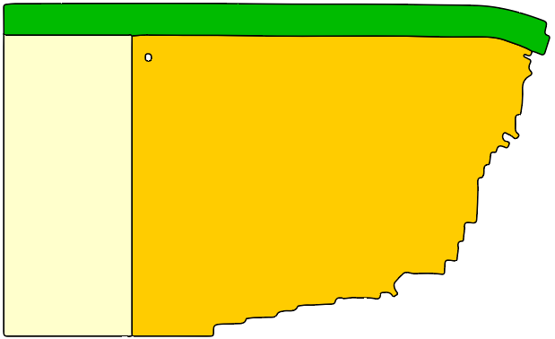
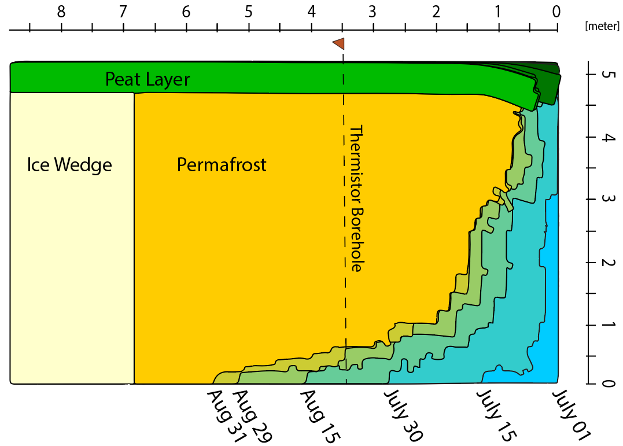
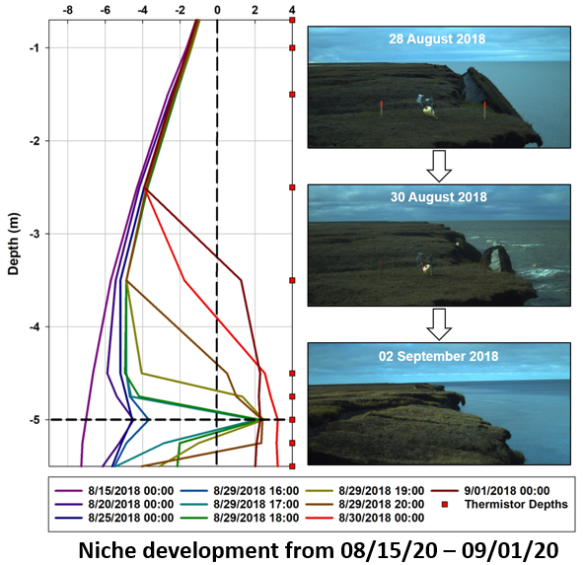

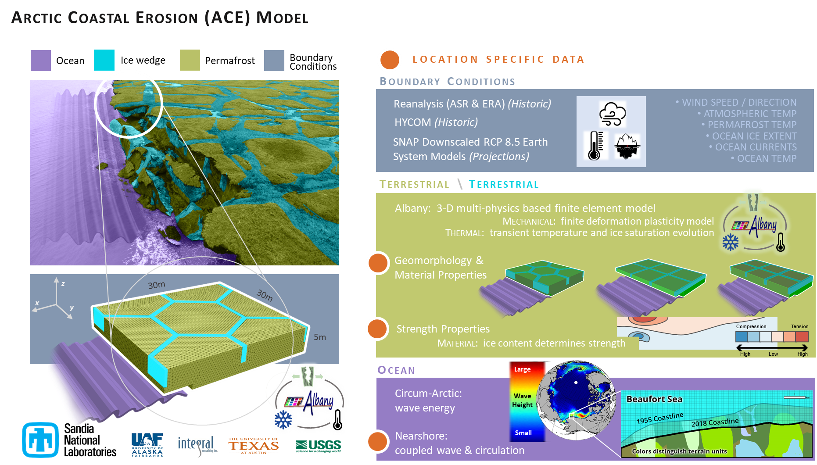

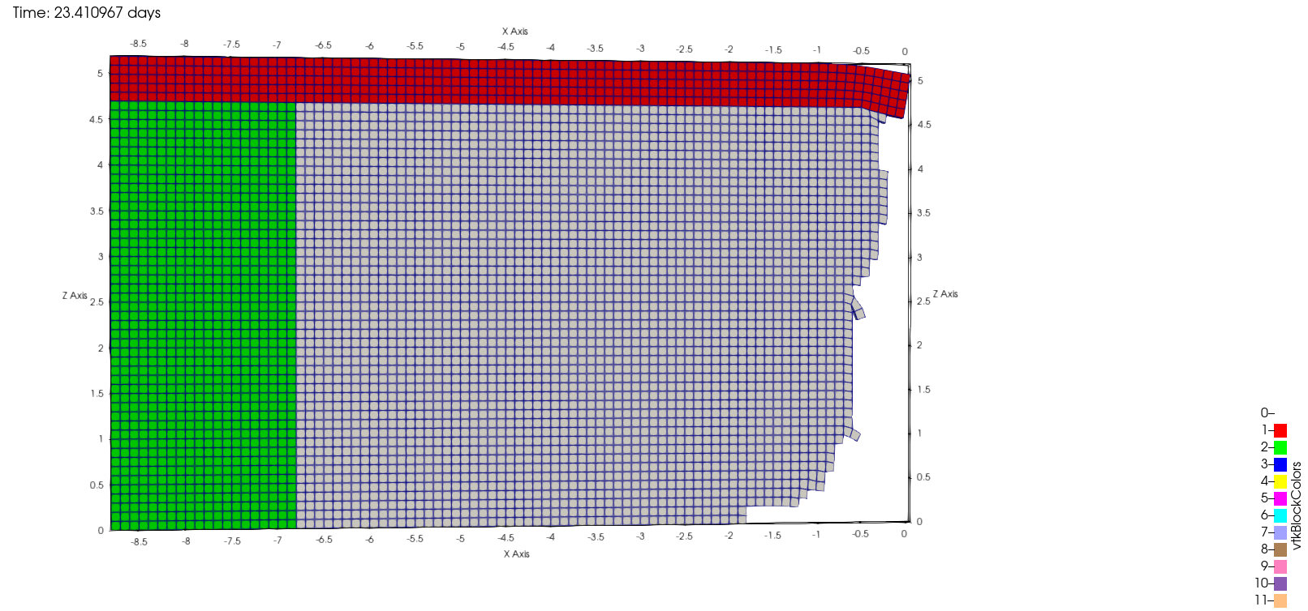
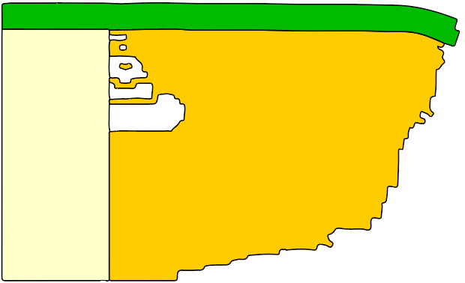
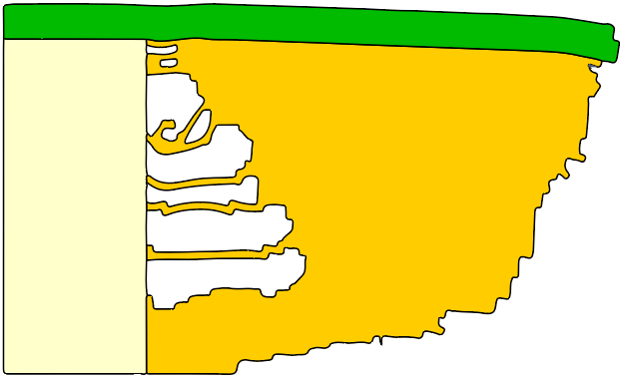
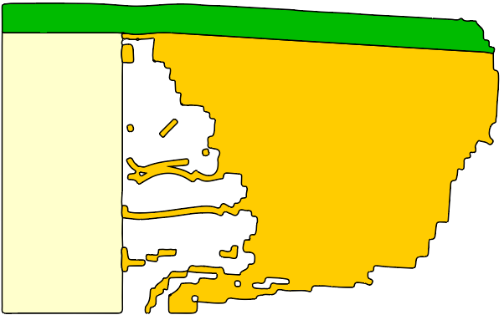
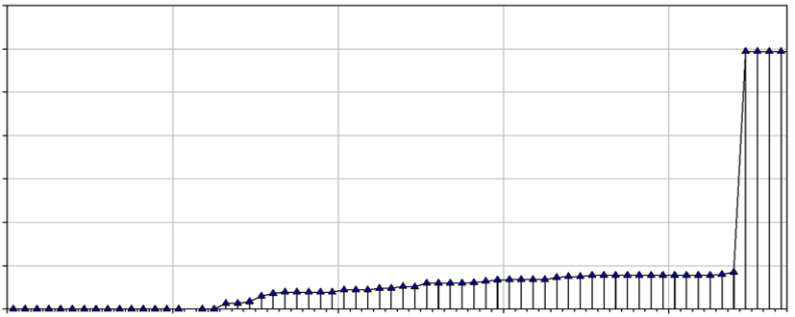
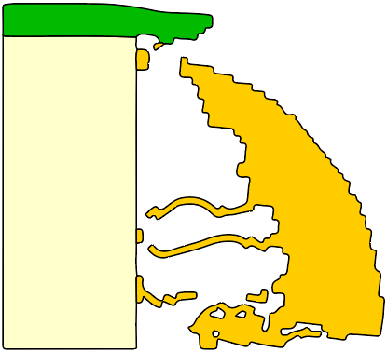
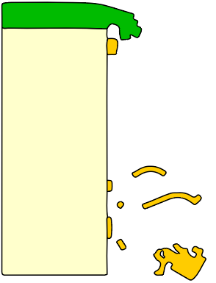
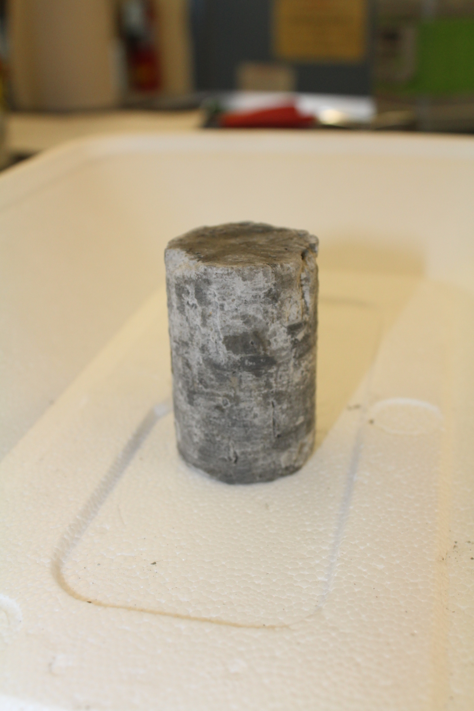
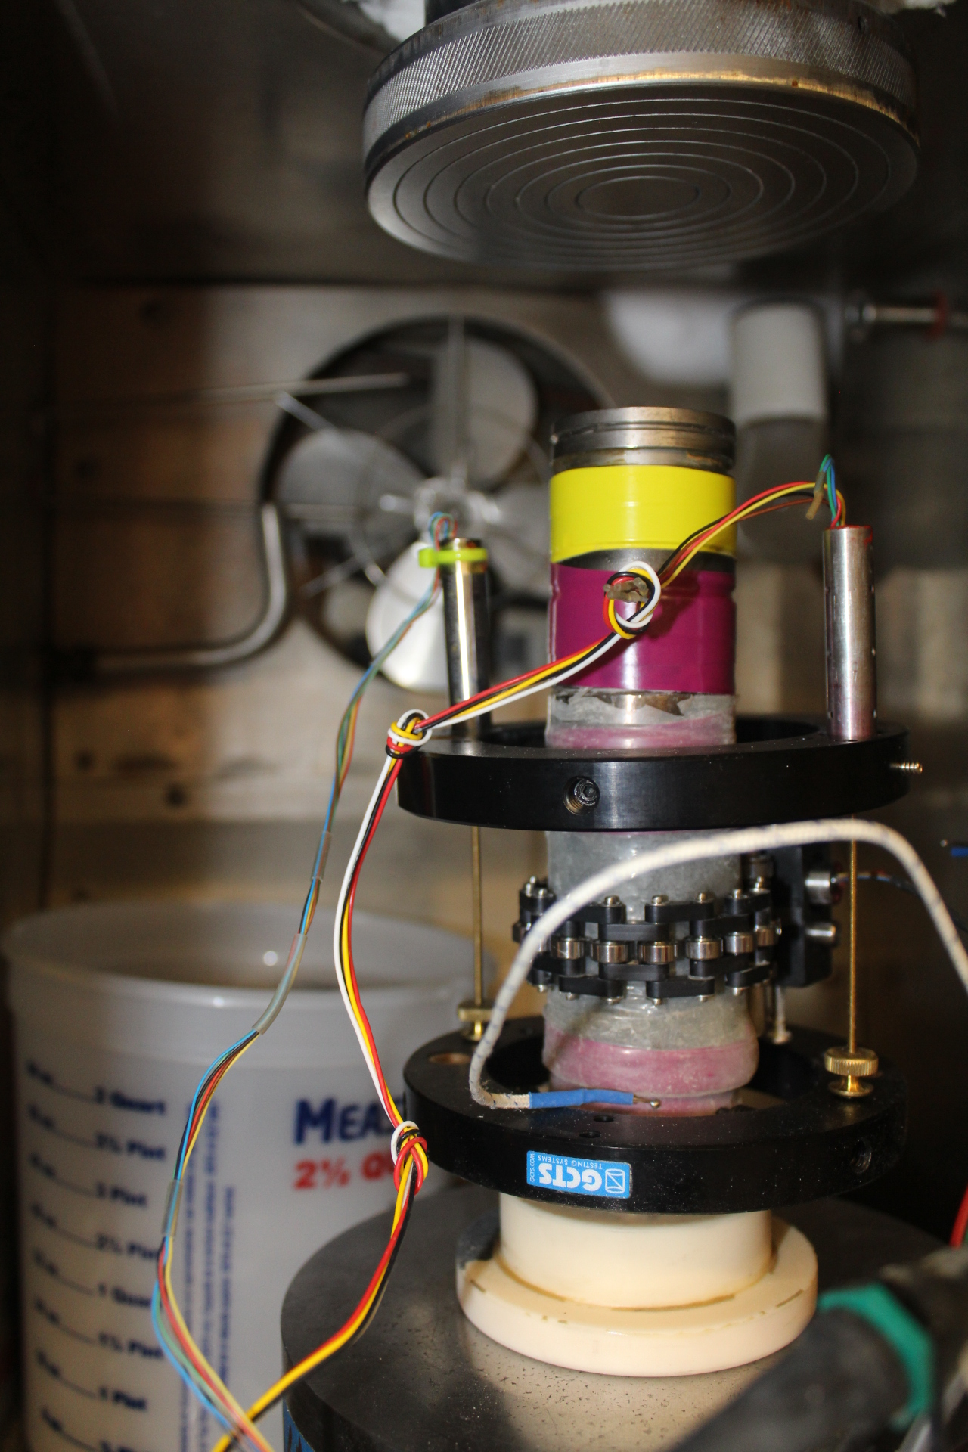
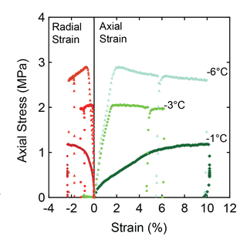
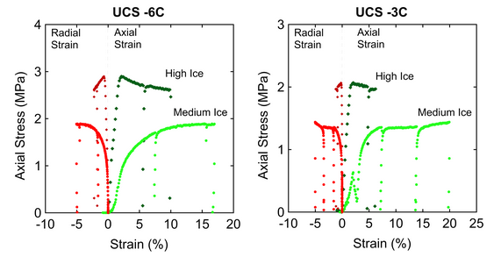
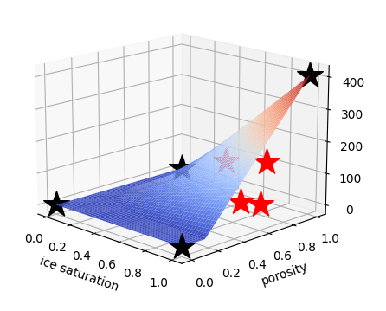
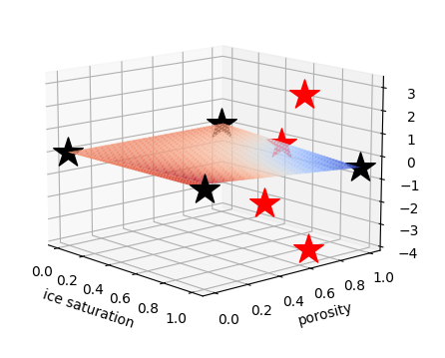
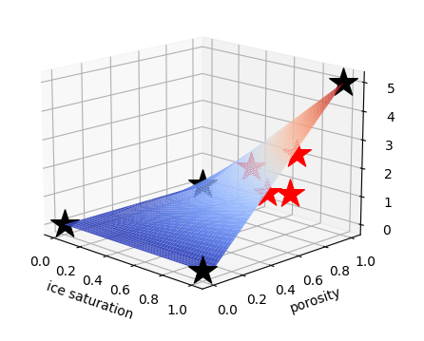
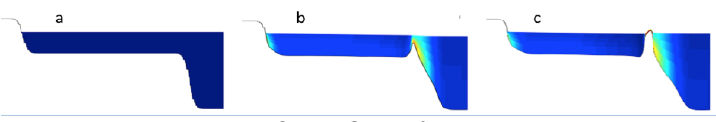
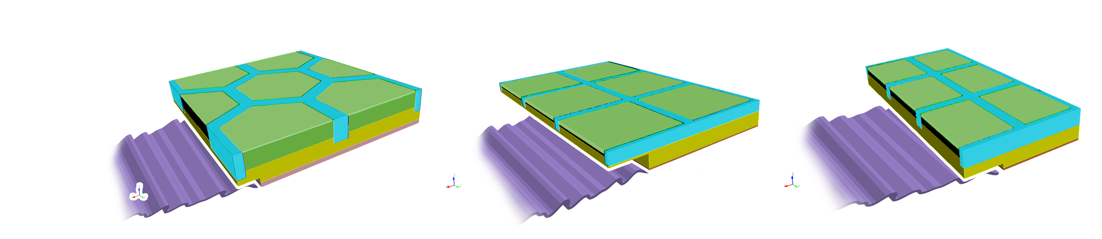
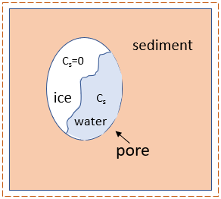
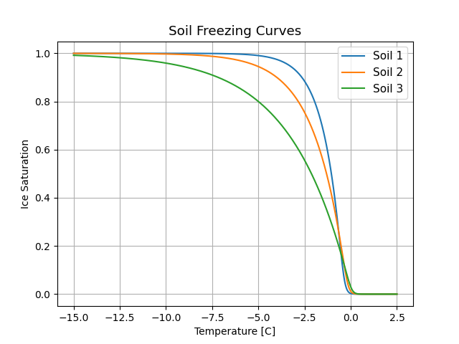
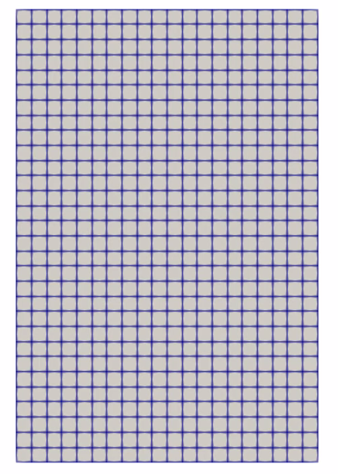



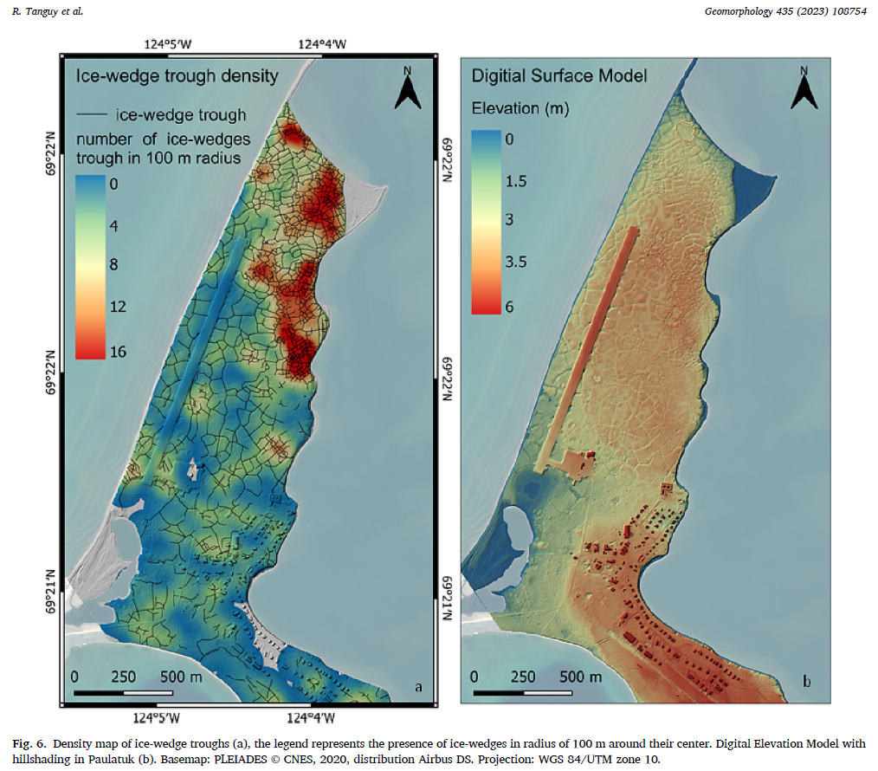
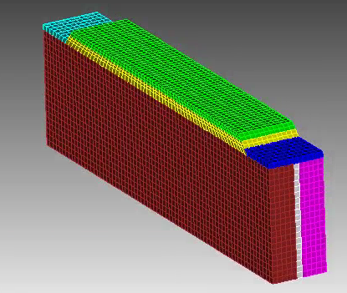
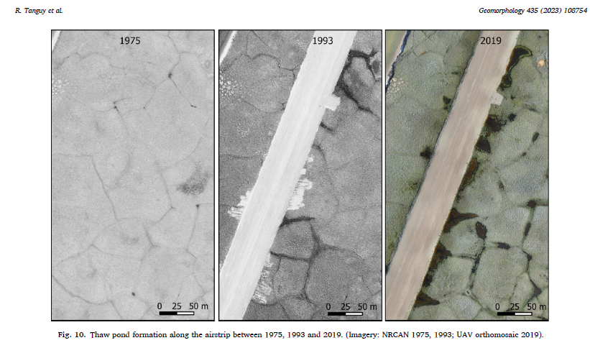

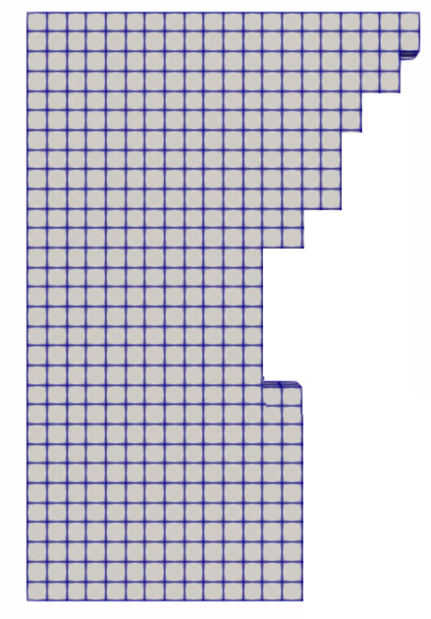

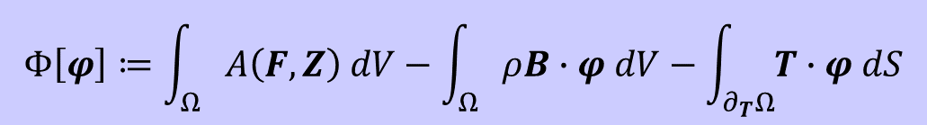
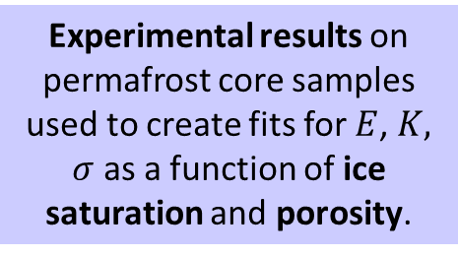

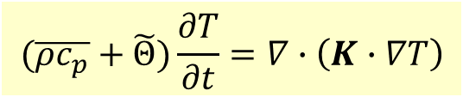
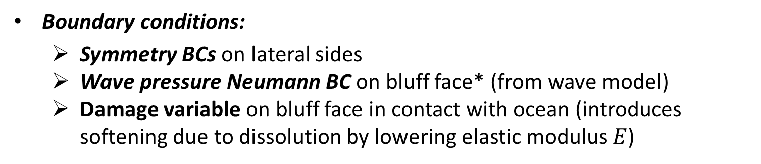


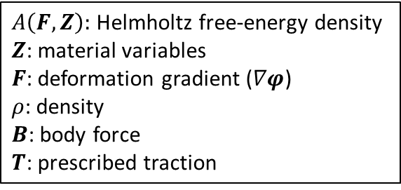

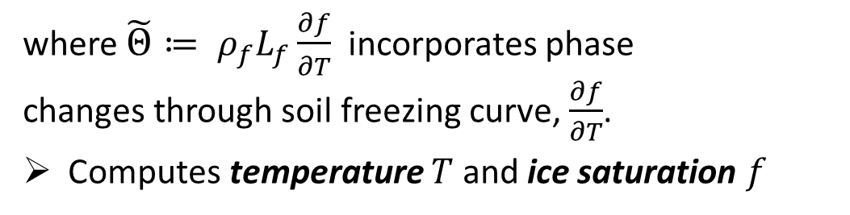

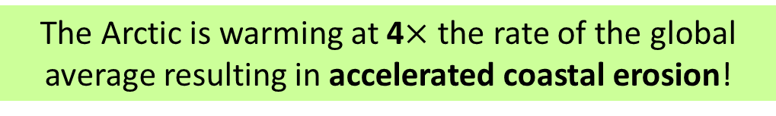

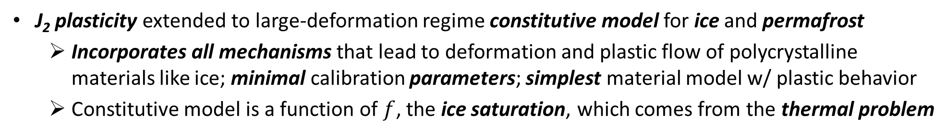

Assessing permafrost demise and infrastructure destabilization using the Arctic Coastal Erosion (ACE) model
Alejandro Mota¹, Jenn Frederick¹, Irina Tezaur¹, Diana Bull¹, Elyce Bayat¹, Charles Choens¹, Ben Jones², Chris Flanary³
Motivation
Mechanical Model and Mesh Erosion
ACE Simulation Results: 2.5D Slice
The Arctic is warming at 4$×$ the rate of the global average resulting in accelerated coastal erosion!
Certain locations lost >250 m (~2 football fields in length) b/w 2007-2019!
Finite deformation time-dependent variational formulation for solid mechanics problem obtained by minimizing the energy functional:
$A\left(F,Z\right):$ Helmholtz free-energy density
$Z$: material variables
$F$: deformation gradient ($∇φ$)
$ρ$: density
$B$: body force
$T$: prescribed traction
Computational domain is 2.5D cross-section of archetypal 3D bluff geometry discretized with uniform hex grid
  Pseudo-realistic problem with realistic oceanic and atmospheric forcing BC data occurring at Drew Point, AK in summer 2018
  Temperature initialized from vertical thermistor string in DP1-1 ice core at Drew Point
Primary culprit is loss of Arctic sea ice: since 1979 sea ice has lost 51% in area and 75% in volume
  Increasing ice-free season
  Increasing wave energy and storm surge
  Increasing sea water temperatures
$$Φ\left[φ\right]≔\int_{Ω}{A\left(F,Z\right) dV−\int_{Ω}{ρB∙φ dV−\int_{∂_{T}Ω}{T∙φ dS}}}$$
Computes displacements and new computational geometry (following erosion)
Block
Collapse!
J₂ plasticity extended to large-deformation regime constitutive model for ice and permafrost
  Incorporates all mechanisms that lead to deformation and plastic flow of polycrystalline materials like ice; minimal calibration parameters; simplest material model w/ plastic behavior
  Constitutive model is a function of $f$, the ice saturation, which comes from the thermal problem
Ground Temperature (@ 2 cm)
Erosion is threatening:
Coastal communities: threatened with displacement
Coastal infrastructure: active DoD sites, including toxic waste sites, in northern Alaska
Global carbon balance: permafrost stores greenhouse gases (CO₂, CH₄, NO₂).
Active DOD sites
(USGS Ground Station)
Symmetry BCs
Water Height
Barrow
Boundary conditions:
  Symmetry BCs on lateral sides
  Wave pressure Neumann BC on bluff face* (from wave model)
  Damage variable on bluff face in contact with ocean (introduces softening due to dissolution by lowering elastic modulus $E$)
July 1st
Aug 1st
Sep 1st
Wainwright
Oliktok
Bullen Point
Barter Island
Calibrated ACE model is capable of simulating Sept. 1, 2018 block collapse event observed at Drew Point, AK!
“Failed” elements are removed from the mesh when any of three failure criteria are reached for all integration points within an element
  Strain criterion: when material reaches a critical value of the stress in tension or compression
  Strain criterion: when material reaches a critical strain limit defined as a function of peat content (distortion)
  Kinematic criterion: when material has tilted excessively, or exceeded a maximum physical displacement, it is assumed to have fallen as part of block erosion.
Bluff face
Symmetry BCs
Block Collapse
Timelapse
Temperature (°C) Time-lapse Camera
Arctic Coastal Erosion (ACE) Model
Sept 1st
Niche development observed in thermistor data.
Erosion at Drew Point (July/Aug 2018)
* Holthuijsen, 2007.
01-Jul
15-Jul
29-Jul
12-Aug
26-Aug
Field Data
Used for
Calibration
Material Model Calibration to Experimental Data
thermal
denudation
Block Collapse at
Ice Wedge Surface
bluff collapse on Sept 1st
σ
Experimental results on permafrost core samples used to create fits for $E$, $K,$ $σ$ as a function of ice saturation and porosity.
0 1 2 3 4 5 6 7
Bluff Top Erosion (m)
E
K
Upscaling under InteRFACE Project
Experiments are very challenging to perform and provide limited data!
Goal: develop typological understanding of Arctic coastline (terrestrial and oceanographic) to upscale models of erosion and flooding
Offshore waves
pure ice
experimental
data points
theoretical
data points
pure ice
$$×$$
Elastic modulus
Hardening modulus
Nearshore environment
Thermal Model
$$E$$
pure
water
$$K$$
$σ$
Yield Stress
pure
water
ACE model implementation with representative terrestrial configurations
Offshore wave environment typology
Looking to establish 6-7 terrestrial configurations
ACE requires unique information not available in landscape work
$$×$$
Transient heat conduction in a non-homogeneous porous media with water-ice phase change:
pure
rock
pure
rock
Terrestrial configuration
$\overline{ρ}$: density from mixture model
$\overline{c_{p}}$: specific heat from mixture model
$K$: thermal diffusivity tensor
$ρ_{f}$: ice density
$L_{f}$: latent heat of water-ice phase change
$f$: ice saturation ($∈[0,1]$)
$\frac{∂f}{∂T}:$soil freezing curve (depends on salinity)
$$(\overline{ρc_{p}}+\tilde{Θ})\frac{∂T}{∂t}=∇∙\left(K∙∇T\right)$$
Gibbs et al., 2015
where $\tilde{Θ}≔ ρ_{f}L_{f}\frac{∂f}{∂T}$ incorporates phase changes through soil freezing curve, $\frac{∂f}{∂T}$.
Computes temperature $T$ and ice saturation $f$
1
Permafrost control volume
Coupled Thermo-Mechanical Formulation
Above
Boundary conditions (from wave model/data)
  Local geothermal heat flux from below
  Air temp* from above
  Air/ocean temp at bluff face
  Ocean salinity at bluff face**
Potential key advantages:
Failure modes develop from constitutive relationships in FEM model
Thermal and mechanical problems can be advanced using different time-steppers (e.g., implicit-explicit coupling)
Thermal:
Inputs: geometry, sediment type,
porosity, salinity. Outputs: temperature field, ice saturation.
Arctic Critical Infrastructure (ACI) Modeling
Ice Saturation
Soil freezing curve $\frac{∂f}{∂T}≠0$ only during phase change, which occurs in narrow temp zone where the width depends on soil components.
Goal of ACI: leverage ACE to develop a computational model capable of analyzing various permafrost-infrastructure scenarios, failure modes and risk-mitigation strategies
Bluff face
Below
Eroded geometry
Ice saturation
We are maturing our permafrost degradation simulation capabilities for use on Arctic infrastructure impact
Initial exemplar: Paulatuk airstrip in northern Canada (right)
* Or, alternatively surface ground temperature (if available). **Used to modify melting temperature of ice.
Temperature [C]
Unique characteristic of coupled model: coupling happens at the level of material model
Mechanical:
Inputs: ice saturation, mechanicals. Outputs: displacements, eroded geometry.
References
[1] J. Frederick, M. Thomas, D. Bull, C. Jones, J. Roberts. “The Arctic Coastal Erosion Problem”. Sandia National Laboratories Report, SAND2016-9762, 2016.
[2] M. Thomas, A. Mota, B. Jones, C. Choens, J. Frederick, D. Bull. “Bluff geometry and material properties influence stress rates relevant to coastal permafrost block failure”. Frontiers in Earth Science 8, 2020.
[3] J. Frederick, A. Mota, D. Bull, I. Tezaur. “Thermo-chemo-mechanical coupling for Arctic Coastal Erosion”, ELSCAM. 397 113533, 2021.
[4] D. Bull et al. "Arctic Coastal Erosion: Modeling and Experimentation". Sandia National Laboratories report, SAND2020-10223, 2020.
Sandia National Laboratories is a multimission laboratory managed and operated by National Technology &Engineering Solutions of Sandia, LLC, a wholly owned subsidiary of Honeywell International Inc., for the U.S. Department of Energy’s National Nuclear Security Administration under contract DE-NA0003525.
¹Sandia National Laboratories. ²University of Alaska Fairbanks. ³Integral Consulting.
SAND2024-05203O

