Slide 1
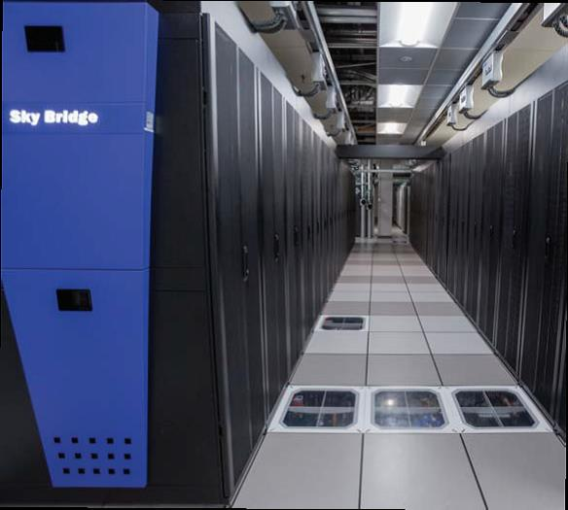
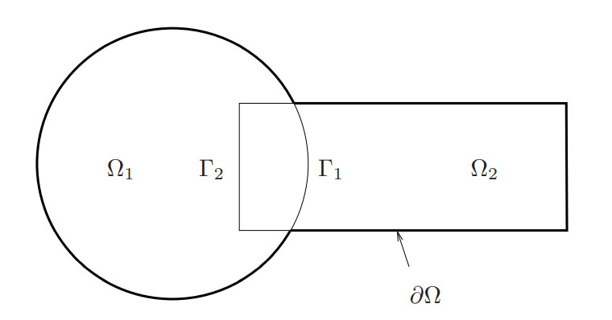
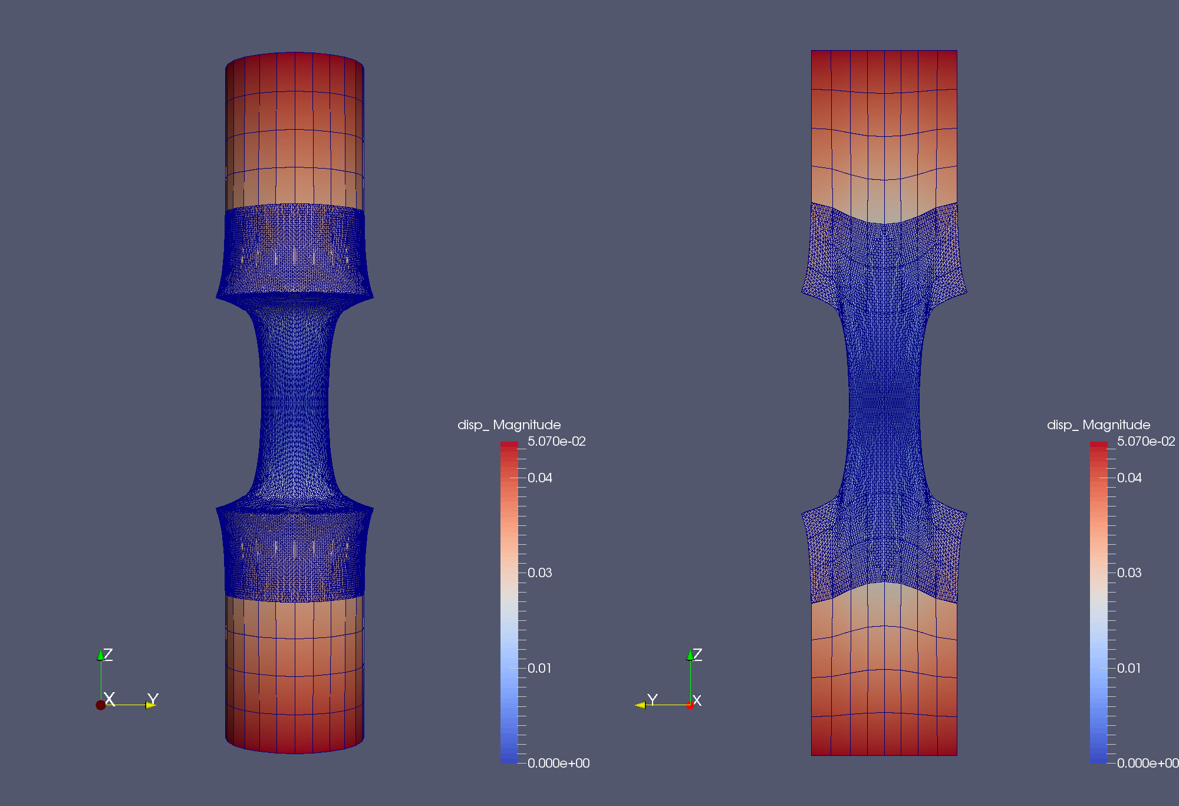
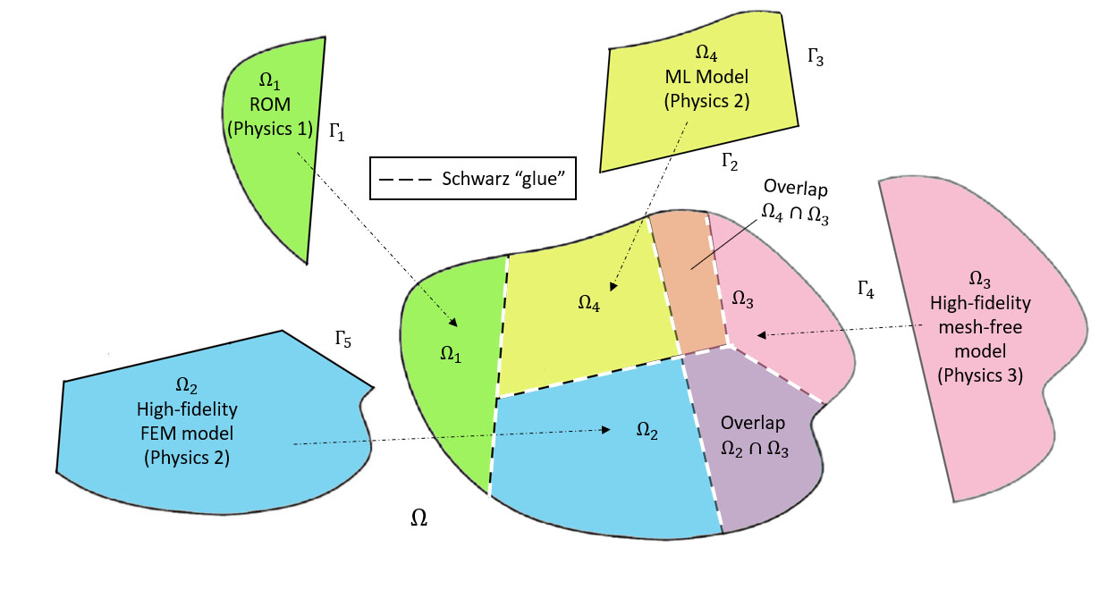
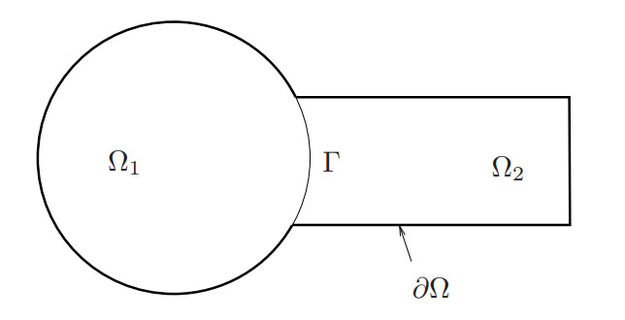
Alternating Schwarz-based coupling of conventional and data-driven models
Irina Tezaur¹, Joshua Barnett^{1,2}, Alejandro Mota¹, Chris Wentland¹, Will Snyder^{1,3}
¹Sandia National Laboratories, ²Stanford University, ³Virginia Tech University
COUPLED 2023
Chania, Greece, June 5-7, 2023
SAND2023-04302C

Slide 2

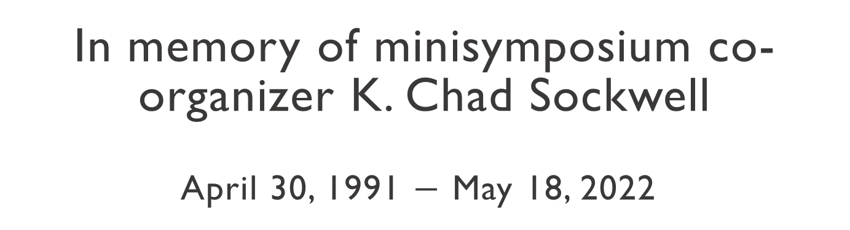
In memory of minisymposium co-organizer K. Chad Sockwell
April 30, 1991 $−$ May 18, 2022

Slide 3
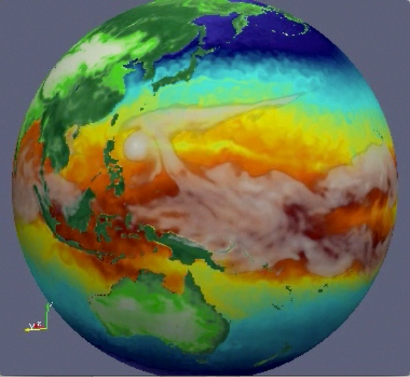

Motivation: multi-scale & multi-physics coupling
Atmos.
(EAM)
Ocean
(MPAS-O)
☺
There exist established rigorous mathematical theories for coupling multi-scale and multi-physics components based on traditional discretization methods (“Full Order Models” or FOMs).
Sea Ice
(MPAS-SI)
Land
(ELM)
Land Ice
(MALI)
N₁
N₂
N₁
N₂
M₁
M₂
M₃
M₄
N₄
N₃
N₄
N₃
N₅
N₅
Complex System Model
Traditional Methods
Coupled Numerical Model
PDEs, ODEs
Nonlocal integral
Classical DFT
Atomistic, …
Mesh-based (FE, FV, FD)
Meshless (SPH, MLS)
Implicit, explicit
Eulerian, Lagrangian…
Monolithic (Lagrange multipliers)
Partitioned (loose) coupling
Iterative (Schwarz, optimization)
Notes:
The past decades have seen a tremendous amount of investment in the development of simulation frameworks for coupled multi-scale and multi-physics problems. These frameworks rely on established mathematical theories to couple physics components discretized using so-called traditional discretization methods such as finite elements, finite volumes and finite differences. A prime example is the DOE’s global climate model, the Energy Exascale Earth System Model (E3SM), which couples 5 physics components (atmosphere, ocean, sea ice, land ice and land). Each component is developed separately according to the relevant physics, dynamics and numerical methods, and the components are coupled in a way that ensures stability, accuracy and conservation.

Slide 4
Motivation: multi-scale & multi-physics coupling
Atmos.
(EAM)
Ocean
(MPAS-O)
☺
There exist established rigorous mathematical theories for coupling multi-scale and multi-physics components based on traditional discretization methods (“Full Order Models” or FOMs).
Sea Ice
(MPAS-SI)
Land
(ELM)
Land Ice
(MALI)
N₁
N₂
N₁
N₂
N₁
PINN=N₂
M₁
M₂
M₃
M₄
N₄
N₃
N₄
ROM=N₄
N₃
N₅
DMD=N₃
N₅
UDE=N₅
Complex System Model
Traditional Methods
Coupled Numerical Model
Traditional + Data-Driven Methods
PDEs, ODEs
Nonlocal integral
Classical DFT
Atomistic, …
Mesh-based (FE, FV, FD)
Meshless (SPH, MLS)
Implicit, explicit
Eulerian, Lagrangian, …
Monolithic (Lagrange multipliers)
Partitioned (loose) coupling
Iterative (Schwarz, optimization)
PINNs
Neural ODEs
Projection-based ROMs, …
While there is currently a big push to integrate data-driven methods into modeling & simulation toolchains, existing algorithmic and software infrastructures are ill-equipped to handle rigorous plug-and-play integration of non-traditional, data-driven models!
☹

Slide 5

Coupling Project, Models and Methods
fHNM (flexible Heterogeneous Numerical Methods) Project: aims to discover the mathematical principles guiding the assembly of standard and data-driven numerical models in stable, accurate and physically consistent ways
Data-driven models: to be “mixed-and-matched” with each other and first-principles models
Class A: projection-based reduced order models (ROMs)
Class B: machine-learned models, i.e., Physics-Informed Neural Networks (PINNs)
Class C: flow map approximation models, i.e., dynamic model decomposition (DMD) models
Coupling methods:
Method 1: Alternating Schwarz-based coupling
Method 2: Optimization-based coupling
Method 3: Coupling via generalized mortar methods (GMMs)

Slide 6
Coupling Project, Models and Methods
fHNM (flexible Heterogeneous Numerical Methods) Project: aims to discover the mathematical principles guiding the assembly of standard and data-driven numerical models in stable, accurate and physically consistent ways
Data-driven models: to be “mixed-and-matched” with each other and first-principles models
Class A: projection-based reduced order models (ROMs)
Class B: machine-learned models, i.e., Physics-Informed Neural Networks (PINNs)
Class C: flow map approximation models, i.e., dynamic model decomposition (DMD) models
This talk
Coupling methods:
Method 1: Alternating Schwarz-based coupling
Method 2: Optimization-based coupling
Method 3: Coupling via generalized mortar methods (GMMs)

Slide 7
Outline
The Schwarz Alternating Method for Domain Decomposition-Based Coupling
Extension to FOM*-ROM# and ROM-ROM Coupling
Numerical Examples
  1D Dynamic Wave Propagation in Hyperelastic Bar
  2D Burgers Equation
Summary & Future Work
*Full-Order Model. #Reduced Order Model.
Notes:
TODO: clean up formatting / spacing.

Slide 8
Outline
The Schwarz Alternating Method for Domain Decomposition-Based Coupling
Extension to FOM*-ROM# and ROM-ROM Coupling
Numerical Examples
  1D Dynamic Wave Propagation in Hyperelastic Bar
  2D Burgers Equation
Summary & Future Work
*Full-Order Model. #Reduced Order Model.
Notes:
TODO: clean up formatting / spacing.

Slide 9
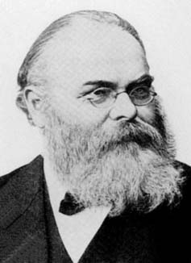
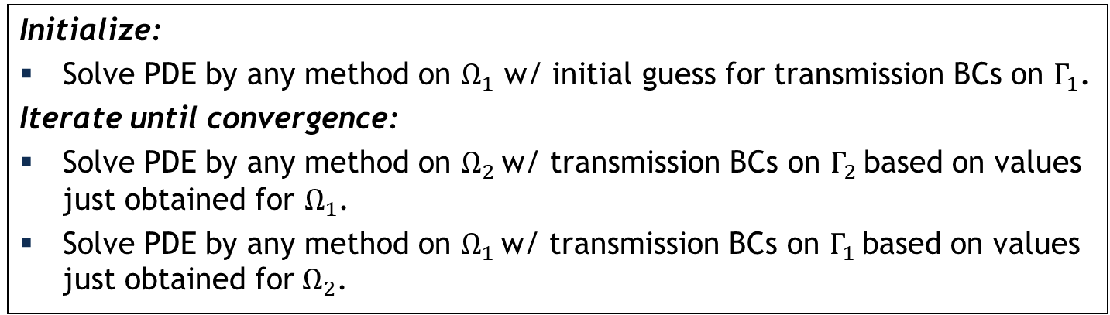
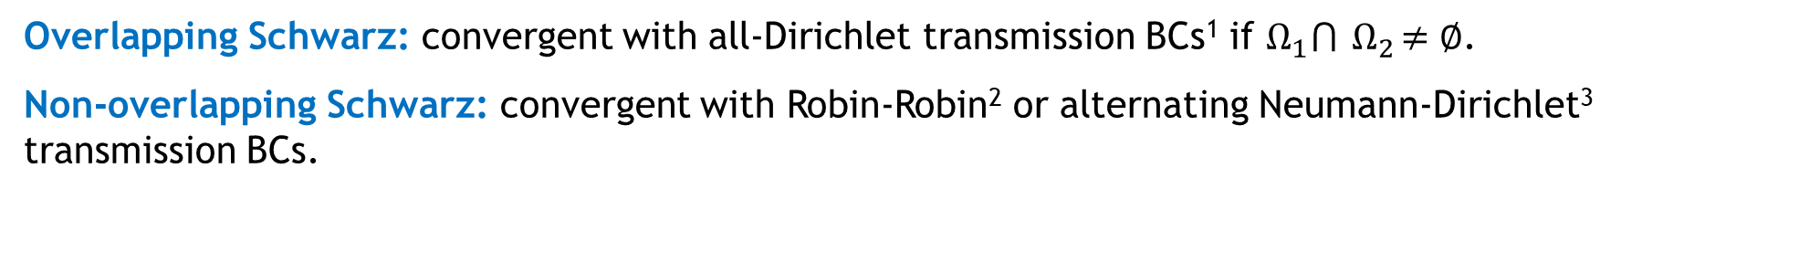
Schwarz Alternating Method for Domain Decomposition
Proposed in 1870 by H. Schwarz for solving Laplace PDE on irregular domains.
Crux of Method: if the solution is known in regularly shaped domains, use those as pieces to iteratively build a solution for the more complex domain.
H. Schwarz (1843–1921)
Basic Schwarz Algorithm
overlapping
Initialize:
Solve PDE by any method on $Ω_{1}$ w/ initial guess for transmission BCs on $Γ_{1}$.
Iterate until convergence:
Solve PDE by any method on $Ω_{2}$ w/ transmission BCs on $Γ_{2}$ based on values just obtained for $Ω_{1}$.
Solve PDE by any method on $Ω_{1}$ w/ transmission BCs on $Γ_{1}$ based on values just obtained for $Ω_{2}$.
non-overlapping
Overlapping Schwarz: convergent with all-Dirichlet transmission BCs¹ if $Ω_{1}⋂{ Ω}_{2}≠∅$.
Non-overlapping Schwarz: convergent with Robin-Robin² or alternating Neumann-Dirichlet³ transmission BCs.
z: convergent with Robin-Robin² or alternating Neumann-Dirichlet³ transmission BCs.
¹Schwarz, 1870; Lions, 1988.
²Lions, 1990. ³Zanolli et al., 1987.
²Lions, 1990. ³Zanolli et al., 1987.

Slide 10
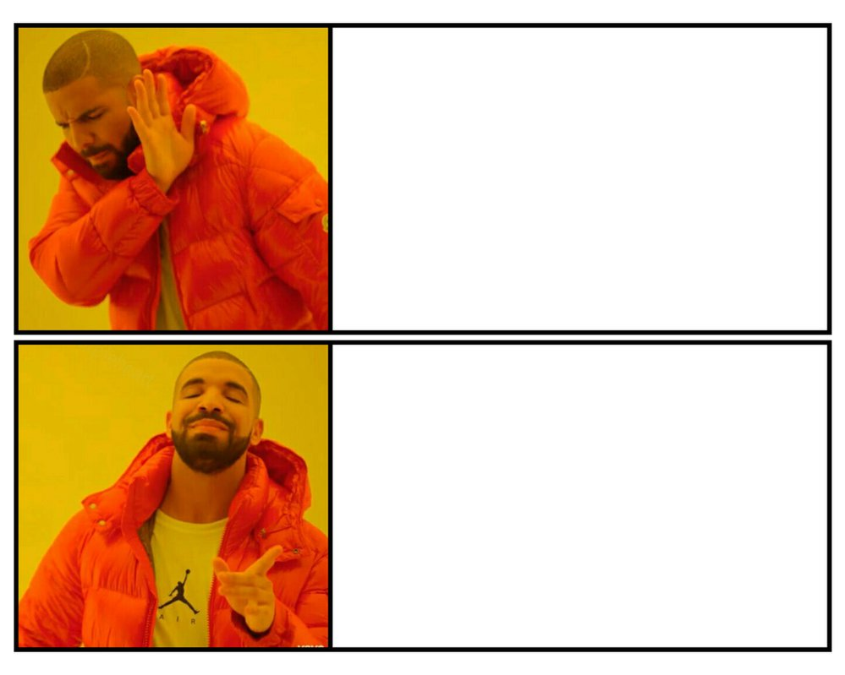
How We Use the Schwarz Alternating Method
10
AS A PRECONDITIONER FOR THE LINEARIZED SYSTEM
AS A SOLVER FOR THE COUPLED
FULLY NONLINEAR PROBLEM

Slide 11
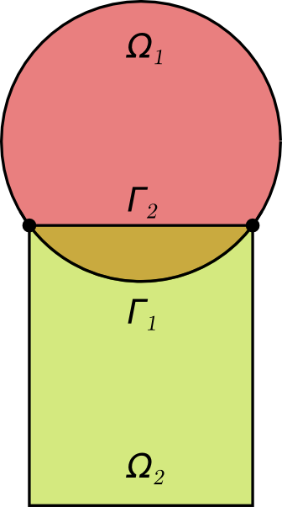
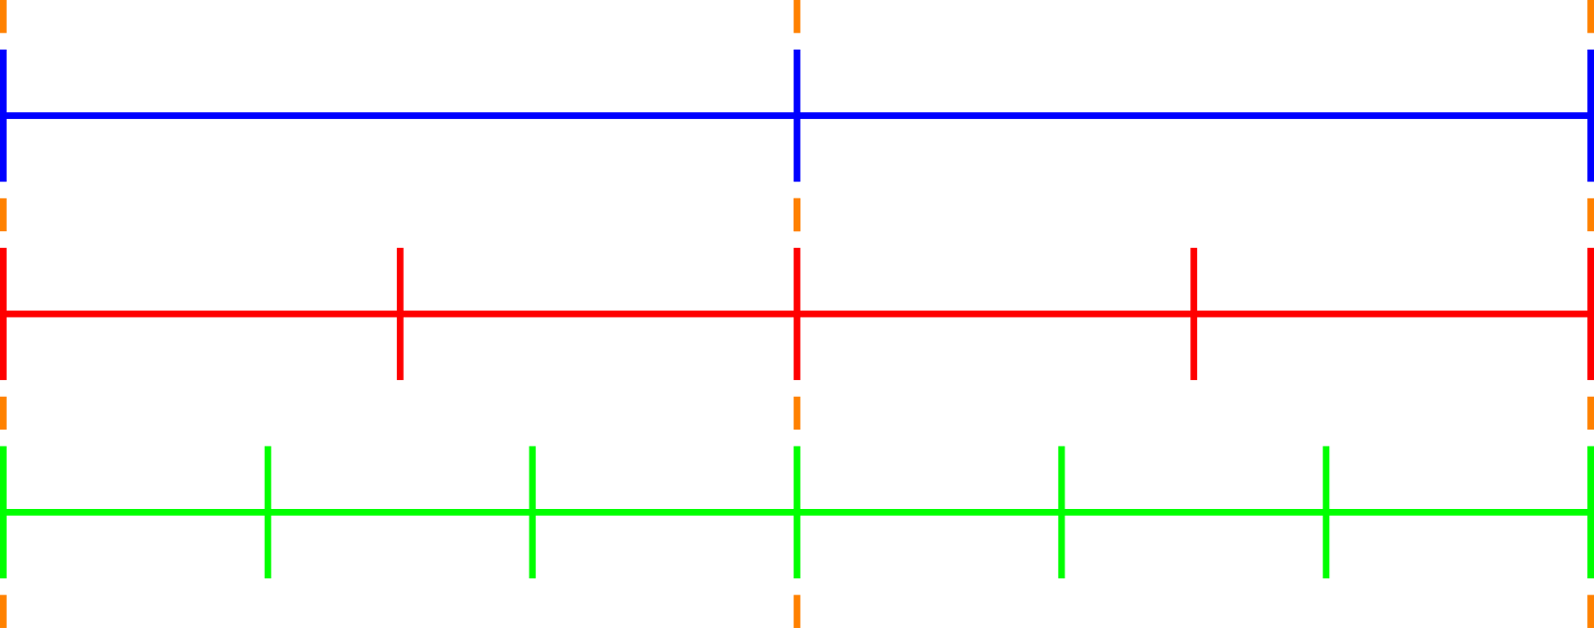
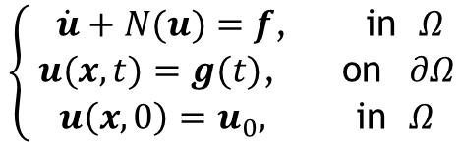
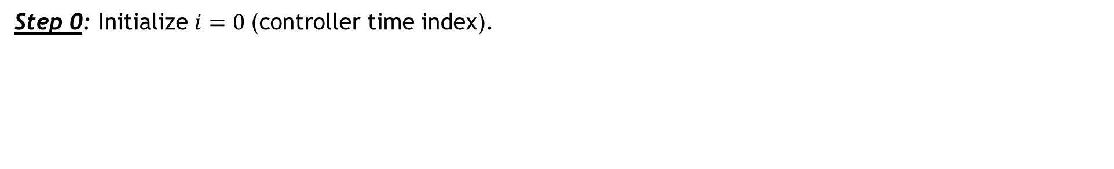


Time-Advancement Within the Schwarz Framework
$$T_{0}$$
$$T_{1}$$
Controller time stepper
Time integrator for Ω₁
Time integrator for Ω₂
Step 0: Initialize $i=0 \text{(}\text{controller} \text{time} \text{index}\text{).}$
$$\left\{ \begin{aligned} \dot{u}+N(u)=f\text{,} \text{in} Ω \\ u(x,t)=g(t)\text{,} \text{on} ∂Ω \\ u\left(x,0\right)=u_{0}, \text{in} Ω\end{aligned}\right.$$
Model PDE:
Notes:
TODO? Change equations?

Slide 12
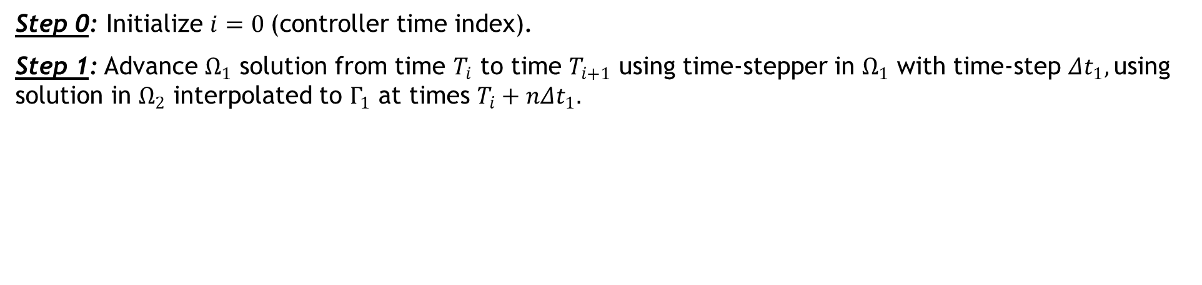

Time-Advancement Within the Schwarz Framework
$$T_{0}$$
$$T_{1}$$
Controller time stepper
Time integrator for Ω₁
Time integrator for Ω₂
Integrate using ${Δt}_{1}$
Step 0: Initialize $i=0 \text{(}\text{controller} \text{time} \text{index}\text{).}$
Step 1: Advance $Ω_{1}$ solution from time $T_{i}$ to time $T_{i+1}$ using time-stepper in $Ω_{1}$ with time-step ${Δt}_{1},$using solution in $Ω_{2}$ interpolated to $Γ_{1}$ at times $T_{i}+n{Δt}_{1}.$
$$\left\{ \begin{aligned} \dot{u}+N(u)=f\text{,} \text{in} Ω \\ u(x,t)=g(t)\text{,} \text{on} ∂Ω \\ u\left(x,0\right)=u_{0}, \text{in} Ω\end{aligned}\right.$$
Model PDE:

Slide 13
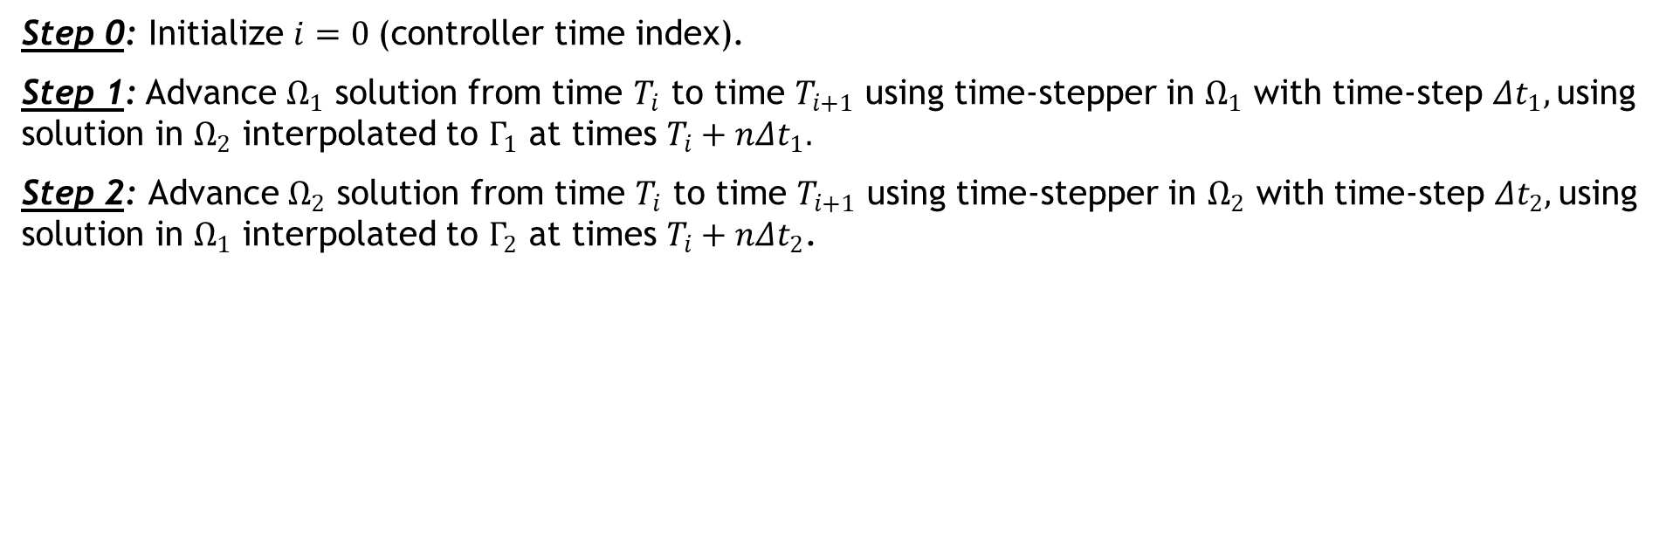


Time-Advancement Within the Schwarz Framework
$$T_{0}$$
$$T_{1}$$
Controller time stepper
Time integrator for Ω₁
Time integrator for Ω₂
Interpolate from $Ω_{1}$ to $Γ_{2}$
Integrate using ${Δt}_{2}$
Step 0: Initialize $i=0 \text{(}\text{controller} \text{time} \text{index}\text{).}$
Step 1: Advance $Ω_{1}$ solution from time $T_{i}$ to time $T_{i+1}$ using time-stepper in $Ω_{1}$ with time-step ${Δt}_{1},$using solution in $Ω_{2}$ interpolated to $Γ_{1}$ at times $T_{i}+n{Δt}_{1}.$
Step 2: Advance $Ω_{2}$ solution from time $T_{i}$ to time $T_{i+1}$ using time-stepper in $Ω_{2}$ with time-step ${Δt}_{2},$using solution in $Ω_{1}$ interpolated to $Γ_{2}$ at times $T_{i}+n{Δt}_{2}$.
$$\left\{ \begin{aligned} \dot{u}+N(u)=f\text{,} \text{in} Ω \\ u(x,t)=g(t)\text{,} \text{on} ∂Ω \\ u\left(x,0\right)=u_{0}, \text{in} Ω\end{aligned}\right.$$
Model PDE:

Slide 14
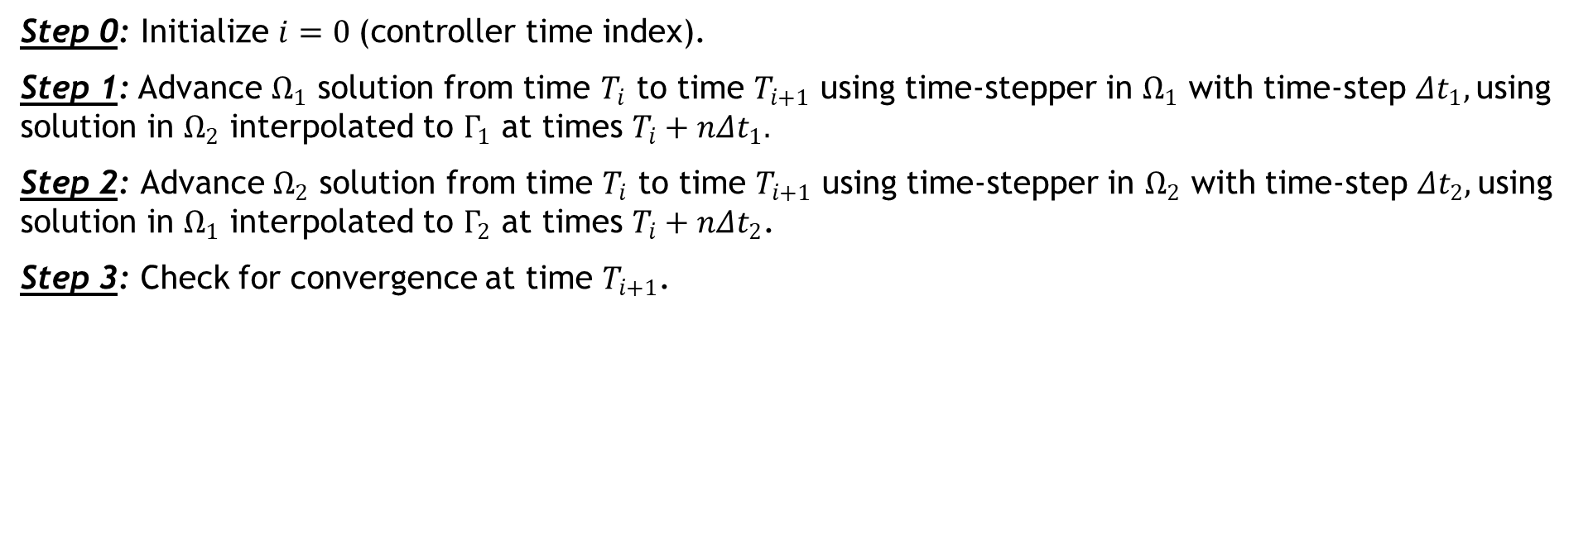
Time-Advancement Within the Schwarz Framework
$$T_{0}$$
$$T_{1}$$
Controller time stepper
Time integrator for Ω₁
Time integrator for Ω₂
Step 0: Initialize $i=0 \text{(}\text{controller} \text{time} \text{index}\text{).}$
Step 1: Advance $Ω_{1}$ solution from time $T_{i}$ to time $T_{i+1}$ using time-stepper in $Ω_{1}$ with time-step ${Δt}_{1},$using solution in $Ω_{2}$ interpolated to $Γ_{1}$ at times $T_{i}+n{Δt}_{1}.$
Step 2: Advance $Ω_{2}$ solution from time $T_{i}$ to time $T_{i+1}$ using time-stepper in $Ω_{2}$ with time-step ${Δt}_{2},$using solution in $Ω_{1}$ interpolated to $Γ_{2}$ at times $T_{i}+n{Δt}_{2}$.
Step 3: Check for convergence at time $T_{i+1}$.
$$\left\{ \begin{aligned} \dot{u}+N(u)=f\text{,} \text{in} Ω \\ u(x,t)=g(t)\text{,} \text{on} ∂Ω \\ u\left(x,0\right)=u_{0}, \text{in} Ω\end{aligned}\right.$$
Model PDE:

Slide 15
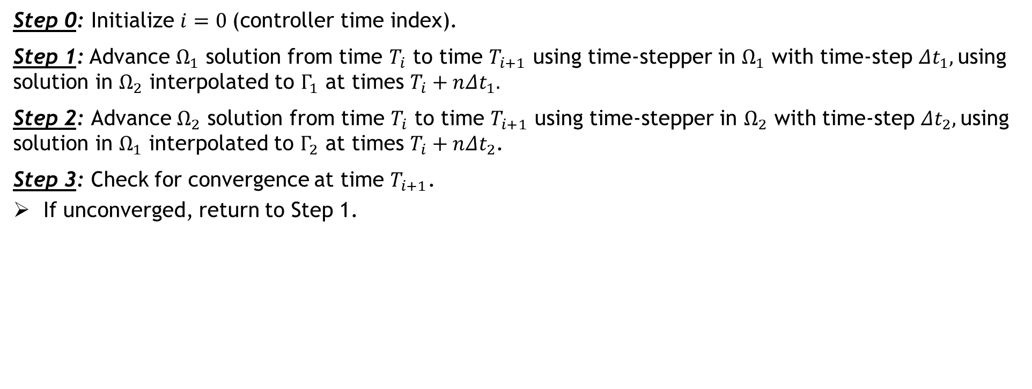

Time-Advancement Within the Schwarz Framework
$$T_{0}$$
$$T_{1}$$
Controller time stepper
Time integrator for Ω₁
Time integrator for Ω₂
Integrate using ${Δt}_{1}$
Interpolate from $Ω_{2}$ to $Γ_{1}$
Step 0: Initialize $i=0 \text{(}\text{controller} \text{time} \text{index}\text{).}$
Step 1: Advance $Ω_{1}$ solution from time $T_{i}$ to time $T_{i+1}$ using time-stepper in $Ω_{1}$ with time-step ${Δt}_{1},$using solution in $Ω_{2}$ interpolated to $Γ_{1}$ at times $T_{i}+n{Δt}_{1}.$
Step 2: Advance $Ω_{2}$ solution from time $T_{i}$ to time $T_{i+1}$ using time-stepper in $Ω_{2}$ with time-step ${Δt}_{2},$using solution in $Ω_{1}$ interpolated to $Γ_{2}$ at times $T_{i}+n{Δt}_{2}$.
Step 3: Check for convergence at time $T_{i+1}$.
If unconverged, return to Step 1.
$$\left\{ \begin{aligned} \dot{u}+N(u)=f\text{,} \text{in} Ω \\ u(x,t)=g(t)\text{,} \text{on} ∂Ω \\ u\left(x,0\right)=u_{0}, \text{in} Ω\end{aligned}\right.$$
Model PDE:

Slide 16

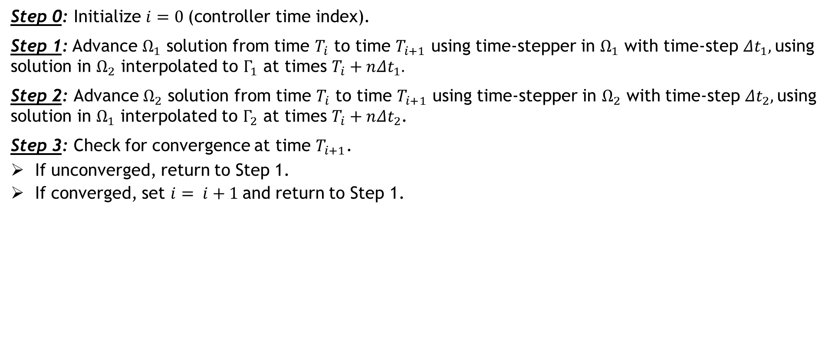

Time-Advancement Within the Schwarz Framework
$$T_{0}$$
$$T_{1}$$
$$T_{2}$$
Controller time stepper
Time integrator for Ω₁
Time integrator for Ω₂
Integrate using ${Δt}_{1}$
Interpolate from $Ω_{2}$ to $Γ_{1}$
Can use different integrators with different time steps within each domain!
Step 0: Initialize $i=0 \text{(}\text{controller} \text{time} \text{index}\text{).}$
Step 1: Advance $Ω_{1}$ solution from time $T_{i}$ to time $T_{i+1}$ using time-stepper in $Ω_{1}$ with time-step ${Δt}_{1},$using solution in $Ω_{2}$ interpolated to $Γ_{1}$ at times $T_{i}+n{Δt}_{1}.$
Step 2: Advance $Ω_{2}$ solution from time $T_{i}$ to time $T_{i+1}$ using time-stepper in $Ω_{2}$ with time-step ${Δt}_{2},$using solution in $Ω_{1}$ interpolated to $Γ_{2}$ at times $T_{i}+n{Δt}_{2}$.
Step 3: Check for convergence at time $T_{i+1}$.
If unconverged, return to Step 1.
If converged, set $i= i+1$and return to Step 1.
$$\left\{ \begin{aligned} \dot{u}+N(u)=f\text{,} \text{in} Ω \\ u(x,t)=g(t)\text{,} \text{on} ∂Ω \\ u\left(x,0\right)=u_{0}, \text{in} Ω\end{aligned}\right.$$
Model PDE:

Slide 17
Time-Advancement Within the Schwarz Framework
$$T_{0}$$
$$T_{1}$$
$$T_{2}$$
Controller time stepper
Time integrator for Ω₁
Time integrator for Ω₂
Integrate using ${Δt}_{1}$
Interpolate from $Ω_{2}$ to $Γ_{1}$
Time-stepping procedure is equivalent to doing Schwarz on space-time domain [Mota et al. 2022].
Step 0: Initialize $i=0 \text{(}\text{controller} \text{time} \text{index}\text{).}$
Step 1: Advance $Ω_{1}$ solution from time $T_{i}$ to time $T_{i+1}$ using time-stepper in $Ω_{1}$ with time-step ${Δt}_{1},$using solution in $Ω_{2}$ interpolated to $Γ_{1}$ at times $T_{i}+n{Δt}_{1}.$
Step 2: Advance $Ω_{2}$ solution from time $T_{i}$ to time $T_{i+1}$ using time-stepper in $Ω_{2}$ with time-step ${Δt}_{2},$using solution in $Ω_{1}$ interpolated to $Γ_{2}$ at times $T_{i}+n{Δt}_{2}$.
Step 3: Check for convergence at time $T_{i+1}$.
If unconverged, return to Step 1.
If converged, set $i= i+1$and return to Step 1.
$$\left\{ \begin{aligned} \dot{u}+N(u)=f\text{,} \text{in} Ω \\ u(x,t)=g(t)\text{,} \text{on} ∂Ω \\ u\left(x,0\right)=u_{0}, \text{in} Ω\end{aligned}\right.$$
Model PDE:

Slide 18


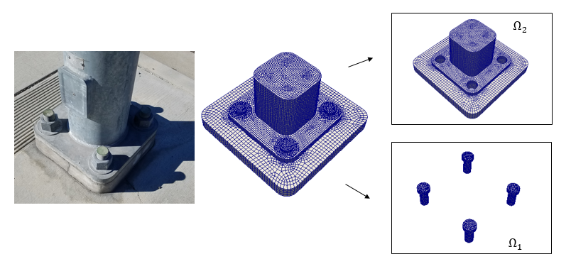
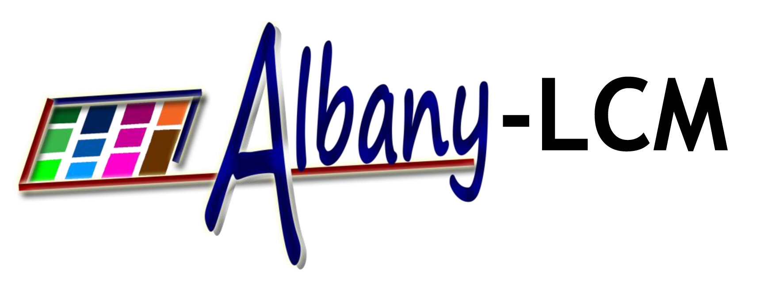

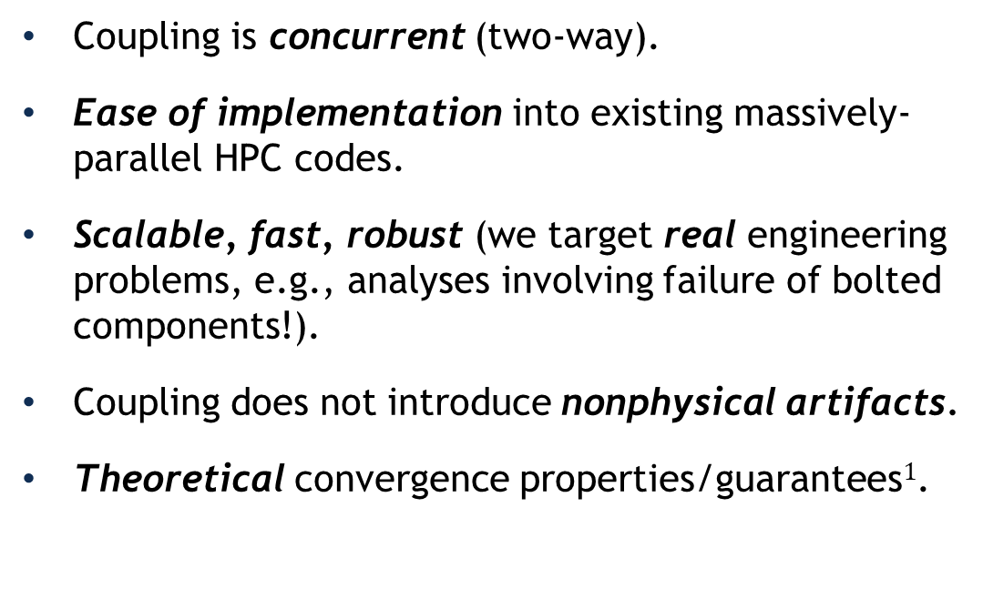
Schwarz for Multiscale FOM-FOM Coupling in Solid Mechanics¹
Model Solid Mechanics PDEs:
Coupling is concurrent (two-way).
Ease of implementation into existing massively-parallel HPC codes.
Scalable, fast, robust (we target real engineering problems, e.g., analyses involving failure of bolted components!).
Coupling does not introduce nonphysical artifacts.
Theoretical convergence properties/guarantees$1$.
Quasistatic:
Dynamic:
“Plug-and-play” framework:
  Ability to couple regions with different non-conformal meshes, different element types and different levels of refinement to simplify task of meshing complex geometries.
  Ability to use different solvers/time-integrators in different regions.
²
¹ Mota et al. 2017; Mota et al. 2022. ² https://github.com/sandialabs/LCM.

Slide 19
Outline
The Schwarz Alternating Method for Domain Decomposition-Based Coupling
Extension to FOM*-ROM# and ROM-ROM Coupling
Numerical Examples
  1D Dynamic Wave Propagation in Hyperelastic Bar
  2D Burgers Equation
Summary & Future Work
*Full-Order Model. #Reduced Order Model.
Notes:
TODO: clean up formatting / spacing.

Slide 20
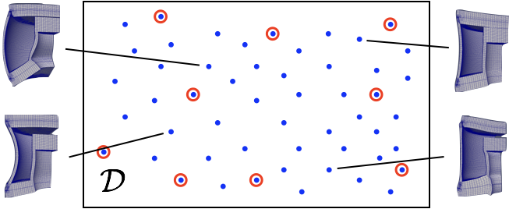




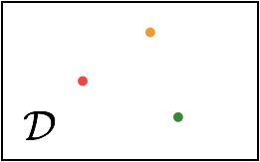

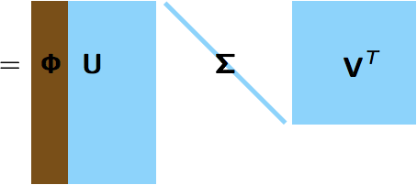


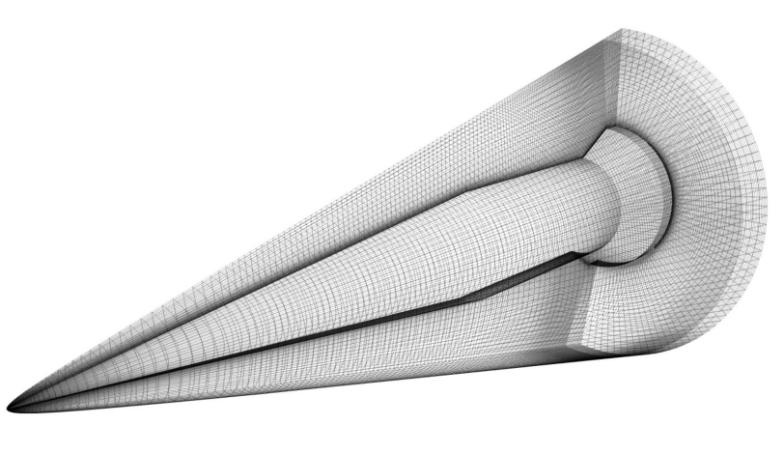
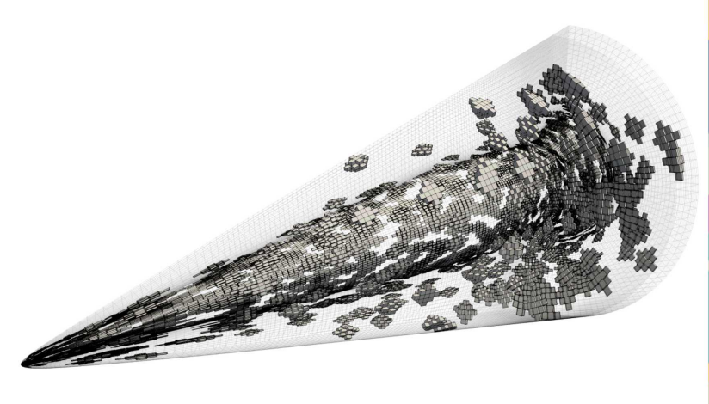



Projection-Based Model Order Reduction via the POD/Galerkin Method
20
Full Order Model (FOM): $M\frac{d^{2}u}{dt^{2}}+f_{int}\left(u\right)=f_{ext}$
1. Acquisition
3. Projection-Based Reduction
Number of time steps
Reduce the number of unknowns
$$u\left(t\right)≈\tilde{u}\left(t\right)=Φ\hat{u}(t)$$
Number of State Variables
Solve ODE at different design points
Save solution data
Perform Galerkin projection
$Φ^{T}MΦ\frac{d^{2}\hat{u}}{dt^{2}}$ + $Φ^{T}f_{int}\left(Φ\hat{u}\right)=Φ^{T}f_{ext}$
2. Learning
Proper Orthogonal Decomposition (POD):
Hyper-reduce nonlinear terms
$$f_{int}\left(Φ\hat{u}\right)≈ A f_{int}\left(Φ\hat{u}\right)$$
Hyper-reduction/sample mesh
ROM = projection-based Reduced Order Model HROM = Hyper-reduced ROM

Slide 21




Projection-Based Model Order Reduction via the POD/LSPG* Method
21
Full Order Model (FOM): $\frac{du}{dt}=f(u;t,μ)$
* Least-Squares Petrov-Galerkin
1. Acquisition
3. Projection-Based Reduction
Number of time steps
Choose ODE temporal discretization
$$\frac{du}{dt}=f(u;t,μ)$$
Number of State Variables
$$r^{n}\left(u^{n};μ\right)=0, n=1,…,T$$
$$u\left(t\right)≈\tilde{u}\left(t\right)=Φ\hat{u}(t)$$
Solve ODE at different design points
Save solution data
Reduce the number of unknowns
2. Learning
Proper Orthogonal Decomposition (POD):
Minimize residual
$$A r^{n}( Φ \hat{v}; μ)$$
Hyper-reduction/sample mesh
ROM = projection-based Reduced Order Model HROM = Hyper-reduced ROM

Slide 22

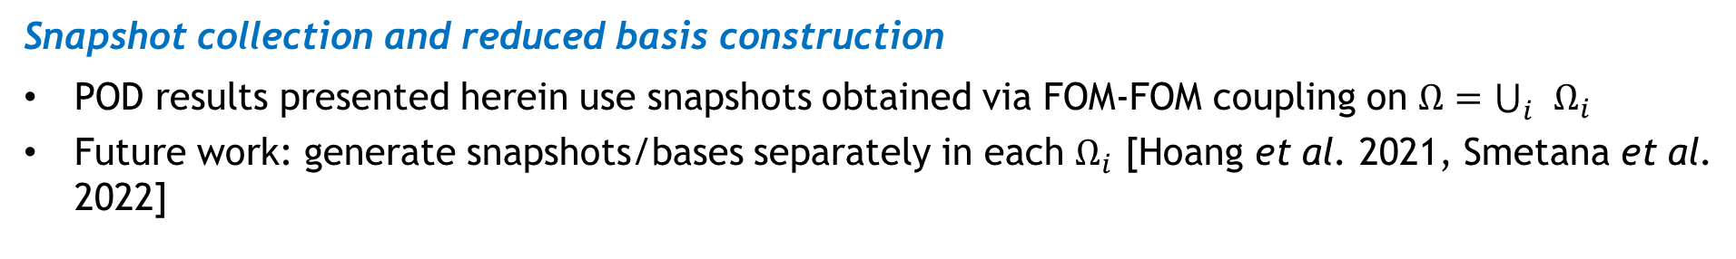
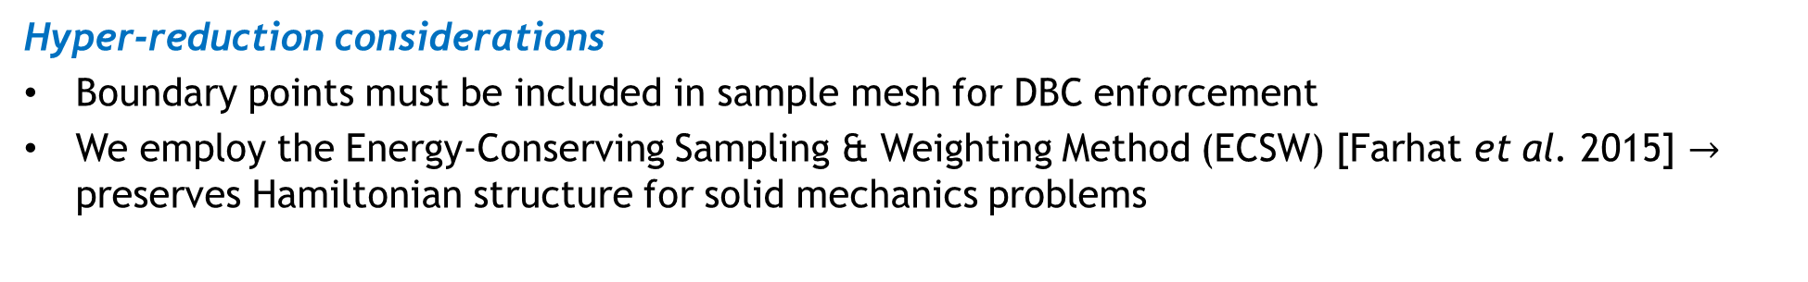
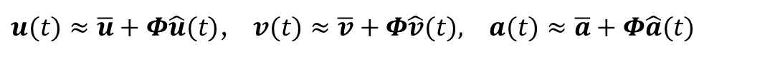
Schwarz Extensions to FOM-ROM and (H)ROM-(H)ROM Couplings
22
Enforcement of Dirichlet boundary conditions (DBCs) in ROM at indices $i_{Dir}$
Method I in [Gunzburger et al. 2007] is employed
$u(t)≈\overline{u}+Φ\hat{u}(t)$, $v(t)≈\overline{v}+Φ\hat{v}(t), a(t)≈\overline{a}+Φ\hat{a}(t)$
POD modes made to satisfy homogeneous DBCs: $Φ\left(i_{Dir}, :\right)=0$
BCs imposed by modifying $\overline{u}$, $\overline{v}$, $\overline{a}$: $\overline{u}\left(i_{Dir}\right)←χ_{u}$, $\overline{v}\left(i_{Dir}\right)←χ_{v}$, $\overline{a}\left(i_{Dir}\right)←χ_{a}$
Hyper-reduction considerations
Boundary points must be included in sample mesh for DBC enforcement
We employ the Energy-Conserving Sampling & Weighting Method (ECSW) [Farhat et al. 2015] $→$ preserves Hamiltonian structure for solid mechanics problems
Choice of domain decomposition
Error-based indicators that help decide in what region of the domain a ROM can be viable should drive domain decomposition [Bergmann et al. 2018] (future work)
Snapshot collection and reduced basis construction
POD results presented herein use snapshots obtained via FOM-FOM coupling on $Ω=\bigcup_{i}{Ω_{i}}$
Future work: generate snapshots/bases separately in each $Ω_{i}$ [Hoang et al. 2021, Smetana et al. 2022]

Slide 23
Outline
The Schwarz Alternating Method for Domain Decomposition-Based Coupling
Extension to FOM*-ROM# and ROM-ROM Coupling
Numerical Examples
  1D Dynamic Wave Propagation in Hyperelastic Bar
  2D Burgers Equation
Summary & Future Work
*Full-Order Model. #Reduced Order Model.
Notes:
TODO: clean up formatting / spacing.

Slide 24
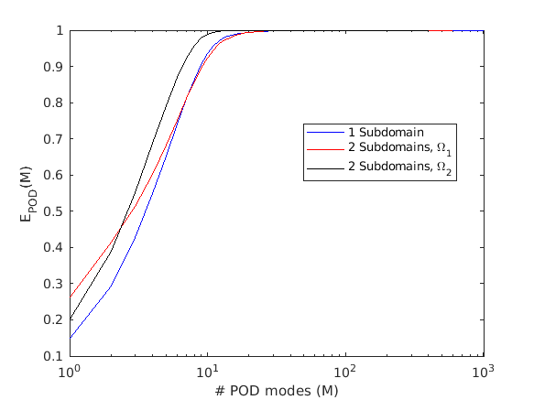
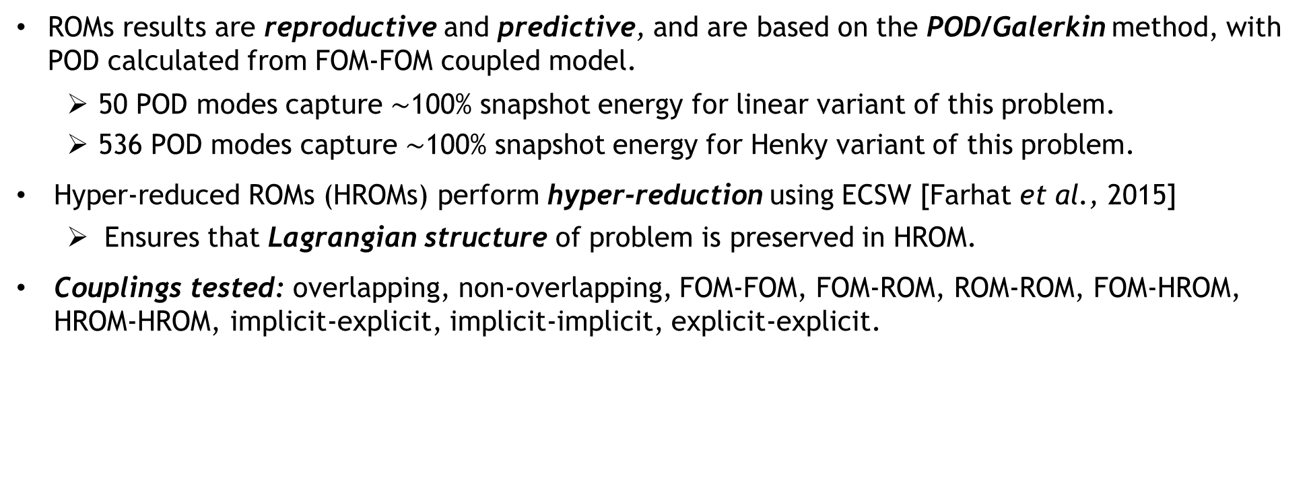
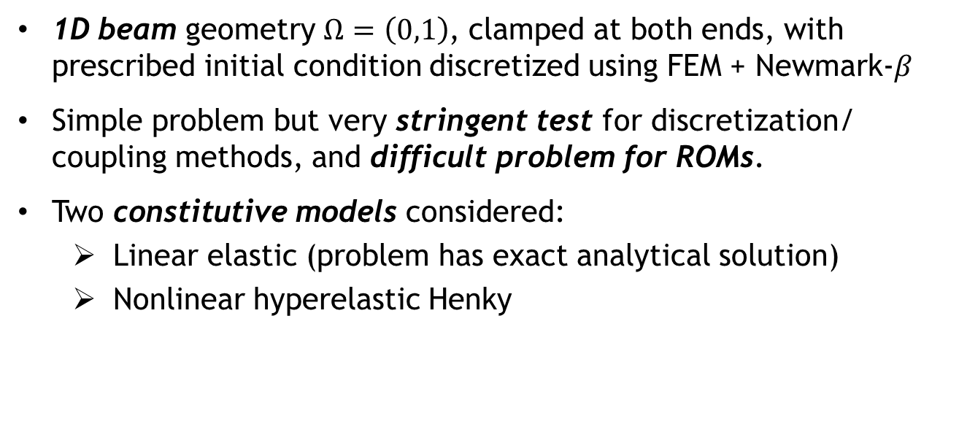
Numerical Example: 1D Dynamic Wave Propagation Problem
24
1D beam geometry $Ω=\left(0,1\right)$, clamped at both ends, with prescribed initial condition discretized using FEM + Newmark-$β$
Simple problem but very stringent test for discretization/ coupling methods, and difficult problem for ROMs.
Two constitutive models considered:
  Linear elastic (problem has exact analytical solution)
  Nonlinear hyperelastic Henky
Figure: POD energy decay for nonlinear Henky problem
This talk
ROMs results are reproductive and predictive, and are based on the POD/Galerkin method, with POD calculated from FOM-FOM coupled model.
  50 POD modes capture $\sim$100% snapshot energy for linear variant of this problem.
  536 POD modes capture $\sim$100% snapshot energy for Henky variant of this problem.
Hyper-reduced ROMs (HROMs) perform hyper-reduction using ECSW [Farhat et al., 2015]
  Ensures that Lagrangian structure of problem is preserved in HROM.
Couplings tested: overlapping, non-overlapping, FOM-FOM, FOM-ROM, ROM-ROM, FOM-HROM, HROM-HROM, implicit-explicit, implicit-implicit, explicit-explicit.
This talk

Slide 25
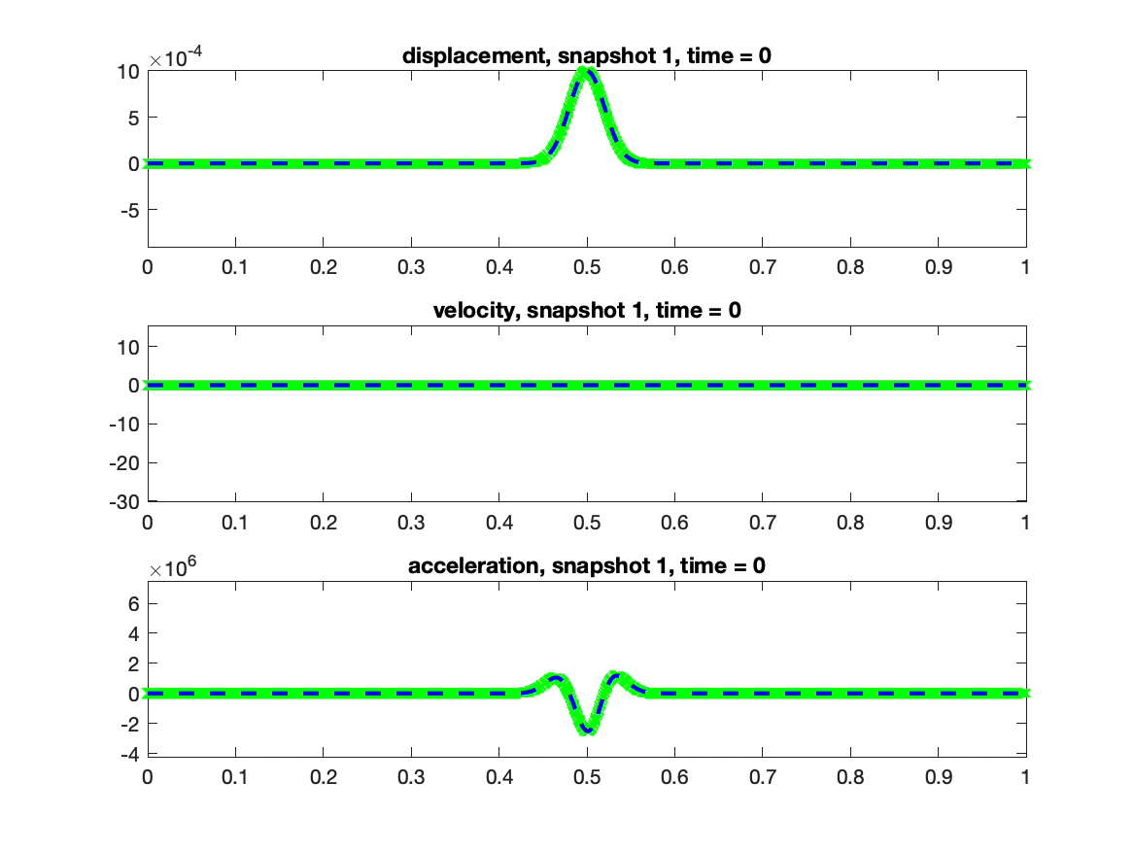
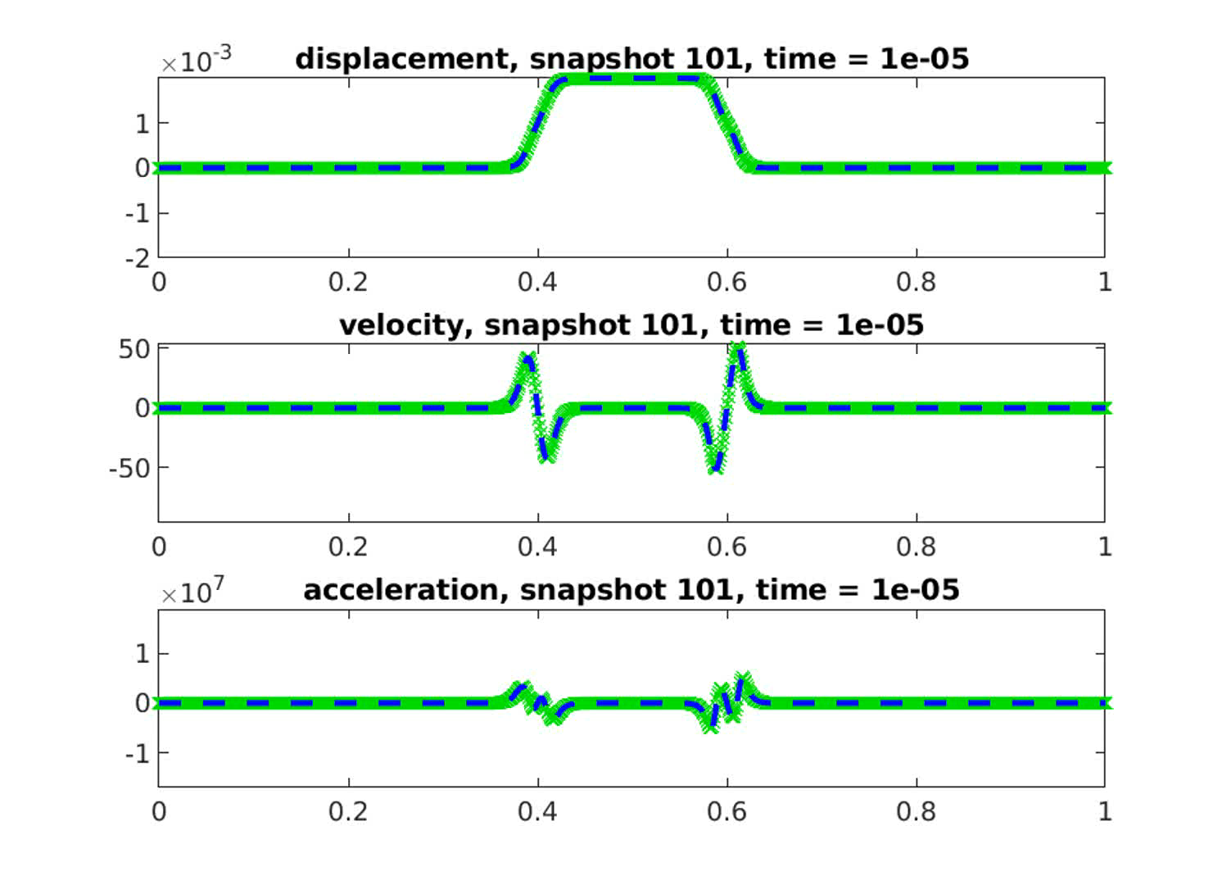
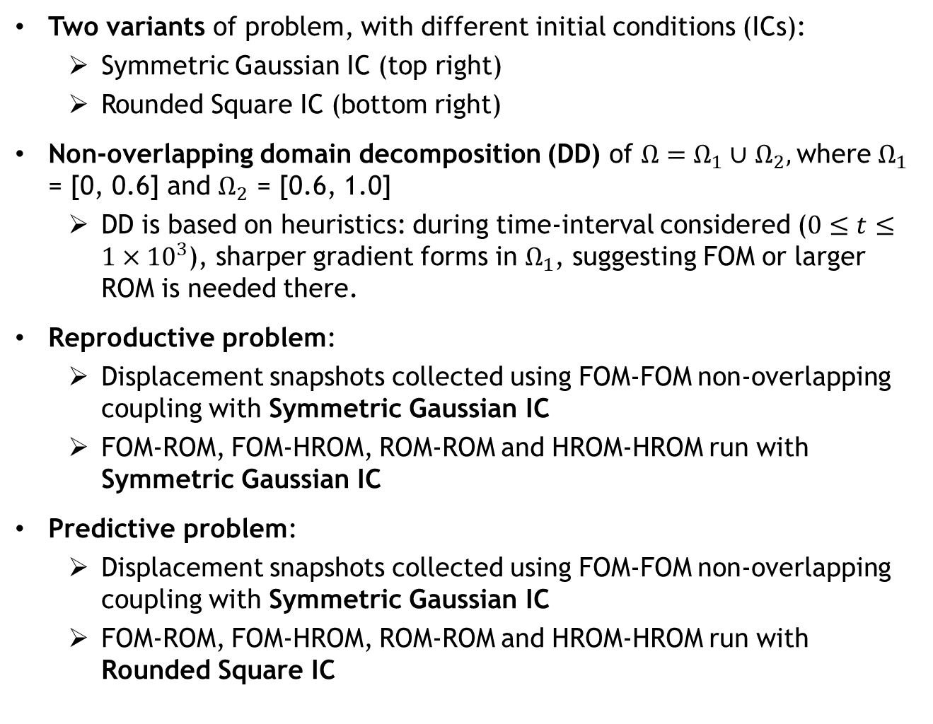
Numerical Example: 1D Dynamic Wave Propagation Problem
25
Two variants of problem, with different initial conditions (ICs):
  Symmetric Gaussian IC (top right)
  Rounded Square IC (bottom right)
Non-overlapping domain decomposition (DD) of $Ω=Ω_{1}∪$ $Ω_{2},$where $Ω_{1}$ = [0, 0.6] and $Ω_{2}$ = [0.6, 1.0]
  DD is based on heuristics: during time-interval considered ($0≤t≤1×{10}^{3}$), sharper gradient forms in $Ω_{1}$, suggesting FOM or larger ROM is needed there.
Reproductive problem:
  Displacement snapshots collected using FOM-FOM non-overlapping coupling with Symmetric Gaussian IC
  FOM-ROM, FOM-HROM, ROM-ROM and HROM-HROM run with Symmetric Gaussian IC
Predictive problem:
  Displacement snapshots collected using FOM-FOM non-overlapping coupling with Symmetric Gaussian IC
  FOM-ROM, FOM-HROM, ROM-ROM and HROM-HROM run with Rounded Square IC
Figure above: Symmetric Gaussian IC problem solution
Figure below: Rounded Square IC problem solution

Slide 26
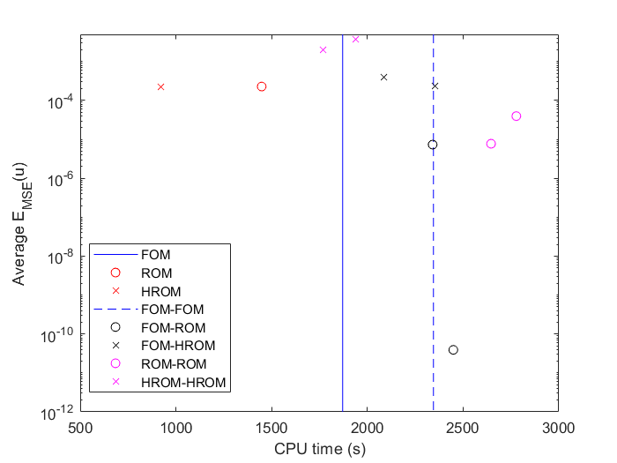
Numerical Example: Reproductive Problem Results
26
Single-domain ROM and HROM are most efficient
Couplings involving ROMs and HROMs enable one to achieve smaller errors
Benefits of hyper-reduction are limited on 1D problem
FOM-HROM and HROM-HROM couplings outperform the FOM-FOM coupling in terms of CPU time by 12.5-32.6%

Slide 27
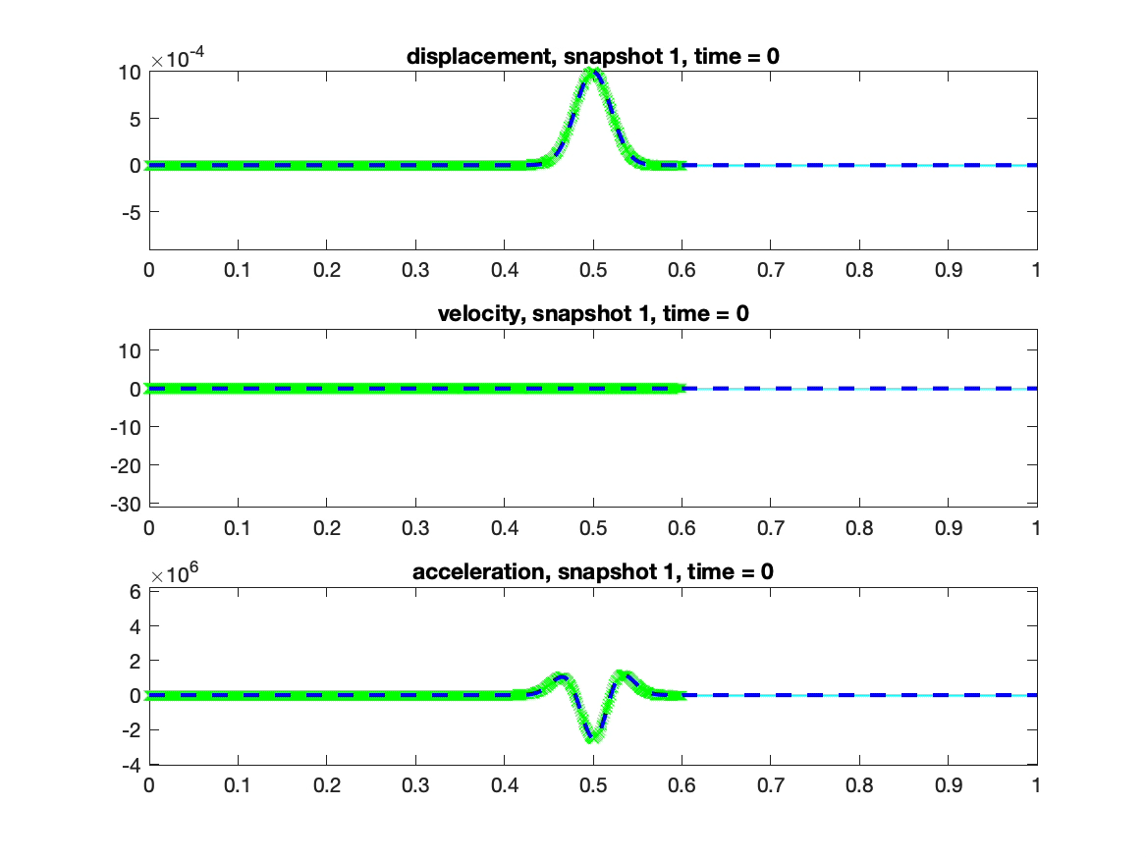
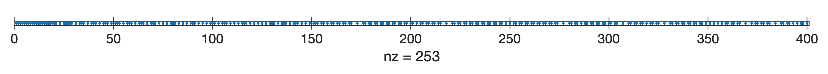
Numerical Example: Reproductive Problem Results
27
Figure left: FOM (green) – HROM (cyan) coupling compared with single-domain FOM solution (blue). HROM has 200 modes.
Figure below: ECSW algorithm samples 253/400 elements

Slide 28
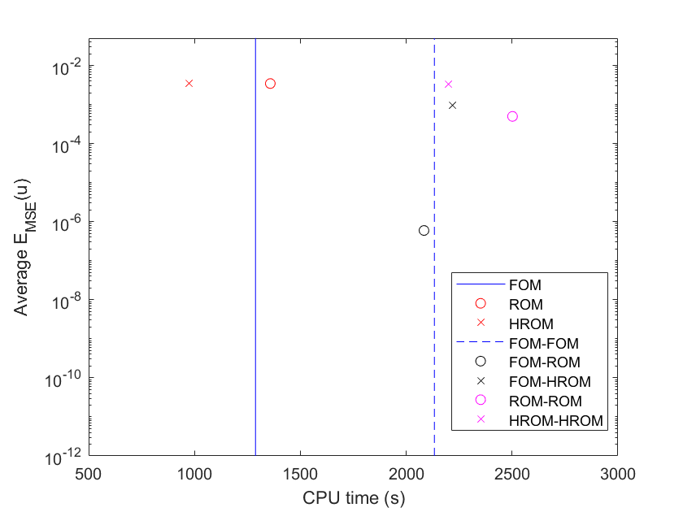
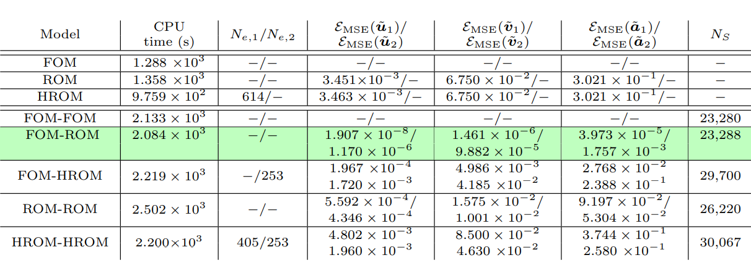
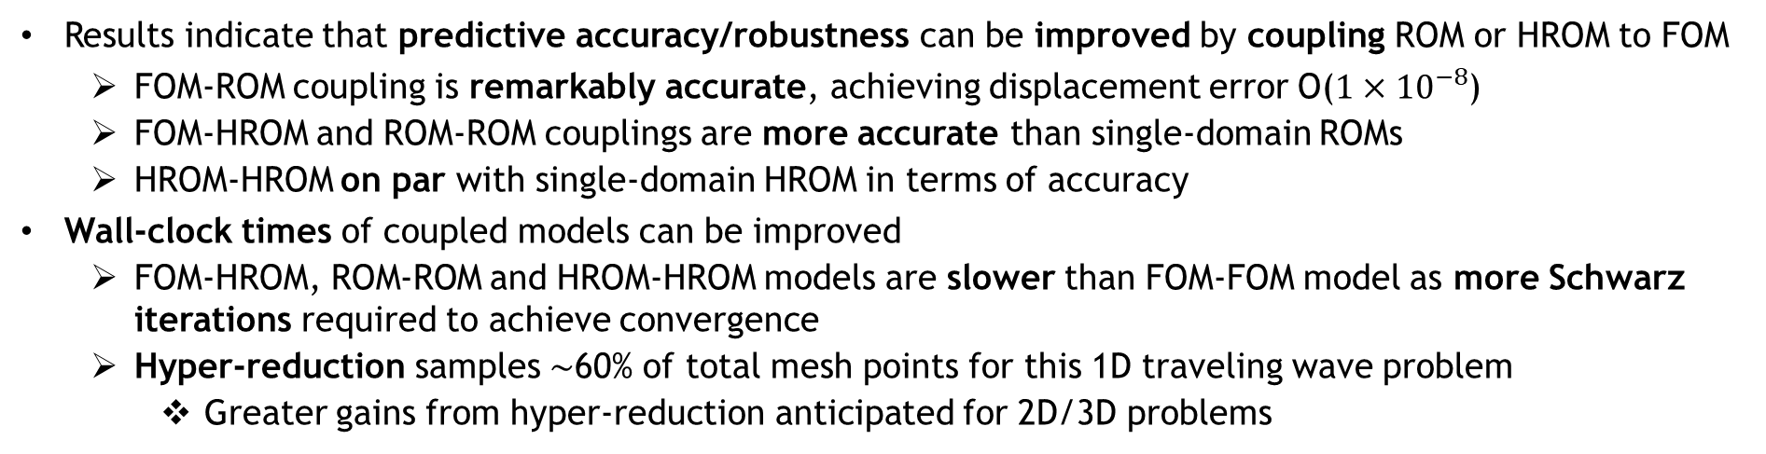
Numerical Example: Predictive Problem Results
28
Results indicate that predictive accuracy/robustness can be improved by coupling ROM or HROM to FOM
  FOM-ROM coupling is remarkably accurate, achieving displacement error O($1×{10}^{−8}$)
  FOM-HROM and ROM-ROM couplings are more accurate than single-domain ROMs
  HROM-HROM on par with single-domain HROM in terms of accuracy
Wall-clock times of coupled models can be improved
  FOM-HROM, ROM-ROM and HROM-HROM models are slower than FOM-FOM model as more Schwarz iterations required to achieve convergence
  Hyper-reduction samples $\sim$60% of total mesh points for this 1D traveling wave problem
    Greater gains from hyper-reduction anticipated for 2D/3D problems

Slide 29
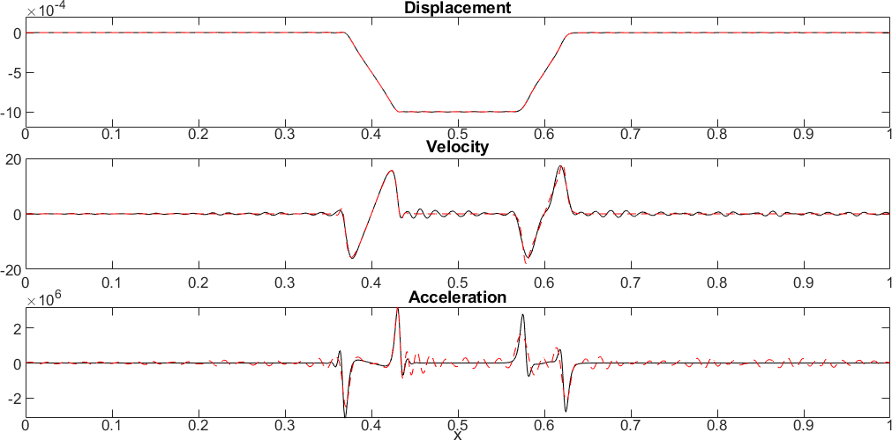
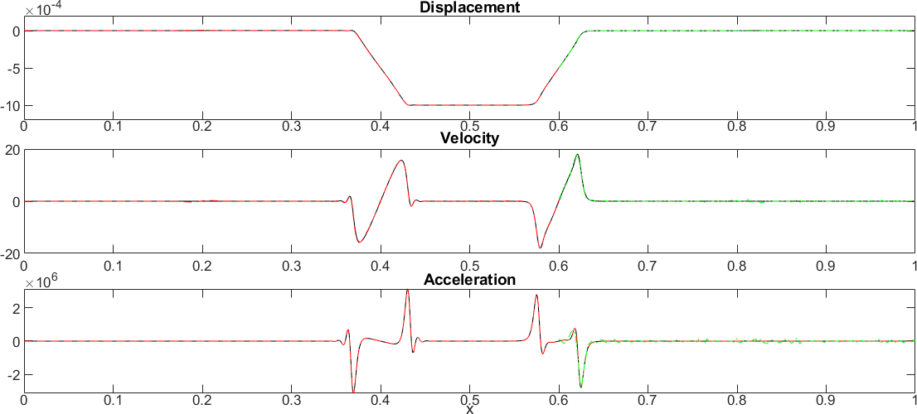
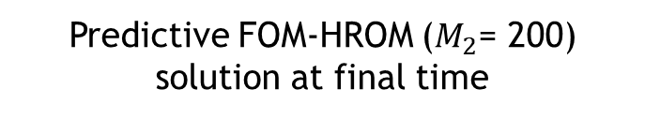
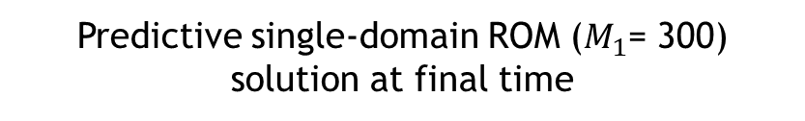
Numerical Example: Predictive Problem Results
29
Predictive single-domain ROM ($M_{1}$= 300) solution at final time
Predictive FOM-HROM ($M_{2}$= 200) solution at final time
$−$Solution in $Ω_{1} −$ Solution in $Ω_{2}$
$−$ Single-domain FOM solution
Predictive single-domain ROM solution exhibits spurious oscillations in velocity and acceleration
Predictive FOM-HROM solution is smooth and oscillation-free
  Highlights coupling method’s ability to improve ROM predictive accuracy

Slide 30
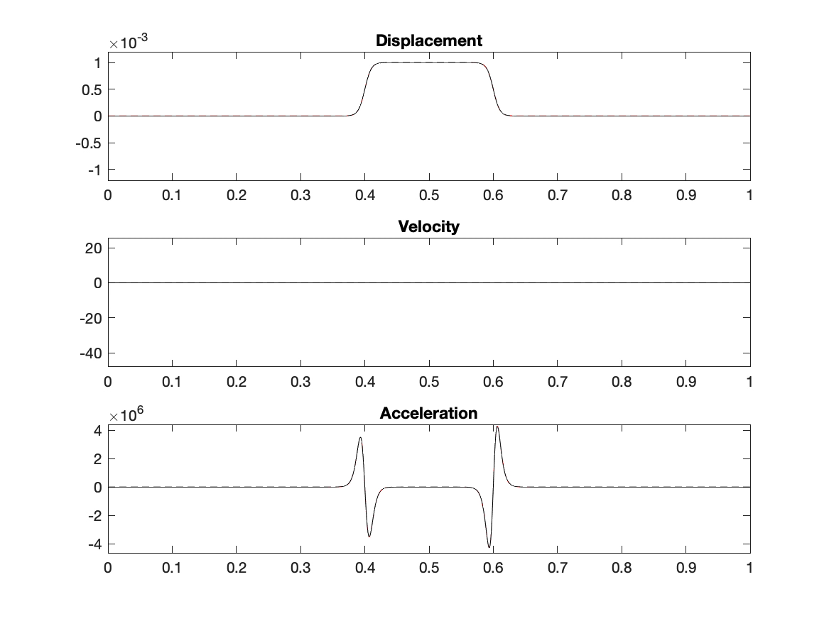
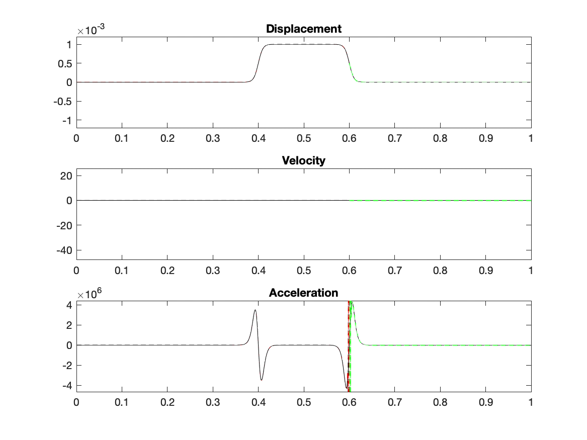

Numerical Example: Predictive Problem Results
30
Predictive single-domain ROM ($M_{1}$= 300)
Predictive FOM-HROM ($M_{2}$= 200)
$−$Solution in $Ω_{1} −$ Solution in $Ω_{2}$
$−$ Single-domain FOM solution

Slide 31
Outline
The Schwarz Alternating Method for Domain Decomposition-Based Coupling
Extension to FOM*-ROM# and ROM-ROM Coupling
Numerical Examples
  1D Dynamic Wave Propagation in Hyperelastic Bar
  2D Burgers Equation
Summary & Future Work
*Full-Order Model. #Reduced Order Model.
Notes:
TODO: clean up formatting / spacing.

Slide 32
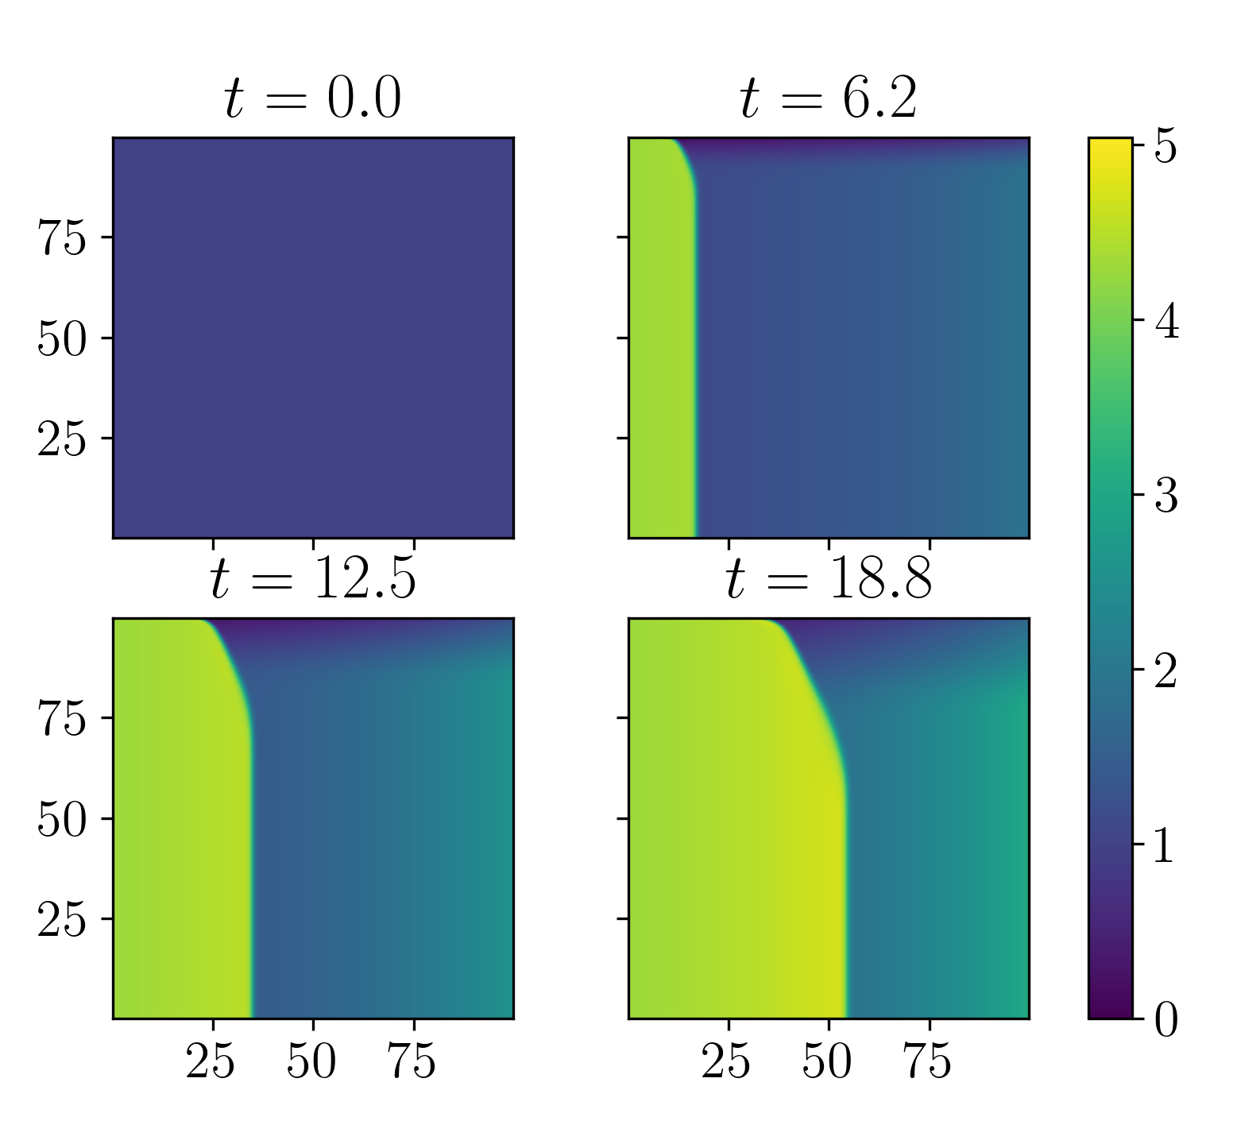






Numerical Example: 2D Inviscid Burgers Problem
FOM discretization:
Spatial discretization given by a Godunov-type scheme with $N = 250$elements in each dimension
Implicit temporal discretization: trapezoidal method with fixed $∆t = 0.05$; Choose $Tf = 25.0$
Figure above: solution of $u$ component at various times
0
$$x$$
100
0
$$Ω_{1}$$
$$y$$
100

Slide 33



Numerical Example: 2D Inviscid Burgers Problem
33
2D makes for a more appropriate testing of potential speedups from coupling subdomains to ROMs
The inviscid Burgers’ equation is a popular analog for fluid problems where shocks are possible, and is particularly difficult for conventional projection-based ROMs
Two parameters considered:
  Dirichlet BC parameterization $μ_{1}$
  Source term parameterization $μ_{2}$
ROMs results are predictive and are based on the Least-Squares Petrov-Galerkin (LSPG) method, with POD calculated from FOM coupling models.
  Greater than 200 POD modes required to capture $99$% snapshot energy for when sampling 9 $μ=[μ_{1}, μ_{2}]$ values
Hyper-reduced ROMs (HROMs) perform hyper-reduction using ECSW [Farhat et al., 2015]
Couplings tested: overlapping, FOM-FOM, FOM-ROM, ROM-ROM, FOM-HROM, HROM-HROM, implicit-explicit, implicit-implicit, explicit-explicit.
This talk

Slide 34




Single Domain ROM
Spatial/temporal resolution: $Δx_{i}=0.4, Δy_{i}=0.4, Δt_{i}=0.05$
Uniform sampling of $𝒟=\left[4.25, 5.50\right]×[0.015, 0.03]$ by a 3×3 grid ⇒ 9 training parameter points characterized by $Δμ_{1}=0.625$ and $Δμ_{2}=0.0075$
Queried but unsampled parameter point $μ=[4.75, 0.02]$ with reduced dimension of $M=95$
Reduced mesh resulting from solving non-negative least squares problem formulate by ECSW gives $n_{e}=5,689$ elements (9.1% of $N_{e}=62,500$ elements).
% SV Energy | $$M$$ | MSE* (%) | CPU time* (s)
95 | 69 | 1.1 | 138
99 | 177 | 0.17 | 447
* Numbers in table are w/o hyper-reduction
0
$$x$$
100
0
$$Ω_{1}$$
$$y$$
Figure above: Reduced mesh of single domain HROM
Figure above: HROM and FOM results at various time steps
100
Notes:
Table shows ROM CPU times (no hyper-reduction)

Slide 35












ROM-ROM-ROM-ROM Coupling
95% Singular Value (SV) Energy Retention
99% Singular Value (SV) Energy Retention
$$Ω_{1}$$
$$Ω_{2}$$
$$Ω_{3}$$
$$Ω_{4}$$
1 SD
Method converges in only 3 Schwarz iterations per controller time-step
Errors O(1%) or less
1.47$×$ speedup over all-FOM coupling for 95% SV energy retention case
Subdomains | 95% SV Energy |  |  | 99% SV Energy
 | $$M$$ | MSE (%) | CPU time (s) | $$M$$ | MSE (%) | CPU time (s)
$$Ω_{1}$$ | 57 | 1.1 | 85 | 146 | 0.18 | 295
$$Ω_{2}$$ | 44 | 1.2 | 56 | 120 | 0.18 | 216
$$Ω_{3}$$ | 24 | 1.4 | 43 | 60 | 0.16 | 89
$$Ω_{4}$$ | 32 | 1.9 | 61 | 66 | 0.25 | 100
Total |  |  | 245 |  |  | 700
0
$$x$$
100
0
$$Ω_{1}$$
$$Ω_{2}$$
$$y$$
$$Ω_{4}$$
$$Ω_{3}$$
100
Notes:
Q for Joshua:
- What are dx and dt in each subdomain? Are they the same or diff?
What is going on with last frame in movie??
Solutions look discontinuous at certain times…
Subdomain 1: 75.38 s 0.94 s
Subdomain 2: 61.52 s 0.91 s
Subdomain 3: 61.54 s 0.91 s
Subdomain 4: 77.02 s 0.93 s

Slide 36












FOM-HROM-HROM-HROM Coupling
Subdomains | 99% SV Energy
 | $$M$$ | MSE (%) | CPU time (s)
$$Ω_{1}$$ | $$−$$ | 0.0 | 95
$$Ω_{2}$$ | 120 | 0.26 | 26
$$Ω_{3}$$ | 60 | 0.43 | 17
$$Ω_{4}$$ | 66 | 0.34 | 21
Total |  |  | 159
$$Ω_{1}$$
$$Ω_{2}$$
$$Ω_{3}$$
$$Ω_{4}$$
1 SD
FOM in $Ω_{1}$ as this is “hardest” subdomain for ROM
HROMs in $Ω_{2}$, $Ω_{3}$, $Ω_{4}$ capture 99% snapshot energy
Method converges in 3 Schwarz iterations per controller time-step
Errors O(0.1%) with 0 error in $Ω_{1}$
2.26$×$ speedup achieved over all-FOM coupling
0
$$x$$
100
0
$$Ω_{1}$$
$$Ω_{2}$$
$$y$$
$$Ω_{4}$$
$$Ω_{3}$$
100
Further speedups possible via code optimizations and additive Schwarz.
Notes:
360: all-FOM case
Not possible for subdomain 2->4 to pollute 1 b/c of direction of propagation

Slide 37
Outline
The Schwarz Alternating Method for Domain Decomposition-Based Coupling
Extension to FOM*-ROM# and ROM-ROM Coupling
Numerical Examples
  1D Dynamic Wave Propagation in Hyperelastic Bar
  2D Burgers Equation
Summary & Future Work
*Full-Order Model. #Reduced Order Model.

Slide 38





Summary and Future Work
38
Summary:
In a 1D solid mechanics and 2D hyperbolic PDE setting, Schwarz has been demonstrated for coupling of FOMs & (H)ROMs
Computational gains can be achieved by coupling (H)ROMs
Ongoing & future work:
Extension to other applications and HPC codes
Improving method efficiency (e.g., additive Schwarz)
Movie above: FOM-FOM coupling via Schwarz for 2D Euler problem using pressio-demoapps*
Coupling nonlinear approximation manifold methods
Dynamic adaptation of domain partitioning & “on-the-fly” ROM-FOM switching
Learning of “optimal” transmission conditions to ensure structure preservation
Extension of Schwarz to coupling of Physics Informed Neural Networks (PINNs)
* https://https://pressio.github.io
Figure above: overlapping alternating Schwarz PINN-PINN coupling for advection-diffusion problem.

Slide 39






Team & Acknowledgments
39
Irina Tezaur
Joshua Barnett
Year-Round Intern
Alejandro Mota
Chris Wentland
Postdoc
Thank you! Questions?
Will Snyder
Summer Intern
Notes:
TODO: get photo from Will.

Slide 40
References
[1] A. Salinger, et al. "Albany: Using Agile Components to Develop a Flexible, Generic Multiphysics Analysis Code", Int. J. Multiscale Comput. Engng. 14(4) (2016) 415-438.
[2] H. Schwarz. “Über einen Grenzübergang durch alternierendes Verfahren”. In: Vierteljahrsschriftder Naturforschenden Gesellschaft in Zurich 15 (1870), pp. 272–286.
[3] S.L. Sobolev. “Schwarz’s Algorithm in Elasticity Theory”. In: Selected Works of S.L Sobolev. Volume I: equations of mathematical physics, computational mathematics and cubature formulats. Ed. By G.V. Demidenko and V.L. Vaskevich. New York: Springer, 2006.
[4] S. Mikhlin. “On the Schwarz algorithm”. In: Proceedings of the USSR Academy of Sciences 77 (1951), pp. 569–571.
[5] P.L. Lions. “On the Schwarz alternating method I.” In: 1988, First International Symposium on Domain Decomposition methods for Partial Differential Equations, SIAM, Philadelphia.
[6] SIERRA Solid Mechanics Team. Sierra/SM 4.48 User’s Guide. Tech. rep. SAND2018-2961. SNL Report, Oct. 2018.
[7] M. Gunzburger, J. Peterson, J. Shadid. “Reduced-order modeling of time-dependent PDEs with multiple parameters in the boundary data”. CMAME 196 (2007) 1030-1047.
[8] C. Hoang, Y. Choi, K. Carlberg. “Domain-decomposition least-squares Petrov–Galerkin (DD-LSPG) nonlinear model reduction”. CMAME 384 (2021) 113997.
[9] K. Smetana, T. Taddei. “Localized model reduction for nonlinear elliptic partial differential equations: localized training, partition of unity, and adaptive enrichment”, ArXiV pre-print, 2022.
[10] C. Farhat, T. Chapman, P. Avery. “Structure-preserving, stability & accuracy properties of the energy-conserving sampling and weighting method for the hyper reduction of nonlinear FE dynamic models”, IJNME 102 (2015) 1077-1110.
[11] M. Bergmann, A. Ferrero, A. Iollo, E. Lombardi, A. Scardigli, H. Telib. “A zonal Galerkin-free POD model for incompressible flows.” JCP 352 (2018) 301-325.

Slide 41
References (cont’d)
Green: GMM-based couplings
Blue: Schwarz-based couplings
[12] C. Sockwell, P. Bochev, K. Peterson, P. Kuberry. Interface Flux Recovery Framework for Constructing Partitioned Heterogeneous Time-Integration Methods. Methods Numer. Meth. PDEs, 2023 (in press).
[13] A. de Castro, P. Bochev, P. Kuberry, I. Tezaur. A synchronous partitioned scheme for coupled reduced order models based on separate reduced order bases for interior and interface nodes”, submitted to special issue of CMAME in honor of Tom Hughes’ 80th birthday.
[14] C. Sockwell, K. Peterson, P. Kuberry, P. Bochev, Interface Flux Recovery Framework for Constructing Partitioned Heterogeneous Time-Integration Methods, to appear.
[15] A. Mota, I. Tezaur, G. Phlipot. "The Schwarz Alternating Method for Dynamic Solid Mechanics”, Comput. Meth. Appl. Mech. Engng. 121 (21) (2022) 5036-5071.
[16] J. Hoy, I. Tezaur, A. Mota. "The Schwarz alternating method for multiscale contact mechanics". in Computer Science Research Institute Summer Proceedings 2021, J.D. Smith and E. Galvan, eds., Technical Report SAND2021-0653R, Sandia National Labs, 360-378, 2021.
[17] J. Barnett, I. Tezaur, A. Mota. "The Schwarz alternating method for the seamless coupling of nonlinear reduced order models and full order models", in Computer Science Research Institute Summer Proceedings 2022, S.K. Seritan and J.D. Smith, eds., Technical Report SAND2022-10280R, Sandia National Laboratories, 2022, pp. 31-55.
Talk by P. Kuberry (IS03-II)
Talk by J. Connors (IS03-I)
This talk
Journal article on ROM-FOM/ROM-ROM coupling using Schwarz is in preparation.
Email: ikalash@sandia.gov
URL: www.sandia.gov/~ikalash

Slide 42
Start of Backup Slides

Slide 43






Spatial Coupling via Alternating Schwarz
Overlapping Domain Decomposition
$$\left\{\begin{aligned} N(u)=f\text{,} \text{in} Ω \\ u=g\text{,} \text{on} ∂Ω \end{aligned}\right.$$
$$\left\{\begin{aligned}N\left(u_{1}^{(n+1)}\right)=f \text{, }\text{in} Ω_{1} \\ u_{1}^{(n+1)}=g\text{, }\text{o}\text{n} ∂Ω_{1}\backslash Γ_{1} \\ u_{1}^{(n+1)}=u_{2}^{(n)} \text{on} Γ_{1}\end{aligned}\right.$$
Model PDE:
Dirichlet-Dirichlet transmission BCs [Schwarz 1870; Lions 1988; Mota et al. 2017; Mota et al. 2022]
$$\left\{\begin{aligned}N\left(u_{2}^{(n+1)}\right)=f \text{, }\text{in} Ω_{2} \\ u_{2}^{(n+1)}=g\text{, }\text{o}\text{n} ∂Ω_{2}\backslash Γ_{2} \\ u_{2}^{(n+1)}=u_{1}^{(n+1)} \text{on} Γ_{2}\end{aligned}\right.$$
This talk: sequential subdomain solves (multiplicative Schwarz). Parallel subdomain solves (additive Schwarz) also possible.
Non-overlapping Domain Decomposition
$$\left\{\begin{aligned}N\left(u_{1}^{(n+1)}\right)=f\text{, } \text{in} Ω_{1} \\ u_{1}^{(n+1)}=g\text{, } \text{on} ∂Ω_{1}\backslash Γ \\ u_{1}^{(n+1)}=λ_{n+1}, \text{on} Γ\end{aligned}\right.$$
Relevant for multi-material and multi-physics coupling
Alternating Dirichlet-Neumann transmission BCs [Zanolli et al. 1987]
Robin-Robin transmission BCs also lead to convergence [Lions 1990]
$θ∈\left[0,1\right]:$relaxation parameter (can help convergence)
$$\left\{\begin{aligned}N\left(u_{2}^{(n+1)}\right)=f \text{, } \text{in} Ω_{2} \\ u_{2}^{(n+1)}=g\text{, } \text{on} ∂Ω_{2}\backslash Γ \\ {∇u}_{2}^{(n+1)}∙n={∇u}_{1}^{(n+1)}∙n\text{, }\text{on} Γ\end{aligned}\right.$$
$$λ_{n+1}=θφ_{2}^{(n)}+\left(1−θ\right)λ_{n}, on Γ, for n≥1$$
Notes:
TODO? Change equations?

Slide 44


Numerical Example: 1D Dynamic Wave Propagation Problem
44
Basis sizes $M_{1}$ and $M_{2}$ vary from 60 to 300
  Larger ROM used in $Ω_{1}$, since solution has steeper gradient here
For couplings involving FOM and ROM/HROM, FOM is placed in $Ω_{1}$, since solution has steeper gradient here
Non-negative least-squares optimization problem for ECSW weights solved using MATLAB’s lsqnonneg function with early termination criterion (solution step-size tolerance = ${10}^{−4}$)
  Ensures all HROMs have consistent termination criterion w.r.t. MATLAB implementation
  However, relative error tolerance of selected reduced elements will differ
    Switching to termination criterion based on relative error is work in progress and expected to improve HROM results
  Convergence tolerance determines size of sample mesh $N_{e,i}$
  Boundary points must be in sample mesh for application of Schwarz BC
Figure left: sample sample mesh for 1D wave propagation problem
J. Barnett, I. Tezaur, A. Mota. "The Schwarz alternating method for the seamless coupling of nonlinear reduced order models and full order models", in Computer Science Research Institute Summer Proceedings 2022, S.K. Seritan and J.D. Smith, eds., Technical Report SAND2022-10280R, Sandia National Laboratories, 2022, pp. 31-55. (https://arxiv.org/abs/2210.12551)

Slide 45


Numerical Example: Reproductive Problem Results
45
Green shading highlights most competitive coupled models
All coupled models evaluated converged on average in $<$3 Schwarz iterations per time-step
Larger FOM-ROM coupling has same total # Schwarz iters ($N_{S}$) as FOM-FOM coupling
Other couplings require more Schwarz iters than FOM-FOM coupling to converge
  More Schwarz iters required when coupling less accurate models
  Larger 300/80 mode ROM-ROM takes less wall-clock time than smaller 200/80 mode ROM-ROM
FOM-HROM and HROM-HROM couplings outperform the FOM-FOM coupling in terms of CPU time by 12.5-32.6%
All couplings involving ROMs/HROMs are at least as accurate as single-domain ROMs/HROMs

Slide 46



Numerical Example: Predictive Problem Results
46
Start by calculating projection error for reproductive and predictive version of the Rounded Square IC problem:
Projection error suggests predictive ROM can achieve accuracy and convergence with basis refinement
O(100) modes are needed to achieve sufficiently accurate ROM
  Larger ROMs containing O(100) modes considered in our coupling experiments: $M_{1}$= 300, $M_{2}$= 200

Slide 47





Theoretical Foundation
Using the Schwarz alternating as a discretization method for PDEs is natural idea with a sound theoretical foundation.
S.L. Sobolev (1936): posed Schwarz method for linear elasticity in variational form and proved method’s convergence by proposing a convergent sequence of energy functionals.
S.G. Mikhlin (1951): proved convergence of Schwarz method for general linear elliptic PDEs.
P.-L. Lions (1988): studied convergence of Schwarz for nonlinear monotone elliptic problems using max principle.
A. Mota, I. Tezaur, C. Alleman (2017): proved convergence of the alternating Schwarz method for finite deformation quasi-static nonlinear PDEs (with energy functional $Φ[φ]$) with a geometric convergence rate.
S.L. Sobolev (1908 – 1989)
S.G. Mikhlin
(1908 – 1990)
P.- L. Lions (1956-)
$$Φ\left[φ\right]= \int_{B}{A\left(F,Z\right) dV−}\int_{B}{B∙φ dV}$$
$$∇∙P+B=0$$
A. Mota, I. Tezaur, C. Alleman
Notes:
A(F,Z) = Helmholtz free-energy density, Z = collection of internal variables, F = grad(phi) = deformation gradient, B = body force, T = traction on boundary
P = \partial A/\partial F = first Piola-Kirchoff stress
2nd equation is Euler-Lagrange equation

Slide 48

Convergence Proof*
*A. Mota, I. Tezaur, C. Alleman. "The Schwarz Alternating Method in Solid Mechanics", CMAME 319 (2017), 19-51.
Notes:
The proof effectively constructs a sequence of solutions phi^n and demonstrates that this sequence converges to the unique minimizer of the energy functional \Phi defining the single-domain problem, and combines concepts used in the analysis of Sobolev, Lions, and others, in studying the convergence of the Schwarz method.

Slide 49



Schwarz Alternating Method for Dynamic Multiscale Coupling: Theory
Like for quasistatics, dynamic alternating Schwarz method converges provided each single-domain problem is well-posed and overlap region is non-empty, under some conditions on $Δt$.
Well-posedness for the dynamic problem requires that action functional $S\left[φ\right]≔\int_{I}{\int_{Ω}{L}\left(φ,\dot{φ}\right)dVdt}$ be strictly convex or strictly concave, where $L\left(φ,\dot{φ}\right)≔$ $T\left(\dot{φ}\right)+V\left(φ\right)$is the Lagrangian.
  This is studied by looking at its second variation $δ^{2}S\text{[}φ_{h}\text{]}$
We can show assuming a Newmark time-integration scheme that for the fully-discrete problem:
$$δ^{2}S\text{[}φ_{h}\text{]=}x^{T}\left[\frac{γ^{2}}{{(βΔt)}^{2}}M−K\right]x$$
$δ^{2}S\text{[}φ_{h}\text{]}$ can always be made positive by choosing a sufficiently small $Δt$
Numerical experiments reveal that $Δt$ requirements for stability/accuracy typically lead to automatic satisfaction of this bound.
*A. Mota, I. Tezaur, G. Phlipot. "The Schwarz alternating method for dynamic solid mechanics", IJNME, 2022.

Slide 50





Schwarz for Multiscale FOM-FOM Coupling in Solid Mechanics¹
Single $Ω$
Schwarz
y-displacement
EQPS
Figure above: tension specimen simulation coupling composite TET10 elements with HEX elements in Sierra/SM.
Figures right: bolted joint simulation coupling composite TET10 elements with HEX elements in Sierra/SM.
Single $Ω$
Schwarz
¹ Mota et al. 2017; Mota et al. 2022.

Slide 51



Numerical Example: Linear Elastic Wave Propagation Problem
51
Linear elastic clamped beam with Gaussian initial condition.
Simple problem with analytical exact solution but very stringent test for discretization/coupling methods.
Couplings tested: FOM-FOM, FOM-ROM, ROM-ROM, implicit-explicit, implicit-implicit, explicit-explicit.
ROMs are reproductive and based on the POD/Galerkin method.
  50 POD modes capture $\sim$100% snapshot energy
Above: 3D rendering of clamped beam with Gaussian initial condition.
Right: Initial condition (blue) and final solution (red). Wave profile is negative of initial profile at time T = 1.0e-3.

Slide 52












Linear Elastic Wave Propagation Problem: FOM-ROM and ROM-ROM Couplings
Coupling delivers accurate solution if each subdomain model is reasonably accurate, can couple different discretizations with different $Δx,$ $Δt$ and basis sizes.
Single Domain FOM
3 overlapping subdomain ROM¹-FOM²-ROM³
2 non-overlapping subdomain FOM⁴-ROM⁵ ($θ=1$)
0
$$Ω$$
1
0
$$Ω_{1}$$
0.5
0
0.3
$$Ω_{2}$$
1
$$Ω_{1}$$
$$Ω_{2}$$
0.3
1
⁵Implicit FOM, $∆t$=2.25e-7, $∆x$=1e-6
⁴Explicit 50 mode POD ROM, $∆t$=2.25e-7, $∆x$=1e-6
¹Implicit 40 mode POD ROM, $∆t$=1e-6, $∆x$=1.25e-3
²Implicit FOM, $∆t$=1e-6, $∆x$=8.33e-4
³Explicit 50 mode POD ROM, $∆t$=1e-7, $∆x$=1e-3
0.25
$$Ω_{3}$$
0.75

Slide 53


Linear Elastic Wave Propagation Problem: FOM-ROM and ROM-ROM Couplings
Coupled models are reasonably accurate w.r.t. FOM-FOM coupled analogs and convergence with respect to basis refinement for FOM-ROM and ROM-ROM coupling is observed.
 | disp MSE⁶ | velo MSE | acce MSE
Overlapping ROM¹-FOM²-ROM³ | 1.05e-4 | 1.40e-3 | 2.32e-2
Non-overlapping FOM⁴-ROM⁵ | 2.78e-5 | 2.20e-4 | 3.30e-3
¹Implicit 40 mode POD ROM, $∆t$=1e-6, $∆x$=1.25e-3
²Implicit FOM, $∆t$=1e-6, $∆x$=8.33e-4
³Explicit 50 mode POD ROM, $∆t$=1e-7, $∆x$=1e-3
⁴Implicit FOM, $∆t$=2.25e-7, $∆x$=1e-6
⁵Explicit 50 mode POD ROM, $∆t$=2.25e-7, $∆x$=1e-6
⁶MSE=

Slide 54










Linear Elastic Wave Propagation Problem: ROM-ROM Couplings
ROM-ROM coupling gives errors < $O$(1e-6) & speedups over FOM-FOM coupling for basis sizes > 40.
MSE in displacement for 2 subdomain ROM-ROM coupling
CPU times for 2 subdomain ROM-ROM coupling normalized by FOM-FOM CPU time
Average # Schwarz iterations for 2 subdomain ROM-ROM coupling
# POD modes in $Ω_{2}$
# POD modes in $Ω_{2}$
# POD modes in $Ω_{2}$
# POD modes in $Ω_{1}$
# POD modes in $Ω_{1}$
# POD modes in $Ω_{1}$
Smaller ROMs are not the fastest: less accurate & require more Schwarz iterations to converge.
All couplings converge in $≤$ 4 Schwarz iterations on average (FOM-(FOM-FOM coupling requires average of 2.4 Schwarz iterations).
Overlapping implicit-implicit coupling with $Ω_{1}=\left[0, 0.75\right], { Ω}_{2}=\left[0.25, 1\right]$
Notes:
TODO: mention how many Schwarz iters FOM-FOM coupling converges in.
For overlapping explicit-explicit coupling
No optimizations have been done to code, which can speed things up further.

Slide 55







Linear Elastic Wave Propagation Problem: FOM-ROM Couplings
FOM-ROM coupling shows convergence with basis refinement. FOM-ROM couplings are 10-15% slower than comparable FOM-FOM coupling due to increased # Schwarz iterations.
CPU times for 2 subdomain FOM-ROM coupling normalized by FOM-FOM CPU time
MSE for 2 subdomain FOM-ROM coupling
Average # Schwarz iterations for 2 subdomain couplings
WIP: understanding & improving FOM-ROM coupling performance.
Average MSE over 2 subdomains
Online normalized CPU time
Average # Schwarz iters
Overlapping implicit-implicit coupling with $Ω_{1}=\left[0, 0.75\right],$
$${ Ω}_{2}=\left[0.25, 1\right]$$
# POD modes in $Ω_{2}$
# POD modes in $Ω_{2}$
# POD modes in $Ω_{2}$

Slide 56








Linear Elastic Wave Propagation Problem: FOM-ROM and ROM-ROM Couplings
Inaccurate model + accurate model $≠$ accurate model.
Accuracy can be improved by “gluing” several smaller, spatially-local models
Single Domain, FOM (truth)
Single Domain, 10 mode POD
10 mode POD – 10 mode POD
Figure above: $Ω_{1}=\left[0, 0.3\right], { Ω}_{2}=\left[0.25, 1\right]$, 20 mode POD – FOM
Figure below: $Ω_{1}=\left[0, 0.26\right], { Ω}_{2}=\left[0.25, 0.75\right], Ω_{3}=\left[0.74, 1\right]$, 15 mode POD – 30 mode POD – 15 mode POD
10 mode POD – 50 mode POD
10 mode POD – FOM
20 mode POD – FOM
Figures above: $Ω_{1}=\left[0, 0.75\right], { Ω}_{2}=\left[0.25, 1\right]$
Observation suggests need for “smart” domain decomposition.

Slide 57


Energy-Conserving Sampling and Weighting (ECSW)
Project-then-approximate paradigm (as opposed to approximate-then-project)
$$r_{k}\left(q_{k},t\right)=W^{T}r\left(\tilde{u}, t\right) \\ =\sum_{e∈ℰ}{W^{T}L_{e}^{T}r_{e}(L_{e^{+}}\tilde{u},t)}$$
$L_{e}∈{\left\{0,1\right\}}^{d_{e}×N}$ where $d_{e}$ is the number of degrees of freedom associated with each mesh element (this is in the context of meshes used in first-order hyperbolic problems where there are $N_{e}$ mesh elements)
$L_{e^{+}}∈{\left\{0,1\right\}}^{d_{e}×N}$ selects degrees of freedom necessary for flux reconstruction
Equality can be relaxed

Slide 58

ECSW: Generating the Reduced Mesh and Weights
Using a subset of the same snapshots $u_{i}, i∈1,…, n_{h}$ used to generate the state basis $V$, we can train the reduced mesh
Snapshots are first projected onto their associated basis and then reconstructed
$$c_{se}=W^{T}L_{e}^{T}r_{e}\left(L_{e^{+}}\left(u_{ref}+V V^{T}\left(u_{s}−u_{ref}\right)\right),t\right)∈ℝ^{n} \\ d_{s} =r_{k}\left(\tilde{u}, t\right)∈ℝ^{n}, s=1, …,n_{h}$$
We can then form the system
$$C=\left(\begin{matrix}c_{11} & … & c_{1N_{e}} \\ ⋮ & ⋱ & ⋮ \\ c_{n_{h}1} & … & c_{n_{h}N_{e}}\end{matrix}\right), d=\left(\begin{matrix}d_{1} \\ ⋮ \\ d_{n_{h}}\end{matrix}\right)$$
Where $Cξ=d, ξ∈ℝ^{N_{e}}$, $ξ=1$ must be the solution
Further relax the equality to yield non-negative least-squares problem:
$ξ={arg min}_{x∈ℝ^{n}}{||Cx−d||}_{2}$ subject to $x≥0$
Solve the above optimization problem using a non-negative least squares solver with an early termination condition to promote sparsity of the vector $ξ$

Slide 59





Numerical Example: 1D Dynamic Wave Propagation Problem
59
Alternating Dirichlet-Neumann Schwarz BCs with no relaxation ($θ=1$) on Schwarz boundary $Γ$
$$\left\{\begin{aligned}Div{ P}_{1}^{(n+1)}+ρB(t_{i})=0 \text{, }\text{in} Ω_{1} \\ φ_{1}^{(n+1)}=χ\text{, } \text{on} ∂Ω_{1}\backslash Γ \\ φ_{1}^{(n+1)}=λ_{n+1} \text{on} Γ\end{aligned}\right.$$
$$θ$$ | Min # Schwarz Iters | Max # Schwarz Iters | Total # Schwarz Iters
1.10 | 3 | 9 | 59,258
1.00 | 1 | 4 | 24,630
0.99 | 1 | 5 | 35,384
0.95 | 3 | 6 | 45,302
0.90 | 3 | 8 | 56,114
$$\left\{\begin{aligned}Div P_{2}^{(n+1)}+ρB(t_{i})=0 \text{, }\text{in}{ Ω}_{2} \\ φ_{2}^{(n+1)}=χ\text{, } \text{on} ∂Ω_{2}\backslash Γ \\ P_{2}^{(n+1)}n=P_{1}^{(n+1)}n\text{, }\text{on} Γ\end{aligned}\right.$$
$$λ_{n+1}=θφ_{2}^{(n)}+\left(1−θ\right)λ_{n}, on Γ, for n≥1$$
A parameter sweep study revealed $θ=0$ gave best performance (min # Schwarz iterations)
All couplings were implicit-implicit with ${Δt}_{1}={Δt}_{2}=ΔT={10}^{−7}$ and ${Δx}_{1}={Δx}_{2}$ $={10}^{−3}$
  Time-step and spatial resolution chosen to be small enough to resolve the propagating wave
All reproductive cases run on the same RHEL8 machine and all predictive cases run on the same RHEL7 machine, in MATLAB
Model accuracy evaluated w.r.t. analogous FOM-FOM coupling using mean square error (MSE):
$$ε_{MSE}\left({\tilde{u}}_{i}\right)≔\frac{\sqrt{\sum_{n=1}^{S}{{||{\tilde{u}}_{i}^{n}−u_{i}^{n}||}_{2}^{2}}}}{\sqrt{\sum_{n=1}^{S}{{||u_{i}^{n}||}_{2}^{2}}}}$$

Slide 60



Overlapping Coupling, Nonlinear Henky MM, 2 Subdomains
$Ω=\left[0, 0.7\right]⋃\left[0.3,1\right],$ implicit-implicit FOM-FOM coupling, dt = 1e-7, dx=1e-3.
Multiplicative Schwarz
Additive Schwarz

Slide 61


Overlapping Coupling, Nonlinear Henky MM, 2 Subdomains
$Ω=\left[0, 0.7\right]⋃\left[0.3,1\right],$ implicit-implicit FOM-FOM coupling, dt = 1e-7, dx=1e-3.
Additive Schwarz requires slightly more Schwarz iterations but is actually faster.
Solutions agree effectively to machine precision in mean square (MS) sense.
 | Additive | Multiplicative
Total # Schwarz iters | 24495 | 24211
CPU time | 2.03e3s | 2.16e3
MS difference in disp | 6.34e-13/6.12e-13
MS difference in velo | 1.35e-11/1.86e-11
MS difference in acce | 5.92e-10/1.07e-9

Slide 62


Overlapping Coupling, Nonlinear Henky MM, 3 Subdomains
$Ω=\left[0, 0.3\right]⋃\left[0.25,0.75\right]⋃\left[0.7,1\right],$ implicit-implicit-explicit FOM-FOM-FOM coupling, dt = 1e-7, dx = 0.001.
Solutions agree effectively to machine precision in mean square (MS) sense.
Additive Schwarz has slightly more Schwarz iterations but is slightly faster than multiplicative.
 | Additive | Multiplicative
Total # Schwarz iters | 26231 | 25459
CPU time | 1.89e3s | 2.05e3s
MS difference in disp | 5.3052e-13/9.3724e-13/6.1911e-13
MS difference in velo | 7.2166e-12/2.2937e-11/2.4975e-11
MS difference in acce | 2.8962e-10/1.1042e-09/1.6994e-09

Slide 63

Non-overlapping Coupling, Nonlinear Henky MM, 2 Subdomains
$Ω=\left[0, 0.3\right]⋃\left[0.3,1\right],$ implicit-implicit FOM-FOM coupling, dt = 1e-7, dx = 1e-3.
Multiplicative Schwarz
Additive Schwarz

Slide 64


Non-overlapping Coupling, Nonlinear Henky MM, 2 Subdomains
$Ω=\left[0, 0.3\right]⋃\left[0.3,1\right],$ implicit-implicit FOM-FOM coupling, dt = 1e-7, dx = 1e-3.
Additive Schwarz requires 1.81x Schwarz iterations (and 1.9x CPU time) to converge. CPU time could be reduced through added parallelism of additive Schwarz.
  Note blue square for additive Schwarz…
Additive and multiplicative solutions differ in mean square (MS) sense by O(1e-5).
 | Additive | Multiplicative
Total # Schwarz iters | 44895 | 24744
CPU time | 1.87e3s | 982.5s
MS difference in disp | 4.26e-5/2.74e-5
MS difference in velo | 1.02e-5/5.91e-6
MS difference in acce | 5.84e-5/1.21e-5

Slide 65


Non-overlapping Coupling, Nonlinear Henky MM, 3 Subdomains
$Ω=\left[0, 0.3\right]⋃\left[0.3,0.7\right]⋃\left[0.7,1\right],$ implicit-implicit-explicit FOM-FOM-FOM coupling, dt = 1e-7, dx = 0.001.
Additive Schwarz has about 1.94x number Schwarz iterations and is about 2.06x slower – similar to 2 subdomain variant of this problem. No “blue square”.
  Results suggest you could win with additive Schwarz if you parallelize and use enough domains.
Additive/multiplicative solutions differ by O(1e-5), like for 2 subdomain variant of this problem.
 | Additive | Multiplicative
Total # Schwarz iters | 53413 | 27509
CPU time | 5.91e3s | 2.87e3s
MS difference in disp | 2.8036e-05/3.1142e-05/ 8.8395e-06
MS difference in velo | 1.4077e-05/1.2104e-05/6.5771e-06
MS difference in acce | 8.7885e-05/3.2707e-05/1.3778e-05

Slide 66




FOM-FOM Coupling: Differing Resolution
$$Ω_{1}$$
$$Ω_{2}$$
Figures above: Two-subdomain explicit-explicit overlapping coupling in x-axis [0, 70] U [30, 100] where $μ=[4.3, 0.021]$, $Δt=0.005$, $Δx_{1}=0.4,Δx_{2}=0.3$
Figures show the mid-plane slice of the solution for $u_{x}$ at various times
The right subdomain is a finer mesh, and the difference in how the shock is resolved can be seen
$Ω_{1}→Ω_{2}$ ordering gives 2 Schwarz iterations per global time step
$Ω_{2}→Ω_{1}$ ordering gives 3 Schwarz iterations per global time step Order can be important!
0
$$x$$
100
0
$$Ω_{1}$$
$$Ω_{2}$$
$$y$$
100

Slide 67

FOM-FOM Coupling: Differing time integrators and $Δt$
$$Ω_{1}$$
$$Ω_{2}$$
Figures above: Two-subdomain implicit-explicit overlapping coupling in x-axis [0, 70] U [30, 100], $μ=\left[4.3, 0.021\right], Δt_{1}=0.05, Δt_{2}=0.005, Δx_{1}=0.4,Δx_{2}=0.3$
0
$$x$$
100
Introducing a different time stepper in $Ω_{1}$ has not introduced artifacts and produces visually identical solution
Choosing $Ω_{1}→Ω_{2}$still only requires 2 Schwarz iterations per global time step
0
$$Ω_{1}$$
$$Ω_{2}$$
$$y$$
100

Slide 68


FOM-FOM Coupling: >2 Subdomains
$$Ω_{1}$$
$$Ω_{2}$$
$$Ω_{3}$$
$$Ω_{4}$$
Figures above: Four-subdomain implicit-explicit-implicit-explicit overlapping coupling in x-axis [0, 60] U [40, 100] and y-axis [0,60] U [40, 100], $μ=\left[4.3, 0.021\right], Δt_{1}=Δt_{3}=0.05, Δt_{2}=Δt_{4}=0.005, Δx_{1}=Δx_{4}=0.4,Δx_{2}=Δx_{3}=0.3$
0
$$x$$
100
Despite a heterogeneous mixture of different subdomains coupled in multiple dimensions with different solvers, resolutions, etc. the solution is still consistent
Choosing $Ω_{1}→Ω_{2}→Ω_{3}→Ω_{4}$ requires 3 Schwarz iterations per global time step
0
$$Ω_{1}$$
$$Ω_{2}$$
$$y$$
$$Ω_{4}$$
$$Ω_{3}$$
100
Notes:
Mention that we’d want a FOM in the top left corner

Slide 69




FOM-FOM Coupling: >2 Subdomains
Subdomain | Wall Clock Time (s) | Total (s)
Monolithic | 124 | 124
$$Ω_{1}$$ | 75 | 300
$$Ω_{2}$$ | 62
$$Ω_{3}$$ | 62
$$Ω_{4}$$ | 77
$$Ω_{1}$$
$$Ω_{2}$$
$$Ω_{3}$$
$$Ω_{4}$$
1 SD
Figures above: Four-subdomain implicit-implicit-implicit-implicit overlapping coupling in x-axis [0, 60] U [40, 100] and y-axis [0,60] U [40, 100], $μ=\left[4.3, 0.021\right], Δt=0.05, Δx_{1}=Δx_{4}=0.4,Δx_{2}=Δx_{3}=0.3$
0
$$x$$
100
Despite a heterogeneous mixture of different subdomains coupled in multiple dimensions with different solvers, resolutions, etc. the solution is still consistent
Choosing $Ω_{1}→Ω_{2}→Ω_{3}→Ω_{4}$ requires 3 Schwarz iterations per global time step
0
$$Ω_{1}$$
$$Ω_{2}$$
$$y$$
$$Ω_{4}$$
$$Ω_{3}$$
100

Slide 70




HROM-FOM-FOM-FOM Coupling
$$Ω_{1}$$
$$Ω_{2}$$
$$Ω_{3}$$
$$Ω_{4}$$
1 SD
$n_{e}$= 4,346 (19% of $N_{e})$
Domain | $$M$$ | $$MSE (\%)$$ | HROM-FOM-FOM-FOM Wall Clock Time (s) | FOM-FOM-FOM-FOM Wall Clock Time (s) | Speedup
$$Ω_{1}$$ | 76 | 1.5 | 30 | 68 | 2.3
Total | $$−$$ | $$−$$ | 276 | 300 | 1.1
0
$$x$$
100
0
$$Ω_{1}$$
$$Ω_{2}$$
$$y$$
$$Ω_{4}$$
$$Ω_{3}$$
We have computational gain even when choosing the “worst” subdomain for HROM
No speedup over single-domain FOM (wall clock time = $124 s$)
  Mitigation: additive Schwarz, which admits more parallelism
100
Notes:
TODO: add Pareto plot result!

Slide 71



HROM-FOM-FOM-FOM Coupling
$$Ω_{1}$$
$$Ω_{2}$$
$$Ω_{3}$$
$$Ω_{4}$$
1 SD
$n_{e}$= 4,346 (19% of $N_{e})$
HROM is in $Ω_{1}$ and retains 95% of snapshot energy $⇒$ 57 modes
  HROM assignment is “worst-case-scenario”
Reduced mesh trained only using a single parameter instance of $μ=\text{[4.25, 0.0225]}$
Method converges in 3 Schwarz iterations per controller time-step.
Some spurious oscillations in first/last time steps due to under-resolved solution
0
100
0
$$x$$
$$Ω_{1}$$
$$Ω_{2}$$
$$y$$
$$Ω_{4}$$
$$Ω_{3}$$
100
Spurious oscillations do not impact Schwarz coupling.
Notes:
Total time: 353 s (300 s for all-FOM case)

Slide 72
Summary
72
Opinion: hybrid FOM-ROM models are the future!
We have developed an iterative coupling formulation based on the Schwarz alternating method and an overlapping or non-overlapping DD
Numerical results show promise in using the proposed methods to create heterogeneous coupled models comprised of arbitrary combinations of ROMs and/or FOMs
  Coupled models can be computationally efficient w.r.t analogous FOM-FOM couplings
  Coupling introduces no numerical artifacts into the solution
FOM-ROM and ROM-ROM have potential to improve the predictive viability of projection-based ROMs, by enabling the spatial localization of ROMs (via DD) and the online integration of high-fidelity information into these models (via FOM coupling)
Notes:
TODO: fix formatting.

Slide 73
Comparison of Methods
73
Alternating Schwarz-based Coupling Method
Lagrange Multiplier-Based Partitioned Coupling Method
Can do FOM-FOM, FOM-ROM, ROM-ROM coupling
Overlapping or non-overlapping DD
Iterative formulation (less intrusive but likely requires more CPU time)
Can couple different mesh resolutions and element types
Can use different time-integrators with different time-steps in different subdomains
No interface bases required
Sequential subdomain solves in multiplicative Schwarz variant
  Parallel subdomain solves possible with additive Schwarz variant (not shown)
Extensible in straightforward way to PINN/DMD data-driven model
Can do FOM-FOM, FOM-ROM, ROM-ROM coupling
Non-overlapping DD
Monolithic formulation requiring hybrid formulation (more intrusive but more efficient)
Can couple different mesh resolutions and element types
Can use different explicit time-integrators with different time-steps in different subdomains
Provably convergent variant requires interface bases
Parallel subdomain solves if explicit or IMEX time-integrator is employed
Extensions to PINN/DMD data-driven models are not obvious
Notes:
TODO: incorporate into summary slide.

Slide 74
Ongoing & Future Work
74
Extension/prototyping on more multi-D (2D/3D compressible flow¹, 2D/3D solid mechanics²) and multi-physics problems (FSI, Air-Sea coupling)
Implementation/testing of additive Schwarz variant, which admits more parallelism
Analysis of method’s convergence for ROM-FOM and ROM-ROM couplings
Learning of “optimal” transmission conditions to ensure structure preservation
Extension of coupling methods to coupling of Physics Informed Neural Networks (PINNs) (WIP)
Exploration of connections between iterative Schwarz and optimization-based coupling [Iollo et al., 2022]
Development of smart domain decomposition approaches based on error indicators, to determine optimal placement of ROM and FOM in a computational domain (including on-the-fly ROM-FOM switching)
Extension of couplings to POD modes built from snapshots on independently-simulated subdomains
Journal article currently in preparation.
¹ https://github.com/ Pressio/pressio-demoapps
² https://github.com/lxmota/norma
Notes:
TODO: fix formatting

