Slide 1

Advertisement: ESD Special Issue on Ensemble Design/Implementation in Climate Science
Earth System Dynamics (ESD)/ Geoscientific Model Development (GMD)/ Nonlinear Processes in Geophysics (NPG) inter-journal special issue
Editors: Francisco de Melo Virissimo, Irina Tezaur, Eviatar Bach, David Stainforth, Christian Franzke
Papers due July 31, 2024
More info found here: https://esd.copernicus.org/articles/special_issue1278.html
Contact: ikalash@sandia.gov

Slide 2

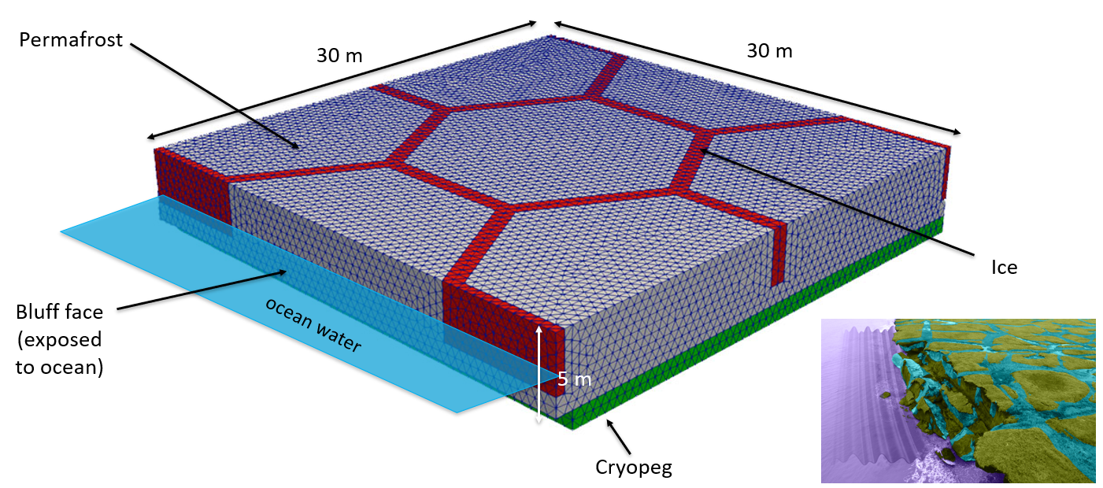
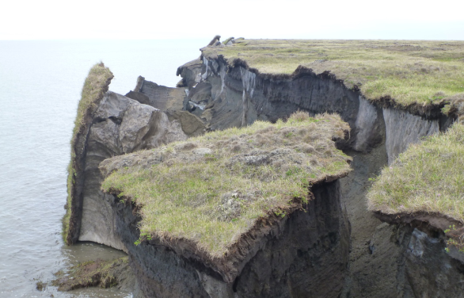
Development and Calibration of the Arctic Coastal Erosion (ACE) Model, Towards UQ of Climate Change-Induced Arctic Permafrost Degradation
Jenn Frederick, Alejandro Mota, Irina Tezaur, Charles Choens, Diana Bull, Elyce Bayat
Sandia National Laboratories, USA
SIAM UQ 2024, Trieste, Italy
SAND2024-01744C
March 1, 2024

Slide 3
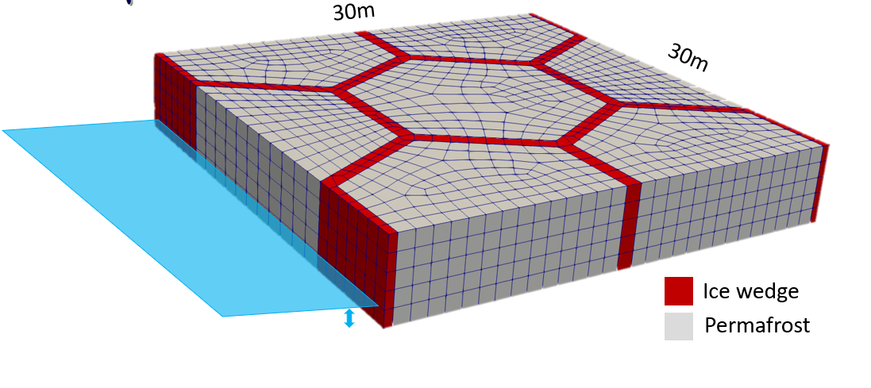
Outline
Motivation and background
The Arctic Coastal Erosion (ACE) model
  Birds-eye-view of ACE
  Thermo-mechanical terrestrial component of ACE
Numerical results
  Sensitivity study for 3D elastic mechanics-only simulation
  Calibration/validation of thermo-mechanical coupling for pseudo-realistic 2.5D slice problem
Summary
Current and future work

Slide 4
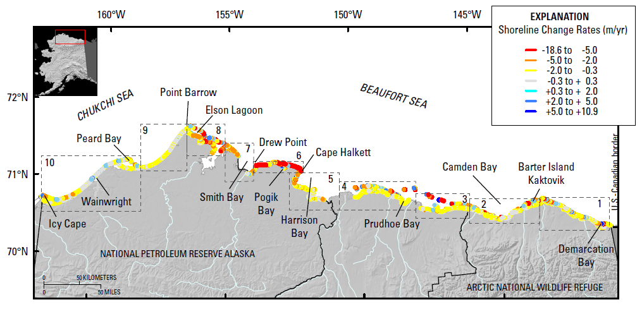
Motivation
The Arctic is warming at 4 times the rate of the global average resulting in accelerated rates of coastal erosion!
Certain locations lost >250 m (~2 football fields in length) b/w 2007-2019!
Primary culprit is loss of Arctic sea ice: since 1979 sea ice has lost 51% in area and 75% in volume
  Increasing ice-free season
  Increasing wave energy and storm surge
  Increasing sea water temperatures
Erosion is threatening:
Coastal communities: threatened with displacement
Coastal infrastructure: active DoD sites, including toxic waste sites, in northern Alaska
Global carbon balance: permafrost stores greenhouse gases (CO₂, CH₄, NO₂).
Active DOD sites
Barrow
Wainwright
Oliktok
Barter Island
Bullen Point
Gibbs & Richmond, 2015.
Notes:
The Arctic is a rapidly changing place.
We now recognize it is warming 4 times the rate as the rest of the globe!
Sea ice is diminishing, creating a longer ice-free season with greater fetch and larger waves.
As a result, the Arctic coastline is experiencing high erosion rates.

Slide 5
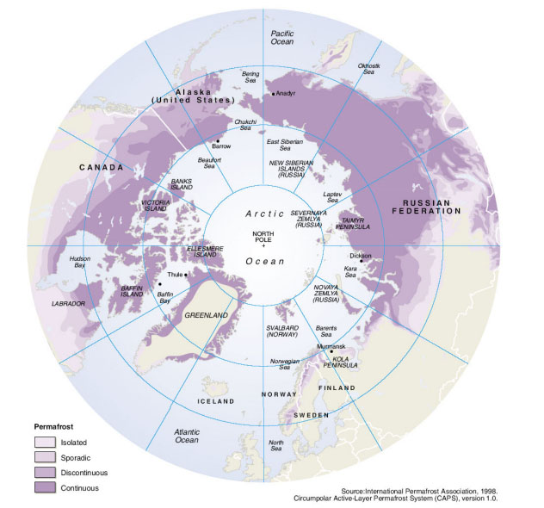
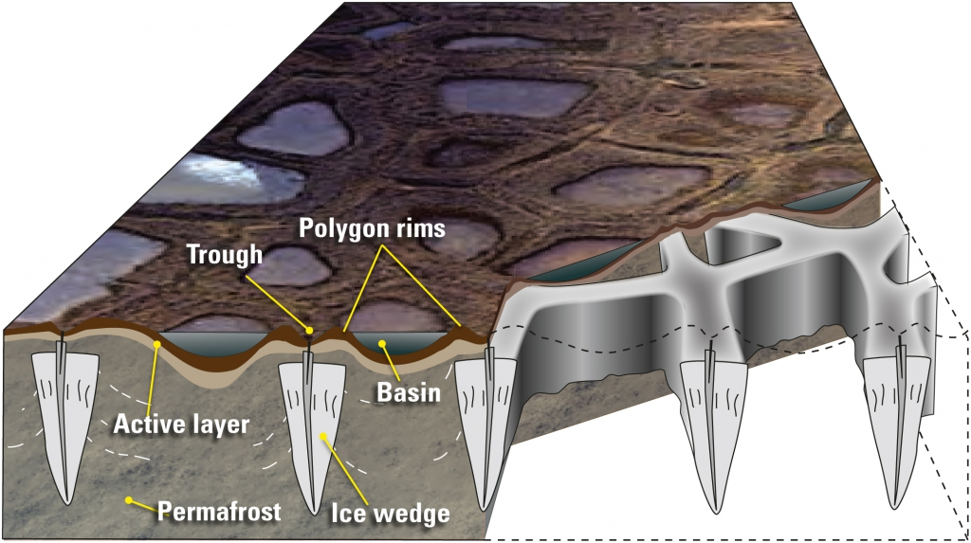
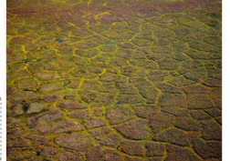
Permafrost thaw & erosion
What is permafrost?
Ground that remains frozen for 2+ consecutive years.
24% of ice-free land area in Northern Hemisphere and 85% of Alaska, Greenland, Canada and Siberia contains permafrost.
34% of global coastline is permafrost.
Left: schematic illustrating formation of ice wedges and ice-wedge polygon landscapes. Right: map of permafrost distribution in Arctic
Polar Media Archive
Brown et al. 1998.
Unique coastal permafrost erosion process in Arctic:
Predominant geomorphology: ice-wedge polygons
  Ice acts to bind unconsolidated soils in permafrost.
  Ice wedges grow/expand up to 10s meters wide and deep.
  Permafrost thaw can cause subsidence, slumping, weakening.
Martin et al. 2009.
Notes:
Many of you here already are familiar with permafrost, so I won’t go into much detail, except to point out that much of the permafrost along the eroding coasts has polygonal geomorphology. . . .

Slide 6
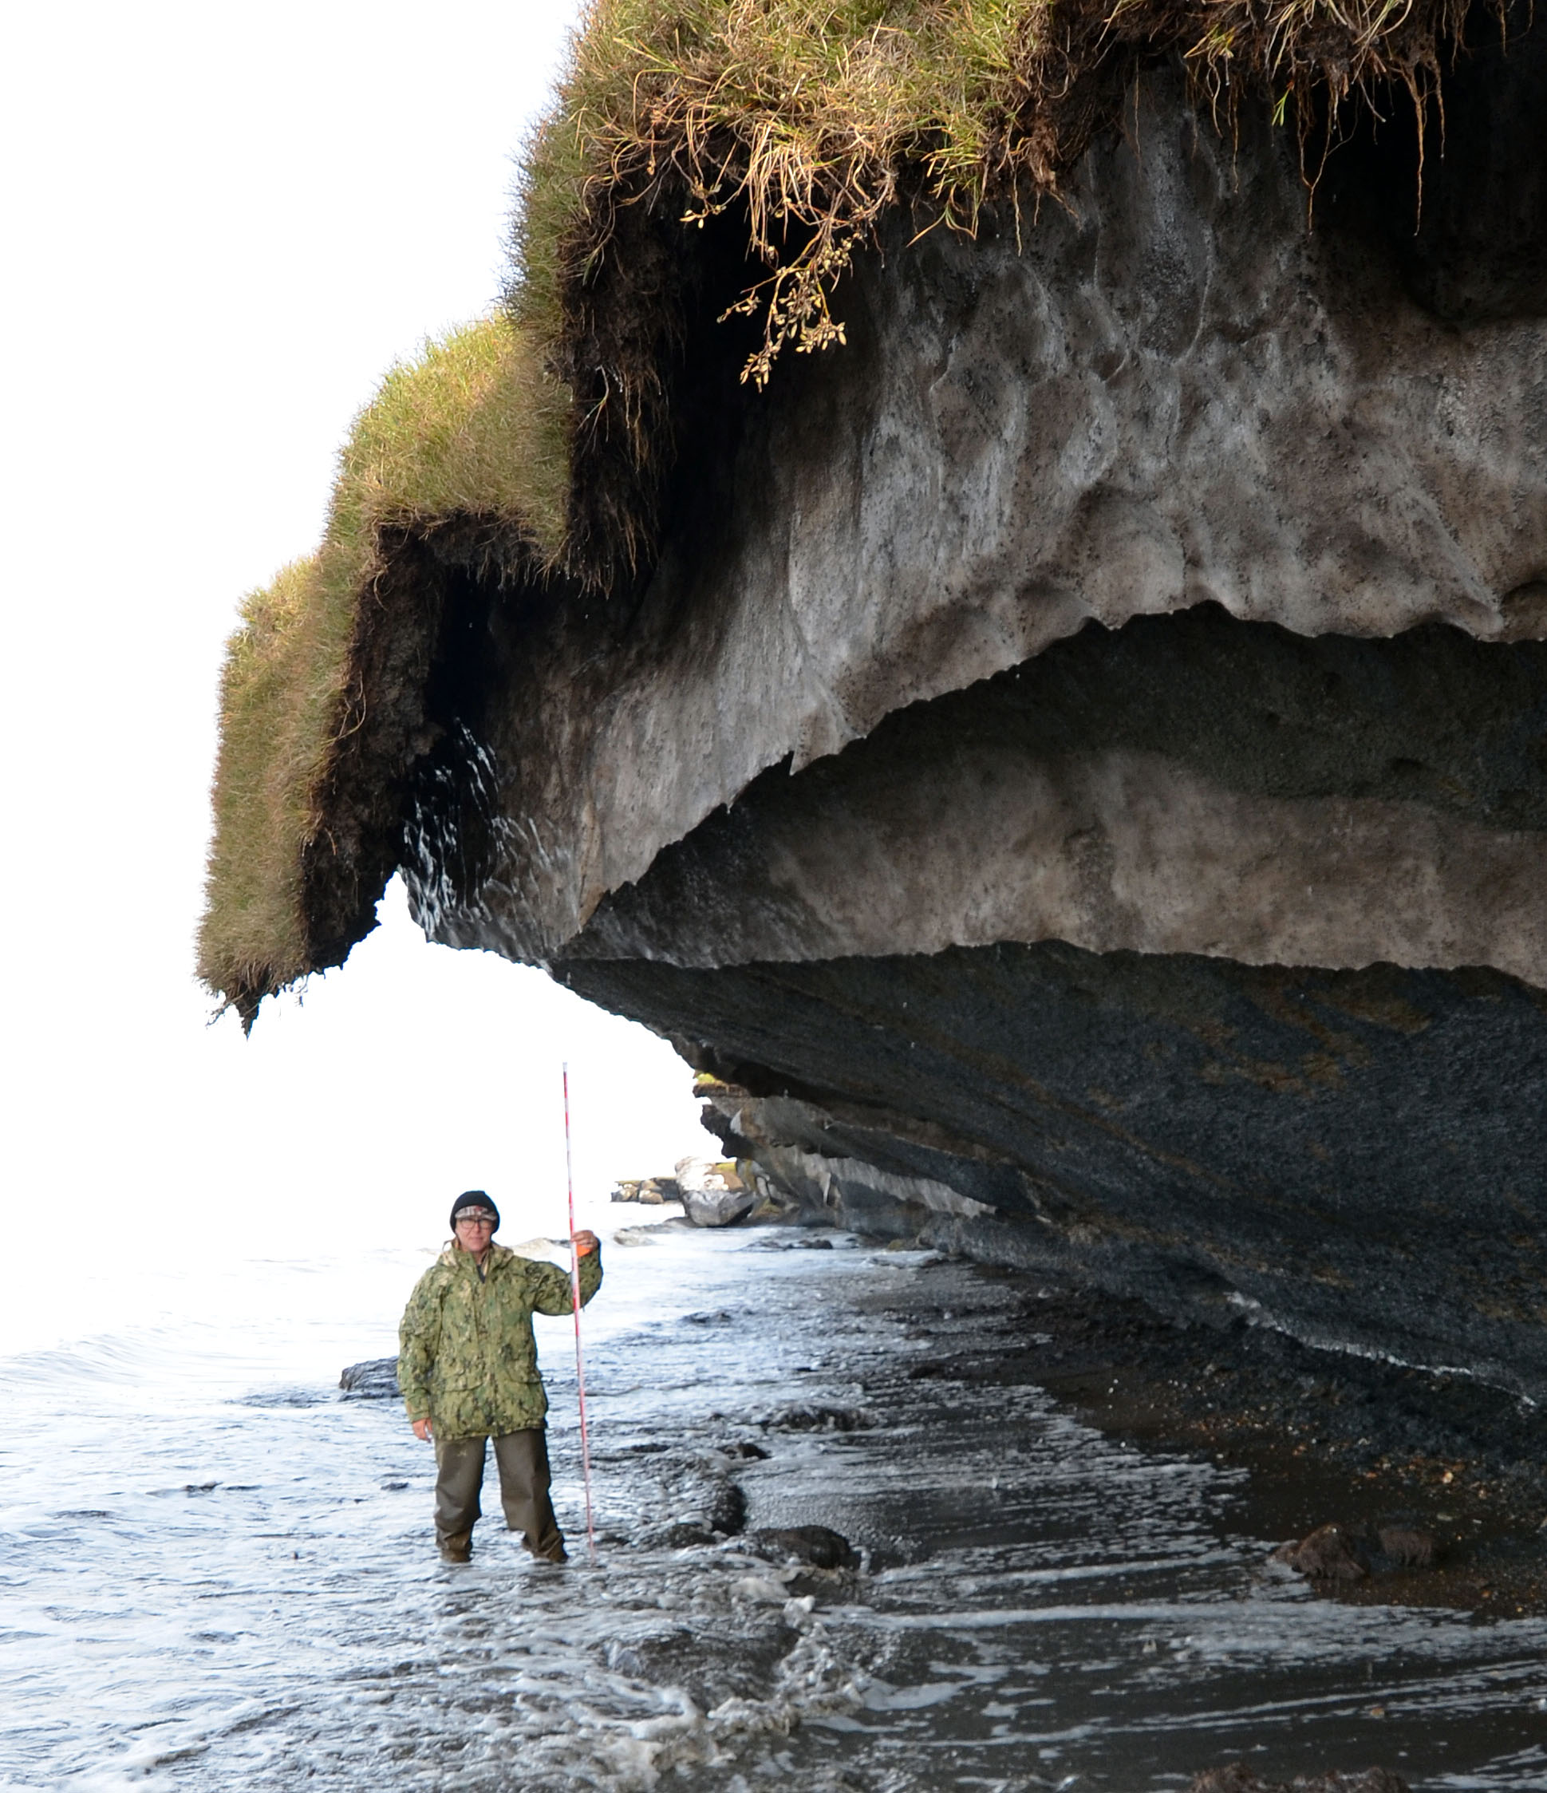
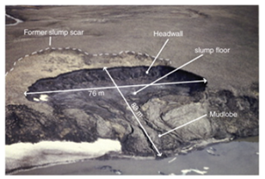
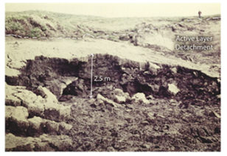
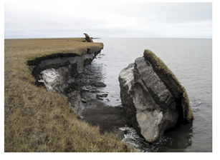
Coastal permafrost failure mechanisms
Retrogressive thaw slumping: a slope failure characterized by thaw of exposed ground ice and slumping of thawed soil, typically caused by thermo-denudation¹.
Active layer detachment: failures are translational landslides that occur in summer in thawing soil overlying permafrost, typically caused by thermo-denudation¹.
Block failure: a niche (recess at bluff base) progresses landward until the overhanging material fails in a shearing or toppling mode known as block failure, caused by thermo-abrasion².
  Fallen blocks can disintegrate in the near-shore environment within 1-2 weeks!
This study
Lantuit et al. 2008
Lantuit et al. 2008
Ravens et al. 2012
Retrogressive thaw slumping
Active layer detachment
Block failure
¹Thawing of permafrost bluffs that proceeds under the influence of gravity. ²Undercutting of permafrost bluff by warming ocean.
6
Notes:
Not all erosion mechanisms are the same, and there can be several types of erosion going on along the same stretch of coast.
The types of erosion are often categorized into these 3 types. . .

Slide 7
Coastal permafrost failure mechanisms
Retrogressive thaw slumping: a slope failure characterized by thaw of exposed ground ice and slumping of thawed soil, typically caused by thermo-denundation¹.
Active layer detachment: failures are translational landslides that occur in summer in thawing soil overlying permafrost, typically caused by thermo-denundation¹.
Block failure: a niche (recess at bluff base) progresses landward until the overhanging material fails in a shearing or toppling mode known as block failure, caused by thermo-abrasion².
  Fallen blocks can disintegrate in the near-shore environment within 1-2 weeks!
This study
Dominant failure mechanism in northern Alaska
Lantuit et al. 2008
Lantuit et al. 2008
Ravens et al. 2012
Retrogressive thaw slumping
Active layer detachment
Block failure
¹Thawing of permafrost bluffs that proceeds under the influence of gravity. ²Undercutting of permafrost bluff by warming ocean.
7

Slide 8
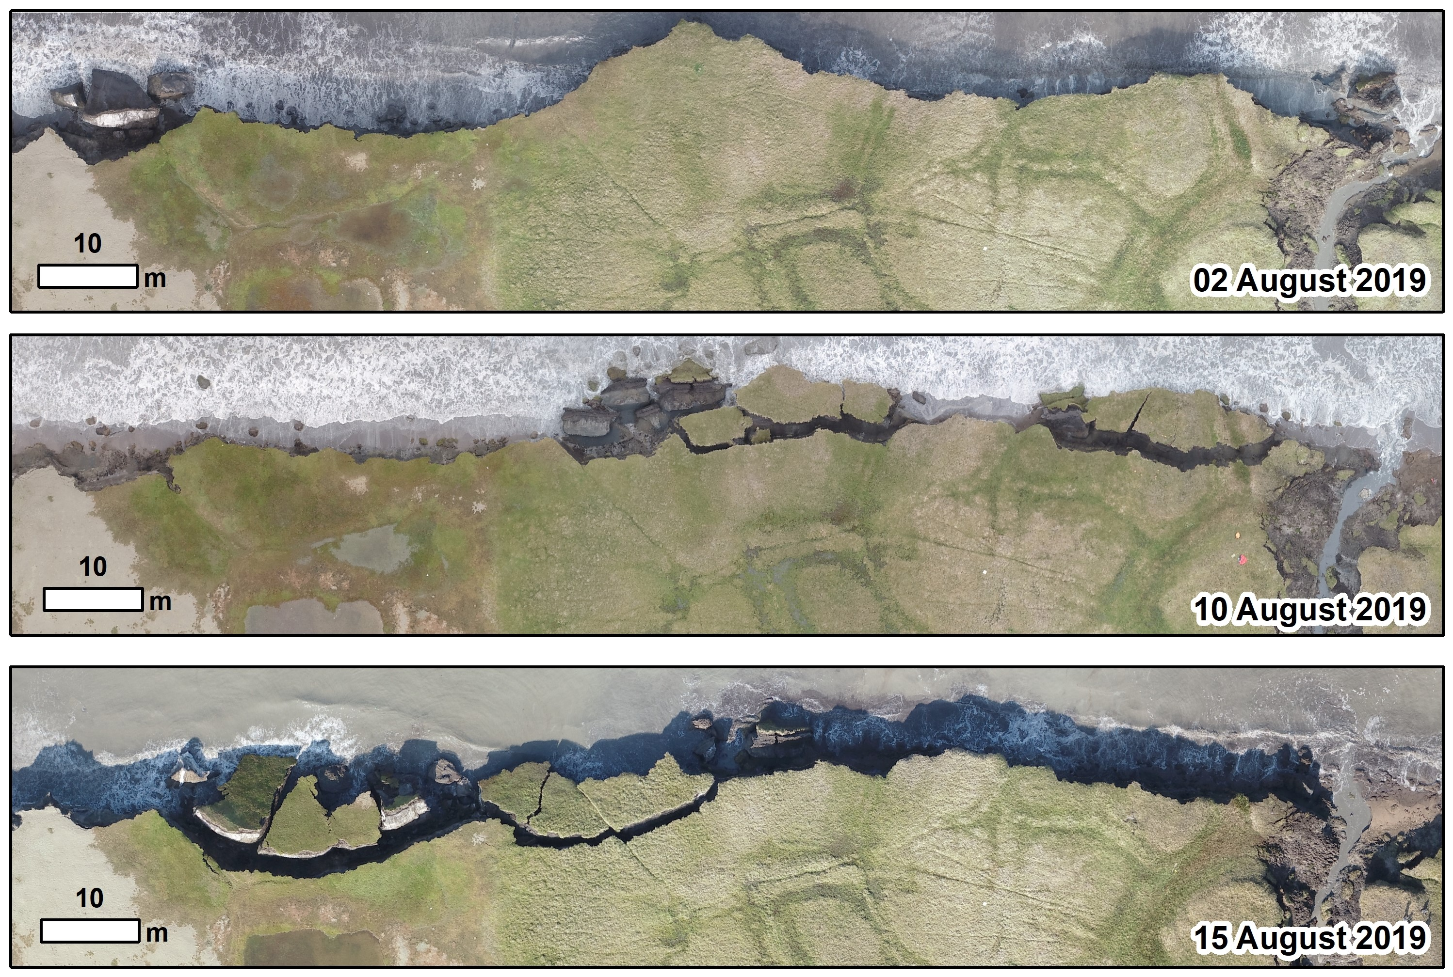
Example of bluff erosion during 2019 UAV surveys*
  Fallen blocks can disintegrate in near-shore environment within 1-2 weeks!
*Images courtesy of Ben Jones, UAF
8
Notes:
Here was can see three consecutive images from a UAV survey in 2019 over a stretch of coastline at Drew Point.
In a matter of just 2 weeks, you can see large blocks fall off and disintegrate.

Slide 9
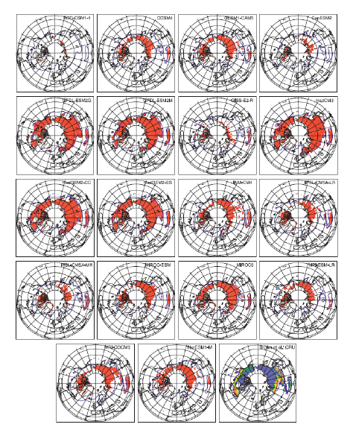
State-of-the-art in permafrost modeling
Most existing permafrost models* (including Earth System Model-, or ESM-, coupled models) are fairly primitive!
  Most models were based on trend projection and/or empirical relationships
  Limited PDE-based models: primarily thermal models, e.g., 1D steady state heat flow (no mechanics/deformation)
  Most models assumed a particular type of erosion (e.g., block failure)
  Models did not include realistic boundary conditions and did not account for permafrost geomorphologies or geophysics.
Premise behind ACE: an accurate, predictive Arctic coastal erosion model must couple the influences of evolving wave dynamics, thermodynamics and mechanics.
Koven et al. 2013
* See (Frederick et al. 2016), Chapter 5, for extensive overview.

Slide 10

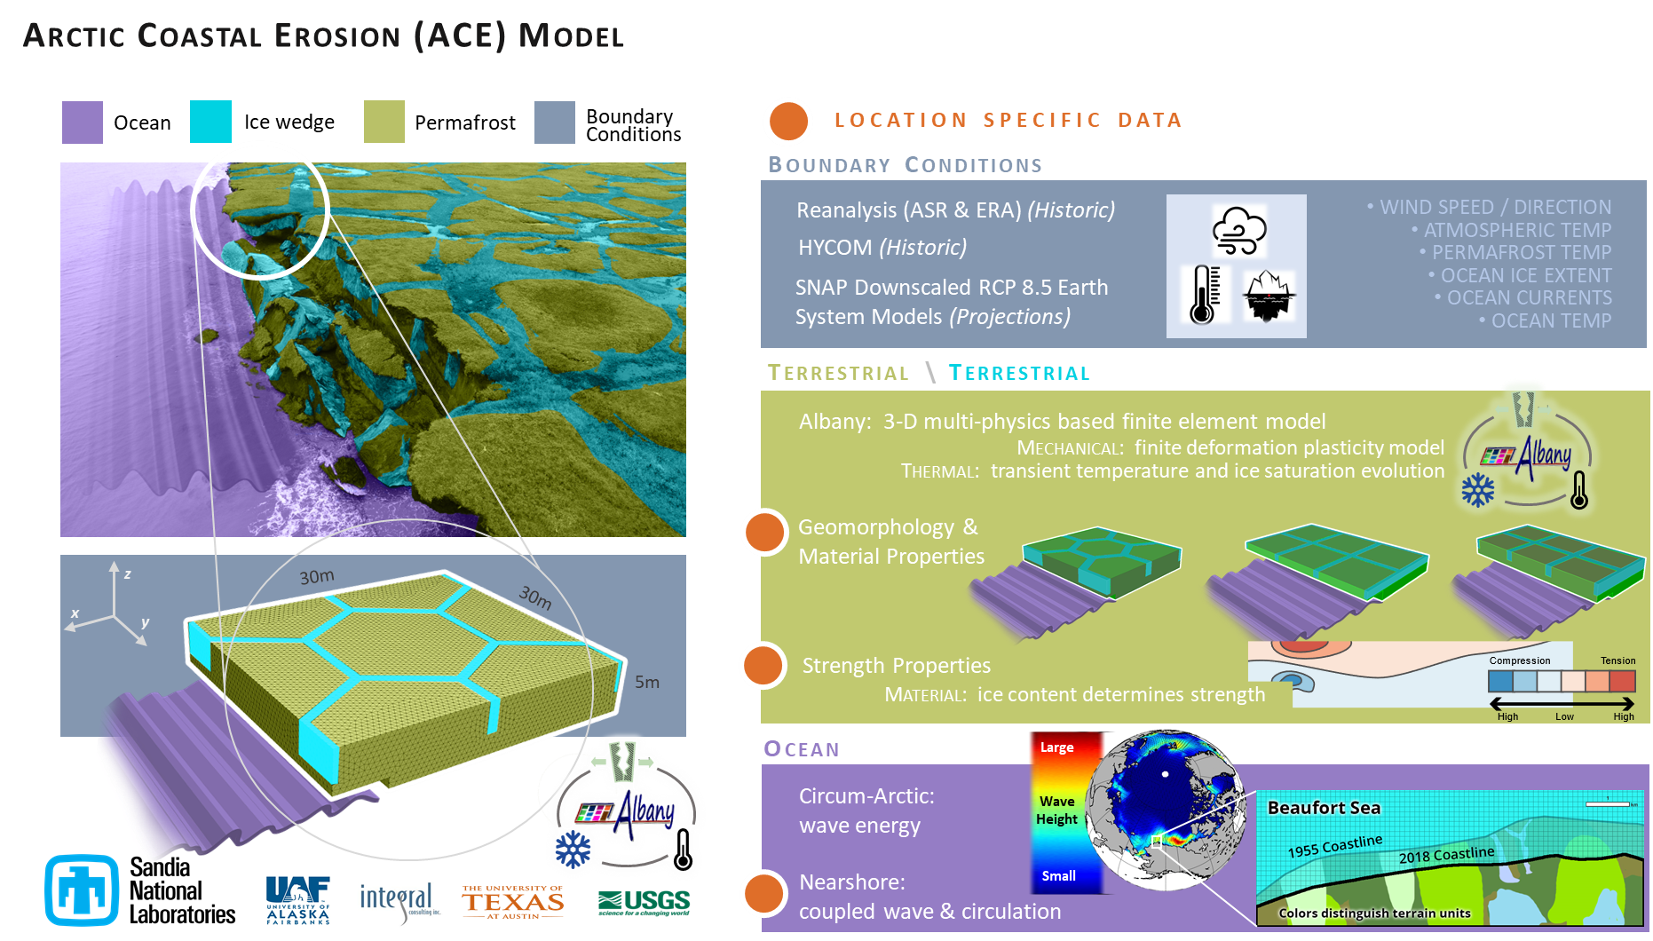
Arctic Coastal Erosion (ACE) model
Notes:
At Sandia, we have created a tool to try and study what the dominant factors are control erosion mechanisms along these permafrost coastal bluffs.
It is a numerical model that has several pieces to it, with the main pieces being the terrestrial and ocean components.

Slide 11
Arctic Coastal Erosion (ACE) model
This talk
11
Notes:
Near-shore ocean model: WWWIII-SWAN-DELFT3D model

Slide 12


Finite element implementation in Albany-LCM
The thermo-mechanical Arctic Coastal Erosion (ACE) model is implemented within the LCM project in Sandia’s open-source parallel, C++, multi-physics, finite element code, Albany.
Component-based design for rapid development.
Contains a wide variety of constitutive models.
Extensive use of libraries from the open-source Trilinos project.
  Use of the Phalanx package to decompose complex problem into simpler problems with managed dependencies.
  Use of the Sacado package for automatic differentiation.
All software available on GitHub.
https://github.com/sandialabs/LCM
https://github.com/trilinos/trilinos

Slide 13
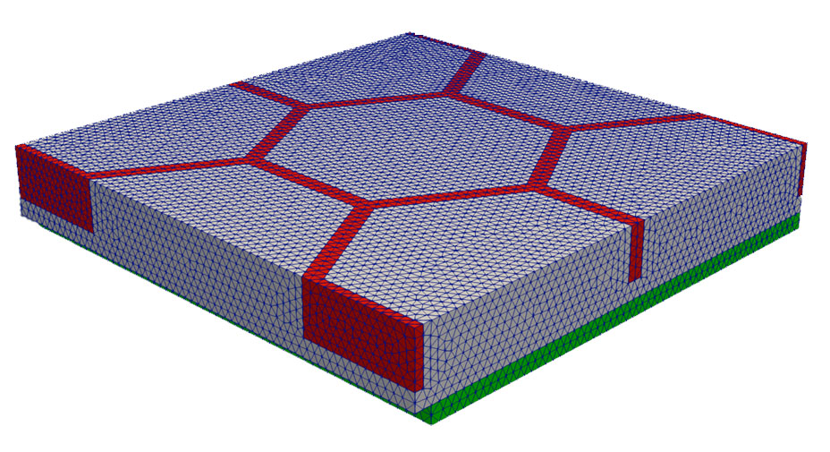
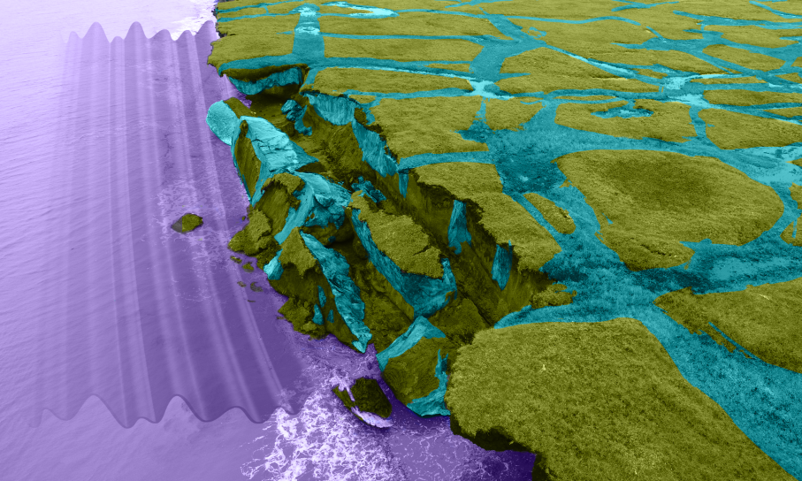
Anatomy of a canonical computational domain
Permafrost
30 m
30 m
Ice
Bluff face (exposed to ocean)
ocean water
5 m
Cryopeg*
* Layer of unfrozen ground that is perennially cryotic (forming part of the permafrost) in which freezing is prevented.

Slide 14
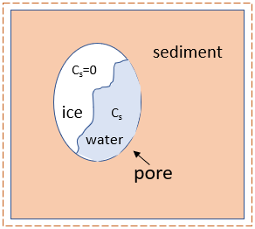
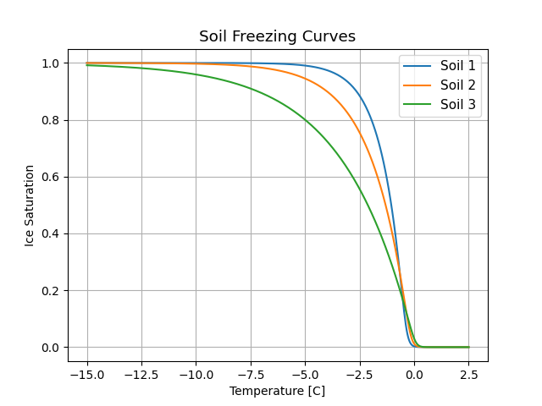

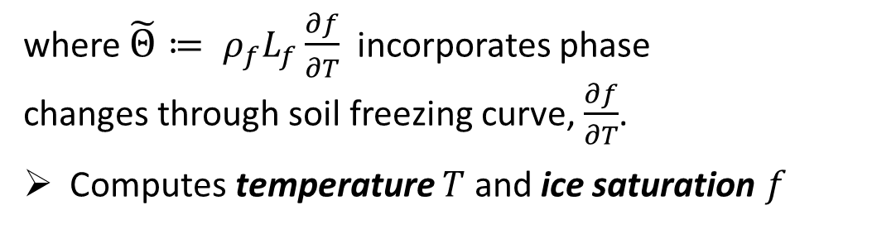
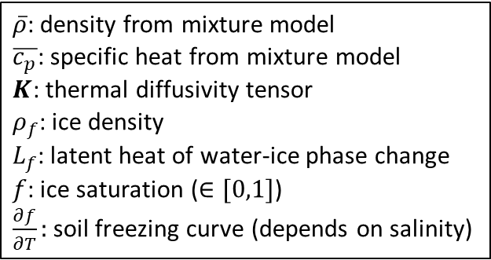
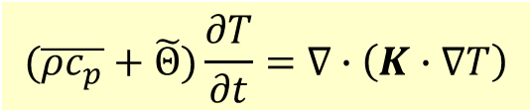
Thermal model
Transient heat conduction in a non-homogeneous porous media with water-ice phase change:
$\overline{ρ}$: density from mixture model
$\overline{c_{p}}$: specific heat from mixture model
$K$: thermal diffusivity tensor
$ρ_{f}$: ice density
$L_{f}$: latent heat of water-ice phase change
$f$: ice saturation ($∈[0,1]$)
$\frac{∂f}{∂T}:$soil freezing curve (depends on salinity)
$$(\overline{ρc_{p}}+\tilde{Θ})\frac{∂T}{∂t}=∇∙\left(K∙∇T\right)$$
where $\tilde{Θ}≔ ρ_{f}L_{f}\frac{∂f}{∂T}$ incorporates phase changes through soil freezing curve, $\frac{∂f}{∂T}$.
Computes temperature $T$ and ice saturation $f$
Permafrost control volume
Above
Soil freezing curve $\frac{∂f}{∂T}≠0$ only during phase change, which occurs in narrow temp zone where the width depends on soil components.
Boundary conditions (from wave model/data)
  Local geothermal heat flux from below
  Air temp* from above
  Air/ocean temp at bluff face
  Ocean salinity at bluff face**
Ice Saturation
Bluff face
Below
Temperature [C]
* Or, alternatively surface ground temperature (if available). ** Used to modify melting temperature of ice.
Notes:
Q: ocean salinity is not “true” BC, right?
From Jenn: That is correct. It is not a true BC because there is no governing equation that solves for the salinity. The integration points that are associated with an erodible surface and are below the sea level, have their salinity value modified. This allows the melting temperature to change for those integration points.

Slide 15
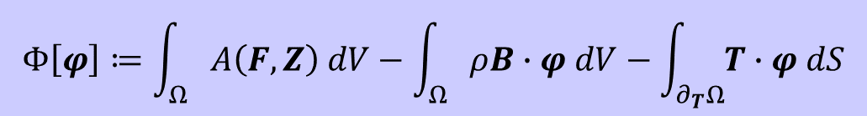
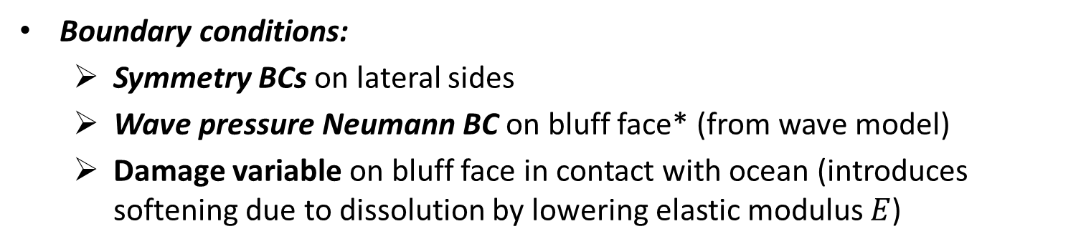
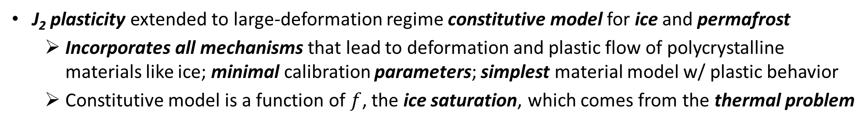
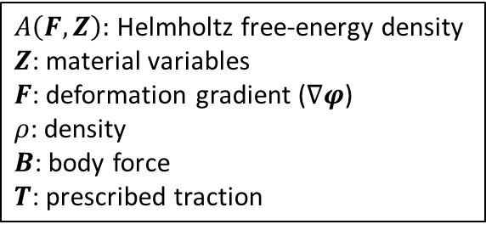
Mechanical model
Finite deformation time-dependent variational formulation for solid mechanics problem obtained by minimizing the energy functional:
$A\left(F,Z\right):$ Helmholtz free-energy density
$Z$: material variables
$F$: deformation gradient ($∇φ$)
$ρ$: density
$B$: body force
$T$: prescribed traction
$$Φ\left[φ\right]≔\int_{Ω}{A\left(F,Z\right) dV−\int_{Ω}{ρB∙φ dV−\int_{∂_{T}Ω}{T∙φ dS}}}$$
Computes displacements and new computational geometry (following erosion)
J₂ plasticity extended to large-deformation regime constitutive model for ice and permafrost
  Incorporates all mechanisms that lead to deformation and plastic flow of polycrystalline materials like ice; minimal calibration parameters; simplest material model w/ plastic behavior
  Constitutive model is a function of $f$, the ice saturation, which comes from the thermal problem
Boundary conditions:
  Symmetry BCs on lateral sides
  Wave pressure Neumann BC on bluff face* (from wave model)
  Damage variable on bluff face in contact with ocean (introduces softening due to dissolution by lowering elastic modulus $E$)
Symmetry BCs
Bluff face
Symmetry BCs
* Holthuijsen 2007.
Notes:
Q: damage variable is not really BC, right?
From Jenn: Yes, the damage variable is the by which the residual elastic modulus is divided by if the integration point is associated with an erodible surface and below the sea level. This decreases the residual elastic modulus and makes the material softer or more compliant.

Slide 16
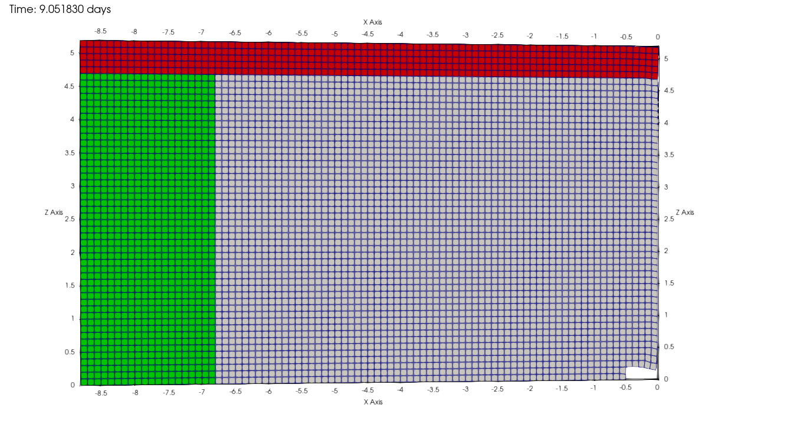
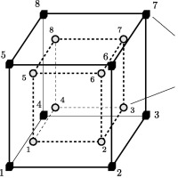
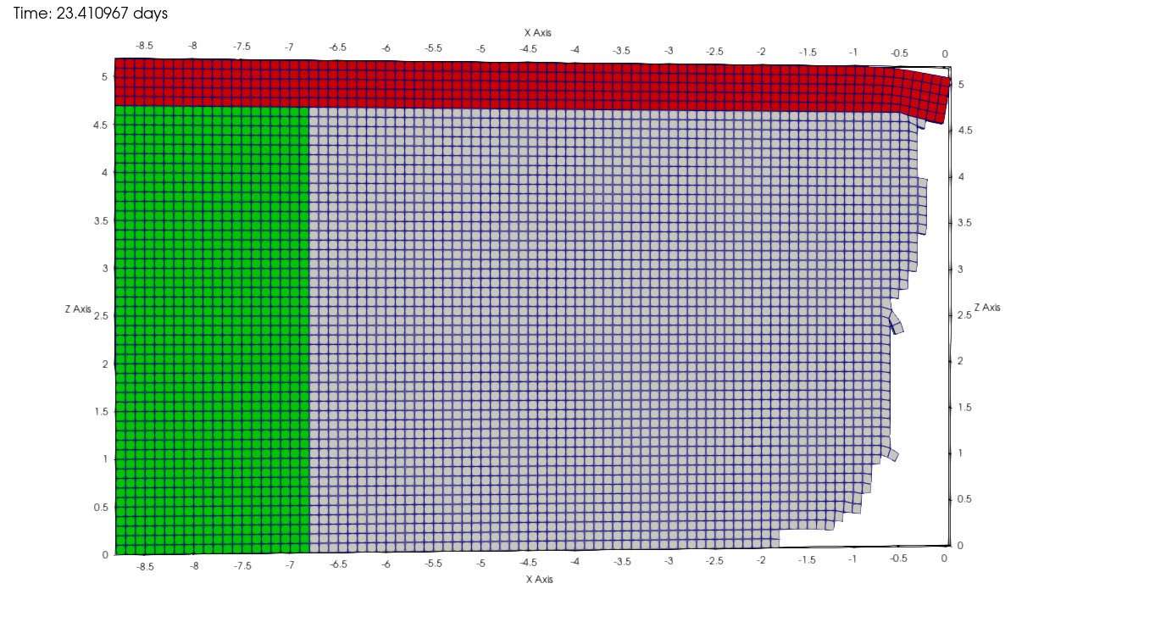
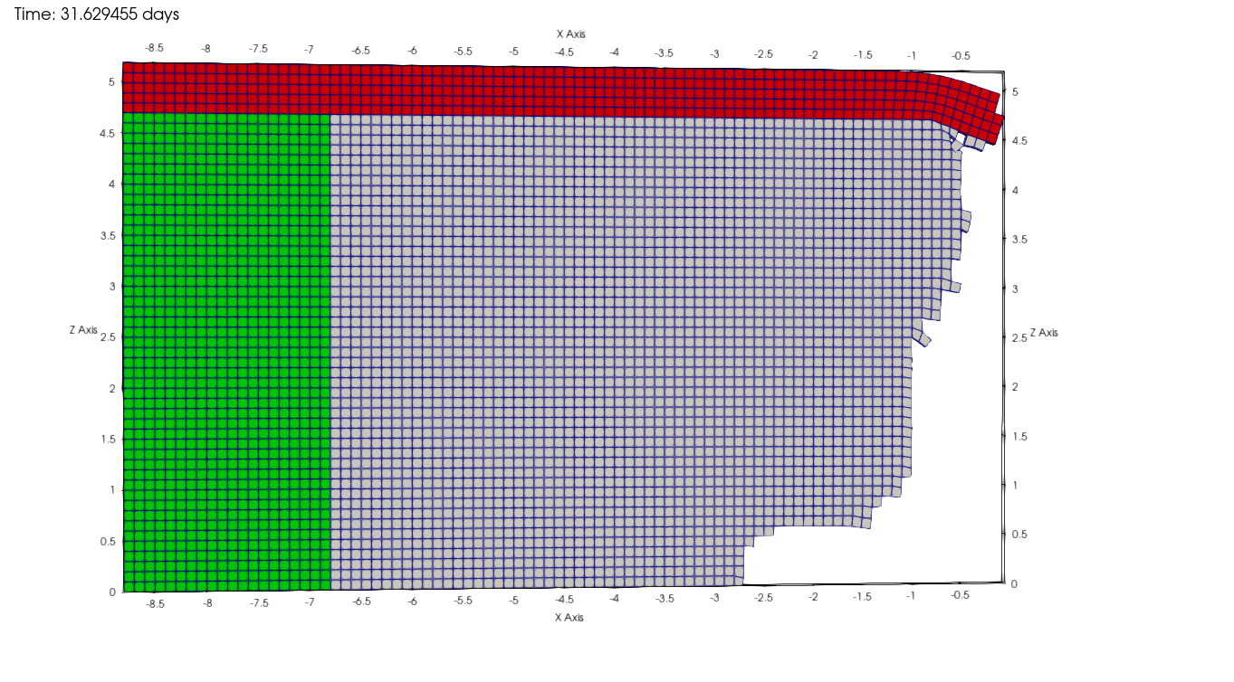
Erosion failure criteria
Stress criterion: when material reaches a critical value of the stress in tension or compression.
Strain criterion: when material reaches a critical strain limit defined as a function of peat content (distortion).
Kinematic criterion: when material has tilted excessively, or exceeded a maximum physical displacement, it is assumed to have fallen as part of block erosion.
element
nodes
element
integration
points
When any of the failure criteria are reached for all integration points within an element, “failed” elements are removed from mesh.

Slide 17
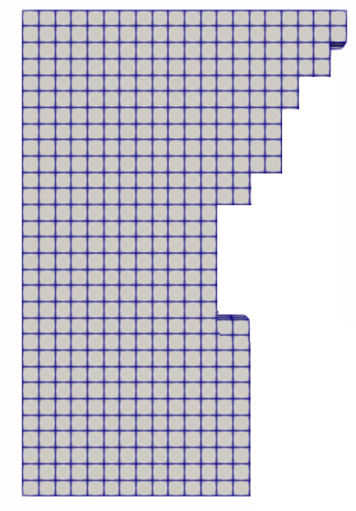
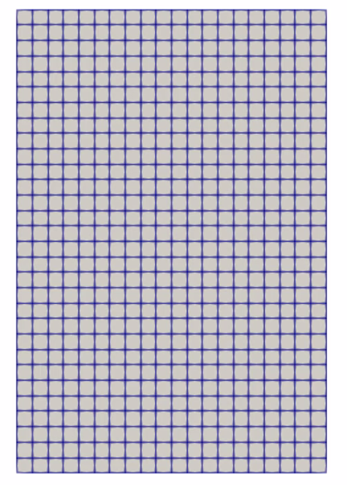
Coupled thermo-mechanical formulation
Potential key advantages:
Failure modes develop from constitutive relationships in FEM model (no empirical relationships!)
3D unsteady heat flow can include chemistry
Thermal and mechanical problems can be advanced using different time-steppers (e.g., implicit-explicit coupling)
Thermal:
Inputs: geometry, sediment type,
porosity, salinity
Outputs: temperature field, ice saturation
Eroded geometry
Ice saturation
Mechanical:
Inputs: ice saturation, mechanical parameter relationships as function of sediment type and ice saturation
Outputs: displacements, eroded geometry
Coupled mechanical + thermal states
Unique characteristic of coupled model: coupling happens at the level of material model

Slide 18
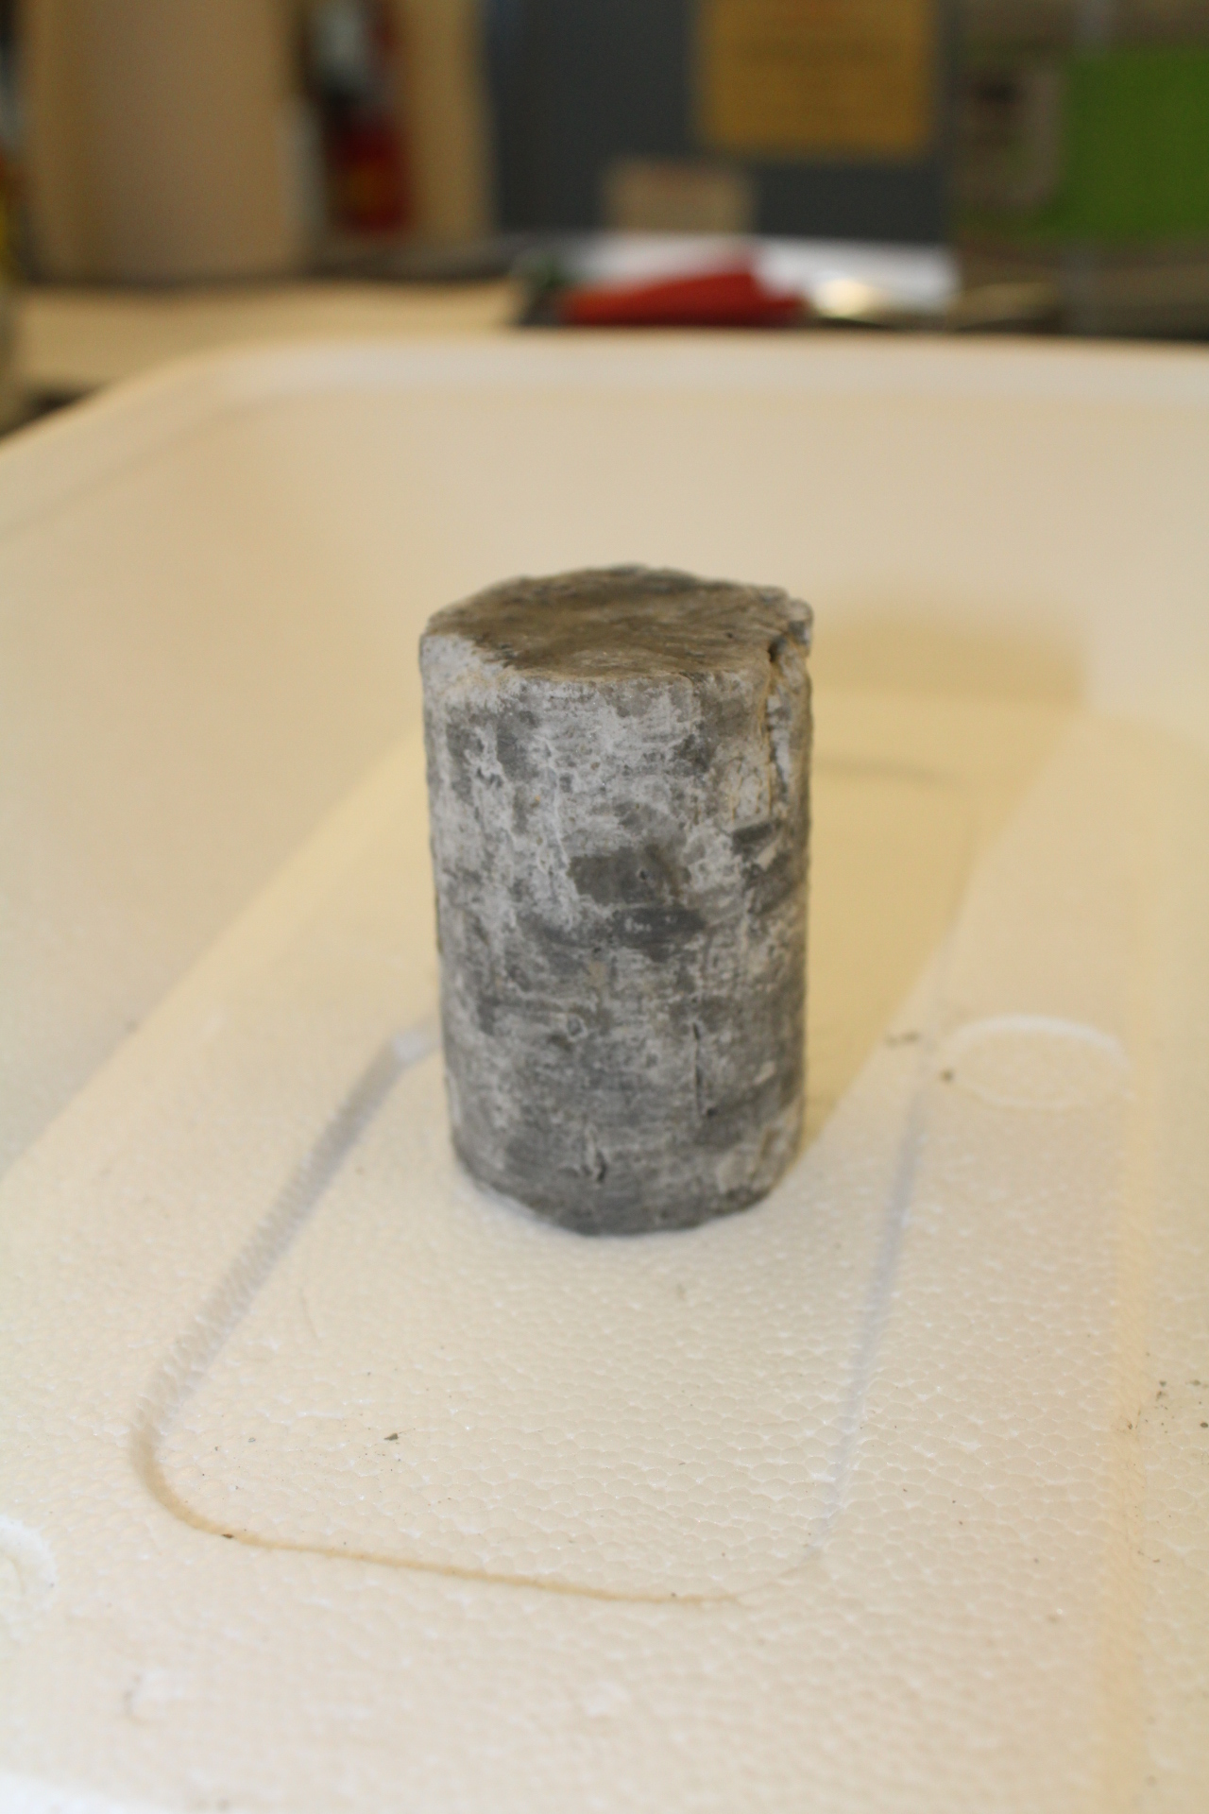
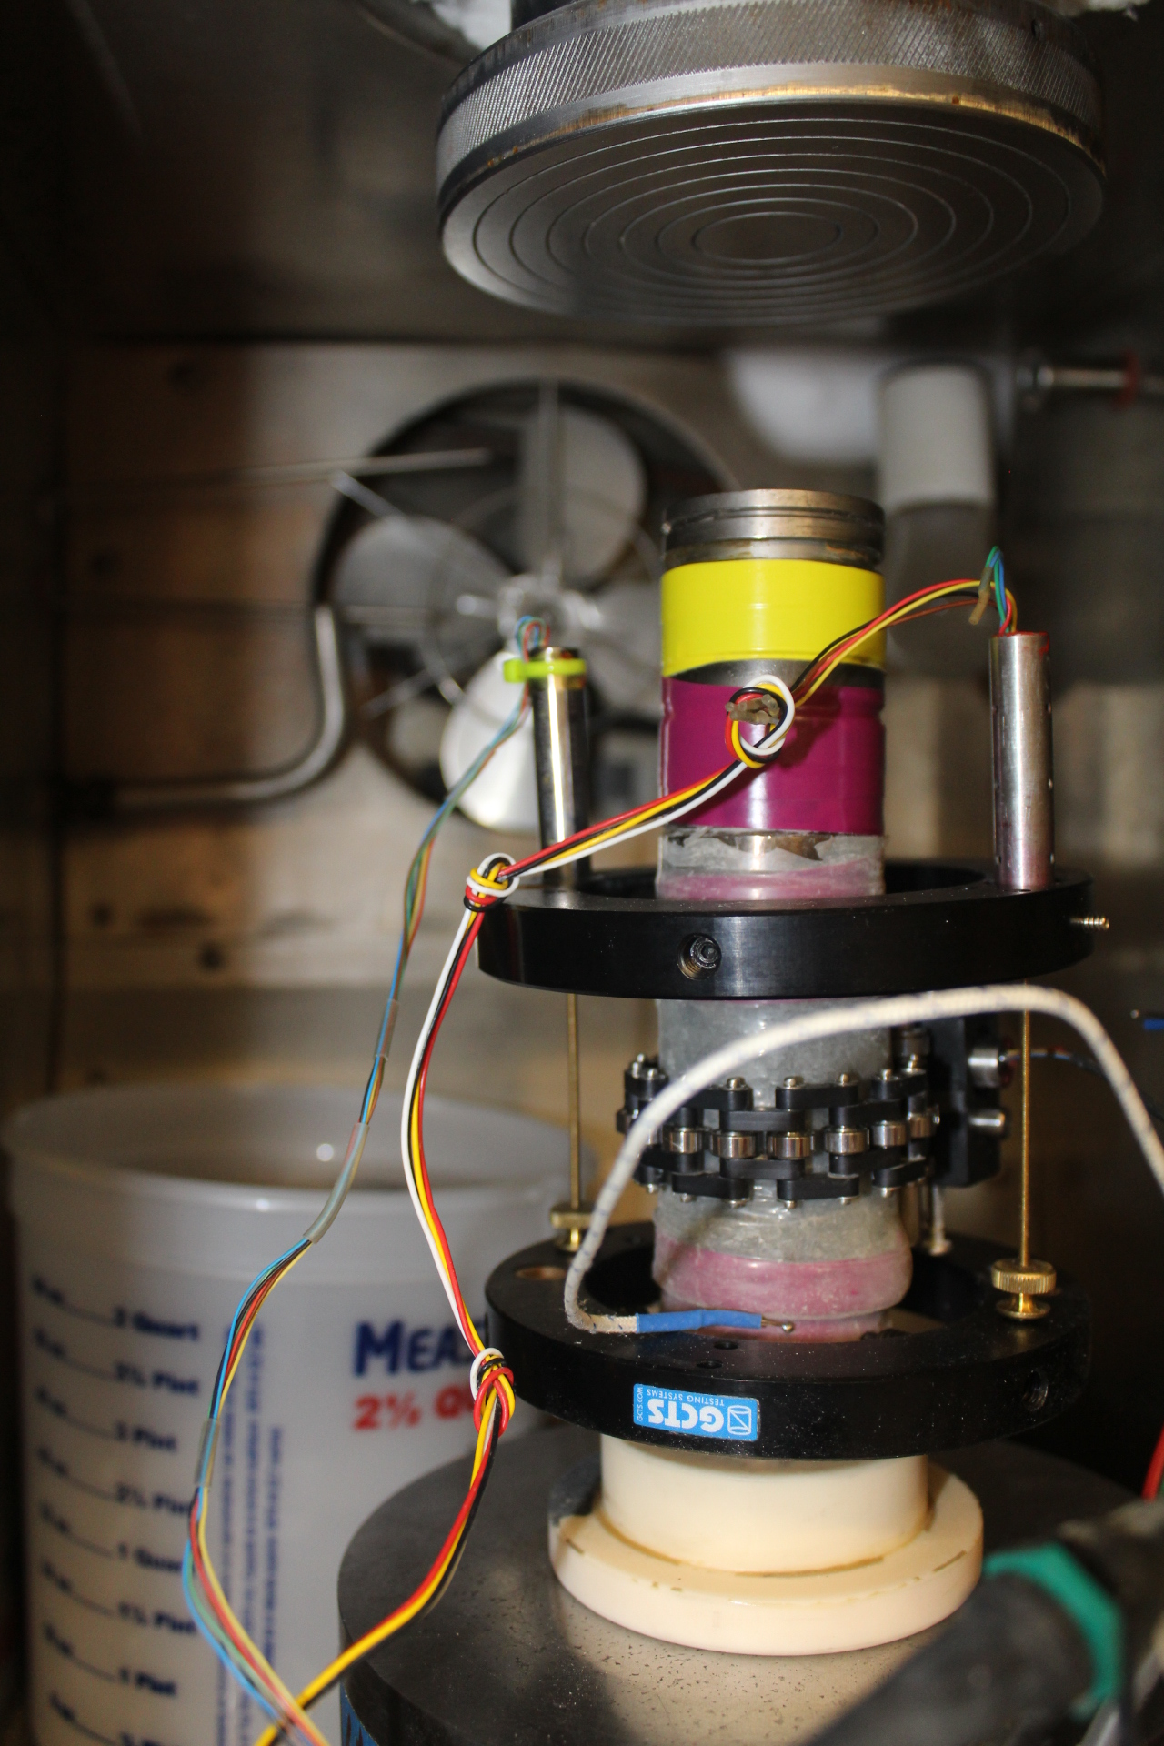
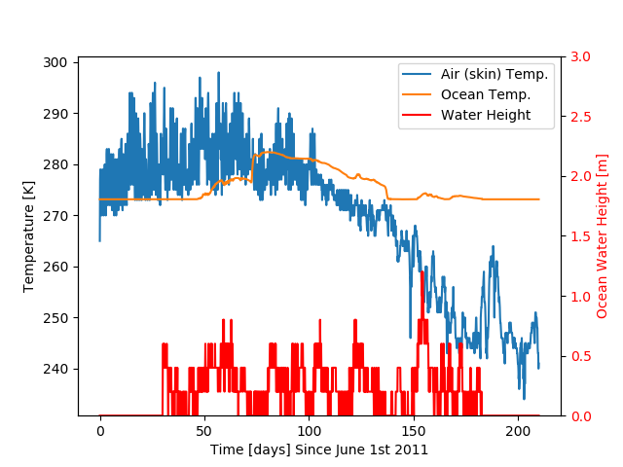
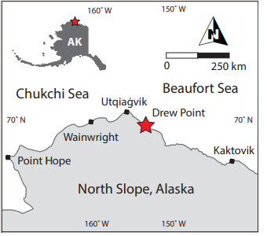
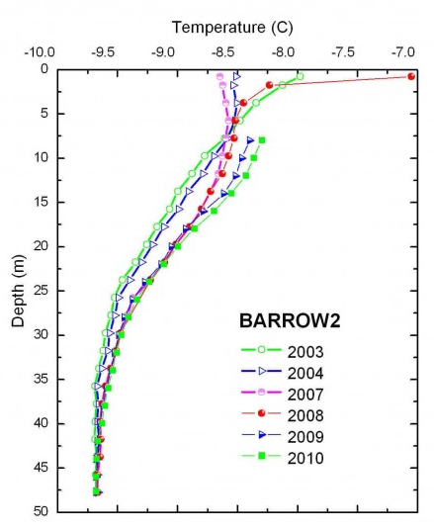
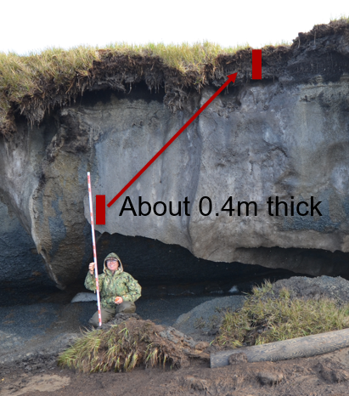

Parameters & inputs
Parameters estimated from core lab experiments:
Elastic modulus, Poisson’s ratio, yield strength
Sand/silt/clay/peat fractions with depth
Porosity with depth
Salinity with depth
Parameters from literature:
Ice/water/sediment densities, thermal conductivities, heat capacities
Freezing curve/width as function of sediment type
BC Data for Drew Point
Parameters estimated from observational data at Drew Point, AK:
Air temp w/ time, initial bluff temp (USGS weather station data)
Geothermal heat flux (borehole at Barrow, AK)
Polygon dimension, ice wedge thickness and depth, bluff height, organic layer (peat) thickness (Aug. 2019 field campaign)
Parameters from wave model (WW3+SWAN+Delft3D):
Ocean temperature, salinity and sea-level w/ time (for thermal and wave pressure mechanical BCs)
Deep borehole

Slide 19
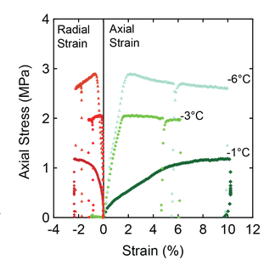
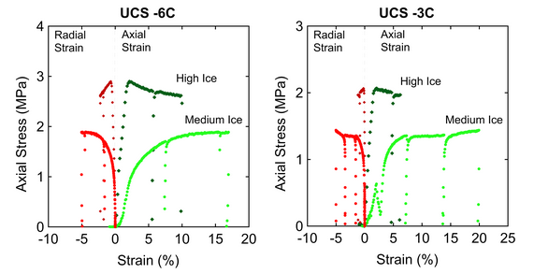
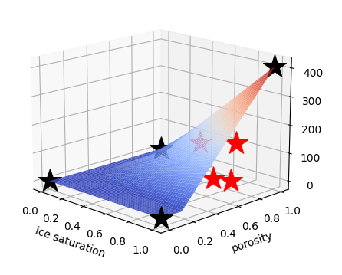
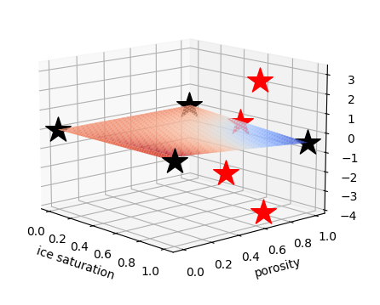
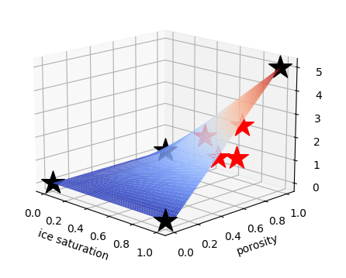



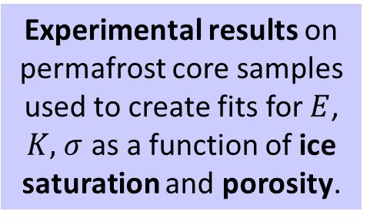
Material model calibration to experimental data
Experimental results on permafrost core samples used to create fits for $E$, $K,$ $σ$ as a function of ice saturation and porosity.
σ
K
E
Experiments are very challenging to perform and provide limited data!
experimental
data points
theoretical
data points
pure ice
pure ice
Elastic modulus
Hardening modulus
$$E$$
pure
water
$$K$$
$σ$
Yield Stress
pure
water
pure
rock
pure
rock
19
Notes:
Q: is point that the fits are not great, and this is why we are doing sens. Studies? What are theoretical points?
Black points = BCs. Strongly applied BCs.
Red points = experimental points – change shape as a result of these.
If use just data fits with experiments, at edges would get something nonphysical. Also not getting good responses w/ just experimental data.
From Jenn: The black theoretical points are values for pure ice (porosity=1), pure water (porosity=1), and pure rock (porosity=0). These are used in the fits in addition to the experimental values (red stars). The surface that is slightly transparent is the fit that is used in ACE. It’s a best fit for the data as a function of porosity and ice saturation, but the r^2 values are not shown on this slide. You are correct in your observation that the fits don’t contain the red stars. The red stars are close (meaning, the red stars were used to determine the equation for the surface fits, but the r^2 value is not perfect). I think you can talk about these fits exactly as you suggested.
4 unconfined compressive stress (UCS) experimental results were used to calibrate the material model.
Sigma (yield strength) is the value of the stress where the sample fails (where the slope changes).
E (elastic modulus) is the slope of the axial strain curves before reaching the point of failure, where the slope changes.
K (hardening modulus) is the slope of the axial strain after reaching the point of failure.
The equations for the fits are given above the bilinear surfaces, along with the r^2 values.

Slide 20
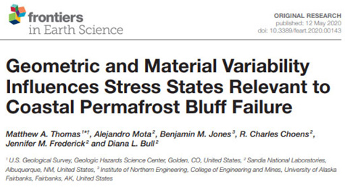
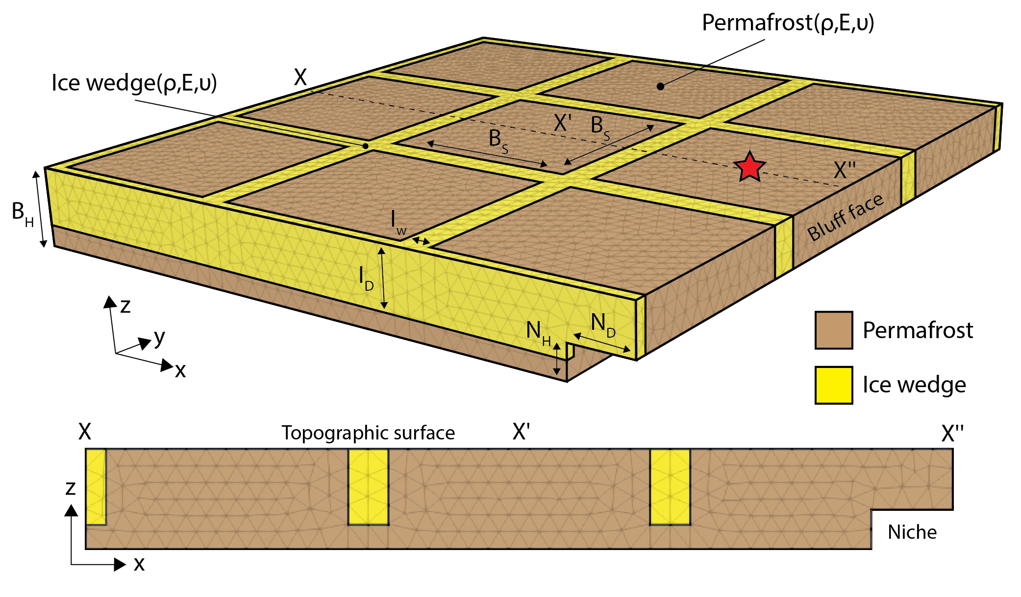
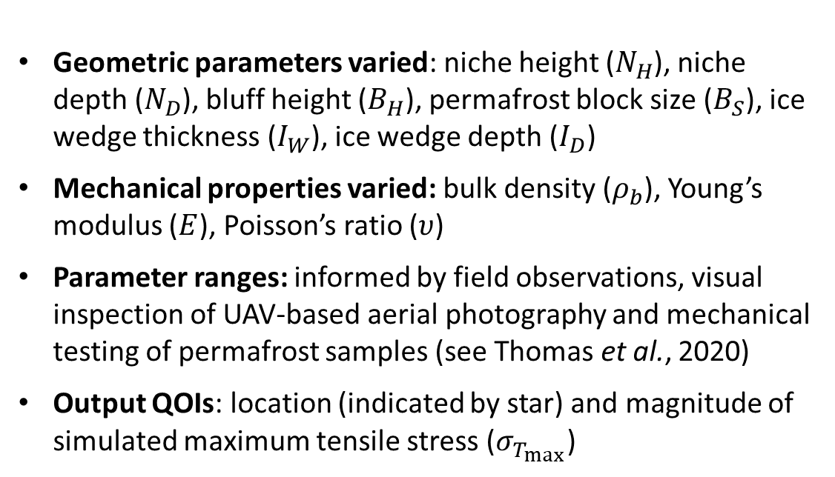
3D elastic mechanics-only sensitivity study
Goal: assess impact of bluff geometry and material variability on stress states leading up to bluff failure, and use results to inform thermo-mechanical analyses
Geometric parameters varied: niche height ($N_{H}$), niche depth ($N_{D}$), bluff height ($B_{H}$), permafrost block size ($B_{S}$), ice wedge thickness ($I_{W}$), ice wedge depth ($I_{D}$)
Mechanical properties varied: bulk density ($ρ_{b}$), Young’s modulus ($E$), Poisson’s ratio ($υ$)
Parameter ranges: informed by field observations, visual inspection of UAV-based aerial photography and mechanical testing of permafrost samples (see Thomas et al., 2020)
Output QOIs: location (indicated by star) and magnitude of simulated maximum tensile stress ($σ_{T_{max}}$)
Notes:
Only load is gravitational
Niche heights: 1-3m.
Niche depths: 2-6m.
Bluff heights: 2.5-7.5m
Block sizes: 10-20m
Ice wedge thickness: 1-3m
Ice wedge depth: 50%-100%B_H

Slide 21
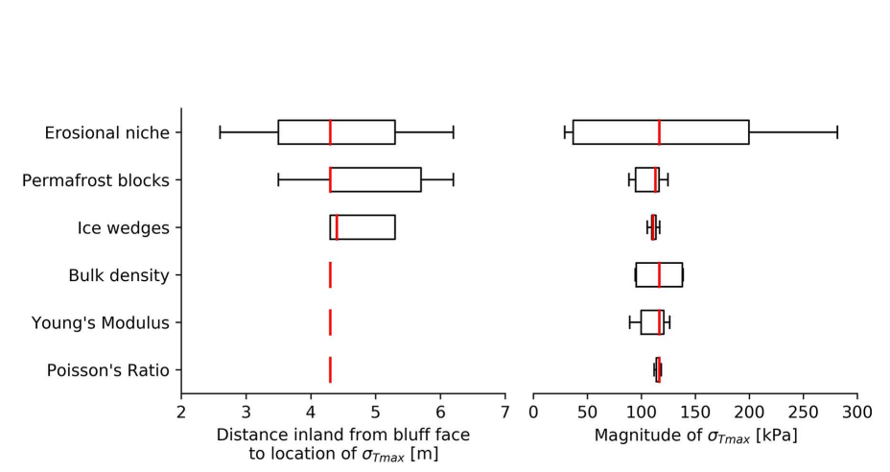


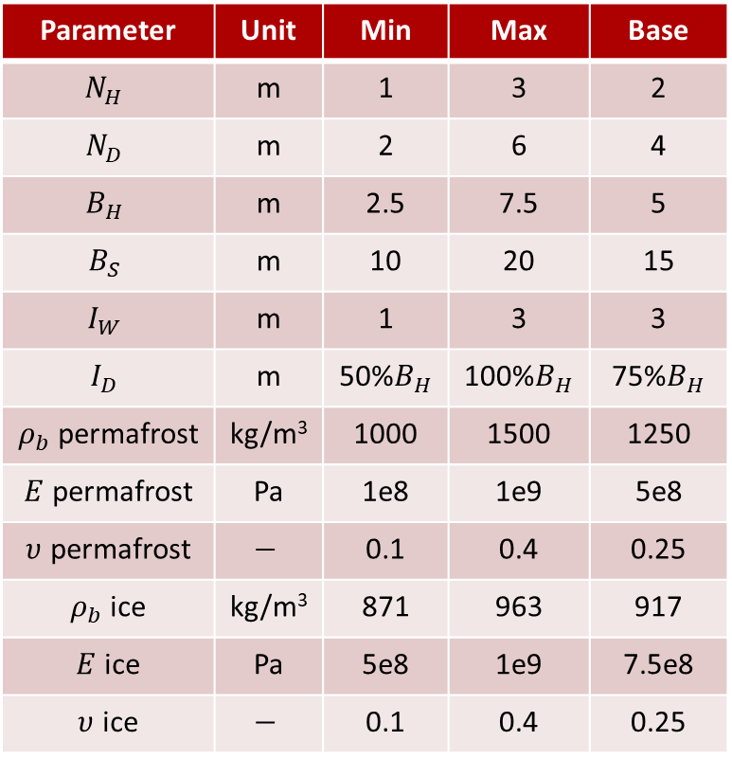


3D elastic mechanics-only sensitivity study
Location $σ_{T_{max}}$
Magnitude $σ_{T_{max}}$
Parameter | Unit | Min | Max | Base
$$N_{H}$$ | m | 1 | 3 | 2
$$N_{D}$$ | m | 2 | 6 | 4
$$B_{H}$$ | m | 2.5 | 7.5 | 5
$$B_{S}$$ | m | 10 | 20 | 15
$$I_{W}$$ | m | 1 | 3 | 3
$$I_{D}$$ | m | 50%$B_{H}$ | 100%$B_{H}$ | 75%$B_{H}$
$ρ_{b}$ permafrost | kg/m³ | 1000 | 1500 | 1250
$E$ permafrost | Pa | 1e8 | 1e9 | 5e8
$υ$ permafrost | $$−$$ | 0.1 | 0.4 | 0.25
$ρ_{b}$ ice | kg/m³ | 871 | 963 | 917
$E$ ice | Pa | 5e8 | 1e9 | 7.5e8
$υ$ ice | $$−$$ | 0.1 | 0.4 | 0.25
Erosional niche properties: $N_{H}$ & $N_{D}$
Permafrost blocks: $B_{H}$ & $B_{S}$, Ice wedges: $I_{W}$ & $I_{D}$
Niche characteristics exert the largest impact on the location and magnitude of $σ_{T_{max}}$
Variability in material properties influences magnitude of $σ_{T_{max}}$but not its location
Notes:
TODO: double check the following with Jenn & Alejandro.
Q: why are ice properties varied?
Erosion niche = erosional niche depth (ND) ?? Or ND + NH?
Permafrost blocks = permafrost block size (BS) ?? Or is it sum of BS + BH?
Ice wedges = ice wedge thickness (IW) ?? Or is it sum of IW + ID?

Slide 22




3D elastic mechanics-only sensitivity study
Niche dimension affects location and magnitude of simulated max tensile stress ($σ_{T_{max}}$) more than the bluff height, ice wedge polygon size, ice wedge geometry, bulk density and Poisson’s ratio
50x exaggeration
Figures plot tensile stress. Lower bound for failure: 100 kPa (from lab measurements).
Taller and narrower erosional niches promote smaller failure masses compared to those with shorter and deeper niches. Orange/green shading highlights potential failure areas (left figure).
As niche advances into the block, an overhanging section in the block acts as cantilever (right figure).
Highest tensile stresses develop on top surface where cantilever meets rest of block (right figure).
Notes:
Lower bound for tensile stress from lab measurements: 100 kPa

Slide 23




3D elastic mechanics-only sensitivity study
Observations have shown that failure can occur along tension cracks in ice wedge polygon centers
Additional sensitivity study: introduce vertical fractures having fracture depth $F_{D}$ from 0 to 25% $B_{H}$
Left figure: highest $F_{D}$ produces ~40% more displacement than lowest $F_{D}$, suggesting that the presence of a tension crack prior to failure can induce localized displacement
Takeaway: even relatively shallow vertical cracks can concentrate strain within ice-bonded permafrost bluffs.

Slide 24


Thermo-mechanical coupling: 2.5D slice
Computational domain is 2.5D cross-section of archetypal 3D bluff geometry discretized using a uniform hex grid
  Pseudo-realistic problem with realistic oceanic and atmospheric forcing BC data occurring at Drew Point, AK in summer 2018
  Initial temperature field obtained from vertical thermistor string placed into DP1-1 ice core at Drew Point
Ground Temperature (@ 2 cm)
(USGS Ground Station)
Water Height
July 1st
Aug 1st
Sep 1st
Notes:
Q: how was the model calibrated? By hand?
From Jenn: We calibrated the model by choosing parameter values for the damage variable (E weakening factor described above) and the residual elastic modulus that goes into the material model fit for elastic modulus. The E weakening factor controls niche growth and the residual elastic modulus controls the thermal denudation rate. We used the sediment mixture model to determine the freezing curves and the thermal parameters like conductivity, density, and specific heat capacity. Sediment mixtures were not varied (the values came from the field work core samples). We used the vertical thermistor data to give us an idea of the niche geometry and timing of niche growth, and the camera data to give us plausible thermal denudation rates and the date/time of the block collapse. We call the model “calibrated” if the denudation, niche growth and day/time of collapse match what was observed.

Slide 25




2.5D slice thermo-mechanical sensitivity study
$E$ weakening factor and redidual $E$ parameters hand-calibrated through sensitivity studies s.t. niche growth and day/time of collapse match observations
Too slow
Residual Elastic Modulus: lowest value the elastic modulus, $E = f($ice saturation, porosity$)$, can take
Increasing value $→$ less deformation/unit stress
Decreasing value $→$ more deformation/unit stress $→$ material more likely to fail in strain
Plays strong role in rate of denudation
$E$ Weakening Factor: factor by which the residual elastic modulus is divided at locations where the ocean is in contact with the bluff
Reflects localized adjustment in material properties from material dissolution due to ocean-bluff contact
Increasing value $→$ more deformation/unit stress $→$ material more likely to fail in strain
Plays strong role in niche formation
Too fast
Good fit in this range

Slide 26





Thermo-mechanical coupling: 2.5D slice
Bluff profiles over simulation time:
Aug 31
July 30
Aug 15
Aug 29
July 15
Block
Collapse!
Ground Temperature (@ 2 cm)
(USGS Ground Station)
Water Height
July 1st
Aug 1st
Sep 1st

Slide 27


Thermo-mechanical coupling: 2.5D slice
Calibrated ACE model capable of simulating Sept. 1, 2018 block collapse event observed at Drew Point, AK!
Notes:
Q: why are we still doing calibration? What is wrong here?
From Jenn: The thing we are not matching very well is the temperature evolution in the bluff (which we know what it was from the vertical thermistor data). The thermistor data shows a temperature evolution that is more consistent with an ice-filled hole that might even have some water convecting in it (based on the estimates of the thermal diffusivity backed out from the data). The temperature in the undisturbed permafrost would occur much slower. The model temperatures are warming in response to the summer air temperatures much slower than the thermistor data shows.
Elyce is re-running the parameter sensitivity study for the E weakening factor and the residual elastic modulus.

Slide 28









Thermo-mechanical coupling: 2.5D slice
Block Collapse
Timelapse
Temperature (°C) Time-lapse Camera
Sept 1st
Niche development observed in thermistor data.
Erosion at Drew Point (July/Aug 2018)
01-Jul
15-Jul
29-Jul
12-Aug
26-Aug
Field Data
Used for
Calibration
thermal
denudation
Block Collapse at
Ice Wedge Surface
bluff collapse on Sept 1st
0 1 2 3 4 5 6 7
Bluff Top Erosion (m)

Slide 29
Thermo-mechanical coupling: 2.5D slice
Block Collapse
Timelapse
Temperature (°C) Time-lapse Camera
Sept 1st
Failure in strain with ice thaw (softening)
Failure in tension
(stress)
Failure in strain with damage
Thaw-dominant
erosion
Niche development observed in thermistor data.
Geometry controls
bending moment
Erosion at Drew Point (July/Aug 2018)
01-Jul
15-Jul
29-Jul
12-Aug
26-Aug
Field Data
Used for
Calibration
Ocean-dominant
erosion
thermal
denudation
Block Collapse at
Ice Wedge Surface
bluff collapse on Sept 1st
0 1 2 3 4 5 6 7
Bluff Top Erosion (m)
29

Slide 30

Summary
We have developed a thermo-mechanical coupled FEM model, ACE, that can simulate transient niche development and permafrost erosion within Albany-LCM.
The model was calibrated using data from a series of experiments on frozen soil samples from Drew Point, Alaska that were performed at Sandia’s Geomechanics Laboratory, as well as observational data collected at the same location.
The model incorporates boundary conditions from the WW3+SWAN+Delft3D wave models and observational data from field campaigns at Drew Point, Alaska.
Sensitivity studies can provide insight into which parameters are most important to permafrost demise, and assist with model calibration.
30m
30m
5m
z
x
y

Slide 31





Current and future work
  Interface project: upscale ACE terrestrial model to meso/macro scales for integration into E3SM
    Upscaling will be performed from “catalog” of 6-7 ACE runs for different terrestrial configurations/locations in northern Alaska
Micro-scale (ACE) model
10s of m, storm duration
Meso-scale model
10s of km, monthly duration
Macro-scale model
100s of km, annual+ duration
  Arctic Critical Infrastructure (ACI) project: aims to develop a computational model capable of analyzing various permafrost- infrastructure scenarios, failure modes, and risk- mitigation strategies
    UQ is critical to this project/problem!
    Initial exemplar: Paulatuk airstrip in northern Canada (right).

Slide 32
References
Drew Point calibration/validation paper in preparation!
[1] J. Frederick, M. Thomas, D. Bull, C. Jones, J. Roberts. “The Arctic Coastal Erosion Problem”. Sandia National Laboratories Report, SAND2016-9762, 2016.
[2] A. Gibbs, B. Richmond. “National assessment of shoreline change – historical shoreline change along the north coast of Alaska, U.S.-Canadian border to Icy Cape”. U.S. Geological Survey Open-File Report, 2015-1048, 2015.
[3] P. Martin et al. “Wildlife response to environmental Arctic change: predicting future habitats of Arctic Alaska”. Report to WildREACH: Predicting Future Habitats of Arctic Alaska Workshop, Farbanks, Alaska, 2008.
[4] J. Brown and O. Ferrians and J. Heginbottom, E. Melnikov. “Circum-Arctic map of permafrost and ground conditions. Boulder, CO: National Snow and Ice Data Center, Digital Media, 1998.
[5] H. Lantuit, W. Pollard. Fifty years of coastal erosion and retrogressive thaw slump activity on Herschel Island, southern Beaufort Sea, Yukon Territory, Canada. Geomorphology, 95, 84-102, 2008.
[6] T. Ravens, B. Jones, J. Zhang, C. Arp, J. Schmutz. “Process-based coastal erosion modeling for Drew Point, North Slope, Alaska”. Journal of Waterway, Port, Coastal, and Ocean Engineering, 138, 2, 122-130, 2012.
[7] C. Koven, J. Riley, A. Stern. “Analysis of permafrost thermal dynamics and response to climate change in the CMPI5 Earth system models”. J Climate, 26, 1877-2900, 2009.
[8] M. Thomas, A. Mota, B. Jones, C. Choens, J. Frederick, D. Bull. “Bluff geometry and material properties influence stress rates relevant to coastal permafrost block failure”. Frontiers in Earth Science 8, 2020.
[9] J. Frederick, A. Mota, D. Bull, I. Tezaur. “Thermo-chemo-mechanical coupling for Arctic Coastal Erosion”, J. Comput. Appl. Math. 397 113533, 2021.
[10] D. Bull, C. Flanary, C. Jones, J. Frederick, A. Mota, I. Tezaur, J. Kasper, E. Brown, B. Jones, M. Jones, E. Bristol, C. Choens, C. Connoly, J. McClelland. "Arctic Coastal Erosion: Modeling and Experimentation". Sandia National Laboratories report, SAND2020-10223, 2020.

