Slide 1

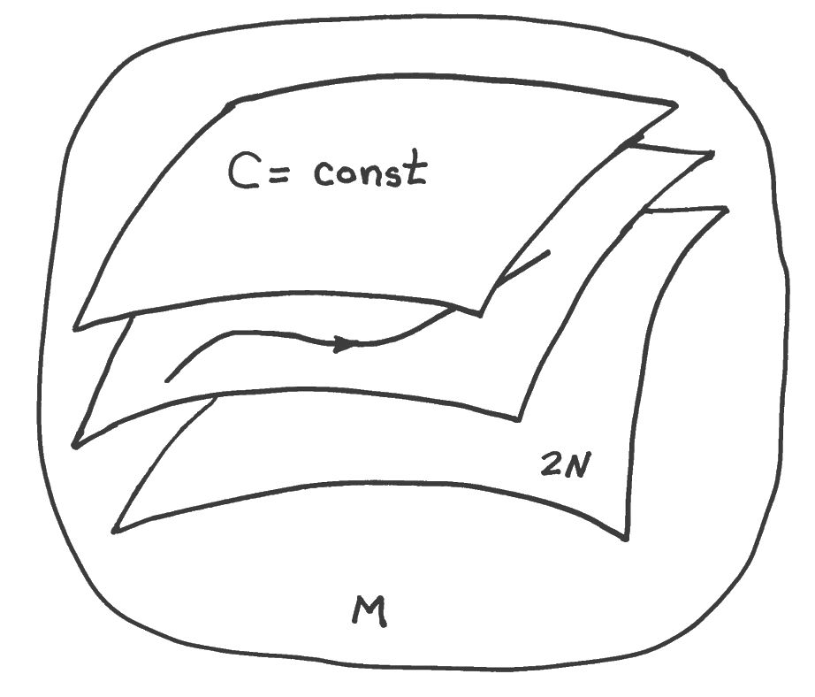
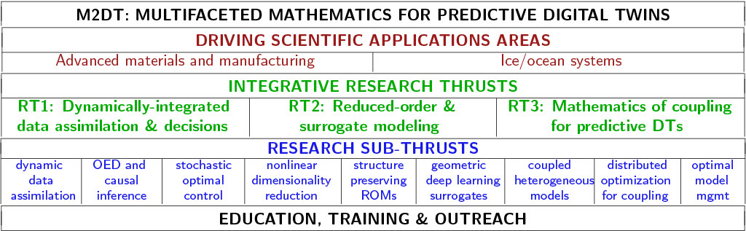
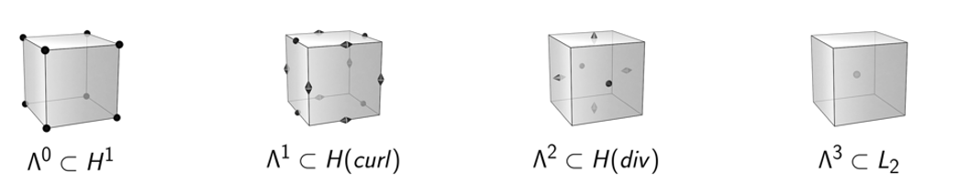
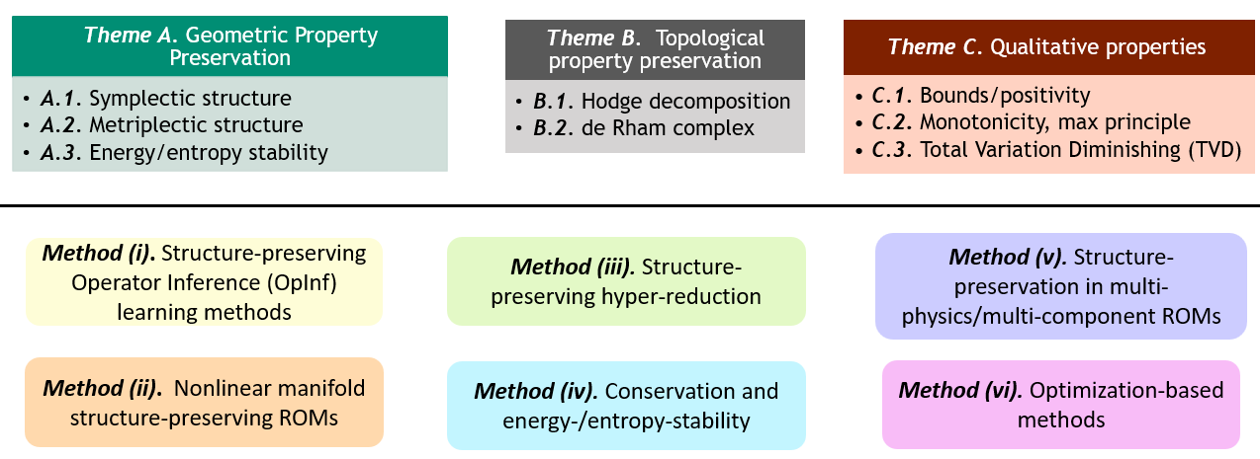
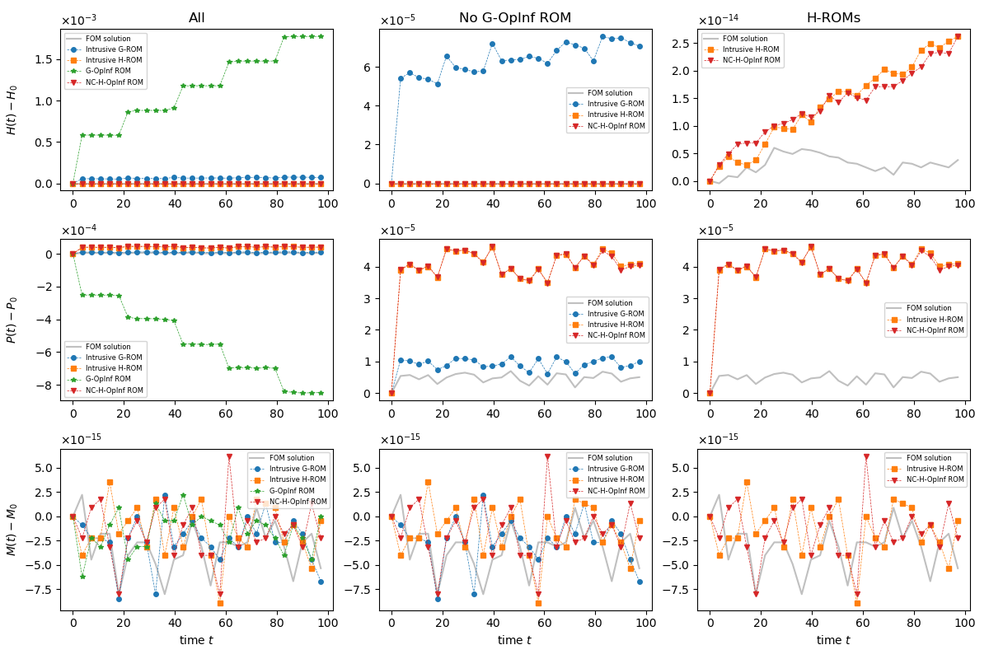
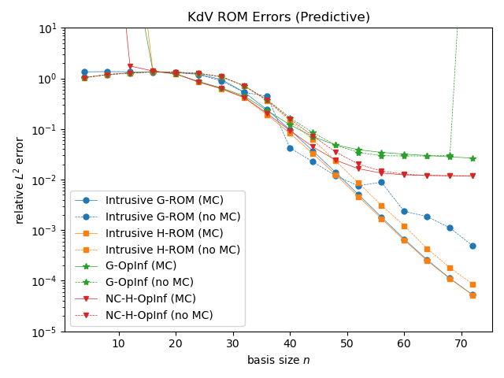
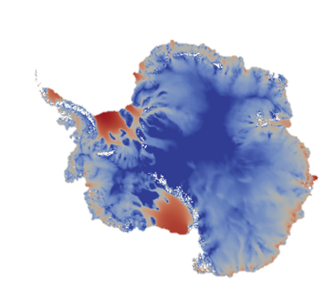
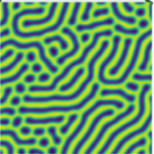
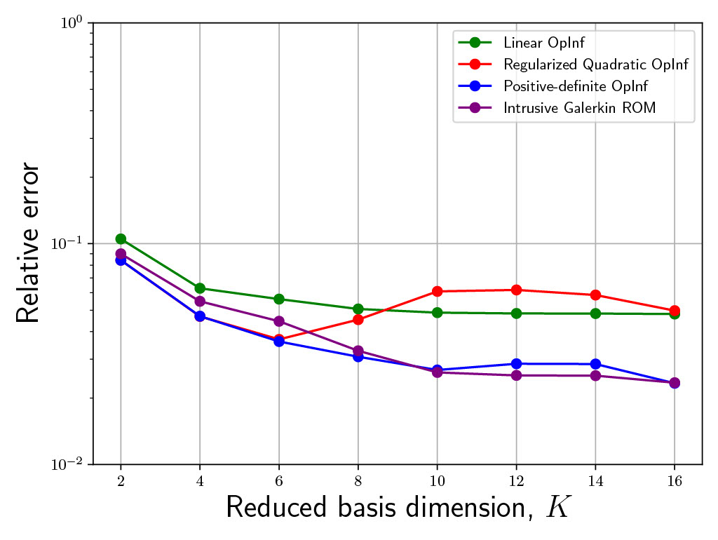
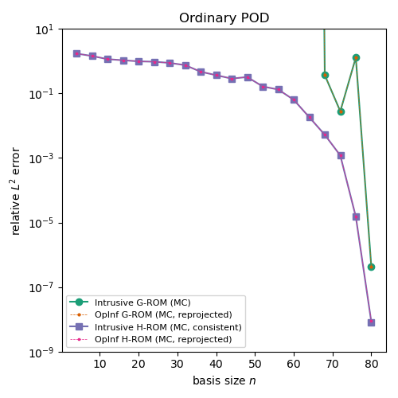
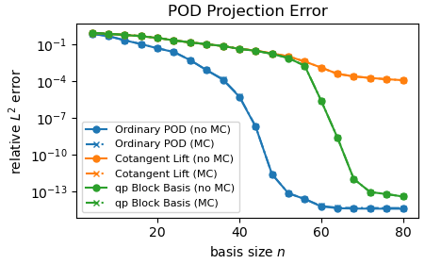


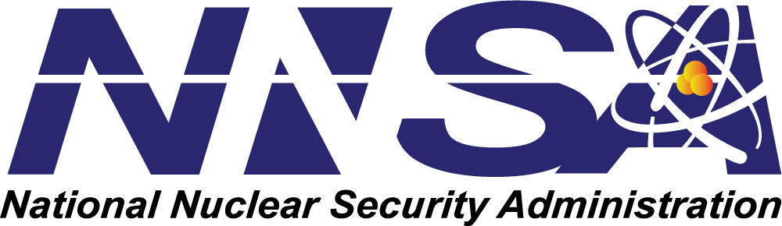
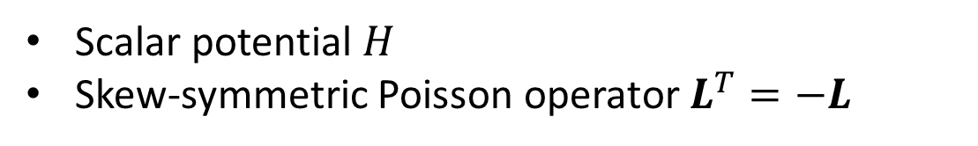



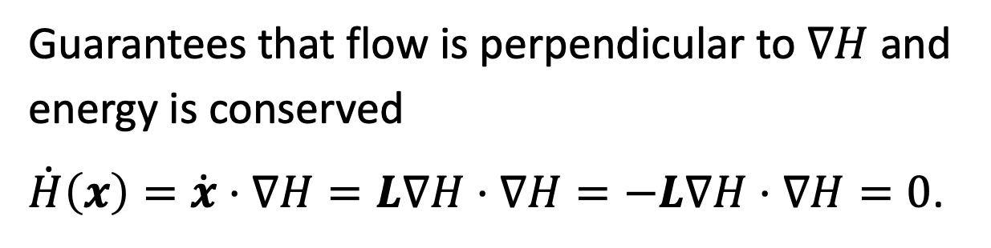







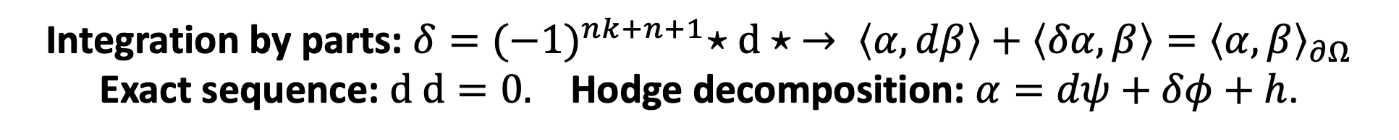

$$\int{ℳ^{2}dt}$$
M2dt: Multifaceted Mathematics for Predictive Digital Twins
Structure-Preserving Model Order Reduction (SP-MOR)
I. Tezaur¹, P. Bochev¹, P. Kuberry¹, A. Gruber¹, C. Eldred¹, E. Parish¹, P. Blonigan¹
Motivation and Role in M2dt
Geometric Property Preservation: Hamiltonian SP-MOR
Ongoing and Future Work
In order to be reliable predictive tools within digital twin workflows, reduced order models (ROMs) & surrogates must preserve key properties of underlying PDEs
Hamiltonian system: $\dot{x}=\left\{x, H(x)\right\}=L\left(x\right)∇H\left(x\right)$
Drawing courtesy of P. J. Morrison.
Topological Property Preservation
ROMs in general do NOT automatically inherit these properties!
Scalar potential $H$
Skew-symmetric Poisson operator $L^{T}=−L$
Finite Element Exterior Calculus (= Single deRham Complex)
Objective (under RT2.2 of M2dt): develop new property-preserving MOR methods to mirror the properties of established compatible discretization methods for FOMs
Guarantees that flow is perpendicular to $∇H$ and energy is conserved
$\dot{H}\left(x\right)=\dot{x}⋅∇H=L∇H⋅∇H=−L∇H⋅∇H=0$.
Casimirs $C$ satisfying $L∇C=0$ also conserved
Integration by parts: $δ={(−1)}^{nk+n+1}⋆d⋆ → \left\langle α, dβ\right\rangle +\left\langle δα,β\right\rangle ={\left\langle α,β\right\rangle }_{∂Ω}$
Exact sequence: $d d=0.$ Hodge decomposition: $α=dψ+δφ+h$.
3 research themes are pursued using the following 6 methods and their combination:
Mass, momentum, etc.
Examples: Incompressible Euler, Maxwell, shallow water, Monge-Ampere, sine-Gordon, nonlinear Schrodinger, …
$$Λ_{h}^{0}⊂H^{1}$$
$$Λ_{h}^{1}⊂H(curl)$$
$$Λ_{h}^{2}⊂H(div)$$
$$Λ_{h}^{3}⊂L_{2}$$
Question: can we design a ROM which respects this structure?
The existence of a discrete Hodge deRham (HdR) complex is essential for constructing topological structure-preserving FOM discretizations [7-8].
Canonical and Noncanonical Hamiltonian Operator Inference
Non-intrusive method for learning Hamiltonian ROMs
  Stable by construction
  Converge to intrusive ROMs in the limit of infinite data
Question: can we design ROMs that preserve a discrete HdR complex?
For snapshots $X≈UΣV^{T}$ and $\hat{M}=U^{T}M$, solve:
HdR FOM (General Theory)
HdR ROM Idea
Geometric Property Preservation: Energy-Stable MOR
Learning Poisson structure $\hat{L}$ is noncanonical inference
  Produces conservative ROM with known quantity $H$ as Hamiltonian
Energy-stable dynamical system:
“Positive-definite” velocity,
Building block of many physical systems
  Fluid flows, solid dynamics, climate
Learning $A=∇H$ is canonical inference
  Produces conservative ROM with known Poisson structure $L$
Idea: define ROM projection operators ${\hat{π}}^{k}:Λ_{h}^{k}→$ ${\hat{Λ}}_{h}^{k}$ and ROM spaces ${\hat{Λ}}^{k}⊂Λ^{k}$such that this diagram commutes: $d{\hat{π}}^{k}={\hat{π}}^{k+1}d$
This will give a ROM with the same properties as the FOM, e.g., annihilation, integration by parts, Hodge decomposition/cohomology
Often we are given ${\hat{π}}^{k}$and ${\hat{Λ}}^{k}$, e.g., from Proper Orthogonal Decomposition/Galerkin projection, so we just need to find commuting ${\hat{π}}^{k+1}$ and corresponding $Λ^{k+1}$
Traditional MOR approaches are NOT automatically energy-stable [1].
Unlike other Hamiltonian SP-MOR methods, e.g., [5], our approach [6] can handle canonical and non-canonical Hamiltonian systems.
Bounded commuting projection operator: $π^{k}:Λ^{k}→Λ_{h}^{k}$satisfies d$π^{k}=$ $π^{k+1}d$
Fundamental object is the inner product $\left\langle ∙,∙\right\rangle ,$which induces the Hodge star $⋆$ and the codifferential $δ={(−1)}^{nk+n+1}⋆d⋆$
Main examples are compatible Galerkin methods [7-8]: finite element exterior calculus (FEEC), mimetic Galerkin differences (MGD), compatible isogeometric methods; mimetic finite differences (MFD)
Positive-definite operator inference (OpInf)
Non-intrusive method for learning “positive-definite” operators
  Extension of classical non-intrusive OpInf [2]
  Learns “positive-definite” operators to build reduced-models endowed with energy stability
  Neural network formulation naturally handles parametric variability and non-polynomial non-linearities
  Relies only on solution snapshots
Example: Korteweg-de Vries (KdV) equation, $x_{t}=αxx_{s}+ρx_{s}+γx_{sss}$
We consider the non-canonical form of the KdV equation, which is bi-Hamiltonian
Technical details: learn a ROM of the form
Other Planned Research Directions
Key idea: construct $−\hat{A}$ to be positive definite by parametrizing it with a skew-symmetric and a symmetric positive definite (SPD) matrix
Entropy-stable hyper-reduction for MOR of hyperbolic systems
Quadratic Hamiltonian SP-ROMs
Development of efficient SP-ROMs for metriplectic systems and systems with dissipation
Optimization-based property (e.g., bounds, positivity, monotonicity, maximum principle, total variation diminishing, etc.) preservation for ROMs
Extensions of SP-MOR methods to multi-physics problems
Applications of methods to M2dt exemplar problems (ice sheet-ocean interaction, self-assembling block copolymers) and within OED workflows
Skew-symmetric
SPD
Resulting ROMs are provably stable since
Predicts correct dynamics well outside of training region. Conserves $H, C$ by construction.
Learning approach: parameterize the operators with neural networks [3-4]
Petrov-Galerkin Hamiltonian OpInf for Canonical Systems
State-of-the-art Hamiltonian ROMs require more than just Galerkin projection
  Usually Galerkin projection + (formal) least-squares solve
  Additional projection can destroy accuracy. Can we fix this?
Potential Impact
This work is pioneering new property-preserving nonlinear dimension reduction methods that will support new classes of compatible ROMs mirroring the properties of established compatible discretization methods for FOMs
  Gradients are easily computed via back-propagation in modern ML codes
  State-of-the-art training approaches handle over-parameterization
  Parametrized dynamical systems are handled by adding parameters to the network inputs
Canonical systems imply $L=J$ is full rank, so use $JU$ as a test basis! If $\tilde{x}=U\hat{x}$,
$\dot{\tilde{x}}=J∇\hat{H}(\tilde{x})$ implies ${\hat{J}}^{T}\dot{\hat{x}}=U^{T}J^{T}U\hat{x}=U^{T}J^{T}J∇H\left(U\hat{x}\right)=∇\hat{H}(\hat{x})$.
The three different types of structures are relevant to numerous problems in science and engineering, including the M2dt exemplar problems
    Geometric structure: Hamiltonian, metriplectic, energy-/entropy-stability, etc.
    Topological structure: HdR complex, cohomology, etc.
    Qualitative properties: maximum principle, monotonicity, positivity, etc.
Example: Shallow ice approximation (future state prediction)
Provably Hamiltonian: energy is conserved.
  Removes the need for an extra column-space projection ${UU}^{T}$
  Amenable to non-intrusive OpInf as before. Problem is convex with a global minimum
Spatial discretization
Structure preservation is a pre-requisite for generating stable and accurate reduced order models for predictive digital twins.
Non-polynomial non-linearities
Compare to classic OpInf methods (linear and quadratic)
”Positive-definite” operator
Error is bounded in reproductive case
  First term is projection error similar to Galerkin ROM
  Second term is “deviation from symplecticity” error
Linear OpInf ROMs not expressive enough
Quadratic OpInf ROMs go unstable w/o significant regularization
Linear and Quadratic OpInf ROMs have noticeable artifacts
References
[1] M. Barone, I. Kalashnikova, D. Segalman, H. Thornquist. Stable Galerkin reduced-order models for linearize compressible flow. J. Comput. Phys. 288 1932-1946, 2009.
[2] B. Peherstorfer, K. Willcox. Data-driven operator inference for non-intrusive projection-based model reduction. CMAME 306, 196-215, 2016.
[3] K. Xu, D. Huang, E. Darve. Learning constitutive relations using symmetric positive definite neural networks, ArXiv:2004.00265, 2020.
[4] E. Parish, P. Lyndsay, T. Shelton, J. Mersch. Embedded symmetric positive semi-definite machine-learned elements for reduced-order modeling in finite-element simulations with application to threaded fasteners. ArXiv:2307.05434, 2023.
[5] H. Sharma, Z. Wang, B. Kramer. Hamiltonian operator inference: Physics-preserving learning of reduced-order models for canonical Hamiltonian systems. Phisica D 431 133122, 2022.
[6] A. Gruber, I. Tezaur. Canonical and non-canonical Hamiltonian operator inference, Comput. Meth. Appl. Numer. Engng. 416, 116334, 2023.
[7] P. Bochev, J. Hyman. Principles of mimetic discretizations of differential operators. In: D. Arnold, P. Bochev, R. Lehoucq, R. Nicolaides, M. Shashkov (eds) Compatible Spatial Discretizations. The IMA Volumes in Mathematics and its Applications, vo. 142, New York, NY, 2006.
[8] J. Kreeft, A. Palha, M. Gerritsma. Mimetic framework on curvilinear quadrilaterals of arbitrary order. arXiv:1111.4304, 2011.
Truth
Positive-definite OpInf
Example: 3D linear elasticity equations
Galerkin projection only is not enough
Petrov-Galerkin ROM errors decay smoothly with increasing basis size
Linear OpInf
Quadratic OpInf
Positive-definite OpInf ROMs are stable and 2-3$×$ more accurate than other ROMs for all basis dimensions!
Sandia National Laboratories is a multimission laboratory managed and operated by National Technology & Engineering Solutions of Sandia, LLC, a wholly owned subsidiary of Honeywell International Inc., for the U.S. Department of Energy’s National Nuclear Security Administration under contract DE-NA0003525.
¹ Sandia National Laboratories.
SAND2023-14990O

