Slide 1
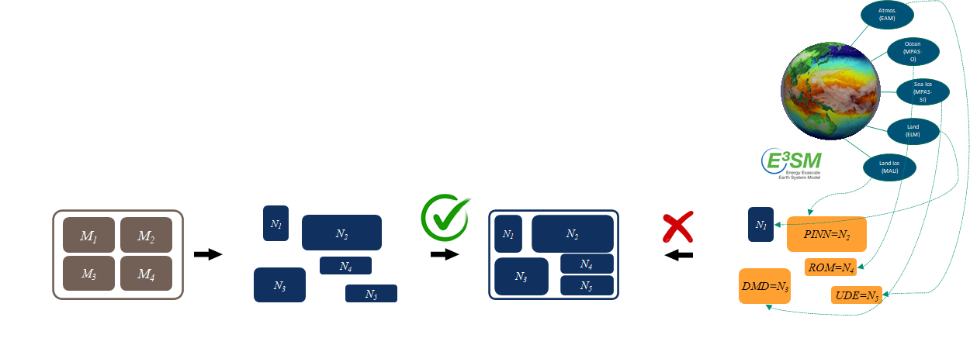
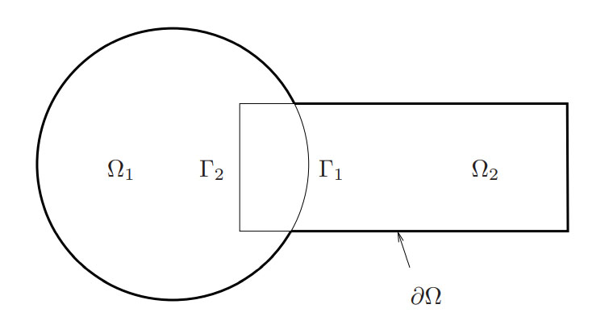
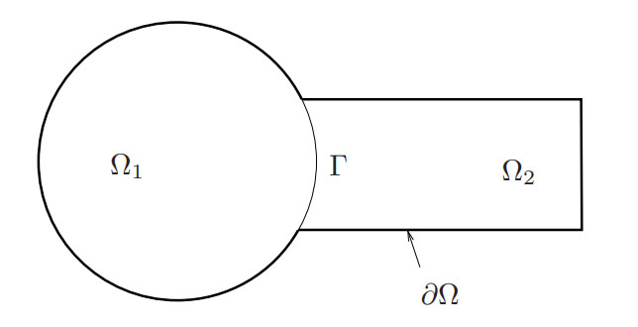
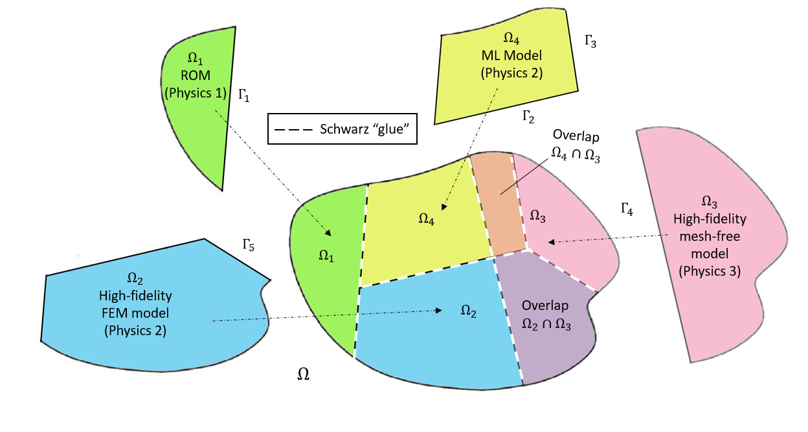
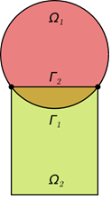
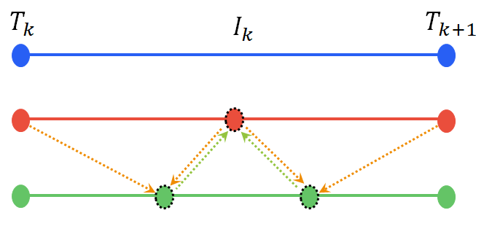
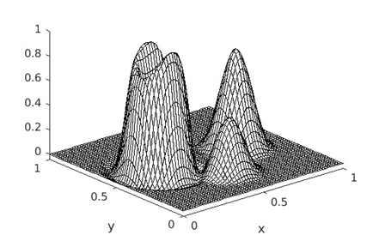
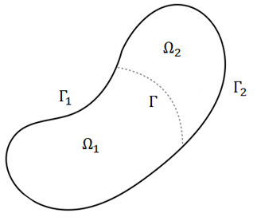
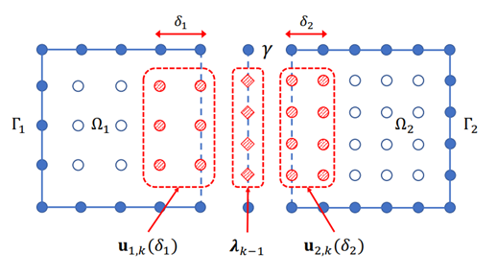
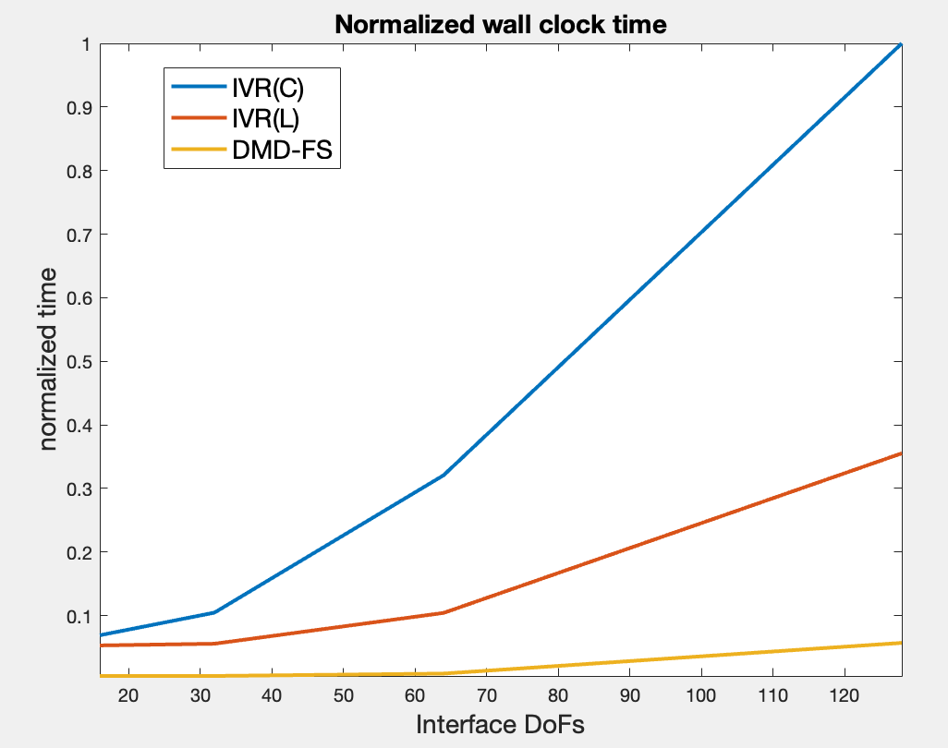
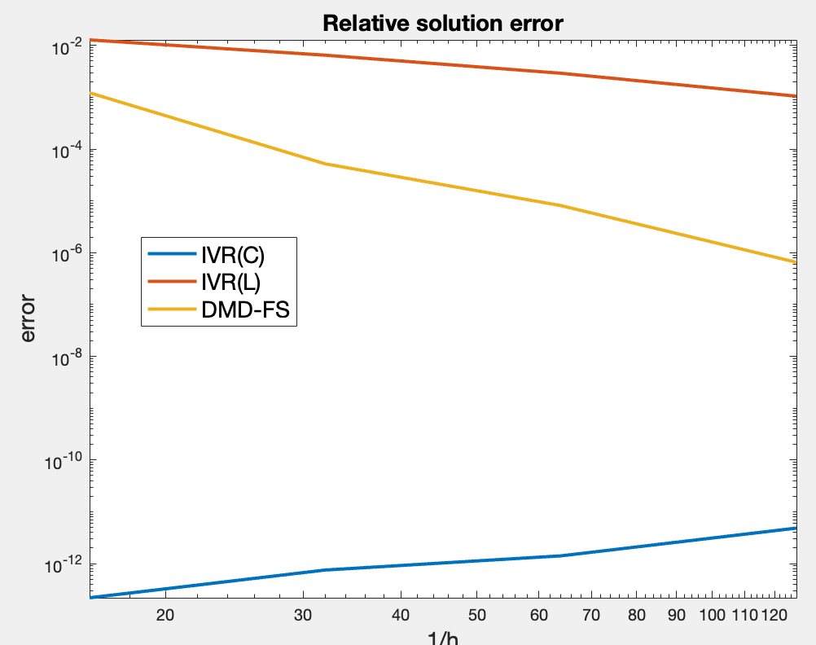
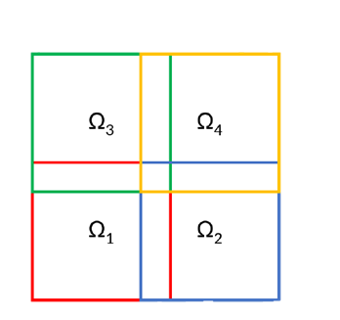
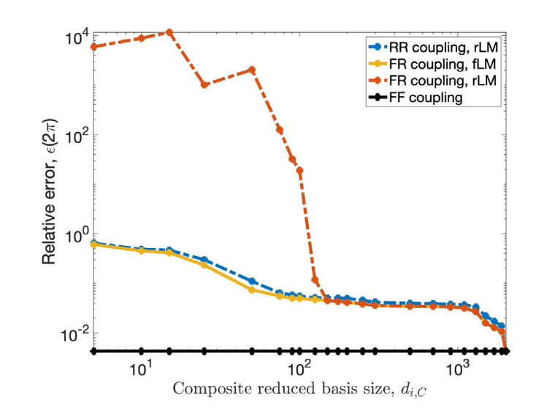
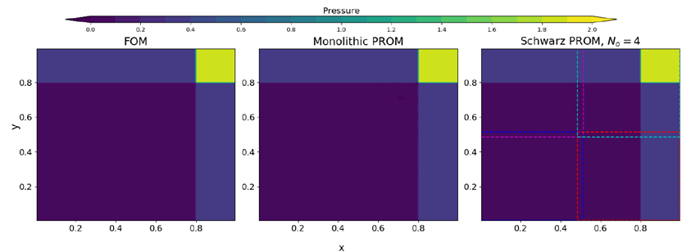
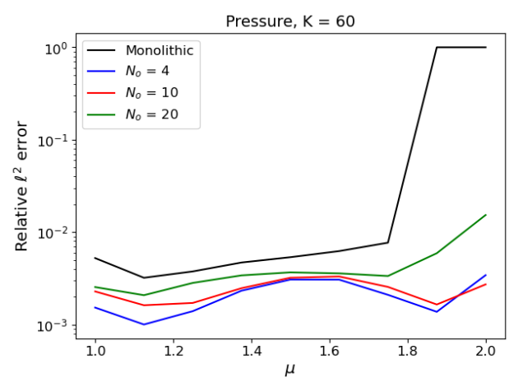
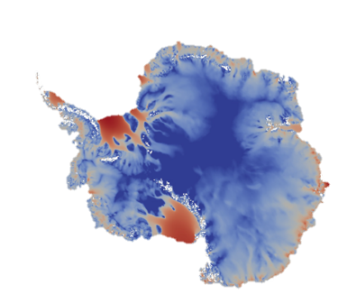
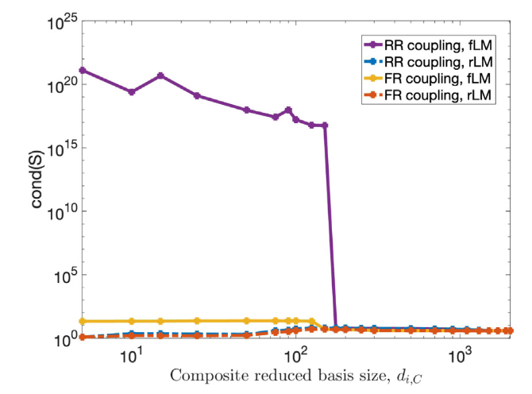
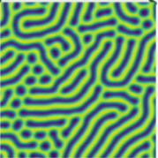
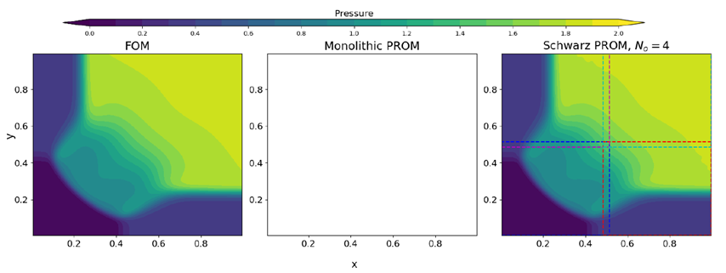
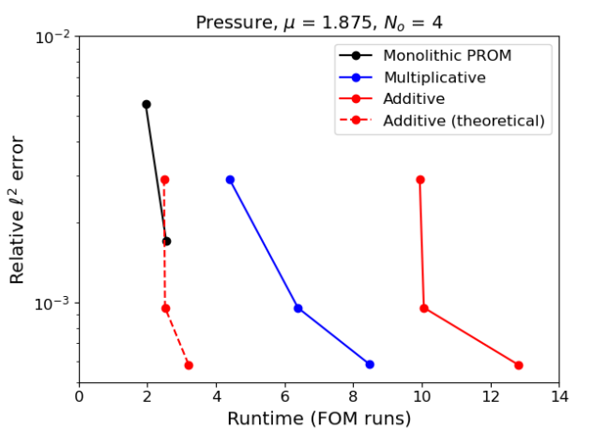
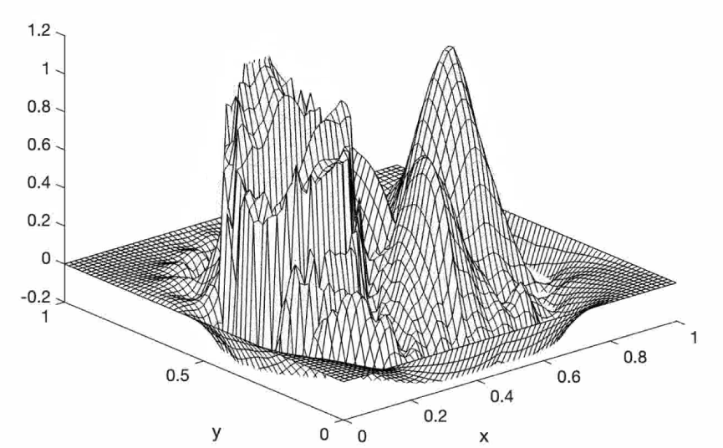
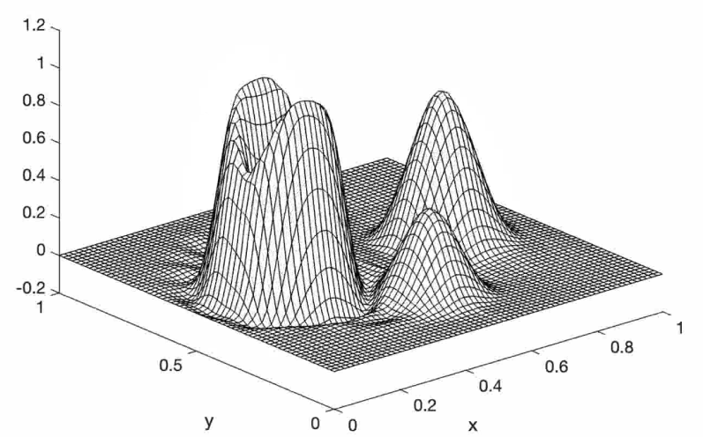
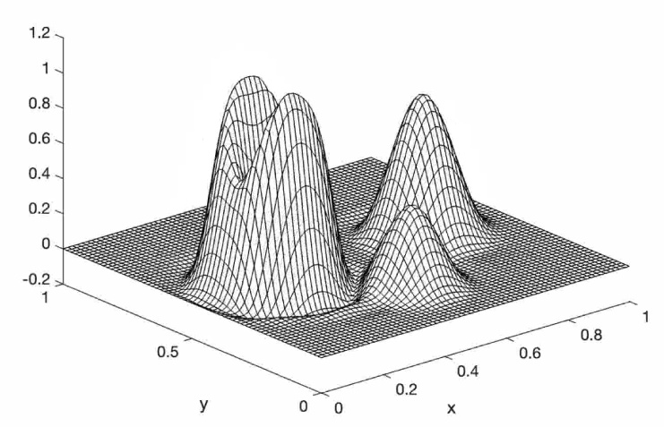
$$\int{ℳ^{2}dt}$$
M2dt: Multifaceted Mathematics for Predictive Digital Twins
Component-Based Coupling of First-Principles and Data-Driven Models
I. Tezaur¹, P. Bochev¹, P. Kuberry¹, C. Wentland¹, J. Barnett^{1,2}, A. de Castro^{1,3}, E. Hawkins^{1,3}, J. Owen¹, E. Huynh^{1,4}
Motivation and Role in M2dt
Alternating Schwarz-Based Coupling
Ongoing and Future Work
The past decades have seen tremendous investment in simulation frameworks for coupled multi-scale and multi-physics problems.
Approach
Other Coupling Approaches
Frameworks rely on established mathematical theories to couple physics components.
Most existing coupling frameworks are based on traditional discretization methods, i.e., full order models (FOMs)
Basic Schwarz Algorithm for Spatial Coupling
Model problem: time-dependent advection-diffusion problem (1)
Compatibility conditions: continuity of states and flux from (2)
Initialize:
Solve PDE by any method on $Ω_{1}$ with initial guess for transmission BCs on $Γ_{1}$(or $Γ$).
Iterate until convergence:
Solve PDE by any method on $Ω_{2}$ with transmission BCs on $Γ_{2}$ (or $Γ$) based on values just obtained for $Ω_{1}$.
Solve PDE by any method on $Ω_{1}$ with transmission BCs on $Γ_{1}$ (or $Γ$) based on values just obtained for $Ω_{2}$.
Overlapping Schwarz: convergent with all-Dirichlet transmission boundary conditions (BCs) if $Ω_{1}⋂{ Ω}_{2}≠∅$.
Optimization-Based Coupling (OBC)
Key Idea: introduce control as the shared Neumann BC on the interface $Γ$(Figure 1) satisfying the continuity of flux, and form a loss function that, when minimized, will enforce the continuity of states.
In each time-step, find $\left(u_{1}^{n},u_{2}^{n},g^{n}\right)∈X_{1}^{n}×X_{2}^{n}×L^{2}(Γ)$ that minimizes
The control $g^{n}$is common to both subdomains, implicitly enforcing continuity of flux
Unfortunately, existing algorithmic and software infrastructures are ill-equipped to handle plug-and-play integration of data-driven models (e.g., projection-based reduced order models or ROMs)!
Non-overlapping Schwarz: convergent with Robin-Robin or alternating Neumann-Dirichlet transmission BCs.
$$J_{δ}\left(u_{1}^{n},u_{2}^{n},g^{n}\right) :=\frac{1}{2}{||u_{1}^{n}−u_{2}^{n}||}_{Γ}^{2}+\frac{1}{2}δ{||g^{n}||}_{Γ}^{2}$$
(6)
Novel Idea: using Schwarz alternating method as a discretization/coupling method for solving multi-scale or multi-physics PDEs [6-8].
subject to
Objective (under RT3.1 of M2dt): discover mathematical principles guiding assembly of standard and data-driven models in stable, accurate and physically consistent ways.
$\frac{1}{Δt}\left(u_{i}^{n}−u_{i}^{n−1},v\right)+\left(σ_{i}\left(u_{i}^{n}\right),∇v\right)=\left(f_{i}^{n},v\right)+{(−1)}^{i}{(g^{n},v)}_{Γ}$, $∀v∈V_{i}, i=1,2$
(7)
Schwarz Algorithm for Dynamics
We relax the constrained optimization problem with a Lagrange multiplier $μ_{i}$
$ℒ\left(u_{1}^{n},u_{2}^{n}{,g}^{n},μ_{1},μ_{2}\right)$ := $J_{δ}\left(u_{1}^{n},u_{2}^{n},g^{n}\right)$+$\sum_{i=1}^{2}{\left[\frac{1}{Δt}\left(u_{i}^{n}−u_{i}^{n−1},μ_{i}\right)+\left(σ_{i}\left(u_{i}^{n}\right),∇μ_{i}\right)=\left(f_{i}^{n},μ_{i}\right)+{(−1)}^{i}{(g^{n},μ_{i})}_{Γ}\right]}$
Controller time stepper
and solve the optimality conditions with gradient descent and a reduced space algorithm
This approach was developed in [12] in the setting of coupled linear elliptic PDEs, extended in [13] to coupled nonlinear parabolic PDEs, and later to fluid-structure interaction in [14]
Time integrator for $Ω_{1}$
Time integrator for $Ω_{2}$
Coupling via Generalized Mortar Methods
Can use different integrators with different time steps within each domain!
Vision: create a “plug-and-play” framework for arbitrary mixing and matching of conventional and data-driven models following a domain decomposition (DD).
Here we further extend this approach to ROM-ROM and ROM-FOM coupling
Accurate results for ROM-ROM coupling when using FEM adjoints (Figure 10)
Linear patch tests pass to the tolerance of the penalty parameter $δ$
Ongoing work investigating alternative snapshot matrices onto which the adjoint equations are projected to enable using fewer modes
Approach
Model problem: time-dependent advection-diffusion problem on $Ω=Ω_{1}∪$ $Ω_{2}$ with $Ω_{1}∩$ $Ω_{2}=∅$
${\dot{c}}_{i}−∇∙F_{i}\left(c_{i}\right)=f_{i}$, in $Ω_{i}×\left[0,T\right], i=1,2$
$c_{i}=g_{i},$ on ${ Γ}_{i}×\left[0,T\right], i=1,2$
$c_{i}\left(x,0\right)=c_{i,0}\left(x\right),$ in $Ω_{i}, i=1,2$
(1)
Key Features of Alternating Schwarz-Based Coupling
Compatibility conditions: on interface $Γ×\left[0,T\right]$ (Figure 1)
Can handle both overlapping or non-overlapping DDs
Can couple arbitrary combinations of ROMs and FOMs
Iterative formulation (less intrusive to implement but can require more CPU time)
Can couple different mesh resolutions and element types
Allows the use of different time-integrators with different time-steps in different subdomains
No interface bases are required in ROM-ROM and ROM-FOM couplings
Requires sequential subdomain solves in multiplicative Schwarz variant
Concurrent subdomain solves possible with additive Schwarz variant
Possesses theoretical convergence properties/guarantees [6-7].
Figure 10. ROM-ROM coupling at final timestep.
Continuity of states: $c_{1}\left(x,t\right)−c_{2}\left(x,t\right)=0$
Continuity of flux: $F_{1}\left(x,t\right)∙$ $n_{Γ }=F_{2}\left(x,t\right)∙$ $n_{Γ }$
$⇒$Imposed weakly using Lagrange multiplier (LM) $λ$
Flux Surrogates
Semi-discrete monolithic coupled formulation: obtained by discretizing weak monolithic formulation using FEM in space.
Note the alternative form of the constraint!
Figure 1. Non-overlapping DD of $Ω=Ω_{1}∪$ $Ω_{2}$.
Key Idea: use data-driven techniques to create efficient surrogates that approximate the dynamics of the interface flux. This eliminates the more expensive Schur complement solves in GMM.
Key Ingredients for Stable POD/Galerkin ROM-ROM and FOM-ROM Coupling
We consider two different surrogates $λ=ℱ\left(y\right)$ for the interface flux dynamics (to replace (4)) using similar states $y$:
DMD surrogate: $y_{k+1}=Ay_{k}$
nODE surrogate: $\frac{dy}{dt}=f(t,y,u;θ)=$feed-forward NN
$\left(\begin{matrix}M_{1} & 0 & G_{1}^{T} \\ 0 & M_{2} & {−G}_{2}^{T} \\ G_{1} & −G_{2} & 0\end{matrix}\right)$ $\left(\begin{matrix}{\dot{c}}_{1} \\ {\dot{c}}_{2} \\ λ\end{matrix}\right)=$ $\left(\begin{matrix}f_{1}−K_{1}c_{1} \\ f_{2}{−K}_{2}c_{2} \\ 0\end{matrix}\right)$
(2)
Calculate “split” reduced bases $Φ_{i,Γ}$ and $Φ_{i,0}$, for interface and interior degrees of freedom (DOFs) via the Proper Orthogonal Decomposition (POD).
Reduce LM space to size $N_{R, Γ}<N_{R, 1Γ}+$ $N_{R, 2Γ}$, where $N_{R, iΓ}$ = # POD modes in $Φ_{i,Γ},$ and approximate $λ≈Φ_{LM}\hat{λ}$ where $Φ_{LM}=Φ_{i,Γ}$ for $i=1,2$, so that $N_{R, Γ}{=N}_{R, iΓ}$.
$M_{i}:$mass matrices, $K_{i}$: stiffness matrices,$G_{i}$: constraint matrices
Numerical Results
Training data consists of both the flux ($λ_{k−1}$) and patches of the states near the interface
DMD or nODE trained to learn the mapping from $y_{k−1} ≔{\left(λ_{k−1},u_{1,k}\left(δ_{1}\right),u_{2,k}\left(δ_{2}\right)\right)}^{T}$to $y_{k}$
Preliminary results indicate that the new DMD approach is more accurate than lumped mass GMM approach and around 20$×$ times cheaper than a consistent mass GMM approach (Figure 11)
Decoupling via Schur complement: equation (2) equivalent to
Model problem: Riemann problem for the 2D unsteady Euler equations
$$\left(\begin{matrix}M_{1} & 0 \\ 0 & M_{2}\end{matrix}\right)\left(\begin{matrix}{\dot{c}}_{1} \\ {\dot{c}}_{2}\end{matrix}\right)=\left(\begin{matrix}f_{1}−K_{1}c_{1}−G_{1}^{T}λ \\ f_{2}−K_{2}c_{2}+G_{2}^{T}λ\end{matrix}\right)$$
(3)
$$\frac{∂}{∂t}\left(\begin{matrix}ρ \\ ρu \\ \begin{aligned}ρv \\ ρE\end{aligned}\end{matrix}\right)+\frac{∂}{∂x}\left(\begin{matrix}ρu \\ ρu^{2}+p \\ \begin{aligned}ρuv \\ \left(E+p\right)u\end{aligned}\end{matrix}\right)+\frac{∂}{∂y}\left(\begin{matrix}ρv \\ ρuv \\ \begin{aligned}ρv^{2}+p \\ \left(E+p\right)v\end{aligned}\end{matrix}\right)=0,$$
$$p=(γ−1)\left(ρE−\frac{1}{2}ρ(u^{2}+v^{2})\right)$$
where ${(G}_{1}M_{1}^{−1}G_{1}^{T}+G_{2}M_{2}^{−1}G_{2}^{T})λ=G_{1}M_{1}^{−1}\left(f_{1}−K_{1}c_{1}\right)−G_{2}M_{2}^{−1}\left(f_{2}−K_{2}c_{2}\right)$
(4)
ROM-ROM coupling with reduced LM space guaranteed to have non-singular dual Schur complement if underlying FOM-FOM coupling satisfies conditions in [1].
Homogeneous Neumann BCs on system boundaries of $Ω×[0,T]=\left(0,1\right)×\left(0,1\right)$ $×[0,0.8].$
FOM discretization: $100×100$Cartesian grid, 1st order finite volume scheme, BDF1 time integration, $Δt=0.005.$
ROM discretization: POD/Least-Squares Petrov-Galerkin (LSPG) projection [9] with no hyper-reduction
Solution has strong gradients/shocks $⇒$ poor linear representation
ROMs evaluated in the predictive regime
Snapshots collected by running monolithic FOM at testing parameters
Coupling specifications:
Four subdomain overlapping DD: $Ω=\bigcup_{i=1}^{4}{Ω_{i}}$ (Figure 5)
Dirichlet BCs on Schwarz boundaries enforced weakly
Fixed parameters: $ρ_{1}=1.5,$ $u_{1}=v_{1}=0,$ $p_{3}=0.029$
Varied parameters: $p_{1}$, initial condition from compatibility relations [10]
$p_{1,train}∈\left[1.0, 1.25, 1.5, 1.75, 2.0\right]$
$p_{1,test}∈\left[1.125, 1.375, 1.625, 1.875\right]$
After solving Schur complement problem (4), the subdomain problems in (3) decouple.
Figure 11. CPU times (left) and relative errors (right) for GMM method with consistent mass (IVR(C)), lumped mass (IVR(L)) and a DMD surrogate (DMD-FS)
Key Features of GMM-Based Coupling
Additional Future Work
Based on a non-overlapping DD (ideal for transmission/multi-physics problems)
Effective for coupling conventional models (FOM) and reduced order models (ROM)
Monolithic formulation (more intrusive to implement but more efficient)
Can couple different mesh resolutions and discretization types
Allows the use of different time-integrators with different time-steps [3,4]
Explicit time-integrators enable concurrent subdomain solves
Possesses theoretical convergence properties/guarantees [1,2]
Development of error indicator-based or reinforcement learning-based algorithm to determine “optimal” DD and ROM/FOM assignment
Development of algorithms for on-the-fly ROM-FOM switching to improve predictive capabilities of the resulting hybrid model
Incorporation of structure preservation into couplings
Development/coupling of “bottom-up” subdomain ROMs that are trained separately
Extension of coupling approaches to DMD and non-intrusive operator inference ROMs
Numerical Results
Figure 5: four subdomain overlapping DD.
Potential Impact
High Peclet advection-diffusion transmission problem (1) on $Ω=\left(0,1\right)×\left(0,1\right)$ with cone, cylinder and smooth hump initial condition, Dirichlet BCs, rotating advection field, run for 1 full rotation (Figure 4)
FOM discretization: finite elements in space ($h=\frac{1}{64}$), Crank-Nicholson in time with ($Δt$ $= 6.734×{10}^{−3}$)
ROM discretization: POD/Galerkin method
ROMs evaluated in predictive regime, with prediction across $κ_{i}$
Snapshots collected by running monolithic FOM at testing parameters
Coupling specifications:
Two subdomain non-overlapping DD with $Ω$ split at $x=\frac{1}{2}$
Dirichlet BCs on system boundaries imposed strongly in ROMs [5]
Training parameters: $κ_{1}=κ_{2}={10}^{−5}$
Testing parameters: $κ_{1}={10}^{−5}$, $κ_{2}={10}^{−4}$
Full LM space has dimension 63
Reduced LM space has dimension $N_{R,iΓ}=\min\left\{\frac{1}{4}N_{R,i0}, 63\right\}$
New coupling methodologies enable the rigorous integration of data-driven models into modeling & simulation toolchains in a “plug-and-play” fashion for both multi- and mono-physics problems, including M2dt exemplars (land ice-ocean interaction, self-assembly of block copolymers)
New DD-based couplings can improve trustworthiness and predictive capabilities of data-driven models by enabling spatial localization of ROMs (via DD) and online integration of high-fidelity information into these models (via FOM coupling).
Figure 2: relative errors as a function of the reduced basis size.
Figure 6: monolithic FOM (left), monolithic ROM (middle) and four subdomain coupled ROM (right) solutions at initial time. ROM solutions have $K=50$modes.
Figure 8: relative $l^{2}$ error in ROM solutions w/ and w/o DD as a function of the basis size $K$.
Blow up!
References
Figure 3: condition #s of (4) as a function of the reduced basis size.
[1] K. Peterson, P. Bochev, P. Kuberry, Explicit synchronous partitioned algorithms for interface problems based on Lagrange multipliers, CMAME, 78 459–482, 2019.
[2] A. de Castro, P. Bochev, P. Kuberry, I. Tezaur. Explicit synchronous partitioned scheme for coupled reduced order models based on composite reduced bases", special issue celebrating Tom Hughes’s 80th birthday Comput. Meth. Appl. Mech. Engng., 2023.
[3] J. Connors, K. Sockwell, A Multirate Discontinuous-Galerkin-in-Time Framework for Interface-Coupled Problems, SIAM J. Numer. Anal., 5 (60), 2373-2404, 2022.
[4] K.C. Sockwell, P. Bochev, K. Peterson, P. Kuberry. Interface Flux Recovery Framework for Constructing Partitioned Heterogeneous Time-Integration Methods, NMPDE, 39(5) 3572-3593, 2023.
[5] M. Gunzburger, J. Peterson, J. Shadid. Reduced-order modeling of time-dependent PDEs with multiple parameters in the boundary data. CMAME 196 1030-1047, 2007.
[6] A. Mota, I. Tezaur, C. Alleman. The Schwarz Alternating Method in Solid Mechanics, CMAME, 319, 19-51, 2017.
[7] A. Mota, I. Tezaur, G. Phlipot. The Schwarz Alternating Method for Dynamic Solid Mechanics, CMAME. 121 (21) (2022) 5036-5071.
[8] J. Barnett, I. Tezaur, A. Mota. The Schwarz alternating method for the seamless coupling of nonlinear reduced order models and full order models, in CSRI Proceedings 2022, S.K. Seritan and J.D. Smith, eds., Technical Report SAND2022-10280R, Sandia National Laboratories, 2022, pp. 31-55.
[9] K. Carlberg, C. Farhat, J. Cortial, D. Amsallem. The GNAT method for nonlinear model reduction: Effective implementation and application to computational fluid dynamics and turbulent flows, JCP, 242, 623-647, 2013.
[10] C. Schulz-Rinne. Classification of the Riemann Problem for Two-Dimensional Gas Dynamics, SINUM 24 (1), 1993.
[11] F. Rizzi, P. Blonigan, E. Parish, K. Carlberg. Pressio: Enabling Projection-based Model Reduction for Large-scale Nonlinear Dynamical Systems, arXiv:2003.07798v3, 2021.
[12] M. Gunzburger, J. Peterson, H. Kwon, An Optimization Based Domain Decomposition Method for Partial Differential Equations, CAMWA, 37, 77-93. 1999.
[13] M. Gunzburger, H.K. Lee, An Optimization-Based Domain Decomposition Method for the Navier-Stokes Equations, SINUM, 37(5), 1455-1480, 2000.
[14] P. Kuberry, H. Lee, A Decoupling Algorithm for Fluid-Structure Interaction Problems Based on Optimization, CMAME, 267, 594-605, 2013.
Main takeaway: provably-stable ROM-ROM GMM method delivers artifact-free solution, maintains Schur complement condition # of O(1) regardless of basis size, and converges with basis refinement!
Figure 7: monolithic FOM (left), monolithic ROM (middle) and four subdomain coupled ROM (right) solutions at final time. ROM solutions have $K=50$modes.
Figure 9: Pareto plots for various ROMs and alternating Schwarz-based couplings.
Main takeaways: DD and Schwarz coupling of ROMs stabilizes the solution! Coupled ROM has comparable CPU time to monolithic ROM with additive Schwarz. Hyper-reduction is needed to achieve true cost savings (WIP).
Suite of test cases (e.g., shallow water equations, compressible flow equations, etc.) available via Pressio demo-apps [11] open-source implementation*!
Figure 4: coupled solutions to the targeted transmission problem at the final time. Naïve ROM-ROM coupling (left), provably-stable ROM-ROM coupling (middle) and FOM-FOM coupling (left).
* The Pressio demo-apps library is available on github: https://github.com/Pressio/pressio-demoapps.
Sandia National Laboratories is a multimission laboratory managed and operated by National Technology & Engineering Solutions of Sandia, LLC, a wholly owned subsidiary of Honeywell International Inc., for the U.S. Department of Energy’s National Nuclear Security Administration under contract DE-NA0003525.
¹ Sandia National Laboratories. ² Stanford University. ³ Clemson University. ⁴University of Arizona.
SAND2024-15038O
Notes:
\newcommand{\half}{\frac{1}{2}}
\newcommand{\bu}{\bar{u}}
\newcommand{\uhi}{u^h_i}
\newcommand{\muhi}{\mu^h_i}
\newcommand{\R}{\mathbb{R}}
\newcommand{\Gz}{\Gamma_0}
\newcommand{\bmu}{\bar{\mu}}
\newcommand{\hu}{\hat{u}}
\newcommand{\dt}{\Delta t}
%&\min \half \|u^n_1-u^n_2\|_{\Gz}^2 + \half \delta \|g^n\|_{\Gz}^2\\
%&(u^n_1,u^n_2,g^n)\in X^n_1\times X^n_2\times L^2(\Gz)\;\; s.t.\\
%&\frac{1}{\dt}(u^n_i-u^{n-1}_i,v)+(\sigma_i(u^n_i),\nabla v)=(f_i^n,v)
%+(-1)^{i}(g^n,v)_{\Gz} \hspace{5pt}\forall v\in V_i.
% \mathcal{L}(u^n_1,u^n_2,g,^n\mu_1,\mu_2):=J_\delta (u^n_1,u^n_2,g^n)+ \sum_{i=1}^2[\frac{1}{\dt}(u^n_i-u^{n-1}_i,\mu_i)+(\sigma_i(u_i),\nabla \mu_i)\\
% -(f_i^n,\mu_i)+(-1)^{i+1}(g^n,\mu_i)_{\Gz}]
\mathbf{y}_{i-1} := \begin{bmatrix}\bm{\lambda}_{i-1}\\ \mathbf{u}_{1,i}\\\mathbf{u}_{2,i}\end{bmatrix}\,,\quad
i=1,2,\ldots \,.

