Slide 1
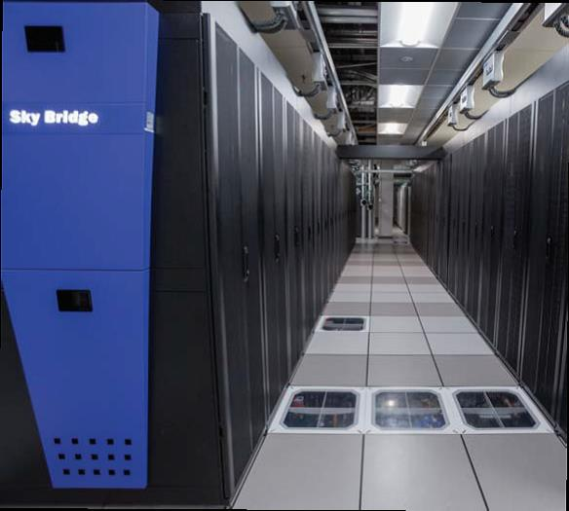
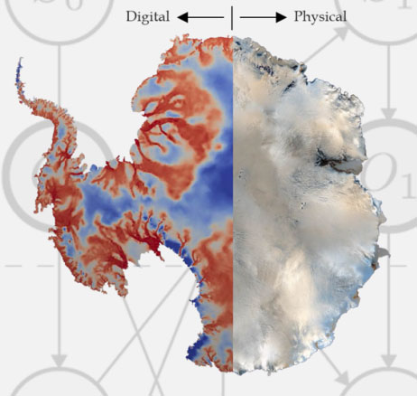
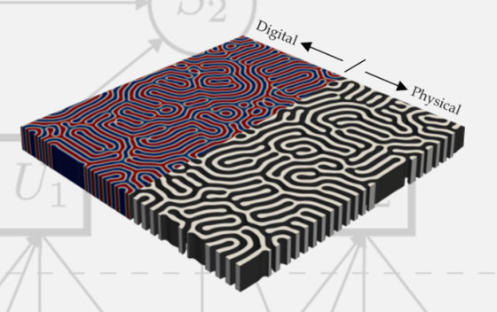
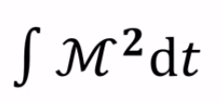
SNL progress highlights: data-driven couplings (RT3.1) and preservation of geometric structure in ROM (RT2.2)
Speakers: Irina Tezaur and Anthony Gruber
Sandia National Laboratories
M2dt Project All-Hands Meeting
Wednesday, October 25, 2023
SAND2023-10975PE

Slide 2
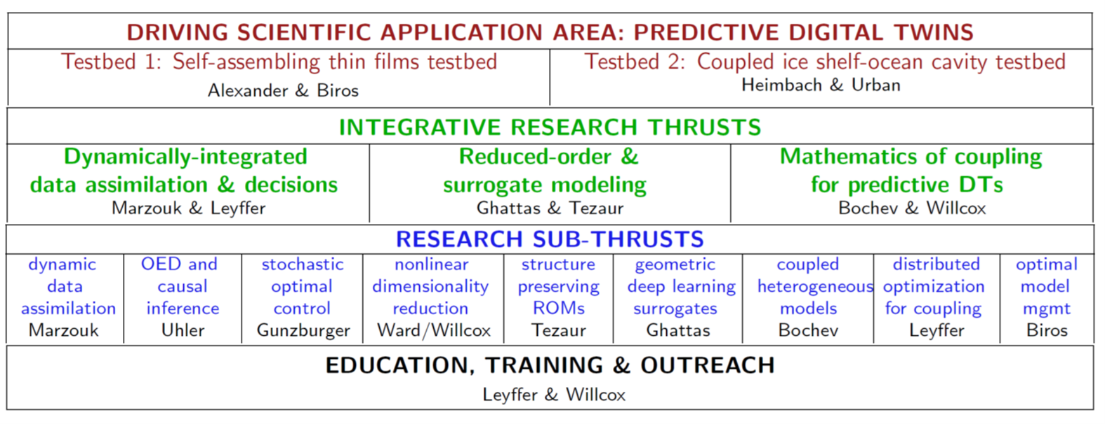
Research thrust organization
ROM = reduced order model
Part 2 of talk (RT2.2)
Anthony Gruber
Part 1 of talk (RT3.1)
Irina Tezaur

Slide 3


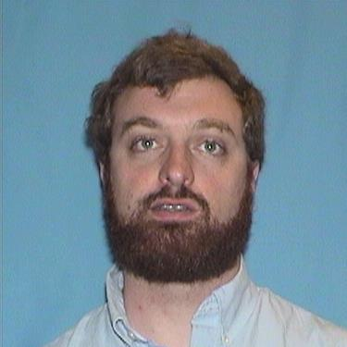
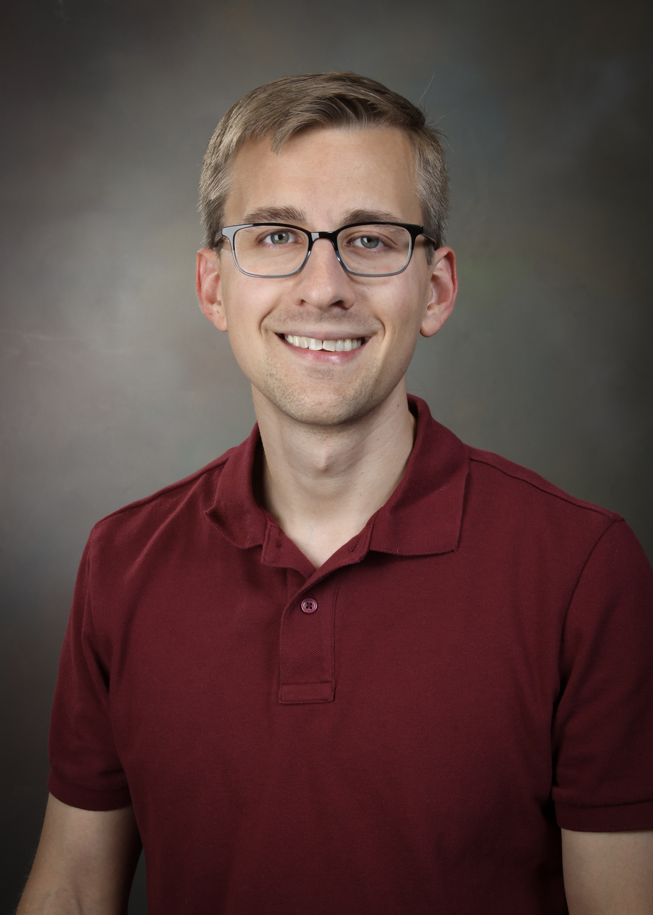


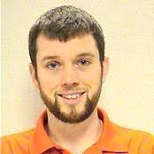

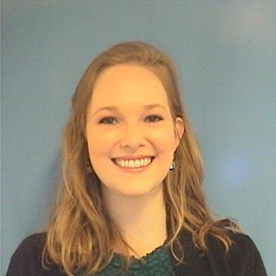



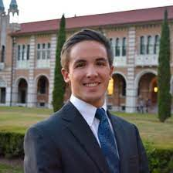
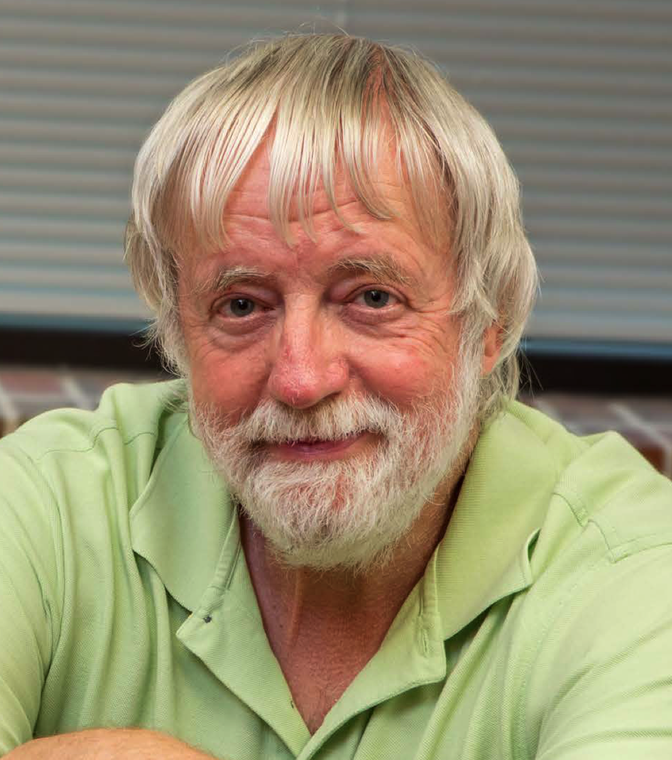



Team
Core Sandia M2dt team
Irina Tezaur
Pavel Bochev
Chris Eldred
Anthony Gruber
Eric Parish
Patrick Blonigan
Paul Kuberry
Other Sandia contributors not officially part of M2dt
Joshua Barnett
Chris Wentland
Amy de Castro
Alejandro Mota
Francesco Rizzi
Collaborations within M2dt
Max Gunzburger
Nicole Aretz
Rudy Geelen

Slide 4
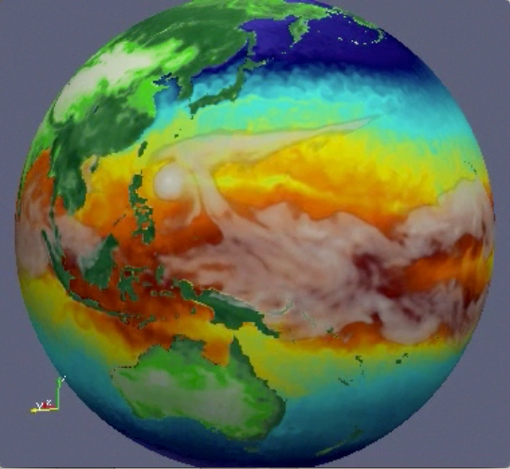

Motivation for RT3.1: coupled heterogeneous methods for multi-scale & multi-physics coupling
Atmos.
(EAM)
Ocean
(MPAS-O)
There exist established rigorous mathematical theories for coupling multi-scale and multi-physics components based on traditional discretization methods (“Full Order Models” or FOMs).
Sea Ice
(MPAS-SI)
☺
Land
(ELM)
Land Ice
(MALI)
N₁
N₂
N₁
N₂
M₁
M₂
M₃
M₄
N₄
N₃
N₄
N₃
N₅
N₅
Complex System Model
Traditional Methods
Coupled Numerical Model
PDEs, ODEs
Nonlocal integral
Classical DFT
Atomistic, …
Mesh-based (FE, FV, FD)
Meshless (SPH, MLS)
Implicit, explicit
Eulerian, Lagrangian…
Monolithic (Lagrange multipliers)
Partitioned (loose) coupling
Iterative (Schwarz, optimization)
Notes:
The past decades have seen a tremendous amount of investment in the development of simulation frameworks for coupled multi-scale and multi-physics problems. These frameworks rely on established mathematical theories to couple physics components discretized using so-called traditional discretization methods such as finite elements, finite volumes and finite differences. A prime example is the DOE’s global climate model, the Energy Exascale Earth System Model (E3SM), which couples 5 physics components (atmosphere, ocean, sea ice, land ice and land). Each component is developed separately according to the relevant physics, dynamics and numerical methods, and the components are coupled in a way that ensures stability, accuracy and conservation.

Slide 5
Motivation for RT3.1: coupled heterogeneous methods for multi-scale & multi-physics coupling
Atmos.
(EAM)
Ocean
(MPAS-O)
There exist established rigorous mathematical theories for coupling multi-scale and multi-physics components based on traditional discretization methods (“Full Order Models” or FOMs).
Sea Ice
(MPAS-SI)
☺
Land
(ELM)
Land Ice
(MALI)
N₁
N₂
N₁
N₂
N₁
PINN=N₂
M₁
M₂
M₃
M₄
N₄
N₃
N₄
ROM=N₄
N₃
N₅
DMD=N₃
N₅
UDE=N₅
Complex System Model
Traditional Methods
Coupled Numerical Model
Traditional + Data-Driven Methods
PDEs, ODEs
Nonlocal integral
Classical DFT
Atomistic, …
Mesh-based (FE, FV, FD)
Meshless (SPH, MLS)
Implicit, explicit
Eulerian, Lagrangian, …
Monolithic (Lagrange multipliers)
Partitioned (loose) coupling
Iterative (Schwarz, optimization)
PINNs
Neural ODEs
Projection-based ROMs, …
While there is currently a big push to integrate data-driven methods into modeling & simulation toolchains, existing algorithmic and software infrastructures are ill-equipped to handle rigorous plug-and-play integration of non-traditional, data-driven models!
☹

Slide 6
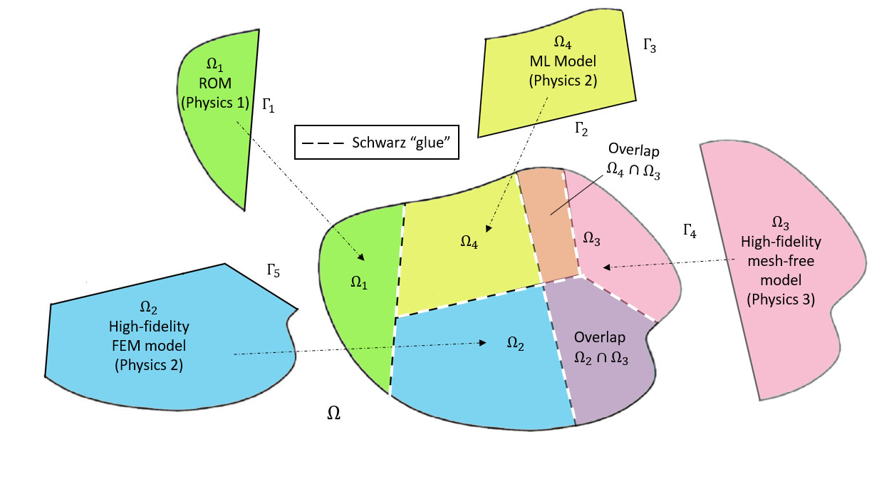
Coupling scenarios, models and methods
Coupling scenarios:
Atmos.
(EAM)
Scenario I:
multi-component coupling with a given domain/component decomposition (for reuse of single-component codes)
Scenario II:
multi-scale coupling where decomposition can be chosen to maximize accuracy, robustness & efficiency of coupled model
Ocean
(MPAS-O)
Sea Ice
(MPAS-SI)
Land
(ELM)
Land Ice
(MALI)
Data-driven models: to be “mixed-and-matched” with each other and first-principles models
Class A: projection-based reduced order models (ROMs)
Class B: machine-learned models, i.e., Neural Networks (NNs)
Class C: flow map approximation models, i.e., dynamic model decomposition (DMD) models
Coupling methods:
Method 1: Alternating Schwarz-based coupling
Method 2: Coupling via generalized mortar methods (GMMs)
Method 3: Optimization-based coupling

Slide 7
Coupling scenarios, models and methods
Coupling scenarios:
Atmos.
(EAM)
Scenario I:
multi-component coupling with a given domain/component decomposition (for reuse of single-component codes)
Scenario II:
multi-scale coupling where decomposition can be chosen to maximize accuracy, robustness & efficiency of coupled model
Ocean
(MPAS-O)
Sea Ice
(MPAS-SI)
Land
(ALM)
Land Ice
(MALI)
Data-driven models: to be “mixed-and-matched” with each other and first-principles models
Class A: projection-based reduced order models (ROMs)
Class B: machine-learned models, i.e., Neural Networks (NNs)
Class C: flow map approximation models, i.e., dynamic model decomposition (DMD) models
This talk
Coupling methods:
Method 1: Alternating Schwarz-based coupling
Method 2: Coupling via generalized mortar methods (GMMs)
Method 3: Optimization-based coupling

Slide 8
Coupling scenarios, models and methods
Coupling scenarios:
Atmos.
(EAM)
Scenario I:
multi-component coupling with a given domain/component decomposition (for reuse of single-component codes)
Scenario II:
multi-scale coupling where decomposition can be chosen to maximize accuracy, robustness & efficiency of coupled model
Ocean
(MPAS-O)
Sea Ice
(MPAS-SI)
Land
(ALM)
Land Ice
(MALI)
Data-driven models: to be “mixed-and-matched” with each other and first-principles models
Class A: projection-based reduced order models (ROMs)
Class B: machine-learned models, i.e., Neural Networks (NNs)
Class C: flow map approximation models, i.e., dynamic model decomposition (DMD) models
This talk
Coupling methods:
Method 1: Alternating Schwarz-based coupling
Method 2: Coupling via generalized mortar methods (GMMs)
Method 3: Optimization-based coupling
This talk

Slide 9
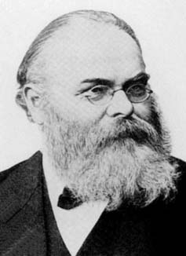
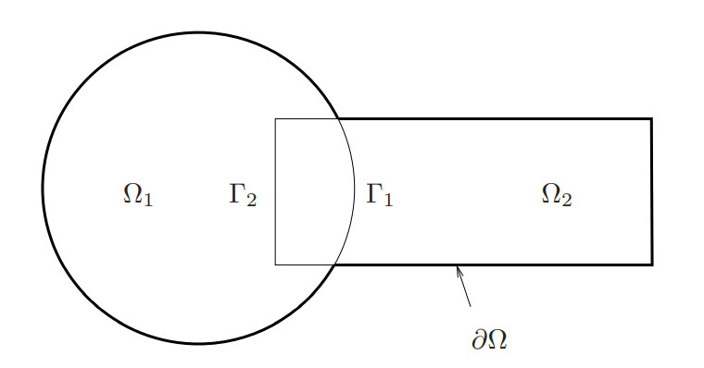
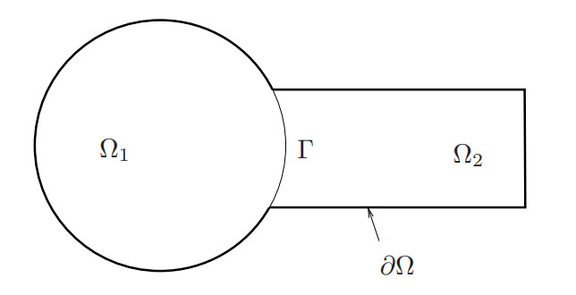
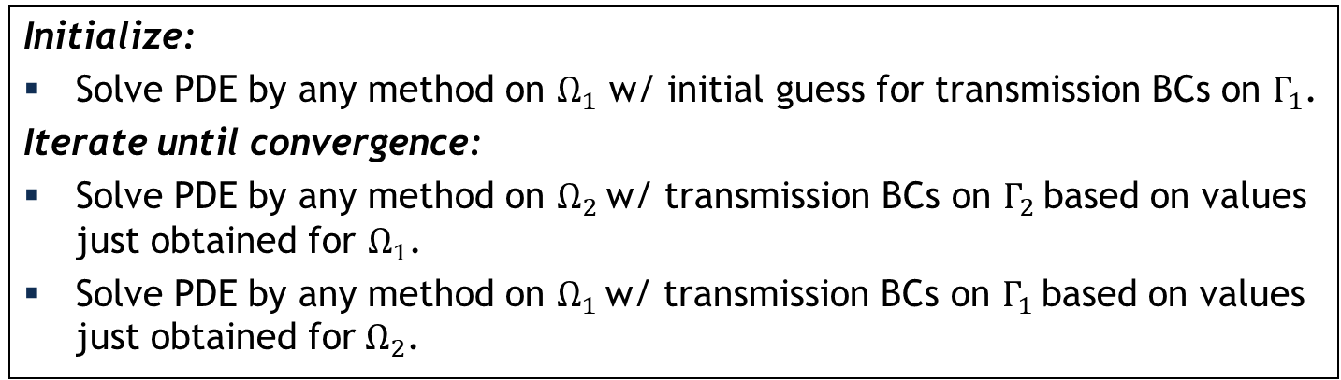
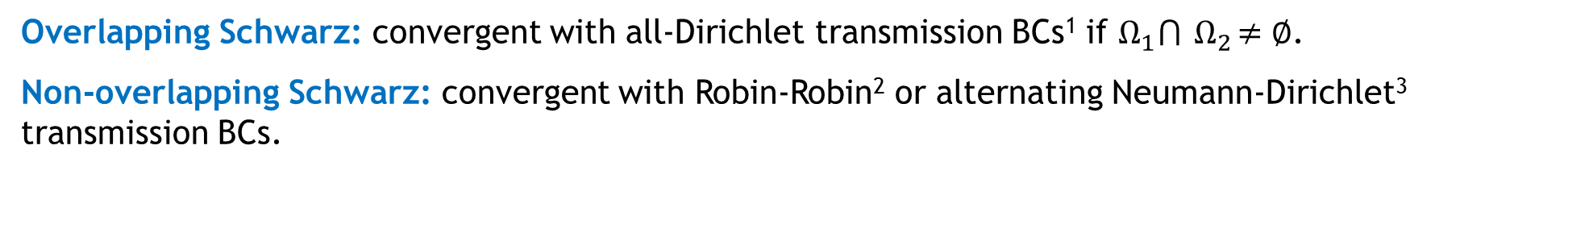
Schwarz alternating method for domain decomposition (DD)
Proposed in 1870 by H. Schwarz for solving Laplace PDE on irregular domains.
Crux of Method: if the solution is known in regularly shaped domains, use those as pieces to iteratively build a solution for the more complex domain.
H. Schwarz (1843–1921)
Basic Schwarz Algorithm
overlapping
Initialize:
Solve PDE by any method on $Ω_{1}$ w/ initial guess for transmission BCs on $Γ_{1}$.
Iterate until convergence:
Solve PDE by any method on $Ω_{2}$ w/ transmission BCs on $Γ_{2}$ based on values just obtained for $Ω_{1}$.
Solve PDE by any method on $Ω_{1}$ w/ transmission BCs on $Γ_{1}$ based on values just obtained for $Ω_{2}$.
non-overlapping
Overlapping Schwarz: convergent with all-Dirichlet transmission BCs¹ if $Ω_{1}⋂{ Ω}_{2}≠∅$.
Non-overlapping Schwarz: convergent with Robin-Robin² or alternating Neumann-Dirichlet³ transmission BCs.
z: convergent with Robin-Robin² or alternating Neumann-Dirichlet³ transmission BCs.
¹Schwarz, 1870; Lions, 1988.
²Lions, 1990. ³Zanolli et al., 1987.
²Lions, 1990. ³Zanolli et al., 1987.

Slide 10

How we use the Schwarz alternating method
10
AS A PRECONDITIONER FOR THE LINEARIZED SYSTEM
AS A SOLVER FOR THE COUPLED
FULLY NONLINEAR PROBLEM

Slide 11


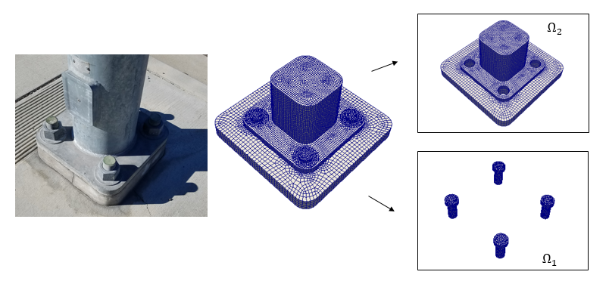


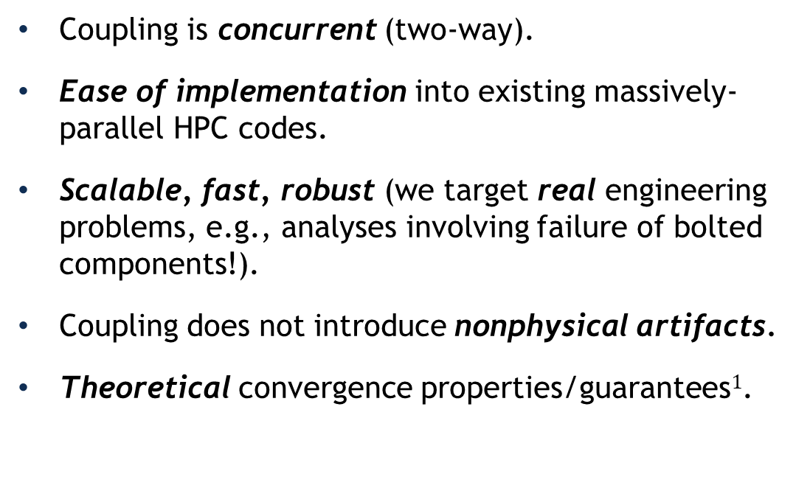
Schwarz for multiscale FOM-FOM coupling in solid mechanics¹
Model Solid Mechanics PDEs:
Coupling is concurrent (two-way).
Ease of implementation into existing massively-parallel HPC codes.
Scalable, fast, robust (we target real engineering problems, e.g., analyses involving failure of bolted components!).
Coupling does not introduce nonphysical artifacts.
Theoretical convergence properties/guarantees$1$.
Quasistatic:
Dynamic:
“Plug-and-play” framework:
  Ability to couple regions with different non-conformal meshes, different element types and different levels of refinement to simplify task of meshing complex geometries.
  Ability to use different solvers/time-integrators in different regions.
²
¹ Mota et al. 2017; Mota et al. 2022. ² https://github.com/sandialabs/LCM.

Slide 12

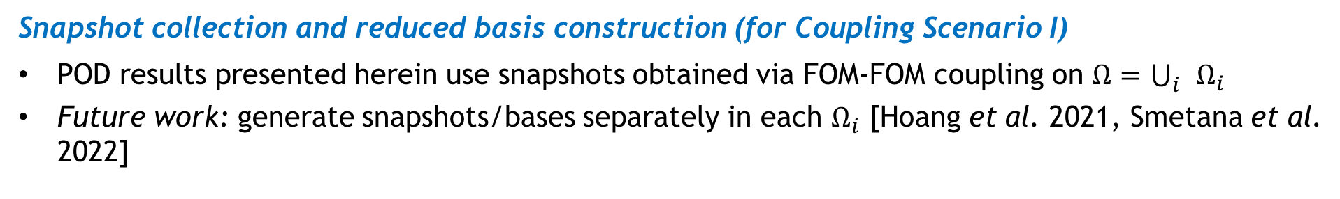
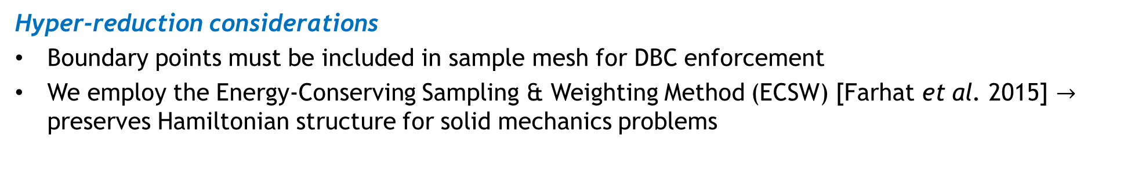
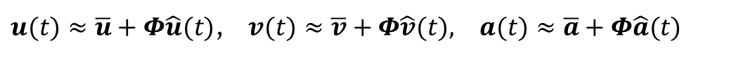
Schwarz extensions to FOM-(H)ROM and (H)ROM-(H)ROM couplings
12
Enforcement of Dirichlet boundary conditions (DBCs) in ROM at indices $i_{Dir}$
Method I in [Gunzburger et al. 2007] is employed
$u(t)≈\overline{u}+Φ\hat{u}(t)$, $v(t)≈\overline{v}+Φ\hat{v}(t), a(t)≈\overline{a}+Φ\hat{a}(t)$
HROM = hyper-reduced ROM
POD modes made to satisfy homogeneous DBCs: $Φ\left(i_{Dir}, :\right)=0$
BCs imposed by modifying $\overline{u}$, $\overline{v}$, $\overline{a}$: $\overline{u}\left(i_{Dir}\right)←χ_{u}$, $\overline{v}\left(i_{Dir}\right)←χ_{v}$, $\overline{a}\left(i_{Dir}\right)←χ_{a}$
Hyper-reduction considerations
Boundary points must be included in sample mesh for DBC enforcement
We employ the Energy-Conserving Sampling & Weighting Method (ECSW) [Farhat et al. 2015] $→$ preserves Hamiltonian structure for solid mechanics problems
Choice of domain decomposition (for Coupling Scenario II)
Future work: error indicator-based or reinforcement learning-based algorithms to determine “optimal” domain decomposition and ROM/FOM assignment, and possibly online ROM-FOM switching
Snapshot collection and reduced basis construction (for Coupling Scenario I)
POD results presented herein use snapshots obtained via FOM-FOM coupling on $Ω=\bigcup_{i}{Ω_{i}}$
Future work: generate snapshots/bases separately in each $Ω_{i}$ [Hoang et al. 2021, Smetana et al. 2022]

Slide 13
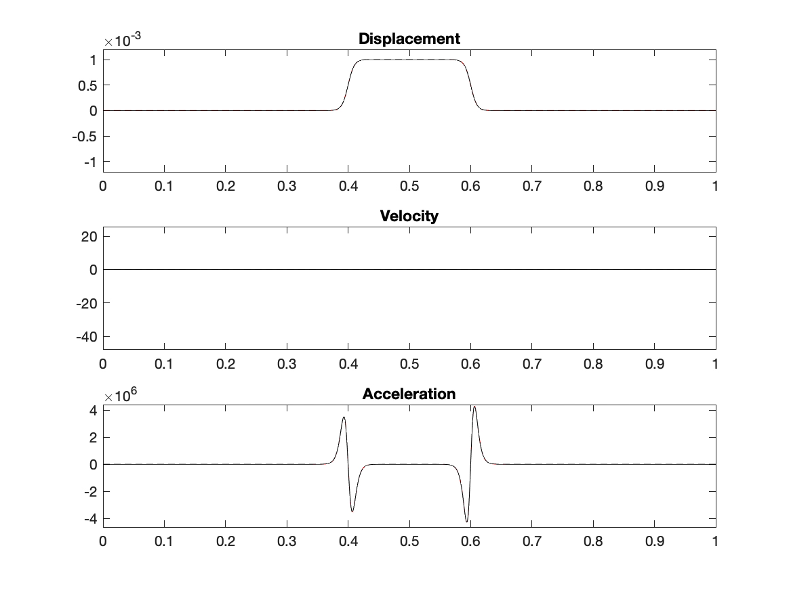
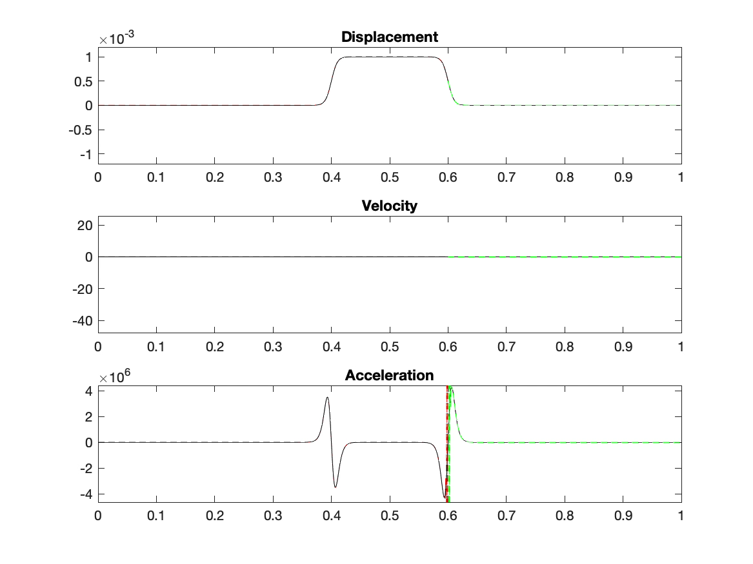
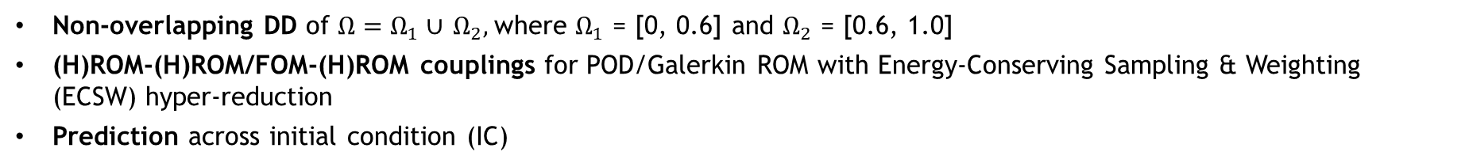

Numerical results
13
Model Problem 1: Dynamic wave propagation in 1D nonlinear hyper-elastic beam
Non-overlapping DD of $Ω=Ω_{1}∪$ $Ω_{2},$where $Ω_{1}$ = [0, 0.6] and $Ω_{2}$ = [0.6, 1.0]
(H)ROM-(H)ROM/FOM-(H)ROM couplings for POD/Galerkin ROM with Energy-Conserving Sampling & Weighting (ECSW) hyper-reduction
Prediction across initial condition (IC)
Predictive single-domain ROM solution exhibits spurious oscillations whereas coupled FOM-HROM solution is smooth and oscillation-free!
Predictive single-domain ROM ($M_{1}$= 300)
Predictive FOM-HROM ($M_{2}$= 200)
$−$Solution in $Ω_{1} −$ Solution in $Ω_{2}$
$−$ Single-domain FOM solution

Slide 14
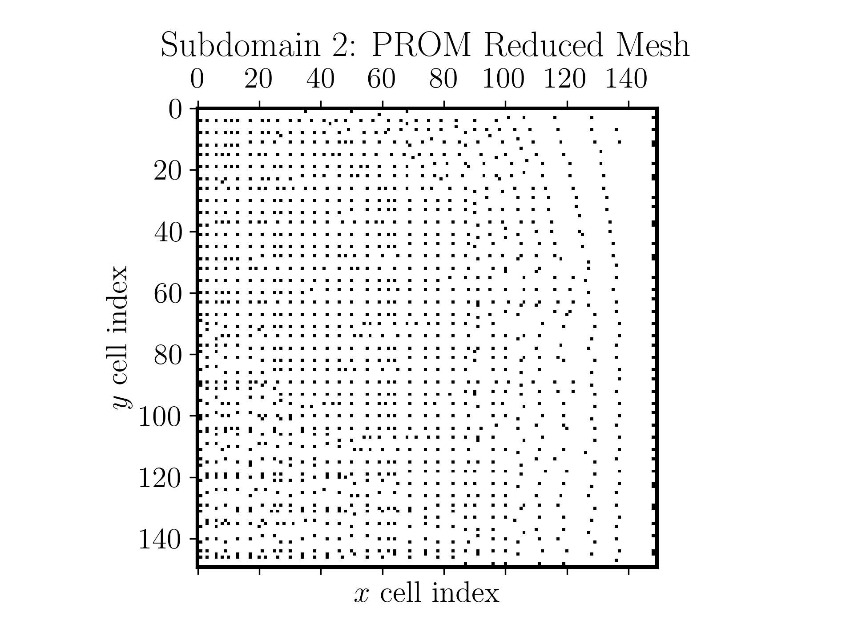
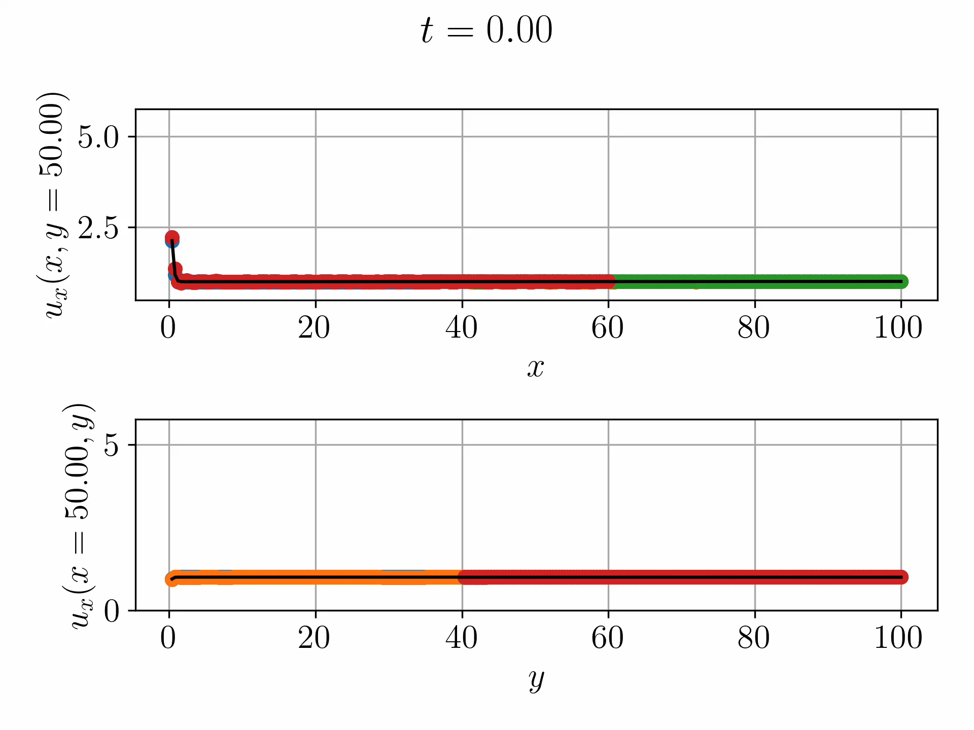
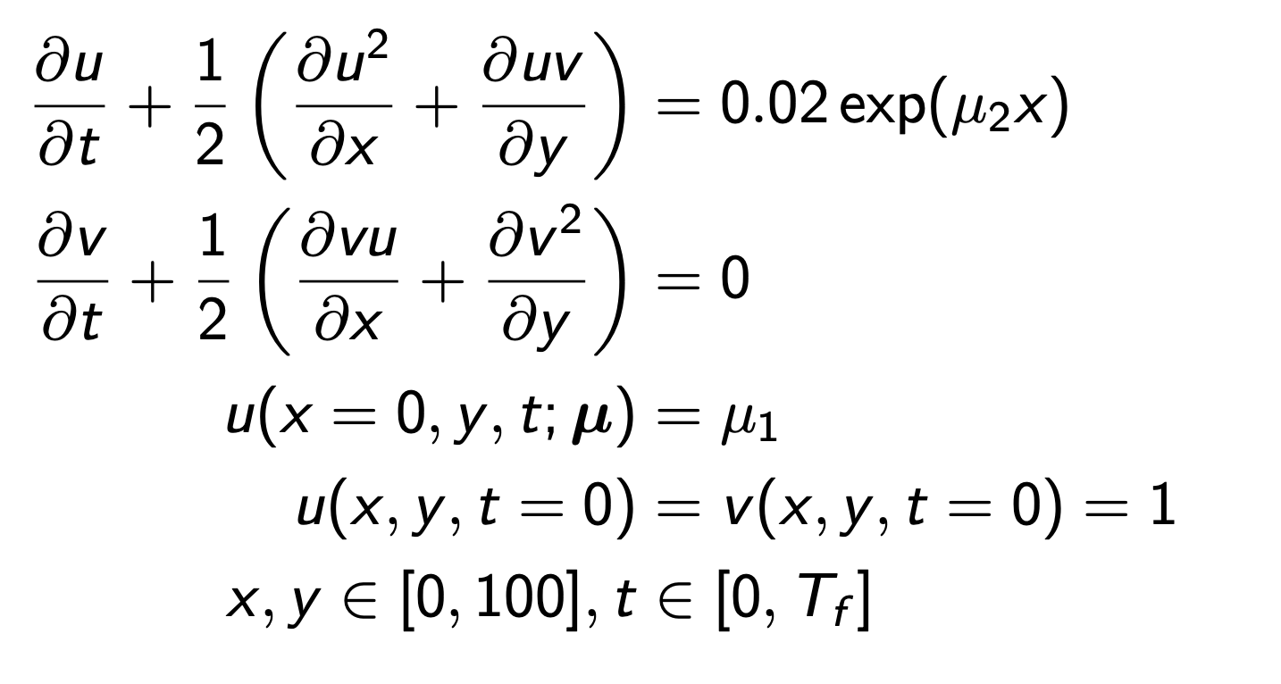
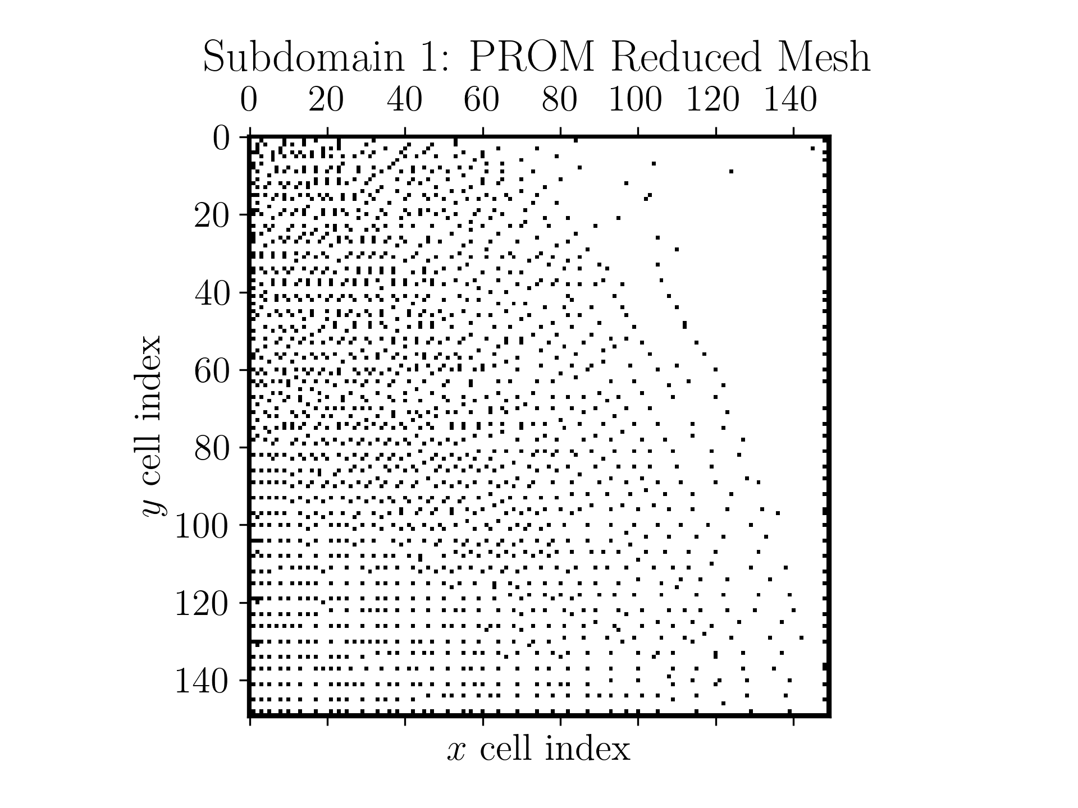
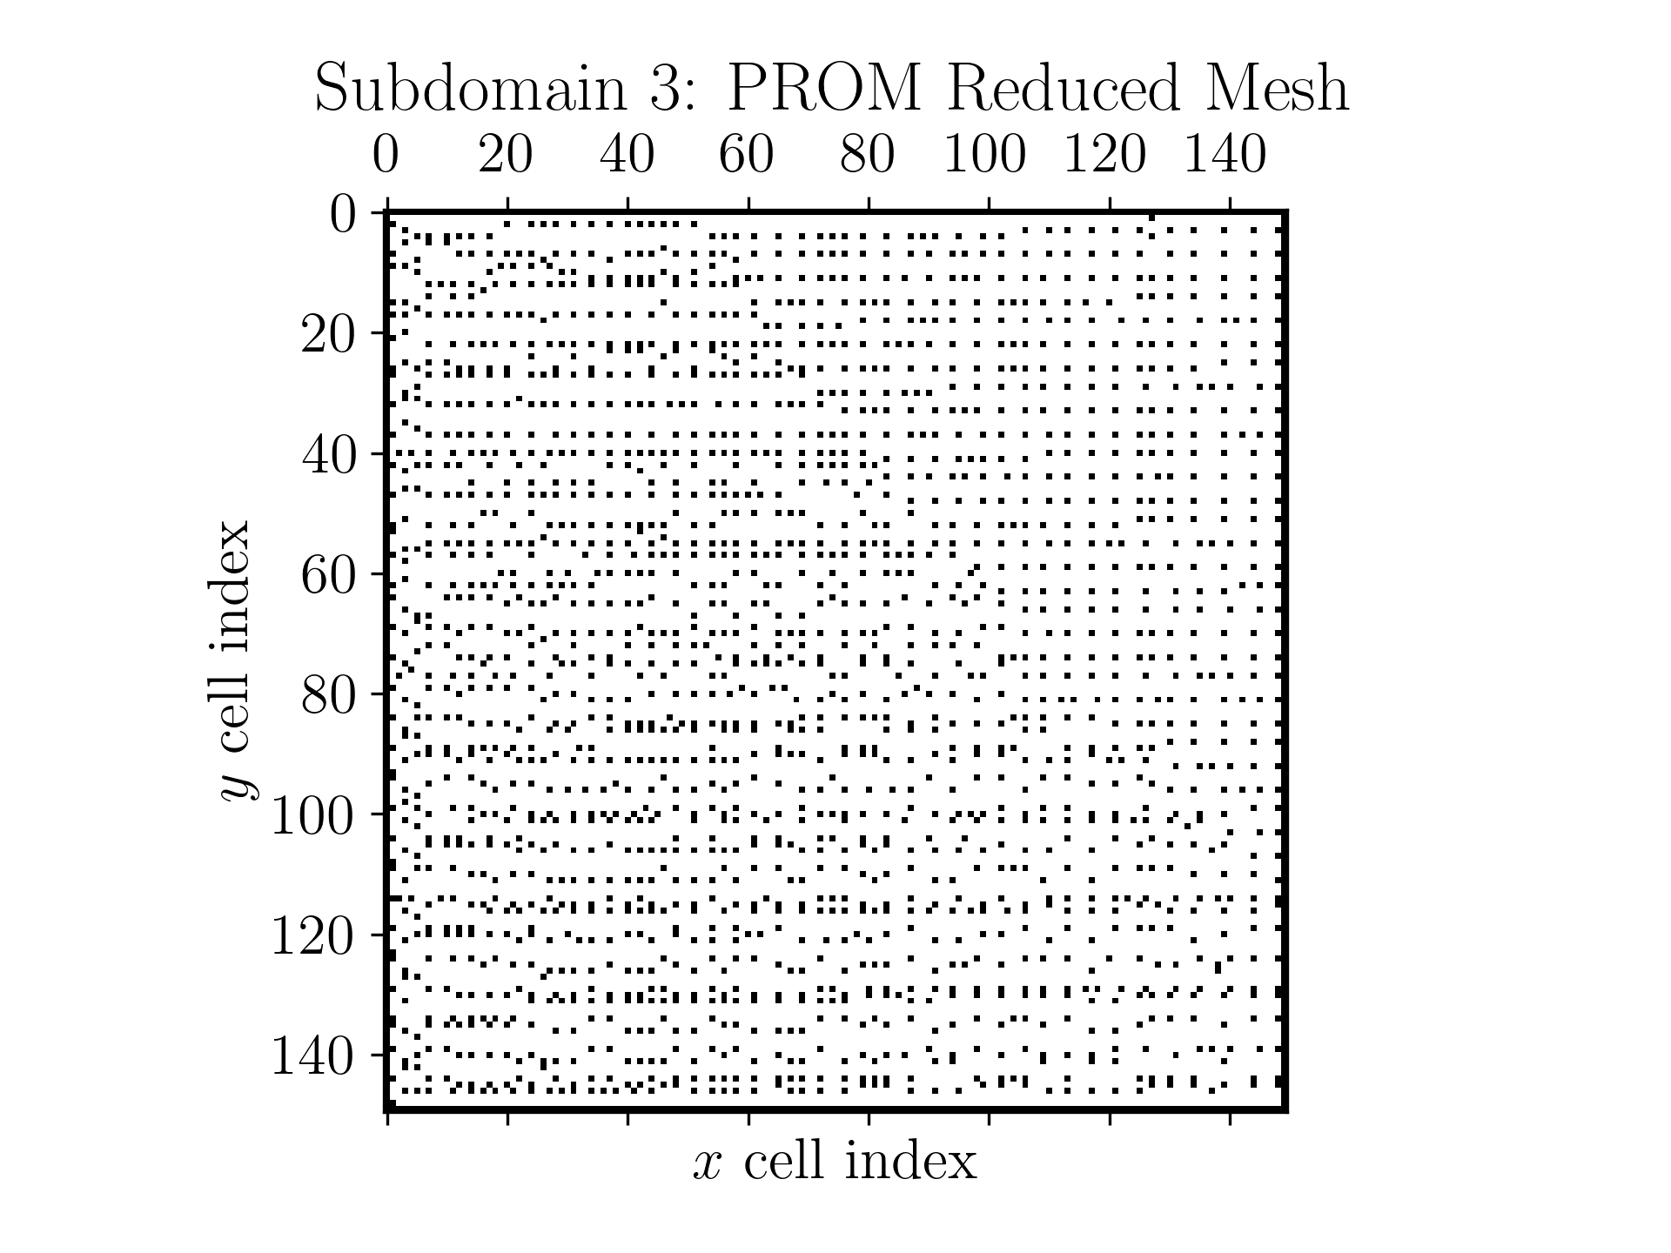
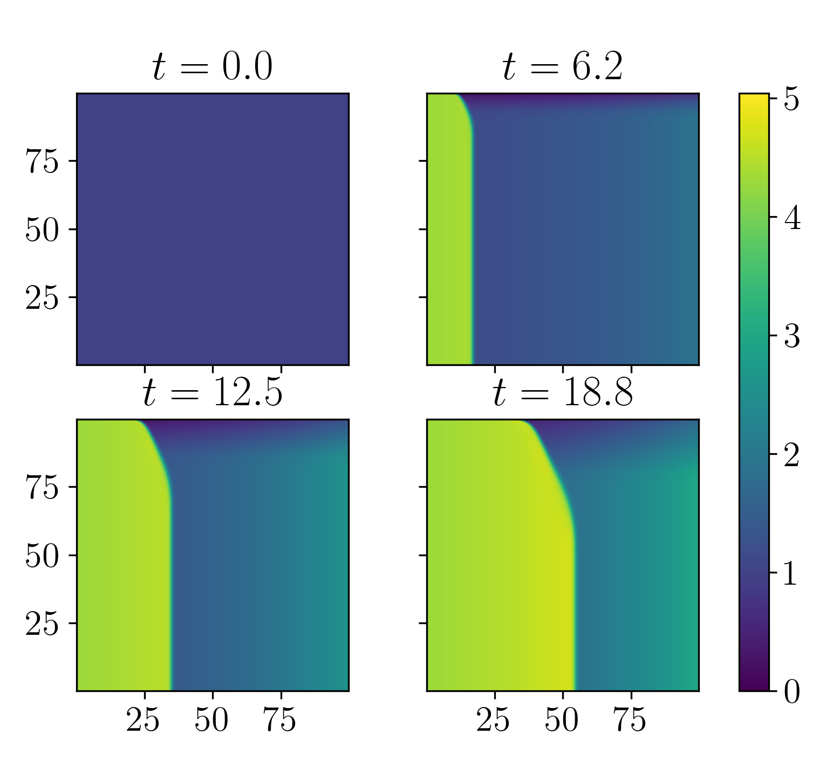

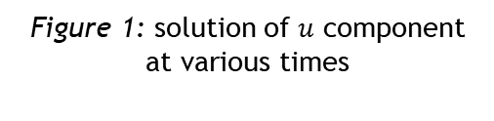




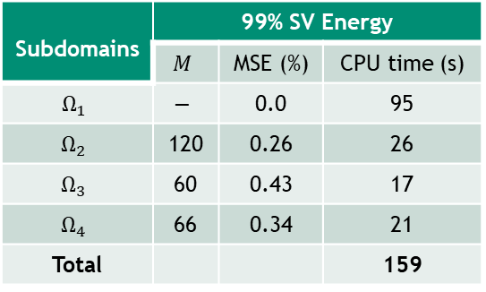


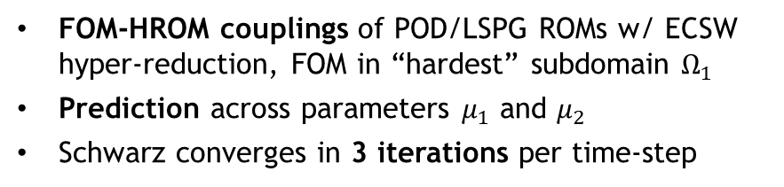





Numerical results
$$Ω_{1}$$
14
$$Ω_{2}$$
$$Ω_{3}$$
Model Problem 2: 2D inviscid Burgers equation with moving shock
$$Ω_{4}$$
$1 Ω$
0
0
$$x$$
100
$$Ω_{1}$$
$$Ω_{2}$$
$$y$$
$$Ω_{4}$$
$$Ω_{3}$$
100
Figure 3: 4 overlapping subdomain DD
Figure 2: 1D cross-sections of solution $u$ for FOM-HROM-HROM-HROM coupling
Subdomains | 99% SV Energy
 | $$M$$ | MSE (%) | CPU time (s)
$$Ω_{1}$$ | $$−$$ | 0.0 | 95
$$Ω_{2}$$ | 120 | 0.26 | 26
$$Ω_{3}$$ | 60 | 0.43 | 17
$$Ω_{4}$$ | 66 | 0.34 | 21
Total |  |  | 159
FOM-HROM couplings of POD/LSPG ROMs w/ ECSW hyper-reduction, FOM in “hardest” subdomain $Ω_{1}$
Prediction across parameters $μ_{1}$ and $μ_{2}$
Schwarz converges in 3 iterations per time-step
Figure 1: solution of $u$ component at various times
Further speedups possible via code optimizations and additive Schwarz.
Errors O(0.1%), 2.26$×$ speedup over all-FOM coupling

Slide 15

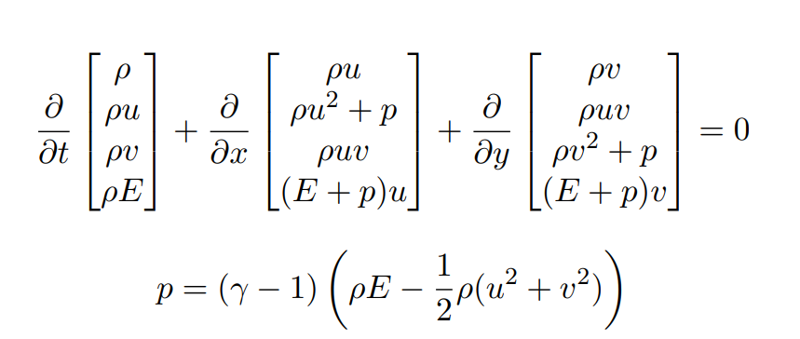
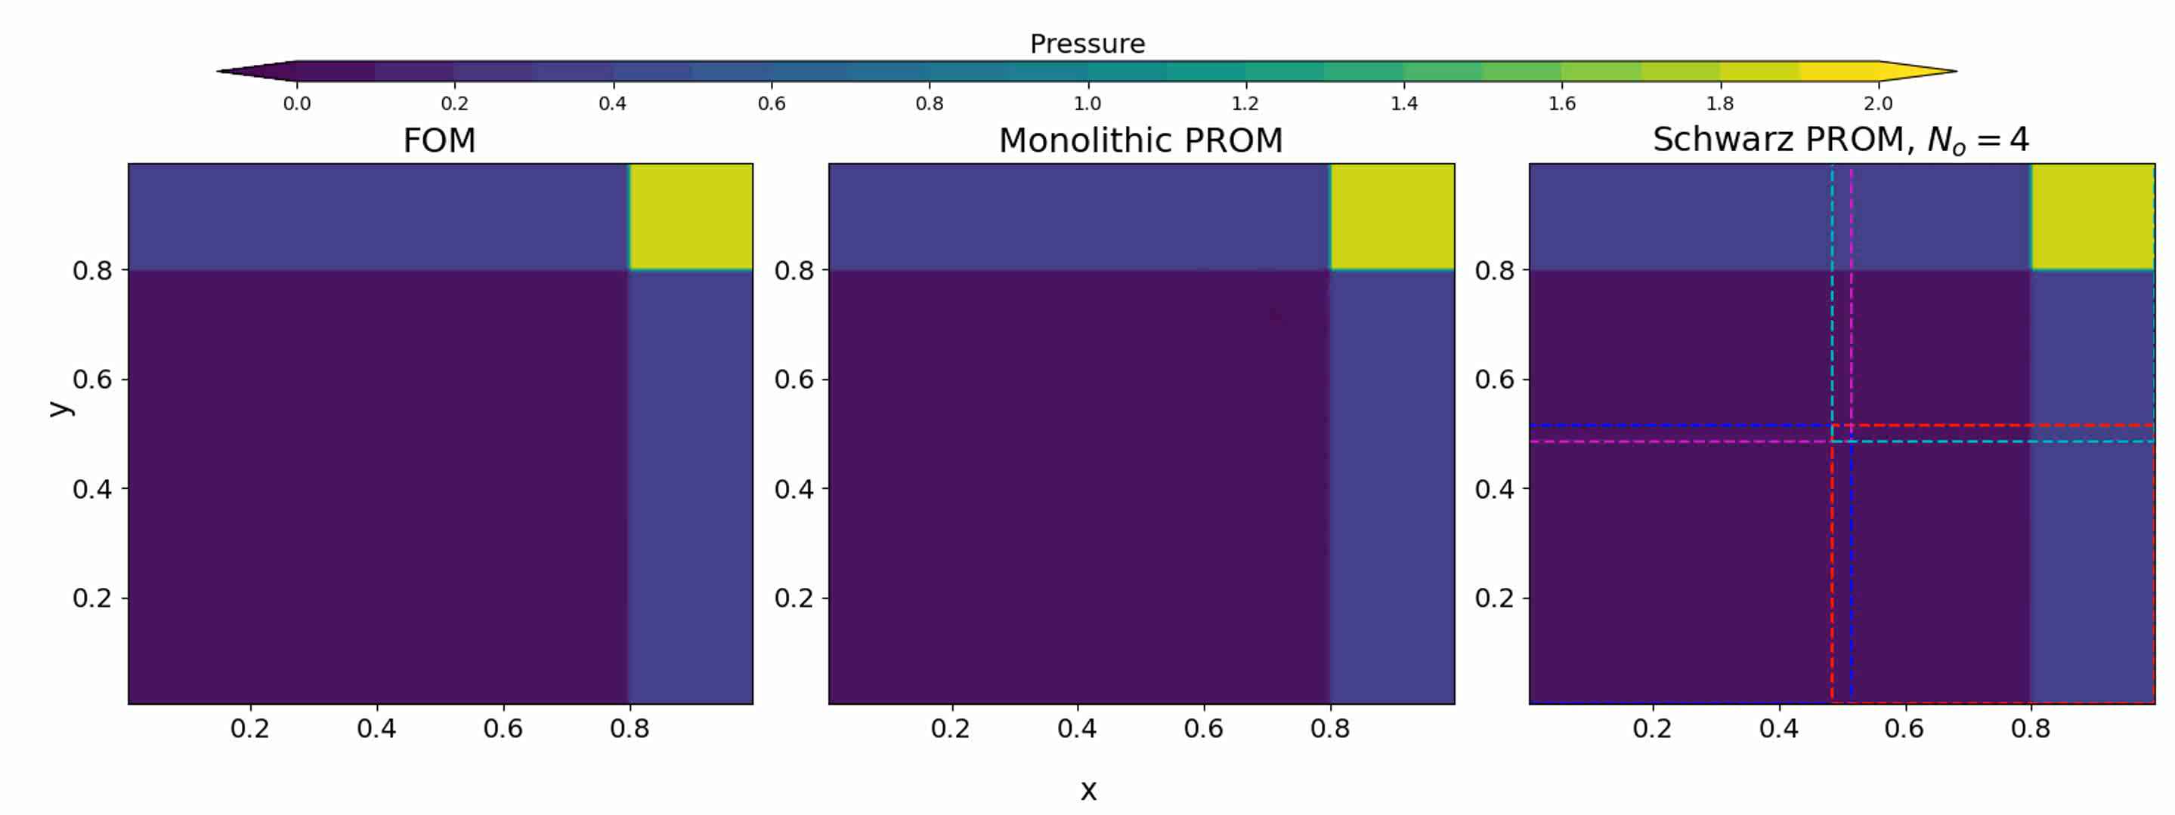
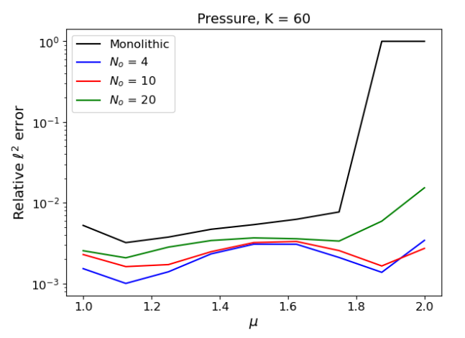
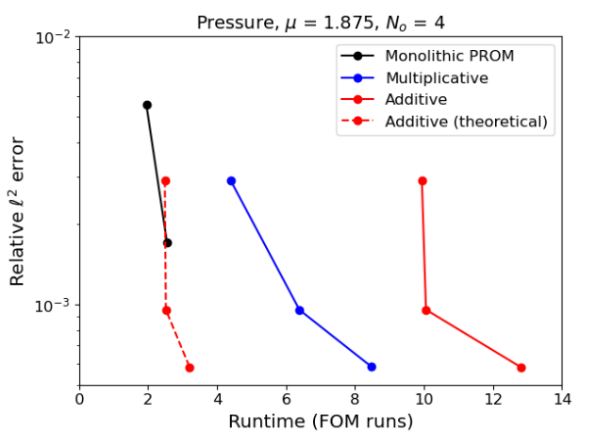
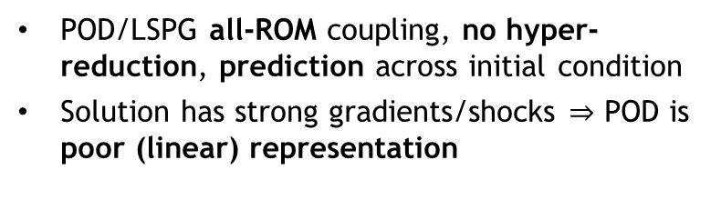
Numerical results
15
Model Problem 3: Riemann problem for 2D Euler equations
Blow up!
POD/LSPG all-ROM coupling, no hyper-reduction, prediction across initial condition
Solution has strong gradients/shocks $⇒$ POD is poor (linear) representation
Movie above: monolithic FOM (left), monolithic 50 mode ROM (middle) and 4 overlapping 50 mode subdomain all-ROM coupled (right) pressure solutions
DD and Schwarz coupling of ROMs stabilizes the solution! Coupled ROM has comparable CPU time to monolithic ROM with additive Schwarz.
Hyper-reduction is needed to achieve true cost savings
Suite of test cases (e.g., shallow water equations) available via Pressio demo-apps open-source implementation*!
* https://github.com/Pressio/pressio-demoapps
Notes:
Monolithic ROM unstable for < 70 modes for some parameter values.

Slide 16
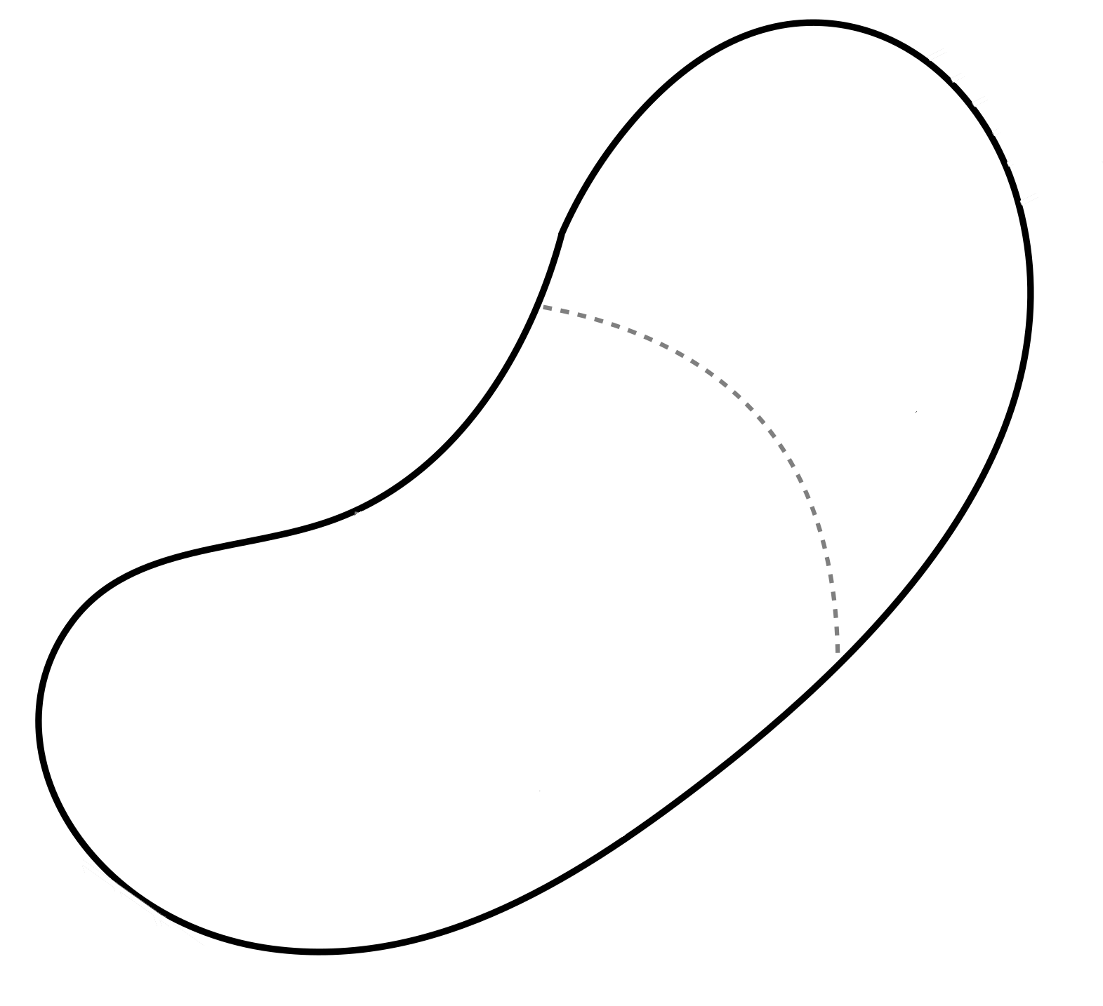

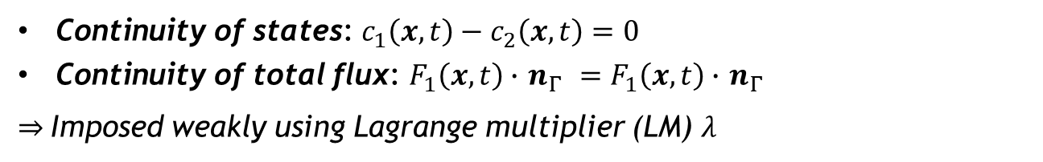

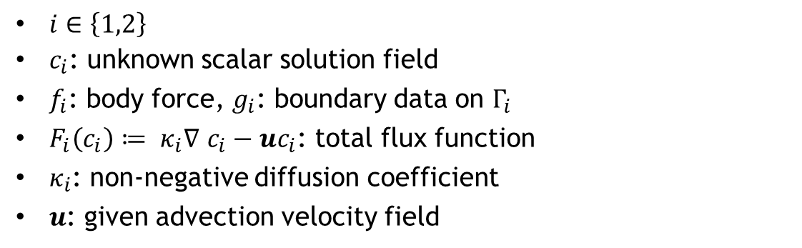

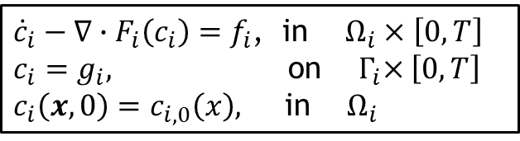

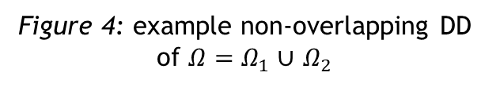
Lagrange multiplier-based partitioned coupling formulation
16
Model problem: time-dependent advection-diffusion problem on $Ω=Ω_{1}∪$ $Ω_{2}$with $Ω_{1}∩$ $Ω_{2}=∅$
${\dot{c}}_{i}−∇∙F_{i}\left(c_{i}\right)=f_{i}$, in $Ω_{i}×\left[0,T\right]$
$c_{i}=g_{i},$ on ${ Γ}_{i}×\left[0,T\right]$
$c_{i}\left(x,0\right)=c_{i,0}\left(x\right),$ in $Ω_{i}$
(1)
$$Ω_{2}$$
$i∈\left\{1,2\right\}$
$c_{i}$: unknown scalar solution field
$f_{i}$: body force, $g_{i}$: boundary data on $Γ_{i}$
$F_{i}\left(c_{i}\right)≔ κ_{i}∇$ $c_{i}−uc_{i}$: total flux function
$κ_{i}$: non-negative diffusion coefficient
$u$: given advection velocity field
$$Γ_{2}$$
$$Γ_{1}$$
$$Γ$$
$$Ω_{1}$$
Compatibility conditions: on interface $Γ×\left[0,T\right]$
Figure 4: example non-overlapping DD of $Ω=Ω_{1}∪$ $Ω_{2}$
Continuity of states: $c_{1}\left(x,t\right)−c_{2}\left(x,t\right)=0$
Continuity of total flux: $F_{1}\left(x,t\right)∙$ $n_{Γ }=F_{1}\left(x,t\right)∙$ $n_{Γ }$
$⇒$Imposed weakly using Lagrange multiplier (LM) $λ$

Slide 17
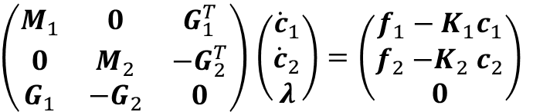



A Lagrange multiplier-based partitioned scheme
17
Hybrid semi-discrete coupled formulation: obtained by differentiating interface conditions in time and discretizing hybrid problem using FEM in space
Implicit Value Recovery (IVR) Algorithm [Peterson et al. 2019]
Pick explicit or IMEX time-integration scheme for $Ω_{1}$ and $Ω_{2}$
Approximate LM space as trace of FE space on $Ω_{1}$ or $Ω_{2}$*
Compute matrices $M_{i},K_{i}$, $G_{i}$ and vectors $f_{i}$
For each timestep $t^{n}$:
  Solve Schur complement system (4) for the LM $λ^{n}$
  Update the state variables $c_{i}^{n}$ by advancing (3) in time
$\left(\begin{matrix}M_{1} & 0 & G_{1}^{T} \\ 0 & M_{2} & {−G}_{2}^{T} \\ G_{1} & −G_{2} & 0\end{matrix}\right)$ $\left(\begin{matrix}{\dot{c}}_{1} \\ {\dot{c}}_{2} \\ λ\end{matrix}\right)=$ $\left(\begin{matrix}f_{1}−K_{1}c_{1} \\ f_{2}{−K}_{2}c_{2} \\ 0\end{matrix}\right)$
(2)
$M_{i}:$mass matrices
$K_{i}≔D_{i}+A_{i}:$ stiffness matrices, where $D_{i}$ and $A_{i}$ are matrices for diffusive and advective terms, respectively
$G_{i}$: constraints matrices enforcing constraints in weak sense
Decoupling via Schur complement: equation (2) is equivalent to
Equations decouple if using explicit or IMEX time-integration!
$$\left(\begin{matrix}M_{1} & 0 \\ 0 & M_{2}\end{matrix}\right)\left(\begin{matrix}{\dot{c}}_{1} \\ {\dot{c}}_{2}\end{matrix}\right)=\left(\begin{matrix}f_{1}−K_{1}c_{1}−G_{1}^{T}λ \\ f_{2}−K_{2}c_{2}+G_{2}^{T}λ\end{matrix}\right)$$
(3)
where ${(G}_{1}M_{1}^{−1}G_{1}^{T}+G_{2}M_{2}^{−1}G_{2}^{T})λ=G_{1}M_{1}^{−1}\left(f_{1}−K_{1}c_{1}\right)−G_{2}M_{2}^{−1}\left(f_{2}−K_{2}c_{2}\right)$
(4)
* Ensures that dual Schur complement of (2) is s.p.d.
Time integration schemes and time-steps in $Ω_{1}$ and $Ω_{2}$ can be different!

Slide 18






Lagrange multiplier-based partitioned FOM-FOM coupling
18
FEM-FEM coupling for high Peclet transport problem
“Plug-and-play” framework:
Ability to couple regions with different non-conformal meshes, different element types and different levels of refinement to simplify task of meshing complex geometries
Ability to use different solvers/time-integrators in different regions^{1,2}
Coupling is non-iterative (single pass)
Method is theoretically rigorous³:
Coupling does not introduce nonphysical artifacts
Theoretical convergence properties/guarantees including well-posedness of coupling force system
Preserves the exact solution for conformal meshes
Method has been applied to several application spaces:
Transport (unsteady advection-diffusion)
Ocean-atmosphere coupling
Elasticity (e.g., ALEGRA-Sierra/SM coupling)
Coupling of nonconforming meshes
Patch test (ALEGRA-Sierra/SM coupling)
ALEGRA: 10x10x50
Schwarz
Sierra : 15x15x50
¹Connors et al. 2022. ²Sockwell et al. 2023. ³Peterson et al. 2019.
Notes:
IVR has been applied to linear elasticity and advection-diffusion.
VFR has been applied to Johnson-Cook elasticity.
Johnson-Cook is approximately linear elasticity in low stress scenario but is nonlinear when exceeding yield stress. We didn’t push it into the plasticity regime, so roughly linear elastic for our case.
IFR has been applied to advection-diffusion with a bulk coupling condition (ocean-atmosphere analog).
Alegra-Sierra coupling: Alegra has a piezoelastic material model that Sierra does not, whcso a charge can be generated such as found on impact.
Forte existed – only coincident meshes. Enabled ability to do non-conforming.
MFR = mortar flux recovery

Slide 19




ROM-ROM/ROM-FOM coupling: split bases & reduced LM spaces
19
Consider two separate expansions for interface and interior DOFs for $i=1,2$:
$c_{i,0}(t)≈{\tilde{c}}_{i,0}(t)≔{\overline{c}}_{i,0}+$ $Φ_{i,0}{\hat{c}}_{i,0}\left(t\right),{ c}_{i,Γ}(t)≈{\tilde{c}}_{i,Γ}(t)≔{\overline{c}}_{i,Γ}+ Φ_{i,Γ}{\hat{c}}_{i,Γ}(t)$
,
Substituting expansions into (2) and projecting PDEs onto RBs gives:
For details, see:
Split basis + reduced LM space guarantees ROM-ROM/ROM-FOM coupling has non-singular dual Schur complement*.
$$\left(\begin{matrix}{\tilde{M}}_{1,Γ} \\ \begin{matrix}{\tilde{M}}_{1,0Γ} \\ 0 \\ 0\end{matrix} \\ {\tilde{G}}_{1}\end{matrix}\begin{matrix}{\tilde{M}}_{1,Γ0} \\ \begin{matrix}{\tilde{M}}_{1,0} \\ 0 \\ 0\end{matrix} \\ 0\end{matrix}\begin{matrix}0 \\ \begin{matrix}0 \\ {\tilde{M}}_{2,Γ} \\ {\tilde{M}}_{2,0Γ}\end{matrix} \\ −{\tilde{G}}_{2}\end{matrix}\begin{matrix}0 \\ \begin{matrix}0 \\ {\tilde{M}}_{2,Γ0} \\ {\tilde{M}}_{2,0}\end{matrix} \\ 0\end{matrix}\begin{matrix}{\tilde{G}}_{1}^{T} \\ \begin{matrix}0 \\ −{\tilde{G}}_{2}^{T} \\ 0\end{matrix} \\ 0\end{matrix}\right)\left(\begin{matrix}{\dot{\hat{c}}}_{1,Γ} \\ \begin{matrix}{\dot{\hat{c}}}_{1,0} \\ {\dot{\hat{c}}}_{2,Γ} \\ {\dot{\hat{c}}}_{1,0}\end{matrix} \\ \hat{λ}\end{matrix}\right)=\left(\begin{matrix}s_{1,Γ} \\ \begin{matrix}s_{1,0} \\ s_{2,Γ} \\ s_{2,0}\end{matrix} \\ 0\end{matrix}\right)$$
Online ROM-ROM IVR Solution Algorithm with Split Bases & Reduced LM Spaces: at each time step $t^{n}$
Use ${\hat{c}}_{i,0}^{n}$and ${\hat{c}}_{i,Γ}^{n}$ to compute updated RHS $s_{i,0}^{n}$ and $s_{i,Γ}^{n}$ for $i=1,2$.
Define ${\tilde{M}}_{i,jk}≔Φ_{i,j}^{T}M_{i,jk}Φ_{i,k}, {\tilde{G}}_{i}≔Φ_{LM}^{T}G_{i}Φ_{i,Γ},$ ${\tilde{P}}_{i}≔{\tilde{M}}_{i,Γ}−{\tilde{M}}_{i,Γ0}M_{i,0}^{−1}{\tilde{M}}_{i,Γ0}$ for $\left\{j,k\right\}∈\left\{0,Γ\right\}$ and solve:
$${(\tilde{G}}_{1}{\tilde{P}}_{1}^{−1}{\tilde{G}}_{1}^{T}+{\tilde{G}}_{2}{\tilde{P}}_{2}^{−1}{\tilde{G}}_{2}^{T}){\hat{λ}}^{n}={\tilde{G}}_{1}{\tilde{P}}_{1}^{−1}\left(s_{1,Γ}^{n}−{\tilde{M}}_{1,Γ0}M_{1,0}^{−1}s_{1,0}^{n}\right)−{\tilde{G}}_{2}{\tilde{P}}_{2}^{−1}\left(s_{2,Γ}^{n}−{\tilde{M}}_{2,Γ0}M_{2,0}^{−1}s_{2,0}^{n}\right)$$
Advance the following systems forward in time:
$\left(\begin{matrix}{\tilde{M}}_{i,Γ} & {\tilde{M}}_{i,Γ0} \\ {\tilde{M}}_{i,Γ0} & {\tilde{M}}_{i,Γ}\end{matrix}\right)$ $\left(\begin{matrix}{\dot{\hat{c}}}_{i,Γ}^{n} \\ {\dot{\hat{c}}}_{i,0}^{n}\end{matrix}\right)=\left(\begin{matrix}s_{i,Γ}^{n}+{(−1)}^{i}{\tilde{G}}_{i}^{T}{\hat{λ}}^{n} \\ s_{i,0}^{n}\end{matrix}\right)$
* If conditions in [Peterson et al., 2019] are satisfied for underlying FOM-FOM coupling.
Notes:
For the split basis case, I have it set up to use \tilde{U}_{i,\gamma} (the interface reduced basis from \Omega_i). Just for ease of running loops, the size of the interface basis is 1/5 the size of the overall basis (i.e., if you want 10 reduced basis functions in total, 8 of those will be interior and 2 will be interface). For the full subdomain case, if the option to reduce the LM space is on, the code additionally calculates a \tilde{U}_{i,\gamma} for whichever subdomain is specified and uses those as the reduced basis for the LM space. The basis size is a user specified option.

Slide 20






Numerical results
20
Model Problem: 2D advection-diffusion transmission problem (TP)
Cone, cylinder & smooth hump IC
Non-overlapping DD w/ $Γ$ at $x=0.5$
Rotating advection field $(0.5 − y, x − 0.5)$for one full rotation
High Peclet predictive problem: $κ_{1}={κ_{2}=10}^{−5}$ for training,${ κ}_{1}={10}^{−5}$ and $κ_{2}={10}^{−4}$ for prediction
Provably-stable methods maintain condition number of O(1) regardless of basis size and converge with basis refinement
“Naïve” ROM-ROM coupling
Provably-stable ROM-ROM coupling
FOM-FOM
Notes:
Q: how is prediction done for TP? Can we get movie for different thermal coeffs?

Slide 21



Motivation for RT2.2: structure-preserving ROM (SP-ROM)
Motivation
To be reliable predictive tools, ROMs & surrogates must preserve key properties of underlying PDEs (e.g., Hamiltonian structure, conservation, energy/entropy-stability, physical bounds, etc.)
Physical bounds
ROMs in general will NOT automatically inherit the properties of the FOMs from which they are constructed!
Above: bounds-preserving (left) vs. bounds-violating (right) tracer-transport solution [Peterson et al., 2014].
Below: energy-stable (left) vs. unstable (right) compressible flow pressure solutions [Tezaur et al., 2017].
Objective
Develop new property-preserving nonlinear dimensionality reduction methods that will support new classes of compatible ROMs mirroring the properties of established compatible discretization methods for FOMs

Slide 22
SP-ROM: research themes & methods
We have identified three research themes, informed by many years of research in discretization and geometric methods communities. Structure preservation related to one or more of these themes is a prerequisite for the stable, accurate and physically-consistent solution of PDEs underpinning the M2dt exemplars.
Theme A. Geometric Property Preservation
Theme B. Topological property preservation
Theme C. Qualitative properties
  A.1. Symplectic structure
  A.2. Metriplectic structure
  A.3. Energy/entropy stability
  B.1. Hodge decomposition
  B.2. de Rham complex
  C.1. Bounds/positivity
  C.2. Monotonicity, max principle
  C.3. Total Variation Diminishing (TVD)
Themes are crucial to many applications, including solid mechanics/material design (Testbed 1) & ice/ocean flow (Testbed 2).
The above three research themes will be pursued using the following methods and their combination:
Method (i). Structure-preserving Operator Inference (OpInf) learning methods
Method (iii). Structure-preserving hyper-reduction
Method (v). Structure-preservation in multi-physics/multi-component ROMs
Method (ii). Nonlinear manifold structure-preserving ROMs
Method (iv). Conservation and energy-/entropy-stability
Method (vi). Optimization-based methods
Notes:
Which “theme” is relevant depends on DPE/application.
Theme A: many applications. CFD. Solid mechanics. Symplectic structure = Hamiltonian / Lagrangian structure. Preserving energy/entropy stability amounts to preserving symmetry/skew-symmetry of matrices in system, as shown on next slide.
Theme B: Darcy flow / Maxwell equations. Anything with Div-Curl. See slide 4 for more info.
Theme C: hyperbolic conservation laws.

Slide 23
SP-ROM: research themes & methods
We have identified three research themes, informed by many years of research in discretization and geometric methods communities. Structure preservation related to one or more of these themes is a prerequisite for the stable, accurate and physically-consistent solution of PDEs underpinning the M2dt exemplars.
Theme A. Geometric Property Preservation
Theme B. Topological property preservation
Theme C. Qualitative properties
  A.1. Symplectic structure
  A.2. Metriplectic structure
  A.3. Energy/entropy stability
  B.1. Hodge decomposition
  B.2. de Rham complex
  C.1. Bounds/positivity
  C.2. Monotonicity, max principle
  C.3. Total Variation Diminishing (TVD)
Themes are crucial to many applications, including solid mechanics/material design (Testbed 1) & ice/ocean flow (Testbed 2).
The above three research themes will be pursued using the following methods and their combination:
Deep dive in this talk
Method (i). Structure-preserving Operator Inference (OpInf) learning methods
Method (iii). Structure-preserving hyper-reduction
Method (v). Structure-preservation in multi-physics/multi-component ROMs
(for discussion of other themes/methods, see next talk by Pavel)
Method (ii). Nonlinear manifold structure-preserving ROMs
Method (iv). Conservation and energy-/entropy-stability
Method (vi). Optimization-based methods

Slide 24




Hamiltonian Operator Inference (H-OpInf)
Hamiltonian systems $\dot{x}=\left\{x, H(x)\right\}=L(x)∇H(x)$ are archetypically conservative.
  Governed by scalar potential $H$ and skew-symmetric matrix operator $L$.
$L$ defines (potentially degenerate) Poisson bracket $\left\{F, G\right\}=∇F⋅L∇G$.
  Satisfies Jacobi identity:
  $\left\{F, \left\{G, H\right\}\right\}+\left\{G, \left\{H,F\right\}\right\}+\left\{H, \left\{F,G\right\}\right\}=0.$
Guarantees that flow is perpendicular to $∇H$ and energy is conserved.
$\dot{H}\left(x\right)=\dot{x}⋅∇H=L∇H⋅∇H=−L∇H⋅∇H=0$.
Examples: Incompressible Euler, Maxwell, shallow water, Monge-Ampere, sine-Gordon, nonlinear Schrodinger, …
Illustration courtesy of P. J. Morrison

Slide 25






Hamiltonian Operator Inference (H-OpInf)
Naïve Galerkin ROM: $\dot{\hat{x}}=U^{T}L∇H(U\hat{x})$
  Data matrix $X≈UΣV^{T}$
  POD approximation $\tilde{x}=U\hat{x}$
Not Hamiltonian! ${\left(L^{T}U\right)}^{T}=U^{T}L≠−L^{T}U$
  (energy not conserved)
Not symplectic!
  (no Jacobi identity)
Conversely, Hamiltonian ROM satisfies $both^{∗}$
  Solve overdetermined system $U^{T}L=\hat{L}U^{T}$.
  Evolution equation:
  $\dot{\hat{x}}=\hat{L}∇\hat{H}\left(\hat{x}\right)=U^{T}L(U\hat{x})UU^{T}∇H(U\hat{x})$
  Closed orbits are preserved.
* When $L$ is $x$-independent

Slide 26

Hamiltonian Operator Inference (H-OpInf)
Naïve model reduction can fail spectacularly in the predictive regime.
  Structure-preserving model reduction comes with guarantees.
Instead of optimizing over $A∈ℝ^{N×N}$, optimize over $A∈ℳ⊂ℝ^{N×N}$.
  Model class $ℳ$contains inductive biases.
Good algebraic/geometric ways of formulating constrained optimizations as unconstrained ones.

Slide 27


Hamiltonian Operator Inference (H-OpInf)
Naïve Galerkin ROM: $\dot{\hat{x}}=U^{T}L∇H(U\hat{x})$
  Data matrix $X≈UΣV^{T}$
  POD approximation $\tilde{x}=U\hat{x}$
Not Hamiltonian! ${\left(L^{T}U\right)}^{T}=U^{T}L≠−L^{T}U$
  (energy not conserved)
Not symplectic!
  (no Jacobi identity)
Conversely, Hamiltonian ROM satisfies $both^{∗}$
  Solve overdetermined system $U^{T}L=\hat{L}U^{T}$.
  Evolution equation:
  $\dot{\hat{x}}=\hat{L}∇\hat{H}\left(\hat{x}\right)=U^{T}L(U\hat{x})UU^{T}∇H(U\hat{x})$
  Closed orbits are preserved.
* When $L$ is $x$-independent

Slide 28



Hamiltonian Operator Inference (H-OpInf)
Non-intrusive case: operator inference
  Solve a minimization for RO operators $\hat{L}, \hat{A}$:
  $\underset{\hat{A} or \hat{L}}{argmin} {\left|{\hat{X}}_{t}−\hat{L}\hat{A}\hat{X}\right|}^{2}, {\hat{L}}^{T}=−\hat{L}\text{, }{\hat{A}}^{T}=\hat{A}.$
Model Problem 1: 1D Korteweg-De Vries (KdV) equation
Reduces to a single linear solve.
Converges to intrusive ROM in the limit of infinite data.
If $L$ is known, this is “canonical inference”.
  Extends previous work (H. Sharma,
  B. Kramer, Z. Wang, 2022)
    To arbitrary basis $U$
    To arbitrary $∇H\left(x\right)=Ax+∇f\left(x\right)$
If $A$ is known, this is noncanonical inference.
  Poisson structure is learned instead.

Slide 29


Hamiltonian Operator Inference (H-OpInf)
Non-intrusive case: operator inference
  Solve a minimization for RO operators $\hat{L}, \hat{A}$:
  $\underset{\hat{A} or \hat{L}}{argmin} {\left|{\hat{X}}_{t}−\hat{L}\hat{A}\hat{X}\right|}^{2}, {\hat{L}}^{T}=−\hat{L}\text{, }{\hat{A}}^{T}=\hat{A}.$
Reduces to a single linear solve.
Converges to intrusive ROM in the limit of infinite data.
If $L$ is known, this is “canonical inference”.
  Extends previous work (H. Sharma,
  B. Kramer, Z. Wang, 2022)
    To arbitrary basis $U$
    To arbitrary $∇H\left(x\right)=Ax+∇f\left(x\right)$
If $A$ is known, this is noncanonical inference.
  Poisson structure is learned instead.

Slide 30


Hamiltonian Operator Inference (H-OpInf)
Model Problem 1: 1D Korteweg-De Vries (KdV) equation

Slide 31



Hamiltonian Operator Inference (H-OpInf)
1
Model Problem 2: 3D transient solid mechanics¹
Noticed mixed results for larger, 3D problems.
  Linear elasticity with material parameters of steel:
After discretization, system looks like²:
$$\left(\begin{matrix}\dot{\hat{q}} \\ \dot{\hat{p}}\end{matrix}\right)=\left(\begin{matrix}0 & I \\ −I & 0\end{matrix}\right)\left(\begin{matrix}\hat{K} & 0 \\ 0 & \hat{M^{−1}}\end{matrix}\right)\left(\begin{matrix}\hat{q} \\ \hat{p}\end{matrix}\right),$$
$$\hat{M^{−1}}=U^{T}M^{−1}U, \hat{K}=U^{T}KU.$$
¹Albany-LCM HPC code: https://github.com/sandialabs/LCM. ²Data/matrices: https://github.com/sandialabs/HamiltonianOpInf.

Slide 32


Hamiltonian Operator Inference (H-OpInf)
Model Problem 2: 3D transient solid mechanics
Neither Hamiltonian nor Galerkin ROM worked well.
  Lagrangian ROM* and equivalent Hamiltonian ROM were stable, but not much better.
    *Galerkin projection from Lagrangian FOM.
Opinf solutions do not match intrusive due to closure error.
  (actually beneficial in this case)

Slide 33




Hamiltonian Operator Inference (H-OpInf)
Model Problem 2: 3D transient solid mechanics
Projection errors are reasonable.
  A good ROM should be possible.
Latest thinking uses a Petrov-Galerkin (PG) projection:
  Linear elasticity has a canonical Hamiltonian form
    So, $JU$ is a valid test basis, implying:
  ${\hat{J}}^{T}\hat{x}=U^{T}J^{T}U\hat{x}=U^{T}J^{T}J∇H\left(U\hat{x}\right)=∇\hat{H}(\hat{x})$
Provably Hamiltonian: energy/symplecticity are conserved.
Removes the need for an extra column-space projection $UU^{T}$.
  Improved accuracy without harming generalizability.
Can show that error (in reproductive case) is balanced between:
  POD projection error $|\left(I−UU^{T}\right)x|$
  Max eigenvalue of ${\hat{J}}^{T}\hat{J} −I$

Slide 34


Hamiltonian Operator Inference (H-OpInf)
Takeaways:
Structure-preservation is necessary but not sufficient for good predictive accuracy.
The best Hamiltonian ROM balances projection error and symplecticity error.
  Explains why “cotangent lift” basis is best when projection error is low.
More work to do to extend to noncanonical systems.
  PG projection not full rank…
For details on new H-OpInf ROM approach, see:
Need to understand structure present in exemplars to see if similar techniques are useful there.

Slide 35
Progress in relation to project plan milestones
Created set of model problems to develop RT3.1 and RT2.2 methods on
  Still need to better define connections to driving testbeds
Defined research roadmap for various tasks (see Pavel & Chris’s talk)
😐 Interested in improving cross-institution collaboration and integration across subthrusts
☺ Opportunity: collaboration on nonlinear manifold ROMs (RT2.1) and use of ROMs to enable cccOED/optimal control (RT1)
Developed ROM formulations that preserve Hamiltonian and energy-/entropy-stability structure
  😐 Discussing and defining structure relevant to exemplars would be worthwhile
Formulated ROM formulations that preserve topological structure (see Pavel & Chris’s talk)
☺ Ahead of schedule: developed monolithic and iterative DD-based ROM-ROM and ROM-FOM coupling methods
3 proceedings papers and 5 journal articles partially or fully funded by M2dt have been published during FY23, with others submitted/in review and in preparation.
16 conference/workshop/seminar talks were given on M2dt work during FY23 (U Reno, SIAM CS&E, ARIA ROM Workshop, CoDA, CFC, INI workshop, COUPLED, USNCCM, MMLDE-CSET, NA G-ROMs seminar, etc.). Abstracts are being submitted for FY24 presentations.

Slide 36
Start of Backup Slides

Slide 37






Motivation for reduced order & surrogate modeling
Despite improved algorithms and powerful supercomputers, “high-fidelity” models are often too expensive for use in a design or analysis setting.
Testbed 1: self-assembling block copolymer thin films in nanomaterials. material design involves multi-component compositions and is extremely high-dimensional; optimal experimental design & optimal control under uncertainty requires reduced order models (ROMs).
Testbed 2: ice-ocean coupling. decadal-century scale simulations can require millions of CPU-hours; high-fidelity simulations are too costly for UQ; Bayesian inference of high-dimensional parameter fields is intractable
Numerous other DOE DT application areas require reduced order & surrogate modeling, e.g.,
Hypersonic vehicles
[Tencer et al., 2020]
...
Additive manufacturing
[Shephard et al., 2019]
Turbulent reacting flows
[Chan et al., 2017]
Notes:
Is image for thin films appropriate? I got it online from a BNL press release.

Slide 38













Approaches to reduced order: Projection-Based Model Order Reduction (MOR)
38
Full Order Model (FOM): $\frac{dx}{dt}=f(x,t;μ)$
1. Acquisition
3. Projection-Based Reduction
Number of time steps
Reduce the number of unknowns
Number of State Variables
Solve ODE at different design points
Save solution data
Perform Galerkin projection
$Φ^{T}Φ\frac{d^{2}\hat{x}}{dt^{2}}$ $=Φ^{T}f(Φ\hat{x},t;μ)$
2. Learning
Unsupervised Learning of Reduced Basis (via Proper Orthogonal Decomposition, Nonlinear Manifold Learning, …):
Hyper-reduce nonlinear terms
$$f(Φ\hat{x},t;μ)≈ A f_{int}\left(Φ\hat{x}\right)$$
Hyper-reduction/sample mesh

Slide 39

Approaches to reduced order modeling: Non-intrusive Operator Inference (OpInf)
Non-intrusive Operator Inference (OpInf) blends the perspectives of projection-based MOR and machine learning.
Notes:
I stole this slide from Karen’s website. Karen: feel free to make a different slide, or if you are including this in your RT2.1 slides, that’s fine too.

Slide 40
Comparison of Methods
40
Alternating Schwarz-based Coupling Method
Lagrange Multiplier-Based Partitioned Coupling Method
Can do FOM-FOM, FOM-ROM, ROM-ROM coupling
Overlapping or non-overlapping DD
Iterative formulation (less intrusive but likely requires more CPU time)
Can couple different mesh resolutions and element types
Can use different time-integrators with different time-steps in different subdomains
No interface bases required
Sequential subdomain solves in multiplicative Schwarz variant
  Parallel subdomain solves possible with additive Schwarz variant (not shown)
Extensible in straightforward way to PINN/DMD data-driven model
Can do FOM-FOM, FOM-ROM, ROM-ROM coupling
Non-overlapping DD
Monolithic formulation requiring hybrid formulation (more intrusive but more efficient)
Can couple different mesh resolutions and element types
Can use different explicit time-integrators with different time-steps in different subdomains
Provably convergent variant requires interface bases
Parallel subdomain solves if explicit or IMEX time-integrator is employed
Extensions to PINN/DMD data-driven models are not obvious
Notes:
Have you ever tried diff. time-ints with diff. time-steps with Amy’s method? Yes. Paper with Jeff on multi-rate.

