Slide 1
Ensemble Design for Sensitivity Analyses using the Energy Exascale Earth System Model (E3SM)
Irina Tezaur, Kara Peterson, Amy Powell, John Jakeman, Erika Roesler
Sandia National Laboratories, Livermore, CA and Albuquerque, NM
SIAM Geosciences 2023
Bergen, Norway. June 19-22, 2023.
SAND2023-03641A

Slide 2
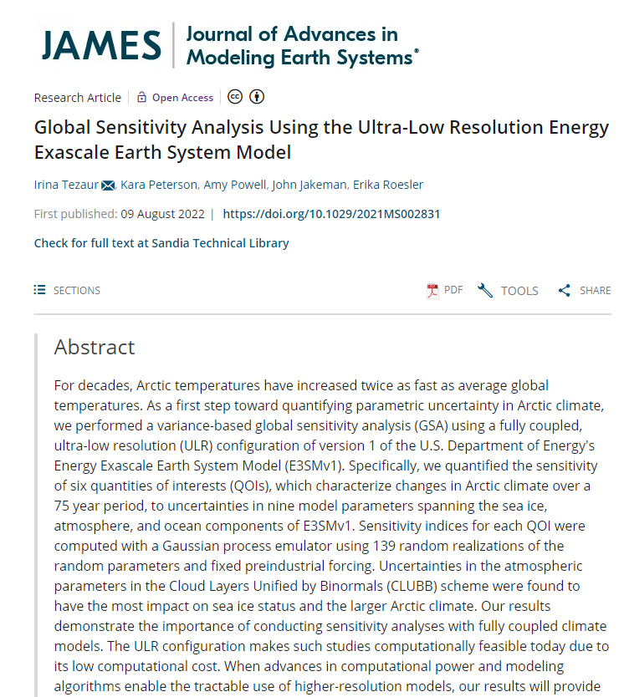
This talk is mostly on the following 2022 JAMES paper…
Goal: perform sensitivity analyses towards quantifying uncertainties in Arctic-focused quantities of interest (QoIs).
Map of North America showing 6m SLR (NASA)
DOI: https://doi.org/10.1029/2021MS002831

Slide 3
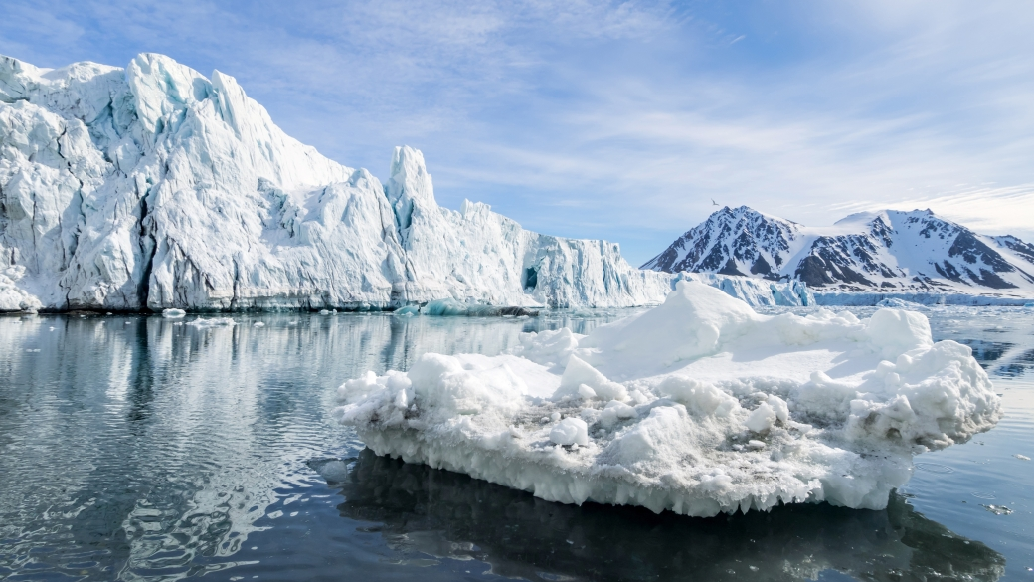
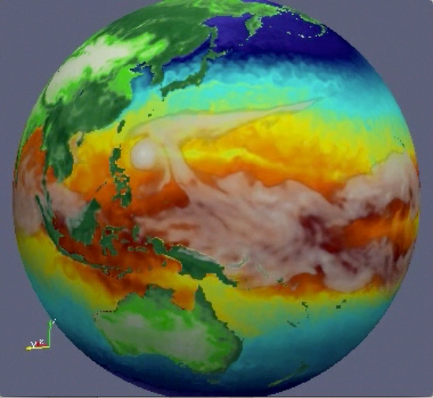
Outline
Background and motivation
Methodology
Model tuning and spin-up
Evaluation of the ultra-low resolution (ULR) E3SM
Global sensitivity analysis results
Summary
Bonus: sensitivity analysis for stratospheric aerosol injection (SAI)
Map of North America showing 6m SLR (NASA)

Slide 4
Outline
Background and motivation
Methodology
Model tuning and spin-up
Evaluation of the ultra-low resolution (ULR) E3SM
Global sensitivity analysis results
Summary
Bonus: sensitivity analysis for stratospheric aerosol injection (SAI)
Map of North America showing 6m SLR (NASA)

Slide 5
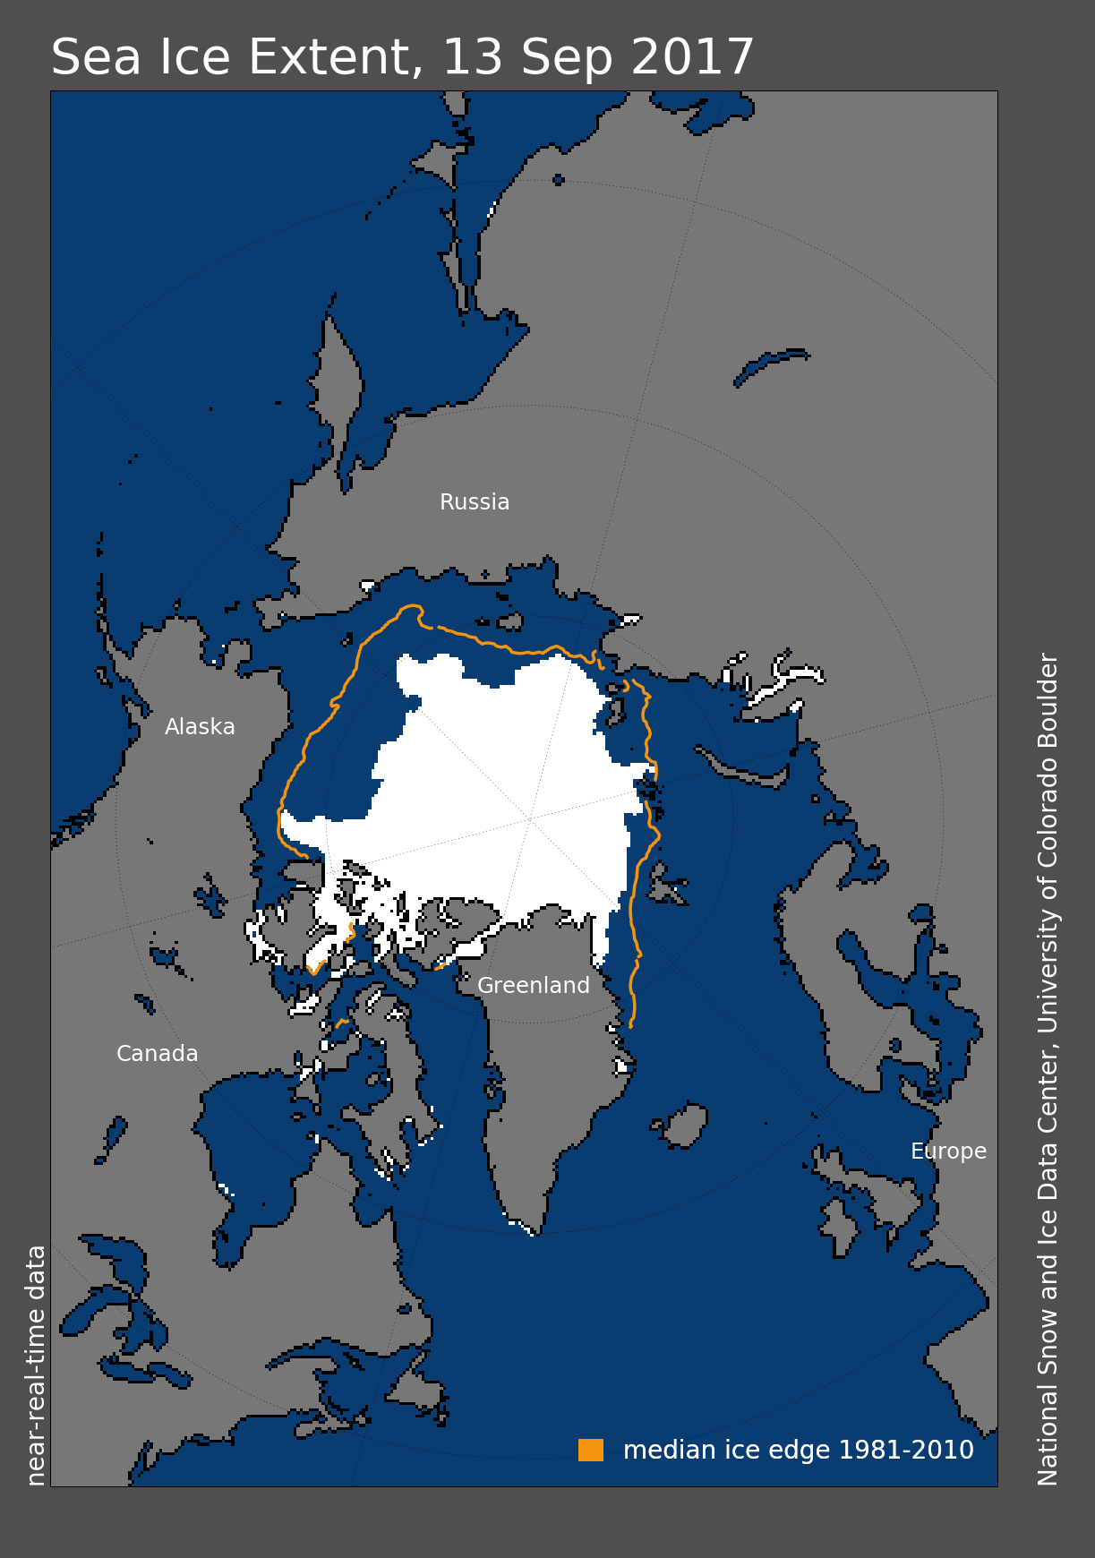
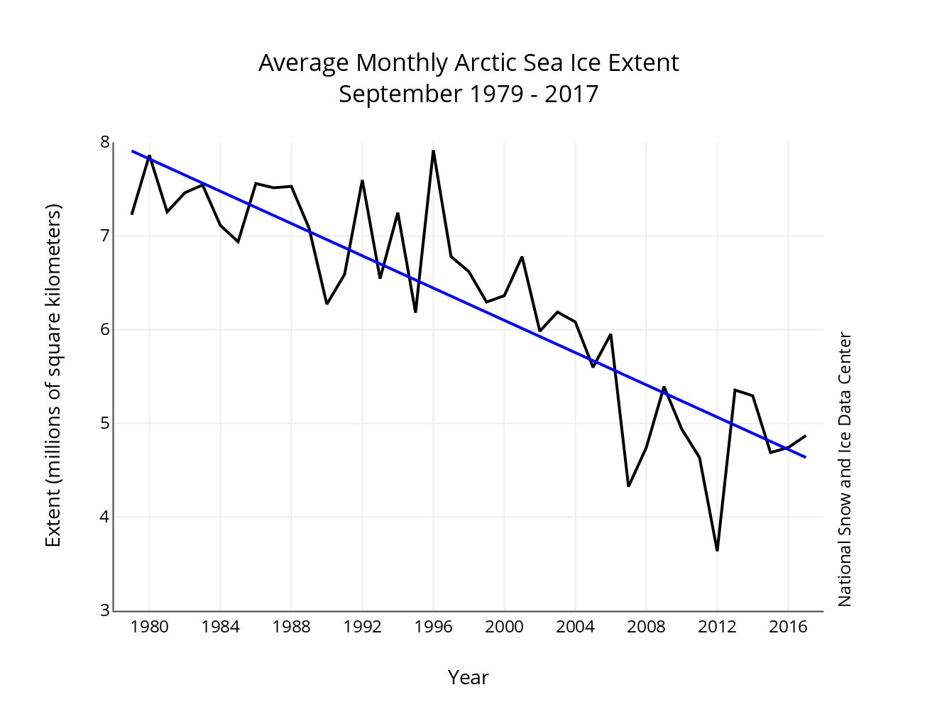
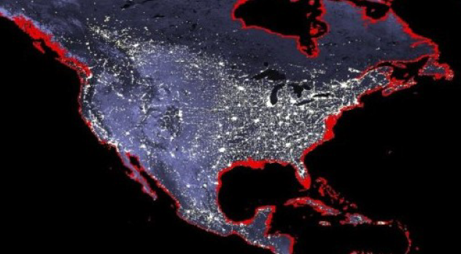
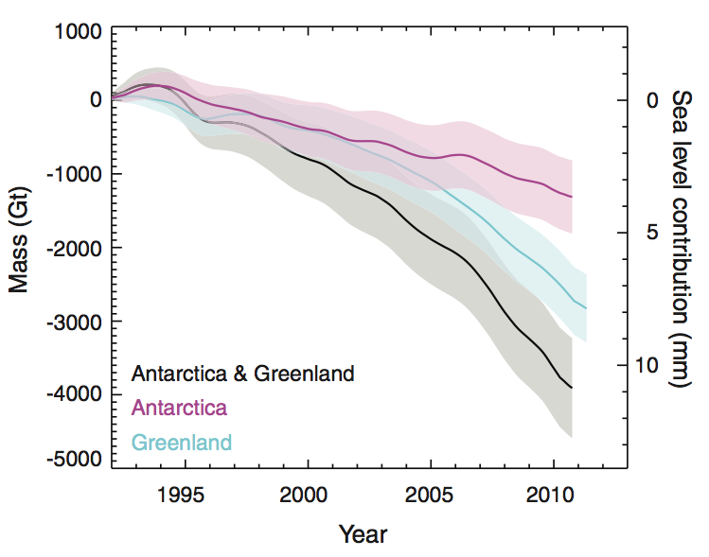
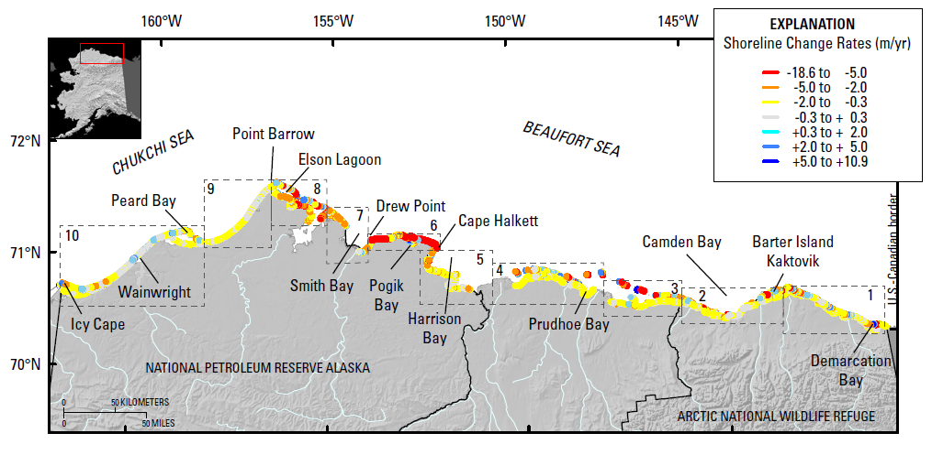

Background and motivation
Arctic systems are strongly coupled and rapidly changing!
4$×$!
Arctic is warming at twice the rate of the rest of the globe¹
Abrupt changes related to sea ice loss, land ice melt and permafrost thaw have the potential to cause significant global climate impacts²
  September sea ice extent has declined 13.1% per decade from 1979-2020 relative to 1979-2010 average¹
  Global mean sea-level is rising at the rate of 3.2 mm/year and this rate is increasing due to melting of polar ice sheets
  Arctic permafrost erosion rates have accelerated, leading to threats to coastal communities, coastal infrastructure and global carbon balance
Changes can potentially lead to tipping events with significant global impacts²
Research to advance predictability and bound uncertainty of Earth system models are crucial to inform planning and decision-making
Map of North America showing 6m SLR (NASA)
Active DOD sites
Loss of up to 200m b/w 2007-2017
Barrow
Wainwright
Oliktok
Barter Island
Bullen Point
¹ NOAA Arctic Report Card 2020.
² “Climate tipping points – too risky to bet against”, Lenton et al. Nature 2019.
Gibbs & Richmond, 2015

Slide 6
Objective and Approach
Objective:
Gain understanding of Arctic system dynamics including feedbacks between Arctic physical systems using sea ice as an exemplar
Approach:
Perform global sensitivity analysis (GSA) using the fully-coupled ultra-low resolution (ULR) configuration of the Energy Exascale Earth System Model (E3SM)
  Investigate uncertainty and stability in E3SM simulations
  Analyze trends and investigate internal variability in E3SM simulations of sea ice extent
Atmosphere
(EAM)
Energy Exascale Earth System Model (E3SM):
U.S. DOE flagship open-source¹ coupled Earth system model
Collaboration between 8 national labs and 12 academic institutions
Development driven by DOE Office of Science mission interests: energy and water issues looking out 40 years
Our study utilized version 1 of the E3SM, denoted by E3SMv1, with pre-industrial control (1850) forcing at the ULR configuration
Ocean
(MPAS-O)
Sea Ice
(MPAS-SI)
Land
(ELM)
Land Ice
(MALI)
¹ www.e3sm.org; https://github.com/E3SM-Project/E3SM.

Slide 7
Outline
Background and motivation
Methodology
Model tuning and spin-up
Evaluation of the ultra-low resolution (ULR) E3SM
Global sensitivity analysis results
Summary
Bonus: sensitivity analysis for stratospheric aerosol injection (SAI)
Map of North America showing 6m SLR (NASA)

Slide 8

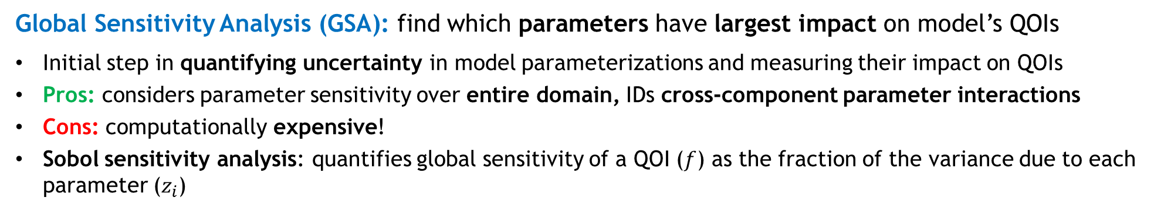


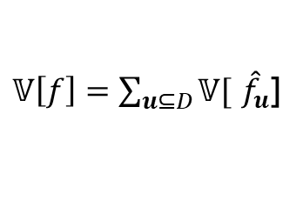
Methodology
Global Sensitivity Analysis (GSA): find which parameters have largest impact on model’s QOIs
Initial step in quantifying uncertainty in model parameterizations and measuring their impact on QOIs
Pros: considers parameter sensitivity over entire domain, IDs cross-component parameter interactions
Cons: computationally expensive!
Sobol sensitivity analysis: quantifies global sensitivity of a QOI ($f$) as the fraction of the variance due to each parameter ($z_{i}$)
$$f\left(z\right)= {\hat{f}}_{0}+\sum_{i=1}^{d}{{\hat{f}}_{i}\left(z_{i}\right)+\sum_{i,j=1}^{d}{{\hat{f}}_{i,j}\left(z_{i},z_{j}\right)+\sum_{i,j,k=1}^{d}{{\hat{f}}_{i,j,k}\left(z_{i},z_{j},z_{k}\right)+ … =\sum_{u⊆D}{{\hat{f}}_{u}\left(z_{u}\right)} }}}$$
ANOVA Expansion of QOI:
Variance of QOI:
$𝕍\left[f\right]=\sum_{u⊆D}{𝕍[}$ ${\hat{f}}_{u}$]
$$S_{i}^{M}=\frac{𝕍\left[{\hat{f}}_{e_{i}}\right]}{𝕍\left[f\right]}$$
Main effect indices:
  Measure effect of individual parameters acting alone
$$S_{i}^{T}=\frac{\sum_{u⊆J}{𝕍[}{\hat{f}}_{u}\text{]}}{𝕍\left[f\right]}$$
Total effect indices:
Measure contribution of each parameter and parameter interactions to the variance of QOI
$$S_{u}=\frac{𝕍\text{[}{\hat{f}}_{u}\text{]}}{𝕍\left[f\right]}$$
Sobol indices:
Notes:
- NOT local sensitivity reflected by a derivative
- Any function f with finite variance parameterized by a set of independent variables z can be decomposed into a finite sum, referred to as the Analysis of Variance (ANOVA) decomposition

Slide 9
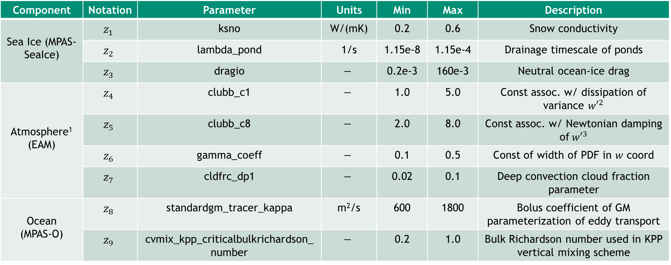
Parameters
Component | Notation | Parameter | Units | Min | Max | Description
Sea Ice (MPAS-SeaIce) | $$z_{1}$$ | ksno | W/(mK) | 0.2 | 0.6 | Snow conductivity
 | $$z_{2}$$ | lambda_pond | 1/s | 1.15e-8 | 1.15e-4 | Drainage timescale of ponds
 | $$z_{3}$$ | dragio | $$−$$ | 0.2e-3 | 160e-3 | Neutral ocean-ice drag
Atmosphere¹ (EAM) | $$z_{4}$$ | clubb_c1 | $$−$$ | 1.0 | 5.0 | Const assoc. w/ dissipation of variance ${w′}^{2}$
 | $$z_{5}$$ | clubb_c8 | $$−$$ | 2.0 | 8.0 | Const assoc. w/ Newtonian damping of${w′}^{3}$
 | $$z_{6}$$ | gamma_coeff | $$−$$ | 0.1 | 0.5 | Const of width of PDF in $w$ coord
 | $$z_{7}$$ | cldfrc_dp1 | $$−$$ | 0.02 | 0.1 | Deep convection cloud fraction parameter
Ocean (MPAS-O) | $$z_{8}$$ | standardgm_tracer_kappa | m²/s | 600 | 1800 | Bolus coefficient of GM parameterization of eddy transport
 | $$z_{9}$$ | cvmix_kpp_criticalbulkrichardson_number | $$−$$ | 0.2 | 1.0 | Bulk Richardson number used in KPP vertical mixing scheme
¹ CLUBB (Cloud Layers Unified by Binormals): cloud physics parameterization in EAM.
Nine parameters span three E3SM components (sea ice, atmosphere, ocean)
Parameters and parameter ranges were guided by past analyses [Urrego-Blanco et al. 2016; Urrego-Blanco et al. 2019; Reckinger et al. 2015; Asay-Davis et al. 2018; Qian et al. 2018; Rasch et al. 2019]
Notes:
Atmosphere parameters are associated with CLUBB (Cloud Layers Unified by Binormals) physics parameterization within the single-column version of CAM5.
GM = Gent-McWilliams

Slide 10
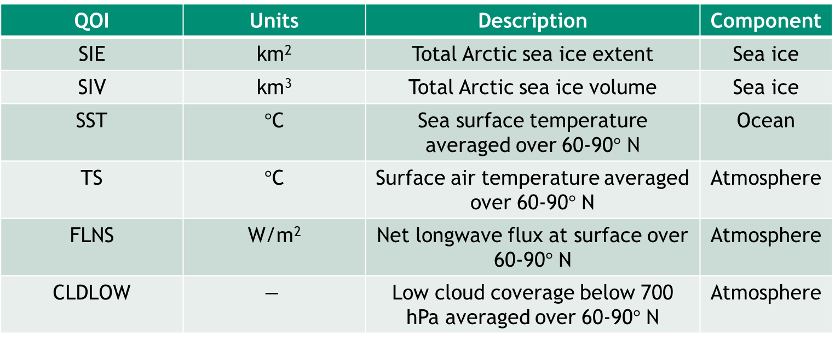
Quantities of Interest (QOIs)
QOI | Units | Description | Component
SIE | km² | Total Arctic sea ice extent | Sea ice
SIV | km³ | Total Arctic sea ice volume | Sea ice
SST | $°$C | Sea surface temperature averaged over 60-90$°$ N | Ocean
TS | $°$C | Surface air temperature averaged over 60-90$°$ N | Atmosphere
FLNS | W/m² | Net longwave flux at surface over 60-90$°$ N | Atmosphere
CLDLOW | $$−$$ | Low cloud coverage below 700 hPa averaged over 60-90$°$ N | Atmosphere
Six QOIs span three E3SM components (sea ice, ocean and atmosphere)
QOIs are Arctic-focused, motivated by literature [Urrego-Blanco et al. 2016; Urrego-Blanco et al. 2019]
QOIs are computed by averaging annually and seasonally over last 25 years of each 75-year simulation

Slide 11
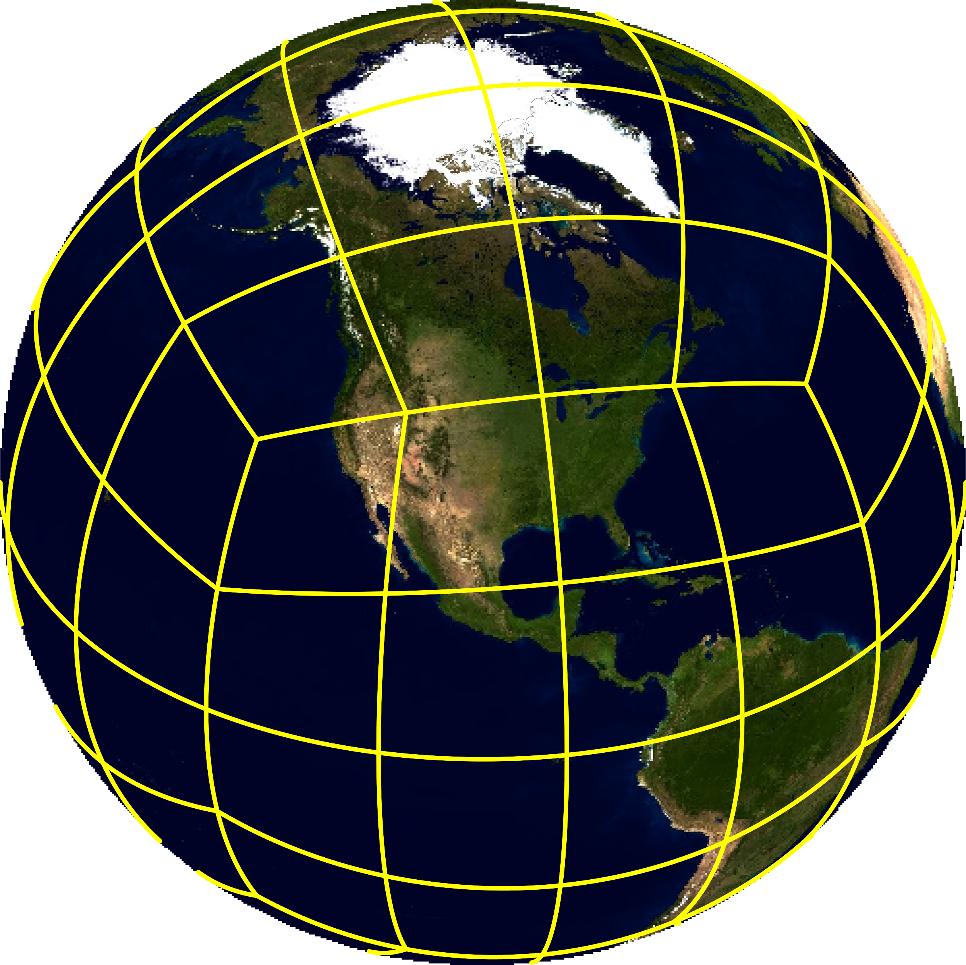
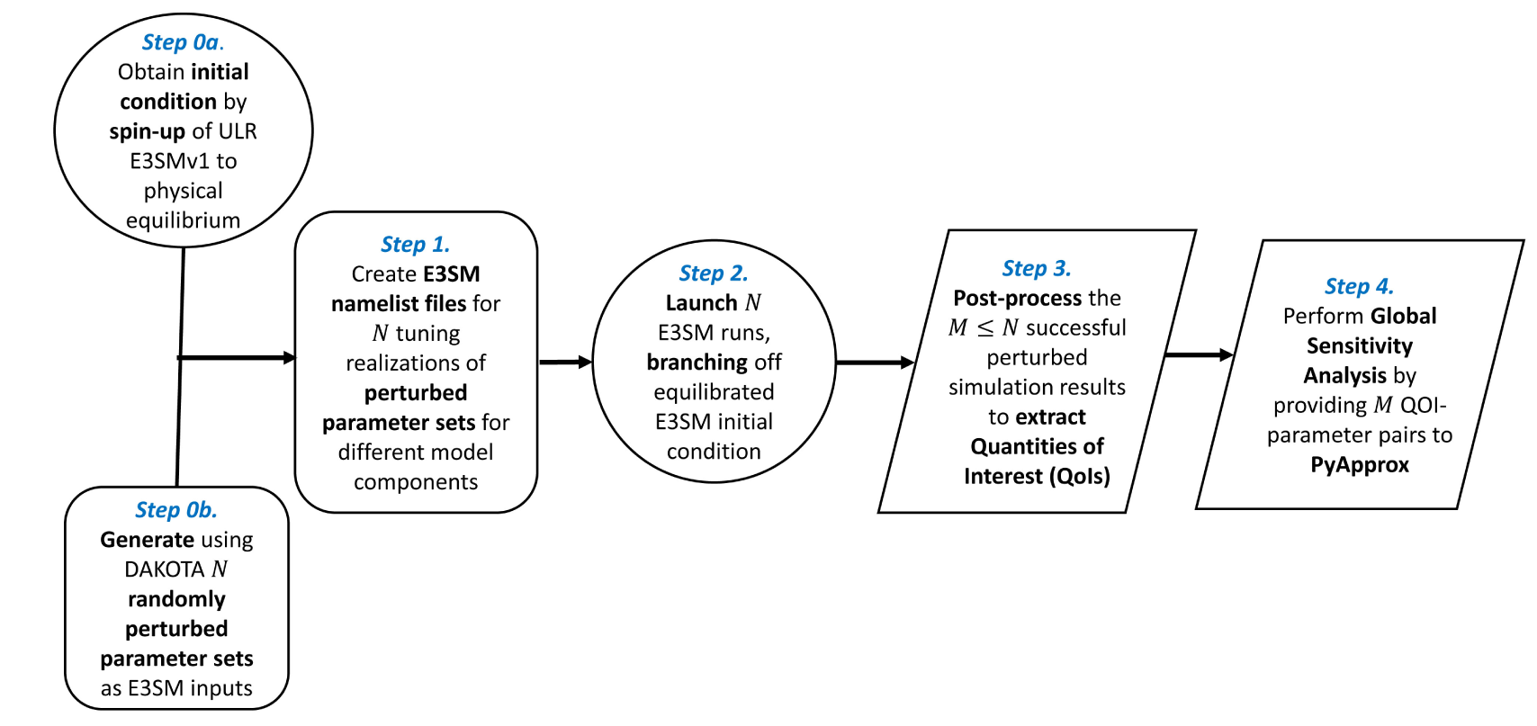
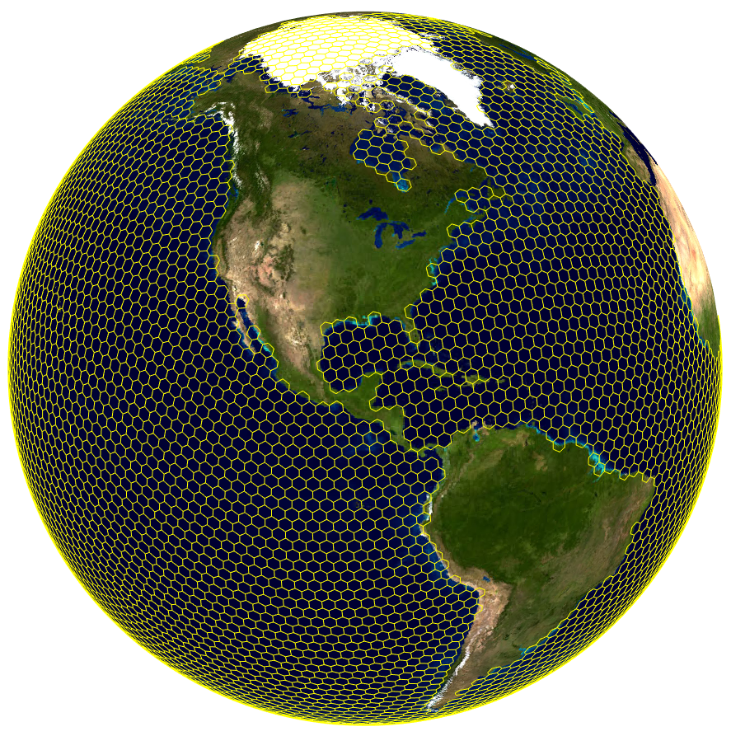

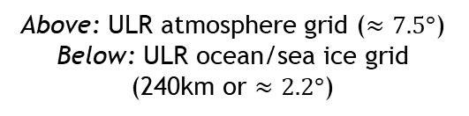
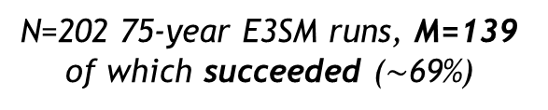
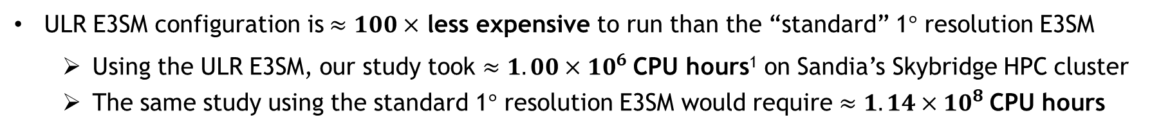
GSA workflow with fully-coupled E3SM
N=202 75-year E3SM runs, M=139 of which succeeded ($\sim$69%)
¹ Flexible and efficient open-source tool for high-dimensional approximation and UQ:
https://github.com/sandialabs/pyapprox
Above: ULR atmosphere grid ($≈7.5°$) Below: ULR ocean/sea ice grid (240km or $≈2.2°$)
Sensitivity indices for each QOI were computed using a Gaussian process (GP) emulator using PyApprox¹
https://dakota.sandia.gov
The ULR configuration enables sufficient ensemble generation for full GSA with the fully-coupled E3SM!
ULR E3SM configuration is $≈100×$ less expensive to run than the “standard” 1$°$ resolution E3SM
  Using the ULR E3SM, our study took $≈1.00×{10}^{6}$CPU hours¹ on Sandia’s Skybridge HPC cluster
  The same study using the standard 1$°$ resolution E3SM would require $≈1.14×{10}^{8}$CPU hours
¹ Equivalent to 24 sypd on 6 Skybridge nodes.

Slide 12
Outline
Background and motivation
Methodology
Model tuning and spin-up
Evaluation of the ultra-low resolution (ULR) E3SM
Global sensitivity analysis results
Summary
Bonus: sensitivity analysis for stratospheric aerosol injection (SAI)
Map of North America showing 6m SLR (NASA)

Slide 13
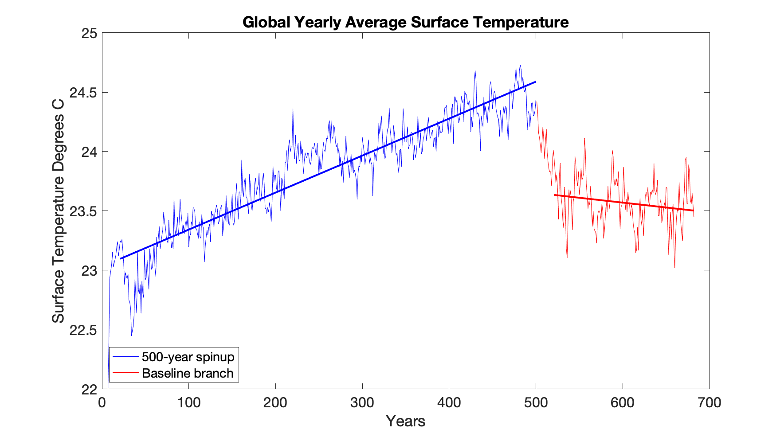
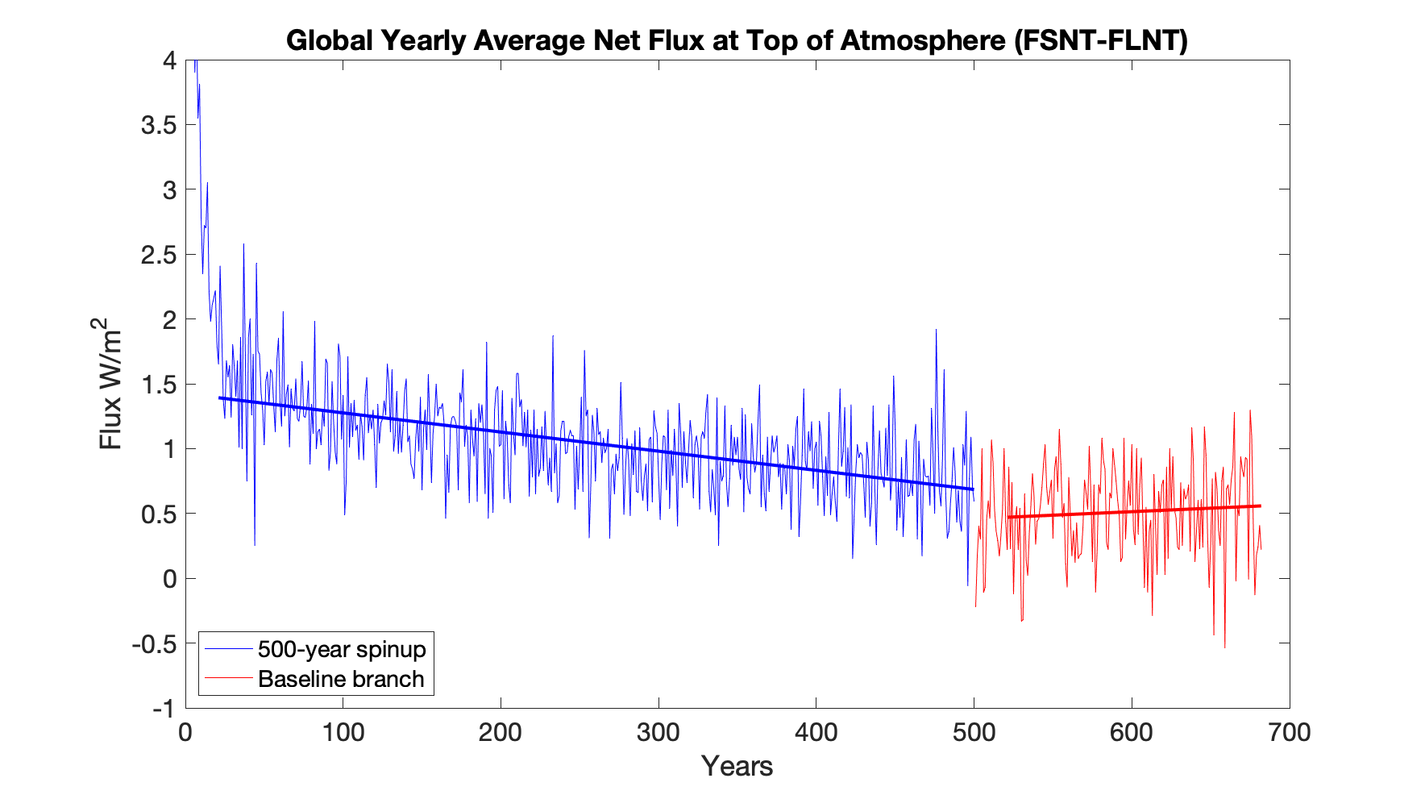
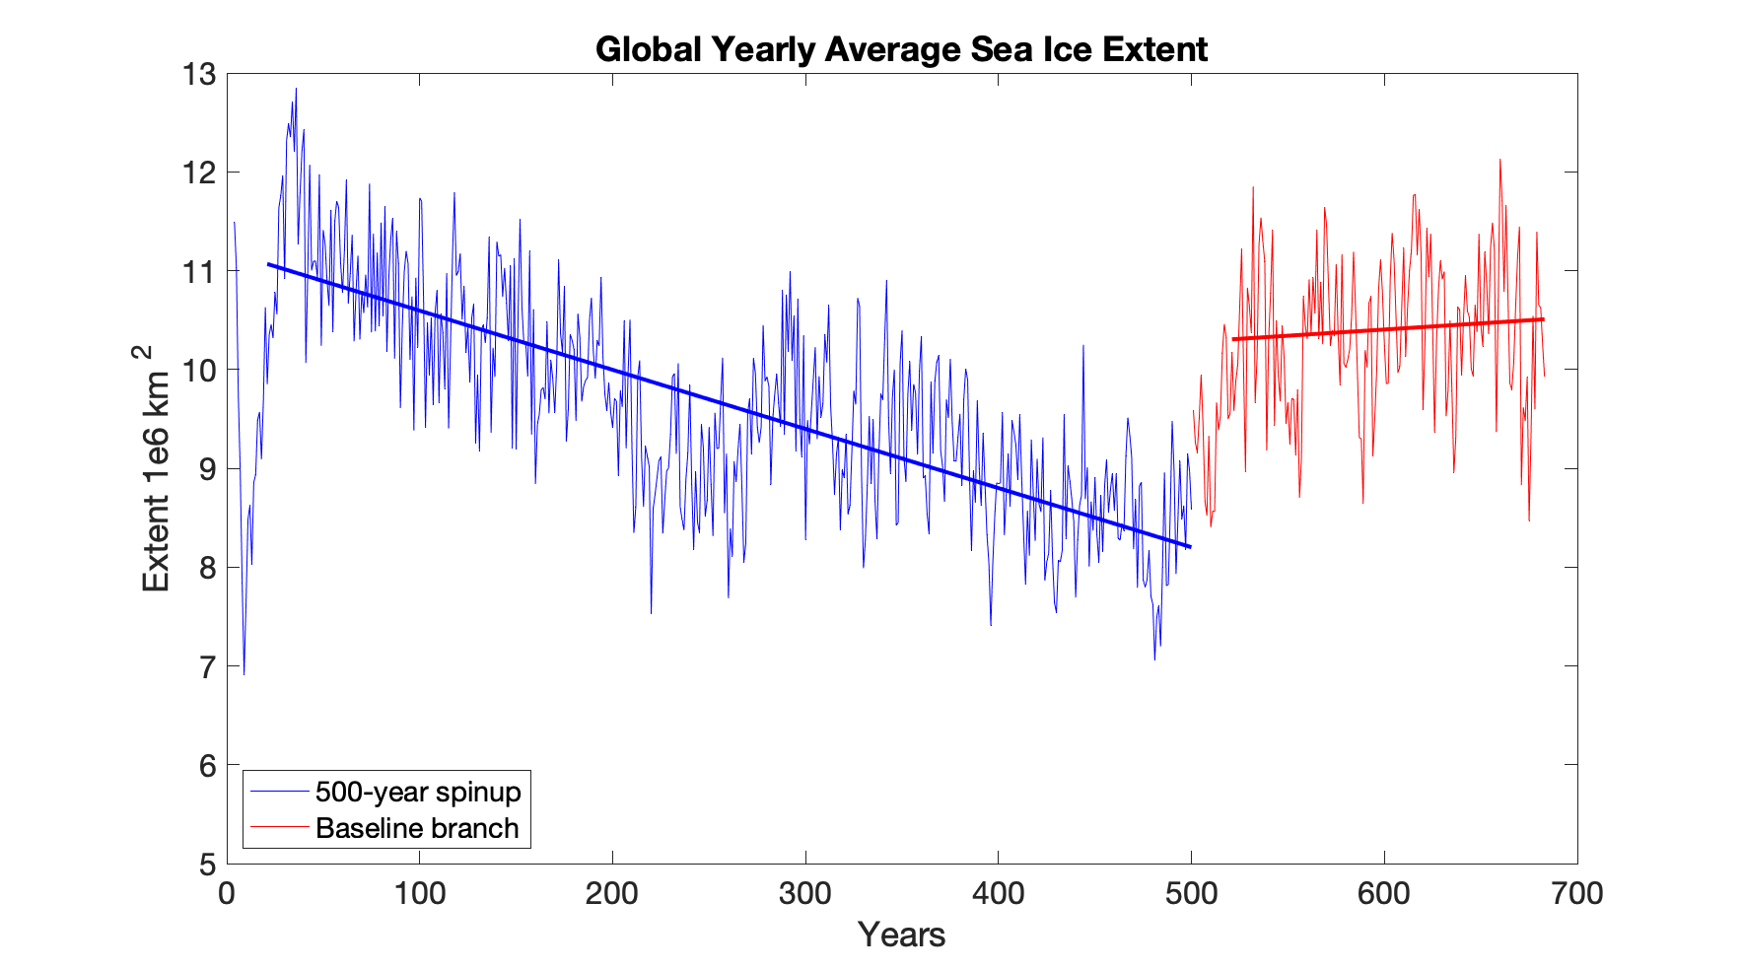
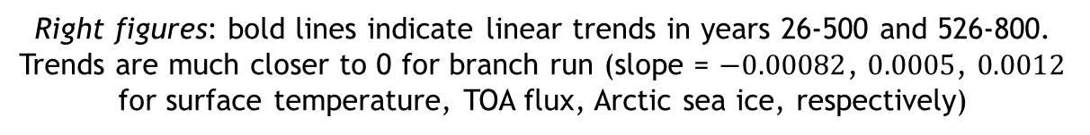
Model tuning and spin-up
(a) Global Yearly Average Surface Temperature
Objective: before initializing perturbed runs, run the model until an equilibrium, Earth-like state is achieved using pre-industrial (1850) control (piControl) forcing in which we have
Constant global average mean surface air temperature, (a)
Near-zero long-term average net top-of-atmosphere (TOA) energy flux, (b)
Stable yearly sea ice coverage, (c)
Spin-up approach:
500 year run with pre-industrial control forcing, default parameter values
180 year run branched from 500 year initial run, with parameter values from Golaz et al. 2018
Year 675 of the branch run was used as IC for GSA runs
(b) Global Yearly Average Net Flux at Atmosphere
(c) Global Yearly Average Sea Ice Extent
Right figures: bold lines indicate linear trends in years 26-500 and 526-800. Trends are much closer to 0 for branch run (slope = $−0.00082$, $0.0005$, $0.0012$ for surface temperature, TOA flux, Arctic sea ice, respectively)

Slide 14
Outline
Background and motivation
Methodology
Model tuning and spin-up
Evaluation of the ultra-low resolution (ULR) E3SM
Global sensitivity analysis results
Summary
Bonus: sensitivity analysis for stratospheric aerosol injection (SAI)
Map of North America showing 6m SLR (NASA)

Slide 15
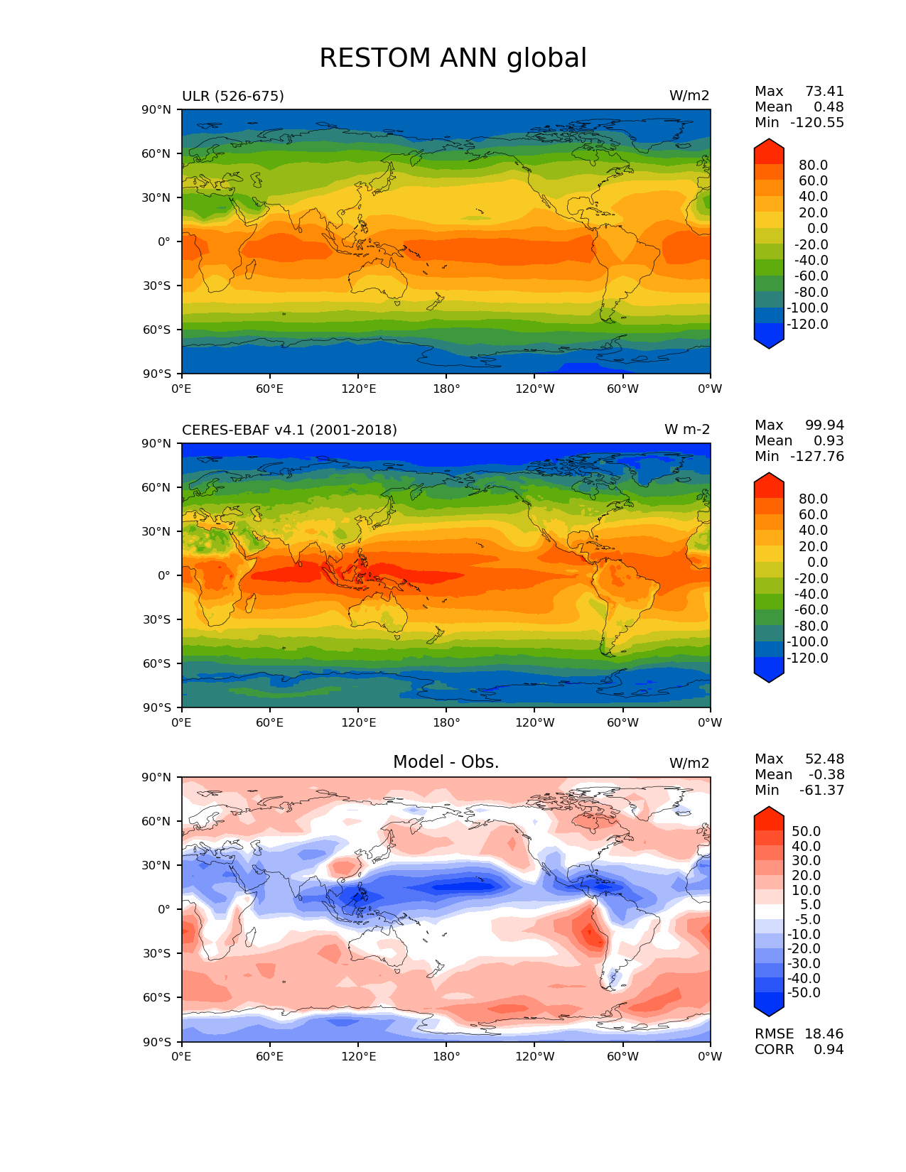
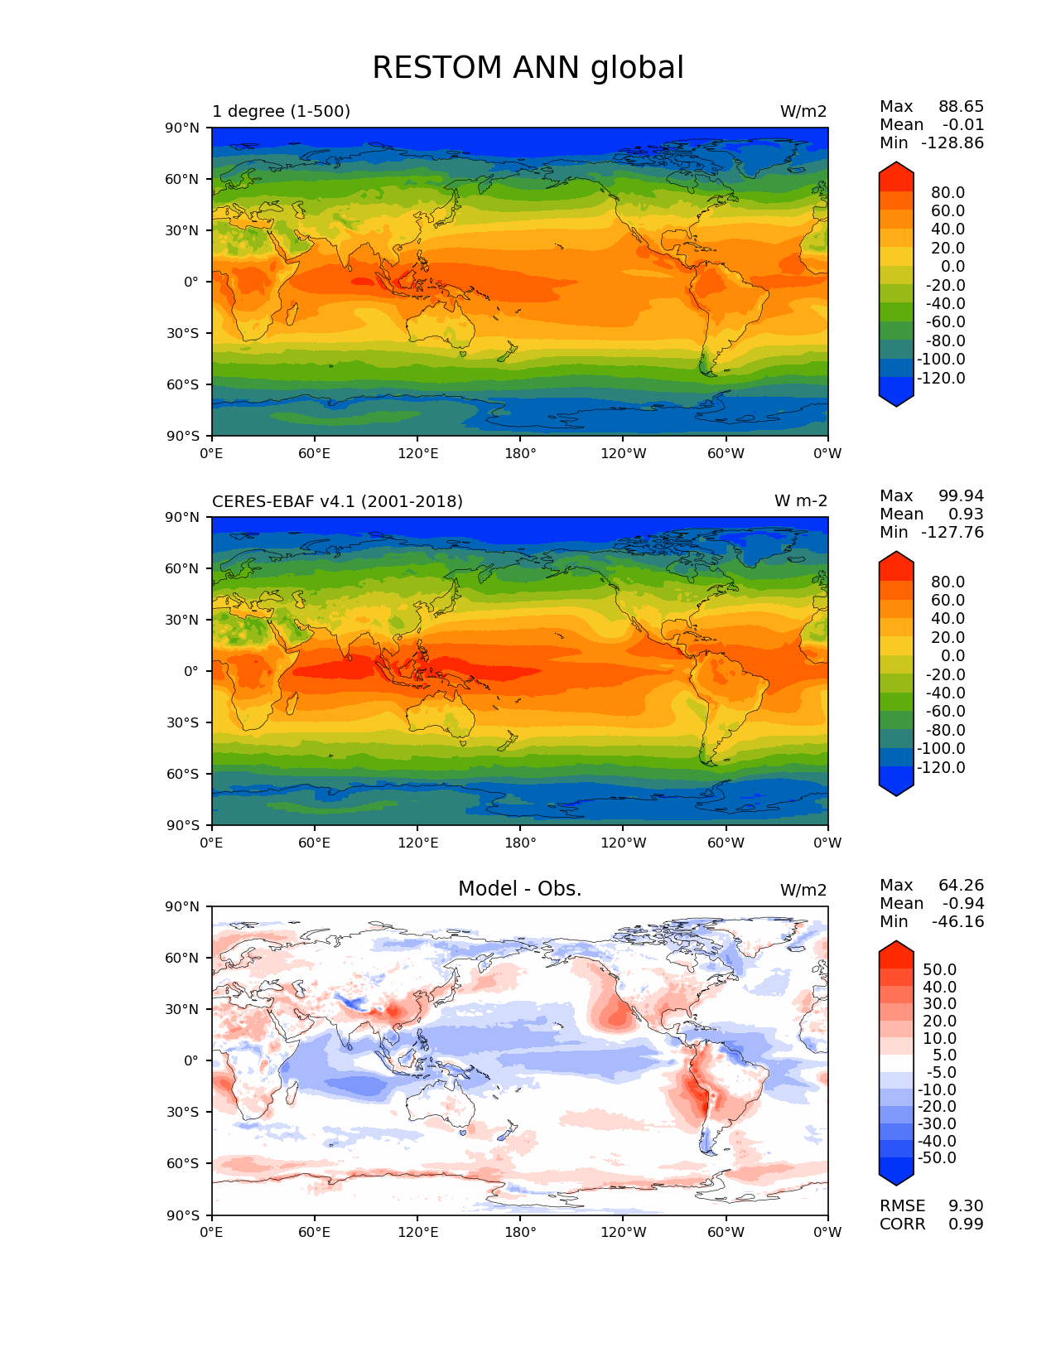
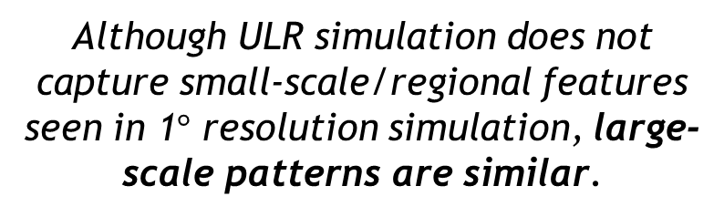
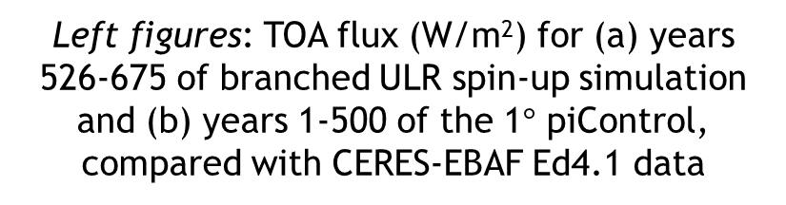

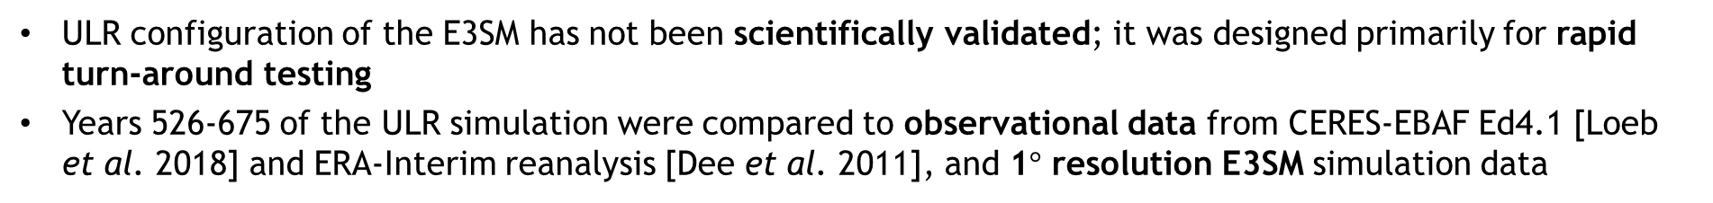
How good is the ULR E3SM?
ULR configuration of the E3SM has not been scientifically validated; it was designed primarily for rapid turn-around testing
Years 526-675 of the ULR simulation were compared to observational data from CERES-EBAF Ed4.1 [Loeb et al. 2018] and ERA-Interim reanalysis [Dee et al. 2011], and 1$°$ resolution E3SM simulation data
Left figures: TOA flux (W/m²) for (a) years 526-675 of branched ULR spin-up simulation and (b) years 1-500 of the 1$°$ piControl, compared with CERES-EBAF Ed4.1 data
Model
CERES-EBAF Ed4.1
Although ULR simulation does not capture small-scale/regional features seen in 1$°$ resolution simulation, large-scale patterns are similar.
Diff.
(a) ULR E3SM
(b) 1$°$E3SM

Slide 16
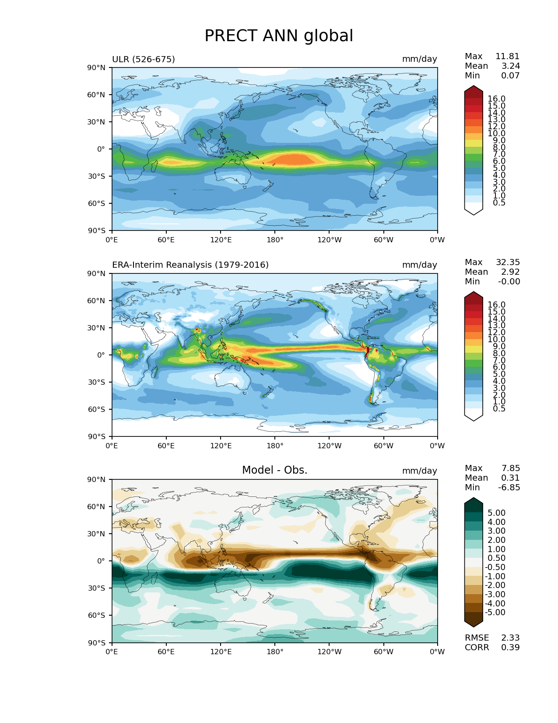
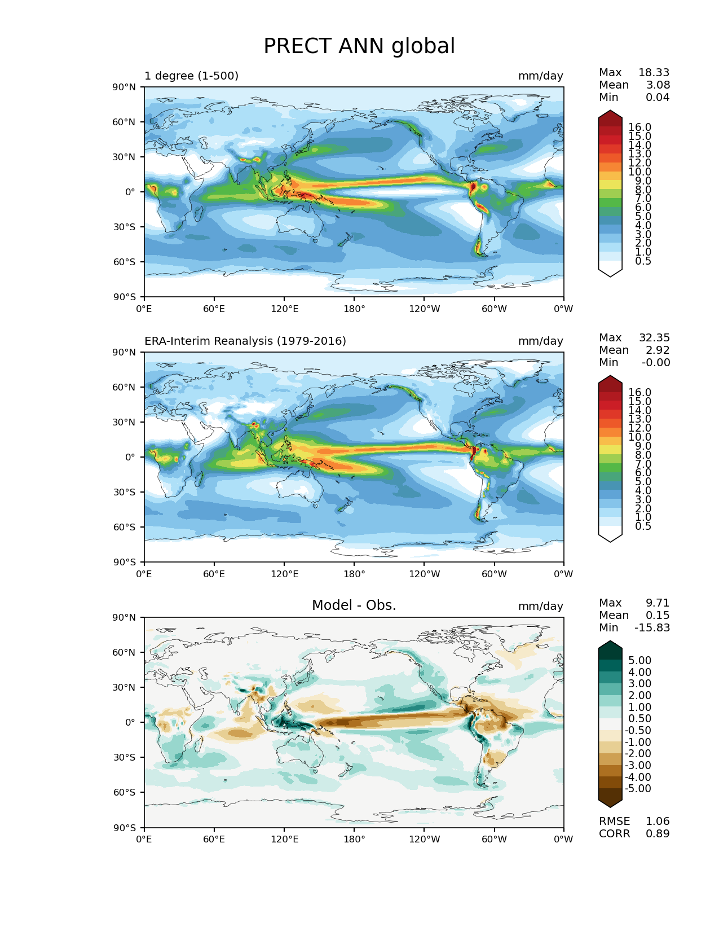
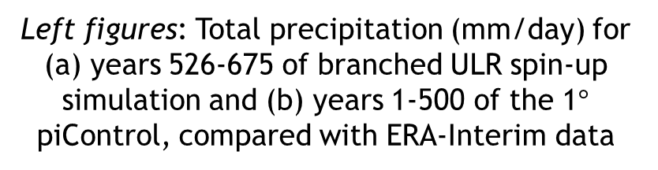
How good is the ULR E3SM?
ULR configuration of the E3SM has not been scientifically validated; it was designed primarily for rapid turn-around testing
Years 526-675 of the ULR simulation were compared to observational data from CERES-EBAF Ed4.1 [Loeb et al. 2018] and ERA-Interim reanalysis [Dee et al. 2011], and 1$°$ resolution E3SM simulation data
Left figures: Total precipitation (mm/day) for (a) years 526-675 of branched ULR spin-up simulation and (b) years 1-500 of the 1$°$ piControl, compared with ERA-Interim data
Model
ERA-Interim
Although ULR simulation does not capture small-scale/regional features seen in 1$°$ resolution simulation, large-scale patterns are similar.
Diff.
(a) ULR E3SM
(b) 1$°$E3SM

Slide 17
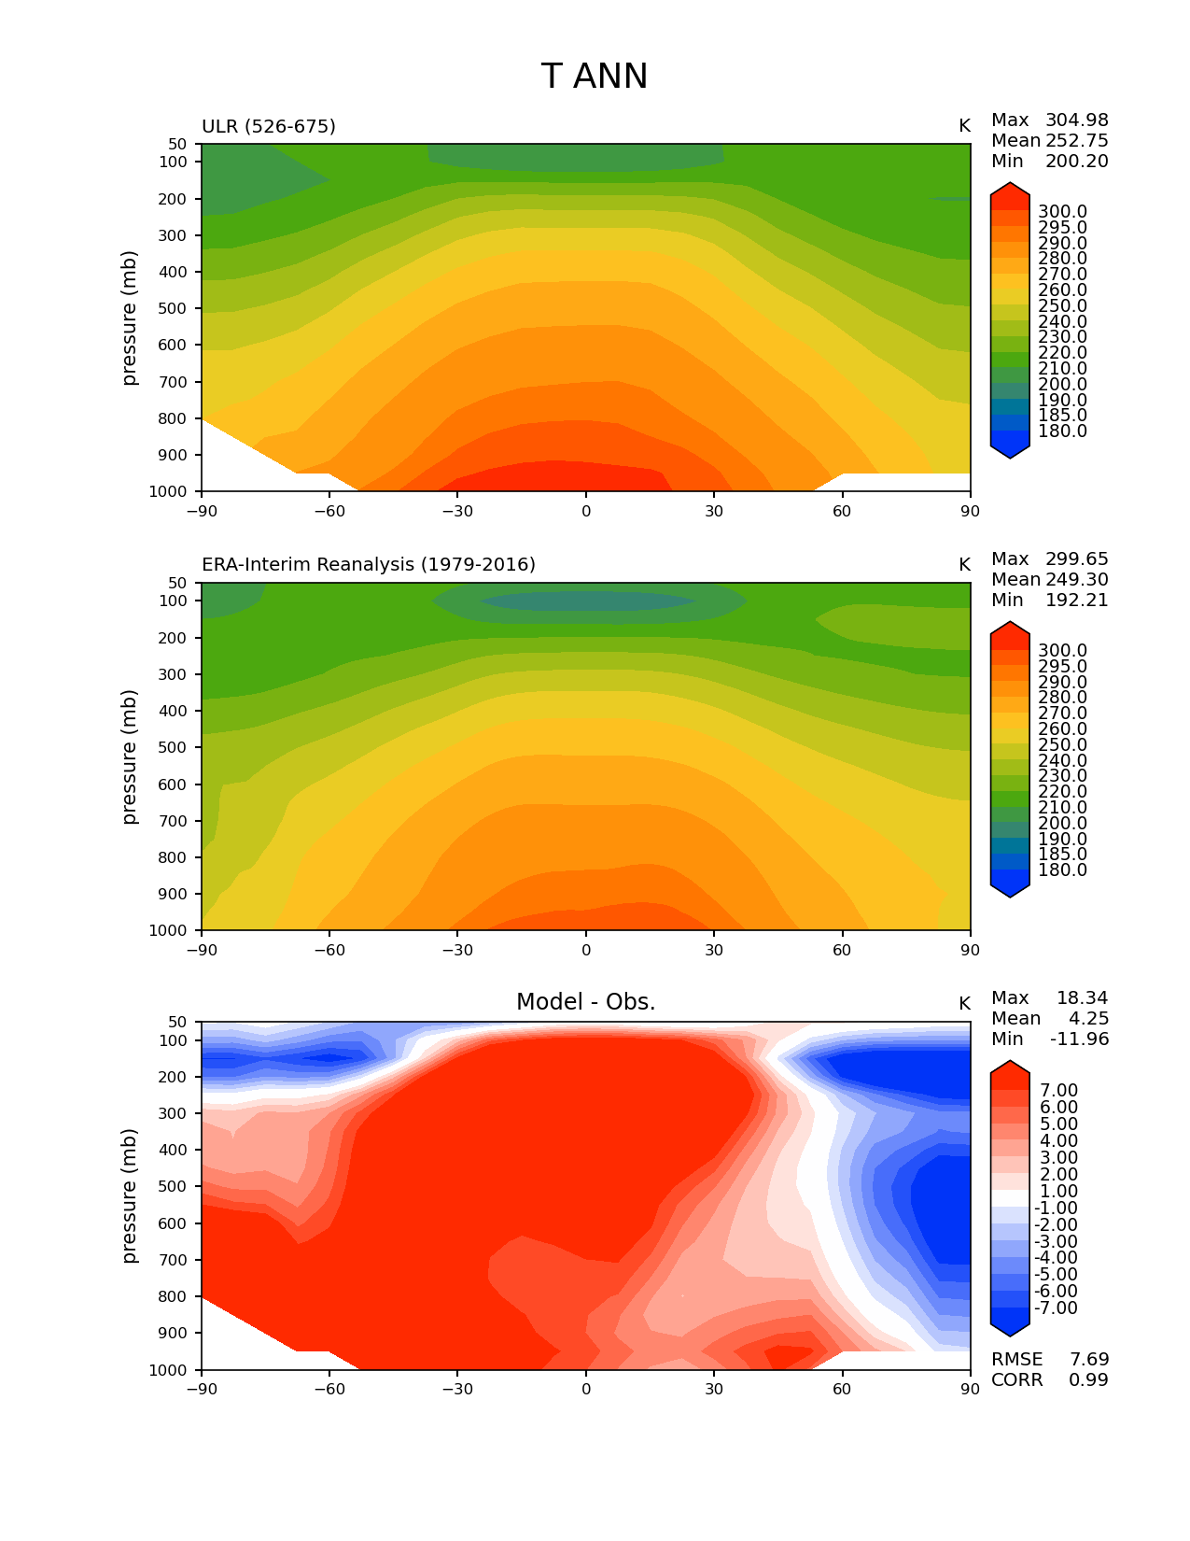
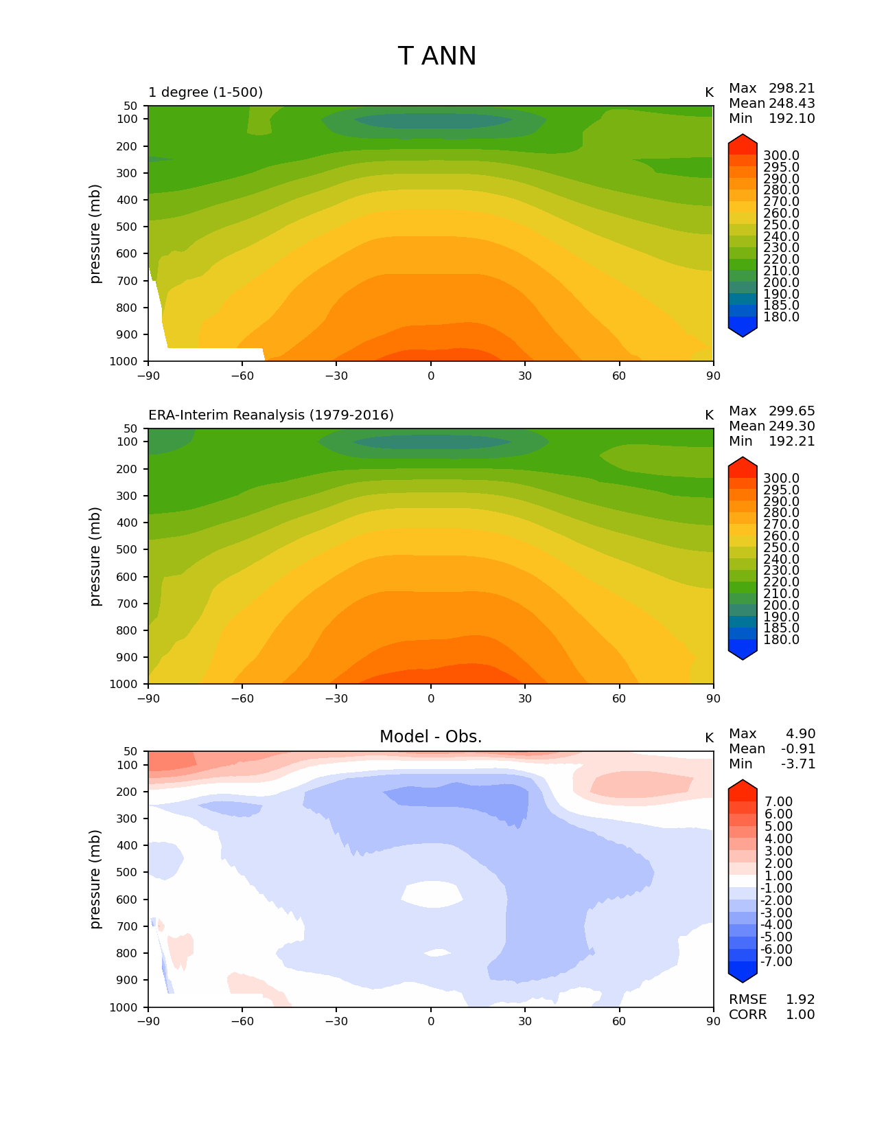
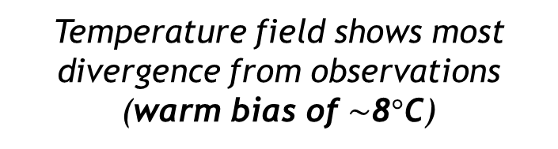
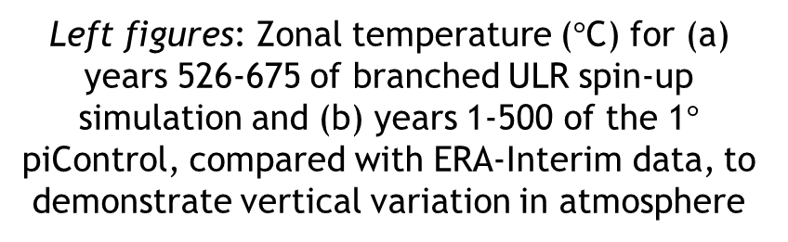
How good is the ULR E3SM?
ULR configuration of the E3SM has not been scientifically validated; it was designed primarily for rapid turn-around testing
Years 526-675 of the ULR simulation were compared to observational data from CERES-EBAF Ed4.1 [Loeb et al. 2018] and ERA-Interim reanalysis [Dee et al. 2011], and 1$°$ resolution E3SM simulation data
Left figures: Zonal temperature ($°$C) for (a) years 526-675 of branched ULR spin-up simulation and (b) years 1-500 of the 1$°$ piControl, compared with ERA-Interim data, to demonstrate vertical variation in atmosphere
Model
ERA-Interim
Temperature field shows most divergence from observations (warm bias of $\sim$8$°$C)
Diff.
(a) ULR E3SM
(b) 1$°$E3SM

Slide 18
Outline
Background and motivation
Methodology
Model tuning and spin-up
Evaluation of the ultra-low resolution (ULR) E3SM
Global sensitivity analysis results
Summary
Bonus: sensitivity analysis for stratospheric aerosol injection (SAI)
Map of North America showing 6m SLR (NASA)

Slide 19
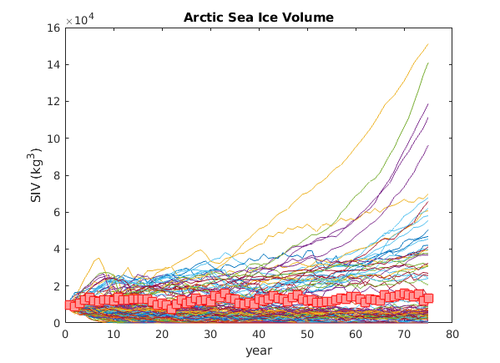
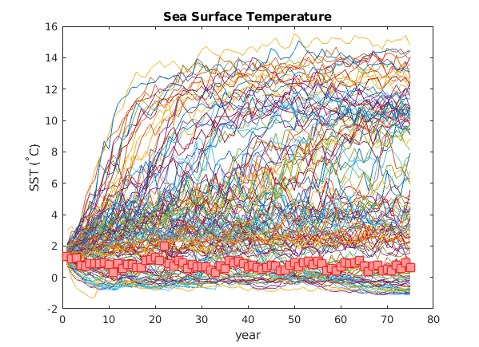
Ensemble trajectories
Arctic Sea Ice Volume
Sea Surface Temperature over Arctic
Most perturbed runs have reached equilibrium by year 40
Runs exhibit a great deal of variability:
  Several runs result in complete loss of Arctic sea ice
  Several runs exhibit apparent exponential growth in sea ice
Figures above: “Spaghetti plot” of two QOIs for our 139 successful ULR runs. Red markers indicate baseline run (no parameter perturbation)
`

Slide 20
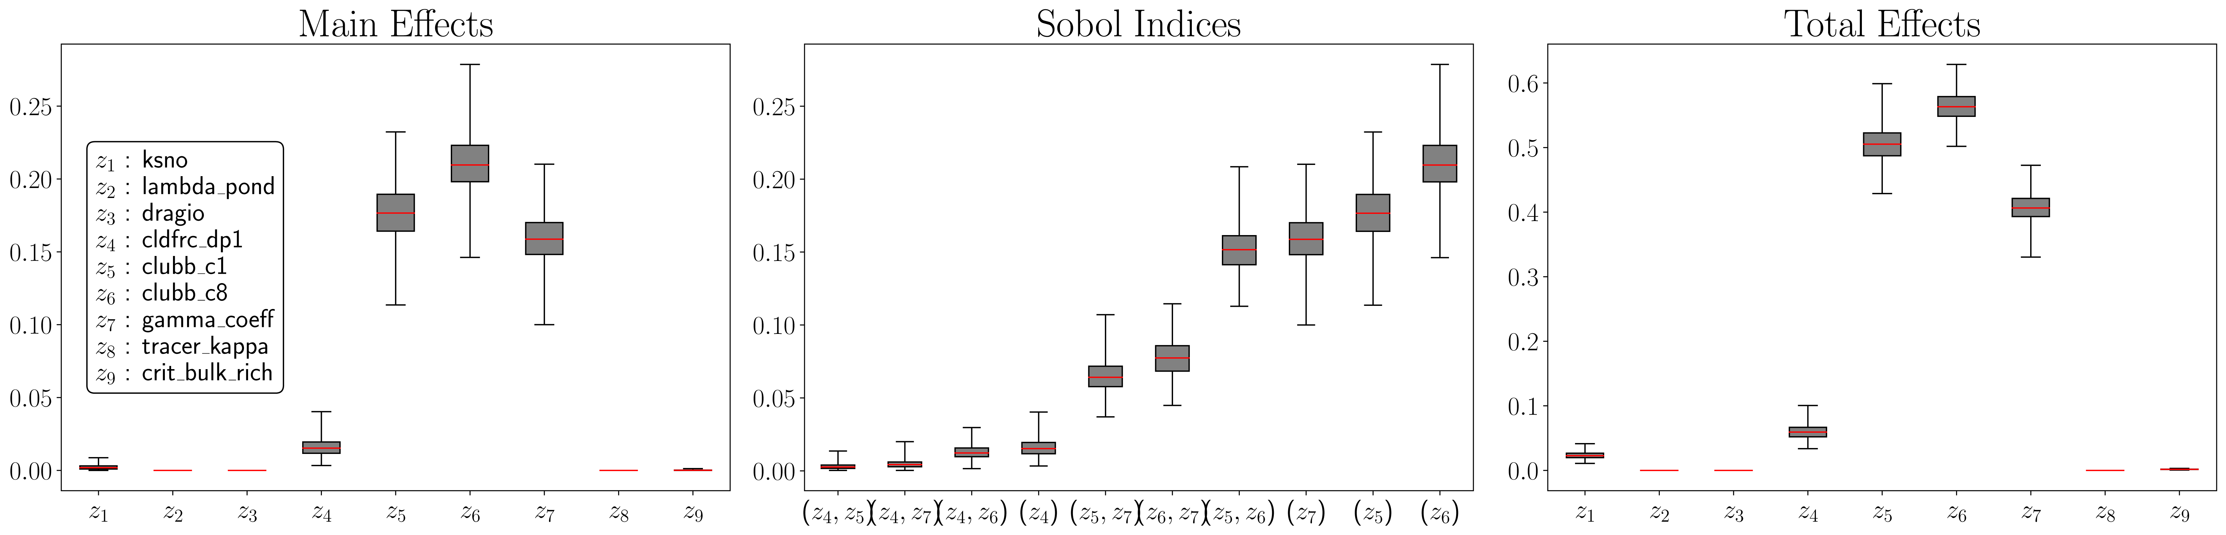
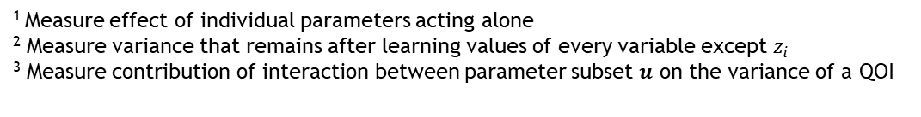
GSA results: sensitivity indices
¹ Measure effect of individual parameters acting alone
² Measure variance that remains after learning values of every variable except $z_{i}$
³ Measure contribution of interaction between parameter subset $u$ on the variance of a QOI
Main Effects¹
Sobol Indices²
Total Effects³
Sea ice
params
Atmosphere
params
Ocean
params
Figure above shows sensitivity indices for Sea Ice Volume QOI in spring
Notes:
Posterior mean and variance are calculated as average of estimates of indices obtained using 1000 different random realizations of the GP
For each realization, we compute sensitivity indices accurately (close to machine precision) using a procedure similar to that used for constructing main effect functions
Total effect indices: measure total contribution of each parameter to variance of a given QOI; specifically, they measure the contributions of all interactions involving a specific parameter; sum > 1
Comparing total effect indices with main effects can be used to determine the strength of high-order (> 2 parameter) interactions
Main effect indices: measure the effect of individual parameters acting alone and can sum to at most 1; as sum -> 1, contribution of all parameter combinations involving 2+ variables increases; value of 1 indicates that function is purely additive, and there is no interaction b/w any parameters

Slide 21
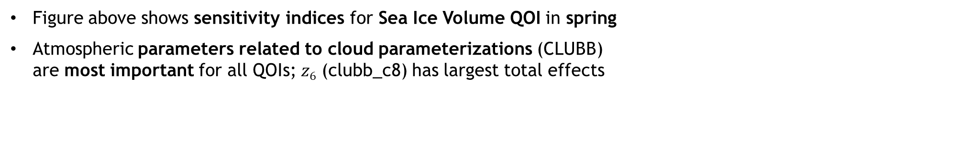
GSA results: sensitivity indices
¹ Measure effect of individual parameters acting alone
² Measure variance that remains after learning values of every variable except $z_{i}$
³ Measure contribution of interaction between parameter subset $u$ on the variance of a QOI
Main Effects¹
Sobol Indices²
Total Effects³
Sea ice
params
Atmosphere
params
Ocean
params
Figure above shows sensitivity indices for Sea Ice Volume QOI in spring
Atmospheric parameters related to cloud parameterizations (CLUBB) are most important for all QOIs; $z6$ (clubb_c8) has largest total effects
Notes:
$z_{5}$ (clubb_c1): CLUBB parameter which controls the balance of cumulus versus stratocumulus clouds
Large positive values favor cumulus clouds, while small or negative values are associated with stratocumulus clouds
$z_{6}$ (clubb_c8): CLUBB parameter developed to achieve radiative balance in atmospheric models
Increasing clubb_c8 brightens clouds, resulting in Earth surface cooling (brighter clouds reflect more incoming solar radiation)

Slide 22
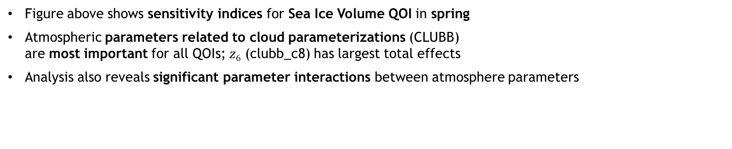
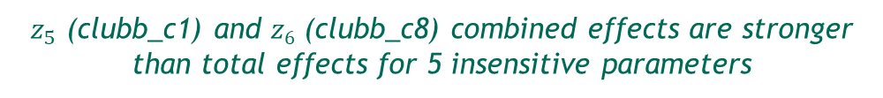
GSA results: sensitivity indices
¹ Measure effect of individual parameters acting alone
² Measure variance that remains after learning values of every variable except $z_{i}$
³ Measure contribution of interaction between parameter subset $u$ on the variance of a QOI
Main Effects¹
Sobol Indices²
Total Effects³
Sea ice
params
Atmosphere
params
Ocean
params
$z_{5}$ (clubb_c1) and $z6$ (clubb_c8) combined effects are stronger than total effects for 5 insensitive parameters
Figure above shows sensitivity indices for Sea Ice Volume QOI in spring
Atmospheric parameters related to cloud parameterizations (CLUBB) are most important for all QOIs; $z6$ (clubb_c8) has largest total effects
Analysis also reveals significant parameter interactions between atmosphere parameters

Slide 23
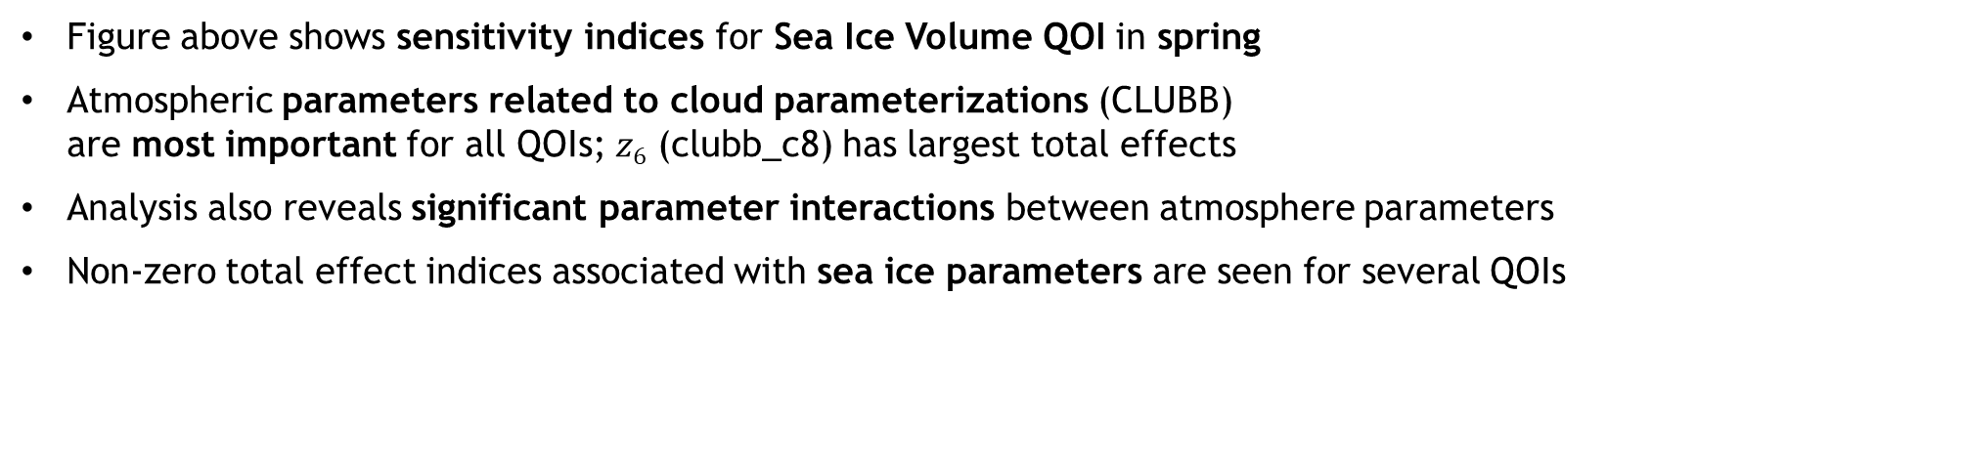
GSA results: sensitivity indices
¹ Measure effect of individual parameters acting alone
² Measure variance that remains after learning values of every variable except $z_{i}$
³ Measure contribution of interaction between parameter subset $u$ on the variance of a QOI
Main Effects¹
Sobol Indices²
Total Effects³
Sea ice
params
Atmosphere
params
Ocean
params
$z_{5}$ (clubb_c1) and $z6$ (clubb_c8) combined effects are stronger than total effects for 5 insensitive parameters
Figure above shows sensitivity indices for Sea Ice Volume QOI in spring
Atmospheric parameters related to cloud parameterizations (CLUBB) are most important for all QOIs; $z6$ (clubb_c8) has largest total effects
Analysis also reveals significant parameter interactions between atmosphere parameters
Non-zero total effect indices associated with sea ice parameters are seen for several QOIs

Slide 24
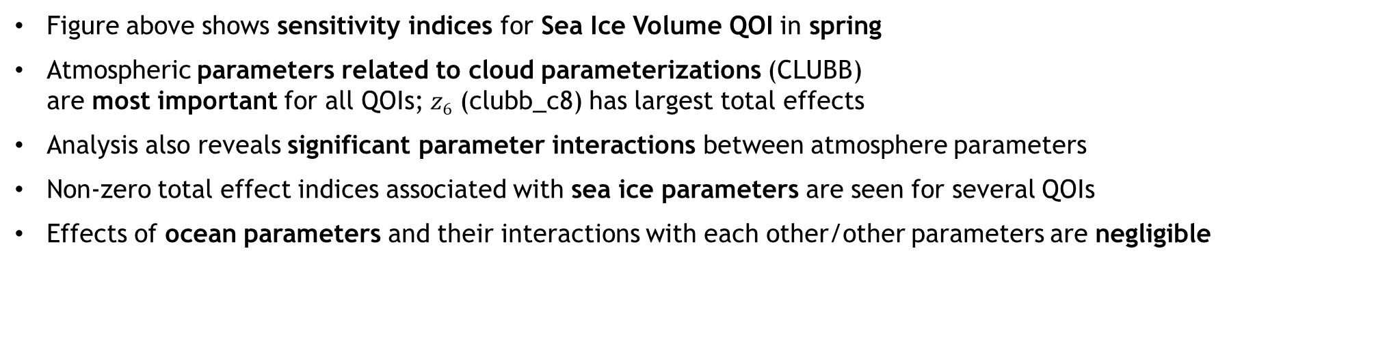
GSA results: sensitivity indices
¹ Measure effect of individual parameters acting alone
² Measure variance that remains after learning values of every variable except $z_{i}$
³ Measure contribution of interaction between parameter subset $u$ on the variance of a QOI
Main Effects¹
Sobol Indices²
Total Effects³
Sea ice
params
Atmosphere
params
Ocean
params
$z_{5}$ (clubb_c1) and $z6$ (clubb_c8) combined effects are stronger than total effects for 5 insensitive parameters
Figure above shows sensitivity indices for Sea Ice Volume QOI in spring
Atmospheric parameters related to cloud parameterizations (CLUBB) are most important for all QOIs; $z6$ (clubb_c8) has largest total effects
Analysis also reveals significant parameter interactions between atmosphere parameters
Non-zero total effect indices associated with sea ice parameters are seen for several QOIs
Effects of ocean parameters and their interactions with each other/other parameters are negligible
Notes:
Comparison to 2019 Urrego-Blanco paper: similar takeaways
cldfrc_rhminl and micro_mg_dcs parameters from CAM5 were overall the most influential – similar result
Other parameters had non-trivial influence on several QOIs (SIE, IVOL, CLDLOW), esp. ksno (snow thermal conductivity) on SIV
Cldfrc_rhminl: water vapor threshold for cloud formation (CAM5)
C: atmospheric stability parameter (POP-CAM5)
micro_mg_dcs: auto-conversion ice crystals to snow (CAM5)

Slide 25
GSA results: sensitivity indices
¹ Measure effect of individual parameters acting alone
² Measure variance that remains after learning values of every variable except $z_{i}$
³ Measure contribution of interaction between parameter subset $u$ on the variance of a QOI
Main Effects¹
Sobol Indices²
Total Effects³
Sea ice
params
Atmosphere
params
Ocean
params
$z_{5}$ (clubb_c1) and $z6$ (clubb_c8) combined effects are stronger than total effects for 5 insensitive parameters
Figure above shows sensitivity indices for Sea Ice Volume QOI in spring
Atmospheric parameters related to cloud parameterizations (CLUBB) are most important for all QOIs; $z6$ (clubb_c8) has largest total effects
Analysis also reveals significant parameter interactions between atmosphere parameters
Non-zero total effect indices associated with sea ice parameters are seen for several QOIs
Effects of ocean parameters and their interactions with each other/other parameters are negligible
Results are qualitatively similar to MOAT fully-coupled E3SMv0 study in [Urrego-Blanco et al. 2019]
Notes:
Comparison to 2019 Urrego-Blanco paper: similar takeaways
cldfrc_rhminl and micro_mg_dcs parameters from CAM5 were overall the most influential – similar result
Other parameters had non-trivial influence on several QOIs (SIE, IVOL, CLDLOW), esp. ksno (snow thermal conductivity) on SIV
Cldfrc_rhminl: water vapor threshold for cloud formation (CAM5)
C: atmospheric stability parameter (POP-CAM5)
micro_mg_dcs: auto-conversion ice crystals to snow (CAM5)

Slide 26
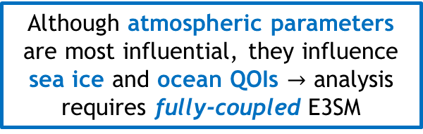
GSA results: sensitivity indices
¹ Measure effect of individual parameters acting alone
² Measure variance that remains after learning values of every variable except $z_{i}$
³ Measure contribution of interaction between parameter subset $u$ on the variance of a QOI
Main Effects¹
Sobol Indices²
Total Effects³
Sea ice
params
Atmosphere
params
Ocean
params
$z_{5}$ (clubb_c1) and $z6$ (clubb_c8) combined effects are stronger than total effects for 5 insensitive parameters
Although atmospheric parameters are most influential, they influence sea ice and ocean QOIs $→$ analysis requires fully-coupled E3SM
Figure above shows sensitivity indices for Sea Ice Volume QOI in spring
Atmospheric parameters related to cloud parameterizations (CLUBB) are most important for all QOIs; $z6$ (clubb_c8) has largest total effects
Analysis also reveals significant parameter interactions between atmosphere parameters
Non-zero total effect indices associated with sea ice parameters are seen for several QOIs
Effects of ocean parameters and their interactions with each other/other parameters are negligible
Notes:
Comparison to 2019 Urrego-Blanco paper: similar takeaways
cldfrc_rhminl and micro_mg_dcs parameters from CAM5 were overall the most influential – similar result
Other parameters had non-trivial influence on several QOIs (SIE, IVOL, CLDLOW), esp. ksno (snow thermal conductivity) on SIV

Slide 27
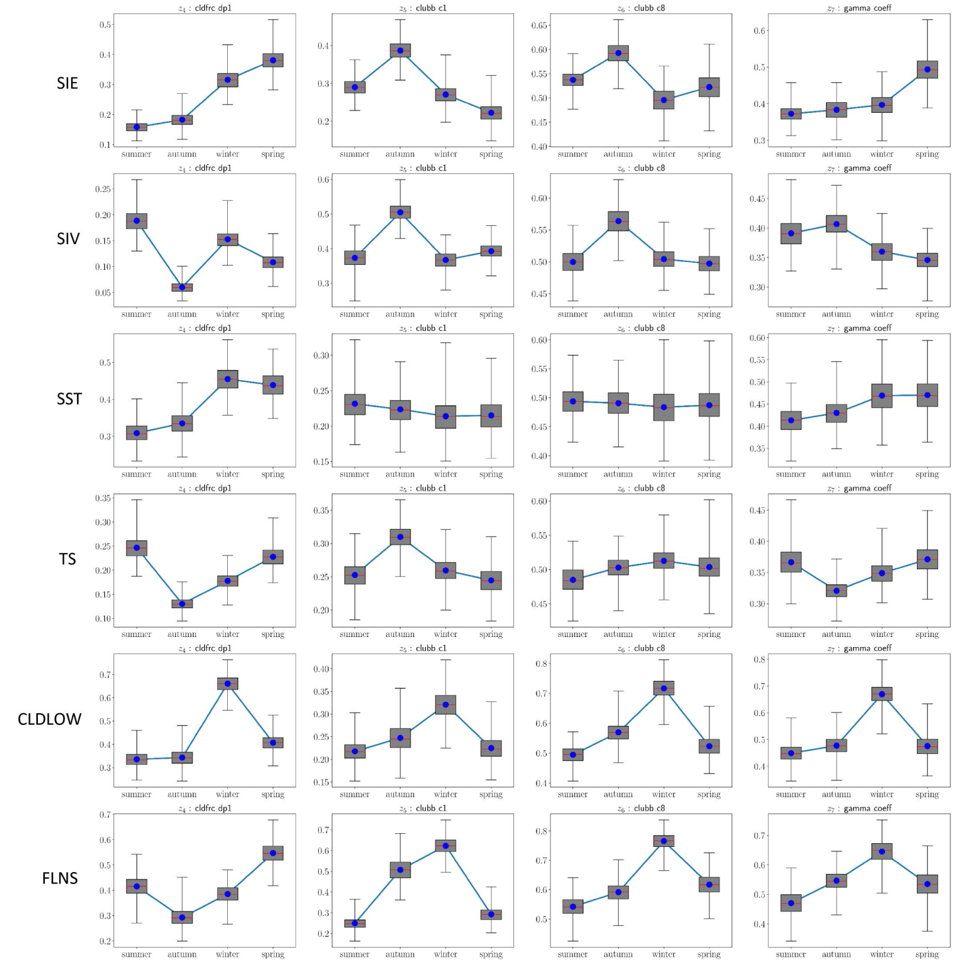
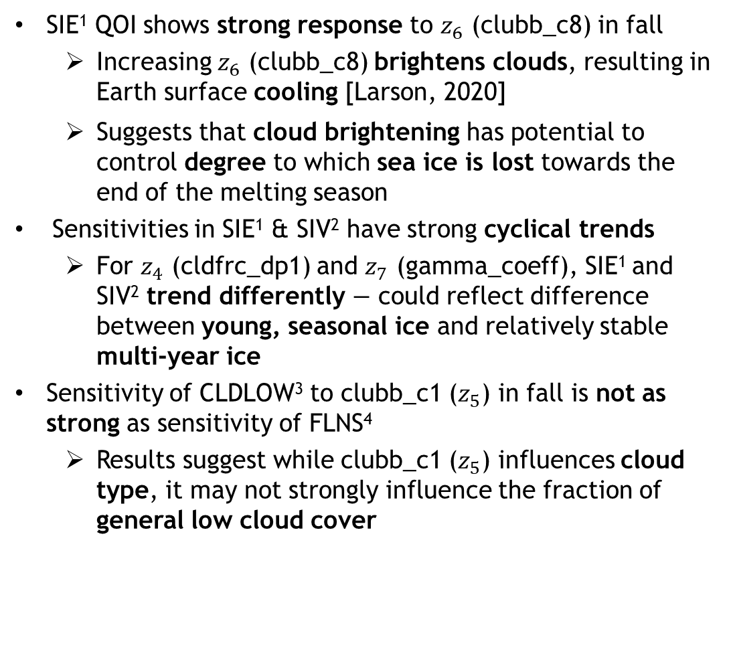

GSA results: total effects indices – atmosphere parameters
Conclusions drawn from atmosphere parameters’ total effects indices can be related to physical processes.
SIE¹ QOI shows strong response to $z_{6}$ (clubb_c8) in fall
  Increasing $z_{6}$ (clubb_c8) brightens clouds, resulting in Earth surface cooling [Larson, 2020]
  Suggests that cloud brightening has potential to control degree to which sea ice is lost towards the end of the melting season
Sensitivities in SIE¹ & SIV² have strong cyclical trends
  For $z_{4}$ (cldfrc_dp1) and $z_{7}$ (gamma_coeff), SIE¹ and SIV² trend differently $−$ could reflect difference between young, seasonal ice and relatively stable multi-year ice
Sensitivity of CLDLOW³ to clubb_c1 ($z_{5}$) in fall is not as strong as sensitivity of FLNS⁴
  Results suggest while clubb_c1 ($z_{5}$) influences cloud type, it may not strongly influence the fraction of general low cloud cover
$$⋮$$
¹ Sea Ice Extent. ² Sea Ice Volume. ³ Low Cloud Overage below 700 hPa over Arctic. ⁴ Net longwave flux at surface over Arctic.

Slide 28
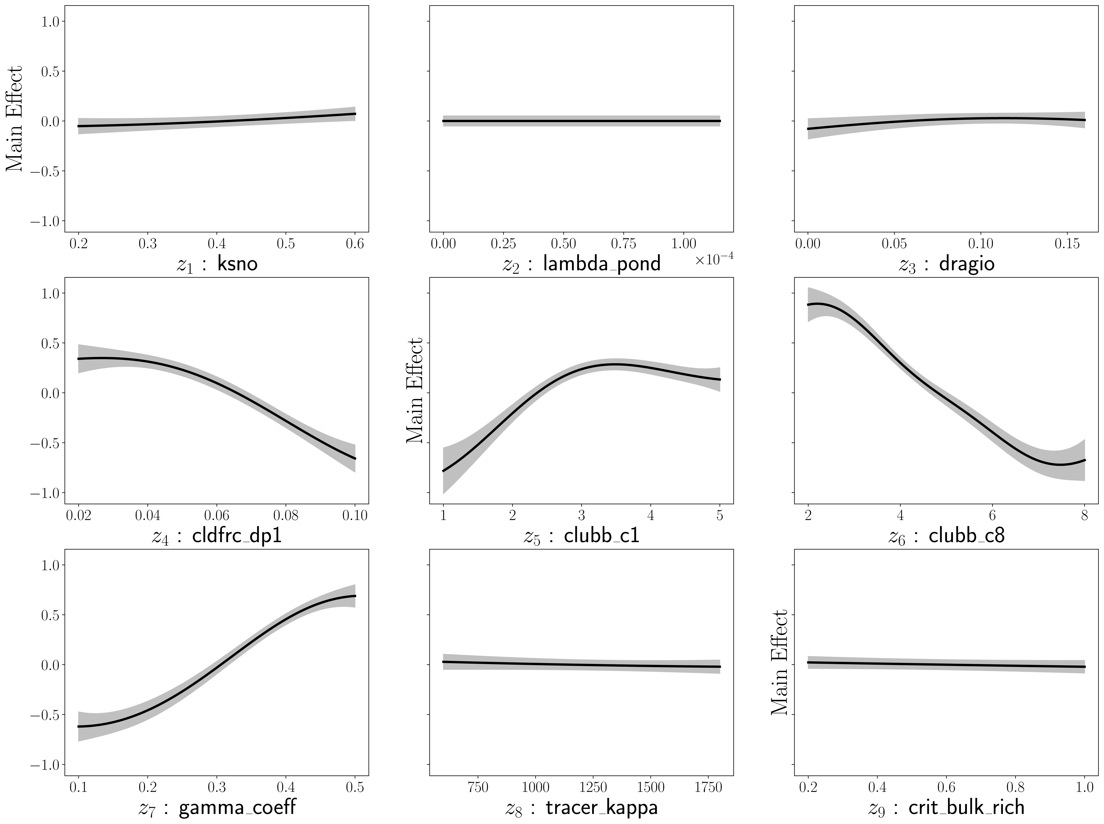
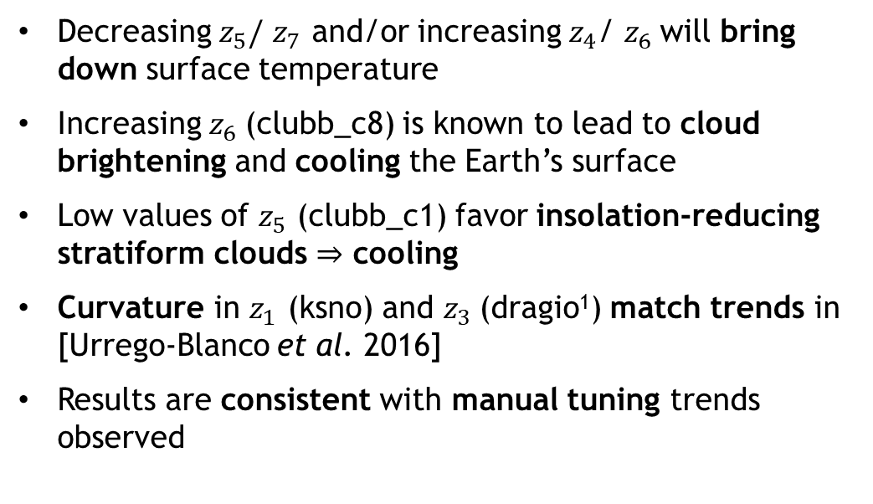
GSA results: marginalized main effects
Sensitivity analysis results can be used to calculate normalized posterior mean of the main effect functions marginalized over one parameter at a time, $±2$ standard deviations:
* : expectation over posterior distribution of GP
$𝕍^{∗}{\left[Y\right]}^{−\frac{1}{2}}(𝔼^{∗}\left[𝔼\left[Y | z_{i}\right]\right]− 𝔼^{∗}$[$𝔼[Y]]±2𝕍^{∗}{\left[Y\right]}^{−\frac{1}{2}}{𝕍^{∗}[𝔼[Y|z_{i}]]}^{1/2}$
Results can help provide confidence in the ULR E3SM and guide model spin-ups.
Decreasing $z_{5}/$ $z_{7}$ and/or increasing $z_{4}$/ $z_{6}$will bring down surface temperature
Increasing $z_{6}$(clubb_c8) is known to lead to cloud brightening and cooling the Earth’s surface
Low values of $z_{5}$ (clubb_c1) favor insolation-reducing stratiform clouds $⇒$ cooling
Curvature in $z_{1}$ (ksno) and $z_{3}$(dragio¹) match trends in [Urrego-Blanco et al. 2016]
Results are consistent with manual tuning trends observed
Figure: marginalized main effects for surface temperature (TS) QOI. 95% CIs shown in gray.
¹ Neutral ocean-ice drag
Notes:
z1: snow conductivity
z3: Neutral ocean-ice drag

Slide 29
Outline
Background and motivation
Methodology
Model tuning and spin-up
Evaluation of the ultra-low resolution (ULR) E3SM
Global sensitivity analysis results
Summary
Bonus: sensitivity analysis for stratospheric aerosol injection (SAI)
Map of North America showing 6m SLR (NASA)

Slide 30
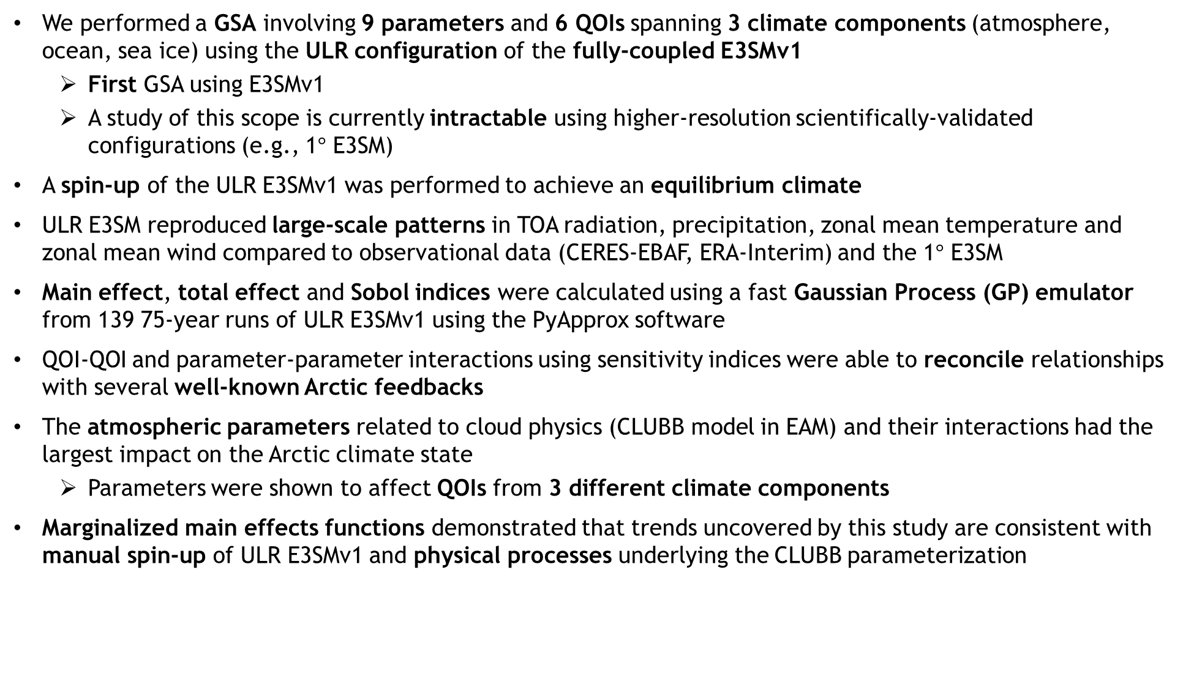
Summary
We performed a GSA involving 9 parameters and 6 QOIs spanning 3 climate components (atmosphere, ocean, sea ice) using the ULR configuration of the fully-coupled E3SMv1
  First GSA using E3SMv1
  A study of this scope is currently intractable using higher-resolution scientifically-validated configurations (e.g., 1$°$ E3SM)
A spin-up of the ULR E3SMv1 was performed to achieve an equilibrium climate
ULR E3SM reproduced large-scale patterns in TOA radiation, precipitation, zonal mean temperature and zonal mean wind compared to observational data (CERES-EBAF, ERA-Interim) and the 1$°$ E3SM
Main effect, total effect and Sobol indices were calculated using a fast Gaussian Process (GP) emulator from 139 75-year runs of ULR E3SMv1 using the PyApprox software
QOI-QOI and parameter-parameter interactions using sensitivity indices were able to reconcile relationships with several well-known Arctic feedbacks
The atmospheric parameters related to cloud physics (CLUBB model in EAM) and their interactions had the largest impact on the Arctic climate state
  Parameters were shown to affect QOIs from 3 different climate components
Marginalized main effects functions demonstrated that trends uncovered by this study are consistent with manual spin-up of ULR E3SMv1 and physical processes underlying the CLUBB parameterization

Slide 31

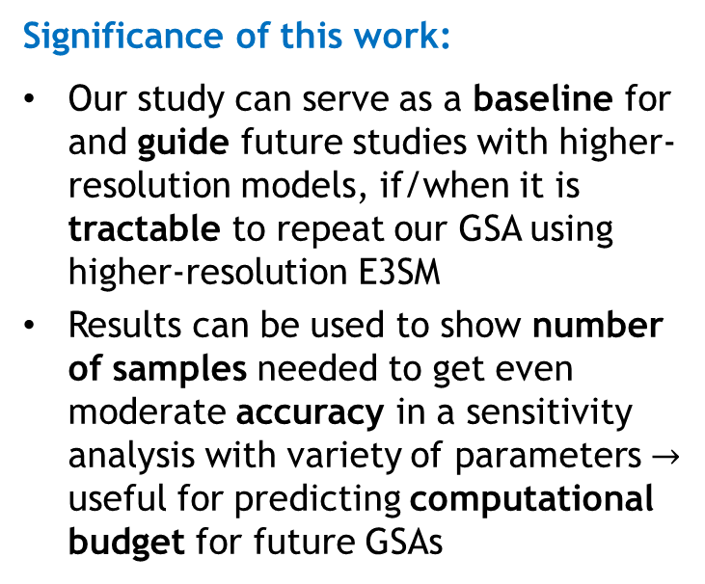

Summary
Significance of this work:
Our study can serve as a baseline for and guide future studies with higher-resolution models, if/when it is tractable to repeat our GSA using higher-resolution E3SM
Results can be used to show number of samples needed to get even moderate accuracy in a sensitivity analysis with variety of parameters $→$ useful for predicting computational budget for future GSAs
USE OUT-OF-THE-BOX ULR E3SM FOR SCIENTIFIC STUDIES
ULR E3SM IS A PLAUSIBLE PHYSICS-BASED SURROGATE FOR UQ STUDIES
Future work:
Augment present study with higher-fidelity ensemble data (e.g., medium-low resolution 2.7$°$ E3SM), towards a multi-fidelity GSA

Slide 32
Outline
Background and motivation
Methodology
Model tuning and spin-up
Evaluation of the ultra-low resolution (ULR) E3SM
Global sensitivity analysis results
Summary
Bonus: sensitivity analysis for stratospheric aerosol injection (SAI)
Map of North America showing 6m SLR (NASA)

Slide 33






Ongoing Work: Sensitivity Study w.r.t. Eruption Elements in Stratospheric Aerosol Injection (SAI)
observed pathways
simulated pathways
attribution
CLDERA (CLimate impact $−$Determining Etiology thRough pAthways) Grand Challenge LDRD Project*:
Goal: Advance climate attribution science by identifying impacts from localized sources.
Exemplar: 1991 eruption of Mt. Pinatubo in the Philippines
Sensitivity analyses (SA) w.r.t. eruption elements:
Injection mass, e.g., 0.25$×$, 0.5$×$, 1$×$, 1.5$×$, 2$×$, 3$×$ Pinatubo
Injection latitude, e.g., 0$°$, 15$°$, 30$°$, 45$°$, 60$°$
Injection altitude, e.g., 14-22 km
Replicate over $\sim$5 ensemble members (corresponding to different initial conditions)
Initial study on HSW++ idealized test case [Hollowed et al. 2023]
Exploring use of medium-low resolution (MLR) E3SMv2 for multi-fidelity sensitivity analysis
CLDERA
For more on CLDERA: see A. McCombs talk (MS51, Wed. PM) and K. Goode’s talk (MS57, Thurs. AM)
Figure above: sensitivity study perturbing various characteristics of Pinatubo-like volcanic eruption using atmosphere-only model [Marshall et al. 2019]
* www.sandia.gov/cldera
Notes:
TODO: fill in.

Slide 34
References
DOI: https://doi.org/10.1029/2021MS002831
Other references:
K. Peterson, A. Powell, I. Tezaur, E. Roesler, J. Nichol, M. Peterson, W. Davis, D. Stracuzzi, D. Bull. "Arctic Tipping Points Triggering Global Change LDRD Final Report", Sand No. 2020-9932. Sandia National Laboratories, Albuquerque, NM (2020) [and references therein].
Code: https://github.com/karapeterson/E3SM
Data: https://github.com/karapeterson/E3SM_ULR_GSA_Data
Thank you! Questions?

Slide 35
Start of Back-Up Slides

Slide 36



Background and motivation
Goal: characterize important factors influencing interannual variability and Arctic sea ice loss in the coupled Earth system
Why sea ice?
Sea ice plays an important role in modulating Earth’s climate
  Reflects solar radiation
  Influences ocean circulation
Sea ice loss impacts other parts of the Earth system¹
  Impacts to mid-latitude weather, potentially increases in winter storms and drought
  Disruption of Atlantic ocean circulation
  Increased coastal erosion
Loss of sea ice is expected to encourage maritime and commercial activity, potentially contributing to geopolitical conflict²
  Potential for new trans-Atlantic shipping routes
https://oceanbites.org/sea-ice-and-albedo-should-we-be-worried/
Ravens et al. 2012
¹ Cohen et al., 2018; Cvijanovic et al., 2018. Sévellec et al., 2017.
² Smith & Stephenson, 2013; “Climate Change and Security in the Arctic”, Center for Climate & Security Report, Jan. 2021.
Smith & Stephenson 2013

Slide 37






E3SM atmosphere grids
Ultra-low resolution (ULR) atmosphere grid ($≈7.5°$)
Medium-low resolution (MLR) atmosphere grid ($≈$2.7$°$)
Standard resolution
atmosphere grid ($≈$1$°$)

Slide 38


GSA workflow with fully-coupled E3SM
Perform spin-up of ultra-low resolution (ULR) model to reach equilibrium conditions of global climate state
Select $P=9$ parameters and parameter ranges from the sea ice, ocean and atmosphere components of the E3SM that play a significant role in model response based on previous literature
Select $K=6$ QOIs, including sea ice extent and surface air temperature averaged over the Arctic
Use DAKOTA toolkit¹ to $N$ generate samples from the parameter distributions
Run 75-year simulations for each sample using the ULR version of E3SM with pre-industrial control forcing
  For our study, $N=202$ perturbed runs were attempted, which led to $M=139$successful 75-year runs
Above: ULR atmosphere grid ($≈7.5°$) Below: ULR ocean/sea ice grid (240km or $≈2.2°$)
The ULR configuration enables sufficient ensemble generation for full GSA with the fully-coupled E3SM!
¹ https://dakota.sandia.gov
ULR E3SM configuration is $≈100×$ less expensive to run than the “standard” 1$°$ resolution E3SM
  Using the ULR E3SM, our study took $≈1.00×{10}^{6}$CPU hours on Sandia’s Skybridge HPC cluster
  The same study using the standard 1$°$ resolution E3SM would require $≈1.14×{10}^{8}$CPU hours

Slide 39


Previous related work
Sensitivity analysis of individual Earth system components:
“Uncertainty quantification and global sensitivity analysis of the Los Alamos sea ice model”, Urrego-Blanco et al., JGR Oceans, 2016.
  Sobol sensitivity analysis of 1$°$ resolution LANL CICE model on 39 sea ice parameters
“Parametric sensitivity and uncertainty quantification in the version 1 of E3SM atmosphere model based on short perturbed parameter ensemble simulations”, Qian et al., JGR Atmospheres, 2018.
  Used short (3-day) simulations of 1$°$ resolution EAM to study sensitivity w.r.t. 18 atmosphere parameters
“Antarctic ice shelf-ocean interactions in high-resolution, global simulations using the E3SM Part 2: Sensitivity studies and model tuning”, Asay-Davis et al., Ocean Sciences Meeting, AGU, 2018.
  Used $≈$30km ($≈$1$°$) resolution in Southern Ocean and Antarctic continental shelf to perform local sensitivity analysis of 12 land ice + ocean parameters using the Greens’ function method (GFM).
Sensitivity analysis of Earth system models for polar quantities of interest:
“Emergent relationships among sea ice, longwave radiation, and the Beaufort high circulation exposed through parameter uncertainty analysis”, Urrego-Blanco et al., JGR Oceans, 2019.
  Used 1$°$ resolution E3SMv0 with MOAT method, 5 parameters and 24 ensemble members
Our work builds on this research by performing the first Global Sensitivity Analysis with a fully-coupled E3SMv1
Notes:
Green's function method (GFM) requires solutions of n² differential equations with m × n subsequent numerical quadratures; the most efficient computational technique for determining linear sensitivity coefficients.

Slide 40


Previous related work
See talk by N. Urban, MS15, Tues PM
Sensitivity analysis of individual Earth system components:
“Uncertainty quantification and global sensitivity analysis of the Los Alamos sea ice model”, Urrego-Blanco et al., JGR Oceans, 2016.
  Sobol sensitivity analysis of 1$°$ resolution LANL CICE model on 39 sea ice parameters
“Parametric sensitivity and uncertainty quantification in the version 1 of E3SM atmosphere model based on short perturbed parameter ensemble simulations”, Qian et al., JGR Atmospheres, 2018.
  Used short (3-day) simulations of 1$°$ resolution EAM to study sensitivity w.r.t. 18 atmosphere parameters
“Antarctic ice shelf-ocean interactions in high-resolution, global simulations using the E3SM Part 2: Sensitivity studies and model tuning”, Asay-Davis et al., Ocean Sciences Meeting, AGU, 2018.
  Used $≈$30km ($≈$1$°$) resolution in Southern Ocean and Antarctic continental shelf to perform local sensitivity analysis of 12 land ice + ocean parameters using the Greens’ function method (GFM).
Sensitivity analysis of Earth system models for polar quantities of interest:
“Emergent relationships among sea ice, longwave radiation, and the Beaufort high circulation exposed through parameter uncertainty analysis”, Urrego-Blanco et al., JGR Oceans, 2019.
  Used 1$°$ resolution E3SMv0 with MOAT method, 5 parameters and 24 ensemble members
Our work builds on this research by performing the first Global Sensitivity Analysis with a fully-coupled E3SMv1
Notes:
Green's function method (GFM) requires solutions of n² differential equations with m × n subsequent numerical quadratures; the most efficient computational technique for determining linear sensitivity coefficients.

Slide 41



E3SM Ultralow Resolution Simulations
At these resolutions we cannot resolve some processes
Can we resolve large scale dynamics we are interested in?

Slide 42
Arctic sea ice decadal trends
Global surface temperature versus sea ice extent (left) and sea ice volume (right) trends. Historical ensemble trends are computed for the years 1979-2014 and overlapping 35-year pseudo-ensembles are created from the pre-industrial control simulation for the computed trends.

Slide 43

Factors controlling sea ice decline
To predict when we will see an Ice-Free Arctic need to understand
  Long-term decline due to external forcing (C0₂)
  Superimposed year-to-year and decade-to-decade variability
No consensus on
  How much internal variability has influenced decline
  Most important factors influencing internal variability
  Recent papers have looked at
Two recent papers looked at this:
  Ding et al., Fingerprints of internal drivers of Arctic sea ice loss in observations and model simulations, Nature Geoscience 2019.
  Screen and Deser, Pacific Ocean Variability Influences the Time of Emergence of Seasonally Ice-Free Arctic Ocean, GRL 2019.

Slide 44



QOI-QOI correlation coefficients
Winter
Summer
Relationships between QOIs are generally consistent with expectations:
Positive correlations between SIE¹ & SIV², SST³ & TS⁴
Negative correlations between SIE/SIV & SST/TS
Negative correlation between CLDLOW⁵ & FLNS⁶, especially in warmer seasons: a lot of low cloud cover $⇒$ less net longwave radiation flux at the surface
Negative correlation between CLDLOW and SST/TS across all 4 seasons
  In winter, cloud coverage expected to increase surface temperature $→$ not observed in our data, may be due to biases from runs without sea ice coverage
Lack of correlation between SIE & FLNS and SIV & CLDLOW in winter is contrary to results obtained using higher resolutions of E3SM [Urrego-Blanco et al., 2019]
¹ Sea Ice Extent. ² Sea Ice Volume. ³ Sea Surface Temperature averaged over 60-90$°$ N. ⁴ Air Temperature averaged over 60-90$°$ N. ⁵ Low Cloud Overage below 700 hPa averaged over 60-90$°$ N. ⁶ Net longwave flux at surface over 60-90$°$ N.
Notes:
Shaded boxed: |corr coeff| > 0.75

Slide 45



GSA results: sensitivity indices – atmosphere parameters
Effects associated with the 4 atmosphere parameters [Larson, 2020]:
$z_{4}$ (cldfrc_dp1): CLUBB parameter which controls cumulus cloud-formation convective regimes in E3SM
$z_{5}$ (clubb_c1): CLUBB parameter which controls the balance of cumulus versus stratocumulus clouds
  Large positive values favor cumulus clouds, while small or negative values are associated with stratocumulus clouds
  Stratocumulus clouds are believed to have planet-wide surface cooling effect, and Arctic cooling effects over most of the year [Eastman & Warren, 2010]
$z_{6}$ (clubb_c8): CLUBB parameter developed to achieve radiative balance in atmospheric models
  Increasing clubb_c8 brightens clouds, resulting in Earth surface cooling (brighter clouds reflect more incoming solar radiation)
$z_{7}$ (gamma_coeff): tunable parameter in CLUBB shallow convection parameterization scheme that can brighten/dim clouds
Figure: cloud brightening produced micro-droplets that reflect more sunlight
http://earthobservatory.nasa.gov/Features/Aerosols/page4.php

Slide 46






GSA results: total effects indices – atmosphere parameters
$z_{4}:$ cldfrc_dp1
$z_{5}:$ clubb_c1
$z_{6}:$ clubb_c8
$z_{7}:$ gamma_coeff
Atmosphere parameters influence sea ice QOIs
Figure: box shows 25-75% CIs for mean total effects. Blue dot indicates mean.
For $z_{4}$ (cldfrc_dp1) and $z_{7}$ (gamma_coeff), SIE¹ and SIV² trend differently
  Could reflect difference between relatively stable multi-year ice (measured by SIV) and young, seasonal ice (measured by SIE)
SIE QOI shows strong response to $z_{6}$ (clubb_c8) in autumn
  Increasing $z_{6}$ (clubb_c8) brightens clouds, resulting in Earth surface cooling [Larson, 2020]
  Suggests that cloud brightening has potential to control degree to which sea ice is lost towards the end of the melting season
¹ Sea Ice Extent. ² Sea Ice Volume.

Slide 47


GSA results: total effects indices – atmosphere parameters
$z_{4}:$ cldfrc_dp1
$z_{5}:$ clubb_c1
$z_{6}:$ clubb_c8
$z_{7}:$ gamma_coeff
Figure: box shows 25-75% CIs for mean total effects. Blue dot indicates mean.
CLDLOW¹ and FLNS² trend similarly for all but $z_{4}$ (cldfrc_dp1) parameter
Sensitivity of CLDLOW to clubb_c1 ($z_{5}$) in autumn is not as strong as sensitivity of FLNS
  clubb_c1 ($z_{5}$) parameter controls balance of cumulus vs. stratocumulus clouds [Larson, 2020]
  Results suggest while clubb_c1 ($z_{5}$) influences cloud type, it may not strongly influence the fraction of general low cloud cover
¹ Low Cloud Overage below 700 hPa averaged over 60-90$°$ N. ² Net longwave flux at surface over 60-90$°$ N.

Slide 48
References
[1] J. Urrego-Blanco, E. Hunke, N. Urban. "Emergent relationships among sea ice, longwave radiatino, and the Beaufort high circulation exposed through parameter uncertainty analysis". J. Geophys. Res. Oceans, 124, pp. 9572-9588, 2019. https://doi.org/10.1029/2091JC014979.
[2] J. Urrego-Blanco, N. Urban, E. Hunke, A. Turner, N. Jeffery. "Uncertainty quantification and global sensitivity analysis of the Los Alamos sea ice model". J. Geophys. Res. Oceans, 121, pp. 2709-2732, 2016. doi: 10.1002/2015JC011558.
[3] Y. Qian et al. "Parametric Sensitivity and Uncertainty Quantification in the Version 1 of E3SM Atmosphere Model Based on Short Perturbed Parameter Ensemble Simulations". J. Geophys. Res. Atmospheres, 123, pp. 13,046-13,073, 2018. https://doi.org/10.1029/2018JD028927.
[4] P. Rasch et al. "An Overview of the Atmospheric Component of the Energy Exascale Earth System Model". J. Adv. Model. Earth Systems, 11, pp. 2377-2411, 2019. https://doi.org/10.1029/1019MS001629.
[5] J.-C. Golaz et al. "The DOE E3SM Coupled Model Version 1: Overview and Evaluation at Standard Resolution". JAMES, 11, 2019. https://doi.org/10.1029/2018MS001603.
[6] X. Asay-Davis, D. Comeau, J. Fyke, M. Hoffman, M. Petersen, S. Price, T. Ringler, L. Van Roekel, P. Wolfram. "Antarctic ice shelf-ocean interactions in high-resolution global simulations using the Energy Exascale Earth System Model (E3SM). Part 2: Sensitivity studies and model turning". 2018 Ocean Sciences Meeting, Portland, Oregon, Feb. 11-16, 2018.
[7] S. Reckinger, M. Petersen, S. Reckinger. "A study of overflow simulations using MPAS-Ocean: vertical grids, resolution and viscosity". Ocean Modeling 96, pp. 291-313, 2015. https://doi.org/10.1016/j.ocemod.2015.09.006.

Slide 49
References
Bathiany et al. Beyond bifurcation: using complex models to understand and predict abrupt climate change”, DSCS (2016).
Cohen et al., Arctic change and possible influence on mid-latitude climate and weather, US CLIVAR report (2018).
Cohen, Pfeiffer and Francis, Warm Arctic episodes linked with increased frequency of extreme winter weather in the U.S, Nature Communications 9, article number 869, (2018).
Cvijanovic et al. Future loss of Arctic sea-ice cover could drive a substantial decrease in California’s rainfall. Nature Communications, 8 (1), (2018).
Duraisamy, et al. Turbulence Modeling in the Age of Data. arXiv preprint arXiv:1804.00183 (2018).
    Enderlin, et al. An improved mass budget for the Greenland ice sheet, Geophys. Res. Lett., 41, 866–872, (2014).
Francis and Skific, evidence linking rapid Arctic warming to mid-latitude weather patterns. Phil. Trans. R. Soc. A 373: 20140170 (2015).
Graeter et al. Ice Core Records of West Greenland Melt and Climate Forcing, GRL, 45, 3164-3172, (2018)
Kinnard et al., Reconstructed changes in Arctic sea ice over the past 1450 years, Nature, 479, 509-512 (2011).
Koven et al., Permafrost carbon-climate feedbacks accelerate global warming PNAS, volume 108, (2011).
Lara et al., Reduced arctic tundra productivity linked with landform and climate change interactions, Scientific Reports, volume 8, (2018).
Lind, Ignvaldsen, and Furevik, Arctic warming hotspot in the northern Barents sea linked to declining sea-ice import, Nature Climate Change, 8 634-639 (2018).
Notz and Stroeve, Observed Arctic sea-ice loss directly follows anthropogenic CO2 emission Science (2016).
Olefeldt, D. et al. Circumpolar distribution and carbon storage of thermokarst landscapes. Nat. Commun. 7, 13043 (2016).
Parazoo et al. Detecting the permafrost carbon feedback: talik formation and increased cold-season respiration as precursors to sink-to-source transitions The Cryosphere, 12, 123–144, (2018).
    Ricciuto, Sargsyan, Thornton, The Impact of Parametric Uncertainties on Biogeochemistry in the E3SM Land Model, JAMES, (2018).
Schädel et al., Potential carbon emissions dominated by carbon dioxide from thawed permafrost soils, Nature Climate Change, 6, (2016).
Schuur et al., Climate change and the permafrost carbon feedback, Nature, 520, (2015).
Sévellec, Fedorov, Liu, Arctic sea-ice decline weakens Atlantic Meridional Overturning Circulation, Nature Climate Change, 7, 604-610 (2017).
Smith and Stephenson, New trans-Arctic shipping routes navigable by mid-century, PNAS 110:13, 4871-4872 (2013).
Strauss et al., Deep Yedoma permafrost: A synthesis of depositional characteristics and carbon vulnerability, Earth-Science Reviews, (2017).
Stroeve et al., Trends in Arctic sea ice extent from CMIP5, CMIP3 and observations GRL (2012).
    van Angelen, et al., Contemporary (1960–2012) Evolution of the Climate and Surface Mass Balance of the Greenland Ice Sheet, Surv. Geophys., 35, 1155–1174, (2013).
    Vernon, et al. Surface mass balance model intercomparison for the Greenland ice sheet, The Cryosphere 7 599-614, (2013).

