Slide 1
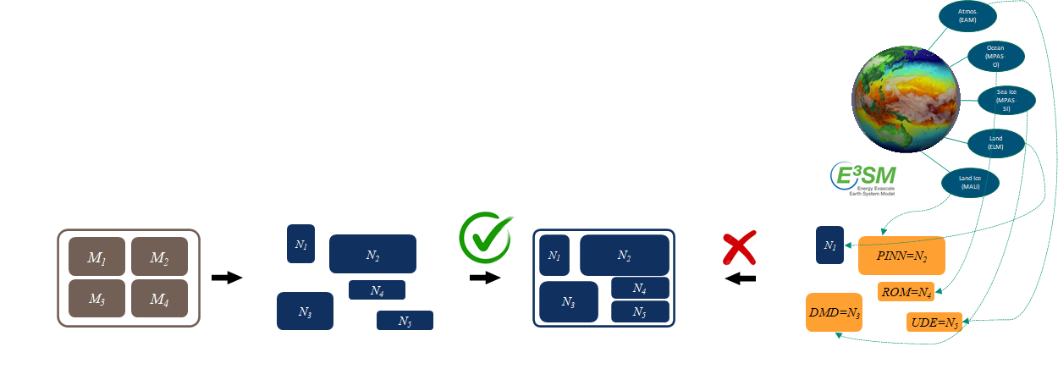
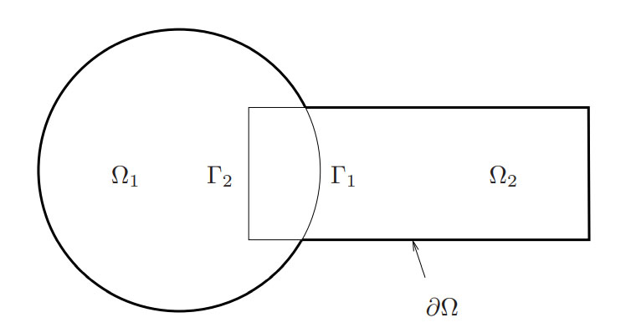
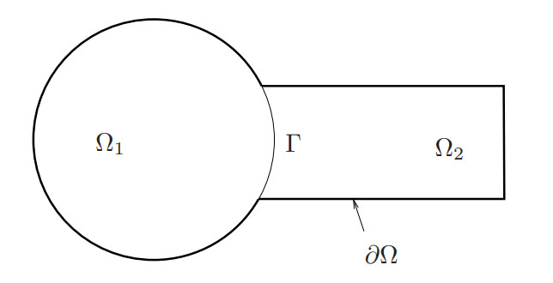
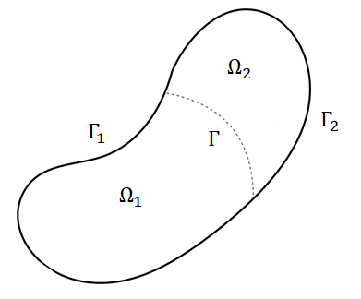
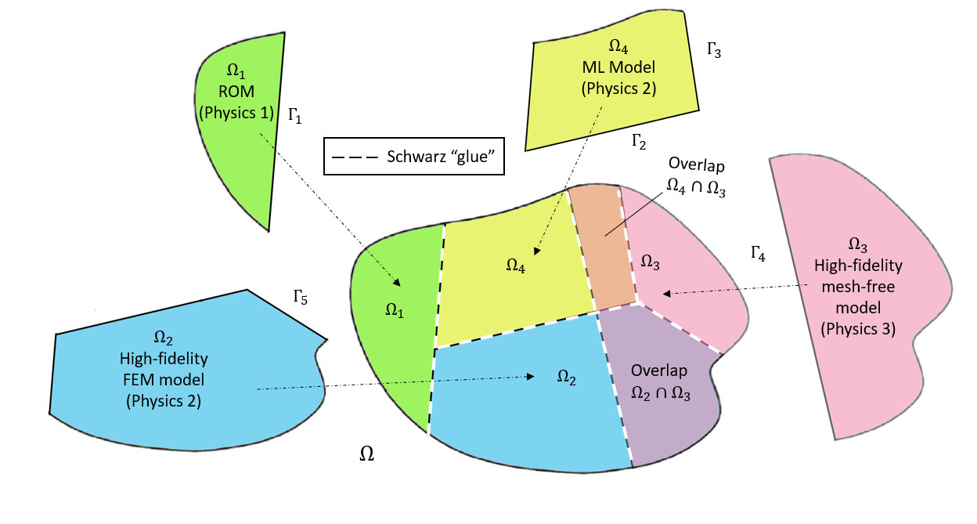
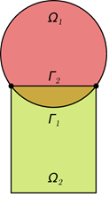
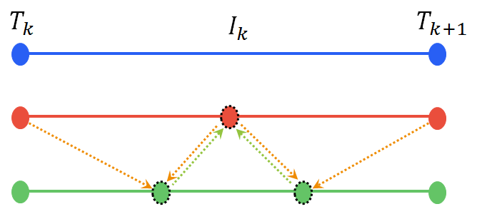
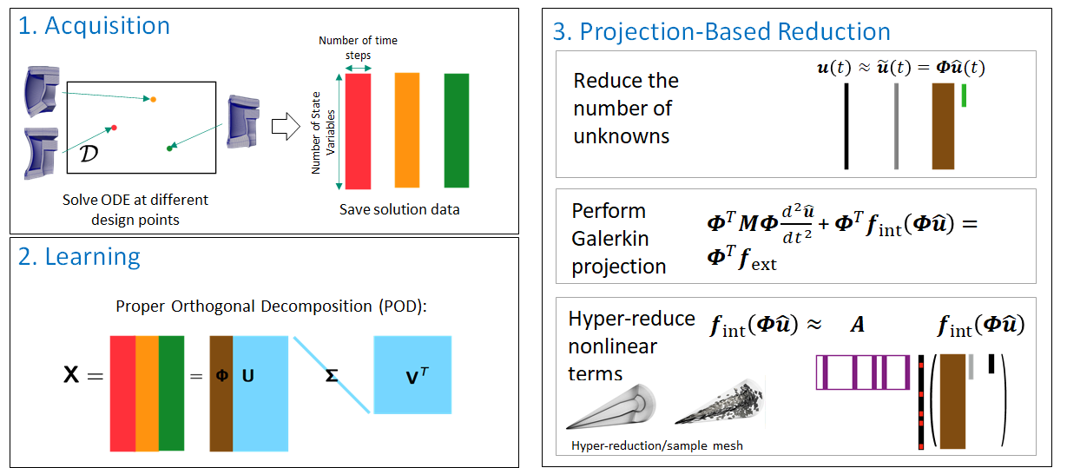
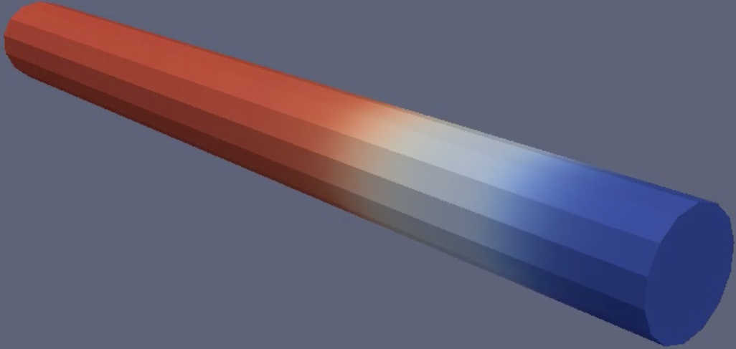
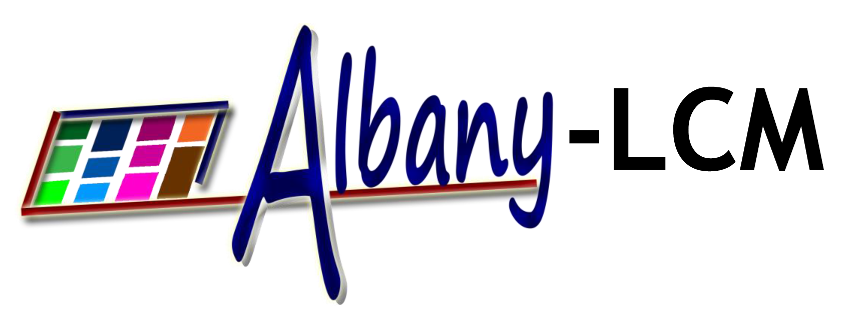
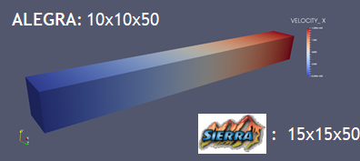
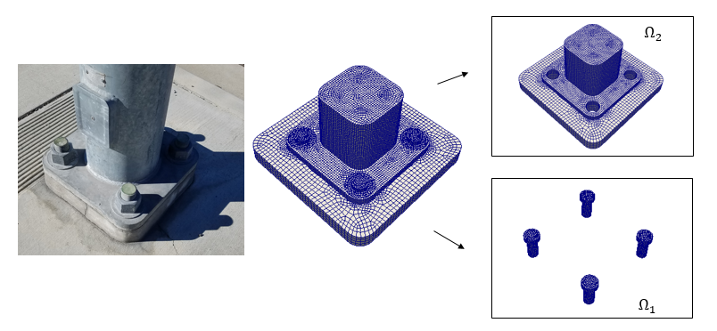
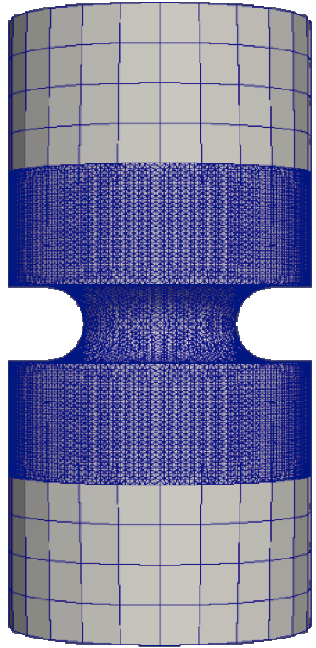
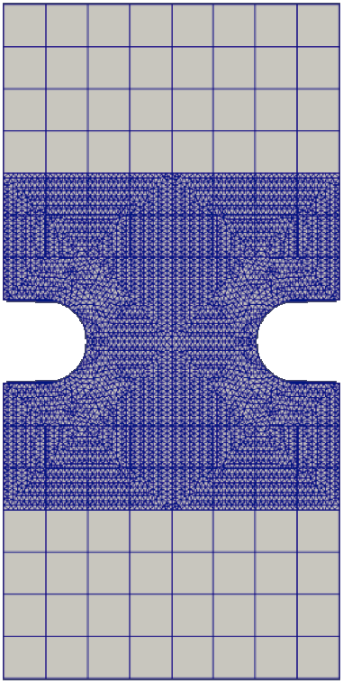
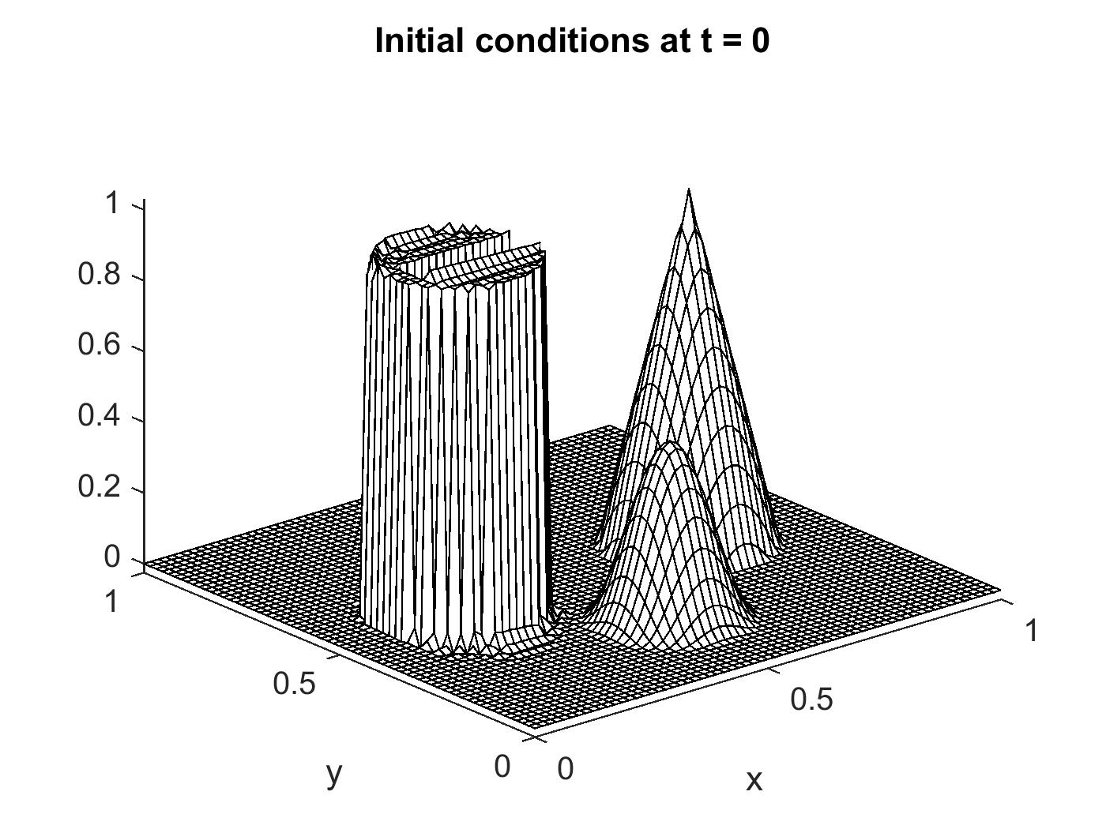
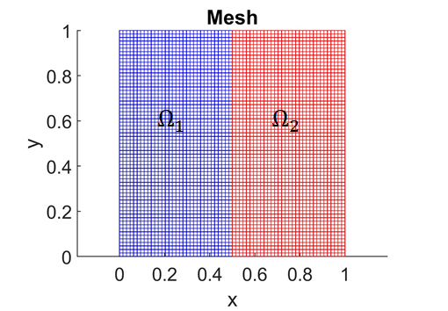
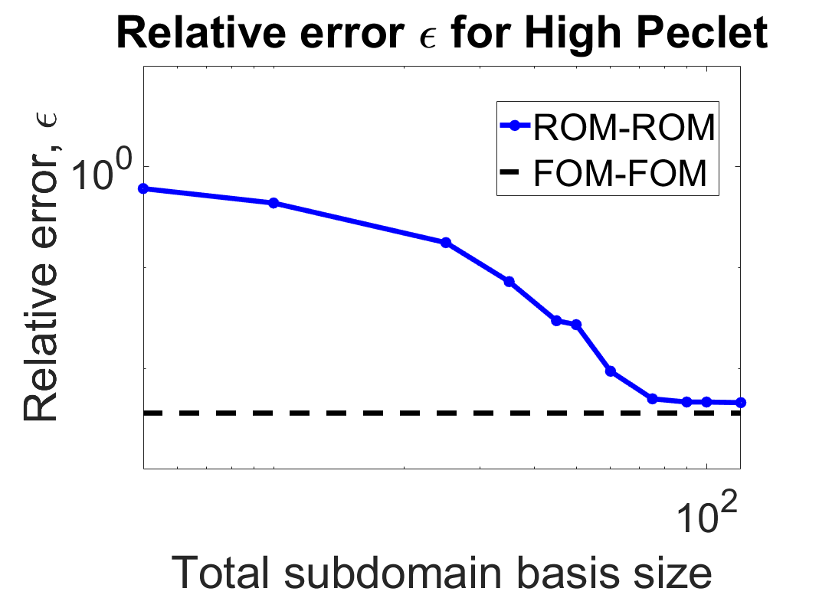
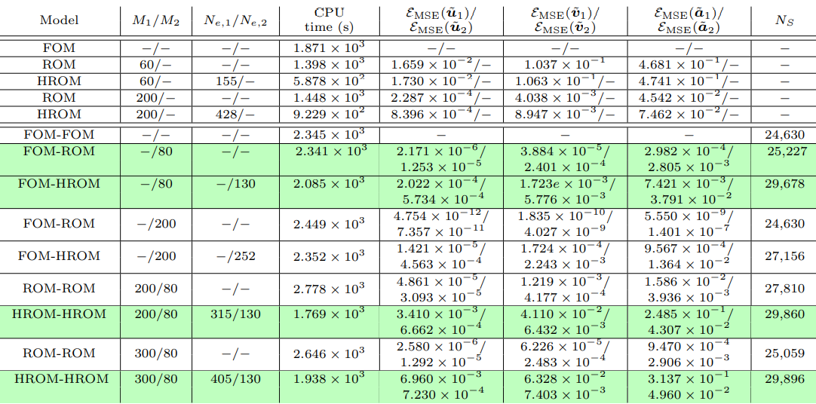
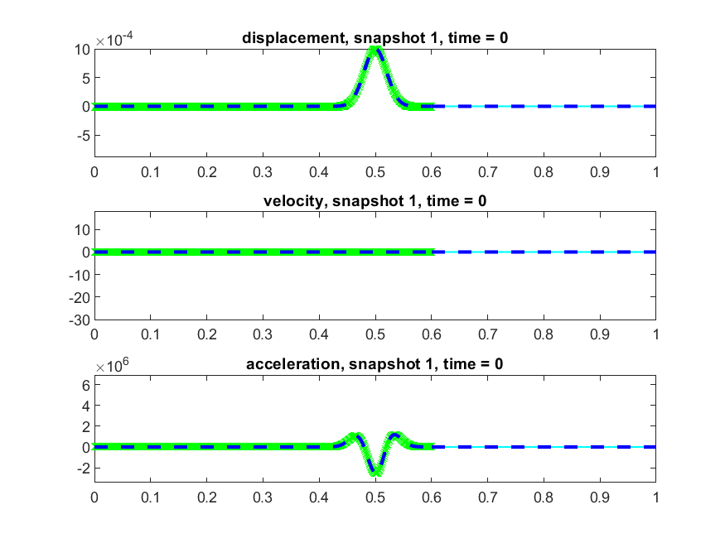
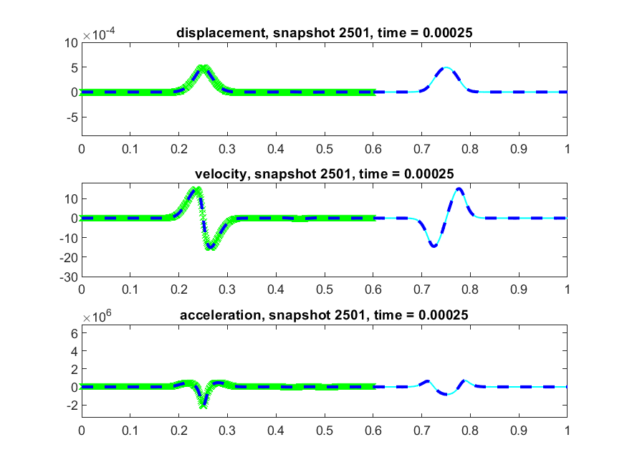
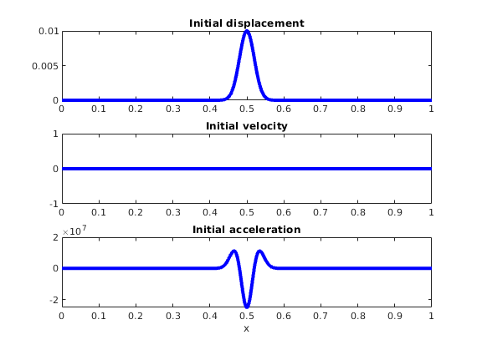
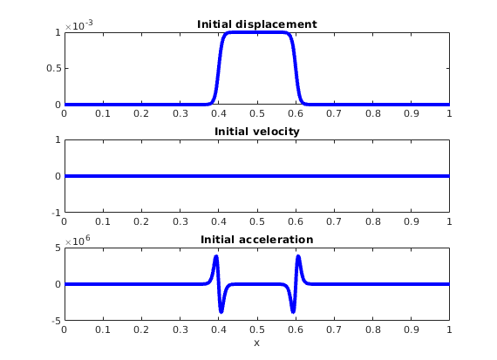
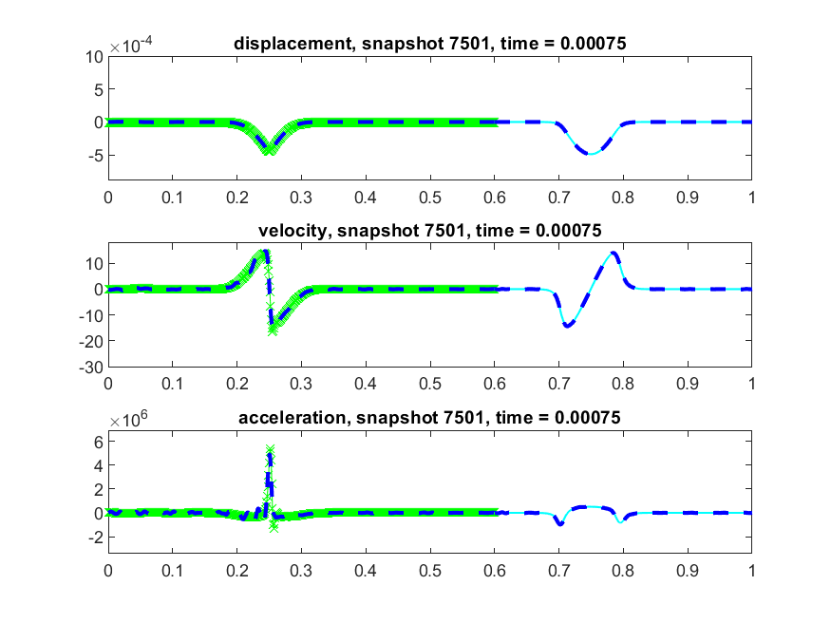
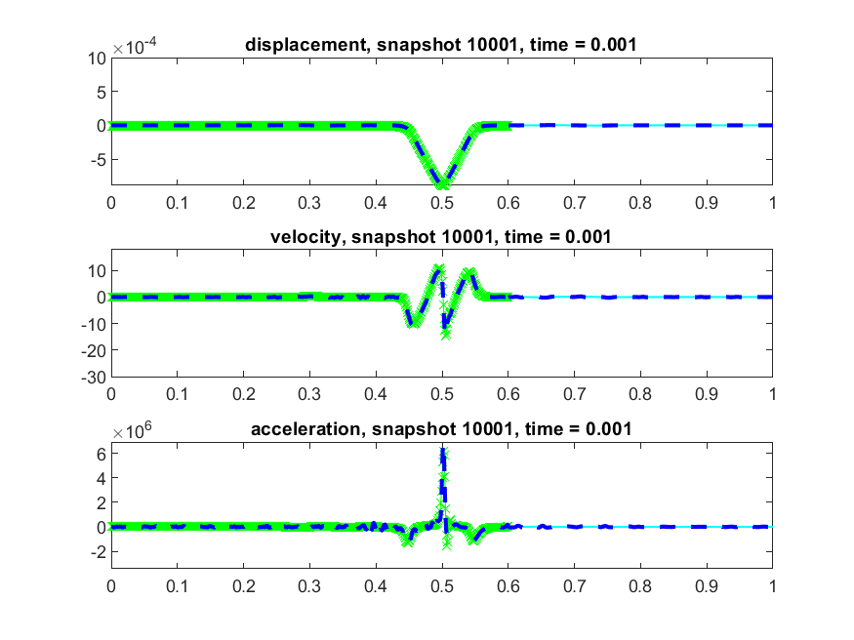
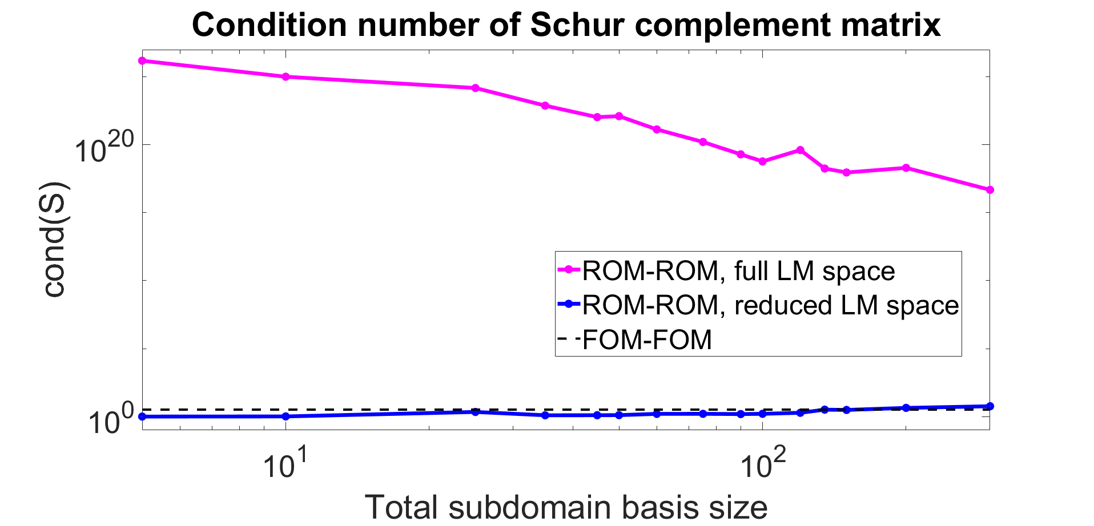
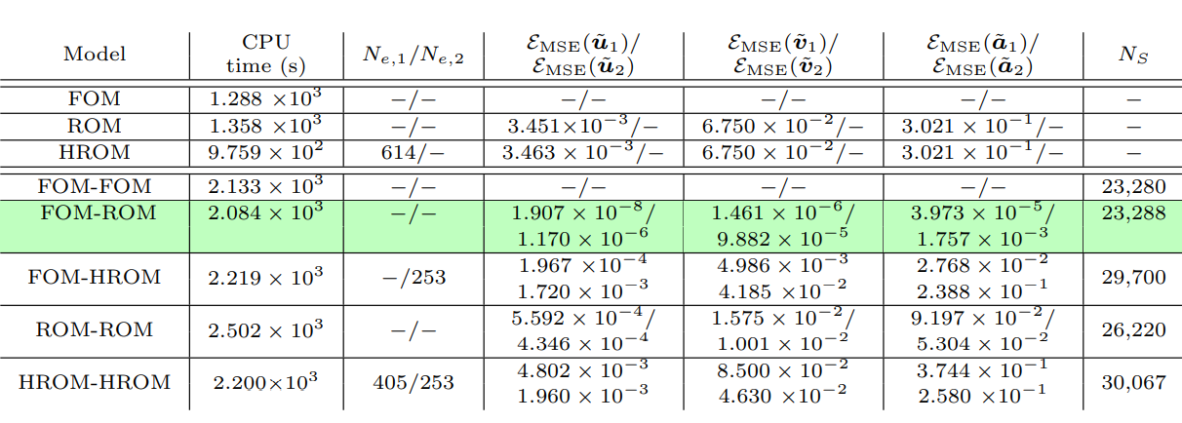
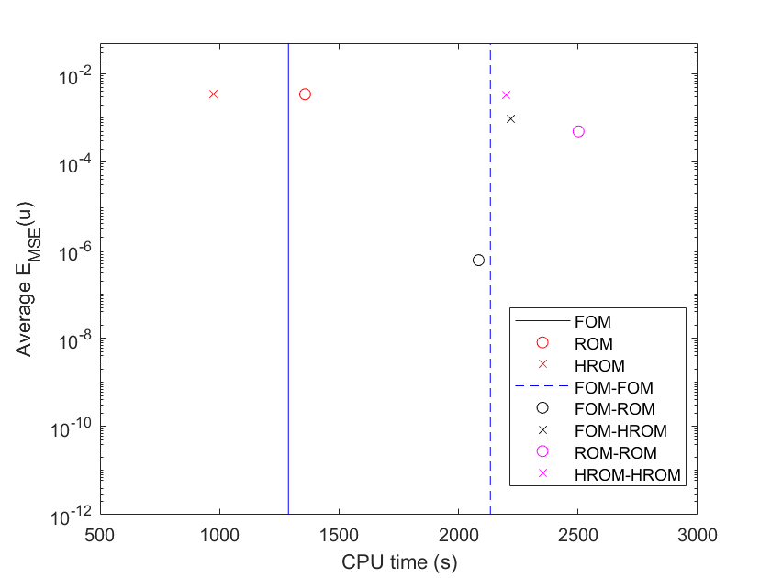
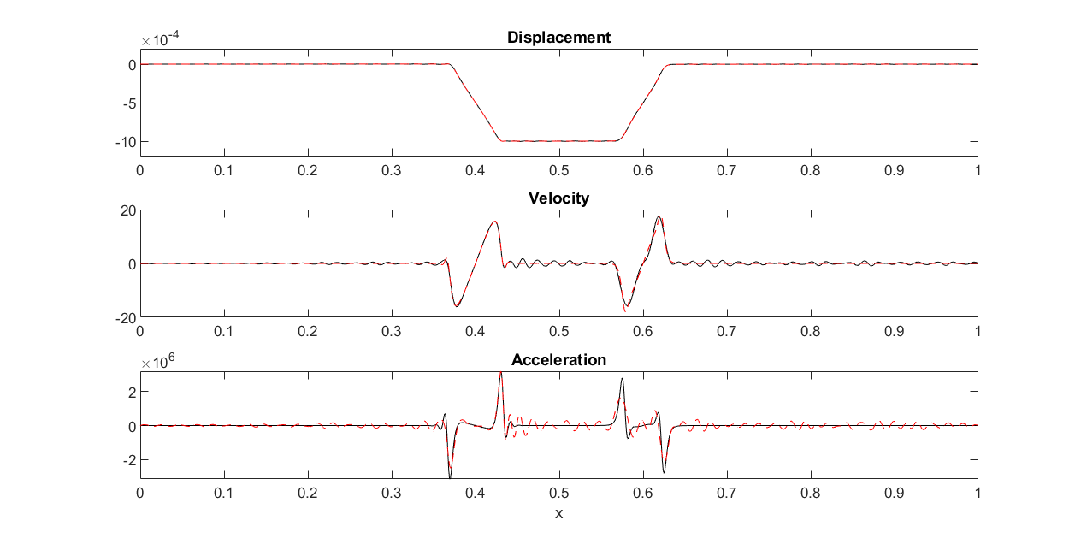
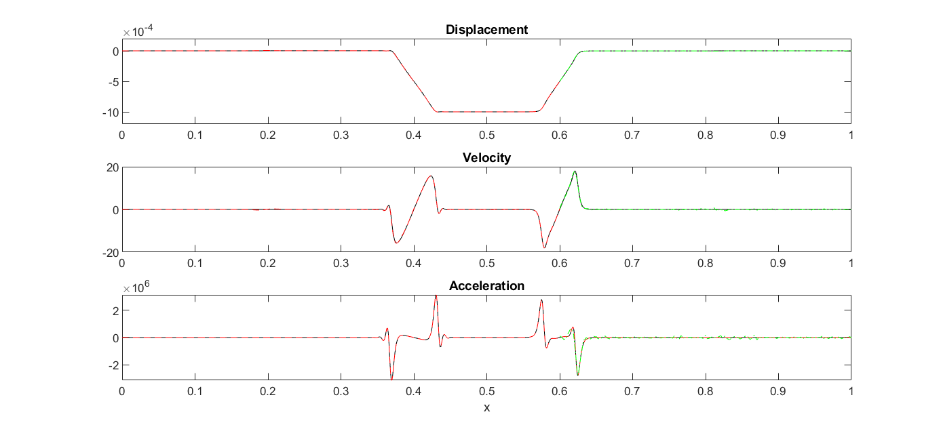
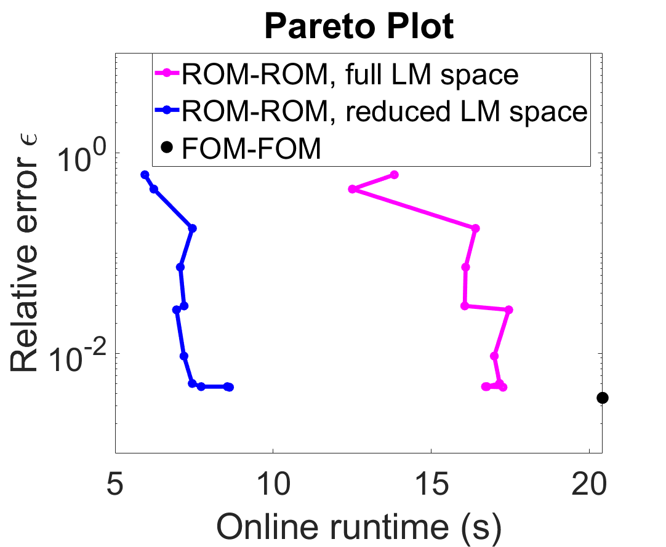
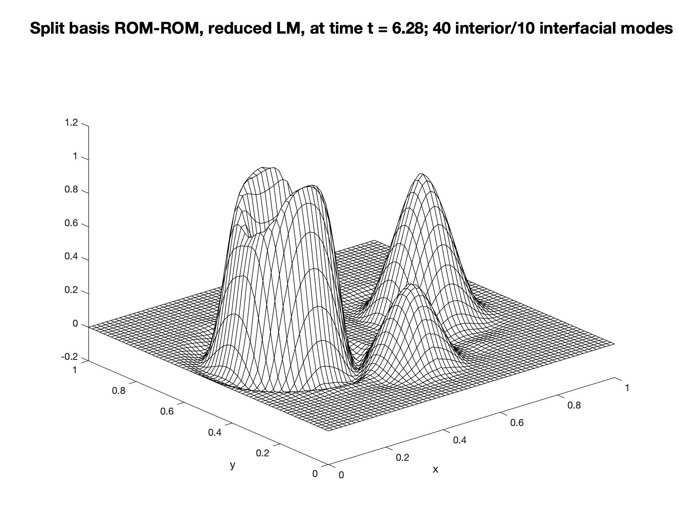
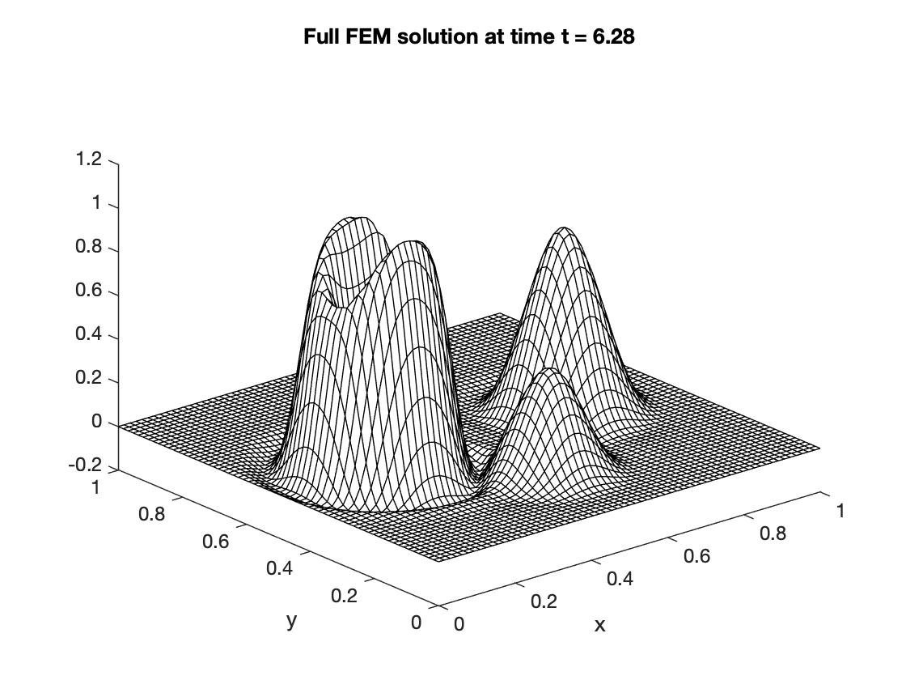
Component-Based Coupling of First-Principles and Data-Driven Models
Irina Tezaur¹, Joshua Barnett^{1,2}, Alejandro Mota¹, Amy De Castro^{1,3}, Paul Kuberry¹, Pavel Bochev¹, Chris Wentland¹
Alternating Schwarz-Based Coupling
Motivation for Coupling
Coupling via Generalized Mortar Methods
Alternating Schwarz Method for Domain Decomposition (DD) and Coupling
The past decades have seen tremendous investment in simulation frameworks for coupled multi-scale and multi-physics problems.
Lagrange Multiplier-Based Partitioned Coupling Formulation
Proposed in 1870 by H. Schwarz for solving Laplace equation on irregular domains.
Frameworks rely on established mathematical theories to couple physics components.
Most existing coupling frameworks are based on traditional discretization methods.
Model problem: time-dependent advection-diffusion problem on $Ω=Ω_{1}∪$ $Ω_{2}$ with $Ω_{1}∩$ $Ω_{2}=∅$
Crux of Method: if the solution of a partial differential equation (PDE) is known in regularly shaped domains, use those as pieces to iteratively build a solution for the more complex domain.
${\dot{c}}_{i}−∇∙F_{i}\left(c_{i}\right)=f_{i}$, in $Ω_{i}×\left[0,T\right]$
$c_{i}=g_{i},$ on ${ Γ}_{i}×\left[0,T\right]$
$c_{i}\left(x,0\right)=c_{i,0}\left(x\right),$ in $Ω_{i}$
(1)
Hybrid semi-discrete coupled formulation: obtained by differentiating interface conditions in time and discretizing hybrid problem using FEM in space
Basic Schwarz Algorithm for Spatial Coupling
Non-overlapping Schwarz: convergent with Robin-Robin or alternating Neumann-Dirichlet transmission BCs.
Initialize:
Solve PDE by any method on $Ω_{1}$ w/ initial guess for transmission BCs on $Γ_{1}$.
Iterate until convergence:
Solve PDE by any method on $Ω_{2}$ w/ transmission BCs on $Γ_{2}$ based on values just obtained for $Ω_{1}$.
Solve PDE by any method on $Ω_{1}$ w/ transmission BCs on $Γ_{1}$ based on values just obtained for $Ω_{2}$.
Overlapping Schwarz: convergent with all-Dirichlet transmission boundary conditions (BCs) if $Ω_{1}⋂{ Ω}_{2}≠∅$.
$i∈\left\{1,2\right\}, c_{i}$: unknown scalar solution field
$f_{i}$: body force, $g_{i}$: boundary data on $Γ_{i}$
$F_{i}\left(c_{i}\right)≔ κ_{i}∇$ $c_{i}−uc_{i}$: total flux function
$κ_{i}$: non-negative diffusion coefficient
$u$: given advection velocity field
$\left(\begin{matrix}M_{1} & 0 & G_{1}^{T} \\ 0 & M_{2} & {−G}_{2}^{T} \\ G_{1} & −G_{2} & 0\end{matrix}\right)$ $\left(\begin{matrix}{\dot{c}}_{1} \\ {\dot{c}}_{2} \\ λ\end{matrix}\right)=$ $\left(\begin{matrix}f_{1}−K_{1}c_{1} \\ f_{2}{−K}_{2}c_{2} \\ 0\end{matrix}\right)$
(2)
Complex System Model
Traditional Methods
Coupled Numerical Model
Traditional + Data-Driven Methods
Figure 5. Non-overlapping DD of $Ω=Ω_{1}∪$ $Ω_{2}$
Schwarz alternating method most commonly used as a preconditioner for Krylov iterative methods to solve linear algebraic equations.
PDEs, ODEs
Nonlocal integral
Atomistic, …
Mesh-based (FE, FV, FD)
Meshless (SPH, MLS)
Eulerian, Lagrangian, …
Monolithic (Lagrange multipliers)
Partitioned (loose) coupling
Iterative (Schwarz, optimization)
Physics-Informed Neural Networks (PINNs)
Neural ODEs
Projection-based ROMs, …
$M_{i}:$mass matrices, $K_{i}$: stiffness matrices,$G_{i}$: constraint matrices
Decoupling via Schur complement: equation (2) is equivalent to
Novel Idea: using Schwarz alternating method as a discretization method for solving multi-scale or multi-physics PDEs.
Unfortunately, existing algorithmic and software infrastructures are ill-equipped to handle plug-and-play integration of data-driven models!
Compatibility conditions: on interface $Γ×\left[0,T\right]$
Schwarz Algorithm for Dynamics
Objective: discover mathematical principles guiding assembly of standard and data-driven models in stable, accurate and physically consistent ways.
Continuity of states: $c_{1}\left(x,t\right)−c_{2}\left(x,t\right)=0$
Continuity of total flux: $F_{1}\left(x,t\right)∙$ $n_{Γ }=F_{2}\left(x,t\right)∙$ $n_{Γ }$
$⇒$Imposed weakly using Lagrange multiplier (LM) $λ$
$$\left(\begin{matrix}M_{1} & 0 \\ 0 & M_{2}\end{matrix}\right)\left(\begin{matrix}{\dot{c}}_{1} \\ {\dot{c}}_{2}\end{matrix}\right)=\left(\begin{matrix}f_{1}−K_{1}c_{1}−G_{1}^{T}λ \\ f_{2}−K_{2}c_{2}+G_{2}^{T}λ\end{matrix}\right)$$
(3)
Equations decouple if using explicit or IMEX time-integration!
Initialize:
Set $k=0 \text{(}\text{controller} \text{time} \text{index}\text{).}$
Iterate until convergence:
Step 1: Advance $Ω_{1}$ solution from time $T_{k}$ to time $T_{k+1}$ using time-stepper in $Ω_{1}$ with time-step ${Δt}_{1},$using solution in $Ω_{2}$ interpolated to $Γ_{1}$ at times $T_{k}+n{Δt}_{1}$
Step 2: Advance $Ω_{2}$ solution from time $T_{k}$ to time $T_{k+1}$ using time-stepper in $Ω_{2}$ with time-step ${Δt}_{2},$using solution in $Ω_{1}$ interpolated to $Γ_{2}$ at times $T_{k}+n{Δt}_{2}$.
Step 3: Check for convergence at time $T_{k+1}$.
(4)
Controller time stepper
where ${(G}_{1}M_{1}^{−1}G_{1}^{T}+G_{2}M_{2}^{−1}G_{2}^{T})λ=G_{1}M_{1}^{−1}\left(f_{1}−K_{1}c_{1}\right)−G_{2}M_{2}^{−1}\left(f_{2}−K_{2}c_{2}\right)$
Time integrator for $Ω_{1}$
Implicit Value Recovery (IVR) Algorithm [5]
Pick explicit or IMEX time-integration scheme for $Ω_{1}$ and $Ω_{2}$. Time integration schemes and time-steps in $Ω_{1}$ and $Ω_{2}$ can be different!
Approximate LM space as trace of finite element space on $Ω_{1}$ or $Ω_{2}$*
Compute matrices $M_{i},K_{i}$, $G_{i}$ and vectors $f_{i}$
For each timestep $t^{n}$:
Solve Schur complement system (4) for the LM $λ^{n}$
Update the state variables $c_{i}^{n}$ by advancing (3) in time
Time integrator for $Ω_{2}$
Can use different integrators with different time steps within each domain!
Projection-Based Model Order Reduction
Lagrange Multiplier-Based Coupling of FOMs
Time-stepping procedure is equivalent to doing Schwarz on space-time domain [2].
Full Order Model (FOM): $M\frac{d^{2}u}{dt^{2}}+f_{int}\left(u\right)=f_{ext}$
“Plug-and-play” framework:
Ability to couple regions with different non-conformal meshes, different element types and different levels of refinement to simplify task of meshing complex geometries
Ability to use different solvers/time-integrators in different regions [6,7]
Coupling is non-iterative (single pass)
If unconverged, return to Step 1.
If converged, set $k=k+1$and return to Step 1.
ROM = Reduced Order Model HROM = Hyper-reduced ROM
Schwarz for Multi-Scale Coupling of Full Order Models (FOMs) in Solid Mechanics
Coupling methods are not limited to linear bases (e.g., POD) and Galerkin projection.
* Ensures that dual Schur complement of (2) is symmetric positive definite
Method is theoretically rigorous [5]:
Coupling does not introduce nonphysical artifacts
Theoretical convergence properties/guarantees including well-posedness of coupling force system
Preserves the exact solution for conformal meshes
Method has been applied to several application spaces:
Transport (unsteady advection-diffusion)
Ocean-atmosphere coupling
Elasticity (e.g., ALEGRA-Sierra coupling)
Coupling is concurrent (two-way).
Easy to implement into existing massively-parallel HPC codes.
Scalable, fast, robust (we target real engineering problems, e.g., analyses involving failure of bolted components!).
Coupling does not introduce nonphysical artifacts.
Theoretical convergence properties/guarantees [1, 2].
“Plug-and-play” framework:
Ability to couple regions with different non-conformal meshes, different element types and different levels of refinement to simplify task of meshing complex geometries.
Ability to use different solvers/time-integrators in different regions.
Model Solid Mechanics PDEs:
*
Lagrange Multiplier-Based FOM-ROM and ROM-ROM Coupling
Collect snapshots using suitable monolithic FOM solve for equation (1) and subtract Dirichlet BC data on ${ Γ}_{1}∪{ Γ}_{2}$.
Partition modified snapshots into subdomain snapshot matrices $X_{1}$ and $X_{2}$ on $Ω_{1}$ and $Ω_{2}$, respectively.
Calculate “split” reduced bases $Φ_{i,Γ}$ and $Φ_{i,0}$, for interface and interior degrees of freedom (DOFs).
Approximate the solution as a linear combination of the POD modes in each subdomain and on each boundary:
$c_{i,0}(t)≈{\tilde{c}}_{i,0}(t)≔{\overline{c}}_{i,0}+$ $Φ_{i,0}{\hat{c}}_{i,0}\left(t\right),{ c}_{i,Γ}(t)≈{\tilde{c}}_{i,Γ}(t)≔{\overline{c}}_{i,Γ}+ Φ_{i,Γ}{\hat{c}}_{i,Γ}(t)$
Reduce LM space to size $N_{R, Γ}<N_{R, 1Γ}+$ $N_{R, 2Γ}$, where $N_{R, iΓ}$ = # POD modes in $Φ_{i,Γ},$ and approximate $λ≈Φ_{LM}\hat{λ}$ where $Φ_{LM}=Φ_{i,Γ}$ for $i=1,2$, so that $N_{R, Γ}{=N}_{R, iΓ}$.
Substitute above expansions into (2) and project equations onto reduced bases to obtain:
Figure 6. Axial pulse bar test simulated with variable resolution
Quasistatic:
Dynamic:
Comparison of Coupling Methods
Figure 7. Patch test (ALEGRA-Sierra coupling)
Alternating Schwarz-based Coupling
Lagrange Multiplier-Based IVR Coupling
Figure 8. Coupling of nonconforming meshes
* https://github.com/sandialabs/LCM.
Online ROM-ROM IVR Solution Algorithm: at each time step $t^{n}$
Use ${\hat{c}}_{i,0}^{n}$and ${\hat{c}}_{i,Γ}^{n}$ to compute updated RHS $s_{i,0}^{n}$ and $s_{i,Γ}^{n}$ for $i=1,2$.
Define ${\tilde{M}}_{i,jk}≔Φ_{i,j}^{T}M_{i,jk}Φ_{i,k}, {\tilde{G}}_{i}≔Φ_{LM}^{T}G_{i}Φ_{i,Γ},$ ${\tilde{P}}_{i}≔{\tilde{M}}_{i,Γ}−{\tilde{M}}_{i,Γ0}M_{i,0}^{−1}{\tilde{M}}_{i,Γ0}$ for $\left\{j,k\right\}∈\left\{0,Γ\right\}$ and solve:
$${(\tilde{G}}_{1}{\tilde{P}}_{1}^{−1}{\tilde{G}}_{1}^{T}+{\tilde{G}}_{2}{\tilde{P}}_{2}^{−1}{\tilde{G}}_{2}^{T}){\hat{λ}}^{n}={\tilde{G}}_{1}{\tilde{P}}_{1}^{−1}\left(s_{1,Γ}^{n}−{\tilde{M}}_{1,Γ0}M_{1,0}^{−1}s_{1,0}^{n}\right)−{\tilde{G}}_{2}{\tilde{P}}_{2}^{−1}\left(s_{2,Γ}^{n}−{\tilde{M}}_{2,Γ0}M_{2,0}^{−1}s_{2,0}^{n}\right)$$
Advance the following systems forward in time:
$\left(\begin{matrix}{\tilde{M}}_{i,Γ} & {\tilde{M}}_{i,Γ0} \\ {\tilde{M}}_{i,Γ0} & {\tilde{M}}_{i,Γ}\end{matrix}\right)$ $\left(\begin{matrix}{\dot{\hat{c}}}_{i,Γ}^{n} \\ {\dot{\hat{c}}}_{i,0}^{n}\end{matrix}\right)=\left(\begin{matrix}s_{i,Γ}^{n}+{(−1)}^{i}{\tilde{G}}_{i}^{T}{\hat{λ}}^{n} \\ s_{i,0}^{n}\end{matrix}\right)$
Can do FOM-FOM, FOM-ROM, ROM-ROM coupling
Overlapping or non-overlapping DD
Iterative formulation (less intrusive but likely requires more CPU time)
Can couple different mesh resolutions and element types
Can use different time-integrators with different time-steps in different subdomains
No interface bases required
Sequential subdomain solves in multiplicative Schwarz variant
Parallel subdomain solves possible with additive Schwarz variant (not shown)
Extensible in straightforward way to PINN/Dynamic Mode Decomposition (DMD) data-driven model
Can do FOM-FOM, FOM-ROM, ROM-ROM coupling
Non-overlapping DD
Monolithic formulation requiring hybrid formulation (more intrusive but more efficient)
Can couple different mesh resolutions and element types
Can use different explicit or IMEX time-integrators with different time-steps in different subdomains
Provably convergent variant requires interface bases
Parallel subdomain solves if explicit or IMEX time-integrator is employed
Extensions to PINN/DMD data-driven models are not obvious
Schwarz Extensions to ROM-FOM and ROM-ROM Couplings
Enforcement of Dirichlet boundary conditions (DBCs) in ROM at indices $i_{Dir}$
Method I in [3] is employed
Snapshot collection and reduced basis construction
POD results presented herein use snapshots obtained via FOM-FOM coupling on $Ω=\bigcup_{i}{Ω_{i}}$.
Future work: generate snapshots/bases separately in each $Ω_{i}.$
$u(t)≈\overline{u}+Φ\hat{u}(t)$, $v(t)≈\overline{v}+Φ\hat{v}(t), a(t)≈\overline{a}+Φ\hat{a}(t)$
$$\left(\begin{matrix}{\tilde{M}}_{1,Γ} \\ \begin{matrix}{\tilde{M}}_{1,0Γ} \\ 0 \\ 0\end{matrix} \\ {\tilde{G}}_{1}\end{matrix}\begin{matrix}{\tilde{M}}_{1,Γ0} \\ \begin{matrix}{\tilde{M}}_{1,0} \\ 0 \\ 0\end{matrix} \\ 0\end{matrix}\begin{matrix}0 \\ \begin{matrix}0 \\ {\tilde{M}}_{2,Γ} \\ {\tilde{M}}_{2,0Γ}\end{matrix} \\ −{\tilde{G}}_{2}\end{matrix}\begin{matrix}0 \\ \begin{matrix}0 \\ {\tilde{M}}_{2,Γ0} \\ {\tilde{M}}_{2,0}\end{matrix} \\ 0\end{matrix}\begin{matrix}{\tilde{G}}_{1}^{T} \\ \begin{matrix}0 \\ −{\tilde{G}}_{2}^{T} \\ 0\end{matrix} \\ 0\end{matrix}\right)\left(\begin{matrix}{\dot{\hat{c}}}_{1,Γ} \\ \begin{matrix}{\dot{\hat{c}}}_{1,0} \\ {\dot{\hat{c}}}_{2,Γ} \\ {\dot{\hat{c}}}_{1,0}\end{matrix} \\ \hat{λ}\end{matrix}\right)=\left(\begin{matrix}s_{1,Γ} \\ \begin{matrix}s_{1,0} \\ s_{2,Γ} \\ s_{2,0}\end{matrix} \\ 0\end{matrix}\right)$$
Extensions to FOM-ROM coupling is straight-forward.
POD modes made to satisfy homogeneous DBCs: $Φ\left(i_{Dir}, :\right)=0$.
BCs imposed by modifying $\overline{u}$, $\overline{v}$, $\overline{a}$: $\overline{u}\left(i_{Dir}\right)←χ_{u}$, $\overline{v}\left(i_{Dir}\right)←χ_{v}$, $\overline{a}\left(i_{Dir}\right)←χ_{a}$.
For nonlinear solid mechanics, hyper-reduction methods need to preserve Hamiltonian structure
We employ the Energy-Conserving Sampling & Weighting Method (ECSW).
Boundary points must be included in sample mesh for DBC enforcement.
ROM-ROM coupling with reduced LM space guaranteed to have non-singular dual Schur complement if underlying FOM-FOM coupling satisfies conditions in [5].
Choice of domain decomposition
Error-based indicators that help decide in what region of the domain a ROM can be viable should drive domain decomposition (future work).
Numerical Example: High-Peclet Advection-Diffusion Problem [8]
Current & Future Work
Errors for ROM-ROM coupling with full and reduced LM spaces are identical to machine precision (Fig. 11).
As expected, using reduced LM space improves condition number (Fig. 12).
Conditioning of the Schur complement for ROM-ROM with reduced LM space is essentially the same as for the FOM-FOM coupling (proven to be well-conditioned in [5]) (Fig. 12).
Each coupling is capable of attaining an error on the order of the relative error for the FOM-FOM coupling (Fig. 13).
Reduced LM ROM-ROM coupling achieves optimal errors in less time (Fig. 13).
Couplings deliver solutions which are smooth and artifact-free (Fig. 14).
Numerical Example: Nonlinear Hyper-Elastic Wave Propagation Problem [4]
Key Takeaways
Extension of Schwarz method to multi-D problems.
Extension of Lagrange multiplier-based method to predictive and nonlinear problems.
Extension of methods to PINN-PINN coupling.
Development of error indicator-based DD approaches, to determine optimal ROM-FOM placement (including on-the-fly ROM-FOM switching).
Extension of couplings to POD modes built from snapshots on independently-simulated subdomains.
Application to multi-physics problems.
Dynamic solid mechanics problem with nonlinear hyperelastic Hencky constitutive model.
1D beam geometry $Ω=\left(0,1\right)$, clamped at both ends, with prescribed initial condition discretized using FEM + implicit Newmark-$β$.
Two initial conditions: (i) Gaussian (Fig. 1(a)), and (ii) rounded square (Fig. 1(b)).
All coupled models evaluated converge in $<$3 Schwarz iterations/$Δt$.
FOM-HROM & HROM-HROM couplings outperform FOM-FOM coupling in CPU time by 12.5-32.6%. Greater speedups expected in multi-D.
All couplings involving ROMs/HROMs are at least as accurate as single-domain ROMs/HROMs.
Figure 9. Initial condition.
Figure 10. Mesh and DD.
Reproductive case: generate snapshots with initial condition (i) and predict solution with initial condition (i)
Predictive case: generate snapshots with initial condition (ii) and predict solution with initial condition (i)
Cone, cylinder and smooth hump initial condition (Fig. 9).
Rotating advection field $(0.5 − y, x − 0.5)$for 1 rotation.
Snapshots from monolithic FEM on $Ω$ with 4225 DOFs ($h=\frac{1}{64}$).
Two subdomains with 2145 DOFs/subdomain (Fig. 10).
High Peclet regime: $κ_{i}={10}^{−5}$, for $i=1,2$.
Homogeneous Dirichlet BCs.
IMEX version of Crank-Nicholson (treating LM explicitly), with snapshot time step $Δt_{s}=6.734×{10}^{−3}.$
$\sim$20 interior modes are needed and only 5 interface modes are needed to capture 99% of their respective snapshot energies.
Full LM space has dimension 63.
Reduced LM space has dimension:
Figure 11. Relative errors w.r.t FOM at $t=2π$
Table 1. CPU times, mean square errors ($ε_{MSE}$) and total # Schwarz iterations ($N_{S}$) for different couplings for reproductive problem. Couplings outperforming the FOM-FOM model in terms of CPU-time and with reasonable errors are highlighted in green.
Figure 2. Plots of the HROM-HROM coupled solutions with $M_{1}=200$ (green), $M_{2}=80$ (cyan) compared to a single-domain FOM solution (blue) for reproductive problem.
Predictive couplings involving ROMs/HROMs are smooth and oscillation-free!
Journal articles on new methods are in preparation.
(a) Gaussian
(b) Rounded Square
References
[1] A. Mota, I. Tezaur, C. Alleman. "The Schwarz Alternating Method in Solid Mechanics", CMAME, 319 (2017), 19-51.
[2] A. Mota, I. Tezaur, G. Phlipot. "The Schwarz Alternating Method for Dynamic Solid Mechanics”, CMAME. 121 (21) (2022) 5036-5071.
[3] M. Gunzburger, J. Peterson, J. Shadid. “Reduced-order modeling of time-dependent PDEs with multiple parameters in the boundary data”. CMAME 196 (2007) 1030-1047.
[4] J. Barnett, I. Tezaur, A. Mota. "The Schwarz alternating method for the seamless coupling of nonlinear ROMs and FOMs", CSRI Summer Proceedings 2022, SNL, pp. 31-55.
[5] K. Peterson, P. Bochev, P. Kuberry, “Explicit synchronous partitioned algorithms for interface problems based on Lagrange multipliers”, CMAME, 78 (2019), pp. 459–482.
[6] J.M. Connors, K. Sockwell, A Multirate Discontinuous-Galerkin-in-Time Framework for Interface-Coupled Problems, SIAM J. Numer. Anal., 5(60), 2373-2404, 2022.
[7] K. Sockwell, K. Peterson, P. Kuberry, P. Bochev, Interface Flux Recovery Framework for Constructing Partitioned Heterogeneous Time-Integration Methods, to appear.
[8] A. de Castro, P. Kuberry, I. Tezaur, P. Bochev. “A synchronous partitioned scheme for coupled reduced order models based on separate reduced order bases for interface and interior variables”, CSRI Summer Proceedings 2022, SNL, pp. 78-92.
Figure 12. Condition numbers of Schur complement
Figure 1: Initial conditions considered.
ROM-ROM
FOM-FOM
Very stringent test case for coupling and for ROMs (traveling wave, sharp gradients in solution)!
Non-overlapping domain decomposition (DD) of $Ω=Ω_{1}∪$ $Ω_{2},$where $Ω_{1}$ = [0, 0.6] and $Ω_{2}$ = [0.6, 1.0] and same $∆x={10}^{−3}$ and $∆t={10}^{−7}$ in both subdomain.
$$N_{R,iΓ}=\min\left\{\frac{1}{4}N_{R,i0}, 63\right\}$$
(a) Single-domain ROM ($M_{1}$= 300) solution (red) compared to FOM.
(b) FOM-HROM ($M_{2}$= 200) solution (red-green) compared to FOM.
Transmission BCs: alternating Dirichlet-Neumann with no relaxation.
Table 2. CPU times, mean square errors ($ε_{MSE}$) and total # Schwarz iterations ($N_{S}$) for different couplings for predictive problem. Couplings outperforming the FOM-FOM model in terms of CPU-time and with reasonable errors are highlighted in green.
Figure 3: Pareto plot showing CPU time (s) vs average displacement MSE over all subdomains coupled for predictive problem.
Figure 4: Solutions to predictive problem at the final time $T={10}^{−3}$. FOM solution shown in black.
Figure 13. Pareto plot for various couplings. Relative errors are w.r.t. FOM at $t=2π$
Figure 14. ROM-ROM (left) and FOM-FOM (right) solutions at final time
Acknowledgements. The work described in this poster was funded by Sandia National Laboratories’ Laboratory Directed Research & Development (LDRD) program. The first author, Irina Tezaur, wishes to acknowledge funding from her Presidential Early Career Award for Scientists and Engineers (PECASE), awarded by the U.S. Department of Energy’s National Nuclear Security Administration (NNSA).
¹Sandia National Laboratories, U.S.A. ²Stanford University, U.S.A. ³Clemson University, U.S.A.
SAND2023-01782C

