Slide 1
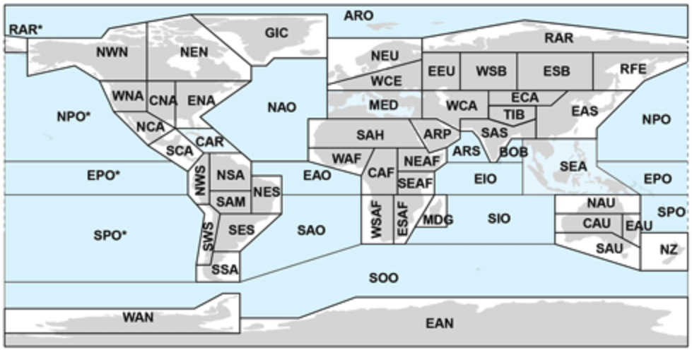
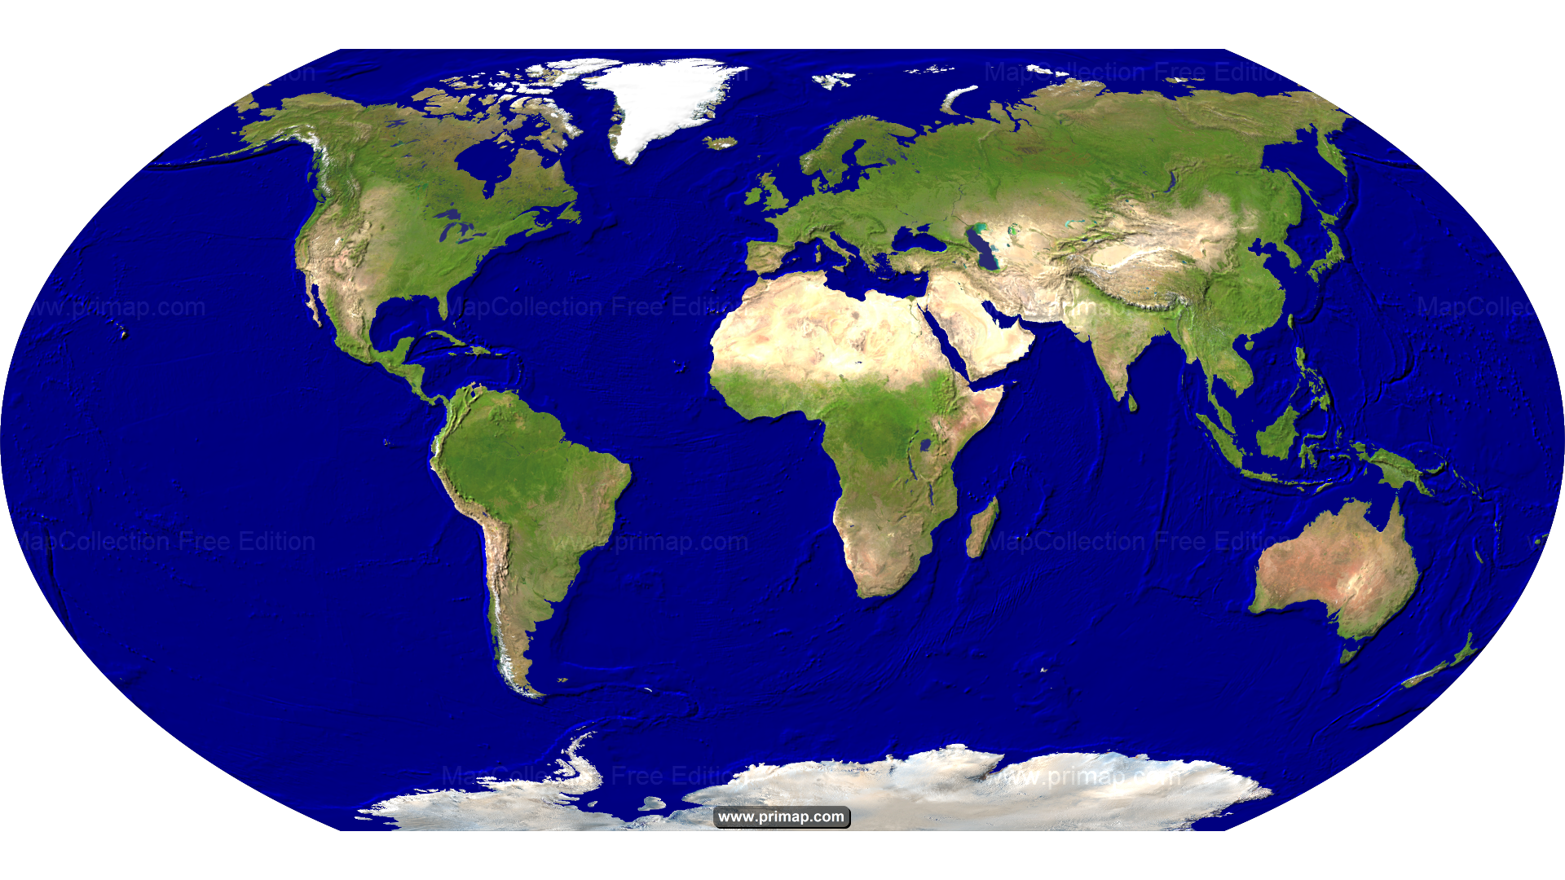

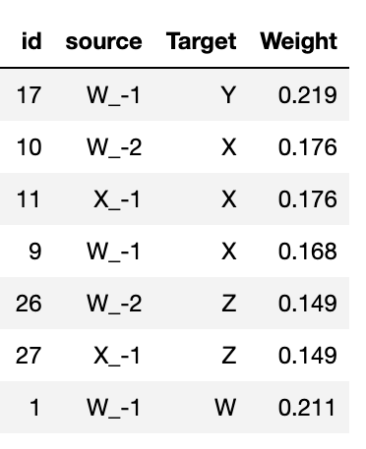
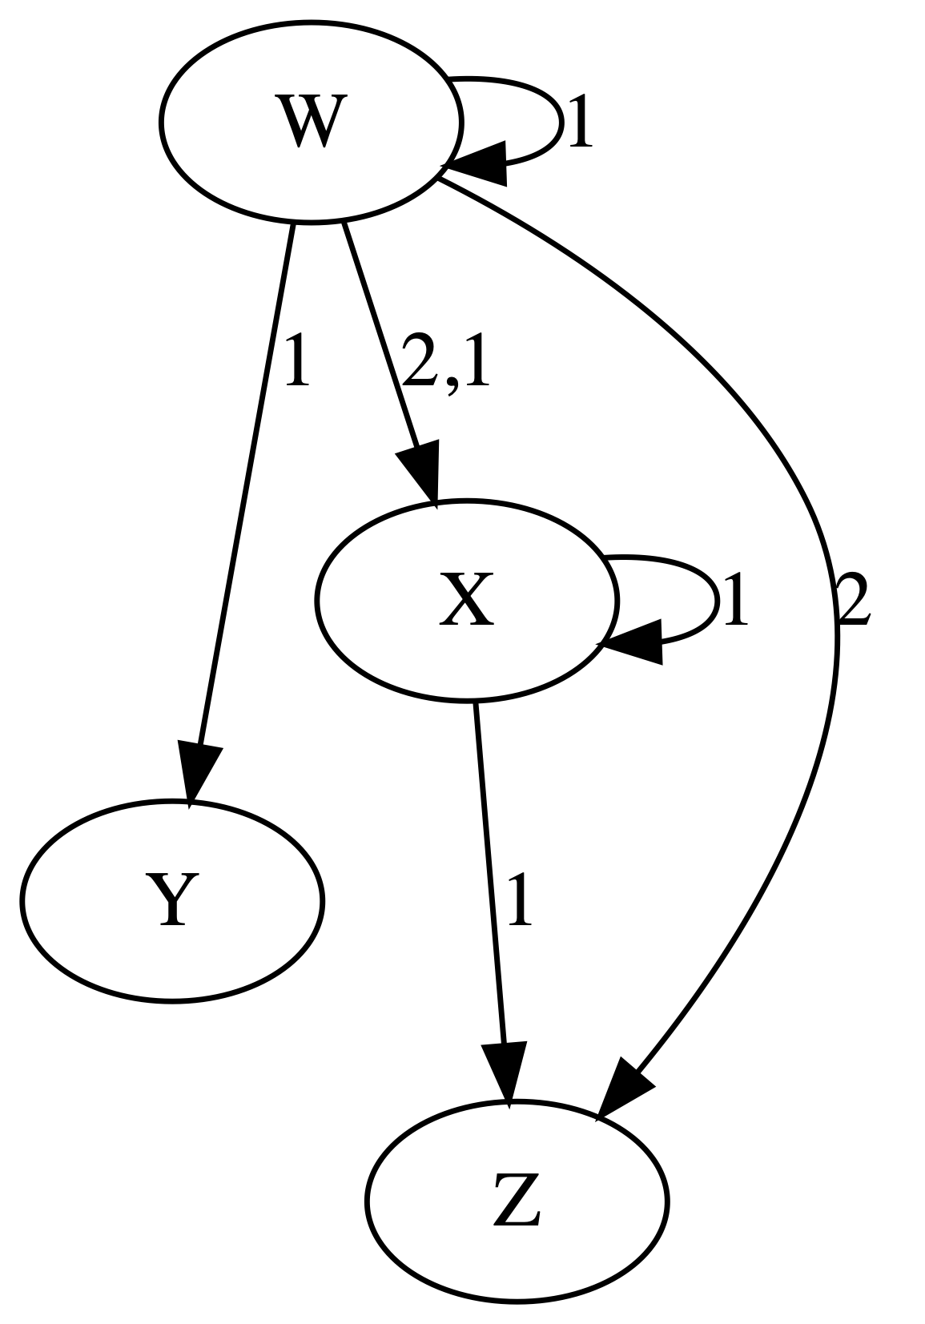
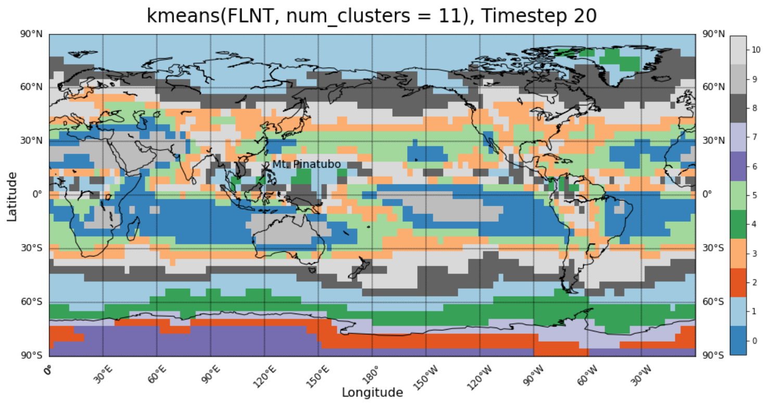
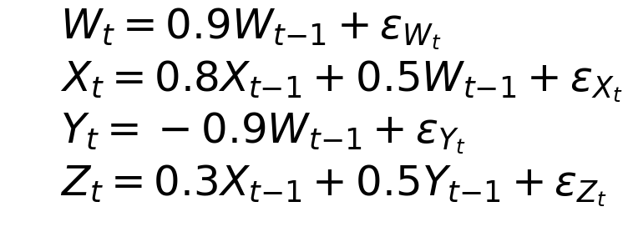
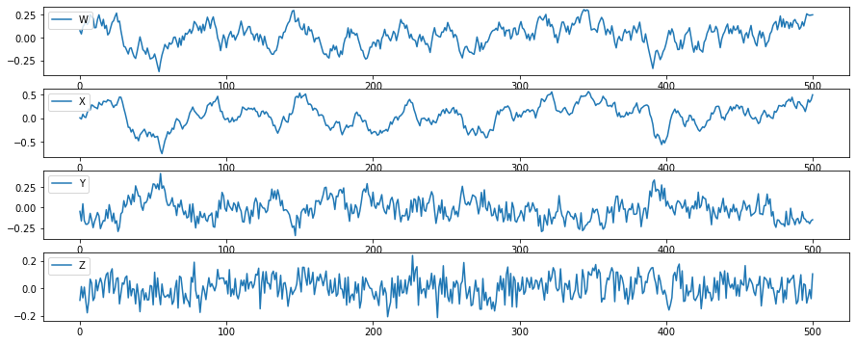
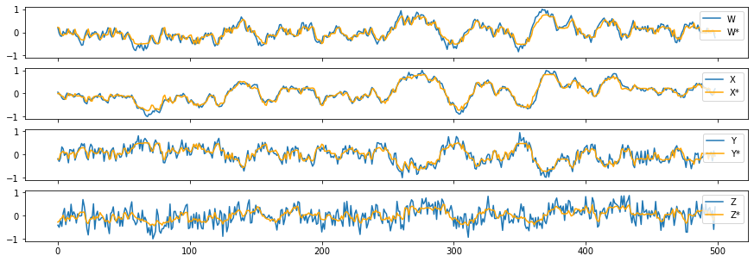

Pathway Detection using Random Forest Regressor Feature Importances Matt Peterson, Meredith Brown, Irina Tezaur, Diana Bull
IPCC region maps
Technical Approach
Motivation
Timeseries Data/Features
The CLDERA Grand Challenge Project is identify causal pathways between various climate features and spatial components.
Goal: Generate a weighted directed graph where the edges indicate influence from one feature of interest to another. Chaining these edges together defines a pathway which we call a Source to Impact pathway.
Random Forest Regressors (RFRs): Machine Learning (ML) predictive models
Require training data comprised of pairs of inputs and outputs
Once trained, can predict outputs given a set of input variables
Feature Importances: a scalar value that indicates the predictive power that a particular input variable has on a given output variable
RFR is commonly used for and well-developed for regression, classification and prediction tasks.
Our approach extends RFR for purpose of discovering pathways
Approach:
Train a multi-variate RFR (python package: sklearn)
Determine feature importances weights between inputs and outputs
Convert weights into a weighted directed graph
F₄
F₅
F₁
F₃
F₂
Iturbide et al., 2020. https://essd.copernicus.org/articles/12/2959/2020/
Train
Random Forest
t-1, t-2, t-3,…
These are climate regions around the globe that we want to be able to identify how one region influences another region and at what time scale.
Inputs
…
F_{1,-4}
F_{5,-6}
Calculate Pairwise Feature Importance Values
(inputs x outputs)
F_{5,-1}
Source to Impact pathways can help analysts identify which features of interest have the largest influence on their results
Which sources are the largest contributors to Arctic Sea Ice extent?
What are the potential downstream effects of a drought in Western Europe?
Find the path of least resistance from a source to impact?
What are the bottleneck features/nodes between source and impact?
Outputs
Source
t
F_{3,-2}
F_{3,-4}
Impact
Convert to Pathway Graph
F₄
F₅
Example of the type of graphs we will produce and how a potential Source to Impact pathway may look like. The most direct path is not always best path.
F₁
F₃
F₂
Feature Importances
Importance Weights calculated using SHAP feature importance
Weights are pruned using a random variable as a cutoff point
Results Summary
Impacts & Successes to date
Example: Synthetic Dataset
Set of coupled equations
Dependencies are 1 timestep, the algorithm will look at 1 and 2 timesteps
Contributions to CLDERA
Developing a suite of verification metrics for feature pathway graphs
Used as tool for explaining model outputs from other thrusts
Identify key pathway differences between simulation runs
Presentations / Papers
Poster at American Geophysical Union (AGU) 2022
In Progress of writing a journal paper
RFR Feature Pathway Graph
Edges indicate influence from one feature to another
The numbers are time lags associated with the path
Mostly correct, but contains two extra edges and one missing edge
These extra pathways are ‘Not wrong, but not correct’
(W_{t-2},Z_{t}) $≈$ (W_{t-2}, X_{t-1}) -> (X_{t-1},Z_{t})
Signature-based Clusters
Variable | R²
W | 0.812
X | 0.940
Y | 0.808
Z | 0.484
Verification metrics
W
X
Example of clustering analysis from another subthrust in CLDERA. We will be using these types of clusters as inputs to identify how these moving clustering influence one another
Y
Z
timesteps
Example of a verification metric to determine if our directed graphs are trustworthy in the absence of ground truth. In this case we are checking to see if the RFR can predict our data well
Initial development of an AI-based surrogate method for mining causal relationships from climate data that can be used to validate and improve upon computational models
0.5 FTE for Subthrust in CLDERA Grand Challenge
SAND2023-00782C

