Slide 1









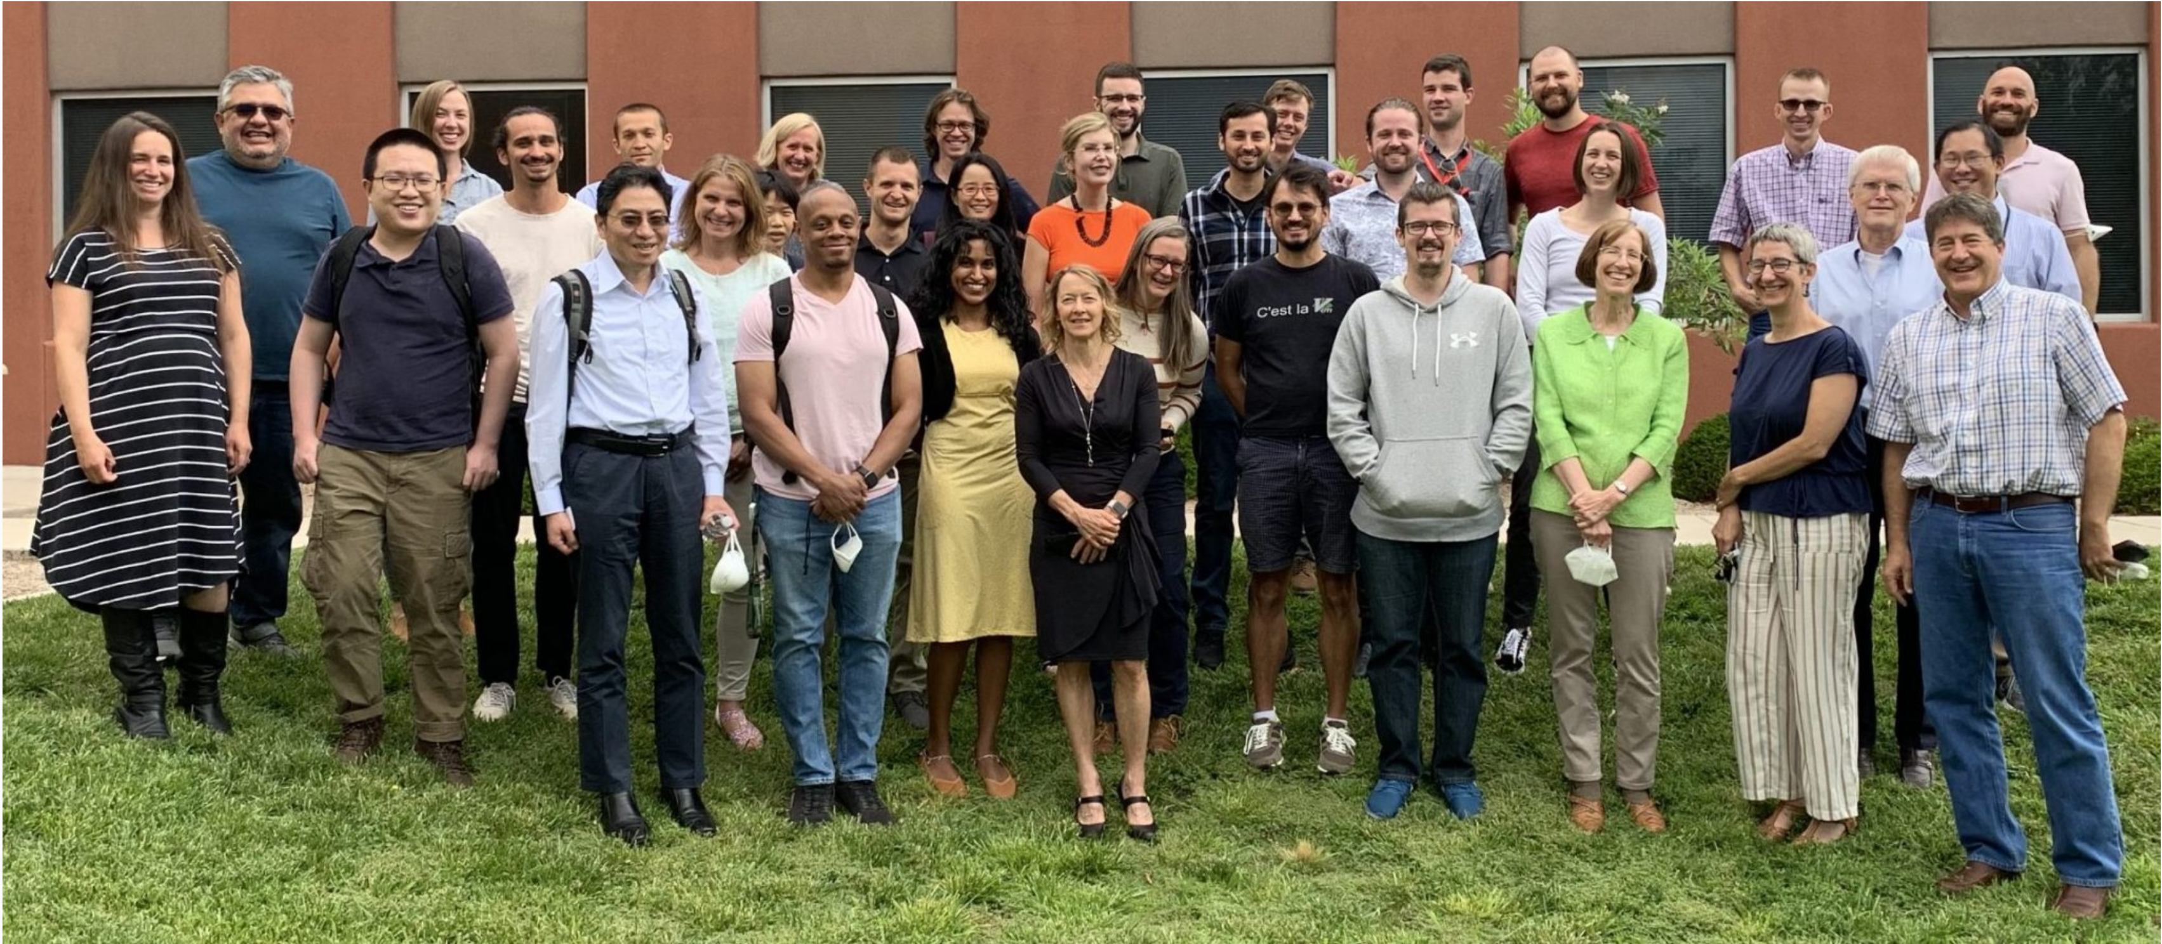




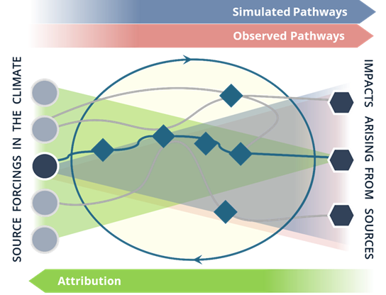




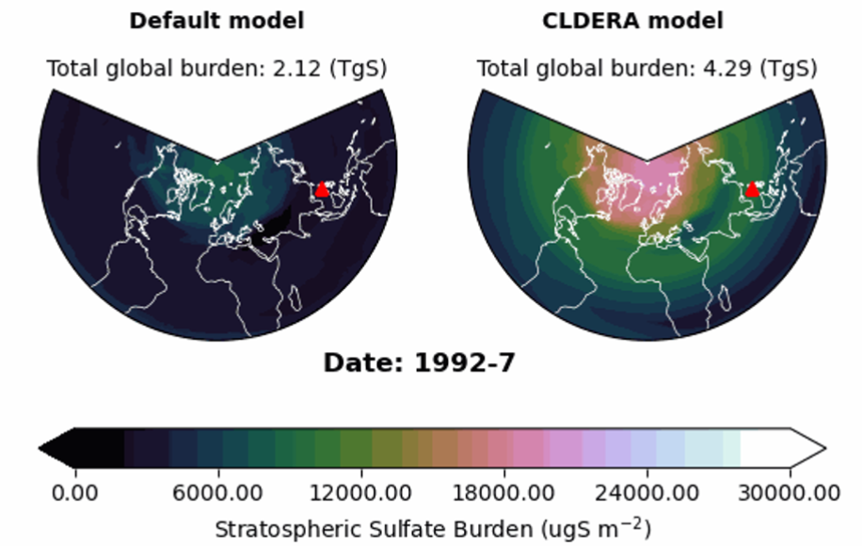
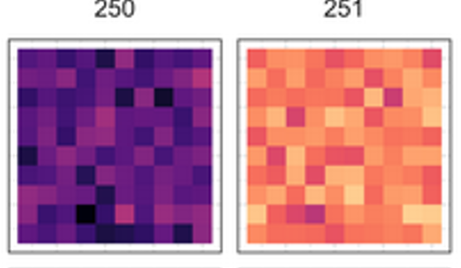
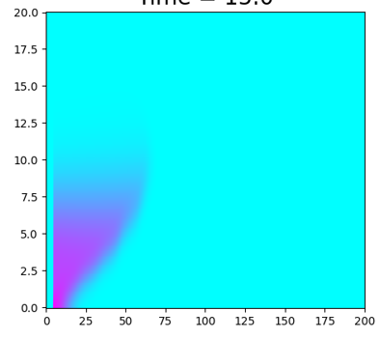
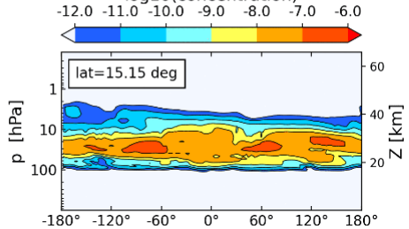
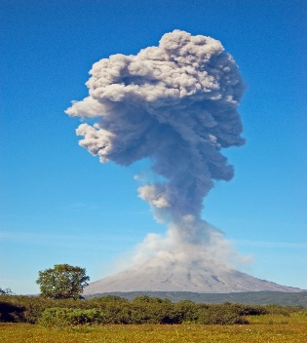
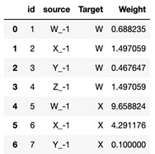
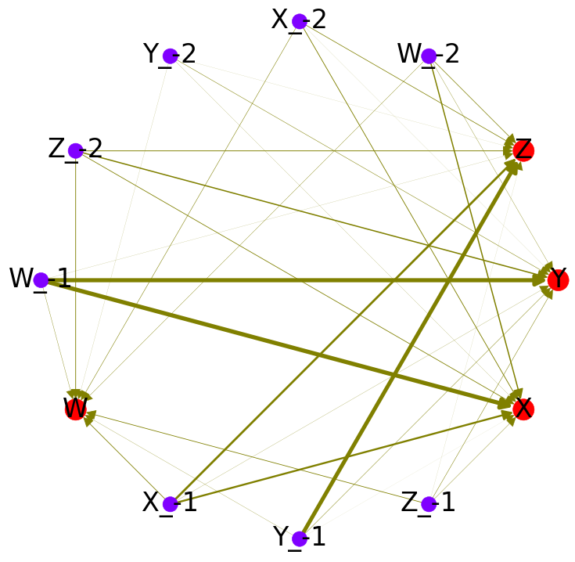
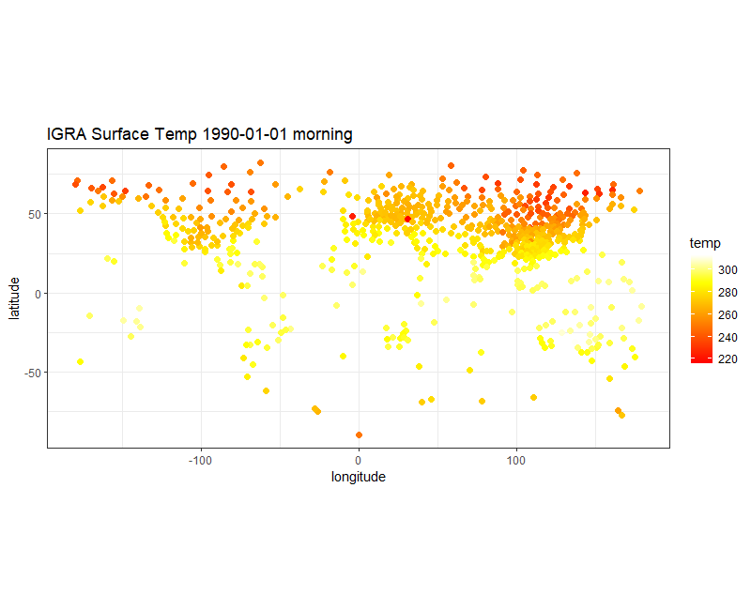
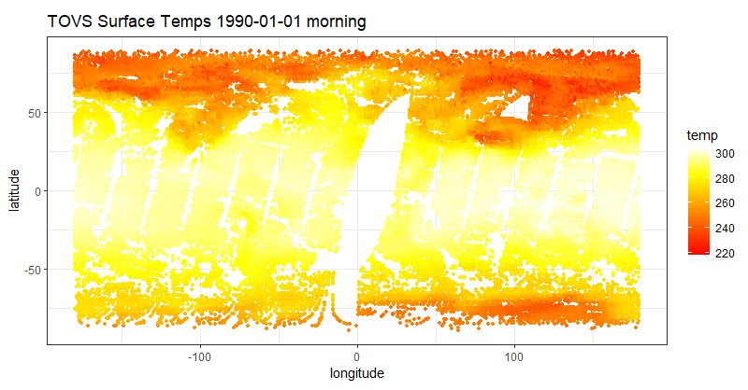
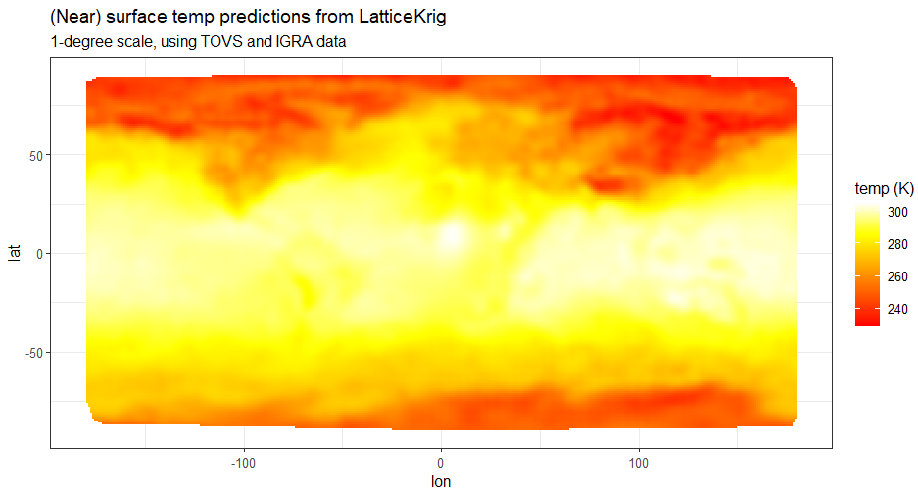
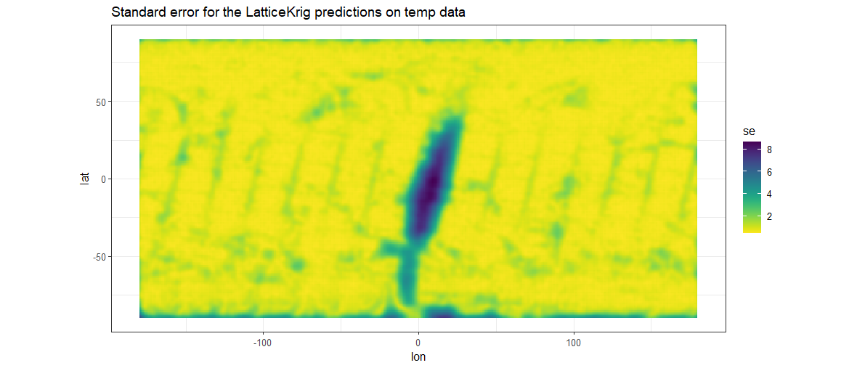
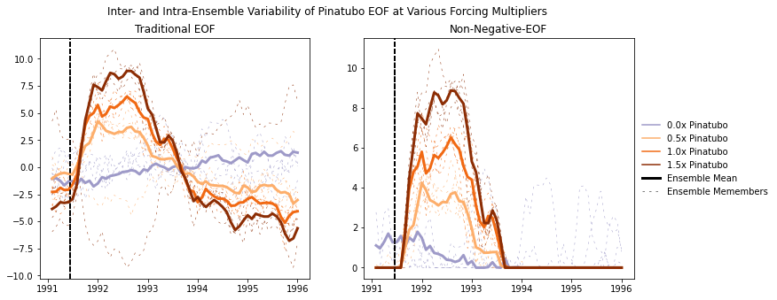
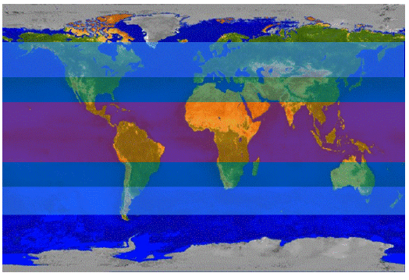
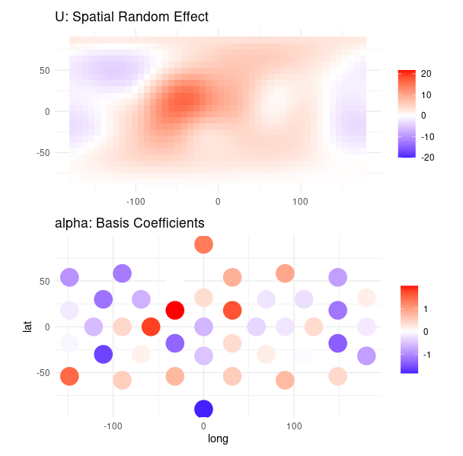

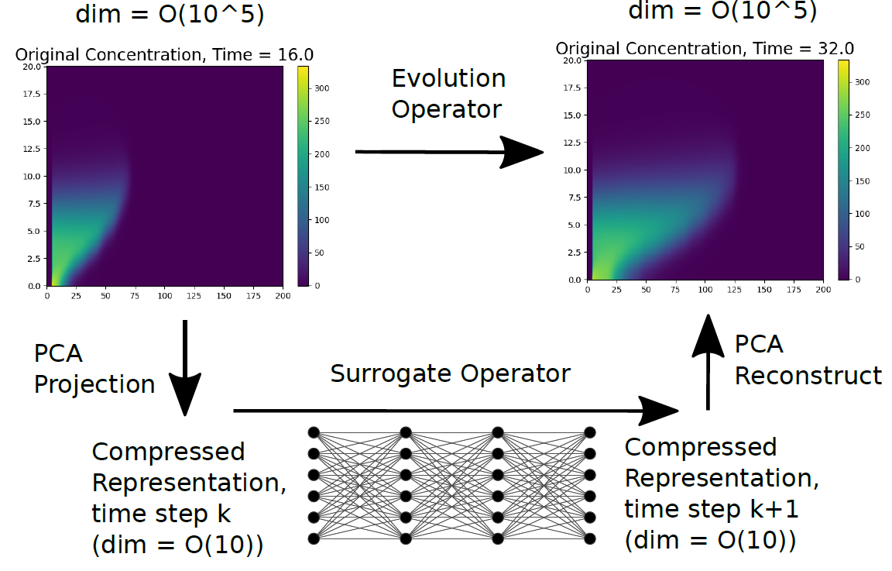
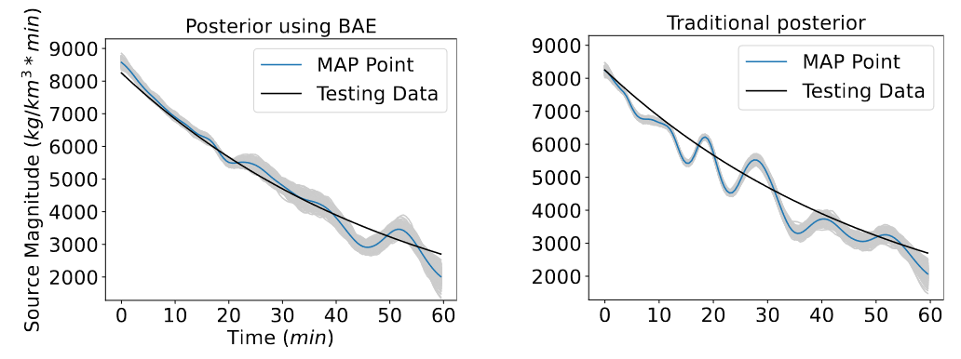
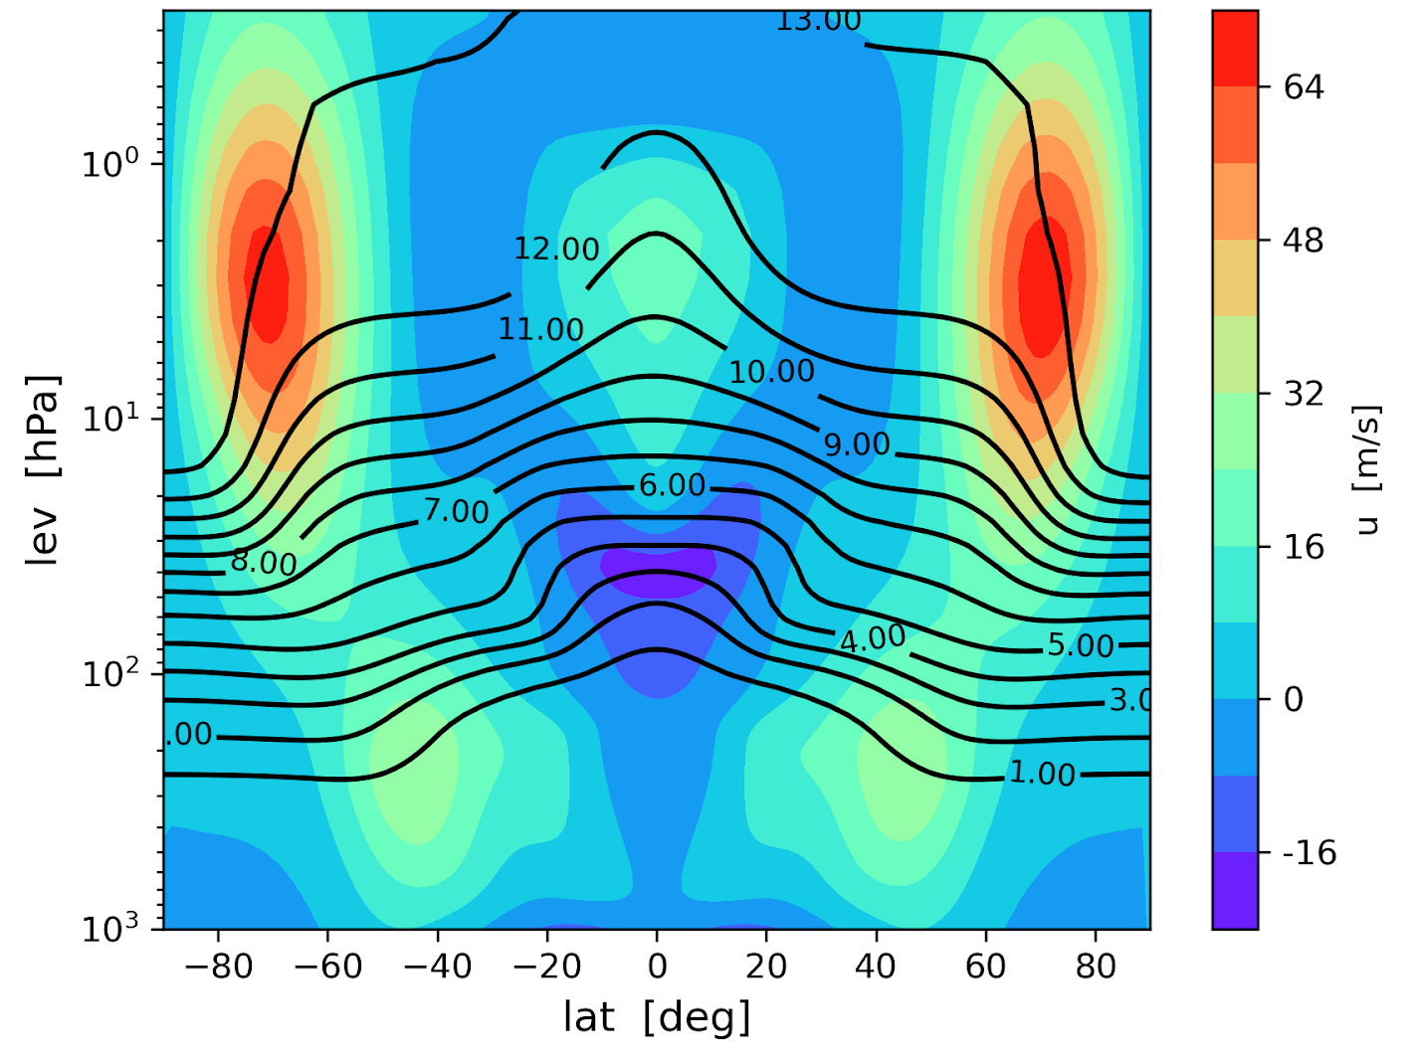
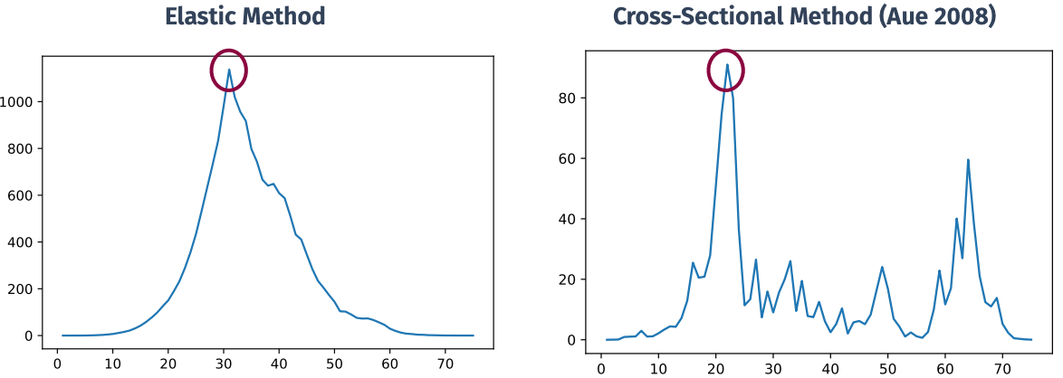

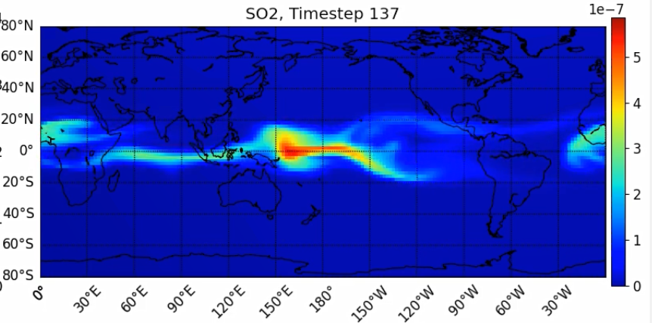
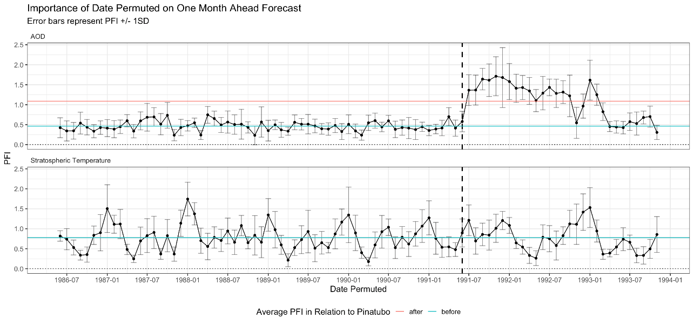
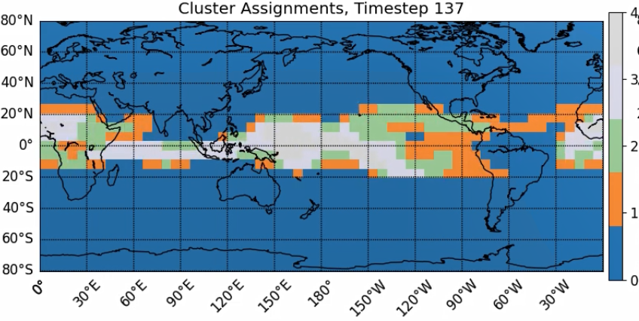
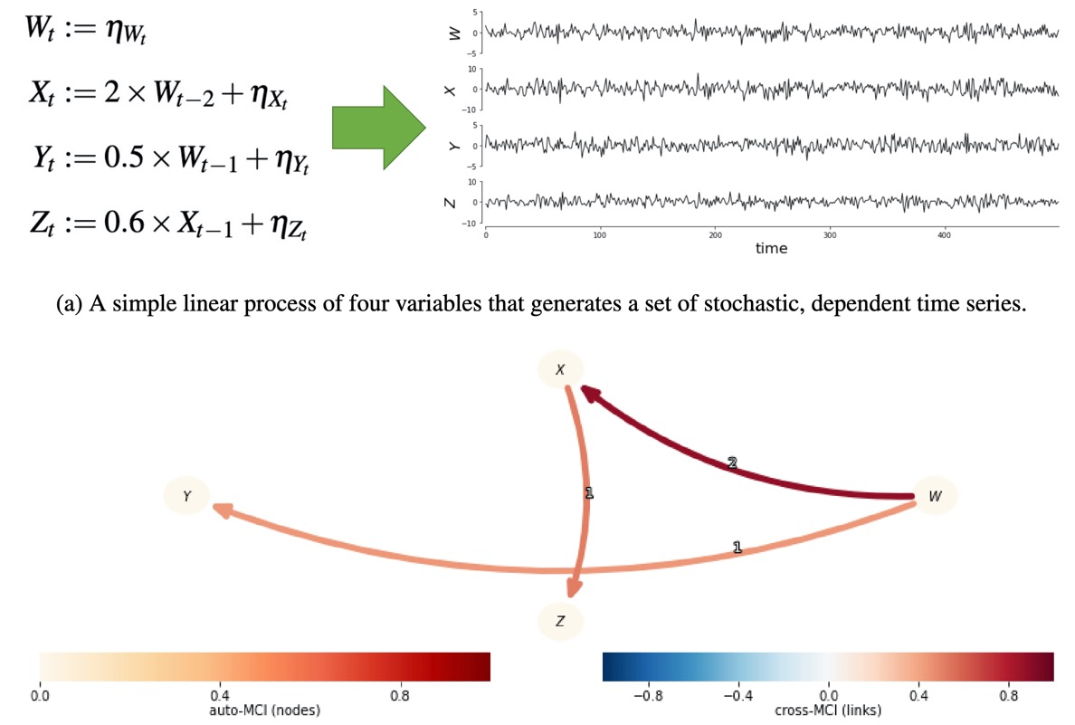







CLDERA – CLimate impact: Determining Etiology thRough pAthways
Sandia National Laboratories is a multimission laboratory managed and operated by National Technology and Engineering Solutions of Sandia LLC, a wholly owned subsidiary of Honeywell International Inc. for the U.S. Department of Energy’s National Nuclear Security Administration under contract DE-NA0003525.SAND 2023-01553PE
Leadership Team: Diana Bull, Kara Peterson, Laura Swiler, Lyndsay Shand, Irina Tezaur
sandia.gov/cldera
OVERVIEW
CLDERA is enabling multi-step attribution in the climate by developing quantitative relationships between a climate forcing and its downstream impacts. CLDERA aims to improve climate risk assessments and decision-making through its transformation in approaches for climate attribution.
NEED
APPROACH
Outcomes
Centers
8900, 1400, 5500, 8700
supporting 42 team members
Climatic impacts (like drought, flooding, or crop yield) are driving national security, legislative and legal foci.
Develop quantitative representations of the pathway, e.g. the spatio-temporally evolving chain of physical processes, between a source and its downstream impacts.
Outcomes
Tools to discover and represent pathways, and analyses to establish pathway robustness to changing conditions.
Cross-validation using simulated and observed pathways will inform areas for model improvement and new measurements.
Complex coupling between processes obscure the relationships between sources and downstream impacts.
Pathways combine multiple variables to strengthen the connection between source and impact.
Contributory ranking of sources to an impact using pathways.
Capability enables robust risk analysis and offers the potential to guide future climate actions.
Sandia Strengths
Uncertainty Quantification
Earth Systems Modeling
Risk-Based Analysis for Complex Systems
Atmospheric Sciences
Remote Sensing
Information Sciences
Traditional attribution connects a source to a primary climate variable in a single step.
Pathways enable new methods to
address variability
rank source importance
constrain attribution approaches
Attribution of source characteristics using inverse optimization methods.
Will provide credible methodology to deter unilateral development of climate interventions.
Modified from: http://www.thesourgrapevine.com/2019/11/the-ball-of-string-theory-for-learning.html
Demonstrate computational approaches on simulations and observations of the 1991 eruption of Mt. Pinatubo in the Philippines
The technical challenge is to draw quantitative relationships in a multi-step attribution framework.
Beginning-to-end attribution in the climate system
Tracing evolving chains of physical processes to enable attribution of climate impacts from a localized source.
CLDERA Positions SNL for Roles in Climate Security
Advancing climate science
Analyzing climate impacts
Motivating sound climate actions
Tiered Verification
Energy Exascale Earth System Model (E3SM)
Develop data sets of increasing complexity with key characteristics of the multi-step attribution problem to explore sensitivities, establish viability, and prove usefulness of advanced methods/tools.
Prognostic Aerosol Modeling: Simulate stratospheric volcanic aerosol in E3SM from SO₂ emissions.
Data & Model complexity (dimensionality of data, number & interaction between processes, …)
Evaluate E3SM’s Stratosphere: Characterize biases and understand what physical processes can be captured.
Synthetic Relationships
Gaussian Plume with prescribed winds
Idealized atm. + embedded pathways
Mt. Pinatubo in fully coupled climate model
Establish climate variability surrounding Mt. Pinatubo: Characterize signal-to-noise for detection & attribution.
Sensitivity Analyses: Determine pathway robustness to altered: eruption characteristics and model parameterizations.
Simulated Pathways
Observed Pathways
Attribution
Random Forest Regression (RFR): Generate feature pathway networks using multi-variate RFR (full pairwise analysis of input features).
Data Fusion: Fuse observational datasets to obtain near-real time measurements over complete space-time grid.
Enhanced Fingerprinting: Investigate advanced principal component analyses (tensor based, non-negative, etc.) and employ multiple nodes in the pathway to sharpen the signal-to-noise ratios and enable downstream impact attribution.
$$W_{t}=ε_{W_{t}}$$
$X_{t}=0.5W_{t−1}+0.2X_{t−1}+$ $ε_{X_{t}}$
$$Y_{t}=−0.5W_{t−1}+ε_{Y_{t}}$$
$$Z_{t}=0.3X_{t−1}+0.5Y_{t−1}+ε_{Z_{t}}$$
Feature
Importances
RFR Feature Pathway Graph
Ground Temp Meas
Satellite Temp Meas
Fused Data
Error
Traditional EOF
Non-Negative EOF
Synthetic Dataset
…
Dynamic space-time models: Adopt space-time dynamic models to incorporate multiple nodes and establish correlations between nodes.
The lat/lon components are averaged per pressure level so that only a 2-D signal (pressure, time) is used in the PCA analysis
Profiling: Dynamically trace pathways through the E3SM software as the software executes (in-situ).
Observed Data
Modeled Data
N. Temperate Band Response in profiling tool
$$106≤t<112$$
Weylandt, Swiler. Beyond PCA: Additional Dimension Reduction Techniques to Consider for Climate Data. To be submitted.
Eruption in idealized model on day 90
$$112≤t<114$$
Synthetically modeled spatial evolution at time t using radial basis functions;
Can estimate spatially-varying dependence between multiple variables through basis coefficients
Inverse Optimization: Identify source characteristics by developing deep operator neural networks (DONNs) to model parts of E3SM for PDE-constrained optimization.
$$114≤t<145$$
Changepoint methods: Detecting significant climate shifts at both regional and global spatial scales using spatially-varying changepoint methods and functional time series methodologies.
$$t>145$$
Tracing: Add active and passive tracers to E3SM to enable model evaluation and pathway identification.
Synthetic Data
oldest air (years) polar stratosphere
10-year mean Age of Air in Spectral Element dycore (2$°$) with idealized climate. Steep gradients in age (in years) imply barrier to mixing (e.g. strong polar jets shown in color)
SoA Changepoint
Functional Changepoint
Ten years of ERA5 reanalysis presented as a functional time series. Before and after Mt. Pinatubo eruption.
Inverse optimization solution provides a close, uncertainty-quantified estimate even in the face of wind variability
Test Statistic
Test Statistic
Tucker, Yarger, Functional Changepoint Detection, Environmetrics
Hart, Gulian, Manickam, Swiler. Solving High-dimensional inverse problems with auxiliary uncertainty via operator learning with limited data. Journal of Machine Learning for Modeling and Computing
Youngest air (years) near tropical tropopause
True changepoint
Signature-Based Clustering: Find & track non-stationary variable clusters for use as features in pathway identification.
Explainable Echo State Networks (ESNs): Develop explainable (permutation feature importance) and interpretable methods to quantify relationships between pathway nodes as modeled by recurrent neural networks.
Causal Modeling: Develop causal discovery method for spatially nonstationary and transient relationships; use directed graphs to represent causal networks.
Importance of AOD
Eruption
Application of (adjusted) permutation feature importance on echo state network trained on MERRA2 reanalysis data.
Variable importance shows increased importance of AOD immediately following Pinatubo.
Importance of Stratospheric Temperature
Space-time varying cluster identification in response to Mt. Pinatubo source.

