Slide 1
Achieving and maintaining performance and performance portability within the Albany multi-physics code: perspectives & tools
Irina Tezaur¹, Max Carlson¹, Jerry Watkins¹, Mauro Perego¹, Kyle Shan², Carolyn Kao³, Kim Liegeois¹
¹ Sandia National Laboratories, Livermore, CA, USA.
² Micron Technology, Boise, ID, USA.
³ TSMC, Hsinchu City, Taiwan.
SIAM CS&E 2023, Amsterdam, Netherlands.
February 26 – March 3, 2023
SAND2023-12634C
Notes:
TODO: add anyone else? Kim?

Slide 2
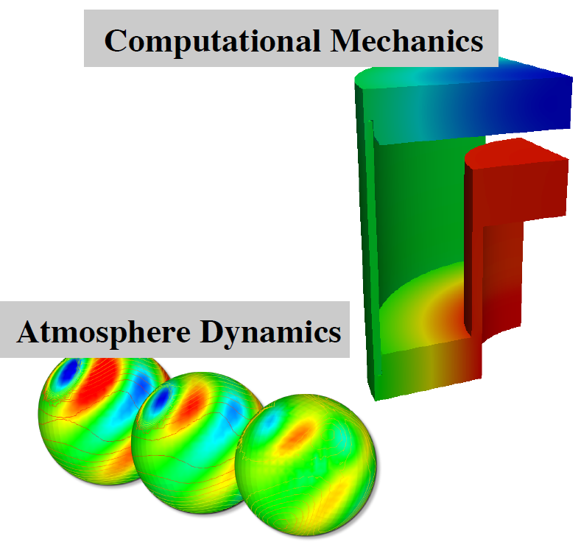
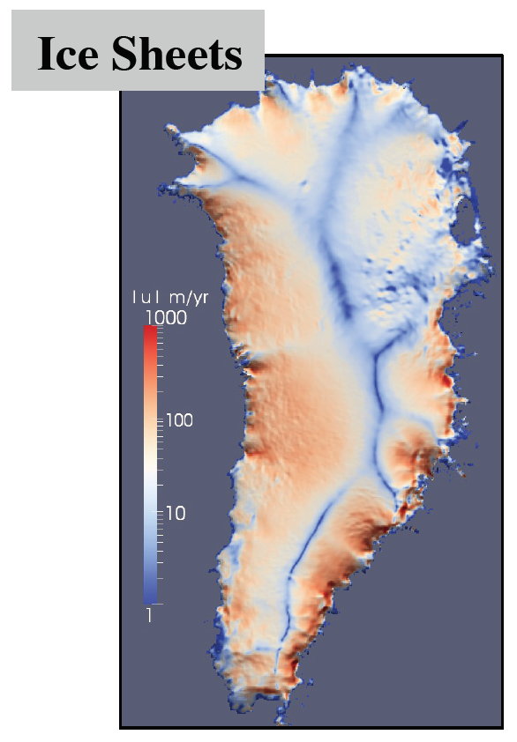
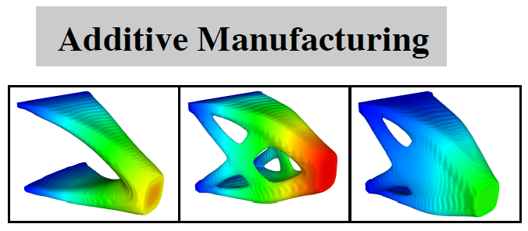
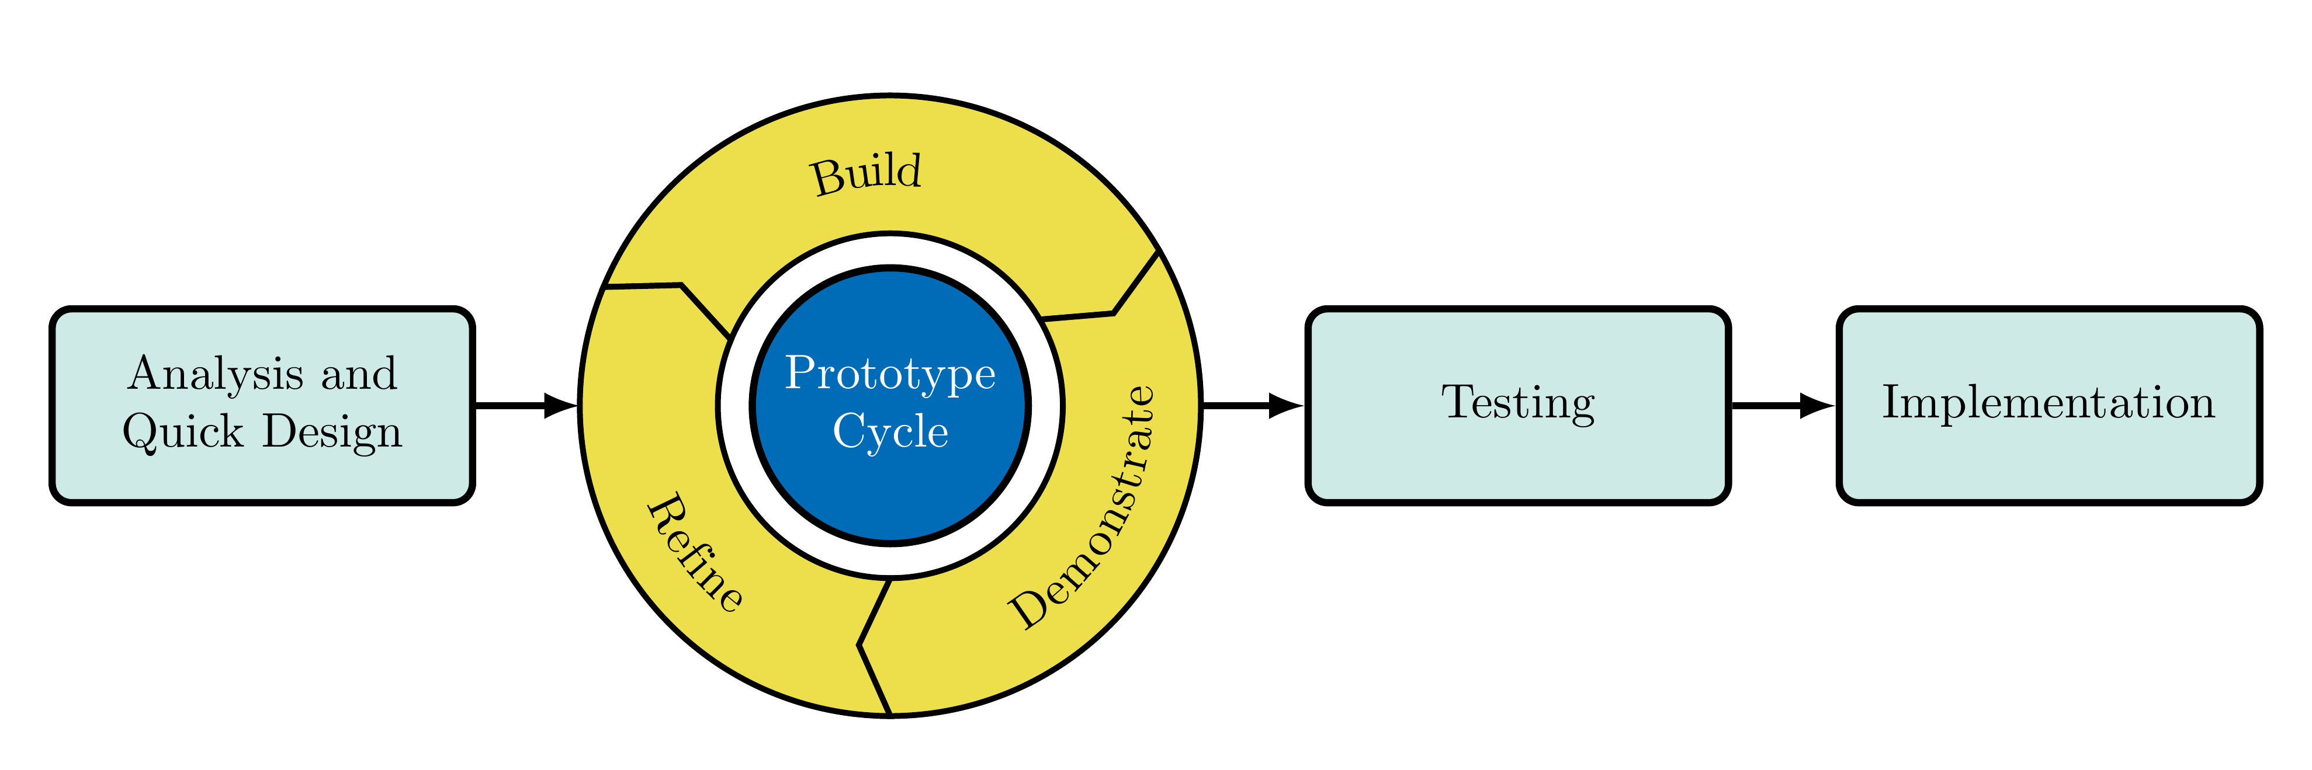
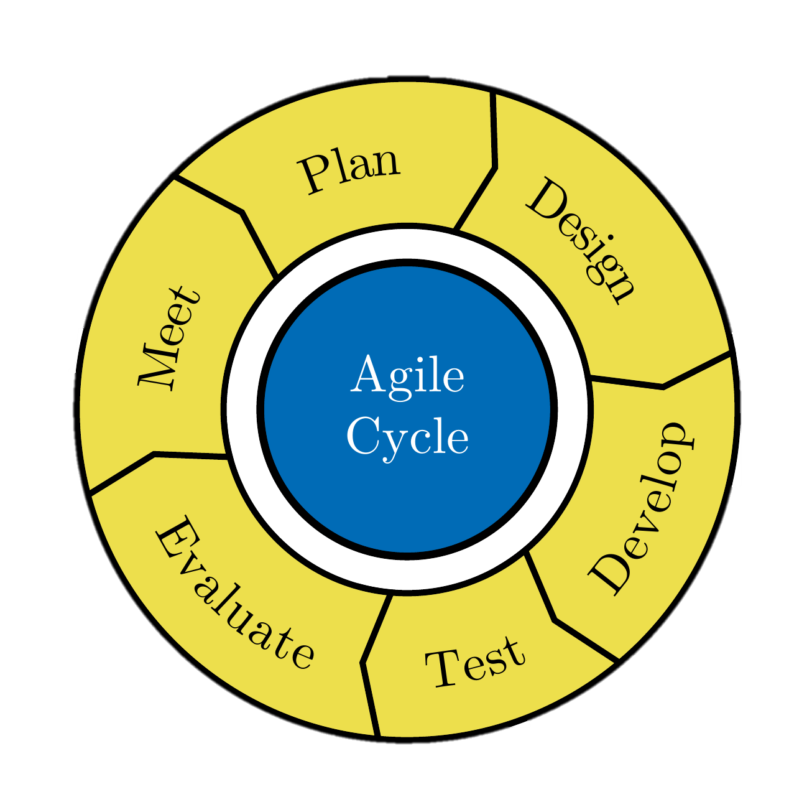
The Albany Code Base
Albany: open-source¹ parallel C++ unstructured-grid multi-physics finite element code built for rapid application development from Trilinos² Agile Components
Distinguishing features of Albany:
Funded entirely by applications residing within
Both a “sand-box” for prototyping new approaches and a production code
Algorithms/software are developed & matured directly on applications
Applications are “born” scalable, fast, robust, performance-portable, and...
Equipped with embedded advanced analysis capabilities: sensitivities, bifurcation analysis, adjoint-based inversion, …
¹ https://github.com/sandialabs/Albany
² https://github.com/trilinos/Trilinos

Slide 3
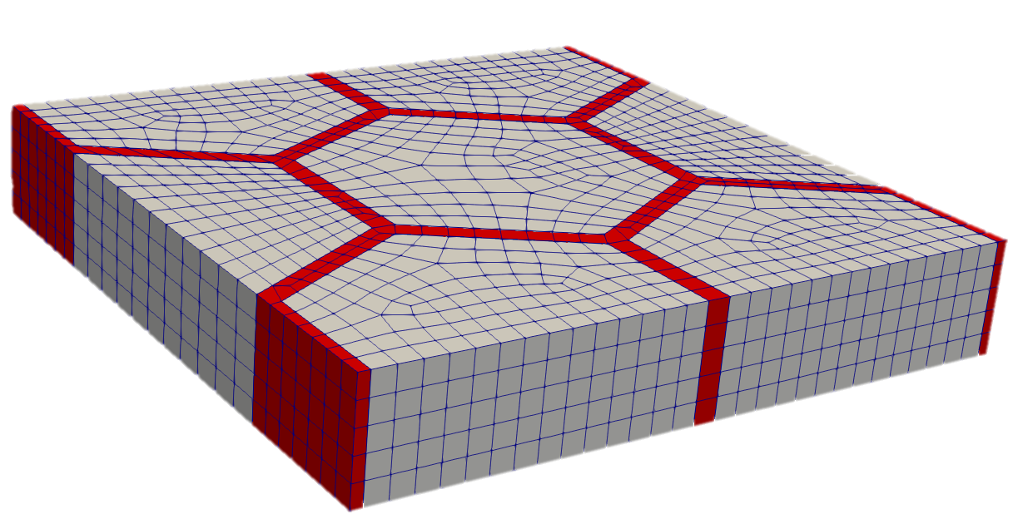
History of Albany
Since its creation $\sim$2009, Albany has housed many diverse algorithmic projects & applications*:
Demo PDEs
Quantum Devices (QCAD)
Ice Sheets (Albany Land-Ice)
Mechanics (LCM)
Atmosphere Dynamics (Aeras)
Particle-continuum coupling (Peridigm-LCM)
Additive Manufacturing Design (ATO)
Additive Manufacturing Processing (AMP)
Arctic Coastal Erosion (ACE)
Coupled Geomechanics (Albotran)
Andy Salinger
“Father” of Albany
* Albany github repo: https://github.com/SNLComputation/Albany.
* I. Tezaur et al. "Albany: a Trilinos-based multi-physics partial differential equation research tool created using the Agile Components code development strategy," SIAM CS&E 2019 (featured MS: "Multiphysics: Extensible, Composable Algorithms and Software"), Spokane, WA.
3

Slide 4
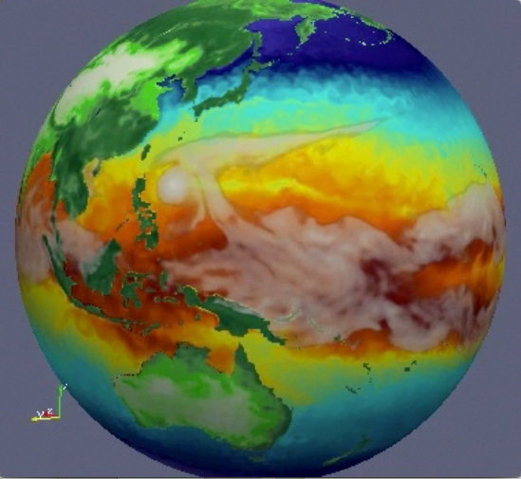
Albany and its Requirements Today
Atmos.
(EAM)
Primary customer/funder: U.S. DOE SciDAC-funded project land-ice modeling project, FAnSSIE (Framework for Antarctic System Science in E3SM, FY23-FY27)
Albany houses the velocity solver of MALI (MPAS-Albany Land Ice), the land-ice component of the U.S. DOE’s Energy Exascale Earth System Model (E3SM)
Required capabilities in Albany for science using MALI:
Easy way to add new physics/PDEs
Performance portability to advanced heterogeneous platforms
Fast, scalable and robust linear solves across different architectures
PDE-constrained optimization capabilities for ice sheet inversion
Adaptive mesh refinement (AMR) of extruded tetrahedral meshes
Ocean
(MPAS-O)
Sea Ice
(MPAS-SI)
Land
(ELM)
Land Ice
(MALI)
Requirements for software quality:
Pruning of unfunded applications/unsupported code
Version control
Automated parameter tuning for various architectures
Automated nightly regression and performance testing using VOTD Albany & Trilinos
See MS284 and MS318 on Thur. Mar. 2 for more on MALI and ice-sheet modeling.

Slide 5
Albany and its Requirements Today
Atmos.
(EAM)
Primary customer/funder: U.S. DOE SciDAC-funded project land-ice modeling project, FAnSSIE (Framework for Antarctic System Science in E3SM, FY23-FY27)
Albany houses the velocity solver of MALI (MPAS-Albany Land Ice), the land-ice component of the U.S. DOE’s Energy Exascale Earth System Model (E3SM)
Required capabilities in Albany for science using MALI:
Easy way to add new physics/PDEs
Performance portability to advanced heterogeneous platforms
Fast, scalable and robust linear solves across different architectures
PDE-constrained optimization capabilities for ice sheet inversion
Adaptive mesh refinement (AMR) of extruded tetrahedral meshes
Ocean
(MPAS-O)
Sea Ice
(MPAS-SI)
Land
(ELM)
Land Ice
(MALI)
This talk: highlight capabilities for achieving/maintaining performance & performance portability in Albany, with focus on pros/cons and lessons learned.
Requirements for software quality:
Pruning of unfunded applications/unsupported code
Version control
Automated parameter tuning for various architectures
Automated nightly regression and performance testing using VOTD Albany & Trilinos

Slide 6
Outline
Albany capabilities & supporting tools
Components effort
Albany under the hood
Kokkos for performance portability
Phalanx for template-based evaluators and DAG-based finite element assembly
Sacado for automatic differentiation (AD)
Some performance & performance portability results
Maintaining software quality of Albany
Code pruning
PyAlbany: a Python interface to Albany
Nightly regression testing
Automated performance testing
Automated performance tuning
Summary & perspectives

Slide 7
Outline
Albany capabilities & supporting tools
Components effort
Albany under the hood
Kokkos for performance portability
Phalanx for template-based evaluators and DAG-based finite element assembly
Sacado for automatic differentiation (AD)
Some performance & performance portability results
Maintaining software quality of Albany
Code pruning
PyAlbany: a Python interface to Albany
Nightly regression testing
Automated performance testing
Automated performance tuning
Summary & perspectives

Slide 8
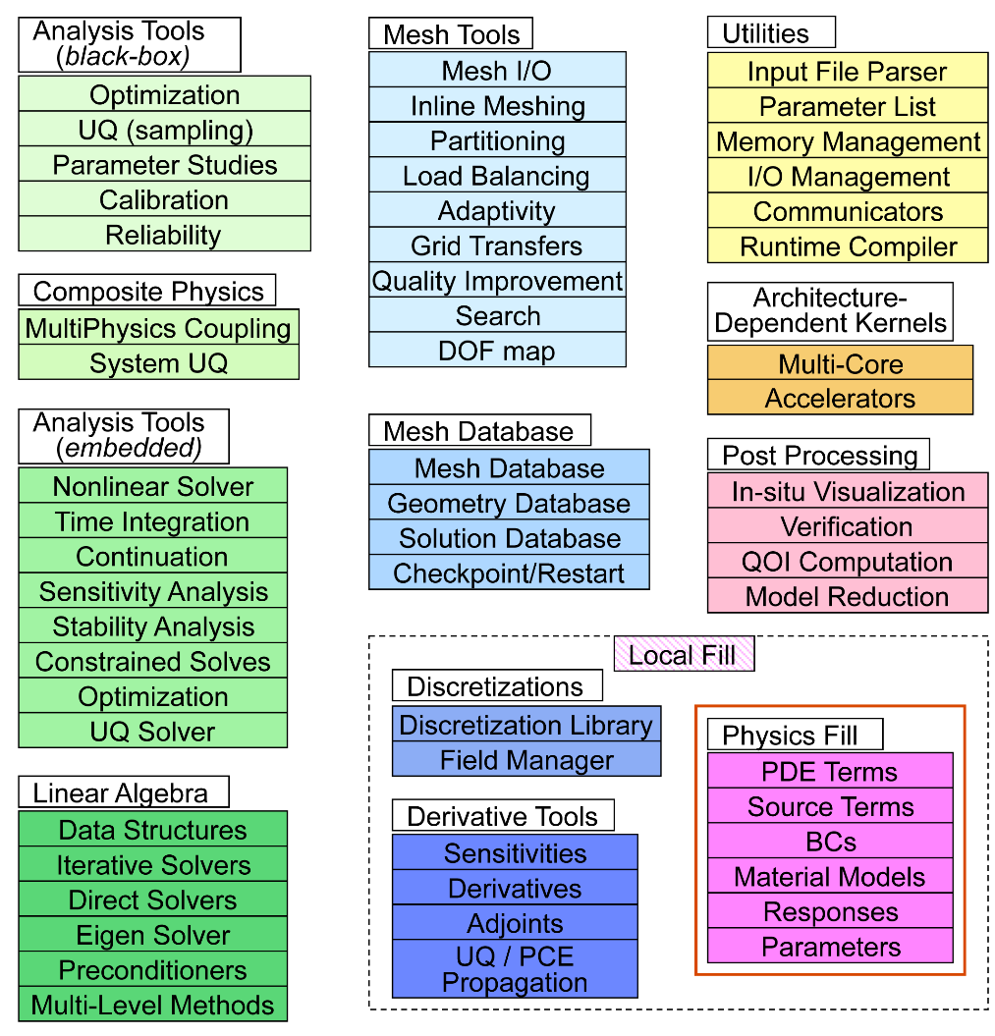
The Components in Albany
Components in Albany = cutting-edge technology from Trilinos, SierraToolKit, DAKOTA, FASTMath, Kitware, etc.
TPL capability
Many components are Trilinos* packages:
Mesh tools (STK)
Discretization tools (Intrepid2)
Nonlinear/Linear solver (NOX/Belos)
Distributed memory linear algebra (Tpetra)
Multigrid Preconditioner (MueLu)
Field DAG (Phalanx)
Automatic differentiation (Sacado)
Shared memory parallelism (Kokkos)
Many more…
Albany developers work with Version of the Day (VOTD) Trilinos, which has pros and cons.
Pro: code can inherit unexpected enhancements “for free”
Con: code might also inherit bugs/regressions which can be frustrating to track down and get fixed to maintain clean dashboard
Clean dashboard
: 40+ packages; 120+ libraries
* https://github.com/trilinos/Trilinos
8

Slide 9
Albany Under the Hood
Albany provides the “glue” that connects components (via abstract interfaces).
Four Key Ingredients:
MPI+X programming model for performance portability
Handled by Kokkos package
Template-based generic programming (TBGP)
E.g., Phalanx evaluators templated on evaluation type (right)
3. Graph-based finite element assembly (FEA)
Handled by Phalanx package
4. Templated-based automatic differentiation
Handled by Sacado package
Evaluators Templated on Evaluation Type:
<EvalT>
(Generic)
Template Specializations:
Residual
Jacobian
Tangent
Hessian
Adjoint
PCE
Shape Opt
For more details on these ingredients, please see talk by Jerry Watkins (MS284: Thurs. Mar. 2).
9
Notes:
FIXME: add pictures??

Slide 10
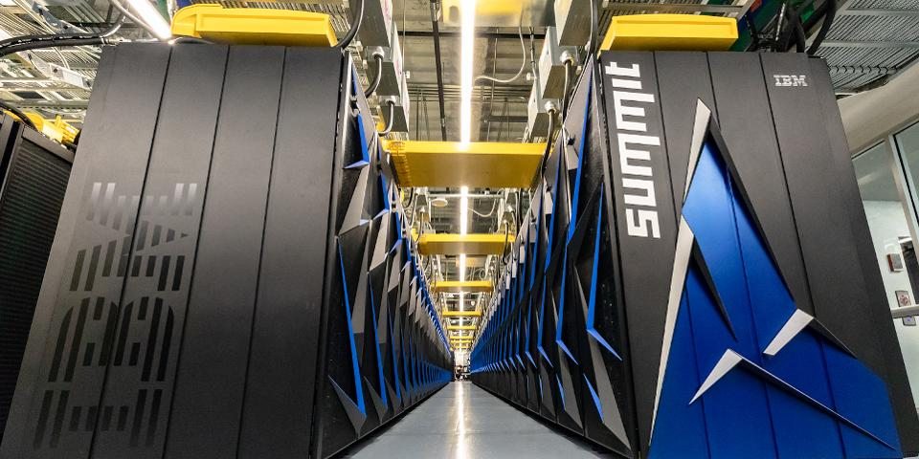
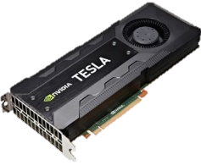
Albany Supporting Tools: Kokkos $–$ Performance Portability
Pros:
Same code runs on diff. platforms
Code is “future-proof”
Forces you to write better code
Cons: better performance may be possible with architecture-specific optimizations
Kokkos¹ is a C++ library that provides performance portability across multiple shared memory computing architectures via MPI+X programming model
Examples: Multicore CPU, NVIDIA GPU, Intel KNL and much more…
Abstract data layouts and hardware features for optimal performance on current and future architectures
Allows researchers to focus on application or algorithmic development instead of architecture specific programming
With Kokkos, you write an algorithm once for multiple hardware architectures. Template parameters are used to get hardware specific features.
¹ https://github.com/kokkos/kokkos.

Slide 11
Albany Supporting Tools: Phalanx Evaluator $–$ Templated Phalanx Node
Pros:
Easy to implement new physics
Easy to Kokkos-ize
A Phalanx node (evaluator) is constructed as a C++ class
Each evaluator is templated on an evaluation type (e.g., residual, Jacobian)
The evaluation type is used to determine the data type (e.g., double, Sacado data types)
Kokkos RangePolicy is used to parallelize over cells over an Execution Space (e.g., Serial, OpenMP, CUDA)
Inline functors are used as kernels
MDField data layouts
Serial/OpenMP $–$ LayoutRight (row-major)
CUDA $–$ LayoutLeft (col-major)
typedef Kokkos::CUDA Execution Space;
template<typename EvalT, typename Traits>
void StokesFOResid<EvalT, Traits>::
evaluateFields(typename Traits::EvalData workset) {
Kokkos::parallel_for(
Kokkos::RangePolicy<ExeSpace>(0,workset.numCells),
*this);
}
template<typename EvalT, typename Traits>
KOKKOS_INLINE_FUNCTION
void StokesFOResid<EvalT, Traits>::
operator() (const int& cell) const{
for (int cell=0; cell < numCells; cell++) {
for (int node=0; node < numNodes; ++node){
Residual(cell,node,0)=0.;
}
}
for (int cell=0; cell < numCells; cell++) {
for (int node=0; node < numNodes; ++node) {
for (int qp=0; qp < numQPs; ++qp) {
Residual(cell,node,0) +=
Ugrad(cell,qp,0,0)*wGradBF(cell,node,qp,0) +
Ugrad(cell,qp,0,1)*wGradBF(cell,node,qp,1) +
force(cell,qp,0)*wBF(cell,node,qp);
}
}
}
}

Slide 12
Albany Supporting Tools: Phalanx Evaluator $–$ Templated Phalanx Node
Pros:
Easy to implement new physics
Easy to Kokkos-ize
A Phalanx node (evaluator) is constructed as a C++ class
Each evaluator is templated on an evaluation type (e.g., residual, Jacobian)
The evaluation type is used to determine the data type (e.g., double, Sacado data types)
Kokkos RangePolicy is used to parallelize over cells over an Execution Space (e.g., Serial, OpenMP, CUDA)
Inline functors are used as kernels
MDField data layouts
Serial/OpenMP $–$ LayoutRight (row-major)
CUDA $–$ LayoutLeft (col-major)
typedef Kokkos::CUDA ExeSpace;
template<typename EvalT, typename Traits>
void StokesFOResid<EvalT, Traits>::
evaluateFields(typename Traits::EvalData workset) {
Kokkos::parallel_for(
Kokkos::RangePolicy<ExeSpace>(0,workset.numCells),
*this);
}
template<typename EvalT, typename Traits>
KOKKOS_INLINE_FUNCTION
void StokesFOResid<EvalT, Traits>::
operator() (const int& cell) const{
for (int cell=0; cell < numCells; cell++) {
for (int node=0; node < numNodes; ++node){
Residual(cell,node,0)=0.;
}
}
for (int cell=0; cell < numCells; cell++) {
for (int node=0; node < numNodes; ++node) {
for (int qp=0; qp < numQPs; ++qp) {
Residual(cell,node,0) +=
Ugrad(cell,qp,0,0)*wGradBF(cell,node,qp,0) +
Ugrad(cell,qp,0,1)*wGradBF(cell,node,qp,1) +
force(cell,qp,0)*wBF(cell,node,qp);
}
}
}
}

Slide 13
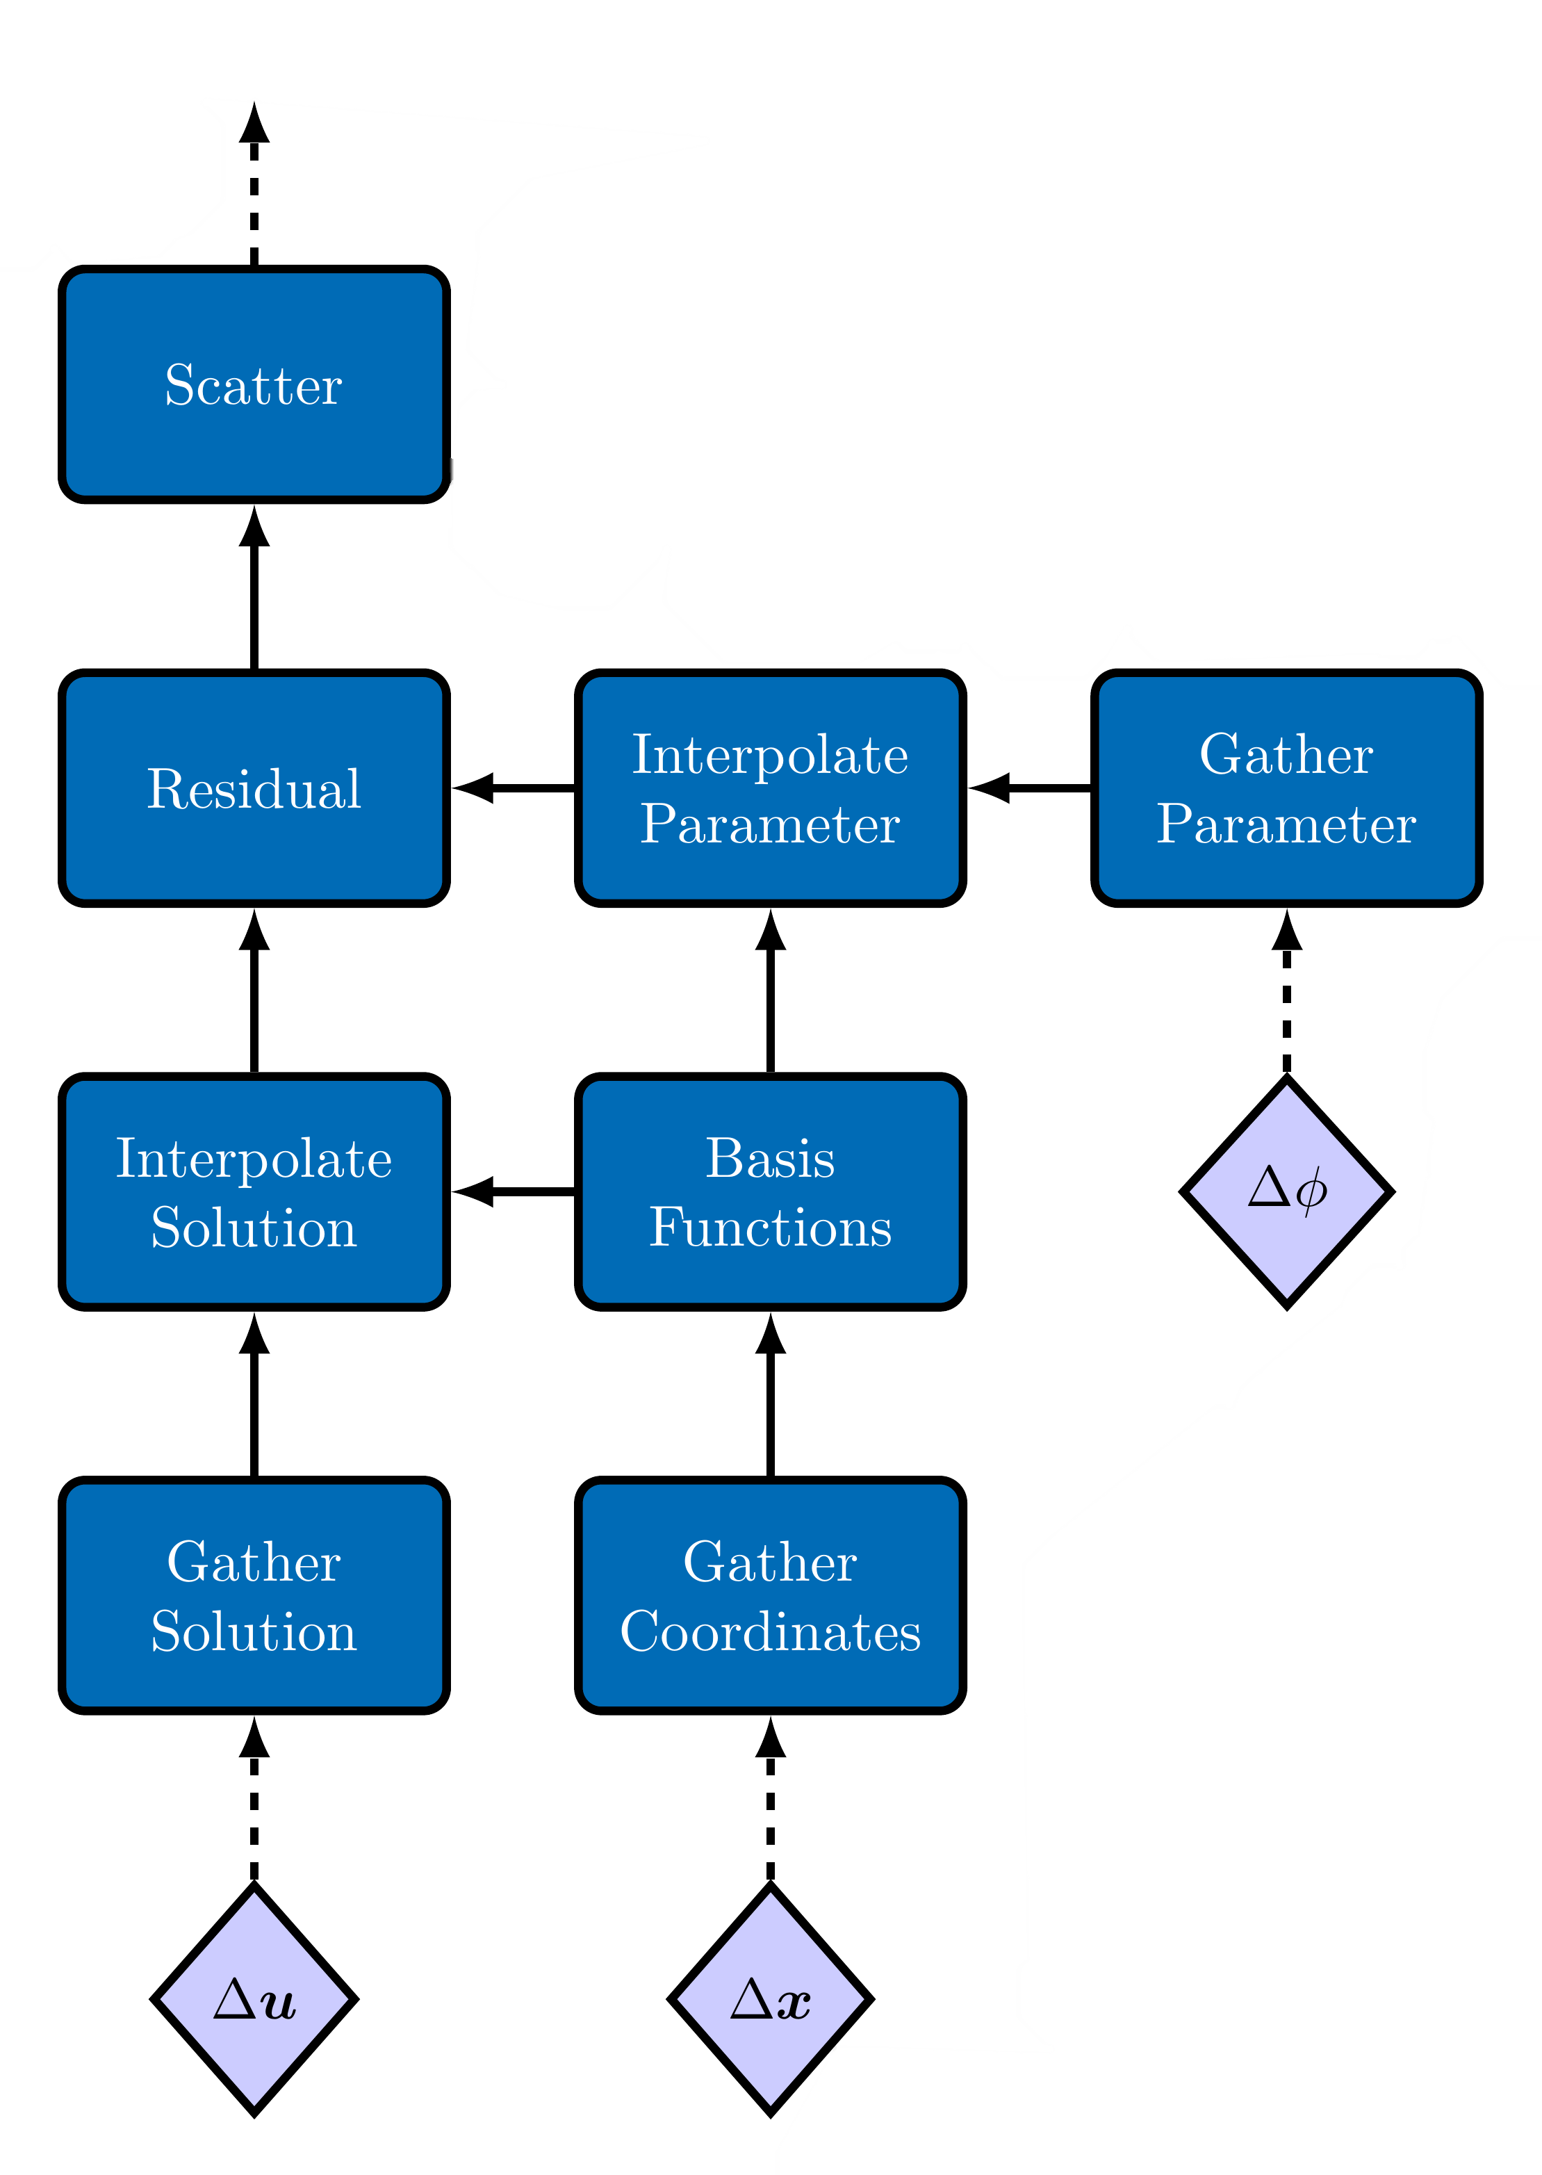
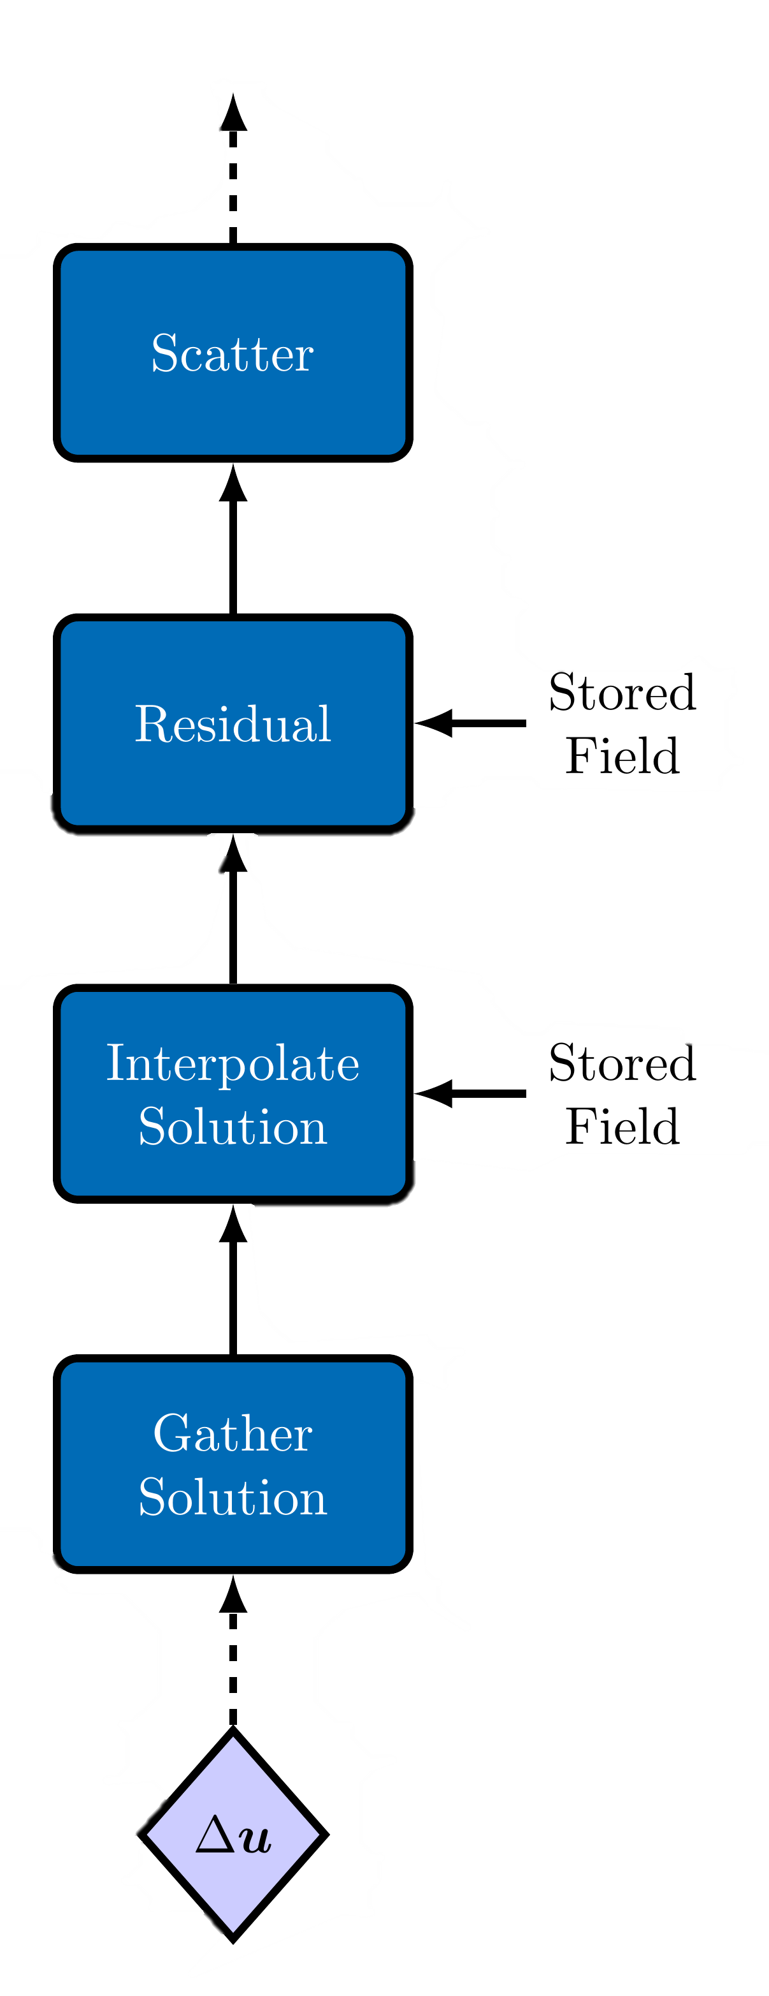
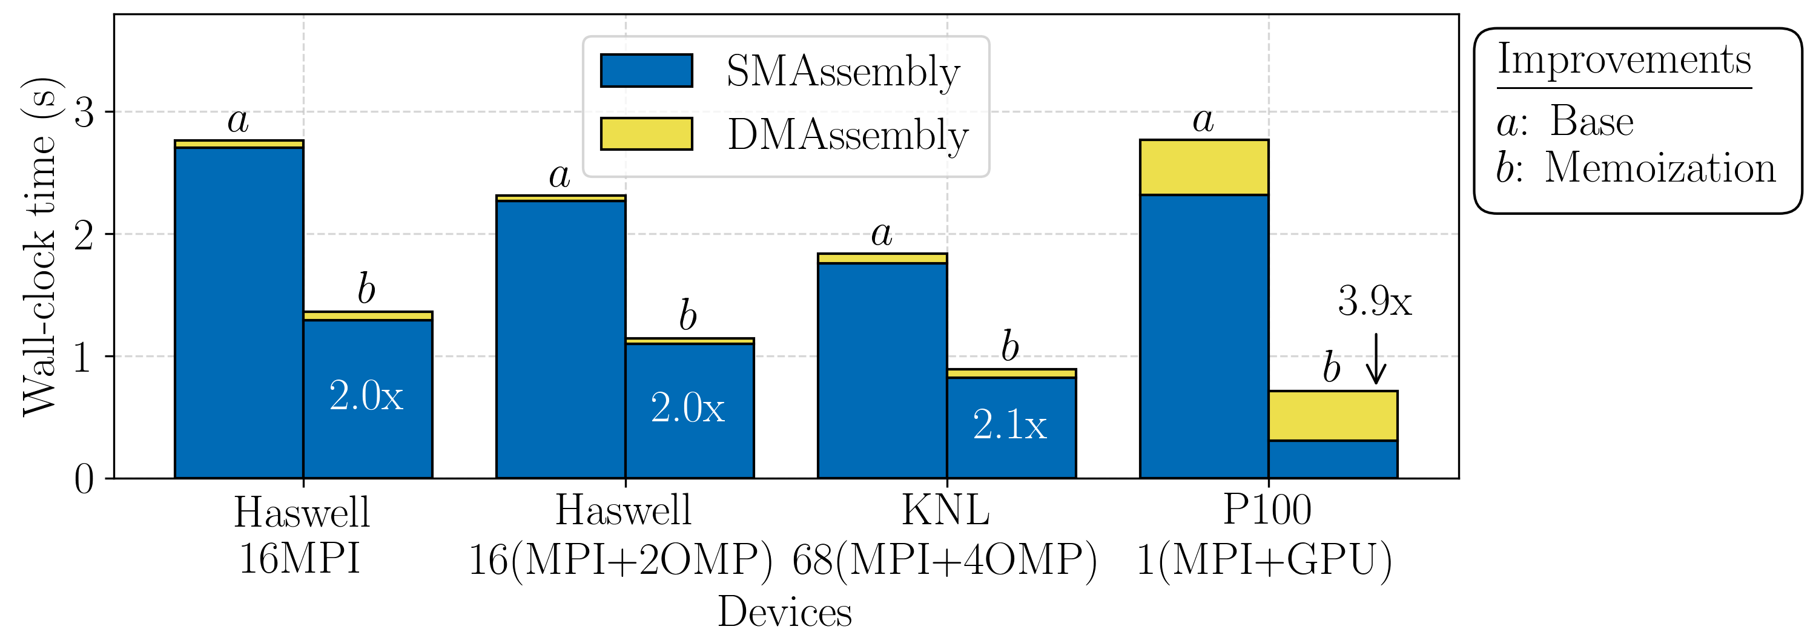
Albany Supporting Tools: Phalanx $–$ Directed Acyclic Graph (DAG)
DAG Example (memoization)
DAG Example
Pros:
Increased flexibility, extensibility, usability
Arbitrary data type support
Potential for task parallelism
Cons: Performance loss through fragmentation
Mitigation: introduction of memoization
Single CPU socket or GPU

Slide 14
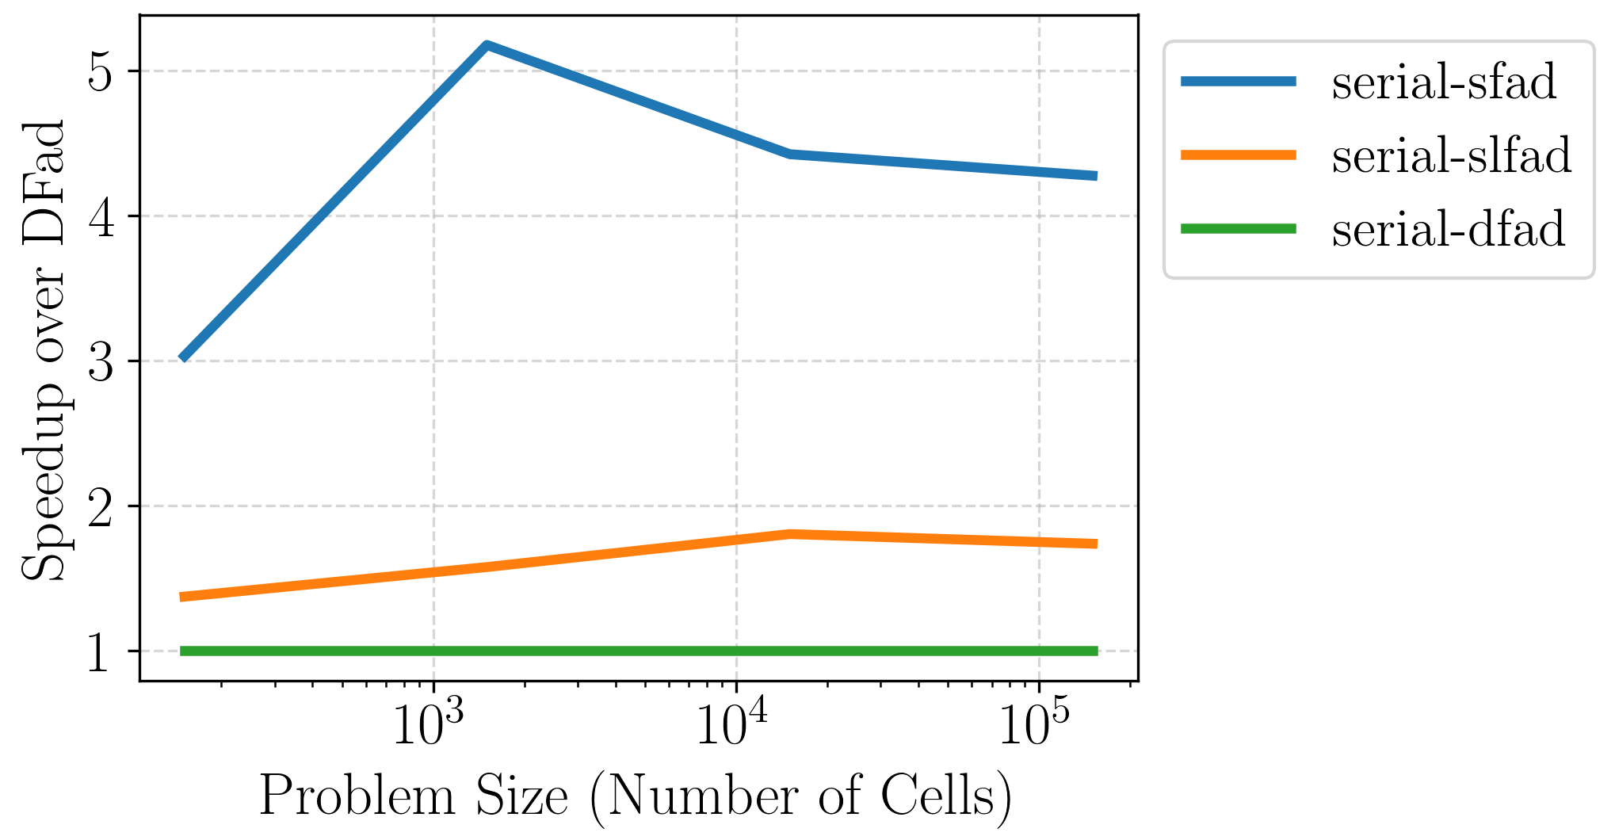
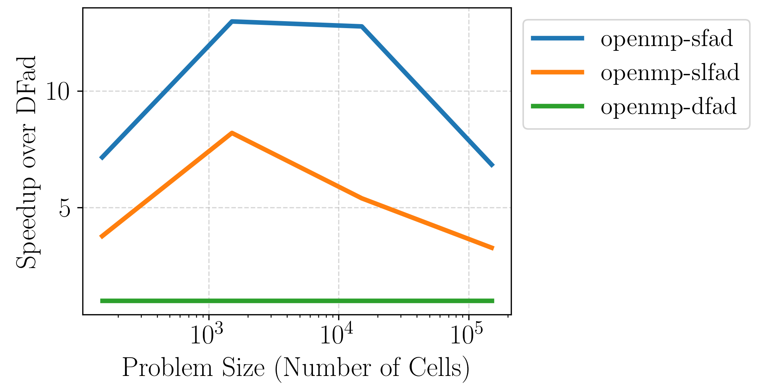
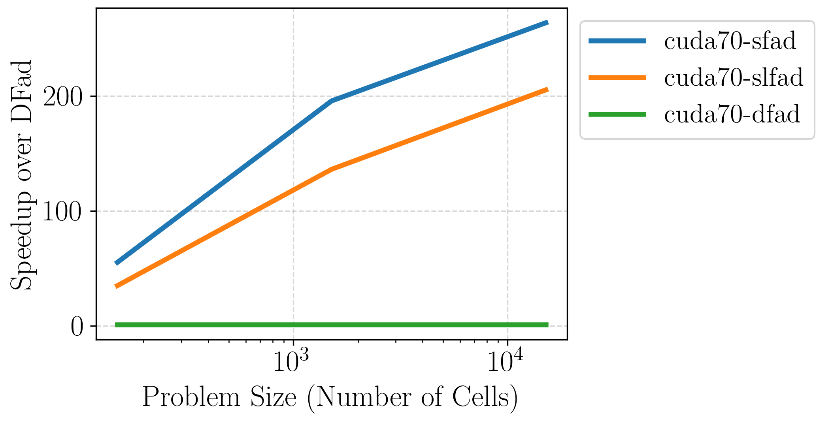
Albany Supporting Tools: Sacado $–$ Automatic Differentiation (AD)
Pros:
AD provides exact derivatives $−$no Jacobian derivation or hand-coding required
Allows for advanced analysis capabilities $–$ easily construct any derivative, Hessian
Examples: optimization, sensitivity analysis
Con: AD has some overhead
Mitigation: specify Sacado data types for deriv. components via class templates
DFad (most flexible) $–$ size set at run-time
SLFad (flexible/efficient) $–$max size set at compile-time
SFad (most efficient) $–$size set at compile-time
Significant speedups possible when deriv. array sizes are known at compile time on GPU (50-250x)
Fad Type Comparison (Serial, OpenMP (12 threads), CUDA)
Size Example: Tetrahedral elements (4 nodes), 2 equations, ND = 4*2 = 8

Slide 15
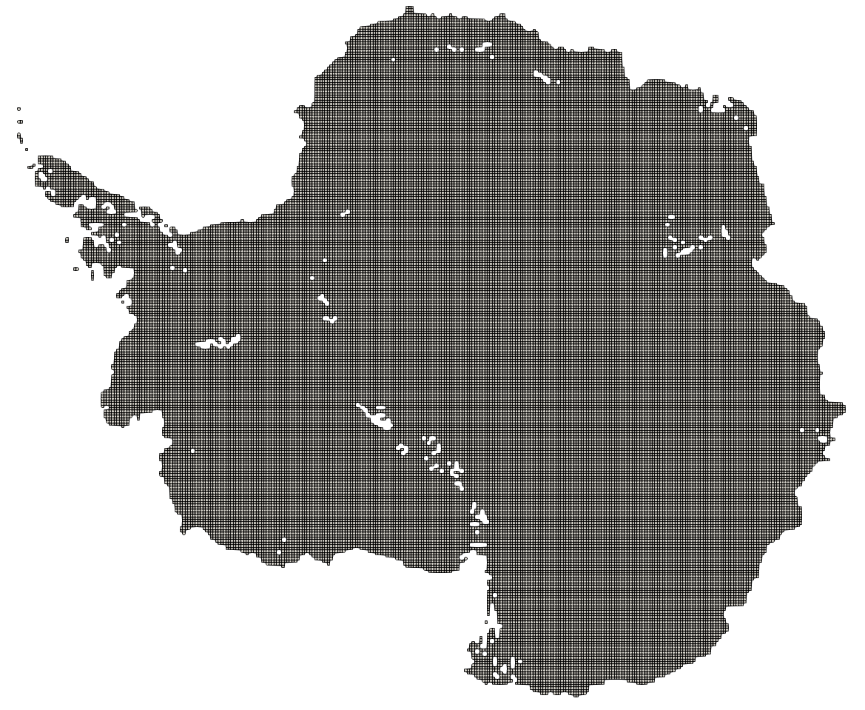
Performance Portability Demonstration: Antarctica Weak Scalability Study
Architectures:
NERSC Cori-Haswell (HSW): 32 cores/node
NERSC Cori-KNL (KNL): 68 cores/node
OLCF Summit-POWER9-only (PWR9): 44 cores/node
OLCF Summit-POWER9-V100 (V100): 44 cores/node + 6 GPU/node
Benchmark:
First-order Stokes solve in ALI
Structured hexahedral element mesh
16 to 1km structured Antarctica meshes, 20 layers
Scaled up from 1 to 256 compute nodes
Mesh Example: 16km, structured Antarctica mesh (2.20E6 DOF: 20 layer, 2 equations)
Benchmark used to assess performance & performance portability.
Notes:
Q: is this good test case to look at?

Slide 16
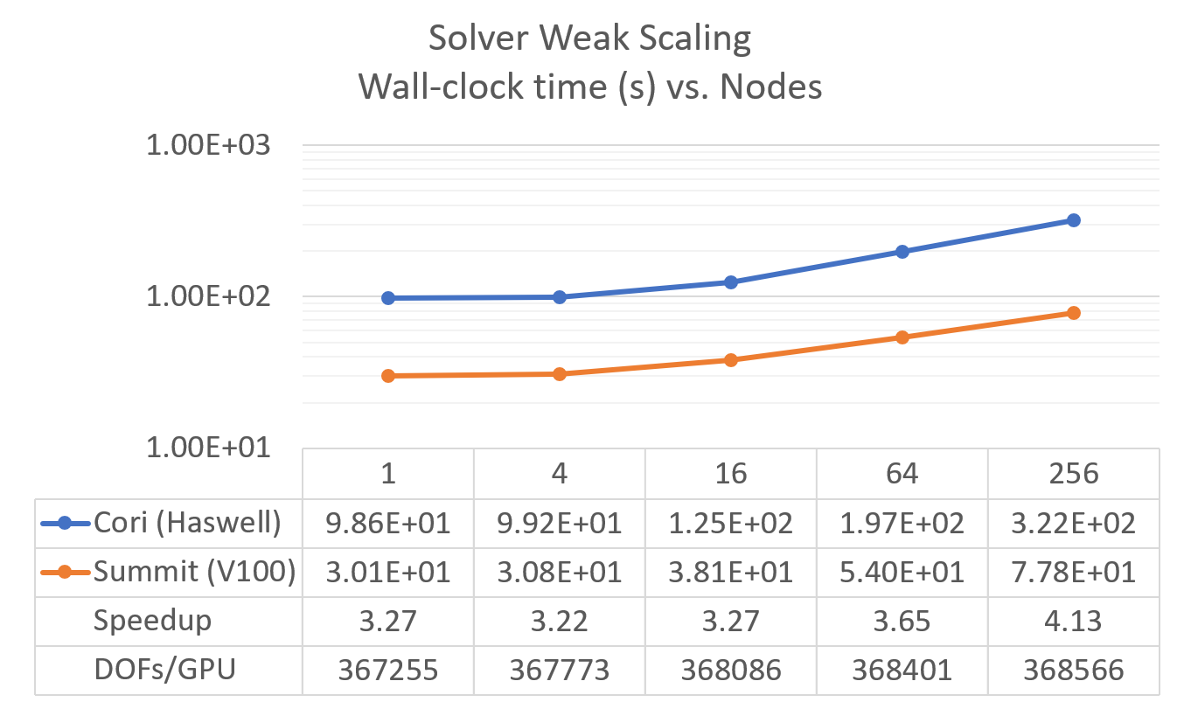
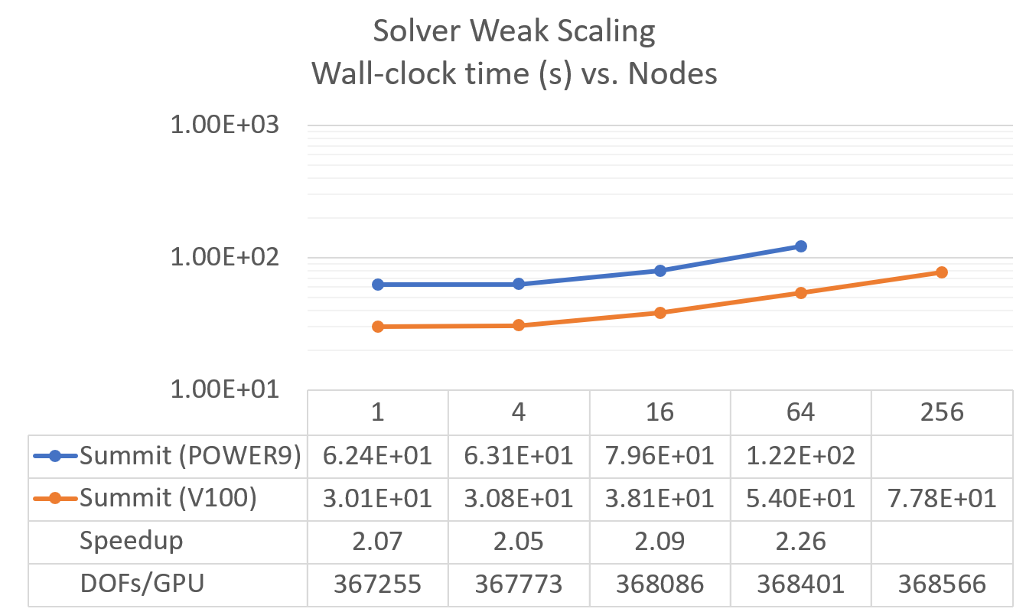
Performance on Cori and Summit
Setup:
Same input file for all cases
Performance portable point smoothers
No architecture specific tuning
Results:
Performance degrades at higher resolutions
(645$→$1798 total linear iterations)
GPU scaling slightly better
Speedup on GPU
3.2-4.1x speedup Summit over Cori
2.1-2.3x speedup V100 over POWER9
Speedup achieved over MPI-only simulations without architecture specific tuning!
For additional results/analysis, please see talks by Jerry Watkins (MS284: Thurs. Mar. 2) and Mauro Perego (MS72: Tues. Feb. 28).
16
Notes:
Q: is this best result to include? Is this best way to present it?
Q: are these CPU times for both FEA and linear solve?
- It is the "Piro::NOXSolver::evalModelImpl::solve:" timer. So "Total Time" without "Setup Time" or you could think of it as "Fill Time" + "Preconditioner Construction" + "Linear Solver" time. Yes, it includes the assembly and the linear solver. It also includes the nonlinear solver but that's pretty negligible.
Q: why no power9 + summit results for 256 node case?
- There was either some mesh decomp issues or I/O issues with Populate Mesh (similar to what is happening on Perlmutter). This was a >10k rank case which seems to have issues (same thing happened on Cori). We probably need to figure out a better workflow (i.e. try to decompose, populate, run the sim all in one go and hope the performance isn't as bad anymore) or switch to an openmp build.
Outdatee results… CPU scaling should look better. GPU would look not so good.
Areas to improve
Assembly on CPU – 40-60% of total time
Solver on GPU – 80-90% of total time

Slide 17
Performance Highlights
From architecture-agnostic improvements to Albany FEA.
Major improvements to finite element assembly time:
Memoization to avoid unnecessary data movement and computation
Boundary condition refactor to reduce memory footprint and data movement
Tpetra::FECrsMatrix refactor to reduce memory footprint and data movement
Solver portability on Cori and Summit:
MueLu SemiCoarsen refactor using Kokkos
Ifpack2 portable smoothers tuned to GPU hardware
From Trilinos enhancements, which Albany inherited.
Albany performance improves in time due to Albany’s development model and maintenance workflows.
J. Watkins, M. Carlson, K. Shan, I. Tezaur, M. Perego, L. Bertagna, C. Kao. et al. “Performance portable ice-sheet modeling with MALI.” (Submitted to IJHPCA, 2022) https://arxiv.org/abs/2204.04321

Slide 18
Outline
Albany capabilities & supporting tools
Components effort
Albany under the hood
Kokkos for performance portability
Phalanx for template-based evaluators and DAG-based finite element assembly
Sacado for automatic differentiation (AD)
Some performance & performance portability results
Maintaining software quality of Albany
Code pruning
PyAlbany: a Python interface to Albany
Nightly regression testing
Automated performance testing
Automated performance tuning
Summary & perspectives

Slide 19
Albany in February 2019
https://github.com/sandialabs/Albany
Demo PDEs
Quantum Devices (QCAD)
Ice Sheets (Albany Land-Ice)
Mechanics (LCM)
Atmosphere Dynamics (Aeras)
Particle-continuum coupling (Peridigm-LCM)
Additive Manufacturing Design (ATO)
Additive Manufacturing Processing (AMP)
Arctic Coastal Erosion (ACE)
Coupled Geomechanics (Albotran)
* Albany github repo: https://github.com/SNLComputation/Albany.
* I. Tezaur et al. "Albany: a Trilinos-based multi-physics partial differential equation research tool created using the Agile Components code development strategy," SIAM CS&E 2019 (featured MS: "Multiphysics: Extensible, Composable Algorithms and Software"), Spokane, WA.
19

Slide 20
Albany Today
Main Albany repo*: https://github.com/sandialabs/Albany
Tags: https://github.com/sandialabs/Albany/tags
Albany-LCM repo*: https://github.com/sandialabs/LCM
Albany-RPI repo: https://github.com/scorec/albany
* Maintained & tested nightly by Sandia teams.
New capability:
PyAlbany, a python wrapper for running Albany!
Demo PDEs
Quantum Devices (QCAD)
Ice Sheets (MPAS-Albany Land Ice)
Mechanics (LCM)
Atmosphere Dynamics (Aeras)
Particle-continuum coupling (Peridigm-LCM)
Additive Manufacturing Design (ATO)
Additive Manufacturing Processing (AMP)
Arctic Coastal Erosion (ACE)
Coupled Geomechanics (Albotran)
Lesson learned: supporting unfunded capabilities in large HPC code is not sustainable long-term…
* Albany github repo: https://github.com/SNLComputation/Albany.
New capability: Albany is know a spack-age (https://github.com/E3SM-Project/spack.git)
20

Slide 21
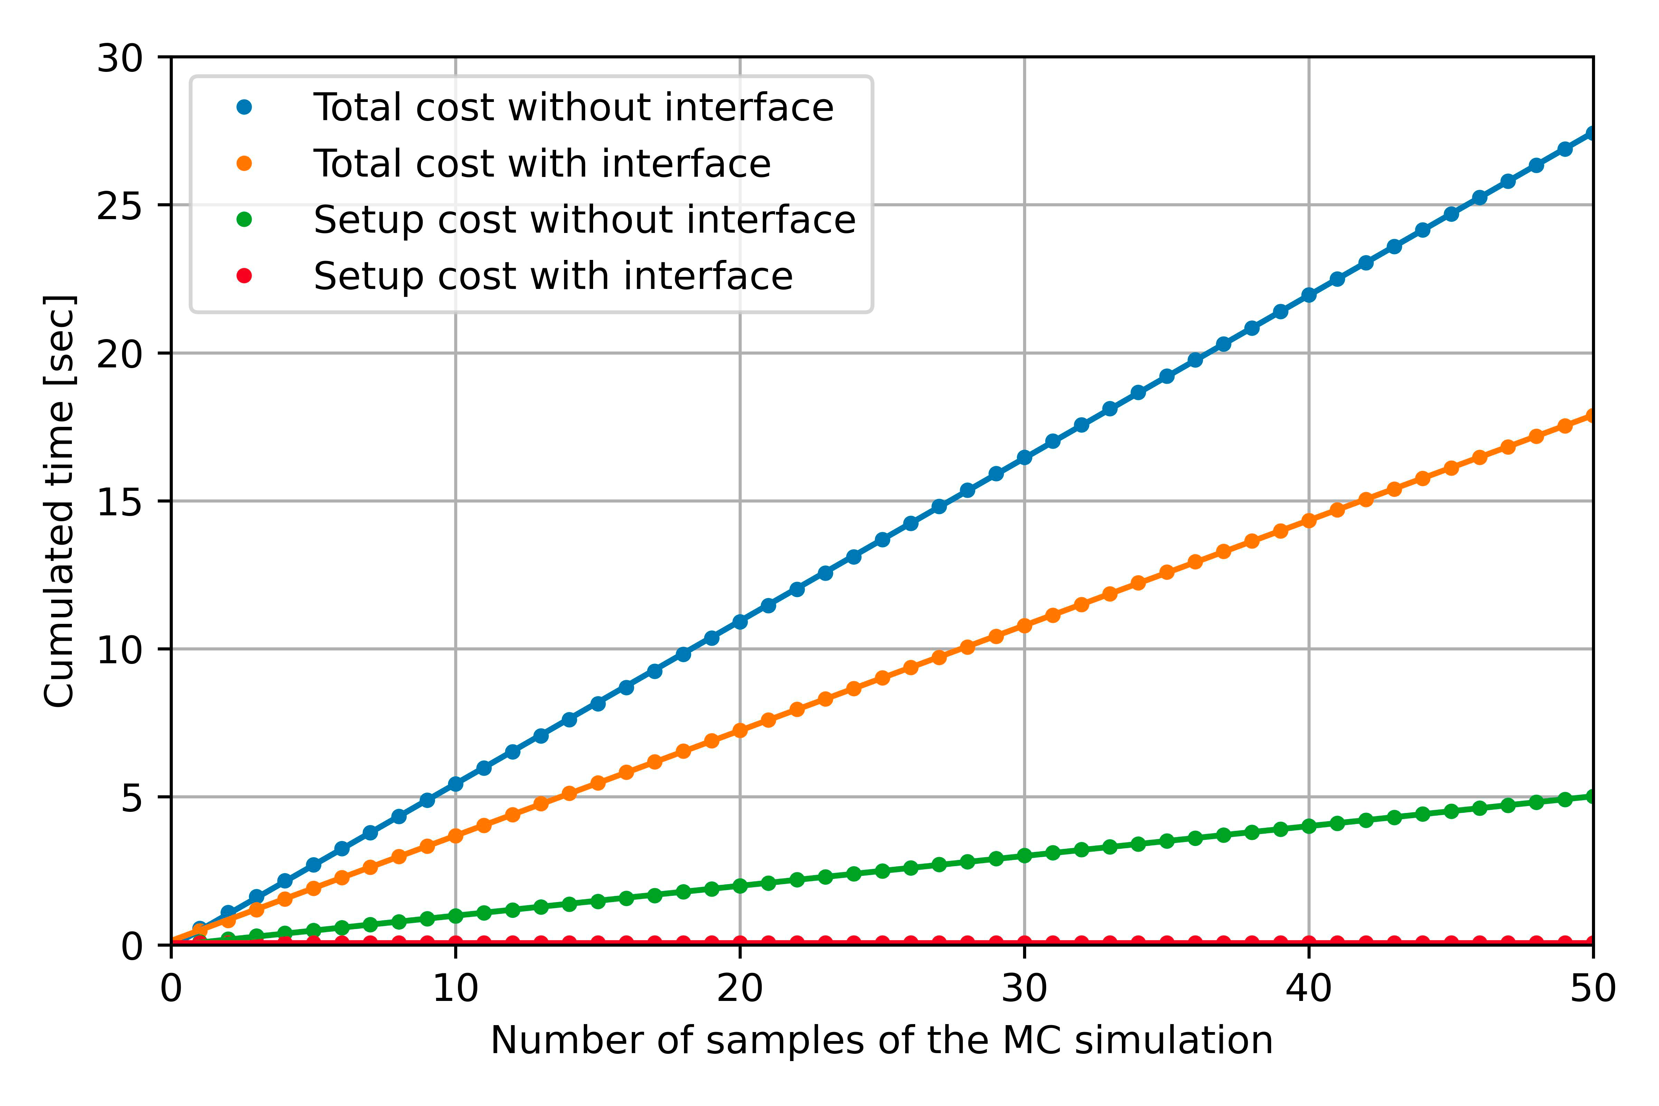
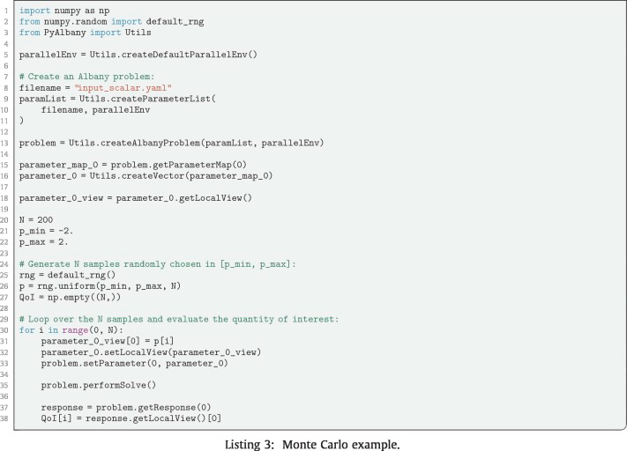
PyAlbany: A Python Interface to Albany
Running Albany through PyAlbany is faster for MCMC analysis! (don't need to go through the setup phase of Albany for every sample)
Lesson learned: PyAlbany allows to easily and quickly…
Use Albany without C++ or bash knowledge (convenient for students)
Prototype applications that require multiple Albany solves
Enable fast pre-processing and post-processing in Python
Use Python as a glue language to couple Albany with other software: for UQ methods (PyDakota), machine learning (TensorFlow, Keras, Scikit-learn), plotting (Matplotlib, Paraview), ...
Please see talk by Kim Liegeois (MS284: Thurs. Mar. 2) for more on PyAlbany.
K. Liegeois, M. Perego, T. Hartland, “PyAlbany: A Python interface to the C++ multiphysics solver Albany”.
Journal of Computational and Applied Mathematics, 425, 115037, 2023.
Notes:
The two figures bellow are associated to a Monte Carlo simulation for UQ of a heat problem.
The image on the left represents the actual Python script that generates the samples, loops over the samples and evaluates Albany for each of them and stores the results into an array.
The code is not meant to be readable in the slide; the main motivations to illustrate it here is to say that the code is very concise and does not need any recompilation of C++ code; it is therefore very time efficient for the user to write it like this.
The second image ( on the right ) represents wall-clock time of the code on the left (with interface) vs a sequence of calls to the Albany executable directly (without interface). The approach with the interface is faster as you don't need to go through the setup phase of Albany for every sample; you can generate the mesh once, allocate the memory once, and reuse them for every sample.
It would be feasible to do the same in C++ directly (and get equivalent performance) but that would require to write a new C++ main function and compile it.

Slide 22
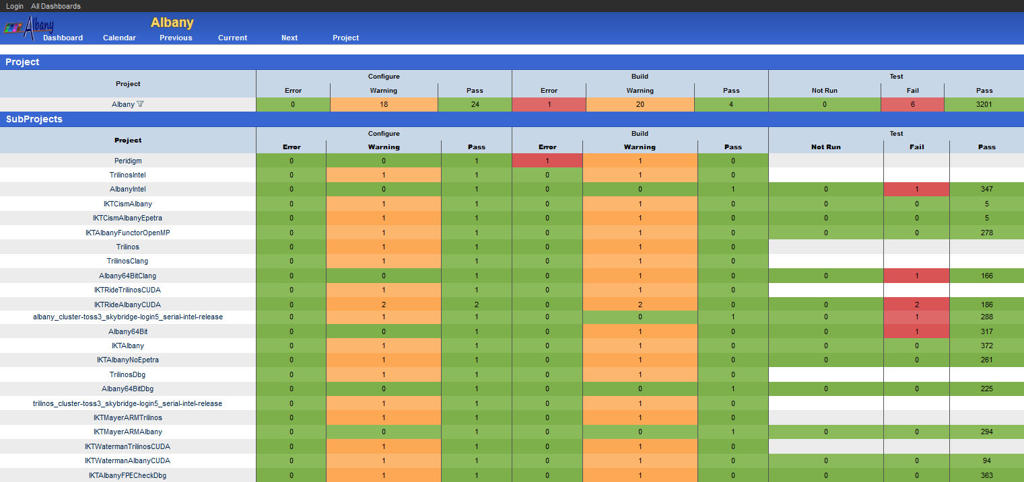
(Automated Regression) Testing, Testing, Testing
Lesson learned: since MALI uses Trilinos and Albany Versions of the Day (VOTD), nightly testing across variety of architectures is essential for maintaining code quality!
Repository*
Version control
Build system
Config mgmt
Regression tests
Nightly test harness
Unit tests
Verification tests
Code coverage
Performance tests
Mailing lists
Issue tracking
Web pages
Licensing
Release process
* https://github.com/sandialabs/Albany
22

Slide 23
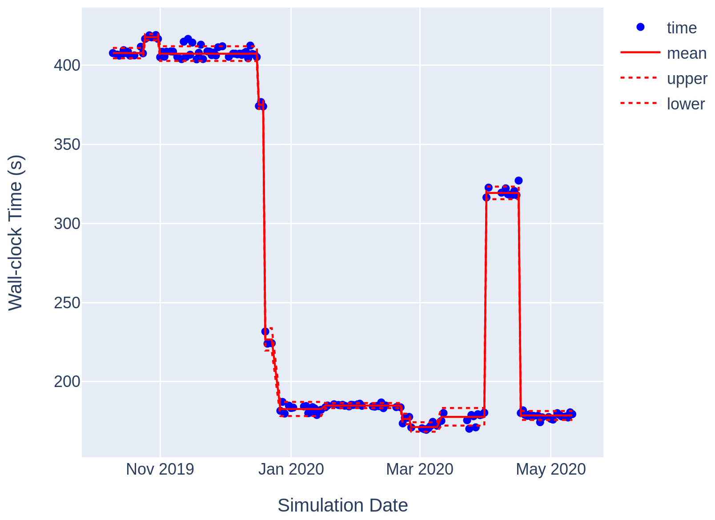
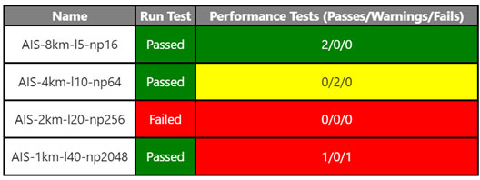
… and More (Automated Performance) Testing!
Lesson learned: nightly regression testing is not sufficient! Performance testing is also needed to secure investments in performance & portability in evolving software.
Changes in code base could cause performance deterioration
Performance improvements in one architecture could decrease performance in another
Manual analysis is time consuming and imprecise
Solution: changepoint detection algorithm automatically applied to nightly performance test data to identify/flag large changes in performance.
Figure below: Total simulation time for a 2-20km resolution Antarctica problem, executed nightly
Infrastructure is provided in a Jupyter notebook, exported as html to a website (https://sandialabs.github.io/ali-perf-data)
Daily email provides nightly performance test summary
Notes:
A generalized likelihood ratio test is used
Null hypothesis – ${\{x\}}_{i=1}^{n}$ belongs to a single distribution
Alternate hypothesis – there exists some $$such that ${\{x\}}_{i=1}^{ν−1}$ and ${\{x\}}_{i=ν}^{n}$ are separate distributions

Slide 24
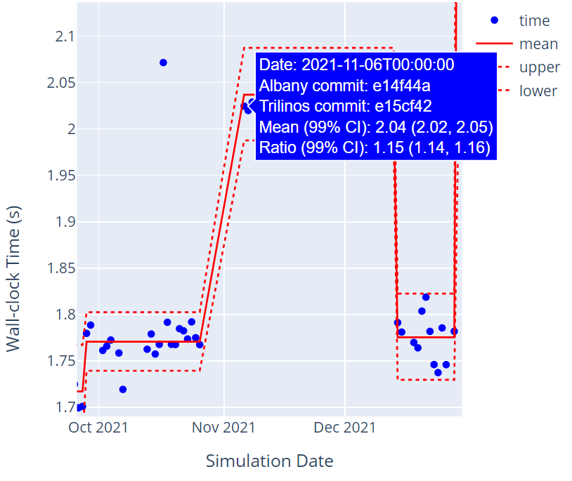
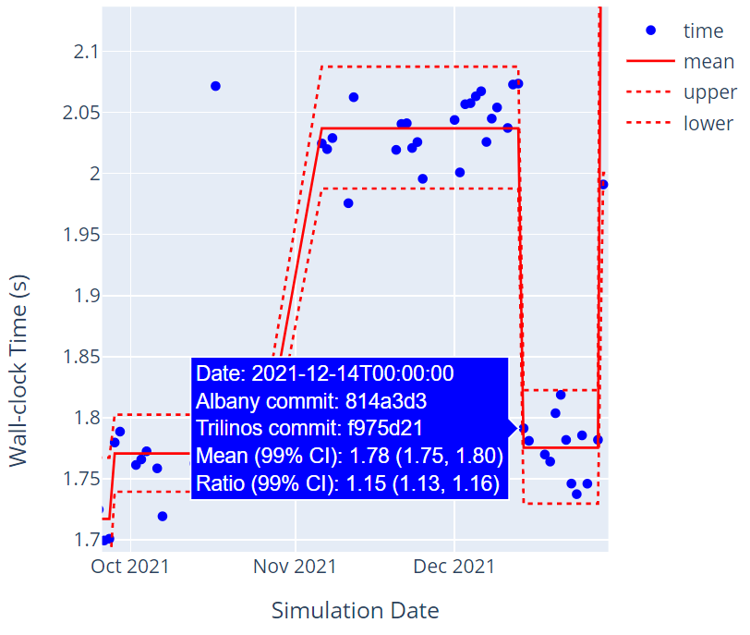
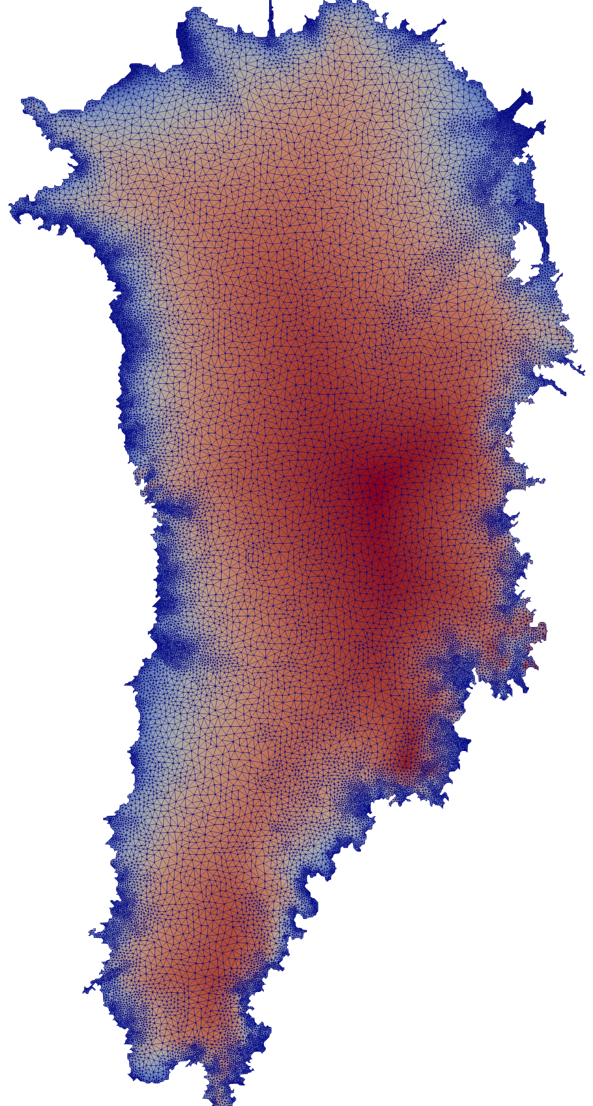
Detecting Performance Regressions/Improvements
Example: transition to Kokkos 3.5.0 caused a performance regression but was soon fixed
Regression
Improvement
Two STDs
Total Fill time: for a 1-to-7 km resolution Greenland mesh, executed nightly in Albany Land Ice.

Slide 25
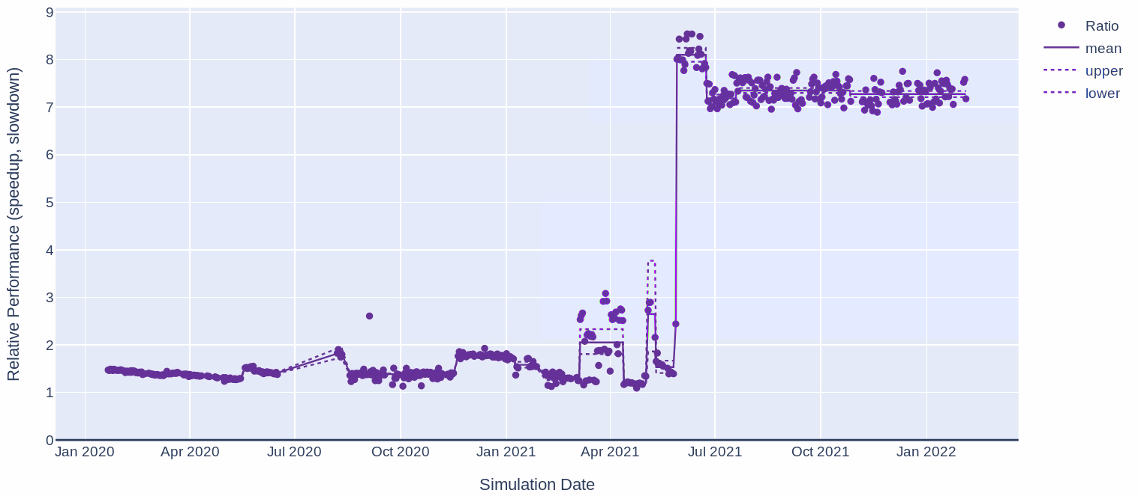
Monitoring Performance Comparisons
Example: Memoization comparison (with & without) shows that relative performance has improved
99% confidence interval for the mean
Speedup of Total Fill time: from memoization for a 1-to-7 km resolution Greenland mesh, executed nightly in Albany Land Ice

Slide 26
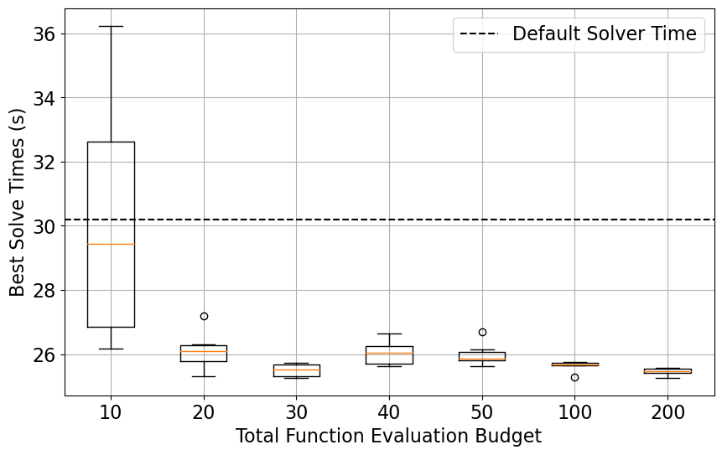
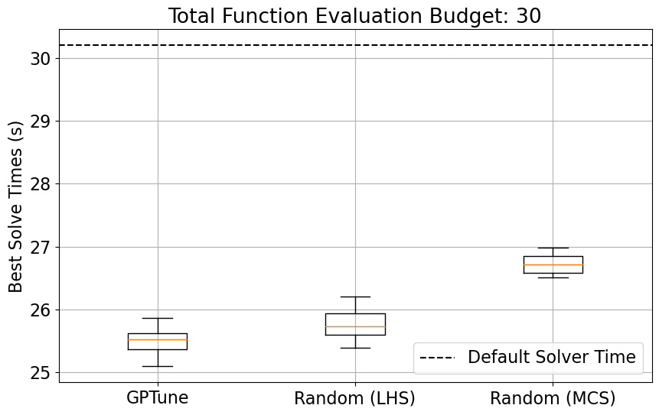
Automated Parameter/Performance Tuning
Lesson learned: hand-tuning solver parameters can be a long/painful process, does not translate b/w architectures.
Solution: create a framework for determining optimal parameter values to achieve best performance (smallest CPU time) on HPC systems using offline and real-time data.
30 total # allotted Albany runs case
Best runtimes for a range of total # allotted Albany run budgets: 3-to-20 km resolution Greenland mesh
Best runtimes using GPTune Bayesian optimization, Latin Hypercube Sampling and Monte Carlo Sampling: 3-to-20 km resolution Greenland mesh
Total # allotted Albany runs
Example: autotuning used to improve performance of multigrid smoothers on GPU
M. Carlson, J. Watkins, I. Tezaur. “Automatic performance tuning for MPAS-Albany Land Ice.” JCAM, 2023.
Notes:
Q: need to understand what this is showing, esp. left figure.
Function evaluation = Albany run
MCMC: uniformly sampling search space -> random search. What Carolyn did. Pretty sure uniform sampling (Carolyn)
LHC: like uniform sampling but fills space better. Also random search.
GPTune: 2 phases. 1st phase is like random search, then fit Gaussian model to predict where good place to search for min/max is. 1st phase: exploration phase. 2nd phase: exploitation phase.

Slide 27
Outline
Albany capabilities & supporting tools
Components effort
Albany under the hood
Kokkos for performance portability
Phalanx for template-based evaluators and DAG-based finite element assembly
Sacado for automatic differentiation (AD)
Some performance & performance portability results
Maintaining software quality of Albany
Code pruning
PyAlbany: a Python interface to Albany
Nightly regression testing
Automated performance testing
Automated performance tuning
Summary & perspectives

Slide 28
Summary & Perspectives
In developing HPC codes, there is often a tradeoff between flexibility and efficiency. Libraries like Kokkos and Trilinos can enable both to a large extent.
Reasonable scalability and performance is obtained across different architectures without architecture-specific optimizations within the Albany code base
Code promised to be “future proof”
Flexibility
Efficiency
Maintaining performance and portability is crucial for an active code base
Supporting unfunded capabilities in large HPC code is not sustainable long-term
Regular regression and performance testing is crucial, especially in presence of every-changing codes
Automatic processes like testing and parameter tuning can save developers a lot of time
A change-point detection algorithm can help identify performance variation automatically
Optimal solver parameters can be determined for a specific architecture automatically using black-box optimization algorithms

Slide 29
Bridging the Gap between Sandia & Academia, and Promoting Inclusion & Diversity through Albany
Recently-funded 5-year Grande CARES MSIPP consortium¹ will connect students/academics from minority serving institutions in U.S. southwest with Sandia National Laboratories via tools like Albany, Trilinos, Kokkos, …
²
¹ https://sites.google.com/view/grande-cares/home
² https://www.utep.edu/newsfeed/2023/utep-receives-1.25m-grant-from-doe-to-produce
-pipeline-of-scientists-and-engineers.html

Slide 30
Special Issue of CiSE on Research Software Engineers
“The goal of this special issue is to explore the future of research software engineers in the U.S., with emphasis on the cultural, educational, and professional paradigm shifts that need to occur.”*
Estimated publication of special CiSE issue:
March/April 2024.
* https://www.computer.org/digital-library/magazines/cs/future-research-software-engineer

Slide 31
References
[1] A. Salinger, R. Bartlett, A. Bradley, Q. Chen, I. Demeshko, X. Gao, G. Hansen, A. Mota, R. Muller, E. Nielsen, J. Ostien, R. Pawlowski, M. Perego, E. Phipps, W. Sun, I. Tezaur. "Albany: Using Agile Components to Develop a Flexible, Generic Multiphysics Analysis Code", Int. J. Multiscale Comput. Engng 14 (4) 415-438, 2016.
[2] R. Tuminaro, M. Perego, I. Tezaur, A. Salinger, S. Price. "A matrix dependent/algebraic multigrid approach for extruded meshes with applications to ice sheet modeling", SIAM J. Sci. Comput. 38 (5) C504-C532, 2016.
[3] S. Price, M. Hoffman, J. Bonin, T. Neumann, I. Howat, J. Guerber, I. Tezaur, J. Saba, J. Lanaerts, D. Chambers, W. Lipscomb, M. Perego, A. Salinger, R. Tuminaro. "An ice sheet model validation framework for the Greenland ice sheet", Geosci. Model Dev. 10 255-270, 2017.
[4] I. Demeshko, J. Watkins, I. Tezaur, O. Guba, W. Spotz, A. Salinger, R. Pawlowski, M. Heroux. "Towards performance-portability of the Albany finite element analysis code using the Kokkos library", J. HPC Appl. 1-23, 2018.
[5] K. Evans, J. Kennedy, D. Lu, M. Forrester, S. Price, J. Fyke, A. Bennett, M. Hoffman, I. Tezaur, C. Zender, M. Vizcaino. "LIVVkit 2.1: Automated and extensible ice sheet model validation", Geosci. Model Develop 12 1067-1086, 2019
[6] M. Hoffman, M. Perego, S. Price, W. Lipscomb, T. Zhang, D. Jacobsen, I. Tezaur, A. Salinger, R. Tuminaro, L. Bertagna, "MPAS-Albany Land Ice (MALI): A variable resolution ice sheet model for Earth system modeling using Voronoi grid", Geosci. Model Develop 11 3747-3780, 2018.
[7] J. Watkins, I. Tezaur, I. Demeshko. "A study on the performance portability of the finite element assembly process within the Albany land ice solver", E. van Brummelen, A. Corsini, S. Perotto, G. Rozza, eds. Numerical Methods for Flows: FEF 2017 Selected Contributions, Elsevier, 2019.
[8] J. Watkins, M. Carlson, K. Shan, I. Tezaur, M. Perego, L. Bertagna, C. Kao, M. Hoffman, S. Price. “Performance portable ice sheet modeling with MPAS-Albany Land Ice”, submitted to Int. J. HPC Appl.
[9] M. Carlson, J. Watkins, I. Tezaur. "Automatic performance tuning for MPAS-Albany Land Ice", submitted to J. Comput. Appl. Math.
[10] K. Liegeois, M. Perego, T. Hartland, “PyAlbany: A Python interface to the C++ multiphysics solver Albany”. Journal of Computational and Applied Mathematics, 425, 115037, 2023.

Slide 32
Funding/Acknowledgements
Support for this work was provided by Scientific Discovery through Advanced Computing (SciDAC) projects funded by the U.S. Department of Energy, Office of Science (OS), Advanced Scientific Computing Research (ASCR) and Biological and Environmental Research (BER).
Computing resources provided by the National Energy Research Scientific Computing Center (NERSC) and Oak Ridge Leadership Computing Facility (OLCF).

Slide 33
Start of backup slides

Slide 34
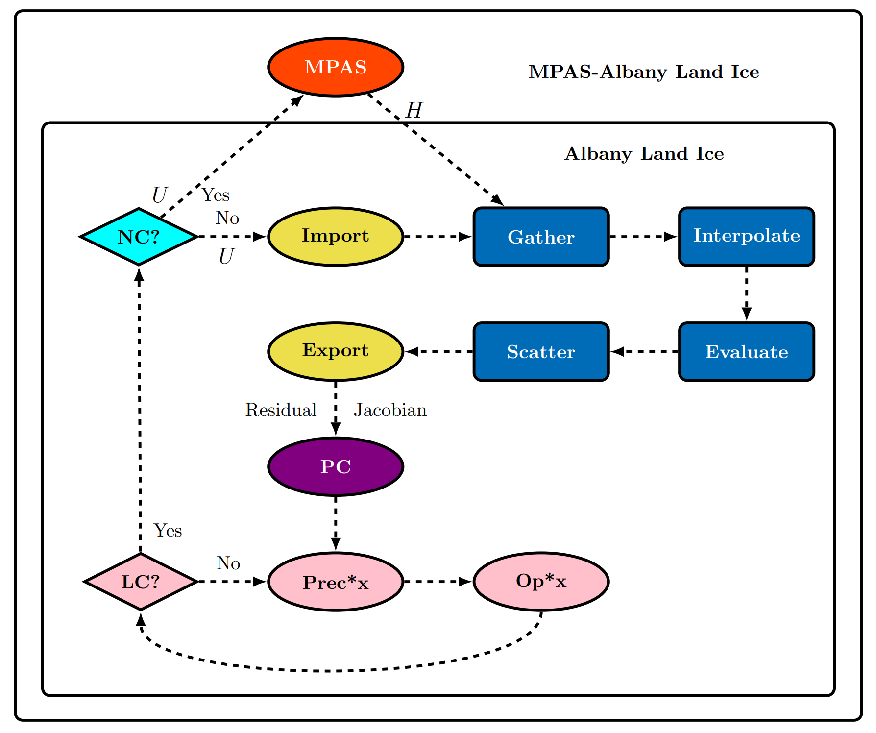
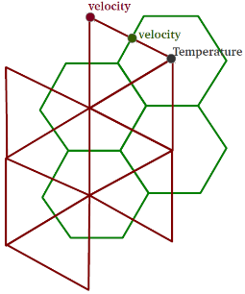
MALI (MPAS-Albany Land Ice) Software Ecosystem
Land Ice
MALI =
+
MPAS¹:
Thickness & temperature evolution
Albany Land Ice²:
First-order Stokes velocity solver
Trilinos³:
Mesh tools (STK)
Discretization tools (Intrepid2)
Nonlinear/Linear solver (NOX/Belos)
Distributed memory linear algebra (Tpetra)
Multigrid Preconditioner (MueLu)
Field DAG (Phalanx)
Automatic differentiation (Sacado)
Shared memory parallelism (Kokkos)
Many more…
¹ https://github.com/MALI-Dev/E3SM. ²https://github.com/sandialabs/Albany. ³https://github.com/trilinos/Trilinos.

Slide 35
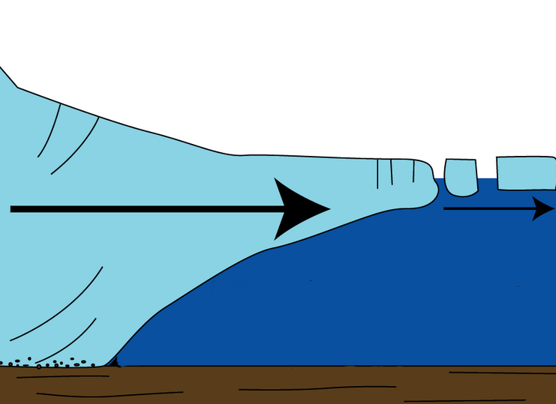
First-Order (FO) Stokes Velocity Model
Ice behaves like a very viscous non-Newtonian shear-thinning fluid (like lava flow) and is modeled quasi-statically using nonlinear incompressible Stokes equations.
(Neumann, Stress-Free)
Surface boundary $Γs$
Ice sheet
Stokes($u,p$) in $Ω∈ℝ^{3}$
Fluid velocity vector: $u=\left(u_{1},u_{2},u_{3}\right)$
Isotropic ice pressure: $p$
Deviatoric stress tensor: $τ = 2με$
Strain rate tensor: $εij=\frac{1}{2}\left(\frac{∂u_{i}}{∂x_{j}}+\frac{∂u_{j}}{∂x_{i}}\right)$
Glen’s Law Viscosity: $μ=\frac{1}{2}{{A(T)}^{−\frac{1}{n}}\left(\frac{1}{2}\sum_{ij}{εij2}\right)}^{\left(\frac{1}{2n}−\frac{1}{2}\right)}$
Flow factor: $A(T)=A_{0}e^{−\frac{Q}{RT}}$
Lateral boundary $Γl$
$\left\{\begin{aligned}−∇∙τ+∇p=ρg \\ ∇∙u=0\end{aligned}\right.$ , in $Ω$
(Neumann)
Basal boundary $Γβ$
)
(Robin)
Implicit solver:
FO Stokes($u,v$) in $Ω∈ℝ^{3}$
FEA* = 50% CPU-time
$\begin{aligned}−∇∙(2μ\dot{ε}1)=−ρg\frac{∂s}{∂x} \\ −∇∙(2μ\dot{ε}2)=−ρg\frac{∂s}{∂y}\end{aligned}$ , in $Ω$
Linear solve = 50% CPU-time
First-Order Stokes model: nice elliptic approximation to the full Stokes equations, derived using hydrostatic approximation & scaling argument based on ice sheets being thin with near-vertical normal
3D model for two unknowns, the $(u_{1},u_{2})$ ice velocities.
Highly nonlinear rheology with viscosity $μ$ given by Glen’s flow law
Valid for both Greenland and Antarctica continental-scale simulations
* Finite element assembly

Slide 36
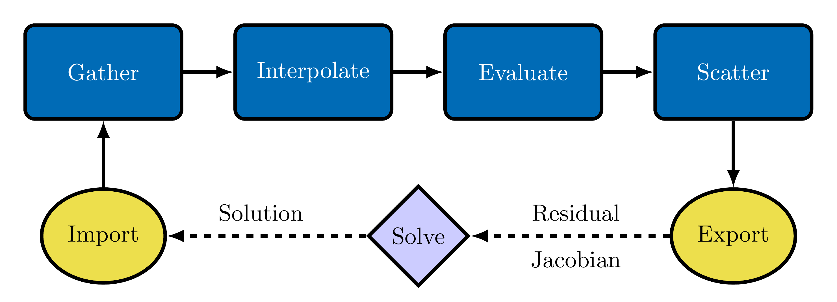
Albany Under the Hood
Albany finite element assembly (FEA):
Tpetra manages distributed memory linear algebra (MPI+X)
Phalanx manages shared memory computations (X)
Gather fills element local solution
Interpolate solution/gradient to quad points
Evaluate residual/Jacobian
Scatter fills global residual/Jacobian
Albany provides the “glue” that connects components (via abstract interfaces).
Trilinos Packages
FEA Overview
Adding new PDEs requires just implementing a new Evaluate routine
Albany design highlights:
Piro manages the solve (e.g., Newton, time-stepper)
Jacobians (+ sensitivities, Hessians, etc.) obtained via automatic differentiation (Sacado)
Kokkos achieves performance portability using MPI+X
Memory Model

Slide 37
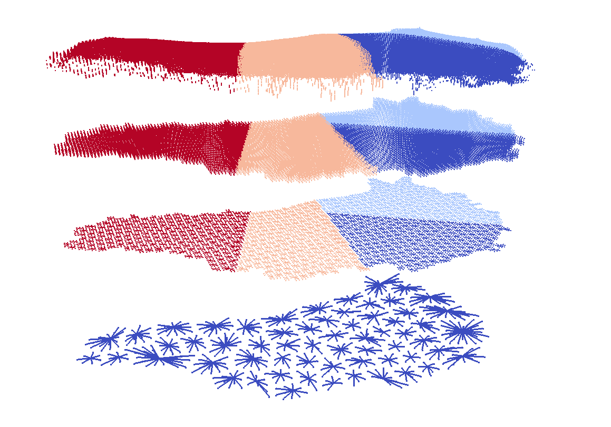
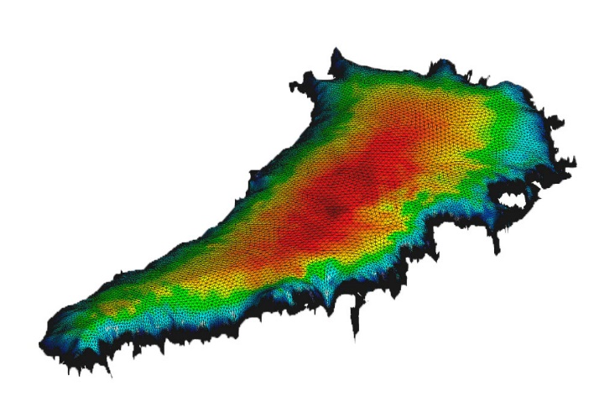
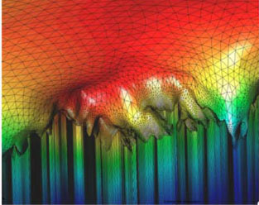
Albany Supporting Tools: Belos/MueLu $–$ Preconditioned Iterative Solver
Problem: Ice sheet meshes are thin with high aspect ratios
Algebraic Structured MG
Algebraic Structured MG
Unstructured AMG
Solution: Matrix dependent semi-coarsening algebraic multigrid (MDSC-AMG)¹
First, apply algebraic structured multigrid to coarsen vertically
Second, apply SA-AMG on single layer
¹ See (Tezaur et al., 2015), (Tuminaro et al., 2016)
Solver: Preconditioned Newton-Krylov
MDSC-AMG is used as preconditioner for GMRES
Performance portability through Trilinos/MueLu (multigrid) + Trilinos/Belos (GMRES)
Notes:
TODO: add ref. to Mauro’s talk?
Q: how much did we rely on Trilinos people to develop/improve stuff?

Slide 38
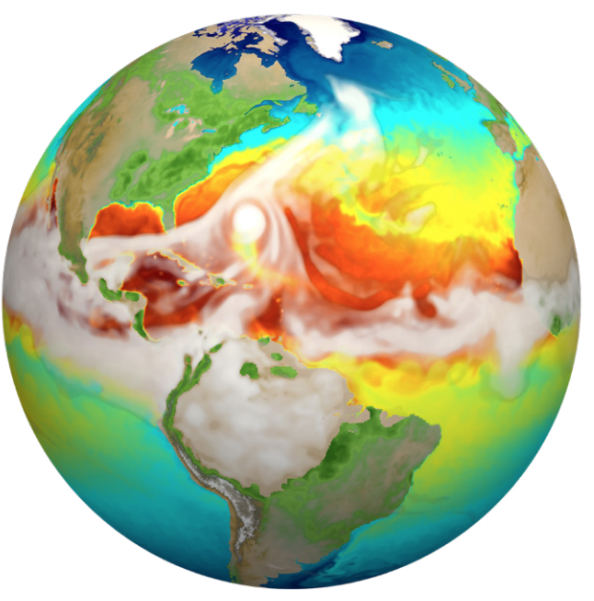
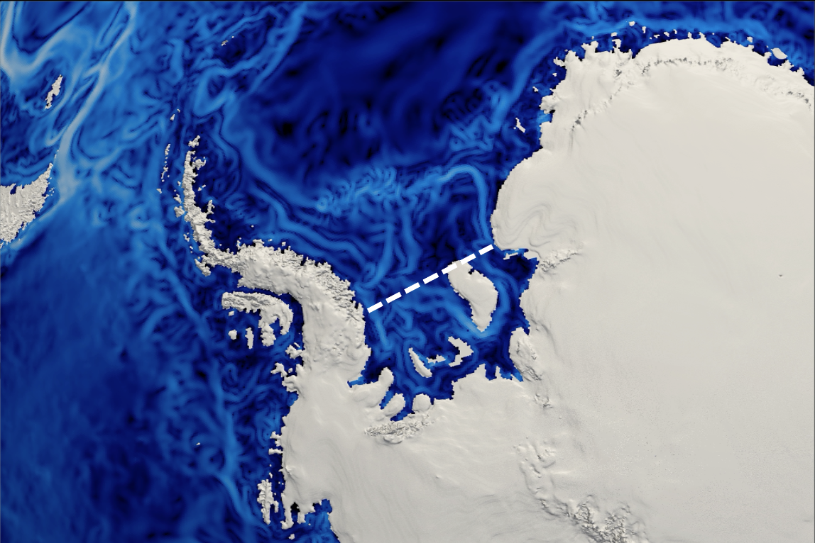
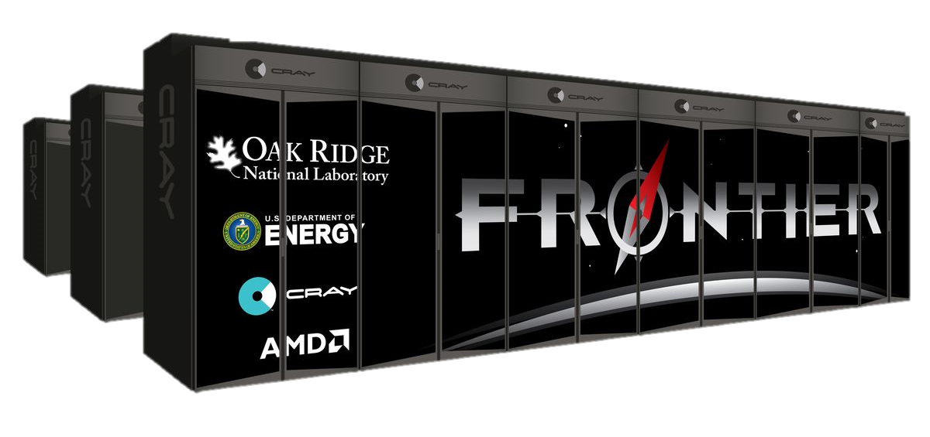
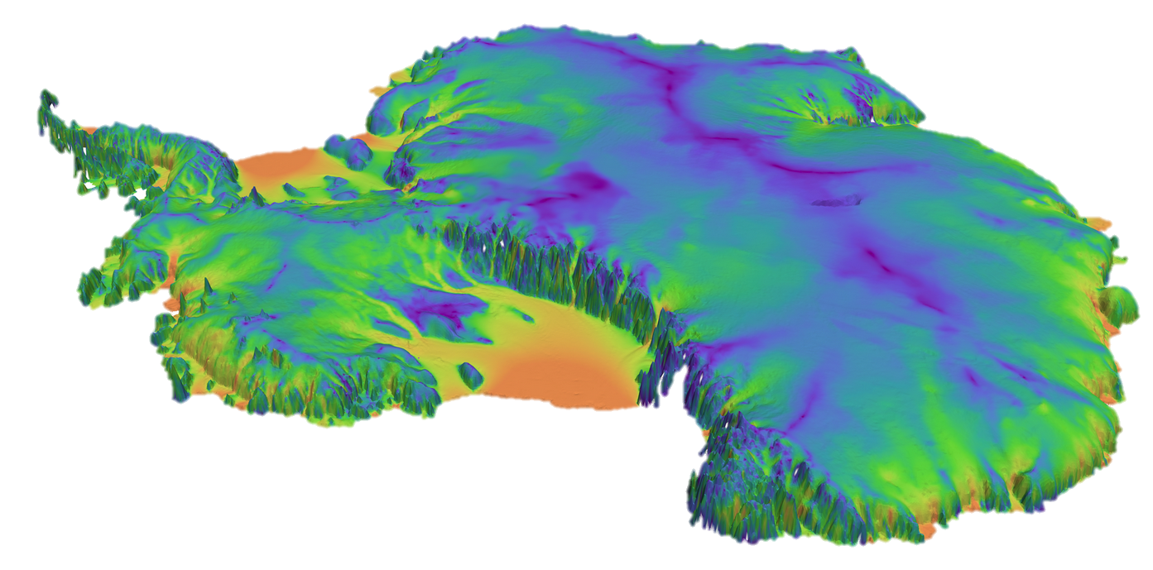
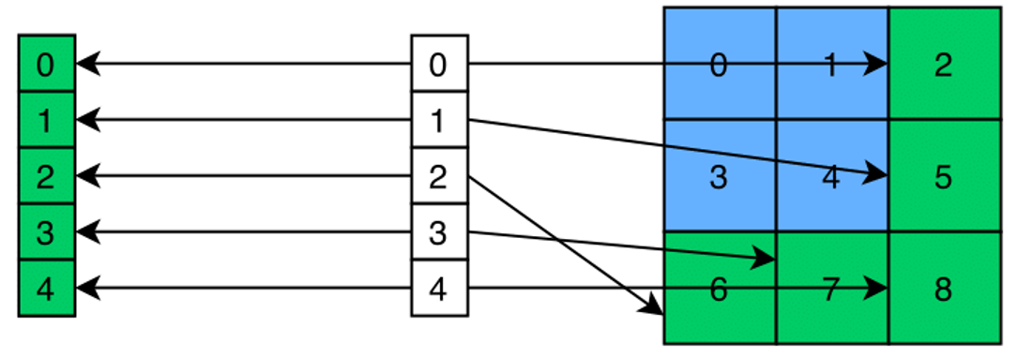
Future Performance Overview
Applications
E3SM + MALI
MALI-standalone
DOE Exascale
NERSC Perlmutter
OLCF Frontier
ALCF Aurora
Performance
Algorithmic improvements
Performance Optimization

Slide 39
Summary & Perspectives
HPC architectures changing rapidly poses a significant challenge for mod/sim codes
The Albany, Trilinos and Kokkos software stack offers an efficient way to meet this challenge for large scale finite element analysis
There are both pros and cons to using ever-changing TPLs like these
Pro: code can inherit unexpected enhancements “for free”
Con: code might also inherit bugs/regressions which can be frustrating to track down and get fixed to maintain clean dashboard
Performance portability to next-generation architectures including GPUs is enabled via Kokkos
Reasonable scalability and performance can be obtained across different architectures without architecture-specific optimizations
Code promised to be “future proof”
TPL capability
Clean dashboard
Maintaining performance and portability is crucial for an active code base
Supporting unfunded capabilities in large HPC code is not sustainable long-term
Regular regression and performance testing is crucial, especially in presence of every-changing codes
A change-point detection algorithm can help identify performance variation automatically
Optimal solver parameters can be determined for a specific architecture automatically using black-box optimization algorithms

