Slide 1


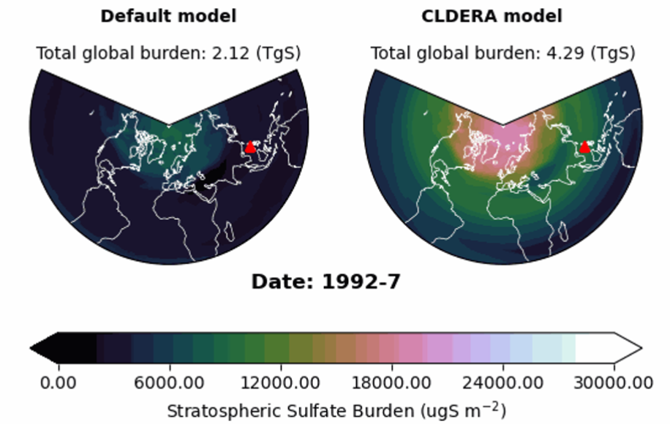
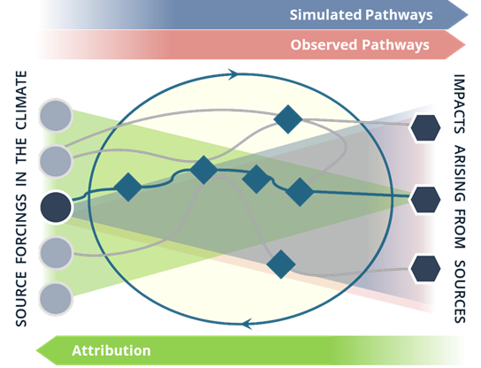
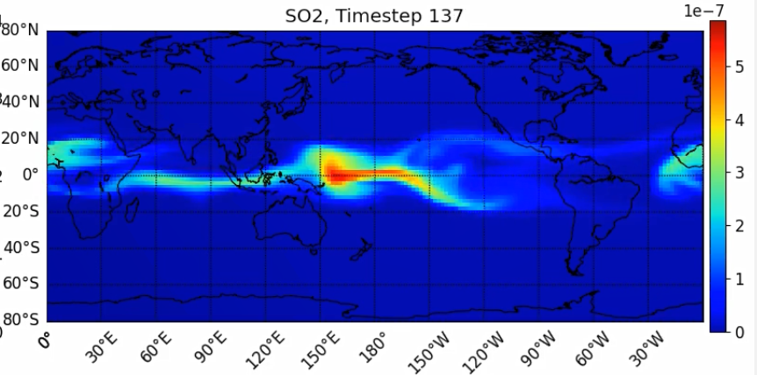
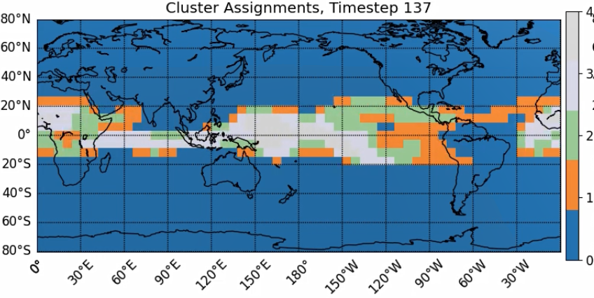
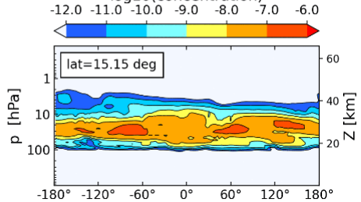
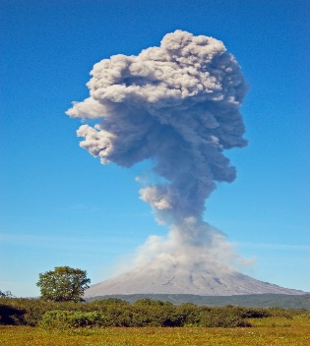
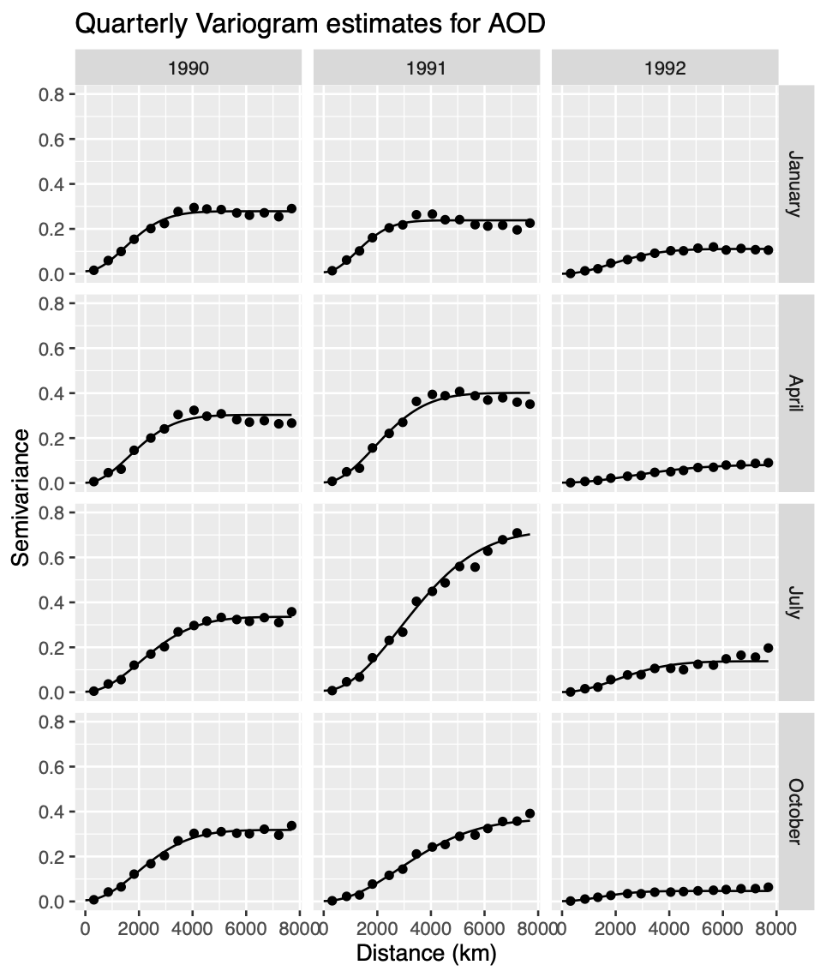
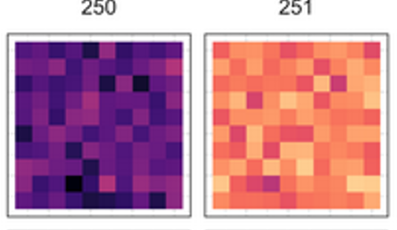
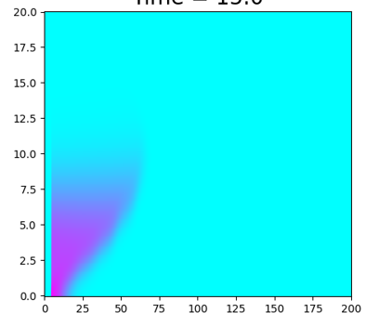
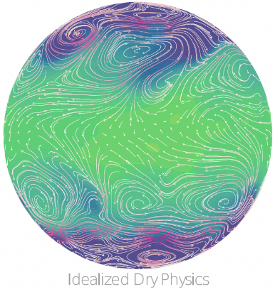
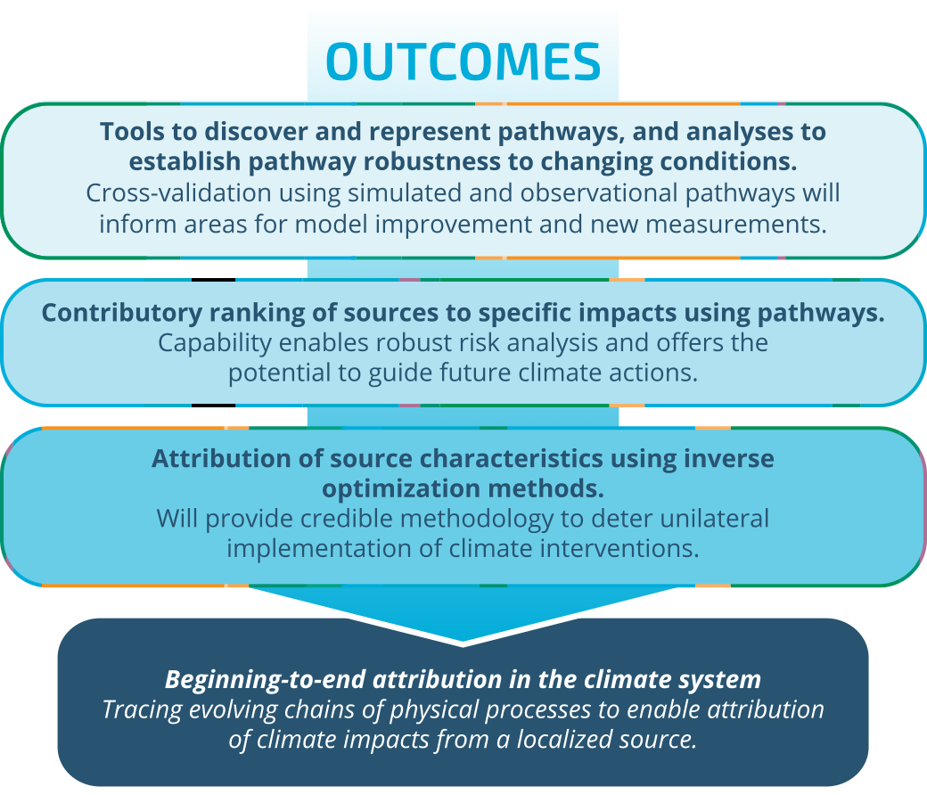
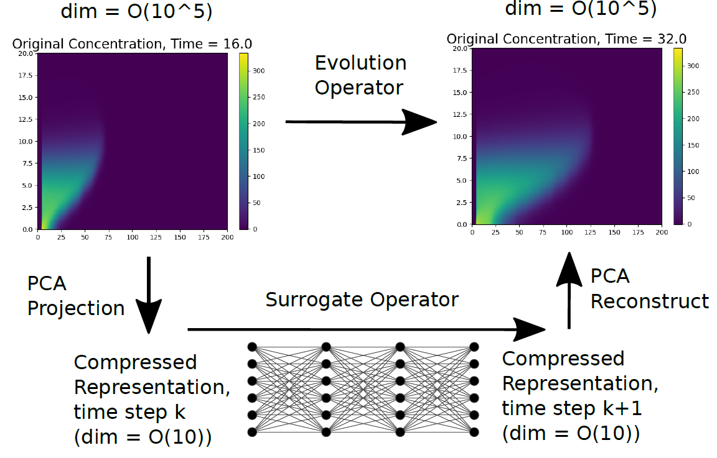




sandia.gov/climate
GC25H-0769
CLDERA – CLimate impact: Determining Etiology thRough pAthways
Leadership Team: Diana Bull, Kara Peterson, Laura Swiler, Lyndsay Shand, Irina Tezaur
sandia.gov/cldera
OVERVIEW
CLDERA will develop new methods to confidently attribute climate impacts to localized sources using a novel pathways approach built upon discovering and representing evolving chains of physical processes. CLDERA aims to improve climate risk assessments and decision-making through its transformation in approaches for climate attribution.
NEED
Energy Exascale Earth System Model (E3SM)
Climatic impacts (like drought, flooding, or crop yield) are driving national security, legislative and legal foci.
See Lin’s A33F-08 on 12/14
See Brown’s A52Q-1203 on 12/16
Complex coupling between processes obscure the relationships between sources and downstream impacts.
Prognostic Aerosol Modeling: Simulate stratospheric volcanic aerosol in E3SM from SO₂ emissions.
Traditional attribution connects a source to a primary climate variable in a single step.
Evaluate E3SM’s Stratosphere: Characterize biases and understand what physical processes can be captured.
Modified from: http://www.thesourgrapevine.com/2019/11/the-ball-of-string-theory-for-learning.html
The technical challenge is to draw quantitative relationships in a multi-step attribution framework.
Establish climate variability surrounding Mt. Pinatubo: Characterize signal-to-noise for detection & attribution.
APPROACH
Sensitivity Analyses: Determine pathway robustness to altered: eruption characteristics and model parameterizations.
Combine evidence from multiple nodes in the pathway to strengthen connection between source and impact.
Simulated Pathways
Random Forest Regression (RFR): Generate feature pathway networks using multi-variate RFR (full pairwise analysis of input features).
See Peterson’s H22P-1036 on 12/13
Profiling: Dynamically trace pathways through the E3SM software as the software executes (in-situ).
Tracing: Add active and passive tracers to E3SM to enable model evaluation and pathway identification.
Signature-Based Clustering: Find & track non-stationary variable clusters for use as features in pathway identification.
Space-time varying cluster identification in response to Mt. Pinatubo source.
Observed Pathways
Tiered Verification
Data Fusion: Fuse observational datasets to obtain near-real time measurements over complete space-time grid.
See Li’s IN22A-07 on 12/13
See Hollowed’s A13C-01 on 12/12
Develop data sets of increasing complexity with key characteristics of the multi-step attribution problem to explore sensitivities, establish viability, and prove usefulness of advanced methods/tools.
Dynamic space-time models: Adopt space-time dynamic models to incorporate multiple nodes and establish correlations between nodes.
Data & Model complexity (dimensionality of data, number & interaction between processes, …)
Spatially-varying changepoint methods: Establish dependence between local climate shifts and distance from source.
Elastic Functional Warping changepoint methods: Identify climate shifts using functional time series methodologies accounting for phase variability.
See Hollowed’s XXXX 12/15
Gaussian Plume with prescribed winds
Log10(concentration) SO₂, Day 40
Mt. Pinatubo in fully coupled climate model
Synthetic Relationships
Idealized atm. + embedded pathways
Explainable Echo State Networks (ESNs): Develop explainable (permutation feature importance) and interpretable methods to quantify relationships between pathway nodes as modeled by recurrent neural networks.
Spatial characteristics are time varying in response to Mt. Pinatubo source.
Attribution
Enhanced Fingerprinting: Investigate advanced principal component analyses (tensor based, non-negative, etc.) and employ multiple nodes in the pathway to sharpen the signal-to-noise ratios and enable downstream impact attribution.
Inverse Optimization: Identify source characteristics by developing deep operator neural networks (DONNs) to model parts of E3SM for PDE-constrained optimization.
Inverse optimization solution provides a close, uncertainty-quantified estimate.
Causal Modeling: Develop causal discovery method for spatially nonstationary and transient relationships; use directed graphs to represent causal networks.

