Slide 1

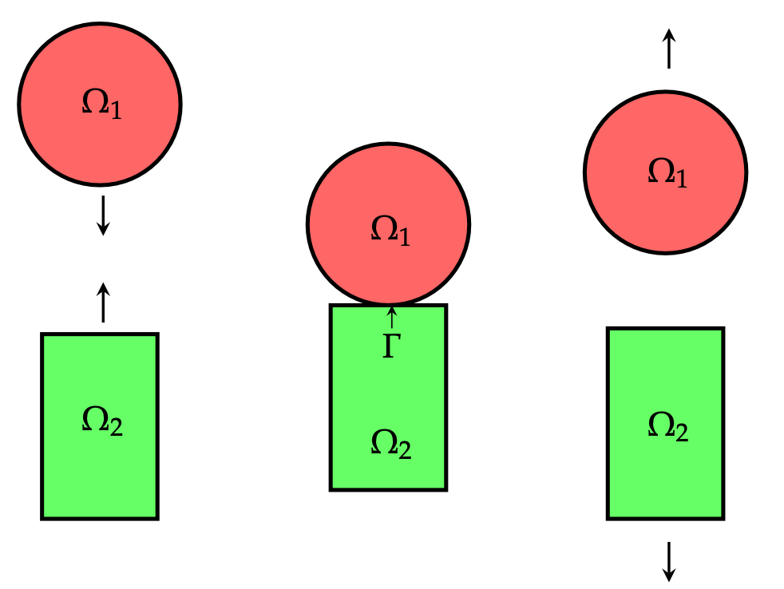
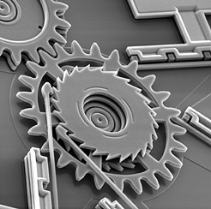
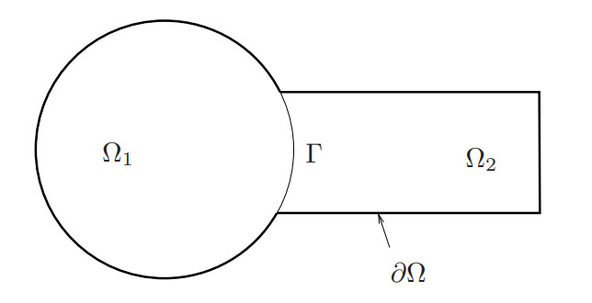
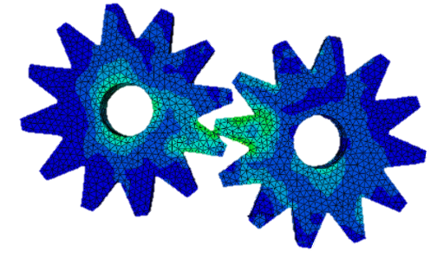
The Schwarz Alternating Method for Multi-Scale Contact Mechanics
Alejandro Mota¹, Irina Tezaur¹, Daria Koliesnikova¹, Jonathan Hoy²
¹Sandia National Laboratories, ²University of Southern California
Congress on Numerical Methods in Engineering (CMN) 2022
Las Palmas de Gran Canaria, Spain September 12-14, 2022
SAND2022-11528C

Slide 2
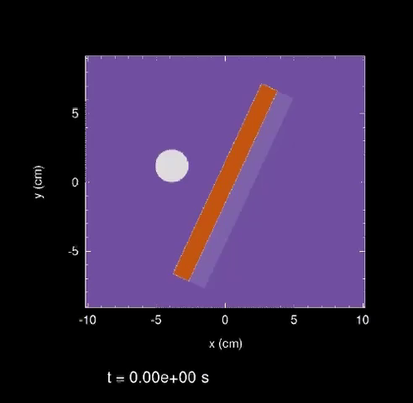
Motivation
Stable, accurate and robust methods for simulating mechanical contact are extremely important in computational solid mechanics
  Example scenarios where contact arises: touching surfaces, sliding, tightened bolts, impact, …
Above: gears in contact within MEMS device. From sandia.gov/media
Below: oblique cylinder impact simulated using Sandia’s ALEGRA code.
Notes:
MEMS = microelectromechanical systems

Slide 3
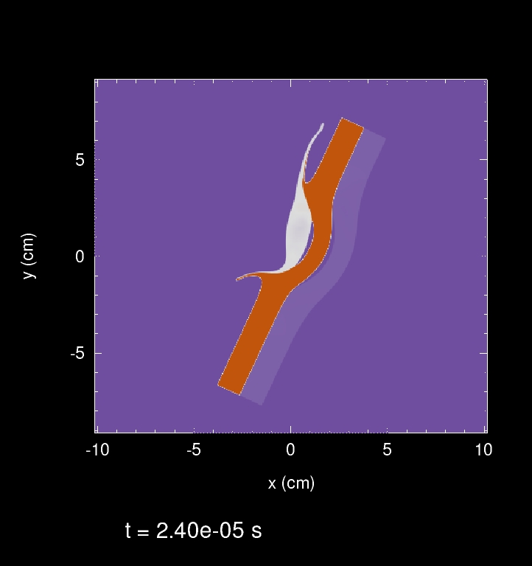
Motivation
Stable, accurate and robust methods for simulating mechanical contact are extremely important in computational solid mechanics
  Example scenarios where contact arises: touching surfaces, sliding, tightened bolts, impact, …
Above: gears in contact within MEMS device. From sandia.gov/media
Two-step process to the computational simulation of contact:
Proximity search: computer science problem, has received much attention due to importance in video game development ☺
Contact enforcement step: existing methods (penalty, Lagrange multiplier, augmented Lagrangian) suffer from poor performance ☹
  Long simulation times ☹
  Lack of accuracy ☹
  Lack of robustness ☹
Below: oblique cylinder impact simulated using Sandia’s ALEGRA code.
Notes:
MEMS = microelectromechanical systems

Slide 4
Motivation
Stable, accurate and robust methods for simulating mechanical contact are extremely important in computational solid mechanics
  Example scenarios where contact arises: touching surfaces, sliding, tightened bolts, impact, …
Above: gears in contact within MEMS device. From sandia.gov/media
Two-step process to the computational simulation of contact:
Proximity search: computer science problem, has received much attention due to importance in video game development ☺
Contact enforcement step: existing methods (penalty, Lagrange multiplier, augmented Lagrangian) suffer from poor performance ☹
  Long simulation times ☹
  Lack of accuracy ☹
  Lack of robustness ☹
Below: oblique cylinder impact simulated using Sandia’s ALEGRA code.
Notes:
MEMS = microelectromechanical systems

Slide 5
Motivation
Stable, accurate and robust methods for simulating mechanical contact are extremely important in computational solid mechanics
  Example scenarios where contact arises: touching surfaces, sliding, tightened bolts, impact, …
Above: gears in contact within MEMS device. From sandia.gov/media
Two-step process to the computational simulation of contact:
Proximity search: computer science problem, has received much attention due to importance in video game development ☺
Contact enforcement step: existing methods (penalty, Lagrange multiplier, augmented Lagrangian) suffer from poor performance ☹
  Long simulation times ☹
  Lack of accuracy ☹
  Lack of robustness ☹
Below: oblique cylinder impact simulated using Sandia’s ALEGRA code.
Notes:
MEMS = microelectromechanical systems

Slide 6
Motivation
Stable, accurate and robust methods for simulating mechanical contact are extremely important in computational solid mechanics
  Example scenarios where contact arises: touching surfaces, sliding, tightened bolts, impact, …
Above: gears in contact within MEMS device. From sandia.gov/media
Two-step process to the computational simulation of contact:
Proximity search: computer science problem, has received much attention due to importance in video game development ☺
Contact enforcement step: existing methods (penalty, Lagrange multiplier, augmented Lagrangian) suffer from poor performance ☹
  Long simulation times ☹
  Lack of accuracy ☹
  Lack of robustness ☹
Below: oblique cylinder impact simulated using Sandia’s ALEGRA code.
This talk: new approach for simulating multi-scale mechanical contact using the Schwarz alternating method.
Notes:
MEMS = microelectromechanical systems

Slide 7
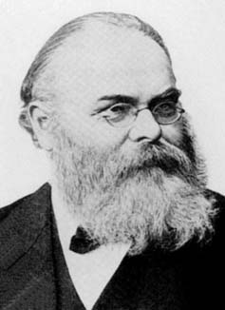
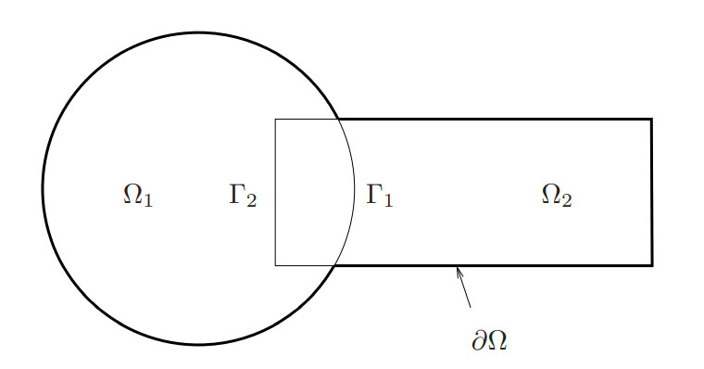
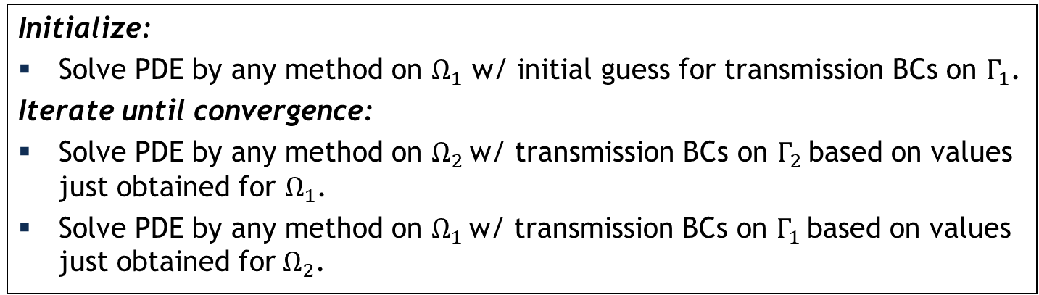
Schwarz Alternating Method for Domain Decomposition
Proposed in 1870 by H. Schwarz for solving Laplace PDE on irregular domains.
Crux of Method: if the solution is known in regularly shaped domains, use those as pieces to iteratively build a solution for the more complex domain.
H. Schwarz (1843–1921)
Basic Schwarz Algorithm
overlapping
Initialize:
Solve PDE by any method on $Ω_{1}$ w/ initial guess for transmission BCs on $Γ_{1}$.
Iterate until convergence:
Solve PDE by any method on $Ω_{2}$ w/ transmission BCs on $Γ_{2}$ based on values just obtained for $Ω_{1}$.
Solve PDE by any method on $Ω_{1}$ w/ transmission BCs on $Γ_{1}$ based on values just obtained for $Ω_{2}$.
non-overlapping
²Lions, 1990. ³Zanolli et al., 1987.

Slide 8

Schwarz Alternating Method for Domain Decomposition
Proposed in 1870 by H. Schwarz for solving Laplace PDE on irregular domains.
Crux of Method: if the solution is known in regularly shaped domains, use those as pieces to iteratively build a solution for the more complex domain.
H. Schwarz (1843–1921)
Basic Schwarz Algorithm
overlapping
Initialize:
Solve PDE by any method on $Ω_{1}$ w/ initial guess for transmission BCs on $Γ_{1}$.
Iterate until convergence:
Solve PDE by any method on $Ω_{2}$ w/ transmission BCs on $Γ_{2}$ based on values just obtained for $Ω_{1}$.
Solve PDE by any method on $Ω_{1}$ w/ transmission BCs on $Γ_{1}$ based on values just obtained for $Ω_{2}$.
Overlapping Schwarz: convergent with all-Dirichlet transmission BCs¹ if $Ω_{1}⋂{ Ω}_{2}≠∅$.
Non-overlapping Schwarz: convergent with Robin-Robin² or alternating Neumann-Dirichlet³ transmission BCs.
¹Schwarz, 1870; Lions, 1988.
²Lions, 1990. ³Zanolli et al., 1987.

Slide 9
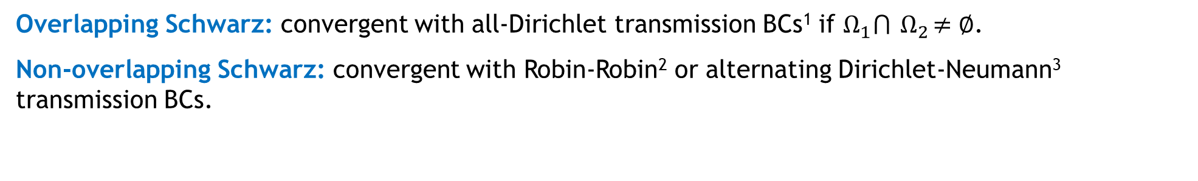
Schwarz Alternating Method for Domain Decomposition
Proposed in 1870 by H. Schwarz for solving Laplace PDE on irregular domains.
Crux of Method: if the solution is known in regularly shaped domains, use those as pieces to iteratively build a solution for the more complex domain.
H. Schwarz (1843–1921)
Basic Schwarz Algorithm
Initialize:
Solve PDE by any method on $Ω_{1}$ w/ initial guess for transmission BCs on $Γ_{1}$.
Iterate until convergence:
Solve PDE by any method on $Ω_{2}$ w/ transmission BCs on $Γ_{2}$ based on values just obtained for $Ω_{1}$.
Solve PDE by any method on $Ω_{1}$ w/ transmission BCs on $Γ_{1}$ based on values just obtained for $Ω_{2}$.
non-overlapping
Overlapping Schwarz: convergent with all-Dirichlet transmission BCs¹ if $Ω_{1}⋂{ Ω}_{2}≠∅$.
Non-overlapping Schwarz: convergent with Robin-Robin² or alternating Dirichlet-Neumann³ transmission BCs.
z: convergent with Robin-Robin² or alternating Neumann-Dirichlet³ transmission BCs.
¹Schwarz, 1870; Lions, 1988.
²Lions, 1990. ³Zanolli et al., 1987.
²Lions, 1990. ³Zanolli et al., 1987.

Slide 10
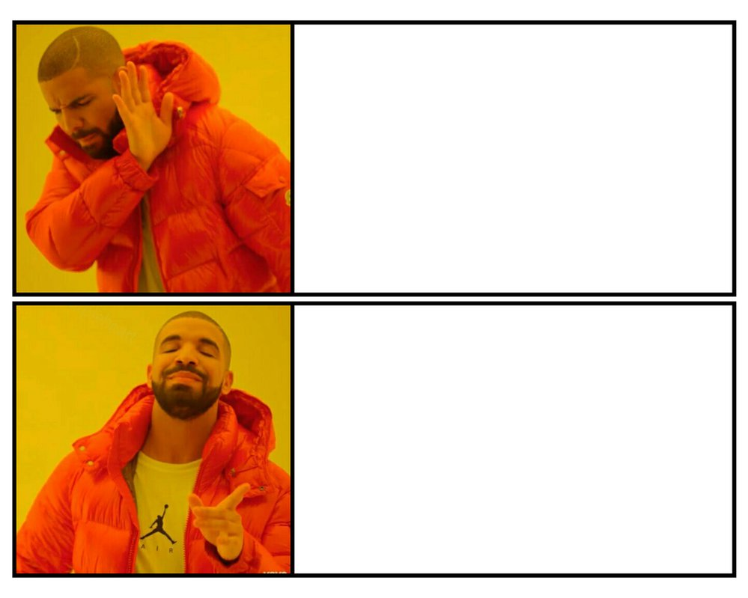
How We Use the Schwarz Alternating Method
10
AS A PRECONDITIONER FOR THE LINEARIZED SYSTEM
AS A SOLVER FOR THE COUPLED
FULLY NONLINEAR PROBLEM

Slide 11
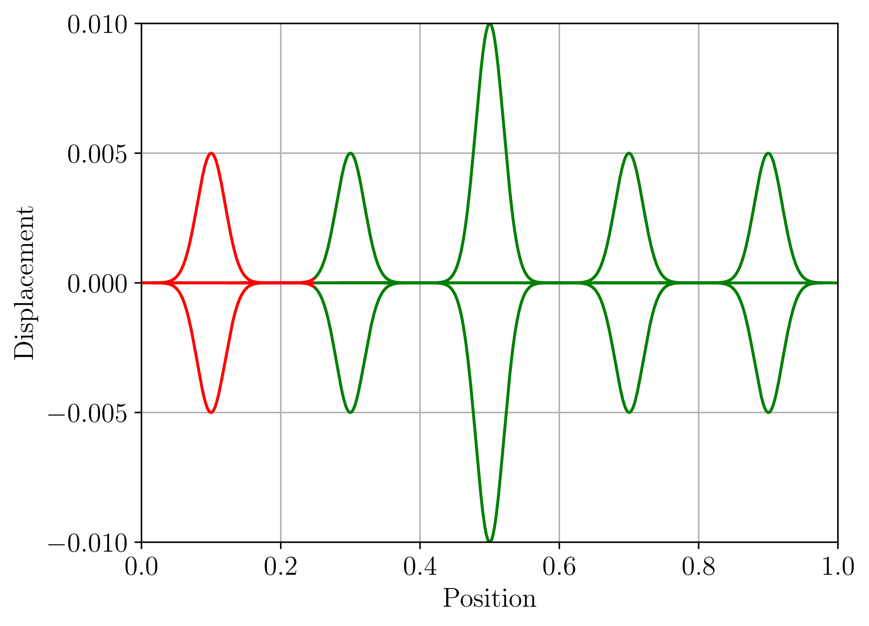
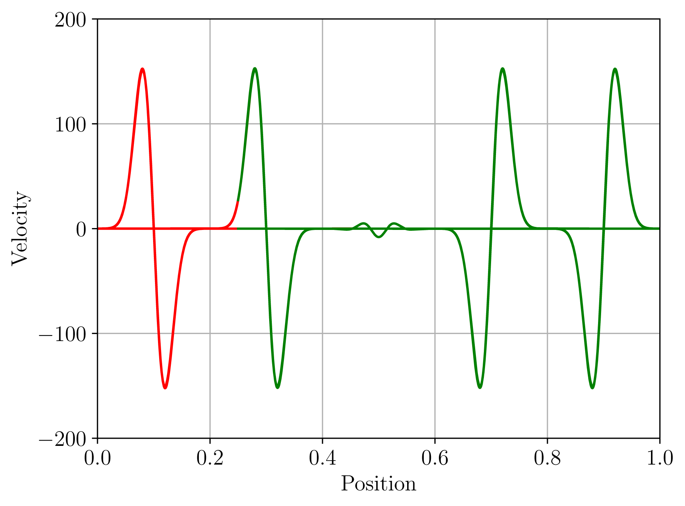
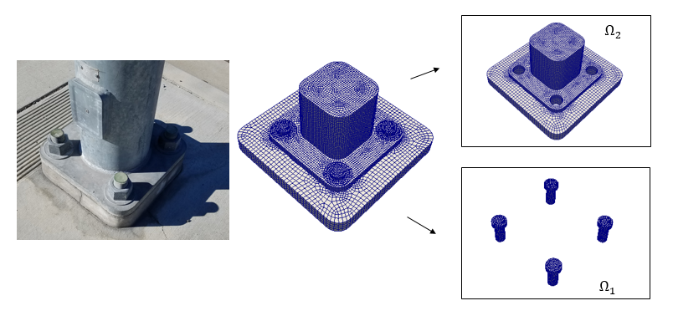


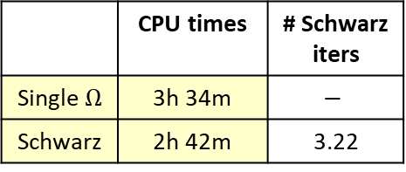
Overlapping Schwarz for Multi-Scale Coupling in Solid Mechanics
The Schwarz alternating method has been developed/implemented for concurrent multi-scale quasistatic & dynamic modeling in Sandia’s Albany/LCM* and Sierra/SM codes.
Displacement
Velocity
Coupling is concurrent (two-way)
“Plug-and-play” framework: couples different meshes, element types, solvers, integrators
No nonphysical artifacts
Theoretical convergence properties¹
Easy to implement in existing HPC codes
Scalable, fast, robust
 | CPU times | # Schwarz iters
Single $Ω$ | 3h 34m | $$−$$
Schwarz | 2h 42m | 3.22
¹Mota et al., 2017; Mota et al., 2022.
*https://github.com/sandialabs/LCM

Slide 12
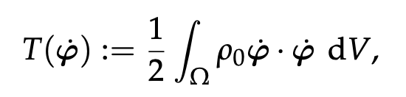
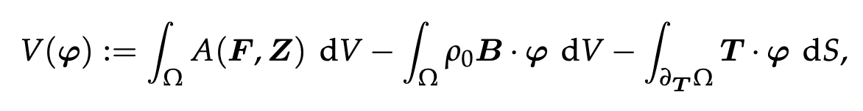

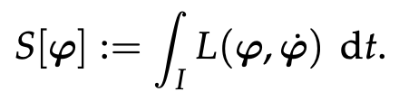

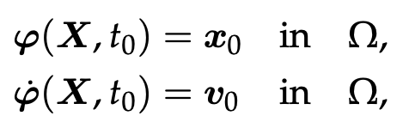
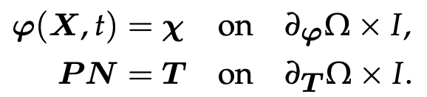
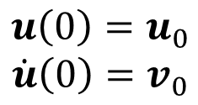

Solid Mechanics Problem Formulation
12
Kinetic Energy:
Potential Energy:
Lagrangian:
Action Functional:
Euler-Lagrange Equations:
Semi-Discrete Problem:
FEM
$$M\ddot{u}+f_{int}(u, \dot{u})=f_{ext}$$
$$u\left(0\right)=u_{0}$$
$$\dot{u}\left(0\right)=v_{0}$$

Slide 13
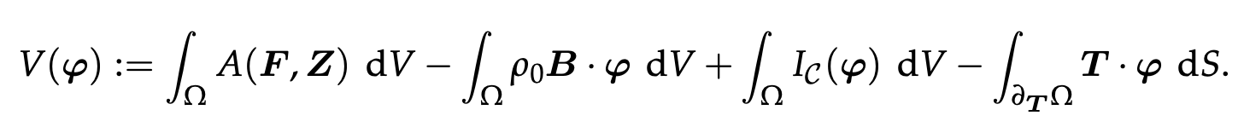
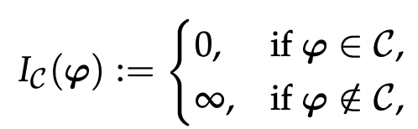
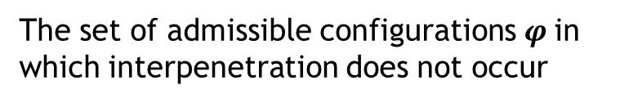

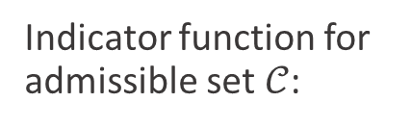
Traditional Solid Mechanics Contact Formulation
13
Kinetic Energy:
Potential Energy Augmented with Contact Constraint:
Lagrangian:
Action Functional:
Contact constraint can be enforced strictly or approximately
Strict enforcement: Lagrange multiplier methods
Approximate enforcement: penalty methods
$𝒞$:
The set of admissible configurations $φ$in which interpenetration does not occur
Indicator function for admissible set $𝒞$:

Slide 14
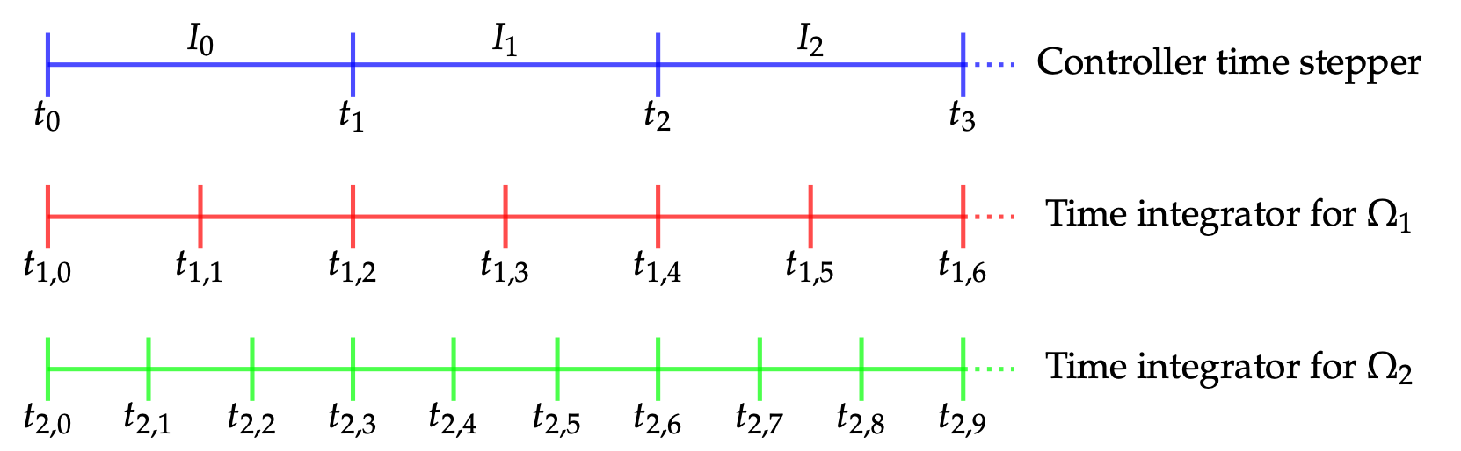
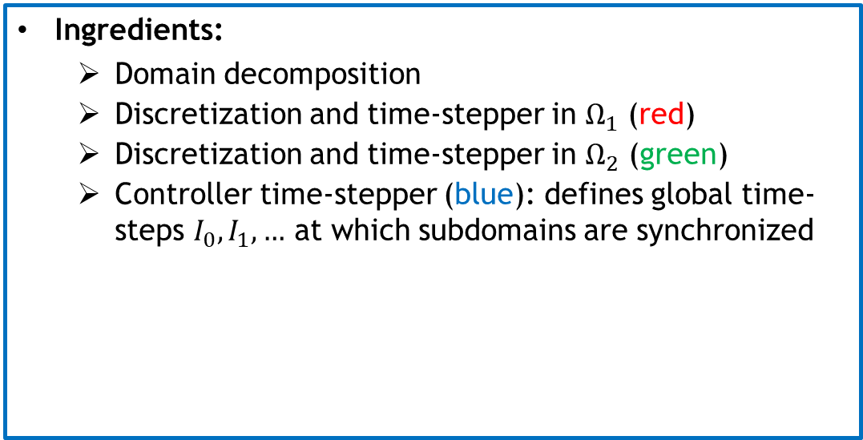
Non-Overlapping Schwarz Contact Formulation
14
Ingredients:
  Domain decomposition
  Discretization and time-stepper in $Ω_{1}$ (red)
  Discretization and time-stepper in $Ω_{2}$ (green)
  Controller time-stepper (blue): defines global time-steps $I_{0},I_{1}, …$ at which subdomains are synchronized
Can use different integrators with different time steps within each domain!

Slide 15
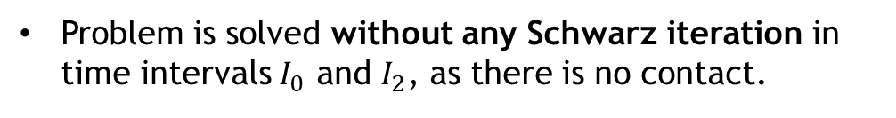
Non-Overlapping Schwarz Contact Formulation
15
Ingredients:
  Domain decomposition
  Discretization and time-stepper in $Ω_{1}$ (red)
  Discretization and time-stepper in $Ω_{2}$ (green)
  Controller time-stepper (blue): defines global time-steps $I_{0},I_{1}, …$ at which subdomains are synchronized
Problem is solved without any Schwarz iteration in time intervals $I_{0}$ and $I_{2}$, as there is no contact.
Can use different integrators with different time steps within each domain!

Slide 16
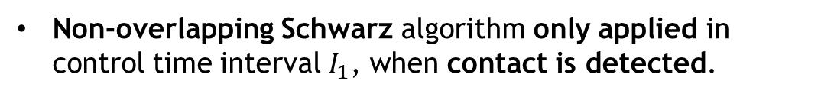
Non-Overlapping Schwarz Contact Formulation
16
Ingredients:
  Domain decomposition
  Discretization and time-stepper in $Ω_{1}$ (red)
  Discretization and time-stepper in $Ω_{2}$ (green)
  Controller time-stepper (blue): defines global time-steps $I_{0},I_{1}, …$ at which subdomains are synchronized
Problem is solved without any Schwarz iteration in time intervals $I_{0}$ and $I_{2}$, as there is no contact.
Non-overlapping Schwarz algorithm only applied in control time interval $I_{1}$, when contact is detected.
Contact Criteria
Overlap: interpenetration of subdomains
Compression: positive normal traction
Persistence: was in contact previous step

Slide 17
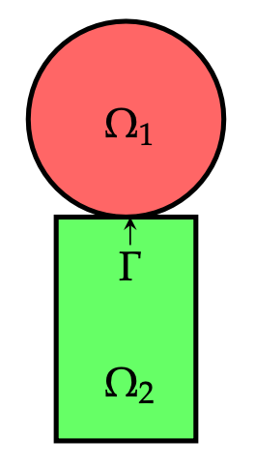
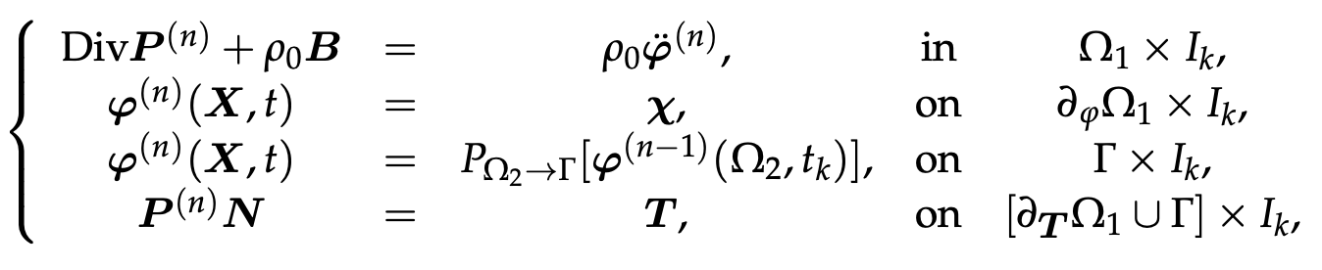
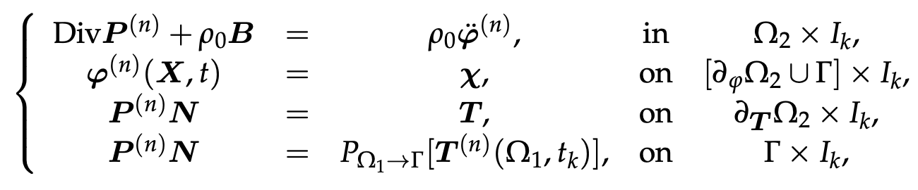
Non-Overlapping Schwarz Contact Formulation
17
Key idea: a contact problem can be viewed as coupled problem while 2+ bodies are in contact
  Alternating Dirichlet-Neumann (traction) Schwarz iteration is applied once interpenetration has been detected, to correct the interpenetration.
There are no contact constraints!
Contact constraints replaced with BCs applied iteratively at contact boundaries.

Slide 18
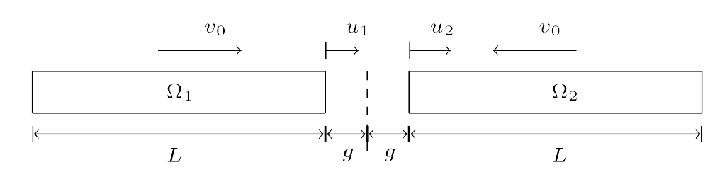
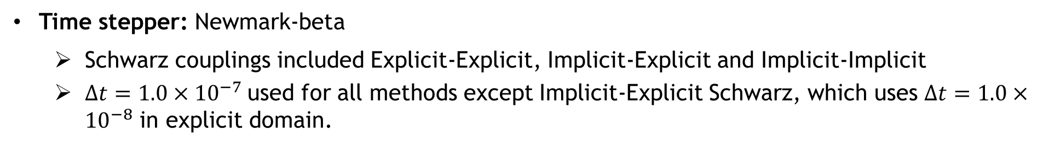
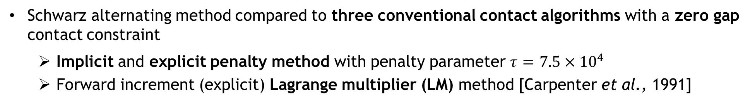
Numerical Results: 1D Impact Problem¹
Impact of two 1D identical linear elastic prismatic rods discretized using $N_{x}=200$ linear elements with exact analytic solution [Carpenter et al., 1991]
Schwarz alternating method compared to three conventional contact algorithms with a zero gap contact constraint
  Implicit and explicit penalty method with penalty parameter $τ=$ $7.5×{10}^{4}$
  Forward increment (explicit) Lagrange multiplier (LM) method [Carpenter et al., 1991]
Time stepper: Newmark-beta
  Schwarz couplings included Explicit-Explicit, Implicit-Explicit and Implicit-Implicit
  $Δt=1.0×{10}^{−7}$used for all methods except Implicit-Explicit Schwarz, which uses $Δt=1.0×{10}^{−8}$ in explicit domain.
¹Hoy et al., 2021; Mota et al., 2022 (under review).

Slide 19
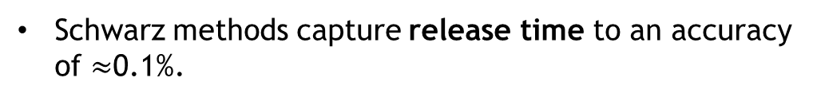
Numerical Results: 1D Impact Problem¹
Contact point position: of the right-most node of left bar ($Ω_{1}$) as a function of time
Penalty methods overpredict contact point location between impact and release times
Explicit LM method under-predicts release time
Schwarz methods capture release time to an accuracy of $≈$0.1%.
¹Hoy et al., 2021; Mota et al., 2022 (under review).

Slide 20
Numerical Results: 1D Impact Problem¹
Mass-averaged velocity: of the left bar ($Ω_{1}$) as a function of time
Similar conclusions can be drawn from mass-averaged velocity
Schwarz variants calculate mass-averaged velocity to a sufficiently greater accuracy than any of the conventional methods, especially near the time of release
¹Hoy et al., 2021; Mota et al., 2022 (under review).

Slide 21
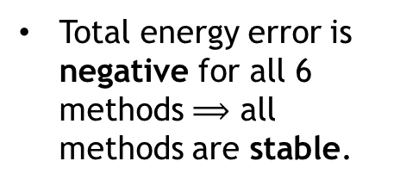
Numerical Results: 1D Impact Problem¹
Total energy relative error: for the left bar ($Ω_{1}$) as a function of time
Total energy error is negative for all 6 methods $⟹$ all methods are stable.
Total energy should be conserved for this problem
All three conventional methods exhibit total energy loss of up to 9% following contact.
Unlike conventional contact methods, Schwarz achieves an error of at most 0.25% in the total energy!
  Explicit-Explicit Schwarz gives most accurate total energy, followed by Implicit-Implicit Schwarz and Implicit-Explicit Schwarz
¹Hoy et al., 2021; Mota et al., 2022 (under review).

Slide 22
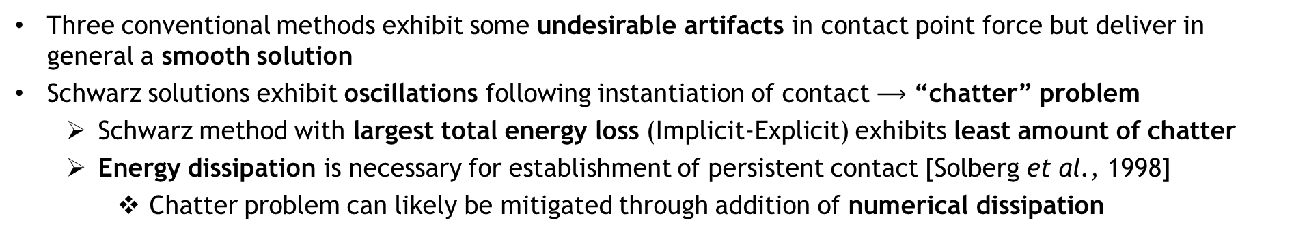
Numerical Results: 1D Impact Problem¹
¹Hoy et al., 2021; Mota et al., 2022 (under review).
Contact point force: for the left bar ($Ω_{1}$) as a function of time
WIP: mitigating chatter problem.
Three conventional methods exhibit some undesirable artifacts in contact point force but deliver in general a smooth solution
Schwarz solutions exhibit oscillations following instantiation of contact $⟶$ “chatter” problem
  Schwarz method with largest total energy loss (Implicit-Explicit) exhibits least amount of chatter
  Energy dissipation is necessary for establishment of persistent contact [Solberg et al., 1998]
    Chatter problem can likely be mitigated through addition of numerical dissipation
Notes:
Chatter = loss/subsequent reestablishment of contact

Slide 23
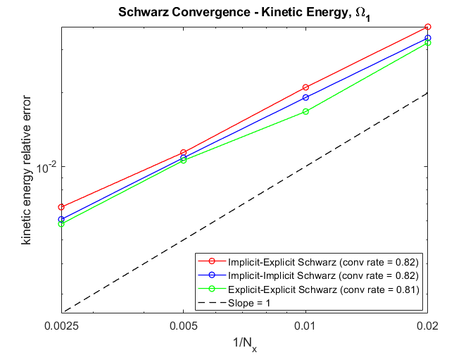
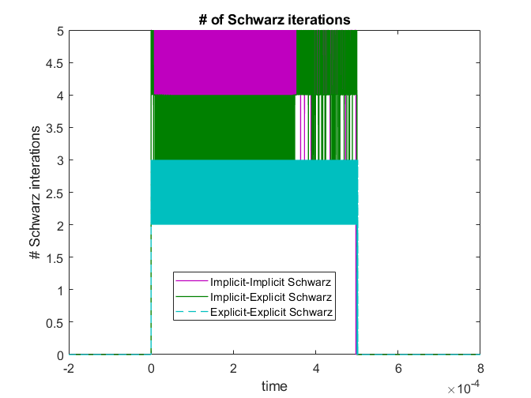
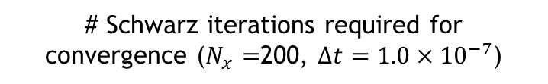
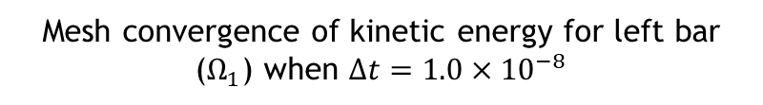
Numerical Results: 1D Impact Problem¹
Convergence of Schwarz methods
Mesh convergence of kinetic energy for left bar ($Ω_{1}$) when $Δt=1.0×{10}^{−8}$
# Schwarz iterations required for convergence ($N_{x}=$200, $Δt=1.0×{10}^{−7}$)
Convergence rates are comparable to published results [Tezaur et al., 2021]
At most 5 Schwarz iterations are needed for convergence
  Explicit-Explicit Schwarz variant requires fewest # iterations for convergence
¹Hoy et al., 2021; Mota et al., 2021 (under review).
Notes:
Chatter = loss/subsequent reestablishment of contact

Slide 24
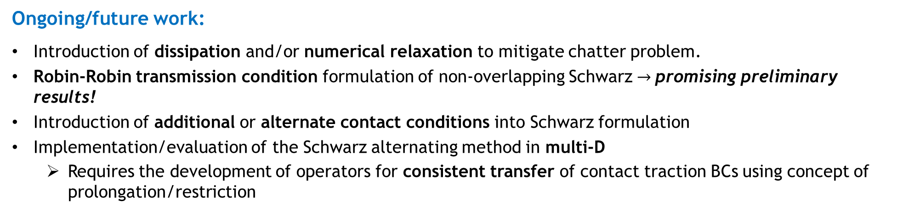
Summary & Future Work
Summary:
The Schwarz alternating method has shown promise as a novel technique for simulating multi-scale mechanical contact
  Contact constraints are replaced with transmission BCs applied iteratively on contact boundaries
  Schwarz method delivers substantially more accurate solution than conventional contact approaches in contact point displacement, mass-averaged velocity, impact time, release time, and kinetic, potential total energies
  An unfortunate consequence of the method’s ability to conserve energy so well appears to be the introduction of chatter in contact point velocity and force.
Ongoing/future work:
Introduction of dissipation and/or numerical relaxation to mitigate chatter problem.
Robin-Robin transmission condition formulation of non-overlapping Schwarz $→$promising preliminary results!
Introduction of additional or alternate contact conditions into Schwarz formulation
Implementation/evaluation of the Schwarz alternating method in multi-D
  Requires the development of operators for consistent transfer of contact traction BCs using concept of prolongation/restriction

Slide 25
References
H. Schwarz, Uber einen Grenzubergang durch alternierendes verfahren, Vierteljahrsschriftder Naturforschenden Gesellschaft in Zurich, 15 (1870), pp. 272–286.
P.L. Lions. “On the Schwarz alternating method I.” In: 1988, First International Symposium on Domain Decomposition methods for Partial Differential Equations, SIAM, Philadelphia.
P. L. Lions, On the Schwarz alternating method III: A variant for nonoverlapping subdomains, in Third International Symposium on Domain Decomposition Methods for Partial Differential Equations, T. F. Chan, R. Glowinski, J. P´eriaux, and O. B. Widlund, eds., Society for Industrial and Applied Mathematics, 1990, pp. 202–223
P. Zanolli, Domain decomposition algorithms for spectral methods, CALCOLO, 24 (1987), pp. 201–240.
A. Mota, I. Tezaur, and C. Alleman, The Schwarz alternating method, Comput. Meth. Appl. Mech. Engng., 319 (2017), pp. 19–51.
A. Mota, I. Tezaur, and G. Phlipot, The Schwarz alternating method for transient solid dynamics, Int. J. Numer. Meth. Engng. 1-35, 2022.
N. J. Carpenter, R. L. Taylor, and M. G. Katona, Lagrange constraints for transient finite element surface contact, International journal for numerical methods in engineering, 32 (1991), pp. 103–128.
J. Hoy, I. Tezaur, A. Mota. The Schwarz alternating method for multi-scale contact mechanics. CSRI Summer Proceedings, E. Galvan and D. Smith, eds., Technical Report SAND2021-9886C, Sandia National Laboratories, 2021.
A. Mota, I. Tezaur, J. Hoy. The Schwarz alternating method for multi-scale contact mechanics. Mathematical & Computational Applications (MCA) (under review).
J. M. Solberg and P. Papadopoulos, A finite element method for contact/impact, Finite Elements in Analysis and Design, 30 (1998), pp. 297–311.
I. Tezaur, T. Voth, J. Niederhaus, J. Robbins, and J. Sanchez, An extended finite element method (XFEM) formulation for multi-material Eulerian solid mechanics in the Alegra code (in preparation).

Slide 26
Start of Backup Slides

Slide 27

Motivation
Large scale structural failure frequently originates from small scale phenomena (e.g, defects, microcracks, inhomogeneities), which grow quickly in unstable manner
  Concurrent multiscale methods are essential to capture correctly the multiscale behavior!
  Stable, accurate and robust methods for simulating mechanical contact (touching surfaces, sliding, tightened bolts, impact) are equally important!
Above: roof failure of Boeing 737 aircraft due to fatigue cracks. From imechanica.org
Two-step process to the computational simulation of contact:
Proximity search: computer science problem, has received much attention due to importance in video game development ☺
Contact enforcement step: existing methods (penalty, Lagrange multiplier, augmented Lagrangian) suffer from poor performance ☹
  Long simulation times ☹
  Lack of accuracy ☹
  Lack of robustness ☹
Above: gears in contact within MEMS device. From sandia.gov/media
This talk.

Slide 28
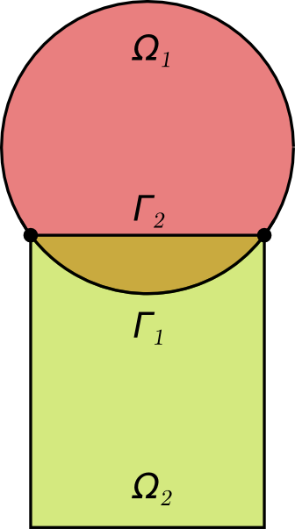
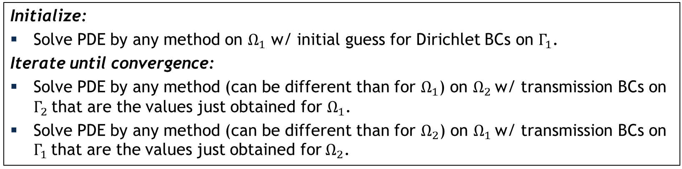
Schwarz Alternating Method for Domain Decomposition
Proposed in 1870 by H. Schwarz for solving Laplace PDE on irregular domains.
Crux of Method: if the solution is known in regularly shaped domains, use those as pieces to iteratively build a solution for the more complex domain.
H. Schwarz (1843 – 1921)
Basic Schwarz Algorithm
Initialize:
Solve PDE by any method on $Ω_{1}$ w/ initial guess for Dirichlet BCs on $Γ_{1}$.
Iterate until convergence:
Solve PDE by any method (can be different than for $Ω_{1}$) on $Ω_{2}$ w/ transmission BCs on $Γ_{2}$ that are the values just obtained for $Ω_{1}$.
Solve PDE by any method (can be different than for $Ω_{2}$) on $Ω_{1}$ w/ transmission BCs on $Γ_{1}$ that are the values just obtained for $Ω_{2}$.
Schwarz alternating method most commonly used as a preconditioner for Krylov iterative methods to solve linear algebraic equations.
Novel idea: using the Schwarz alternating as a discretization method for solving multi-scale partial differential equations (PDEs).

Slide 29
Non-Overlapping Schwarz Contact Formulation
Notes:
Key idea: the contact problem can be viewed as a coupled problem while the 2+ bodies are in contact

Slide 30
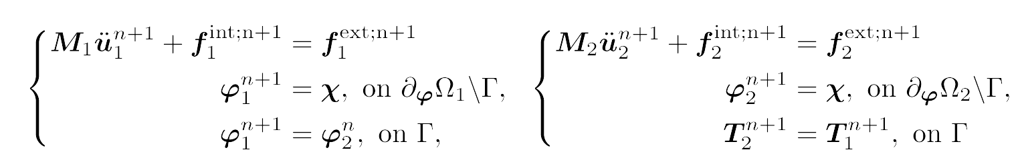






Non-Overlapping Schwarz Contact Formulation
Before contact: simulation proceeds as usual
Key idea: a contact problem can be viewed as coupled problem while 2+ bodies are in contact
$$Ω_{1}$$
$$Ω_{2}$$
Detection of contact: proximity search and application of contact conditions to determine contact
Overlap condition: triggered when two or more objects/domains have begun to overlap/penetrate each other
Compression condition: positive normal traction
Persistence condition: contact occurred in the previous step
$$Ω_{1}$$
$$Ω_{2}$$
Enforcement of contact: alternating Schwarz iteration with Dirichlet-Neumann transmission BCs
$$Ω_{1}$$
$$Ω_{2}$$
Notes:
Key idea: the contact problem can be viewed as a coupled problem while the 2+ bodies are in contact

Slide 31
Non-Overlapping Schwarz Contact Formulation
Before contact: simulation proceeds as usual
There are no contact constraints!
Contact constraints replaced with BCs applied iteratively at contact boundaries.
$$Ω_{1}$$
$$Ω_{2}$$
Detection of contact: proximity search and application of contact conditions to determine contact
Overlap condition: triggered when two or more objects/domains have begun to overlap/penetrate each other
Compression condition: positive normal traction
Persistence condition: contact occurred in the previous step
$$Ω_{1}$$
$$Ω_{2}$$
Enforcement of contact: alternating Schwarz iteration with Dirichlet-Neumann transmission BCs
$$Ω_{1}$$
$$Ω_{2}$$
Notes:
Key idea: the contact problem can be viewed as a coupled problem while the 2+ bodies are in contact

Slide 32
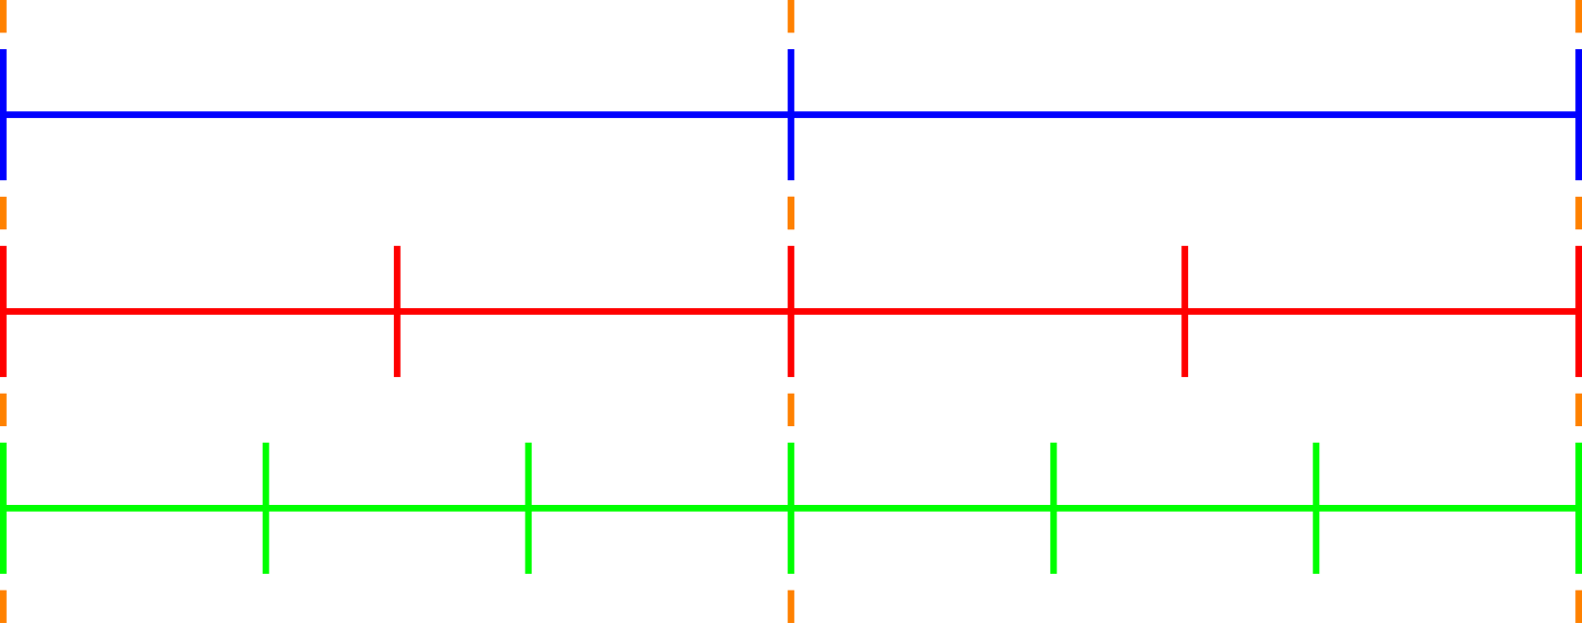
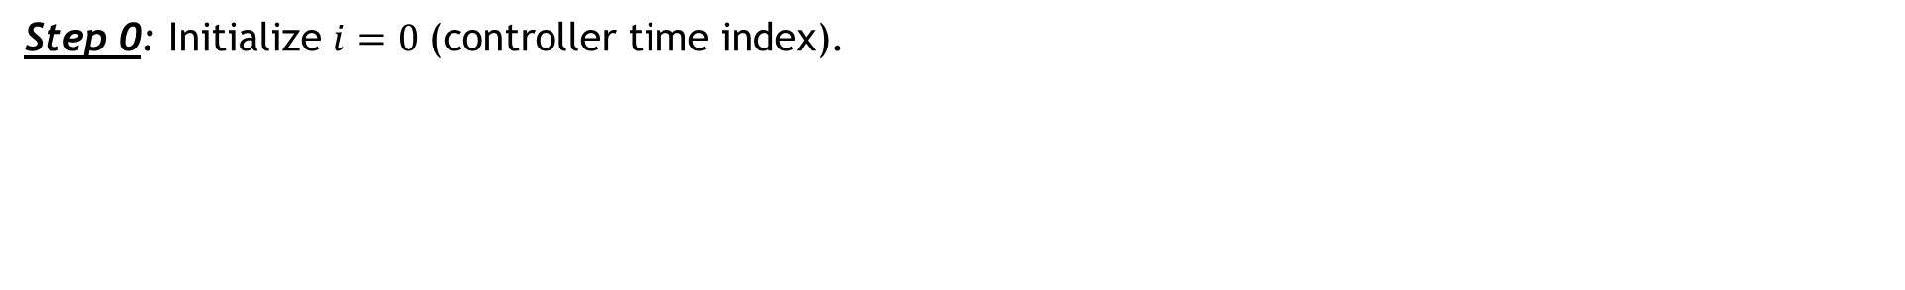


Enforcement of Contact via Alternating Schwarz
$$T_{0}$$
$$T_{1}$$
Key idea: a contact problem can be viewed as coupled problem while 2+ bodies are in contact
Controller time stepper
Time integrator for Ω₁
Time integrator for Ω₂
Step 0: Initialize $i=0 \text{(}\text{controller} \text{time} \text{index}\text{).}$

Slide 33
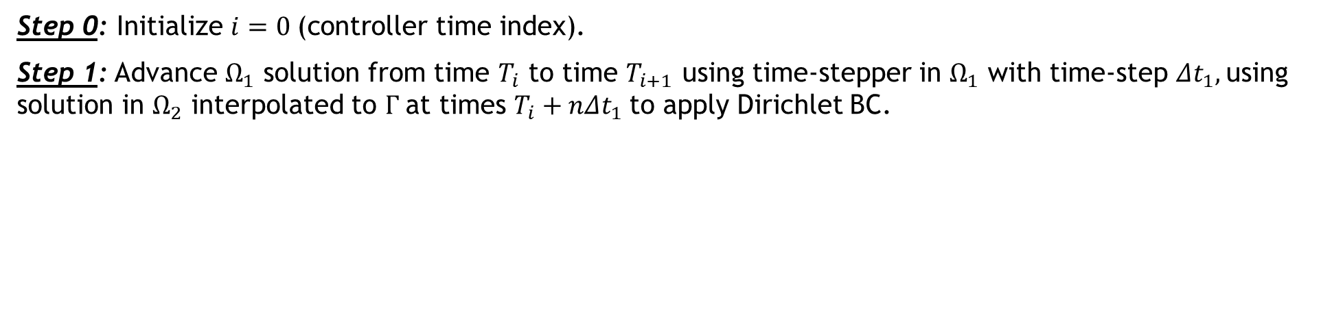


Enforcement of Contact via Alternating Schwarz
$$T_{0}$$
$$T_{1}$$
Key idea: a contact problem can be viewed as coupled problem while 2+ bodies are in contact
Controller time stepper
Time integrator for Ω₁
Time integrator for Ω₂
Integrate using ${Δt}_{1}$
Interpolate from $Ω_{2}$ to $Γ_{1}$
Step 0: Initialize $i=0 \text{(}\text{controller} \text{time} \text{index}\text{).}$
Step 1: Advance $Ω_{1}$ solution from time $T_{i}$ to time $T_{i+1}$ using time-stepper in $Ω_{1}$ with time-step ${Δt}_{1},$using solution in $Ω_{2}$ interpolated to $Γ$at times $T_{i}+n{Δt}_{1}$to apply Dirichlet BC.

Slide 34

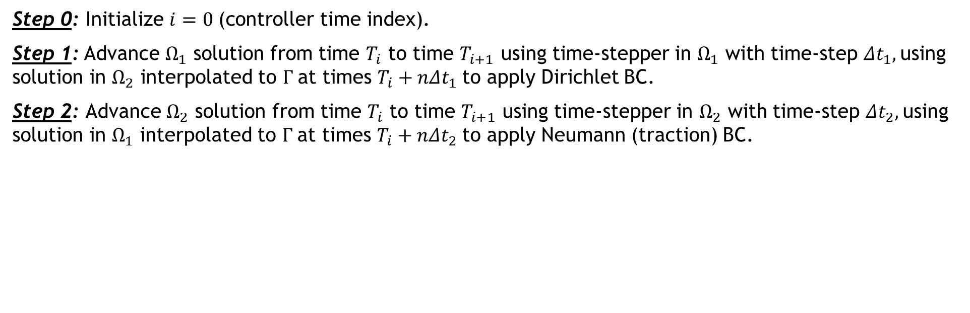

Enforcement of Contact via Alternating Schwarz
$$T_{0}$$
$$T_{1}$$
Key idea: a contact problem can be viewed as coupled problem while 2+ bodies are in contact
Controller time stepper
Time integrator for Ω₁
Time integrator for Ω₂
Interpolate from $Ω_{1}$ to $Γ_{2}$
Integrate using ${Δt}_{2}$
Step 0: Initialize $i=0 \text{(}\text{controller} \text{time} \text{index}\text{).}$
Step 1: Advance $Ω_{1}$ solution from time $T_{i}$ to time $T_{i+1}$ using time-stepper in $Ω_{1}$ with time-step ${Δt}_{1},$using solution in $Ω_{2}$ interpolated to $Γ$at times $T_{i}+n{Δt}_{1}$to apply Dirichlet BC$\text{.}$
Step 2: Advance $Ω_{2}$ solution from time $T_{i}$ to time $T_{i+1}$ using time-stepper in $Ω_{2}$ with time-step ${Δt}_{2},$using solution in $Ω_{1}$ interpolated to $Γ$at times $T_{i}+n{Δt}_{2}$to apply Neumann (traction) BC.

Slide 35

Enforcement of Contact via Alternating Schwarz
$$T_{0}$$
$$T_{1}$$
Key idea: a contact problem can be viewed as coupled problem while 2+ bodies are in contact
Controller time stepper
Time integrator for Ω₁
Time integrator for Ω₂
Step 0: Initialize $i=0 \text{(}\text{controller} \text{time} \text{index}\text{).}$
Step 1: Advance $Ω_{1}$ solution from time $T_{i}$ to time $T_{i+1}$ using time-stepper in $Ω_{1}$ with time-step ${Δt}_{1},$using solution in $Ω_{2}$ interpolated to $Γ$at times $T_{i}+n{Δt}_{1}$to apply Dirichlet BC.
Step 2: Advance $Ω_{2}$ solution from time $T_{i}$ to time $T_{i+1}$ using time-stepper in $Ω_{2}$ with time-step ${Δt}_{2},$using solution in $Ω_{1}$ interpolated to $Γ$at times $T_{i}+n{Δt}_{2}$to apply Neumann (traction) BC.
Step 3: Check for convergence at time $T_{i+1}$.

Slide 36


Enforcement of Contact via Alternating Schwarz
$$T_{0}$$
$$T_{1}$$
Key idea: a contact problem can be viewed as coupled problem while 2+ bodies are in contact
Controller time stepper
Time integrator for Ω₁
Time integrator for Ω₂
Integrate using ${Δt}_{1}$
Interpolate from $Ω_{2}$ to $Γ_{1}$
Step 0: Initialize $i=0 \text{(}\text{controller} \text{time} \text{index}\text{).}$
Step 1: Advance $Ω_{1}$ solution from time $T_{i}$ to time $T_{i+1}$ using time-stepper in $Ω_{1}$ with time-step ${Δt}_{1},$using solution in $Ω_{2}$ interpolated to $Γ$at times $T_{i}+n{Δt}_{1}$to apply Dirichlet BC$\text{.}$
Step 2: Advance $Ω_{2}$ solution from time $T_{i}$ to time $T_{i+1}$ using time-stepper in $Ω_{2}$ with time-step ${Δt}_{2},$using solution in $Ω_{1}$ interpolated to $Γ$at times $T_{i}+n{Δt}_{2}$to apply Neumann (traction) BC.
Step 3: Check for convergence at time $T_{i+1}$.
If unconverged, return to Step 1.
Notes:
Controller time-stepper – defines global dTs at which subdomains are synchronized

Slide 37



Enforcement of Contact via Alternating Schwarz
$$T_{0}$$
$$T_{1}$$
$$T_{2}$$
Key idea: a contact problem can be viewed as coupled problem while 2+ bodies are in contact
Controller time stepper
Time integrator for Ω₁
Time integrator for Ω₂
Integrate using ${Δt}_{1}$
Interpolate from $Ω_{2}$ to $Γ_{1}$
Step 0: Initialize $i=0 \text{(}\text{controller} \text{time} \text{index}\text{).}$
Step 1: Advance $Ω_{1}$ solution from time $T_{i}$ to time $T_{i+1}$ using time-stepper in $Ω_{1}$ with time-step ${Δt}_{1},$using solution in $Ω_{2}$ interpolated to $Γ$at times $T_{i}+n{Δt}_{1}$to apply Dirichlet BC.
Step 2: Advance $Ω_{2}$ solution from time $T_{i}$ to time $T_{i+1}$ using time-stepper in $Ω_{2}$ with time-step ${Δt}_{2},$using solution in $Ω_{1}$ interpolated to $Γ$at times $T_{i}+n{Δt}_{2}$to apply Neumann (traction) BC.
Step 3: Check for convergence at time $T_{i+1}$.
If unconverged, return to Step 1.
If converged, set $i= i+1$and return to Step 1.

Slide 38


Schwarz Algorithm for Contact
38
Contact criteria:
Overlap: interpenetration of subdomains
Compression: Positive normal traction
Persistence: Was in contact previous step

Slide 39




A Canonical 1D Problem – 2 Colliding Elastic Bars
39
Position and velocity of left contact point:
Impact & release times:
Contact force:

Slide 40
Comparison of Results
Analytic solution
Lagrange multiplier method with implicit time integration
Lagrange multiplier method with explicit time integration
Penalty method with implicit time integration
Penalty method with explicit time integration
Schwarz method with implicit-implicit integration
Schwarz method with implicit-explicit time integration
Schwarz method with explicit-explicit time integration

Slide 41

Contact Point Position
41

Slide 42

Mass-Averaged Velocity
42

Slide 43

Kinetic Energy
43

Slide 44

Potential Energy
44

Slide 45

Total Energy
45

Slide 46


Contact Force
46

Slide 47

Contact Velocity
47

