Slide 1
An Overview of the CLDERA Grand Challenge LDRD Project:
Developing a Novel Foundational Approach for Attributing Climate Impacts
PI: Diana Bull, Deputy PI: Kara Peterson
Thrust Leads: Irina Tezaur, Lyndsay Shand, Laura Swiler
Project Managers: Andy Salinger, Ben Cook
Sandia National Laboratories
CCR Summer Internship Program Seminar, August 23, 2022
SAND2022-11010PE

Slide 2
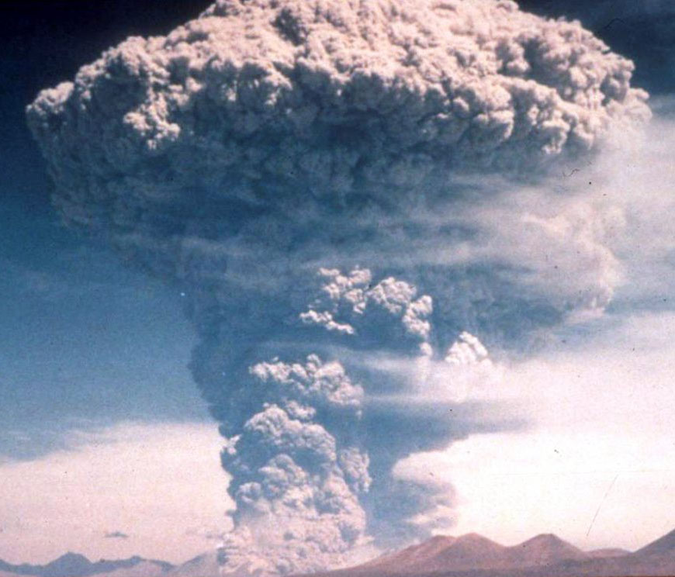
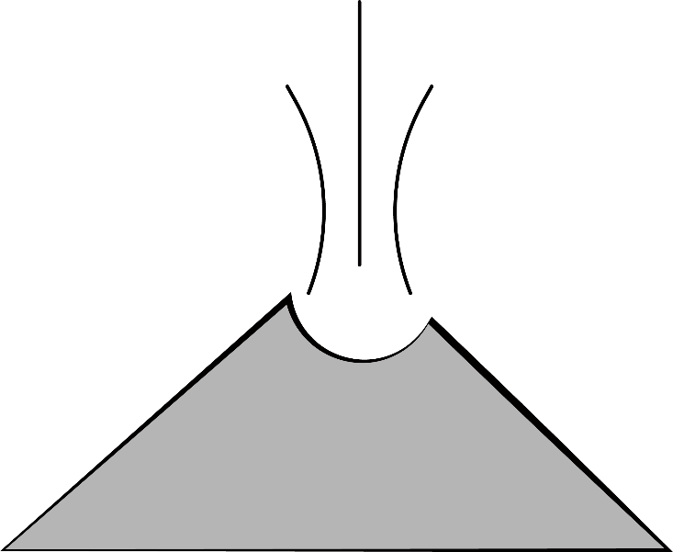
Outline
Motivation
The CLDERA Grand Challenge LDRD Project
Mt. Pinatubo & Stratospheric Aerosol Injection (SAI)
Energy Exascale Earth System Model (E3SM)
Simulating Mt. Pinatubo using E3SM
The Three CLDERA Thrusts
  Simulated Pathways Thrust
  Observed Pathways Thrust
  Attribution Thrust
Verification & Validation
Some Early Simulation Results
Summary
observed pathways
simulated pathways
attribution
CLDERA
2

Slide 3
Outline
Motivation
The CLDERA Grand Challenge LDRD Project
Mt. Pinatubo & Stratospheric Aerosol Injection (SAI)
Energy Exascale Earth System Model (E3SM)
Simulating Mt. Pinatubo using E3SM
The Three CLDERA Thrusts
  Simulated Pathways Thrust
  Observed Pathways Thrust
  Attribution Thrust
Verification & Validation
Some Early Simulation Results
Summary
observed pathways
simulated pathways
attribution
CLDERA
3

Slide 4
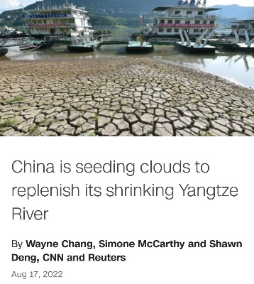
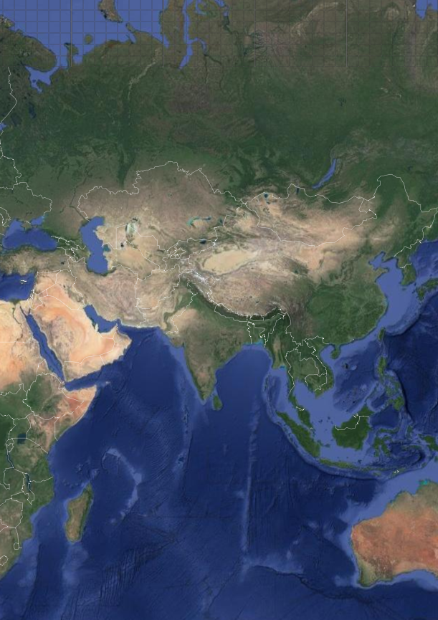

Motivation
Climate Change is a Growing National & Global Security Concern!
Sources of climate change: natural forcings, policy choices, climate interventions (geo-engineering*).
Federal agencies (DHS, DoD, DOS, DOE) have articulated an interest in risk assessments of climate impacts due to both natural climate change events and climate interventions.
  The ability to distinguish the impacts of intervention, anthropogenic climate change, and natural variability will become increasingly important as the effects of climate change compound.
Decisions will need to be made on policy, legislation, treaties and national security posture.
  As an FFRDC and National Security Lab, we must be prepared to inform these decisions.
Timely example: China’s Sky River Project
Unilaterally launched form of climate intervention to control rainfall over the Tibetan Plateau.
Currently, confident scientific-attribution of a source (e.g., Sky River) to a physical impact (e.g., regional drought over Southeast Asia) is at best onerous and at worst impossible!
‘Sky River’ cloud seeding impacts
* Deliberate manipulation of the Earth system to try to counteract effects of climate change.
4
Notes:
Climate change can result from a number of different sources, including non-persistent natural forcing, policy choices and climate interventions.
As part of the Sky River project, China has installed tens of thousands of fuel-burning chambers across the Tibetan mountains, which will produce silver iodide particles, expected to seed moisture clouds capable of producing rain and snow over the Tibetan Plateau.
FFRDC = federally funded research and development centers
As noted in National Academies of Sciences Engineering Medicine (NASEM) [12], detecting a unilateral launch of SAI will likely be trivial because of the change in aerosol optical depth, but questions of impacts that can be attributed to the SAI event is an outstanding and critical research topic to be addressed for governance and equity around climate intervention techniques.
For instance, the inability to attribute secondary and tertiary climate impacts to the development of China’s ‘Sky River’ cloud-seeding arrays—being developed to control rainfall over the Tibetan Plateau [10]—highlights the disincentive to establish multilateral agreements in which spatially distant negative impacts would be criteria in design development and optimization.

Slide 5

Motivation
Tools to Identify Source-Impact Relationships are Lacking
Attribution: the process of evaluating the relative contributions of multiple causal factors to a change or impact with an assignment of statistical confidence.
Technical Challenges/Limitations:
High internal variability of the Earth system obscures the connective relationships between sources and impacts.
  Earth system is like a tangled ball of yarn!
  Exacerbated by complex coupling of processes in Earth System Models (ESMs)
Limited simulation data and limited observation data until recently.
Wealth of recent high-resolution measurements have been historically under-utilized to improve our knowledge of the Earth system.
Modified from: http://www.thesourgrapevine.com/2019/11/the-ball-of-string-theory-for-learning.html
Attribution techniques capable of identifying a dominant source are infeasible with current approaches due to ill-posedness of the attribution inverse problem (many possible sources lead to similar impacts).
5

Slide 6
Outline
Motivation
The CLDERA Grand Challenge LDRD Project
Mt. Pinatubo & Stratospheric Aerosol Injection (SAI)
Energy Exascale Earth System Model (E3SM)
Simulating Mt. Pinatubo using E3SM
The Three CLDERA Thrusts
  Simulated Pathways Thrust
  Observed Pathways Thrust
  Attribution Thrust
Verification & Validation
Some Early Simulation Results
Summary
observed pathways
simulated pathways
attribution
CLDERA
6

Slide 7
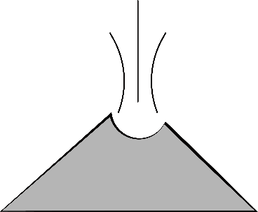





The CLDERA Grand Challenge LDRD Project
A Novel Foundational Approach to Understanding the Causation of Impacts
CLDERA: CLimate impact $−$Determining Etiology thRough pAthways
Need
Hypothesis
observed pathways
simulated pathways
attribution
Determine how a geographically and temporally localized source drives the climate system to respond with particular impacts to enable downstream impact attribution.
Tracing pathways between source and impacts will increase certainty of attribution and deepen understanding of dependent causal-like relationships.
Pathways represent the spatio-temporally evolving chain of physical processes that connects a source to impacts.
CLDERA
Technical Approach
Build upon key strengths of Sandia (modeling & simulation, detection & attribution, risk analysis)
Develop novel methods and tools in three cross-validating thrusts
Use the 1991 eruption of Mt. Pinatubo as exemplar
Outcome
Advance climate attribution science by identifying impacts from localized sources.
Duration: FY22-FY24
Budget: $5M/year
Staffing: $\sim$45 Sandians,
4 Academic Partners
Notes:
We propose to develop methods that enable the discovery of source-impact pathways in simulated and observational data. Pathways represent the spatio-temporally evolving chain of physical processes that connects a source to its impacts. The uncovered pathways will elucidate connective relationships, enabling a deeper understanding of etiology in the climate, and offer much needed constraints for the mathematical techniques to achieve attribution in this highly complex climate system with nonlinearities, stochasticity and high-dimensionality.
Addressing this challenging problem requires integrating foundational research to improve the intelligibility of ESMs and fuse disparate observational data sources in order to bridge the gap between observations and models and enable reliable attribution.

Slide 8
The CLDERA Grand Challenge LDRD Project
A Novel Foundational Approach to Understanding the Causation of Impacts
Motivating Research Questions:
Can pathways be discovered within simulation and observation datasets that reveal the connective relationships between source and impacts?
Can pathways inform contributory ranking of sources to an impact?
Can pathways cull the included space while preserving complex climate features to more confidently enable attribution?
observed pathways
simulated pathways
attribution
Hypothesis: tracing pathways between sources and impacts will increase certainty of attribution.
CLDERA
Notes:
Can pathways provide a constraint for the inverse problem
A big part of a successful inverse problem is taking a high dimensional problem and reducing it in a smart way so that we can traverse the manifold containing good solutions.

Slide 9

Current State of the Art
In Establishing Connective Relationships in Earth’s Climate
Confounding characteristics of the climate attribution problem:
High internal variability in the Earth system
Limited ESM ensembles
Historically limited observational data
Multiple sources contributing to an impact
Techniques currently applied to climate attribution:
Fingerprinting (e.g., Hasselmann, 1997; Hegerl & North, 1997; Marvel et al., 2020)
Structural Causal Modeling (e.g., Runge et al., 2019; Nowack et al., 2020)
Emergent Constraints (e.g., Hall et al., 2019; Williamson et al., 2021)
“Pecking Order”, Edgar Hunt
“Connective relationships are often unbounded from etiological relationships allowing physically meaningless source-impact correlations.” [Caldwell et al., 2014]
Under CLDERA, we are moving beyond a correlative approach $–$ establishing connective relationships.
Notes:
Due to the innate complexity of the climate, enough data must be available to overcome large sources of variability and uncover complex, often nonlinear, correlations; this is an underlying hurdle to the successful discovery of source-impact relationships
Current evaluation techniques often posit these source-impact pairs and then employ standard statistical methods on simulation and observational data to infer connective, often linear, relationships between the posited source-impact pair.
We intend to build on the current research to develop multivariate approaches that encode pathways information.

Slide 10

What is a Grand Challenge LDRD Project?
LDRD: Laboratory Directed Research & Development
“Transformational research inspired by & enabling the mission”
Funding program at the national labs that focuses on high-risk/high-reward ideas
Extremely competitive!
1-3 year projects, $200K-$600K/year.
Structured into Research Foundations, Mission Foundations and Strategic Initiatives
Grand Challenge (GC) LDRD: LDRD++
One of the Strategic Initiatives in the LDRD program
Even more competitive than regular LDRD!
3-year projects with maximum $5M/year budget
Focused on building differentiating capability relevant to critical national security problems
Focused on building talent pipeline and fostering critical skills
Projects must have a targeted roadmap for maturing results to achieve mission impact
Projects aimed at making strides towards tackling recognized “Grand Challenge” problems
CLDERA is one of 4 currently-funded GC LDRDs at Sandia and the 1st one focused on climate.
Notes:
GC LDRDs focus on developing core differentiating capabilities in which Sandia wants to establish a foothold.

Slide 11
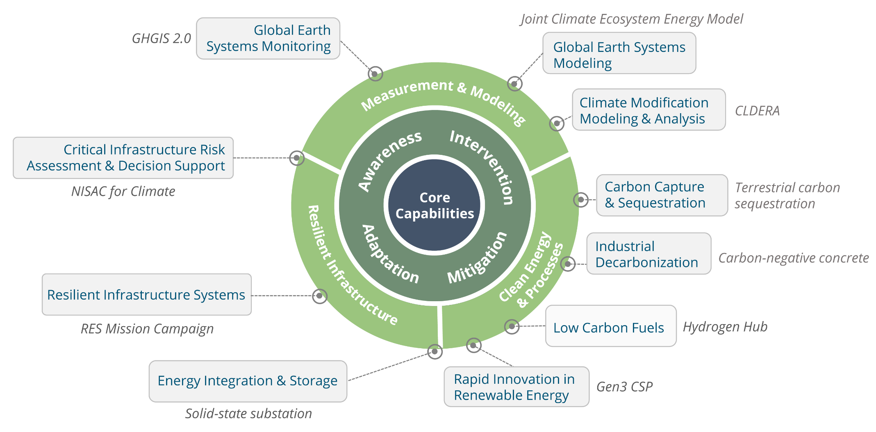
Connection to Sandia Missions & Strategies
CLDERA is aligned with Sandia’s recently-launched climate security strategy, which aims to advance the state-of-the-art in the following key climate capabilities.
Notes:
Climate security strategy included the creation of Climate Change Security Center, 8900
Rob Leland, director of new climate security center, 8900

Slide 12
Outline
Motivation
The CLDERA Grand Challenge LDRD Project
Mt. Pinatubo & Stratospheric Aerosol Injection (SAI)
Energy Exascale Earth System Model (E3SM)
Simulating Mt. Pinatubo using E3SM
The Three CLDERA Thrusts
  Simulated Pathways Thrust
  Observed Pathways Thrust
  Attribution Thrust
Verification & Validation
Some Early Simulation Results
Summary
observed pathways
simulated pathways
attribution
CLDERA
12

Slide 13
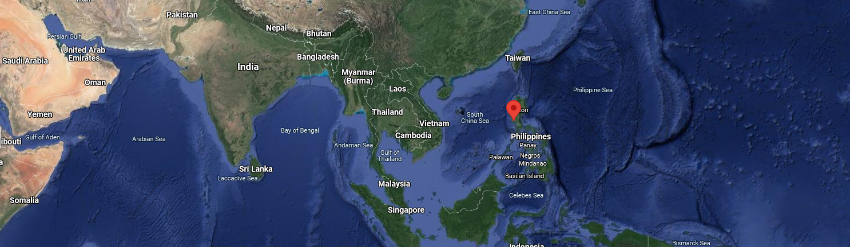
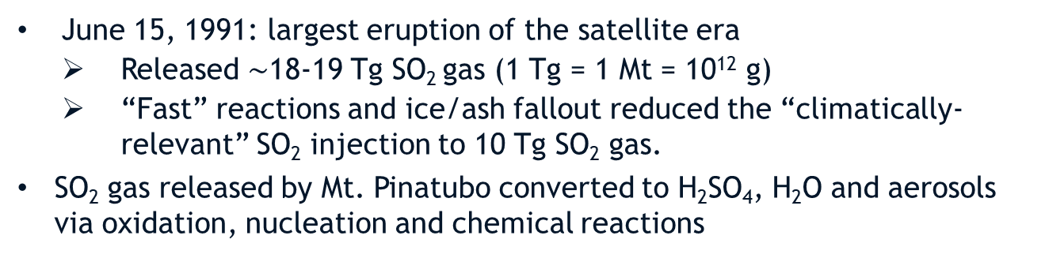
Mt. Pinatubo Eruption
Stratospheric Aerosol Injection (SAI)
CLDERA R&D is be driven using an exemplar of Stratospheric Aerosol Injection (SAI): the 1991 eruption of Mt. Pinatubo.
Mt. Pinatubo before eruption
Philippines: 15.08° N, 120.21° E
Large Eruption (June 12, 1991)
June 15, 1991: largest eruption of the satellite era
Released $\sim$18-19 Tg SO₂ gas (1 Tg = 1 Mt = 10¹² g)
“Fast” reactions and ice/ash fallout reduced the “climatically-relevant” SO₂ injection to 10 Tg SO₂ gas.
SO₂ gas released by Mt. Pinatubo converted to H₂SO₄, H₂O and aerosols via oxidation, nucleation and chemical reactions
Main Eruption (June 15, 1991)

Slide 14
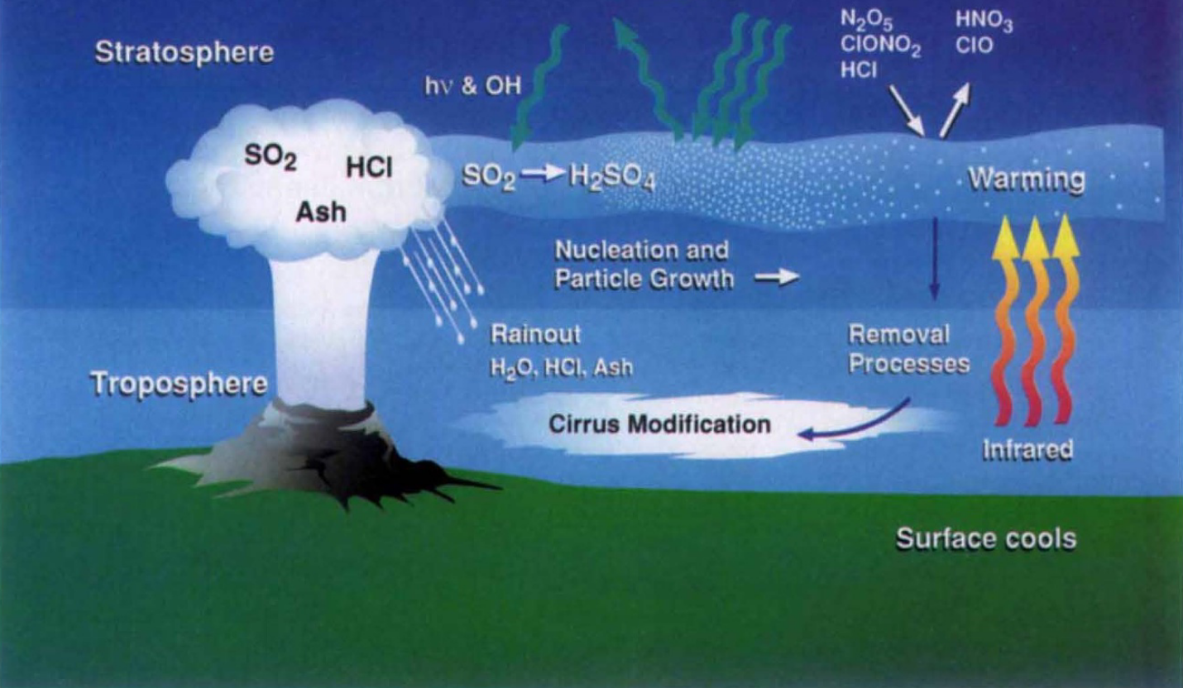
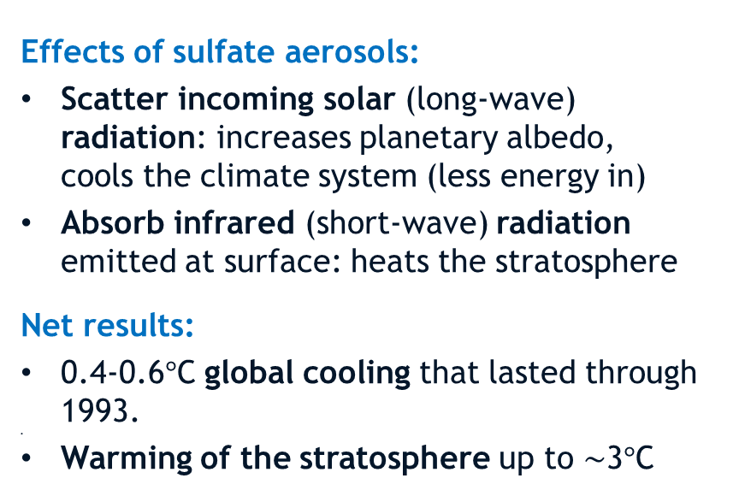
Mt. Pinatubo Eruption
Stratospheric Aerosol Injection (SAI)
Schematic of Immediate Effects post SAI
Effects of sulfate aerosols:
Scatter incoming solar (long-wave) radiation: increases planetary albedo, cools the climate system (less energy in)
Absorb infrared (short-wave) radiation emitted at surface: heats the stratosphere
Net results:
0.4-0.6$°$C global cooling that lasted through 1993.
Warming of the stratosphere up to $\sim$3$°$C
McCormick et al., 1995
Important nodes in pathway: SAI $→$ secondary aerosols (sulfate) $→$ radiation effects $→$ temperature
Notes:
It took 22 days to circle the globe in the tropics

Slide 15
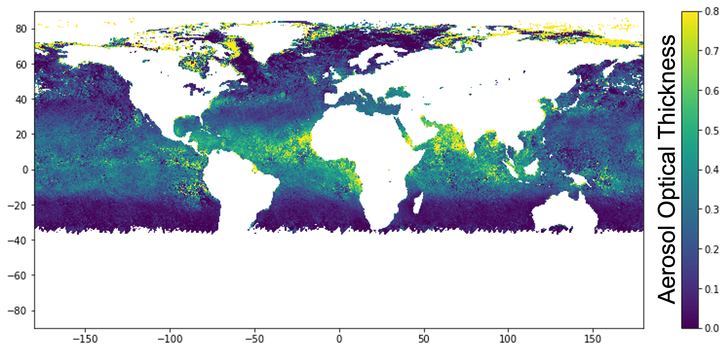
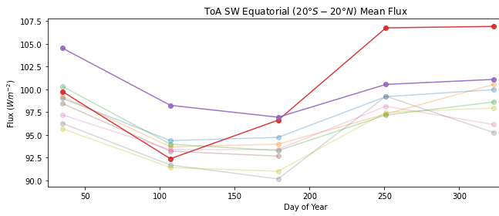
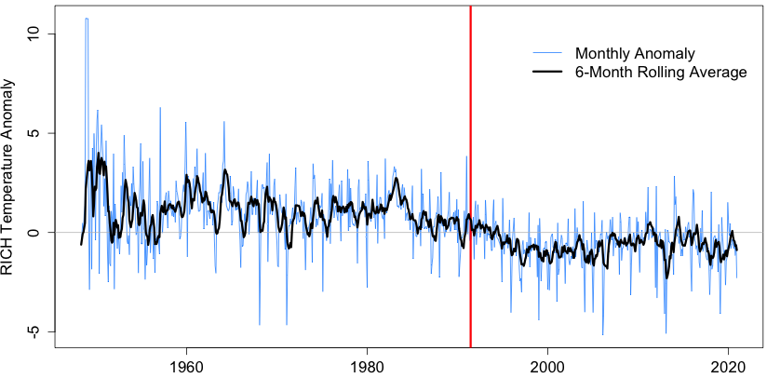

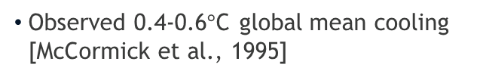
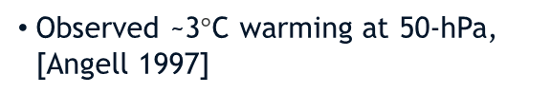
Mt. Pinatubo Eruption
Temperature Impacts
Emission/Aerosol Formation
Aerosol Optical Depth (AOD)*
Change in Radiation Flux
Net shortwave & longwave
Temperature Change
2m and 50hPa
Pinatubo Eruption
1991 SW in red
continuing into 1992
Reduced temperatures lasting several years
Map shows 1.5 months post-eruption
Northern Hemisphere (NH) Winter Warming
Stratosphere
Troposphere
Absorption of terrestrial longwave (LW) and incident solar near-IR radiation by sulfate aerosols
Reduction in solar radiation at surface due to scattering by sulfate aerosols
Water vapor feedback [Soden et al., 2002]
Tropical stratospheric warming intensifies polar vortex and induces a strong positive phase in the NAO
Mechanism
Confounding factors: ozone changes
Confounding factors: ENSO, LW radiation, aerosol indirect effects, climate dynamics
Disputed: natural variability or forced by eruption
Impact
Observed ~3$°$C warming at 50-hPa, [Angell 1997]
Observed 0.4-0.6$°$C global mean cooling [McCormick et al., 1995]
    Warming in NH first winter after tropical eruption [Robock & Mao, 1992]
* Measure of extinction of solar beam by dust/haze (how much direct sunlight prevented from reaching ground by aerosols)

Slide 16
Mt. Pinatubo Eruption
Impact Space & Notional Representation of Pathways
SOURCE
Atmospheric Circulation
IMPACTS
Broader Impact Space
Tropospheric cooling; stratospheric warming; northern-hemisphere winter warming
Increase in planetary albedo
Effects on soil, agriculture, vegetation
Global reduction in precipitation, evaporation, water vapor
Interactions with atmospheric modes of variability (e.g., NAO)
Interactions with coupled modes of variability (e.g., ENSO, AMOC)
Interactions with Asian monsoon
Stratospheric chemistry (e.g., ozone depletion)
Aerosol indirect effects (e.g., cirrus clouds)
Sea level decrease
Other
Source
Event
Air
Temperature
Sea
Level
Dust
Storms
Radiative
Flux
Aerosol
Sedimentation
Sulfate
Aerosol
Production
H₂O
Nuclei
Volcanic
Eruption
Cloud
Brightness
Combustion
Aerosols
Radiation
Diffusivity
Net Primary
Productivity
Other
Source
Event
General Pathway
Aerosol Direct Effect
Aerosol Indirect Effect
Downstream Impacts
Notional Representation of Subset of Physical Processes
Notes:
Aerosol indirect effects: Mt. Pinatubo eruption $→$ sulfate aerosol production $→$ aerosol sedimentation transports aerosols into the troposphere $→$ modification of cloud optical properties $→$ increased cloud brightness/decreased rainfall.
Besides air temperature changes, another downstream impact of Mt. Pinatubo was decreased global sea level, caused by thermal expansion due to lower sea surface temperatures / ocean heat content.
This is because Mt. Pinatubo caused lower sea surface temperatures / ocean heat content that—due to thermal expansion—decreased the global sea level.
We subselected 3 impacts to call our “science questions”
The volcanic stratospheric sulfate aerosols increased the aerosol optical depth by a factor of five over the tropical Pacific in mid-August [15], resulting in a decrease in monthly mean clear-sky total solar irradiance over the first 10 months [21].
The aerosol direct effect, notionally shown in Figure 1 as the red dashed line, is responsible for the scattering of incoming shortwave radiation and absorption of longwave outgoing radiation [14, 20-22], which led to negative forcing observed until mid-1993 [18]. This change in radiative flux caused a 0.6$°$ C global cooling of the lower troposphere [16, 23], but also a warming of the stratosphere where the particles resided [14, 16] (the dark orange dash-dot downstream impact shown in Figure 1).
Further downstream impacts from the eruption of Mt. Pinatubo have been documented to include reductions in precipitation [27] and global mean sea level [28]. These downstream impacts are triggered by the overall cooling resulting in decreased evaporation [28], and lower sea surface temperatures / ocean heat content [29] that—due to thermal expansion—decreased the global sea level [30].
Aerosol indirect effects occur when sulfate aerosols enter the troposphere via stratosphere-troposphere exchange and sedimentation. . Here there are multiple processes by which sulfate aerosols can then affect clouds through the microphysics, MG2 [34],and chemistry parameterizations. Aerosol activation (acting as nuclei for condensation) can affect cloud reflectivity and lifetime [35]. Ice homogenous nucleation (the formation of ice from supercooled liquid) affects cirrus clouds and their forcing with high uncertainty [36].

Slide 17
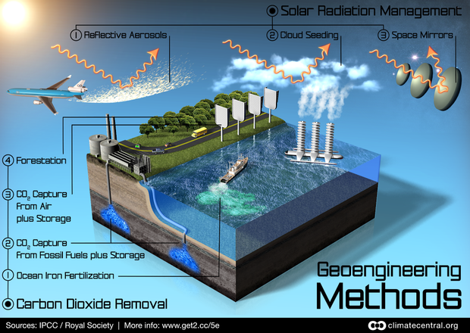
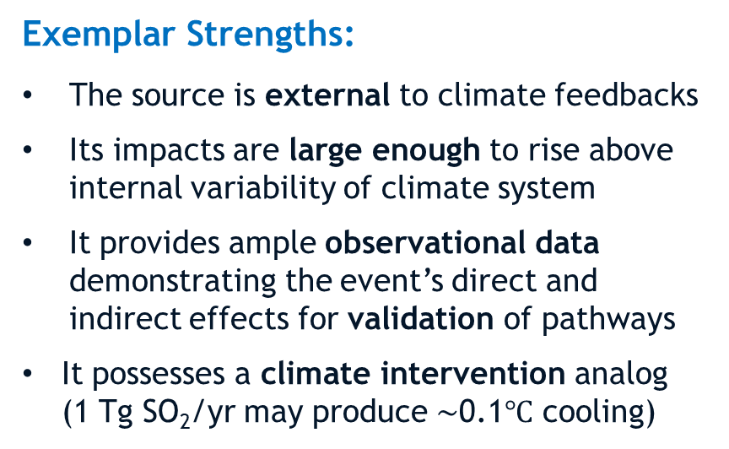
Mt. Pinatubo Eruption
Stratospheric Aerosol Injection (SAI)
SAI as climate intervention
Exemplar Strengths:
The source is external to climate feedbacks
    Its impacts are large enough to rise above internal variability of climate system
    It provides ample observational data demonstrating the event’s direct and indirect effects for validation of pathways
It possesses a climate intervention analog (1 Tg SO₂/yr may produce $\sim$0.1$℃$ cooling)
While impacts of Mt. Pinatubo are well-characterized, no publications have demonstrated concrete pathways connecting >2 processes.
McCormick et al., 1995

Slide 18
Outline
Motivation
The CLDERA Grand Challenge LDRD Project
Mt. Pinatubo & Stratospheric Aerosol Injection (SAI)
Energy Exascale Earth System Model (E3SM)
Simulating Mt. Pinatubo using E3SM
The Three CLDERA Thrusts
  Simulated Pathways Thrust
  Observed Pathways Thrust
  Attribution Thrust
Verification & Validation
Some Early Simulation Results
Summary
observed pathways
simulated pathways
attribution
CLDERA
18

Slide 19


Energy Exascale Earth System Model (E3SM)
Earth System Models (ESMs) are the primary testbed for understanding future climate impacts.
E3SM: U.S. DOE-funded Earth system model.
Collaboration among 8 national labs and 12 academic institutions.
Designed to run on DOE’s advanced computing platforms and address energy-relevant science questions.
Development driven by DOE Office of Science mission interests: energy/water issues looking out 40 years.
CLDERA used E3SM version 2 (v2) obtained through collaboration agreement with the E3SM project to facilitate data and code sharing.
www.e3sm.org, https://github.com/E3SM-Project/E3SM

Slide 20
Outline
Motivation
The CLDERA Grand Challenge LDRD Project
Mt. Pinatubo & Stratospheric Aerosol Injection (SAI)
Energy Exascale Earth System Model (E3SM)
Simulating Mt. Pinatubo using E3SM
The Three CLDERA Thrusts
  Simulated Pathways Thrust
  Observed Pathways Thrust
  Attribution Thrust
Verification & Validation
Some Early Simulation Results
Summary
observed pathways
simulated pathways
attribution
CLDERA
20

Slide 21


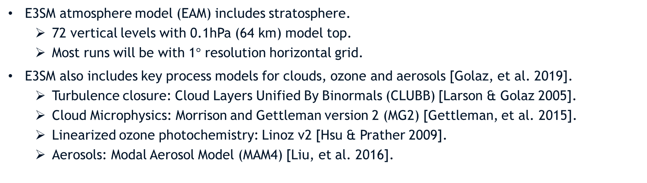
Simulating Mt. Pinatubo in E3SM
Simulation Lead Lead: Kara Peterson (Org. 1442)
Simulating the effects of stratospheric aerosol injection (SAI) is challenging for most climate models and is an active area of research.
E3SMv2 Capabilities:
E3SM atmosphere model (EAM) includes stratosphere.
  72 vertical levels with 0.1hPa (64 km) model top.
  Most runs will be with 1$°$ resolution horizontal grid.
E3SM also includes key process models for clouds, ozone and aerosols [Golaz, et al. 2019].
  Turbulence closure: Cloud Layers Unified By Binormals (CLUBB) [Larson & Golaz 2005].
  Cloud Microphysics: Morrison and Gettleman version 2 (MG2) [Gettleman, et al. 2015].
  Linearized ozone photochemistry: Linoz v2 [Hsu & Prather 2009].
  Aerosols: Modal Aerosol Model (MAM4) [Liu, et al. 2016].
Key Limitation:
Before CLDERA, there were no prognostic volcanic aerosols in E3SM (radiative forcing due to aerosols from volcanic eruptions was prescribed).

Slide 22
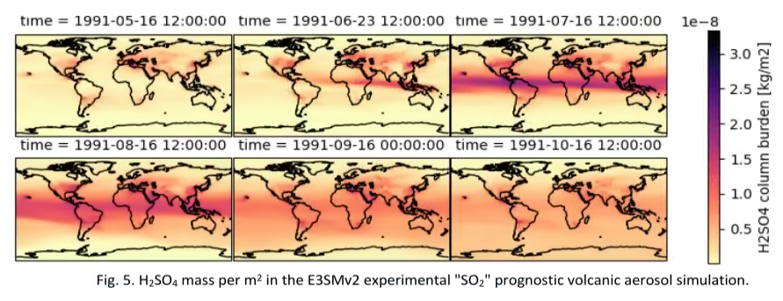
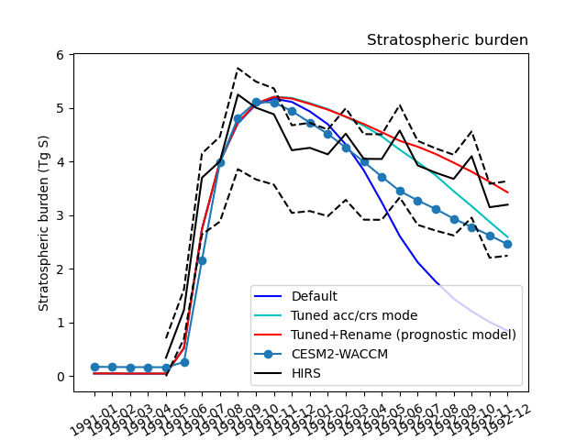
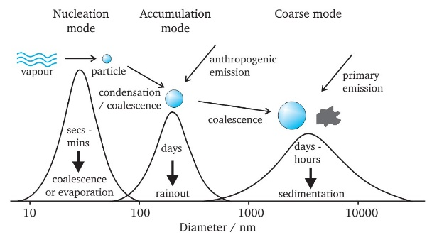
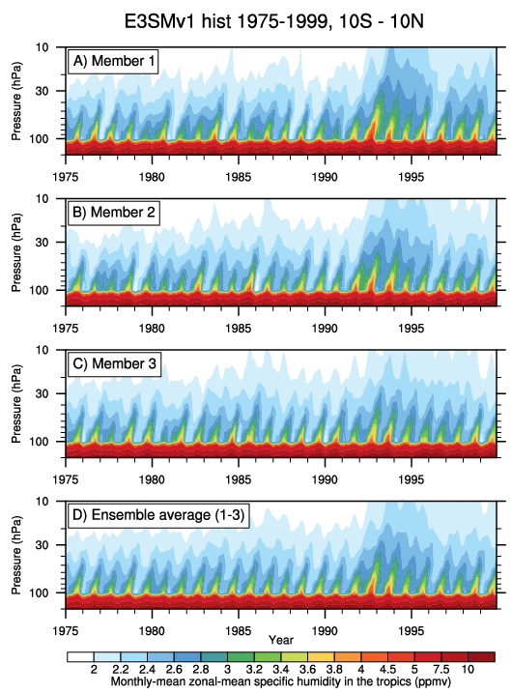
Simulating Mt. Pinatubo in E3SM
Initial modifications made to run E3SM with stratospheric SO₂ injection demonstrated that SO₂ evolves into H₂SO₄ but aerosols sediment out too quickly.
Improved implementation of prognostic volcanic aerosols in E3SMv2 (MAM4)
  Changed aerosol coarse and accumulation mode properties to match stratospheric size distributions
  Validated against High resolution Infrared Radiation Sounder (HIRS) data and CESM/WACCM
Evaluating E3SM simulation capabilities
  Assess Quasi-Biennial Oscillation (QBO) and realism of E3SM’s stratospheric circulation
  Evaluate E3SM’s Brewer Dobson circulation via age-of-air tracers and water vapor tape recorder
Water vapor tape recorder: E3SMv1 CMIP6
Mt. Pinatubo
Team: B. Wagman, H. Brown, X. Liu [TAMU], A. Hu [TAMU], C. Jablonowski [U Michigan], J. Hollowed [U Michigan]
Notes:
Middle plot:
- HIRS observations have ±1.4 Tg uncertainty in H2SO4 background conditions
Our Prognostic Model simulations agree well with HIRS in 1992, tending to overestimate in 1993 (red).
Only modifying size changes (tuning) appears to agree better with HIRS in 1993 (cyan).
However, still need to compare to observations of AOD and aerosol size
QBO: quasiperiodic oscillation of the equatorial zonal wind between easterlies and westerlies in the tropic stratosphere; mean period of 28-29 months
Brewer-Dobson circulation: global atmospheric circulation pattern in tropical tropospheric air rising into the stratosphere and then moving poleward as it descends.
Changes to aerosol coarse and accumulation mode properties to better match aerosol size distributions of volcanic aerosol in stratosphere.
Tuned dust and sea salt emissions to account for reduced coarse mode removal in troposphere
Validated against data from HIRS (High resolution Infrared Radiation Sounder) data and CESM/WACCM
Also evaluating E3SM’s ability to simulate stratospheric circulation and comparing against observed features of the circulation including QBO.

Slide 23

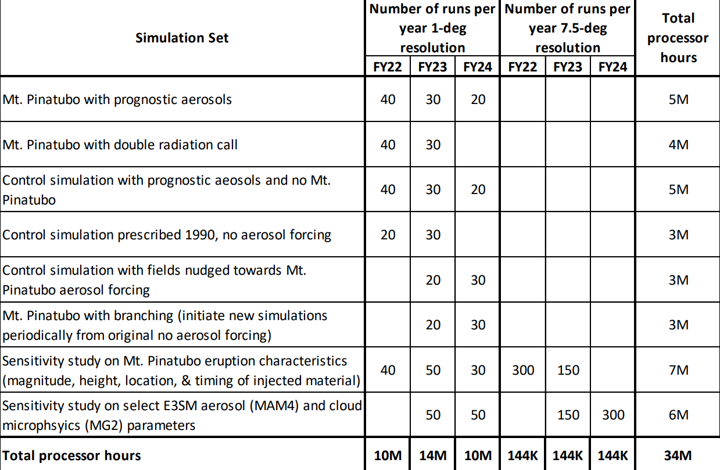
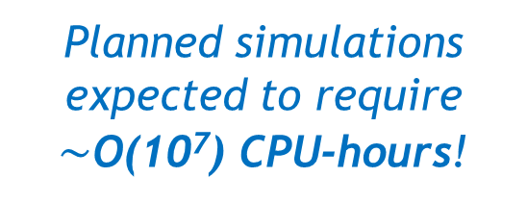
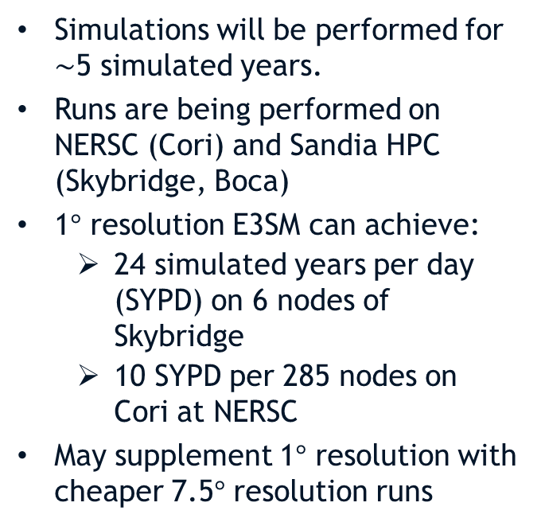
Simulation Plan
Simulations will be performed for $\sim$5 simulated years.
Runs are being performed on NERSC (Cori) and Sandia HPC (Skybridge, Boca)
1$°$ resolution E3SM can achieve:
  24 simulated years per day (SYPD) on 6 nodes of Skybridge
  10 SYPD per 285 nodes on Cori at NERSC
May supplement 1$°$ resolution with cheaper 7.5$°$ resolution runs
Planned simulations expected to require $\sim$O(10⁷) CPU-hours!
Notes:
Mention challenges of knowing in advance what to output and how often.
Boca = condo cluster

Slide 24
Outline
Motivation
The CLDERA Grand Challenge LDRD Project
Mt. Pinatubo & Stratospheric Aerosol Injection (SAI)
Energy Exascale Earth System Model (E3SM)
Simulating Mt. Pinatubo using E3SM
The Three CLDERA Thrusts
  Simulated Pathways Thrust
  Observed Pathways Thrust
  Attribution Thrust
Verification & Validation
Some Early Simulation Results
Summary
observed pathways
simulated pathways
attribution
CLDERA
24

Slide 25

Simulated Pathways Thrust
Finding Impacts from a Source
Thrust Lead: Irina Tezaur (Org. 8734)
Research Composition:
SOURCE
Atmospheric Circulation
IMPACTS
1. Statistical Approaches: use and extend sensitivity analyses and Random Forest Regression to identify and rank physical pathways while establishing susceptibility to initial conditions and E3SM representations
2. Computational Monitoring: instrument E3SM with tracers and profiling capabilities to enable pathway detection; additionally deploy novel simulation strategies to elucidate Mt. Pinatubo impacts on climate
3. Anomaly Detection: define pathways through extensions to existing anomaly detection algorithms in order to spatio-temporally trace anomaly progression
Other
Source
Event
Air
Temperature
Sea
Level
Dust
Storms
Radiative
Flux
Aerosol
Sedimentation
Sulfate
Aerosol
Production
H₂O
Nuclei
Volcanic
Eruption
Cloud
Brightness
Combustion
Aerosols
Radiation
Diffusivity
Net Primary
Productivity
Other
Source
Event
IDENTIFY Driving Pathways
25
25

Slide 26
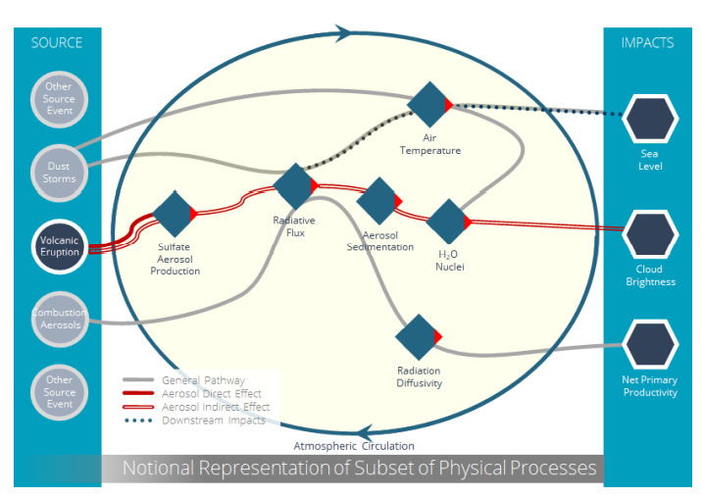
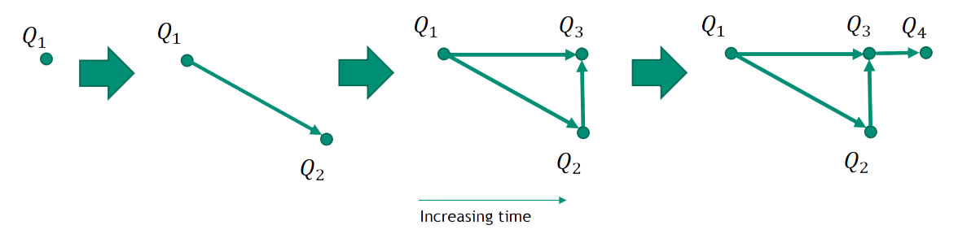
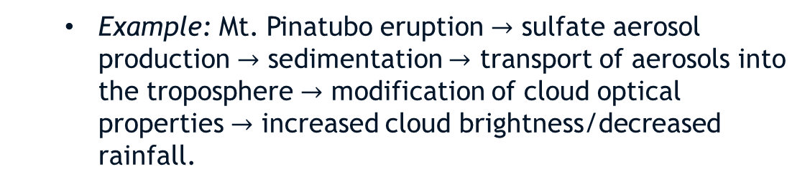
Simulated Pathways Thrust
What is a Simulated Pathway?
Heuristic definition: a pathway is the chain of physical processes from a source to impacts and their evolution in space and time.
  Example: Mt. Pinatubo eruption $→$ sulfate aerosol production $→$ sedimentation $→$ transport of aerosols into the troposphere $→$ modification of cloud optical properties $→$ increased cloud brightness/decreased rainfall.
Mathematical definition: a pathway is a time-dependent directed acyclic graph (DAG) representing the dynamics of a physical system.
Q_{i} = impacts = “nodes” on pathway graph
Edge from Q_{i} to Q_{j} $⇒$ Q_{j} is impacted by Q_{i} at time $t$
26

Slide 27


Simulated Pathways Thrust
Sub-thrusts
Development of the proposed framework for identifying & ranking pathways will be pursued using three complementary research sub-thrusts that fuse Sandia’s strengths in data analytics, computational modeling and E3SM/climate science.
E3SM Simulations
Data
Simulated pathways thrust will generate simulation data for CLDERA.
Methods developed in one sub-thrust will feed into the others.
Multiple sub-thrusts minimize risk.
Identifying same pathway with different methods will provide confidence.
Data
Data
Data
Sub-thrust 2: Computational monitoring
  Random forest regression (RFR)
  (b) Sensitivity analysis
Extract
Info
  Profiling
  Tracing
Sub-thrust 3: Anomaly detection
Sub-thrust 1: Statistical methods
$←$Component feature generation
Data $⟶$

Slide 28

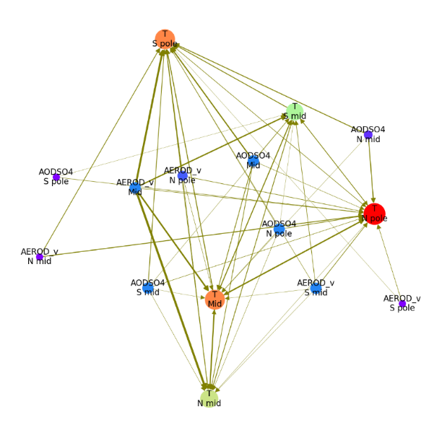
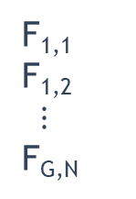
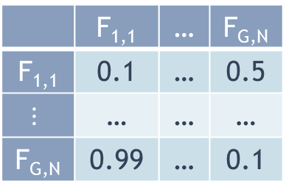
Simulated Pathways Thrust
Statistical Methods
Random forest regression (RFR):
Goal: use feature importances from Random Forests (RFs) to identify weighted pathways from one variable to another
Raw data
Train RF Regressors
Calculate Feature Importances
Create Pathway Graph
 | F_{1,1} | … | F_{G,N}
F_{1,1} | 0.1 | … | 0.5
$$⋮$$ | … | … | …
F_{G,N} | 0.99 | … | 0.1
F_{1,1}
F_{1,2}
$⋮$
F_{G,N}
F_{i,j}
Pruned feature importance graph using latitudinal bands
Inputs: time-series of various features or variables of interest (simulated or observed data)
Output: a list of “single-hop” paths that form a network/graph
  Graph can be queried to see what kinds of paths exist between features and their relative strengths
Thick edge = important feature
Team: M. Peterson, J. Nichol, W. Davis, I. Tezaur
28
Notes:
Let me now dive into each of the sub-thrusts I mentioned a couple slides back, starting with statistical methods.
There are two classes of methods that will be pursued here.
The first is random forest regression or RFR. RFR is a technique for determining feature importance and finding associations in datasets using groups of decision trees trained using available data.
Often RFR is used as a prediction tool, but this is not what we are doing here. Here, the goal is to use feature importances from random forests to identify weighted pathways from one variable or feature, to another. The basic workflow we envision is shown here.
One starts with some raw climate data with N variables or features on a given grid.
The data gets grouped or clustered into G groups and a random forest is trained for each feature and each group.
Next, feature importances are calculated for each feature and group using the random forests.
Based on these feature importances, one can construct a pathways graph, as shown on the right.
By traversing this graph and looking at the relative values of the feature importances, one can identify not only pathways but also pathways strengths.
RFR has several synergies with other parts of the project. There is a synergy with the observational thrust, as RFR is applicable to both simulation as well as observational data. Additionally, there is a synergy with sub-thrust 3, anomaly detection as anomaly detection can help with the grouping part of the workflow, as well as with generating features for RFR.
Finally, I wanted to mention that we are not new to RFR – we have extensive experience with using RFR feature importance under an LDRD project that ended a year ago led by Kara Peterson. We will be leveraging a lot of our experience gained under this project.
RFR = technique for determining feature importance and finding associations in datasets
can extract which input features F_{i,j} contribute the most to output prediction
Determine pathway components strengths
Discover pathways: (i) perform a full pairwise analysis of input features generated by anomaly detection, (ii) ID dominant pairwise connections, (iii) connect them to obtain full pathway
Globe is gridded up in M cells - each cell has a set of N features
Combine cells into G groups, combine features within groups (average or sum)
Some Features may be redundant and need to be combined and/or removed - this could impact feature importance calculations
Splitting the importance across multiple features
Train multiple RFs, one for each feature output
The input is all the other features
G x N total RFRs
Each Feature will have an importance from all the other features
We can identify the potential “strongest” pathways from one feature to another by traversing the graph
The vision here is to extend this approach for the purpose of discovering pathways by using it to perform a full pairwise analysis of input features generated by our anomaly detection thrust, identify dominant pairwise connections and connect them to give a full pathway.

Slide 29

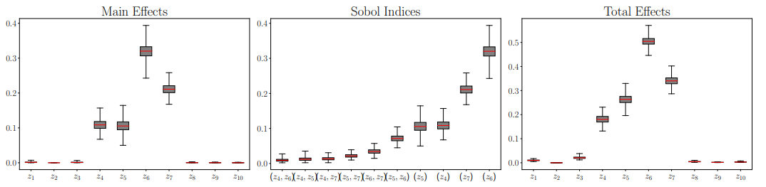
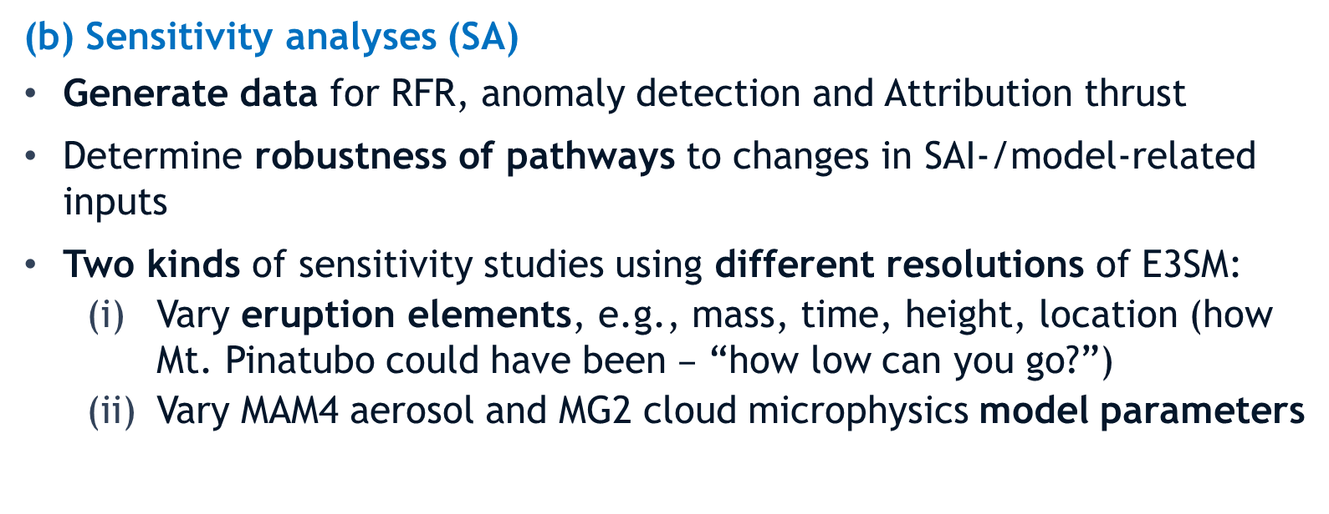
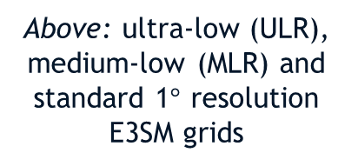
Simulated Pathways Thrust
Statistical Methods
(b) Sensitivity analyses (SA)
Generate data for RFR, anomaly detection and Attribution thrust
Determine robustness of pathways to changes in SAI-/model-related inputs
Two kinds of sensitivity studies using different resolutions of E3SM:
  Vary eruption elements, e.g., mass, time, height, location (how Mt. Pinatubo could have been $–$ “how low can you go?”)
  Vary MAM4 aerosol and MG2 cloud microphysics model parameters
Above: ultra-low (ULR), medium-low (MLR) and standard 1$°$ resolution E3SM grids
Right: global sensitivity analysis (GSA) results for surface temperature QOI using ULR E3SMv1 [Tezaur et al., 2022]
Team: I. Tezaur, K. Peterson, B. Wagman, H. Brown
Notes:
ULR does 20-30 SYPD on 4 nodes of skybridge
ULR is about 100x faster than standard 1-degree resolution
ULR: 7.5-degree atmosphere
MLR: 1.9-degree atmosphere in v2 (ne16)
2.7-degree atmosphere in v1 (ne11)

Slide 30


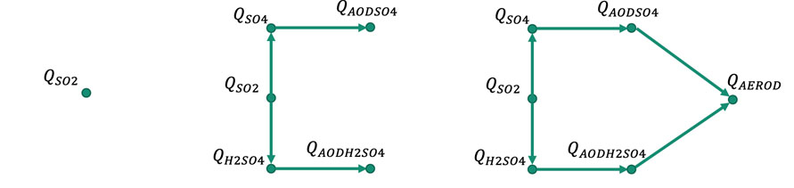
Simulated Pathways Thrust
Computational Monitoring
Profiling: finding pathways in-situ while running E3SM
Goal: instrument E3SM and develop Directed Acyclic Graphs (DAGs) of process interactions executed within code
Control runs (e.g., no Mt. Pinatubo eruption run) generate baseline.
CLDERA-tools performs statistical analysis by comparing QOIs inside code with baseline and tracking propagation of “anomalies” in real time.
Inputs: baseline, “base DAG” (tells E3SM what to track)
Outputs: Time-evolving pathway DAG
Subroutine DAG
E3SM function dependencies
Month 6
Month 7
Months 8-9
Base DAG
Relevant physics dependencies
Pathway DAG
Anomalous dependency chain
CLDERA-tools
In-situ operation
Team: A. Steyer, J. Watkins, L. Bertagna, G. Harper, I. Tezaur
Notes:
Go/no-go: not trying to quantify it – yes/no answer

Slide 31
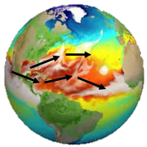
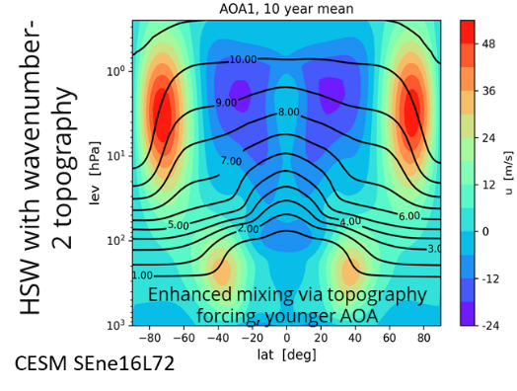
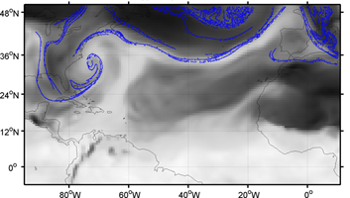
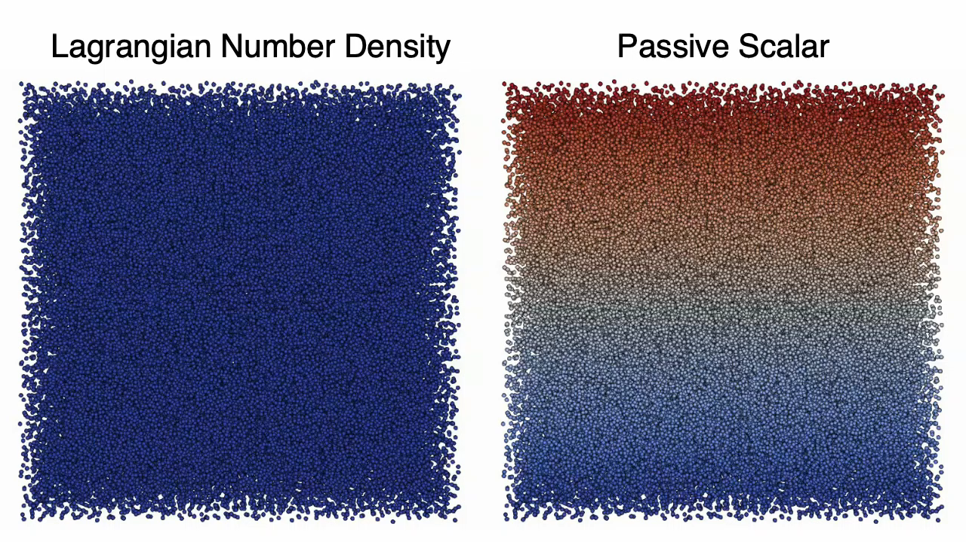
Simulated Pathways Thrust
Computational Monitoring
(b) Tracing: add tracers to E3SM, use them to evaluate E3SM and explore ways to repurpose them to identify source-impact pathways
Tracers
  Passive tracers: do not feedback to the atmosphere, but can track source evolution
    Evaluate climatological dynamics (like “Age of Air”) and changes to those dynamics.
    Infer pathways/pathway changes by detecting tracer flow patterns/evolution using Lagrangian Coherent Structures (LCS): surface trajectories which exponentially attract or repel tracers.
  Active (“tagged”) tracers: feedback into atmosphere through physics processes
    Enable tracking of relative contributions along nodes in pathway.
[Garaboa-Paz et al., 2015]
Team: B. Hillman, A. Steyer, E. Wenzel, B. Wagman, C. Jablonowski [U Michigan], J. Hollowed [U. Michigan], I. Tezaur
Notes:
LCS:
Videos show advective transport of massless Lagrangian particles.
As time advances, passive scalar quantity evolves from an initially simple distribution to a complicated structure characterized by large gradients.
The characteristic feature of this flow field is a dominant LCS. The LCS can be identified by computing the number density of Lagrangian particles.
The particles move with the local Eulerian velocity, and they transport a passive scalar quantity (pure advection, no diffusion). The velocity field is an array of translating vorticies.
Color = dimensionless particle number density (red = high, blue = low).
Simulation run in Everett’s research code, which is incompressible NS (Eulerian grid) + smooth particle hydrodynamics solver (which provides particles)
To do this with an existing code, one would simply need to add particles that move with the local velocity. The number density can then be computed using a variety of procedures.
Enable separation of SO₂ from Mt. Pinatubo vs. regular emissions in a single simulation, toward tracing radiative impact and secondary (downstream) products of eruption
Hunter: debate on how to use active tracers
- Unclear if we will do this – would it give more info than w/ and w/o simulations
Changes in Lagrangian Coherent Structures inform changes in large circulation patters, e.g,. Flow across the equator, changes in polar vortex and impact on NH winter warming
LCS = structures which exponentially attract or repel tracers

Slide 32
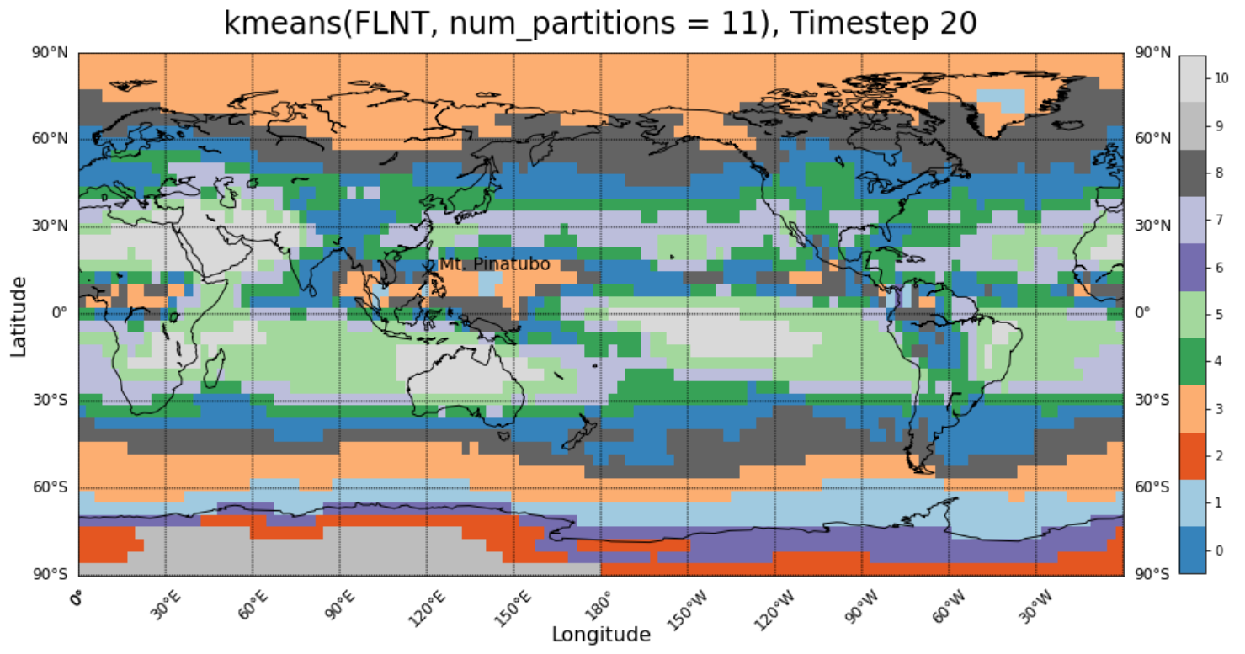
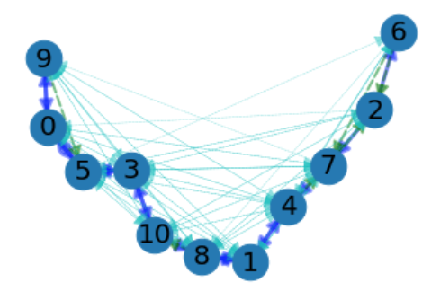
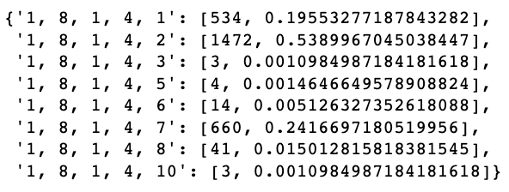
Simulated Pathways Thrust
Anomaly Detection*
Goal: produce clusterings over climate simulations that can serve as foundations of pathway discovery
Approach: combine existing anomaly (event) detection algorithms [Davis et al., 2021] with clustering to enable spatio-temporal anomaly progression, defining pathways
Leverages “In-Situ Machine Learning for Intelligent Data Capture on Exascale Platforms” (ISML) project (PI: W. Davis)
Compressed ISML signatures used for clustering
Clusters used to inform pathway analysis
Tracers
*Finds “interesting” (localized in space or time) events or outliers
Team: W. Davis, M. Carlson, I. Tezaur
Notes:
Anomaly detection: finds “interesting” (localized in space or time) events or outliers
Will be used in this project to also create features for others to use to describe the evolution of the climate system, and identify structure/causality within data
Changepoint detection: separates data into segments, find sudden abrupt changes that persist, not necessarily outliers

Slide 33
Outline
Motivation
The CLDERA Grand Challenge LDRD Project
Mt. Pinatubo & Stratospheric Aerosol Injection (SAI)
Energy Exascale Earth System Model (E3SM)
Simulating Mt. Pinatubo using E3SM
The Three CLDERA Thrusts
  Simulated Pathways Thrust
  Observed Pathways Thrust
  Attribution Thrust
Verification & Validation
Some Early Simulation Results
Summary
observed pathways
simulated pathways
attribution
CLDERA
33

Slide 34

Observed Pathways Thrust
Finding Impacts from a Source
Thrust Lead: Lyndsay Shand (Org. 5573)
Research Composition:
SOURCE
Atmospheric Circulation
IMPACTS
1. Data Fusion: strategically source and fuse relevant data of varying resolutions and fidelities to create a “near-global” picture of the relevant processes
2. Change Point: identify the underlying fundamental shifts in climate processes
3. Space-Time Statistical Methods: adapt Bayesian hierarchical approaches to represent process dependencies and their dynamic spatio-temporal evolution over the first 3-4months post eruption
4. Hybrid Statistical & Deep Learning (DL) Methods: develop hierarchical statistical approaches embedded with DL techniques to trace secondary and tertiary temporally-lagged effects
Other
Source
Event
Air
Temperature
Sea
Level
Dust
Storms
Radiative
Flux
Aerosol
Sedimentation
Aerosol
Optical
Depth
H₂O
Nuclei
Volcanic
Eruption
Cloud
Brightness
Combustion
Aerosols
Radiation
Diffusivity
Net Primary
Productivity
Other
Source
Event
IDENTIFY Driving Pathways
34
Notes:
No slides on data fusion – what is being done there?

Slide 35
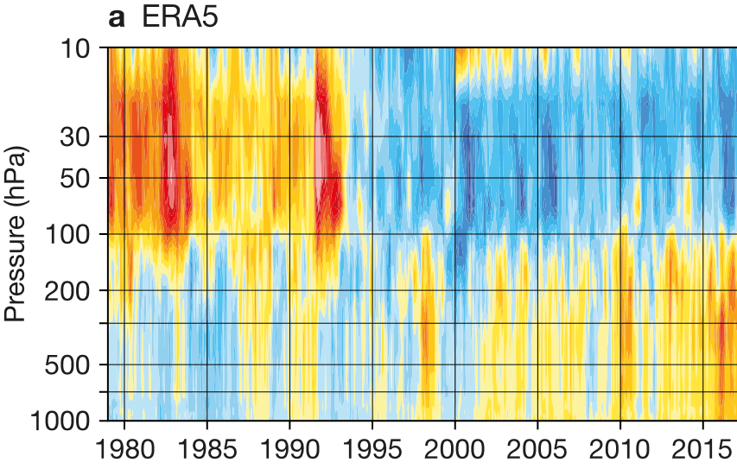
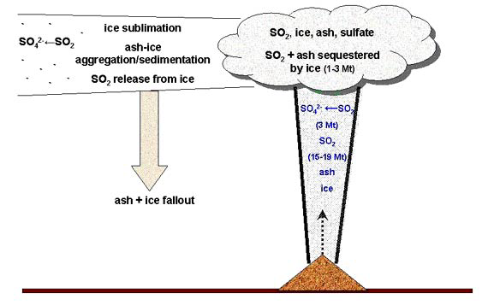
Observed Pathways Thrust
What is an Observed Pathway?
Definition: observed pathways are interpreted as relationships (or correlations) between dependent climate processes (pathway nodes).
Objective: rather than finding pathways that have not been postulated, validate proposed pathways and quantify changes in the relationship between pathway nodes.
Approach: develop statistical methods that can account for the dynamic evolution of aerosols over space and time, multiple complementary sources of data and uncertainty.
SO₂
H₂SO₄
Net Radiative Flux
Temperature Changes
Driving Science Questions:
What are the spatio-temporal signatures of the temp. change due to Mt. Pinatubo?
For how long after can we link sulfates created by Mt Pinatubo to climate effects? When does signal become too noisy or convoluted?
When and where do we first see changes due to the event? How precise can we get with uncertainties?
35

Slide 36
Observed Pathways Thrust
Available Satellite Data for Mt. Pinatubo
Instrument | Satellite | Measurements | Satellite Orbit | Data Collected
Total Ozone Mapping Spectrometer (TOMS) | Nimbus-7 | UV albedo (nadir) | Polar, sun-synchronous | SO₂ mass and ozone (Bluth et al., 1992; McPeters et al., 1992)
Solar Backscatter Ultraviolet Spectral Radiometer (SBUV) | NOAA-11 | UV albedo (nadir) | Polar, sun-synchronous | SO₂ mass and ozone (McPeters et al., 1992)
NOAA Advanced Very High Resolution Radiometer (AVHRR) | NOAA-10, -11, -12 | 4 Vis-IR channels (nadir) | Polar, sun-synchronous | Aerosol optical depth (Stowe et al., 1992; Long and Stowe, 1994), plume height (Lynch and Stephens, 1996), cloud cover (Stowe et al., 1999)
High Resolution Radiation Sounder (HIRS) | NOAA 6-17 | 19 IR channels (nadir) | Polar, sun-synchronous | SO₂ mass and cloud-top height (Miles et al., 2017)
Stratospheric Aerosol and Gas Experiment (SAGE II) | Earth Radiation Budget Satellite (ERBS) | 5 channels, Vis—IR (limb scanning) | Polar | Aerosol optical depth/extinction, aerosol max heights, Ozone (McCormick and Veiga, 1992)
Microwave Sounding Unit (MSU) | NOAA-10,-11,-12 | 4 MW channels (nadir) | Polar, sun-synchronous | Surface-Upper Stratospheric temperature anomalies (Spencer et al., 1990; Dutton and Christy, 1992)
Improved Stratospheric and Mesospheric Sounder (ISAMS) | Upper Atmosphere Research Satellite (UARS) | 8 IR channels (limb scanning) | Near-Polar | Aerosol extinction, mass, and height (Lamberte et al., 1993)
Microwave Limb Sounder (MLS) | UARS | 4 MW channels (limb scanning) | Near-Polar | SO₂ mass and temperature profiles (Read et al., 1993)
36

Slide 37


Observed Pathways Thrust
Available Reanalysis Data for Mt. Pinatubo
What is reanalysis data?
Blend of observations with past short-range weather/climate forecasts rerun with modern weather/climate forecasting models.
Generated using data assimilation techniques.
Provides the most complete picture of past weather and climate.
Available reanalysis data for Mt. Pinatubo eruption:
ERA-5 reanalysis
  1979-present
  Observations from various satellites, radiosonde data and surface observations
  Model input is from ECMWF (European Centre for Medium-Range Weather Forecasts) forecast model, which takes into account forcing from total solar irradiance, GHGs, ozone and some aerosols.
MERRA-2 reanalysis
  1979-present
  Uses similar observations to ERA-5
  Model input is from NASA Goddard Earth Observing System (GEOS) model
https://climate.copernicus.eu/climate-reanalysis
37

Slide 38
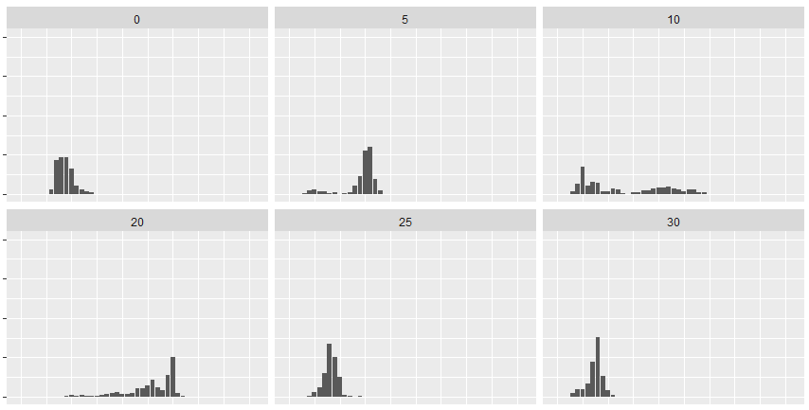
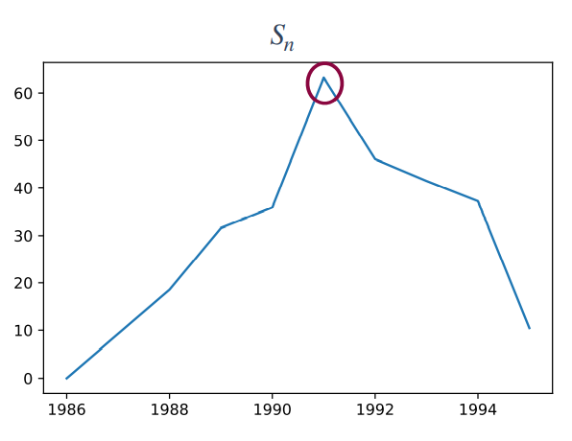
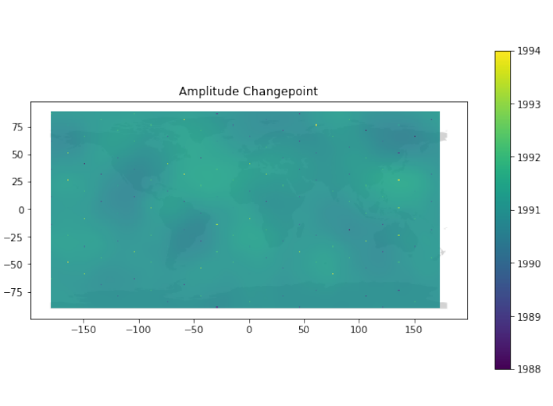
Observed Pathways Thrust
Changepoint Detection*
* Significant persistent shift in underlying mean or variance of a process (not just an outlier)
Goal: inform pathways by finding significant changes/shifts in climate processes, towards accounting for them in statistical models.
Space-time methods: can detect when and where climate shifts have occurred w.r.t. source.
Elastic Functional Warping Methods [Tucker et al., 2019]: use diffeomorphisms/elastic distance to isolate amplitude and phase shifts not due to expected weather patterns.
Posterior distribution of estimated spatially-varying changepoints for 6 different locations (using synthetic data)
Phase shift (left) and amplitude (right) changepoints identified in ERA-5 Reanalysis Data (1986-1995). Phase shift changepoint and majority of amplitude changepoints are in 1991.
Team: D. Tucker, L. Shand, B. Li [UIUC], S. Jun [UIUC]
38
Notes:
Goal: inform pathways, by identifying regions in inference solutions to evaluate further
Anomaly detection: Finds “interesting” (localized in space or time) events or outliers
Elastic changepoint: uses elastic distance, concept of diffeomorphisms – gives measure of bending/stretching to align spatial data at time 0 and N
Derek’s results – amplitude shift:
Looked a grid of locations (100x100)
Computed changepoint at each location
Interpolated estimated changepoint across entire globe
Most changepoints around 1991, with a few points at 1989
Space-time changepoint methods can detect when and where climate shifts are observed.
Developed novel framework dependent on distance from event.
Tested on synthetic data

Slide 39
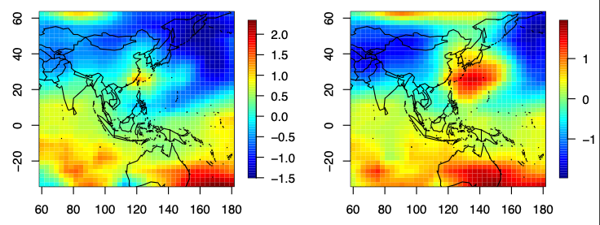
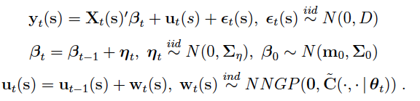
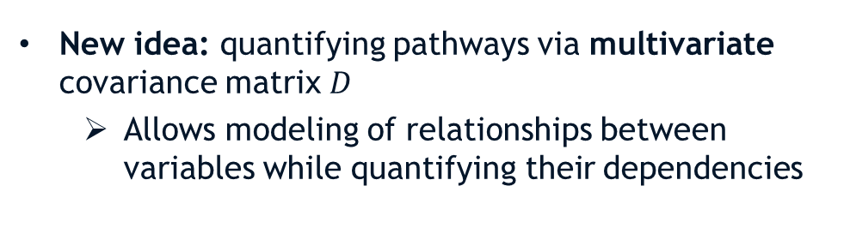


Observed Pathways Thrust
Space-Time Statistical Methods
June 1991 – March 1992
Stratosphere
$$σ^{2}$$
Goal: quantify the spatio-temporal evolution of aerosols and climate impacts with interpretable approaches.
Dynamic spatio-temporal models: intuitive and interpretable ways to represent complex, dependent physical processes that change across space and time simultaneously.
Surface
$$σ^{2}$$
June 1991
July 1991
New idea: quantifying pathways via multivariate covariance matrix $D$
  Allows modeling of relationships between variables while quantifying their dependencies
Time-varying variance parameter estimates with red line representing time of event (top) and estimated spatial dynamic components (bottom) of the dynamic model applied to stratospheric temps.
Team: K. Goode, B. Hillman, G. Huerta, J. Li, L. Shand
39
Notes:
- Dynamic stace-time models are also known as state-space or Kalman filter models
Baseline trends (e.g., seasonal, ENSO effects) can be captured in X_t(s)’beta_t and u_t
- \epsilon_t(s) and w_t(s) capture measurement error and spatial variability, respectively
theta_t allows for temporally varying spatial distn. of dynamic parameters.
We expect effects from Pinatubo to be captured in our dynamical params/processes
- Implementation of [Finley et al., 2012] to reanalysis temperatures at multiple pressure levels reveal evidence of Mt. Pinatubo impact.
- Estimating/fitting of models typically done with some form of Bayesian computation, requires priors.
- How can we use dynamic model to interpret the changes due to a changepoint? Which parameters/processes capture the changepoint?
Spacetime dynamic models
Dynamic models can flexibly account for the nonlinear space-time patterns of climate data.
Developed univariate dynamic modeling workflow

Slide 40



Observed Pathways Thrust
Hybrid Statistical and Deep Learning (DL) Methods
Goals:
Understand trends in observation data using interpretable/explainable methods
Test if data supports postulated pathways
Quadratic ESN Residuals: need for increased spatial fidelity to correctly account for high latitude temperatures
Echo-State Networks (ESNs)
Use reservoir computing to efficiently estimate recurrent neural networks (RNNs), which can capture short-term/long-term spatio-temporal dependence
Data stage $Z_{t}≈ Φα_{t}+δ_{t}(s)$, $δ_{t}\left(s\right)=$spatio-temporal residual
Output stage $α_{t}=V_{1}h_{t}+V_{2}h_{t}^{2}+η_{t}, { η}_{t}\sim N\left(0,σ_{η}^{2}I\right)$
Hidden stage $h_{t}=g_{h}\left(\frac{v}{\left|λ_{W}\right|}Wh_{t−1}+U{\tilde{x}}_{t}\right)$
PFI: identifying how ESNs make use of historical temperatures by investigating influence of lagged temperature on forecast temperatures
RNN
Permutation Feature Importance (PFI)
Determines which variables at which times are important for forecasting.
Novel method to increase explainability of ESNs.
Team: K. Goode, B. Hillman, G. Huerta, J. Li, L. Shand
40
Notes:
RNN = output + hidden stages
- All parameters in ESN are learned from data.
- adding spatio-temporal residual accounts for regional spatial trends not captured by temperature or AOD effects and makes the model more explainable
The choice to add a spatial residual came from the existence of spatial correlation in the model residuals after some initial data fittings.
RNNs are used to estimate the quadratic parameters at the 2nd level of the model used to model the EOF coefficients.
Z_t = temperature
Phi = EOF
Alpha_t = ESN
Xtilde_t = lagged temperature
Delta_t(s) = spatial temporal residual -> makes network explainable; spatial residual is interpretable (accounts for regional spatial trends not captured by temperature or AOD effects).
Echo-State Network (ESN) – developed work flow and
ESNs are efficient networks that have been shown to be capable of representing dependent processes on different time scales.
Developed workflow for ESNs applied to univariate data
Tested sensitivities on synthetic data
Adding interpretability through spatially dependent parameters
The concept of reservoir computing stems from the use of recursive connections within neural networks to create a complex dynamical system
Permutation Feature Importance (PFI)
PFI is intended to make black-box ESNs explainable but has never been applied to deep networks.
Developed workflow for PFI applied to ESNs

Slide 41
Outline
Motivation
The CLDERA Grand Challenge LDRD Project
Mt. Pinatubo & Stratospheric Aerosol Injection (SAI)
Energy Exascale Earth System Model (E3SM)
Simulating Mt. Pinatubo using E3SM
The Three CLDERA Thrusts
  Simulated Pathways Thrust
  Observed Pathways Thrust
  Attribution Thrust
Verification & Validation
Some Early Simulation Results
Summary
observed pathways
simulated pathways
attribution
CLDERA
41

Slide 42

Attribution
Finding Predominant Source Driving Impact
Thrust Lead: Laura Swiler (Org. 1400)
Research Composition
SOURCE
Atmospheric Circulation
IMPACTS
1. Enhanced Fingerprinting: use pathway information to expand multi-variate analyses, sharpening the signal-to-noise ratios and enabling significant correlations between source-impact
2. Inverse Optimization: develop deep operator neural networks (DONNs) to model parts of E3SM to enable PDE-constrained optimization without intrusion into the E3SM code directly; pathways will act as penalty terms or constraints
3. Causal Modeling: ID causal relationships and dominant pathways by developing causal networks through iterative independence tests and the resulting directed acyclic graphs
Other
Source
Event
Air
Temperature
Sea
Level
Dust
Storms
Radiative
Flux
Aerosol
Sedimentation
Sulfate
Aerosol
Production
H₂O
Nuclei
Volcanic
Eruption
Cloud
Brightness
Combustion
Aerosols
Radiation
Diffusivity
Net Primary
Productivity
Other
Source
Event
What precipitates the impact?
42

Slide 43



Attribution
Enhanced Fingerprinting
“Fingerprint” = a spatial and/or temporal pattern that highlights an impact
  Commonly the first principal component or empirical orthogonal function (EOF) from an SVD of a data matrix
Detection involves identifying if the signal projected back onto the EOF goes out of 2𝜎 limits.
Attribution involves examining the magnitude of the fingerprint in a regression formulation and checking its significance (Signal/Noise ratio).
Enhanced Fingerprinting Approach:
  Multivariate fingerprints
  Use multiple variables along a pathway in the fingerprint
  Use pathway info to refine fingerprints for use within a short-term SAI event with a more regional impact (fingerprints typically used over long-time period data to detect changes decadal means).
Traditional Fingerprint – Detection of Pinatubo
Temperature Anomalies
Attribution of Temperature Anomaly to Pinatubo. Signal/Noise ratio > 10
Signal/Noise Ratio
Leverages [Wagman et al. 2021]
Team: B. Wagman, K. Chowdhary, L. Swiler, K. Marvel [Columbia]
Notes:
Detection = the process of demonstrating that climate has changed in some defined statistical sense w/o providing a reason for that change.
Attribution = the process of evaluating the relative contributions of multiple causal factors to a change or impact with an assignment of statistical confidence
-> calculate the slope of the fingerprint beta from initial time (1900) to various times
-> calculate uncertainty in the slope and the signal/noise ratio beta/sigma
-> smaller uncertainty => larger signal to noise ratio given same slope
Beta = slope of fingerprint
Sigma(beta) = std. dev. of trend (noise), calculated from long piControl run (1000 years).
S/N ratio = beta / sigma -> assume to be normally distributed; assess probability
For a multivariate fingerprint, the plan is to normalize multiple variables and simply concatenate the data into one larger matrix over which we would perform the SVD. An example of this is shown with reference height temperature and net short wave flux on slide 8 of the attached.
Fingerprinting: Establish we can reproduce SoA analysis. Establish workflow.
Developed workflow and applied to both the detection of a change in temperature (lat, lon average over a month & detrended per pressure level) (EOF represents data at every pressure level, the projection of the data onto the EOF gives the amplitudes as a time series. BLUE line represents the data projected onto the first EOF (first principal component) from the singular value decomposition of the data

Slide 44








Attribution
Inverse Optimization
Gaussian Plume+: Advection-Diffusion-Reaction with Gaussian Plume Source
Goal: identify magnitude, height and location of the source is a large-scale, PDE constrained inverse problem
(test case for initial prototyping)
Find source parameters $θ$ that minimize the difference between simulated and observed aerosol concentration s.t. atmosphere PDEs as constraints:
$$\min_{θ}{J\left(θ\right)= \sum_{i=1}^{n}{\sum_{j=1}^{m}{[{c\text{obs}\left(x_{j},t_{i}\right)−c\text{sim}(x_{j},t_{i},θ)]}^{2}+R(θ)}}}$$
$$\min_{θ }J\left(θ\right)= \sum_{i=1}^{n}{\int_{Ω}{\left[c_{obs}\left(x,t_{i}\right)−c_{sim}\left(x,t_{i},θ\right)\right]2}dx}$$
s.t. $\frac{∂ρ}{∂t}=−∇∙\left(ρv\right)$
$\frac{∂v}{∂t}=−\frac{1}{ρ}∇p−g+F−2Cv$
$$⋮$$
Approximated by DONNs
Core idea: develop deep operator neural networks (DONNs) to model parts of E3SM to enable PDE-constrained optimization without intrusion into the E3SM code directly.
Add pathway information as penalty terms in the objective and/or additional constraints.
Team: J. Hart, M. Gulian, I. Manickam, L. Swiler
Notes:
Goal: estimate SO2 source given downrange concentration measurements
Use PCA to create a reduced operator
Use TensorFlow to approximate this operator via a NN trained on time-step pairs
Use ROL to perform optimization with NN-based constraints.
Inverse Optimization – develop the software interfaces, establish verification, and test viability of deep-operator neural networks.
Working to train a surrogate operator on gaussian plume + data
Neural network construction for the operator proved more challenging than anticipated due to strong advection properties of the example
Using ideas from ResNet (Residual neural network), plus weighting of information from early times, to improve the training process. We now have pipeline established to do hyperparameter studies to help find an “optimal” neural network to model the evolution operator.
Establishing that ROL is working
Irina’s notes:
Inverse problem to estimate SO2 source given downrange concentration msrts.
Test operator regression surrogates within inverse problem
Connect Tensorflow models with ROL
Use optimization tools to facilitate sampling of Bayesian posterior

Slide 45



Attribution
Causal Modeling
Preliminary Causal Network Results on Mt. Pinatubo Simulation Data with Prognostic Aerosols
Goal: establish relationships between a set of variables to discover or confirm a causal relationship
Causal Network Learning Approach:
    Fit a graphical model of covariates by iterative conditional independence tests.
    PCMCI algorithm: Peter Clark Momentary Conditional Independence [Runge, 2019]
    Allows for and detects contemporaneous dependencies.
Tropical SO₂ causes Tropical H₂SO₄ (over a 1 and 3 month lag)
Tropical SO₂ causes a change in aerosol optical depth (AEROD)
Tropical AEROD shows a negative contemporaneous dependence with global surface radiation flux.
Nonlinear attractor
$X^{i}=$ variables/features
Team: J. Nichol, M. Smith, L. Swiler
Notes:
Causal modeling takes in large-scale time series data and discovers a causal network, represented by a graph like the one on the right. This network can account for both linear and nonlinear dependencies in the data, as well as time lags. The nodes in the graph are important variables or features identified in creating the causal network., and you can see that the network graph is directed, so you can infer causality.
Structural causal modeling: involves positing a causal relationship or causal model and confirming / refuting it.
What we are doing is more data-driven causal discorvery

Slide 46
Outline
Motivation
The CLDERA Grand Challenge LDRD Project
Mt. Pinatubo & Stratospheric Aerosol Injection (SAI)
Energy Exascale Earth System Model (E3SM)
Simulating Mt. Pinatubo using E3SM
The Three CLDERA Thrusts
  Simulated Pathways Thrust
  Observed Pathways Thrust
  Attribution Thrust
Verification & Validation
Some Early Simulation Results
Summary
observed pathways
simulated pathways
attribution
CLDERA
46

Slide 47




Tiered Verification Approach
Test Sensitivity of Method
FY22
Prove Usefulness of Method
FY23/FY24
Method form informed by Real Data
Refine Method Formulation
Apply to Synthetic Cases
Apply to Mt. Pinatubo
Sensitivity Analyses
Refine Method Formulation
Apply to idealized cases
Refine Method Formulation
Establish Viability of Method
FY23
Synthetic
Idealized
Pinatubo Pathways
Coupled ODEs devoid of governing physics that enable exploration of tool/method sensitivities
Gaussian Plume+
Basic physics (advection-diffusion-reaction), reduced dimensionality, reduced coupling
HSW++
Realistic Earth circulation, idealized forcings/ topography/chemistry, controllable relationships
Full complexity of Earth’s climate $–$ verify method solution against known pathways
HSW = Held Suarez Williamson [Williamson et al., 1998]

Slide 48

Mt. Pinatubo Validation
Aerosol Direct Effect
Temp changes
Decreased Precipitation & GMSL
Aerosol Indirect Effect
An identified pathway will be considered “correct” if it contains as “nodes” most of the known aerosol direct, indirect and downstream effects from Mt. Pinatubo eruption
Easy
Pathway Identification
Hard
SOURCE
Atmospheric Circulation
IMPACTS
Other
Source
Event
Air
Temperature
Sea
Level
Validation requires assessments of SAI-related processes in E3SM
  Conservation checks
  STE processes in E3SM (figure below)
  E3SM’s climatic response to Pinatubo
  Compare E3SM’s circulation to reanalysis products (ERA-5)
  Idealized tracer transport experiments
Dust
Storms
Radiative
Flux
Aerosol
Sedimentation
Sulfate
Aerosol
Production
H₂O
Nuclei
Volcanic
Eruption
Cloud
Brightness
Combustion
Aerosols
Radiation
Diffusivity
Net Primary
Productivity
Other
Source
Event
General Pathway
Aerosol Direct Effect
Aerosol Indirect Effect
Downstream Impacts
Notional Representation of Subset of Physical Processes
Above: enhanced H₂0 vapor in 1992-93 (“tropical tape recorder”, CMIP6 E3SMv1 coupled historical simulations)
48
Notes:
There are a lot of observational data we can validate against.
Using different approaches to find pathways will provide confidence in them
- Assess E3SM’s STE processes (e.g., tropical tape recorder)
- Evaluate E3SM’s climatic response to Pinatubo
Tropical tape recorder in water vapor
For assessing E3SM’s troposphere-stratosphere exchange processes
Major moisture source for stratosphere
An effect in which a seasonal cycle in the mixing ratio of a gas is imposed on air entering the stratosphere and is then transported upwards by the Brewer-Dobson circulation

Slide 49
Outline
Motivation
The CLDERA Grand Challenge LDRD Project
Mt. Pinatubo & Stratospheric Aerosol Injection (SAI)
Energy Exascale Earth System Model (E3SM)
Simulating Mt. Pinatubo using E3SM
The Three CLDERA Thrusts
  Simulated Pathways Thrust
  Observed Pathways Thrust
  Attribution Thrust
Verification & Validation
Some Early Simulation Results
Summary
observed pathways
simulated pathways
attribution
CLDERA
49

Slide 50


Some Early Simulation Results
Default E3SMv2
CLDERA-E3SM
CLDERA-E3SM prognostic model tuned to better represent stratospheric aerosol lifetime and evolution, and agrees better with observations (red curve in figure above).
Movie above: stratospheric sulfate burden from Mt. Pinatubo eruption for default E3SMv2 (left) and CLDERA-E3SM simulation with tuned aerosols (right) 1 month before $→$30 months after Mt. Pinatubo eruption.
Notes:
Burden = total mass over some area
Sulfate burden = burden of sulfur from sulfate (neglecting mass of oxygen and hydrogen) (note that this is column burden, so only over each grid cell)
Total global burden = over entire earth
Plots show comparison of two different E3SMv2 simulations, both of which are using explicit volcanic emission files for SO2 (as opposed to the standard prescribed volcanic forcing).
The left is the default E3SMv2 simulation and the right is our prognostic model tuned to better represent stratospheric aerosol lifetime and evolution.
Differences b/w two simulations are due to our tunings, which are largely driven by increased aerosol lifetime in the stratosphere. With this increase in strat aerosol lifetime, our model agrees better with observations (see red line in plot right)
Default model tends to have a narrower band of aerosol early after the eruption associated with the high SO2 concentrations and more rapid aerosol deposition in this model.
CLDERA model shows a wider band of sulfate in the stratosphere that remains at higher concentrations than the default model as it concentrates over the North Pole.
Overall, this increased lifetime will impact the radiative impact of volcanic eruptions, increasing the time over which they are affecting the earth radiative balance.
Figure top right:
For the prognostic model, we had to tune the default aerosol size mode properties as well as adjust the mass and number “renaming” in the code. “Renaming” is just a non-intuitive way of referring to how the model transfers number and mass between modes and represents aerosol growth.
So, the cyan curve is step one on the way to a full prognostic model that only tunes aerosol size modes, and the red curve is the final prognostic model with tuning+renaming. Does that clear it up?
Changes to aerosol coarse and accumulation mode properties to better match aerosol size distributions of volcanic aerosol in stratosphere.
Tuned dust and sea salt emissions to account for reduced coarse mode removal in troposphere
Validated against data from HIRS (High resolution Infrared Radiation Sounder) data and CESM/WACCM

Slide 51
Outline
Motivation
The CLDERA Grand Challenge LDRD Project
Mt. Pinatubo & Stratospheric Aerosol Injection (SAI)
Energy Exascale Earth System Model (E3SM)
Simulating Mt. Pinatubo using E3SM
The Three CLDERA Thrusts
  Simulated Pathways Thrust
  Observed Pathways Thrust
  Attribution Thrust
Verification & Validation
Some Early Simulation Results
Summary
observed pathways
simulated pathways
attribution
CLDERA
51

Slide 52


Summary of CLDERA
Simulated Pathways
Observed Pathways
SOURCE FORCINGS IN THE CLIMATE
IMPACTS ARISING FROM SOURCES
Attribution

Slide 53

CLDERA Team
CLDERA Leadership Team
L. Bertagna (1446)
H. Brown (8917)
M. Carlson (8734)
W. Davis (1441)
G. Harper (1442)
B. Houchens (8921)
A. Hu (8913)
J. Lien (8913)
D. Krofchek (5522)
J. Nichol (1441)
M. Peterson (1441)
A. Steyer (1442)
J. Watkins (8734)
E. Wenzel (8751)
C. Jablonowski (U Michigan)
J. Hollowed (U Michigan)
X. Liu (TAMU)
CLDERA PI: D. Bull (8917)
CLDERA Deputy PI: K. Peterson (1442)
Simulated Pathways Lead: I. Tezaur (8734)
Observed Pathways Lead: L. Shand (5573)
Attribution Lead: L. Swiler (1400)
K. Goode (5573)
J. Hickey (5573)
B. Hillman (8917)
G. Huerta (5573)
J. Li (5553)
K. McClernon (5574)
D. Ries (5574)
D. Tucker (5573)
A. McCombs (5574)
B. Li (UIUC)
S. Jun (UIUC)
M. Gulian (8734)
J. Hart (1441)
I. Manickam (5555)
K. Maupin (1463)
M. Smith (5493)
B. Wagman (8917)
K. Marvel (Columbia U)
Thank you for your attention!

Slide 54
References
Caldwell, P., et al., Statistical significance of climate sensitivity predictors obtained by data mining. Geophysical Research Letters, 2014. 41.
Finley, Andrew, Banerjee, Sudipto,Gelfand, Alan. (2012). Bayesian Dynamic Modeling for Large Space–Time Datasets Using Gaussian Predictive Processes. Journal of Geographical Systems. 14. 29-47.
Golaz, J.-C., et al., The DOE E3SM Coupled Model Version 1: Overview and Evaluation at Standard Resolution. Journal of Advances in Modeling Earth Systems, 2019. 11(7): p. 2089-2129.
Goode, K., Ries, D., and Zollweg, J. “Explaining Neural Networks with Functional Data Using PCA and Feature Importance”. AAAI 2020 Fall Symposium on AI in the Government and Public Sector. November 13-14, 2020. https://arxiv.org/abs/2010.12063.
Hall, A. et al., Progressing emergent constraints on future climate change. Nature Climate Change, 2019. 9, p 269-278.
Hasselmann, K., Multi-pattern fingerprint method for detection and attribution of climate change. Climate Dynamics, 1997. 13(9): p. 601-611.
Hegerl, G.C. and G.R. North, Comparison of Statistically Optimal Approaches to Detecting Anthropogenic Climate Change. Journal of Climate, 1997. 10(5): p. 1125-1133.
Kravitz, B., et al., First Simulations of Designing Stratospheric Sulfate Aerosol Geoengineering to Meet Multiple Simultaneous Climate Objectives. Journal of Geophysical Research: Atmospheres, 2017. 122(23): p. 12,616-12,634.
Marvel, K., M. Biasutti, and C. Bonfils, Fingerprints of external forcings on Sahel rainfall: aerosols, greenhouse gases, and model-observation discrepancies. Environmental Research Letters, 2020: p. Medium: ED; Size: Article No. 084023.
McDermott, Patrick & Wikle, Christopher. (2018). Deep echo state networks with uncertainty quantification for spatio‐temporal forecasting. Environmetrics. 30. 10.1002/env.2553.
National Academies of Sciences Engineering Medicine (NASEM), Reflecting Sunlight: Recommendations for Solar Geoengineering Research and Research Governance. 2021, Washington, DC: The National Academies Press. 328.
Nowack, P., et al., Causal networks for climate model evaluation and constrained projections. Nature Communications, 2020. 11(1): p. 1415.
Runge, J., et al., Inferring causation from time series in Earth system sciences. Nature Communications 2019. 10(1).
Tezaur, I., et al., Global sensitivity analysis of ultra-low resolution E3SM. Submitted to JAMES, 2022.
Wagman, B. M., L. P. Swiler, K. Chowdhary, B. Hillman. “The Fingerprints of Stratospheric Aerosol Injection in E3SM.” LDRD project 224535 final report, Sept. 2021.
Williamson, MS et al., Emergent constraints on climate sensitivities. Reviews of Modern Physics, 2021. 93 (2)
54

Slide 55
Start of Backup Slides
55

Slide 56




Attribution in Climate
CLDERA
How do rising concentrations of GHGs in the atmosphere affect climate state variables?
What are the relative contributions of different sectors, activities, and entities to concentrations of GHGs in the atmosphere?
How do changes in the global climate system affect the relative frequency and severity of extreme events?
What are the downstream impacts from large, spatio-temporally localized sources within the climate?
What is the question?
What is the
source?
Long-term, slowly accumulating GHG emissions
Changes to global climate system
Geographically and temporally localized source forcings in the climate
Sector-specific emissions
Examples
WG1 and WG2 IPCC reports
Cement industry, transportation
Likelihood of Hurricane Katrina
Volcanic eruptions, wildfires
Is the attribution direct/ quantitative?
WG1- yes (temp/precip/…)
WG2 – normally no, notional linkage
yes, linked through multiple process-nodes
yes
no, notional connection
The goal of CLDERA is to develop new tools to enable downstream impact attribution from geographically and temporally localized source forcings in the climate.
56

Slide 57











Connection to Sandia Capabilities & Other Applications
Multi-component Sensor Systems
Inverse Optimization
Information Sciences
Bio-Security
Cyber-Security
Multi-Physics Modeling
Uncertainty Quantification
Computational Science
Regulatory
Frameworks
Analysis of Extremes
“Always/ Never” Ethos
Modeling & Simulation
Detection & Attribution
Risk Analysis & High-Reliability Engineering
Dual-Nature National Security Issues
CLDERA-Critical Capabilities
Bioscience
Materials Science
Engineering Science
Earth Science
Nanodevices & Microsystems
Computing & Information Science
Radiation, Electrical, & High Energy Density Science
Foundational Research that Enables Climate Work
57
Notes:
Under CLDERA, we will be leveraging tools and methods developed previously under a variety of different investment areas (e.g., E3SM, optimization libraries such as ROL, regulatory frameworks such as the Waste Isolation Pilot Plant or WIPP). We will also be creating new tools and capabilities that can be relevant for other applications beyond climate science. These include tools for multi-physics modeling, tools for dimension reduction / ML, tools for uncertainty quantification and inversion, tools for fusing observational data,
Can you help establish concrete examples of our heritage in:
Computational science: (e3sm comp lead)
Uncertainty quantification
Multi-physics modeling
Multi-component sensor systems – USNDS / IMS treaty verification --weapons
All source fusing of observations -- information sciences /
Systems approach & engineering
Regulatory frameworks – WIPP
Analysis of extremes --
Always / never ethos.

Slide 58



Observed Pathways Thrust
Data Fusion
Aerosol optical thickness (AOT) at 0.63 micron derived from NOAA PATMOS-x AVHRR (0.1 x 0.1 degree spatial grid collected daily) before (Jan. 1- Jun. 14, 1991) and after (Jun. 15-Dec.31, 1991) eruption.
Global monthly mean AOT from January 1991 to January 1992
Mt Pinatubo Eruption
Goal: develop/deploy sensor-level data fusion techniques to leverage high-dimensional data from at least 8 different sources.
[Ma and Kang, 2019] proposes a Dynamic Fused Gaussian Process (DFGP) methodology to combine multiple datasets from different satellite instruments.
[Nychka et al., 2015] combines Multi-resolution Gaussian Process Model and Geometric Mean Fold Rise (GMRF) approaches.
58

Slide 59




Synthetic Test Case Formulation
Two Variable Changepoint Exemplar
Tiered Datasets, four formulations across
  Temporal trends
  Temporal trends on spatial grid
  Temporal trend on linearly-trended spatial grid
Characteristics
  Distinct numbers of couplings with both linear and nonlinear relationships
  Distinct lags
  Quasi-periodicity
  Noise degree
  Change in mean value
Temporal Trend
Temporal Trend in Space
Spatio-Temporal Trend
Linearly-trended Spatial Grid

Slide 60






Idealized Test Case Formulations
PDE solution: based on transient convection-diffusion-reaction PDE in 2D.
Input: variable winds, reaction functions for chemistry, realistic lifetimes, and variable source magnitudes/durations
Gaussian Plume Plus
Create realistic circulation with E3SM’s dynamic solver using idealizations for process physics/forcings
  Radiation: Newtonian temperature relaxation towards T_{eq}
  Planetary boundary layer: Rayleigh friction & optional topography
Mimic Mt. Pinatubo eruption via a prescribed, time-limited injection of an SO₂ and ash Gaussian plume
Develop series of correlated tracers for ‘toy’ chemistry, develop temperature/radiation feedbacks in plume, …
Held-Suarez Williamson ++
Notes:
Upper four plots show Plume plus model over time. X axis is x-direction, Y-axis is vertical direction (Z or height).
HSW:
- Replace complex physics package with simpler processes
- Optional topography

