Slide 1
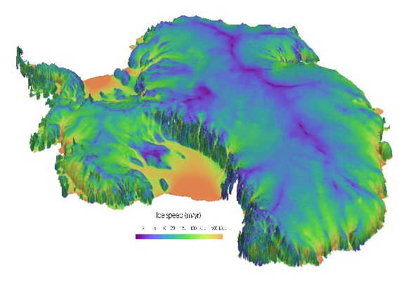
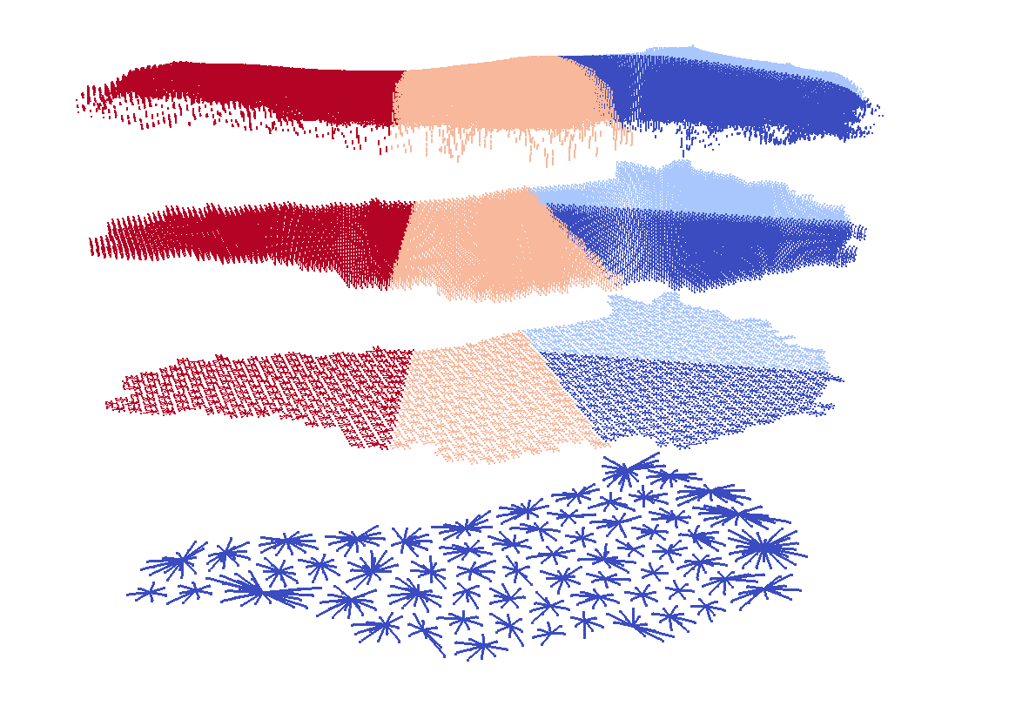

Large-scale Deterministic Inversion and Bayesian Calibration in Land-Ice Modeling
I. Tezaur¹, J. Jakeman¹, M. Eldred¹, M. Perego¹, S. Price², A. Salinger¹
¹ Sandia National Laboratories, Albuquerque, NM and Livermore, CA, USA.
² Los Alamos National Laboratory, Los Alamos, NM, USA.
USNCCM 2017 Montreal, Quebec July 17-20, 2017
Sandia National Laboratories is a multi-mission laboratory managed and operated by National Technology and Engineering Solutions of Sandia, LLC., a wholly owned subsidiary of Honeywell International, Inc., for the U.S. Department of Energy’s National Nuclear Security Administration under contract DE-NA0003525.
SAND2017-6948C

Slide 2
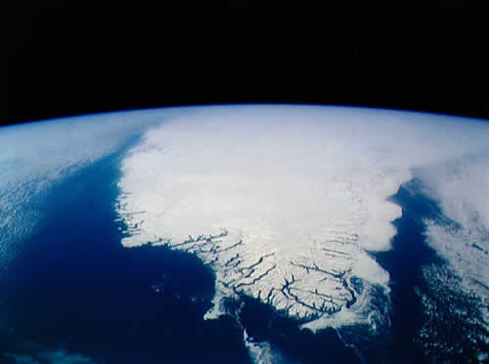
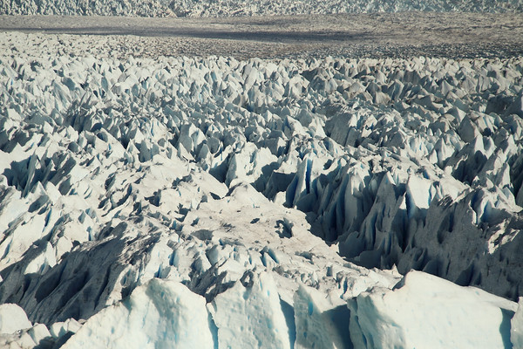
Outline
Background.
  PISCEES project for land-ice modeling.
  Land-ice model.
UQ problem definition.
Inversion/calibration.
  Deterministic inversion.
  Bayesian inference.
Summary & future work.

Slide 3
Outline
Background.
  PISCEES project for land-ice modeling.
  Land-ice model.
UQ problem definition.
Inversion/calibration.
  Deterministic inversion.
  Bayesian inference.
Summary & future work.

Slide 4

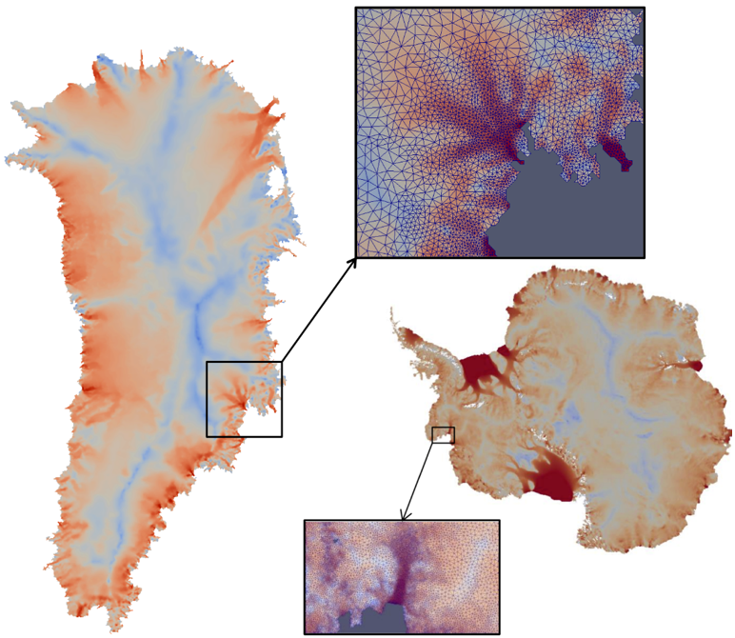

PISCEES Project for Land-Ice Modeling
  “PISCEES” = Predicting Ice Sheet Climate Evolution at Extreme Scales
  5 year SciDAC3 project began in June 2012; proposal for 5 year continuation project submitted to SciDAC4 call.
  Sandia’s Role in the PISCEES Project: to develop and support a robust and scalable land ice solver based on the “First-Order” (FO) Stokes equations $→$Albany/FELIX*
Requirements for Albany/FELIX:
  Unstructured grid finite elements.
  Scalable, fast and robust.
  Verified and validated.
  Portable to new architecture machines.
  Advanced analysis capabilities: deterministic inversion, calibration, uncertainty quantification.
As part of ACME DOE Earth System Model, solver will provide actionable predictions of 21st century sea-level change (including uncertainty bounds).
*Finite Elements for Land Ice eXperiments

Slide 5
PISCEES Project for Land-Ice Modeling
  “PISCEES” = Predicting Ice Sheet Climate Evolution at Extreme Scales
  5 year SciDAC3 project began in June 2012; proposal for 5 year continuation project submitted to SciDAC4 call.
  Sandia’s Role in the PISCEES Project: to develop and support a robust and scalable land ice solver based on the “First-Order” (FO) Stokes equations $→$Albany/FELIX*
Requirements for Albany/FELIX:
  Unstructured grid finite elements.
  Scalable, fast and robust.
  Verified and validated.
  Portable to new architecture machines.
  Advanced analysis capabilities: deterministic inversion, calibration, uncertainty quantification.
This talk
As part of ACME DOE Earth System Model, solver will provide actionable predictions of 21st century sea-level change (including uncertainty bounds).
*Finite Elements for Land Ice eXperiments

Slide 6
Outline
Background.
  PISCEES project for land-ice modeling.
  Land-ice model.
UQ problem definition.
Inversion/calibration.
  Deterministic inversion.
  Bayesian inference.
Summary & future work.

Slide 7
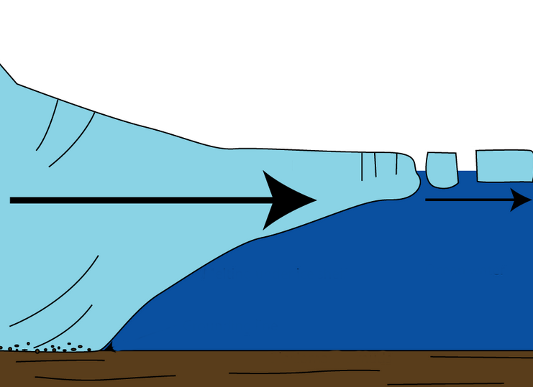
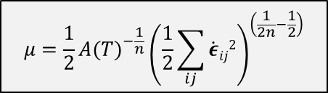

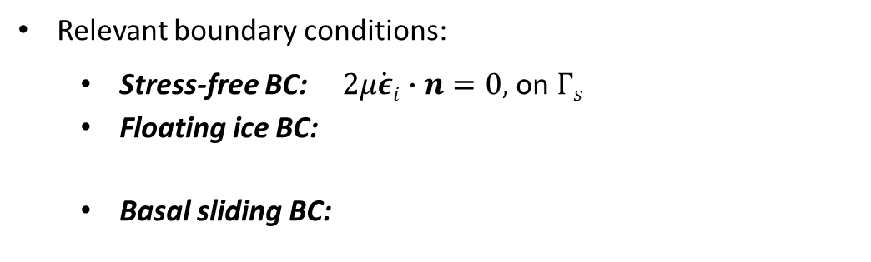
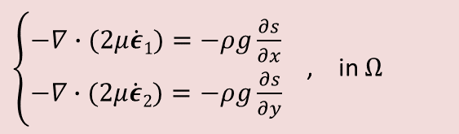




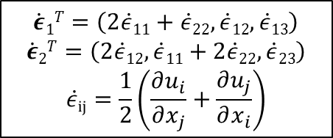

The First-Order Stokes Model
Ice behaves like a very viscous shear-thinning fluid (similar to lava flow).
Quasi-static model with momentum balance given by “First-Order” Stokes PDEs: “nice” elliptic approximation* to Stokes’ flow equations.
$$\dot{ε}1T=\left(2\dot{ε}11+\dot{ε}22,\dot{ε}12,\dot{ε}13\right)$$
$$\dot{ε}2T=\left(2\dot{ε}12, \dot{ε}11+2\dot{ε}22,\dot{ε}23\right)$$
$$\dot{ε}ij=\frac{1}{2}\left(\frac{∂u_{i}}{∂x_{j}}+\frac{∂u_{j}}{∂x_{i}}\right)$$
$\left\{\begin{aligned}−∇∙(2μ\dot{ε}1)=−ρg\frac{∂s}{∂x} \\ −∇∙(2μ\dot{ε}2)=−ρg\frac{∂s}{∂y}\end{aligned}\right.$ , in $Ω$
Viscosity $μ$ is nonlinear function given by “Glen’s law”:
  Surface boundary $Γs$
$$μ=\frac{1}{2}{{A(T)}^{−\frac{1}{n}}\left(\frac{1}{2}\sum_{ij}{\dot{ε}ij2}\right)}^{\left(\frac{1}{2n}−\frac{1}{2}\right)}$$
$$(n=3)$$
Ice sheet
Albany/FELIX
Relevant boundary conditions:
  Stress-free BC: $2μ\dot{ε}i∙n=0,$ on $Γs$
  Floating ice BC:
  Basal sliding BC:
Lateral boundary $Γl$
  $2μ\dot{ε}i∙n$ = $\left\{\begin{aligned}ρgzn\text{, }\text{if} z>0 \\ 0, if z≤0\end{aligned}, \right.on Γl$
  Basal boundary $Γβ$
)
  $2μ\dot{ε}i∙n+β(x,y)u_{i}=0$, on $Γβ$
*Assumption: aspect ratio $δ$is small and normals to upper/lower surfaces are almost vertical.

Slide 8
The First-Order Stokes Model
Ice behaves like a very viscous shear-thinning fluid (similar to lava flow).
Quasi-static model with momentum balance given by “First-Order” Stokes PDEs: “nice” elliptic approximation* to Stokes’ flow equations.
$$\dot{ε}1T=\left(2\dot{ε}11+\dot{ε}22,\dot{ε}12,\dot{ε}13\right)$$
$$\dot{ε}2T=\left(2\dot{ε}12, \dot{ε}11+2\dot{ε}22,\dot{ε}23\right)$$
$$\dot{ε}ij=\frac{1}{2}\left(\frac{∂u_{i}}{∂x_{j}}+\frac{∂u_{j}}{∂x_{i}}\right)$$
$\left\{\begin{aligned}−∇∙(2μ\dot{ε}1)=−ρg\frac{∂s}{∂x} \\ −∇∙(2μ\dot{ε}2)=−ρg\frac{∂s}{∂y}\end{aligned}\right.$ , in $Ω$
Viscosity $μ$ is nonlinear function given by “Glen’s law”:
  Surface boundary $Γs$
$$μ=\frac{1}{2}{{A(T)}^{−\frac{1}{n}}\left(\frac{1}{2}\sum_{ij}{\dot{ε}ij2}\right)}^{\left(\frac{1}{2n}−\frac{1}{2}\right)}$$
$$(n=3)$$
Ice sheet
Albany/FELIX
Relevant boundary conditions:
  Stress-free BC: $2μ\dot{ε}i∙n=0,$ on $Γs$
  Floating ice BC:
  Basal sliding BC:
Lateral boundary $Γl$
  $2μ\dot{ε}i∙n$ = $\left\{\begin{aligned}ρgzn\text{, }\text{if} z>0 \\ 0, if z≤0\end{aligned}, \right.on Γl$
  Basal boundary $Γβ$
)
  $2μ\dot{ε}i∙n+β(x,y)u_{i}=0$, on $Γβ$
*Assumption: aspect ratio $δ$is small and normals to upper/lower surfaces are almost vertical.

Slide 9
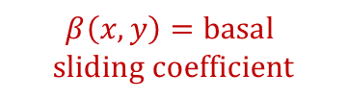

The First-Order Stokes Model
Ice behaves like a very viscous shear-thinning fluid (similar to lava flow).
Quasi-static model with momentum balance given by “First-Order” Stokes PDEs: “nice” elliptic approximation* to Stokes’ flow equations.
$$\dot{ε}1T=\left(2\dot{ε}11+\dot{ε}22,\dot{ε}12,\dot{ε}13\right)$$
$$\dot{ε}2T=\left(2\dot{ε}12, \dot{ε}11+2\dot{ε}22,\dot{ε}23\right)$$
$$\dot{ε}ij=\frac{1}{2}\left(\frac{∂u_{i}}{∂x_{j}}+\frac{∂u_{j}}{∂x_{i}}\right)$$
$\left\{\begin{aligned}−∇∙(2μ\dot{ε}1)=−ρg\frac{∂s}{∂x} \\ −∇∙(2μ\dot{ε}2)=−ρg\frac{∂s}{∂y}\end{aligned}\right.$ , in $Ω$
Viscosity $μ$ is nonlinear function given by “Glen’s law”:
  Surface boundary $Γs$
$$μ=\frac{1}{2}{{A(T)}^{−\frac{1}{n}}\left(\frac{1}{2}\sum_{ij}{\dot{ε}ij2}\right)}^{\left(\frac{1}{2n}−\frac{1}{2}\right)}$$
$$(n=3)$$
Ice sheet
Albany/FELIX
Relevant boundary conditions:
  Stress-free BC: $2μ\dot{ε}i∙n=0,$ on $Γs$
  Floating ice BC:
  Basal sliding BC:
Lateral boundary $Γl$
  $2μ\dot{ε}i∙n$ = $\left\{\begin{aligned}ρgzn\text{, }\text{if} z>0 \\ 0, if z≤0\end{aligned}, \right.on Γl$
  Basal boundary $Γβ$
)
$$β\left(x,y\right)=basal$$
$$sliding coefficient$$
  $2μ\dot{ε}i∙n+β(x,y)u_{i}=0$, on $Γβ$
*Assumption: aspect ratio $δ$is small and normals to upper/lower surfaces are almost vertical.

Slide 10
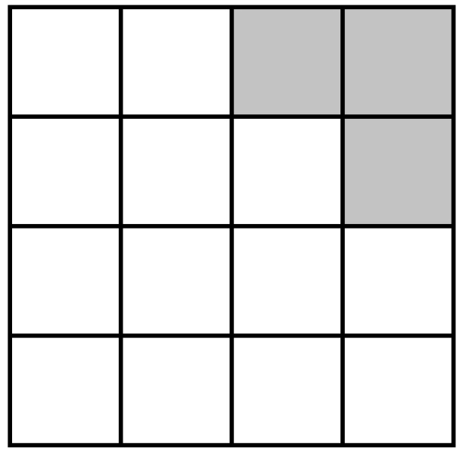
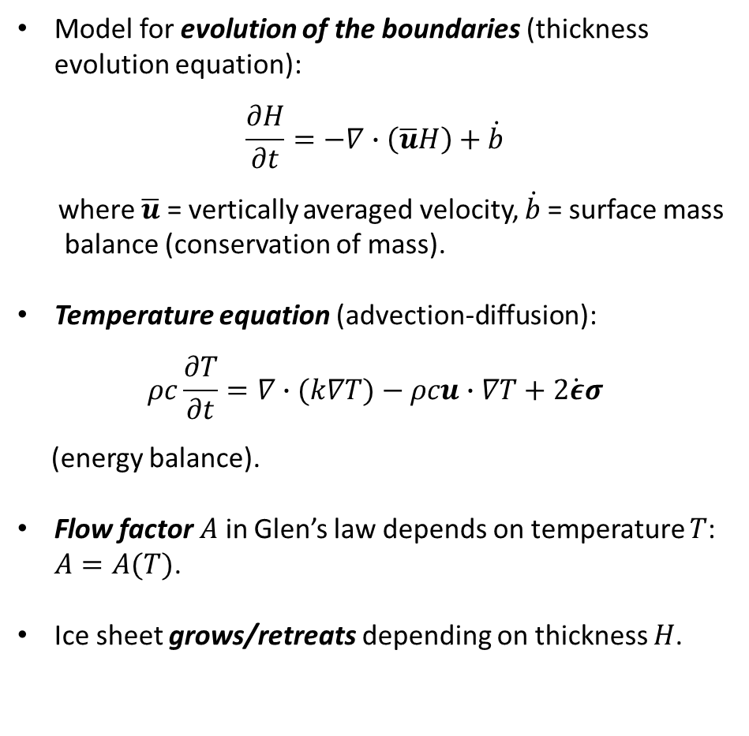
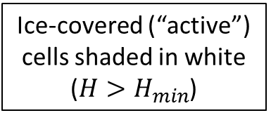
Thickness & Temperature Equations
Model for evolution of the boundaries (thickness evolution equation):
$$\frac{∂H}{∂t}=−∇∙\left(\overline{u}H\right)+\dot{b}$$
where $\overline{u}$ = vertically averaged velocity, $\dot{b}$= surface mass
balance (conservation of mass).
Temperature equation (advection-diffusion):
$$ρc\frac{∂T}{∂t}=∇∙(k∇T)−ρcu∙∇T+2\dot{ε}σ$$
(energy balance).
Flow factor $A$ in Glen’s law depends on temperature $T$: $A=A(T)$.
Ice sheet grows/retreats depending on thickness $H$.
Ice-covered (“active”) cells shaded in white
($H>H_{min}$)

Slide 11
Outline
Background.
  PISCEES project for land-ice modeling.
  Land-ice model.
UQ problem definition.
Inversion/calibration.
  Deterministic inversion.
  Bayesian inference.
Summary & future work.

Slide 12
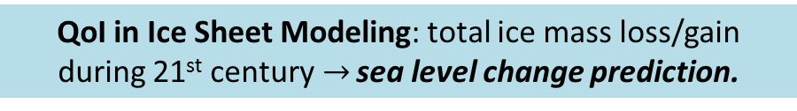
Uncertainty Quantification Problem Definition
QoI in Ice Sheet Modeling: total ice mass loss/gain during 21st century$→$ sea level change prediction.

Slide 13

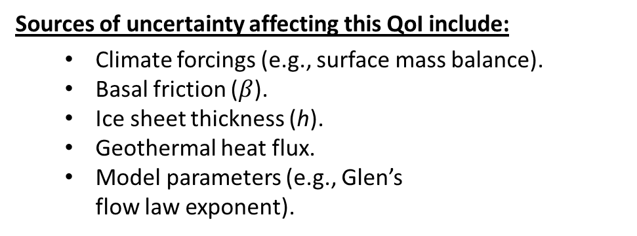

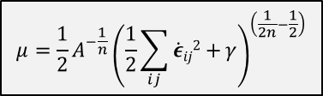

Uncertainty Quantification Problem Definition
QoI in Ice Sheet Modeling: total ice mass loss/gain during 21st century$→$ sea level change prediction.
Sources of uncertainty affecting this QoI include:
  Climate forcings (e.g., surface mass balance).
  Basal friction ($β$).
  Ice sheet thickness (h).
  Geothermal heat flux.
  Model parameters (e.g., Glen’s flow law exponent).
$$μ=\frac{1}{2}{A^{−\frac{1}{n}}\left(\frac{1}{2}\sum_{ij}{\dot{ε}ij2+}γ\right)}^{\left(\frac{1}{2n}−\frac{1}{2}\right)}$$
$n$ = Glen’s law exponent
thickness
(h)
Ice sheet
  Basal sliding BC:
  $2μ\dot{ε}i∙n+βu_{i}=0$, on $Γβ$
  Basal boundary $Γβ$
)

Slide 14
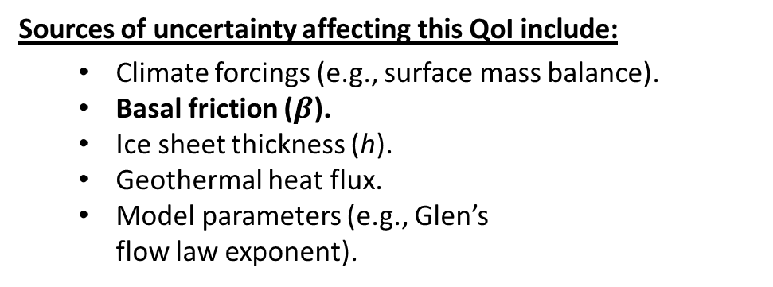
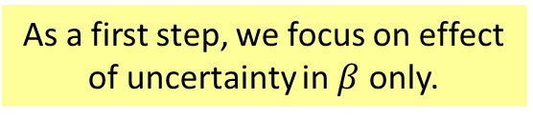
Uncertainty Quantification Problem Definition
QoI in Ice Sheet Modeling: total ice mass loss/gain during 21st century$→$ sea level change prediction.
  As a first step, we focus on effect of uncertainty in $β$ only.
Sources of uncertainty affecting this QoI include:
  Climate forcings (e.g., surface mass balance).
  Basal friction ($β$).
  Ice sheet thickness (h).
  Geothermal heat flux.
  Model parameters (e.g., Glen’s flow law exponent).
$$μ=\frac{1}{2}{A^{−\frac{1}{n}}\left(\frac{1}{2}\sum_{ij}{\dot{ε}ij2+}γ\right)}^{\left(\frac{1}{2n}−\frac{1}{2}\right)}$$
$n$ = Glen’s law exponent
thickness
(h)
Ice sheet
  Basal sliding BC:
  $2μ\dot{ε}i∙n+βu_{i}=0$, on $Γβ$
  Basal boundary $Γβ$
)

Slide 15
Uncertainty Quantification Problem Definition
QoI in Ice Sheet Modeling: total ice mass loss/gain during 21st century$→$ sea level change prediction.
  As a first step, we focus on effect of uncertainty in $β$ only.
Sources of uncertainty affecting this QoI include:
  Climate forcings (e.g., surface mass balance).
  Basal friction ($β$).
  Ice sheet thickness (h).
  Geothermal heat flux.
  Model parameters (e.g., Glen’s flow law exponent).
UQ Workflow
Stage 1:
Estimate ice sheet initial condition (MAP point).
Stage 2:
Update prior uncertainty in ice sheet initial condition
using observational data
and steady state model
$$μ=\frac{1}{2}{A^{−\frac{1}{n}}\left(\frac{1}{2}\sum_{ij}{\dot{ε}ij2+}γ\right)}^{\left(\frac{1}{2n}−\frac{1}{2}\right)}$$
$n$ = Glen’s law exponent
thickness
(h)
Ice sheet
Stage 3:
Propagate uncertain initial condition through ice-sheet evolution model
  Basal sliding BC:
  $2μ\dot{ε}i∙n+βu_{i}=0$, on $Γβ$
  Basal boundary $Γβ$
)

Slide 16
Uncertainty Quantification Problem Definition
QoI in Ice Sheet Modeling: total ice mass loss/gain during 21st century$→$ sea level change prediction.
  As a first step, we focus on effect of uncertainty in $β$ only.
Sources of uncertainty affecting this QoI include:
  Climate forcings (e.g., surface mass balance).
  Basal friction ($β$).
  Ice sheet thickness (h).
  Geothermal heat flux.
  Model parameters (e.g., Glen’s flow law exponent).
UQ Workflow
Deterministic inversion
Stage 1:
Estimate ice sheet initial condition (MAP point).
Stage 2:
Update prior uncertainty in ice sheet initial condition
using observational data
and steady state model
$$μ=\frac{1}{2}{A^{−\frac{1}{n}}\left(\frac{1}{2}\sum_{ij}{\dot{ε}ij2+}γ\right)}^{\left(\frac{1}{2n}−\frac{1}{2}\right)}$$
Bayesian calibration
$n$ = Glen’s law exponent
thickness
(h)
Ice sheet
Forward propagation
Stage 3:
Propagate uncertain initial condition through ice-sheet evolution model
  Basal sliding BC:
  $2μ\dot{ε}i∙n+βu_{i}=0$, on $Γβ$
  Basal boundary $Γβ$
)

Slide 17
Uncertainty Quantification Problem Definition
QoI in Ice Sheet Modeling: total ice mass loss/gain during 21st century$→$ sea level change prediction.
  As a first step, we focus on effect of uncertainty in $β$ only.
Sources of uncertainty affecting this QoI include:
  Climate forcings (e.g., surface mass balance).
  Basal friction ($β$).
  Ice sheet thickness (h).
  Geothermal heat flux.
  Model parameters (e.g., Glen’s flow law exponent).
UQ Workflow
Deterministic inversion
Stage 1:
Estimate ice sheet initial condition (MAP point).
Stage 2:
Update prior uncertainty in ice sheet initial condition
using observational data
and steady state model
$$μ=\frac{1}{2}{A^{−\frac{1}{n}}\left(\frac{1}{2}\sum_{ij}{\dot{ε}ij2+}γ\right)}^{\left(\frac{1}{2n}−\frac{1}{2}\right)}$$
Bayesian calibration
$n$ = Glen’s law exponent
thickness
(h)
Ice sheet
Forward propagation
Stage 3:
Propagate uncertain initial condition through ice-sheet evolution model
  Basal sliding BC:
  $2μ\dot{ε}i∙n+βu_{i}=0$, on $Γβ$
  Basal boundary $Γβ$
)

Slide 18
Outline
Background.
  PISCEES project for land-ice modeling.
  Land-ice model.
UQ problem definition.
Inversion/calibration.
  Deterministic inversion.
  Bayesian inference.
Summary & future work.

Slide 19
Estimation of Ice Sheet Initial Condition
UQ Workflow
Goal: find ice sheet initial state that:
matches observations (e.g. surface velocity, temperature, etc.).
matches present-day geometry (elevation, thickness).
is in “equilibrium” with climate forcings (SMB).
Stage 1:
Estimate ice sheet initial condition (MAP point).
Stage 2:
Update prior uncertainty in ice sheet initial condition
using observational data
and steady state model
Stage 3:
Propagate uncertain initial condition through ice-sheet evolution model

Slide 20
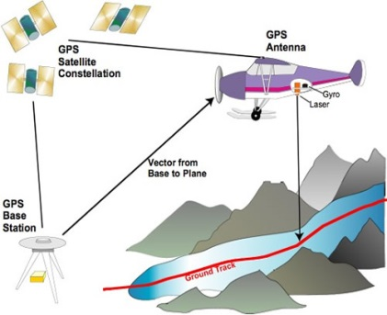
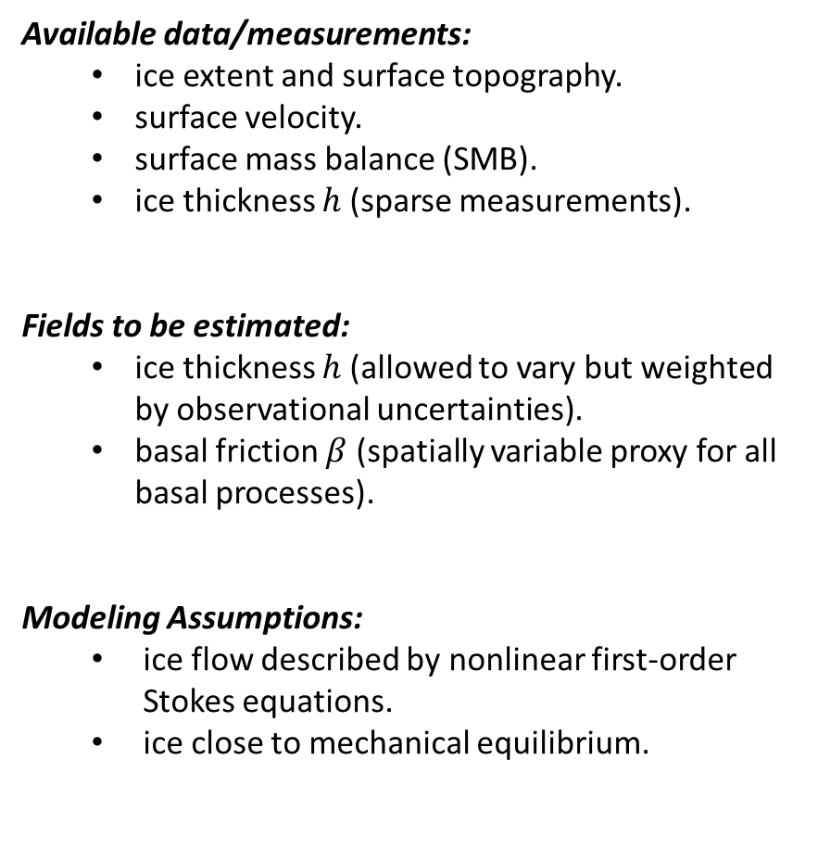

Available Data & Assumptions
Available data/measurements:
  ice extent and surface topography.
  surface velocity.
  surface mass balance (SMB).
  ice thickness $h$ (sparse measurements).
Fields to be estimated:
  ice thickness $h$ (allowed to vary but weighted by observational uncertainties).
  basal friction $β$ (spatially variable proxy for all basal processes).
Modeling Assumptions:
  ice flow described by nonlinear first-order Stokes equations.
  ice close to mechanical equilibrium.
Sources of data: satellite infrarometry, radar, altimetry, etc.
Ice sheet
$$h$$
  β
Ocean
Bedrock

Slide 21
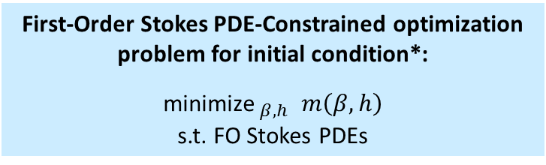
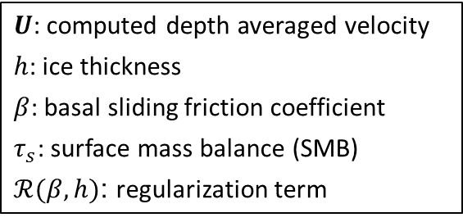
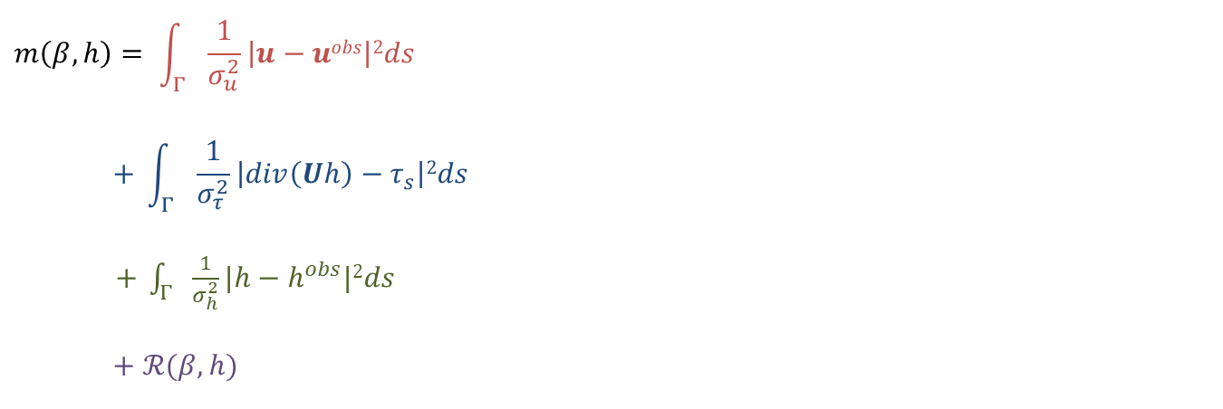
Deterministic Inversion
First-Order Stokes PDE-Constrained optimization problem for initial condition*:
${\text{minimize} }_{β,h}$ $m\left(β,h\right)$
s.t. FO Stokes PDEs
$U$: computed depth averaged velocity
$h$: ice thickness
$β$: basal sliding friction coefficient
$τ_{s}$: surface mass balance (SMB)
$ℛ(β,h)$: regularization term
$$m\left(β,h\right)= \int_{Γ}{\frac{1}{σ_{u}^{2}}\left|u−uobs\right|2ds}$$
$$+ \int_{Γ}{\frac{1}{σ_{τ}^{2}}\left|div\left(Uh\right)−τ_{s}\right|2ds}$$
$+ \int_{Γ}{\frac{1}{σ_{h}^{2}}|{h−h}^{obs}|2ds}$
$$+ ℛ(β,h)$$
surface velocity mismatch
SMB mismatch
thickness mismatch
regularization terms
* Perego, Stadler, Price, JGR, 2014.

Slide 22
Deterministic Inversion
First-Order Stokes PDE-Constrained optimization problem for initial condition*:
${\text{minimize} }_{β,h}$ $m\left(β,h\right)$
s.t. FO Stokes PDEs
$U$: computed depth averaged velocity
$h$: ice thickness
$β$: basal sliding friction coefficient
$τ_{s}$: surface mass balance (SMB)
$ℛ(β,h)$: regularization term
$$m\left(β,h\right)= \int_{Γ}{\frac{1}{σ_{u}^{2}}\left|u−uobs\right|2ds}$$
$$+ \int_{Γ}{\frac{1}{σ_{τ}^{2}}\left|div\left(Uh\right)−τ_{s}\right|2ds}$$
$+ \int_{Γ}{\frac{1}{σ_{h}^{2}}|{h−h}^{obs}|2ds}$
$$+ ℛ(β,h)$$
surface velocity mismatch
SMB mismatch
thickness mismatch
regularization terms
Solving FO Stokes PDE-constrained optimization problem for initial condition significantly reduces non-physical model transients!
* Perego, Stadler, Price, JGR, 2014.

Slide 23


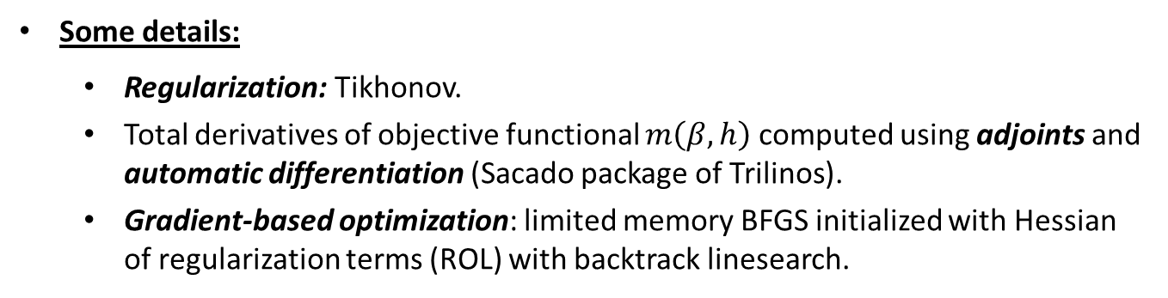
Deterministic Inversion Algorithm & Software
First-Order Stokes PDE-Constrained optimization problem for initial condition*:
${\text{minimize} }_{β,h}$ $m\left(β,h\right)$
s.t. FO Stokes PDEs
Solved via embedded adjoint-based PDE-constrained optimization algorithm in Albany/FELIX.
Algorithm | Software
Finite Element Method discretization | Albany
Quasi-Newton optimization (L-BFGS) | ROL
Nonlinear solver (Newton) | NOX
Krylov linear solvers | AztecOO+Ifpack/ML
Some details:
  Regularization: Tikhonov.
  Total derivatives of objective functional $m\left(β,h\right)$ computed using adjoints and automatic differentiation (Sacado package of Trilinos).
  Gradient-based optimization: limited memory BFGS initialized with Hessian of regularization terms (ROL) with backtrack linesearch.
* Perego, Stadler, Price, JGR, 2014.

Slide 24
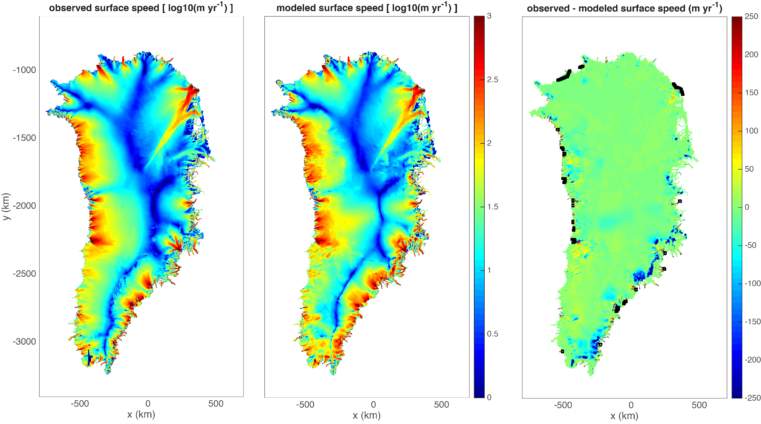



Deterministic Inversion: 1km Greenland
Initial Condition
|$u$| observed
|$u$| computed
Error in |$u$| computed

Slide 25
Outline
Background.
  PISCEES project for land-ice modeling.
  Land-ice model.
UQ problem definition.
Inversion/calibration.
  Deterministic inversion.
  Bayesian inference.
Summary & future work.

Slide 26
Bayesian Inference
Goal: solve inverse problem for ice sheet initial state but in Bayesian framework
UQ Workflow
Stage 1:
Estimate ice sheet initial condition (MAP point).
Stage 2:
Update prior uncertainty in ice sheet initial condition
using observational data
and steady state model
Stage 3:
Propagate uncertain initial condition through ice-sheet evolution model

Slide 27

Bayesian Inference
Goal: solve inverse problem for ice sheet initial state but in Bayesian framework
UQ Workflow
Naïve parameterization: represent each degree of freedom on mesh be an uncertain variable
Stage 1:
Estimate ice sheet initial condition (MAP point).
$$β\left(x\right)=(z_{1},z_{2}, …,z_{n_{dof}})$$
Stage 2:
Update prior uncertainty in ice sheet initial condition
using observational data
and steady state model
Stage 3:
Propagate uncertain initial condition through ice-sheet evolution model

Slide 28
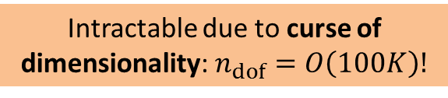
Bayesian Inference
Goal: solve inverse problem for ice sheet initial state but in Bayesian framework
UQ Workflow
Naïve parameterization: represent each degree of freedom on mesh be an uncertain variable
Stage 1:
Estimate ice sheet initial condition (MAP point).
$$β\left(x\right)=(z_{1},z_{2}, …,z_{n_{dof}})$$
Stage 2:
Update prior uncertainty in ice sheet initial condition
using observational data
and steady state model
Intractable due to curse of dimensionality: $n_{dof}=O\left(100K\right)!$
Stage 3:
Propagate uncertain initial condition through ice-sheet evolution model

Slide 29
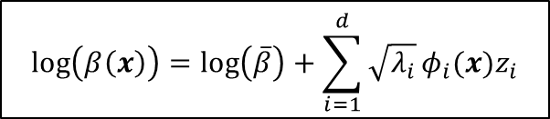
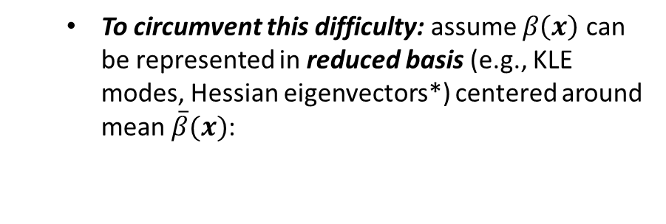
Bayesian Inference
Goal: solve inverse problem for ice sheet initial state but in Bayesian framework
UQ Workflow
Naïve parameterization: represent each degree of freedom on mesh be an uncertain variable
Stage 1:
Estimate ice sheet initial condition (MAP point).
$$β\left(x\right)=(z_{1},z_{2}, …,z_{n_{dof}})$$
Stage 2:
Update prior uncertainty in ice sheet initial condition
using observational data
and steady state model
Intractable due to curse of dimensionality: $n_{dof}=O\left(100K\right)!$
  To circumvent this difficulty: assume $β\left(x\right)$ can be represented in reduced basis (e.g., KLE modes, Hessian eigenvectors*) centered around mean $\overline{β}(x)$:
Stage 3:
Propagate uncertain initial condition through ice-sheet evolution model
$$\log\left(β\left(x\right)\right)=\log\left(\overline{β}\right)+\sum_{i=1}^{d}{\sqrt{λ_{i}}}φ_{i}(x)z_{i}$$
* Isaac, Petra, Stadler, Ghattas, JCP, 2015.

Slide 30

Bayesian Inference
Goal: solve inverse problem for ice sheet initial state but in Bayesian framework
UQ Workflow
Naïve parameterization: represent each degree of freedom on mesh be an uncertain variable
Stage 1:
Estimate ice sheet initial condition (MAP point).
$$β\left(x\right)=(z_{1},z_{2}, …,z_{n_{dof}})$$
Stage 2:
Update prior uncertainty in ice sheet initial condition
using observational data
and steady state model
Intractable due to curse of dimensionality: $n_{dof}=O\left(100K\right)!$
  To circumvent this difficulty: assume $β\left(x\right)$ can be represented in reduced basis (e.g., KLE modes, Hessian eigenvectors*) centered around mean $\overline{β}(x)$:
Stage 3:
Propagate uncertain initial condition through ice-sheet evolution model
$$\log\left(β\left(x\right)\right)=\log\left(\overline{β}\right)+\sum_{i=1}^{d}{\sqrt{λ_{i}}}φ_{i}(x)z_{i}$$
Mean field $\overline{β}\left(x\right)$ = initial condition.
* Isaac, Petra, Stadler, Ghattas, JCP, 2015.

Slide 31
Bayesian Inference
Goal: solve inverse problem for ice sheet initial state but in Bayesian framework
UQ Workflow
Naïve parameterization: represent each degree of freedom on mesh be an uncertain variable
Stage 1:
Estimate ice sheet initial condition (MAP point).
$$β\left(x\right)=(z_{1},z_{2}, …,z_{n_{dof}})$$
Stage 2:
Update prior uncertainty in ice sheet initial condition
using observational data
and steady state model
Intractable due to curse of dimensionality: $n_{dof}=O\left(100K\right)!$
  To circumvent this difficulty: assume $β\left(x\right)$ can be represented in reduced basis (e.g., KLE modes, Hessian eigenvectors*) centered around mean $\overline{β}(x)$:
Stage 3:
Propagate uncertain initial condition through ice-sheet evolution model
$$\log\left(β\left(x\right)\right)=\log\left(\overline{β}\right)+\sum_{i=1}^{d}{\sqrt{λ_{i}}}φ_{i}(x)z_{i}$$
Deterministic inversion is consistent with Bayesian analog: it is used to find the MAP point of posterior.
Mean field $\overline{β}\left(x\right)$ = initial condition.
* Isaac, Petra, Stadler, Ghattas, JCP, 2015.
Notes:
Mean field = 0. Find MAP point of posterior
Using AS to build approximation of subspace.
Can build full Hessian approximation

Slide 32
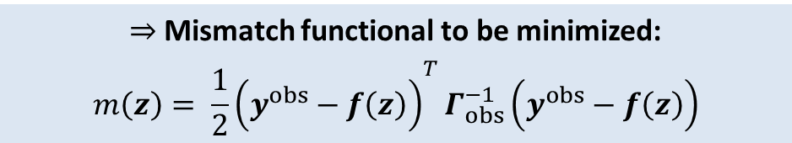

Bayesian Inference Assumptions
  Additive Gaussian noise model: $y^{obs}=f\left(z\right)+ε,$ $ε \sim N(0,Γ_{obs})$
$⇒$Mismatch functional to be minimized:
$${m\left(z\right)= \frac{1}{2}\left(y^{obs}−f\left(z\right)\right)}^{T}Γ_{obs}^{−1}\left(y^{obs}−f\left(z\right)\right)$$
Gaussian prior with exponential covariance and mean $z_{MAP}$ = $\overline{β}$.
Notation*:
$y^{obs}$= observations
$z$ = random params
$f(z)$ = deterministic map from params to observables.
* Constantine, Kent, Bui-Thanh, SISC, 2016.
Notes:
Apply Bayes rule + linearization at MAP point for nonlinear model => Laplace posterior.
New work: Laplace prior.
Covariance is exponential kernel
Mistake: no regularization

Slide 33
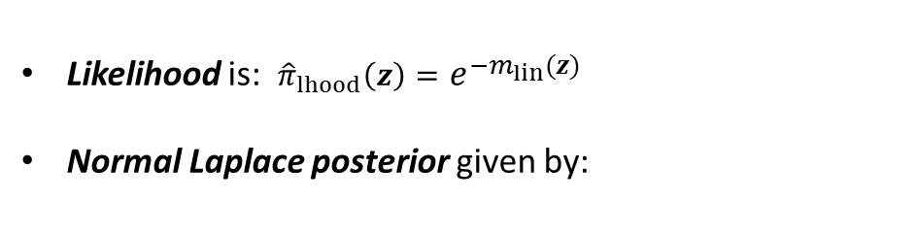
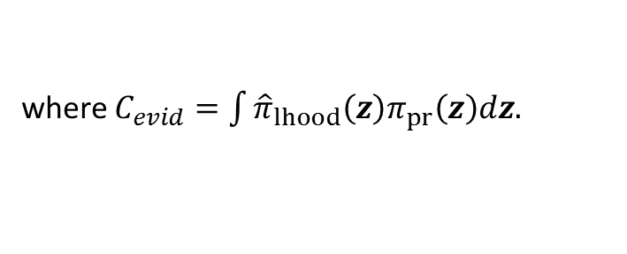
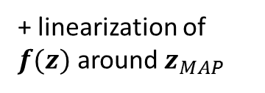

Bayesian Inference Assumptions
  Additive Gaussian noise model: $y^{obs}=f\left(z\right)+ε,$ $ε \sim N(0,Γ_{obs})$
$⇒$Mismatch functional to be minimized:
$${m\left(z\right)= \frac{1}{2}\left(y^{obs}−f\left(z\right)\right)}^{T}Γ_{obs}^{−1}\left(y^{obs}−f\left(z\right)\right)$$
Gaussian prior with exponential covariance and mean $z_{MAP}$ = $\overline{β}$.
Notation*:
$y^{obs}$= observations
$z$ = random params
$f(z)$ = deterministic map from params to observables.
+ linearization of $f(z)$ around $z_{MAP}$
Bayes’ rule
  Likelihood is: ${\hat{π}}_{lhood}\left(z\right)=e^{−m_{lin}(z)}$
Normal Laplace posterior given by:
$$π_{pos}\left(z\right)=C_{evid}^{−1}{\hat{π}}_{lhood}(z)π_{pr}\left(z\right)$$
where $C_{evid}=\int{{\hat{π}}_{lhood}\left(z\right)π_{pr}\left(z\right)dz.}$
* Constantine, Kent, Bui-Thanh, SISC, 2016.
Notes:
Apply Bayes rule + linearization at MAP point for nonlinear model => Laplace posterior.
New work: Laplace prior.
Covariance is exponential kernel
Mistake: no regularization

Slide 34
Bayesian Inference Assumptions
  Additive Gaussian noise model: $y^{obs}=f\left(z\right)+ε,$ $ε \sim N(0,Γ_{obs})$
$⇒$Mismatch functional to be minimized:
$${m\left(z\right)= \frac{1}{2}\left(y^{obs}−f\left(z\right)\right)}^{T}Γ_{obs}^{−1}\left(y^{obs}−f\left(z\right)\right)$$
Gaussian prior with exponential covariance and mean $z_{MAP}$ = $\overline{β}$.
Notation*:
$y^{obs}$= observations
$z$ = random params
$f(z)$ = deterministic map from params to observables.
Covariance of Gaussian posterior related to inverse of misfit Hessian at MAP point**.
+ linearization of $f(z)$ around $z_{MAP}$
Bayes’ rule
  Likelihood is: ${\hat{π}}_{lhood}\left(z\right)=e^{−m_{lin}(z)}$
Normal Laplace posterior given by:
$$π_{pos}\left(z\right)=C_{evid}^{−1}{\hat{π}}_{lhood}(z)π_{pr}\left(z\right)$$
where $C_{evid}=\int{{\hat{π}}_{lhood}\left(z\right)π_{pr}\left(z\right)dz.}$
* Constantine, Kent, Bui-Thanh, SISC, 2016. **Bui-Thanh, Ghattas, Martin, Stadler, SISC, 2013.
Notes:
Apply Bayes rule + linearization at MAP point for nonlinear model => Laplace posterior.
New work: Laplace prior.
Covariance is exponential kernel
Mistake: no regularization

Slide 35
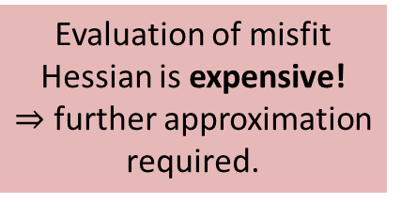
Bayesian Inference Assumptions
  Additive Gaussian noise model: $y^{obs}=f\left(z\right)+ε,$ $ε \sim N(0,Γ_{obs})$
$⇒$Mismatch functional to be minimized:
$${m\left(z\right)= \frac{1}{2}\left(y^{obs}−f\left(z\right)\right)}^{T}Γ_{obs}^{−1}\left(y^{obs}−f\left(z\right)\right)$$
Evaluation of misfit Hessian is expensive!
$⇒$ further approximation required.
Gaussian prior with exponential covariance and mean $z_{MAP}$ = $\overline{β}$.
Notation*:
$y^{obs}$= observations
$z$ = random params
$f(z)$ = deterministic map from params to observables.
Covariance of Gaussian posterior related to inverse of misfit Hessian at MAP point**.
+ linearization of $f(z)$ around $z_{MAP}$
Bayes’ rule
  Likelihood is: ${\hat{π}}_{lhood}\left(z\right)=e^{−m_{lin}(z)}$
Normal Laplace posterior given by:
$$π_{pos}\left(z\right)=C_{evid}^{−1}{\hat{π}}_{lhood}(z)π_{pr}\left(z\right)$$
where $C_{evid}=\int{{\hat{π}}_{lhood}\left(z\right)π_{pr}\left(z\right)dz.}$
* Constantine, Kent, Bui-Thanh, SISC, 2016. **Bui-Thanh, Ghattas, Martin, Stadler, SISC, 2013.
Notes:
Apply Bayes rule + linearization at MAP point for nonlinear model => Laplace posterior.
New work: Laplace prior.
Covariance is exponential kernel
Mistake: no regularization

Slide 36
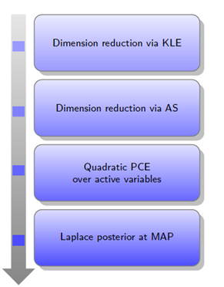
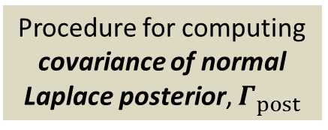
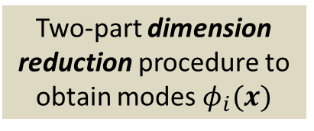
Bayesian Inference Workflow
KLE = Karhunen-Loeve Expansion
AS = Active Subspace
PCE = Polynomial Chaos Expansion
MAP = Maximum a Posteriori
Two-part dimension reduction procedure to obtain modes $φ_{i}(x)$
*
Procedure for computing covariance of normal Laplace posterior, $Γ_{post}$
*
* Bui-Thanh, Ghattas, Martin, Stadler, SISC, 2013.
Notes:
Quadratic PCE over active variables to form Hessian.

Slide 37
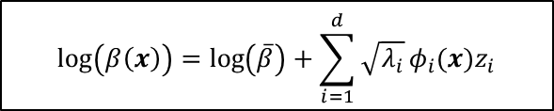

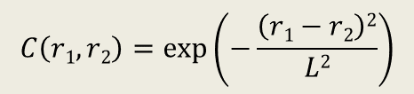

Karhunen-Loeve Expansion (KLE)
$O(100K)$ dimensional inversion problem can be reduced to smaller dimensional problem using Karhunen-Loeve Expansion (KLE)
$$\log\left(β\left(x\right)\right)=\log\left(\overline{β}\right)+\sum_{i=1}^{d}{\sqrt{λ_{i}}}φ_{i}(x)z_{i}$$
KLE modes $φ_{i}$
Best fit $\overline{β}$
KLE modes $φ_{i}(x)$ are eigenvectors of assumed exponential covariance kernel:
$$C\left(r1,r2\right)=exp\left(−\frac{\left(r1−r2\right)2}{L2}\right)$$

Slide 38
Karhunen-Loeve Expansion (KLE)
$O(100K)$ dimensional inversion problem can be reduced to smaller dimensional problem using Karhunen-Loeve Expansion (KLE)
$$\log\left(β\left(x\right)\right)=\log\left(\overline{β}\right)+\sum_{i=1}^{d}{\sqrt{λ_{i}}}φ_{i}(x)z_{i}$$
KLE modes $φ_{i}$
Best fit $\overline{β}$
KLE modes $φ_{i}(x)$ are eigenvectors of assumed exponential covariance kernel:
$$C\left(r1,r2\right)=exp\left(−\frac{\left(r1−r2\right)2}{L2}\right)$$
Parameters to be selected: correlation length $L$, basis size $d$.

Slide 39
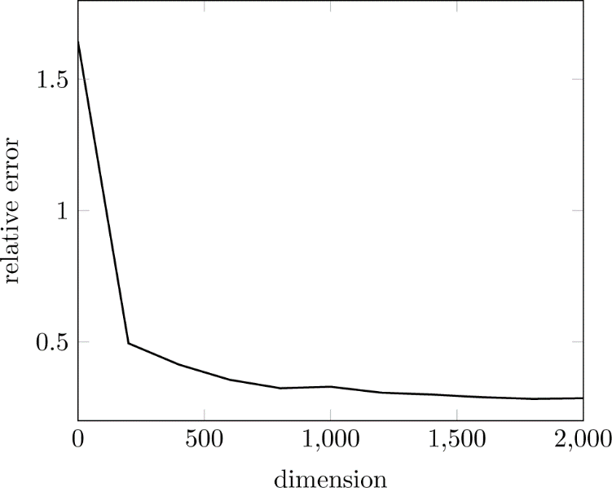
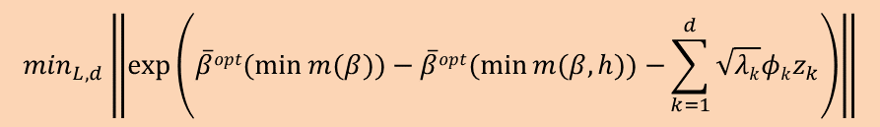
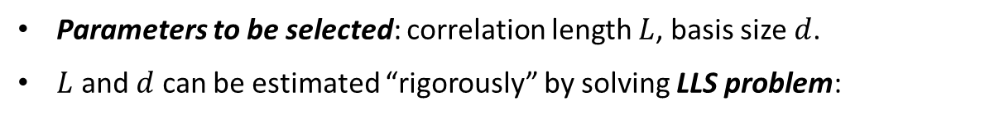
Karhunen-Loeve Expansion (KLE)
$O(100K)$ dimensional inversion problem can be reduced to smaller dimensional problem using Karhunen-Loeve Expansion (KLE)
$$\log\left(β\left(x\right)\right)=\log\left(\overline{β}\right)+\sum_{i=1}^{d}{\sqrt{λ_{i}}}φ_{i}(x)z_{i}$$
KLE modes $φ_{i}$
Best fit $\overline{β}$
KLE modes $φ_{i}(x)$ are eigenvectors of assumed exponential covariance kernel:
$$C\left(r1,r2\right)=exp\left(−\frac{\left(r1−r2\right)2}{L2}\right)$$
Parameters to be selected: correlation length $L$, basis size $d$.
$L$ and $d$ can be estimated “rigorously” by solving LLS problem:
LLS representation error decay is independent of L
$$\min_{L,d}\left\|exp⁡\left(\overline{β}opt(\min{m(β))−\overline{β}opt(\min{m(β,h))}−}\sum_{k=1}^{d}{\sqrt{λk}φkz_{k}}\right)\right\|$$
d

Slide 40

Karhunen-Loeve Expansion (KLE)
$O(100K)$ dimensional inversion problem can be reduced to smaller dimensional problem using Karhunen-Loeve Expansion (KLE)
$$\log\left(β\left(x\right)\right)=\log\left(\overline{β}\right)+\sum_{i=1}^{d}{\sqrt{λ_{i}}}φ_{i}(x)z_{i}$$
KLE modes $φ_{i}$
Best fit $\overline{β}$
KLE modes $φ_{i}(x)$ are eigenvectors of assumed exponential covariance kernel:
$$C\left(r1,r2\right)=exp\left(−\frac{\left(r1−r2\right)2}{L2}\right)$$
Parameters to be selected: correlation length $L$, basis size $d$.
$L$ and $d$ can be estimated “rigorously” by solving LLS problem:
LLS representation error decay is independent of L
$$\min_{L,d}\left\|exp⁡\left(\overline{β}opt(\min{m(β))−\overline{β}opt(\min{m(β,h))}−}\sum_{k=1}^{d}{\sqrt{λk}φkz_{k}}\right)\right\|$$
  $⇒ d$ should be $O(1000)$
d

Slide 41
Active Subspaces (AS)
KLE eigenvalue analysis suggests $d$ = $O(1000)$ – still large for MCMC!

Slide 42
Active Subspaces (AS)
KLE eigenvalue analysis suggests $d$ = $O(1000)$ – still large for MCMC!
Idea: combine KLE with Active Subspace (AS) information for further (and better) data-informed dimension reduction.

Slide 43
Active Subspaces (AS)
KLE eigenvalue analysis suggests $d$ = $O(1000)$ – still large for MCMC!
Idea: combine KLE with Active Subspace (AS) information for further (and better) data-informed dimension reduction.
Active Subspace (AS) = directions along which objective function has strongest variability.

Slide 44
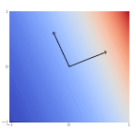
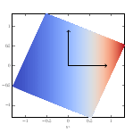
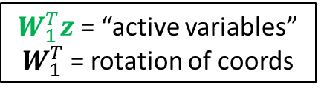
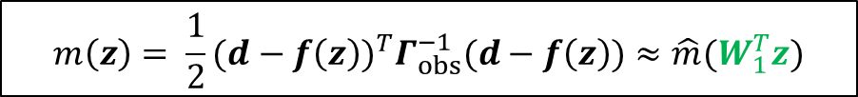


Active Subspaces (AS)
KLE eigenvalue analysis suggests $d$ = $O(1000)$ – still large for MCMC!
Idea: combine KLE with Active Subspace (AS) information for further (and better) data-informed dimension reduction.
Active Subspace (AS) = directions along which objective function has strongest variability.
Active subspace approach: mismatch approximated by related function of fewer variables$\hat{m}$:
$${m\left(z\right)= \frac{1}{2}(d−f\left(z\right))}^{T}Γ_{obs}^{−1}(d−f\left(z\right))≈\hat{m}(W_{1}^{T}z)$$
$W_{1}^{T}z$ = “active variables” $W_{1}^{T}$ = rotation of coords
Example*: $m(z)=exp⁡(0.7z_{1}+0.3z_{2})$
(i) Rotate coords s.t. directions of strongest variation are aligned with the rotated coords.
(ii) Construct response surface using only most important rotated coords.
$→$ Bivariate function $m(z)$ is effectively univariate in rotated coordinate system
Dimension reduction via AS:
* Constantine, Dow, Wang, SISC, 2014.

Slide 45
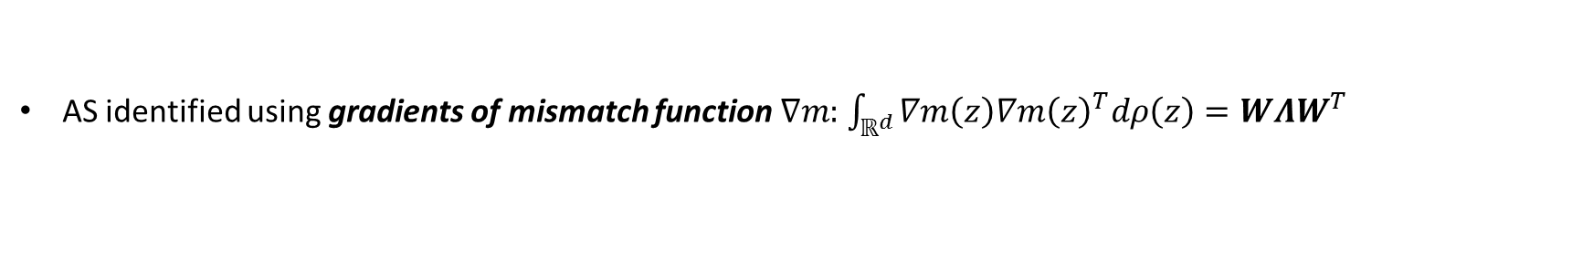
Active Subspaces (AS)
KLE eigenvalue analysis suggests $d$ = $O(1000)$ – still large for MCMC!
Idea: combine KLE with Active Subspace (AS) information for further (and better) data-informed dimension reduction.
Active Subspace (AS) = directions along which objective function has strongest variability.
Active subspace approach: mismatch approximated by related function of fewer variables$\hat{ m}$:
$${m\left(z\right)= \frac{1}{2}(d−f\left(z\right))}^{T}Γ_{obs}^{−1}(d−f\left(z\right))≈\hat{m}(W_{1}^{T}z)$$
$W_{1}^{T}z$ = “active variables” $W_{1}^{T}$ = rotation of coords
AS identified using gradients of mismatch function $∇m:$ $\int_{ℝ^{d}}{∇m\left(z\right)∇{m\left(z\right)}^{T}dρ\left(z\right)=WΛW^{T}}$
Example*: $m(z)=exp⁡(0.7z_{1}+0.3z_{2})$
(i) Rotate coords s.t. directions of strongest variation are aligned with the rotated coords.
(ii) Construct response surface using only most important rotated coords.
$→$ Bivariate function $m(z)$ is effectively univariate in rotated coordinate system
Dimension reduction via AS:
* Constantine, Dow, Wang, SISC, 2014.

Slide 46
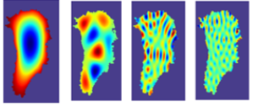
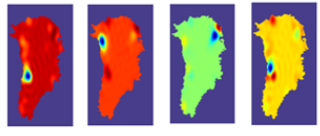




Greenland Bayesian Inference via KLE + AS
KLE modes
Data-informed (AS) directions ($d$=$73$*)
KLE and AS amplitudes
AS principal component
Gradients of mismatch function obtained via adjoint solve in Albany/FELIX.
index
Above, left: fewer modes are needed to build the basal friction parameter map when using KLE + AS methods than when using straight KLE.
Above, right: relative clustering of large values towards smaller indices implies KLE coefficients corresponding to larger singular values contribute most to variability in $m(z)$.
* Value of $d$ was obtained via cross-validation.
Notes:
~73 modes
Principal component:
Find rotation matrix.
Columns of matrix are eigenvecs of Hessian. Each entry is weight associated with variable in original space. Dots are associated with linear reconstruction.
Marginal distributions: variance is smaller

Slide 47

Active Subspaces for Inference
Various levels of approximation can be employed:
  Reduce dimension but no surrogate of misfit
    Perform MCMC in active subspace to improve mixing
  Surrogate of misfit with rotation but no dimension reduction
    Leverage increased sparsity induced by rotation
  Surrogate of misfit and dimension reduction
    Combine MCMC in active subspaces with surrogates that adaptively target regions of high probability
Notes:
Down: more tractable

Slide 48







Quadratic PCE over Active Variables
Idea: approximate misfit $m(z)$ using quadratic PCE for efficient computation of misfit Hessian.
$m(z)≈\hat{m}(z)$ = quadratic PCE function
Approximate misfit over active variables using a quadratic function obtained via compressed sensing (using $M$= 733 samples and a PCE with 20,301 terms)*:
$$\frac{||m\left(z\right)−\hat{m}(z){||}_{l_{ρ}^{2}}}{||m\left(z\right)−\sum_{i=1}^{M}{m(z^{(i)})}{||}_{l_{ρ}^{2}}}≈0.981$$
Approximate misfit with quadratic PCE in rotated $d$ = $200$ space:
$$\frac{||m\left(z\right)−\hat{m}(W^{T}z){||}_{l_{ρ}^{2}}}{||m\left(z\right)−\sum_{i=1}^{M}{m(z^{(i)})}{||}_{l_{ρ}^{2}}}≈0.190$$
Approximate misfit with quadratic PCE in rotated and truncated $d$ = $73$space:
$$\frac{||m\left(z\right)−{\hat{m}}_{s=73} (W_{1}^{T}z){||}_{l_{ρ}^{2}}}{||m\left(z\right)−\sum_{i=1}^{M}{m(z^{(i)})}{||}_{l_{ρ}^{2}}}≈0.136$$
* Ratios are improvements relative to using mean of data; want ratio close to 0.
Notes:
Mhat(z)

Slide 49


Low Rank Laplace-Based Covariance*
$π_{pos}\left(z | y^{obs}\right)=N(z_{MAP}$, $Γ_{post})$
Linearize parameter-to-observable map around MAP point:
$$y^{obs}=f\left(z\right)+ε≈f\left(z_{MAP}\right)+F\left(z−z_{MAP}\right)+ε$$
where $F$ = Frechet derivative of $f$.
* Bui-Thanh, Ghattas, Martin, Stadler, SISC, 2013.
Notes:
FIXME: What is motivation for Laplace-like prior covariance?

Slide 50

Low Rank Laplace-Based Covariance*
$π_{pos}\left(z | y^{obs}\right)=N(z_{MAP}$, $Γ_{post})$
Linearize parameter-to-observable map around MAP point:
$$y^{obs}=f\left(z\right)+ε≈f\left(z_{MAP}\right)+F\left(z−z_{MAP}\right)+ε$$
where $F$ = Frechet derivative of $f$.
Covariance of Gaussian Laplace posterior given by:
$$Γ_{post}={\left(H_{misfit}^{PCE}+Γ_{prior}^{−1}\right)}^{−1}$$
* Bui-Thanh, Ghattas, Martin, Stadler, SISC, 2013.
Notes:
FIXME: What is motivation for Laplace-like prior covariance?

Slide 51

Low Rank Laplace-Based Covariance*
$Γ_{post}$is dense!
$⇒$ prohibitively expensive to store & construct.
$π_{pos}\left(z | y^{obs}\right)=N(z_{MAP}$, $Γ_{post})$
Linearize parameter-to-observable map around MAP point:
$$y^{obs}=f\left(z\right)+ε≈f\left(z_{MAP}\right)+F\left(z−z_{MAP}\right)+ε$$
where $F$ = Frechet derivative of $f$.
Covariance of Gaussian Laplace posterior given by:
$$Γ_{post}={\left(H_{misfit}^{PCE}+Γ_{prior}^{−1}\right)}^{−1}$$
* Bui-Thanh, Ghattas, Martin, Stadler, SISC, 2013.
Notes:
FIXME: What is motivation for Laplace-like prior covariance?

Slide 52




Low Rank Laplace-Based Covariance*
$Γ_{post}$is dense!
$⇒$ prohibitively expensive to store & construct.
$π_{pos}\left(z | y^{obs}\right)=N(z_{MAP}$, $Γ_{post})$
Linearize parameter-to-observable map around MAP point:
$$y^{obs}=f\left(z\right)+ε≈f\left(z_{MAP}\right)+F\left(z−z_{MAP}\right)+ε$$
where $F$ = Frechet derivative of $f$.
Symbols*:
$V_{r},D_{r}:$ eigenvecs, eigenvals of ${\tilde{H}}_{misfit}$
${\tilde{H}}_{misfit}$ = prior-preconditioned Hessian of data misfit = $Γ_{prior}^{1/2}H_{misfit}Γ_{prior}^{1/2}$
$H_{misfit}$ = Gauss-Newton portion of Hessian misfit = $F^{\text{𝄯}}Γ_{obs}^{−1}F$
${\tilde{V}}_{r}$ = $Γ_{prior}^{1/2}V_{r}$, ${\tilde{V}}_{r}^{♢}$= adjoint of ${\tilde{V}}_{r}$
$Γ_{prior}^{−1}$ = $M^{−1}K, K$= Laplace stiffness.
Covariance of Gaussian Laplace posterior given by:
$$Γ_{post}={\left(H_{misfit}^{PCE}+Γ_{prior}^{−1}\right)}^{−1}$$
Low-rank approximation of $Γ_{post}$obtained using Sherman-Morrison-Woodbury formula:
$$Γ_{post}≈Γ_{prior}−{\tilde{V}}_{r}D_{r}{\tilde{V}}_{r}^{♢}$$
${\tilde{H}}_{misfit}$ and its EV decomposition can be computed efficiently using a parallel matrix-free Lanczos method.
Rank of $Γ_{post}$ = # of modes that informed directions of posterior (AS vectors).
* Bui-Thanh, Ghattas, Martin, Stadler, SISC, 2013.
Notes:
FIXME: What is motivation for Laplace-like prior covariance?

Slide 53


Greenland Bayesian Inference via KLE + AS
KLE modes
Data-informed (AS) directions ($d$=$73$*)
Gradients of mismatch function obtained via adjoint solve in Albany/FELIX.
KLE and AS amplitudes
AS principal component
Above: marginal distributions of Gaussian posterior computed using KLE vs. KLE+AS; any shift from mean of 0 is due to observations.
  KLE eigenvectors have variance and mean close to prior.
  Data-informed eigenvectors have smaller variance and are most shifted w.r.t. prior distribution (as expected).
index
* Value of $d$ was obtained via cross-validation.
Notes:
~73 modes
Principal component:
Find rotation matrix.
Columns of matrix are eigenvecs of Hessian. Each entry is weight associated with variable in original space. Dots are associated with linear reconstruction.
Marginal distributions: variance is smaller

Slide 54
Outline
Background.
  PISCEES project for land-ice modeling.
  Land-ice model.
UQ problem definition.
Inversion/calibration.
  Deterministic inversion.
  Bayesian inference.
Summary & future work.

Slide 55




Summary & future work
This talk described our workflow for quantifying uncertainties in expected aggregate ice sheet mass change and its demonstration on a Greenland ice sheet problem, focusing on inversion.

Slide 56
Summary & future work
This talk described our workflow for quantifying uncertainties in expected aggregate ice sheet mass change and its demonstration on a Greenland ice sheet problem, focusing on inversion.
Future work:
  Execute full UQ workflow (inversion + forward propagation) on realistic Greenland/Antarctic ice sheet problems.
  Squared Laplace covariance operator approach* (no KLE)
    Less expensive than building PCE.
    Allows higher dimensional parameter spaces.
  Incorporate effects of other sources of uncertainty, e.g., surface height, surface mass balance.
* Bui-Thanh, Ghattas, Martin, Stadler, SISC, 2013.

Slide 57
Summary & future work
This talk described our workflow for quantifying uncertainties in expected aggregate ice sheet mass change and its demonstration on a Greenland ice sheet problem, focusing on inversion.
Future work:
  Execute full UQ workflow (inversion + forward propagation) on realistic Greenland/Antarctic ice sheet problems.
  Squared Laplace covariance operator approach* (no KLE)
    Less expensive than building PCE.
    Allows higher dimensional parameter spaces.
  Incorporate effects of other sources of uncertainty, e.g., surface height, surface mass balance.
We are well-positioned to
do these efforts in parallel!
* Bui-Thanh, Ghattas, Martin, Stadler, SISC, 2013.

Slide 58










Funding/acknowledgements
Support for this work was provided through Scientific Discovery through Advanced Computing (SciDAC) projects funded by the U.S. Department of Energy, Office of Science (OSCR), Advanced Scientific Computing Research and Biological and Environmental Research (BER) $→$PISCEES SciDAC Application Partnership.
PISCEES team members: K. Evans, M. Gunzburger, M. Hoffman, C. Jackson, P. Jones, W. Lipscomb, M. Perego, S. Price, A. Salinger, I. Tezaur, R. Tuminaro, P. Worley.
Trilinos/DAKOTA collaborators: M. Eldred, J. Jakeman, E. Phipps, L. Swiler.
  Computing resources: NERSC, OLCF.

Slide 59
References
[1] M.A. Heroux et al. “An overview of the Trilinos project.” ACM Trans. Math. Softw. 31(3) (2005).
[2] A. Salinger, et al. "Albany: Using Agile Components to Develop a Flexible, Generic Multiphysics Analysis Code", Int. J. Multiscale Comput. Engng. 14(4) (2016) 415-438.
[3] I. Tezaur, M. Perego, A. Salinger, R. Tuminaro, S. Price. "Albany/FELIX: A Parallel, Scalable and Robust Finite Element Higher-Order Stokes Ice Sheet Solver Built for Advanced Analysis", Geosci. Model Develop. 8 (2015) 1-24.
[4] M. Perego, S. Price, G. Stadler. “Optimal initial conditions for coupling ice sheet models to Earth system models”. J. Geophys. Res. Earth Surf. 119 (2014) 1894-1917.
[5] P. Constantine, E. Dow, Q. Wang. “Active subspace methods in theory and practice: applications to Kriging surfaces”. SIAM J. Sci. Comput. 36(4) (2014) A1500-A1524.
[6] P. Constantine, C. Kent, T. Bui-Thanh. “Accelerating Markov Chain Monte Carlo with Active Subspaces”. SIAM J. Sci. Comput. 38 (5) (2016) A2779-A2805.
[7] T. Bui-Thanh, O. Ghattas. J. Martin. G. Stadler. “A computational framework for infinite-dimensional Bayesian inverse problems part I: the linearized case, with application to global seismic inversion”. SIAM J. Sci. Comput. 35(6) (2013) A2494-2523.
[8] T. Isaac, N. Petra, G. Stadler, O. Ghattas. “Scalable and efficient algorithms for the propagation of uncertainty from data through inference to prediction for large-scale problems, with application to flow of the Antarctic ice sheet”. J. Comput. Phys. 296 (2015) 348-368.
[9] J. Jakeman, M. Eldred, K. Sargsyan. “Enhancing l1-minimization estimates of polynomial chaos expansions using basis selection”, J. Comp. Phys. 289 (2015) 18-34.
[10] N. Petra, J. Martin, G. Stadler, O. Ghattas. “A computational framework for infinite dimensional Bayesian inverse problems. Part II: stochastic Newton with application to ice sheet flow inverse problems”. SIAM J. Sci. Comput. 36 (4) (2014) A1525-1555.
[11] J. Jakeman, I. Tezaur, M. Perego, S. Price. "Probabalistic Projections of Sea-Level Change from the Greenland Ice Sheet", in preparation.

Slide 60


Multiphysics Code
  The Albany/FELIX land-ice solver is implemented within the Albany multi-physics code.
Albany = Sandia open-source* parallel, C++, multi-physics finite element code.
40+ packages; 120+ libraries
Component-based design for rapid development of new physics & capabilities.
Extensive use of libraries from the open-source Trilinos project:
  Automatic differentiation.
  Discretizations/meshes, mesh adaptivity.
  Solvers, time-integration schemes.
  Performance-portable kernels.
Advanced analysis capabilities:
  Parameter estimation.
  Uncertainty quantification (DAKOTA).
  Optimization (DAKOTA, ROL).
  Sensitivity analysis.
* https://github.com/gahansen/Albany.

Slide 61






Computing the Active Subspace
Gradients of mismatch $∇_{β}m$ can be used to identify subspace that controls variation in likelihood function (active subspace)
Mismatch approximated by related function of fewer variables $g$:
$W_{1}^{T}z$ = “active variables”
$${m\left(z\right)= \frac{1}{2}(d−f\left(z\right))}^{T}Γ_{obs}^{−1}(d−f\left(z\right))≈g(W_{1}^{T}z)$$
Linear transformation (rotation) of coords
$$\int_{ℝ^{d}}{∇m\left(z\right)∇{m\left(z\right)}^{T}dρ\left(z\right)=WΛW^{T}}$$
Active subspace computed using
  Sample gradient using MC: $\left[∇m\left(z^{\left(1\right)}\right), \text{…, }∇m\left(z^{\left(M\right)}\right)\right]$.
  Form Gauss-Newton approx. of Hessian averaged over prior:
  $$C=\frac{1}{M}\sum_{i=1}^{M}{∇m\left(z^{\left(i\right)}\right){∇m\left(z^{\left(i\right)}\right)}^{T}}$$
  Compute eigenvalue decomposition: $C=WΛW^{T}$
    $→$eigenvectors $W$ define rotation of $ℝ^{M}.$
Perturbing $m(z)$ along columns of $W_{1}$changes $m(z)$ more.
Partition $z$ into active and inactive variables:
$z=W_{1}^{T}z+W_{2}^{T}z,$ $W=\left[W_{1} W_{2}\right]$
Notes:
FIXME:

Slide 62

Full UQ Workflow: Varying Levels of Approx.
As with Bayesian inference:
Future work: compare errors as accuracy of approximation is increased to gain insight into viability of lower-dimensional approximations.
Lessons can be learned by avoiding use of highest fidelity model.

