Slide 1
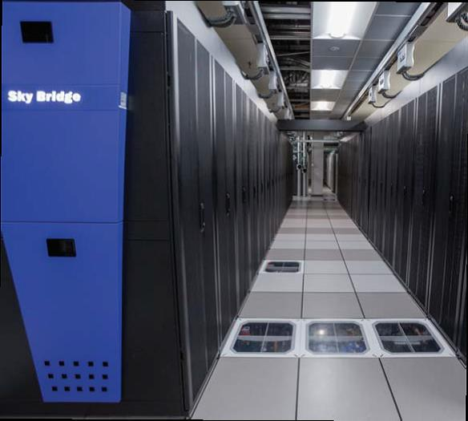
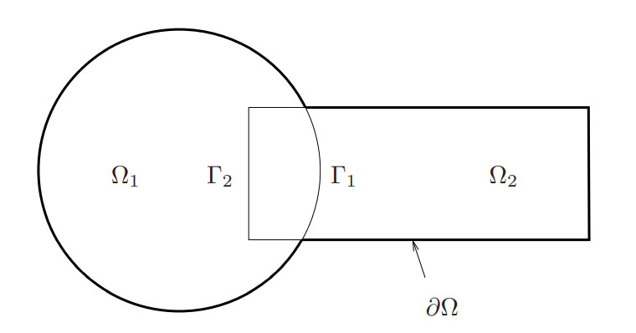
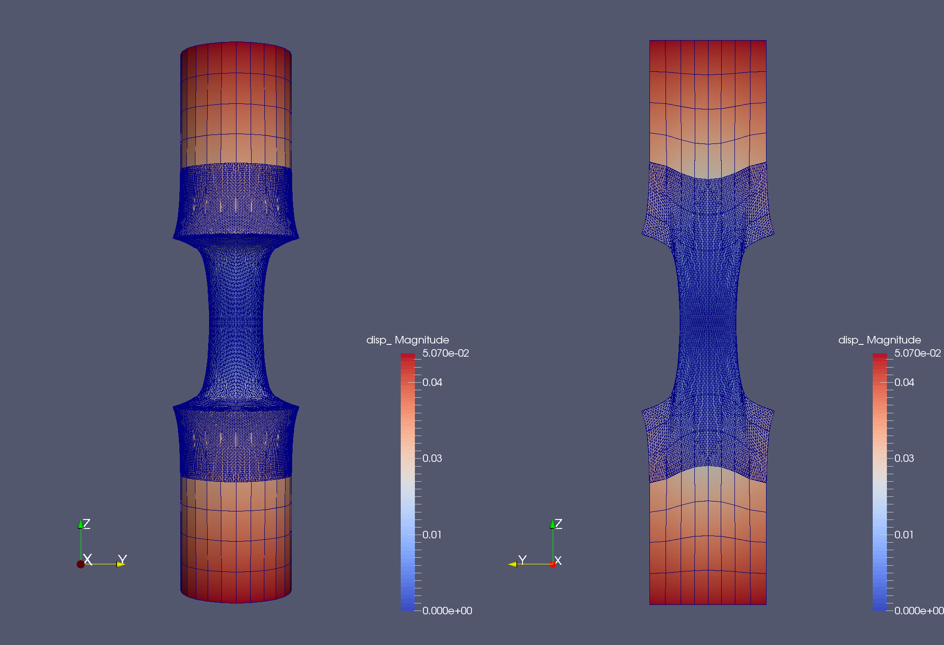
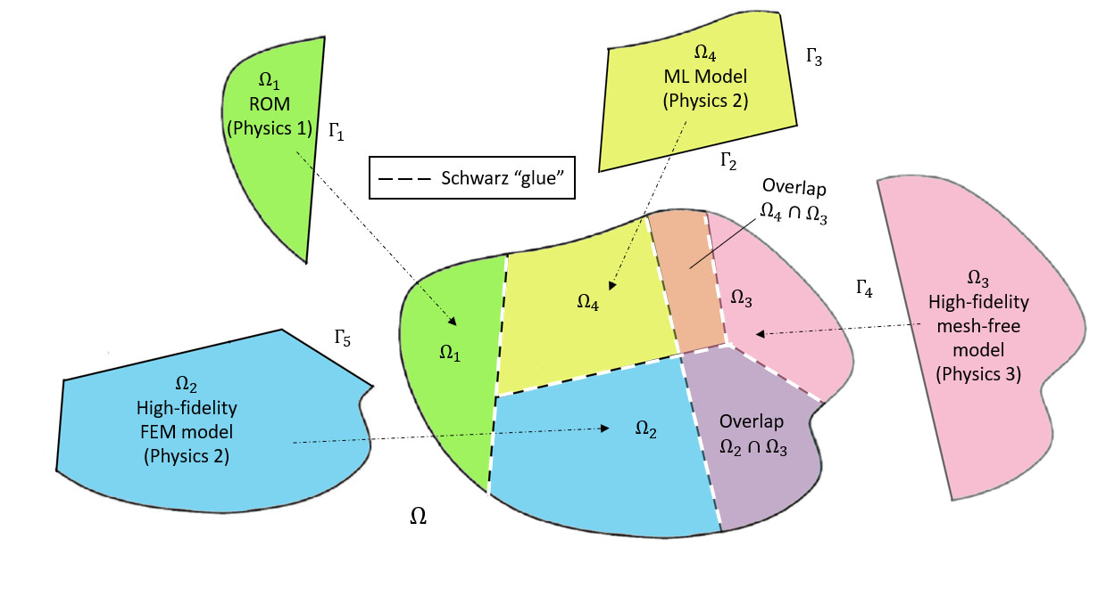
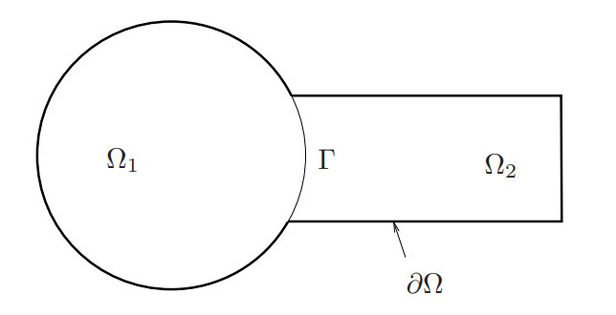
The Schwarz Alternating Method for FOM*-ROM# and ROM-ROM Coupling
* Full Order Model
# Reduced Order Model
Irina Tezaur¹, Alejandro Mota¹, Yukiko Shimizu¹, Joshua Barnett^{1,2}
¹Sandia National Laboratories, ²Stanford University
WCCM 2022
July 31 – August 5, 2022
SAND2022-8753C

Slide 2
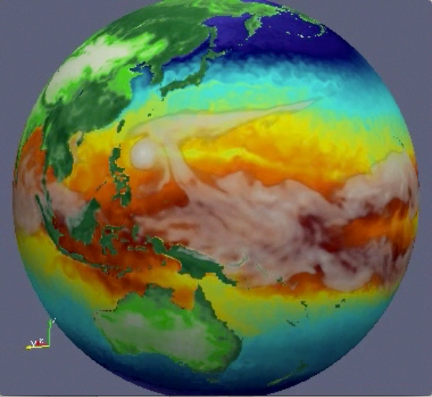

Motivation
Atmos.
(EAM)
Ocean
(MPAS-O)
The past decades have seen tremendous investment in simulation frameworks for coupled multi-scale and multi-physics problems.
Sea Ice
(MPAS-SI)
Frameworks rely on established mathematical theories to couple physics components.
Land
(ALM)
Land Ice
(MALI)
N₁
N₂
N₁
N₂
M₁
M₂
M₃
M₄
N₄
N₃
N₄
N₃
N₅
N₅
Complex System Model
Traditional Methods
Coupled Numerical Model
PDEs, ODEs
Nonlocal integral
Classical DFT
Atomistic…
Mesh-based (FE, FV, FD)
Meshless (SPH, MLS)
Implicit, explicit
Eulerian, Lagrangian…
Monolithic (Lagrange multipliers)
Partitioned (loose) coupling
Iterative (Schwarz, optimization)

Slide 3
Motivation
Atmos.
(EAM)
Ocean
(MPAS-O)
The past decades have seen tremendous investment in simulation frameworks for coupled multi-scale and multi-physics problems.
Sea Ice
(MPAS-SI)
Frameworks rely on established mathematical theories to couple physics components.
Most existing coupling frameworks are based on traditional discretization methods.
Land
(ALM)
Land Ice
(MALI)
N₁
N₂
N₁
N₂
M₁
M₂
M₃
M₄
N₄
N₃
N₄
N₃
N₅
N₅
Complex System Model
Traditional Methods
Coupled Numerical Model
PDEs, ODEs
Nonlocal integral
Classical DFT
Atomistic…
Mesh-based (FE, FV, FD)
Meshless (SPH, MLS)
Implicit, explicit
Eulerian, Lagrangian…
Monolithic (Lagrange multipliers)
Partitioned (loose) coupling
Iterative (Schwarz, optimization)
Notes:
The past decades have seen a tremendous amount of investment in the development of simulation frameworks for coupled multi-scale and multi-physics problems. These frameworks rely on established mathematical theories to couple physics components discretized using so-called traditional discretization methods such as finite elements, finite volumes and finite differences. A prime example is the DOE’s global climate model, the Energy Exascale Earth System Model (E3SM), which couples 5 physics components (atmosphere, ocean, sea ice, land ice and land). Each component is developed separately according to the relevant physics, dynamics and numerical methods, and the components are coupled in a way that ensures stability, accuracy and conservation.

Slide 4
Motivation
Atmos.
(EAM)
Ocean
(MPAS-O)
The past decades have seen tremendous investment in simulation frameworks for coupled multi-scale and multi-physics problems.
Sea Ice
(MPAS-SI)
Frameworks rely on established mathematical theories to couple physics components.
Most existing coupling frameworks are based on traditional discretization methods.
Land
(ALM)
Land Ice
(MALI)
N₁
N₂
N₁
N₂
N₁
PINN=N₂
M₁
M₂
M₃
M₄
N₄
N₃
N₄
ROM=N₄
N₃
N₅
DMD=N₃
N₅
UDE=N₅
Complex System Model
Traditional Methods
Coupled Numerical Model
Traditional + Data-Driven Methods
PDEs, ODEs
Nonlocal integral
Classical DFT
Atomistic, …
Mesh-based (FE, FV, FD)
Meshless (SPH, MLS)
Implicit, explicit
Eulerian, Lagrangian, …
Monolithic (Lagrange multipliers)
Partitioned (loose) coupling
Iterative (Schwarz, optimization)
PINNs
Neural ODEs
Projection-based ROMs, …
There is currently a big push to integrate data-driven methods into modeling & simulation toolchains.
Unfortunately, existing algorithmic and software infrastructures are ill-equipped to handle plug-and-play integration of non-traditional, data-driven models!

Slide 5
Flexible Heterogeneous Numerical Methods (fHNM) Project
Principal research objective:
Discover mathematical principles guiding the assembly of standard and data-driven numerical models in stable, accurate and physically consistent ways.
Principal research challenges: we lack mathematical and algorithmic understanding of how to
“Mix-and-match” standard and data-driven models from three-classes
  Class A: projection-based reduced order models (ROMs)
  Class B: machine-learned models, i.e., Physics-Informed Neural Networks (PINNs)
  Class C: flow map approximation models, i.e., dynamic model decomposition (DMD) models
This talk
Ensure well-posedness & physical consistency of the resulting heterogeneous models.
Solve such heterogeneous models efficiently.
Three coupling methods:
This talk
Alternating Schwarz-based coupling
Optimization-based coupling
Coupling via generalized mortar methods
Talk by A. DeCastro

Slide 6
Outline For Remainder of Presentation
Overview of the Schwarz Alternating Method for Concurrent Coupling
Overview of Projection-Based Model Order Reduction
Extension of Schwarz Alternating Method to FOM-ROM and ROM-ROM coupling
Numerical Results
5. Summary and Future Work

Slide 7
Outline For Remainder of Presentation
Overview of the Schwarz Alternating Method for Concurrent Coupling
Overview of Projection-Based Model Order Reduction
Extension of Schwarz Alternating Method to FOM-ROM and ROM-ROM coupling
Numerical Results
5. Summary and Future Work

Slide 8
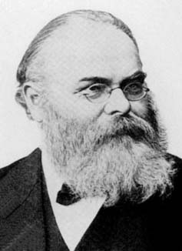
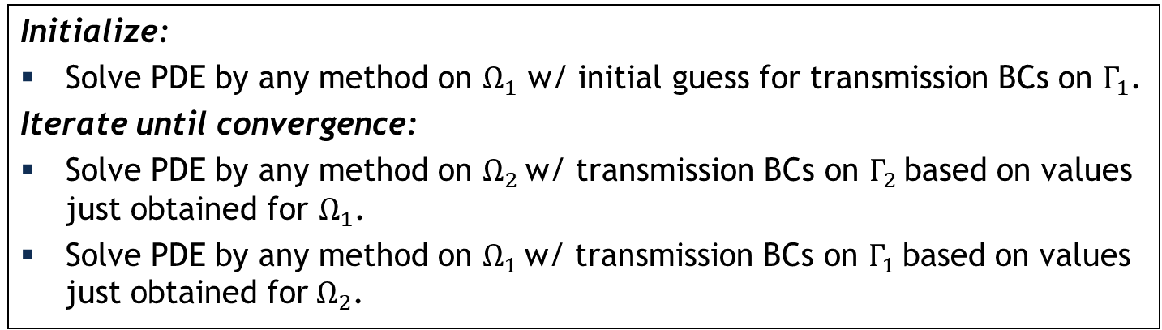
Schwarz Alternating Method for Domain Decomposition
Proposed in 1870 by H. Schwarz for solving Laplace PDE on irregular domains.
Crux of Method: if the solution is known in regularly shaped domains, use those as pieces to iteratively build a solution for the more complex domain.
H. Schwarz (1843–1921)
Basic Schwarz Algorithm
overlapping
Initialize:
Solve PDE by any method on $Ω_{1}$ w/ initial guess for transmission BCs on $Γ_{1}$.
Iterate until convergence:
Solve PDE by any method on $Ω_{2}$ w/ transmission BCs on $Γ_{2}$ based on values just obtained for $Ω_{1}$.
Solve PDE by any method on $Ω_{1}$ w/ transmission BCs on $Γ_{1}$ based on values just obtained for $Ω_{2}$.
non-overlapping
Schwarz alternating method most commonly used as a preconditioner for Krylov iterative methods to solve linear algebraic equations.
Novel idea: using the Schwarz alternating as a discretization method for solving multi-scale or multi-physics partial differential equations (PDEs).
²Lions, 1990. ³Zanolli et al., 1987.

Slide 9
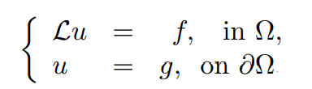
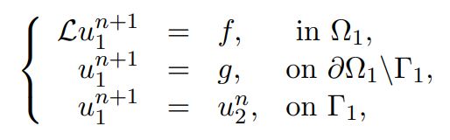
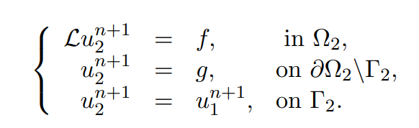
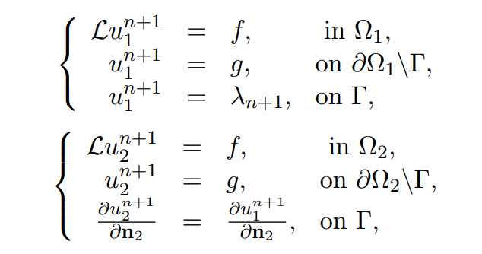
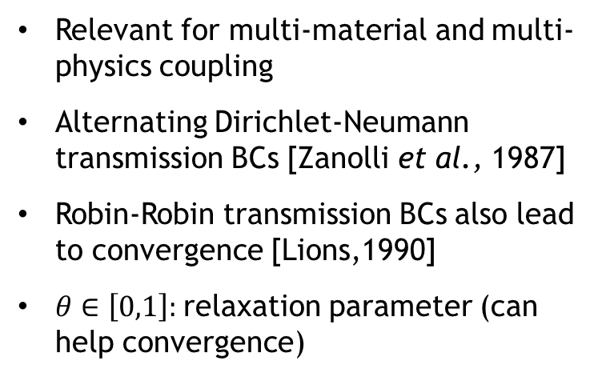
Spatial Coupling via Alternating Schwarz
Overlapping Domain Decomposition
Model PDE:
Dirichlet-Dirichlet transmission BCs [Schwarz, 1870; Lions, 1988]
Non-overlapping Domain Decomposition
Relevant for multi-material and multi-physics coupling
Alternating Dirichlet-Neumann transmission BCs [Zanolli et al., 1987]
Robin-Robin transmission BCs also lead to convergence [Lions,1990]
$θ∈\left[0,1\right]:$relaxation parameter (can help convergence)

Slide 10
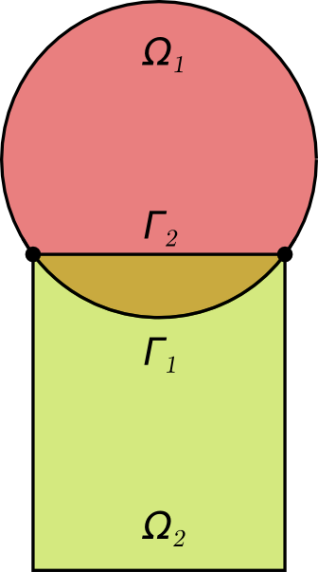
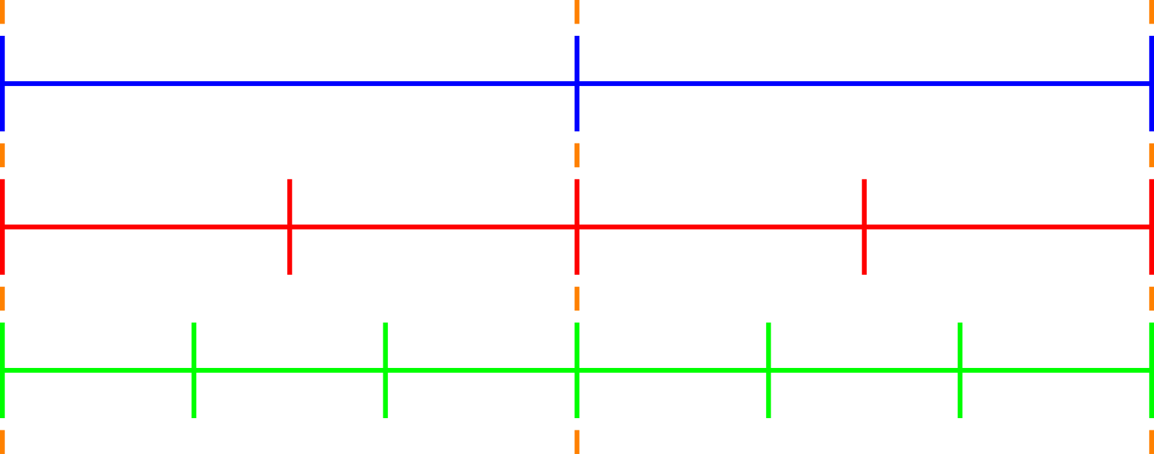
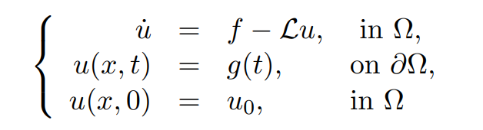
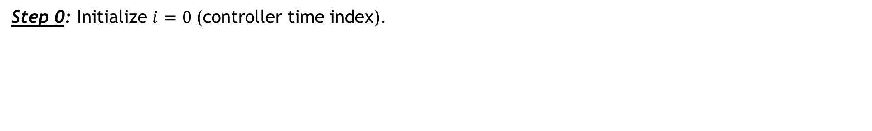


Time-Advancement Within the Schwarz Framework
$$T_{0}$$
$$T_{1}$$
Controller time stepper
Time integrator for Ω₁
Time integrator for Ω₂
Step 0: Initialize $i=0 \text{(}\text{controller} \text{time} \text{index}\text{).}$
Model PDE:

Slide 11
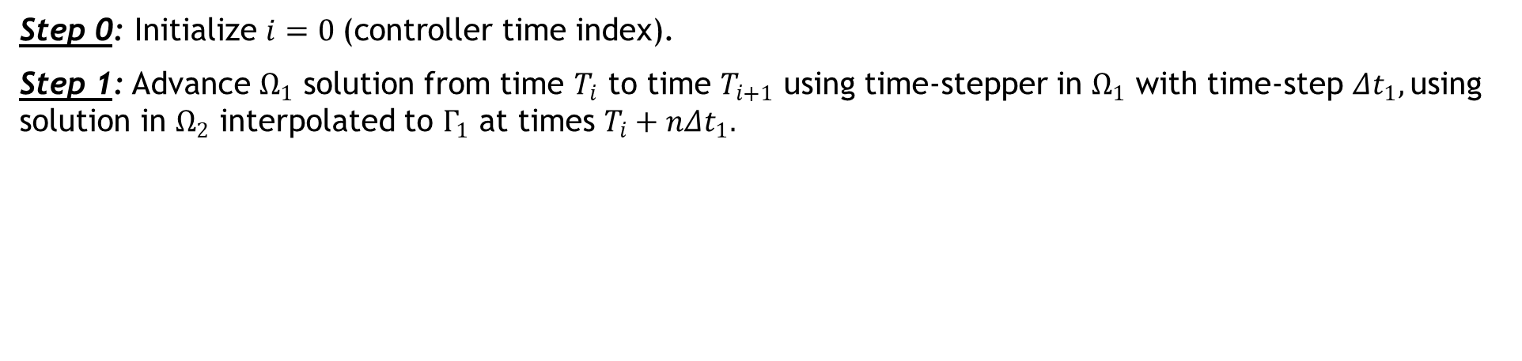


Time-Advancement Within the Schwarz Framework
$$T_{0}$$
$$T_{1}$$
Controller time stepper
Time integrator for Ω₁
Time integrator for Ω₂
Integrate using ${Δt}_{1}$
Interpolate from $Ω_{2}$ to $Γ_{1}$
Step 0: Initialize $i=0 \text{(}\text{controller} \text{time} \text{index}\text{).}$
Step 1: Advance $Ω_{1}$ solution from time $T_{i}$ to time $T_{i+1}$ using time-stepper in $Ω_{1}$ with time-step ${Δt}_{1},$using solution in $Ω_{2}$ interpolated to $Γ_{1}$ at times $T_{i}+n{Δt}_{1}.$
Model PDE:

Slide 12
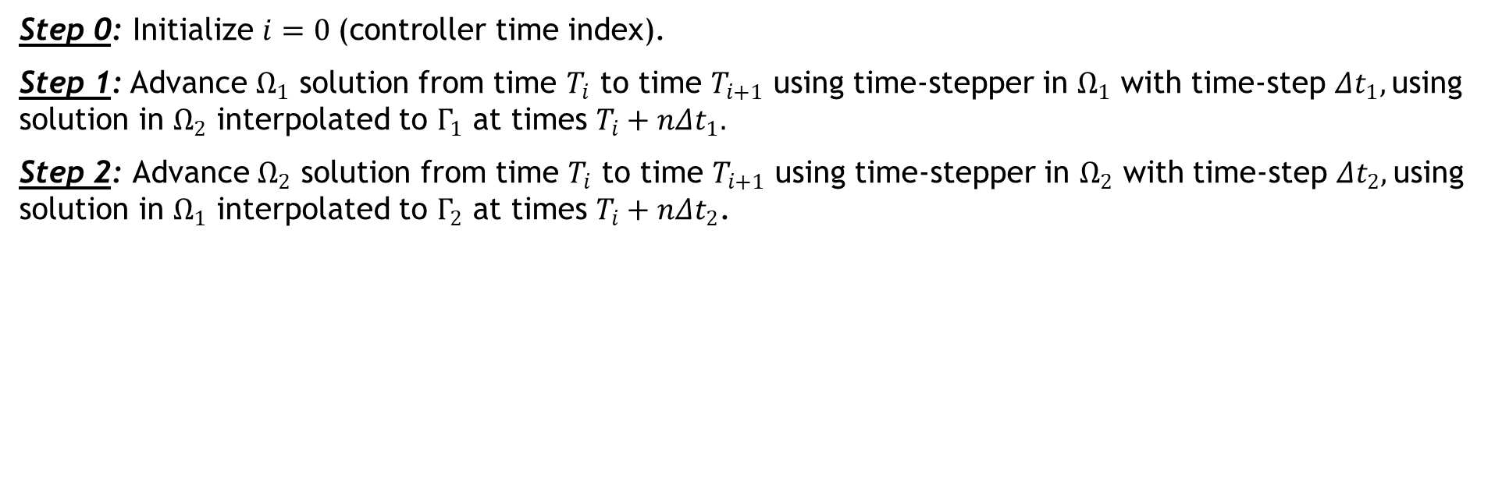


Time-Advancement Within the Schwarz Framework
$$T_{0}$$
$$T_{1}$$
Controller time stepper
Time integrator for Ω₁
Time integrator for Ω₂
Interpolate from $Ω_{1}$ to $Γ_{2}$
Integrate using ${Δt}_{2}$
Step 0: Initialize $i=0 \text{(}\text{controller} \text{time} \text{index}\text{).}$
Step 1: Advance $Ω_{1}$ solution from time $T_{i}$ to time $T_{i+1}$ using time-stepper in $Ω_{1}$ with time-step ${Δt}_{1},$using solution in $Ω_{2}$ interpolated to $Γ_{1}$ at times $T_{i}+n{Δt}_{1}.$
Step 2: Advance $Ω_{2}$ solution from time $T_{i}$ to time $T_{i+1}$ using time-stepper in $Ω_{2}$ with time-step ${Δt}_{2},$using solution in $Ω_{1}$ interpolated to $Γ_{2}$ at times $T_{i}+n{Δt}_{2}$.
Model PDE:

Slide 13
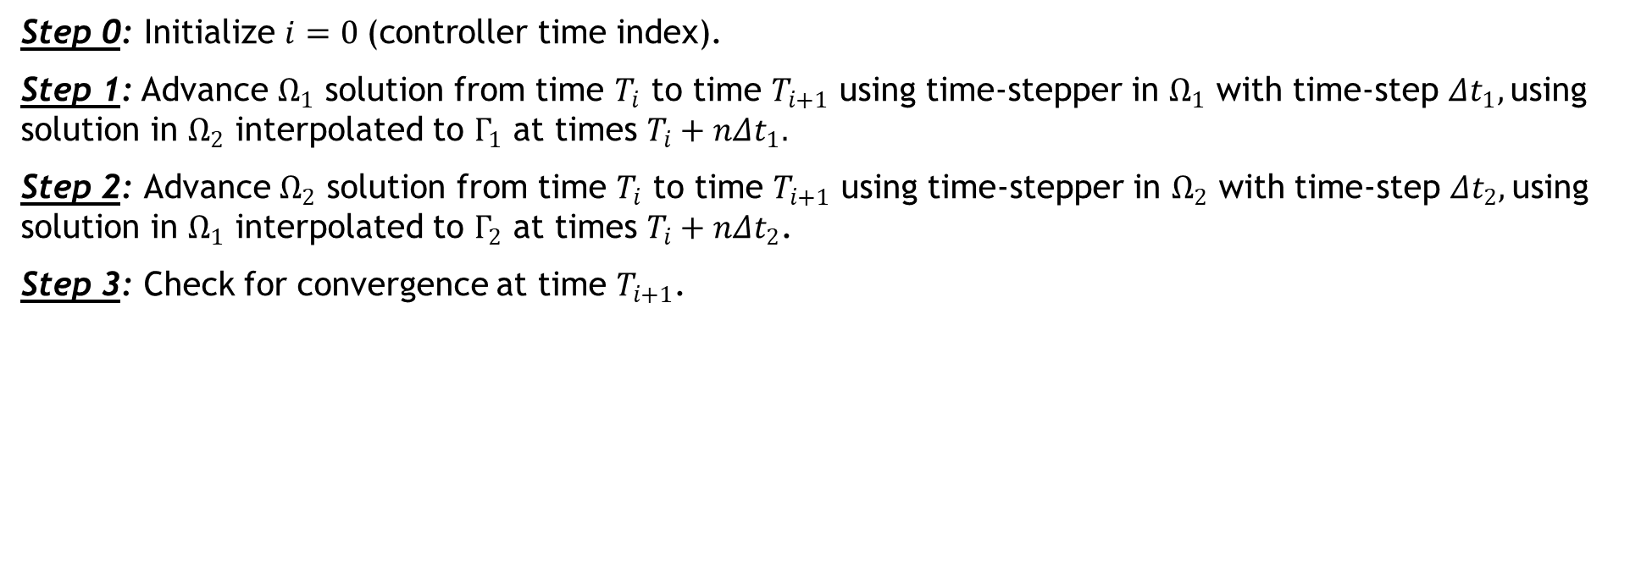
Time-Advancement Within the Schwarz Framework
$$T_{0}$$
$$T_{1}$$
Controller time stepper
Time integrator for Ω₁
Time integrator for Ω₂
Step 0: Initialize $i=0 \text{(}\text{controller} \text{time} \text{index}\text{).}$
Step 1: Advance $Ω_{1}$ solution from time $T_{i}$ to time $T_{i+1}$ using time-stepper in $Ω_{1}$ with time-step ${Δt}_{1},$using solution in $Ω_{2}$ interpolated to $Γ_{1}$ at times $T_{i}+n{Δt}_{1}.$
Step 2: Advance $Ω_{2}$ solution from time $T_{i}$ to time $T_{i+1}$ using time-stepper in $Ω_{2}$ with time-step ${Δt}_{2},$using solution in $Ω_{1}$ interpolated to $Γ_{2}$ at times $T_{i}+n{Δt}_{2}$.
Step 3: Check for convergence at time $T_{i+1}$.
Model PDE:

Slide 14
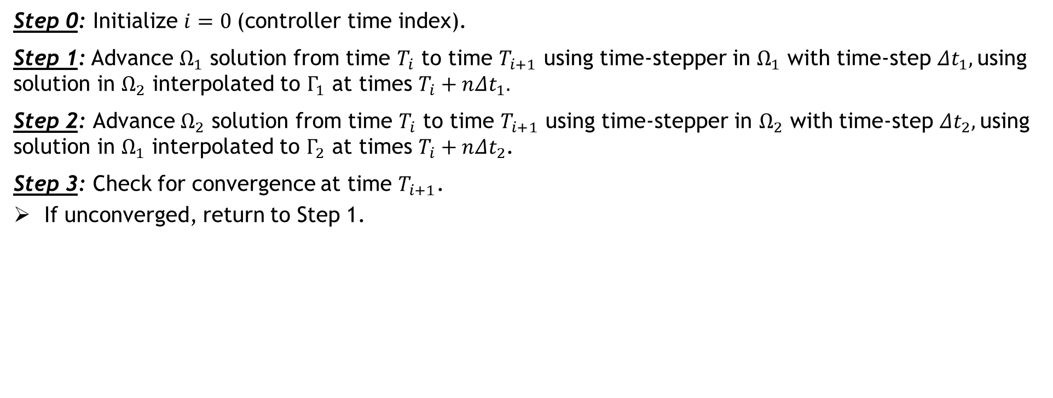

Time-Advancement Within the Schwarz Framework
$$T_{0}$$
$$T_{1}$$
Controller time stepper
Time integrator for Ω₁
Time integrator for Ω₂
Integrate using ${Δt}_{1}$
Interpolate from $Ω_{2}$ to $Γ_{1}$
Step 0: Initialize $i=0 \text{(}\text{controller} \text{time} \text{index}\text{).}$
Step 1: Advance $Ω_{1}$ solution from time $T_{i}$ to time $T_{i+1}$ using time-stepper in $Ω_{1}$ with time-step ${Δt}_{1},$using solution in $Ω_{2}$ interpolated to $Γ_{1}$ at times $T_{i}+n{Δt}_{1}.$
Step 2: Advance $Ω_{2}$ solution from time $T_{i}$ to time $T_{i+1}$ using time-stepper in $Ω_{2}$ with time-step ${Δt}_{2},$using solution in $Ω_{1}$ interpolated to $Γ_{2}$ at times $T_{i}+n{Δt}_{2}$.
Step 3: Check for convergence at time $T_{i+1}$.
If unconverged, return to Step 1.
Model PDE:

Slide 15

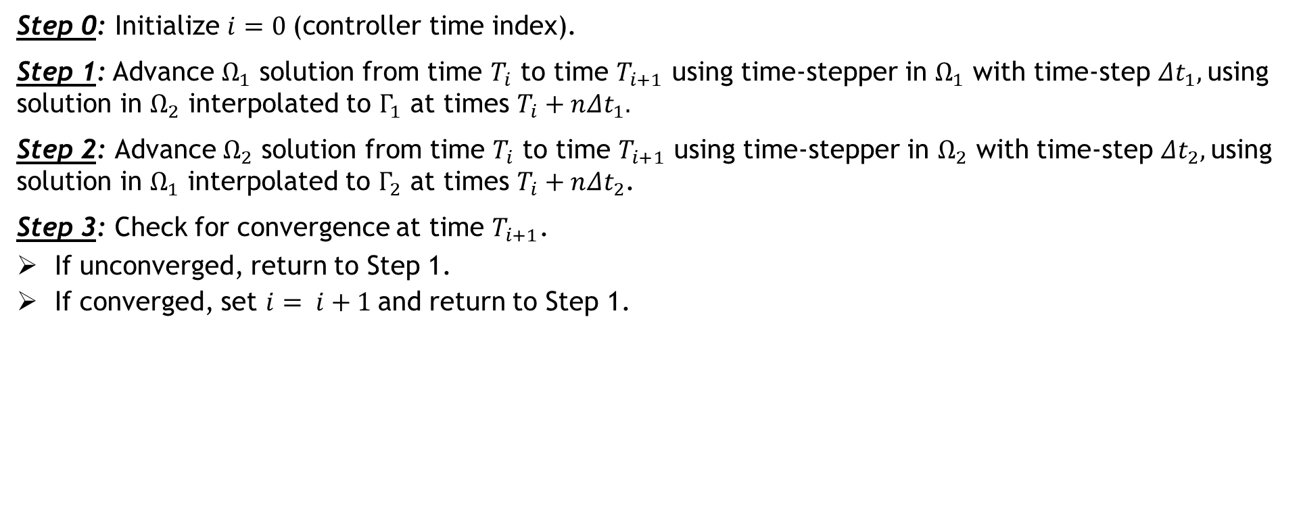

Time-Advancement Within the Schwarz Framework
$$T_{0}$$
$$T_{1}$$
$$T_{2}$$
Controller time stepper
Time integrator for Ω₁
Time integrator for Ω₂
Integrate using ${Δt}_{1}$
Interpolate from $Ω_{2}$ to $Γ_{1}$
Can use different integrators with different time steps within each domain!
Step 0: Initialize $i=0 \text{(}\text{controller} \text{time} \text{index}\text{).}$
Step 1: Advance $Ω_{1}$ solution from time $T_{i}$ to time $T_{i+1}$ using time-stepper in $Ω_{1}$ with time-step ${Δt}_{1},$using solution in $Ω_{2}$ interpolated to $Γ_{1}$ at times $T_{i}+n{Δt}_{1}.$
Step 2: Advance $Ω_{2}$ solution from time $T_{i}$ to time $T_{i+1}$ using time-stepper in $Ω_{2}$ with time-step ${Δt}_{2},$using solution in $Ω_{1}$ interpolated to $Γ_{2}$ at times $T_{i}+n{Δt}_{2}$.
Step 3: Check for convergence at time $T_{i+1}$.
If unconverged, return to Step 1.
If converged, set $i= i+1$and return to Step 1.
Model PDE:

Slide 16


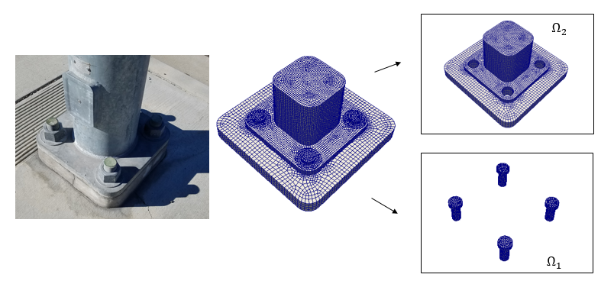


Schwarz for Multi-scale FOM-FOM Coupling in Solid Mechanics¹
Model Solid Mechanics PDEs:
Coupling is concurrent (two-way).
Ease of implementation into existing massively-parallel HPC codes.
Scalable, fast, robust (we target real engineering problems, e.g., analyses involving failure of bolted components!).
Coupling does not introduce nonphysical artifacts.
Theoretical convergence properties/guarantees.
Quasistatic:
Dynamic:
“Plug-and-play” framework:
  Ability to couple regions with different non-conformal meshes, different element types and different levels of refinement to simplify task of meshing complex geometries.
  Ability to use different solvers/time-integrators in different regions.
¹ Mota et al. 2017; Mota et al. 2022.

Slide 17
Outline For Remainder of Presentation
Overview of the Schwarz Alternating Method for Concurrent Coupling
Overview of Projection-Based Model Order Reduction
Extension of Schwarz Alternating Method to FOM-ROM and ROM-ROM coupling
Numerical Results
5. Summary and Future Work

Slide 18
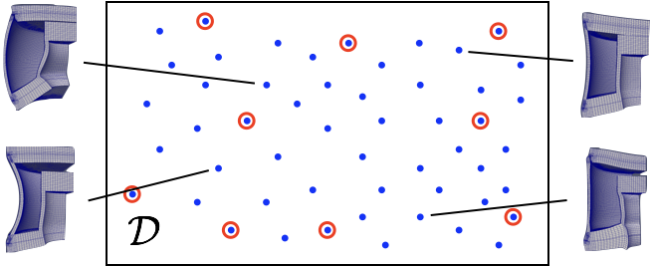

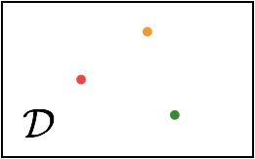




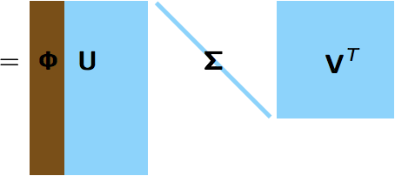


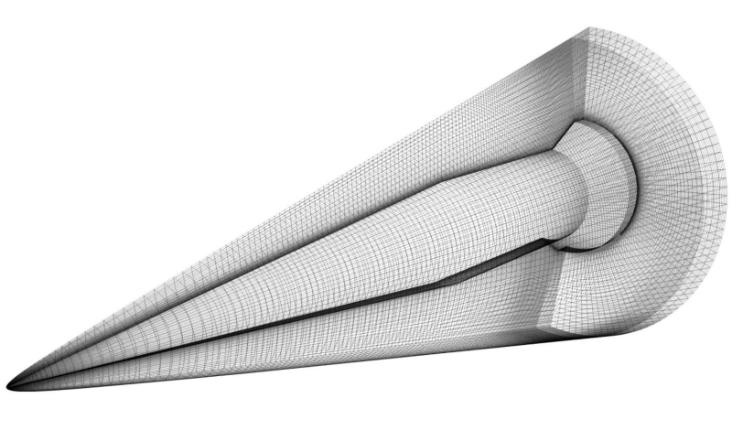
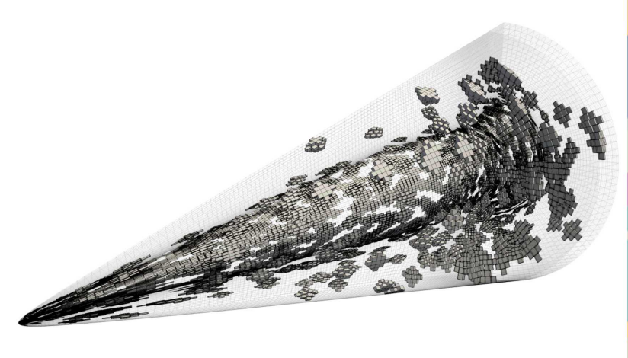


Projection-Based Model Order Reduction via the POD/Galerkin Method
18
Full Order Model (FOM): $M\frac{d^{2}x}{dt^{2}}+f_{int}\left(x\right)=f_{ext}$
1. Acquisition
3. Projection-Based Reduction
Number of time steps
Reduce the number of unknowns
Number of State Variables
Solve ODE at different design points
Save solution data
Perform Galerkin projection
$Φ^{T}MΦ\frac{d^{2}\hat{x}}{dt^{2}}$ + $Φ^{T}f_{int}\left(Φ\hat{x}\right)=Φ^{T}f_{ext}$
2. Learning
Proper Orthogonal Decomposition (POD):
Hyper-reduce nonlinear terms
$$f_{int}\left(Φ\hat{x}\right)≈ A f_{int}\left(Φ\hat{x}\right)$$
Hyper-reduction/sample mesh

Slide 19
Outline For Remainder of Presentation
Overview of the Schwarz Alternating Method for Concurrent Coupling
Overview of Projection-Based Model Order Reduction
Extension of Schwarz Alternating Method to FOM-ROM and ROM-ROM coupling
Numerical Results
5. Summary and Future Work

Slide 20

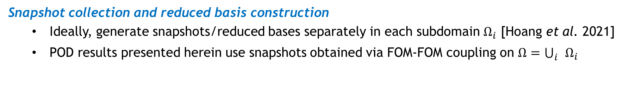
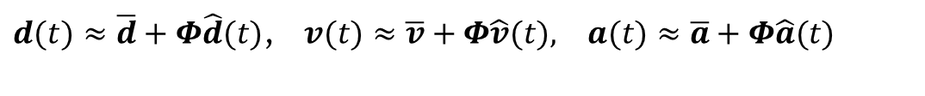
Schwarz Extensions to FOM-ROM and ROM-ROM Couplings
20
Enforcement of Dirichlet boundary conditions (DBCs) in ROM at indices $i_{Dir}$
  Method I in [Gunzburger et al. 2007] is employed
$d(t)≈\overline{d}+Φ\hat{d}(t)$, $v(t)≈\overline{v}+Φ\hat{v}(t), a(t)≈\overline{a}+Φ\hat{a}(t)$
POD modes made to satisfy homogeneous DBCs: $Φ\left(i_{Dir}, :\right)=0$
BCs imposed by modifying $\overline{d}$, $\overline{v}$, $\overline{a}$: $\overline{d}\left(i_{Dir}\right)←χ_{d}$, $\overline{v}\left(i_{Dir}\right)←χ_{v}$, $\overline{a}\left(i_{Dir}\right)←χ_{a}$
Choice of domain decomposition
  Error-based indicators that help decide in what region of the domain a ROM can be viable should drive domain decomposition (future work) [Bergmann et al. 2018]
Snapshot collection and reduced basis construction
  Ideally, generate snapshots/reduced bases separately in each subdomain $Ω_{i}$ [Hoang et al. 2021]
  POD results presented herein use snapshots obtained via FOM-FOM coupling on $Ω=\bigcup_{i}{Ω_{i}}$
For nonlinear solid mechanics, special hyper-reduction methods need to preserve Hamiltonian structure, e.g., Energy-Conserving Sampling and Weighting Method (ECSW) [Farhat et al. 2015]
  Results here are for linear problem, so hyper-reduction is not required

Slide 21
Outline For Remainder of Presentation
Overview of the Schwarz Alternating Method for Concurrent Coupling
Overview of Projection-Based Model Order Reduction
Extension of Schwarz Alternating Method to FOM-ROM and ROM-ROM coupling
Numerical Results
5. Summary and Future Work

Slide 22
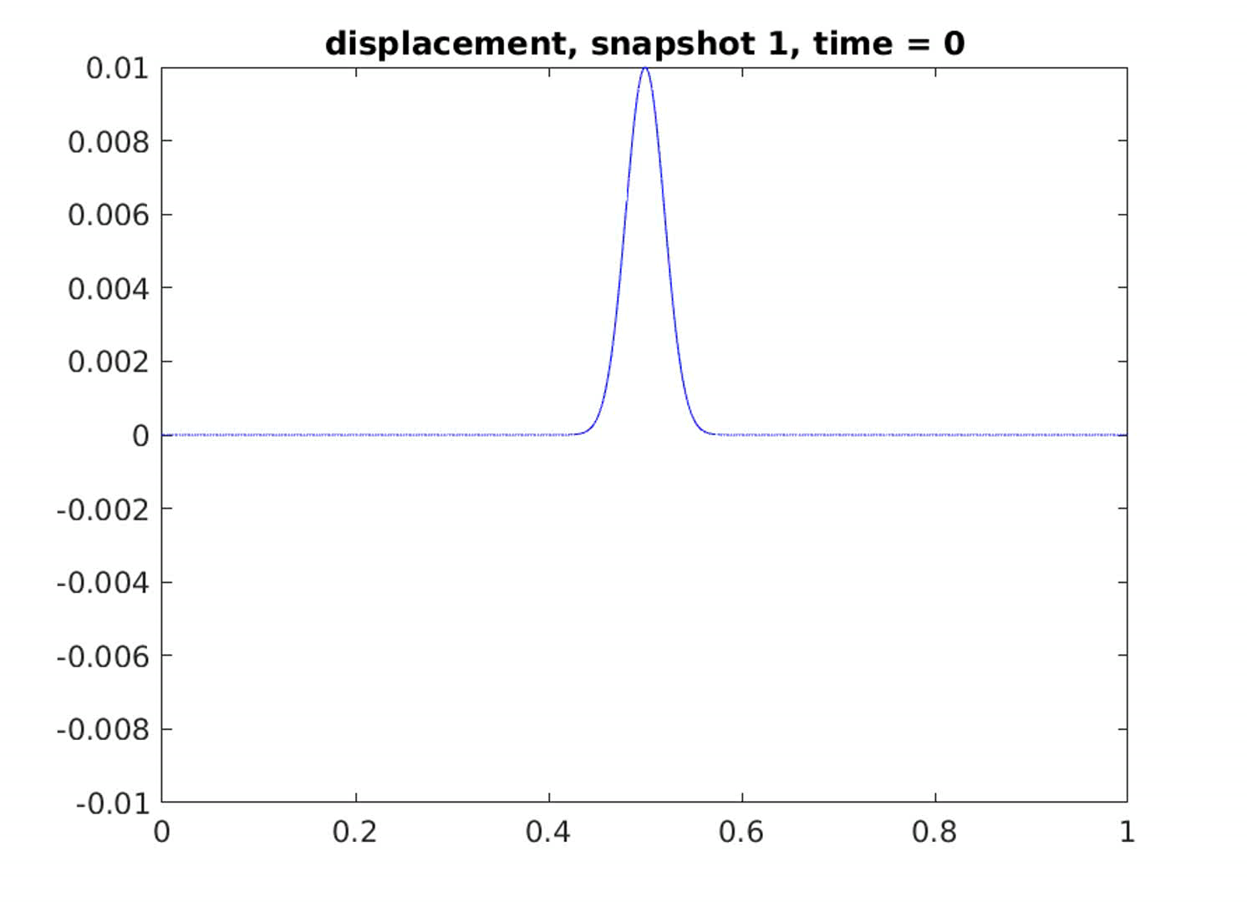


Numerical Example: Linear Elastic Wave Propagation Problem
22
Linear elastic clamped beam with Gaussian initial condition.
Simple problem with analytical exact solution but very stringent test for discretization/coupling methods.
Couplings tested: FOM-FOM, FOM-ROM, ROM-ROM, implicit-explicit, implicit-implicit, explicit-explicit.
ROMs are reproductive and based on the POD/Galerkin method.
  50 POD modes capture $\sim$100% snapshot energy
Above: 3D rendering of clamped beam with Gaussian initial condition.
Right: Initial condition (blue) and final solution (red). Wave profile is negative of initial profile at time T = 1.0e-3.

Slide 23
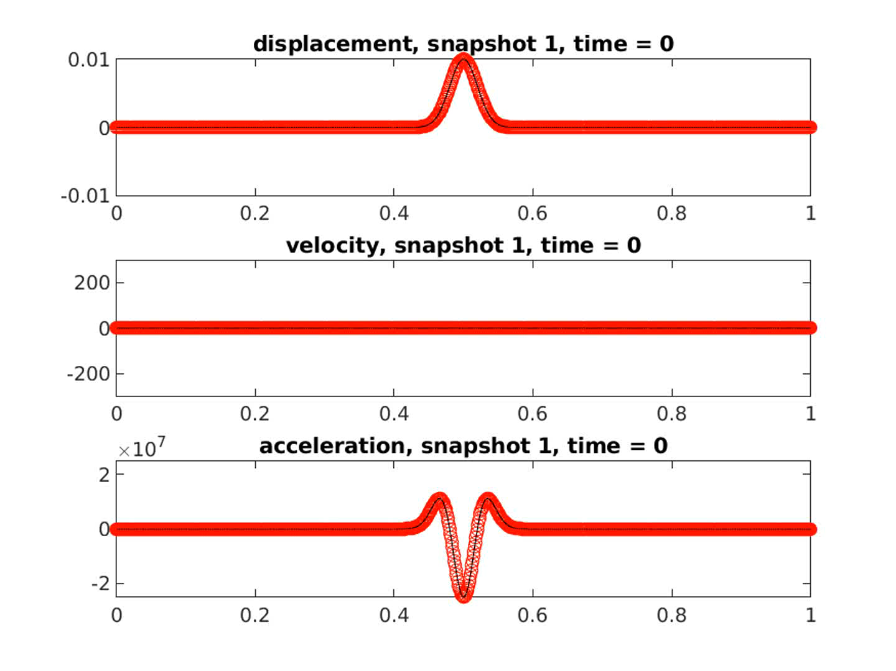
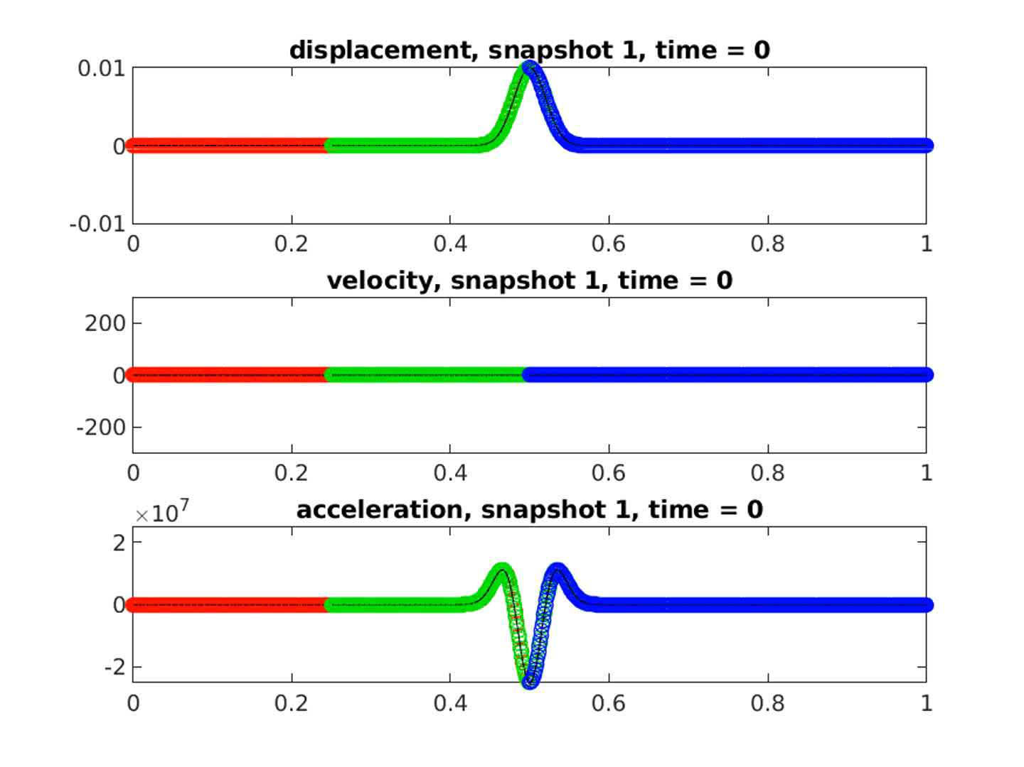
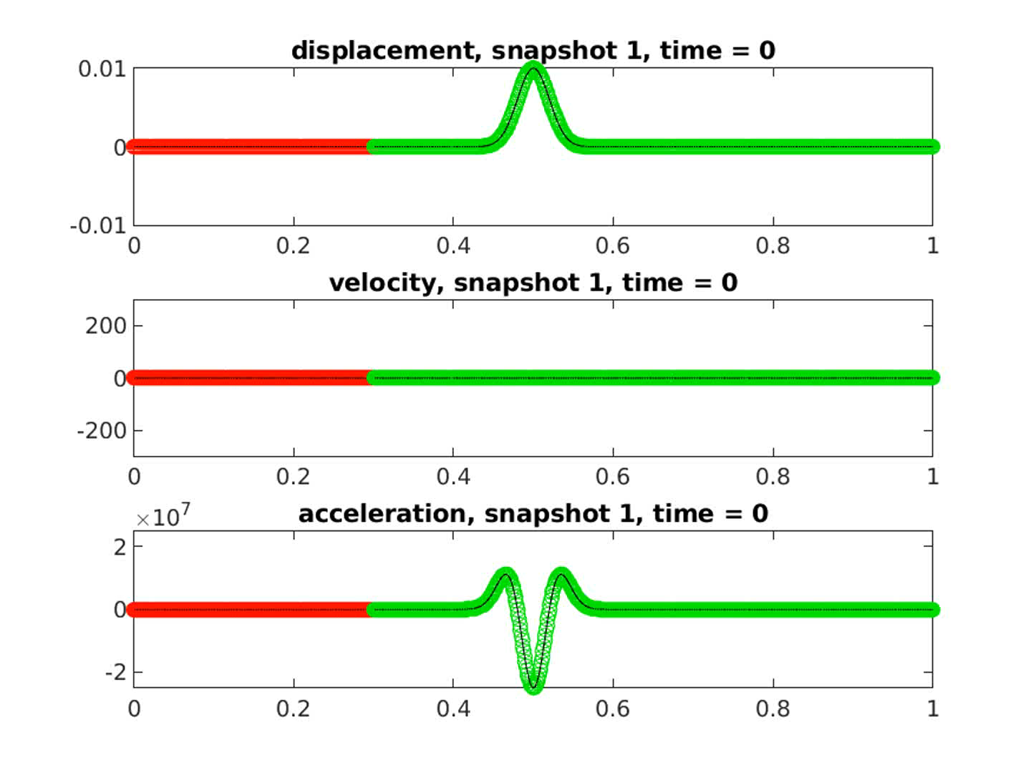
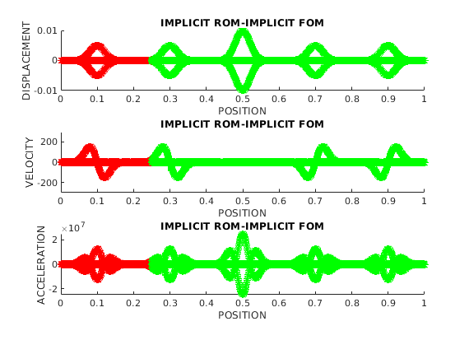
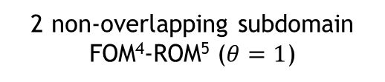

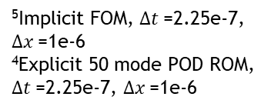


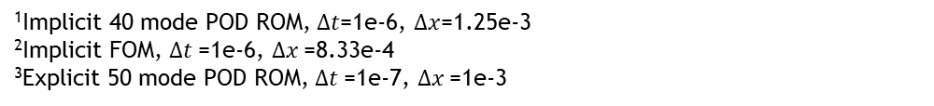


Linear Elastic Wave Propagation Problem: FOM-ROM and ROM-ROM Couplings
Coupling delivers accurate solution if each subdomain model is reasonably accurate, can couple different discretizations with different $Δx,$ $Δt$ and basis sizes.
Single Domain FOM
3 overlapping subdomain ROM¹-FOM²-ROM³
2 non-overlapping subdomain FOM⁴-ROM⁵ ($θ=1$)
0
$$Ω$$
1
0
$$Ω_{1}$$
0.5
0
0.3
$$Ω_{2}$$
1
$$Ω_{1}$$
$$Ω_{2}$$
0.3
1
⁵Implicit FOM, $∆t$=2.25e-7, $∆x$=1e-6
⁴Explicit 50 mode POD ROM, $∆t$=2.25e-7, $∆x$=1e-6
¹Implicit 40 mode POD ROM, $∆t$=1e-6, $∆x$=1.25e-3
²Implicit FOM, $∆t$=1e-6, $∆x$=8.33e-4
³Explicit 50 mode POD ROM, $∆t$=1e-7, $∆x$=1e-3
0.25
$$Ω_{3}$$
0.75

Slide 24
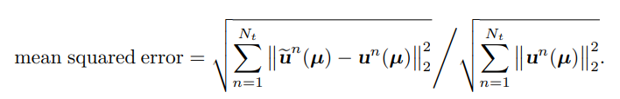
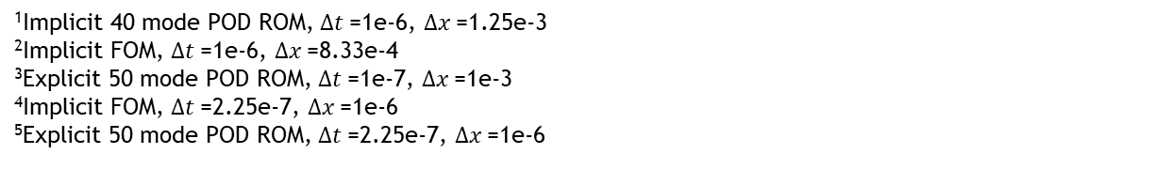
Linear Elastic Wave Propagation Problem: FOM-ROM and ROM-ROM Couplings
Coupled models are reasonably accurate w.r.t. FOM-FOM coupled analogs and convergence with respect to basis refinement for FOM-ROM and ROM-ROM coupling is observed.
 | disp MSE⁶ | velo MSE | acce MSE
Overlapping ROM¹-FOM²-ROM³ | 1.05e-4 | 1.40e-3 | 2.32e-2
Non-overlapping FOM⁴-ROM⁵ | 2.78e-5 | 2.20e-4 | 3.30e-3
¹Implicit 40 mode POD ROM, $∆t$=1e-6, $∆x$=1.25e-3
²Implicit FOM, $∆t$=1e-6, $∆x$=8.33e-4
³Explicit 50 mode POD ROM, $∆t$=1e-7, $∆x$=1e-3
⁴Implicit FOM, $∆t$=2.25e-7, $∆x$=1e-6
⁵Explicit 50 mode POD ROM, $∆t$=2.25e-7, $∆x$=1e-6
⁶MSE=

Slide 25
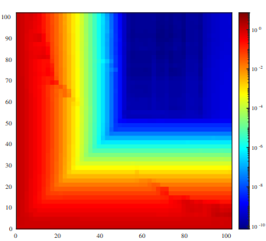
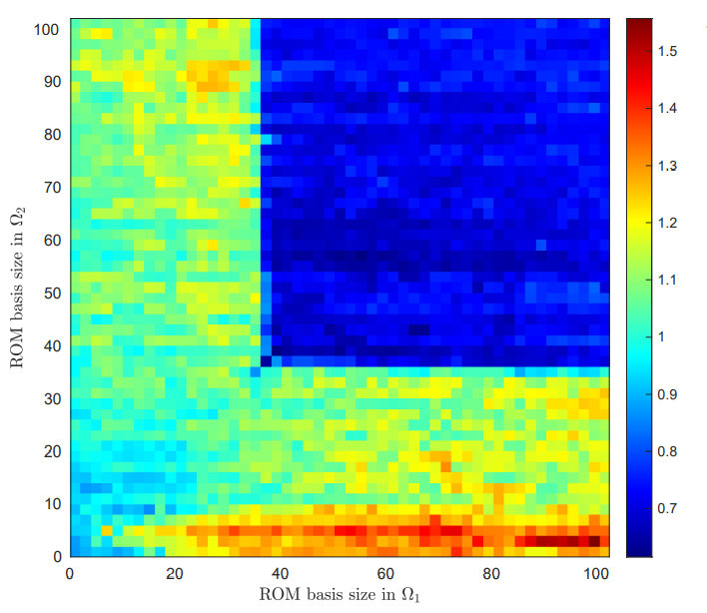
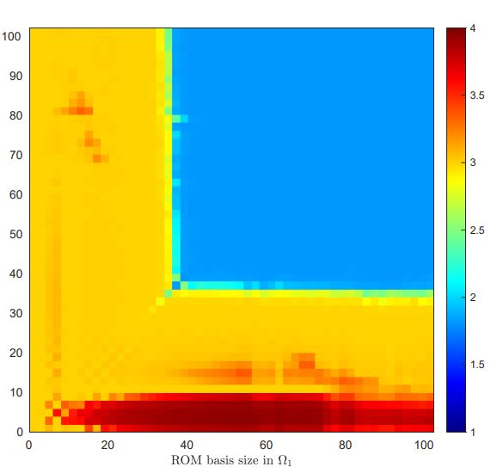






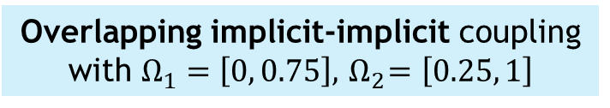
Linear Elastic Wave Propagation Problem: ROM-ROM Couplings
ROM-ROM coupling gives errors < $O$(1e-6) & speedups over FOM-FOM coupling for basis sizes > 40.
MSE in displacement for 2 subdomain ROM-ROM coupling
CPU times for 2 subdomain ROM-ROM coupling normalized by FOM-FOM CPU time
Average # Schwarz iterations for 2 subdomain ROM-ROM coupling
# POD modes in $Ω_{2}$
# POD modes in $Ω_{2}$
# POD modes in $Ω_{2}$
# POD modes in $Ω_{1}$
# POD modes in $Ω_{1}$
# POD modes in $Ω_{1}$
Smaller ROMs are not the fastest: less accurate & require more Schwarz iterations to converge.
All couplings converge in $≤$ 4 Schwarz iterations on average (FOM-(FOM-FOM coupling requires average of 2.4 Schwarz iterations).
Overlapping implicit-implicit coupling with $Ω_{1}=\left[0, 0.75\right], { Ω}_{2}=\left[0.25, 1\right]$
Notes:
TODO: mention how many Schwarz iters FOM-FOM coupling converges in.
For overlapping explicit-explicit coupling
No optimizations have been done to code, which can speed things up further.

Slide 26
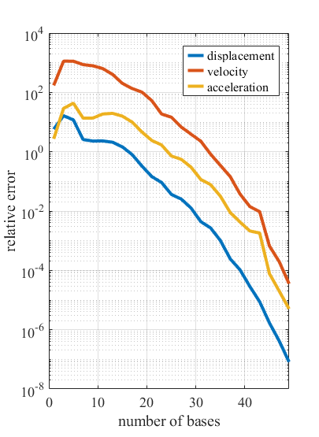
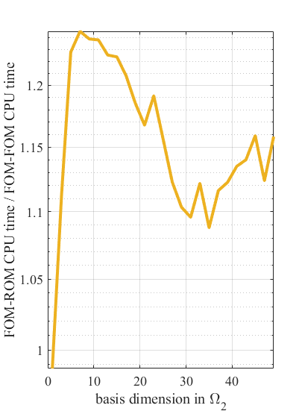
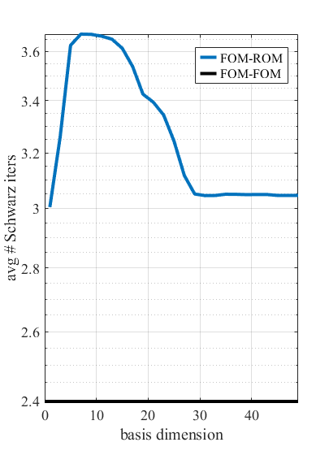



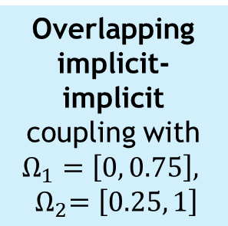
Linear Elastic Wave Propagation Problem: FOM-ROM Couplings
FOM-ROM coupling shows convergence with basis refinement. FOM-ROM couplings are 10-15% slower than comparable FOM-FOM coupling due to increased # Schwarz iterations.
CPU times for 2 subdomain FOM-ROM coupling normalized by FOM-FOM CPU time
MSE for 2 subdomain FOM-ROM coupling
Average # Schwarz iterations for 2 subdomain couplings
WIP: understanding & improving FOM-ROM coupling performance.
Average MSE over 2 subdomains
Online normalized CPU time
Average # Schwarz iters
Overlapping implicit-implicit coupling with $Ω_{1}=\left[0, 0.75\right],$
$${ Ω}_{2}=\left[0.25, 1\right]$$
# POD modes in $Ω_{2}$
# POD modes in $Ω_{2}$
# POD modes in $Ω_{2}$

Slide 27
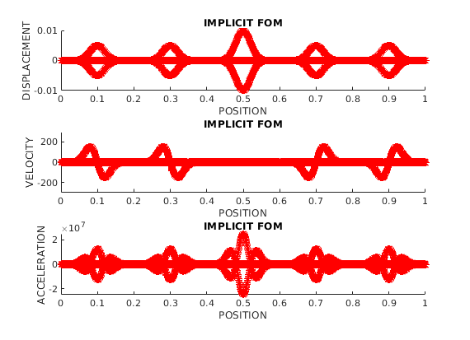







Linear Elastic Wave Propagation Problem: FOM-ROM and ROM-ROM Couplings
Inaccurate model + accurate model $≠$ accurate model.
Accuracy can be improved by “gluing” several smaller, spatially-local models
Single Domain, FOM (truth)
Single Domain, 10 mode POD
10 mode POD – 10 mode POD
Figure above: $Ω_{1}=\left[0, 0.3\right], { Ω}_{2}=\left[0.25, 1\right]$, 20 mode POD – FOM
Figure below: $Ω_{1}=\left[0, 0.26\right], { Ω}_{2}=\left[0.25, 0.75\right], Ω_{3}=\left[0.74, 1\right]$, 15 mode POD – 30 mode POD – 15 mode POD
10 mode POD – 50 mode POD
10 mode POD – FOM
20 mode POD – FOM
Figures above: $Ω_{1}=\left[0, 0.75\right], { Ω}_{2}=\left[0.25, 1\right]$
Observation suggests need for “smart” domain decomposition.

Slide 28
Outline For Remainder of Presentation
Overview of the Schwarz Alternating Method for Concurrent Coupling
Overview of Projection-Based Model Order Reduction
Extension of Schwarz Alternating Method to FOM-ROM and ROM-ROM coupling
Numerical Results
5. Summary and Future Work

Slide 29
Summary & Future Work
Summary:
Initial prototyping suggests that the Schwarz alternating method can be effective coupling method that enables coupling of conventional and data-driven models (projection-based ROMs).
The coupling methodology enables the use of different mesh resolutions, reduced basis sizes, and different time integrators with different time steps in different subdomains.
Preliminary results suggest that the choice of domain decomposition (DD) is critical to accuracy of the coupled model.
Ongoing/future work:
Implementation/prototyping of coupling method on non-linear problems with ECSW-based hyper-reduction.
Implementation/prototyping of coupling method in multi-D.
Optimizing FOM-ROM and ROM-ROM coupling code/algorithm.
Development of error indicators to guide DD in an error-controlling way, e.g., [Bergmann et al. 2018].
Analysis of proposed coupling approach for FOM-ROM and ROM-ROM coupling.
Development of snapshot collection approaches that do not require full system simulation [Hoang et al. 2021]
Extension of the coupling framework to include Physics-Informed Neural Networks (PINNs).
Extension of coupling method to multi-material and multi-physics problems.

Slide 30
References
H. Schwarz, Uber einen Grenzubergang durch alternierendes verfahren, Vierteljahrsschriftder Naturforschenden Gesellschaft in Zurich, 15 (1870), pp. 272–286.
P.L. Lions. “On the Schwarz alternating method I.” In: 1988, First International Symposium on Domain Decomposition methods for Partial Differential Equations, SIAM, Philadelphia.
P. L. Lions, On the Schwarz alternating method III: A variant for nonoverlapping subdomains, in Third International Symposium on Domain Decomposition Methods for Partial Differential Equations, T. F. Chan, R. Glowinski, J. P´eriaux, and O. B. Widlund, eds., Society for Industrial and Applied Mathematics, 1990, pp. 202–223
P. Zanolli, Domain decomposition algorithms for spectral methods, CALCOLO, 24 (1987), pp. 201–240.
A. Mota, I. Tezaur, and C. Alleman, The Schwarz alternating method, Comput. Meth. Appl. Mech. Engng., 319 (2017), pp. 19–51.
A. Mota, I. Tezaur, and G. Phlipot, The Schwarz alternating method for transient solid dynamics, Int. J. Numer. Meth. Engng. (in press).
N. J. Carpenter, R. L. Taylor, and M. G. Katona, Lagrange constraints for transient finite element surface contact, International journal for numerical methods in engineering, 32 (1991), pp. 103–128.
J. Hoy, I. Tezaur, A. Mota. The Schwarz alternating method for multi-scale contact mechanics. CSRI Summer Proceedings 2021.
A. Mota, I. Tezaur, J. Hoy. The Schwarz alternating method for multi-scale contact mechanics. Mathematical & Computational Applications (MCA) (under review).
Charbel Farhat, Todd Chapman, and Philip Avery. Structure-preserving, stability, and accuracy properties of the energy-conserving sampling and weighting method for the hyper reduction of nonlinear finite element dynamic models. International Journal for Numerical Methods in Engineering, 102(5):1077–1110, 2015.
Max D. Gunzburger, Janet S. Peterson, and John N. Shadid. Reduced-order modeling of time-dependent PDEs with multiple parameters in the boundary data. In: Computer Methods in Applied Mechanics and Engineering 196.4 (2007), pp. 1030–1047. issn: 0045-7825.
M. Buffoni, H. Telib, and A. Iollo. Iterative Methods for Model Reduction by Domain Decomposition. Tech. rep. 6383. INRIA Report, 2007.
M. Bergmann, A. Ferrero, A. Iollo, E. Lombardi. A zonal Galerkin-free POD model for incompressible flows. J. Comput. Phys. 352: 301-325, 2018.
C. Hoang, Y. Choi, K. Carlberg. Domain-decomposition least-squares Petrov-Galerkin (DD-LSPG) nonlinear model reduction. Comput. Meth. Appl. Mech. Engng. 364: 113997, 2021.
Thank you for your attention!
Notes:
Add Gunzburger ref, Iollo/Taddei refs.

Slide 31
Start of Backup Slides

Slide 32

How We Use the Schwarz Alternating Method
32
AS A PRECONDITIONER FOR THE LINEARIZED SYSTEM
AS A SOLVER FOR THE COUPLED
FULLY NONLINEAR PROBLEM

Slide 33



Schwarz for Multi-scale FOM-FOM Coupling in Solid Mechanics and Contact Dynamics
The overlapping Schwarz alternating method has been developed/implemented for concurrent multi-scale quasistatic¹ & dynamic² modeling in Sandia’s Albany/LCM and Sierra/SM codes.
We are currently developing a novel contact method³ based on non-overlapping Schwarz.
 | CPU times | # Schwarz iters
Single $Ω$ | 3h 34m | $$−$$
Schwarz | 2h 42m | 3.22
³Hoy et al., 2021; Mota et al., 2022.
¹Mota et al., 2017. ²Mota et al., 2022.

Slide 34

Schwarz for Multi-scale FOM-FOM Coupling in Solid Mechanics and Contact Dynamics
The overlapping Schwarz alternating method has been developed/implemented for concurrent multi-scale quasistatic¹ & dynamic² modeling in Sandia’s Albany/LCM and Sierra/SM codes.
We are currently developing a novel contact method³ based on non-overlapping Schwarz.
Talk by A. Mota
 | CPU times | # Schwarz iters
Single $Ω$ | 3h 34m | $$−$$
Schwarz | 2h 42m | 3.22
³Hoy et al., 2021; Mota et al., 2022.
¹Mota et al., 2017. ²Mota et al., 2022.

Slide 35

Linear Elastic Wave Propagation Problem: FOM-ROM and ROM-ROM Couplings
Coupling delivers accurate solution if each subdomain model is reasonably accurate, can couple different discretizations with different $Δx,$ $Δt$ and basis sizes.
Single Domain FOM
3 overlapping subdomain ROM¹-FOM²-ROM³
2 non-overlapping subdomain FOM⁴-ROM⁵ ($θ=1$)
0
$$Ω$$
1
0
$$Ω_{1}$$
0.5
0
0.3
$$Ω_{2}$$
1
$$Ω_{1}$$
$$Ω_{2}$$
0.3
1
⁵Implicit FOM, $∆t$=2.25e-7, $∆x$=1e-6
⁴Explicit 50 mode POD ROM, $∆t$=2.25e-7, $∆x$=1e-6
¹Implicit 40 mode POD ROM, $∆t$=1e-6, $∆x$=1.25e-3
²Implicit FOM, $∆t$=1e-6, $∆x$=8.33e-4
³Explicit 50 mode POD ROM, $∆t$=1e-7, $∆x$=1e-3
0.25
$$Ω_{3}$$
0.75

Slide 36



Linear Elastic Wave Propagation Problem: FOM-ROM and ROM-ROM Couplings
 | Online CPU time | Total # Schwarz iters
Overlapping FOM¹-FOM²-FOM³ | 68.7s | 2972
Overlapping ROM⁴-FOM²-ROM⁵ | 81.6s | 4000
Non-overlapping FOM⁶-FOM⁷ | 38.0s | 10,516
Non-overlapping FOM⁶-ROM⁸ | 49.8s | 13,366
CPU-Time FOM-FOM: 7.48e1
CPU-Time FOM-ROM: 1.16e2
CPU-Time ROM-ROM: 7.16e1
# Schwarz iters
$Ω_{1}=\left[0, 0.75\right], { Ω}_{2}=\left[0.25, 1\right]$
FOM-ROM and ROM-ROM couplings often (but not always) increase # Schwarz iterations relative to FOM-FOM coupling.
Key to improving efficiency is reducing # Schwarz iterations.
time
¹Implicit FOM, $∆t$=1e-6, $∆x$=1.25e-3
²Implicit FOM, $∆t$=1e-6, $∆x$=8.33e-4
³Explicit FOM, $∆t$=1e-7, $∆x$=1e-3
⁴Implicit 30 mode POD ROM, $∆t$=1e-6, $∆x$=1.25e-3
⁵Explicit 50 mode POD ROM, $∆t$=1e-7, $∆x$=1e-3
⁶Implicit FOM, $∆t$=2.25e-7, $∆x$=1e-6
⁷Explicit FOM, $∆t$=2.25e-7, $∆x$=1e-6
⁸Explicit 50 mode POD ROM, $∆t$=2.25e-7, $∆x$=1e-6
ROMs with fewer modes do not always give rise to smaller CPU times.
Less accurate models $⟹$ more Schwarz iterations needed for convergence.
Using smaller time steps can decrease # Schwarz iterations.
WIP: optimizing FOM-ROM and ROM-ROM coupling implementation and devising ways to reduce # Schwarz iterations (e.g., through relaxation parameter $θ$)
Notes:
Errors are of course just a part of the story; also of interest is performance, and this is where we still need to do a little bit of work. The table on the left shows the online CPU time and total # of Schwarz iterations for the 2 couplings I focused on in the past 2 slides, compared with these quantities for corresponding all-FOM couplings. You can see that even though the couplings with the ROMs have less dofs, the online CPU time is actually higher than the all-FOM couplings. This is because the total # of Schwarz iterations required for convergence often (but not always, as the right plot shows) goes up when you through a ROM into the mix. The key to improving efficiency seems to be to reduce the number of Schwarz iterations required for convergence; we’re looking at ways to do this, for instance through the specification of the relaxation parameter theta in the non-overlapping Schwarz case.
There are a couple more comments here on behavior we have observed. First, ROMs with fewer modes do not always give rise to smaller CPU times. This is because if you are coupling less accurate models, typically more Schwarz iterations are needed to achieve convergence. We have also observed that decreasing the time-step can decrease the number of Schwarz iterations.

