Slide 1
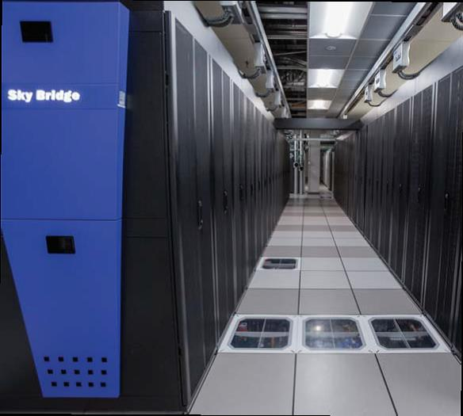
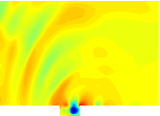
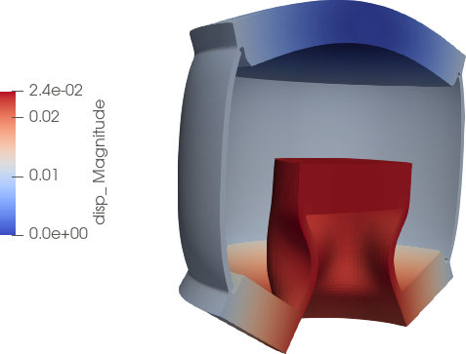
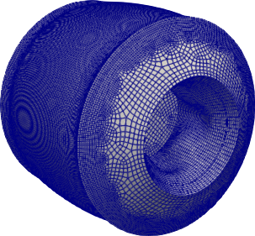
Preconditioned Least-Squares Petrov-Galerkin Reduced Order Models for Fluid and Solid Mechanics Problems
Payton Lindsay¹, Jeff Fike¹, Irina Tezaur¹, Kevin Carlberg²
¹Sandia National Labs, ²Meta Research Labs/U Washington
ECCOMAS 2022 June 6-9, 2022 Oslo, Norway
SAND2021-11141C

Slide 2
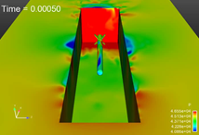
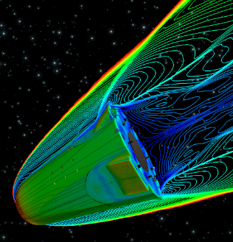
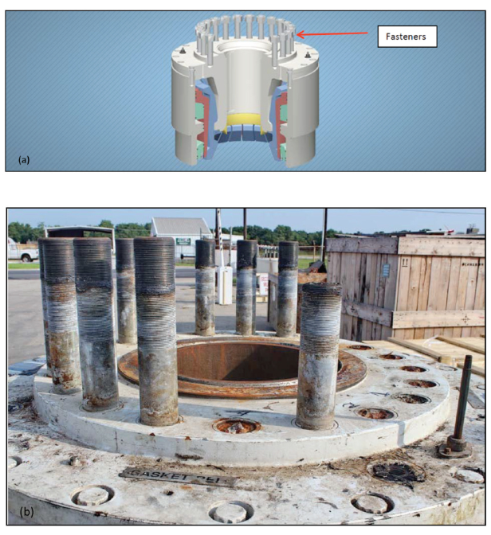
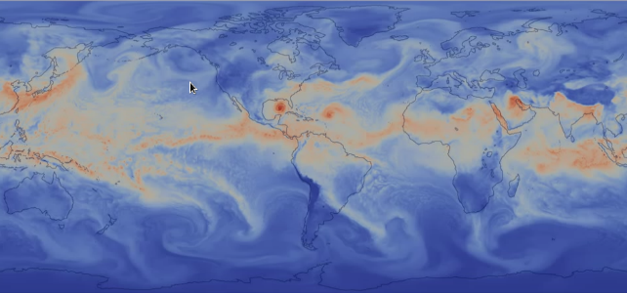

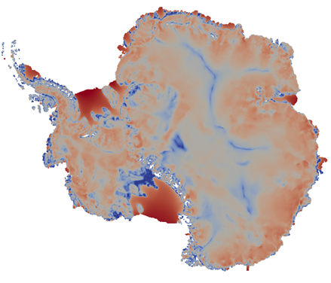
Motivation
Despite improved algorithms and powerful supercomputers, “high-fidelity” models are often too expensive for use in a design or analysis setting.
Sandia application areas in which this situation arises:
Captive-carry and re-entry environments: Large Eddy Simulations (LES) runs require very fine meshes and can take on the order of weeks.
Fastener failure modeling: modeling fastener behavior in a full system presents meshing and computational challenges, which limits the number of configurations that can be studied.
Climate modeling (e.g., land-ice, atmosphere): high-fidelity simulations too costly for uncertainty quantification (UQ); Bayesian inference of high-dimensional parameter fields is intractable.
Notes:
Despite improved algorithms and powerful supercomputers, high-fidelity models are often to expensive for use in a design or analysis setting.
This is especially the case when one is interested in studies involving real-time or multi-query analyses, such as optimization or UQ.
I have shown here some application areas in which this situation arises that are relevant to Sandia.
Our simulations of the captive-carry and re-entry environments require very fine meshes and can take on the order of weeks to perform.
The modeling of fastener behavior in a full system to predict failure presents meshing and computational challenges, which limits the number of configurations that can be studied.
The computational cost of climate model simulations, together with the presence of high-dimensional parameter fields, makes UQ and Bayesian inference intractable.

Slide 3
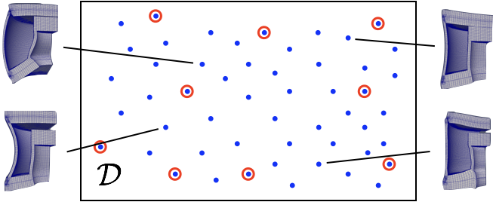



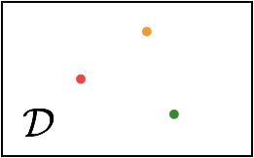


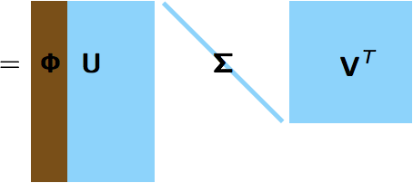

POD/LSPG* Approach to Model Reduction
Full Order Model (FOM) = Ordinary Differential Equation (ODE):
1. Acquisition
3. Reduction
Number of time steps
Choose ODE Temporal Discretization
Number of State Variables
Solve ODE at different design points
Reduce the number of unknowns
Save solution data
2. Learning
Proper Orthogonal Decomposition (POD):
Minimize
the Residual
*Least-Squares Petrov-Galerkin Projection [K. Carlberg et al., 2011; K. Carlberg et al., 2017]
Notes:
Reduced order modeling is a promising tool for enabling analyses such as those shown on the previous slide.
This talk will focus on the POD/Least Squares Galerkin projection approach to model reduction, which is outlined in this slide. Assume you have a semi-discretized full order model of the form at the top of the slide. The first step is to run your FOM to collect snapshot data in space and/or time. From this snapshot data, we learn a reduced basis, in our case, using the proper orthogonal decomposition method or POD. Finally we perform the projection-based reduction. First, we choose a temporal discretization for our FOM ODE to get a fully discrete FOM nonlinear problem give r(x,mu) = 0. Next, we approximate the FOM solution x(t) as a linear combination of the reduced basis vector Phi and the unknown ROM solution x-hat.
And finally, we minimize the FOM residual at each time-step in the l2 norm. To deal with the cost of this minimization, which scales like the cost of the FOM, it is common practice to introduce hyper-reduction using a sample mesh, the basic idea of which is to compute the residual at some small number of points encapsulated into the sampling matrix A shown here.
Sample mesh: maybe emphasize that we have an under constrained minimization problem
Relate hyper reduction to sparse quadrature, I think that gives it a nice mathematical basis

Slide 4


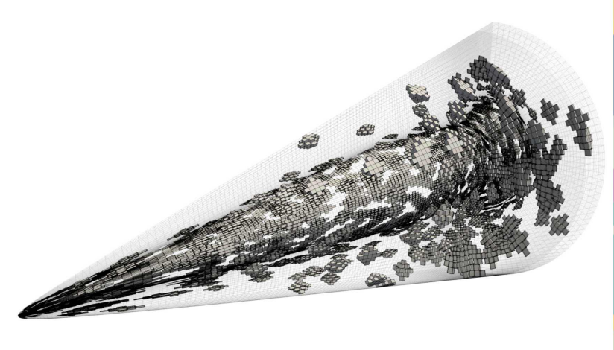
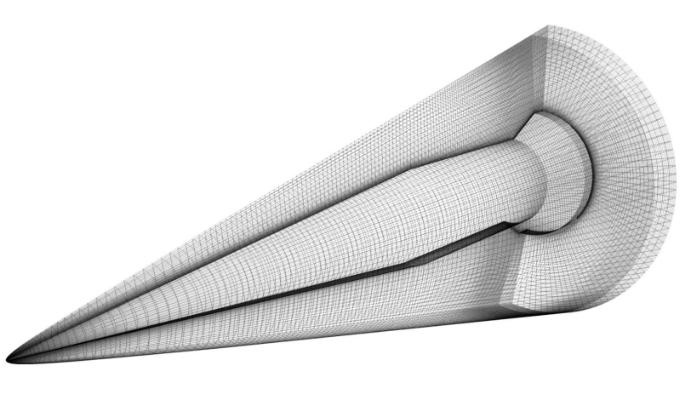
POD/LSPG* Approach to Model Reduction
Full Order Model (FOM) = Ordinary Differential Equation (ODE):
1. Acquisition
3. Reduction
Number of time steps
Choose ODE Temporal Discretization
Number of State Variables
Solve ODE at different design points
Reduce the number of unknowns
Save solution data
2. Learning
Proper Orthogonal Decomposition (POD):
Minimize
the Residual
Hyper-reduction/sample mesh
*Least-Squares Petrov-Galerkin Projection [K. Carlberg et al., 2011; K. Carlberg et al., 2017]
Notes:
Reduced order modeling is a promising tool for enabling analyses such as those shown on the previous slide.
This talk will focus on the POD/Least Squares Galerkin projection approach to model reduction, which is outlined in this slide. Assume you have a semi-discretized full order model of the form at the top of the slide. The first step is to run your FOM to collect snapshot data in space and/or time. From this snapshot data, we learn a reduced basis, in our case, using the proper orthogonal decomposition method or POD. Finally we perform the projection-based reduction. First, we choose a temporal discretization for our FOM ODE to get a fully discrete FOM nonlinear problem give r(x,mu) = 0. Next, we approximate the FOM solution x(t) as a linear combination of the reduced basis vector Phi and the unknown ROM solution x-hat.
And finally, we minimize the FOM residual at each time-step in the l2 norm. To deal with the cost of this minimization, which scales like the cost of the FOM, it is common practice to introduce hyper-reduction using a sample mesh, the basic idea of which is to compute the residual at some small number of points encapsulated into the sampling matrix A shown here.
Sample mesh: maybe emphasize that we have an under constrained minimization problem
Relate hyper reduction to sparse quadrature, I think that gives it a nice mathematical basis

Slide 5
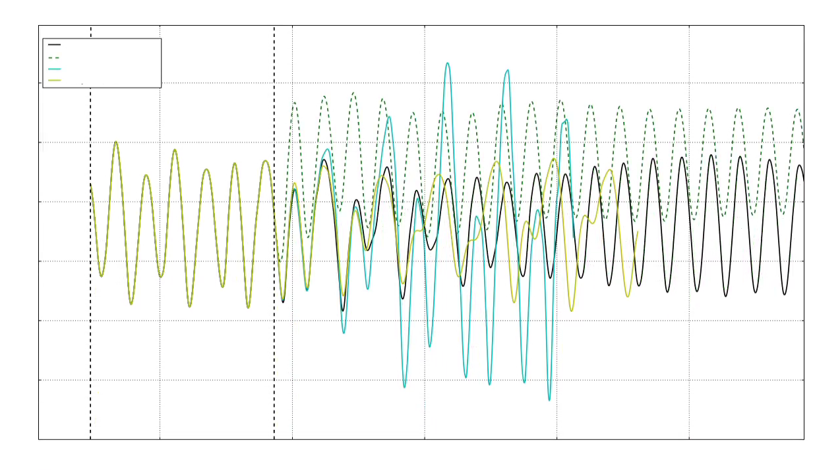
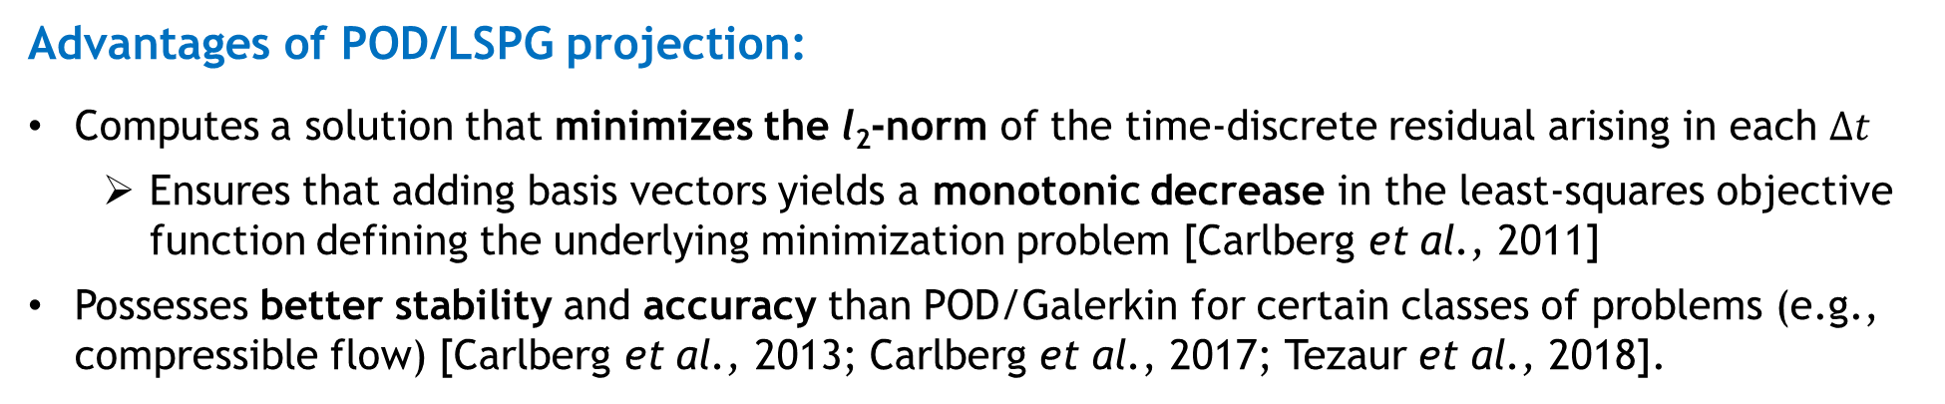

POD/LSPG Approach to Model Reduction
Advantages of POD/LSPG projection:
Computes a solution that minimizes the l₂-norm of the time-discrete residual arising in each $∆t$
  Ensures that adding basis vectors yields a monotonic decrease in the least-squares objective function defining the underlying minimization problem [Carlberg et al., 2011]
Possesses better stability and accuracy than POD/Galerkin for certain classes of problems (e.g., compressible flow) [Carlberg et al., 2013; Carlberg et al., 2017; Tezaur et al., 2018].
Room for improvement for realistic predictive applications:
Accuracy for predictive problems can be inadequate
Method may fail to converge for some realistic problems run in the predictive regime
Method may struggle when applied to problems with disparate scales [Washabaugh, 2016]
$−$ FOM
-- 1000 mode POD/LSPG ROM
$−$ 2000 mode POD/LSPG ROM
$−$ 3000 mode POD/LSPG ROM
Pressure
Reproductive
Predictive
Time
Mitigation: introduction of preconditioning into LSPG ROM formulation.
Notes:
Now, in general, POD/LSPG is a very nice method that has some favorable properties.
Computing a solution that minimized the l2-norm of the time-discrete residual arising in each time-step ensures that adding basis vectors yields a monotonic decrease in the least-squares objective function defining the underlying minimization problem. Additionally, LSPG ROMs tend to have better stability and accuracy properties that Galerkin ROMs for certain classes of problems, in particular compressible flow problems.
However, like with any method, there is some room for improvemenin tt when it comes to applying the POD/LSPG to realistic predictive applications.
First, ROMs constructed using this method may not be sufficiently accurate in the time-predictive regime (when the ROM is run past the time up to which snapshots were collected). This can be seen for a fluid POD/LSPG ROM in the figure on the right, where even a 2000 mode POD/LSPG ROM is noticeably inaccurate in the predictive regime.
Second, Galerkin ROMs tend to outperform LSPG ROMs for solid mechanics applications.
And finally, the method may struggle when applied to problems with disparate scales.
This is because when there are differences in scale between components of PDE systems, residual components corresponding to certain variables can be very large compared to the residual components corresponding to other variables, which can bias the minimization procedure.
It turns out that one way to deal with these issues is through the introduction of preconditioning into the LSPG/ROM formulation, the subject of this talk.

Slide 6
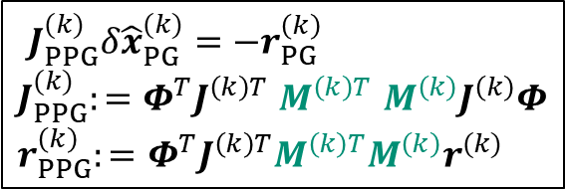

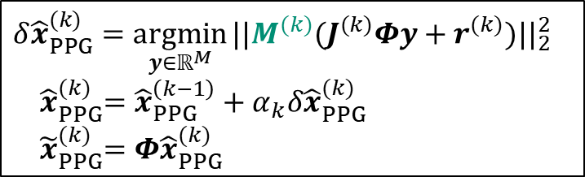

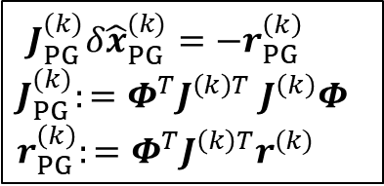
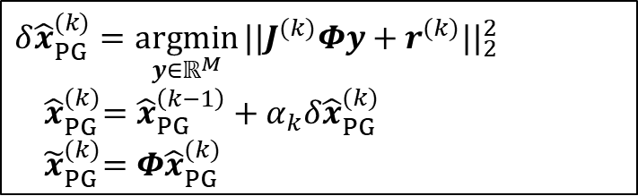
Preconditioned LSPG ROMs
LSPG Formulation:
Normal equations
$$δ{\hat{x}}_{PG}^{(k)}=\underset{y∈ℝ^{M}}{argmin}{||J^{(k)}{Φy+r^{(k)}||}_{2}^{2}}$$
${ \hat{x}}_{PG}^{(k)}=$ ${\hat{x}}_{PG}^{\left(k−1\right)}+α_{k}δ{\hat{x}}_{PG}^{(k)}$
${ \tilde{x}}_{PG}^{(k)}=$ $Φ{\hat{x}}_{PG}^{(k)}$
$J_{PG}^{(k)}δ{\hat{x}}_{PG}^{(k)}=−r_{PG}^{\left(k\right)}$
$J_{PG}^{(k)}:=Φ^{T}J^{\left(k\right)T}$ $J^{\left(k\right)}Φ$
$r_{PG}^{\left(k\right)}:=$ $Φ^{T}J^{\left(k\right)T}r^{(k)}$
$$\hat{x}=\underset{y∈ℝ^{M}}{argmin}{||r\left(Φy\right){||}_{2}^{2}}$$
Optimization problem
Gauss-Newton iteration
Preconditioned LSPG Formulation:
Normal equations
$$δ{\hat{x}}_{PPG}^{(k)}=\underset{y∈ℝ^{M}}{argmin}{||{M^{(k)}(J}^{(k)}{Φy+r^{(k)})||}_{2}^{2}}$$
${ \hat{x}}_{PPG}^{(k)}=$ ${\hat{x}}_{PPG}^{\left(k−1\right)}+α_{k}δ{\hat{x}}_{PPG}^{(k)}$
${ \tilde{x}}_{PPG}^{(k)}=$ $Φ{\hat{x}}_{PPG}^{(k)}$
$J_{PPG}^{(k)}δ{\hat{x}}_{PG}^{(k)}=−r_{PG}^{\left(k\right)}$
$J_{PPG}^{(k)}:=Φ^{T}J^{\left(k\right)T}$ ${M^{\left(k\right)T} M^{\left(k\right)}J}^{\left(k\right)}Φ$
$r_{PPG}^{\left(k\right)}:=$ $Φ^{T}J^{\left(k\right)T}M^{\left(k\right)T}M^{\left(k\right)}r^{(k)}$
$$\hat{x}=\underset{y∈ℝ^{M}}{argmin}{||Mr\left(Φy\right){||}_{2}^{2}}$$
Optimization problem
Gauss-Newton iteration
Notes:
Lets look in a little bit more detail at LSPG and how preconditioning within the context of LSPG would work. At the top of the slide, we have the LSPG formulation. The optimization problem defining LSPG is on the left. If you solve this problem using the Gauss-Newton method, as typically done, you get the Gauss-Newton iteration shown here in the middle, where J^k is the FOM Jacobian and r^k is the FOM residual. On the right are the normal equations for this problem, which define the linear system solved in each Gauss-Newton iteration, where J_PG is the so-called reduced Jacobian.
Lets look at how this formulation changes when we introduce preconditioning. Let M denote the preconditioning matrix, an approximation of the inverse of the Jacobian operator. We insert the preconditioner into our optimization problem as a pre-multiplier of the residual being minimized, as shown on the left. You can see in the right two boxes how the preconditioning propagates through the relevant equations. In particular, note that we are _not_ simply preconditioning the linear system in the normal equations by pre-multiplying this by the preconditioner matrix – the preconditioner shows up in this middle part of the reduced Jacobian defining the normal equations.

Slide 7

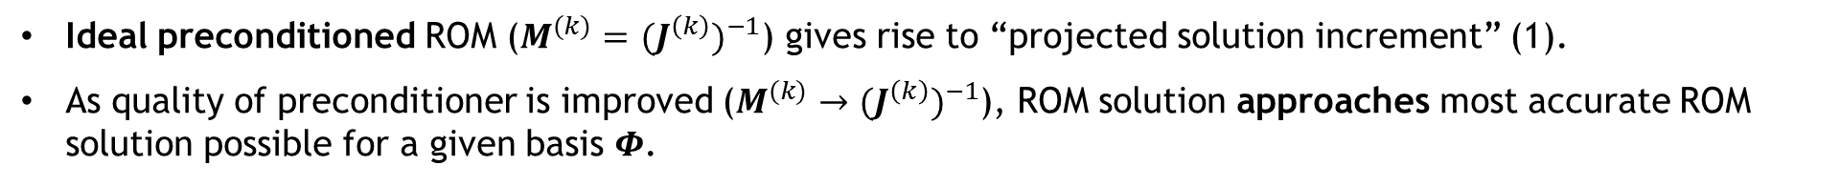

Preconditioned LSPG ROMs
Adding preconditioning to the POD/LSPG formulation can improve not only ROM efficiency but also ROM accuracy.
Ideal preconditioned ROM emulates projection of FOM solution increment onto POD basis.
Upper limit on ROM accuracy is obtained by taking solution increment computed by FOM, $δx^{(k)},$at each time step $k$ and projecting it onto the POD basis:
$$δ{\tilde{x}}^{(k)}=Φ{(Φ^{T}Φ)}^{−1}Φ^{T}δx^{(k)}$$
(1)
Ideal preconditioned ROM ($M^{(k)}=$ ${{(J}^{\left(k\right)})}^{−1}$) gives rise to “projected solution increment” (1).
As quality of preconditioner is improved ($M^{(k)}→$ ${{(J}^{\left(k\right)})}^{−1}$), ROM solution approaches most accurate ROM solution possible for a given basis $Φ$.
Preconditioning can get different residual components on approximately the same scale.
Minimizing the raw (unweighted) residual $r$ can be problematic for systems of PDEs where different variables have drastically different magnitudes (e.g., dimensional PDEs, multi-physics) [Washabaugh, 2016].
Adding a preconditioner can scale the ROM residual to get all the equations to be roughly of the same order.
Preconditioning LSPG formulation changes the norm defining the residual minimization.
Norm change can improve residual-based stability constant bounding ROM solution’s error ($κ_{0}$, $κ_{1}→1$) .
$$\frac{1}{κ_{0}}{||r(\tilde{w})||}_{2}≤{|\left|w−\tilde{w}\right||}_{2}≤\frac{1}{κ_{1}}{||r(\tilde{w})||}_{2}$$
Notes:
And so, the interesting thing that I will show in this slide and in my numerical results, is that adding preconditioning to the POD/LSPG formulation can improve not only ROM efficiency but also ROM accuracy. Why would this be the case? There are two reasons.
First, it turns out that an ideal preconditioned ROM (a ROM in which M is J^(-1)) emulates projection of the FOM solution increment onto the POD basis, an upper limit on the accuracy of a ROM with a given basis Phi. It’s straight forward to work this out by substituting M = J^(-1) into the normal equations on the previous slide, which will give equation (1), the expression for what I’ll refer to as the projected solution increment. It follows from this that by designing preconditioners that approach J^(-1), it’s possible to obtain a ROM solution that approaches the most accurate ROM solution possible for a given basis Phi.
Second, preconditioning adding a preconditioner amounts to scaling the ROM residual to get all the equations to be roughly on the same scale in order to avoid biases in the minimization procedure. This is particularly relevant for problems which are non-dimensionalized and multi-physics problems.

Slide 8

Numerical Examples: Albany and SPARC codes
multi-physics finite element code
SPARC⁴ Flow Solver
Open-source¹, parallel, C++ code
Component-based design for rapid development
Contains a wide variety of constitutive models for mechanical/thermo-mechanical problems.
Makes extensive use of libraries from the open-source Trilinos project², including preconditioners from the Ifpack library
Next-generation transonic and hypersonic C++ CFD code developed at Sandia
Simulates compressible flow
Used for analyses involving captive carry and reentry vehicles
Primary discretization is cell-centered finite volume method
Leverages libraries from the Trilinos project²
Problems tested: quasi-static mechanical and thermo-mechanical with prediction across material parameter space³.
Problems tested: transient compressible laminar flow over an open cavity with prediction in time
¹https://github.com/SNLComputation/Albany/releases/tag/MOR_support_end ²https://github.com/trilinos/trilinos
³P. Lindsay et al., IJNME, 2022 (accepted), https://arxiv.org/abs/2203.12180
⁴Sandia Parallel Aerodynamics and Reentry Code
Notes:
Having described the proposed approach, let me now show how it performs on several numerical examples implemented in two codes, into which we have added embedded model reduction capabilities: Albany and SPARC. The numerical examples I am going to show are from two codes. First, I will show results for two quasi-static thermo-mechanical problems where prediction is performed across the material parameter space. These are simulated using an open-source, parallel, multi-physics C++ finite element code known as Albany. The third example is that of a transient compressible laminar flow over an open cavity, where prediction in time is performed using a ROM. This simulation is done using an in-house compressible flow solver known as SPARC. I wanted to emphasize that all the examples I will be showing are for ROMs run in the predictive (rather than just reproductive) regime.

Slide 9
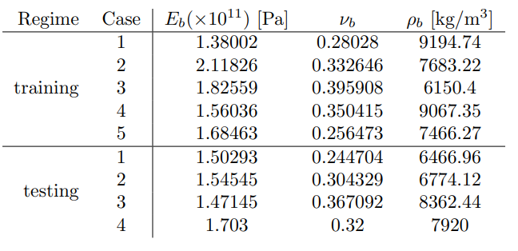
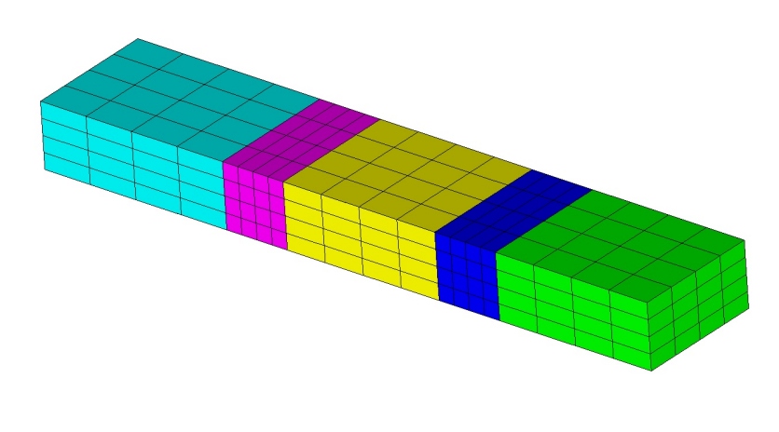
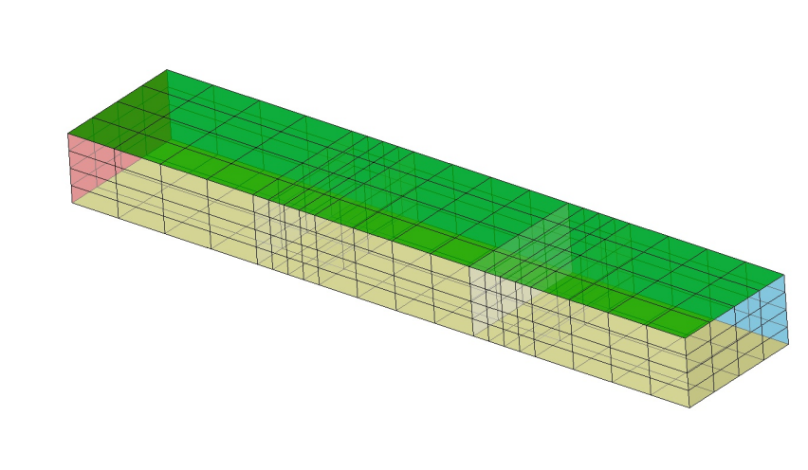
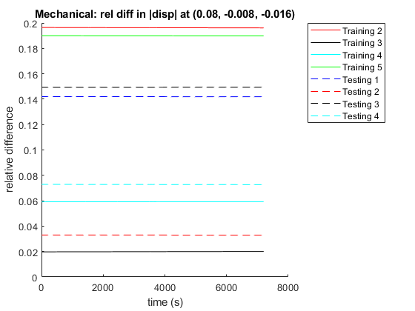



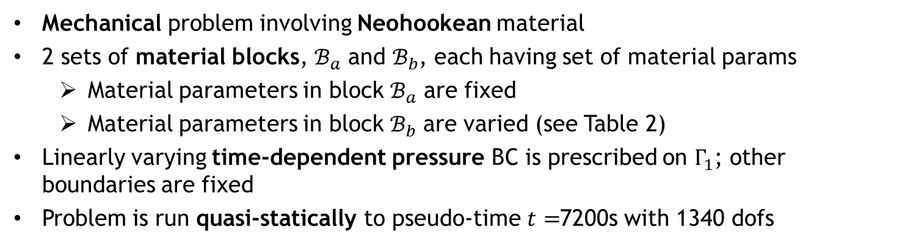

Mechanical Beam (Albany)
Table 2. Parameters in block $ℬ_{b}$ for mechanical beam problem.
$$ℬ_{b}$$
$ℬ_{a}$
$$Γ_{1}$$
Mechanical problem involving Neohookean material
2 sets of material blocks, $ℬ_{a}$ and $ℬ_{b}$, each having set of material params
  Material parameters in block $ℬ_{a}$ are fixed
  Material parameters in block $ℬ_{b}$ are varied (see Table 2)
Linearly varying time-dependent pressure BC is prescribed on $Γ_{1}$; other boundaries are fixed
Problem is run quasi-statically to pseudo-time $t=$7200s with 1340 dofs
Training is performed for 6 sets of parameters; testing/prediction is performed for 4 sets of parameters (see Table 2)
  Nontrivial variations in displacement (up to 20%) are observed with the parameter variations considered (right figure)
[Lindsay et al., in prep.]

Slide 10
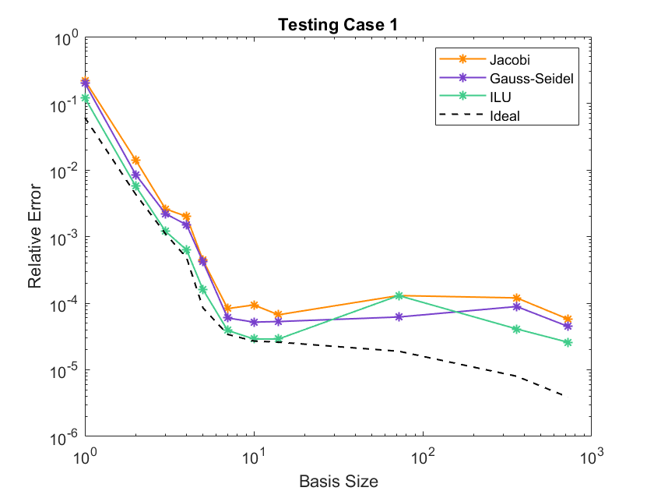
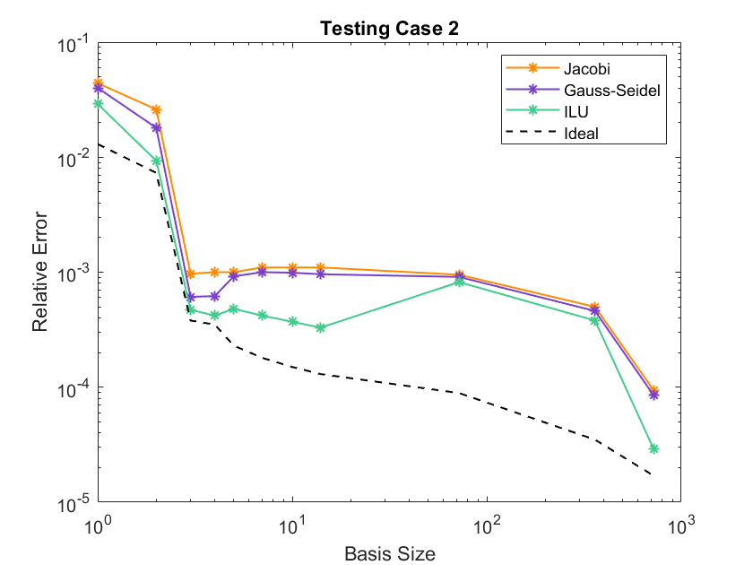
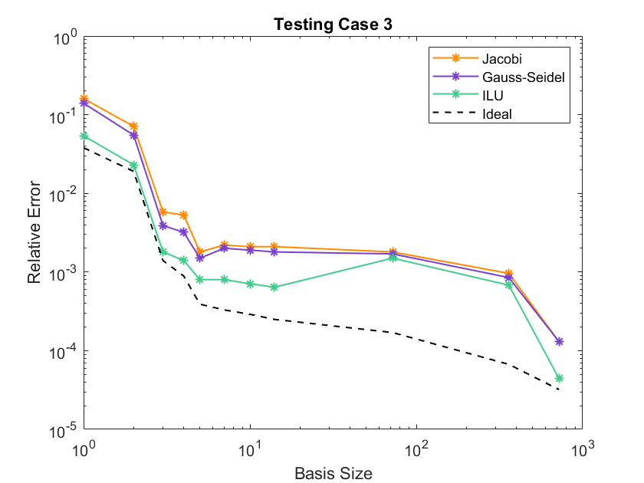
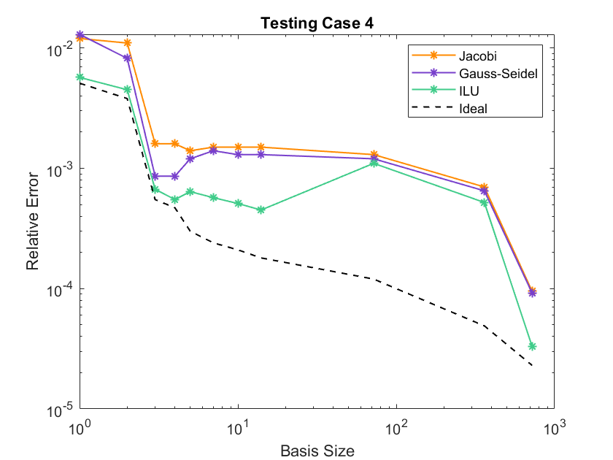
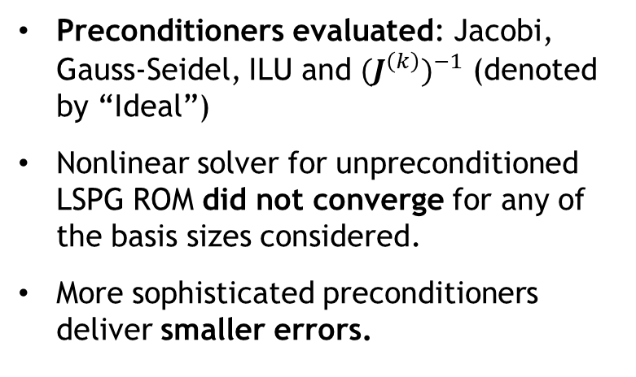
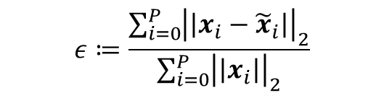
Mechanical Beam (Albany)
Figure plots global relative error in approximate ROM solutions:
$$ε≔\frac{\sum_{i=0}^{P}{{\left|\left|x_{i}−{\tilde{x}}_{i}\right|\right|}_{2}}}{\sum_{i=0}^{P}{{\left|\left|x_{i}\right|\right|}_{2}}}$$
Preconditioners evaluated: Jacobi, Gauss-Seidel, ILU and ${{(J}^{\left(k\right)})}^{−1}$ (denoted by “Ideal”)
Nonlinear solver for unpreconditioned LSPG ROM did not converge for any of the basis sizes considered.
More sophisticated preconditioners deliver smaller errors.

Slide 11
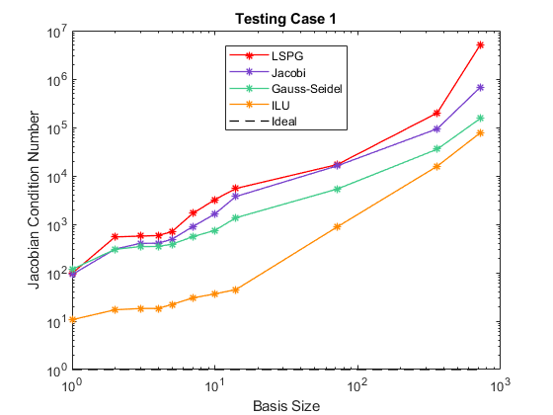
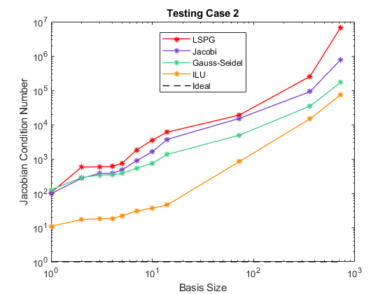
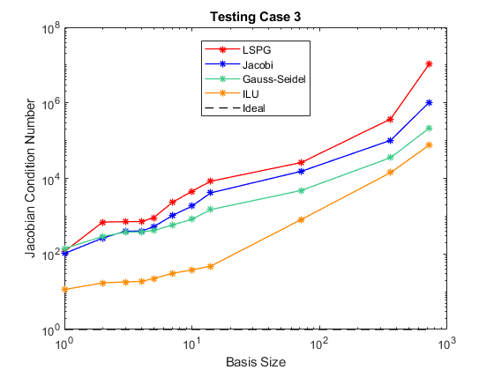
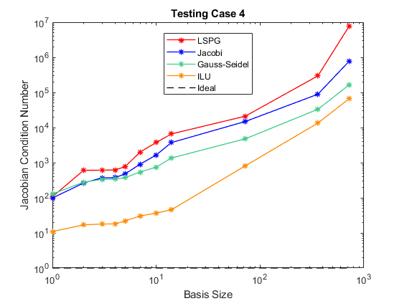
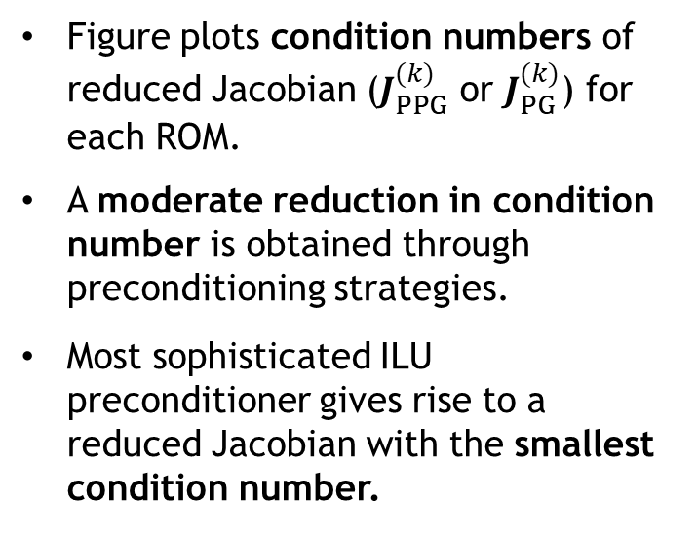
Mechanical Beam (Albany)
Figure plots condition numbers of reduced Jacobian ($J_{PPG}^{(k)}$ or $J_{PG}^{(k)}$) for each ROM.
A moderate reduction in condition number is obtained through preconditioning strategies.
Most sophisticated ILU preconditioner gives rise to a reduced Jacobian with the smallest condition number.

Slide 12
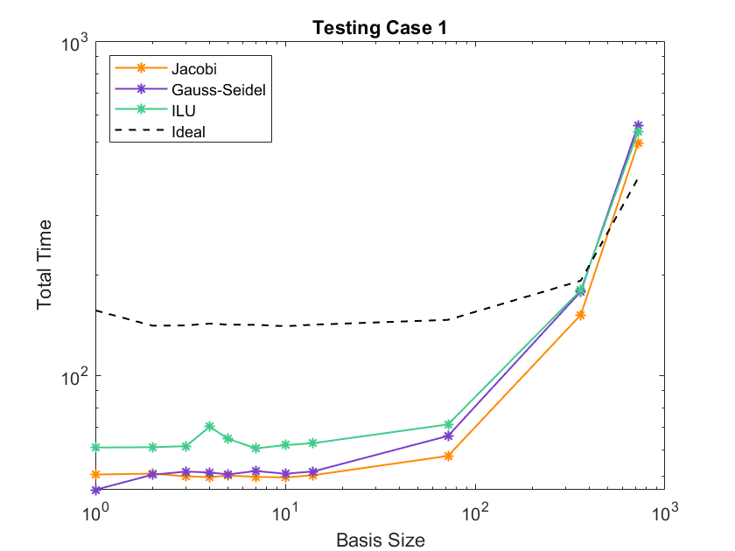
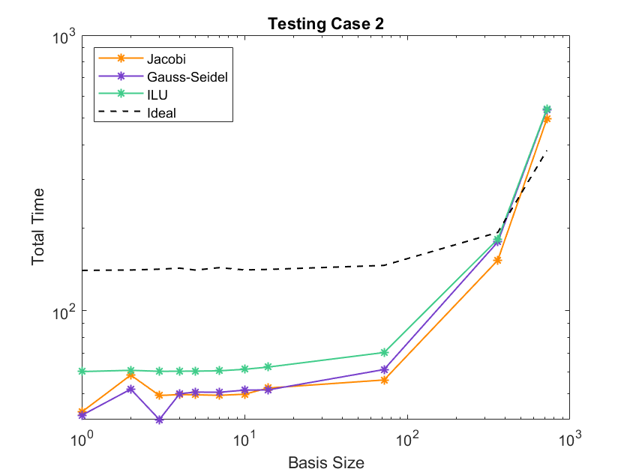
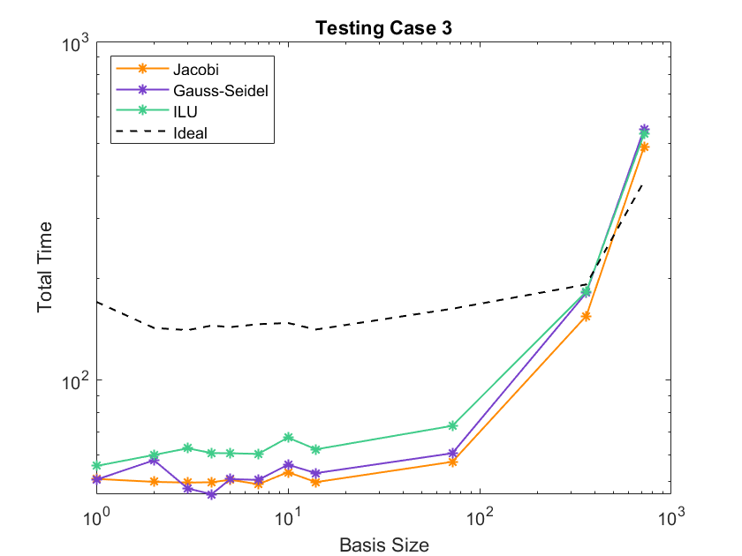
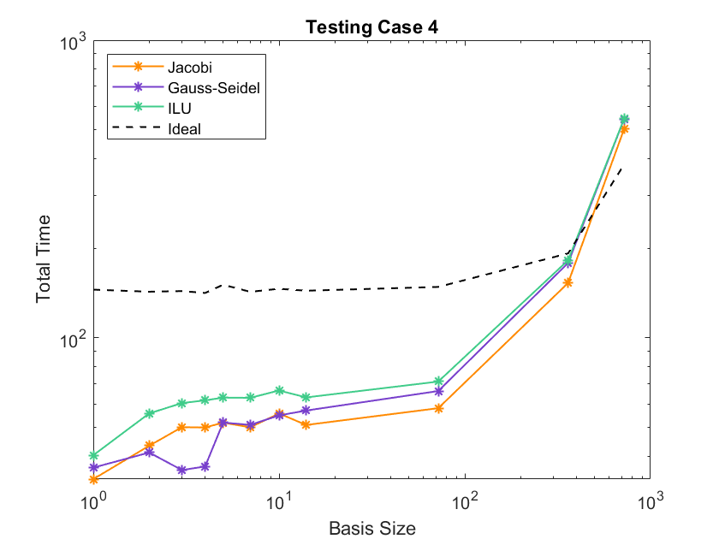
Mechanical Beam (Albany)
Figures shows CPU-times for all ROMs considered
As expected, the projected solution increment is the most expensive to compute

Slide 13
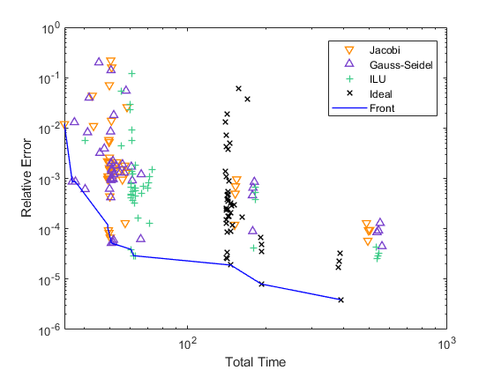
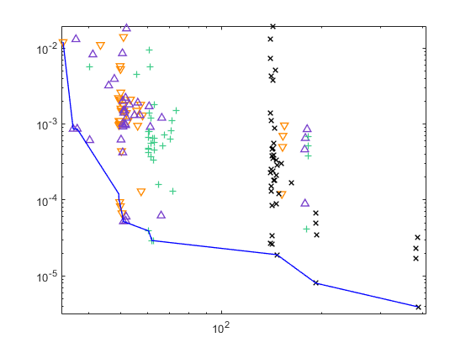
Mechanical Beam (Albany)
The best preconditioner given error/CPU-time requirements can be inferred from Pareto plot shown here.

Slide 14
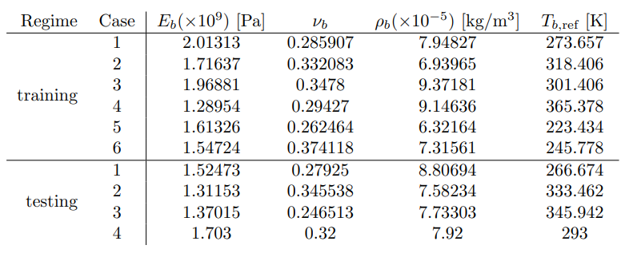
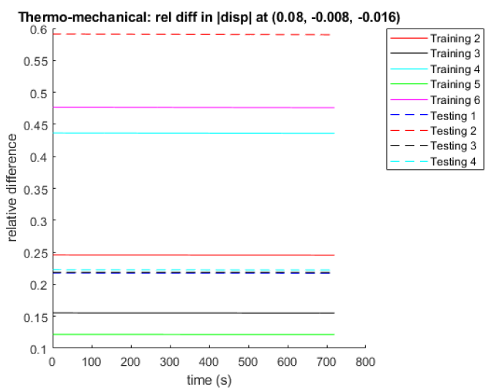

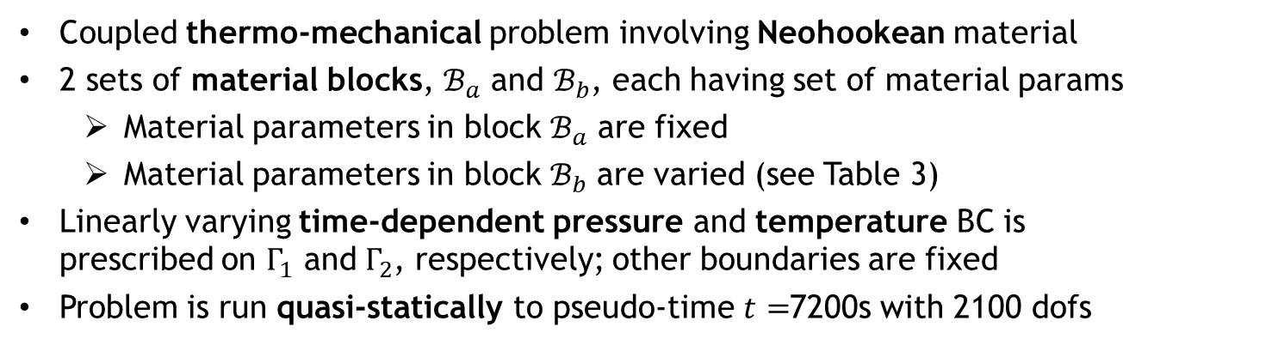

Thermo-Mechanical Beam (Albany)
Table 3. Parameters in block $ℬ_{b}$ for thermo-mechanical beam problem.
$$ℬ_{b}$$
$$Γ_{2}$$
$ℬ_{a}$
$$Γ_{1}$$
Coupled thermo-mechanical problem involving Neohookean material
2 sets of material blocks, $ℬ_{a}$ and $ℬ_{b}$, each having set of material params
  Material parameters in block $ℬ_{a}$ are fixed
  Material parameters in block $ℬ_{b}$ are varied (see Table 3)
Linearly varying time-dependent pressure and temperature BC is prescribed on $Γ_{1}$ and $Γ_{2}$, respectively; other boundaries are fixed
Problem is run quasi-statically to pseudo-time $t=$7200s with 2100 dofs
Training is performed for 6 sets of parameters; testing/prediction is performed for 4 sets of parameters (see Table 3)
  Significant variations in displacement (up to 60%) are observed with the parameter variations considered (right figure)
[Lindsay et al., in prep.]
Notes:
The first problem is that of a thermo-mechanical beam, simulated using the Albany code base. The governing PDEs are a coupled thermo-mechanical system with a Neohookean (nonlinear elastic) material. The geometry, discretized using 2100 dofs, is shown at the top. A linearly varying time-dependent pressure and temperature BC is prescribed on two of the side boundaries, shown in yellow. The problem is run quasi-statically to pseudo-time 7200s. We break up the domain into two sets of block, demoted by curly B_a and curly B_b, each of which have different material parameters: the Young’s modulus, Poisson’s ratio, density and reference temperature (relates to thermal expansion). While material parameters in block B_a are fixed, the material parameters in block B_b are varied for the purpose of training and testing the model. We perform training using 6 sets of parameters in B_b, shown in Table 1, and test the model using 4 different sets of parameters, also shown in Table 1. The parameters are selected so that there are significant variations in the solution – the displacement of the beam changes up to 60% with the parameter variations in Table 1.

Slide 15
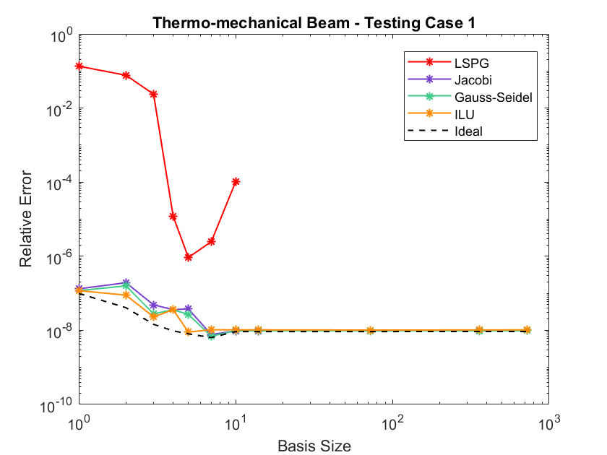
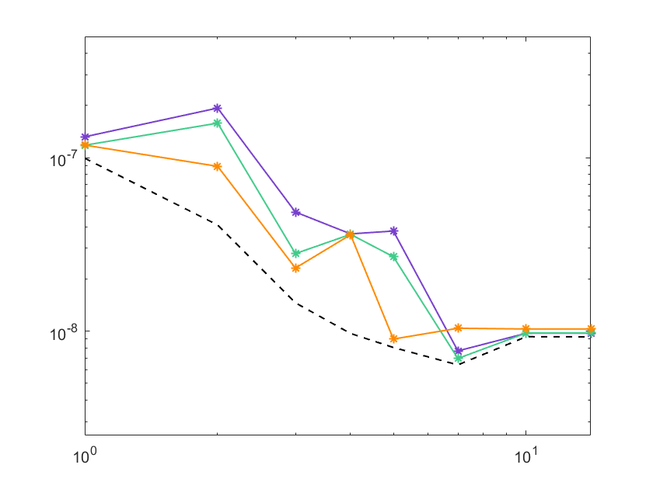
Thermo-Mechanical Beam (Albany)
Notes:
The first result I am going to show is the global relative error in the approximate ROM solutions, given by the equation shown on this slide. We evaluated in this study 11 different preconditioners, including Jacobi, Gauss-Seidel, Incomplete Cholesky and ILU. We included also the ideal preconditioner, J^(-1), denoted by projSoln, for projected solution increment, and the plain vanilla unpreconditioned LSPG ROM. Relative errors for each of the test cases for a variety of basis sizes are plotted in the figures on the right. One can see from this figure that the LSPG solution, shown in red, is the least accurate. By introducing preconditioning, it’s possible to reduce the error by 2-6 orders of magnitude. Moreover, it’ sinteresting to note that all the preconditioned LSPG ROMs achieve errors within one order of magnitude of the “best-case scenario”, the projected solution increment ROM, shown in black.

Slide 16
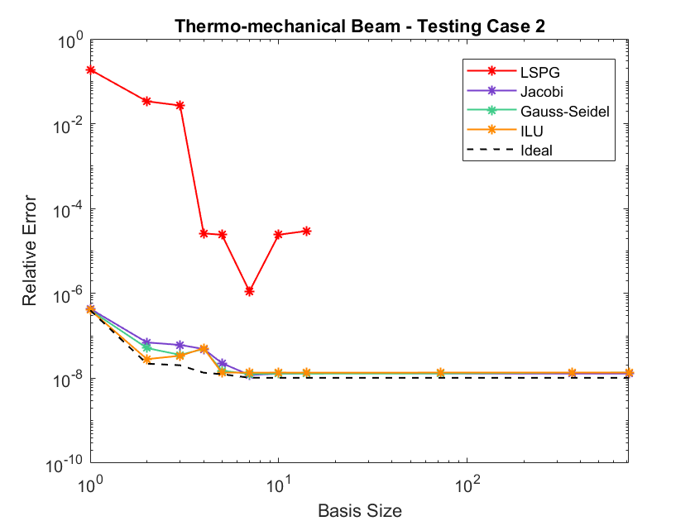
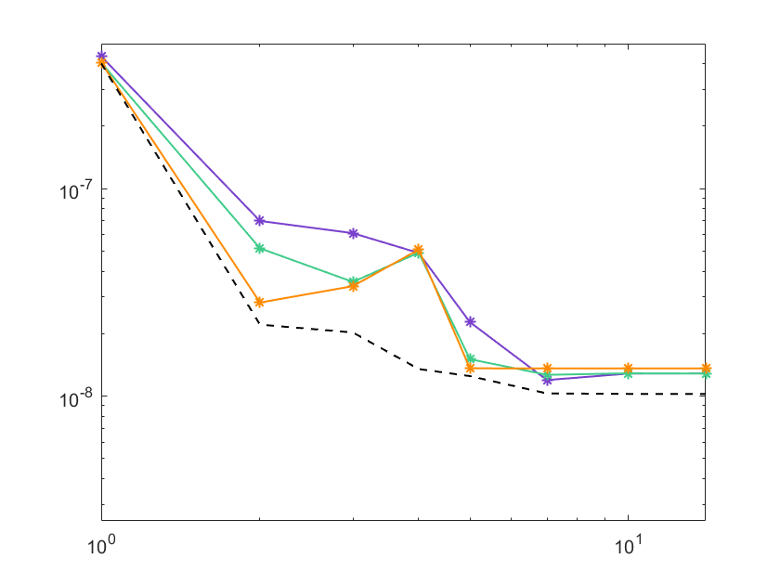
Thermo-Mechanical Beam (Albany)

Slide 17


Thermo-Mechanical Beam (Albany)

Slide 18


Thermo-Mechanical Beam (Albany)

Slide 19





Thermo-Mechanical Beam (Albany)
Figure plots condition numbers of reduced Jacobian ($J_{PPG}^{(k)}$ or $J_{PG}^{(k)}$) for each ROM.
Reduced Jacobians for regular LSPG ROM are very ill-conditioned ($>O\left({10}^{14}\right)$)
  Ill-conditioning is due to extreme differences in scale b/w displacement and temperature solutions (9 orders of magnitude)
Results demonstrate that simple preconditioning strategy can reduce condition numbers by as many as 10 orders of magnitude
As expected, projected solution increment reduced Jacobian has perfect condition number
Notes:
Next, we look at the condition numbers of the reduced Jacobians for all the ROMs considered for each of the 4 test cases. The reduced Jacobians for the regular LSPG ROM, shown in red, are very ill-conditioned, with condition numbers on othe order of 10^16. This is due to the multi-scale and multi-physics nature of the problem – there are extreme differences in scale b/w the displacement and temperature solutions of about 9 orders of magnitude. You can see from these plots that even very simple preconditioning strategies like Gauss-Seidel, shown in purple, bring the condition number down by as many as 10 order of magnitude. As expected, the projected solution increment case has a perfect condition number of 1.

Slide 20




Thermo-Mechanical Beam (Albany)
Figures shows CPU-times for all ROMs considered
In general, preconditioned LSPG ROMs achieve CPU-times smaller than unpreconditioned LSPG ROM
As expected, the projected solution increment is the most expensive to compute in general
Notes:
So far, the preconditioned LSPG ROMs are the clear winner, but what about CPU times? These are plotted in the figured on the right for each of the test cases. You can see here that the preconditioned ROMs, especially those with the more sophisticated preconditioners like incomplete Cholesky or ILU, are marginally more expensive (less than 1 order of magnitude) than the unpreconditioned LSPG ROM. However, since the preconditioned ROMs deliver solution that are 2-6 times more accurate, there is a significant computational advantage in performing preconditioning. Interestingly, Gauss-Seidel preconditioners give rise to the lower CPU-times, so the CPU-time appears to correlate inversely with the condition number, as expected.

Slide 21


Thermo-Mechanical Beam (Albany)
Pareto plot results confirm that there is a significant computational advantage in applying preconditioning
Notes:
So far, the preconditioned LSPG ROMs are the clear winner, but what about CPU times? These are plotted in the figured on the right for each of the test cases. You can see here that the preconditioned ROMs, especially those with the more sophisticated preconditioners like incomplete Cholesky or ILU, are marginally more expensive (less than 1 order of magnitude) than the unpreconditioned LSPG ROM. However, since the preconditioned ROMs deliver solution that are 2-6 times more accurate, there is a significant computational advantage in performing preconditioning. Interestingly, Gauss-Seidel preconditioners give rise to the lower CPU-times, so the CPU-time appears to correlate inversely with the condition number, as expected.

Slide 22







Thermo-Mechanical Pressure Vessel (Albany)
Table 1. Parameters in block $ℬ_{b}$ for thermo-mechanical pressure vessel problem.
Coupled thermo-mechanical problem involving Neohookean material
  Multi-physics problem: temperature and displacement solutions differ by 9 orders of magnitude; 370K dofs
2 sets of material blocks, $ℬ_{a}$ and $ℬ_{b}$, each having set of material params
  Material parameters in block $ℬ_{a}$ (magenta, cyan) are fixed
  Material parameters in block $ℬ_{b}$ (green, yellow, blue) are varied
Pressure vessel is heated and pressurized from the inside
Problem is run quasi-statically to pseudo-time $t=$720s
Testing 1
Testing 2
Training is performed for 4 sets of parameters; testing/prediction is performed for 2 sets of parameters (see Table 1)
[Lindsay et al., IJNME, 2022 (accepted)]
Notes:
To really highlight the power of the preconditioning, lets look now at a bigger, more realistic problem, that of a thermo-mechanical pressure vessel. We have the same PDEs and material model as before, but now our geometry is cylindrical vessel, a quarter of which is shown in the images at the top of the slide. There are approximately 370,000 dofs. The vessel is heated and pressurized from the lateral side. As before, we split up the geometry into several sets of material blocks, shown in the different colors, fix the material parameters in block B_a and vary the materials in Block B_b. Training is performed for 4 sets of parameters, and testing for 2 sets of parameters, summarized in Table 2.

Slide 23





Thermo-Mechanical Pressure Vessel (Albany)
Global relative error:
$$ε≔\frac{\sum_{i=0}^{P}{{\left|\left|x_{i}−{\tilde{x}}_{i}\right|\right|}_{2}}}{\sum_{i=0}^{P}{{\left|\left|x_{i}\right|\right|}_{2}}}$$
Preconditioned (PC) LSPG ROMs are up to 5 orders of magnitude more accurate than LSPG ROMs.
LSPG ROMs do not converge for larger basis sizes.
Accuracy is improved by improving the preconditioner.
Seven basis sizes evaluated: 2,4,8,16, 32,79,790
PC LSPG ROM
LSPG ROM
FOM

Slide 24




Thermo-Mechanical Pressure Vessel (Albany)
Preconditioned LSPG ROMs are up to 12x faster than vanilla LSPG ROMs
More sophisticated preconditioners lead to greater CPU times
Top figures: CPU times
Bottom figures: # nonlinear iterations
Speed-ups are largely due to reduction in # nonlinear iterations (by factor of >12x)

Slide 25


Thermo-Mechanical Pressure Vessel (Albany)
Pareto plot confirms competitiveness of preconditioned LSPG ROMs.

Slide 26





Compressible Cavity Flow (SPARC)
2D viscous laminar flow around an open cavity geometry
  Simple model for the captive carry scenario
Mach number = 0.6, Reynolds number $≈$ 3000
Problem is run non-dimensionally
Domain is discretized using 104,500 hexahedral cells (right)
Of primary interest are long-time predictive simulations
  ROM is run at same parameters as FOM but much longer in time
  Relevant QOIs: statistics of the flow (e.g., pressure power spectral densities or PSDs)
$y$-axis
$x$-axis
[Tezaur et al. 2017; Fike et al. 2018]
Notes:
Switching gears now from solid mechanics to fluid dynamics, the last example is that of a 2D viscous laminar compressible flow over an open 2D cavity geometry, simulated using the SPARC compressible flow solver. This example is intended to be a simple model for the captive carry scenario of interest to Sandia. The Mach number for this problem is 0.6 and the Reynolds number is approximately 3000. The discretized domain is shown on the right, and has about 100,000 hexahedral elements. As before, we are interested in predictive ROMs, but now we will be performing prediction in time rather than across parameter space – here, the ROM is run at the same parameters as the FOM but much longer in time. The problem is run non-dimensionally, so the preconditioning here does more than just get the residual components to be of the same order.

Slide 27



Compressible Cavity Flow (SPARC)
Figure top left: pressure time history for a point halfway up the downstream wall of the cavity for an LSPG ROM having 327 modes with a Jacobi preconditioner
Figure bottom left: pressure PSD for the signal in the top left figure (solid line is mean PSD, shaded regions indicate range of values used to construct the mean)
Preconditioned LSPG ROM captures well the pressure PSD, including its peaks (Rossiter modes) and the RMS OASPL¹
Vanilla LSPG ROM did not run successfully
Method | RMS OASPL¹ in dB | % Difference from FOM
FOM | 66.176 | $$−$$
Ideal | 67.552 | 2.08%
LSPG | N/A | N/A
LSPG + Jacobi PC | 68.033 | 2.80%
¹Overall sound pressure level
Notes:
And so, here are the main results for this problem. The figure on the top left shows the pressure time-history for a point halfway up the downstream wall of the cavity for an LSPG ROM preconditioned with a Jacobi preconditioner having 327 modes, in red, compared to the full-order model, in black. Training was performed for the time-interval shown in blue, and the ROM was run forward in time, starting at the end of this interval. Now, for this application, the main quantity of interest is not the individual pressure signal but the pressure power spectral density or PSD. This is shown in the figure on the bottom left. The solid line is the mean PSD and shaded regions indicate a range of values used to construct the mean. The preconditioned LSPG ROM captures well the pressure PSD, including its peaks, the Rossiter modes. It also captures the root-mean-square overall sound pressure level up to an error of 2.8%. I am not showing the unpreconditioned LSPG ROM here, as it did not run successfully to completion for this problem – nonphysical quantities were computed during the simulation and the run died. This is a similar result as the one obtained for the thermo-mechanical pressure vessel problem.

Slide 28
Summary & Future Work
Summary:
Adding preconditioning to the LSPG formulation gives rise to ROMs with improved accuracy and robustness, especially in the predictive regime
  Preconditioning attempts to emulate projection of FOM solution increment onto POD basis (the ROM “best-case scenario” for a given basis)
  Preconditioning can ensure all components of residual being minimized are of the same magnitude
  Preconditioning changes the norm in which the residual is minimized, which can improve residual-based stability constant bounding the ROM solution’s error
  Results on predictive (across parameter space) thermo-mechanical and predictive (in time) compressible flow problems are compelling
Ongoing/future work:
Manuscript in preparation: J. Fike, P. Lindsay, K. Carlberg, I. Tezaur. “Preconditioned Least-Squares Petrov-Galerkin Reduced Order Models for Compressible Flows”, in prep.
Application of preconditioned LSPG approach to more sophisticated problems relevant to Sandia’s mission spaces
  Preconditioning LSPG ROMs has been helpful for hypersonic aero, thermal/ablation and reacting hypersonic flow problems

Slide 29

The End
For more details (mechanical/thermo-mechanical application), please see the following pre-print, which was just accepted for publication in IJNME:
Thank you for your Attention!

Slide 30
Start of Backup Slides

