Slide 1
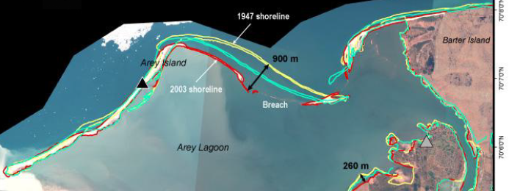
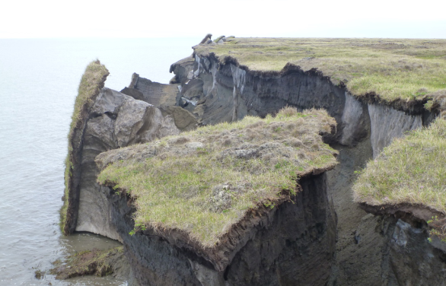
Development of a novel thermo-mechanical model for simulating permafrost demise and Arctic coastal erosion d
Jenn Frederick, Alejandro Mota, Irina Tezaur, Charles Choens, Diana Bull g
Sandia National Laboratories, U.S.A.
Glaciological Seminar, ETH Zurich
SAND2021-5492PE
April 28, 2022

Slide 2
Outline
Motivation and background
The Arctic Coastal Erosion (ACE) project
Thermo-mechanical finite element model of permafrost
Numerical results
Summary
Ongoing/future work

Slide 3
Outline
Motivation and background
The Arctic Coastal Erosion (ACE) project
Thermo-mechanical finite element model of permafrost
Numerical results
Summary
Ongoing/future work

Slide 4
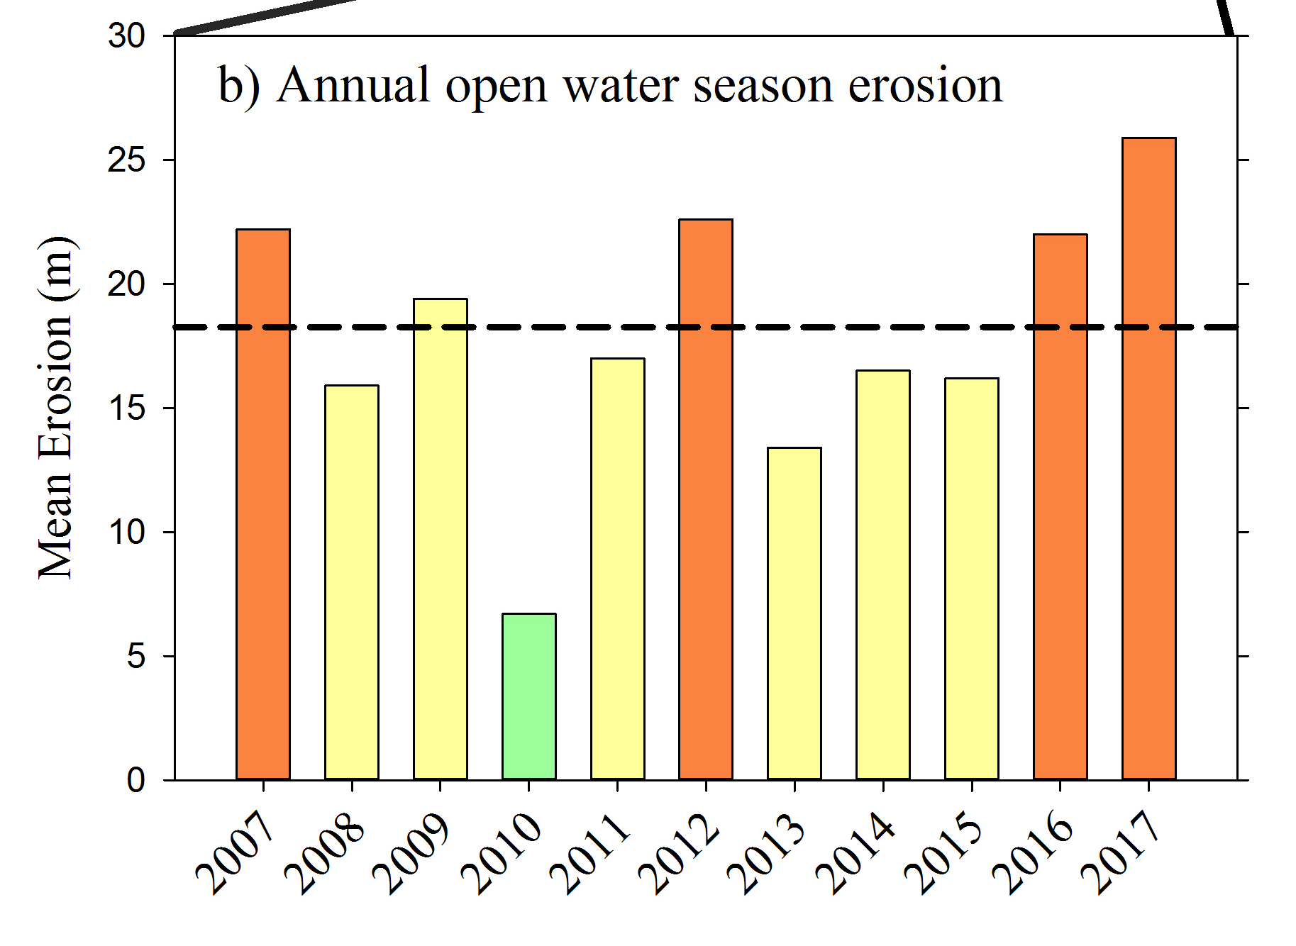
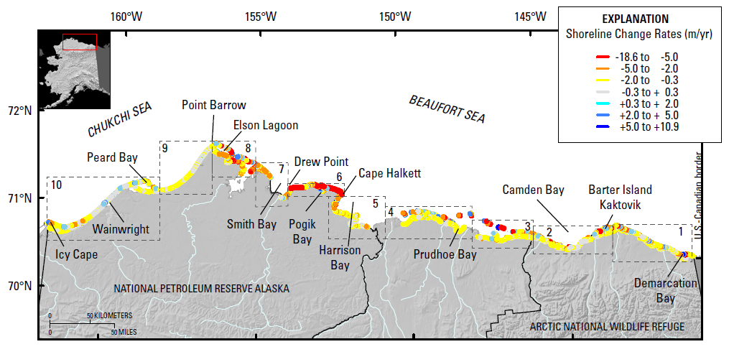
Motivation
The Arctic is warming at 2-3 times the rate of the rest of the globe resulting in accelerated rates of coastal erosion!
Certain locations lost ~200 m (~2 football fields in length) b/w 2007-2017!
Primary culprit is loss of Arctic sea ice: since 1979 sea ice has lost 51% in area and 75% in volume
  Increasing ice-free season
  Increasing wave energy and storm surge
  Increasing sea water temperatures
Erosion is threatening:
Coastal communities: threatened with displacement
Coastal infrastructure: active DoD sites, including toxic waste sites, in northern Alaska
Global carbon balance: permafrost stores greenhouse gases (CO₂, CH₄, NO₂).
Active DOD sites
Barrow
Wainwright
Oliktok
Barter Island
Bullen Point
Gibbs & Richmond, 2015.
4

Slide 5
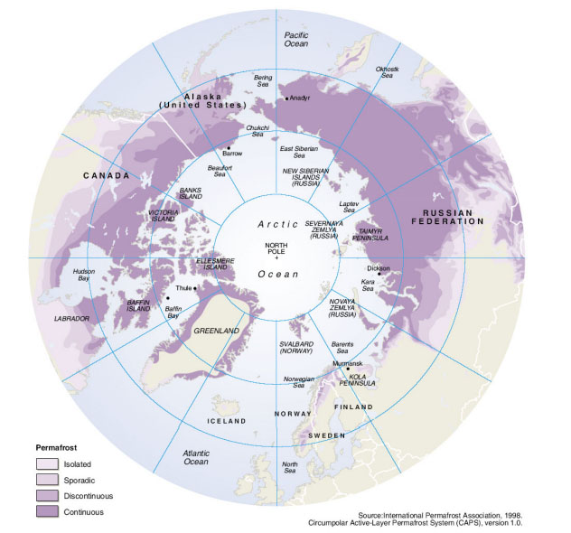
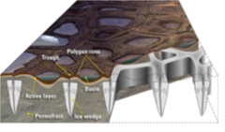
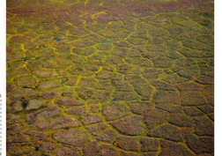
Permafrost erosion
What is permafrost?
Ground, comprised of soil, rock, silt, clay and sand, held together by ice, that remains frozen for 2+ consecutive years.
24% of ice-free land area in Northern Hemisphere and 85% of Alaska, Greenland, Canada and Siberia sits on top of permafrost.
Left: schematic illustrating formation of ice wedges and ice-wedge polygon landscapes. Right: map of permafrost distribution in Arctic
Brown et al. 1998.
Unique coastal permafrost erosion process in Arctic:
Predominant geomorphology: ice-wedge polygons
  Ice acts to bind unconsolidated soils in permafrost forming ice wedges.
  Ice wedges grow/expand up to ms wide and 10s meters deep.
  Melting of ice wedges causes permafrost failure.
Martin et al. 2009.

Slide 6
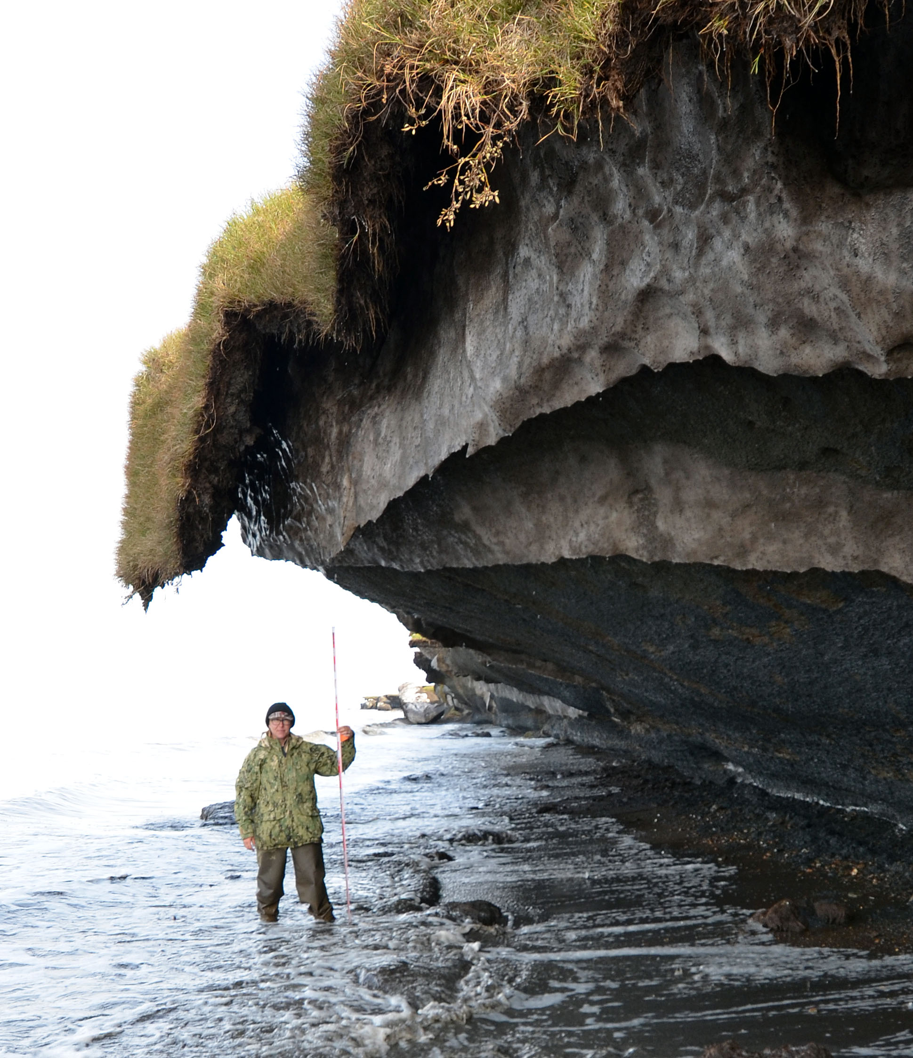
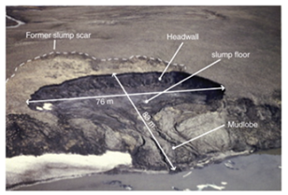
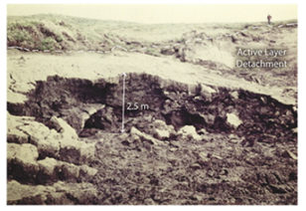
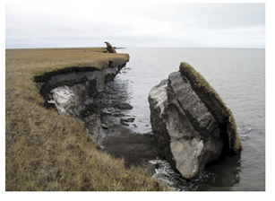
Permafrost failure mechanisms
Retrogressive thaw slumping: a slope failure characterized by thaw of exposed ground ice and slumping of thawed soil, typically caused by thermo-denundation¹.
Active layer detachment: failures are translational landslides that occur in summer in thawing soil overlying permafrost, typically caused by thermo-denundation¹.
Block failure: a niche (recess at bluff base) progresses landward until the overhanging material fails in a shearing or toppling mode known as block failure, caused by thermo-abrasion².
  Fallen blocks can disintegrate in the near-shore environment within 1-2 weeks!
Lantuit et al. 2008
Lantuit et al. 2008
Ravens et al. 2012
Retrogressive thaw slumping
Active layer detachment
Block failure
¹Thawing of permafrost bluffs that proceeds under the influence of gravity. ²Undercutting of permafrost bluff by warming ocean.
6

Slide 7
Permafrost failure mechanisms
Retrogressive thaw slumping: a slope failure characterized by thaw of exposed ground ice and slumping of thawed soil, typically caused by thermo-denundation¹.
Active layer detachment: failures are translational landslides that occur in summer in thawing soil overlying permafrost, typically caused by thermo-denundation¹.
Block failure: a niche (recess at bluff base) progresses landward until the overhanging material fails in a shearing or toppling mode known as block failure, caused by thermo-abrasion².
  Fallen blocks can disintegrate in the near-shore environment within 1-2 weeks!
Dominant failure mechanism in northern Alaska
Lantuit et al. 2008
Lantuit et al. 2008
Ravens et al. 2012
Retrogressive thaw slumping
Active layer detachment
Block failure
¹Thawing of permafrost bluffs that proceeds under the influence of gravity. ²Undercutting of permafrost bluff by warming ocean.
7

Slide 8
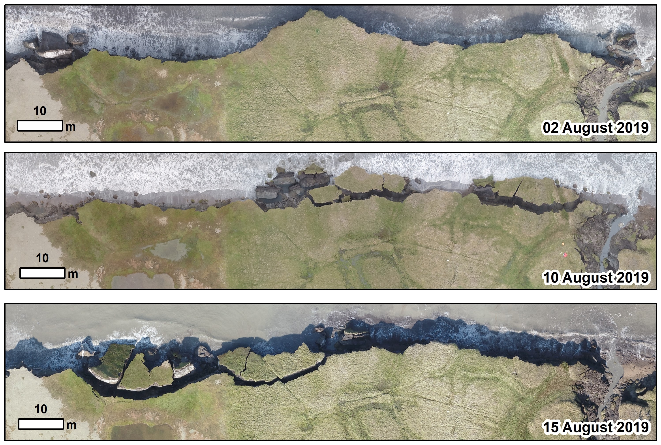
Example of bluff erosion during 2019 UAV surveys*
  Fallen blocks can disintegrate in near-shore environment within 1-2 weeks!
*Images courtesy of Ben Jones, UAF
8

Slide 9
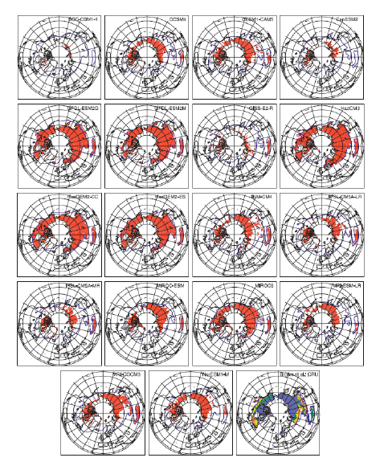
State-of-the-art in permafrost modeling
When this project began in 2017, tools to accurately predict Arctic coastal erosion did not exist!
Most existing models* (including Earth System Model-, or ESM-, coupled models) are primitive:
  Most models were based on trend projection and/or empirical relationships
  Limited PDE-based models: primarily thermal models, e.g., 1D steady state heat flow (no mechanics/deformation)
  Most models assumed a particular type of erosion (e.g., block failure)
  Models did not include realistic boundary conditions and did not account for permafrost geomorphologies or geophysics.
Premise behind the ACE project/model: an accurate, predictive Arctic coastal erosion model must couple the influences of evolving wave dynamics, thermodynamics and mechanics.
Koven et al. 2013
* See (Frederick et al. 2016), Chapter 5, for extensive overview.

Slide 10
Outline
Motivation and background
The Arctic Coastal Erosion (ACE) project
Thermo-mechanical finite element model of permafrost
Numerical results
Summary
Ongoing/future work

Slide 11



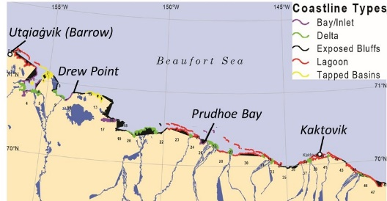
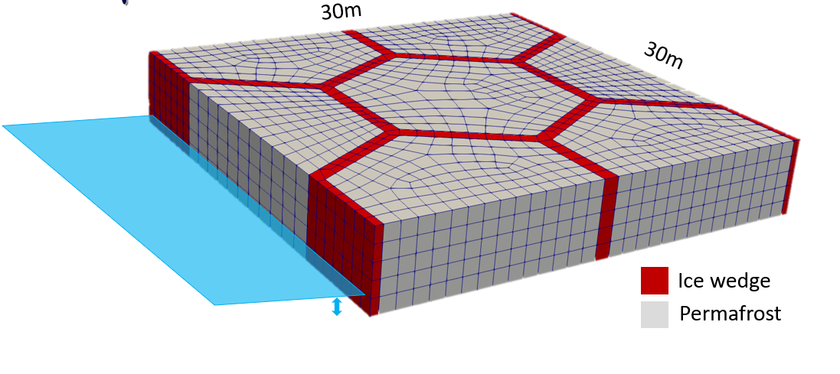
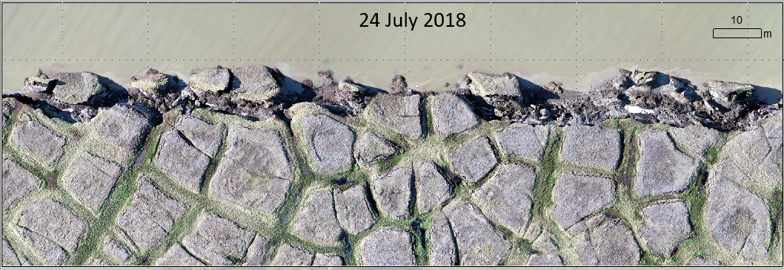
Proposed solution: multi-scale approach
Goal of the Arctic Coastal Erosion (ACE) project is to deliver a field-validated predictive model of thermo-abrasive erosion for the permafrost Arctic coastline
Micro-Scale Model | Meso-Scale Model | Macro-Scale Model
10’s of meters & storm duration | 10’s of kilometers & monthly duration | 100’s of kilometers & annual (+) durations
One set of input variables defining the geomorphology and geophysics of the terrestrial model. | A number of micro-scale models that represent the stochastic distributions of input variables along a confined coastline. | A number of meso-scale models representing different coastline types (delta, exposed bluffs, lagoons, etc.) along the AK coastline.
This talk
3D heat transfer + mechanics-based plastic deformation
Wave circulation BCs representing time-varying realizations of individual storm events.
Longer term vision: upscale micro-scale model to meso- and macro-scales
Create “catalog” of smaller-scale models for diff. Arctic locations, use catalog to derive (physics-based) statistical parameterizations of things like aggregate retreat rates

Slide 12


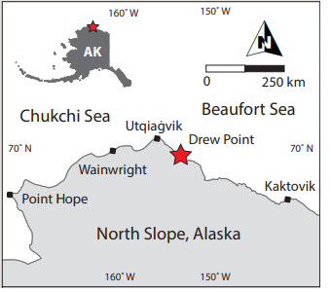


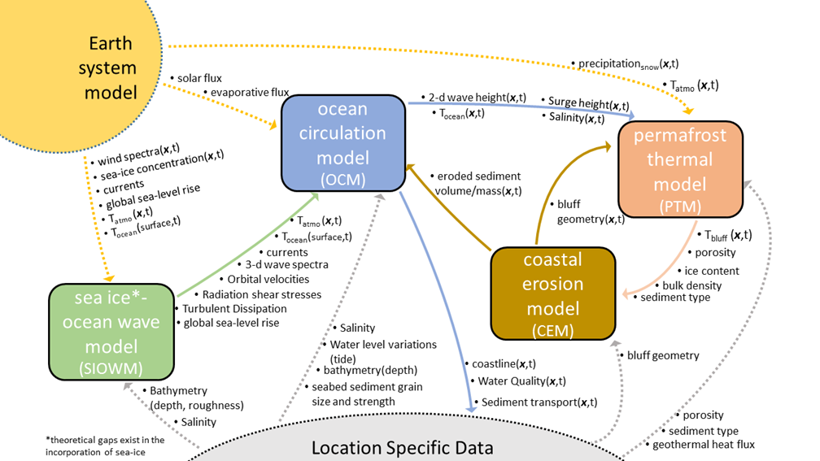
ACE Model Component Coupling
ACE project has many pieces!
Terrestrial model: thermo-mechanical coupled FEM model that can simulate transient niche development.
Oceanographic model: WW3 + SWAN + Delft3D wave models for providing oceanic BCs (ocean temp/height) to terrestrial model.
Geomechanical testing: for characterization of permafrost parameters in terrestrial model.
Field campaign: offshore oceanographic measurements, bathymetric survey, niche measurements, etc.
(Drew Point, Alaska)

Slide 13
ACE Model Component Coupling
ACE project has many pieces!
Terrestrial model: thermo-mechanical coupled FEM model that can simulate transient niche development.
Oceanographic model: WW3 + SWAN + Delft3D wave models for providing oceanic BCs (ocean temp/height) to terrestrial model.
Geomechanical testing: for characterization of permafrost parameters in terrestrial model.
Field campaign: offshore oceanographic measurements, bathymetric survey, niche measurements, etc.
This talk
(Drew Point, Alaska)

Slide 14
Outline
Motivation and background
The Arctic Coastal Erosion (ACE) project
Thermo-mechanical finite element model of permafrost
Numerical results
Summary
Ongoing/future work

Slide 15
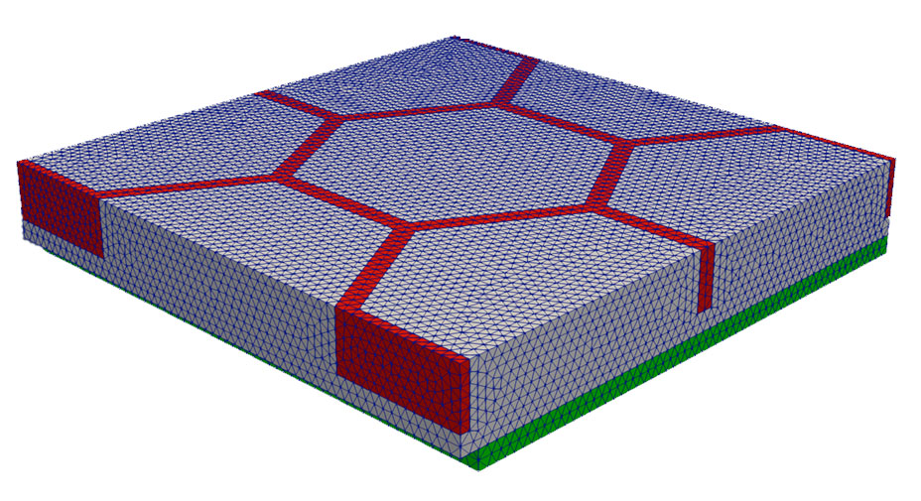
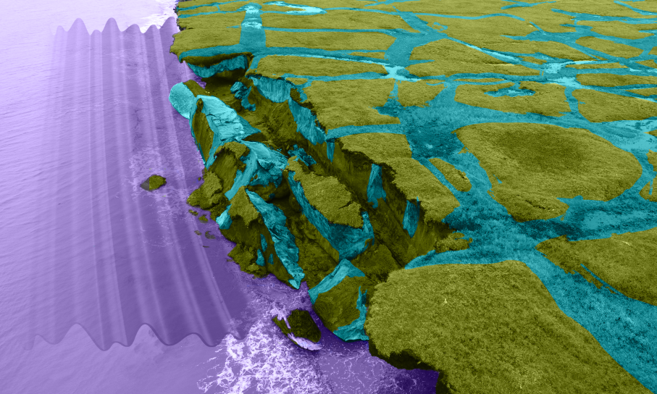
Anatomy of a canonical computational domain
Permafrost
30 m
30 m
Ice
Bluff face (exposed to ocean)
ocean water
5 m
Cryopeg*
* Layer of unfrozen ground that is perennially cryotic (forming part of the permafrost) in which freezing is prevented.

Slide 16
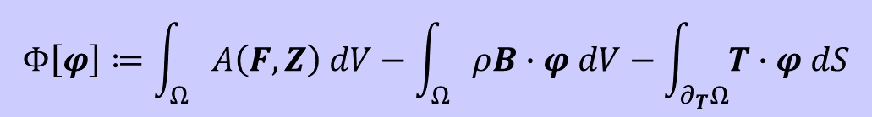
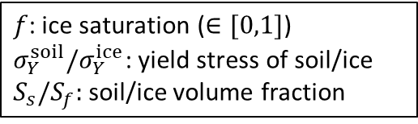
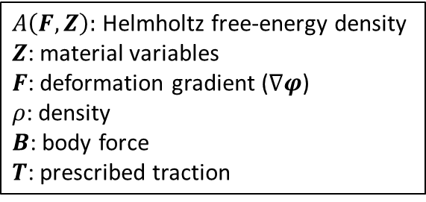
Mechanical model
Finite deformation time-dependent variational formulation for solid mechanics problem obtained by minimizing the energy functional:
$A\left(F,Z\right):$ Helmholtz free-energy density
$Z$: material variables
$F$: deformation gradient ($∇φ$)
$ρ$: density
$B$: body force
$T$: prescribed traction
$$Φ\left[φ\right]≔\int_{Ω}{A\left(F,Z\right) dV−\int_{Ω}{ρB∙φ dV−\int_{∂_{T}Ω}{T∙φ dS}}}$$
Computes displacements and new computational geometry (following erosion)
J₂ plasticity extended to large-deformation regime constitutive model for ice and permafrost
  Incorporates all mechanisms that lead to deformation, plastic flow and creep of polycrystalline materials like ice; minimal calibration parameters; simplest material model w/ plastic behavior.
Boundary conditions:
  Symmetry BCs on lateral sides
  Wave pressure Neumann BC on bluff face* (from wave model).
Symmetry BCs
Yield stress: $σ_{0}\left(T\right)≔S_{s}σ_{Y}^{soil}+S_{f}f(T)σ_{Y}^{ice}$
$f$: ice saturation ($∈[0,1]$)
$σ_{Y}^{soil}{/σ}_{Y}^{ice}$: yield stress of soil/ice
$S_{s}/S_{f}:$soil/ice volume fraction
Used in erosion failure criteria
Bluff face
Symmetry BCs
* Partenscky, 1988.

Slide 17
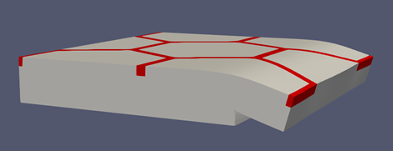
Erosion failure criteria
Erosion criterion: when material exposed to water reaches a critical exposure time.
Stress criterion: when material reaches a critical value of the yield stress.
Kinematic criterion: when material has tilted excessively, it is assumed to have fallen as part of block erosion.
Once failure criterion is reached, “failed” elements are removed from mesh.

Slide 18
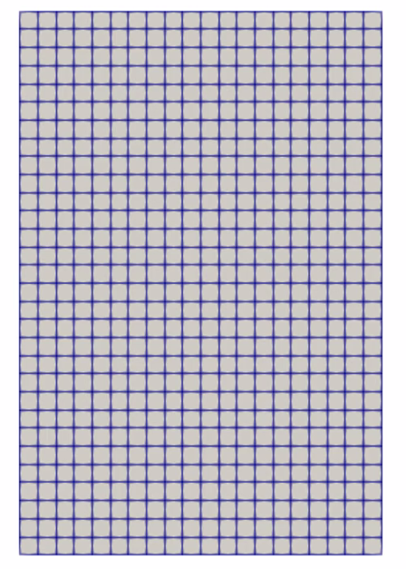
Erosion failure criteria
Erosion criterion: when material exposed to water reaches a critical exposure time.
Stress criterion: when material reaches a critical value of the yield stress.
Kinematic criterion: when material has tilted excessively, it is assumed to have fallen as part of block erosion.
Once failure criterion is reached, “failed” elements are removed from mesh.
Bluff face

Slide 19
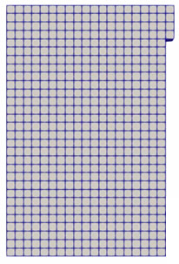
Erosion failure criteria
Erosion criterion: when material exposed to water reaches a critical exposure time.
Stress criterion: when material reaches a critical value of the yield stress.
Kinematic criterion: when material has tilted excessively, it is assumed to have fallen as part of block erosion.
Once failure criterion is reached, “failed” elements are removed from mesh.
Bluff face

Slide 20
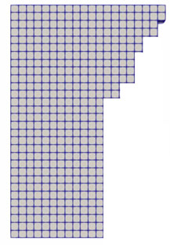
Erosion failure criteria
Erosion criterion: when material exposed to water reaches a critical exposure time.
Stress criterion: when material reaches a critical value of the yield stress.
Kinematic criterion: when material has tilted excessively, it is assumed to have fallen as part of block erosion.
Once failure criterion is reached, “failed” elements are removed from mesh.
Bluff face
Niche

Slide 21
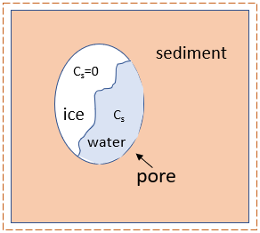
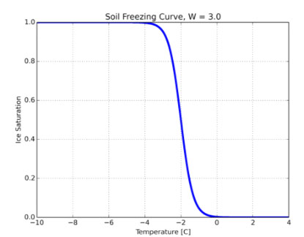

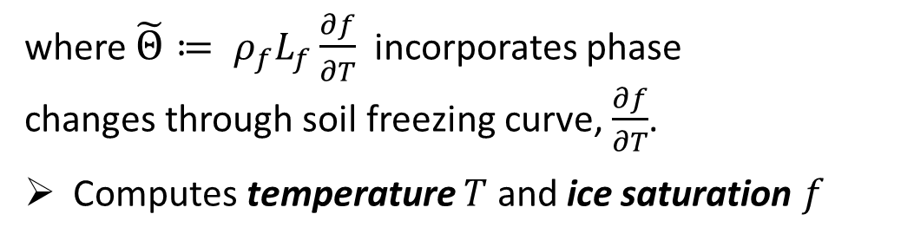
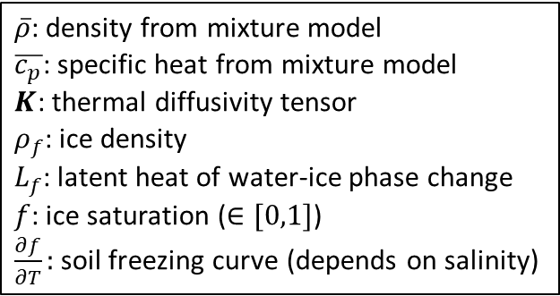
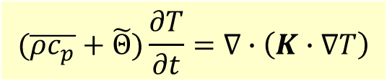
Thermal model
Transient heat conduction in a non-homogeneous porous media with water-ice phase change:
$\overline{ρ}$: density from mixture model
$\overline{c_{p}}$: specific heat from mixture model
$K$: thermal diffusivity tensor
$ρ_{f}$: ice density
$L_{f}$: latent heat of water-ice phase change
$f$: ice saturation ($∈[0,1]$)
$\frac{∂f}{∂T}:$soil freezing curve (depends on salinity)
$$(\overline{ρc_{p}}+\tilde{Θ})\frac{∂T}{∂t}=∇∙\left(K∙∇T\right)$$
where $\tilde{Θ}≔ ρ_{f}L_{f}\frac{∂f}{∂T}$ incorporates phase changes through soil freezing curve, $\frac{∂f}{∂T}$.
Computes temperature $T$ and ice saturation $f$
Permafrost control volume
Above
Soil freezing curve $\frac{∂f}{∂T}≠0$ only during phase change, which occurs in narrow temp zone (~-1C)
Boundary conditions (from wave model/data)
  Local geothermal heat flux from below
  Mean annual air temp from above
  Air/ocean temp at bluff face
Ice Saturation
Bluff face
Below
Temperature [C]

Slide 22
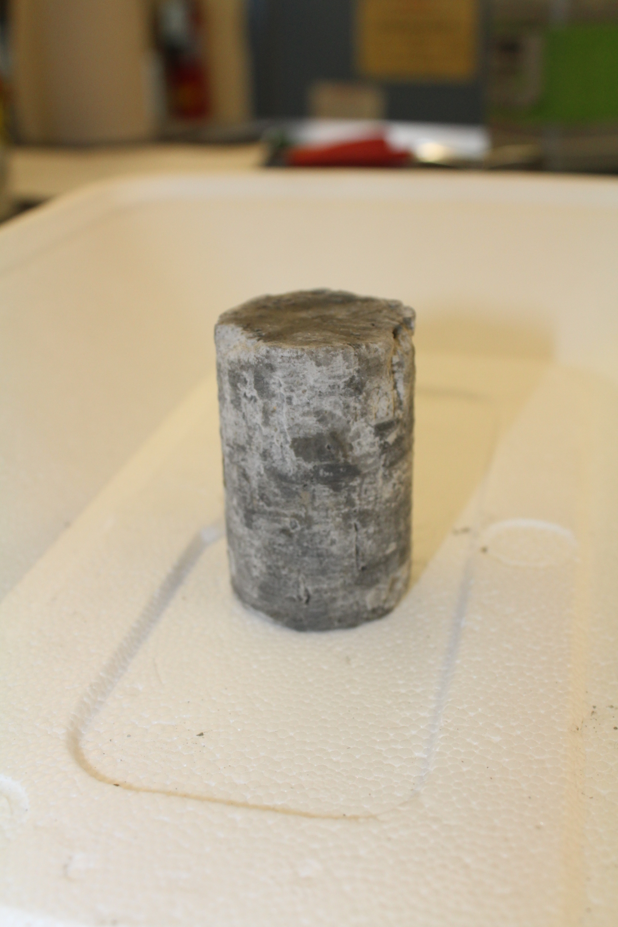
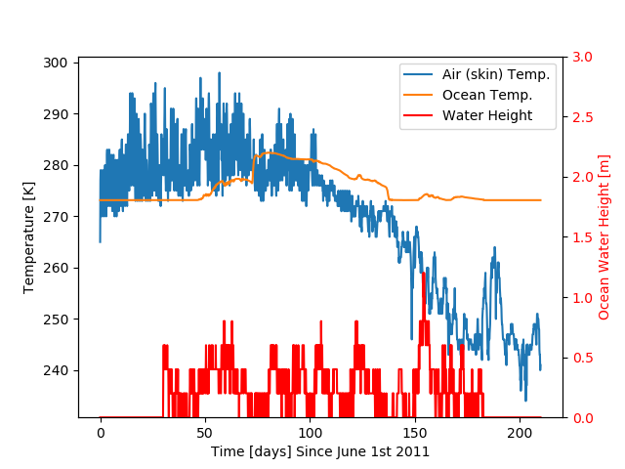
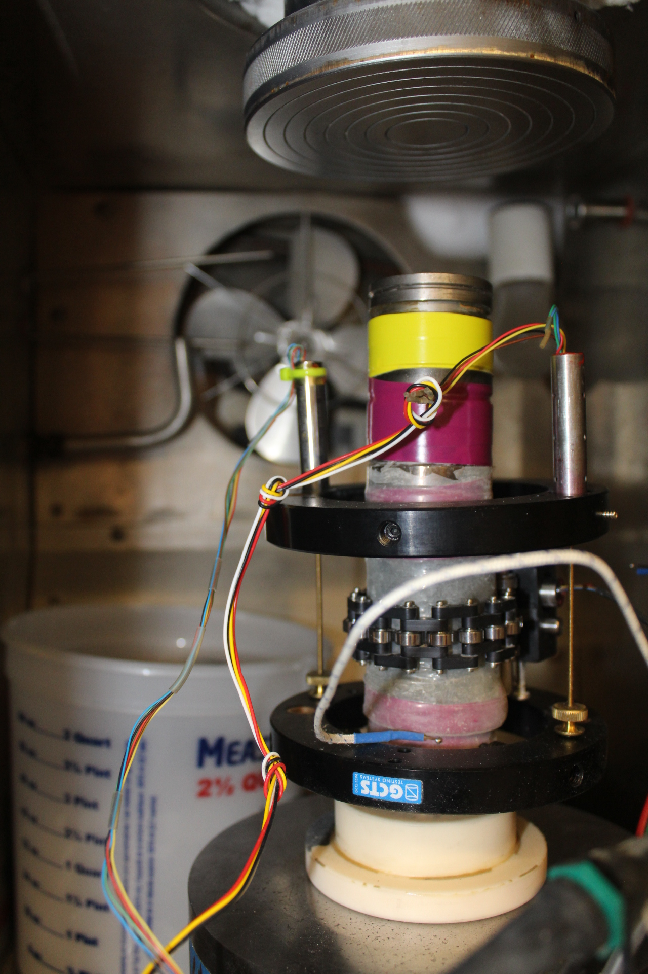
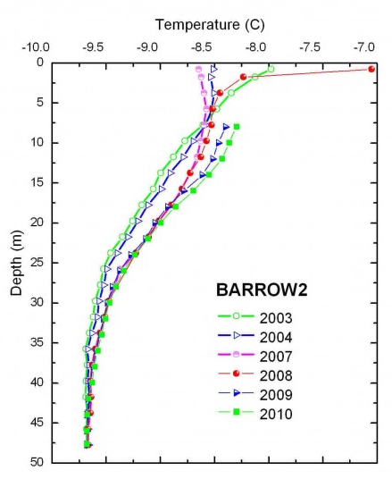
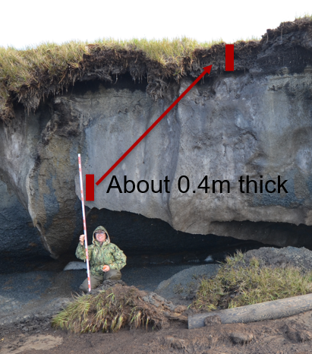
Parameters & inputs
BC Data for Drew Point
Parameters estimated from lab experiments:
Elastic modulus, Poisson’s ratio, yield stress
Sand/silt/clay fractions with depth
Porosity with depth
Parameters from literature:
Ice/water/sediment densities, thermal conductivities, heat capacities
Freezing curve/width as function of sediment type
Bluff salinity with depth
Parameters estimated from observational data at Drew Point, AK:
Skin temp w/ time, initial bluff temp (USGS weather station data)
Geothermal heat flux (borehole at Barrow, AK)
Polygon dimension, ice wedge thickness and depth, bluff height, living organic layer thickness (Aug. 2019 field campaign)
Parameters from wave model (WW3+SWAN+Delft3D):
Ocean temperature, salinity and sea-level w/ time (for thermal & wave pressure BCs)
Deep borehole

Slide 23
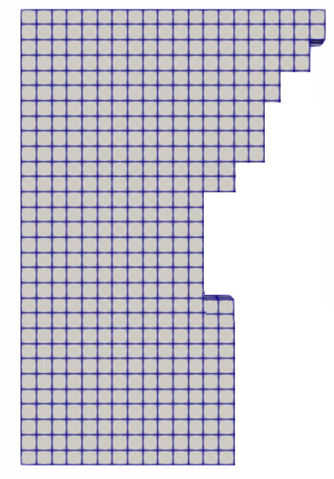

Coupled thermo-mechanical formulation
Potential key advantages:
Failure modes develop from constitutive relationships in FEM model (no empirical relationships!)
3D unsteady heat flow can include chemistry
Thermal and mechanical problems can be advanced using different time-steppers (e.g., implicit-explicit coupling)
Thermal:
Inputs: geometry, sediment type, ice volume, water volume, pore size, salinity
Outputs: temperature field, ice saturation
Eroded geometry
Ice saturation
Mechanical:
Inputs: ice saturation, strength relationship as function of thermal state, stress-strain relationships of permafrost and ice
Outputs: displacements, eroded geometry
Tightly coupled strength + thermal states
Unique characteristic of coupled model: coupling happens at the level of material model

Slide 24
Outline
Motivation and background
The Arctic Coastal Erosion (ACE) project
Thermo-mechanical finite element model of permafrost
Numerical results
Summary
Ongoing/future work

Slide 25

Finite element implementation within Albany-LCM
The thermo-mechanical Arctic Coastal Erosion (ACE) model is implemented within the LCM project in Sandia’s open-source parallel, C++, multi-physics, finite element code, Albany.
https://github.com/ SNLComputation/LCM
Component-based design for rapid development.
Contains a wide variety of constitutive models.
Extensive use of libraries from the open-source Trilinos project.
  Use of the Phalanx package to decompose complex problem into simpler problems with managed dependencies.
  Use of the Sacado package for automatic differentiation.
Coupled to the DOE’s Energy Exascale Earth System Model (E3SM) through MPAS - Albany Land Ice (MALI) component.
All software available on GitHub.
https://github.com/trilinos/trilinos

Slide 26
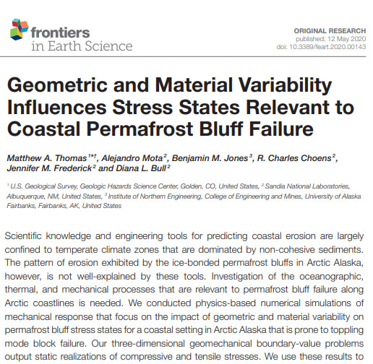
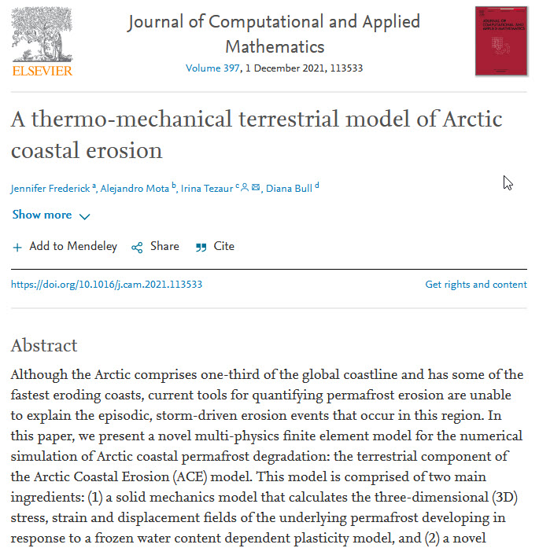
Numerical results summary
Mechanics-only simulation¹
Thermo-mechanical simulations²
¹ M. Thomas et al. Frontiers in Earth Science 8, April 2020. ² Frederick, Mota, Tezaur, Bull, J. Comput. Appl. Math. 2021.

Slide 27
Mechanics-only simulation
Mechanics-only simulation*
* M. Thomas et al. Frontiers in Earth Science 8, April 2020.

Slide 28
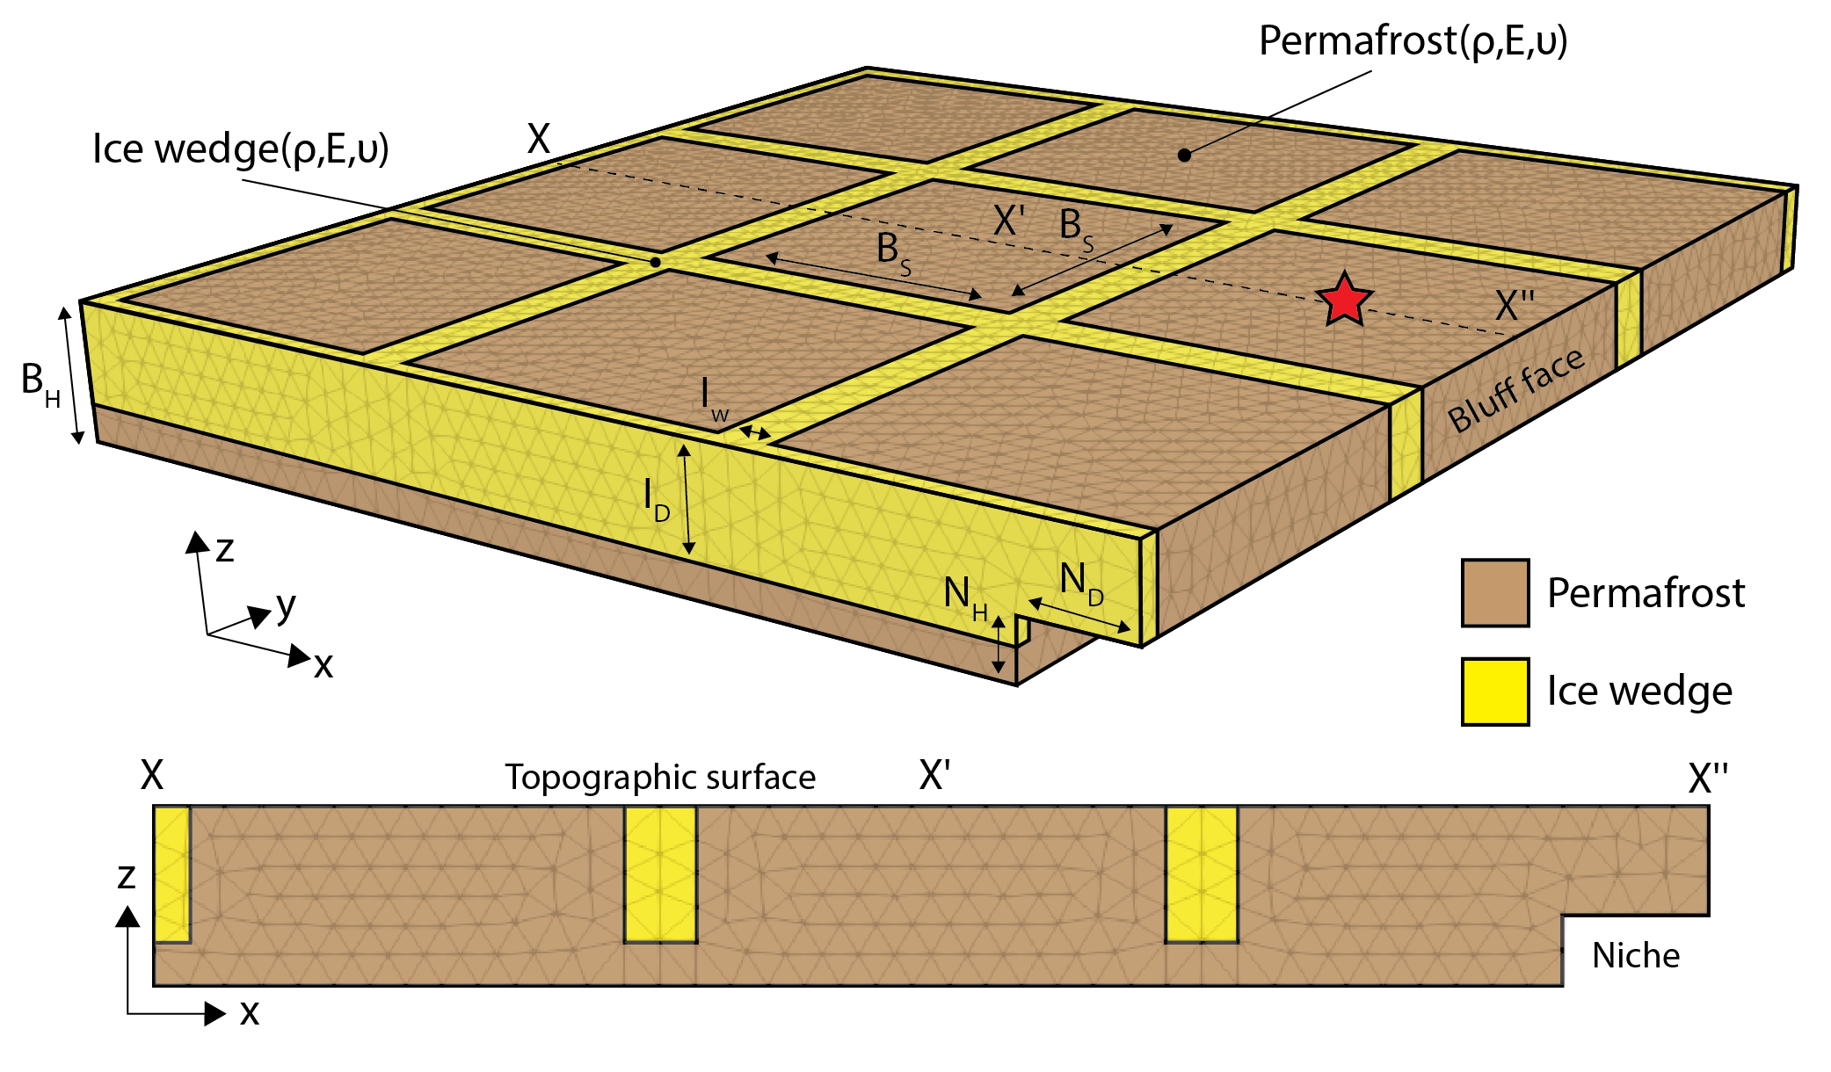
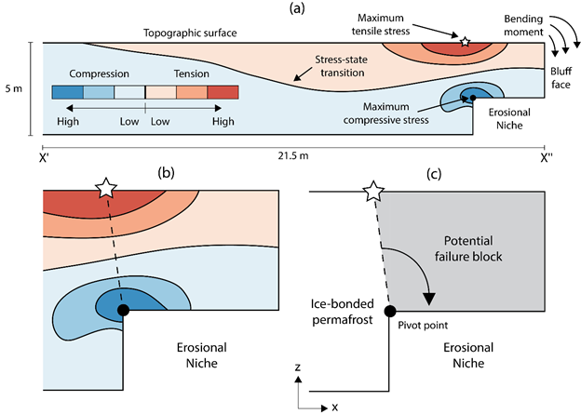
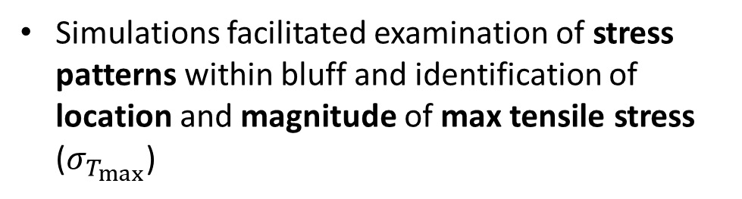
Mechanics-only simulation*
3D elastic mechanics-only simulations assessed impact of bluff geometry and material variability on stress states leading up to bluff failure
  Only load is gravitational.
Simulations facilitated examination of stress patterns within bluff and identification of location and magnitude of max tensile stress ($σ_{T_{max}}$)
* M. Thomas et al. Frontiers in Earth Science 8, April 2020.

Slide 29
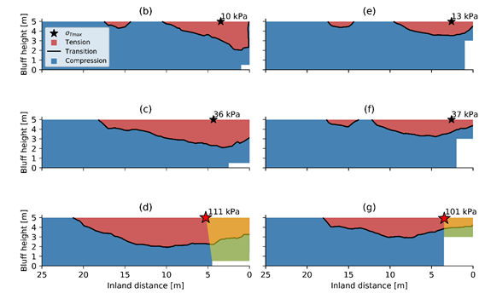
Mechanics-only simulation*: main takeaways
Niche dimension affects location and magnitude of simulated max tensile stress ($σ_{T_{max}}$) more than the bluff height, ice wedge polygon size, ice wedge geometry, bulk density and Poisson’s ratio
Inland extent of niche was advanced for 6 erosional niche heights from 0.1-3 m
Taller and narrower erosional niches promote smaller failure masses compared to those with shorter and deeper niches
Lower bound for tensile stress from lab measurements: 100 kPa
Orange/green shading highlights potential failure areas.
* M. Thomas et al. Frontiers in Earth Science 8, April 2020.

Slide 30
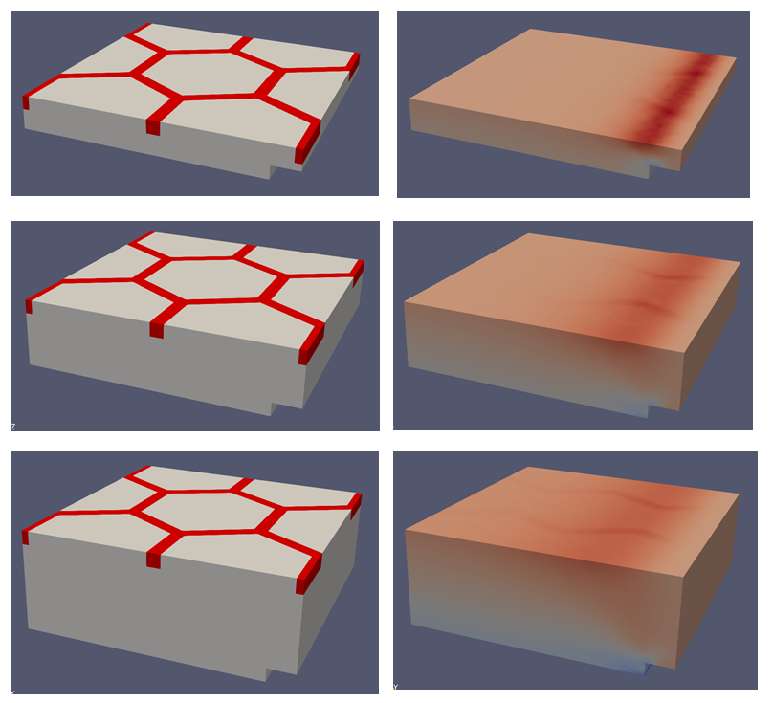
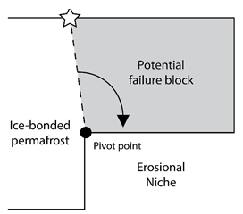
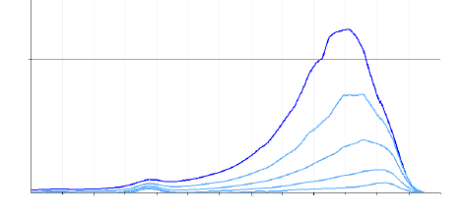

Mechanics-only simulation*: main takeaways
Taller and narrower erosional niches promote smaller failure masses compared to those with shorter and deeper niches
As niche advances into the block, an overhanging section in the block acts as cantilever.
Highest tensile stresses develop on top surface where cantilever meets rest of block
100
50x exaggeration
(1,1) stress component (kPa)
0 2 4 6 8 10 12 14 16 18 20 24 26
Distance from back (m)
* M. Thomas et al. Frontiers in Earth Science 8, April 2020.

Slide 31
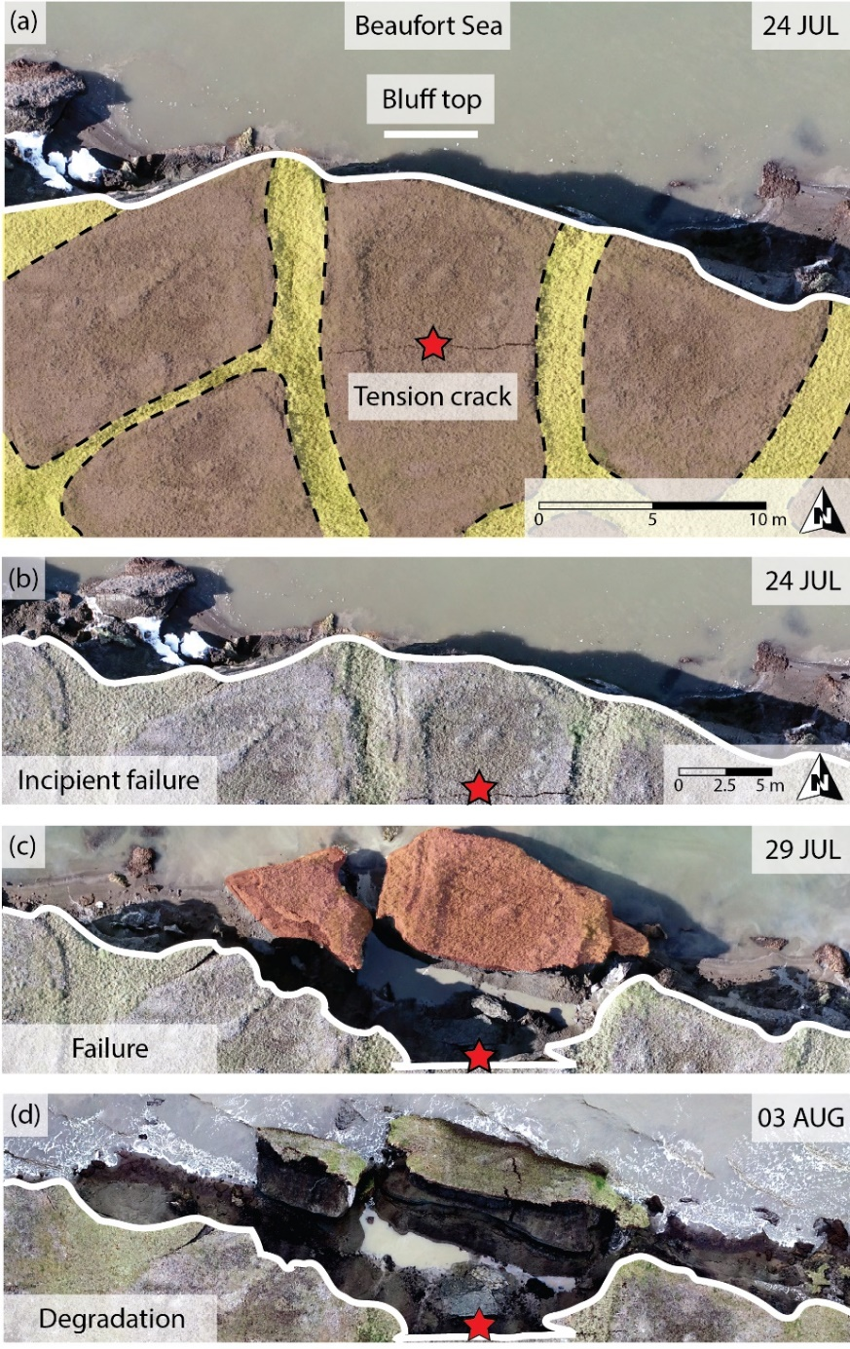
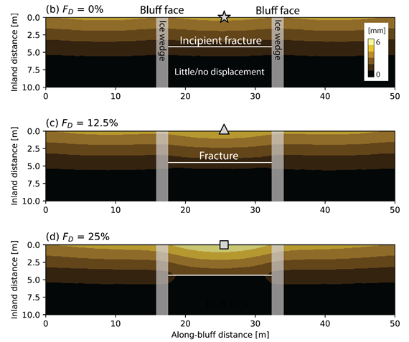

Mechanics-only simulation*: main takeaways
It has been observed that failure can occur along tension cracks in ice wedge polygon centers.
Simulations suggest tension cracks can form within the range of niche depths/heights considered here.
Even relatively shallow vertical cracks can concentrate strain within ice-bonded permafrost bluffs.
$F_{D}$: fracture depth
* M. Thomas et al. Frontiers in Earth Science 8, April 2020.

Slide 32
Thermo-mechanical 2.5D slice simulation
Thermo-mechanical simulations*
* Frederick, Mota, Tezaur, Bull, J. Comput. Appl. Math. 2021.

Slide 33

Thermo-mechanical coupling: cuboid problem
Cuboid is comprised of block of ice material, wedged between two blocks of permafrost material.
Cuboid subjected to simultaneous heating and stretching from the top
Cuboid is affixed to the bottom and with symmetry boundary conditions on the sides.
Temperature is initialized to 265K.
permafrost
ice
permafrost
3.0 m
1.0 m
1.0 m

Slide 34


Thermo-mechanical coupling: cuboid problem
Temp = 280 K
Disp = 0.2 m
$−$ Ice Saturation
$−$ Water Saturation
permafrost
ice
permafrost
Plots (right) show quantities along vertical line as a function of $z$ in the ice block
3.0 m
Temp
$−$ Temperature
1.0 m
1.0 m

Slide 35


Thermo-mechanical coupling: cuboid problem
Temp = 280 K
Disp = 0.2 m
$−$ Ice Saturation
$−$ Water Saturation
4 days
permafrost
ice
permafrost
Plots (right) show quantities along vertical line as a function of $z$ in the ice block
3.0 m
Temp
$−$ Temperature
1.0 m
1.0 m
Notes:
Now, we advance the simulation. You can see after 4 days, the temperature of the ice has gone up in the top part of the ice, past the melting point of 273K. As soon as this happens, you see the ice saturation go down, and the water saturation go up, meaning that the ice is melting.

Slide 36


Thermo-mechanical coupling: cuboid problem
Temp = 280 K
Disp = 0.2 m
$−$ Ice Saturation
$−$ Water Saturation
24 days
permafrost
ice
permafrost
Plots (right) show quantities along vertical line as a function of $z$ in the ice block
3.2 m
Temp
$−$ Temperature
<1.0 m
<1.0 m

Slide 37


Thermo-mechanical coupling: cuboid problem
Temp = 280 K
Disp = 0.2 m
$−$ Ice Saturation
$−$ Water Saturation
226 days
permafrost
ice
permafrost
Plots (right) show quantities along vertical line as a function of $z$ in the ice block
3.2 m
Temp
$−$ Temperature
<1.0 m
<1.0 m

Slide 38


Thermo-mechanical coupling: cuboid problem
permafrost
ice
permafrost
3.0 m
$$σ_{33}$$
Temp
1.0 m
1.0 m
As cuboid is heated and stretched at top, heat propagates down, melting ice and causing failure.

Slide 39




2.5D slice at Drew Point, Alaska*
Computational domain is 2.5D cross-section of archetypal 3D bluff geometry discretized using a uniform hex grid.
  Slice of permafrost is exposed to realistic BC data occurring at Drew Point, Alaska in July 2018 (pseudorealistic problem)
Initial temperature field obtained from vertical thermistor string placed into DP1-1 ice core at Drew Point.
Material properties determined from laboratory experiments on frozen soil samples from Drew Point, Alaska (next slide)
Implicit Newmark for mechanical, explicit forward Euler for thermal (stable $Δt = 1$hour)
* For details, see: Frederick, Mota, Tezaur, Bull, J. Comput. Appl. Math. 2021.

Slide 40












Material Model Calibration to Experimental Data
Experimental results on permafrost core samples were analyzed to create fits for parameters* $E$, $K$, $σ$ as a function of ice saturation and sediment fractions (peat content).
$$σ$$
$$K$$
$$E$$
$$E$$
$$σ$$
$$K$$
*$E$ = elastic modulus, $K$ = hardening modulus, $σ$ = yield stress (value of stress where sample fails)
Notes:
Our coauthor, Charles Choens, performed four unconfined compressive stress (UCS) experiments, which were used to calibrate the material model. Shown here are bilinear fits for fthree material model parameters. Sigma is the yield stress; this is the value of the stress where the sample fails (where the slope changes). E is the elastic modulus. This is the slope of the axial strain curves before reaching the point of failure, where the slope changes. K is the hardening modulus, which is the slope of the axial strain after reaching the point of failure. The equations for the fits are given above the bilinear surfaces, along with the r^2 values.

Slide 41










2.5D slice at Drew Point, Alaska*
$t≈8$days
Simulation showing niche progression beginning at the bluff toe and block failure/collapse event*
Peat
0.5m
~3m deep niche forms before a block collapse event similar to observed collapse at Drew Point, Alaska in early fall 2018.
$t≈39$days
5.2m
Bluff face (exposed to ocean)
Niche formation
$t≈39$days
Ice wedge
Permafrost
Overhanging peat material
Once niche advanced far enough, tension crack development in response to niche formation is observed
6.8m
Qualitative comparison to observations
$t≈39$days
Thermal denudation simultaneously with realistic niche geometry development.
Block failure!
* For details, see: Frederick, Mota, Tezaur, Bull, J. Comput. Appl. Math. 2021.

Slide 42





2.5D slice problem variant
Tension cracks
No-peat variant of the 2.5D slice problem with slightly different material parameters
Block failure!
5.2m
Bluff face (exposed to ocean)
Ice wedge
Permafrost
Niche
Once niche advanced far enough, tension crack development in response to niche formation is observed
6.8m
Once niche advanced far enough, tension crack development in response to niche formation is observed
Block failure!

Slide 43
Outline
Motivation and background
The Arctic Coastal Erosion (ACE) project
Thermo-mechanical finite element model of permafrost
Numerical results
Summary
Ongoing/future work

Slide 44

Summary
We have developed a thermo-mechanical coupled FEM model, ACE, that can simulate transient niche development and permafrost erosion within Albany.
The model was calibrated using data from a series of experiments on frozen soil samples from Drew Point, Alaska that were performed at Sandia’s Geomechanics Laboratory, as well as observational data collected at the same location.
The model incorporates boundary conditions from the WW3+SWAN+Delft3D wave models and observational data from field campaigns at Drew Point, Alaska.
30m
30m
5m
z
x
y

Slide 45
Outline
Motivation and background
The Arctic Coastal Erosion (ACE) project
Thermo-mechanical finite element model of permafrost
Numerical results
Summary
Ongoing/future work

Slide 46


Ongoing/future work
Near term:
Quantitative validation study in which the ACE model predictions are compared to available observational data collected during the 2018-2019 summer seasons at Drew Point, Alaska (2.5D slice + 3D).
Testing/tuning of ACE thermo-denudation simulation capabilities.
Further calibration and sensitivity studies using a range of environmental, geomorphological and numerical parameters for thermo-mechanical model.
Manuscript on above work is in preparation.
Longer term:
Integrate chemical transport into thermal model.
Infer statistical meso-/macro-scale models and relevant physics-based parameterizations from ACE micro-model, towards integration into ESMs.
  ACE is member of the DOE- sponsored InteRFACE project* focused on coastal processes in Arctic.
* Interdisciplinary Research for Arctic Coastal Environments
Notes:
thermo-denundation = basically thawing of permafrost bluffs that proceeds under the influences of gravity.
Peat MM = J2: That’s up for debate. But there are reasons why I think we are not grossly wrong using J2 for this. Most materials will exhibit some degree of elastic behavior at low loads and inelastic behavior at high loads. My understanding is that peat is organic material that has consolidated over time, forming a dense layer of compacted organic matter that in the absence of air formed a layer of mostly carbon. I the absence of other evidence, using J2 as a first approximation is a good choice, as most materials that are dense (not foamy, formed by strings, or very porous, etc) will have a much higher resistance to volume changes than to distortion. This is classic J2 behavior.
In summary, for inelastic behavior, J2 is generally a good first order approximation.

Slide 47
References
[1] J. Frederick, M. Thomas, D. Bull, C. Jones, J. Roberts. “The Arctic Coastal Erosion Problem”. Sandia National Laboratories Report, SAND2016-9762, 2016.
[2] A. Gibbs, B. Richmond. “National assessment of shoreline change – historical shoreline change along the north coast of Alaska, U.S.-Canadian border to Icy Cape”. U.S. Geological Survey Open-File Report, 2015-1048, 2015.
[3] P. Martin et al. “Wildlife response to environmental Arctic change: predicting future habitats of Arctic Alaska”. Report to WildREACH: Predicting Future Habitats of Arctic Alaska Workshop, Farbanks, Alaska, 2008.
[4] J. Brown and O. Ferrians and J. Heginbottom, E. Melnikov. “Circum-Arctic map of permafrost and ground conditions. Boulder, CO: National Snow and Ice Data Center, Digital Media, 1998.
[5] H. Lantuit, W. Pollard. Fifty years of coastal erosion and retrogressive thaw slump activity on Herschel Island, southern Beaufort Sea, Yukon Territory, Canada. Geomorphology, 95, 84-102, 2008.
[6] T. Ravens, B. Jones, J. Zhang, C. Arp, J. Schmutz. “Process-based coastal erosion modeling for Drew Point, North Slope, Alaska”. Journal of Waterway, Port, Coastal, and Ocean Engineering, 138, 2, 122-130, 2012.
[7] C. Koven, J. Riley, A. Stern. “Analysis of permafrost thermal dynamics and response to climate change in the CMPI5 Earth system models”. J Climate, 26, 1877-2900, 2009.
[8] M. Thomas, A. Mota, B. Jones, C. Choens, J. Frederick, D. Bull. “Bluff geometry and material properties influence stress rates relevant to coastal permafrost block failure”. Frontiers in Earth Science 8, 2020.
[9] J. Frederick, A. Mota, D. Bull, I. Tezaur. “Thermo-chemo-mechanical coupling for Arctic Coastal Erosion”, J. Comput. Appl. Math. 397 113533, 2021.
[10] D. Bull, C. Flanary, C. Jones, J. Frederick, A. Mota, I. Tezaur, J. Kasper, E. Brown, B. Jones, M. Jones, E. Bristol, C. Choens, C. Connoly, J. McClelland. "Arctic Coastal Erosion: Modeling and Experimentation". Sandia National Laboratories report, SAND2020-10223, 2020.

Slide 48


Acknowledgements
Research Team
SNL: D. Bull (PI), J. Frederick, A. Mota, C. Choens, I. Tezaur, L. Criscenti
USGS: M. Thomas, B. Jones
UAF: J. Kasper, E. Brown
Integral Consulting: C. Jones, C. Flanary
U Texas: J. McClelland, E. Bristol, C. Connolly

Slide 49
Start of Backup Slides

Slide 50

Potential impacts
3D model capable of predicting erosion from the material’s constitutive relationships capturing all types of deformation (block & denudation) leading to:
  Data-driven understanding of the characteristics that cause erosion
  A tool to guide military and civil infrastructure investments
  An improved understanding of coastal food web impacts and carbon-climate feedbacks
Redistributed eroded sediment in the environment enables:
  Prediction of deposition locations
  Estimates of fluxes (biogeochemical, toxins, etc.)
PC: Andrew Burton, NPR
Approach for moving from mechanistic micro-scale to stochastic meso-scale model sets stage for integration into global climate models built upon parametric analyses of input variables

Slide 51

Oceanography in Mechanistic Model
WW3
SWAN
Wave set-up conditions 2-way coupled with circulation
Delft3D
Circulation and thermodynamic mixing 2-way coupled with waves
ice cover
temperature (surface and ocean)
surface winds
solar radiation
persistent currents
capture set-up (storm surge and runup)
wave energy inclusive of induced current effects
capture induced currents in nearshore
ability to model mixing of temperature and salinity clines
Development of wave field in the Arctic to develop nearshore BCs
high resolution near shore environment
Potential Key Advances
  Inclusion of ice coverage for fetch limited wave growth
  Knowledge of wave energy along broad coastline
  Set-up determination inclusive of bathymetry and wave energy
  Ability to accurately predict temperature at bluff face through mixing of clines in the ocean
WW3 polar stereographic model initially developed by NRL (Erick Rogers) and NOAA (Arun Chawla)

Slide 52





Proposed solution
Goal of the Arctic Coastal Erosion (ACE) project is to deliver a field-validated predictive model of thermo-abrasive erosion for the permafrost Arctic coastline
2017-2022
Multi-physics finite element model of an archetype of the coastline coupled with high-fidelity model of storm intensities
  Input variables define geomorphology & geophysics
  Plastic deformation model of material (J2 class)
  Geomechanical testing to determine coupled thermal-mechanical strength characteristics
  Time-varying ocean BCs (water level, temp, salinity)
  Eroded sediment and biogeochemical flux tracking
This talk
field measurements
Micro-scale Model
oceanographic model
10’s of meters & storm duration
thermo-chemical-mechanical terrestrial model
30m
5m
30m
Significant Wave Height (m)
0.0 0.5 1.0 1.5 2.0 2.5 3.0
ocean water
July 23rd 2017. 6am.
Ice wedge
WW3 polar stereographic model initially developed by NRL (Erick Rogers) and NOAA (Arun Chawla)
Permafrost
A “catalog” of micro-scale models that represent the statistical distributions of input variables along a ~10km stretch of coastline.
  Probability distribution functions of geomorphology and geophysics used to weight erosion output
    Will validate approach with decade long annual measurements at Drew Point.
  Evaluating ocean “exposure metrics” to represent time-varying ocean
2023+
Meso-scale Model
10’s of km’s & seasonal duration
Notes:
The ACE project started as an internally funded LDRD (Laboratory Directed Research and Development) project, which ended last September, but we are continuing this work now under the BER-funded InterFACE project. The aim of the ACE project is to change the state-of-the-art in permafrost erosion modeling by creating a field-validated predictive model of thermo-abrasive erosion for the permafrost Arctic coastline.
We are taking a physics-based multi-scale approach in this project. Up to now, we have been focusing on developing a micro-scale multi-physics finite element model, the subject of this talk. This model can be used to simulate small subregions (10s of meters long/wide) of the Arctic coastline, is designed to capture 3D heat transfer together with mechanics-based plastic deformation, and takes as boundary conditions wave circulation data representing time-varying realizations of individual storm events. I’ll talk more about this model in the coming slides.
The microscale model is likely be too expensive to model the entire Arctic coastline. To deal with this, the idea is to create a “catalog” or micro-scale models for different locations in the Arctic, and to use this catalog to derive statistical parameterizations of things like aggregate retreat rates. These parameterizations would be based on physics, rather than empirical relationships, as done in the past.

Slide 53
Multi-scale approach
Micro-Scale Model | Meso-Scale Model | Macro-Scale Model
10’s of meters & storm duration | 10’s of kilometers & monthly duration | 100’s of kilometers & annual (+) durations
One set of input variables defining the geomorphology and geophysics of the terrestrial model. | A number of micro-scale models that represent the stochastic distributions of input variables along a confined coastline. | A number of meso-scale models that represent the diversity of coastline types (delta, exposed bluffs, lagoons, etc.) along the AK coastline.
  Working towards a series of fully coupled studies to determine terrestrial model sensitivities to:
    Height of water on bluff face
    Exposure time of bluff face to water
    Temperature of water
    Salinity of water

Slide 54

Parameters & inputs
Permafrost properties depend on ice content, unfrozen water content and frost susceptibility.
Few mathematical relationships exist that describe changes in tensile strength, shear strength and cohesion of ice/permafrost with changes in temperature.
Series of experiments (UCS¹, BTS², DT³) on frozen soil samples at different temps (-6C, -3C, -1C) and ice content from Drew Point, AK were performed at SNL’s Geomechanics Laboratory to estimate:
  Strength: 1-3 MPa
  Young’s modulus: 0.01-0.16 GPa
  Poisson’s ratio: 0.1-0.35
  Porosity values: 40-95%
y=-1.872*x
R²=0.3908
BTS (MPa)
Lots of noise in data!
IceVolFrac
¹ Unconfined compressive test. ² Brazilian tensile tests. ³ Direct tensile tests.
Notes:
So, the mechanical and thermal models we have developed contain a number of parameters and other inputs like boundary condition. Where do these come from? I’ll start with the mechanical parameters. There is limited data for mechanical parameters of permafrost in the literature, so we ended up performing a series of experiments on frozen soil samples at different temperatures and having different ice contents to estimate things like strength, Young’s modulus, Poisson’s ratio and porosity. These were done by my colleague, Charles Choens, at Sandia’s geomechanics laboratory, and the samples tested came from Drew Point in northern Alaska, the region we are currently targeting with the ACE model

