Slide 1
Energy-Stable Galerkin Reduced Order Models for Nonlinear Compressible Flow
1
Irina Kalashnikova¹, Matthew F. Barone², Jeffrey A. Fike³,
Srinivasan Arunajatesan², Bart G. van Bloemen Waanders⁴
¹Computational Mathematics Department, Sandia National Laboratories, Albuquerque, NM, USA.
²Aerosciences Department, Sandia National Laboratories, Albuquerque NM, USA.
³Component Science & Mechanics Department, Sandia National Laboratories, Albuquerque, NM, USA.
⁴Optimization and UQ Department, Sandia National Laboratories, Albuquerque, NM, USA.
11th World Congress on Computational Mechanics (WCCM XI)
Barcelona, Spain
Tuesday, July 22, 2014
SAND 2014-15602PE
Sandia National Laboratories is a multi-program laboratory managed and operated by Sandia Corporation, a wholly owned subsidiary of Lockheed Marin Corporation, for the U.S. Department of Energy’s National Security Administration under contract DE-AC04-94AL85000.

Slide 2
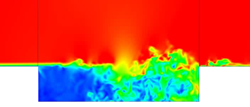
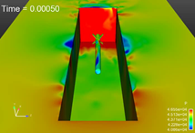
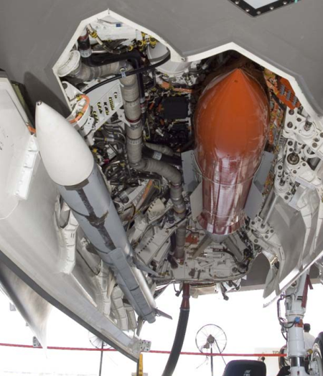
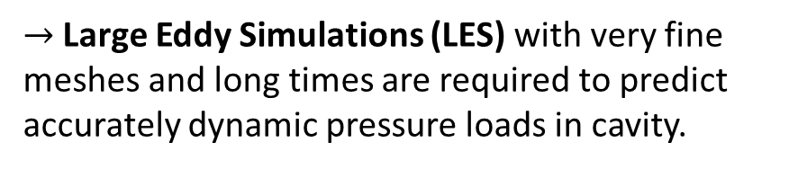
2
Motivation
Despite improved algorithms and powerful supercomputers, “high-fidelity” models are often too expensive for use in a design or analysis setting.
Targeted application area in which this situation arises: compressible cavity flow problem.
  $→$ Large Eddy Simulations (LES) with very fine meshes and long times are required to predict accurately dynamic pressure loads in cavity.
  These simulations take weeks even when run in parallel on state-of-the-art supercomputers!

Slide 3
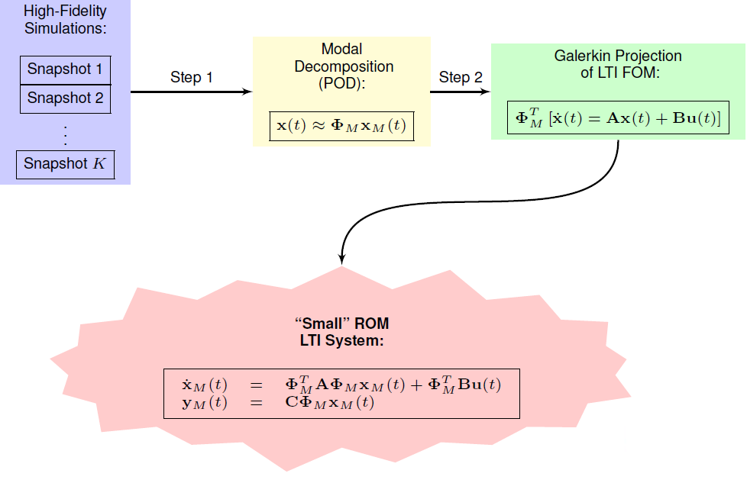
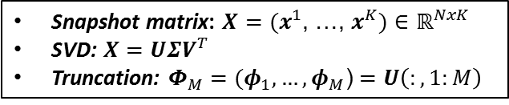
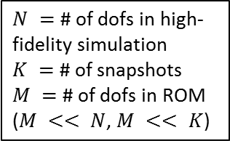
3
Proper Orthogonal Decomposition (POD)/
Galerkin Method to Model Reduction
Snapshot matrix: $X=(x^{1}$, …, $x^{K})$ $∈ℝ^{NxK}$
SVD: $X=UΣV^{T}$
Truncation: $Φ_{M}=(φ_{1}, …, φ_{M}$) $=U\left(:,1:M\right)$
$N =$ # of dofs in high-fidelity simulation
$K =$ # of snapshots
$M =$ # of dofs in ROM
($M << N$, $M << K$)

Slide 4
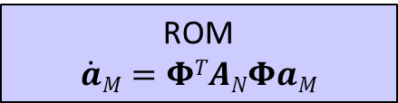
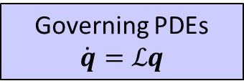
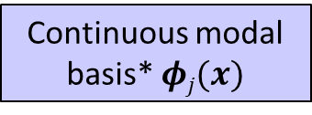
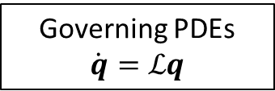
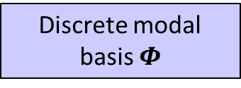
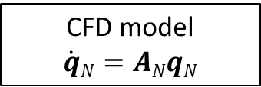
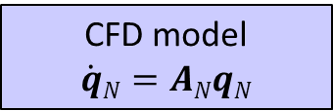
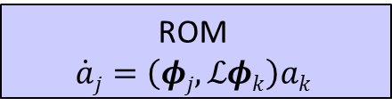
4
Discrete vs. Continuous Galerkin
Projection
Discrete Projection
Continuous Projection
Governing PDEs
$$\dot{q}=ℒq$$
This talk focuses on
Governing PDEs
$$\dot{q}=ℒq$$
If PDEs are linear or have polynomial non-linearities, projection can be calculated in offline stage of MOR.
CFD model
$$\dot{q}N=ANqN$$
CFD model
$$\dot{q}N=ANqN$$
Discrete modal basis $Φ$
Continuous modal basis* $φj(x)$
Projection of CFD model (matrix operation)
Projection of governing PDEs (numerical integration)
ROM
$$\dot{a}M=ΦTANΦaM$$
ROM
$$\dot{a}j=\left(φj,ℒφk\right)ak$$
* Continuous functions space is defined using finite elements.

Slide 5
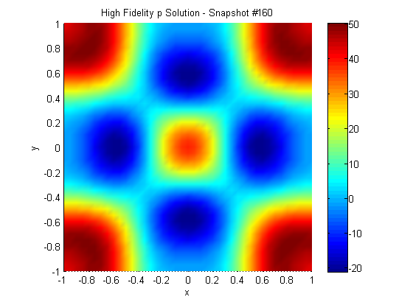
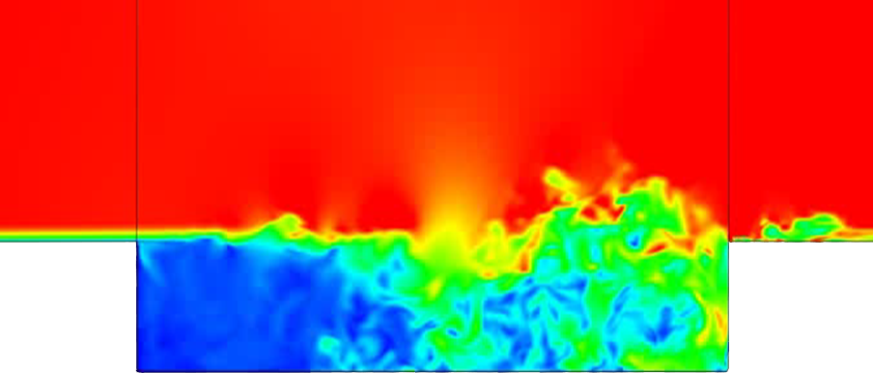
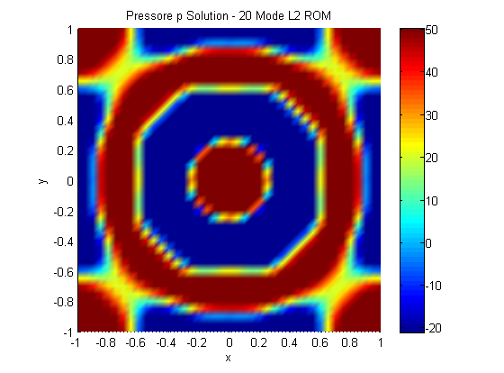
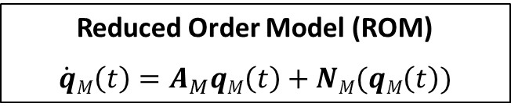
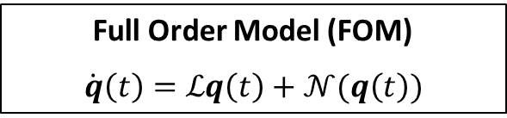

5
Stability Issues of POD/Galerkin ROMs
Full Order Model (FOM)
$$\dot{q}\left(t\right)=ℒq\left(t\right)+𝒩(q\left(t\right))$$
Reduced Order Model (ROM)
$$\dot{q}M\left(t\right)=A_{M}qM\left(t\right)+NM(qM\left(t\right))$$
Problem: FOM stable $⇏$ ROM stable!
There is no a priori stability guarantee for POD/Galerkin ROMs.
Stability of a ROM is commonly evaluated a posteriori – RISKY!
Instability of POD/Galerkin ROMs is a real problem in some applications…
Top right: FOM
\
Bottom right: ROM
…e.g., compressible flows, high-Reynolds number flows.

Slide 6
6
Energy-Stability
Practical Definition: Numerical solution does not “blow up” in finite time.
More Precise Definition: Numerical discretization does not introduce any spurious instabilities inconsistent with natural instability modes supported by the governing continuous PDEs.
Numerical solutions must maintain proper energy balance.
Stability of ROM is intimately tied to choice of inner product for the Galerkin projection.
Stability-preserving inner product derived using the energy method:
  Bounds numerical solution energy in a physical way.
  Borrowed from spectral methods community.
  Analysis is straightforward for ROMs constructed via continuous projection.
Practical implication of energy-stability analysis:
energy inner product ensures that any “bad” modes will not introduce spurious non-physical numerical instabilities into the Galerkin approximation.

Slide 7
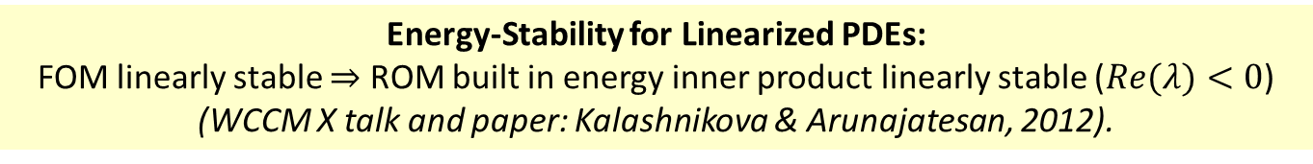
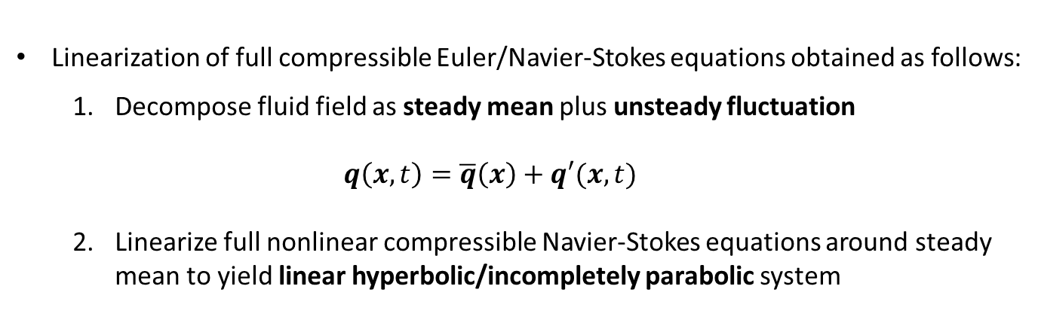

7
Linearized Compressible Flow
Equations
Energy-Stability for Linearized PDEs:
FOM linearly stable $⇒$ ROM built in energy inner product linearly stable ($Re(λ)<0$)
(WCCM X talk and paper: Kalashnikova & Arunajatesan, 2012).
Linearized compressible Euler/Navier-Stokes equations are appropriate when a compressible fluid system can be described by small-amplitude perturbations about a steady-state mean flow.
Linearization of full compressible Euler/Navier-Stokes equations obtained as follows:
  Decompose fluid field as steady mean plus unsteady fluctuation
  $$q\left(x,t\right)=\overline{q}\left(x\right)+q′(x,t)$$
  Linearize full nonlinear compressible Navier-Stokes equations around steady mean to yield linear hyperbolic/incompletely parabolic system
  $$\dot{q′}+Ai\left(\overline{q}\right)\frac{∂q′}{∂xi}+\frac{∂}{∂xj}\left[Kij(\overline{q})\frac{∂q′}{∂xi}\right]=0$$

Slide 8
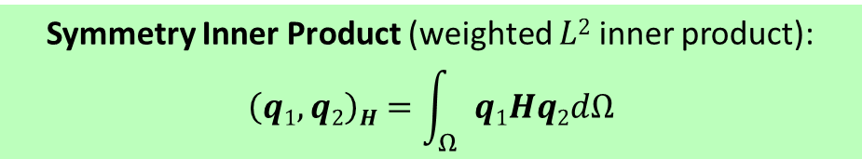
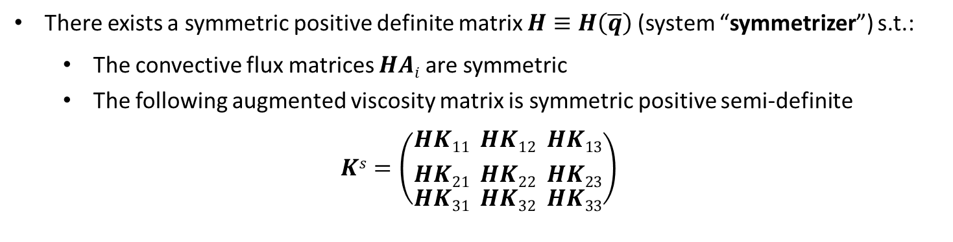
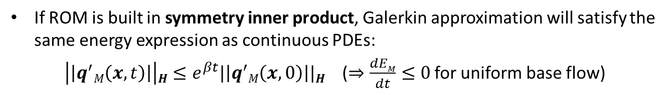
8
Energy-Stable ROMs for Linearized
Compressible Flow
Linearized compressible Euler/Navier-Stokes equations are symmetrizable (Barone & Kalashnikova, 2009; Kalashnikova & Arunajatesan, 2012).
There exists a symmetric positive definite matrix $H≡H\left(\overline{q}\right)$(system “symmetrizer”) s.t.:
  The convective flux matrices $HAi$ are symmetric
  The following augmented viscosity matrix is symmetric positive semi-definite
$$Ks=\left(\begin{aligned}{HK11 \atop HK21} \\ HK31\end{aligned}\begin{aligned}{ HK12 \atop HK22} \\ HK32\end{aligned}\begin{aligned}{ HK13 \atop HK23} \\ HK33\end{aligned}\right)$$
Symmetry Inner Product (weighted $L2$ inner product):
$$\left(q1,q2\right)H=\int_{Ω}{q1Hq2dΩ}$$
If ROM is built in symmetry inner product, Galerkin approximation will satisfy the same energy expression as continuous PDEs:
$\left|\left|q^{′}M\left(x,t\right)\right|\right|H≤e^{βt}|\left|q^{′}M\left(x,0\right)\right||H$ ($⇒\frac{dEM}{dt}≤0$ for uniform base flow)

Slide 9

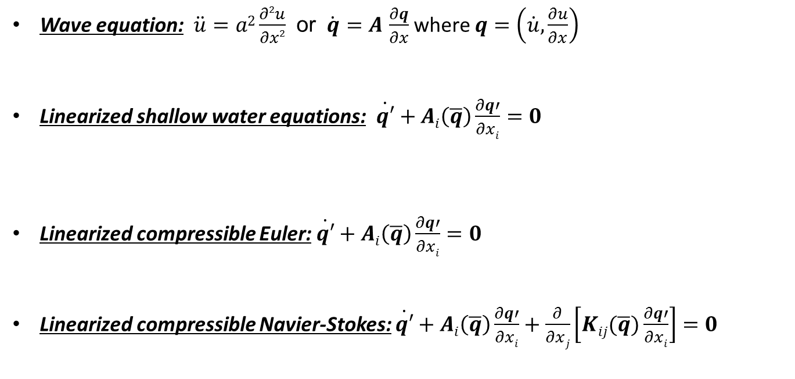
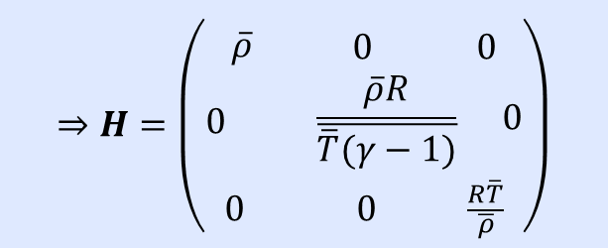

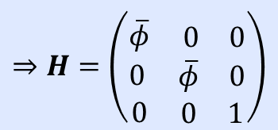
9
Symmetrizers for Several Hyperbolic/
Incompletely Parabolic Systems
$$⇒H=\left(\begin{matrix}1 & 0 \\ 0 & a2\end{matrix}\right)$$
Wave equation: $\ddot{u}=a2\frac{∂2u}{∂x2}$ or $\dot{q}=A$ $\frac{∂q}{∂x}$ where $q=\left(\dot{u},\frac{∂u}{∂x}\right)$
Linearized shallow water equations: $\dot{q′}+Ai\left(\overline{q}\right)\frac{∂q′}{∂xi}=0$
Linearized compressible Euler: $\dot{q′}+Ai\left(\overline{q}\right)\frac{∂q′}{∂xi}=0$
  Linearized compressible Navier-Stokes: $\dot{q′}+Ai\left(\overline{q}\right)\frac{∂q′}{∂xi}+\frac{∂}{∂xj}\left[Kij(\overline{q})\frac{∂q′}{∂xi}\right]=0$
$$⇒H=\left(\begin{aligned} \\ \overline{φ}\begin{matrix} 0 & 0\end{matrix} \\ 0 \begin{matrix}\overline{φ} & 0\end{matrix} \\ 0 \begin{matrix}0 & 1\end{matrix}\end{aligned}\right)$$
$$⇒H=\left(\begin{aligned} \\ \overline{ρ}\begin{matrix} 0 & 0\end{matrix} \\ 0 \begin{matrix}α2γ\overline{ρ}2\overline{p} & \overline{ρ}α2\end{matrix} \\ \begin{matrix}0 & 0\end{matrix} \frac{(1+α2)}{γ\overline{p}}\end{aligned}\right)$$
$$⇒H=\left(\begin{aligned} \\ \overline{ρ}\begin{matrix} 0 & 0\end{matrix} \\ 0 \begin{matrix} \frac{\overline{ρ}R}{\overline{\overline{T}(γ−1)}} & 0\end{matrix} \\ \begin{matrix}0 & 0\end{matrix} \frac{R\overline{T}}{\overline{ρ}}\end{aligned}\right)$$
Barone & Kalashnikova, JCP, 2009.
Kalashnikova & Arunajatesan, WCCM X, 2012.
Kalashnikova et al., SAND report, 2014.

Slide 10
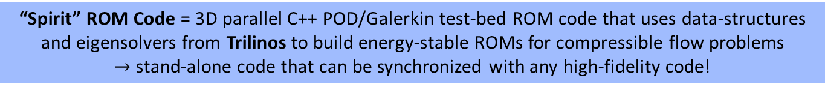
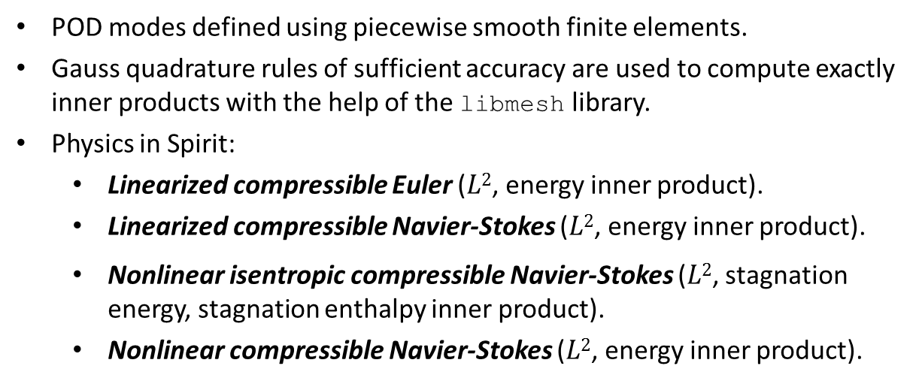
10
Continuous Projection
Implementation: “Spirit” Code
“Spirit” ROM Code = 3D parallel C++ POD/Galerkin test-bed ROM code that uses data-structures and eigensolvers from Trilinos to build energy-stable ROMs for compressible flow problems
$→$ stand-alone code that can be synchronized with any high-fidelity code!
POD modes defined using piecewise smooth finite elements.
Gauss quadrature rules of sufficient accuracy are used to compute exactly inner products with the help of the libmesh library.
Physics in Spirit:
  Linearized compressible Euler ($L2$, energy inner product).
  Linearized compressible Navier-Stokes ($L2$, energy inner product).
  Nonlinear isentropic compressible Navier-Stokes ($L2$, stagnation energy, stagnation enthalpy inner product).
  Nonlinear compressible Navier-Stokes ($L2$, energy inner product).
First, testing of ROMs for these physics
“SIGMA CFD” High-Fidelity Code = Sandia in-house finite volume flow solver derived from LESLIE3D (Genin & Menon, 2010), an LES flow solver originally developed in the Computational Combustion Laboratory at Georgia Tech.

Slide 11
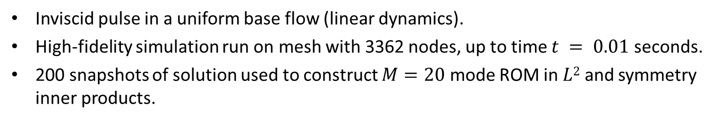


11
Numerical Experiment: 2D Inviscid
Pressure Pulse
Inviscid pulse in a uniform base flow (linear dynamics).
High-fidelity simulation run on mesh with 3362 nodes, up to time $t = 0.01$ seconds.
200 snapshots of solution used to construct $M=20$ mode ROM in $L2$ and symmetry inner products.
$x_{M,i}(t)$vs.$(q’CFD,φi)$ for $i=1,2$
$L2$ROM
Symmetry ROM

Slide 12

12
Numerical Experiment: 2D Inviscid
Pressure Pulse (cont’d)
Inviscid pulse in a uniform base flow (linear dynamics).
High-fidelity simulation run on mesh with 3362 nodes, up to time $t = 0.01$ seconds.
200 snapshots of solution used to construct $M=20$ mode ROM in $L2$ and symmetry inner products.
p’: High-fidelity
p’: Symmetry ROM
p’: $L2$ ROM
time of snapshot 0
time of snapshot 160

Slide 13
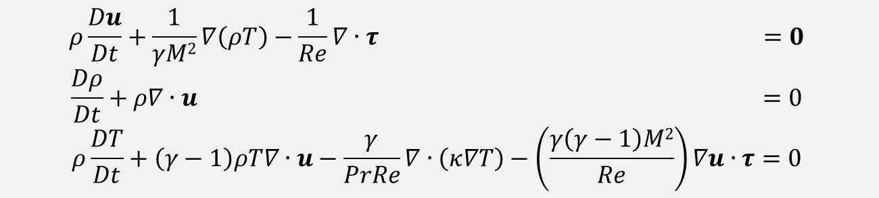
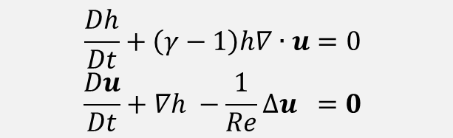
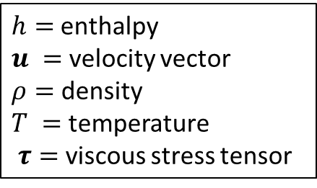
13
Nonlinear Compressible Flow Equations
Energy-Stability for Nonlinear PDEs:
ROM built in energy inner product will preserve stability of an equilibrium point at 0 for the governing nonlinear system of PDEs (Rowley, 2004; Kalashnikova et al., 2014).
Compressible isentropic Navier-Stokes equations (cold flows, moderate Mach #):
$$\frac{Dh}{Dt}+\left(γ−1\right)h∇∙u=0$$
$$\frac{Du}{Dt}+∇h −\frac{1}{Re}∆u =0$$
$h=$enthalpy
$u =$ velocity vector
$ρ=$ density
$T =$ temperature
$τ=$viscous stress tensor
Full compressible Navier-Stokes equations:
$$ρ\frac{Du}{Dt}+\frac{1}{γM2}∇\left(ρT\right)−\frac{1}{Re}∇∙τ =0$$
$$\frac{Dρ}{Dt}+ρ∇∙u =0$$
$$ρ\frac{DT}{Dt}+\left(γ−1\right)ρT∇∙u−\frac{γ}{PrRe}∇∙\left(κ∇T\right)−\left(\frac{γ\left(γ−1\right)M2}{Re}\right)∇u∙τ=0$$

Slide 14
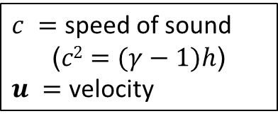
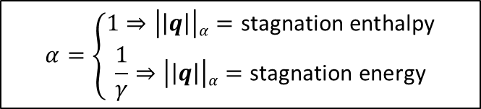
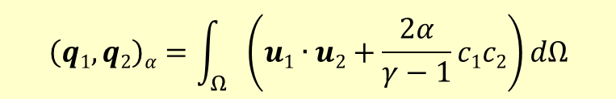
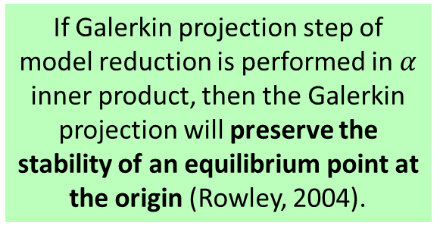
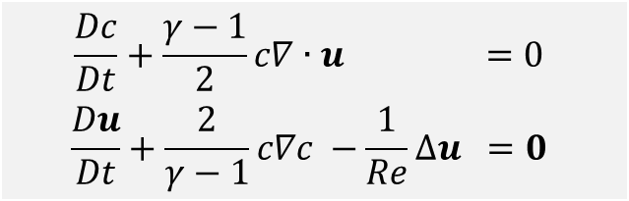
14
Energy-Stable ROMs for Nonlinear
Compressible Flow (Isentropic NS)
In (Rowley, 2004), Rowley et al. showed that energy inner product for the compressible isentropic Navier-Stokes equations can be defined following a transformation of these equations.
Transformed compressible isentropic Navier-Stokes equations:
$c =$ speed of sound
($c2=(γ−1)h$)
$u =$ velocity
$$\frac{Dc}{Dt}+\frac{γ−1}{2}c∇∙u =0$$
$$\frac{Du}{Dt}+\frac{2}{γ−1}c∇c −\frac{1}{Re}∆u =0$$
If Galerkin projection step of model reduction is performed in $α$ inner product, then the Galerkin projection will preserve the stability of an equilibrium point at the origin (Rowley, 2004).
Family of inner products:
$$\left(q1,q2\right)α=\int_{Ω}{\left(u1∙u2+\frac{2α}{γ−1}c1c2\right)dΩ}$$
$$α=\left\{\begin{aligned}1⇒\left|\left|q\right|\right|α=\text{stagnation} \text{enthalpy} \\ \frac{1}{γ}⇒\left|\left|q\right|\right|α=\text{stagnation} \text{energy}\end{aligned}\right.$$

Slide 15
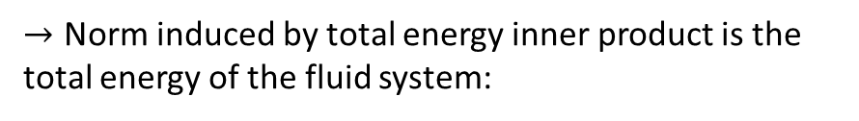
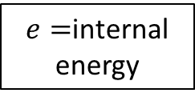

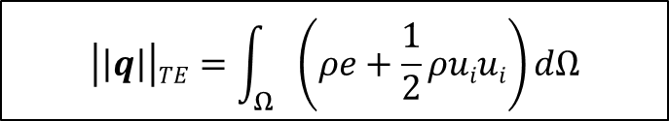
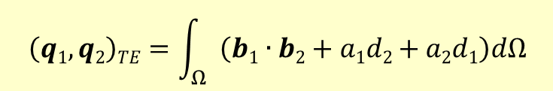
15
Energy-Stable ROMs for Nonlinear
Compressible Flow (Full NS)
Present work extends ideas in (Rowley, 2004) to full compressible Navier-Stokes equations.
Requirement: transformation/inner product yields PDEs with only polynomial non-linearities.
First, full compressible Navier-Stokes equations are transformed into the following variables:
If Galerkin projection step of model reduction is performed in total energy inner product, then the Galerkin projection will preserve the stability of an equilibrium point at the origin
(Kalashnikova et al., 2014)
$e=$internal energy
$a=\sqrt{ρ}$, $b=au$, $d=ae$
Next, the following “total energy” inner product is defined:
$$\left(q1,q2\right)TE=\int_{Ω}{\left(b1∙b2+a1d2+a2d1\right)dΩ}$$
☺ Transformed equations have only polynomial non-linearities (projection of which can be computed in offline stage of MOR and stored).
☹ Transformation introduces higher order polynomial non-linearities.
  ☺ Efficiency of online stage of MOR can be recovered using interpolation (e.g., DEIM, gappy POD).
$→$ Norm induced by total energy inner product is the total energy of the fluid system:
$$\left|\left|q\right|\right|TE=\int_{Ω}{\left(ρe+\frac{1}{2}ρuiui\right)}dΩ$$

Slide 16
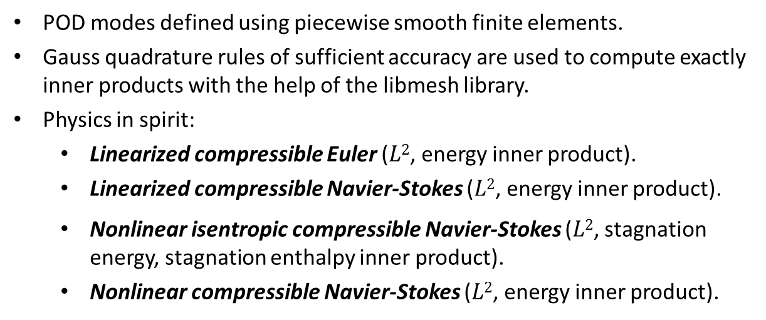
16
Continuous Projection
Implementation: “Spirit” Code
“Spirit” ROM Code = 3D parallel C++ POD/Galerkin test-bed ROM code that uses data-structures and eigensolvers from Trilinos to build energy-stable ROMs for compressible flow problems
$→$ stand-alone code that can be synchronized with any high-fidelity code!
POD modes defined using piecewise smooth finite elements.
Gauss quadrature rules of sufficient accuracy are used to compute exactly inner products with the help of the libmesh library.
Physics in spirit:
  Linearized compressible Euler ($L2$, energy inner product).
  Linearized compressible Navier-Stokes ($L2$, energy inner product).
  Nonlinear isentropic compressible Navier-Stokes ($L2$, stagnation energy, stagnation enthalpy inner product).
  Nonlinear compressible Navier-Stokes ($L2$, energy inner product).
Now, testing of ROMs for these physics
“SIGMA CFD” High-Fidelity Code = Sandia in-house finite volume flow solver derived from LESLIE3D (Genin & Menon, 2010), a LES flow solver originally developed in the Computational Combustion Laboratory at Georgia Tech.

Slide 17
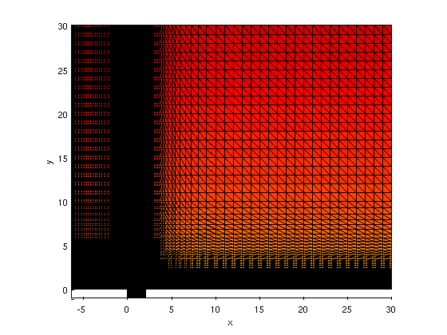
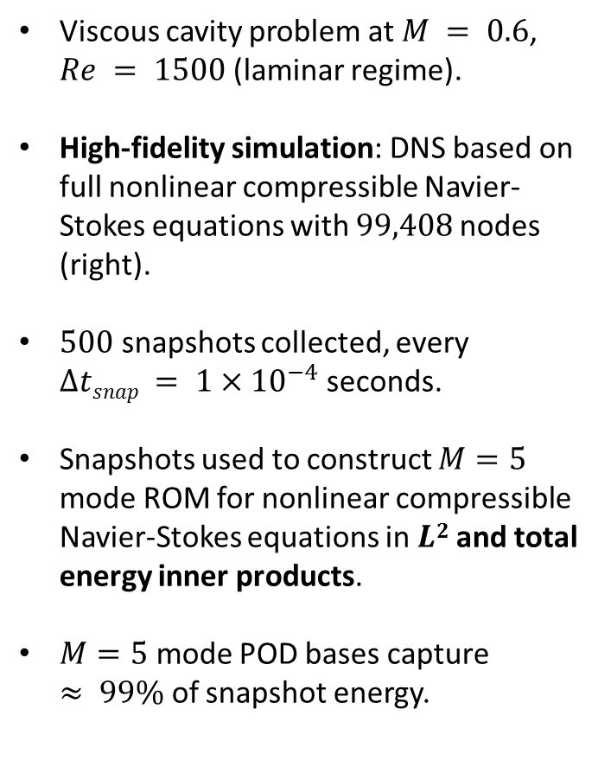
17
Numerical Experiment: Viscous Laminar
Cavity
Viscous cavity problem at $M = 0.6$, $Re = 1500$(laminar regime).
High-fidelity simulation: DNS based on full nonlinear compressible Navier-Stokes equations with $99,408$nodes (right).
$500$ snapshots collected, every $∆tsnap = 1×{10}^{−4}$seconds.
Snapshots used to construct $M=5$ mode ROM for nonlinear compressible Navier-Stokes equations in $L2$ and total energy inner products.
$M=5$ mode POD bases capture $≈ 99\%$ of snapshot energy.
Figure above: viscous laminar cavity problem domain/mesh.

Slide 18
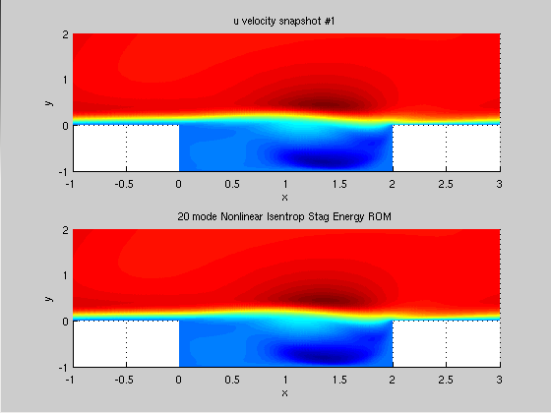
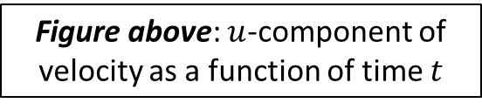
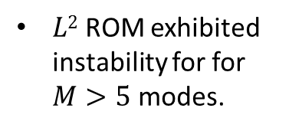

18
Numerical Experiment: Viscous Laminar Cavity (cont’d)
High-Fidelity
$L2$ ROM exhibited instability for for $M>5$ modes.
ROM ($M=5$ modes) | Error ($L2$ norm)
Nonlinear $L2$ ROM | $$NaN$$
Total Energy ROM | $$5.52×{10}^{−2}$$
5 mode total energy ROM
In contrast, total energy ROM remained stable and agreed well with high-fidelity solution!
Figure above: $u$-component of velocity as a function of time $t$

Slide 19

19
Summary & Future Work
A Galerkin model reduction approach in which the continuous equations are projected onto the basis modes in a continuous inner product is proposed.
It is shown that the choice of inner product for the Galerkin projection step is crucial to stability of the ROM.
  For linearized compressible flow, Galerkin projection in the “symmetry” inner product leads to a ROM that is energy-stable for any choice of basis.
  For nonlinear compressible flow, an inner product that induces the total energy of the fluid system is developed. A ROM constructed in this inner product will preserve the stability of an equilibrium point at 0 for the system.
Results are promising for a nonlinear problem involving compressible viscous laminar flow over an open cavity: a total energy ROM remains stable whereas an $L2$ ROM exhibits an instability.
Ongoing/Future Work
Improve efficiency of nonlinear total energy ROMs through interpolation (e.g., DEIM, gappy POD)
Studies of predictive capabilities of ROMs (robustness w.r.t. parameter changes).

Slide 20


20
Acknowledgements
This work was funded by the Laboratories’ Directed Research and Development (LDRD) Program at Sandia National Laboratories.
Thank You! Questions?
ikalash@sandia.gov
http://www.sandia.gov/~ikalash
Some references on these ideas:
I. Kalashnikova, S. Arunajatesan, M.F. Barone, B.G. van Bloemen Waanders, J.A. Fike. Reduced Order Modeling for Prediction and Control of Large-Scale Systems. Sandia National Laboratories Report, SAND No. 2014-4693 (2014).
I. Kalashnikova, S. Arunajatesan. A Stable Galerkin Reduced Order Model (ROM) for Compressible Flow, WCCM-2012-18407, 10th World Congress on Computational Mechanics (WCCM X), Sao Paulo, Brazil (2012).
M.F. Barone, I. Kalashnikova, D.J. Segalman, H. Thornquist. Stable Galerkin reduced order models for linearized compressible flow. J. Comput. Phys. 288: 1932-1946, 2009.

Slide 21
21
References
I. Kalashnikova, B.G. van Bloemen Waanders, S. Arunajatesan, M.F. Barone. "Stabilization of Projection-Based Reduced Order Models for Linear Time-Invariant Systems via Optimization-Based Eigenvalue Reassignment". Comput. Meth. Appl. Mech. Engng. 272 (2014) 251-270.
M.F. Barone, I. Kalashnikova, D.J. Segalman, H. Thornquist. Stable Galerkin reduced order models for linearized compressible flow. J. Comput. Phys. 288: 1932-1946, 2009.
C.W. Rowley, T. Colonius, R.M. Murray. Model reduction for compressible flows using POD and Galerkin projection. Physica D. 189: 115-129, 2004.
G. Serre, P. Lafon, X. Gloerfelt, C. Bailly. Reliable reduced-order models for time-dependent linearized Euler equations. J. Comput. Phys. 231(15): 5176-5194, 2012.
B. Bond, L. Daniel, Guaranteed stable projection-based model reduction for indefinite and unstable linear systems, In: Proceedings of the 2008 IEEE/ACM International Conference on Computer-Aided Design, 728–735, 2008.
D. Amsallem, C. Farhat. Stabilization of projection-based reduced order models. Int. J. Numer. Methods Engng. 91 (4) (2012) 358-377.
F. Genin and S. Menon. Studies of shock/turbulent shear layer interaction using large-eddy simulation. Computers and Fluids, 39 800–819 (2010).

Slide 22
22
References (continued)
Z. Wang, I. Akhtar, J. Borggaard, T. Iliescu. Proper orthogonal decomposition closure models for turbulent flows: a numerical comparison. Comput. Methods Appl. Mech. Engrg. 237-240:10-26, 2012.
I. Kalashnikova, S. Arunajatesan, M.F. Barone, B.G. van Bloemen Waanders, J.A. Fike. Reduced Order Modeling for Prediction and Control of Large-Scale Systems. Sandia National Laboratories Report, SAND No. 2014-4693 (2014).
I. Kalashnikova, S. Arunajatesan. A Stable Galerkin Reduced Order Model (ROM) for Compressible Flow, WCCM-2012-18407, 10th World Congress on Computational Mechanics (WCCM X), Sao Paulo, Brazil (2012).
K. Carlberg, C. Bou-Mosleh, C. Farhat. Efficient nonlinear model reduction via a least-squares Petrov-Galerkin projection and compressive tensor approximations. Int. J. Numer. Meth. Engng. 86 (2) 155-181 (2011).
S. Chaturantabut, D.C. Sorensen. Discrete empirical interpolation for nonlinear model reduction. Technical Report TR09-05, Department of Computational and Applied Mathematics, Rice University (2009).
I. Kalashnikova, B.G. van Bloemen Waanders, S. Arunajatesan, M.F. Barone. "Stabilization of Projection-Based Reduced Order Models for Linear Time-Invariant Systems via Optimization-Based Eigenvalue Reassignment". Comput. Meth. Appl. Mech. Engng. 272 (2014) 251-270.

