Slide 1
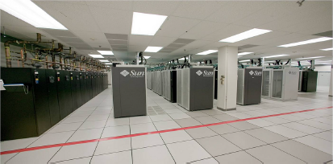
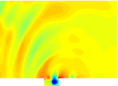
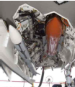
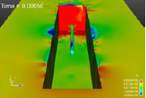
A minimal subspace rotation approach for obtaining stable & accurate low-order projection-based reduced order models for nonlinear compressible flow
Irina Tezaur¹, Maciej Balajewicz²
¹ Quantitative Modeling & Analysis Department, Sandia National Laboratories
² Aerospace Engineering Department, University of Illinois Urbana-Champaign
WCCM 2016 Seoul, South Korea July 25-30, 2016
SAND2016-6345 C

Slide 2
Outline
Motivation
2. Projection-based model order reduction
3. Accounting for modal truncation
  Traditional linear eddy-viscosity approach
  New proposed approach via subspace rotation
Applications
  Low Reynolds number channel driven cavity
  Moderate Reynolds number channel driven cavity
Summary
6. Future work
7. References
SAND2016-6345 C

Slide 3
Outline
Motivation
2. Projection-based model order reduction
3. Accounting for modal truncation
  Traditional linear eddy-viscosity approach
  New proposed approach via subspace rotation
Applications
  Low Reynolds number channel driven cavity
  Moderate Reynolds number channel driven cavity
Summary
6. Future work
7. References
SAND2016-6345 C

Slide 4
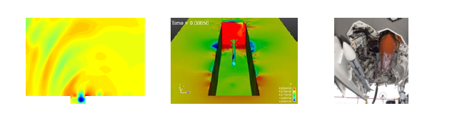
Motivation
Targeted application: compressible fluid flow (e.g., captive-carry)
SAND2016-6345 C

Slide 5
Motivation
Targeted application: compressible fluid flow (e.g., captive-carry)
Desired numerical properties of ROMs:
  Consistency (w.r.t. the continuous PDEs).
  Stability: if full order model (FOM) is stable, ROM should be stable.
  Convergence: requires consistency and stability.
  Accuracy (w.r.t. FOM).
  Efficiency.
  Robustness (w.r.t. time or parameter changes).
SAND2016-6345 C

Slide 6
Motivation
Targeted application: compressible fluid flow (e.g., captive-carry)
Desired numerical properties of ROMs:
  Consistency (w.r.t. the continuous PDEs).
  Stability: if full order model (FOM) is stable, ROM should be stable.
  Convergence: requires consistency and stability.
  Accuracy (w.r.t. FOM).
  Efficiency.
  Robustness (w.r.t. time or parameter changes).
This talk focuses on remedying “mode truncation instability” problem for projection-based (POD/Galerkin) compressible flow ROMs.
SAND2016-6345 C

Slide 7
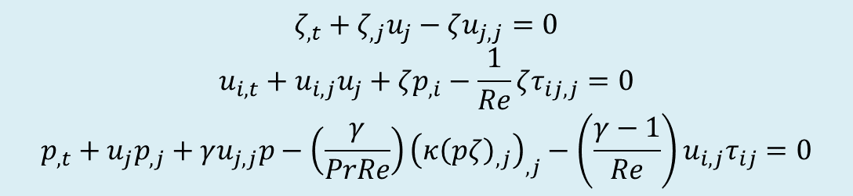
Projection-based model order reduction
Governing equations
3D compressible Navier-Stokes equations in primitive specific volume form:
$$ζ_{,t}+ζ_{,j}u_{j}−ζu_{j,j}=0$$
$$u_{i,t}+u_{i,j}u_{j}+ζp_{,i}−\frac{1}{Re}ζτ_{ij,j}=0$$
$$p_{,t}+u_{j}p_{,j}+γu_{j,j}p−\left(\frac{γ}{PrRe}\right){\left(κ{\left(pζ\right)}_{,j}\right)}_{,j}−\left(\frac{γ−1}{Re}\right)u_{i,j}τ_{ij}=0$$
[PDEs]
(1)
SAND2016-6345 C
Notes:
Add equation numbers (1) and (2)!

Slide 8
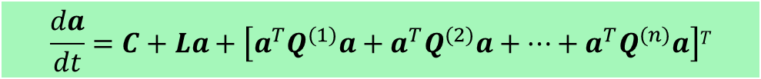
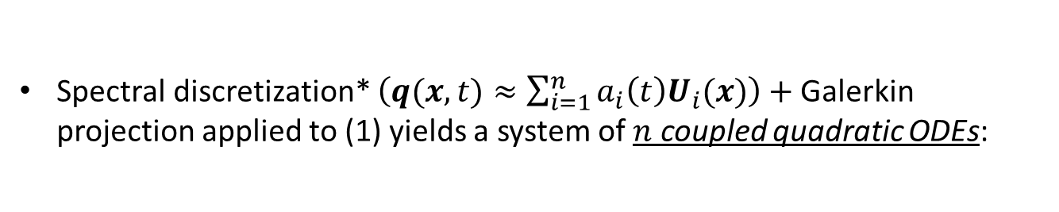
Projection-based model order reduction
Governing equations
3D compressible Navier-Stokes equations in primitive specific volume form:
$$ζ_{,t}+ζ_{,j}u_{j}−ζu_{j,j}=0$$
$$u_{i,t}+u_{i,j}u_{j}+ζp_{,i}−\frac{1}{Re}ζτ_{ij,j}=0$$
$$p_{,t}+u_{j}p_{,j}+γu_{j,j}p−\left(\frac{γ}{PrRe}\right){\left(κ{\left(pζ\right)}_{,j}\right)}_{,j}−\left(\frac{γ−1}{Re}\right)u_{i,j}τ_{ij}=0$$
[PDEs]
(1)
Spectral discretization* $\left(q(x,t)≈\sum_{i=1}^{n}{a_{i}\left(t\right)U_{i}(x)}\right)+$Galerkin projection applied to (1) yields a system of $n$ coupled quadratic ODEs:
[ROM]
$$\frac{da}{dt}=C+La+\left[a^{T}Q^{(1)}a+a^{T}Q^{(2)}a+⋯+a^{T}Q^{(n)}a\right]T$$
(2)
where $C∈ℝ^{n}, L∈ℝ^{n×n}$ and $Q^{(i)}$ $∈ℝ^{n×n}$ for all $i=1,…,n.$
* Here we use a Proper Orthogonal Decomposition (POD) basis $U_{i}(x)$.
SAND2016-6345 C
Notes:
Add equation numbers (1) and (2)!

Slide 9
Projection-based model order reduction
ROM limitations due to basis truncation
Projection-based MOR necessitates truncation.
SAND2016-6345 C

Slide 10
Projection-based model order reduction
ROM limitations due to basis truncation
Projection-based MOR necessitates truncation.
POD is, by definition and design, biased towards the large, energy producing scales of the flow (i.e., modes with large POD eigenvalues).
SAND2016-6345 C

Slide 11
Projection-based model order reduction
ROM limitations due to basis truncation
Projection-based MOR necessitates truncation.
POD is, by definition and design, biased towards the large, energy producing scales of the flow (i.e., modes with large POD eigenvalues).
Truncated/unresolved modes are negligible form a data compression point of view (i.e., small POD eigenvalues) but are crucial for the dynamical equations.
SAND2016-6345 C

Slide 12

Projection-based model order reduction
ROM limitations due to basis truncation
Projection-based MOR necessitates truncation.
POD is, by definition and design, biased towards the large, energy producing scales of the flow (i.e., modes with large POD eigenvalues).
Truncated/unresolved modes are negligible form a data compression point of view (i.e., small POD eigenvalues) but are crucial for the dynamical equations.
For fluid flow applications, higher-order modes are associated with energy dissipation $⟹$ low-dimensional ROMs are often inaccurate and sometimes unstable.
SAND2016-6345 C

Slide 13
Projection-based model order reduction
ROM limitations due to basis truncation
Projection-based MOR necessitates truncation.
POD is, by definition and design, biased towards the large, energy producing scales of the flow (i.e., modes with large POD eigenvalues).
Truncated/unresolved modes are negligible form a data compression point of view (i.e., small POD eigenvalues) but are crucial for the dynamical equations.
For fluid flow applications, higher-order modes are associated with energy dissipation $⟹$ low-dimensional ROMs are often inaccurate and sometimes unstable.
For a ROM to be stable and accurate, the truncated/unresolved subspace must be accounted for.
SAND2016-6345 C

Slide 14
Projection-based model order reduction
ROM limitations due to basis truncation
Projection-based MOR necessitates truncation.
POD is, by definition and design, biased towards the large, energy producing scales of the flow (i.e., modes with large POD eigenvalues).
Truncated/unresolved modes are negligible form a data compression point of view (i.e., small POD eigenvalues) but are crucial for the dynamical equations.
For fluid flow applications, higher-order modes are associated with energy dissipation $⟹$ low-dimensional ROMs are often inaccurate and sometimes unstable.
For a ROM to be stable and accurate, the truncated/unresolved subspace must be accounted for.
Turbulence Modeling
(traditional approach)
Subspace Rotation
(our approach)
SAND2016-6345 C

Slide 15
Outline
Motivation
2. Projection-based model order reduction
3. Accounting for modal truncation
  Traditional linear eddy-viscosity approach
  New proposed approach via subspace rotation
Applications
  Low Reynolds number channel driven cavity
  Moderate Reynolds number channel driven cavity
Summary
6. Future work
7. References
SAND2016-6345 C

Slide 16
Outline
Motivation
2. Projection-based model order reduction
3. Accounting for modal truncation
  Traditional linear eddy-viscosity approach
  New proposed approach via subspace rotation
Applications
  Low Reynolds number channel driven cavity
  Moderate Reynolds number channel driven cavity
Summary
6. Future work
7. References
SAND2016-6345 C

Slide 17
Accounting for modal truncation
Traditional linear eddy-viscosity approach
Dissipative dynamics of truncated higher-order modes are modeled using an additional linear term:
$$\frac{da}{dt}=C+La+\left[a^{T}Q^{\left(1\right)}a+a^{T}Q^{\left(2\right)}a+⋯+a^{T}Q^{\left(n\right)}a\right]T$$
SAND2016-6345 C

Slide 18
Accounting for modal truncation
Traditional linear eddy-viscosity approach
Dissipative dynamics of truncated higher-order modes are modeled using an additional linear term:
$$\frac{da}{dt}=C+\left(L+L_{ν}\right)a+\left[a^{T}Q^{\left(1\right)}a+a^{T}Q^{\left(2\right)}a+⋯+a^{T}Q^{\left(n\right)}a\right]T$$
SAND2016-6345 C

Slide 19
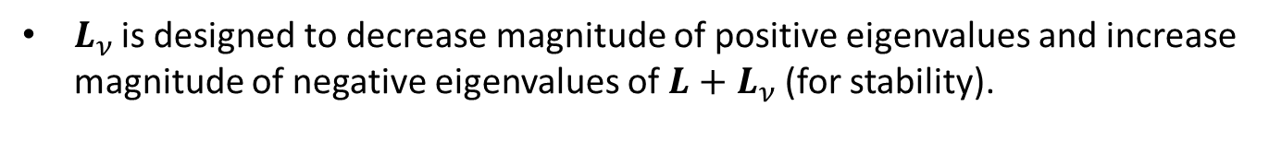
Accounting for modal truncation
Traditional linear eddy-viscosity approach
Dissipative dynamics of truncated higher-order modes are modeled using an additional linear term:
$$\frac{da}{dt}=C+\left(L+L_{ν}\right)a+\left[a^{T}Q^{\left(1\right)}a+a^{T}Q^{\left(2\right)}a+⋯+a^{T}Q^{\left(n\right)}a\right]T$$
$L_{ν }$is designed to decrease magnitude of positive eigenvalues and increase magnitude of negative eigenvalues of $L+L_{ν}$(for stability).
SAND2016-6345 C

Slide 20
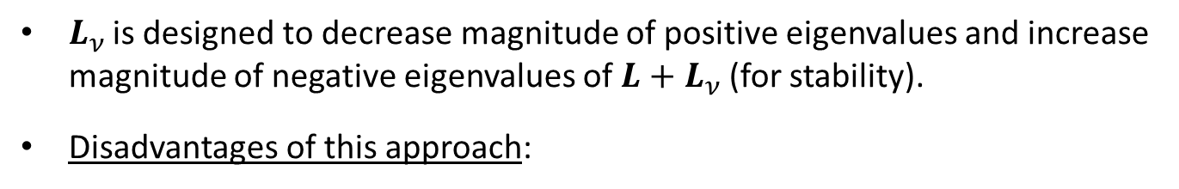
Accounting for modal truncation
Traditional linear eddy-viscosity approach
Dissipative dynamics of truncated higher-order modes are modeled using an additional linear term:
$$\frac{da}{dt}=C+\left(L+L_{ν}\right)a+\left[a^{T}Q^{\left(1\right)}a+a^{T}Q^{\left(2\right)}a+⋯+a^{T}Q^{\left(n\right)}a\right]T$$
$L_{ν }$is designed to decrease magnitude of positive eigenvalues and increase magnitude of negative eigenvalues of $L+L_{ν}$(for stability).
Disadvantages of this approach:
SAND2016-6345 C

Slide 21
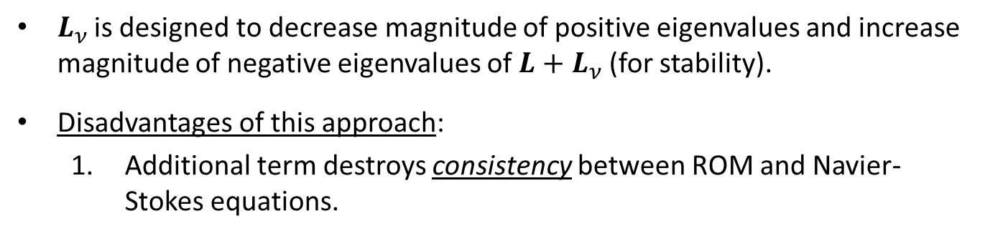
Accounting for modal truncation
Traditional linear eddy-viscosity approach
Dissipative dynamics of truncated higher-order modes are modeled using an additional linear term:
$$\frac{da}{dt}=C+\left(L+L_{ν}\right)a+\left[a^{T}Q^{\left(1\right)}a+a^{T}Q^{\left(2\right)}a+⋯+a^{T}Q^{\left(n\right)}a\right]T$$
$L_{ν }$is designed to decrease magnitude of positive eigenvalues and increase magnitude of negative eigenvalues of $L+L_{ν}$(for stability).
Disadvantages of this approach:
  Additional term destroys consistency between ROM and Navier-Stokes equations.
SAND2016-6345 C

Slide 22
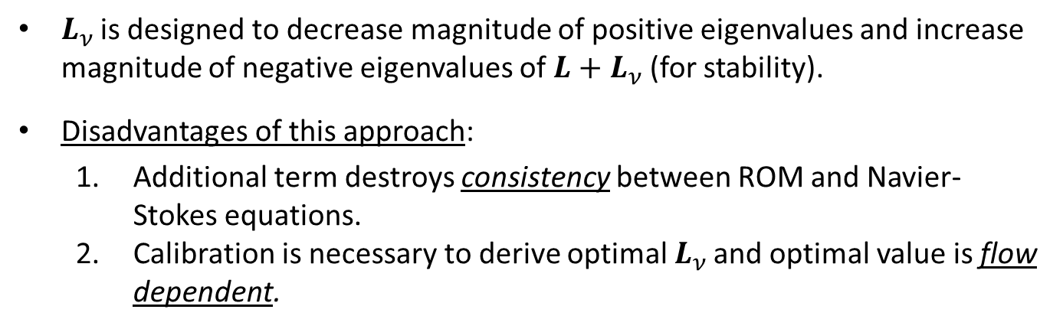
Accounting for modal truncation
Traditional linear eddy-viscosity approach
Dissipative dynamics of truncated higher-order modes are modeled using an additional linear term:
$$\frac{da}{dt}=C+\left(L+L_{ν}\right)a+\left[a^{T}Q^{\left(1\right)}a+a^{T}Q^{\left(2\right)}a+⋯+a^{T}Q^{\left(n\right)}a\right]T$$
$L_{ν }$is designed to decrease magnitude of positive eigenvalues and increase magnitude of negative eigenvalues of $L+L_{ν}$(for stability).
Disadvantages of this approach:
  Additional term destroys consistency between ROM and Navier-Stokes equations.
  Calibration is necessary to derive optimal $L_{ν }$and optimal value is flow dependent.
SAND2016-6345 C

Slide 23

Accounting for modal truncation
Traditional linear eddy-viscosity approach
Dissipative dynamics of truncated higher-order modes are modeled using an additional linear term:
$$\frac{da}{dt}=C+\left(L+L_{ν}\right)a+\left[a^{T}Q^{\left(1\right)}a+a^{T}Q^{\left(2\right)}a+⋯+a^{T}Q^{\left(n\right)}a\right]T$$
$L_{ν }$is designed to decrease magnitude of positive eigenvalues and increase magnitude of negative eigenvalues of $L+L_{ν}$(for stability).
Disadvantages of this approach:
  Additional term destroys consistency between ROM and Navier-Stokes equations.
  Calibration is necessary to derive optimal $L_{ν }$and optimal value is flow dependent.
  Inherently a linear model $→$cannot be expected to perform well for all classes of problems (e.g., nonlinear).
SAND2016-6345 C

Slide 24
Outline
Motivation
2. Projection-based model order reduction
3. Accounting for modal truncation
  Traditional linear eddy-viscosity approach
  New proposed approach via subspace rotation
Applications
  Low Reynolds number channel driven cavity
  Moderate Reynolds number channel driven cavity
Summary
6. Future work
7. References
SAND2016-6345 C

Slide 25
Accounting for modal truncation
Proposed new approach
Instead of modeling truncation via additional linear term, model the truncation a priori by “rotating” the projection subspace into a more dissipative regime
SAND2016-6345 C

Slide 26
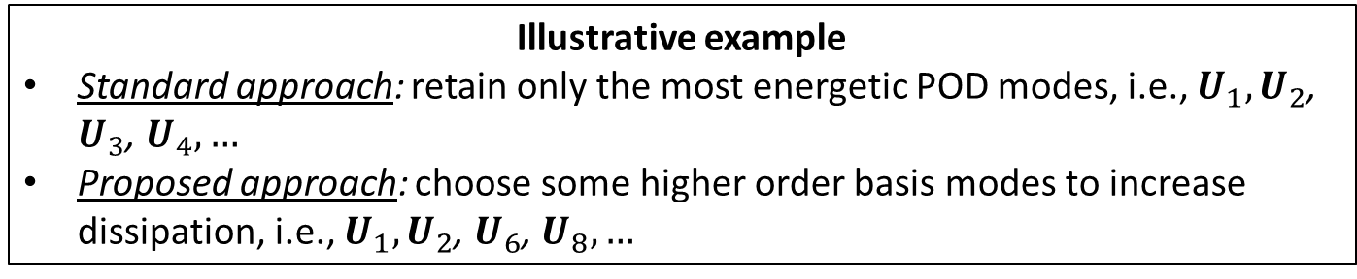
Accounting for modal truncation
Proposed new approach
Instead of modeling truncation via additional linear term, model the truncation a priori by “rotating” the projection subspace into a more dissipative regime
Illustrative example
Standard approach: retain only the most energetic POD modes, i.e., $U_{1},U_{2}$, $U_{3}$, $U_{4},…$
Proposed approach: choose some higher order basis modes to increase dissipation, i.e., $U_{1},U_{2}$, $U_{6}$, $U_{8},…$
SAND2016-6345 C

Slide 27
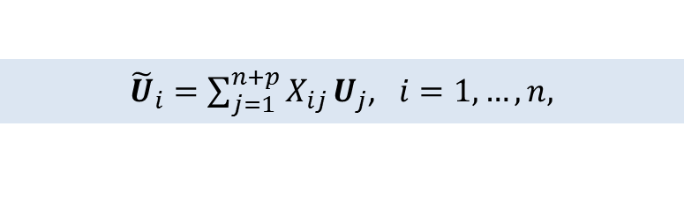
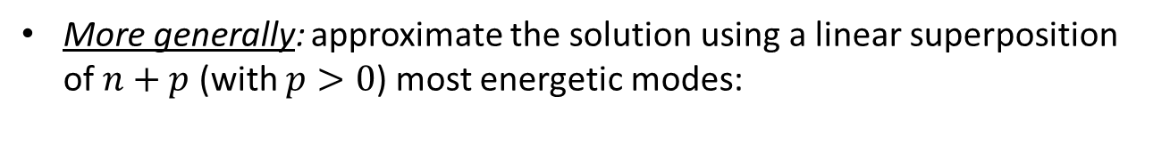
Accounting for modal truncation
Proposed new approach
Instead of modeling truncation via additional linear term, model the truncation a priori by “rotating” the projection subspace into a more dissipative regime
Illustrative example
Standard approach: retain only the most energetic POD modes, i.e., $U_{1},U_{2}$, $U_{3}$, $U_{4},…$
Proposed approach: choose some higher order basis modes to increase dissipation, i.e., $U_{1},U_{2}$, $U_{6}$, $U_{8},…$
More generally: approximate the solution using a linear superposition of $n+p$ (with $p>0$) most energetic modes:
${\tilde{U}}_{i}=\sum_{j=1}^{n+p}{X_{ij}}U_{j}$, $i=1,…,n,$
(3)
where $X∈ℝ^{\left(n+p\right)×n}$is an orthonormal ($X^{T}X=I_{n×n}$) “rotation” matrix.
SAND2016-6345 C

Slide 28

Accounting for modal truncation
Goals of proposed new approach
Find $X$ such that:
  New modes $\tilde{U}$ remain good approximations of the flow
  $→$ minimize the “rotation” angle, i.e., minimize $\left\|X−I_{\left(n+p\right),n}\right\|F$
  New modes produce stable and accurate ROMs.
    $→$ ensure appropriate balance between energy production and energy dissipation.
SAND2016-6345 C

Slide 29

Accounting for modal truncation
Goals of proposed new approach
Find $X$ such that:
  New modes $\tilde{U}$ remain good approximations of the flow
  $→$ minimize the “rotation” angle, i.e., minimize $\left\|X−I_{\left(n+p\right),n}\right\|F$
  New modes produce stable and accurate ROMs.
    $→$ ensure appropriate balance between energy production and energy dissipation.
SAND2016-6345 C

Slide 30

Accounting for modal truncation
Goals of proposed new approach
Find $X$ such that:
  New modes $\tilde{U}$ remain good approximations of the flow
  $→$ minimize the “rotation” angle, i.e., minimize $\left\|X−I_{\left(n+p\right),n}\right\|F$
  New modes produce stable and accurate ROMs.
    $→$ ensure appropriate balance between energy production and energy dissipation.
SAND2016-6345 C

Slide 31

Accounting for modal truncation
Goals of proposed new approach
Find $X$ such that:
  New modes $\tilde{U}$ remain good approximations of the flow
  $→$ minimize the “rotation” angle, i.e., minimize $\left\|X−I_{\left(n+p\right),n}\right\|F$
  New modes produce stable and accurate ROMs.
    $→$ ensure appropriate balance between energy production and energy dissipation.
SAND2016-6345 C

Slide 32

Accounting for modal truncation
Goals of proposed new approach
Find $X$ such that:
  New modes $\tilde{U}$ remain good approximations of the flow
  $→$ minimize the “rotation” angle, i.e., minimize $\left\|X−I_{\left(n+p\right),n}\right\|F$
  New modes produce stable and accurate ROMs.
    $→$ ensure appropriate balance between energy production and energy dissipation.
SAND2016-6345 C

Slide 33
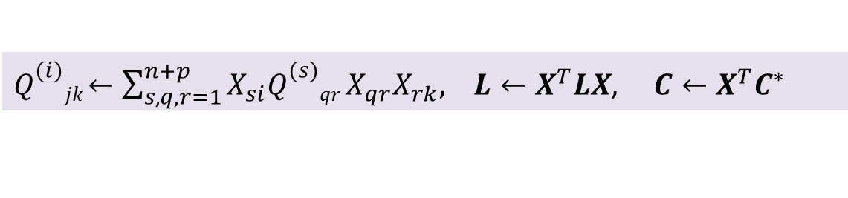
Accounting for modal truncation
Goals of proposed new approach
Find $X$ such that:
  New modes $\tilde{U}$ remain good approximations of the flow
  $→$ minimize the “rotation” angle, i.e., minimize $\left\|X−I_{\left(n+p\right),n}\right\|F$
  New modes produce stable and accurate ROMs.
    $→$ ensure appropriate balance between energy production and energy dissipation.
Once $X$ is found, the result is a system of the form (2) with:
$Q_{}^{(i)}jk$ $←\sum_{s,q,r=1}^{n+p}{X_{si}Q_{}^{(s)}qr}X_{qr}X_{rk}, L$ $←X^{T}LX$, $C$ $←X^{T}C^{∗}$
SAND2016-6345 C

Slide 34

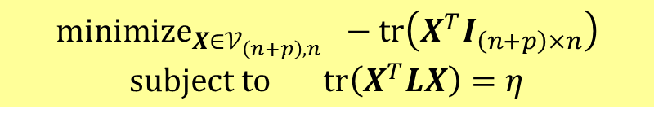
Accounting for modal truncation
Minimal subspace rotation: trace minimization on Stiefel manifold
$${minimize}_{X∈𝒱_{\left(n+p\right),n}} −tr\left(X^{T}I_{\left(n+p\right)×n}\right)$$
$$subject to tr\left(X^{T}LX\right)=η$$
(9)
$𝒱_{\left(n+p\right),n}∈\left\{X∈ℝ^{\left(n+p\right)×n}:X^{T}X=I_{n}, p>0\right\}$ is the Stiefel manifold.
  Constraint is traditional linear eddy-viscosity closure model ansatz $→$ involves overall balance between linear energy production and dissipation / vanishing of averaged total power ($=tr(X^{T}LX)$ $+$ energy transfer).
    $η∈ℝ$: proxy for the balance between linear energy production and energy dissipation (calculated iteratively using modal energy).
Equation (9) is solved efficiently offline using the method of Lagrange multipliers (Manopt MATLAB toolbox).
See (Balajewicz, Tezaur, Dowell, 2016) and Appendix slide for Algorithm.
SAND2016-6345 C

Slide 35
Accounting for modal truncation
Remarks
Proposed approach may be interpreted as an a priori consistent formulation of the eddy-viscosity turbulence modeling approach.
SAND2016-6345 C

Slide 36
Accounting for modal truncation
Remarks
Proposed approach may be interpreted as an a priori consistent formulation of the eddy-viscosity turbulence modeling approach.
Advantages of proposed approach:
SAND2016-6345 C

Slide 37
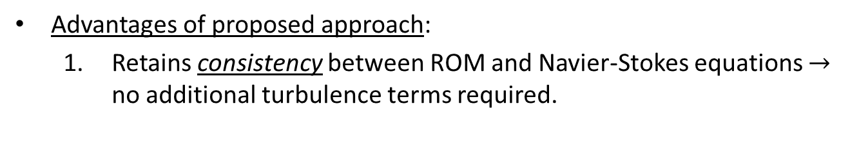
Accounting for modal truncation
Remarks
Proposed approach may be interpreted as an a priori consistent formulation of the eddy-viscosity turbulence modeling approach.
Advantages of proposed approach:
  Retains consistency between ROM and Navier-Stokes equations $→$ no additional turbulence terms required.
SAND2016-6345 C

Slide 38
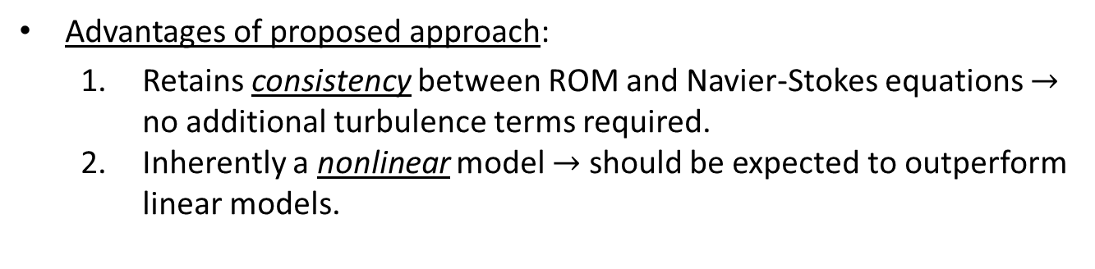
Accounting for modal truncation
Remarks
Proposed approach may be interpreted as an a priori consistent formulation of the eddy-viscosity turbulence modeling approach.
Advantages of proposed approach:
  Retains consistency between ROM and Navier-Stokes equations $→$ no additional turbulence terms required.
  Inherently a nonlinear model $→$ should be expected to outperform linear models.
SAND2016-6345 C

Slide 39
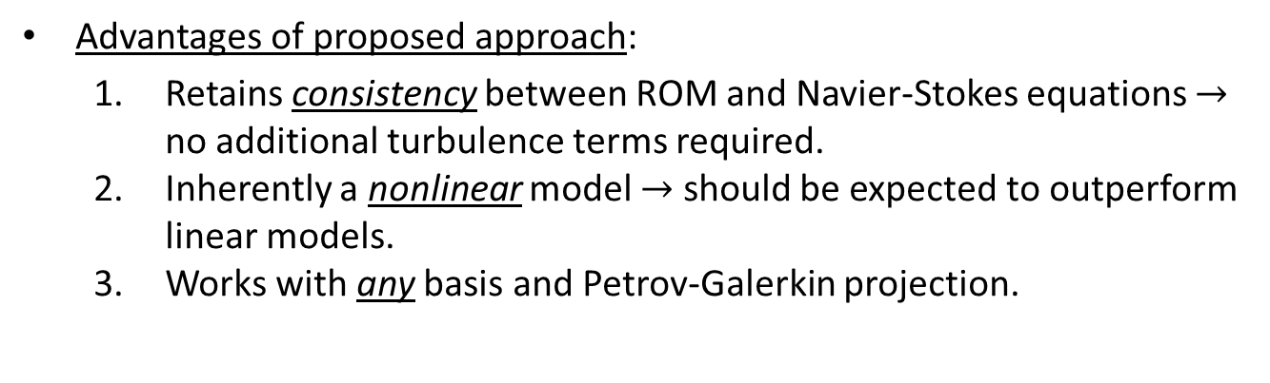
Accounting for modal truncation
Remarks
Proposed approach may be interpreted as an a priori consistent formulation of the eddy-viscosity turbulence modeling approach.
Advantages of proposed approach:
  Retains consistency between ROM and Navier-Stokes equations $→$ no additional turbulence terms required.
  Inherently a nonlinear model $→$ should be expected to outperform linear models.
  Works with any basis and Petrov-Galerkin projection.
SAND2016-6345 C

Slide 40

Accounting for modal truncation
Remarks
Proposed approach may be interpreted as an a priori consistent formulation of the eddy-viscosity turbulence modeling approach.
Advantages of proposed approach:
  Retains consistency between ROM and Navier-Stokes equations $→$ no additional turbulence terms required.
  Inherently a nonlinear model $→$ should be expected to outperform linear models.
  Works with any basis and Petrov-Galerkin projection.
Disadvantages of proposed approach:
SAND2016-6345 C

Slide 41

Accounting for modal truncation
Remarks
Proposed approach may be interpreted as an a priori consistent formulation of the eddy-viscosity turbulence modeling approach.
Advantages of proposed approach:
  Retains consistency between ROM and Navier-Stokes equations $→$ no additional turbulence terms required.
  Inherently a nonlinear model $→$ should be expected to outperform linear models.
  Works with any basis and Petrov-Galerkin projection.
Disadvantages of proposed approach:
  Off-line calibration of free parameter $η$ is required.
SAND2016-6345 C

Slide 42

Accounting for modal truncation
Remarks
Proposed approach may be interpreted as an a priori consistent formulation of the eddy-viscosity turbulence modeling approach.
Advantages of proposed approach:
  Retains consistency between ROM and Navier-Stokes equations $→$ no additional turbulence terms required.
  Inherently a nonlinear model $→$ should be expected to outperform linear models.
  Works with any basis and Petrov-Galerkin projection.
Disadvantages of proposed approach:
  Off-line calibration of free parameter $η$ is required.
  Stability cannot be proven like for incompressible case.
SAND2016-6345 C

Slide 43
Outline
Motivation
2. Projection-based model order reduction
3. Accounting for modal truncation
  Traditional linear eddy-viscosity approach
  New proposed approach via subspace rotation
Applications
  Low Reynolds number channel driven cavity
  Moderate Reynolds number channel driven cavity
Summary
6. Future work
7. References
SAND2016-6345 C

Slide 44
Outline
Motivation
2. Projection-based model order reduction
3. Accounting for modal truncation
  Traditional linear eddy-viscosity approach
  New proposed approach via subspace rotation
Applications
  Low Reynolds number channel driven cavity
  Moderate Reynolds number channel driven cavity
Summary
6. Future work
7. References
SAND2016-6345 C

Slide 45
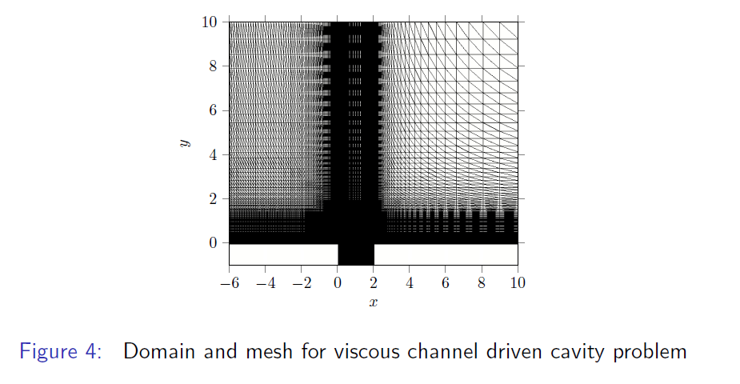
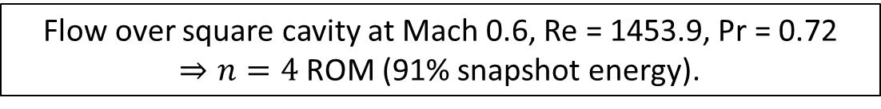
Applications
Channel driven cavity: low Reynolds number case
Flow over square cavity at Mach 0.6, Re = 1453.9, Pr = 0.72 $⇒n=4$ ROM (91% snapshot energy).
Figure 1: Domain and mesh for viscous channel driven cavity problem.
SAND2016-6345 C

Slide 46
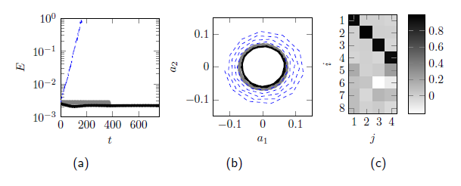
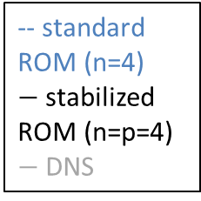
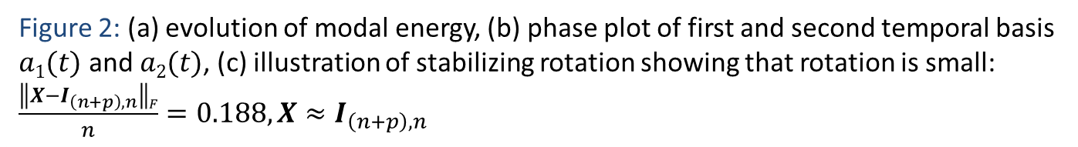
Applications
Channel driven cavity: low Reynolds number case
-- standard ROM (n=4)
$−$stabilized ROM (n=p=4)
$−$DNS
Figure 2: (a) evolution of modal energy, (b) phase plot of first and second temporal basis $a1(t)$ and $a2(t)$, (c) illustration of stabilizing rotation showing that rotation is small: $\frac{\left\|X−I_{\left(n+p\right),n}\right\|F}{n}=0.188, X≈I_{\left(n+p\right),n}$
SAND2016-6345 C

Slide 47
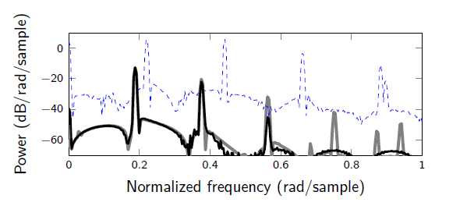
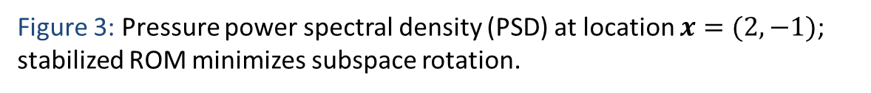
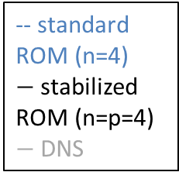
Applications
Channel driven cavity: low Reynolds number case
-- standard ROM (n=4)
$−$stabilized ROM (n=p=4)
$−$DNS
Figure 3: Pressure power spectral density (PSD) at location $x=(2,−1)$; stabilized ROM minimizes subspace rotation.
SAND2016-6345 C

Slide 48
Outline
Motivation
2. Projection-based model order reduction
3. Accounting for modal truncation
  Traditional linear eddy-viscosity approach
  New proposed approach via subspace rotation
Applications
  Low Reynolds number channel driven cavity
  Moderate Reynolds number channel driven cavity
Summary
6. Future work
7. References
SAND2016-6345 C

Slide 49
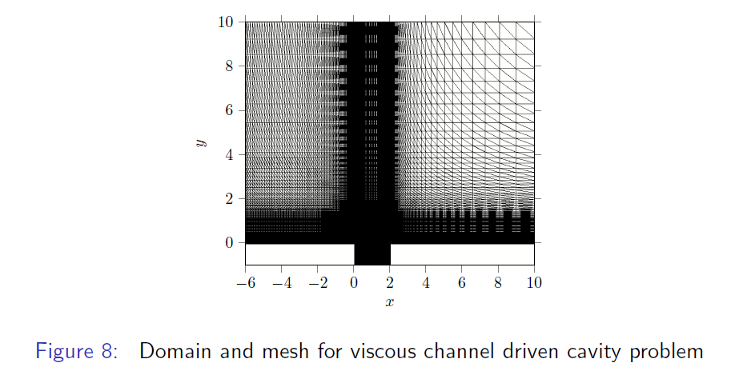
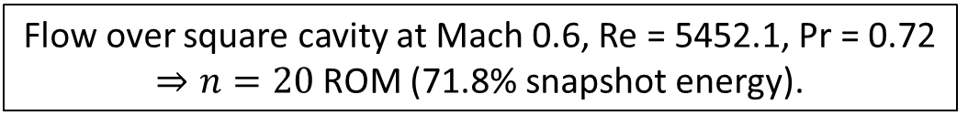
Applications
Channel driven cavity: moderate Reynolds number case
Flow over square cavity at Mach 0.6, Re = 5452.1, Pr = 0.72 $⇒n=20$ ROM (71.8% snapshot energy).
Figure 4: Domain and mesh for viscous channel driven cavity problem.
SAND2016-6345 C

Slide 50
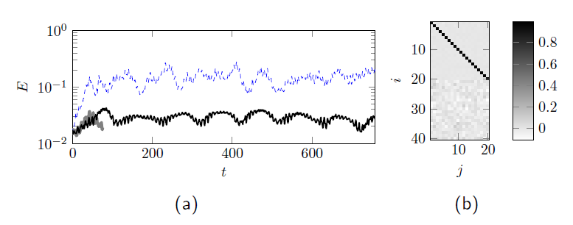
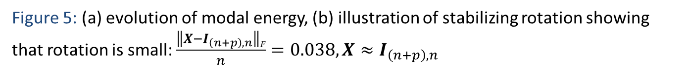
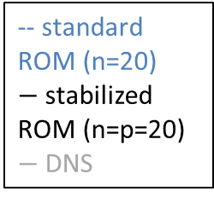
Applications
Channel driven cavity: moderate Reynolds number case
-- standard ROM (n=20)
$−$stabilized ROM (n=p=20)
$−$DNS
Figure 5: (a) evolution of modal energy, (b) illustration of stabilizing rotation showing that rotation is small: $\frac{\left\|X−I_{\left(n+p\right),n}\right\|F}{n}=0.038, X≈I_{\left(n+p\right),n}$
SAND2016-6345 C

Slide 51
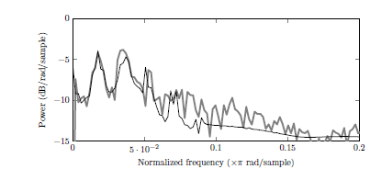
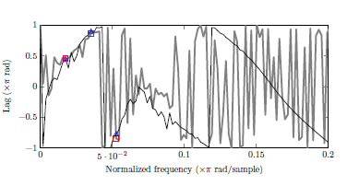
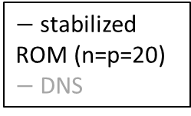
Applications
$−$stabilized ROM (n=p=20)
$−$DNS
Channel driven cavity: moderate Reynolds number case
Figure 6: Pressure cross PSD of of $p(x1,t)$ and $p(x2,t)$ where $x1=\left(2,−0.5\right),$ $x2=(0,−0.5)$
Power and phase lag at fundamental frequency, and first two super harmonics are predicted accurately using the fine-tuned ROM ($∆ =$ stabilized ROM, $=$DNS)
SAND2016-6345 C

Slide 52
Outline
Motivation
2. Projection-based model order reduction
3. Accounting for modal truncation
  Traditional linear eddy-viscosity approach
  New proposed approach via subspace rotation
Applications
  Low Reynolds number channel driven cavity
  Moderate Reynolds number channel driven cavity
Summary
6. Future work
7. References
SAND2016-6345 C

Slide 53
Summary
We have developed a non-intrusive approach for stabilizing and fine-tuning projection-based ROMs for compressible flows.
The standard POD modes are “rotated” into a more dissipative regime to account for the dynamics in the higher order modes truncated by the standard POD method.
The new approach is consistent and does not require the addition of empirical turbulence model terms unlike traditional approaches.
Mathematically, the approach is formulated as a quadratic matrix program on the Stiefel manifold.
The constrained minimization problem is solved offline and small enough to be solved in MATLAB.
The method is demonstrated on several compressible flow problems and shown to deliver stable and accurate ROMs.
SAND2016-6345 C

Slide 54
Outline
Motivation
2. Projection-based model order reduction
3. Accounting for modal truncation
  Traditional linear eddy-viscosity approach
  New proposed approach via subspace rotation
Applications
  Low Reynolds number channel driven cavity
  Moderate Reynolds number channel driven cavity
Summary
6. Future work
7. References
SAND2016-6345 C

Slide 55
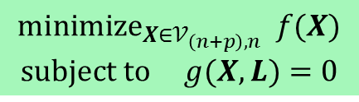
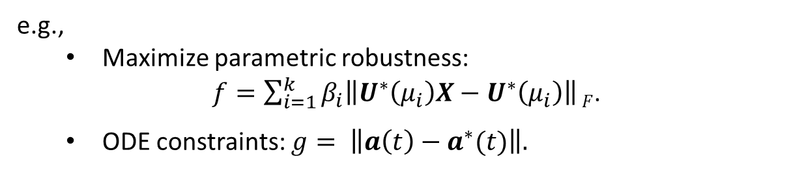
Future work
Application to higher Reynolds number problems.
Extension of the proposed approach to problems with generic nonlinearities, where the ROM involves some form of hyper-reduction (e.g., DEIM, gappy POD).
Extension of the method to minimal-residual-based nonlinear ROMs.
Extension of the method to predictive applications, e.g., problems with varying Reynolds number and/or Mach number.
Selecting different goal-oriented objectives and constraints in our optimization problem:
$${minimize}_{X∈𝒱_{\left(n+p\right),n}} f(X)$$
$$subject to g(X,L)=0$$
e.g.,
  Maximize parametric robustness:
        $f=\sum_{i=1}^{k}{β_{i}\left\|U^{∗}\left(μ_{i}\right)X−U^{∗}\left(μ_{i}\right)\right\|}F$.
  ODE constraints: $g= \left\|a\left(t\right)−a^{∗}(t)\right\|.$
SAND2016-6345 C

Slide 56
Outline
Motivation
2. Projection-based model order reduction
3. Accounting for modal truncation
  Traditional linear eddy-viscosity approach
  New proposed approach via subspace rotation
Applications
  Low Reynolds number channel driven cavity
  Moderate Reynolds number channel driven cavity
Summary
6. Future work
7. References
SAND2016-6345 C

Slide 57
References
SAND2016-6345 C

Slide 58
Outline
Motivation
2. Projection-based model order reduction
3. Accounting for modal truncation
  Traditional linear eddy-viscosity approach
  New proposed approach via subspace rotation
4. Applications
  Low Reynolds number channel driven cavity
  Moderate Reynolds number channel driven cavity
Summary
6. Future work
7. References
8. Appendix
SAND2016-6345 C

Slide 59
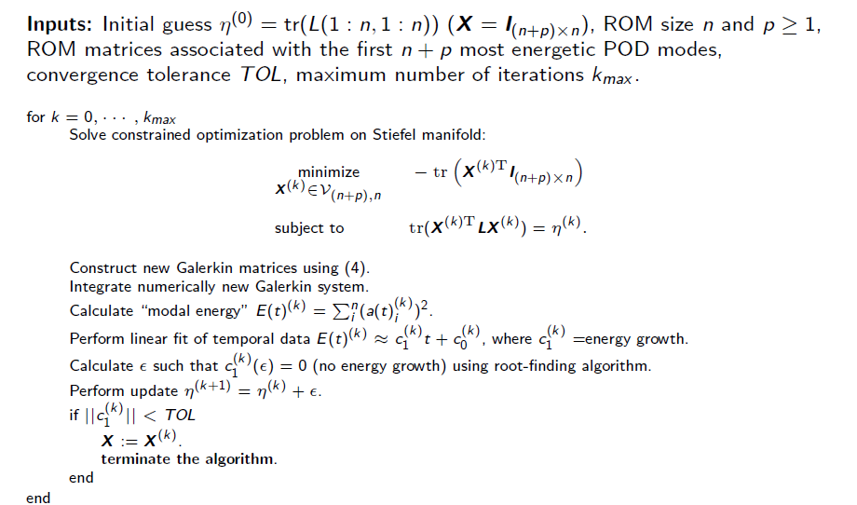

Appendix: Accounting for modal truncation
Stabilization algorithm: returns stabilizing rotation matrix $X$.
SAND2016-6345 C

Slide 60



Applications
Channel driven cavity: low Reynolds number case
Standard ROM ($n=4$)
Stabilized ROM ($n=p=4$)
DNS
Figure 7: Channel driven cavity Re $≈$ 1500 contours of $u$-velocity at time of final snapshot.
SAND2016-6345 C

Slide 61



Applications
Channel driven cavity: moderate Reynolds number case
Standard ROM ($n=20$)
Stabilized ROM ($n=p=$20)
DNS
Figure 8: Channel driven cavity Re $≈$ 5500 contours of $u$-velocity at time of final snapshot.
SAND2016-6345 C

Slide 62


Applications
CPU times (CPU-hours) for offline and online computations
Procedure | Low Re Cavity | Moderate Re Cavity
FOM # of DOF | 288,250 | 243,750
Time-integration of FOM | 72 hrs | 179 hrs
Basis construction (size $n+p$ ROM) | 0.88 hrs | 3.44 hrs
Galerkin projection (size $n+p$ ROM) | 5.44 hrs | 14.8 hrs
Stabilization | 14 sec | 170 sec
ROM # of DOF | 4 | 20
Time-integration of ROM | 0.16 sec | 0.83 sec
Online computational speed-up | 1.6e6 | 7.8e5
offline
online
Stabilization is fast ($O$(sec) or $O$(min)).
Significant online computational speed-up!
SAND2016-6345 C

