Slide 1
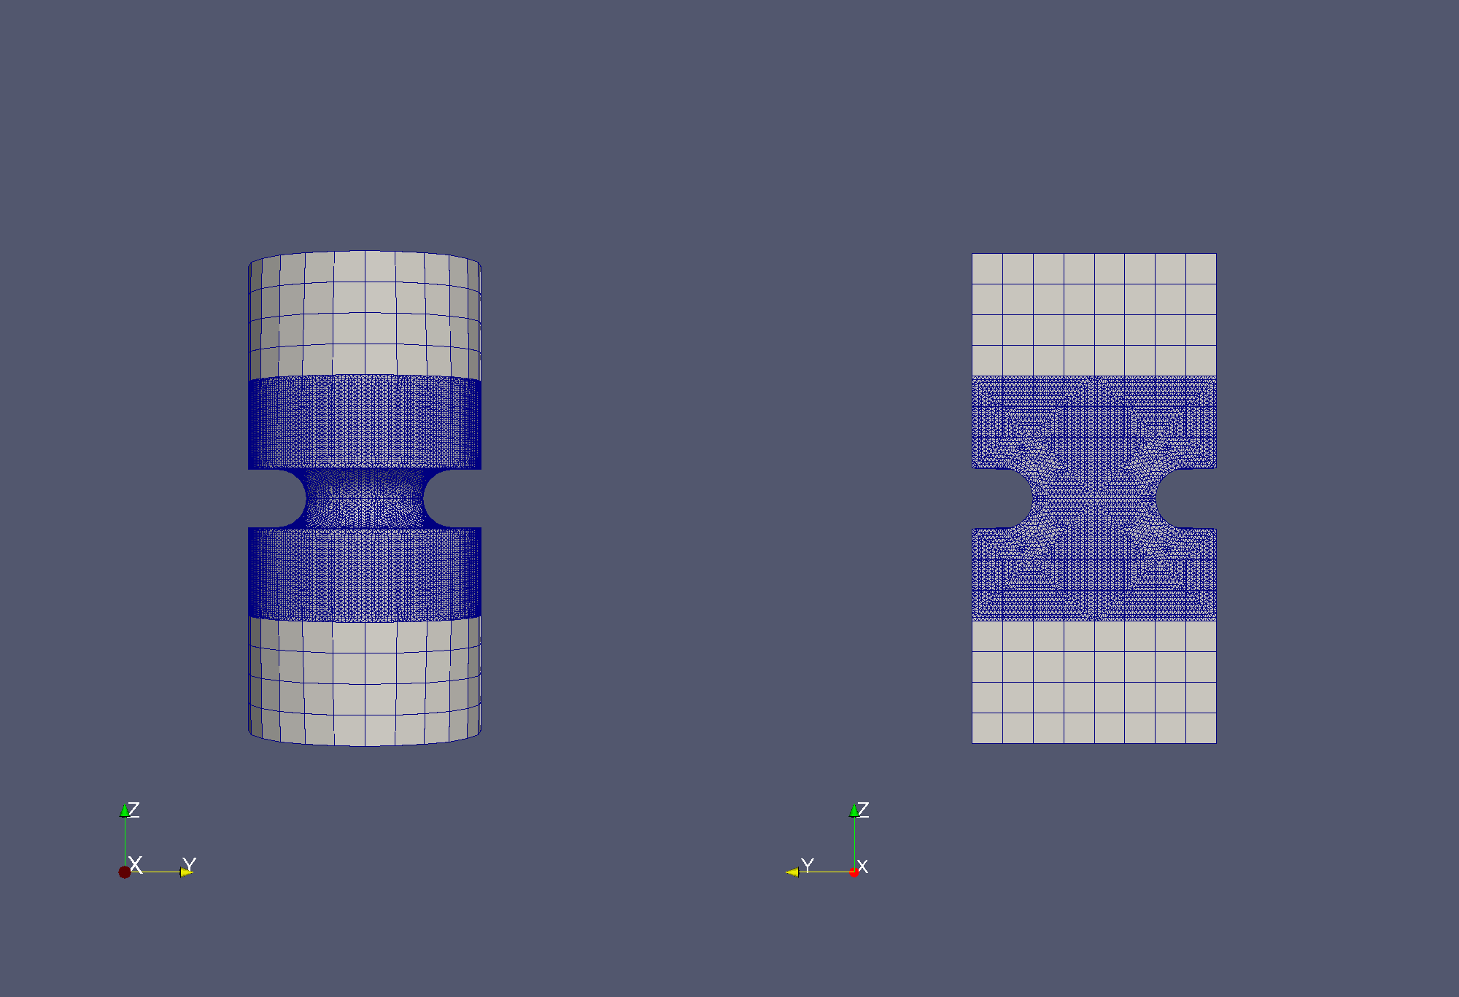
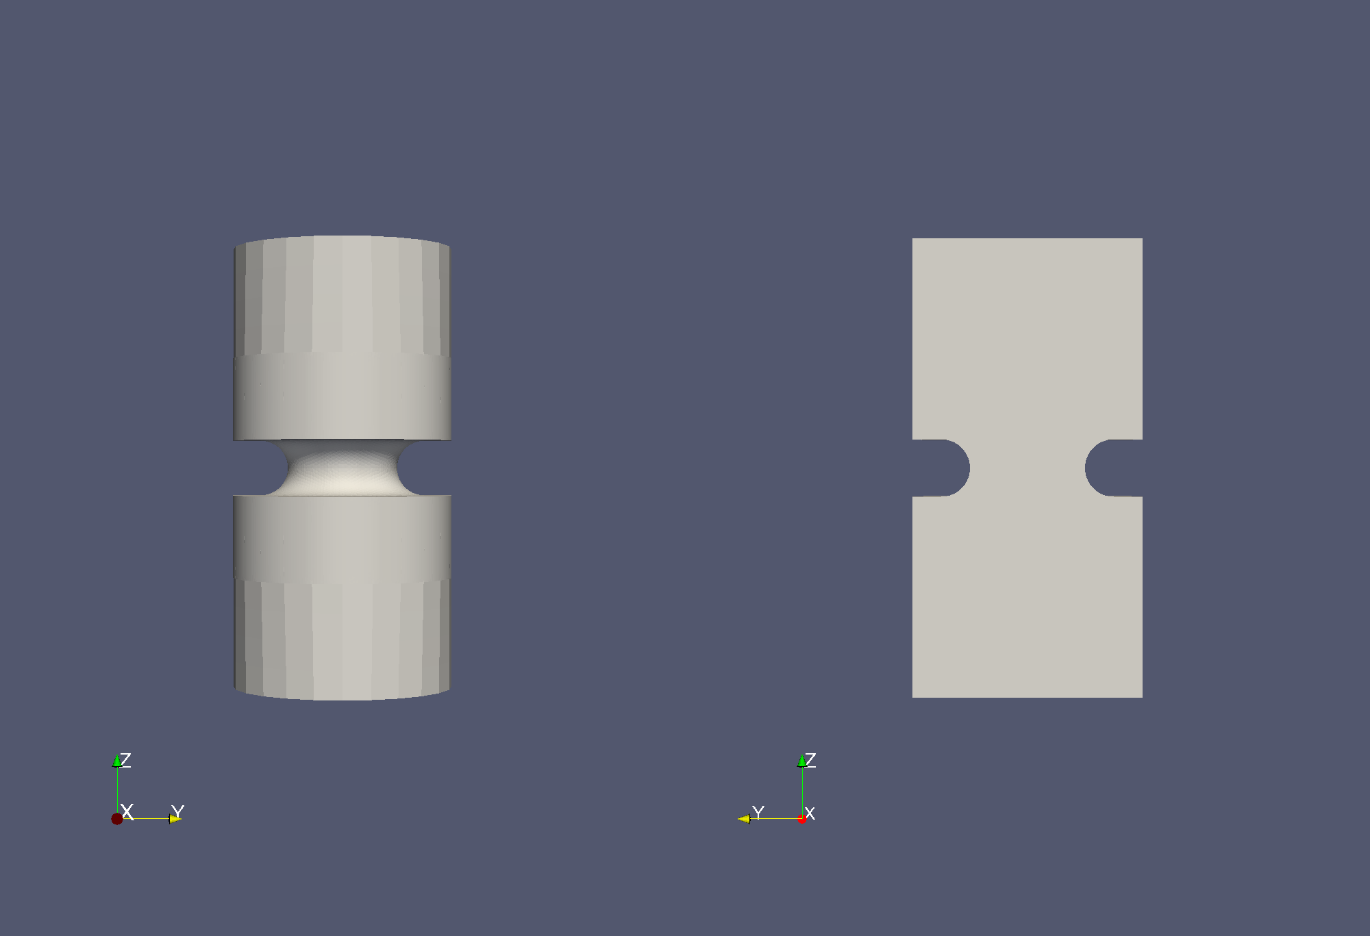
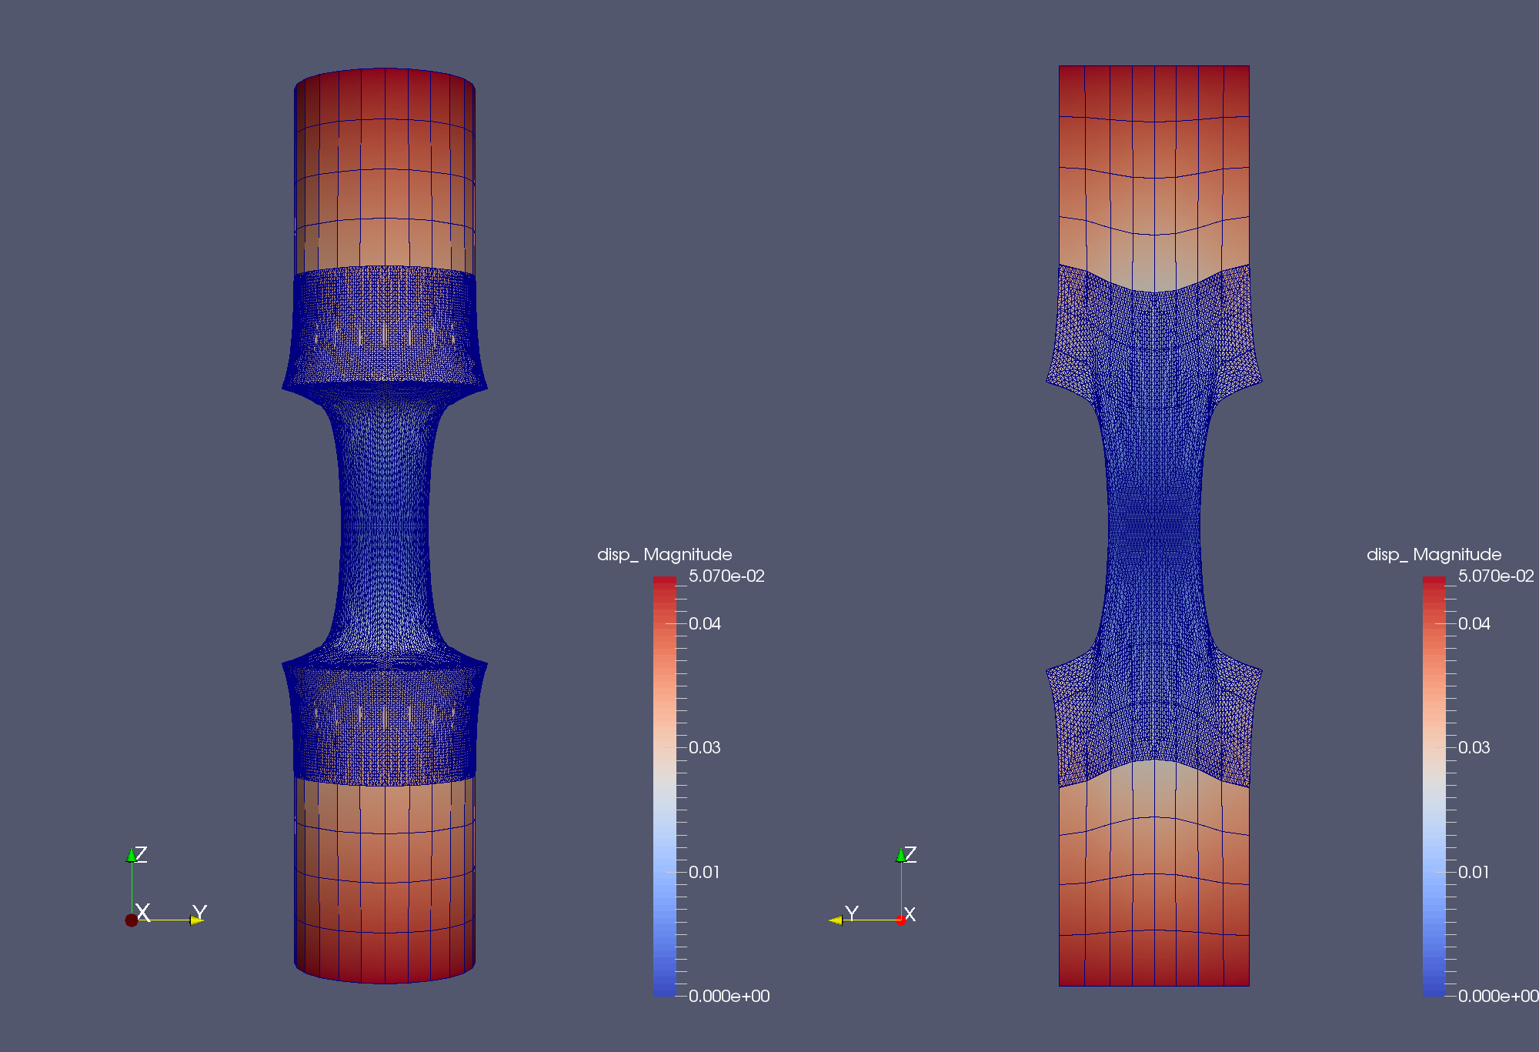
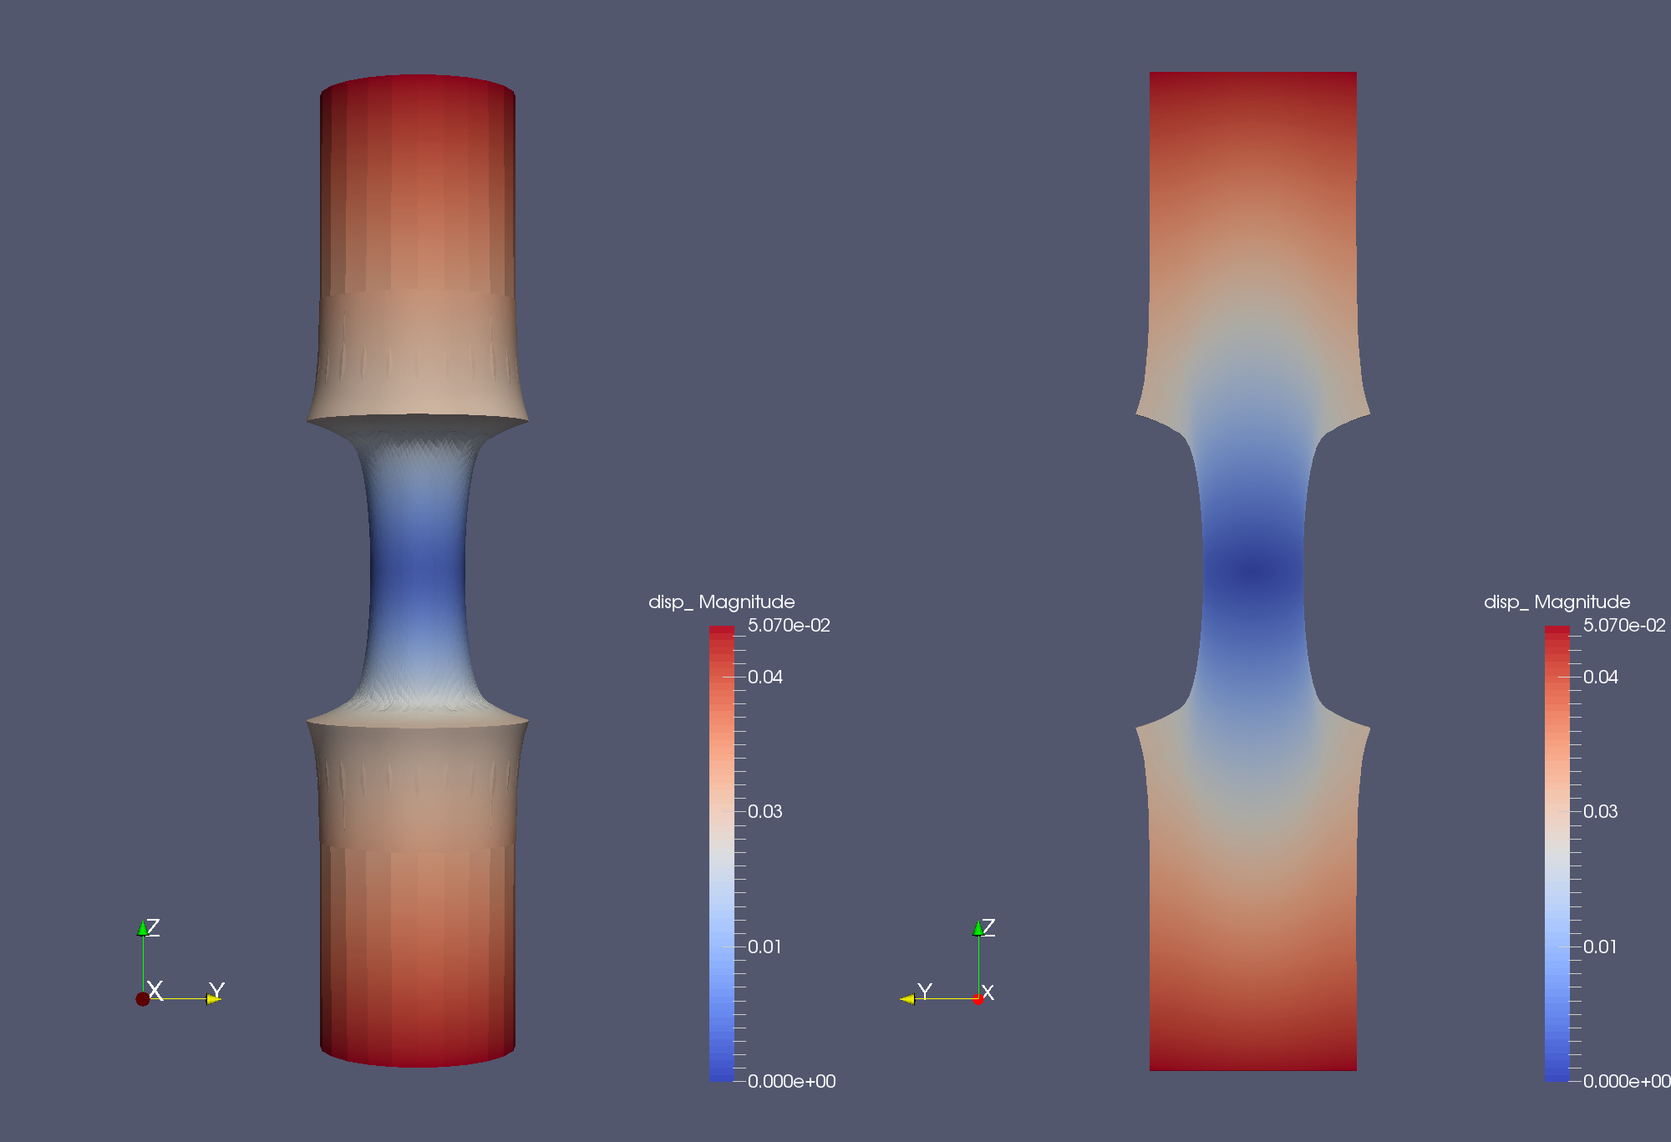


The Schwarz Alternating Method for Dynamic Multiscale Coupling in Solid Mechanics
Irina Tezaur¹, Alejandro Mota¹, Greg Phlipot²
¹Sandia National Laboratories, Livermore, CA, USA. ²California Institute of Technology, Pasadena, CA, USA.
WCCM 2018 New York, NY July 22-27, 2018
Sandia National Laboratories is a multi-mission laboratory managed and operated by National Technology and Engineering Solutions of Sandia, LLC., a wholly owned subsidiary of Honeywell International, Inc., for the U.S. Department of Energy’s National Nuclear Security Administration under contract DE-NA0003525.
SAND2018-7751 C

Slide 2
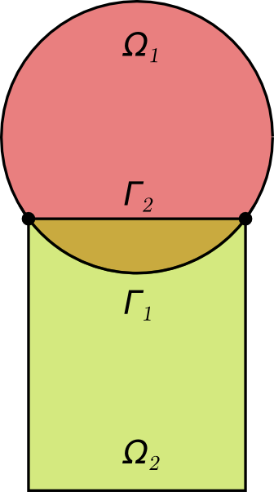
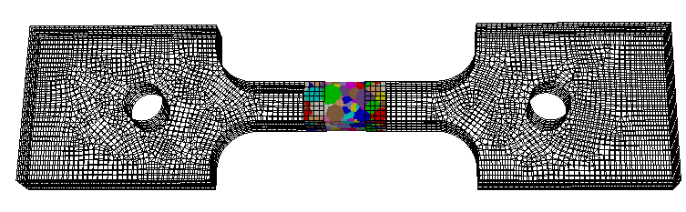
Outline
This talk goes hand-in-hand with the previous talk in this MS: #2018677 - A. Mota, I. Tezaur, C. Alleman, “The Schwarz Alternating Method for Quasistatic Multiscale Coupling in Solid Mechanics”
Motivation and Background*.
Schwarz for Dynamic Multiscale Coupling.
Numerical Examples.
Summary and Future Work.
References.
Appendix.
* Review from previous talk #2018677 by A. Mota.

Slide 3
Outline
This talk goes hand-in-hand with the previous talk in this MS: #2018677 - A. Mota, I. Tezaur, C. Alleman, “The Schwarz Alternating Method for Quasistatic Multiscale Coupling in Solid Mechanics”
Motivation and Background*.
Schwarz for Dynamic Multiscale Coupling.
Numerical Examples.
Summary and Future Work.
References.
Appendix.
* Review from previous talk #2018677 by A. Mota.

Slide 4
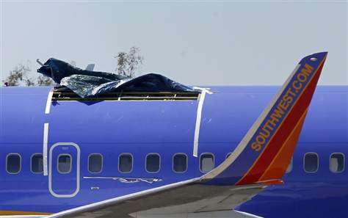
Motivation for Concurrent Multiscale Coupling
Large scale structural failure frequently originates from small scale phenomena such as defects, microcracks, and inhomogeneities, which grow quickly in unstable manner.
Failure occurs due to tightly coupled interaction between small scale (stress concentrations, material instabilities, cracks, etc.) and large scale (vibration, impact, high loads and other perturbations).
Roof failure of Boeing 737 aircraft due to fatigue cracks. From imechanica.org
Concurrent multiscale methods are essential for understanding and predicting the behavior of engineering systems when a small scale failure determines the performance of the entire system.
Surface flaw in pressure vessel: interacts with microstructure, which may or may not lead to failure.
Notes:
Fuselage failure: small flaws grow quickly in unstable manner
Pressure vessel: flaw in surface interacts with microstructure, which can lead to failure or microstructure or not; determining which one happens is complex
If the activity score is YELLOW or RED then be prepared to address issues, cause, and
path forward.

Slide 5
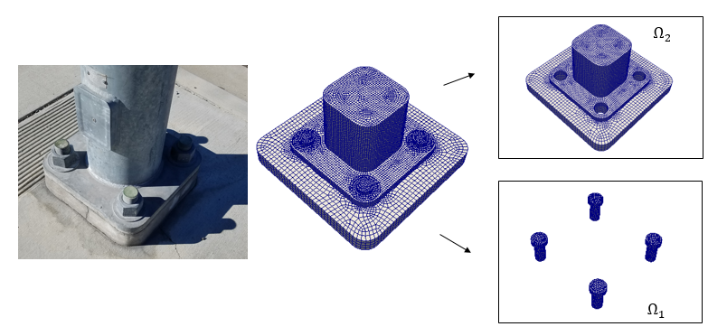
Requirements for Multiscale Coupling Method
Coupling is concurrent (two-way).
Ease of implementation into existing massively-parallel HPC codes.
Scalable, fast, robust (we target real engineering problems, e.g., analyses involving failure of bolted components!).
“Plug-and-play” framework: simplifies task of meshing complex geometries!
  Ability to couple regions with different non-conformal meshes, different element types and different levels of refinement.
  Ability to use different solvers/time-integrators in different regions.
Coupling does not introduce nonphysical artifacts.
Theoretical convergence properties/guarantees.

Slide 6
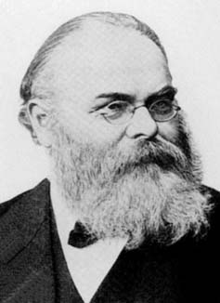

Schwarz Alternating Method for Domain Decomposition
Proposed in 1870 by H. Schwarz for solving Laplace PDE on irregular domains.
Crux of Method: if the solution is known in regularly shaped domains, use those as pieces to iteratively build a solution for the more complex domain.
H. Schwarz (1843 – 1921)
Basic Schwarz Algorithm
Initialize:
Solve PDE by any method on Ω₁ w/ initial guess for Dirichlet BCs on Γ₁.
Iterate until convergence:
Solve PDE by any method (can be different than for Ω₁) on Ω₂ w/ Dirichlet BCs on Γ₂ that are the values just obtained for Ω₁.
Solve PDE by any method (can be different than for Ω₂) on Ω₁ w/ Dirichlet BCs on Γ₁ that are the values just obtained for Ω₂.
Requirement for convergence: $Ω_{1}⋂{ Ω}_{2}≠∅$
Schwarz alternating method most commonly used as a preconditioner for Krylov iterative methods to solve linear algebraic equations.
Novel idea: using the Schwarz alternating as a discretization method for solving multiscale partial differential equations (PDEs).
Notes:
If the activity score is YELLOW or RED then be prepared to address issues, cause, and
path forward.

Slide 7
Outline
This talk goes hand-in-hand with the previous talk in this MS: #2018677 - A. Mota, I. Tezaur, C. Alleman, “The Schwarz Alternating Method for Quasistatic Multiscale Coupling in Solid Mechanics”
Motivation and Background*.
Schwarz for Dynamic Multiscale Coupling.
Numerical Examples.
Summary and Future Work.
References.
Appendix.
* Review from previous talk #2018677 by A. Mota.

Slide 8
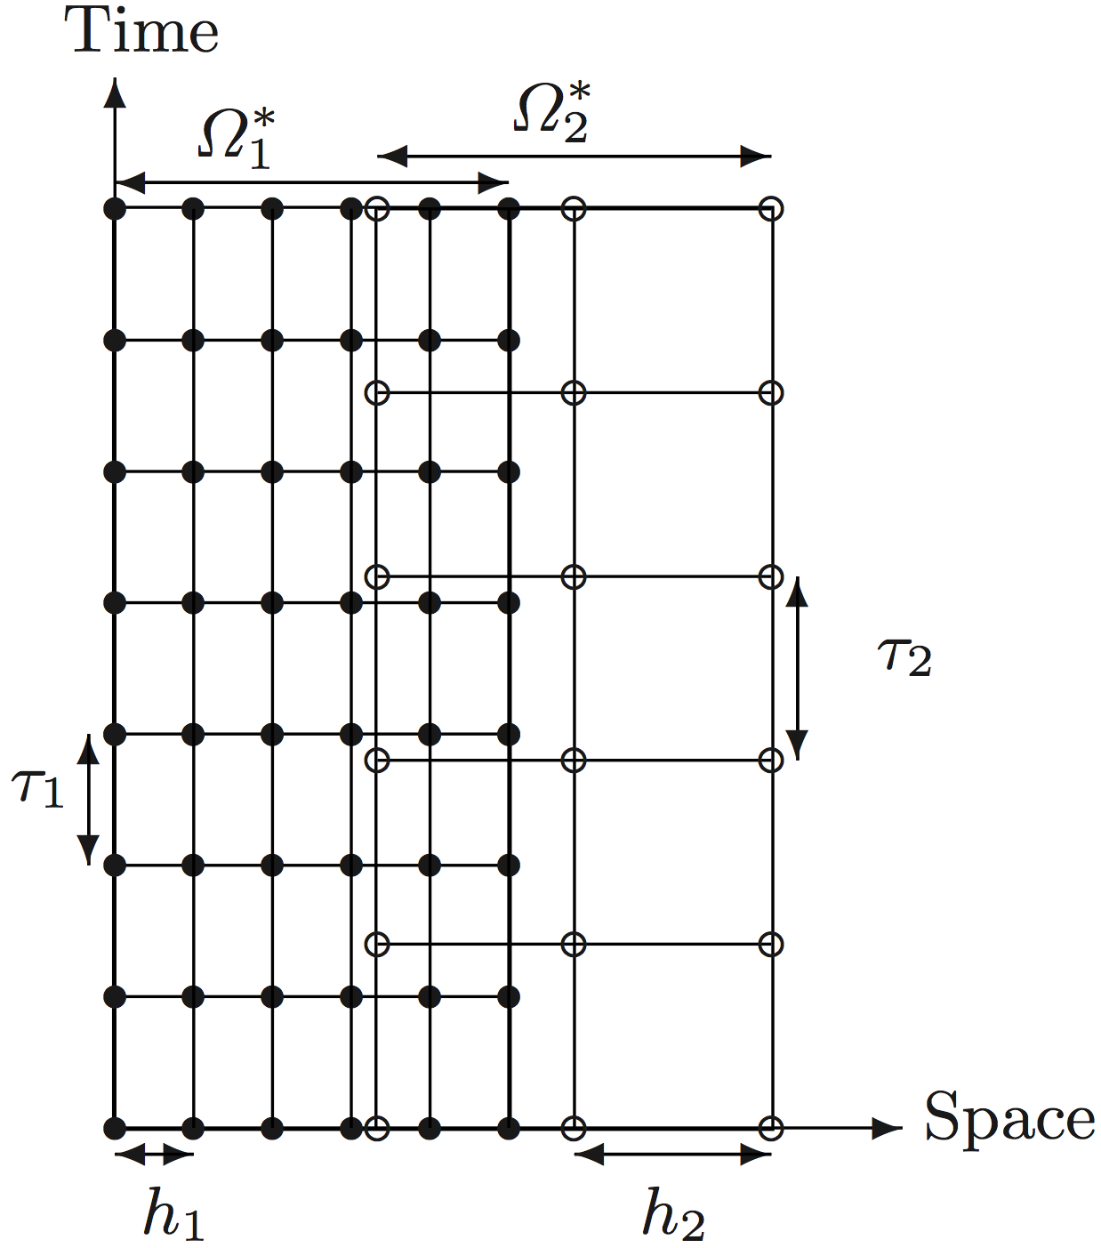
Schwarz Alternating Method for Dynamic Multiscale Coupling
In the literature the Schwarz method is applied to dynamics by using space-time discretizations.
Overlapping non-matching meshes and time steps in dynamics.
Notes:
FIXME: add refs?
FIXME: have Alejandro explain picture

Slide 9
Schwarz Alternating Method for Dynamic Multiscale Coupling
In the literature the Schwarz method is applied to dynamics by using space-time discretizations.
Pro ☺: Can use non-matching meshes and time-steps (see right figure).
Con ☹: Unfeasible given the design of our current codes and size of simulations.
Overlapping non-matching meshes and time steps in dynamics.
Notes:
FIXME: add refs?
FIXME: have Alejandro explain picture

Slide 10
Schwarz Alternating Method for Dynamic Multiscale Coupling
In the literature the Schwarz method is applied to dynamics by using space-time discretizations.
Pro ☺: Can use non-matching meshes and time-steps (see right figure).
Con ☹: Unfeasible given the design of our current codes and size of simulations.
Our objective: formulate dynamic Schwarz method for standard (non-space-time) discretizations (discretize in space, march forward in time).
Overlapping non-matching meshes and time steps in dynamics.
Notes:
FIXME: add refs?
FIXME: have Alejandro explain picture

Slide 11
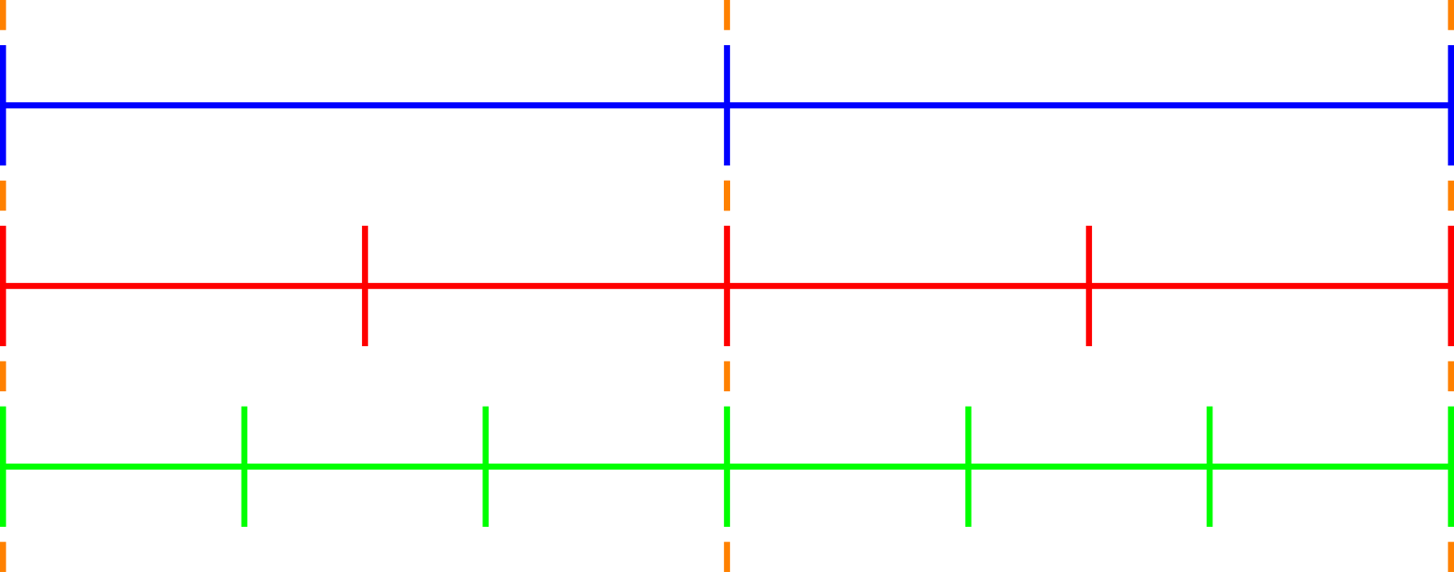
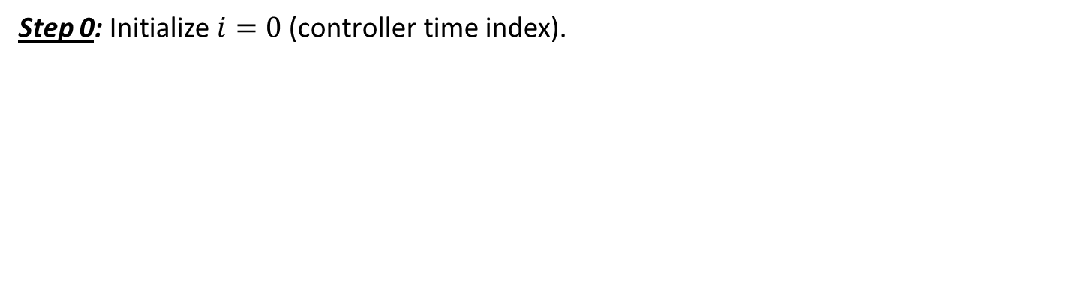


Schwarz Alternating Method for Dynamic Multiscale Coupling
Controller time stepper = convenient checkpoint to facilitate implementation
$$T_{0}$$
$$T_{1}$$
Controller time stepper
Time integrator for Ω₁
Time integrator for Ω₂
Step 0: Initialize $i=0 \text{(}\text{controller} \text{time} \text{index}\text{).}$
Notes:
FIXME: add algorithm?

Slide 12




Schwarz Alternating Method for Dynamic Multiscale Coupling
Controller time stepper = convenient checkpoint to facilitate implementation
$$T_{0}$$
$$T_{1}$$
$$T_{1}$$
Controller time stepper
Time integrator for Ω₁
Time integrator for Ω₂
Integrate using ${Δt}_{1}$
Interpolate from $Ω_{2}$ to $Γ_{1}$
Step 0: Initialize $i=0 \text{(}\text{controller} \text{time} \text{index}\text{).}$
Step 1: Advance $Ω_{1}$ solution from time $T_{i}$ to time $T_{i+1}$ using time-stepper in $Ω_{1}$ with time-step ${Δt}_{1},$using solution in $Ω_{2}$ interpolated to $Γ_{1}$ at times $T_{i}+n{Δt}_{1}.$
Notes:
FIXME: add algorithm?

Slide 13


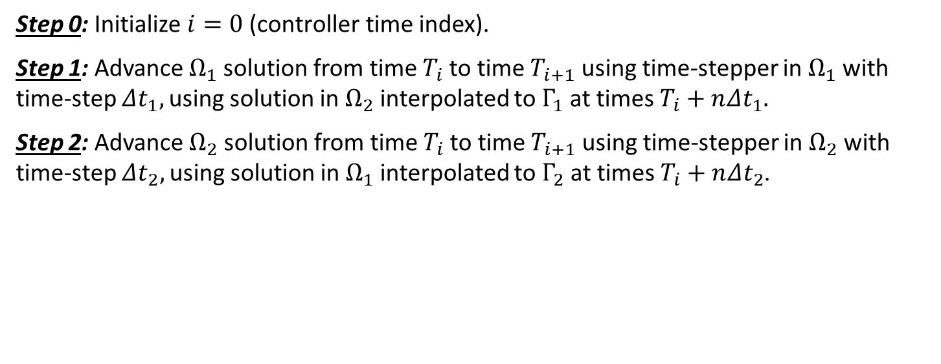
Schwarz Alternating Method for Dynamic Multiscale Coupling
Controller time stepper = convenient checkpoint to facilitate implementation
$$T_{0}$$
$$T_{1}$$
Controller time stepper
Time integrator for Ω₁
Time integrator for Ω₂
Interpolate from $Ω_{1}$ to $Γ_{2}$
Integrate using ${Δt}_{2}$
Step 0: Initialize $i=0 \text{(}\text{controller} \text{time} \text{index}\text{).}$
Step 1: Advance $Ω_{1}$ solution from time $T_{i}$ to time $T_{i+1}$ using time-stepper in $Ω_{1}$ with time-step ${Δt}_{1},$using solution in $Ω_{2}$ interpolated to $Γ_{1}$ at times $T_{i}+n{Δt}_{1}.$
Step 2: Advance $Ω_{2}$ solution from time $T_{i}$ to time $T_{i+1}$ using time-stepper in $Ω_{2}$ with time-step ${Δt}_{2},$using solution in $Ω_{1}$ interpolated to $Γ_{2}$ at times $T_{i}+n{Δt}_{2}$.
Notes:
FIXME: add algorithm?

Slide 14
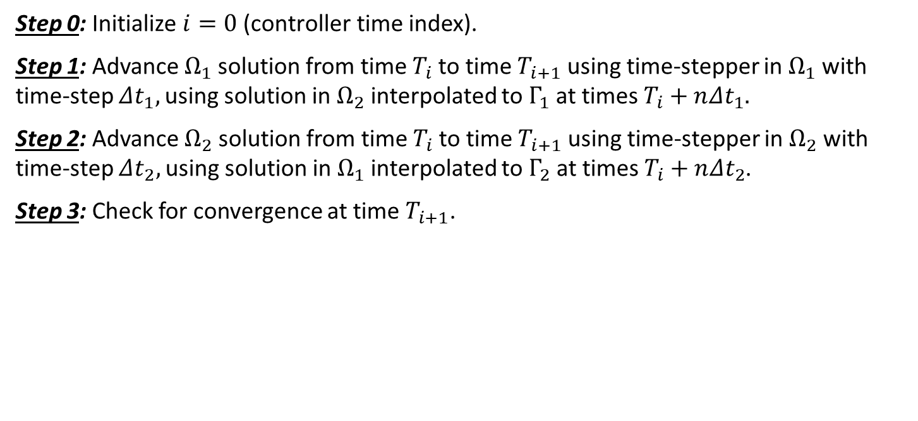
Schwarz Alternating Method for Dynamic Multiscale Coupling
Controller time stepper = convenient checkpoint to facilitate implementation
$$T_{0}$$
$$T_{1}$$
Controller time stepper
Time integrator for Ω₁
Time integrator for Ω₂
Step 0: Initialize $i=0 \text{(}\text{controller} \text{time} \text{index}\text{).}$
Step 1: Advance $Ω_{1}$ solution from time $T_{i}$ to time $T_{i+1}$ using time-stepper in $Ω_{1}$ with time-step ${Δt}_{1},$using solution in $Ω_{2}$ interpolated to $Γ_{1}$ at times $T_{i}+n{Δt}_{1}.$
Step 2: Advance $Ω_{2}$ solution from time $T_{i}$ to time $T_{i+1}$ using time-stepper in $Ω_{2}$ with time-step ${Δt}_{2},$using solution in $Ω_{1}$ interpolated to $Γ_{2}$ at times $T_{i}+n{Δt}_{2}$.
Step 3: Check for convergence at time $T_{i+1}$.
Notes:
FIXME: add algorithm?

Slide 15
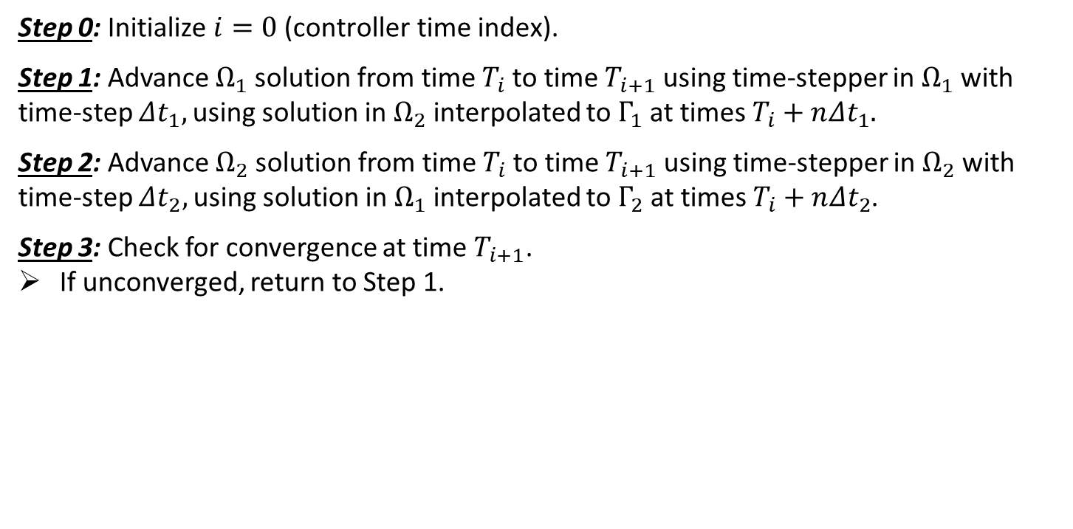
Schwarz Alternating Method for Dynamic Multiscale Coupling
Controller time stepper = convenient checkpoint to facilitate implementation
$$T_{0}$$
$$T_{1}$$
Controller time stepper
Time integrator for Ω₁
Time integrator for Ω₂
Integrate using ${Δt}_{1}$
Interpolate from $Ω_{2}$ to $Γ_{1}$
Step 0: Initialize $i=0 \text{(}\text{controller} \text{time} \text{index}\text{).}$
Step 1: Advance $Ω_{1}$ solution from time $T_{i}$ to time $T_{i+1}$ using time-stepper in $Ω_{1}$ with time-step ${Δt}_{1},$using solution in $Ω_{2}$ interpolated to $Γ_{1}$ at times $T_{i}+n{Δt}_{1}.$
Step 2: Advance $Ω_{2}$ solution from time $T_{i}$ to time $T_{i+1}$ using time-stepper in $Ω_{2}$ with time-step ${Δt}_{2},$using solution in $Ω_{1}$ interpolated to $Γ_{2}$ at times $T_{i}+n{Δt}_{2}$.
Step 3: Check for convergence at time $T_{i+1}$.
If unconverged, return to Step 1.
Notes:
FIXME: add algorithm?

Slide 16

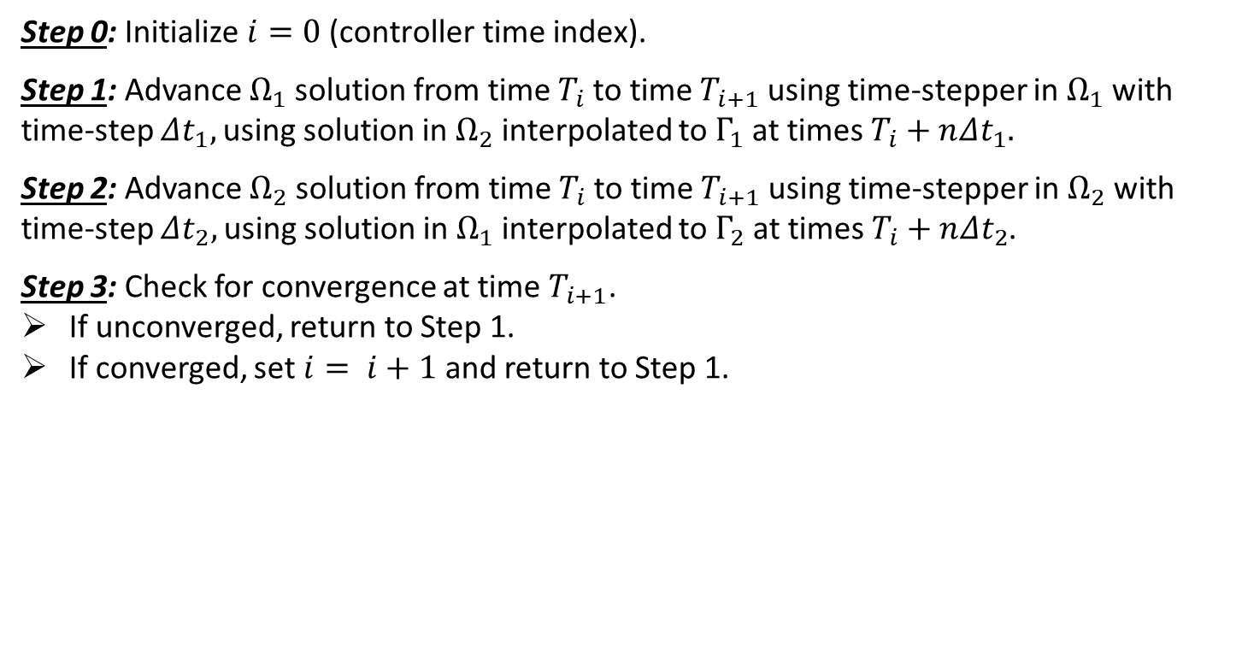

Schwarz Alternating Method for Dynamic Multiscale Coupling
Controller time stepper = convenient checkpoint to facilitate implementation
$$T_{0}$$
$$T_{1}$$
$$T_{2}$$
Controller time stepper
Time integrator for Ω₁
Time integrator for Ω₂
Integrate using ${Δt}_{1}$
Interpolate from $Ω_{2}$ to $Γ_{1}$
Step 0: Initialize $i=0 \text{(}\text{controller} \text{time} \text{index}\text{).}$
Step 1: Advance $Ω_{1}$ solution from time $T_{i}$ to time $T_{i+1}$ using time-stepper in $Ω_{1}$ with time-step ${Δt}_{1},$using solution in $Ω_{2}$ interpolated to $Γ_{1}$ at times $T_{i}+n{Δt}_{1}.$
Step 2: Advance $Ω_{2}$ solution from time $T_{i}$ to time $T_{i+1}$ using time-stepper in $Ω_{2}$ with time-step ${Δt}_{2},$using solution in $Ω_{1}$ interpolated to $Γ_{2}$ at times $T_{i}+n{Δt}_{2}$.
Step 3: Check for convergence at time $T_{i+1}$.
If unconverged, return to Step 1.
If converged, set $i= i+1$and return to Step 1.
Notes:
FIXME: add algorithm?

Slide 17
Schwarz Alternating Method for Dynamic Multiscale Coupling
Controller time stepper = convenient checkpoint to facilitate implementation
$$T_{0}$$
$$T_{1}$$
$$T_{2}$$
Controller time stepper
Time integrator for Ω₁
Time integrator for Ω₂
Integrate using ${Δt}_{1}$
Interpolate from $Ω_{2}$ to $Γ_{1}$
Step 0: Initialize $i=0 \text{(}\text{controller} \text{time} \text{index}\text{).}$
Step 1: Advance $Ω_{1}$ solution from time $T_{i}$ to time $T_{i+1}$ using time-stepper in $Ω_{1}$ with time-step ${Δt}_{1},$using solution in $Ω_{2}$ interpolated to $Γ_{1}$ at times $T_{i}+n{Δt}_{1}.$
Step 2: Advance $Ω_{2}$ solution from time $T_{i}$ to time $T_{i+1}$ using time-stepper in $Ω_{2}$ with time-step ${Δt}_{2},$using solution in $Ω_{1}$ interpolated to $Γ_{2}$ at times $T_{i}+n{Δt}_{2}$.
Step 3: Check for convergence at time $T_{i+1}$.
If unconverged, return to Step 1.
If converged, set $i= i+1$and return to Step 1.
Can use different integrators with different time steps within each domain!
Notes:
FIXME: add algorithm?

Slide 18
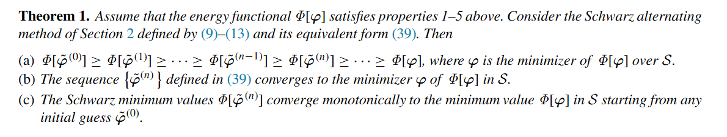
Schwarz Alternating Method for Dynamic Multiscale Coupling: Theory
For quasistatics, we derived a proof of convergence of the alternating Schwarz method for the finite deformation problem, and determined a geometric convergence rate [(Mota, Tezaur, Alleman, CMAME, 2017) and previous talk].
Extending these results to dynamics is work in progress.
  Quasistatic proof extends naturally assuming conformal meshes and the same time step is used in each Schwarz subdomain.
  Some analysis of Schwarz for evolution problems was performed in (Lions, 1988) and may be possible to leverage.
  Our numerical results suggest theoretical analysis is possible.
Notes:
FIXME: add some discussion of theory?

Slide 19
Outline
This talk goes hand-in-hand with the previous talk in this MS: #2018677 - A. Mota, I. Tezaur, C. Alleman, “The Schwarz Alternating Method for Quasistatic Multiscale Coupling in Solid Mechanics”
Motivation and Background*.
Schwarz for Dynamic Multiscale Coupling.
Numerical Examples.
Summary and Future Work.
References.
Appendix.
* Review from previous talk #2018677 by A. Mota.

Slide 20


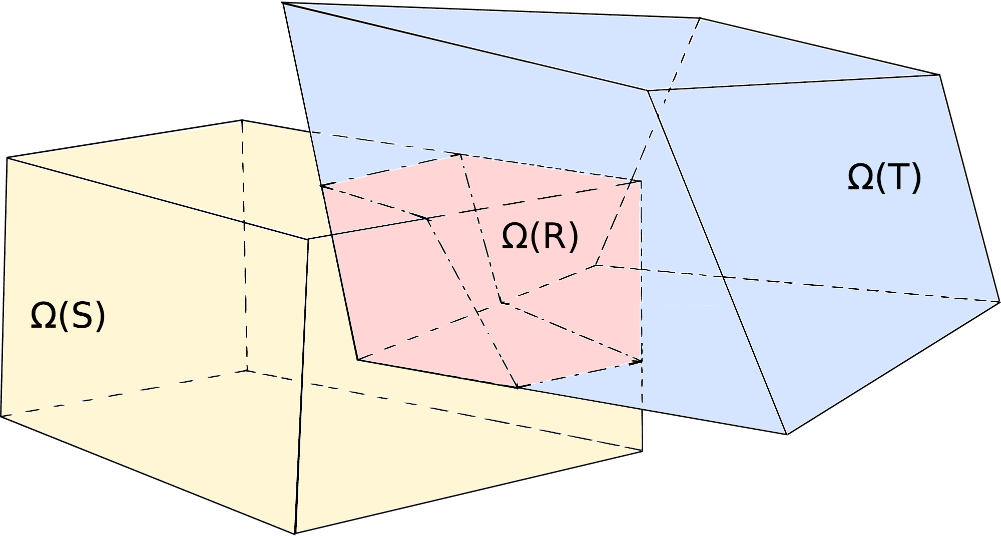
Implementation within Albany Code
The proposed dynamic alternating Schwarz method has been implemented within the LCM project in Sandia’s open-source parallel, C++, multi-physics, finite element code, Albany.
Component-based design for rapid development of capabilities.
Contains a wide variety of constitutive models.
Extensive use of libraries from the open-source Trilinos project.
  Use of the Phalanx package to decompose complex problem into simpler problems with managed dependencies.
  Use of the Sacado package for automatic differentiation.
  Use of Tempus package for time-integration*.
Parallel implementation of Schwarz alternating method uses the Data Transfer Kit (DTK).
All software available on GitHub.
https://github.com/gahansen/Albany
https://github.com/trilinos/trilinos
https://github.com/ORNL-CEES/DataTransferKit
* Current dynamic Schwarz implementation in Albany requires same $Δt$ in different subdomains.

Slide 21
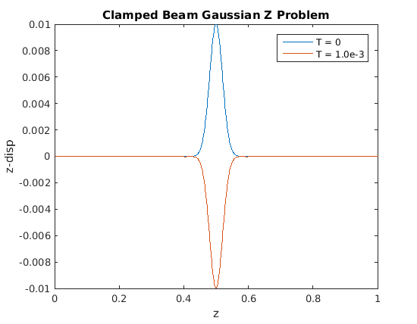
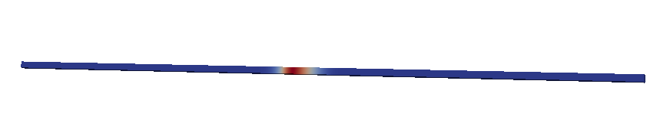
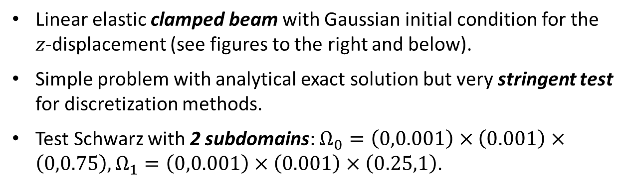
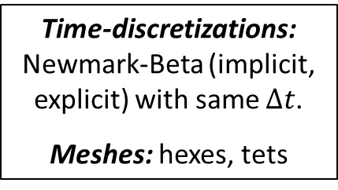
Example #1: Elastic Wave Propagation
Linear elastic clamped beam with Gaussian initial condition for the 𝑧-displacement (see figures to the right and below).
Simple problem with analytical exact solution but very stringent test for discretization methods.
Test Schwarz with 2 subdomains: $Ω_{0}=\left(0,0.001\right)×\left(0.001\right)×\left(0,0.75\right),Ω_{1}=\left(0,0.001\right)×\left(0.001\right)×\left(0.25,1\right)$.
Left: Initial condition (blue) and final solution (red). Wave profile is negative of initial profile at time T = 1.0e-3.
Time-discretizations: Newmark-Beta (implicit, explicit) with same $Δt$.
Meshes: hexes, tets

Slide 22
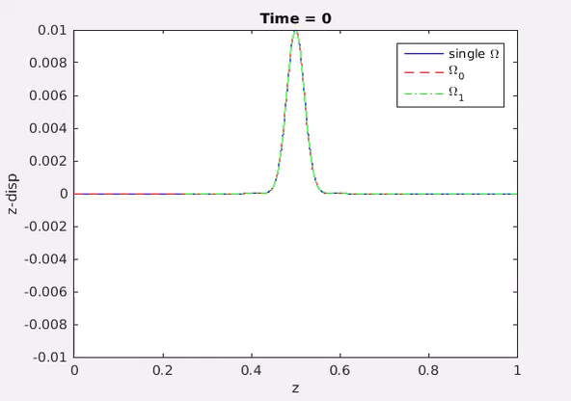
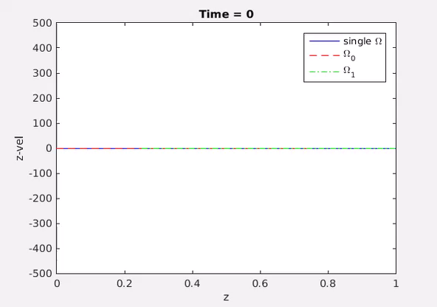
Example #1: Elastic Wave Propagation
Dynamic Schwarz coupling introduces no dynamic artifacts that are pervasive in other coupling methods!
z-velocity
z-displacement
Table 1: Averaged (over times + domains) relative errors in z–displacement (blue) and z-velocity (green) for several different Schwarz couplings, 50% overlap volume fraction
 | Implicit-Implicit |  | Explicit(CM)-Implicit |  | Explicit(LM)-Implicit
Conformal hex-hex | 2.79e-3 | 7.32e-3 | 3.53e-3 | 8.70e-3 | 4.72e-3 | 1.19e-2
Nonconformal hex-hex | 2.90e-3 | 7.10e-3 | 2.82e-3 | 7.29e-3 | 2.84e-3 | 7.33e-3
Tet-hex | 2.79e-3 | 7.58e-3 | 3.52e-3 | 8.92e-3 | 4.72e-3 | 1.19e-2
LM = Lumped Mass, CM = Consistent Mass

Slide 23
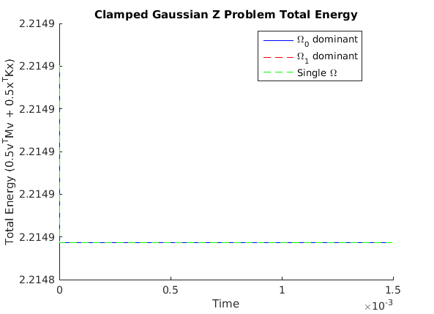
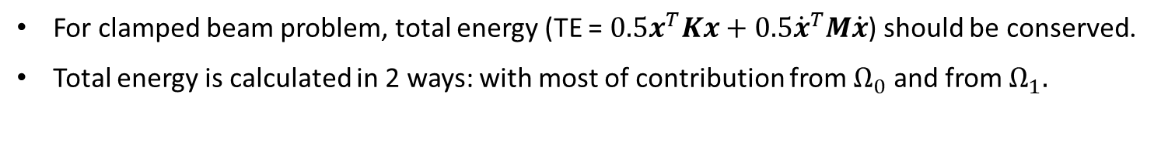
Example #1: Elastic Wave Propagation
Energy Conservation
Total energy is conserved and matches single-domain total energy.
For clamped beam problem, total energy (TE = $0.5x^{T}Kx+0.5{\dot{x}}^{T}M\dot{x}$) should be conserved.
Total energy is calculated in 2 ways: with most of contribution from $Ω_{0}$ and from $Ω_{1}.$

Slide 24
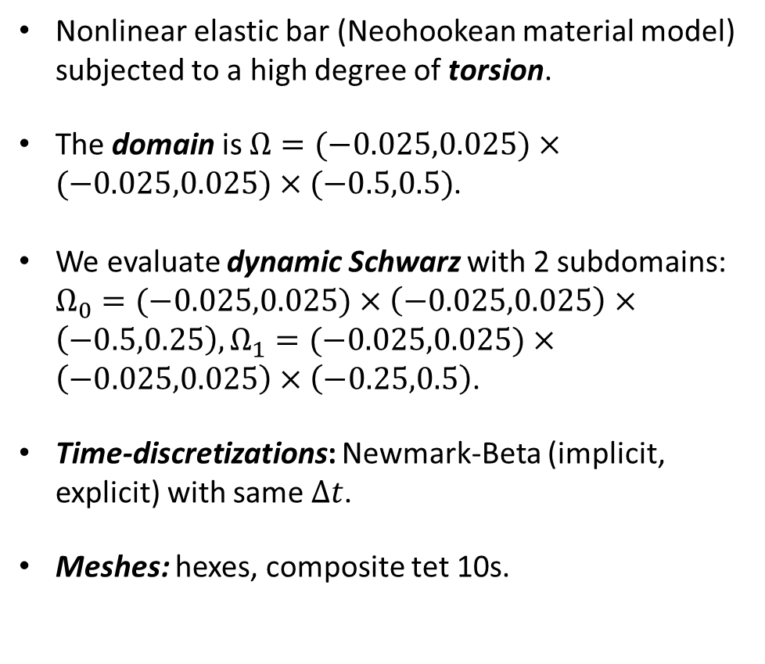



Example #2: Torsion
$$Ω_{0}$$
$$Ω_{1}$$
$$Ω_{ref}$$
Nonlinear elastic bar (Neohookean material model) subjected to a high degree of torsion.
The domain is $Ω=(−0.025,0.025)×$ $(−0.025,0.025)×(−0.5,0.5)$.
We evaluate dynamic Schwarz with 2 subdomains: $Ω_{0}=(−0.025,0.025)×$ $\left(−0.025,0.025\right)×\left(−0.5,0.25\right), Ω_{1}=(−0.025,0.025)×$ $\left(−0.025,0.025\right)×\left(−0.25,0.5\right)$.
Time-discretizations: Newmark-Beta (implicit, explicit) with same $Δt$.
Meshes: hexes, composite tet 10s.

Slide 25
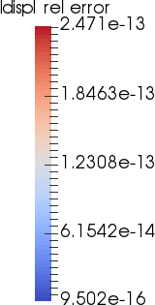
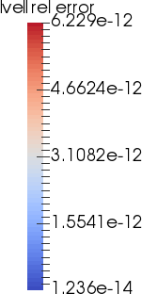







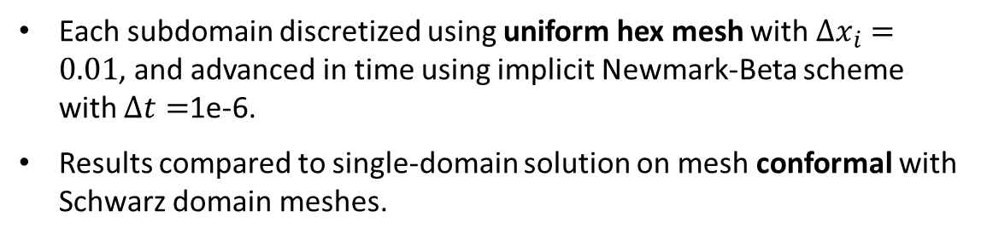
Example #2: Torsion
Schwarz and single-domain results agree to almost machine-precision!
Conformal Hex + Hex Coupling
$$Ω_{0}$$
$$Ω_{1}$$
$$Ω_{ref}$$
Each subdomain discretized using uniform hex mesh with $∆x_{i}=0.01$, and advanced in time using implicit Newmark-Beta scheme with $∆t=$1e-6.
Results compared to single-domain solution on mesh conformal with Schwarz domain meshes.
Displacement relative errors at final time (T=0.002)
$$Ω_{0}$$
$$Ω_{1}$$
Velocity relative errors at final time (T=0.002)
$$Ω_{1}$$
$$Ω_{0}$$

Slide 26
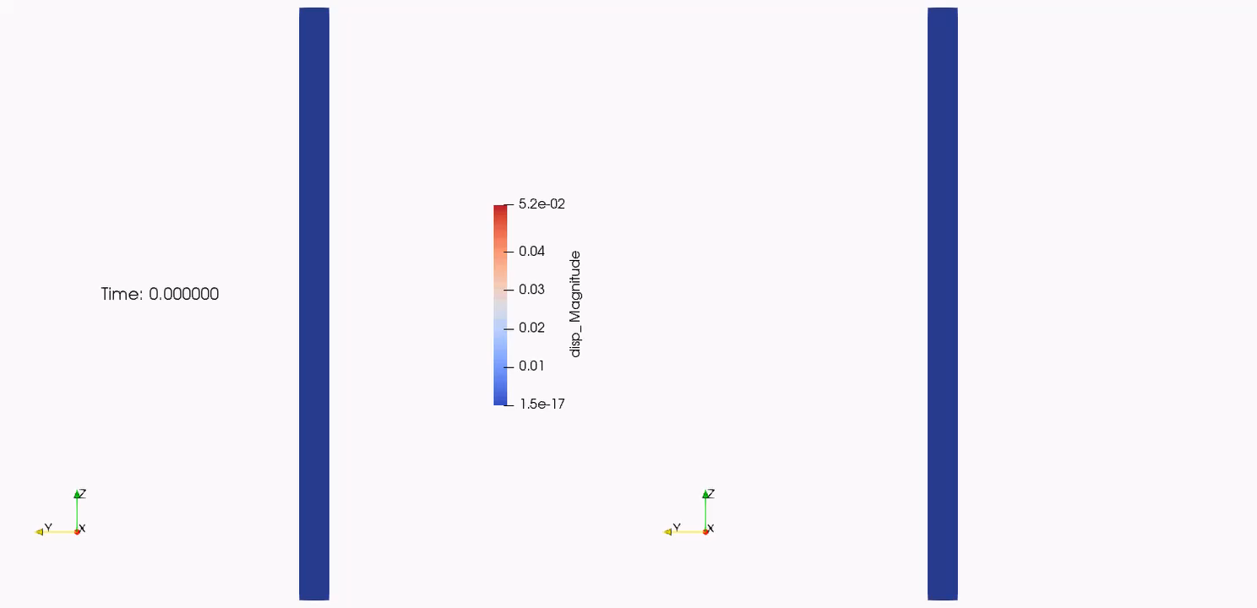
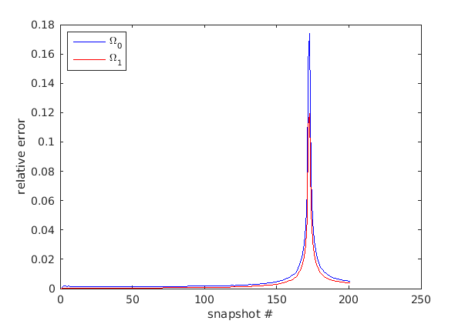


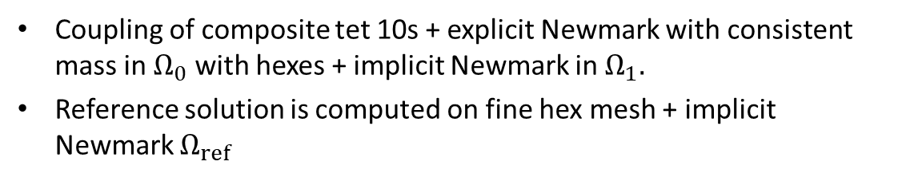

Example #2: Torsion
Hex + Composite Tet 10 Coupling
$$Ω_{0}$$
$$Ω_{1}$$
$$Ω_{ref}$$
Coupling of composite tet 10s + explicit Newmark with consistent mass in $Ω_{0}$ with hexes + implicit Newmark in $Ω_{1}.$
Reference solution is computed on fine hex mesh + implicit Newmark $Ω_{ref}$
Relative error <1% and does not grow in time!
No dynamic artifacts!
Movie of |displacement|
Left: Single-domain,
Right: Schwarz

Slide 27
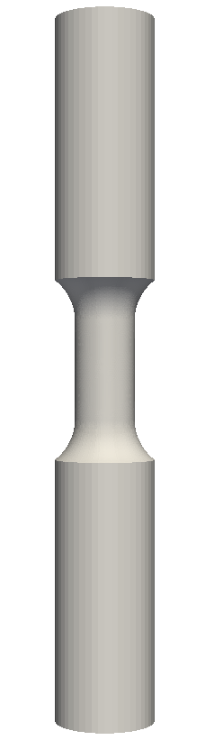
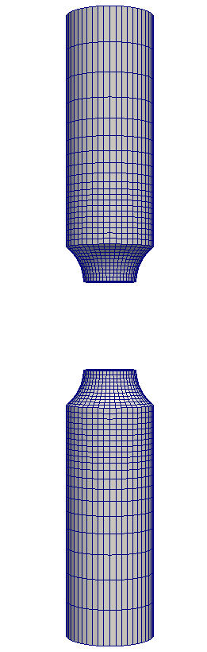
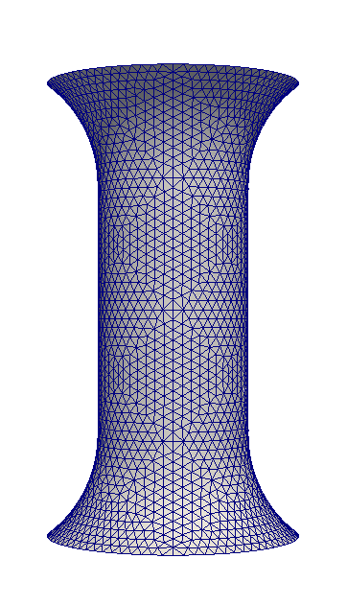
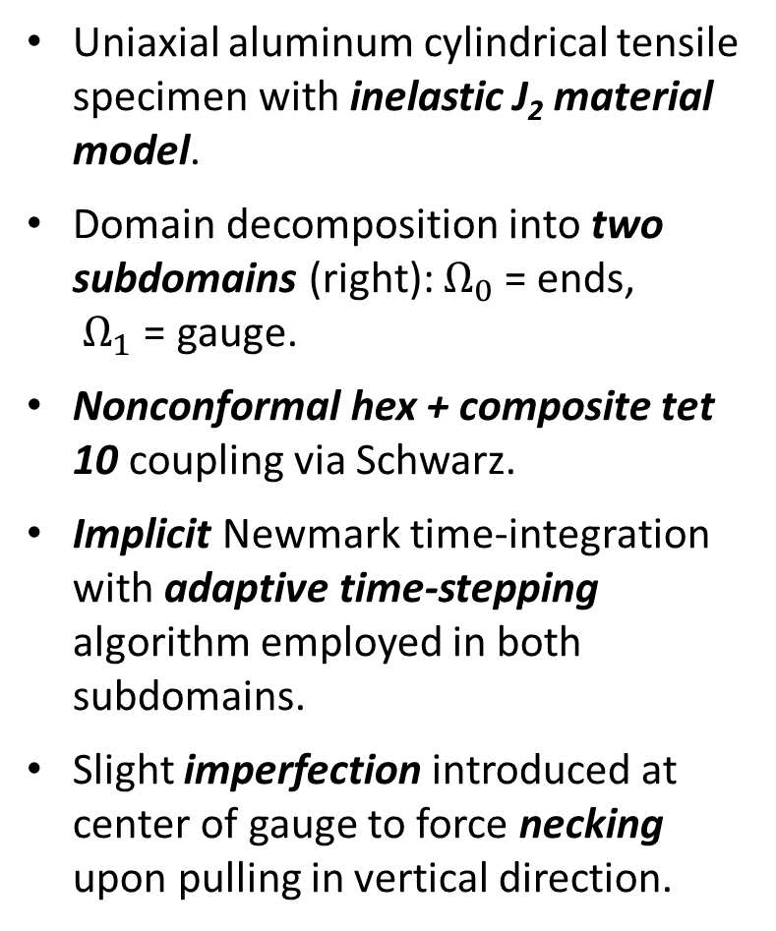


Example #3: Tension Specimen
Uniaxial aluminum cylindrical tensile specimen with inelastic J₂ material model.
Domain decomposition into two subdomains (right): $Ω_{0}$ = ends, ${ Ω}_{1}$ = gauge.
Nonconformal hex + composite tet 10 coupling via Schwarz.
Implicit Newmark time-integration with adaptive time-stepping algorithm employed in both subdomains.
Slight imperfection introduced at center of gauge to force necking upon pulling in vertical direction.
$$Ω_{0}$$
$$Ω_{1}$$
+

Slide 28
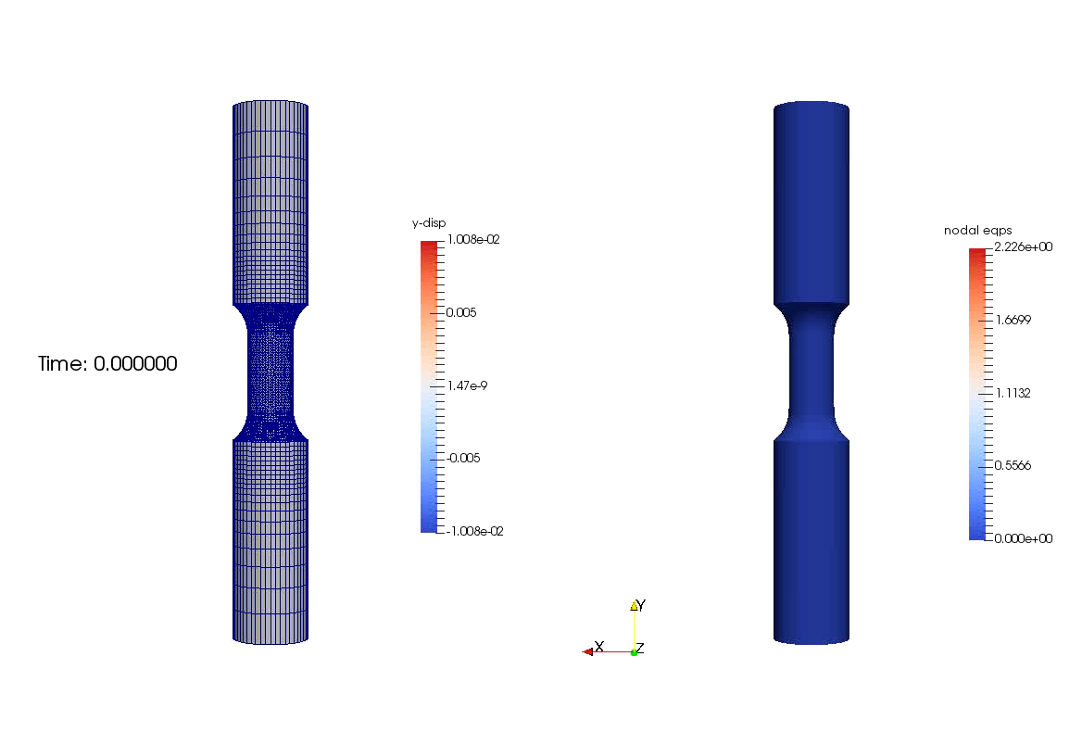
Example #3: Tension Specimen
y-displacement
Nodal eqps*
Average of ~7 Schwarz iterations/time step required for convergence to Schwarz tolerance of 1e-6.
*Nodal eqps = equivalent plastic strain computed via weighted volume average.
Notes:
Schwarz iters is b/w 3-15 depending on time step

Slide 29
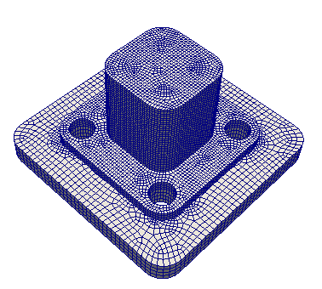
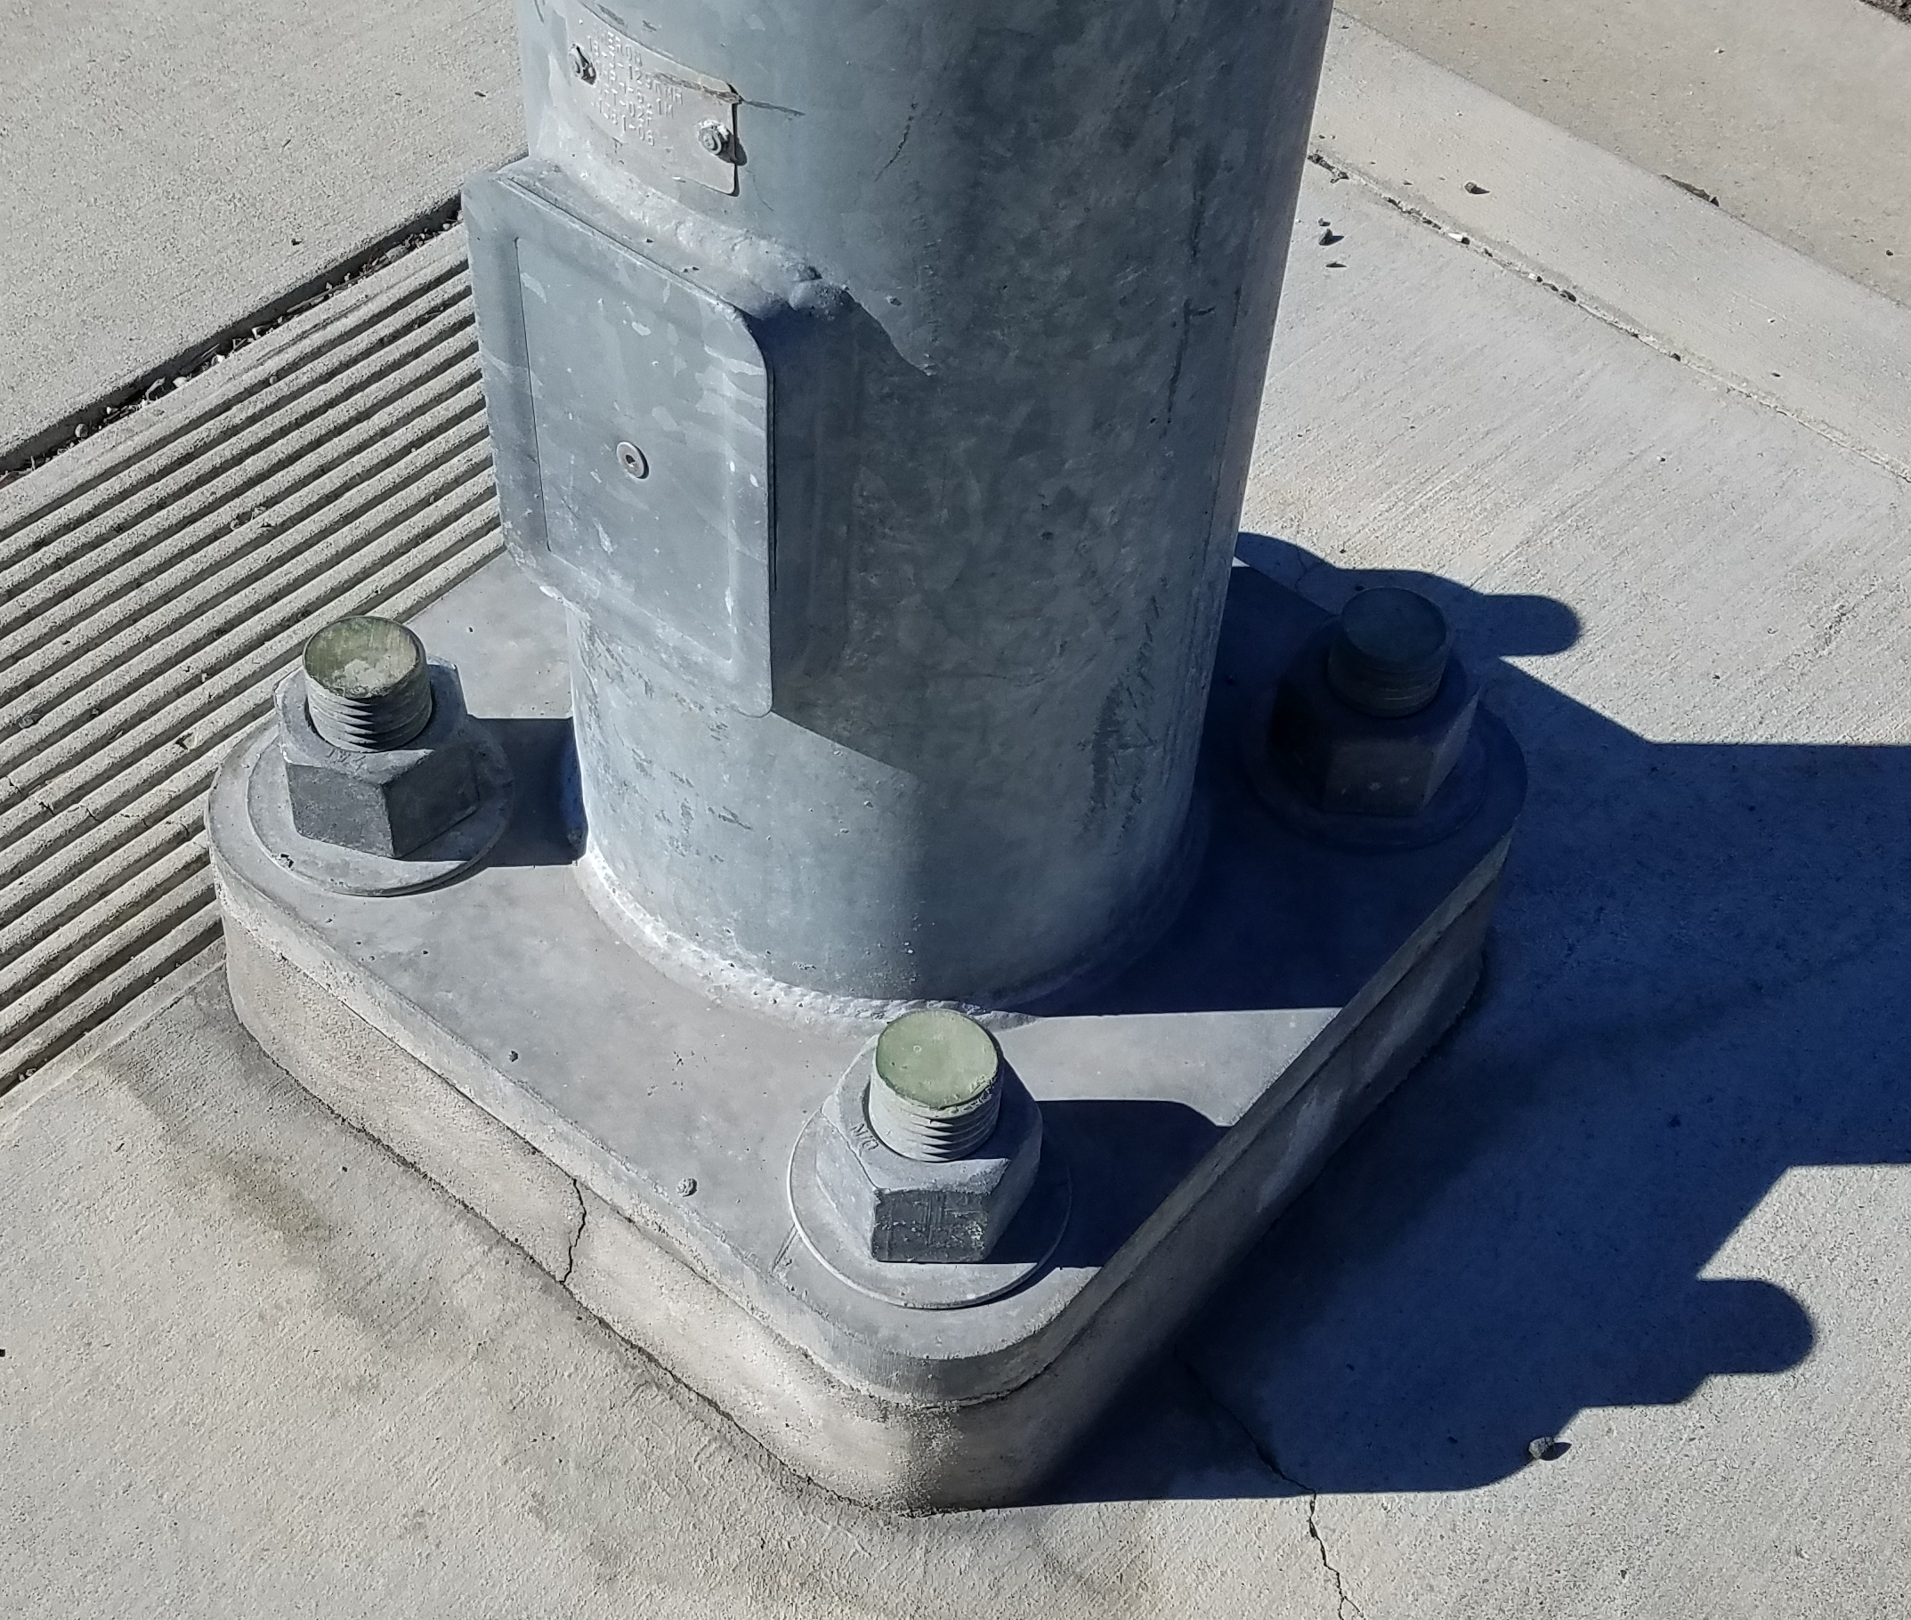
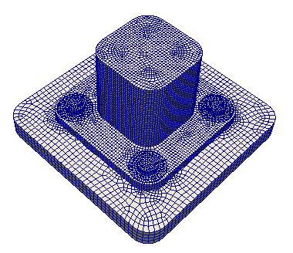
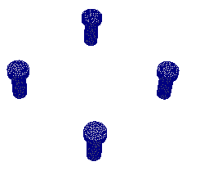


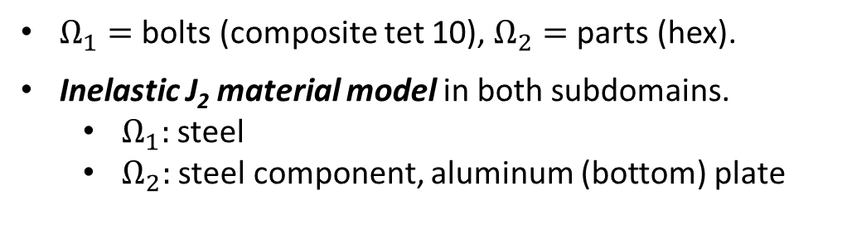
Example #4: Bolted Joint Problem
Problem of practical scale.
$$Ω_{2}$$
Schwarz solution compared to single-domain solution on composite tet 10 mesh.
BC: x-disp = 0.02 at T = 1.0e-3 on top of parts.
Run until T = 5.0e-4 w/ dt = 1e-5 + implicit Newmark with analytic mass matrix for composite tet 10s.
$Ω_{1}=$ bolts (composite tet 10), $Ω_{2}=$ parts (hex).
Inelastic J₂ material model in both subdomains.
  $Ω_{1}:$ steel
  $Ω_{2}:$ steel component, aluminum (bottom) plate
$$Ω_{1}$$

Slide 30
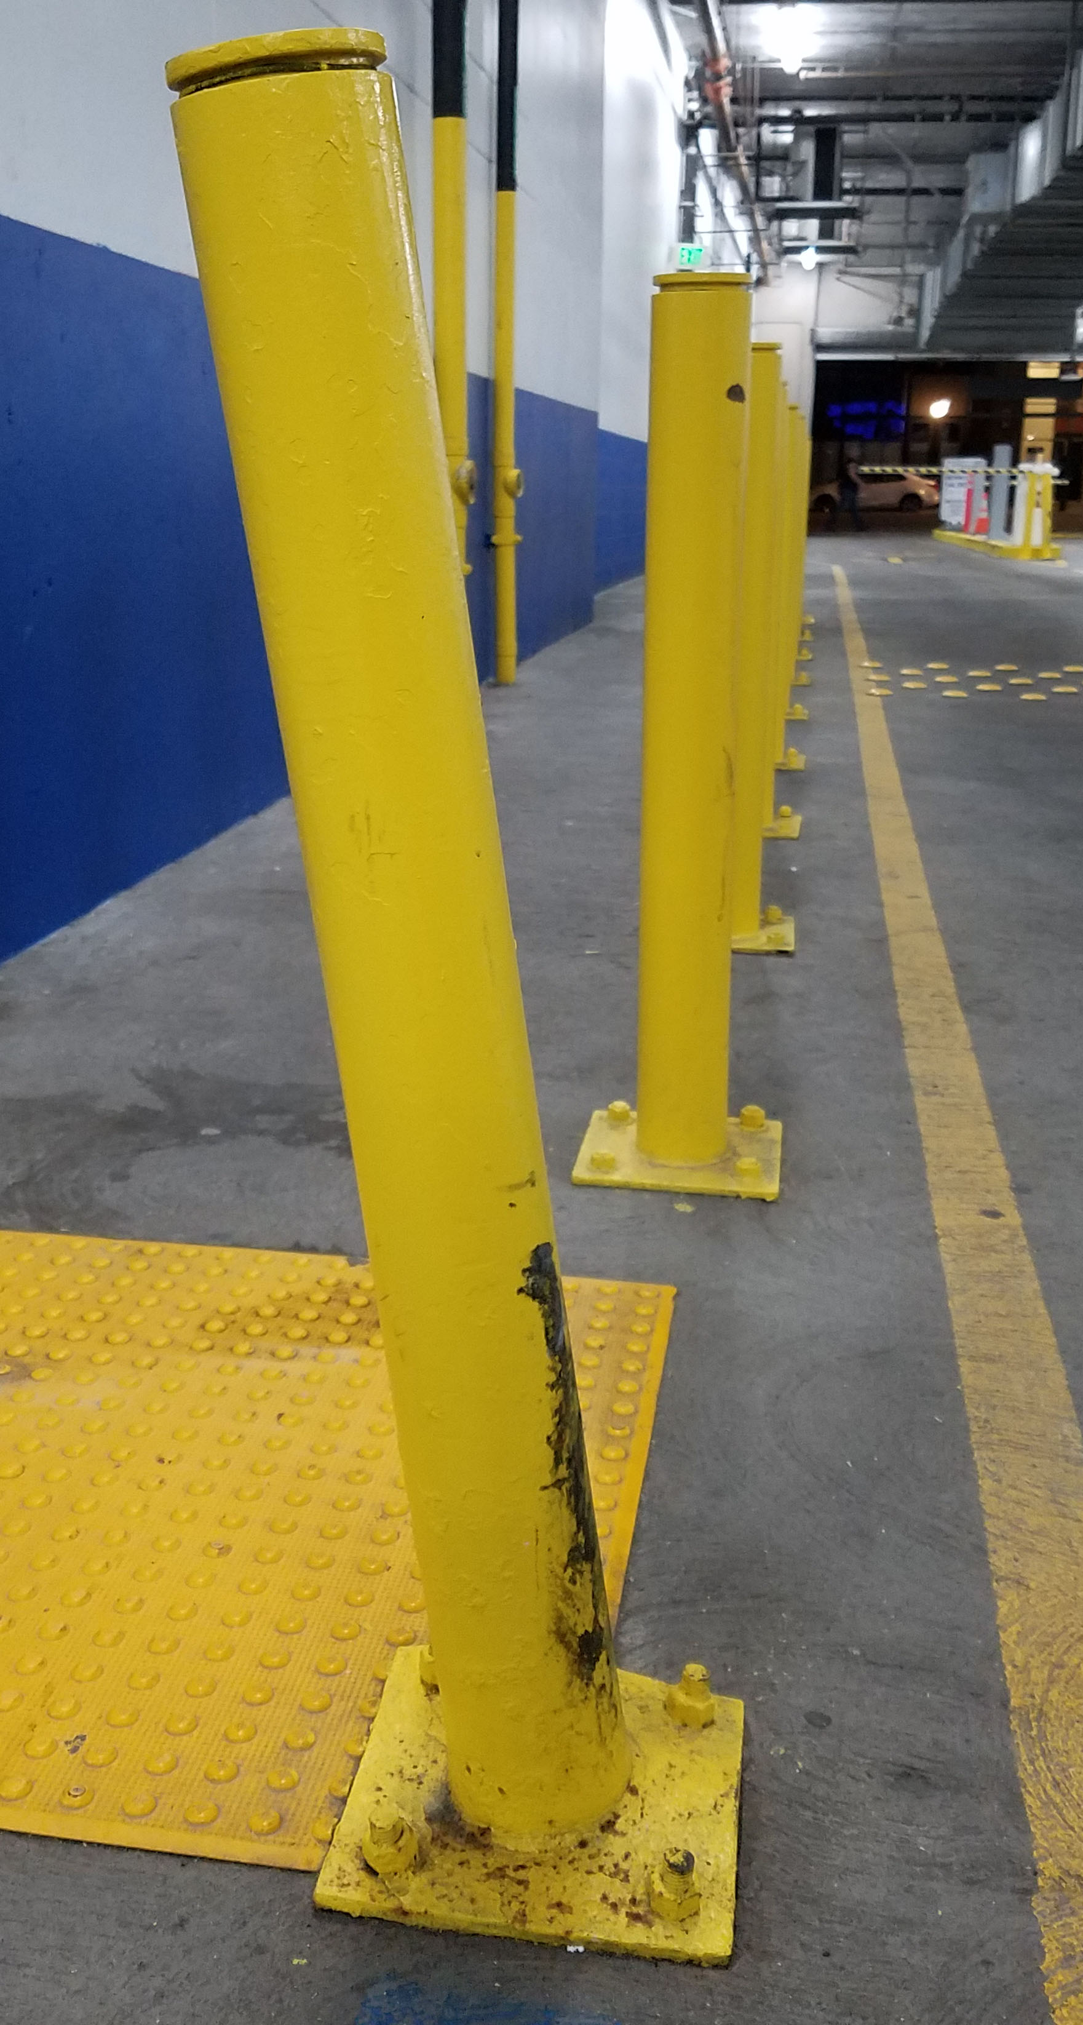
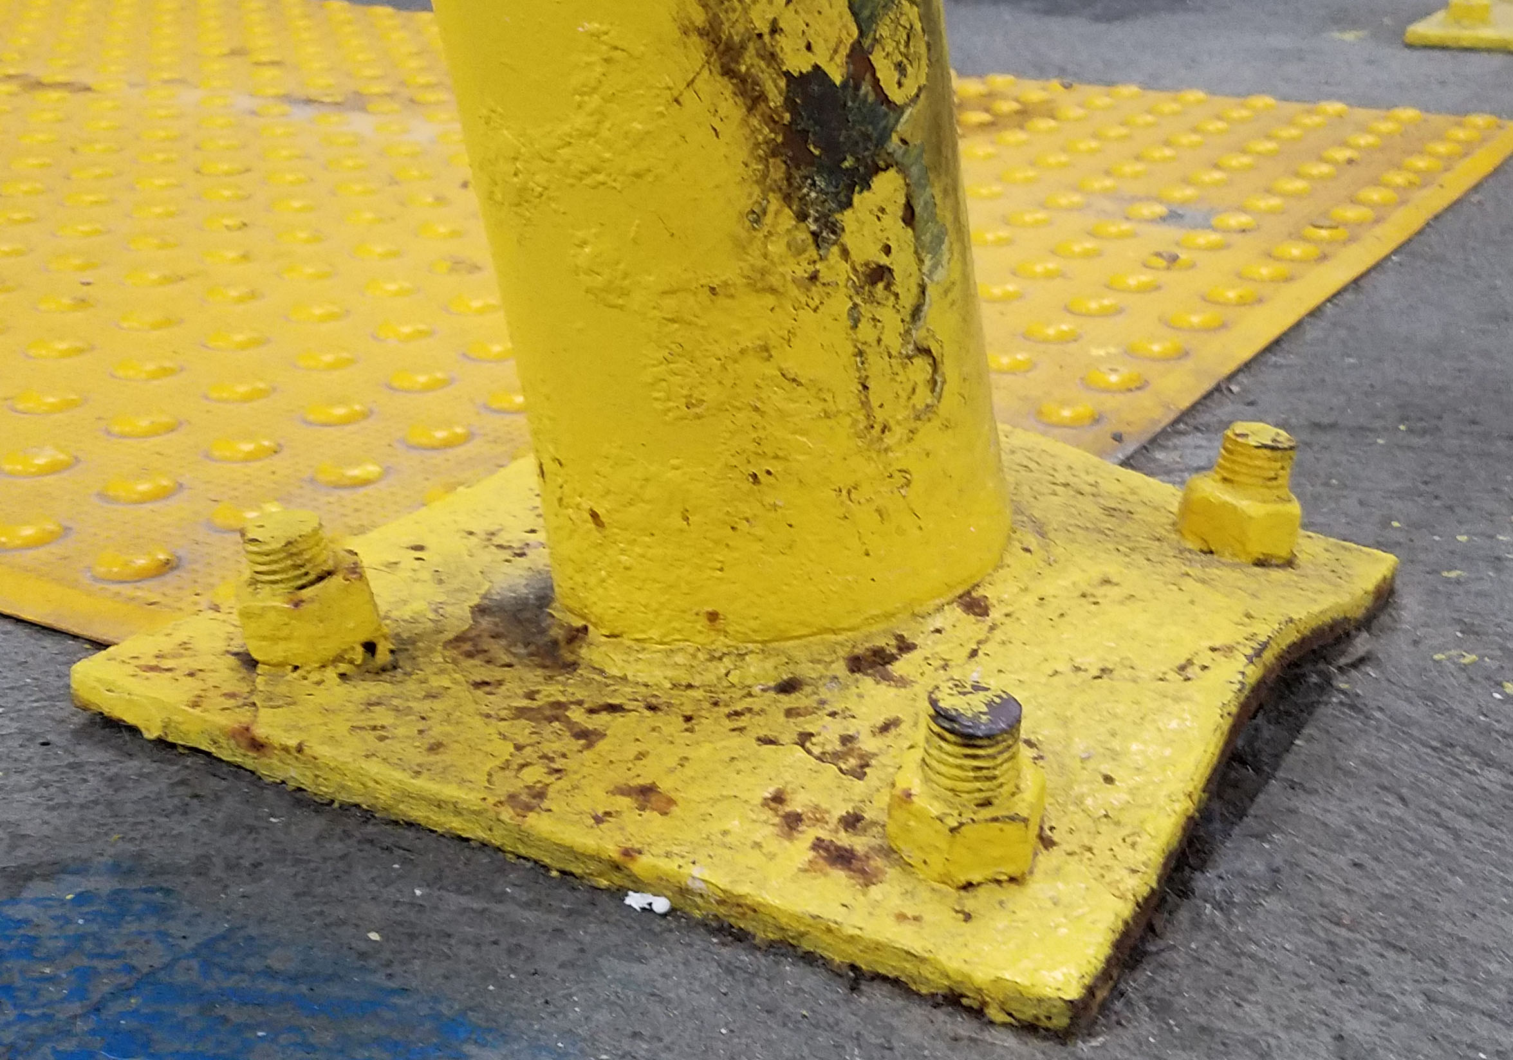
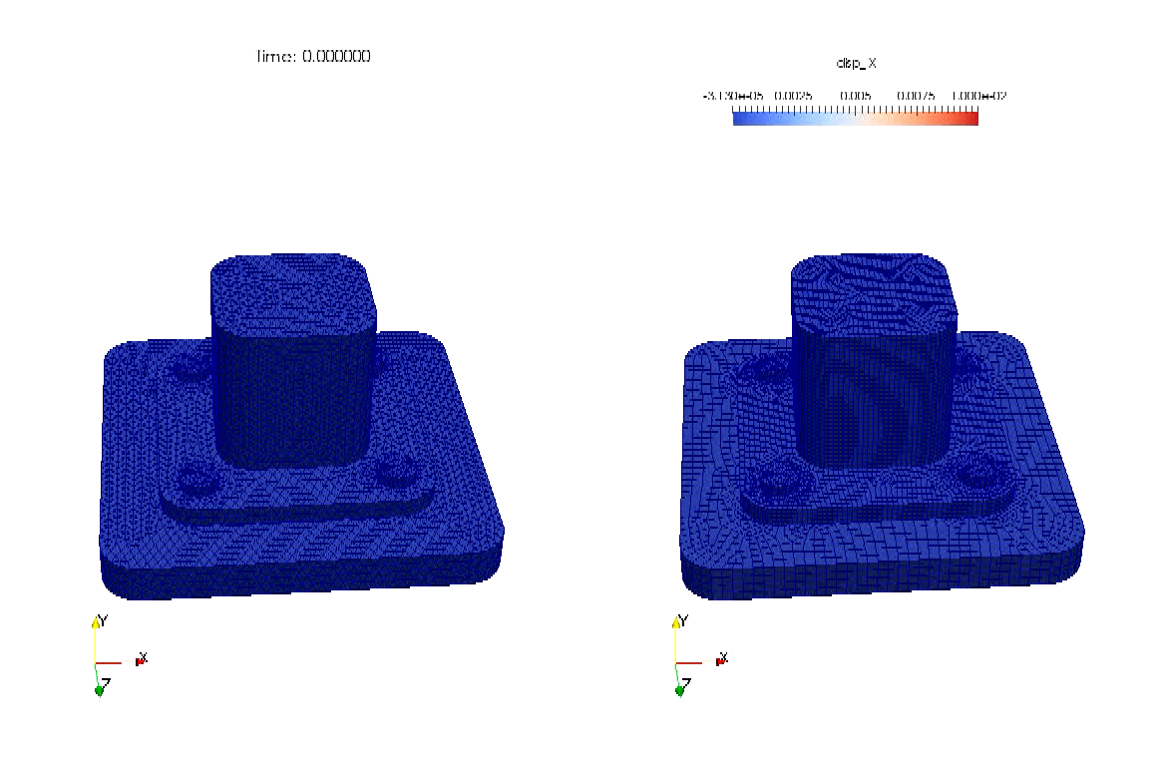

Example #4: Bolted Joint Problem
x-displacement
Single $Ω$
Schwarz

Slide 31
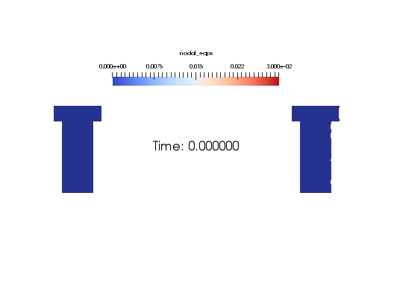
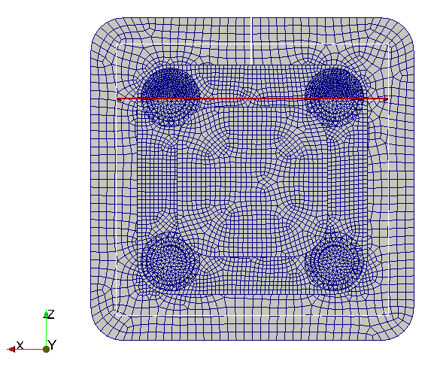
Example #4: Bolted Joint Problem
Nodal Equivalent Plastic Strain (eqps)
Cross-section of bolts obtained via clip (right)

Slide 32
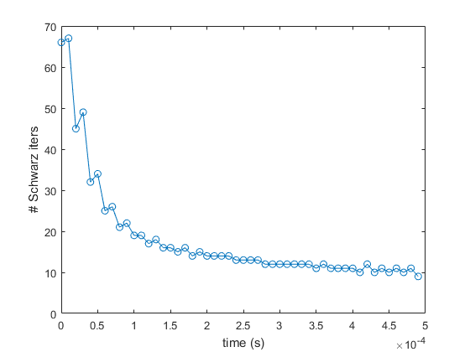
Example #4: Bolted Joint Problem
Some Performance Results
Schwarz / solver settings
Relatively loose Schwarz tolerances were used:
  Relative Tolerance: 1.0e-3.
  Absolute Tolerance: 1.0e-4.
Newton tolerance on NormF: 1e-8
Linear solver tolerance: 1e-5
MueLu preconditioner
Top right plot: # Schwarz iterations for each time step.
  After start-up, # Schwarz iterations / time step is ~9-10. This is not bad given how small is the size of the overlap region for this problem.

Slide 33
Outline
This talk goes hand-in-hand with the previous talk in this MS: #2018677 - A. Mota, I. Tezaur, C. Alleman, “The Schwarz Alternating Method for Quasistatic Multiscale Coupling in Solid Mechanics”
Motivation and Background*.
Schwarz for Dynamic Multiscale Coupling.
Numerical Examples.
Summary and Future Work.
References.
Appendix.
* Review from previous talk #2018677 by A. Mota.

Slide 34
Summary
The alternating Schwarz coupling method has been developed and implemented for concurrent multiscale dynamic modeling in Sandia’s Albany/LCM code.
☺
Coupling is concurrent (two-way).
Ease of implementation into existing massively-parallel HPC codes.
Scalable, fast, robust (we target real engineering problems, e.g., analyses involving failure of bolted components!).
“Plug-and-play” framework: simplifies task of meshing complex geometries!
  Ability to couple regions with different non-conformal meshes, different element types and different levels of refinement.
  Ability to use different solvers/time-integrators in different regions.
Coupling does not introduce nonphysical artifacts.
Theoretical convergence properties/guarantees.
☺
☺
☺
☺
☺
☺
😐

Slide 35

Ongoing/Future Work
Development of theory for dynamic alternating Schwarz formulation.
Journal article on the work presented in this talk is in preparation.
Extension of Albany/LCM implementation to allow for different time steps in different subdomains.
Application of dynamic Schwarz for problems and test cases of interest to production.
Implementation of alternating Schwarz method for concurrent multiscale coupling in Sandia production codes (Sierra Solid Mechanics), comparison to other methods (e.g., GFEM).
Development of a multi-physics coupling framework based on variational formulations and the Schwarz alternating method.

Slide 36
Outline
This talk goes hand-in-hand with the previous talk in this MS: #2018677 - A. Mota, I. Tezaur, C. Alleman, “The Schwarz Alternating Method for Quasistatic Multiscale Coupling in Solid Mechanics”
Motivation and Background*.
Schwarz for Dynamic Multiscale Coupling.
Numerical Examples.
Summary and Future Work.
References.
Appendix.
* Review from previous talk #2018677 by A. Mota.

Slide 37
References
[1] M.A. Heroux et al. “An overview of the Trilinos project.” ACM Trans. Math. Softw. 31(3) (2005).
[2] A. Salinger, et al. "Albany: Using Agile Components to Develop a Flexible, Generic Multiphysics Analysis Code", Int. J. Multiscale Comput. Engng. 14(4) (2016) 415-438.
[3] H. Schwarz. “Über einen Grenzübergang durch alternierendes Verfahren”. In: Vierteljahrsschriftder Naturforschenden Gesellschaft in Zurich 15 (1870), pp. 272–286.
[4] S.L. Sobolev. “Schwarz’s Algorithm in Elasticity Theory”. In: Selected Works of S.L Sobolev. Volume I: equations of mathematical physics, computational mathematics and cubature formulats. Ed. By G.V. Demidenko and V.L. Vaskevich. New York: Springer, 2006.
[5] S. Mikhlin. “On the Schwarz algorithm”. In: Proceedings of the USSR Academy of Sciences (in Russian) 77 (1951), pp. 569–571.
[6] P.L. Lions. “On the Schwarz alternating method I.” In: 1988, First International Symposium on Domain Decomposition methods for Partial Differential Equations, SIAM, Philadelphia.
[7] J. Ostien, J. Foulk, A. Mota, M. Veilleux. A 10-node composite tetrahedral finite element for solid mechanics. Int. J. Numer. Mod. Engng. 107 (2016) 1145-1170.
[8] A. Mota, I. Tezaur, C. Alleman. "The Schwarz Alternating Method in Solid Mechanics", Comput. Meth. Appl. Mech. Engng. 319 (2017), 19-51. [http://www.sandia.gov/~ikalash/journal.html].
[9] A. Mota, I. Tezaur. "The Schwarz alternating method for dynamic solid mechanics", in preparation for submission to Comput. Meth. Appl. Mech. Engng.

Slide 38
Outline
This talk goes hand-in-hand with the previous talk in this MS: #2018677 - A. Mota, I. Tezaur, C. Alleman, “The Schwarz Alternating Method for Quasistatic Multiscale Coupling in Solid Mechanics”
Motivation and Background*.
Schwarz for Dynamic Multiscale Coupling.
Numerical Examples.
Summary and Future Work.
References.
Appendix.
* Review from previous talk #2018677 by A. Mota.

Slide 39






Appendix. Schwarz Alternating Method for Dynamic Multiscale Coupling
We developed an extension of Schwarz coupling to dynamics using a governing time stepping algorithm that controls time integrators within each domain.
$$T_{0}$$
$$T_{1}$$
$$T_{2}$$
$ΔT$
$ΔT$
Controller time stepper
Time integrator for Ω₁
Time integrator for Ω₂
Can use different integrators with different time steps within each domain (w/o space-time discretization)!
Ingredients:
Controller time step $ΔT$ $⇒$ $T_{0}+nΔT$ are times at which Schwarz is synchronized
  Convenient checkpoint to facilitate implementation
Discretization + time-integrator for $Ω_{1}$ with time-step ${Δt}_{1}$ (divides $ΔT$)
Discretization + time-integrator for $Ω_{2}$ with time-step ${Δt}_{2}$ (divides $ΔT$)
Notes:
FIXME: add algorithm?

Slide 40






Appendix. Dynamic Singular Bar (MATLAB)
Inelasticity masks problems by introducing energy dissipation.
Schwarz does not introduce numerical artifacts.
Can couple domains with different time integration schemes (Explicit-Implicit below).

Slide 41


Appendix. Example #1: Elastic Wave
Some Performance Results
Left figure shows # of iterations as a function of overlap region size for 2 subdomains. The method does not converge for 0% overlap. If the overlap is 100% then the single-domain solution is recovered for each of the subdomains.
Right figure shows linear convergence rate of dynamic Schwarz implementation (for small overlap fraction of 0.2%).

Slide 42

Appendix. Example #2: Torsion
Some Performance Results
Convergence behavior of the dynamic Schwarz algorithm for the torsion problem for small overlap volume fraction (2%) in which each subdomain is discretized using a hexahedral mesh. The plot shows that a linear convergence rate is achieved.

Slide 43


Appendix. Example #4: Bolted Joint Problem
y-displacement
Single $Ω$
Schwarz

Slide 44


Appendix. Example #4: Bolted Joint Problem
z-displacement
Single $Ω$
Schwarz

