Slide 1
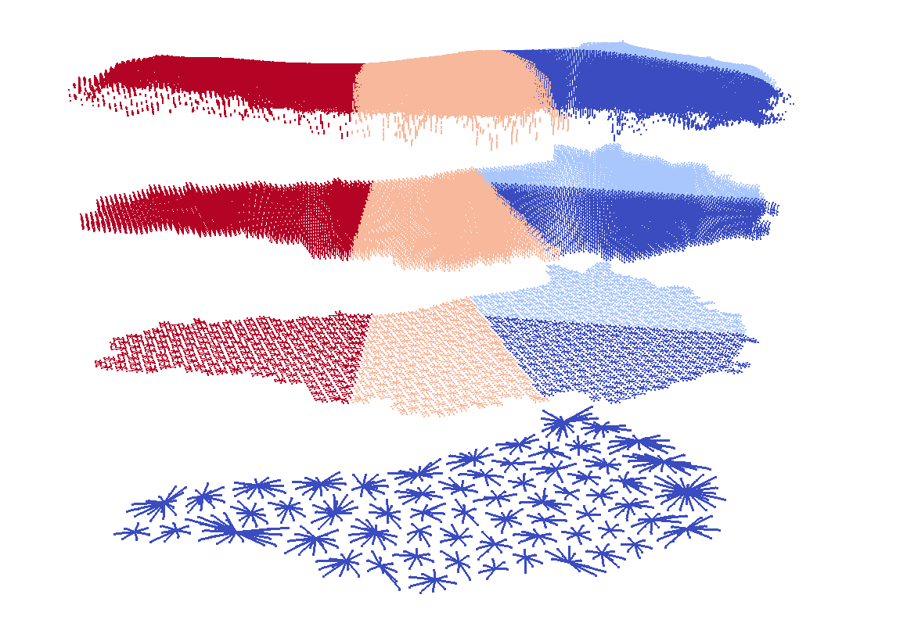
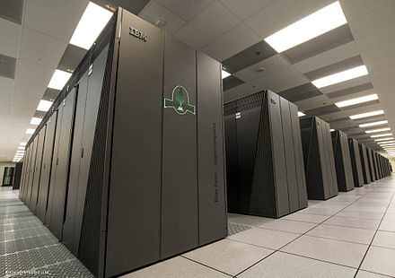
The Albany/FELIX First-Order Stokes Finite Element Ice Sheet Dynamical Core Built Using Trilinos Software Components: Performance, Next-Generation Capabilities and Validation
I. Tezaur¹, A. Salinger¹, M. Perego¹, R. Tuminaro¹, S. Price², J. Watkins¹, G. Hansen¹
¹ Sandia National Laboratories, Albuquerque, NM and Livermore, CA, USA.
² Los Alamos National Laboratory, Los Alamos, NM, USA.
SIAM MPE 2016 Philadelphia, PA Sept. 30 – Oct. 2, 2016
SAND2016-8943 C

Slide 2
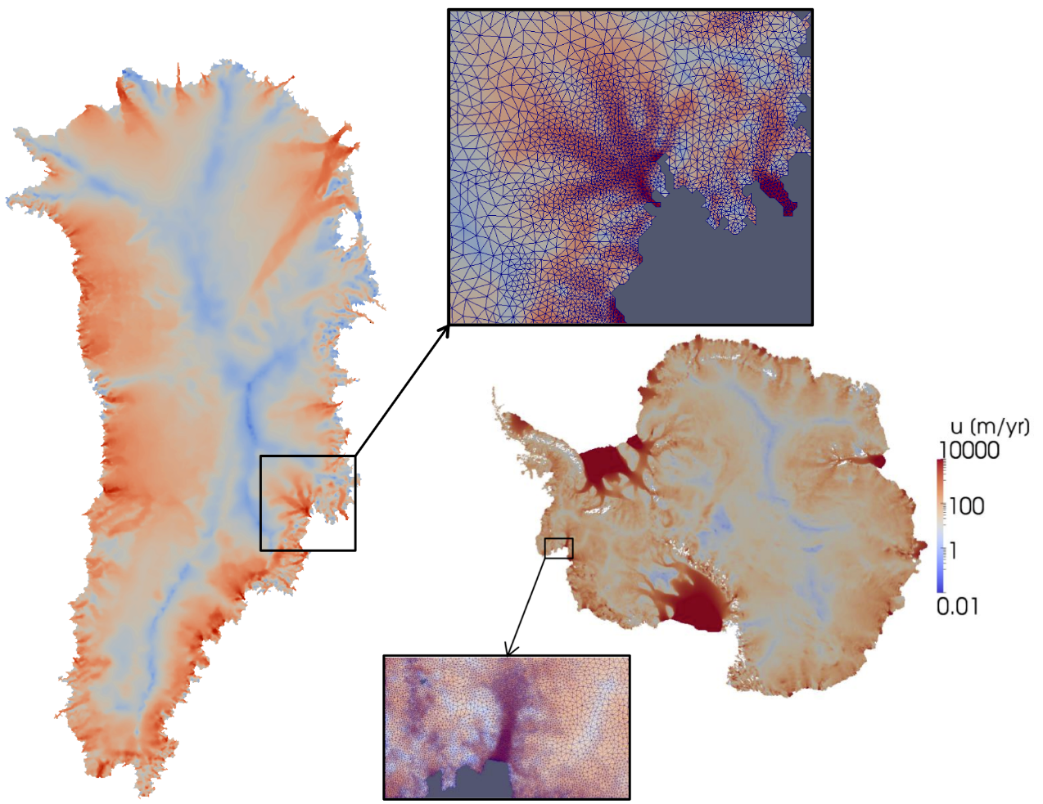


PISCEES* Project for Land-Ice Modeling
  Sandia’s Role in the PISCEES Project: to develop and support a robust and scalable land ice solver based on the “First-Order” (FO) Stokes equations $→$Albany/FELIX**
Requirements for Albany/FELIX:
  Unstructured grid finite elements.
  Scalable, fast and robust
  Verified and validated.
  Portable to new/emerging architecture machines (multi-core, many-core, GPU)
  Advanced analysis capabilities: deterministic inversion, calibration, uncertainty quantification.
As part of ACME DOE earth system model, solver will provide actionable predictions of 21st century sea-level rise (including uncertainty).
**Finite Elements for Land Ice eXperiments
*PISCEES = Predicting Ice Sheet Climate Evolution at Extreme Scales.

Slide 3
PISCEES* Project for Land-Ice Modeling
  Sandia’s Role in the PISCEES Project: to develop and support a robust and scalable land ice solver based on the “First-Order” (FO) Stokes equations $→$Albany/FELIX**
Requirements for Albany/FELIX:
  Unstructured grid finite elements.
  Scalable, fast and robust
  Verified and validated.
  Portable to new/emerging architecture machines (multi-core, many-core, GPU)
  Advanced analysis capabilities: deterministic inversion, calibration, uncertainty quantification.
As part of ACME DOE earth system model, solver will provide actionable predictions of 21st century sea-level rise (including uncertainty).
**Finite Elements for Land Ice eXperiments
*PISCEES = Predicting Ice Sheet Climate Evolution at Extreme Scales.

Slide 4
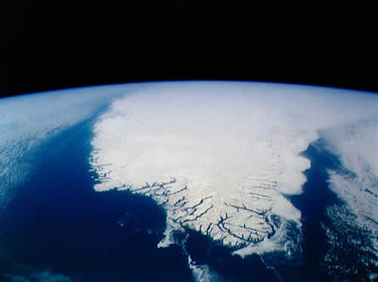
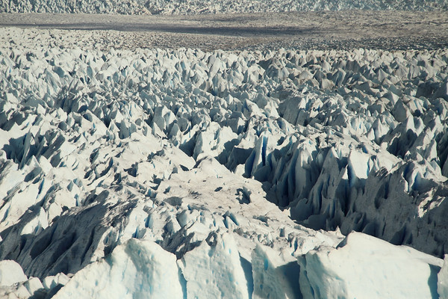
Outline
1. Ice Sheet Equations and Codes.
2. Mesh Adaptivity.
3. Scalability.
4. Performance Portability.
5. Validation.
6. Summary and Future Work.

Slide 5
Outline
1. Ice Sheet Equations and Codes.
2. Mesh Adaptivity.
3. Scalability.
4. Performance Portability.
5. Validation.
6. Summary and Future Work.
Steps towards creating a production-ready code

Slide 6
Outline
1. Ice Sheet Equations and Codes.
2. Mesh Adaptivity.
3. Scalability.
4. Performance Portability.
5. Validation.
6. Summary and Future Work.
Steps towards creating a production-ready code

Slide 7
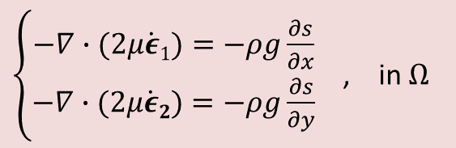
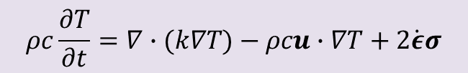
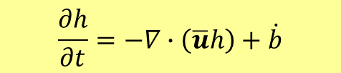
Ice Sheet Equations and Codes
Momentum Balance: First-Order Stokes PDEs
$\left\{\begin{aligned}−∇∙(2μ\dot{ε}1)=−ρg\frac{∂s}{∂x} \\ −∇∙(2μ\dot{ε}2)=−ρg\frac{∂s}{∂y}\end{aligned}\right.$ , in $Ω$
with Glen’s law viscosity $μ=\frac{1}{2}{{A(T)}^{−\frac{1}{3}}\left(\frac{1}{2}\sum_{ij}{\dot{ε}ij2}\right)}^{\left(−\frac{2}{3}\right)}$.
Conservation of Mass: thickness evolution PDE
Albany/FELIX
$$\frac{∂h}{∂t}=−∇∙\left(\overline{u}h\right)+\dot{b}$$
Energy Balance: temperature advection-diffusion PDE
$$ρc\frac{∂T}{∂t}=∇∙(k∇T)−ρcu∙∇T+2\dot{ε}σ$$

Slide 8

Ice Sheet Equations and Codes
Code:
Momentum Balance: First-Order Stokes PDEs
=multi-physics PDE code
$\left\{\begin{aligned}−∇∙(2μ\dot{ε}1)=−ρg\frac{∂s}{∂x} \\ −∇∙(2μ\dot{ε}2)=−ρg\frac{∂s}{∂y}\end{aligned}\right.$ , in $Ω$
Albany*/FELIX**
with Glen’s law viscosity $μ=\frac{1}{2}{{A(T)}^{−\frac{1}{3}}\left(\frac{1}{2}\sum_{ij}{\dot{ε}ij2}\right)}^{\left(−\frac{2}{3}\right)}$.
Conservation of Mass: thickness evolution PDE
Albany/FELIX
$$\frac{∂h}{∂t}=−∇∙\left(\overline{u}h\right)+\dot{b}$$
Energy Balance: temperature advection-diffusion PDE
$$ρc\frac{∂T}{∂t}=∇∙(k∇T)−ρcu∙∇T+2\dot{ε}σ$$
*https://github.com/gahansen/Albany. **FELIX = Finite Elements for Land Ice eXperiments.

Slide 9
Ice Sheet Equations and Codes
Code:
Momentum Balance: First-Order Stokes PDEs
=multi-physics PDE code
$\left\{\begin{aligned}−∇∙(2μ\dot{ε}1)=−ρg\frac{∂s}{∂x} \\ −∇∙(2μ\dot{ε}2)=−ρg\frac{∂s}{∂y}\end{aligned}\right.$ , in $Ω$
Albany*/FELIX**
with Glen’s law viscosity $μ=\frac{1}{2}{{A(T)}^{−\frac{1}{3}}\left(\frac{1}{2}\sum_{ij}{\dot{ε}ij2}\right)}^{\left(−\frac{2}{3}\right)}$.
Conservation of Mass: thickness evolution PDE
Albany/FELIX
$$\frac{∂h}{∂t}=−∇∙\left(\overline{u}h\right)+\dot{b}$$
CISM/Albany
MPAS/Albany
Energy Balance: temperature advection-diffusion PDE
$$ρc\frac{∂T}{∂t}=∇∙(k∇T)−ρcu∙∇T+2\dot{ε}σ$$
*https://github.com/gahansen/Albany. **FELIX = Finite Elements for Land Ice eXperiments.

Slide 10
Outline
1. Ice Sheet Equations and Codes.
2. Mesh Adaptivity.
3. Scalability.
4. Performance Portability.
5. Validation.
6. Summary and Future Work.
Steps towards creating a production-ready code

Slide 11
Mesh Adaptivity
New capability for land-ice solver!
Why?
Notes:
To ask: is my workflow description correct?
What is SPR-based error estimator?
Why prism elements and not tets?

Slide 12
Mesh Adaptivity
New capability for land-ice solver!
Why?
To concentrate computational power where it is needed.
Notes:
To ask: is my workflow description correct?
What is SPR-based error estimator?
Why prism elements and not tets?

Slide 13
Mesh Adaptivity
New capability for land-ice solver!
How?
Notes:
To ask: is my workflow description correct?
What is SPR-based error estimator?
Why prism elements and not tets?

Slide 14
Mesh Adaptivity
New capability for land-ice solver!
How?
PAALS = Parallel Albany Adaptive Loop with SCOREC*
Notes:
To ask: is my workflow description correct?
What is SPR-based error estimator?
Why prism elements and not tets?

Slide 15

Mesh Adaptivity
New capability for land-ice solver!
How?
PAALS = Parallel Albany Adaptive Loop with SCOREC*
    In collaboration with Rensselaer Polytechnical Institute (M. Shephard, C. Smith, D. Ibanez): added mesh adaptation capabilities (PAALS) to Albany.
*SCOREC = Scientific Computation Research Center at RPI: https://github.com/SCOREC
Notes:
To ask: is my workflow description correct?
What is SPR-based error estimator?
Why prism elements and not tets?

Slide 16
Mesh Adaptivity
New capability for land-ice solver!
How?
PAALS = Parallel Albany Adaptive Loop with SCOREC*
    In collaboration with Rensselaer Polytechnical Institute (M. Shephard, C. Smith, D. Ibanez): added mesh adaptation capabilities (PAALS) to Albany.
    PAALS provides:
    Fully-coupled, in-memory adaptation and solution transfer services.
*SCOREC = Scientific Computation Research Center at RPI: https://github.com/SCOREC
Notes:
To ask: is my workflow description correct?
What is SPR-based error estimator?
Why prism elements and not tets?

Slide 17

Mesh Adaptivity
New capability for land-ice solver!
How?
PAALS = Parallel Albany Adaptive Loop with SCOREC*
    In collaboration with Rensselaer Polytechnical Institute (M. Shephard, C. Smith, D. Ibanez): added mesh adaptation capabilities (PAALS) to Albany.
    PAALS provides:
    Fully-coupled, in-memory adaptation and solution transfer services.
    Parallel mesh infrastructure and services via PUMI (Parallel Unstructured Mesh Infrastructure): an efficient, distributed mesh data structure that supports adaptivity.
*SCOREC = Scientific Computation Research Center at RPI: https://github.com/SCOREC
Notes:
To ask: is my workflow description correct?
What is SPR-based error estimator?
Why prism elements and not tets?

Slide 18
Mesh Adaptivity
New capability for land-ice solver!
How?
PAALS = Parallel Albany Adaptive Loop with SCOREC*
    In collaboration with Rensselaer Polytechnical Institute (M. Shephard, C. Smith, D. Ibanez): added mesh adaptation capabilities (PAALS) to Albany.
    PAALS provides:
    Fully-coupled, in-memory adaptation and solution transfer services.
    Parallel mesh infrastructure and services via PUMI (Parallel Unstructured Mesh Infrastructure): an efficient, distributed mesh data structure that supports adaptivity.
    Predictive dynamic load balancing via ParMetis/Zoltan + ParMA.
*SCOREC = Scientific Computation Research Center at RPI: https://github.com/SCOREC
Notes:
To ask: is my workflow description correct?
What is SPR-based error estimator?
Why prism elements and not tets?

Slide 19
Mesh Adaptivity
New capability for land-ice solver!
How?
PAALS = Parallel Albany Adaptive Loop with SCOREC*
    In collaboration with Rensselaer Polytechnical Institute (M. Shephard, C. Smith, D. Ibanez): added mesh adaptation capabilities (PAALS) to Albany.
    PAALS provides:
    Fully-coupled, in-memory adaptation and solution transfer services.
    Parallel mesh infrastructure and services via PUMI (Parallel Unstructured Mesh Infrastructure): an efficient, distributed mesh data structure that supports adaptivity.
    Predictive dynamic load balancing via ParMetis/Zoltan + ParMA.
SPR**-based generalized error estimation of velocity gradient drives adaptation.
*SCOREC = Scientific Computation Research Center at RPI: https://github.com/SCOREC
Ryder glacier (north coast)
Left: before mesh adaptation; Right: after mesh adaptation
**Super-convergent Patch Recovery: technique for estimating $∇u$ using quadratic approximation within a patch of elements.
Notes:
To ask: is my workflow description correct?
What is SPR-based error estimator?
Why prism elements and not tets?

Slide 20

Parallel Adaptive Loop with SCOREC (PAALS)
Error bound = 0.5
Error bound = 0.1
Error bound = 0.01
$$|u|$$
Notes:
To ask: how to decompose input file for different #s of procs?
Delaunay meshes?

Slide 21
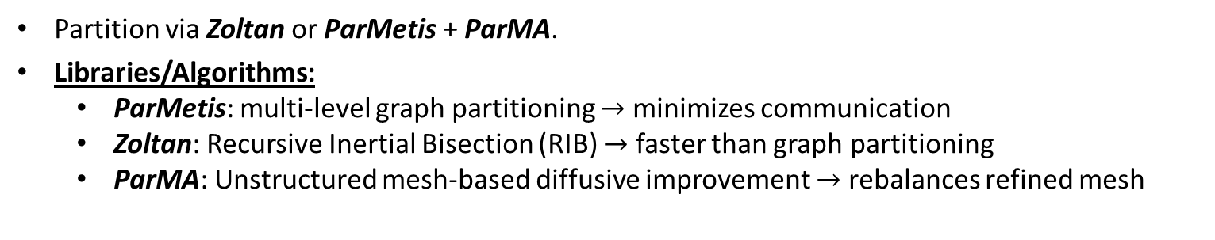
Dynamic Load Balancing
In each box below
Left: Initial ParMetis/Zoltan partition
Right: ParMA partition
Partition via Zoltan or ParMetis + ParMA.
Libraries/Algorithms:
  ParMetis: multi-level graph partitioning $→$ minimizes communication
  Zoltan: Recursive Inertial Bisection (RIB) $→$ faster than graph partitioning
  ParMA: Unstructured mesh-based diffusive improvement $→$ rebalances refined mesh
ParMetis (left) + ParMA (right)
Zoltan (left) + ParMA (right)
Notes:
To ask: what is difference in partition? What does ParMA do with initial mesh partition?

Slide 22

Mesh Generation/Adaptation Algorithm
offline
PAALS = Parallel Albany Adaptive Loop with SCOREC
  Step 1: determine geometry and generate initial tetrahedral mesh (e.g., using Triangle or Simmetrix).
  Step 2: 2D slice of initial mesh adaptively refined in-memory via PAALS based on gradient of velocity in Albany.
  Step 3: 3D mesh obtained by extruding 2D mesh vertically as prisms or tetrahedra in Albany.
online

Slide 23
Mesh Generation/Adaptation Algorithm
offline
PAALS = Parallel Albany Adaptive Loop with SCOREC
  Step 1: determine geometry and generate initial tetrahedral mesh (e.g., using Triangle or Simmetrix).
  Step 2: 2D slice of initial mesh adaptively refined in-memory via PAALS based on gradient of velocity in Albany.
  Step 3: 3D mesh obtained by extruding 2D mesh vertically as prisms or tetrahedra in Albany.
Discussion:
online

Slide 24
Mesh Generation/Adaptation Algorithm
offline
PAALS = Parallel Albany Adaptive Loop with SCOREC
  Step 1: determine geometry and generate initial tetrahedral mesh (e.g., using Triangle or Simmetrix).
  Step 2: 2D slice of initial mesh adaptively refined in-memory via PAALS based on gradient of velocity in Albany.
  Step 3: 3D mesh obtained by extruding 2D mesh vertically as prisms or tetrahedra in Albany.
Discussion:
  PAALS adaptive loop driven by homotopy continuation using LOCA package in Trilinos.
online

Slide 25
Mesh Generation/Adaptation Algorithm
offline
PAALS = Parallel Albany Adaptive Loop with SCOREC
  Step 1: determine geometry and generate initial tetrahedral mesh (e.g., using Triangle or Simmetrix).
  Step 2: 2D slice of initial mesh adaptively refined in-memory via PAALS based on gradient of velocity in Albany.
  Step 3: 3D mesh obtained by extruding 2D mesh vertically as prisms or tetrahedra in Albany.
Discussion:
  PAALS adaptive loop driven by homotopy continuation using LOCA package in Trilinos.
  Currently adaptation is done in stand-alone Albany.
online

Slide 26
Mesh Generation/Adaptation Algorithm
offline
PAALS = Parallel Albany Adaptive Loop with SCOREC
  Step 1: determine geometry and generate initial tetrahedral mesh (e.g., using Triangle or Simmetrix).
  Step 2: 2D slice of initial mesh adaptively refined in-memory via PAALS based on gradient of velocity in Albany.
  Step 3: 3D mesh obtained by extruding 2D mesh vertically as prisms or tetrahedra in Albany.
Discussion:
  PAALS adaptive loop driven by homotopy continuation using LOCA package in Trilinos.
  Currently adaptation is done in stand-alone Albany.
  Future work: integrating adaptation into dynamical cores (MPAS-Albany).
online

Slide 27
Outline
1. Ice Sheet Equations and Codes.
2. Mesh Adaptivity.
3. Scalability.
4. Performance Portability.
5. Validation.
6. Summary and Future Work.
Steps towards creating a production-ready code

Slide 28
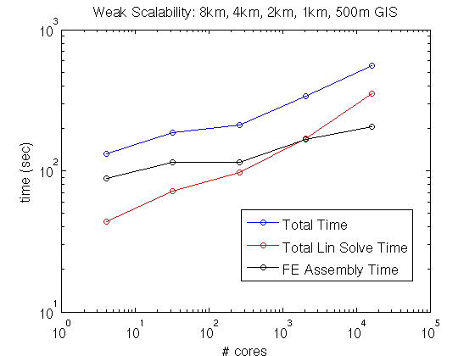
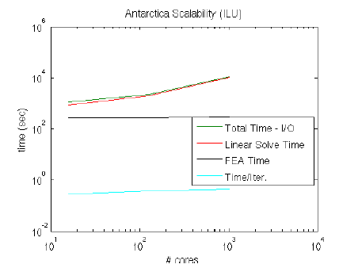
Initial Weak Scalability Study Using ILU
Greenland Ice Sheet
Antarctic Ice Sheet

Slide 29
Initial Weak Scalability Study Using ILU
Greenland Ice Sheet
Antarctic Ice Sheet
Scalability results are not acceptable!

Slide 30
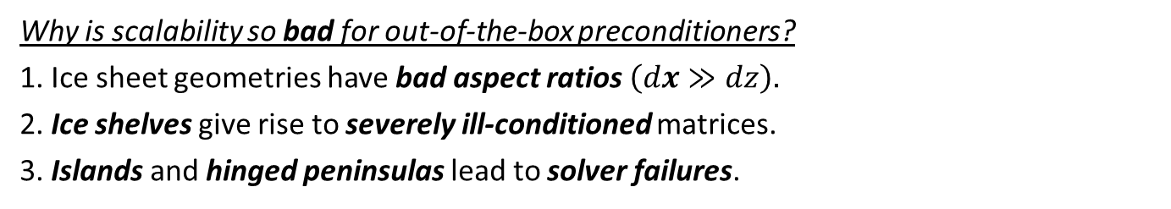
Initial Weak Scalability Study Using ILU
Greenland Ice Sheet
Antarctic Ice Sheet
Scalability results are not acceptable!
Why is scalability so bad for out-of-the-box preconditioners?
1. Ice sheet geometries have bad aspect ratios $\left(dx≫dz\right).$
2. Ice shelves give rise to severely ill-conditioned matrices.
3. Islands and hinged peninsulas lead to solver failures.

Slide 31
Initial Weak Scalability Study Using ILU
Greenland Ice Sheet
Antarctic Ice Sheet
Scalability results are not acceptable!
We mitigate these difficulties through the development of:
New AMG preconditioner based on semi-coarsening.
Island/hinge removal algorithm.
Why is scalability so bad for out-of-the-box preconditioners?
1. Ice sheet geometries have bad aspect ratios $\left(dx≫dz\right).$
2. Ice shelves give rise to severely ill-conditioned matrices.
3. Islands and hinged peninsulas lead to solver failures.

Slide 32

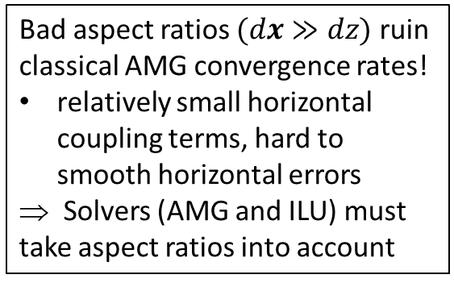
Scalability via Algebraic Multi-Grid
Preconditioning with Semi-Coarsening
Bad aspect ratios $(dx≫dz)$ ruin classical AMG convergence rates!
relatively small horizontal coupling terms, hard to smooth horizontal errors
⇒ Solvers (AMG and ILU) must take aspect ratios into account
Algebraic Structured MG
Algebraic Structured MG
We developed a new AMG solver based on aggressive semi-coarsening (available in ML/MueLu packages of Trilinos)
Unstructured AMG
See (Tezaur et al., 2015),
(Tuminaro et al., 2016).
Scaling studies (next slides):
New AMG preconditioner vs. ILU

Slide 33
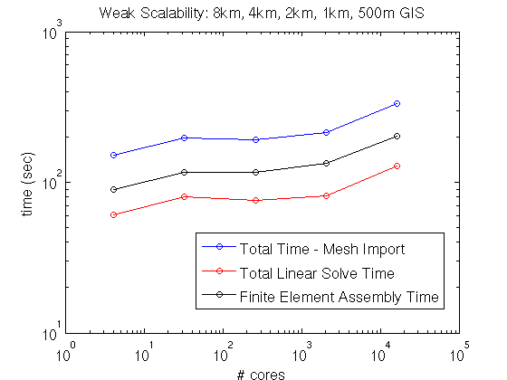

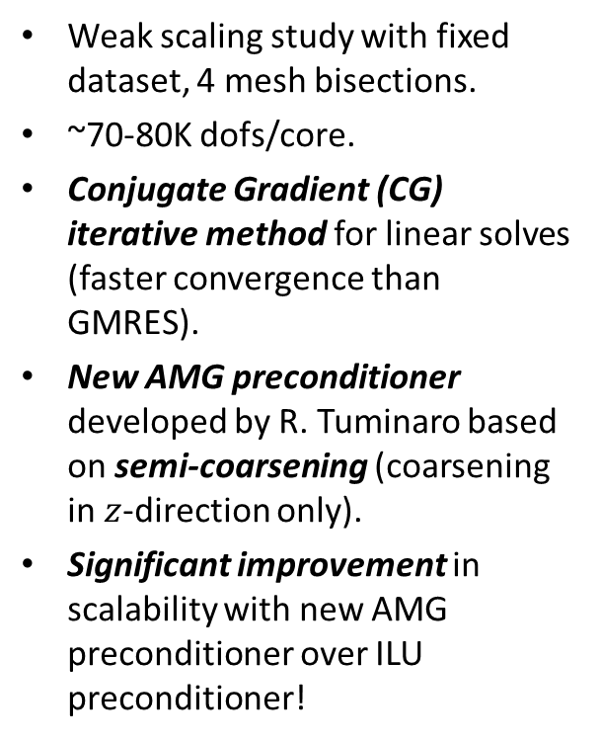
Greenland Controlled Weak Scalability Study
Weak scaling study with fixed dataset, 4 mesh bisections.
~70-80K dofs/core.
Conjugate Gradient (CG) iterative method for linear solves (faster convergence than GMRES).
New AMG preconditioner developed by R. Tuminaro based on semi-coarsening (coarsening in $z$-direction only).
Significant improvement in scalability with new AMG preconditioner over ILU preconditioner!
4 cores
334K dofs
8 km Greenland,
5 vertical layers
16,384 cores
1.12B dofs(!)
0.5 km Greenland,
80 vertical layers
$×84$
scale up

Slide 34
Greenland Controlled Weak Scalability Study
New AMG preconditioner preconditioner
ILU preconditioner
Weak scaling study with fixed dataset, 4 mesh bisections.
~70-80K dofs/core.
Conjugate Gradient (CG) iterative method for linear solves (faster convergence than GMRES).
New AMG preconditioner developed by R. Tuminaro based on semi-coarsening (coarsening in $z$-direction only).
Significant improvement in scalability with new AMG preconditioner over ILU preconditioner!
4 cores
334K dofs
8 km Greenland,
5 vertical layers
16,384 cores
1.12B dofs(!)
0.5 km Greenland,
80 vertical layers
$×84$
scale up

Slide 35
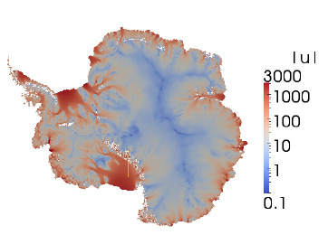
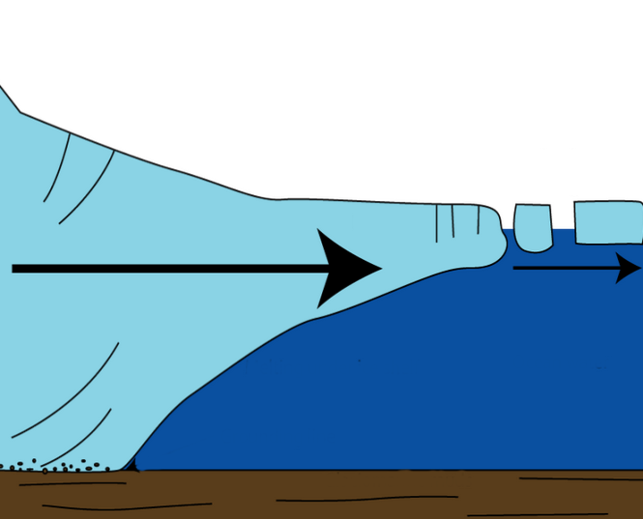
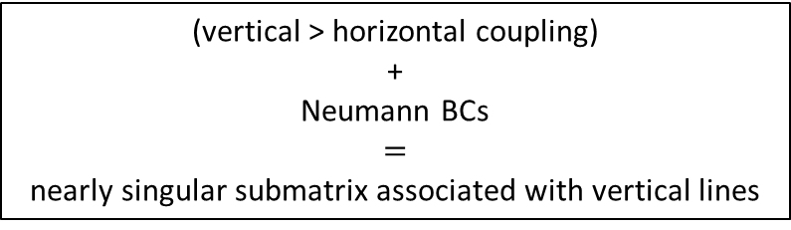


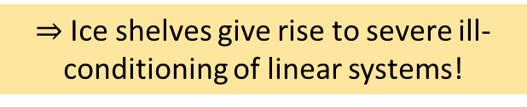

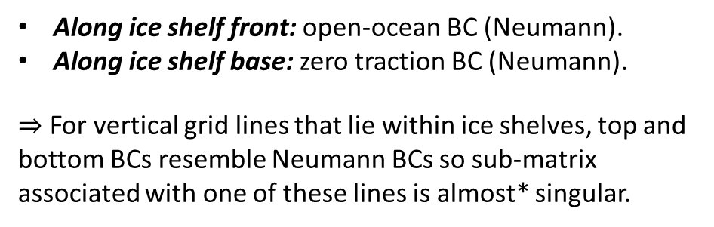
Moderate Resolution Antarctica Weak Scaling Study
Antarctica is fundamentally different than Greenland:
AIS contains large ice shelves (floating extensions of land ice).
Along ice shelf front: open-ocean BC (Neumann).
Along ice shelf base: zero traction BC (Neumann).
$⇒$ For vertical grid lines that lie within ice shelves, top and bottom BCs resemble Neumann BCs so sub-matrix associated with one of these lines is almost* singular.
  Surface boundary $Γs$
Ice sheet
(vertical > horizontal coupling)
+
Neumann BCs
$=$
nearly singular submatrix associated with vertical lines
Albany/FELIX
Glimmer/CISM
Lateral boundary $Γl$
  Basal boundary $Γβ$
)
$⇒$Ice shelves give rise to severe ill-conditioning of linear systems!
*Completely singular in the presence of islands and some ice tongues.
Notes:
- AMG: Gauss-Seidel smoothing on finest level (where lines are defined in mesh extruded direction), Chebyshev smoothing on coarser levels.
- ILU: ordering is important to maintain acceptable convergence rates (need row-wise ordering)!
- GMRES less sensitive than CG to rounding errors associated w/ severe ill-conditioning introduced by presence of ice shelves.
- CG and GMRES minimize different norms.
- Floating ice shelves: matrix entries corresponding to vertical coupling are much stronger than entries corresponding to horizontal coupling. Vertical grid lines lie within ice shelves, top/bottom BCs resemble Neumann conditions and so the submatrix associated with the vertical lines is nearly singular. Ill-conditioning creates challenges for solver.

Slide 36
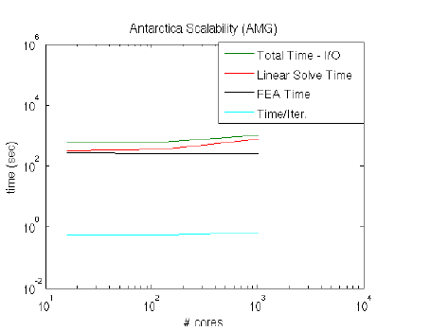
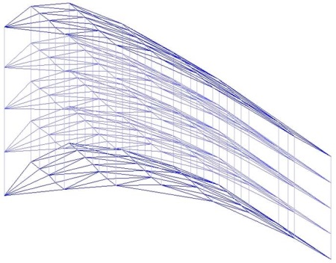
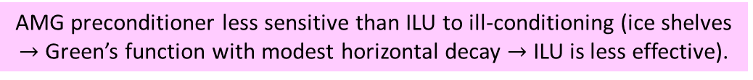
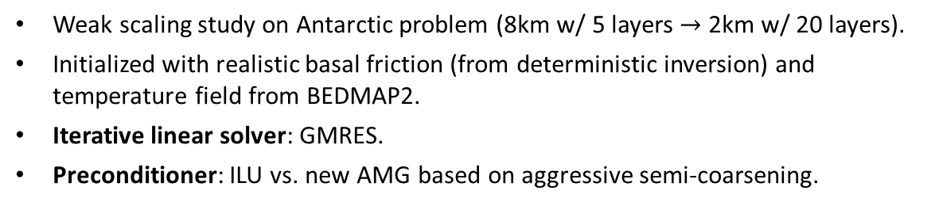
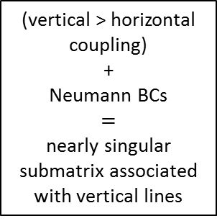
Moderate Resolution Antarctica Weak Scaling Study
Weak scaling study on Antarctic problem (8km w/ 5 layers $→$ 2km w/ 20 layers).
Initialized with realistic basal friction (from deterministic inversion) and temperature field from BEDMAP2.
Iterative linear solver: GMRES.
Preconditioner: ILU vs. new AMG based on aggressive semi-coarsening.
ILU
Severe ill-conditioning caused by ice shelves!
AMG
Albany/FELIX
Glimmer/CISM
AMG preconditioner
(vertical > horizontal coupling)
+
Neumann BCs
$=$
nearly singular submatrix associated with vertical lines
16 cores
1024 cores
16 cores
1024 cores
# cores
# cores
AMG preconditioner less sensitive than ILU to ill-conditioning (ice shelves $→$ Green’s function with modest horizontal decay $→$ ILU is less effective).
Notes:
- AMG: Gauss-Seidel smoothing on finest level (where lines are defined in mesh extruded direction), Chebyshev smoothing on coarser levels.
- ILU: ordering is important to maintain acceptable convergence rates (need row-wise ordering)!
- GMRES less sensitive than CG to rounding errors associated w/ severe ill-conditioning introduced by presence of ice shelves.
- CG and GMRES minimize different norms.
- Floating ice shelves: matrix entries corresponding to vertical coupling are much stronger than entries corresponding to horizontal coupling. Vertical grid lines lie within ice shelves, top/bottom BCs resemble Neumann conditions and so the submatrix associated with the vertical lines is nearly singular. Ill-conditioning creates challenges for solver.

Slide 37
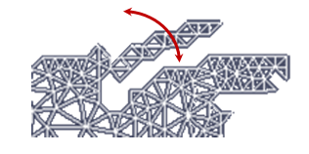
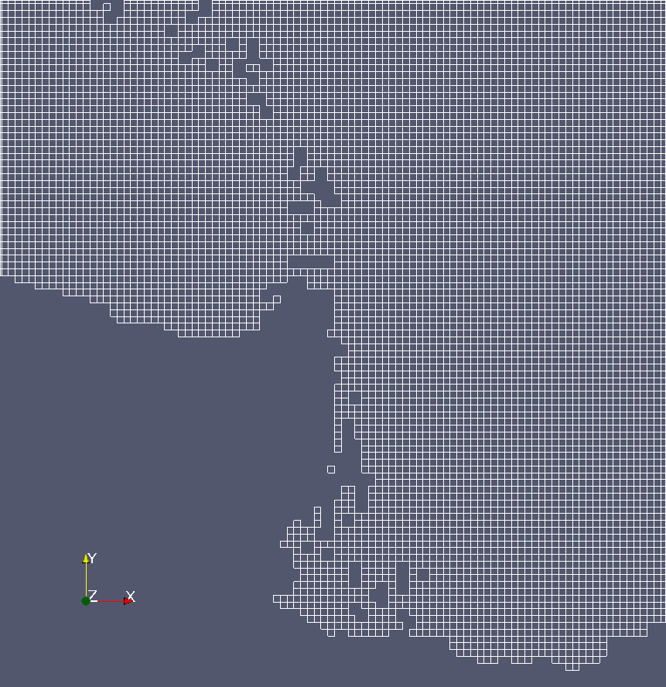
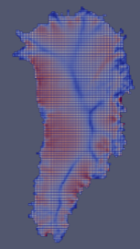
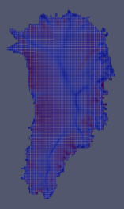
Improved Linear Solver Performance through Removal of Hinged Peninsulas
Islands and certain hinged peninsulas lead to solver failures
We have developed an algorithm to detect/remove problematic hinged peninsulas & islands based on coloring and repeated use of connected component algorithms (Tuminaro et al., 2016).
Solves are ~2x faster with hinges removed.
Current implementation is MATLAB, but working on C++ implementation for integration into dycores.
Greenland Problem
Resolu-tion | ILU – hinges | ILU – no hinges | ML – hinges | ML – no hinges
8km/5 layers | 878 sec, 84 iter/solve | 693 sec, 71 iter/solve | 254 sec, 11 iter/solve | 220 sec, 9 iter/solve
4km/10 layers | 1953 sec, 160 iter/solve | 1969 sec, 160 iter/solve | 285 sec, 13 iter/solve | 245 sec, 12 iter/solve
2km/20 layers | 10942 sec, 710 iter/solve | 5576 sec, 426 iter/solve | 482 sec, 24 iter/solve | 294 sec, 15 iter/solve
1km/40 layers | -- | 15716 sec, 881 iter/solve | 668 sec, 34 iter/solve | 378 sec, 20 iter/solve

Slide 38
Outline
1. Ice Sheet Equations and Codes.
2. Mesh Adaptivity.
3. Scalability.
4. Performance Portability.
5. Validation.
6. Summary and Future Work.
Steps towards creating a production-ready code

Slide 39


Performance-Portability via Kokkos
We need to be able to run Albany/FELIX on new architecture machines (hybrid systems) and manycore devices (multi-core CPU, NVIDIA GPU, Intel Xeon Phi, etc.) .
*.

Slide 40
Performance-Portability via Kokkos
We need to be able to run Albany/FELIX on new architecture machines (hybrid systems) and manycore devices (multi-core CPU, NVIDIA GPU, Intel Xeon Phi, etc.) .
MPI (task parallelism) + X* (thread + data-level parallelism)
*X = OpenMP, CUDA, etc.

Slide 41
Performance-Portability via Kokkos
We need to be able to run Albany/FELIX on new architecture machines (hybrid systems) and manycore devices (multi-core CPU, NVIDIA GPU, Intel Xeon Phi, etc.) .
MPI (task parallelism) + X* (thread + data-level parallelism)
Kokkos: open-source library that provides performance portability across diverse devises with different memory models.
  A programming model as much as a software library.
  Provides automatic access to OpenMP, CUDA, Pthreads, ...
  Templated meta-programming: parallel_for, parallel_reduce (templated on an execution space).
  Memory layout abstraction (“array of structs” vs. “struct of arrays”, locality).
With Kokkos, you write an algorithm once, and just change a template parameter to get the optimal data layout for your hardware (e.g., (i,j,k) vs. (k,i,j).
*X = OpenMP, CUDA, etc.

Slide 42
Performance-Portability via Kokkos
We need to be able to run Albany/FELIX on new architecture machines (hybrid systems) and manycore devices (multi-core CPU, NVIDIA GPU, Intel Xeon Phi, etc.) .
MPI (task parallelism) + X* (thread + data-level parallelism)
Kokkos: open-source library that provides performance portability across diverse devises with different memory models.
  A programming model as much as a software library.
  Provides automatic access to OpenMP, CUDA, Pthreads, ...
  Templated meta-programming: parallel_for, parallel_reduce (templated on an execution space).
  Memory layout abstraction (“array of structs” vs. “struct of arrays”, locality).
With Kokkos, you write an algorithm once, and just change a template parameter to get the optimal data layout for your hardware (e.g., (i,j,k) vs. (k,i,j).
Finite element assembly in Albany has recently been rewritten using Kokkos functors.
*X = OpenMP, CUDA, etc.

Slide 43
Performance-Portability via Kokkos
We need to be able to run Albany/FELIX on new architecture machines (hybrid systems) and manycore devices (multi-core CPU, NVIDIA GPU, Intel Xeon Phi, etc.) .
MPI (task parallelism) + X* (thread + data-level parallelism)
Kokkos: open-source library that provides performance portability across diverse devises with different memory models.
  A programming model as much as a software library.
  Provides automatic access to OpenMP, CUDA, Pthreads, ...
  Templated meta-programming: parallel_for, parallel_reduce (templated on an execution space).
  Memory layout abstraction (“array of structs” vs. “struct of arrays”, locality).
With Kokkos, you write an algorithm once, and just change a template parameter to get the optimal data layout for your hardware (e.g., (i,j,k) vs. (k,i,j).
Finite element assembly in Albany has recently been rewritten using Kokkos functors.
Linear solvers in Belos package of Trilinos can run on next-generation platforms with simple preconditioners (Jacobi, Gauss-Seidel, Chebyshev, ILU).
*X = OpenMP, CUDA, etc.

Slide 44
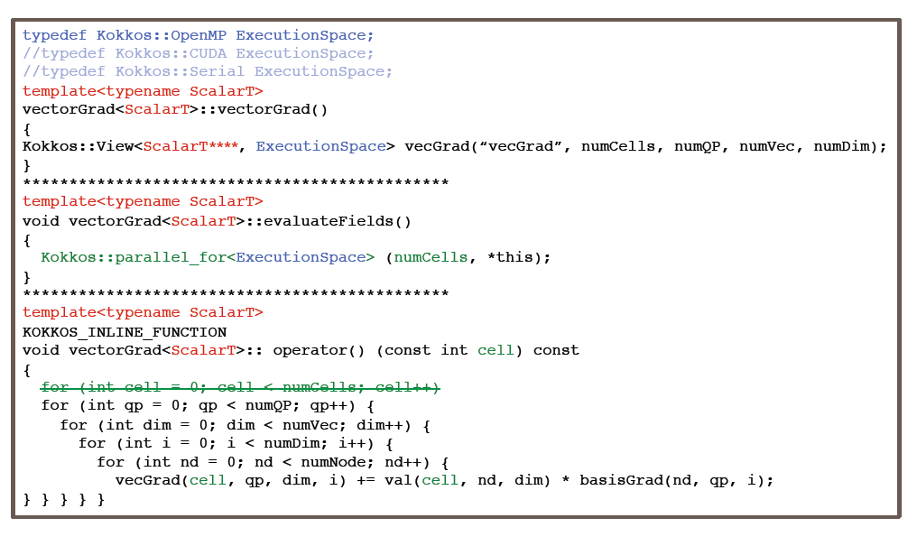
Kokkos-ification of Finite Element Assembly
ExecutionSpace parameter tailors code for device (e.g., OpenMP, CUDA, etc.)

Slide 45
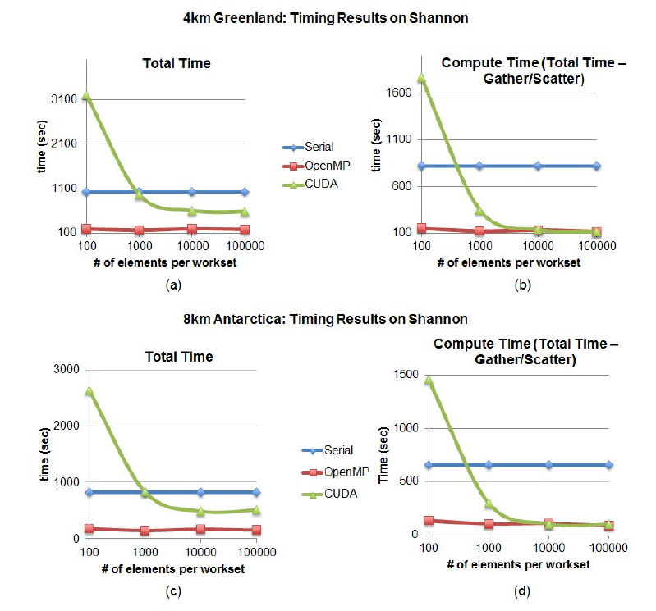

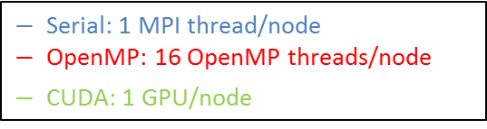
Results on Shannon: 4km Greenland
& 8km Antarctica Problems
Shannon: 32 nodes
2 8-core Sandy Bridge Xeon E5-2670 @ 2.6GHz (HT deactivated)/node.
128GB DDR3 memory/node
2x NVIDIA K20x/node.
4km Greenland
Total Time
Compute Time
$−$ Serial: 1 MPI thread/node
$−$OpenMP: 16 OpenMP threads/node
$−$CUDA: 1 GPU/node
8km Antarctica
Total Time
Compute Time
Max speedup over Serial for workset size > 1000
 | OpenMP | CUDA
Total Time | 5.6x | 1.7x
Compute Time | 7.2x | 6.7x
  “# of elements/workset” = threading index (allows for on-node parallelism)

Slide 46
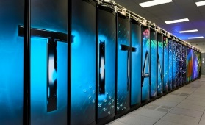

Results on Titan: Weak Scalability for Greenland (8km, 4km, 2km, 1km)
Total Time
Compute Time (Total Time – Gather/Scatter)
CUDA implementation is slower than MPI-only for total time but faster for compute time (due to communication costs).
Filling the matrix requires use of atomics, which are difficult to optimize (work in progress by Kokkos team).
Work is distributed more thinly on Titan than on Shannon $→$ worse for GPU (less work, more communications).
Titan: 18,688 AMD Opteron nodes
16 cores per node
1 K20X Kepler GPUs per node
32GB + 6GB memory per node

Slide 47
Outline
1. Ice Sheet Equations and Codes.
2. Mesh Adaptivity.
3. Scalability.
4. Performance Portability.
5. Validation.
6. Summary and Future Work.
Steps towards creating a production-ready code

Slide 48
Validation: Definition & Workflow
Validation*: how well does our model represent the real ice sheet?
*vs. verification: is our code bug free? (some of my past SIAM talks on PISCEES)

Slide 49
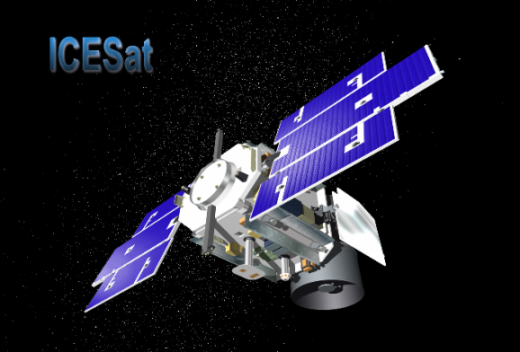
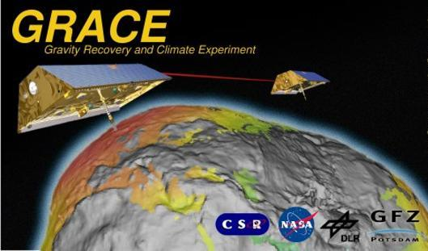
Validation: Definition & Workflow
Validation*: how well does our model represent the real ice sheet?
There are currently (up to) 2 decades of large-scale satellite observations of Greenland ice sheet geometry change:
ICESat1 | 2003 – 2009
GRACE | 2002 – 201? (ongoing)
*vs. verification: is our code bug free? (some of my past SIAM talks on PISCEES)

Slide 50
Validation: Definition & Workflow
Validation*: how well does our model represent the real ice sheet?
There are currently (up to) 2 decades of large-scale satellite observations of Greenland ice sheet geometry change:
Future missions will extend these observational time series:
ICESat1 | 2003 – 2009
GRACE | 2002 – 201? (ongoing)
ICESat1 | 2017-20??
GRACE “follow-on” | 2017-20??
GRACE2 | 2020s-?
*vs. verification: is our code bug free? (some of my past SIAM talks on PISCEES)

Slide 51
Validation: Definition & Workflow
Validation*: how well does our model represent the real ice sheet?
There are currently (up to) 2 decades of large-scale satellite observations of Greenland ice sheet geometry change:
Future missions will extend these observational time series:
ICESat1 | 2003 – 2009
GRACE | 2002 – 201? (ongoing)
ICESat1 | 2017-20??
GRACE “follow-on” | 2017-20??
GRACE2 | 2020s-?
Validation Workflow:
Run ice sheet model over period where ICESat/GRACE observations exist.
Process model output for comparison to these observations.
Process observations for comparison to model output.
Evaluate model performance relative to observations.
  ICESat: ice sheet surface elevation [state comparison]
  GRACE: rate of mass change [trend comparison]
*vs. verification: is our code bug free? (some of my past SIAM talks on PISCEES)

Slide 52
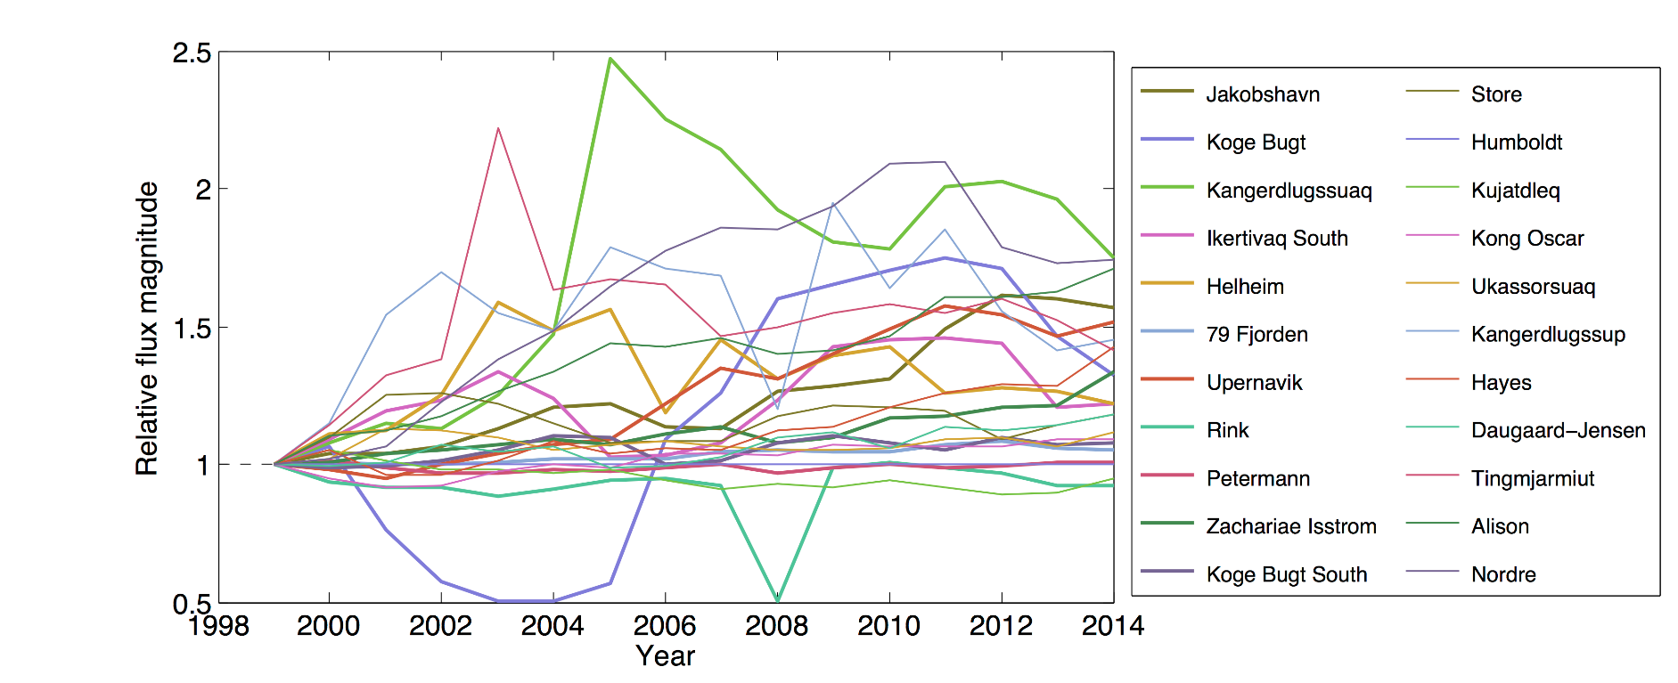
Validation: Observations & Forcing
Validation time period:
  ICESat: 2003-2009
  GRACE: 2003-2011 (CSR Release-05)
Model forcing: the following datasets taken as “truth”
  Monthly surface mass balance (SMB) from RACMO2¹ anomalies applied (1960-present)
    Well-validated over Greenland
  Mean-annual outlet glacier flux² applied at grounding line (1990-present)
    Figure below: outlet glacier flux forcing (FF) time series
Code: CISM-Albany (CISM2.0 + Albany/FELIX)
¹ van Angelen et al. (Surv. Geophys., 2013) ² Enderlin et al. (GRL, 2014)

Slide 53
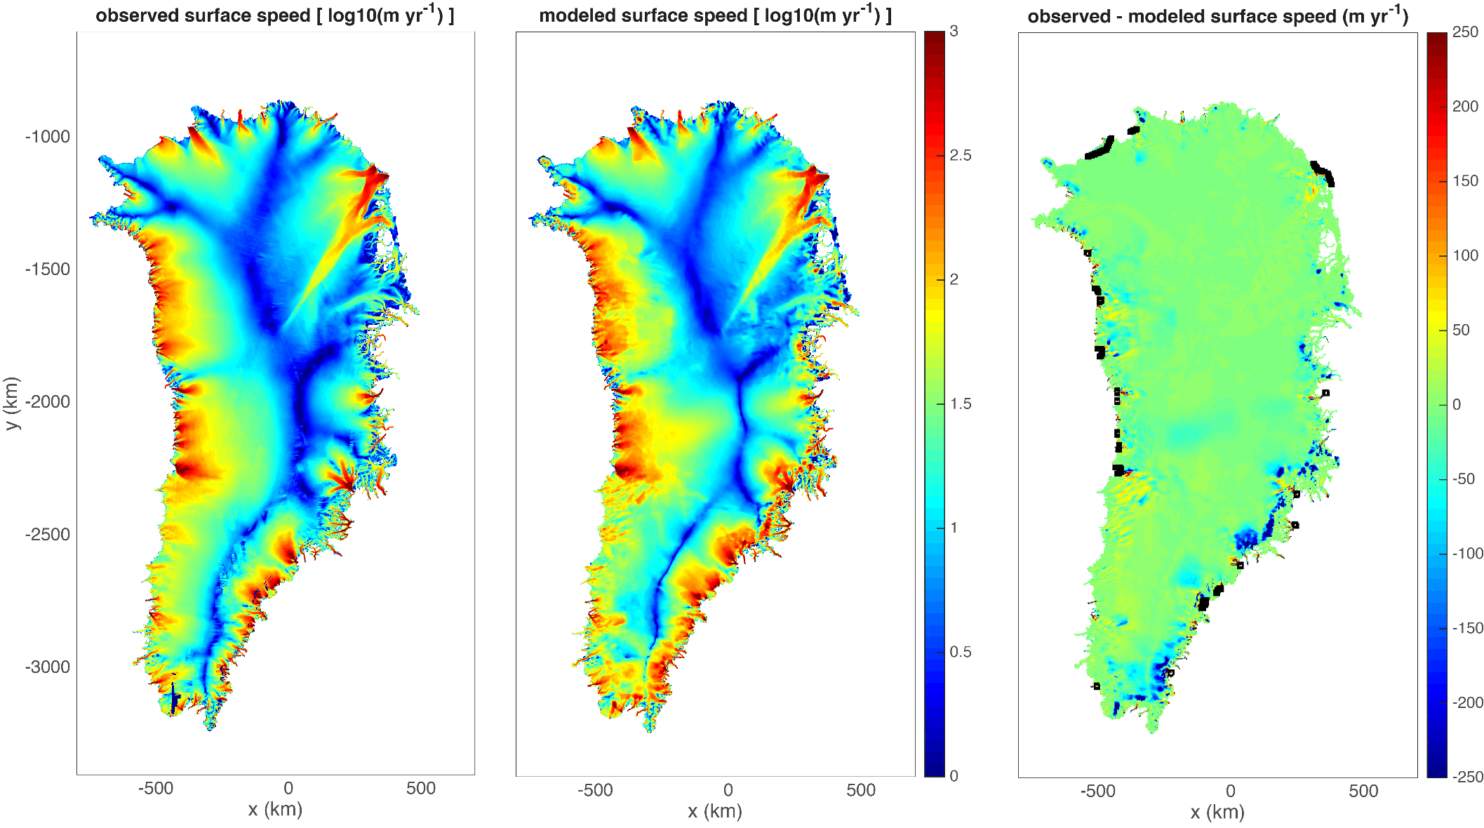
Validation: 1km GIS initial condition*
*Initial condition obtained through deterministic inversion; see talk by M. Perego.

Slide 54
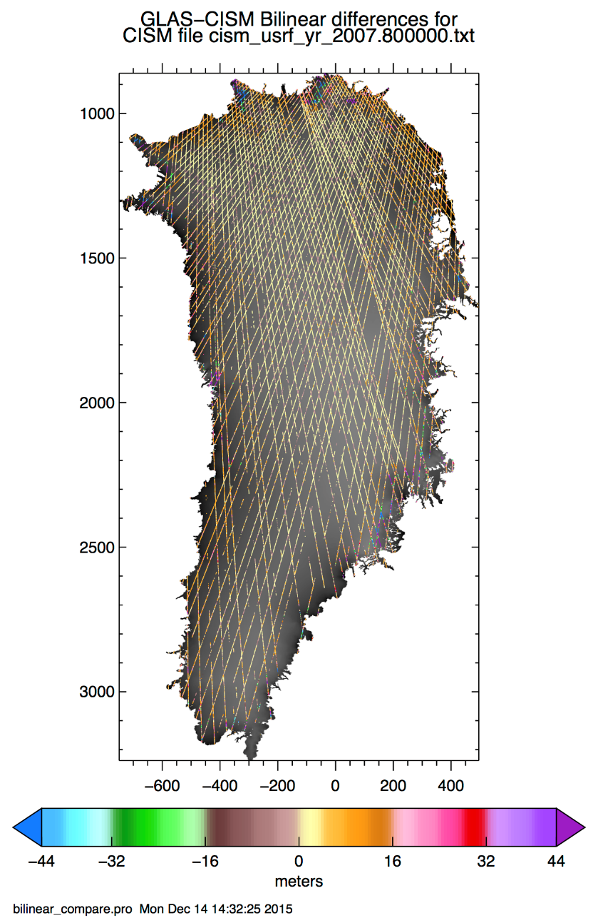
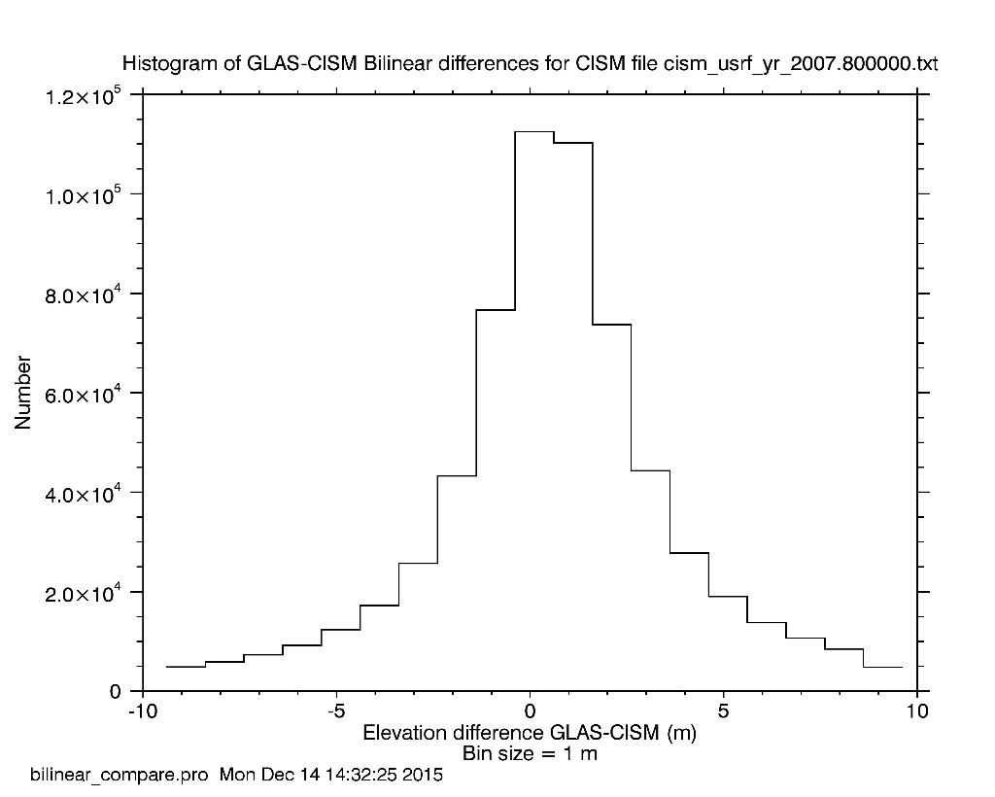
Validation: Surface Elevation Observations
Model evaluated: CISM-Albany with SMB + FF in October 2007.
Surface elevation predictions (states) agree pretty well with GLAS (Geoscience Laser Altimeter System aboard ICESat): mean differences are <1 m

Slide 55
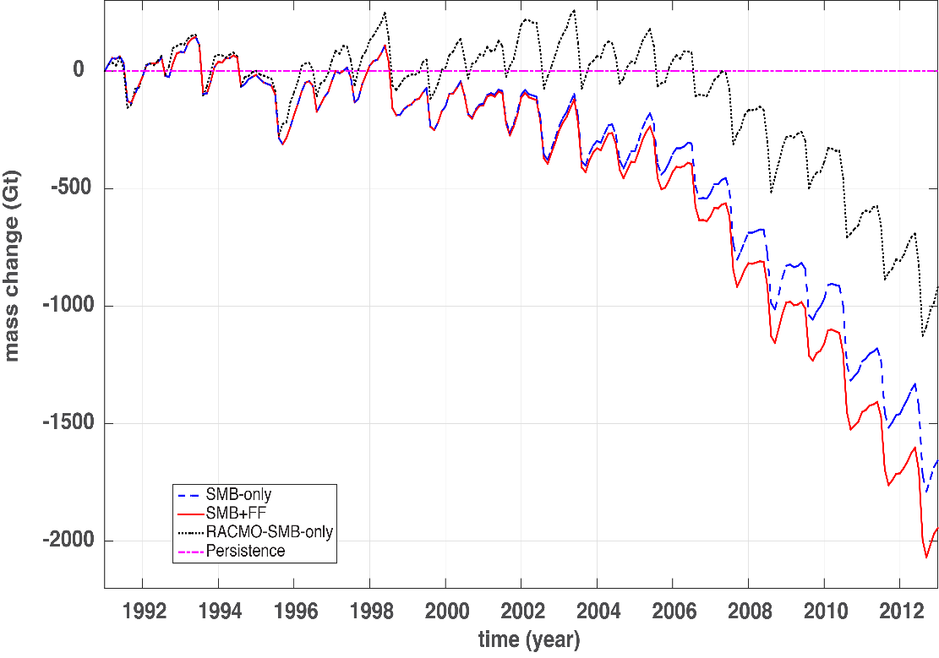
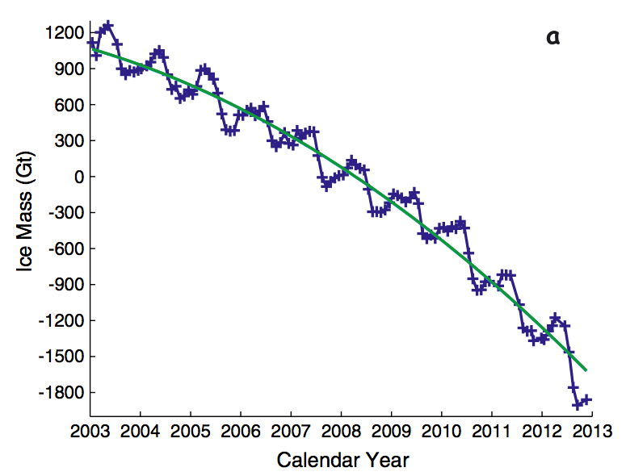
Validation: Whole Ice Sheet Mass Trends
Ice Sheet Model Predictions
GRACE Observations at Sub-Annual Scale³
Persistence¹
RACMO2 SMB-only²
SMB-only
SMB + FF
³Velicogna and Wahr, Geophys. Res. Lett., 40, 2013
Overall mass trends from the CISM-Albany simulations look fairly realistic (left figure, red & blue)
CISM-Albany trends look more realistic (closer to observations; right figure) than the “idealized” simulations (left figure, pink & black).
There is more mass loss from the simulation when we account for changes in outlet glacier flux (i.e., the evolution of the ice sheet is not only forced by surface mass balance changes, but also be changes in outlet glacier dynamics).
¹Geometry held constant in time. ²RACMO2 SMB time series applied to dh/dt; includes SS “discharge” using 1960-1990 mean SMB.

Slide 56
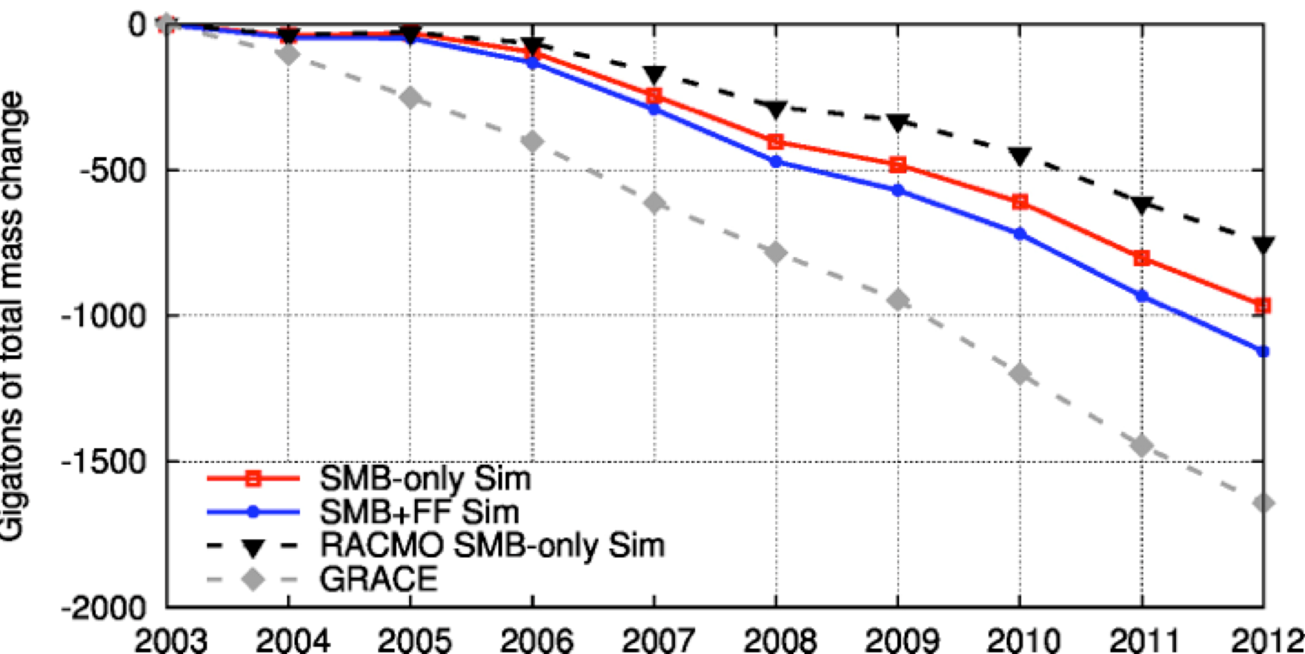
Validation: Whole Ice Sheet Mass Trends
Apples-to-apples comparison between models and GRACE:
  Information is all on the same plot.
  Model output and observations were both processed in the same way.

Slide 57
Validation Takeaways
Current generation ice sheet models, when appropriately forced, show skill at mimicking ice sheet observations

Slide 58
Validation Takeaways
Current generation ice sheet models, when appropriately forced, show skill at mimicking ice sheet observations
  Clear improvement over a decade ago: SLR projections from ice sheet models were not included in the IPCC’s AR4 b/c models could not explain observed ice dynamical behaviors.

Slide 59
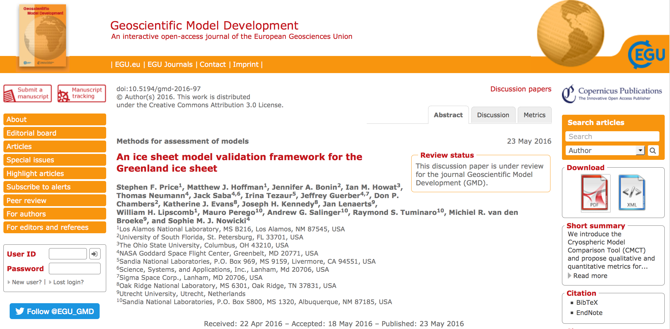
Validation Takeaways
Current generation ice sheet models, when appropriately forced, show skill at mimicking ice sheet observations
  Clear improvement over a decade ago: SLR projections from ice sheet models were not included in the IPCC’s AR4 b/c models could not explain observed ice dynamical behaviors.
For more details on validation study, see our GMD paper, currently under review.

Slide 60
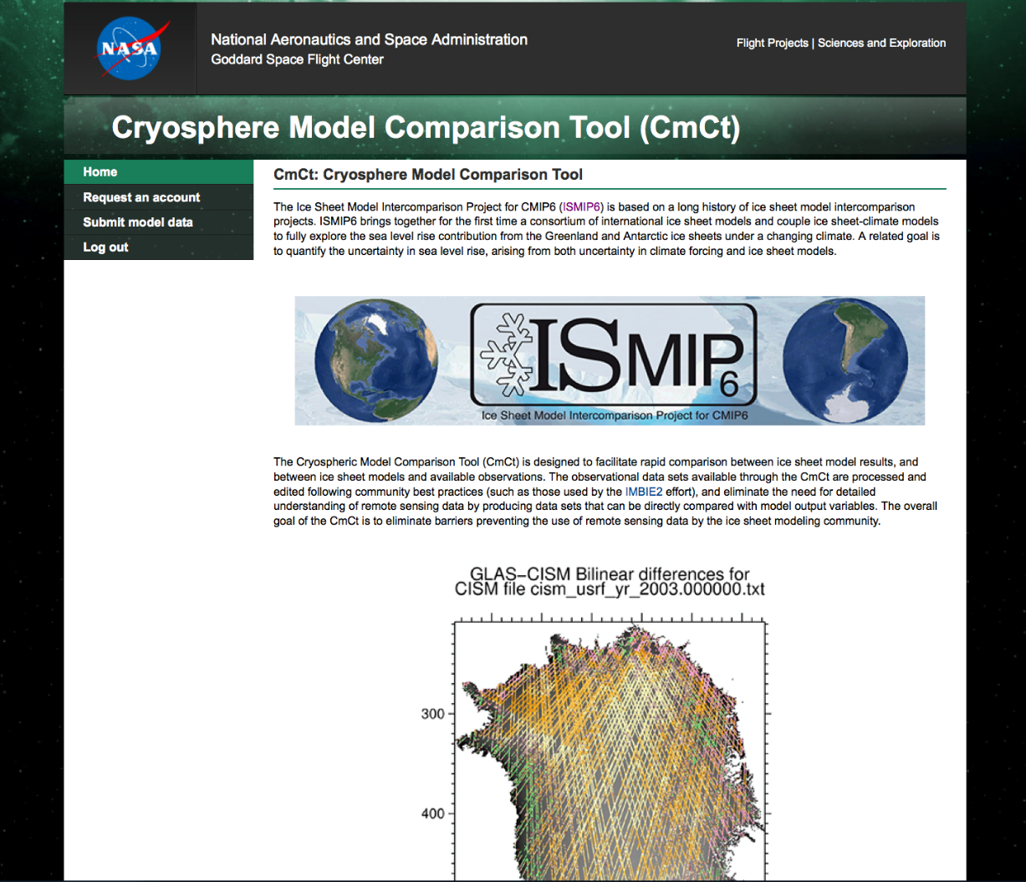
Cryospheric Model Comparison Tool (CmCt)
Validation work involved development of new ice sheet model validation framework – the Cryospheric Model Comparison Tool (CmCt) – which includes proposed qualitative and quantitative metrics for use in comparing models to observations.
CmCt is online and ready for testing by community
https://ggsghpcc.sgt-inc.com/cmct/

Slide 61
Outline
1. Ice Sheet Equations and Codes.
2. Mesh Adaptivity.
3. Scalability.
4. Performance Portability.
5. Validation.
6. Summary and Future Work.
Steps towards creating a production-ready code

Slide 62

Summary and Future Work
Summary:
We have developed a land-ice solver known as Albany/FELIX using Trilinos libraries.
This solver is:
  Equipped with in-memory parallel unstructured mesh adaption.
  Scalable, fast, robust.
  Coupled to CISM and MPAS codes for dynamic runs and integration into ESMs.
  Verified and validated.
  Portable to new and emerging architecture machines.
  Equipped with advanced analysis capabilities (deterministic inversion, UQ).
Ongoing/future work:
Mesh adaptivity for transient runs.
Integration of hinge removal algorithm into transient runs.
Science runs using CISM-Albany and MPAS-Albany.
Code optimizations for new architecture machines (GPUs, multi-core, many-core).
Uncertainty quantification (not covered in this talk).
Delivering code to climate community and coupling to ESMs.

Slide 63
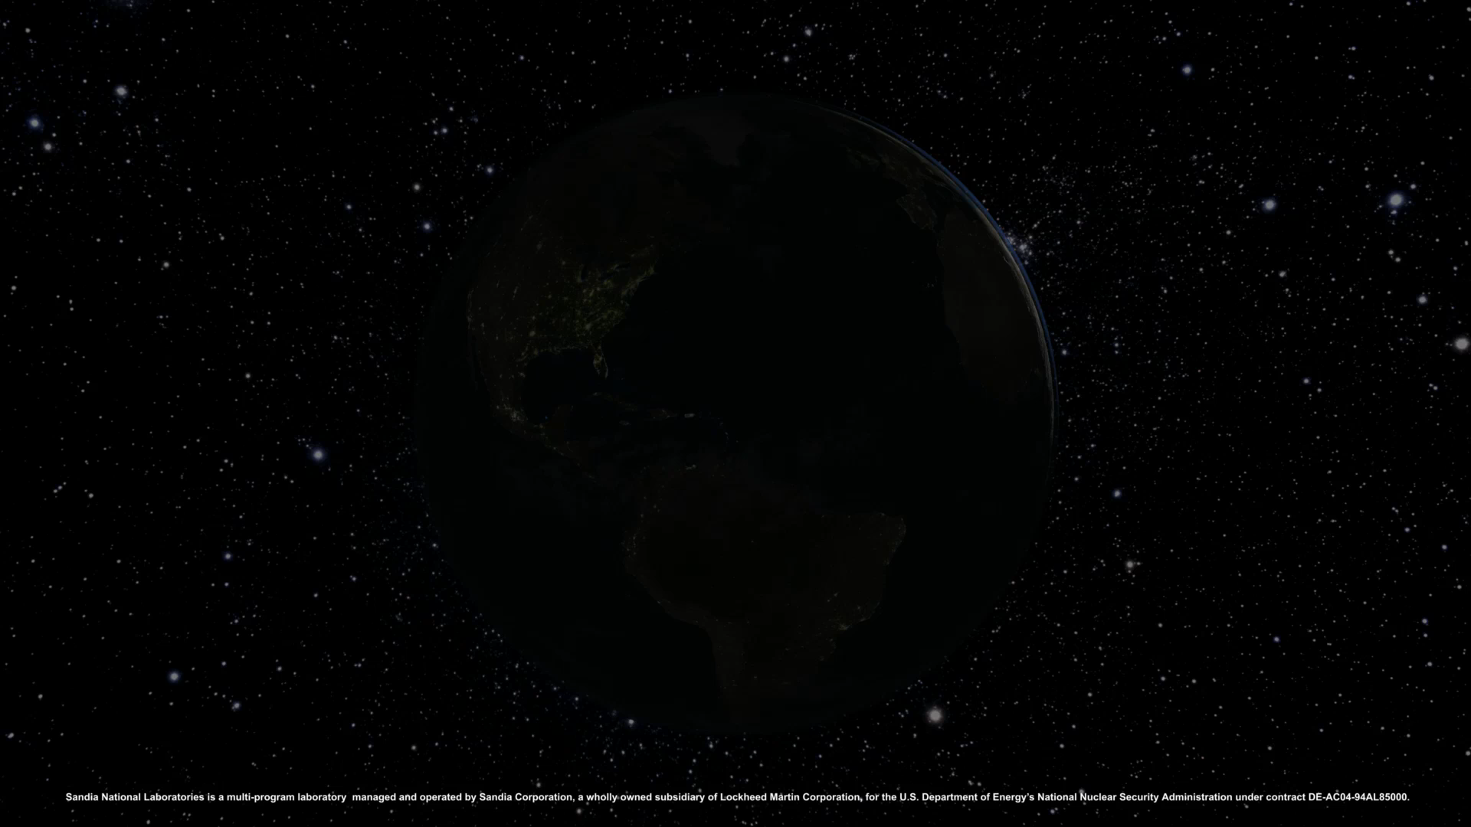
Thank you! Questions?
Video acknowledgement: B. Carvey (SNL)

Slide 64









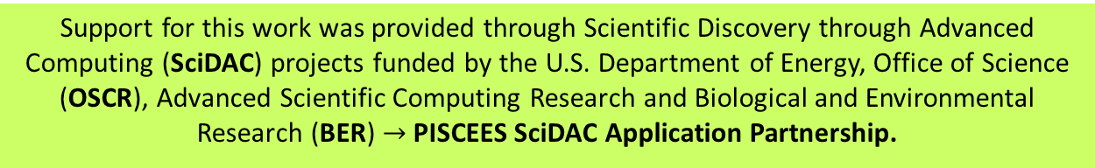
Funding/Acknowledgements
Support for this work was provided through Scientific Discovery through Advanced Computing (SciDAC) projects funded by the U.S. Department of Energy, Office of Science (OSCR), Advanced Scientific Computing Research and Biological and Environmental Research (BER) $→$PISCEES SciDAC Application Partnership.
PISCEES team members: K. Evans, M. Gunzburger, M. Hoffman, C. Jackson, P. Jones, W. Lipscomb, M. Perego, S. Price, A. Salinger, I. Tezaur, R. Tuminaro, P. Worley.
Trilinos/DAKOTA collaborators: M. Eldred, J. Jakeman, E. Phipps, L. Swiler.
  Computing resources: NERSC, OLCF.

Slide 65
References
[1] M.A. Heroux et al. “An overview of the Trilinos project.” ACM Trans. Math. Softw. 31(3) (2005).
[2] A. Salinger, et al. "Albany: Using Agile Components to Develop a Flexible, Generic Multiphysics Analysis Code", accepted for publication in Int. J. Multiscale Comput. Engng.
[3] I. Tezaur, M. Perego, A. Salinger, R. Tuminaro, S. Price. "Albany/FELIX: A Parallel, Scalable and Robust Finite Element Higher-Order Stokes Ice Sheet Solver Built for Advanced Analysis", Geosci. Model Develop. 8 (2015) 1-24.
[4] I. Tezaur, R. Tuminaro, M. Perego, A. Salinger, S. Price. "On the scalability of the Albany/FELIX first-order Stokes approximation ice sheet solver for large-scale simulations of the Greenland and Antarctic ice sheets", MSESM/ICCS15, Reykjavik, Iceland (June 2014).
[5] R.S. Tuminaro, I. Tezaur, M. Perego, A.G. Salinger. "A Hybrid Operator Dependent Multi-Grid/Algebraic Multi-Grid Approach: Application to Ice Sheet Modeling", SIAM J. Sci. Comput. (in press).
[6] S. Price, M. Hoffman, J. Bonin, T. Neumann, I. Howat, J. Guerber, I. Tezaur, J. Saba, J. Lanaerts, D. Chambers, W. Lipscomb, M. Perego, A. Salinger, R. Tuminaro. "An ice sheet model validation framework for the Greenland ice sheet", submitted to Geoscientific Model Development (GMD).

Slide 66
References (cont’d)
[7] S. Shannon, et al. “Enhanced basal lubrication and the contribution of the Greenland ice sheet to future sea-level rise”, P. Natl. Acad. Sci., 110 (2013) 14156-14161.
[8] P. Fretwell, et al. “BEDMAP2: Improved ice bed, surface, and thickness datasets for Antarctica”, The Cryosphere 7(1) (2013) 375-393.
[9] F. Pattyn. “Antarctic subglacial conditions inferred from a hybrid ice sheet/ice stream model”, Earth and Planetary Science Letters 295 (2010).
[10] M. Perego, S. Price, G. Stadler. “Optimal Initial Conditions for Coupling Ice Sheet Models to Earth System Models”, J. Geophys. Res. 119 (2014) 1894-1917.
[11] J.H. van Angelen, M.R. Van Den Broeke, B. Wouters, J.T.M. Lenaerts, “Contemporary (1960–2012) Evolution of the Climate and Surface Mass Balance of the Greenland Ice Sheet”, Surveys in Geophysics, 35, 1155–1174, 2013.
[12] E.M. Enderlin, I.M. Howat, S. Jeong, M.J. Noh, J.H. Angelen, J. H., M.R. Broeke, “An improved mass budget for the Greenland ice sheet”, Geophysical Research Letters, 41, 866–872, 2014.
[13] I. Velicogna, J. Wahr, “Time-variable gravity observations of ice sheet mass balance: Precision and limitations of the GRACE satelliteData”, Geophysical Research Letters, 2013.

Slide 67
PISCEES Project for Land-Ice Modeling
FSU FELIX
FSU
Finite Element
Full Stokes Model
PISCEES*
SciDaC Application Partnership
(DOE’s BER + ASCR divisions)
2012-2017
3 land-ice dycores developed under PISCEES
Albany/FELIX
SNL
Finite Element
“Higher-Order” Stokes Model
Increased fidelity
BISICLES
LBNL
Finite Volume
L1L2 Model
Goal: support DOE climate missions (sea-level rise predictions)
*Predicting Ice Sheet Climate & Evolution at Extreme Scales.
Multi-lab/multi-university project involving mathematicians, climate scientists, and computer scientists.
Leverages software/expertise from SciDAC Institutes (FASTMath, QUEST, SUPER) and hardware from DOE Leadership Class Facilities.
Sandia staff: Irina Tezaur, Andy Salinger, Mauro Perego, Ray Tuminaro, John Jakeman, Mike Eldred; PI: Steve Price (LANL)

Slide 68
Unstructured Mesh Generation & Adaptivity
Original approach:
  Step 1: geometry boundary and possible holes determined in MATLAB
  Step 2: uniform triangular mesh is generated and refined based on surface velocity gradient in Triangle (2D meshing software)
  Step 3: 3D mesh obtained by extruding 2D mesh vertically as prisms, then splitting each prism into 3 tetrahedra (Albany).
New approach:
  Step 1: geometry determined from *.nc file using scripts.
  Step 2: uniform tetrahedral mesh generated (using Triangle or Simmetrix).
  Step 3: 2D slice of initial mesh adaptively refined via in-memory Parallel Albany Adaptive Loop with SCOREC (PAALS).
  Step 4: 3D mesh obtained by extruding 2D mesh vertically as prisms in Albany.
  :
offline
online
Parallel Albany Adaptive Loop with SCOREC* (PAALS)
offline
online
*Scientific Computation Research Center at Rensselaer Polytechnic Institute (RPI); https://github.com/SCOREC

Slide 69
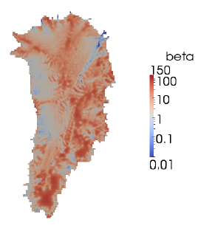
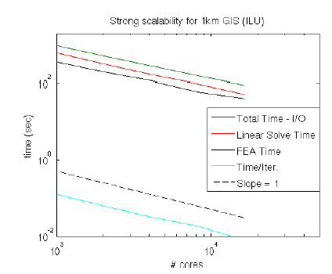
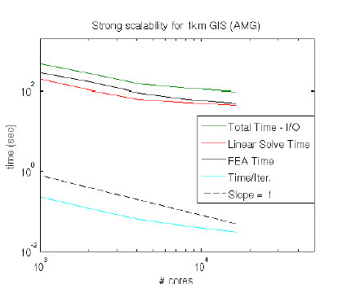


Fine-Resolution Greenland Strong Scaling Study
Strong scaling on 1km Greenland with 40 vertical layers (143M dofs, hex elements).
Initialized with realistic basal friction (from deterministic inversion) and temperature fields $→$ interpolated from coarser to fine mesh.
Iterative linear solver: CG.
Preconditioner: ILU vs. new AMG (based on aggressive semi-coarsening).
ILU
AMG
Albany/FELIX
Glimmer/CISM
1024 cores
16,384 cores
1024 cores
16,384 cores
# cores
# cores
ILU solver scales better than AMG but ILU solve is slightly slower: AMG solver becomes inefficient when # unknowns/core small (expensive setup; a lot of communications).

Slide 70

Validation - Total Mass Change
2003-2012
GRACE
RACMO2
SMB+FF
SMB

