Slide 1
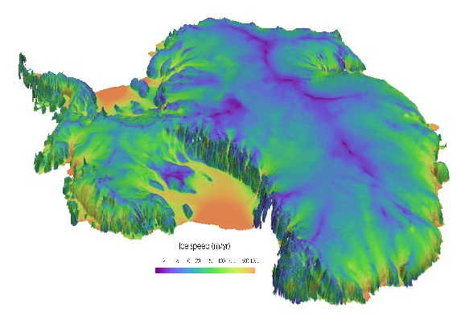
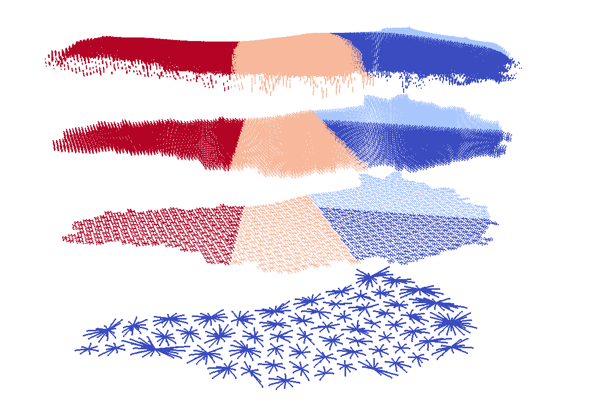
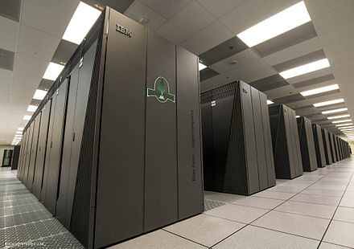
Performance & Performance Portability of the Albany/FELIX Finite Element Land-Ice Solver
I. Tezaur¹, J. Watkins¹, R. Tuminaro¹, I. Demeshko²
¹ Sandia National Laboratories, Livermore, CA, USA.
² Los Alamos National Laboratory, Los Alamos, NM, USA.
SIAM GS 2017 Erlangen, Germany September 11-14, 2017
Sandia National Laboratories is a multi-mission laboratory managed and operated by National Technology and Engineering Solutions of Sandia, LLC., a wholly owned subsidiary of Honeywell International, Inc., for the U.S. Department of Energy’s National Nuclear Security Administration under contract DE-NA0003525.
SAND2017-9362C

Slide 2
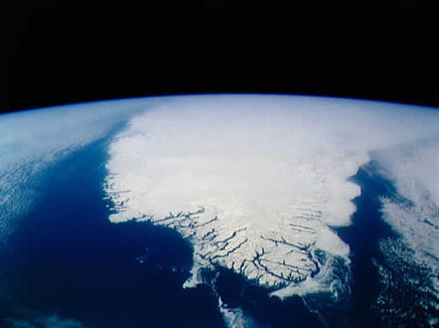
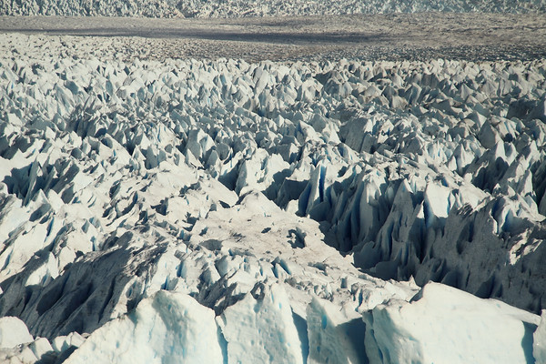
Outline
Background.
  Motivation.
  PISCEES project for land-ice modeling.
  Albany/FELIX “First-Order Stokes” land-ice model.
Finite Element Assembly.
  Performance-portability via Kokkos.
Linear Solve.
  AMG preconditioning.
Summary & future work.

Slide 3
Outline
Background.
  Motivation.
  PISCEES project for land-ice modeling.
  Albany/FELIX “First-Order Stokes” land-ice model.
Finite Element Assembly.
  Performance-portability via Kokkos.
Linear Solve.
  AMG preconditioning.
Summary & future work.

Slide 4

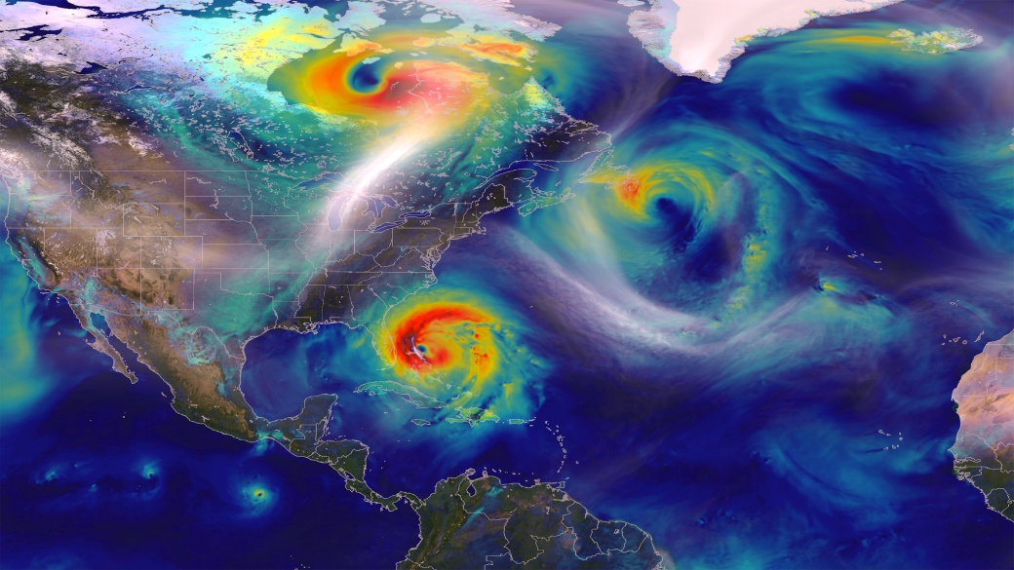
Motivation
Scientific models (e.g. climate models) need more computational power to achieve higher resolutions.
High performance computing (HPC) architectures are becoming increasingly more heterogeneous in a move towards exascale.
Climate models need to adapt to execute correctly & efficiently on new HPC architectures with drastically different memory models.
Notes:
Water cycle: How do the hydrological cycle and water resources interact with the climate on local to global scales?
Biogeochemistry: How do biogeochemical cycles interact with global climate change?
Cryosphere-Ocean System: How do rapid changes in areas of the Earth where water exists as ice and snow interact with the climate system?

Slide 5
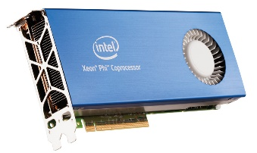
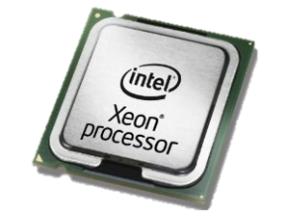
MPI+X Programming Model
HPC architectures are rapidly changing, but trends remain the same.
  Computations are cheap, memory transfer is expensive.
  Single core cycle time has improved but stagnated.
  Increased computational power achieved through manycore architectures.
  → MPI-only is not enough to exploit emerging massively parallel architectures.
Year | Memory Access Time | Single Core Cycle Time
1980s | ~100 ns | ~100 ns
Today | ~50-100 ns | ~1 ns
Approach: MPI+X Programming Model
MPI: inter-node parallelism.
X: intra-node parallelism.
  → Examples: X = OpenMP, CUDA, Pthreads, etc.

Slide 6
Outline
Background.
  Motivation.
  PISCEES project for land-ice modeling.
  Albany/FELIX “First-Order Stokes” land-ice model.
Finite Element Assembly.
  Performance-portability via Kokkos.
Linear Solve.
  AMG preconditioning.
Summary & future work.

Slide 7

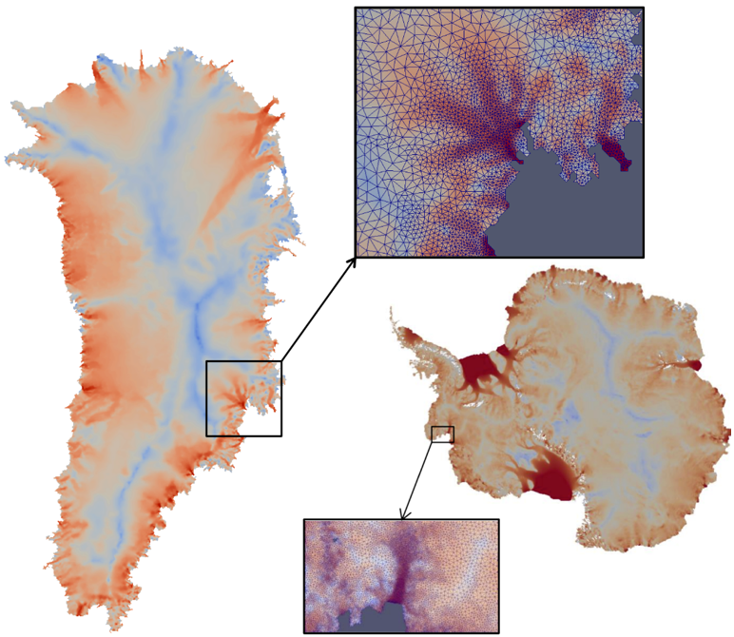

PISCEES Project for Land-Ice Modeling
  “PISCEES” = Predicting Ice Sheet Climate Evolution at Extreme Scales
  5 year SciDAC3 project (2012-2017).
  Sandia’s Role in the PISCEES Project: to develop and support a robust and scalable land ice solver based on the “First-Order” (FO) Stokes equations $→$Albany/FELIX*
Requirements for Albany/FELIX:
  Unstructured grid meshes.
  Scalable, fast and robust.
  Verified and validated.
  Portable to new architecture machines.
  Advanced analysis capabilities: deterministic inversion, calibration, uncertainty quantification.
As part of ACME DOE Earth System Model, solver will provide actionable predictions of 21st century sea-level change (including uncertainty bounds).
* Finite Elements for Land Ice eXperiments

Slide 8
Outline
Background.
  Motivation.
  PISCEES project for land-ice modeling.
  Albany/FELIX “First-Order Stokes” land-ice model.
Finite Element Assembly.
  Performance-portability via Kokkos.
Linear Solve.
  AMG preconditioning.
Summary & future work.

Slide 9

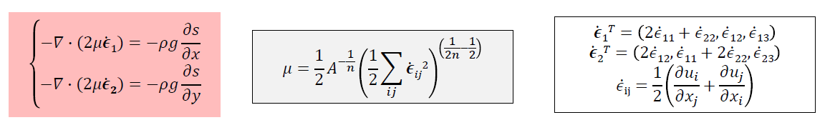
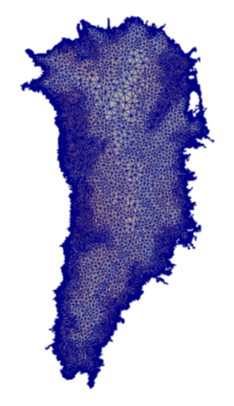
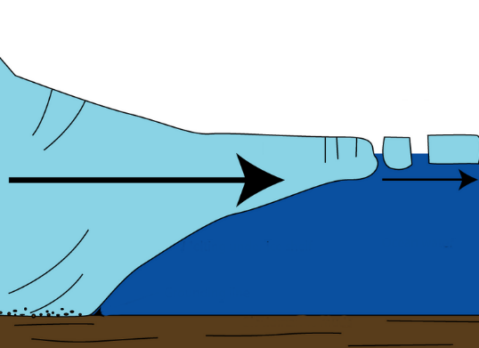


First-Order (FO) Stokes Model
Ice velocities given by the “First-Order” Stokes PDEs with nonlinear viscosity:
Algorithmic choices for Albany/FELIX:
3D unstructured grid FEM discretization.
Newton method nonlinear solver with automatic differentiation Jacobians.
Preconditioned Krylov iterative linear solvers.
Advanced analysis capabilities: deterministic inversion, calibration, UQ.
Albany/FELIX implemented in open-source* multi-physics FE Trilinos-based code:
Ice sheet
* https://github.com/gahansen/Albany.

Slide 10
First-Order (FO) Stokes Model
Ice velocities given by the “First-Order” Stokes PDEs with nonlinear viscosity:
Algorithmic choices for Albany/FELIX:
3D unstructured grid FEM discretization.
Newton method nonlinear solver with automatic differentiation Jacobians.
Preconditioned Krylov iterative linear solvers.
Advanced analysis capabilities: deterministic inversion, calibration, UQ.
Implicit solver:
FEA** = 50% CPU-time
Linear solve = 50% CPU-time
Albany/FELIX implemented in open-source* multi-physics FE Trilinos-based code:
Ice sheet
* https://github.com/gahansen/Albany. **Finite Element Assembly

Slide 11
Outline
Background.
  Motivation.
  PISCEES project for land-ice modeling.
  Albany/FELIX “First-Order Stokes” land-ice model.
Finite Element Assembly.
  Performance-portability via Kokkos.
Linear Solve.
  AMG preconditioning.
Summary & future work.
FEA = 50% CPU-time

Slide 12
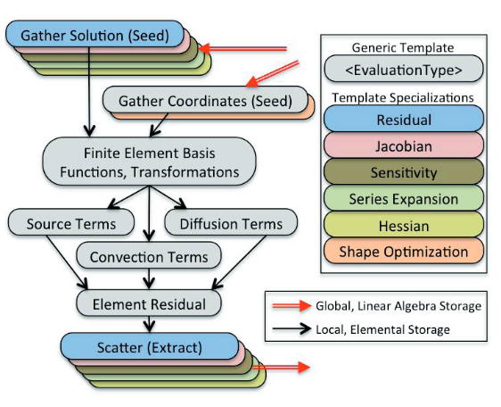
Albany/FELIX Finite Element Assembly (FEA)
Gather operation extracts solution values out of global solution vector.
Physics evaluator functions operate on workset of elements, store evaluated quantities in local field arrays.
FEA relies on template based generic programming + automatic differentiation for Jacobians, tangents, etc.
Scatter operation adds local residual, Jacobian to global residual, Jacobian.
Performance-portability: focus on FEA.
Problem Type | % CPU time for FEA
Implicit | 50%
Explicit | 99%

Slide 13
Albany/FELIX Finite Element Assembly (FEA)
Gather operation extracts solution values out of global solution vector.
Physics evaluator functions operate on workset of elements, store evaluated quantities in local field arrays.
FEA relies on template based generic programming + automatic differentiation for Jacobians, tangents, etc.
Scatter operation adds local residual, Jacobian to global residual, Jacobian.
Performance-portability: focus on FEA.
MPI-only FEA:
  Each MPI process has workset of cells & computes nested parallel for loops.
Problem Type | % CPU time for FEA
Implicit | 50%
Explicit | 99%

Slide 14
Albany/FELIX Finite Element Assembly (FEA)
Gather operation extracts solution values out of global solution vector.
Physics evaluator functions operate on workset of elements, store evaluated quantities in local field arrays.
FEA relies on template based generic programming + automatic differentiation for Jacobians, tangents, etc.
Scatter operation adds local residual, Jacobian to global residual, Jacobian.
Performance-portability: focus on FEA.
MPI-only FEA:
  Each MPI process has workset of cells & computes nested parallel for loops.
MPI+X FEA:
  Each MPI process has workset of cells.
  Multi-dimensional parallelism with +X (X=OpenMP, CUDA) for nested parallel for loops.
Problem Type | % CPU time for FEA
Implicit | 50%
Explicit | 99%

Slide 15
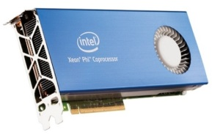
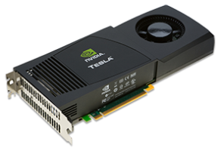
Performance-portability via Kokkos
We need to be able to run climate models on new architecture machines (hybrid systems) and manycore devices (multi-core CPU, NVIDIA GPU, Intel Xeon Phi, etc.) .
In Albany/FELIX, we achieve performance-portability via Kokkos.
  Kokkos: C++ library and programming model that provides performance portability across multiple computing architectures.
    → Examples: Multicore CPU, NVIDIA GPU, Intel Xeon Phi, and more.
  Provides automatic access to OpenMP, CUDA, Pthreads, etc.
  Designed to work with the MPI+X programming model.
  Abstracts data layouts for optimal performance (“array of strucs” vs. struct of arrays”, locality).
With Kokkos, you write an algorithm once, and just change a template parameter to get the optimal data layout for your hardware.
→ Allows researcher to focus on application development for large heterogeneous architectures.

Slide 16
MPI+X FEA via Kokkos
MPI-only nested for loop:
for (int cell=0; cell<numCells; ++cell)
for (int node=0; node<numNodes; ++node)
for (int qp=0; qp<numQPs; ++qp)
compute A;
MPI process n

Slide 17

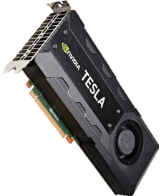
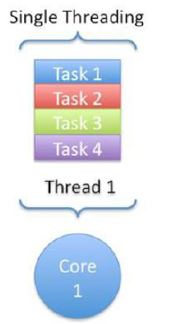

MPI+X FEA via Kokkos
Thread 1 computes A for
(cell,node,qp)=(0,0,0)
Multi-dimensional parallelism for nested for loops via Kokkos:
Thread 2 computes A for
(cell,node,qp)=(0,0,1)
for (int cell=0; cell<numCells; ++cell)
for (int node=0; node<numNodes; ++node)
for (int qp=0; qp<numQPs; ++qp)
compute A;
Thread N computes A for
(cell,node,qp)=(numCells,numNodes,numQPs)
MPI process n

Slide 18
MPI+X FEA via Kokkos
Thread 1 computes A for
(cell,node,qp)=(0,0,0)
Multi-dimensional parallelism for nested for loops via Kokkos:
Thread 2 computes A for
(cell,node,qp)=(0,0,1)
for (int cell=0; cell<numCells; ++cell)
for (int node=0; node<numNodes; ++node)
for (int qp=0; qp<numQPs; ++qp)
compute A;
Thread N computes A for
(cell,node,qp)=(numCells,numNodes,numQPs)
MPI process n
computeA_Policy range({0,0,0},{(int)numCells,(int)numNodes,(int)numQPs});
Kokkos::Experimental::md_parallel_for<ExecutionSpace>(range,*this);
* Unified Virtual Memory.
* Unified Virtual Memory.

Slide 19
MPI+X FEA via Kokkos
Thread 1 computes A for
(cell,node,qp)=(0,0,0)
Multi-dimensional parallelism for nested for loops via Kokkos:
Thread 2 computes A for
(cell,node,qp)=(0,0,1)
for (int cell=0; cell<numCells; ++cell)
for (int node=0; node<numNodes; ++node)
for (int qp=0; qp<numQPs; ++qp)
compute A;
Thread N computes A for
(cell,node,qp)=(numCells,numNodes,numQPs)
MPI process n
computeA_Policy range({0,0,0},{(int)numCells,(int)numNodes,(int)numQPs});
Kokkos::Experimental::md_parallel_for<ExecutionSpace>(range,*this);
ExecutionSpace defined at compile time, e.g.
  typedef Kokkos::OpenMP ExecutionSpace; //MPI+OpenMP
  typedef Kokkos::CUDA ExecutionSpace; //MPI+CUDA
  typedef Kokkos::Serial ExecutionSpace; //MPI-only

Slide 20
MPI+X FEA via Kokkos
Thread 1 computes A for
(cell,node,qp)=(0,0,0)
Multi-dimensional parallelism for nested for loops via Kokkos:
Thread 2 computes A for
(cell,node,qp)=(0,0,1)
for (int cell=0; cell<numCells; ++cell)
for (int node=0; node<numNodes; ++node)
for (int qp=0; qp<numQPs; ++qp)
compute A;
Thread N computes A for
(cell,node,qp)=(numCells,numNodes,numQPs)
MPI process n
computeA_Policy range({0,0,0},{(int)numCells,(int)numNodes,(int)numQPs});
Kokkos::Experimental::md_parallel_for<ExecutionSpace>(range,*this);
ExecutionSpace defined at compile time, e.g.
  typedef Kokkos::OpenMP ExecutionSpace; //MPI+OpenMP
  typedef Kokkos::CUDA ExecutionSpace; //MPI+CUDA
  typedef Kokkos::Serial ExecutionSpace; //MPI-only
Atomics used to scatter local data to global data structures
  Kokkos::atomic_fetch_add

Slide 21
MPI+X FEA via Kokkos
Thread 1 computes A for
(cell,node,qp)=(0,0,0)
Multi-dimensional parallelism for nested for loops via Kokkos:
Thread 2 computes A for
(cell,node,qp)=(0,0,1)
for (int cell=0; cell<numCells; ++cell)
for (int node=0; node<numNodes; ++node)
for (int qp=0; qp<numQPs; ++qp)
compute A;
Thread N computes A for
(cell,node,qp)=(numCells,numNodes,numQPs)
MPI process n
computeA_Policy range({0,0,0},{(int)numCells,(int)numNodes,(int)numQPs});
Kokkos::Experimental::md_parallel_for<ExecutionSpace>(range,*this);
ExecutionSpace defined at compile time, e.g.
  typedef Kokkos::OpenMP ExecutionSpace; //MPI+OpenMP
  typedef Kokkos::CUDA ExecutionSpace; //MPI+CUDA
  typedef Kokkos::Serial ExecutionSpace; //MPI-only
Atomics used to scatter local data to global data structures
  Kokkos::atomic_fetch_add
For MPI+CUDA, data transfer from host to device handled by CUDA UVM*.
* Unified Virtual Memory.

Slide 22
MPI+X FEA via Kokkos
Thread 1 computes A for
(cell,node,qp)=(0,0,0)
Multi-dimensional parallelism for nested for loops via Kokkos:
Thread 2 computes A for
(cell,node,qp)=(0,0,1)
Kokkos parallelization in FELIX is only over cells.
for (int cell=0; cell<numCells; ++cell)
for (int node=0; node<numNodes; ++node)
for (int qp=0; qp<numQPs; ++qp)
compute A;
Thread N computes A for
(cell,node,qp)=(numCells,numNodes,numQPs)
MPI process n
computeA_Policy range({0,0,0},{(int)numCells,(int)numNodes,(int)numQPs});
Kokkos::Experimental::md_parallel_for<ExecutionSpace>(range,*this);
ExecutionSpace defined at compile time, e.g.
  typedef Kokkos::OpenMP ExecutionSpace; //MPI+OpenMP
  typedef Kokkos::CUDA ExecutionSpace; //MPI+CUDA
  typedef Kokkos::Serial ExecutionSpace; //MPI-only
Atomics used to scatter local data to global data structures
  Kokkos::atomic_fetch_add
For MPI+CUDA, data transfer from host to device handled by CUDA UVM*.
* Unified Virtual Memory.

Slide 23
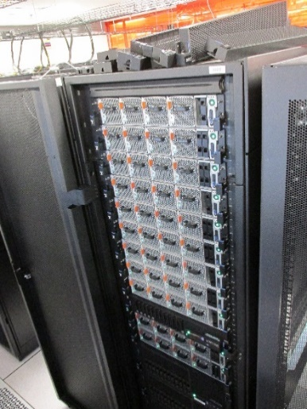
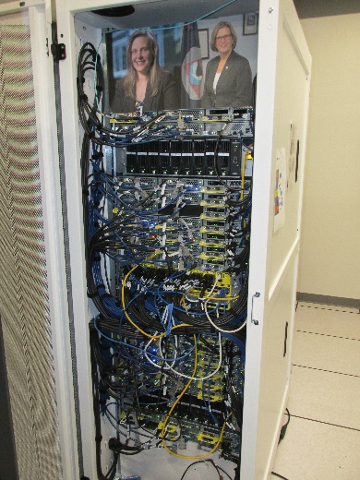

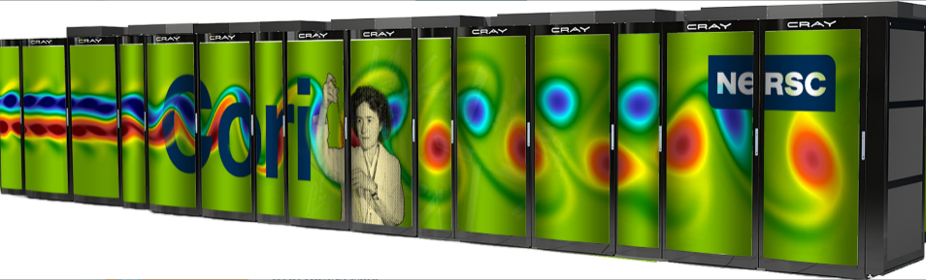
Computer Architectures
Performance-portability of FEA in Albany has been tested across multiple architectures: Intel Sandy Bridge, IBM Power8, Keplar/Pascal GPUs, KNL Xeon Phi
Ride (SNL) used for verification, performance tests
  12 nodes (dual-Power8 (16 cores) + P100 quad-GPU)
Bowman (SNL) used for verification
10 nodes (Intel Xeon Phi KNL (68 cores))
Cori (NERSC) used for verification, performance tests
9688 nodes (Intel Xeon Phi KNL (68 cores))
Summit (ORLCF) is ultimate GPU target
4600 nodes (dual-Power9 + 6 NVIDIA Volta)
Ride
Bowman

Slide 24
Computer Architectures
Performance-portability of FEA in Albany has been tested across multiple architectures: Intel Sandy Bridge, IBM Power8, Keplar/Pascal GPUs, KNL Xeon Phi
Ride (SNL) used for verification, performance tests
  12 nodes (dual-Power8 (16 cores) + P100 quad-GPU)
Bowman (SNL) used for verification
10 nodes (Intel Xeon Phi KNL (68 cores))
Cori (NERSC) used for verification, performance tests
9688 nodes (Intel Xeon Phi KNL (68 cores))
Summit (ORLCF) is ultimate GPU target
4600 nodes (dual-Power9 + 6 NVIDIA Volta)
Ride
Bowman
Platforms utilized here.

Slide 25
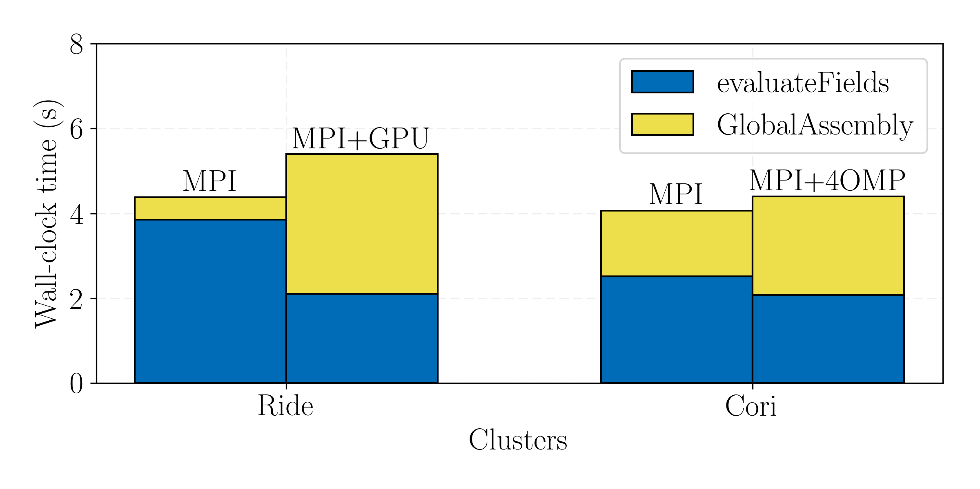
GIS Kokkos Execution Space Comparison
A single node comparison: 16MPI vs. 4(MPI+GPU) [Left], 68MPI vs. 68(MPI+4OMP) [Right]
(GIS 4km-20km unstructured mesh with 1.51M tet elements)
Blue (evaluateFields): mostly Residual/Jacobian computation + Gather/Scatter (Albany/FELIX);
Yellow (GlobalAssembly): mostly communication + Trilinos operations.
Notes:
Blue Ride:
IKT: comparison different architectures
IKT: if remove data movement, will speed things up a lot (GPU code more than CPU code) – multiple copies
IKT: can improve by removing CudaUVM
IKT: can make even faster than 20x using padding
Yellow Ride:
IKT: all Tpetra, stuff Mark et al are working on fixing – would expect 4x slowdown but we are getting 8x slowdown; could be due to CudaUVM (CUDA-aware MPI)
Ride: 16MPI vs. 4(MPI+GPU)
Blue:
- ~2x speedup is not much considering 4 GPUs, need at least 10x ideally.
- Slow down caused by large spread in evaluateFields<Residual>. evaluateFields<Jacobian> is ~5x faster.
- Computing the Jacobian/Residual (StokesFOResid) is 20x/4x faster, data movement is what’s lagging the speedup
- Kernels still needed for boundaries but this would not improve results that much
Yellow:
- ~8x slowdown is not reasonable considering mesh is only 4 times larger per process (16MPI vs. 4MPI)
- Global assembly of Jacobian is faster (~2x speedup), slowdown is caused by residual (~6x slower)
Conclusion: Most issues caused by large spread in MPI processes (maybe fixed by padding), faster speedups if we remove CUDA UVM, unnecessary data movement and add CUDA Aware MPI
Cori: 68MPI vs. 68(MPI+4OMP)
IKT: best configuration for FEA
Blue:
- ~1.2 speedup from hardware threads is reasonable (expected 2x, most likely limited by cache size in core)
- Speedup may be improved once we move towards using more openmp threads in the nonlinear solver (e.g. 4(MPI+68OMP)) but more openmp threads on cores in FEA reduces performance because it takes away from coarser grain parallelism
Yellow:
- ~1.5 slowdown is in Jacobian assembly. This seems like a bug, need to look into why hardware threads are causing a slowdown here and not residual assembly
Conclusion: Besides the global Jacobian assembly, results are promising. More studies are need once we profile nonlinear solver

Slide 26
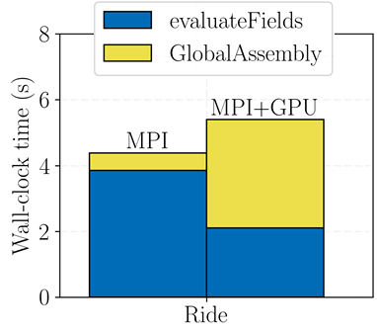
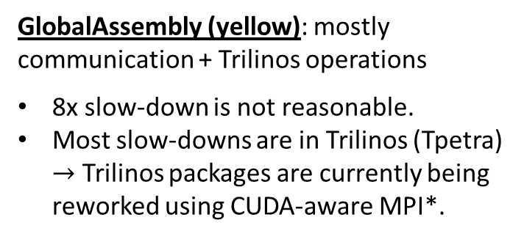
GIS Kokkos 16 MPI vs. 4(MPI+GPU) Results
GlobalAssembly (yellow): mostly communication + Trilinos operations
8x slow-down is not reasonable.
Most slow-downs are in Trilinos (Tpetra) $→$ Trilinos packages are currently being reworked using CUDA-aware MPI*.
8x slow-down (yellow)
2x speed-up (blue)
Summary: speed-ups on GPU are not yet as expected but may be improved by introducing padding, removing CUDA UVM and unnecessary data movement, switching to CUDA-aware MPI.
evaluateFields (blue): mostly residual/Jacobian computation + Gather/Scatter
evaluateFields<Jacobian> much faster than evaluateFields<Residual> b/c there is more work in computing Jacobian.
2x speedup not much considering 4 GPUs (desirable speedup: 10x or more).
  Data movement is lagging speedup – can be improved by removing CUDA UVM, data padding to prevent data misalignment.
  A few kernels still for boundary conditions still need to be ported to Kokkos.
* With CUDA-aware MPI, GPU buffers can be passed directly to MPI w/o staging using cudaMemcpy.
Notes:
CUDA-aware MPI: With regular MPI, only pointers to host memory can be passed to MPI. If combine CUDA + MPI, you often need to send GPU buffers instead of host buffers. W/o CUDA-aware MPI, you need to stage GPU buffers through host memory using cudaMemcpy. With CUDA-aware MPI, this is not necessary – GPU buffers can be directly passed to MPI.
CUDA-aware MPI makes application run more efficiently for 2 reasons: 1. all operations that are required to carry out the message transfer can be pipelines. 2. acceleration technologies like GPUDirect can be utilized by the MPI library transparently to the user.
Examples of CUDA-aware MPI: MVAPICH2, OpenMP, CRAY MPI, IBM Platform MPI, SGI MPI.
Blue Ride:
IKT: comparison different architectures
IKT: if remove data movement, will speed things up a lot (GPU code more than CPU code) – multiple copies
IKT: can improve by removing CudaUVM
IKT: can make even faster than 20x using padding
Yellow Ride:
IKT: all Tpetra, stuff Mark et al are working on fixing – would expect 4x slowdown but we are getting 8x slowdown; could be due to CudaUVM (CUDA-aware MPI)
Ride: 16MPI vs. 4(MPI+GPU)
Blue:
- ~2x speedup is not much considering 4 GPUs, need at least 10x ideally.
- Slow down caused by large spread in evaluateFields<Residual>. evaluateFields<Jacobian> is ~5x faster.
- Computing the Jacobian/Residual (StokesFOResid) is 20x/4x faster, data movement is what’s lagging the speedup
- Kernels still needed for boundaries but this would not improve results that much
Yellow:
- ~8x slowdown is not reasonable considering mesh is only 4 times larger per process (16MPI vs. 4MPI)
- Global assembly of Jacobian is faster (~2x speedup), slowdown is caused by residual (~6x slower)
Conclusion: Most issues caused by large spread in MPI processes (maybe fixed by padding), faster speedups if we remove CUDA UVM, unnecessary data movement and add CUDA Aware MPI
Cori: 68MPI vs. 68(MPI+4OMP)
IKT: best configuration for FEA
Blue:
- ~1.2 speedup from hardware threads is reasonable (expected 2x, most likely limited by cache size in core)
- Speedup may be improved once we move towards using more openmp threads in the nonlinear solver (e.g. 4(MPI+68OMP)) but more openmp threads on cores in FEA reduces performance because it takes away from coarser grain parallelism
Yellow:
- ~1.5 slowdown is in Jacobian assembly. This seems like a bug, need to look into why hardware threads are causing a slowdown here and not residual assembly
Conclusion: Besides the global Jacobian assembly, results are promising. More studies are need once we profile nonlinear solver

Slide 27
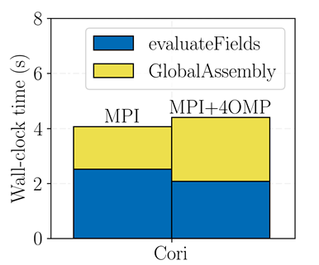
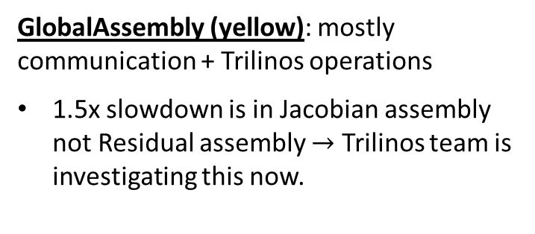
GIS Kokkos 68MPI vs. 68(MPI+4OMP) Results
GlobalAssembly (yellow): mostly communication + Trilinos operations
1.5x slowdown is in Jacobian assembly not Residual assembly $→$ Trilinos team is investigating this now.
1.5x slow-down (yellow)
1.2x speed-up (blue)
Summary: besides the global Jacobian assembly, results are promising. More studies are needed once we profile nonlinear/linear solvers.
evaluateFields (blue): mostly residual/Jacobian computation + Gather/Scatter
1.2x speedup from hardware threads is reasonable (there are 2 VPUs/KNL core, so 2x speedup is ideal but will be limited by L1 cache size in core for bandwidth bound operation)
Once the nonlinear/linear solver is included, more OpenMP threads will likely be used (e.g. 4(MPI+68OMP)) to improve speedup.
  More OpenMP threads on cores in FEA reduces performance because it takes away from coarser grain MPI parallelism
Notes:
IKT:
There is indeed 2 VPUs and one L1 Cache per KNL core so, as I said before, 2x speedup would be ideal but that will be limited by L1 Cache size for a bandwidth bound operation
Optimal configuration for FEA is selected here
Speedup is 1.2x on single core
2x speedup expected b/c 2 VPU units (processing units)
Coarse grain parallelism = MPI
OpenMP threads compete for cache
Blue Ride:
IKT: comparison different architectures
IKT: if remove data movement, will speed things up a lot (GPU code more than CPU code) – multiple copies
IKT: can improve by removing CudaUVM
IKT: can make even faster than 20x using padding
Yellow Ride:
IKT: all Tpetra, stuff Mark et al are working on fixing – would expect 4x slowdown but we are getting 8x slowdown; could be due to CudaUVM (CUDA-aware MPI)
Ride: 16MPI vs. 4(MPI+GPU)
Blue:
- ~2x speedup is not much considering 4 GPUs, need at least 10x ideally.
- Slow down caused by large spread in evaluateFields<Residual>. evaluateFields<Jacobian> is ~5x faster.
- Computing the Jacobian/Residual (StokesFOResid) is 20x/4x faster, data movement is what’s lagging the speedup
- Kernels still needed for boundaries but this would not improve results that much
Yellow:
- ~8x slowdown is not reasonable considering mesh is only 4 times larger per process (16MPI vs. 4MPI)
- Global assembly of Jacobian is faster (~2x speedup), slowdown is caused by residual (~6x slower)
Conclusion: Most issues caused by large spread in MPI processes (maybe fixed by padding), faster speedups if we remove CUDA UVM, unnecessary data movement and add CUDA Aware MPI
Cori: 68MPI vs. 68(MPI+4OMP)
IKT: best configuration for FEA
Blue:
- ~1.2 speedup from hardware threads is reasonable (expected 2x, most likely limited by cache size in core)
- Speedup may be improved once we move towards using more openmp threads in the nonlinear solver (e.g. 4(MPI+68OMP)) but more openmp threads on cores in FEA reduces performance because it takes away from coarser grain parallelism
Yellow:
- ~1.5 slowdown is in Jacobian assembly. This seems like a bug, need to look into why hardware threads are causing a slowdown here and not residual assembly
Conclusion: Besides the global Jacobian assembly, results are promising. More studies are need once we profile nonlinear solver

Slide 28
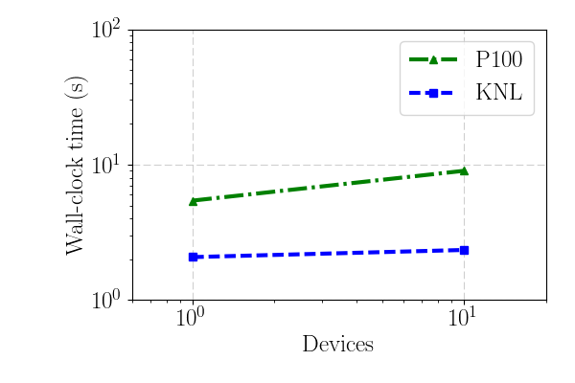
GIS MPI+Device Weak Scalability
Scalability of GlobalAssembly + evaluateFields is studied.
Weak Scalability is for GIS 4km-20km and 1km-7km (1.51M and 14.4M elements) tet meshes.
Weak scalability is comparable for P100 and KNL.
  KNL performs better because of heavy use of MPI.
Optimizations/profiling required for strong scalability of FELIX; we have demonstrated strong scalability for other applications in Albany (I. Demeshko et al 2017).
Notes:
IKT: GPU much slower b/c of data movement – can fix by removing data movement (statefields loading, etc.)
IKT: not all evaluators have been Kokkos-ized.
Single GPU is most likely slow because of data movement (CUDAUVM)
IKT: super-linear speedup – could be due to alignment
IKT: MPI scaling is best case

Slide 29
Outline
Background.
  Motivation.
  PISCEES project for land-ice modeling.
  Albany/FELIX “First-Order Stokes” land-ice model.
Finite Element Assembly.
  Performance-portability via Kokkos.
Linear Solve.
  AMG preconditioning.
Summary & future work.
Linear Solve = 50% CPU-time

Slide 30
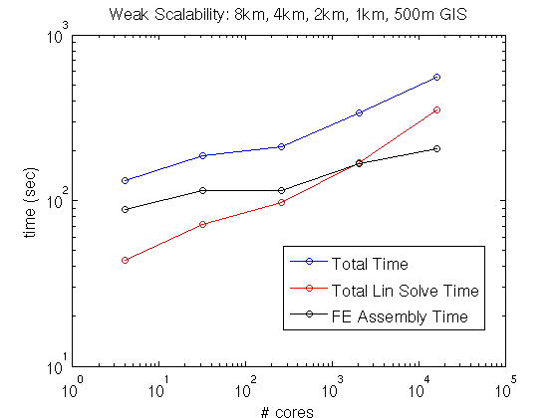
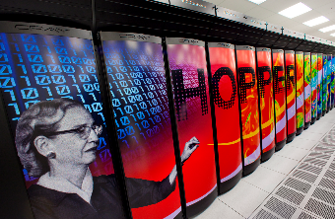
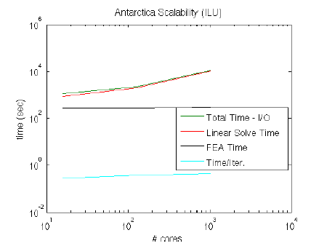
Initial Weak Scalability Study Using ILU
Greenland Ice Sheet
Antarctic Ice Sheet

Slide 31
Initial Weak Scalability Study Using ILU
Greenland Ice Sheet
Antarctic Ice Sheet
Scalability results are not acceptable!

Slide 32
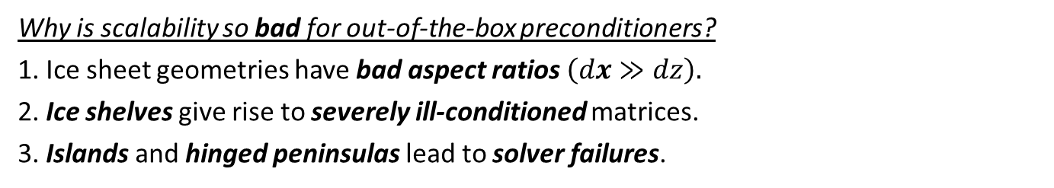
Initial Weak Scalability Study Using ILU
Greenland Ice Sheet
Antarctic Ice Sheet
Scalability results are not acceptable!
Why is scalability so bad for out-of-the-box preconditioners?
1. Ice sheet geometries have bad aspect ratios $\left(dx≫dz\right).$
2. Ice shelves give rise to severely ill-conditioned matrices.
3. Islands and hinged peninsulas lead to solver failures.

Slide 33
Initial Weak Scalability Study Using ILU
Greenland Ice Sheet
Antarctic Ice Sheet
Scalability results are not acceptable!
We mitigate these difficulties through the development of:
New AMG* preconditioner based on semi-coarsening.
Island/hinge removal algorithm.
Why is scalability so bad for out-of-the-box preconditioners?
1. Ice sheet geometries have bad aspect ratios $\left(dx≫dz\right).$
2. Ice shelves give rise to severely ill-conditioned matrices.
3. Islands and hinged peninsulas lead to solver failures.
* Algebraic Multi-Grid.

Slide 34
Outline
Background.
  Motivation.
  PISCEES project for land-ice modeling.
  Albany/FELIX “First-Order Stokes” land-ice model.
Finite Element Assembly.
  Performance-portability via Kokkos.
Linear Solve.
  AMG preconditioning.
Summary & future work.
FEA = 50% CPU-time

Slide 35

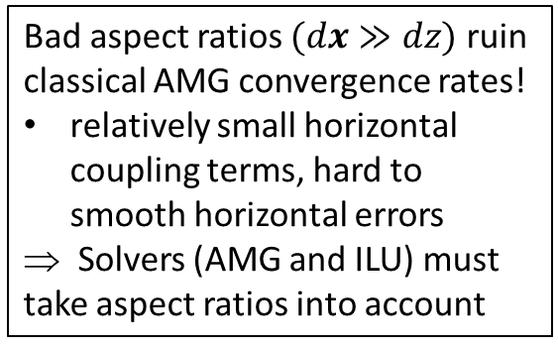
Scalability via Algebraic Multi-Grid
Preconditioning with Semi-Coarsening
Bad aspect ratios $(dx≫dz)$ ruin classical AMG convergence rates!
relatively small horizontal coupling terms, hard to smooth horizontal errors
⇒ Solvers (AMG and ILU) must take aspect ratios into account
Algebraic Structured MG
Algebraic Structured MG
We developed a new AMG solver based on aggressive semi-coarsening (available in ML/MueLu packages of Trilinos)
Unstructured AMG
See (Tezaur et al., 2015),
(Tuminaro et al., 2016).
Scaling studies (next slides):
New AMG preconditioner vs. ILU

Slide 36
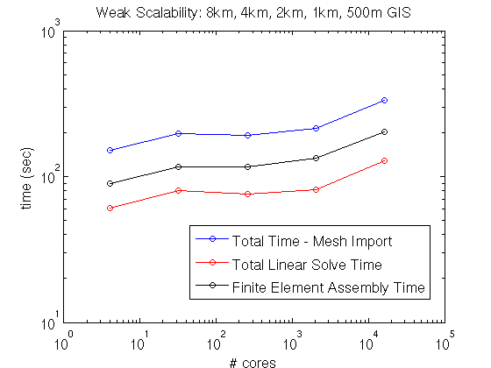

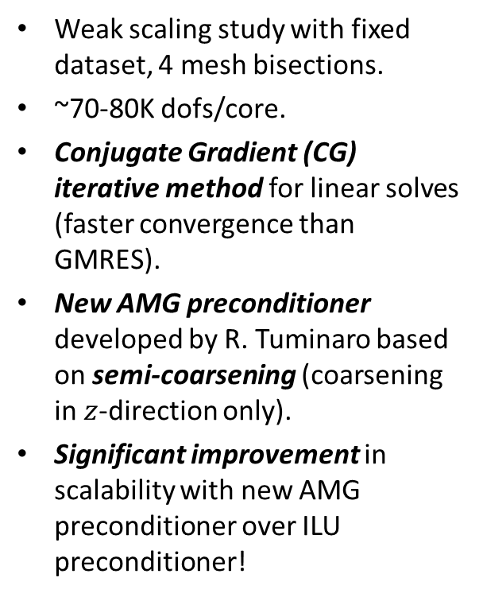
Greenland Controlled Weak Scalability Study
Weak scaling study with fixed dataset, 4 mesh bisections.
~70-80K dofs/core.
Conjugate Gradient (CG) iterative method for linear solves (faster convergence than GMRES).
New AMG preconditioner developed by R. Tuminaro based on semi-coarsening (coarsening in $z$-direction only).
Significant improvement in scalability with new AMG preconditioner over ILU preconditioner!
4 cores
334K dofs
8 km Greenland,
5 vertical layers
16,384 cores
1.12B dofs(!)
0.5 km Greenland,
80 vertical layers
$×84$
scale up

Slide 37
Greenland Controlled Weak Scalability Study
New AMG preconditioner preconditioner
ILU preconditioner
Weak scaling study with fixed dataset, 4 mesh bisections.
~70-80K dofs/core.
Conjugate Gradient (CG) iterative method for linear solves (faster convergence than GMRES).
New AMG preconditioner developed by R. Tuminaro based on semi-coarsening (coarsening in $z$-direction only).
Significant improvement in scalability with new AMG preconditioner over ILU preconditioner!
4 cores
334K dofs
8 km Greenland,
5 vertical layers
16,384 cores
1.12B dofs(!)
0.5 km Greenland,
80 vertical layers
$×84$
scale up

Slide 38
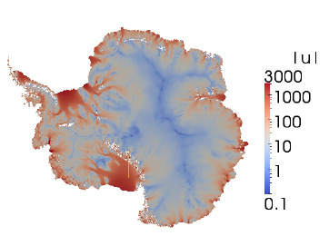

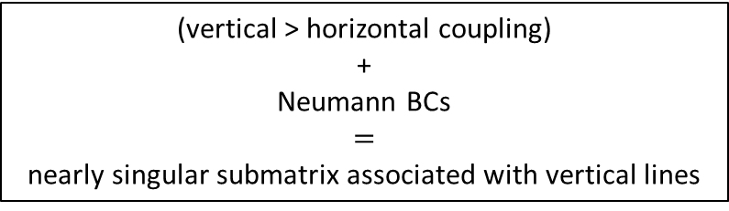


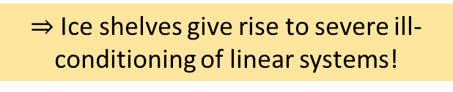

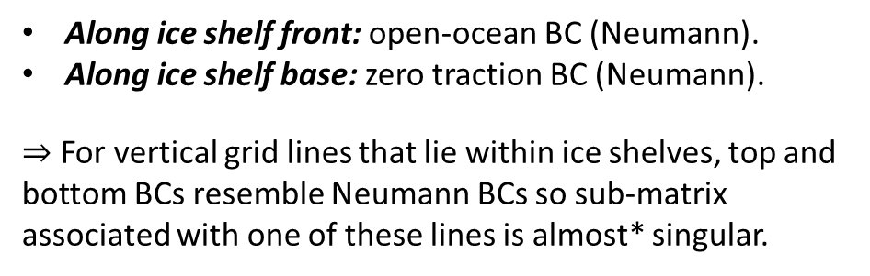
Moderate Resolution Antarctica Weak Scaling Study
Antarctica is fundamentally different than Greenland:
AIS contains large ice shelves (floating extensions of land ice).
Along ice shelf front: open-ocean BC (Neumann).
Along ice shelf base: zero traction BC (Neumann).
$⇒$ For vertical grid lines that lie within ice shelves, top and bottom BCs resemble Neumann BCs so sub-matrix associated with one of these lines is almost* singular.
  Surface boundary $Γs$
Ice sheet
(vertical > horizontal coupling)
+
Neumann BCs
$=$
nearly singular submatrix associated with vertical lines
Albany/FELIX
Glimmer/CISM
Lateral boundary $Γl$
  Basal boundary $Γβ$
)
$⇒$Ice shelves give rise to severe ill-conditioning of linear systems!
*Completely singular in the presence of islands and some ice tongues.
Notes:
- AMG: Gauss-Seidel smoothing on finest level (where lines are defined in mesh extruded direction), Chebyshev smoothing on coarser levels.
- ILU: ordering is important to maintain acceptable convergence rates (need row-wise ordering)!
- GMRES less sensitive than CG to rounding errors associated w/ severe ill-conditioning introduced by presence of ice shelves.
- CG and GMRES minimize different norms.
- Floating ice shelves: matrix entries corresponding to vertical coupling are much stronger than entries corresponding to horizontal coupling. Vertical grid lines lie within ice shelves, top/bottom BCs resemble Neumann conditions and so the submatrix associated with the vertical lines is nearly singular. Ill-conditioning creates challenges for solver.

Slide 39
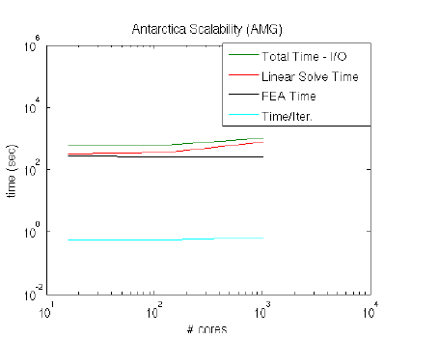
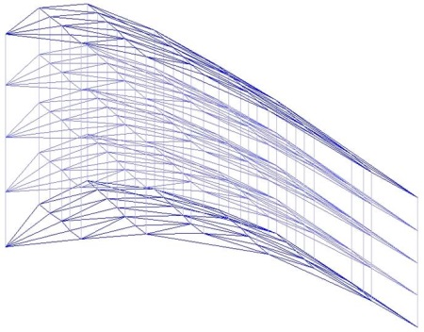

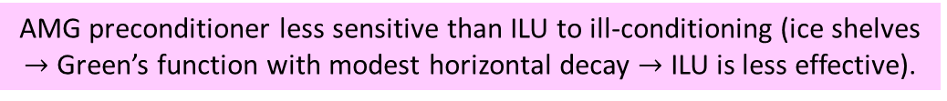
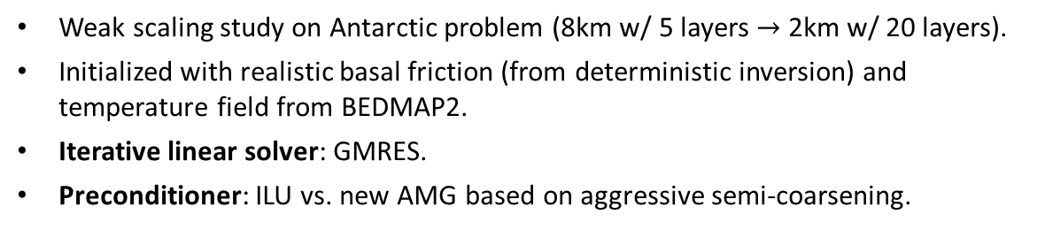
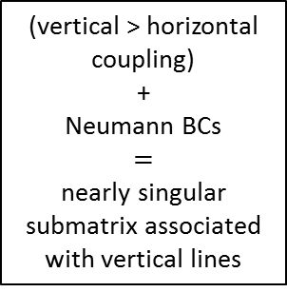
Moderate Resolution Antarctica Weak Scaling Study
Weak scaling study on Antarctic problem (8km w/ 5 layers $→$ 2km w/ 20 layers).
Initialized with realistic basal friction (from deterministic inversion) and temperature field from BEDMAP2.
Iterative linear solver: GMRES.
Preconditioner: ILU vs. new AMG based on aggressive semi-coarsening.
ILU
Severe ill-conditioning caused by ice shelves!
AMG
Albany/FELIX
Glimmer/CISM
AMG preconditioner
(vertical > horizontal coupling)
+
Neumann BCs
$=$
nearly singular submatrix associated with vertical lines
16 cores
1024 cores
16 cores
1024 cores
# cores
# cores
AMG preconditioner less sensitive than ILU to ill-conditioning (ice shelves $→$ Green’s function with modest horizontal decay $→$ ILU is less effective).
Notes:
- AMG: Gauss-Seidel smoothing on finest level (where lines are defined in mesh extruded direction), Chebyshev smoothing on coarser levels.
- ILU: ordering is important to maintain acceptable convergence rates (need row-wise ordering)!
- GMRES less sensitive than CG to rounding errors associated w/ severe ill-conditioning introduced by presence of ice shelves.
- CG and GMRES minimize different norms.
- Floating ice shelves: matrix entries corresponding to vertical coupling are much stronger than entries corresponding to horizontal coupling. Vertical grid lines lie within ice shelves, top/bottom BCs resemble Neumann conditions and so the submatrix associated with the vertical lines is nearly singular. Ill-conditioning creates challenges for solver.

Slide 40
Outline
Background.
  Motivation.
  PISCEES project for land-ice modeling.
  Albany/FELIX “First-Order Stokes” land-ice model.
Finite Element Assembly.
  Performance-portability via Kokkos.
Linear Solve.
  AMG preconditioning.
Summary & future work.

Slide 41
Summary & Conclusions
A performance portable implementation of the FEA in the FELIX land-ice model was created using Kokkos within the Albany code base.
  - With this implementation, the same code can run on devices with drastically different memory models (many-core CPU, NVIDIA GPU, Intel Xeon Phi, etc.).
  - Performance studies show that further optimization is needed to fully utilize all resources.
More on performance-portability of Albany using Kokkos can be found here: https://github.com/gahansen/Albany/wiki/Albany-performance-on-next-generation-platforms

Slide 42
Summary & Conclusions
A performance portable implementation of the FEA in the FELIX land-ice model was created using Kokkos within the Albany code base.
  - With this implementation, the same code can run on devices with drastically different memory models (many-core CPU, NVIDIA GPU, Intel Xeon Phi, etc.).
  - Performance studies show that further optimization is needed to fully utilize all resources.
More on performance-portability of Albany using Kokkos can be found here: https://github.com/gahansen/Albany/wiki/Albany-performance-on-next-generation-platforms
Scalable, fast and robust linear solve is achieved via algebraic multigrid (AMG) preconditioner that takes advantage of layered nature of meshes.
- Performance portability of linear solve is work in progress.

Slide 43
Summary & Conclusions
A performance portable implementation of the FEA in the FELIX land-ice model was created using Kokkos within the Albany code base.
  - With this implementation, the same code can run on devices with drastically different memory models (many-core CPU, NVIDIA GPU, Intel Xeon Phi, etc.).
  - Performance studies show that further optimization is needed to fully utilize all resources.
More on performance-portability of Albany using Kokkos can be found here: https://github.com/gahansen/Albany/wiki/Albany-performance-on-next-generation-platforms
Scalable, fast and robust linear solve is achieved via algebraic multigrid (AMG) preconditioner that takes advantage of layered nature of meshes.
- Performance portability of linear solve is work in progress.
Heterogeneous HPC architectures can now be utilized for land-ice research using Albany/FELIX.

Slide 44



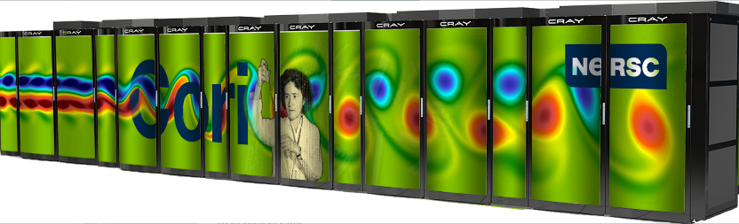
Ongoing/Future Work
Finite Element Assembly (FEA):
Profiling using TAU and nvprof.
Methods for improving performance:
        - Reduce excess memory usage.
        - Utilize shared memory.
  - Replace CUDA UVM with manual memory transfer.
  - Parallelize over nodes, quad points, levels in addition to cells.
  - Add data padding to prevent misalignment.
  - Switch to CUDA-aware MPI.
  Large-scale runs on Cori and Summit.
Linear Solve:
Performance-portability of preconditioned iterative linear solve using Kokkos for implicit problems in Albany (e.g., FELIX).
  - Finish converting MueLu/Ifpack2 to use Kokkos.
  - Algorithm redesign may be necessary for GPUs.
  - Considering other solvers, e.g., hierarchical solvers, Shylu (FAST-ILU, multi- cccccthreaded GS).

Slide 45









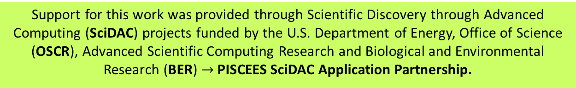
Funding/Acknowledgements
Support for this work was provided through Scientific Discovery through Advanced Computing (SciDAC) projects funded by the U.S. Department of Energy, Office of Science (OSCR), Advanced Scientific Computing Research and Biological and Environmental Research (BER) $→$PISCEES SciDAC Application Partnership.
PISCEES team members: K. Evans, M. Gunzburger, M. Hoffman, C. Jackson, P. Jones, W. Lipscomb, M. Perego, S. Price, A. Salinger, I. Tezaur, R. Tuminaro, P. Worley.
Trilinos/DAKOTA collaborators: M. Eldred, J. Jakeman, E. Phipps, L. Swiler.
  Computing resources: NERSC, OLCF.

Slide 46
References
[1] M.A. Heroux et al. “An overview of the Trilinos project.” ACM Trans. Math. Softw. 31(3) (2005).
[2] A. Salinger, et al. "Albany: Using Agile Components to Develop a Flexible, Generic Multiphysics Analysis Code", Int. J. Multiscale Comput. Engng. 14(4) (2016) 415-438.
[3] I. Tezaur, M. Perego, A. Salinger, R. Tuminaro, S. Price. "Albany/FELIX: A Parallel, Scalable and Robust Finite Element Higher-Order Stokes Ice Sheet Solver Built for Advanced Analysis", Geosci. Model Develop. 8 (2015) 1-24.
[4] C. Edwards, C. Trott, D. Sunderland. “Kokkos: Enabling manycore performance portability through
polymorphic memory access patterns”, J. Par. & Distr. Comput. 74 (12) (2014) 3202-3216.
[5] R. Tuminaro, M. Perego, I. Tezaur, A. Salinger, S. Price. "A matrix dependent/algebraic multigrid approach for extruded meshes with applications to ice sheet modeling", SIAM J. Sci. Comput. 38(5) (2016) C504-C532.
[6] I. Tezaur, R. Tuminaro, M. Perego, A. Salinger, S. Price. "On the scalability of the Albany/FELIX first-order Stokes approximation ice sheet solver for large-scale simulations of the Greenland and Antarctic ice sheets", Procedia Computer Science, 51 (2015) 2026-2035.
[7] I. Demeshko, J. Watkins, I. Tezaur, O. Guba, W. Spotz, A. Salinger, R. Pawlowski, M. Heroux. "Towards performance-portability of the Albany finite element analysis code using the Kokkos library", submitted to J. HPC Appl.
[8] S. Price, M. Hoffman, J. Bonin, T. Neumann, I. Howat, J. Guerber, I. Tezaur, J. Saba, J. Lanaerts, D. Chambers, W. Lipscomb, M. Perego, A. Salinger, R. Tuminaro. "An ice sheet model validation framework for the Greenland ice sheet", Geosci. Model Dev. 10 (2017) 255-270

Slide 47
Appendix: Parallelism on Modern Hardware
Year | Memory Access Time | Single Core Cycle Time
1980s | ~100 ns | ~100 ns
Today | ~50-100 ns | ~1 ns
Memory access time has remained the same.
Single core performance has improved but stagnated.
Computations are cheap, memory transfer is expensive.
More performance from multicore/manycore processors.

Slide 48
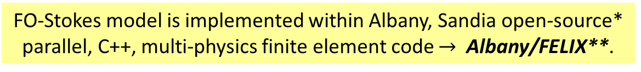
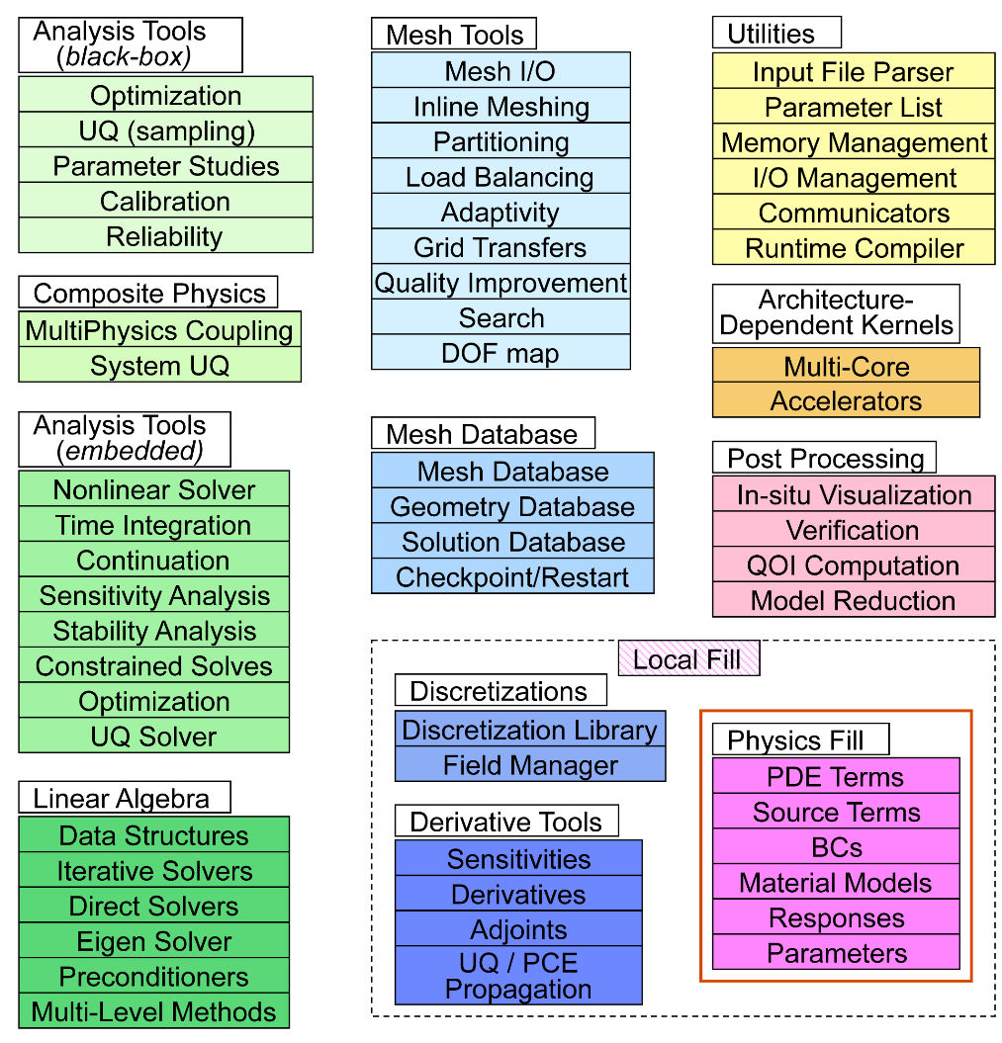
Appendix:
Multiphysics Code
FO-Stokes model is implemented within Albany, Sandia open-source* parallel, C++, multi-physics finite element code $→$ Albany/FELIX**.
Component-based design for rapid development of new physics & capabilities.
Extensive use of libraries from the open-source Trilinos project:
  Automatic differentiation.
  Discretizations/meshes, mesh adaptivity.
  Solvers, preconditioners.
  Performance-portable kernels.
Advanced analysis capabilities:
  Parameter estimation.
  Uncertainty quantification (DAKOTA).
  Optimization.
  Sensitivity analysis.
40+ packages; 120+ libraries
**Finite Elements for Land Ice eXperiments
* https://github.com/gahansen/Albany.

Slide 49
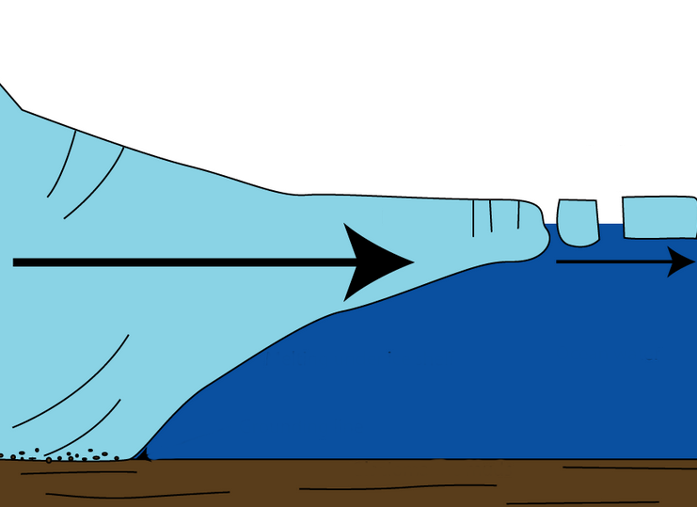
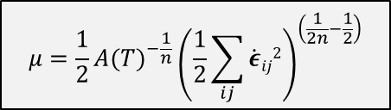

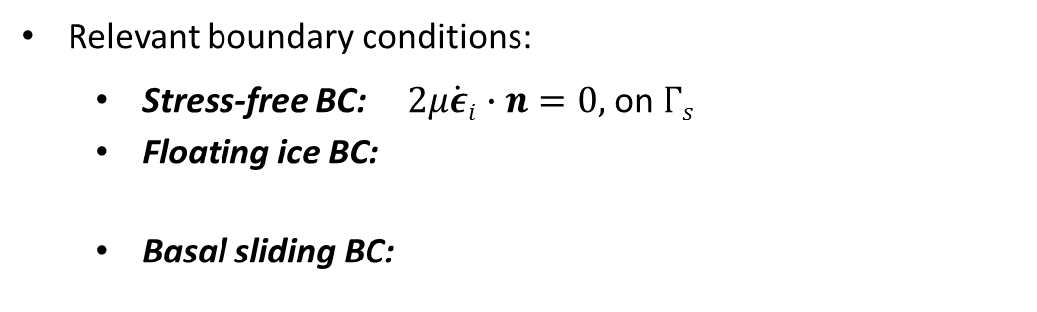
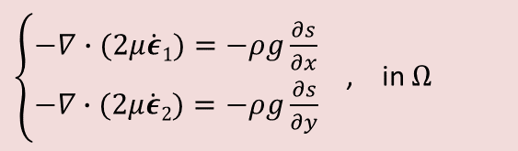







Appendix: First-Order (FO) Stokes Model
Ice behaves like a very viscous shear-thinning fluid (similar to lava flow).
Quasi-static model with momentum balance given by “First-Order” Stokes PDEs: “nice” elliptic approximation* to Stokes’ flow equations.
$$\dot{ε}1T=\left(2\dot{ε}11+\dot{ε}22,\dot{ε}12,\dot{ε}13\right)$$
$$\dot{ε}2T=\left(2\dot{ε}12, \dot{ε}11+2\dot{ε}22,\dot{ε}23\right)$$
$$\dot{ε}ij=\frac{1}{2}\left(\frac{∂u_{i}}{∂x_{j}}+\frac{∂u_{j}}{∂x_{i}}\right)$$
$\left\{\begin{aligned}−∇∙(2μ\dot{ε}1)=−ρg\frac{∂s}{∂x} \\ −∇∙(2μ\dot{ε}2)=−ρg\frac{∂s}{∂y}\end{aligned}\right.$ , in $Ω$
Viscosity $μ$ is nonlinear function given by “Glen’s law”:
  Surface boundary $Γs$
$$μ=\frac{1}{2}{{A(T)}^{−\frac{1}{n}}\left(\frac{1}{2}\sum_{ij}{\dot{ε}ij2}\right)}^{\left(\frac{1}{2n}−\frac{1}{2}\right)}$$
$$(n=3)$$
Ice sheet
Albany/FELIX
Relevant boundary conditions:
  Stress-free BC: $2μ\dot{ε}i∙n=0,$ on $Γs$
  Floating ice BC:
  Basal sliding BC:
Lateral boundary $Γl$
  $2μ\dot{ε}i∙n$ = $\left\{\begin{aligned}ρgzn\text{, }\text{if} z>0 \\ 0, if z≤0\end{aligned}, \right.on Γl$
  Basal boundary $Γβ$
)
$$β\left(x,y\right)=basal$$
$$sliding coefficient$$
  $2μ\dot{ε}i∙n+β(x,y)u_{i}=0$, on $Γβ$
*Assumption: aspect ratio $δ$is small and normals to upper/lower surfaces are almost vertical.

Slide 50

Appendix: Kokkos-ification of Finite Element Assembly (Example)
ExecutionSpace parameter tailors code for device (e.g., OpenMP, CUDA, etc.)

Slide 51



Appendix: Ice Sheet Dynamic Equations
Model for evolution of the boundaries (thickness evolution equation):
$$\frac{∂H}{∂t}=−∇∙\left(\overline{u}H\right)+\dot{b}$$
where $\overline{u}$ = vertically averaged velocity, $\dot{b}$= surface mass
balance (conservation of mass).
Temperature equation (advection-diffusion):
$$ρc\frac{∂T}{∂t}=∇∙(k∇T)−ρcu∙∇T+2\dot{ε}σ$$
(energy balance).
Flow factor $A$ in Glen’s law depends on temperature $T$: $A=A(T)$.
Ice sheet grows/retreats depending on thickness $H$.
Ice-covered (“active”) cells shaded in white
($H>H_{min}$)

Slide 52


Appendix: MPI+Device Scalability Study
Strong Scalability
Weak Scalability
Device Comparison, P100 vs. KNL (GIS 4km-20km mesh)
1. Blue: mostly Residual/Jacobian computation, Yellow: mostly communication.
2. KNL performs better because of heavy use of MPI
3. P100 performance is hindered by communication cost
(worse when scaling because of lack of CUDA aware MPI)
Notes:
IKT: GPU much slower b/c of data movement – can fix by removing data movement (statefields loading, etc.)
IKT: not all evaluators have been Kokkos-ized.
Single GPU is most likely slow because of data movement (CUDAUVM)

Slide 53

Appendix: MPI+Device Scalability Study
Strong Scalability
Weak Scalability
Scalability of GlobalAssembly + evaluateFields is studied.
Strong Scalability is for GIS 4km-20km tet mesh (1.51M elements).
Weak Scalability is for GIS 4km-20km and 1km-7km (1.51M and 14.4M elements) tet meshes.
KNL strong scaling under investigation – requires profiling.
P100 results hindered by communication cost (worse when scaling b/c no CUDA-aware MPI)
  Scalability can likely be improved by removing CUDA UVM.
Weak scaling is comparable for P100 and KNL.
  KNL performs better because of heavy use of MPI.
Notes:
IKT: GPU much slower b/c of data movement – can fix by removing data movement (statefields loading, etc.)
IKT: not all evaluators have been Kokkos-ized.
Single GPU is most likely slow because of data movement (CUDAUVM)
IKT: super-linear speedup – could be due to alignment
IKT: MPI scaling is best case

Slide 54




Appendix: Greenland Weak Scalability on Titan
Weak scalability on Titan (16km, 8km, 4km, 2km, 1km Greenland)
Wall-clock Time: FEA
Wall-clock Time:
Total Time – Setup Time
Titan: 18,688 AMD Opteron nodes
16 cores per node
1 K20X Kepler GPUs/ node
32GB + 6GB memory/ node

Slide 55
Appendix: Scalability with Increasing Order Elements
Left: speedup plot shows benefit of using higher orders to obtain better strong scalability for MPI+OpenMP for Aeras atmosphere dycore shallow water test case.
Right: weak scalability for MPI + GPU on the Ride for Aeras atmosphere dycore shallow water test case. Efficiency drops significantly for lower order elements, but GPU is better able to maintain weak scaling for higher order p6 spectral element.

Slide 56
Appendix: Kokkos Range vs. MDRange Policy
Range vs. MDRange policy for shallow water test case in Aeras atmosphere dycore with p6 spectral element for MPI + GPU.

Slide 57




Appendix: Improved Linear Solver Performance through Hinge Removal
Islands and certain hinged peninsulas lead to solver failures
We have developed an algorithm to detect/remove problematic hinged peninsulas & islands based on coloring and repeated use of connected component algorithms (Tuminaro et al., 2016).
Solves are ~2x faster with hinges removed.
Current implementation is MATLAB, but working on C++ implementation for integration into dycores.
Greenland Problem
Resolu-tion | ILU – hinges | ILU – no hinges | ML – hinges | ML – no hinges
8km/5 layers | 878 sec, 84 iter/solve | 693 sec, 71 iter/solve | 254 sec, 11 iter/solve | 220 sec, 9 iter/solve
4km/10 layers | 1953 sec, 160 iter/solve | 1969 sec, 160 iter/solve | 285 sec, 13 iter/solve | 245 sec, 12 iter/solve
2km/20 layers | 10942 sec, 710 iter/solve | 5576 sec, 426 iter/solve | 482 sec, 24 iter/solve | 294 sec, 15 iter/solve
1km/40 layers | -- | 15716 sec, 881 iter/solve | 668 sec, 34 iter/solve | 378 sec, 20 iter/solve

