Slide 1
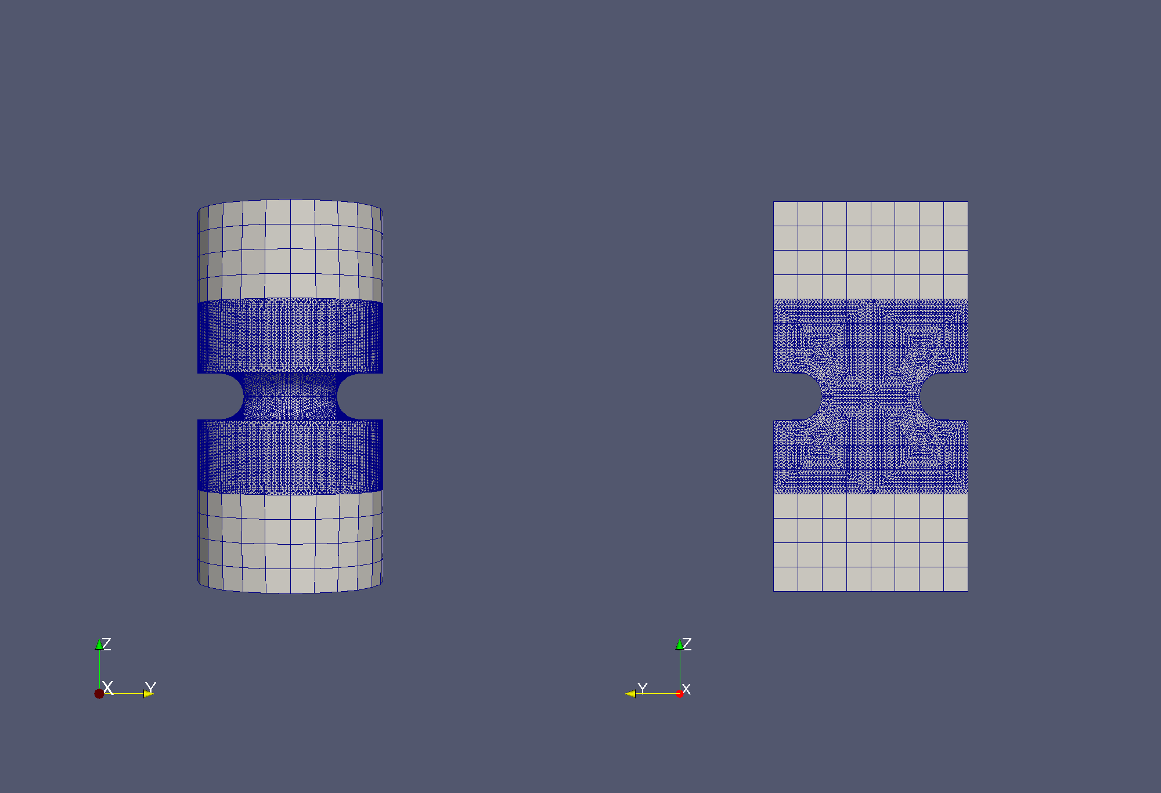
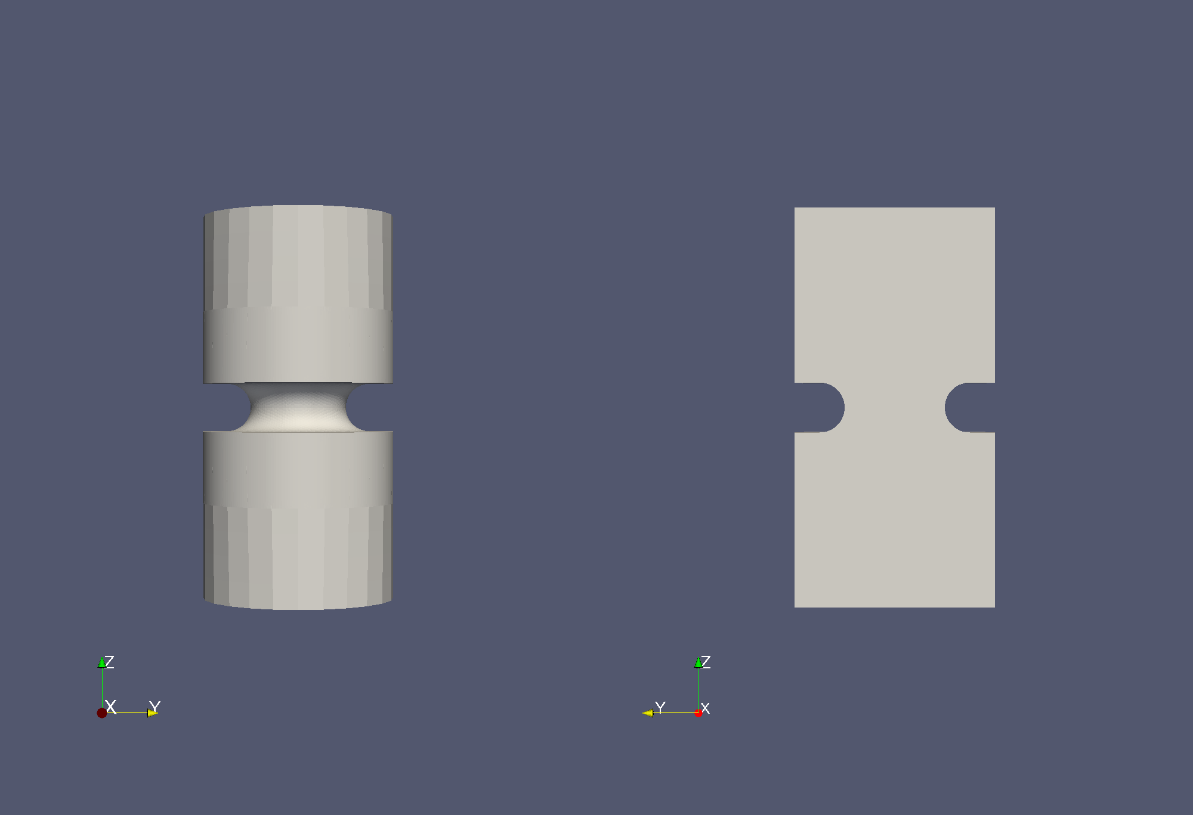
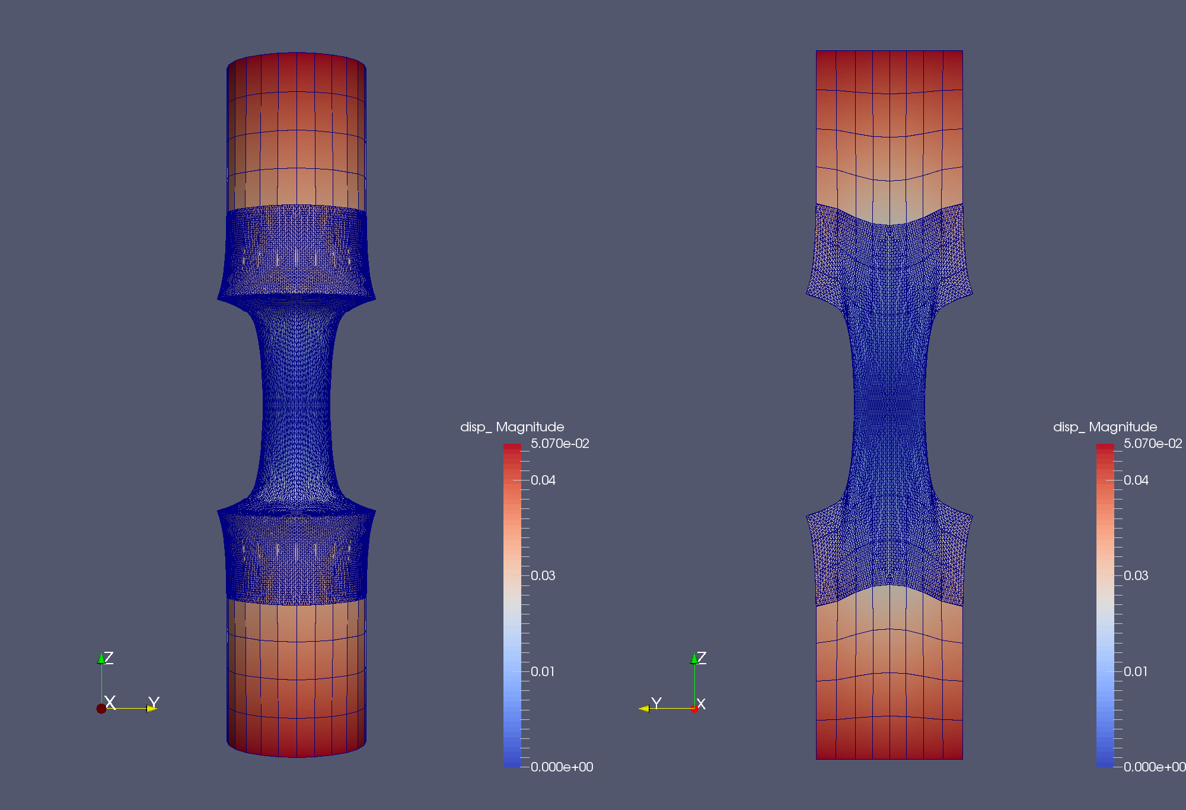
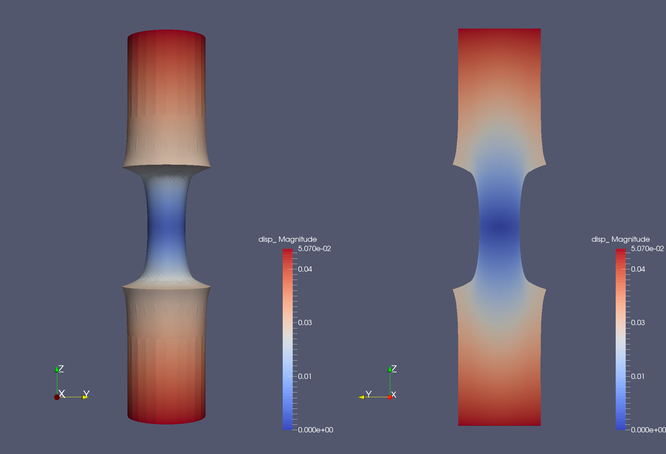
Continuum-to-Continuum Concurrent Multiscale Coupling in Solid Mechanics via the Schwarz Alternating Method
Irina Tezaur, Alejandro Mota, Coleman Alleman
Sandia National Laboratories, Livermore, CA, USA.
SIAM CS&E 2017 Atlanta, GA Feb. 27 – March 3, 2017
SAND2017-1755 C

Slide 2
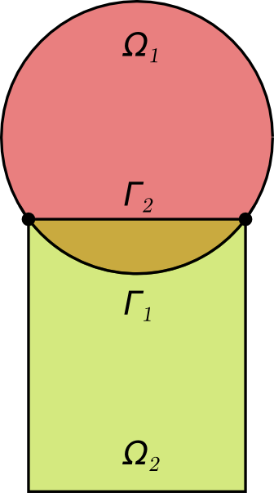
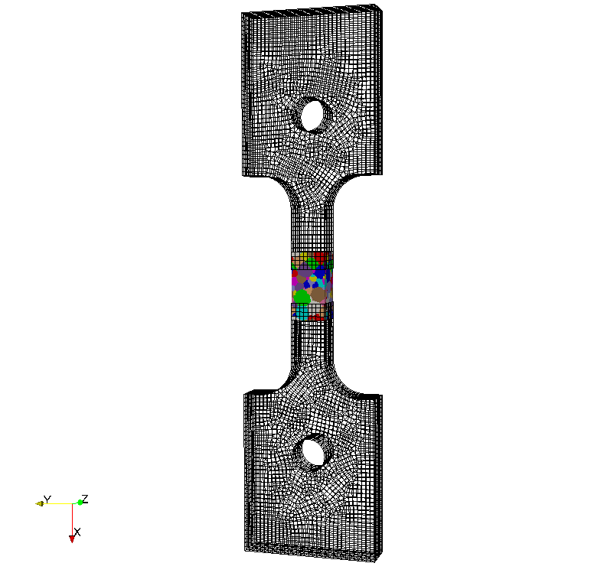
Outline
Motivation
History of Schwarz Alternating Method
Schwarz Alternating Method for Concurrent Multiscale Coupling in Quasistatics
  Four Variants: Full Schwarz, Inexact Schwarz, Modified Schwarz, Monolithic Schwarz
  Implementations: MATLAB, Albany
Numerical Examples
Summary
Future Work
7. References
8. Appendix

Slide 3
Outline
Motivation
History of Schwarz Alternating Method
Schwarz Alternating Method for Concurrent Multiscale Coupling in Quasistatics
  Four Variants: Full Schwarz, Inexact Schwarz, Modified Schwarz, Monolithic Schwarz
  Implementations: MATLAB, Albany
Numerical Examples
Summary
Future Work
7. References
8. Appendix

Slide 4

Motivation for Concurrent Multiscale Coupling
Large scale structural failure frequently originates from small scale phenomena such as defects, microcracks, inhomogeneities and more, which grow quickly in unstable manner.
Failure occurs due to tightly coupled interaction between small scale (stress concentrations, material instabilities, cracks, etc.) and large scale (vibration, impact, high loads and other perturbations).
Roof failure of Boeing 737 aircraft due to fatigue cracks. From imechanica.org
Concurrent multiscale methods are essential for understanding and prediction of behavior of engineering systems when a small scale failure determines the performance of the entire system.
Surface flaw in pressure vessel: interacts with microstructure, which may or may not lead to failure.
Notes:
Fuselage failure: small flaws grow quickly in unstable manner
Pressure vessel: flw in surface interacts with microstructure, which can lead to failure or microstructure or not; determining which one happens is complex
If the activity score is YELLOW or RED then be prepared to address issues, cause, and
path forward.

Slide 5
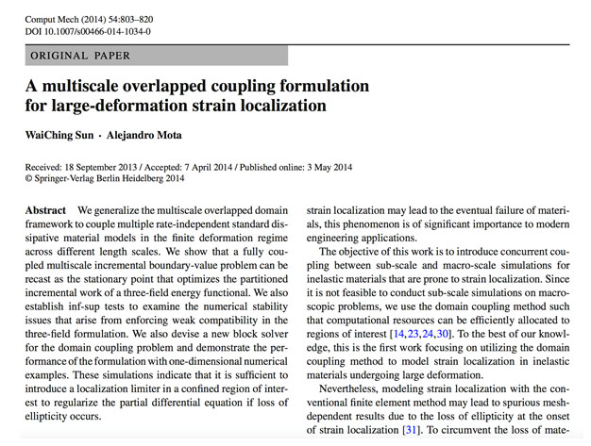
Previous Concurrent Multiscale Coupling Work
Notes:
- Three-field formulation with weak compatibility enforced weakly using LMs.
If the activity score is YELLOW or RED then be prepared to address issues, cause, and
path forward.

Slide 6
Previous Concurrent Multiscale Coupling Work
Three-field multiscale coupling formulation with compatibility enforced weakly using Lagrange multipliers.
Notes:
- Three-field formulation with weak compatibility enforced weakly using LMs.
If the activity score is YELLOW or RED then be prepared to address issues, cause, and
path forward.

Slide 7
Previous Concurrent Multiscale Coupling Work
Method works well, but is difficult to implement into existing codes.
Notes:
- Three field multiscale coupling formulation, with compatibility enforced weakly using LMs.
If the activity score is YELLOW or RED then be prepared to address issues, cause, and
path forward.

Slide 8
Outline
Motivation
History of Schwarz Alternating Method
Schwarz Alternating Method for Concurrent Multiscale Coupling in Quasistatics
  Four Variants: Full Schwarz, Inexact Schwarz, Modified Schwarz, Monolithic Schwarz
  Implementations: MATLAB, Albany
Numerical Examples
Summary
Future Work
7. References
8. Appendix

Slide 9
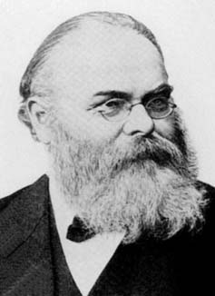
Schwarz Alternating Method for Domain Decomposition
Proposed in 1870 by H. Schwarz for solving Laplace PDE on irregular domains.
Simple idea: if the solution is known in regularly shaped domains, use those as pieces to iteratively build a solution for the more complex domain.
H. Schwarz (1843 – 1921)
Schwarz Alternating Method
Initialize:
Solve PDE by any method on Ω₁ w/ initial guess for Dirichlet BCs on Γ₁.
Iterate until convergence:
Solve PDE by any method (can be different than for Ω₁) on Ω₂ w/ Dirichlet BCs on Γ₂ that are the values just obtained for Ω₁.
Solve PDE by any method (can be different than for Ω₂) on Ω₁ w/ Dirichlet BCs on Γ₁ that are the values just obtained for Ω₂.
Notes:
If the activity score is YELLOW or RED then be prepared to address issues, cause, and
path forward.

Slide 10

Schwarz Alternating Method for Domain Decomposition
Proposed in 1870 by H. Schwarz for solving Laplace PDE on irregular domains.
Simple idea: if the solution is known in regularly shaped domains, use those as pieces to iteratively build a solution for the more complex domain.
H. Schwarz (1843 – 1921)
Schwarz Alternating Method
Initialize:
Solve PDE by any method on Ω₁ w/ initial guess for Dirichlet BCs on Γ₁.
Iterate until convergence:
Solve PDE by any method (can be different than for Ω₁) on Ω₂ w/ Dirichlet BCs on Γ₂ that are the values just obtained for Ω₁.
Solve PDE by any method (can be different than for Ω₂) on Ω₁ w/ Dirichlet BCs on Γ₁ that are the values just obtained for Ω₂.
Requirement for convergence: $Ω_{1}⋂{ Ω}_{2}≠∅$
Notes:
If the activity score is YELLOW or RED then be prepared to address issues, cause, and
path forward.

Slide 11
Schwarz Alternating Method for Domain Decomposition
Proposed in 1870 by H. Schwarz for solving Laplace PDE on irregular domains.
Simple idea: if the solution is known in regularly shaped domains, use those as pieces to iteratively build a solution for the more complex domain.
H. Schwarz (1843 – 1921)
Schwarz Alternating Method
Initialize:
Solve PDE by any method on Ω₁ w/ initial guess for Dirichlet BCs on Γ₁.
Iterate until convergence:
Solve PDE by any method (can be different than for Ω₁) on Ω₂ w/ Dirichlet BCs on Γ₂ that are the values just obtained for Ω₁.
Solve PDE by any method (can be different than for Ω₂) on Ω₁ w/ Dirichlet BCs on Γ₁ that are the values just obtained for Ω₂.
Requirement for convergence: $Ω_{1}⋂{ Ω}_{2}≠∅$
Schwarz alternating method most commonly used as a preconditioner for Krylov iterative methods to solve linear algebraic equations.
Notes:
If the activity score is YELLOW or RED then be prepared to address issues, cause, and
path forward.

Slide 12
Schwarz Alternating Method after Schwarz
Using the Schwarz alternating as a discretization method for PDEs is natural idea with a sound theoretical foundation.
Notes:
If the activity score is YELLOW or RED then be prepared to address issues, cause, and
path forward.

Slide 13
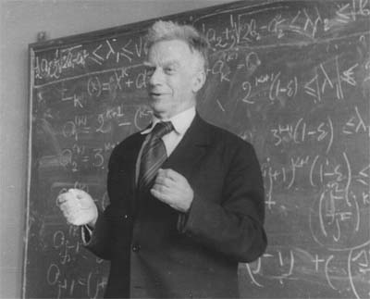
Schwarz Alternating Method after Schwarz
Using the Schwarz alternating as a discretization method for PDEs is natural idea with a sound theoretical foundation.
S. L. Sobolev (1936): posed Schwarz method for linear elasticity in variational form and proved method’s convergence by proposing a convergent sequence of energy functionals.
S. L. Sobolev (1908 – 1989)
Notes:
If the activity score is YELLOW or RED then be prepared to address issues, cause, and
path forward.

Slide 14
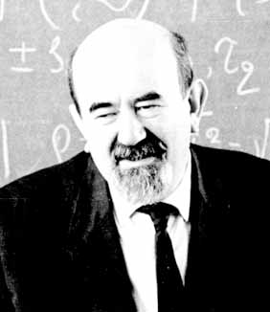
Schwarz Alternating Method after Schwarz
Using the Schwarz alternating as a discretization method for PDEs is natural idea with a sound theoretical foundation.
S. L. Sobolev (1936): posed Schwarz method for linear elasticity in variational form and proved method’s convergence by proposing a convergent sequence of energy functionals.
S. G. Mikhlin (1951): proved convergence of Schwarz method for general linear elliptic PDEs.
S. L. Sobolev (1908 – 1989)
S. G. Mikhlin (1908 – 1990)
Notes:
If the activity score is YELLOW or RED then be prepared to address issues, cause, and
path forward.

Slide 15

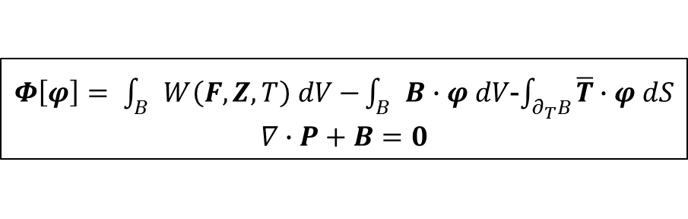
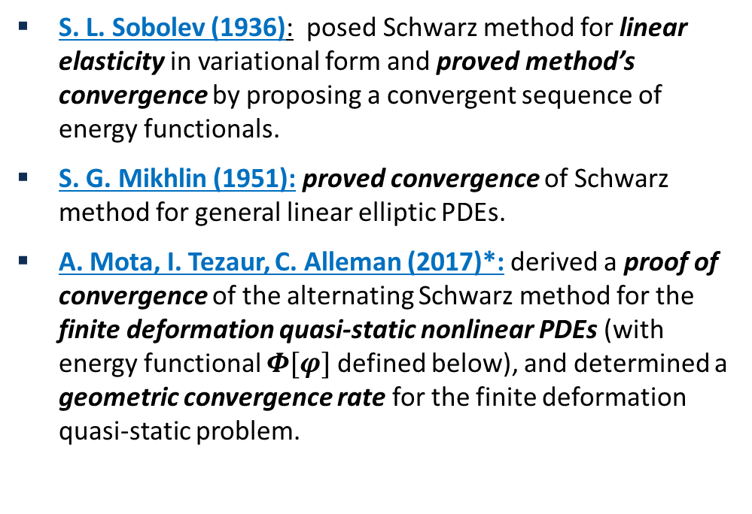
Schwarz Alternating Method after Schwarz
Using the Schwarz alternating as a discretization method for PDEs is natural idea with a sound theoretical foundation.
S. L. Sobolev (1936): posed Schwarz method for linear elasticity in variational form and proved method’s convergence by proposing a convergent sequence of energy functionals.
S. G. Mikhlin (1951): proved convergence of Schwarz method for general linear elliptic PDEs.
A. Mota, I. Tezaur, C. Alleman (2017)*: derived a proof of convergence of the alternating Schwarz method for the finite deformation quasi-static nonlinear PDEs (with energy functional $Φ[φ]$ defined below), and determined a geometric convergence rate for the finite deformation quasi-static problem.
S. L. Sobolev (1908 – 1989)
S. G. Mikhlin (1908 – 1990)
$Φ\left[φ\right]= \int_{B}{W\left(F,Z,T\right) dV−}\int_{B}{B∙φ dV}$-$\int_{∂_{T}B}{\overline{T}∙φ dS}$
$$∇∙P+B=0$$
A. Mota, I. Tezaur, C. Alleman
*A. Mota, I. Tezaur, C. Alleman. "The Schwarz Alternating Method in Solid Mechanics", CMAME (2017), in press.
Notes:
If the activity score is YELLOW or RED then be prepared to address issues, cause, and
path forward.

Slide 16
Outline
Motivation
History of Schwarz Alternating Method
Schwarz Alternating Method for Concurrent Multiscale Coupling in Quasistatics
  Four Variants: Full Schwarz, Inexact Schwarz, Modified Schwarz, Monolithic Schwarz
  Implementations: MATLAB, Albany
Numerical Examples
Summary
Future Work
7. References
8. Appendix

Slide 17
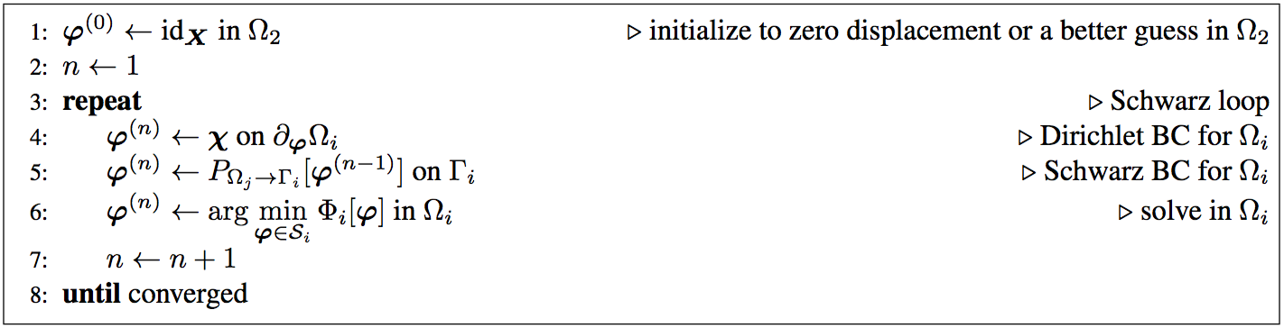
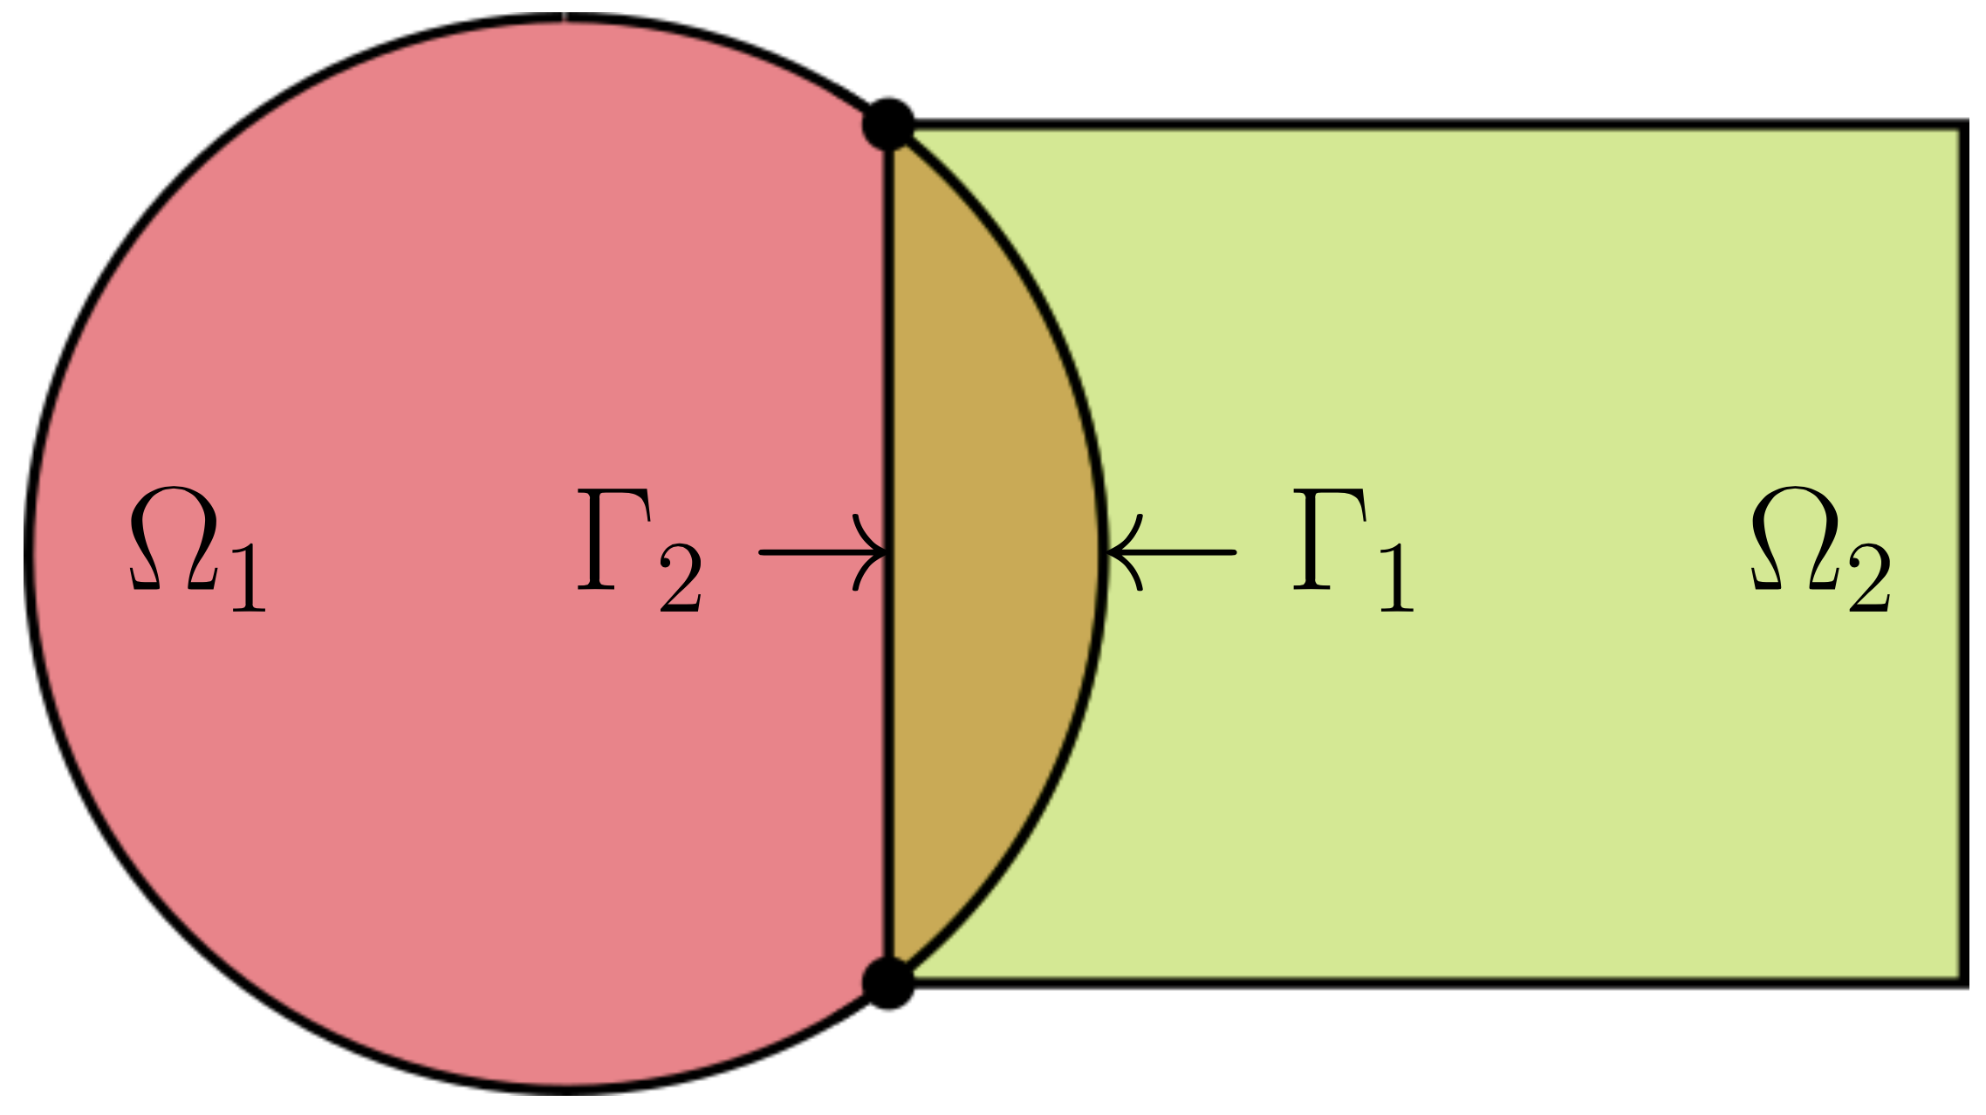
Schwarz Alternating Method for Multiscale Coupling in Quasistatics
Advantages:
Conceptually very simple.

Slide 18
Schwarz Alternating Method for Multiscale Coupling in Quasistatics
Advantages:
Conceptually very simple.
Allows the coupling of regions with different non-conforming meshes, different element types, and different levels of refinement.

Slide 19
Schwarz Alternating Method for Multiscale Coupling in Quasistatics
Advantages:
Conceptually very simple.
Allows the coupling of regions with different non-conforming meshes, different element types, and different levels of refinement.
Information is exchanged among two or more regions, making coupling concurrent.

Slide 20
Schwarz Alternating Method for Multiscale Coupling in Quasistatics
Advantages:
Conceptually very simple.
Allows the coupling of regions with different non-conforming meshes, different element types, and different levels of refinement.
Information is exchanged among two or more regions, making coupling concurrent.
Different solvers can be used for the different regions.

Slide 21
Schwarz Alternating Method for Multiscale Coupling in Quasistatics
Advantages:
Conceptually very simple.
Allows the coupling of regions with different non-conforming meshes, different element types, and different levels of refinement.
Information is exchanged among two or more regions, making coupling concurrent.
Different solvers can be used for the different regions.
Different material models can be coupled provided that they are compatible in the overlap region.

Slide 22
Schwarz Alternating Method for Multiscale Coupling in Quasistatics
Advantages:
Conceptually very simple.
Allows the coupling of regions with different non-conforming meshes, different element types, and different levels of refinement.
Information is exchanged among two or more regions, making coupling concurrent.
Different solvers can be used for the different regions.
Different material models can be coupled provided that they are compatible in the overlap region.
Simplifies the task of meshing complex geometries for the different scales.

Slide 23
Schwarz Alternating Method for Multiscale Coupling in Quasistatics
Advantages:
Conceptually very simple.
Allows the coupling of regions with different non-conforming meshes, different element types, and different levels of refinement.
Information is exchanged among two or more regions, making coupling concurrent.
Different solvers can be used for the different regions.
Different material models can be coupled provided that they are compatible in the overlap region.
Simplifies the task of meshing complex geometries for the different scales.

Slide 24
Outline
Motivation
History of Schwarz Alternating Method
Schwarz Alternating Method for Concurrent Multiscale Coupling in Quasistatics
  Four Variants: Full Schwarz, Inexact Schwarz, Modified Schwarz, Monolithic Schwarz
  Implementations: MATLAB, Albany
Numerical Examples
Summary
Future Work
7. References
8. Appendix

Slide 25
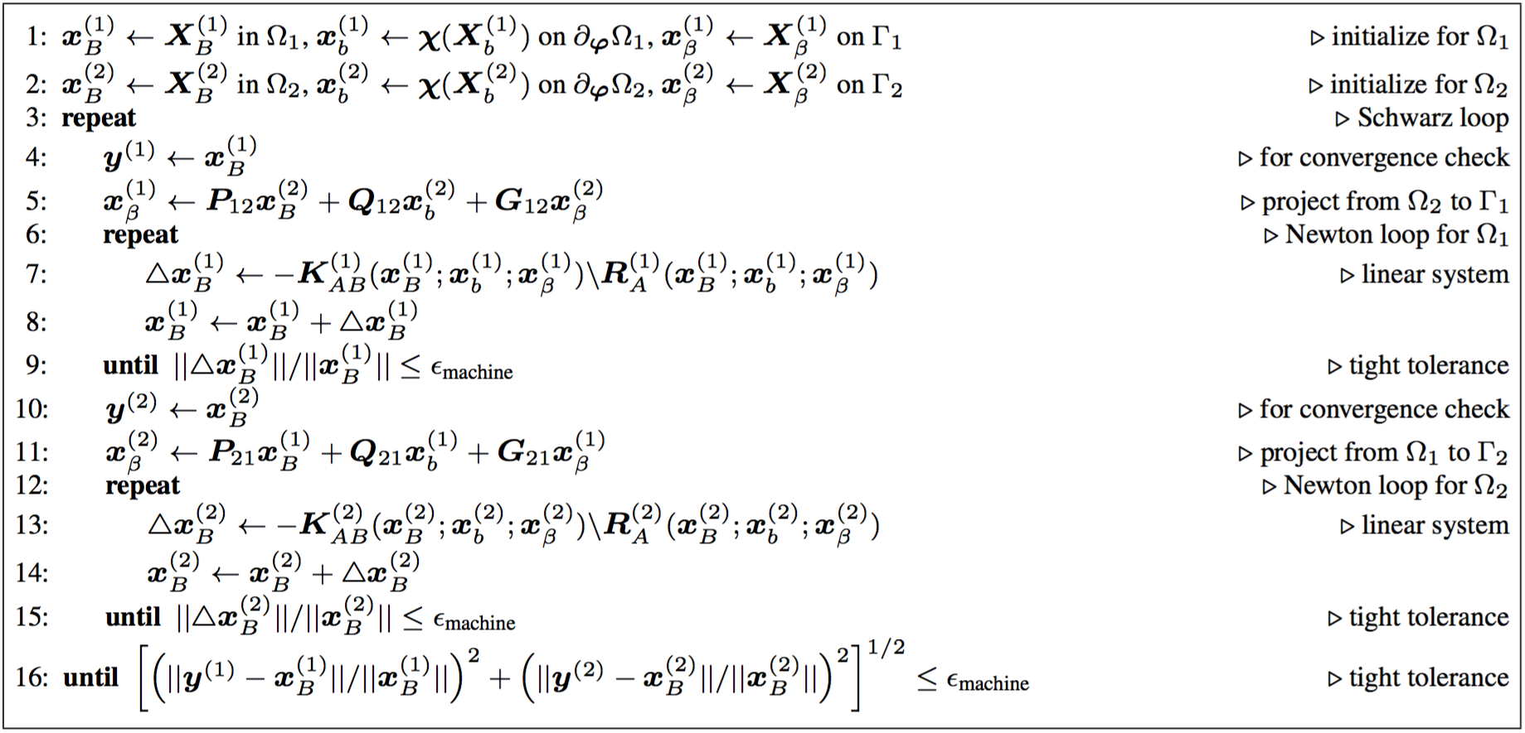
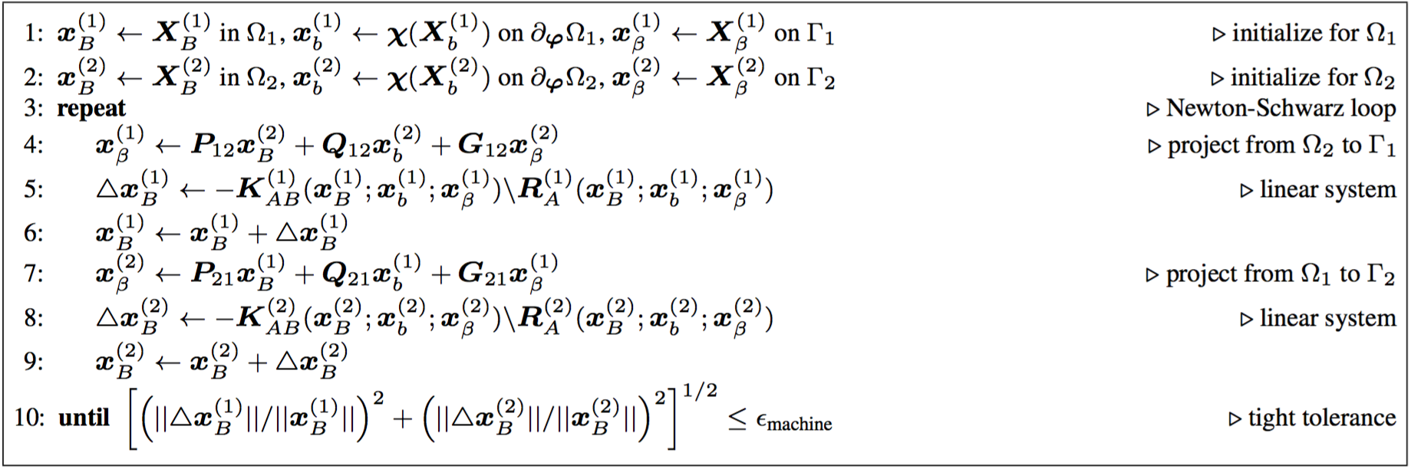
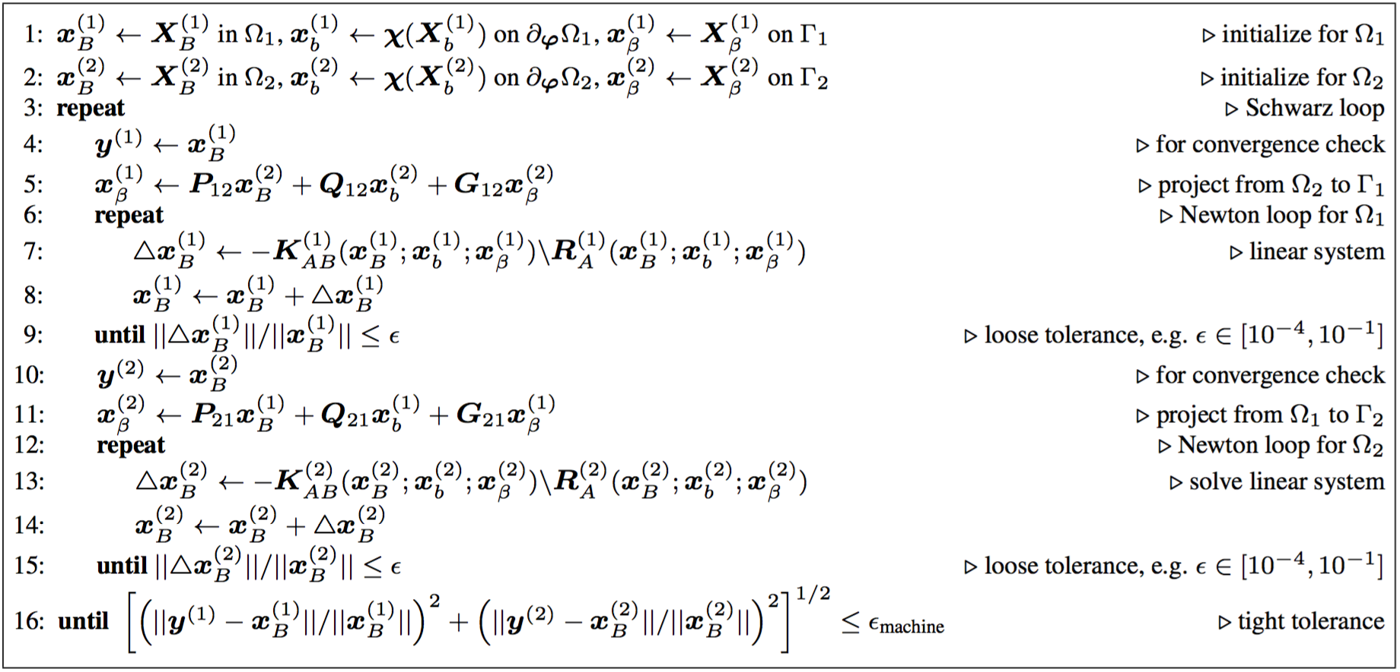
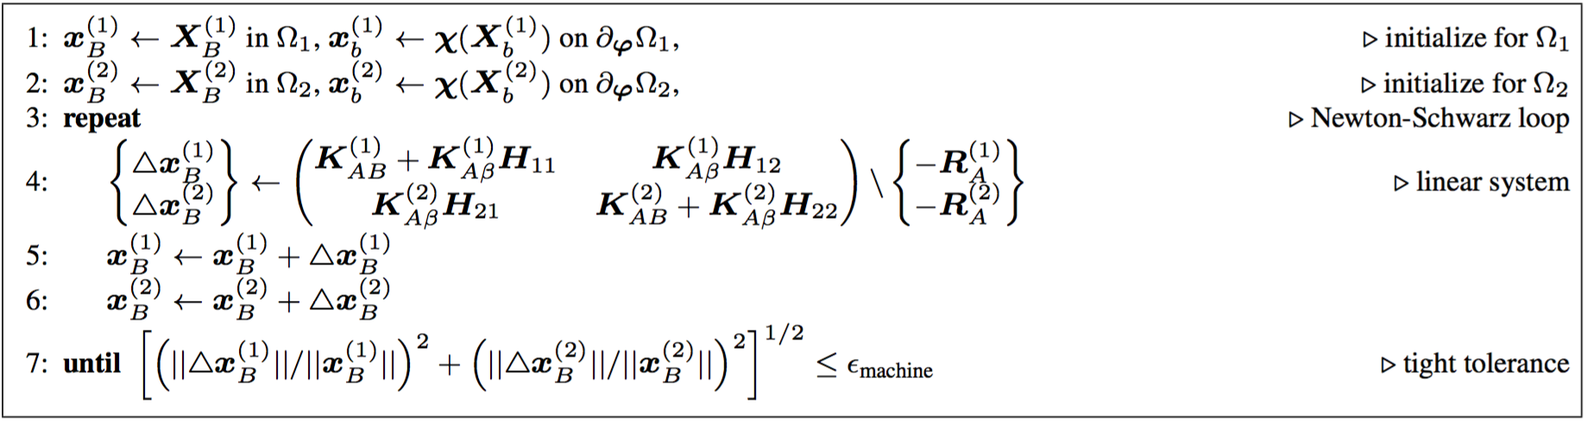
Four Variants of the Schwarz Alternating Method
Full Schwarz
Modified Schwarz
Inexact Schwarz
Monolithic Schwarz

Slide 26
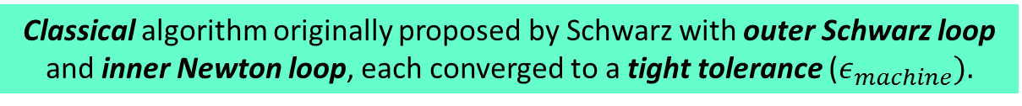
Full Schwarz Method
Classical algorithm originally proposed by Schwarz with outer Schwarz loop and inner Newton loop, each converged to a tight tolerance ($ε_{machine}).$

Slide 27
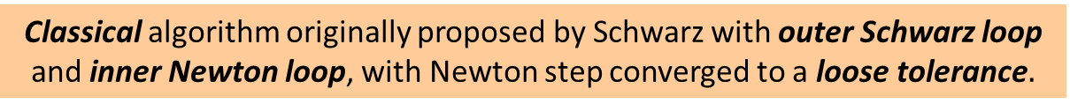
Inexact Schwarz Method
Classical algorithm originally proposed by Schwarz with outer Schwarz loop and inner Newton loop, with Newton step converged to a loose tolerance$.$

Slide 28
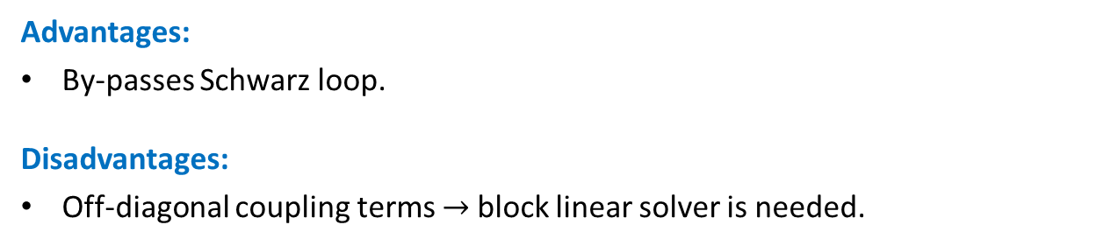
Monolithic Schwarz Method
Combines Schwarz and Newton loop into since Newton-Schwarz loop, with elimination of Schwarz boundary DOFs, and tight convergence tolerance.
Advantages:
By-passes Schwarz loop.
Disadvantages:
Off-diagonal coupling terms $→$block linear solver is needed.

Slide 29
Modified Schwarz Method
Combines Schwarz and Newton loop into since Newton-Schwarz loop, with Schwarz boundaries at Dirichlet boundaries and tight convergence tolerance.
Advantages:
By-passes Schwarz loop.
No diagonal coupling (conventional linear solver can be used in each subdomain).

Slide 30
Modified Schwarz Method
Combines Schwarz and Newton loop into since Newton-Schwarz loop, with Schwarz boundaries at Dirichlet boundaries and tight convergence tolerance.
Advantages:
By-passes Schwarz loop.
No diagonal coupling (conventional linear solver can be used in each subdomain).
Least-intrusive variant: by-passes Schwarz iteration, no need for block solver.

Slide 31
Outline
Motivation
History of Schwarz Alternating Method
Schwarz Alternating Method for Concurrent Multiscale Coupling in Quasistatics
  Four Variants: Full Schwarz, Inexact Schwarz, Modified Schwarz, Monolithic Schwarz
  Implementations: MATLAB, Albany
Numerical Examples
Summary
Future Work
7. References
8. Appendix

Slide 32
Implementations
All four variants implemented in 3D MATLAB code.
Full Schwarz
Modified Schwarz
Inexact Schwarz
Monolithic Schwarz

Slide 33

Implementations
All four variants implemented in 3D MATLAB code.
Modified & monolithic Schwarz variants implemented in parallel C++ Albany code.
Full Schwarz
Modified Schwarz
Inexact Schwarz
Monolithic Schwarz

Slide 34
Implementations
All four variants implemented in 3D MATLAB code.
Modified & monolithic Schwarz variants implemented in parallel C++ Albany code.
Full Schwarz
Modified Schwarz
Inexact Schwarz
Monolithic Schwarz

Slide 35

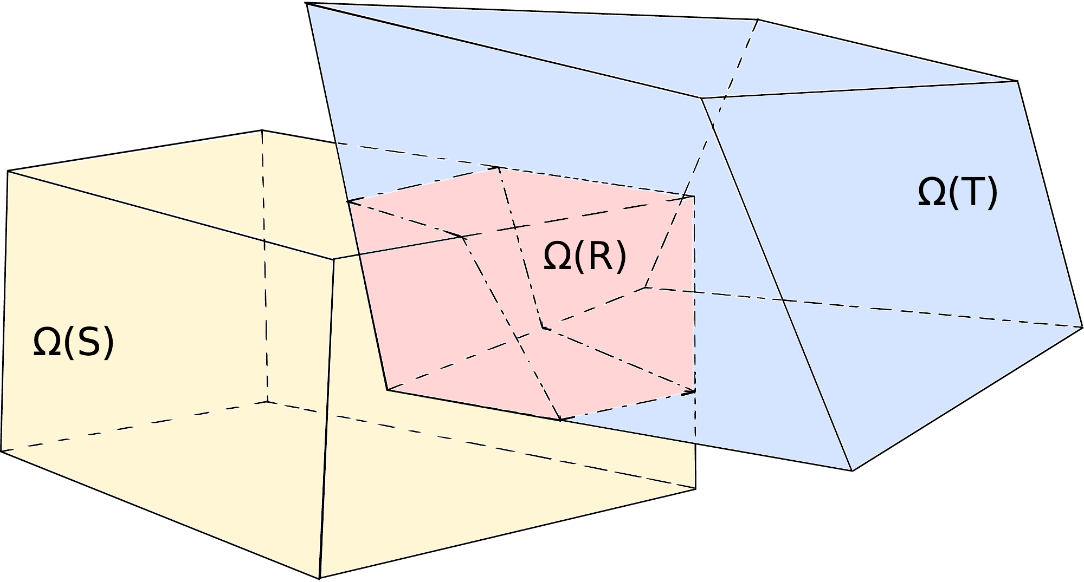
Schwarz Alternating Method in Albany Code
Modified & monolithic Schwarz versions have been implemented within the LCM project in Sandia’s open-source parallel, C++, multi-physics, finite element code, Albany.
Component-based design for rapid development of capabilities.
Extensive use of libraries from the open-source Trilinos project.
  Use of the Phalanx package to decompose complex problem into simpler problems with managed dependencies.
  Use of the Sacado package for automatic differentiation.
  Use of Teko package for block preconditioning.
Parallel implementation of Schwarz alternating method uses the Data Transfer Kit (DTK).
All software available on GitHub.
https://github.com/gahansen/Albany
https://github.com/trilinos/trilinos
https://github.com/ORNL-CEES/DataTransferKit

Slide 36
Outline
Motivation
History of Schwarz Alternating Method
Schwarz Alternating Method for Concurrent Multiscale Coupling in Quasistatics
  Four Variants: Full Schwarz, Inexact Schwarz, Modified Schwarz, Monolithic Schwarz
  Implementations: MATLAB, Albany
Numerical Examples
Summary
Future Work
7. References
8. Appendix

Slide 37
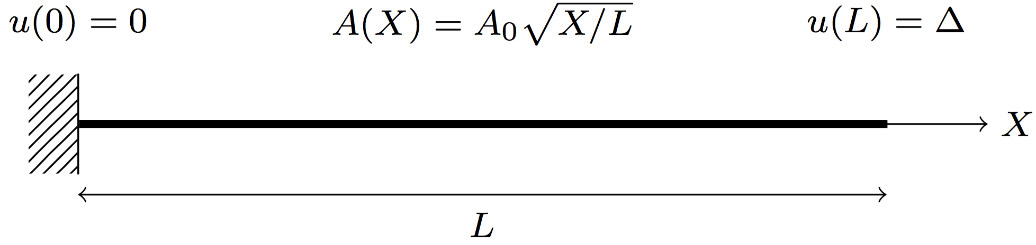
Example #1: Foulk’s Singular Bar
1D proof of concept problem:
  1D bar with area proportional to square root of length.
  Strong singularity on left end of bar.
  Simple hyperelestic material model with no damage.
  MATLAB implementation.
Problem goals:
  Explore viability of 4 variants of the Schwarz alternating method.
  Test convergence and compare with literature (Evans, 1986).
    Expect faster convergence in fewer iterations with increased overlap.

Slide 38
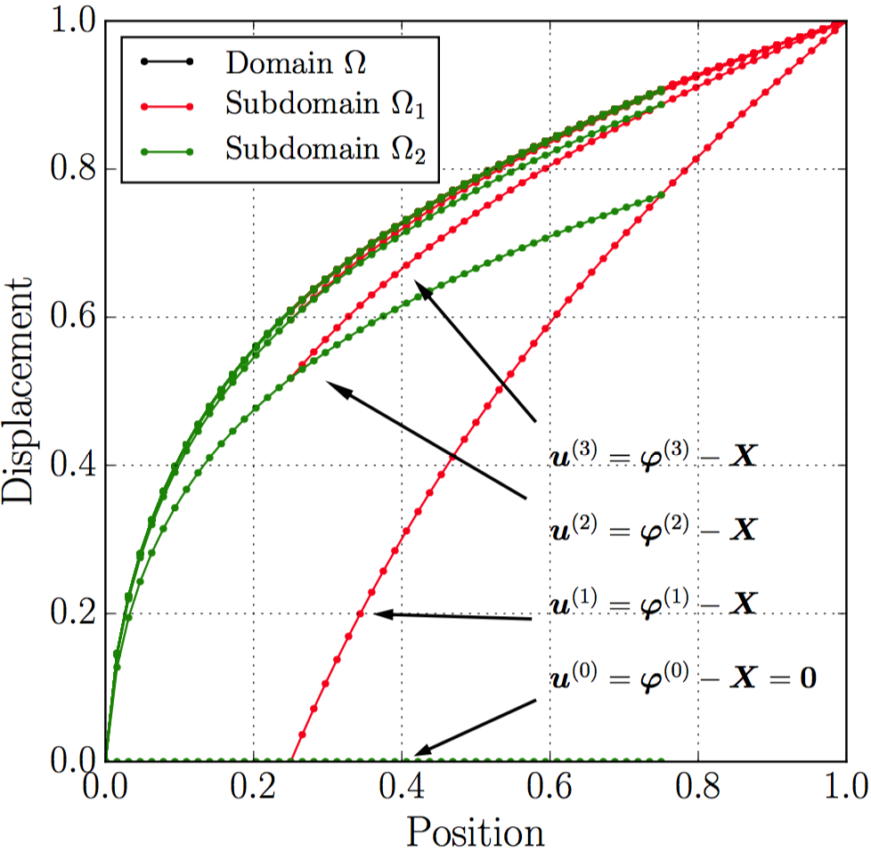
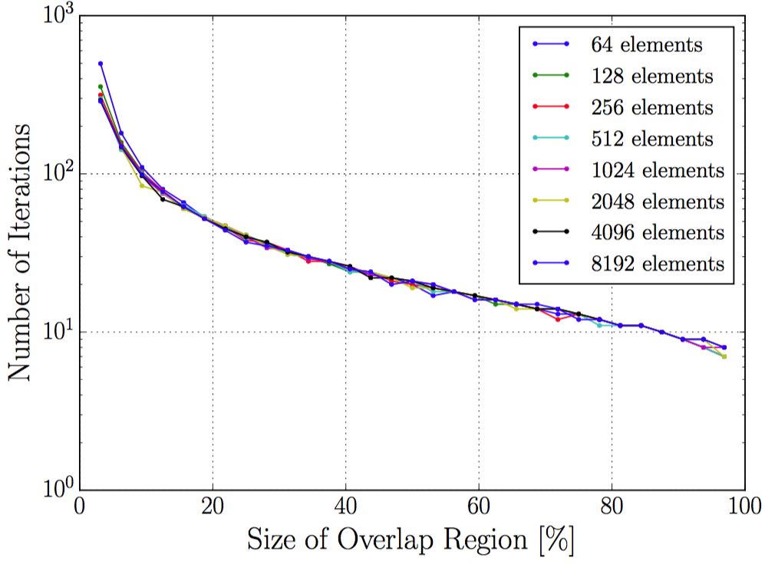
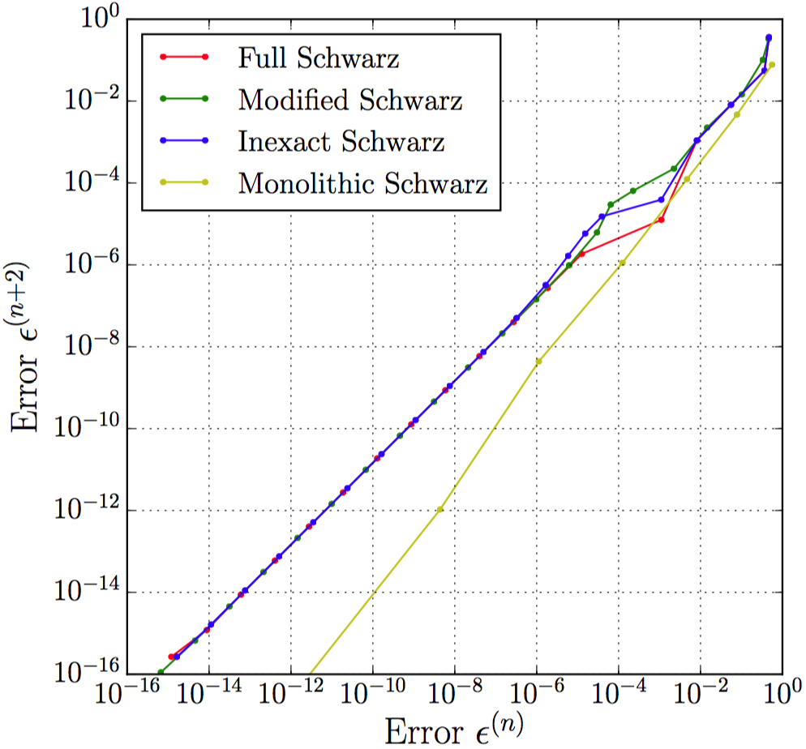
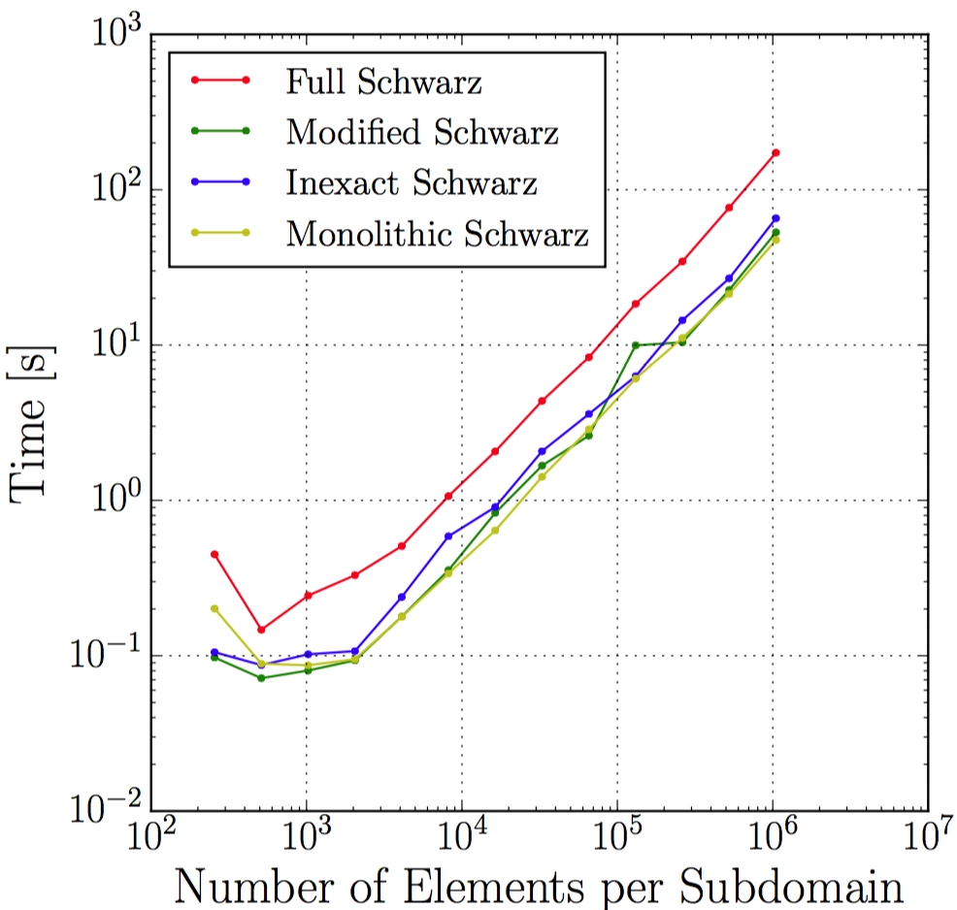
Singular Bar and Schwarz Variants
Notes:
Linear convergence for all methods (bottom left)
Monolithic Schwarz converges faster but timings are similar -> all implementations are interchangeable (bottom right)
Amount of overlap critical for convergence (top right)

Slide 39
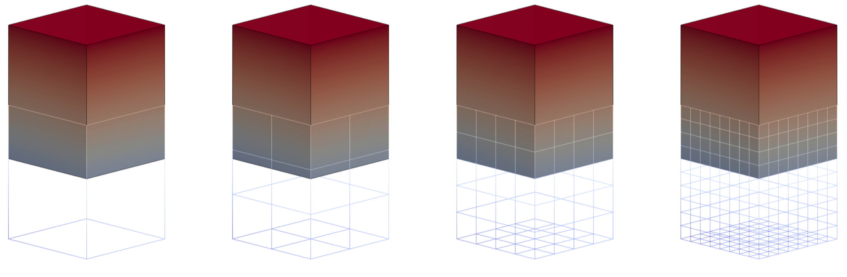
Example #2: Cuboid Problem
Coupling of two cuboids with square base (above).
Neohookean-type material model.
Combined Newton-Schwarz Iteration

Slide 40
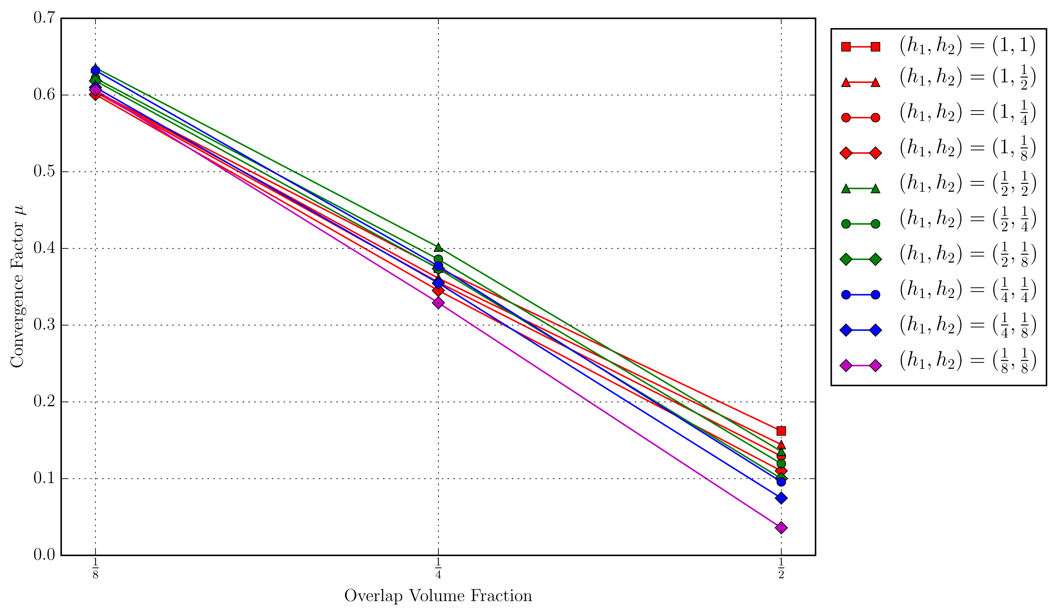
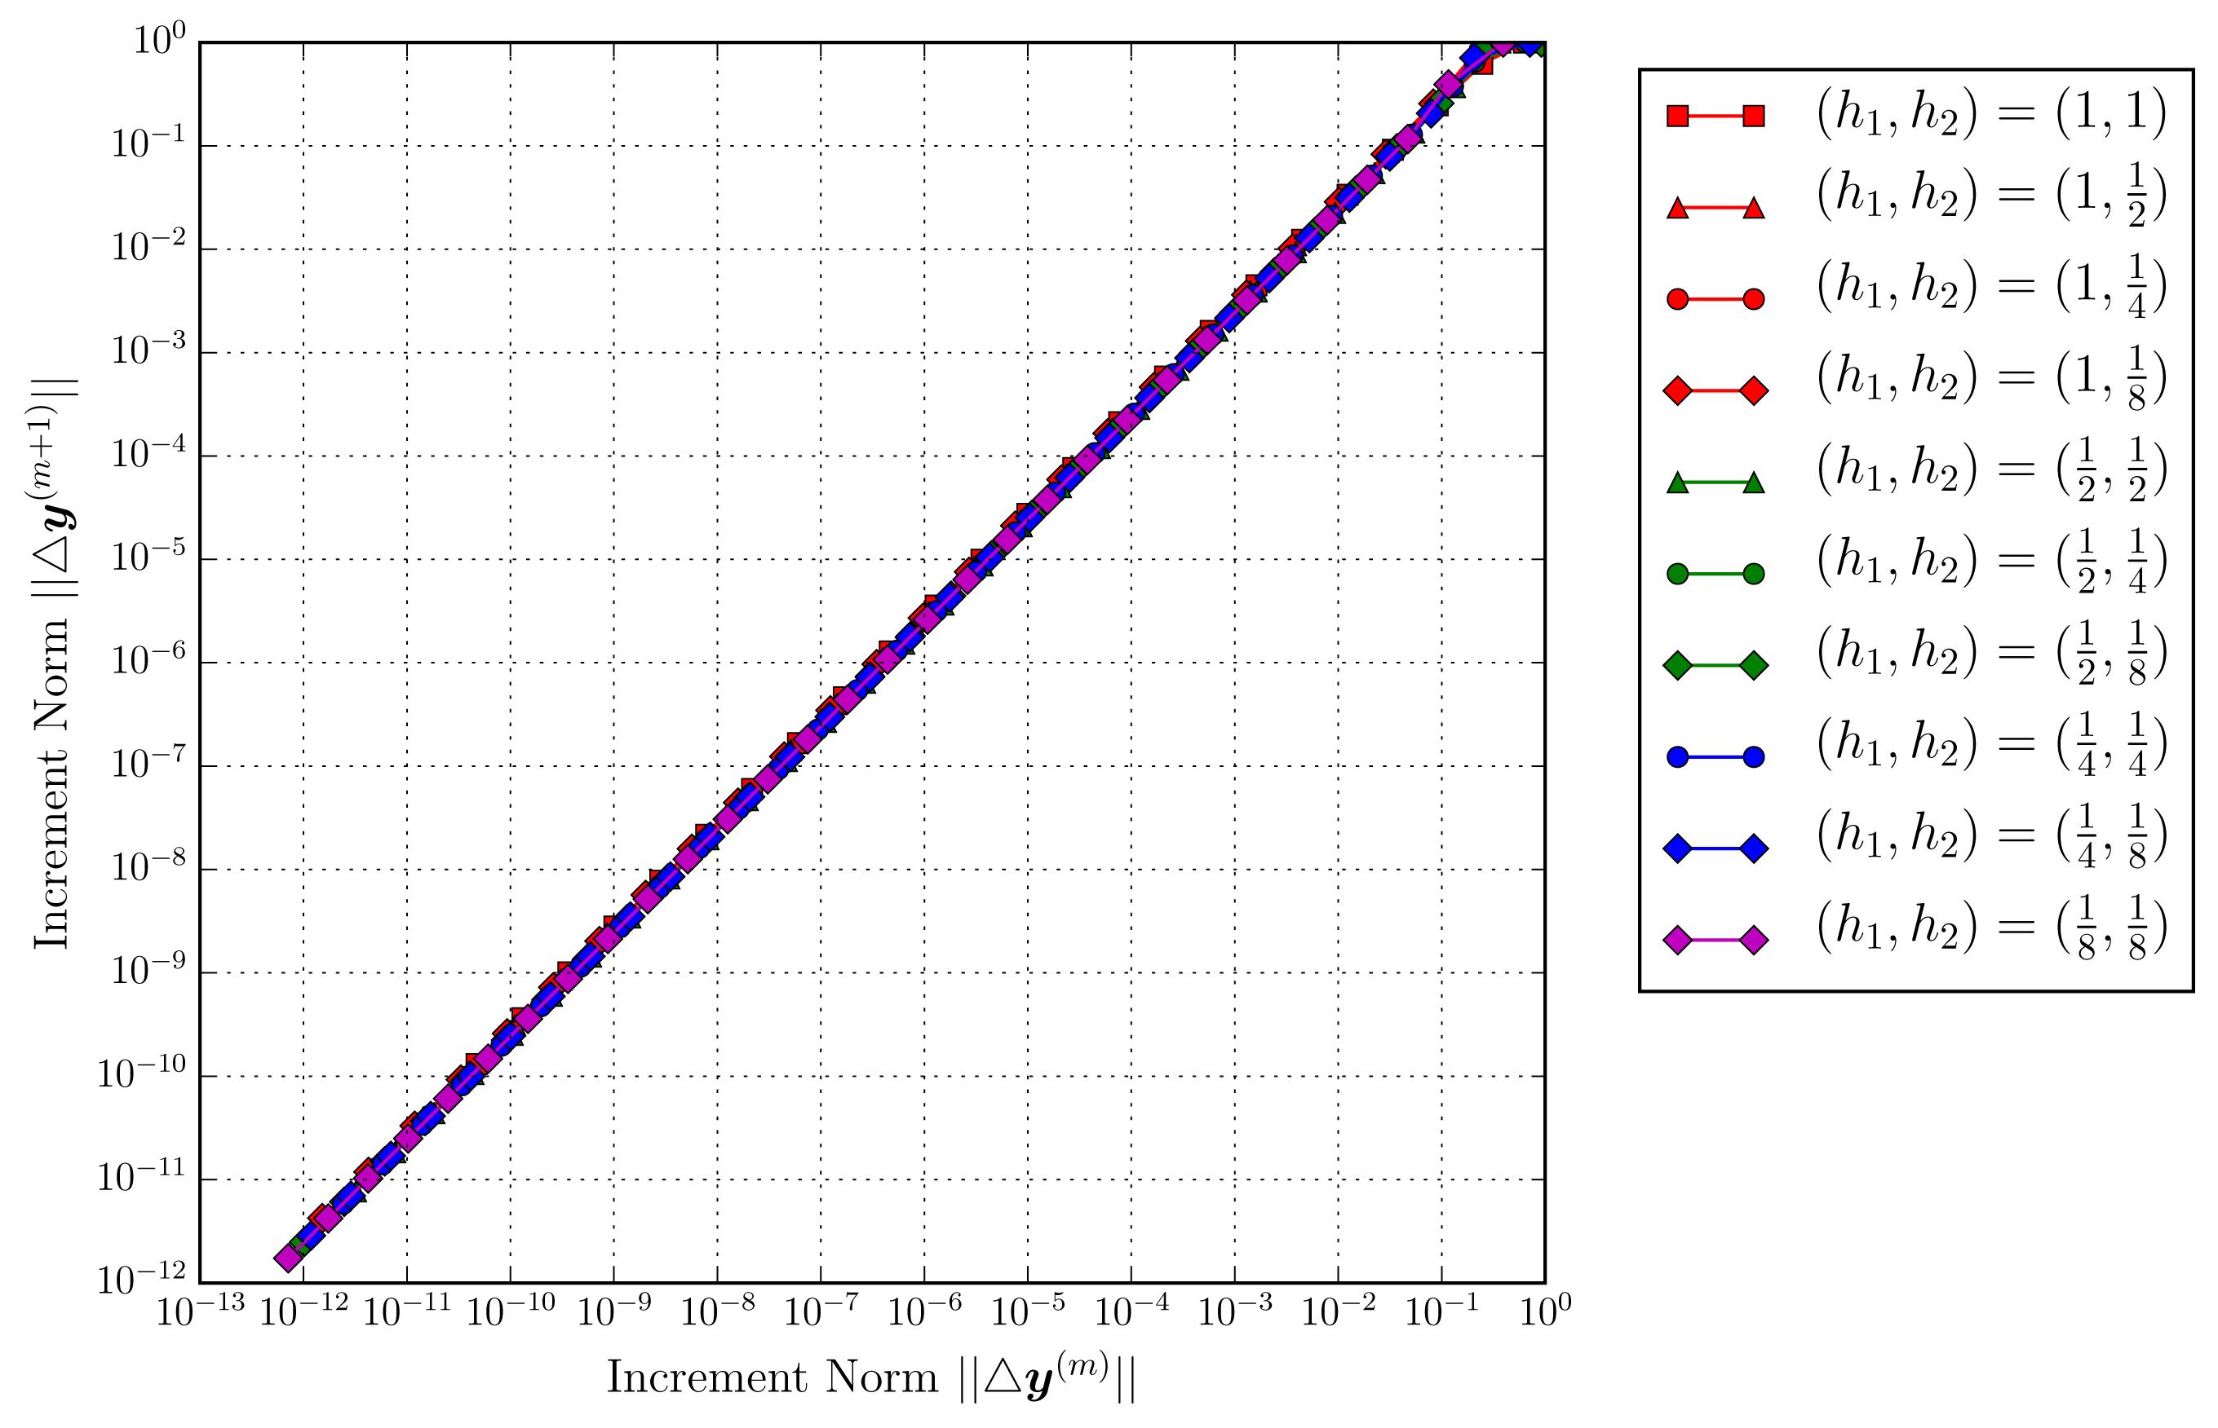

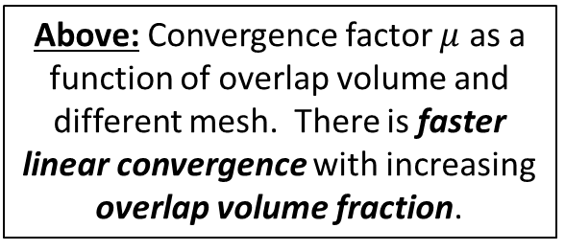
Cuboid Problem: Convergence with Overlap & Refinement
Below: Convergence of the cuboid problem for different mesh sizes and fixed overlap volume fraction. The Schwarz alternating method converges linearly.
Above: Convergence factor $μ$ as a function of overlap volume and different mesh. There is faster linear convergence with increasing overlap volume fraction.
$$∆y^{(m+1)}≤μ∆y^{(m)}$$

Slide 41
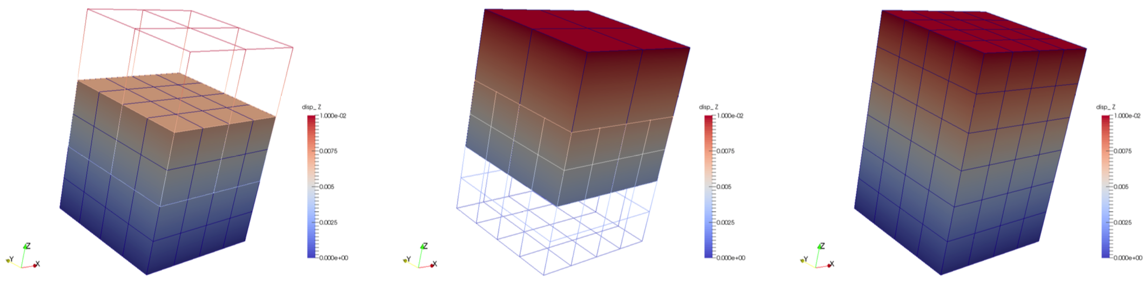
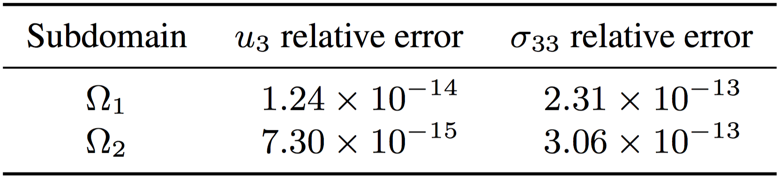
Cuboid Problem: Schwarz Error

Slide 42
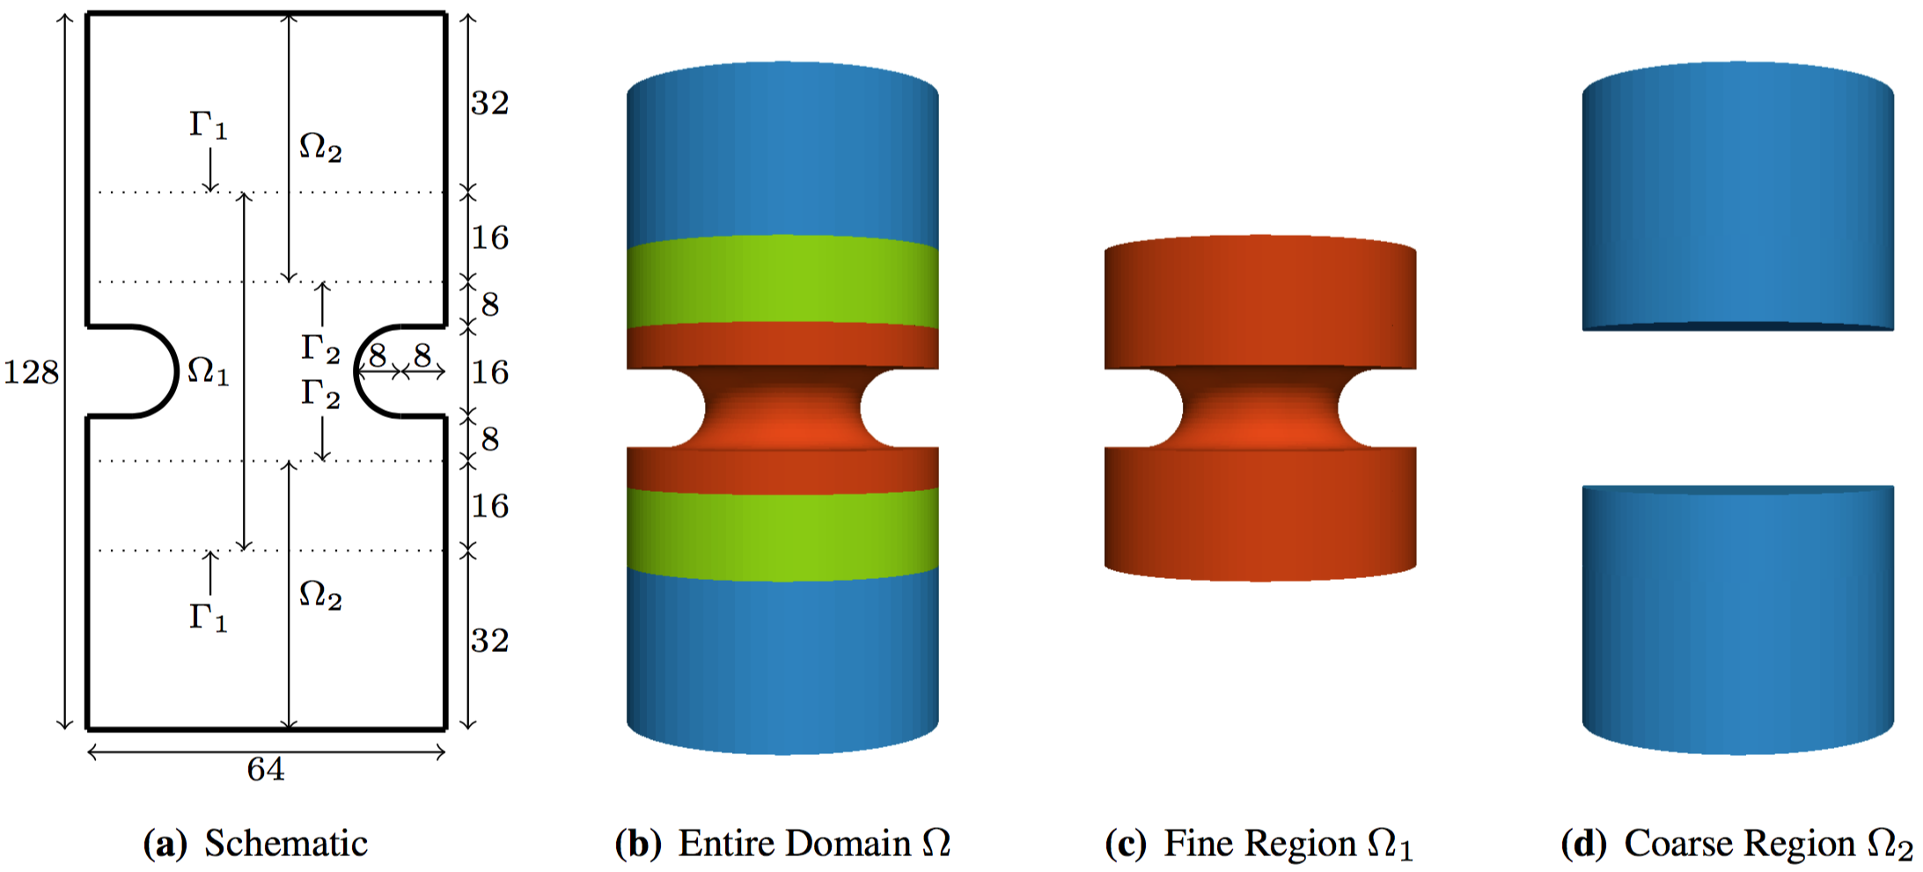
Example #3: Notched Cylinder
Notched cylinder that is stretched along its axial direction.
Domain decomposed into two subdomains.
Neohookean-type material model.

Slide 43
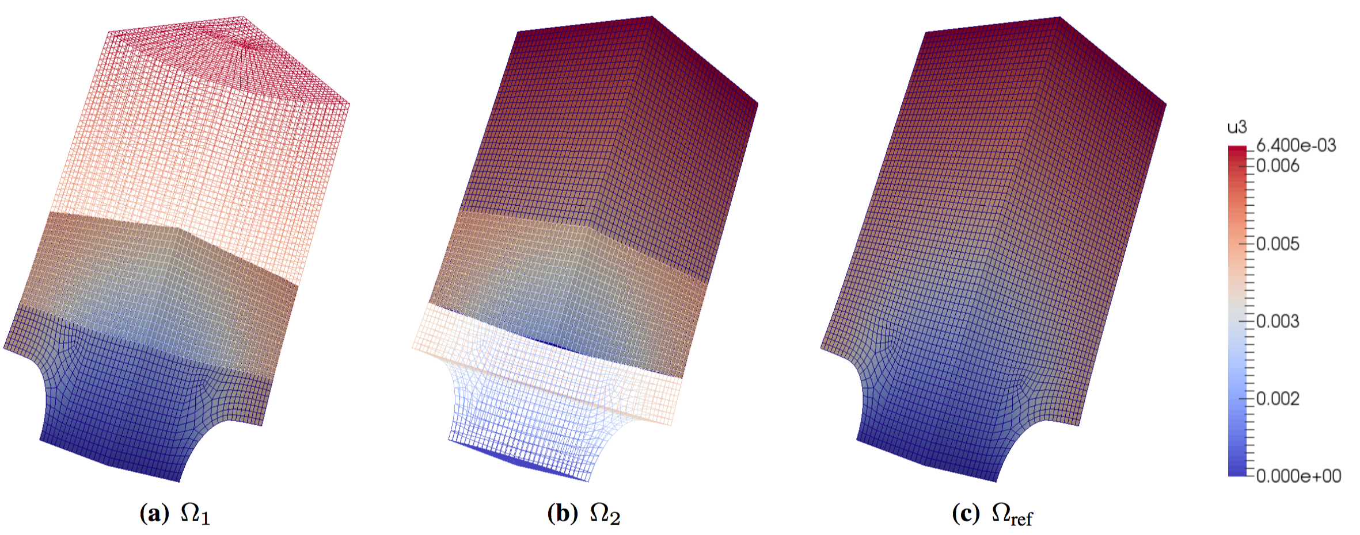
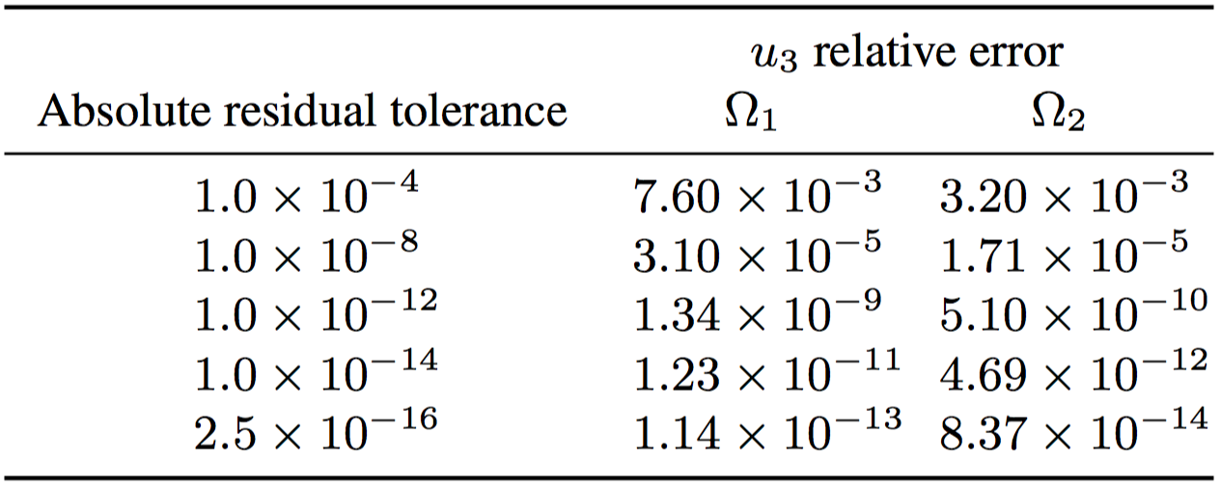
Notched Cylinder: Conformal HEX-HEX Coupling

Slide 44
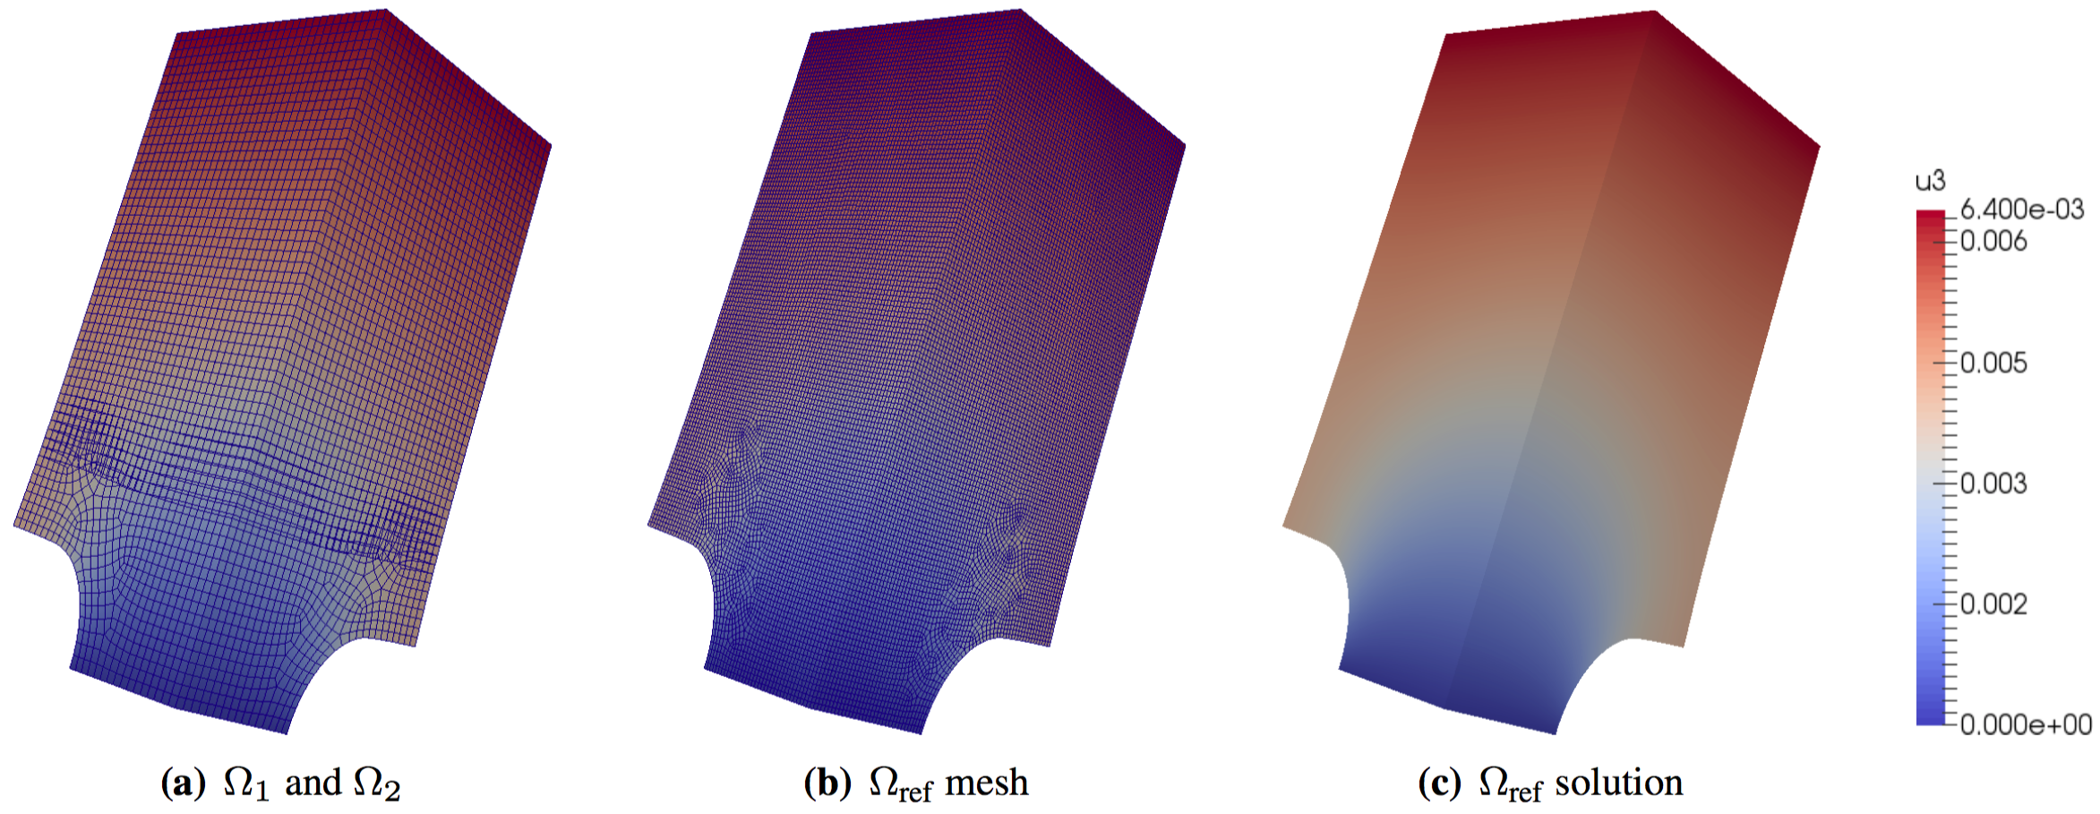
Notched Cylinder: Nonconformal HEX-HEX Coupling

Slide 45
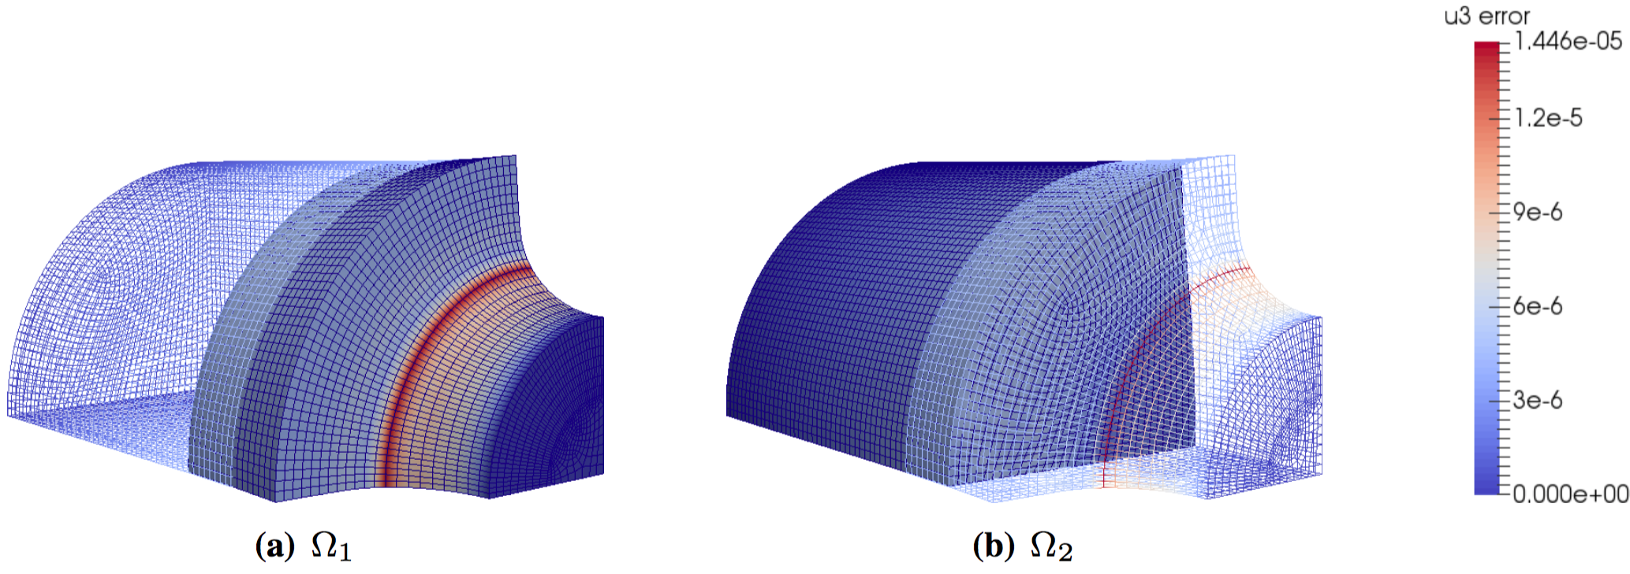
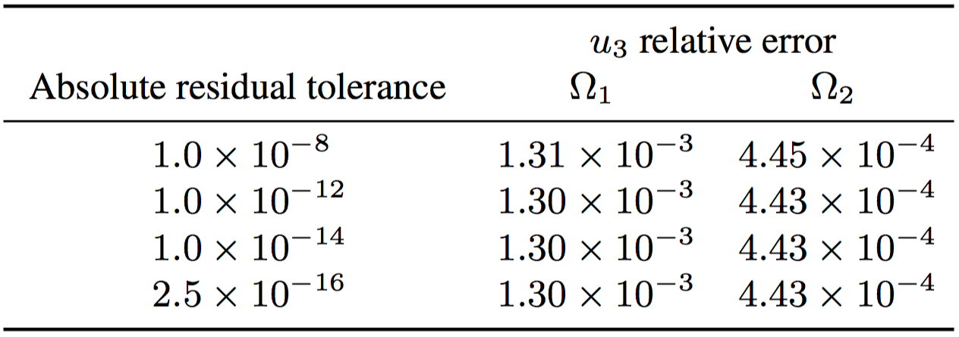
Notched Cylinder: Nonconformal HEX-HEX Coupling
Notes:
- Geometric error

Slide 46
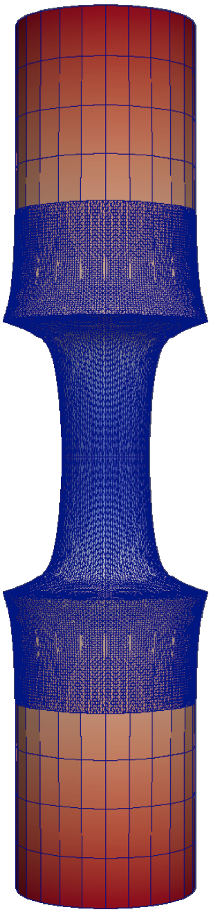
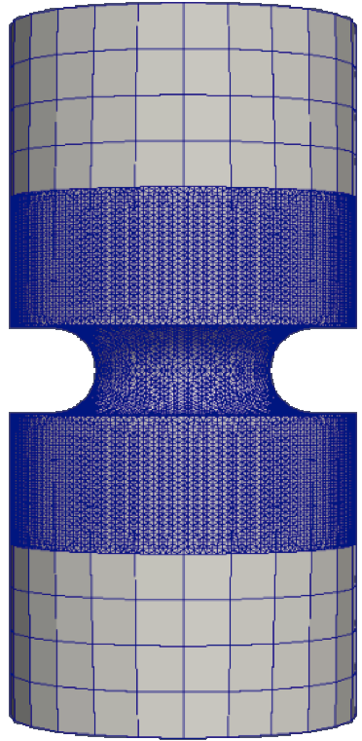
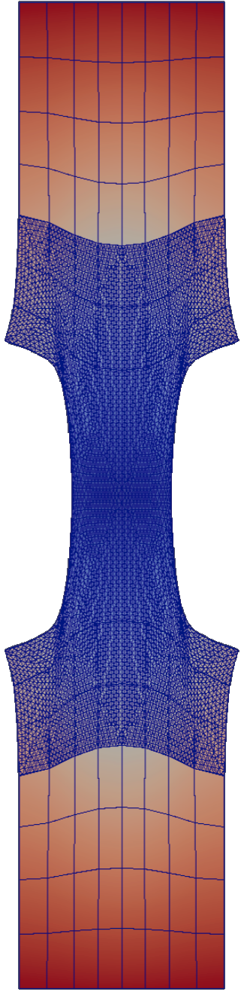
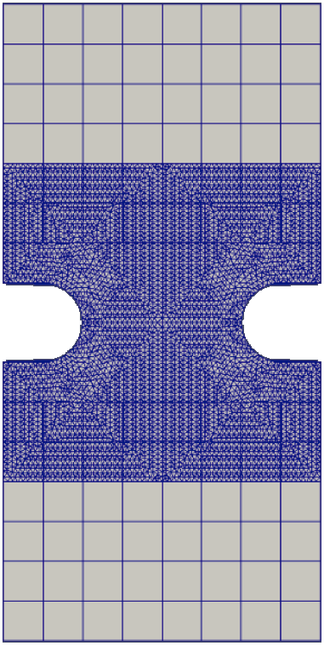
Notched Cylinder: TET-HEX Coupling
The Schwarz alternating method is capable of coupling different mesh topologies.
The notched region, where stress concentrations are expected, is finely meshed with tetrahedral elements.
The top and bottom regions, presumably of less interest, are meshed with coarser hexahedral elements.

Slide 47
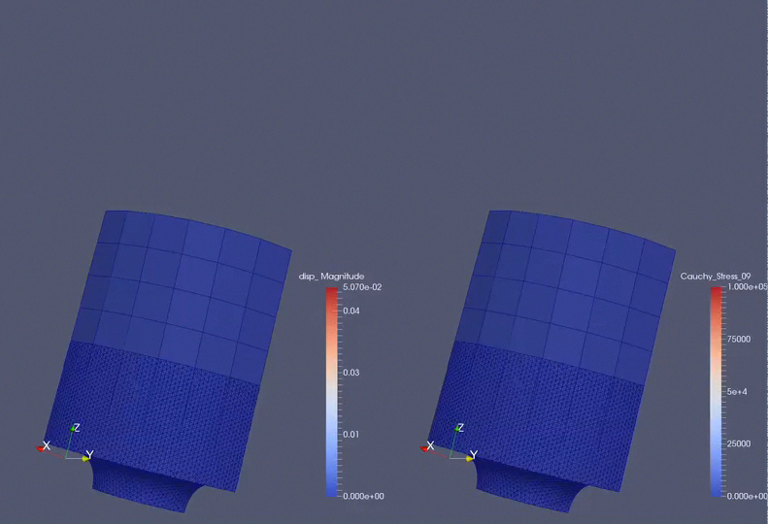
Notched Cylinder: TET-HEX Coupling

Slide 48
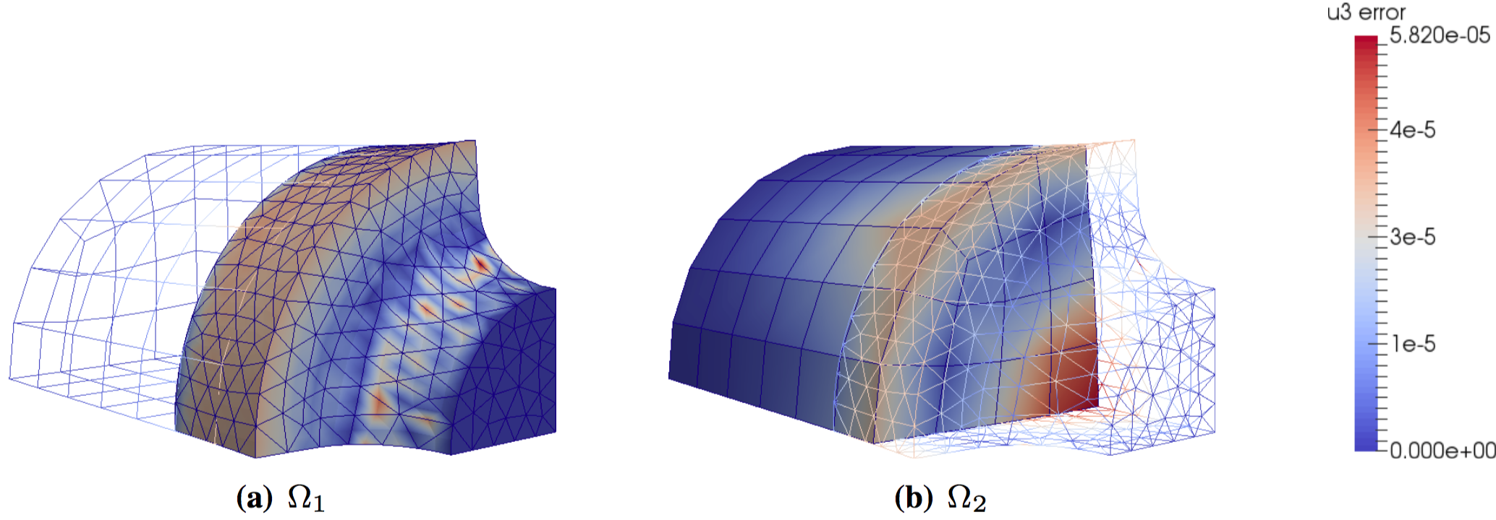
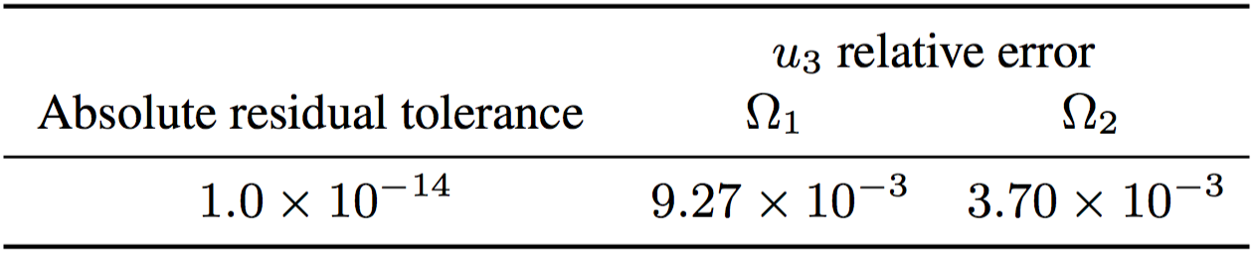
Notched Cylinder: Conformal TET-HEX Coupling
Notes:
- Geometric error

Slide 49
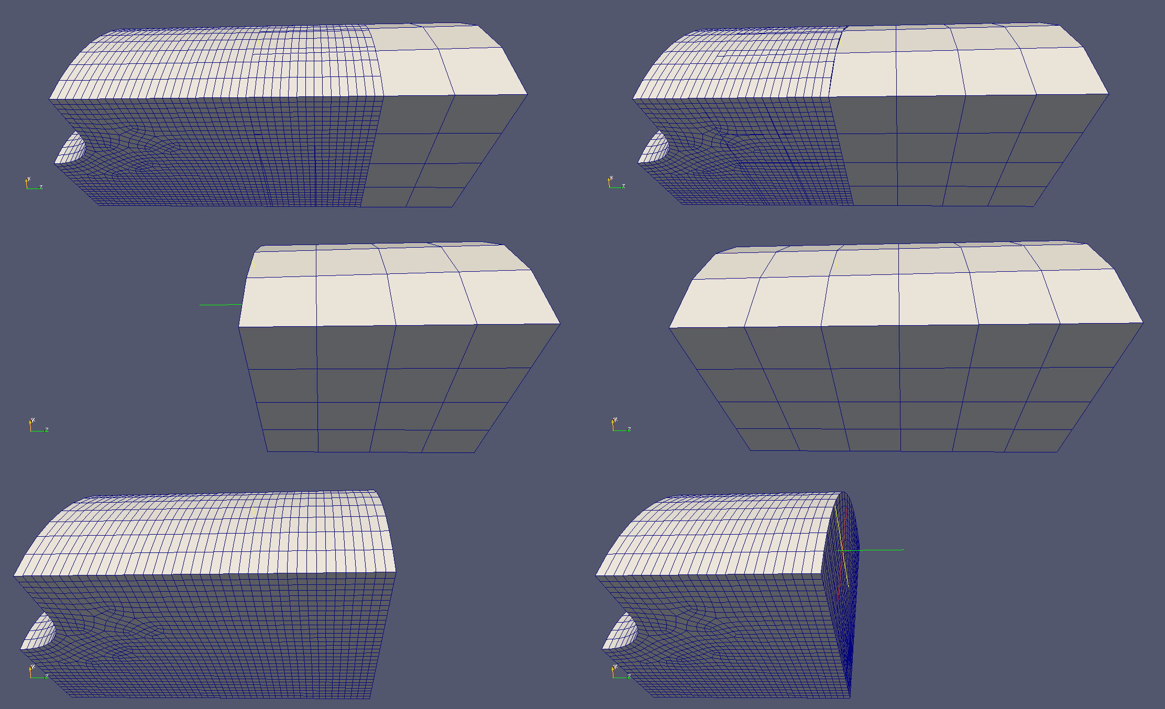
Notched Cylinder: Coupling Different Materials
The Schwarz method is capable of coupling regions with different material models.
Notched cylinder subjected to tensile load with an elastic and J2 elasto-plastic regions.
Coarse region is elastic and fine region is elasto-plastic.
The overlap region in the first mesh is nearer the notch, where plastic behavior is expected.
Overlap far from notch.
Overlap near notch.
Coupled regions
Coarse, elastic region
Fine, elasto-plastic region

Slide 50
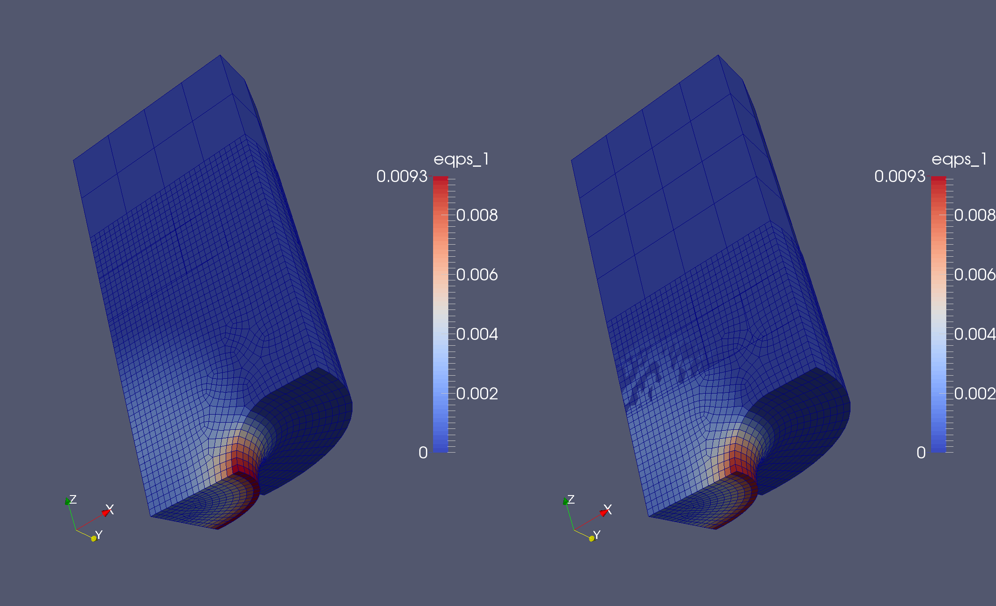
Notched Cylinder: Coupling Different Materials
Need to be careful to do domain decomposition so that material models are consistent in overlap region.
When the overlap region is far from the notch, no plastic deformation exists in it: the coarse and fine regions predict the same behavior.
When the overlap region is near the notch, plastic deformation spills onto it and the two models predict different behavior, affecting convergence adversely.
Overlap far from notch.
Overlap near notch.

Slide 51
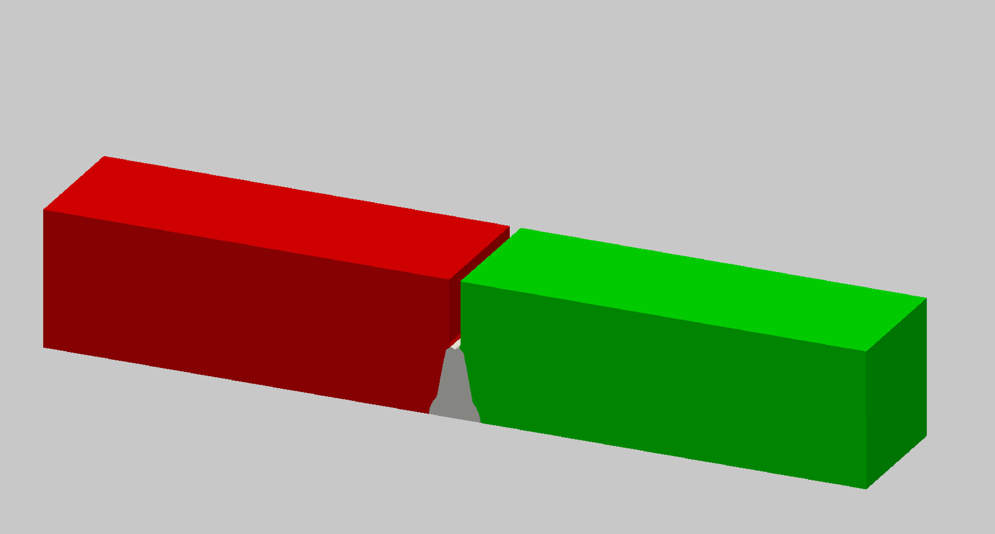
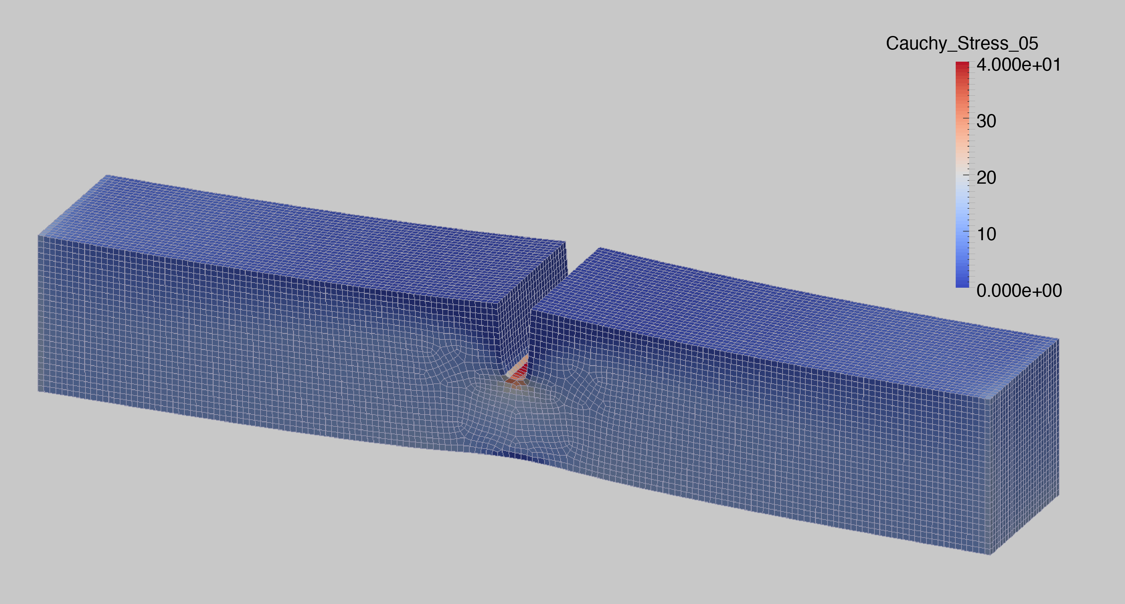
Example #4: Laser Weld with 3 Subdomains
Laser weld specimen
Single domain discretization
Coupled Schwarz discretization
(50% reduction in model size)
Problem of practical scale (~200K dofs).
Isotropic elasticity and J2 plasticity with linear isotropic hardening.
Identical parameters for weld and base materials for proof of concept, to become independent models.
Notes:
Stress contours show Cauchy stress in the loading direction; total strain is approximately 2%.

Slide 52


Laser Weld: Strong Scalability of Parallel Schwarz with DTK
Near-ideal linear speedup (64-1024 cores).
Data Transfer Kit (DTK)

Slide 53
Outline
Motivation
History of Schwarz Alternating Method
Schwarz Alternating Method for Concurrent Multiscale Coupling in Quasistatics
  Four Variants: Full Schwarz, Inexact Schwarz, Modified Schwarz, Monolithic Schwarz
  Implementations: MATLAB, Albany
Numerical Examples
Summary
Future Work
7. References
8. Appendix

Slide 54

Summary
We have proposed the Schwarz alternating method as a means of concurrent multiscale coupling in finite deformation quasistatic solid mechanics.
We have developed four variants of the Schwarz alternating method (Full Schwarz, Modified Schwarz, Inexact Schwarz, Monolithic Schwarz).
We have proven that the Full Schwarz variant converges geometrically for the solid mechanics problem.
We have demonstrated numerically that the convergence of the Schwarz method in its four variants is linear.
We have demonstrated coupling of conformal and non-conformal meshes, meshes with different levels of refinement, meshes with different element topologies, and $>$ two subdomains via the proposed method.
We have demonstrated that the error in the coupling can be decreased up to numerical precision provided that no other sources of error exist.
We have developed a parallel implementation of the Modified Schwarz method in the Albany code and demonstrated that the strong scalability of our implementation is close to ideal.

Slide 55
Outline
Motivation
History of Schwarz Alternating Method
Schwarz Alternating Method for Concurrent Multiscale Coupling in Quasistatics
  Four Variants: Full Schwarz, Inexact Schwarz, Modified Schwarz, Monolithic Schwarz
  Implementations: MATLAB, Albany
Numerical Examples
Summary
Future Work
7. References
8. Appendix

Slide 56
Future Work
Extension of the methods presented herein to transient dynamics (hyperbolic) problems with the ability to use different time steps and time integrators for each subdomain.
Development of a multi-physics coupling framework based on variational formulations and the Schwarz alternating method.
Analysis of the convergence for the other Schwarz variants introduced herein, namely Modified Schwarz, Inexact Schwarz, and Monolithic Schwarz.
Using the Schwarz alternating method with different solvers in different domains.
Develop a hybrid FOM-ROM (full-order-model – reduced-order-model) framework using the Schwarz alternating method.
Introduction of pervasive multi-threading into our Albany implementation of the Schwarz alternating method using the Kokkos framework.
Multiscale coupling using the proposed Schwarz alternating method in other applications.

Slide 57
Outline
Motivation
History of Schwarz Alternating Method
Schwarz Alternating Method for Concurrent Multiscale Coupling in Quasistatics
  Four Variants: Full Schwarz, Inexact Schwarz, Modified Schwarz, Monolithic Schwarz
  Implementations: MATLAB, Albany
Numerical Examples
Summary
Future Work
7. References
8. Appendix

Slide 58
References
[1] M.A. Heroux et al. “An overview of the Trilinos project.” ACM Trans. Math. Softw. 31(3) (2005).
[2] A. Salinger, et al. "Albany: Using Agile Components to Develop a Flexible, Generic Multiphysics Analysis Code", Int. J. Multiscale Comput. Engng. 14(4) (2016) 415-438.
[3] H. Schwarz. “Über einen Grenzübergang durch alternierendes Verfahren”. In: Vierteljahrsschriftder Naturforschenden Gesellschaft in Zurich 15 (1870), pp. 272–286.
[4] S.L. Sobolev. “Schwarz’s Algorithm in Elasticity Theory”. In: Selected Works of S.L Sobolev. Volume I: equations of mathematical physics, computational mathematics and cubature formulats. Ed. By G.V. Demidenko and V.L. Vaskevich. New York: Springer, 2006.
[5] W. Sun and A. Mota. “A multiscale overlapped coupling formulation for large-deformation strain localization”. English. In: Computational Mechanics 54.3 (Sept. 2014), 803–820. ISSN : 0178-7675.
[6] S. Mikhlin. “On the Schwarz algorithm”. In: Proceedings of the USSR Academy of Sciences (in Russian) 77 (1951), pp. 569–571.
[7] D.J. Evans et al. “The convergence rate of the Schwarz alternating procedure (II): For two-dimensional problems”. In: International Journal for Computer Mathematics 20.3–4 (1986), pp. 325–339.
[8] P.L. Lions. “On the Schwarz alternating method I.” In: 1988, First International Symposium on Domain Decomposition methods for Partial Differential Equations, SIAM, Philadelphia.
[9] A. Mota, I. Tezaur, C. Alleman. "The Schwarz Alternating Method in Solid Mechanics", Comput. Meth. Appl. Mech. Engng. (2017), in press. [http://www.sandia.gov/~ikalash/journal.html].

Slide 59
Outline
Motivation
History of Schwarz Alternating Method
Schwarz Alternating Method for Concurrent Multiscale Coupling in Quasistatics
  Four Variants: Full Schwarz, Inexact Schwarz, Modified Schwarz, Monolithic Schwarz
  Implementations: MATLAB, Albany
Numerical Examples
Summary
Future Work
7. References
8. Appendix

Slide 60


Appendix: Multiscale Modeling of Localization
Region of localization (fracture)
Region of localization (necking)
  Strain localization can cause localized necking (left) and ultimately fracture (above).
  Goals:
  Connect physical length scales to engineering scale models.
  Investigate importance of microstructural detail.
  Develop bridging technologies for spatial multiscale/ multiphysics.
Notes:
Strain localization is a ubiquitous feature of elastoplastic materials undergoing nonhomogeneous deformation. The phenomenon manifests in the form of a shear band, a narrow zone of intense straining across which some kinematical fields in a deforming body may be discontinuous.
Strain localization can cause local necking and ultimately fracture.

Slide 61



Appendix. Parallelization via DTK: Weak Scaling on Cubes Problem
1 Processor,
2.5*10³ DOF / proc
8 Processors,
2.1*10³ DOF / proc
64 Processors,
1.9*10³ DOF / proc

Slide 62
Appendix. Parallelization via DTK: Strong Scaling on Cubes Problem
Small problem (2.5*10³ DOFs)
Medium problem (1.7*10⁴ DOFs)
107 DOF/processor
176 DOF/processor
Large problem (1.6*10⁵ DOFs)
5124 DOF/processor

Slide 63



Appendix. Rubiks Cube Problem
Two distinct bodies, the component scale and the microstructural scale, are coupled iteratively with alternating Schwarz
Work by J. Foulk, D. Littlewood, C. Battaile, H. Lim
distinct
models
concurrent coupling
component
scale
plotting axial
stress
microstructural
scale

Slide 64

Appendix. Tensile Bar
Embed microstructure in ASTM tensile geometry

Slide 65


Appendix. Tensile Bar: Meso-Macroscale Coupling
Macroscale
Mesoscale
+
SPARKS-generated microstructure (F. Abdeljawad)
Load microstructural ensembles in uniaxial stress
Fit flow curves with a macroscale J₂ plasticity model
Fix microstructure, investigate ensembles
151 axial vectors from 3 of the 10 ensembles of random rotations
(blue, green, red)
Notes:
\text{cubic elastic constant}: C_{11} = 204.6 \; \text{GPa} \\
\text{cubic elastic constant}: C_{12} = 137.7 \; \text{GPa} \\
\text{cubic elastic constant}: C_{44} = 126.2 \; \text{GPa} \\
\text{reference shear rate}: \dot{\gamma}_{0} = 1.0 \; \text{1/s} \\
\text{rate sensitivity factor}: m = 20 \\
\text{hardening rate parameter}: \dot{g_{0}} = 2.0 \times 10^{4} \; \text{1/s} \\
\text{initial hardness}: g_{0} = 90 \; \text{MPa} \\
\text{saturation hardness}: g_{s} = 202 \; \text{MPa} \\
\text{saturation exponent}: \omega = 0.01
\text{Young's modulus}: E = 195.0 \; \text{GPa} \\
\text{Poission's ratio}: \nu = 0.3 \\
\text{yield stress}: \sigma_{0} = 144 \; \text{MPa} \\
\text{hardening modulus}: H = 300 \; \text{MPa} \\
\text{saturation modulus}: S = 170 \; \text{MPa} \\
\text{saturation exponent}: \alpha = 190
\sigma_{y} = \sigma_{0} + H \epsilon_{p} + S (1 - e^{-\alpha \epsilon_{p}})

Slide 66


Appendix. Tensile Bar: Results
Reduction in cross-sectional area over time

Slide 67

Appendix. Schwarz Alternating Method
for Dynamics
In the literature the Schwarz method is applied to dynamics by using space-time discretizations.
This was deemed unfeasible given the design of our current codes and size of simulations.
Overlapping non-matching meshes and time steps in dynamics.

Slide 68

Appendix. A Schwarz-like Time Integrator
We developed an extension of Schwarz coupling to dynamics using a governing time stepping algorithm that controls time integrators within each domain.
Can use different integrators with different time steps within each domain.
1D results show smooth coupling without numerical artifacts such as spurious wave reflections at boundaries of coupled domains.
Controller time stepper
Time integrator for Ω₁
Time integrator for Ω₂

Slide 69






Appendix. Dynamic Singular Bar
Inelasticity masks problems by introducing energy dissipation.
Schwarz does not introduce numerical artifacts.
Can couple domains with different time integration schemes (Explicit-Implicit below).

