Slide 1
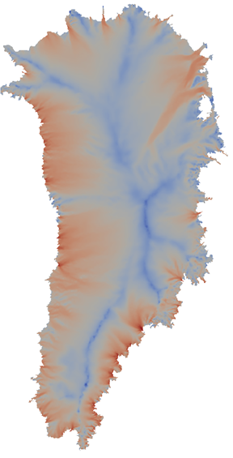
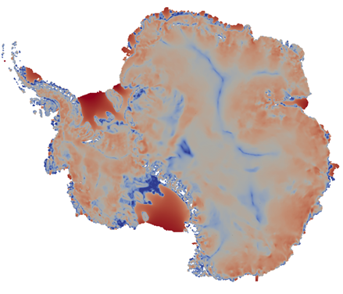
Towards Uncertainty Quantification in 21st Century Sea-Level Rise Predictions: Efficient Methods for Bayesian Calibration and Forward Propagation of Uncertainty for Land-Ice Models
I. Tezaur¹, J. Jakeman¹, M. Eldred¹, M. Perego¹, A. Salinger¹, S. Price²
¹ Sandia National Laboratories
Livermore, CA and Albuquerque, NM, USA
² Los Alamos National Laboratory
Los Alamos, NM, USA
SIAM Conference on Uncertainty Quantification (SIAM UQ16)
April 5-8, 2016
Lausanne, Switzerland
SAND2016-2717C
Notes:
Background: describe dynamic simulations (equations, interfaces to MPAS and CISM, algorithms in CISM code, show science run result – from Steve/Matt’s paper); describe UQ tools (Dakota, QUESO)?
Forward propagation: describe workflow/ objective (QoI = SLR predictions); describe challenges (transients, a lot of CPU-hours required, bad surrogates).

Slide 2
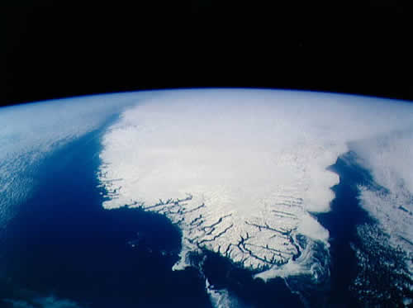
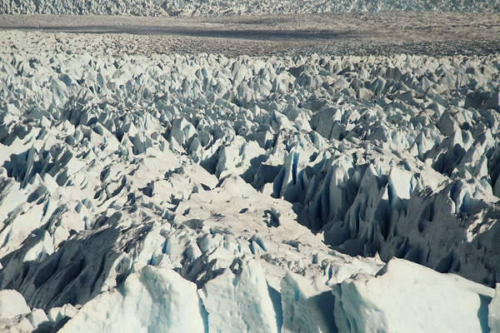
Outline
The PISCEES project, land-ice equations and relevant codes (Albany/FELIX, CISM-Albany, MPAS-Albany).
Uncertainty Quantification Problem Definition.
Bayesian Calibration.
Methodology.
Demonstrations.
Forward Propagation of Uncertainty.
Methodology.
Demonstrations.
Summary and Future Work.

Slide 3
Outline
The PISCEES project, land-ice equations and relevant codes (Albany/FELIX, CISM-Albany, MPAS-Albany).
Uncertainty Quantification Problem Definition.
Bayesian Calibration.
Methodology.
Demonstrations.
Forward Propagation of Uncertainty.
Methodology.
Demonstrations.
Summary and Future Work.

Slide 4
PISCEES Project and Relevant Solvers (Albany-FELIX, CISM/MPAS-Albany)
“PISCEES” = Predicting Ice Sheet Climate Evolution at Extreme Scales
5 year project funded by SciDAC, which began in June 2012
Sandia’s Role in the PISCEES Project: to develop and support a robust and scalable land ice solver based on the “First-Order” (FO) Stokes approximation
Dycore will provide actionable predictions of 21st century sea-level rise (including uncertainty).
Requirements for our land-ice solver:
Scalable, fast, robust.
Dynamical core (dycore) when coupled to codes that solve thickness and temperature evolution equations (CISM/MPAS LI codes).
Performance-portability.
Advanced analysis capabilities (adjoint-based deterministic inversion, Bayesian calibration, UQ, sensitivity analysis).
Albany/FELIX Solver (steady):
Ice Sheet PDEs (First Order Stokes)
(stress-velocity solve)
CISM/MPAS Land Ice Codes (dynamic):
Ice Sheet Evolution PDEs
(thickness, temperature evolution)

Slide 5
PISCEES Project and Relevant Solvers (Albany-FELIX, CISM/MPAS-Albany)
“PISCEES” = Predicting Ice Sheet Climate Evolution at Extreme Scales
5 year project funded by SciDAC, which began in June 2012
Sandia’s Role in the PISCEES Project: to develop and support a robust and scalable land ice solver based on the “First-Order” (FO) Stokes approximation
Dycore will provide actionable predictions of 21st century sea-level rise (including uncertainty).
Requirements for our land-ice solver:
Scalable, fast, robust.
Dynamical core (dycore) when coupled to codes that solve thickness and temperature evolution equations (CISM/MPAS LI codes).
Performance-portability.
Advanced analysis capabilities (adjoint-based deterministic inversion, Bayesian calibration, UQ, sensitivity analysis).
This talk
Albany/FELIX Solver (steady):
Ice Sheet PDEs (First Order Stokes)
(stress-velocity solve)
CISM/MPAS Land Ice Codes (dynamic):
Ice Sheet Evolution PDEs
(thickness, temperature evolution)

Slide 6
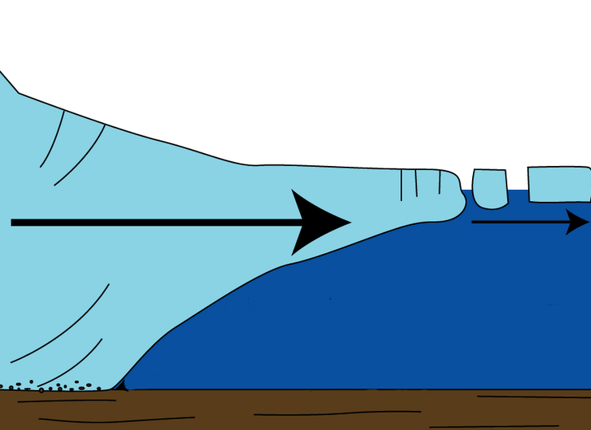
The First-Order Stokes
Model for Ice Sheets & Glaciers
Ice sheet dynamics are given by the “First-Order” Stokes PDEs: approximation* to viscous incompressible quasi-static Stokes flow with power-law viscosity.
$\left\{\begin{aligned}−∇∙(2μ\dot{ε}1)=−ρg\frac{∂s}{∂x} \\ −∇∙(2μ\dot{ε}2)=−ρg\frac{∂s}{∂y}\end{aligned}\right.$ , in $Ω$
$$\dot{ε}1T=\left(2\dot{ε}11+\dot{ε}22,\dot{ε}12,\dot{ε}13\right)$$
$$\dot{ε}2T=\left(2\dot{ε}12, \dot{ε}11+2\dot{ε}22,\dot{ε}23\right)$$
$$\dot{ε}ij=\frac{1}{2}\left(\frac{∂ui}{∂xj}+\frac{∂uj}{∂xi}\right)$$
Viscosity $μ$ is nonlinear function given by “Glen’s law”:
$$μ=\frac{1}{2}{A^{−\frac{1}{n}}\left(\frac{1}{2}\sum_{ij}{\dot{ε}ij2}\right)}^{\left(\frac{1}{2n}−\frac{1}{2}\right)}$$
Surface boundary $Γs$
Albany/FELIX
$$(n=3)$$
Ice sheet
Relevant boundary conditions:
Stress-free BC: $2μ\dot{ε}i∙n=0,$ on $Γs$
Floating ice BC:
$2μ\dot{ε}i∙n$ = $\left\{\begin{aligned}ρgzn\text{, }\text{if} z>0 \\ 0, if z≤0\end{aligned}, \right.on Γl$
Basal sliding BC: $2μ\dot{ε}i∙n+βui=0$, on $Γβ$
Lateral boundary $Γl$
Basal boundary $Γβ$
)
$$β=sliding coefficient≥0$$
*Assumption: aspect ratio $δ$is small and normals to upper/lower surfaces are almost vertical.

Slide 7
Implementation of
Albany/FELIX using Trilinos
The Albany/FELIX* First Order Stokes solver is implemented in a Sandia parallel C++ finite element code called…
“Agile Components”
Discretizations/meshes
Solver libraries
Preconditioners
Automatic differentiation
Many others!
Started by A. Salinger
Parameter estimation
Uncertainty quantification
Optimization
Bayesian inference
Land Ice Physics Set (Albany/FELIX code)
Other Albany Physics Sets
Configure/build/test/documentation
Use of Trilinos components has enabled the rapid development of the Albany/FELIX First Order Stokes dycore!
*FELIX = “Finite Elements for Land Ice eXperiments”.

Slide 8
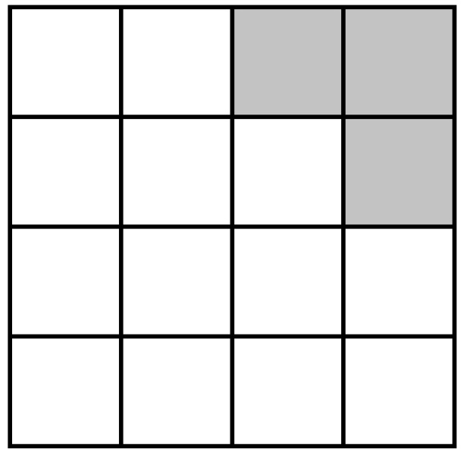
Ice Sheet Evolution Models
Model for evolution of the boundaries (thickness evolution equation):
$$\frac{∂h}{∂t}=−∇∙\left(\overline{u}h\right)+\dot{b}$$
where $\overline{u}$ = vertically averaged velocity, $\dot{b}$= surface mass
balance (conservation of mass).
Temperature equation (advection-diffusion):
$$ρc\frac{∂T}{∂t}=∇∙(k∇T)−ρcu∙∇T+2\dot{ε}σ$$
(energy balance).
Flow factor $A$ in Glen’s law depends on temperature $T$: $A=A(T)$.
Ice sheet grows/retreats depending on thickness $h$.
time $t0$
Ice-covered (“active”) cells shaded in white ($h>hmin$)

Slide 9
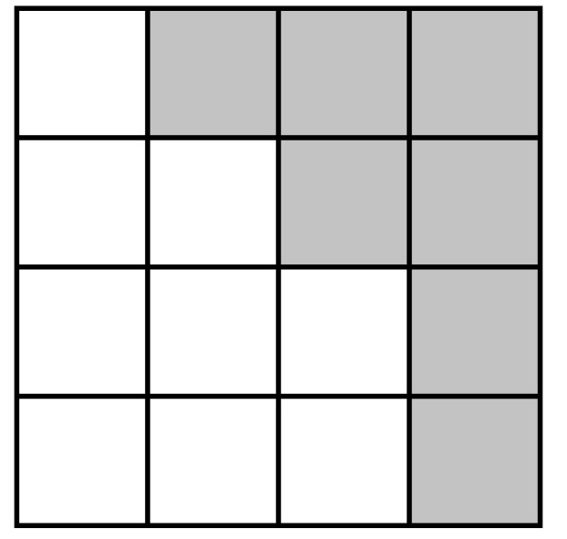
Ice Sheet Evolution Models
Model for evolution of the boundaries (thickness evolution equation):
$$\frac{∂h}{∂t}=−∇∙\left(\overline{u}h\right)+\dot{b}$$
where $\overline{u}$ = vertically averaged velocity, $\dot{b}$ = surface mass
balance (conservation of mass).
Temperature equation (advection-diffusion):
$$ρc\frac{∂T}{∂t}=∇∙(k∇T)−ρcu∙∇T+2\dot{ε}σ$$
(energy balance).
Flow factor $A$ in Glen’s law depends on temperature $T$: $A=A(T)$.
Ice sheet grows/retreats depending on thickness $h$.
time $t0$
time $t1$
Ice-covered (“active”) cells shaded in white ($h>hmin$)

Slide 10
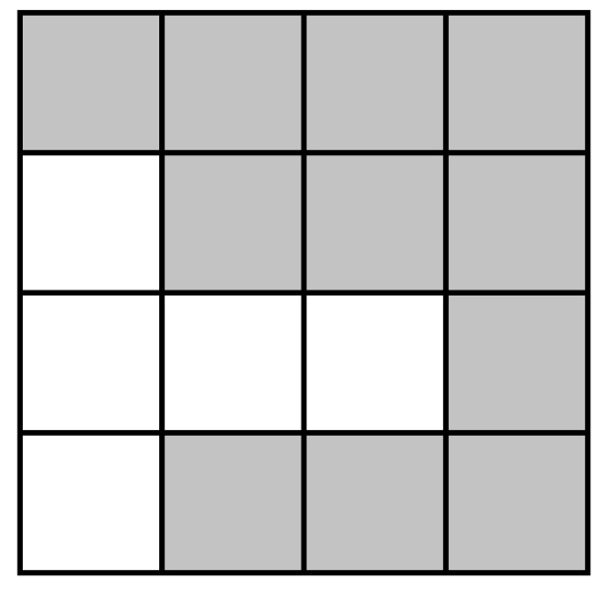
Ice Sheet Evolution Models
Model for evolution of the boundaries (thickness evolution equation):
$$\frac{∂h}{∂t}=−∇∙\left(\overline{u}h\right)+\dot{b}$$
where $\overline{u}$ = vertically averaged velocity, $\dot{b}$= surface mass
balance (conservation of mass).
Temperature equation (advection-diffusion):
$$ρc\frac{∂T}{∂t}=∇∙(k∇T)−ρcu∙∇T+2\dot{ε}σ$$
(energy balance).
Flow factor $A$ in Glen’s law depends on temperature $T$: $A=A(T)$.
Ice sheet grows/retreats depending on thickness $h$.
time $t$₂
time $t0$
time $t1$
Ice-covered (“active”) cells shaded in white ($h>hmin$)

Slide 11
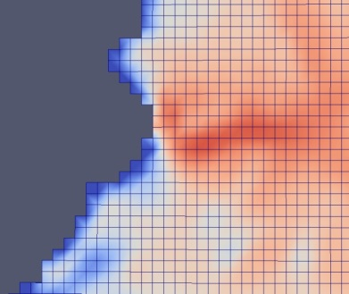
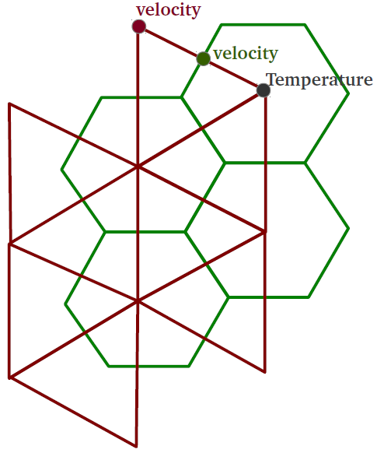
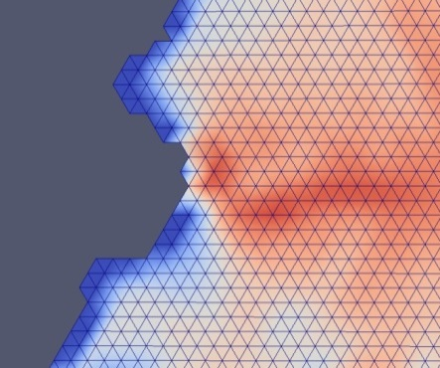
Interfaces to CISM and MPAS LI for Transient Simulations
CISM-Albany
MPAS LI-Albany
cism_driver
Albany/FELIX (C++)
velocity solve
LandIce_model
MPAS Land-Ice (Fortran)
Thickness evolution,
temperature solve,
coupling to DOE-ESM
CISM (Fortran)
Thickness evolution, temperature solve, coupling to CESM
C++/Fortran Interface, Mesh Conversion
C++/Fortran Interface, Mesh Conversion
Tetrahedral meshes (dual of hexaganonal mesh, extruded to tets).
output file
output file
Structured hexahedral meshes (rectangles extruded to hexes).
Albany/FELIX has been coupled to two land ice dycores: Community Ice Sheet Model (CISM) and Model for Prediction Across Scales for Land Ice (MPAS LI)
7/20

Slide 12
Outline
The PISCEES project, land-ice equations and relevant codes (Albany/FELIX, CISM-Albany, MPAS-Albany).
Uncertainty Quantification Problem Definition.
Bayesian Calibration.
Methodology.
Demonstrations.
Forward Propagation of Uncertainty.
Methodology.
Demonstrations.
Summary and Future Work.

Slide 13
Uncertainty Quantification (UQ)
Problem Definition
Quantity of Interest (QoI) in Ice Sheet Modeling:
total ice mass loss/gain during 21st century
$→$ sea level rise prediction.
There are several sources of uncertainty, most notably:
Climate forcings (e.g., surface mass balance).
Basal friction ($β$).
Ice sheet thickness (h).
Geothermal heat flux.
Model parameters (e.g., Glen’s flow law exponent).
$$μ=\frac{1}{2}{A^{−\frac{1}{n}}\left(\frac{1}{2}\sum_{ij}{\dot{ε}ij2+}γ\right)}^{\left(\frac{1}{2n}−\frac{1}{2}\right)}$$
$n$ = Glen’s law exponent
thickness
(h)
Ice sheet
Basal boundary $Γβ$
)
Basal sliding BC:
$2μ\dot{ε}i∙n+βui=0$, on $Γβ$

Slide 14
Uncertainty Quantification (UQ)
Problem Definition
Quantity of Interest (QoI) in Ice Sheet Modeling:
total ice mass loss/gain during 21st century
$→$ sea level rise prediction.
There are several sources of uncertainty, most notably:
Climate forcings (e.g., surface mass balance).
Basal friction ($β$).
Ice sheet thickness (h).
Geothermal heat flux.
Model parameters (e.g., Glen’s flow law exponent).
$$μ=\frac{1}{2}{A^{−\frac{1}{n}}\left(\frac{1}{2}\sum_{ij}{\dot{ε}ij2+}γ\right)}^{\left(\frac{1}{2n}−\frac{1}{2}\right)}$$
$n$ = Glen’s law exponent
thickness
(h)
Ice sheet
As a first step, we focus on effect of uncertainty in basal friction ($β$) only.
Basal boundary $Γβ$
)
Basal sliding BC:
$2μ\dot{ε}i∙n+βui=0$, on $Γβ$

Slide 15
Uncertainty Quantification (UQ)
Problem Definition
Quantity of Interest (QoI) in Ice Sheet Modeling:
total ice mass loss/gain during 21st century
$→$ sea level rise prediction.
There are several sources of uncertainty, most notably:
Climate forcings (e.g., surface mass balance).
Basal friction ($β$).
Ice sheet thickness (h).
Geothermal heat flux.
Model parameters (e.g., Glen’s flow law exponent).
$$μ=\frac{1}{2}{A^{−\frac{1}{n}}\left(\frac{1}{2}\sum_{ij}{\dot{ε}ij2+}γ\right)}^{\left(\frac{1}{2n}−\frac{1}{2}\right)}$$
$n$ = Glen’s law exponent
thickness
(h)
Ice sheet
As a first step, we focus on effect of uncertainty in basal friction ($β$) only.
Basal boundary $Γβ$
)
This is a real application where standard UQ methods do not work out of the box!
Basal sliding BC:
$2μ\dot{ε}i∙n+βui=0$, on $Γβ$

Slide 16
Uncertainty Quantification (UQ)
Problem Definition
Quantity of Interest (QoI) in Ice Sheet Modeling:
total ice mass loss/gain during 21st century
$→$ sea level rise prediction.
There are several sources of uncertainty, most notably:
Climate forcings (e.g., surface mass balance).
Basal friction ($β$).
Ice sheet thickness (h).
Geothermal heat flux.
Model parameters (e.g., Glen’s flow law exponent).
$$μ=\frac{1}{2}{A^{−\frac{1}{n}}\left(\frac{1}{2}\sum_{ij}{\dot{ε}ij2+}γ\right)}^{\left(\frac{1}{2n}−\frac{1}{2}\right)}$$
$n$ = Glen’s law exponent
thickness
(h)
Ice sheet
As a first step, we focus on effect of uncertainty in basal friction ($β$) only.
Basal boundary $Γβ$
)
This is a real application where standard UQ methods do not work out of the box!
Basal sliding BC:
$2μ\dot{ε}i∙n+βui=0$, on $Γβ$
$→$This talk tells the story of what we have tried and learned.

Slide 17
Uncertainty Quantification
Workflow
Goal: UQ in 21st century aggregate ice sheet mass loss (QoI)
Deterministic inversion: perform adjoint-based deterministic inversion to estimate initial ice sheet state (i.e., characterize the present state of the ice sheet to be used for performing prediction runs).
Bayesian calibration: construct the posterior distribution using Markov Chain Monte Carlo (MCMC) run on an emulator of the forward model $→$Bayes’ Theorem: assume prior distribution; update using data:
Forward propagation: sample the obtained distribution and perform ensemble of forward propagation runs to compute the uncertainty in the QoI.
What are the parameters that render a given set of observations?
What is the impact of uncertain parameters in the model on quantities of interest (QoI)?

Slide 18
Uncertainty Quantification
Workflow
Goal: UQ in 21st century aggregate ice sheet mass loss (QoI)
Deterministic inversion: perform adjoint-based deterministic inversion to estimate initial ice sheet state (i.e., characterize the present state of the ice sheet to be used for performing prediction runs).
Bayesian calibration: construct the posterior distribution using Markov Chain Monte Carlo (MCMC) run on an emulator of the forward model $→$Bayes’ Theorem: assume prior distribution; update using data:
Forward propagation: sample the obtained distribution and perform ensemble of forward propagation runs to compute the uncertainty in the QoI.
What are the parameters that render a given set of observations?
This talk
What is the impact of uncertain parameters in the model on quantities of interest (QoI)?

Slide 19
Outline
The PISCEES project, land-ice equations and relevant codes (Albany/FELIX, CISM-Albany, MPAS-Albany).
Uncertainty Quantification Problem Definition.
Bayesian Calibration.
Methodology.
Demonstrations.
Forward Propagation of Uncertainty.
Methodology.
Demonstrations.
Summary and Future Work.

Slide 20
Bayesian Calibration: Demonstration of Workflow using KLE
Albany/FELIX has been hooked up to DAKOTA (in “black-box” mode) for UQ/ Bayesian calibration.
Difficulty in UQ: “Curse of Dimensionality”
The $β$ field inversion problems has $O(100K)$ dimensions!

Slide 21
Bayesian Calibration: Demonstration of Workflow using KLE
Albany/FELIX has been hooked up to DAKOTA (in “black-box” mode) for UQ/ Bayesian calibration.
Difficulty in UQ: “Curse of Dimensionality”
The $β$ field inversion problems has $O(100K)$ dimensions!
Approach: Reduce $O(100K)$ dimensional problem to $O(10)$ dimensional problem.

Slide 22
Bayesian Calibration: Demonstration of Workflow using KLE
Albany/FELIX has been hooked up to DAKOTA (in “black-box” mode) for UQ/ Bayesian calibration.
Difficulty in UQ: “Curse of Dimensionality”
The $β$ field inversion problems has $O(100K)$ dimensions!
Approach: Reduce $O(100K)$ dimensional problem to $O(10)$ dimensional problem.
For initial demonstration of workflow, we use the Karhunen-Loeve Expansion (KLE):

Slide 23
Bayesian Calibration: Demonstration of Workflow using KLE
Albany/FELIX has been hooked up to DAKOTA (in “black-box” mode) for UQ/ Bayesian calibration.
Difficulty in UQ: “Curse of Dimensionality”
The $β$ field inversion problems has $O(100K)$ dimensions!
Approach: Reduce $O(100K)$ dimensional problem to $O(10)$ dimensional problem.
For initial demonstration of workflow, we use the Karhunen-Loeve Expansion (KLE):
Assume analytic covariance kernel $C\left(r1,r2\right)=exp\left(−\frac{\left(r1−r2\right)2}{L2}\right)$.

Slide 24
Bayesian Calibration: Demonstration of Workflow using KLE
Albany/FELIX has been hooked up to DAKOTA (in “black-box” mode) for UQ/ Bayesian calibration.
Difficulty in UQ: “Curse of Dimensionality”
The $β$ field inversion problems has $O(100K)$ dimensions!
Approach: Reduce $O(100K)$ dimensional problem to $O(10)$ dimensional problem.
For initial demonstration of workflow, we use the Karhunen-Loeve Expansion (KLE):
Assume analytic covariance kernel $C\left(r1,r2\right)=exp\left(−\frac{\left(r1−r2\right)2}{L2}\right)$.
Perform eigenvalue decomposition of $C$.

Slide 25
Bayesian Calibration: Demonstration of Workflow using KLE
Albany/FELIX has been hooked up to DAKOTA (in “black-box” mode) for UQ/ Bayesian calibration.
Difficulty in UQ: “Curse of Dimensionality”
The $β$ field inversion problems has $O(100K)$ dimensions!
Approach: Reduce $O(100K)$ dimensional problem to $O(10)$ dimensional problem.
For initial demonstration of workflow, we use the Karhunen-Loeve Expansion (KLE):
Assume analytic covariance kernel $C\left(r1,r2\right)=exp\left(−\frac{\left(r1−r2\right)2}{L2}\right)$.
Perform eigenvalue decomposition of $C$.
Expand* $β−\overline{β}$ in basis of eigenvectors $\{φk\}$ of $C$, with random variables $\{{ξk}_{}^{β}\}$:
$\overline{β}$= initial condition for $β$ (from deterministic inversion or spin-up)
$β\left(ω\right)=\overline{β}+\sum_{k=1}^{K}{\sqrt{λkβ}φk}{ξk}_{}^{β}(ω)$,
*In practice, expansion is done on $log(β$) to avoid negative values of $β$.

Slide 26
Bayesian Calibration: Demonstration of Workflow using KLE
Albany/FELIX has been hooked up to DAKOTA (in “black-box” mode) for UQ/ Bayesian calibration.
Difficulty in UQ: “Curse of Dimensionality”
The $β$ field inversion problems has $O(100K)$ dimensions!
Approach: Reduce $O(100K)$ dimensional problem to $O(10)$ dimensional problem.
For initial demonstration of workflow, we use the Karhunen-Loeve Expansion (KLE):
Assume analytic covariance kernel $C\left(r1,r2\right)=exp\left(−\frac{\left(r1−r2\right)2}{L2}\right)$.
Perform eigenvalue decomposition of $C$.
Expand* $β−\overline{β}$ in basis of eigenvectors $\{φk\}$ of $C$, with random variables $\{{ξk}_{}^{β}\}$:
Offline
$\overline{β}$= initial condition for $β$ (from deterministic inversion or spin-up)
Online
$β\left(ω\right)=\overline{β}+\sum_{k=1}^{K}{\sqrt{λkβ}φk}{ξk}_{}^{β}(ω)$,
Inference/calibration is for coefficients of KLE
$⇒$ significant dimension reduction.
*In practice, expansion is done on $log(β$) to avoid negative values of $β$.

Slide 27
Bayesian Calibration: Demonstration of Workflow using KLE (cont’d)
Step 1 (Trilinos): Reduce $O(100K)$ dimensional problem to $O(10)$ dimensional problem using Karhunen-Loeve Expansion (KLE):
Assume analytic covariance kernel $C\left(r1,r2\right)=exp\left(−\frac{\left(r1−r2\right)2}{L2}\right)$.
Perform eigenvalue decomposition of $C$.
Expand* $β−\overline{β}$ in basis of eigenvectors $\{φk\}$ of $C$, with random variables $\{{ξk}_{}^{β}\}$:
Offline
Online
$\overline{β}$= initial condition for $β$ (from deterministic inversion or spin-up)
$β\left(ω\right)=\overline{β}+\sum_{k=1}^{K}{\sqrt{λkβ}φk}{ξk}_{}^{β}(ω)$,
*In practice, expansion is done on $log(β$) to avoid negative values of $β$.

Slide 28
Bayesian Calibration: Demonstration of Workflow using KLE (cont’d)
Step 1 (Trilinos): Reduce $O(100K)$ dimensional problem to $O(10)$ dimensional problem using Karhunen-Loeve Expansion (KLE):
Assume analytic covariance kernel $C\left(r1,r2\right)=exp\left(−\frac{\left(r1−r2\right)2}{L2}\right)$.
Perform eigenvalue decomposition of $C$.
Expand* $β−\overline{β}$ in basis of eigenvectors $\{φk\}$ of $C$, with random variables $\{{ξk}_{}^{β}\}$:
Offline
Online
$\overline{β}$= initial condition for $β$ (from deterministic inversion or spin-up)
$β\left(ω\right)=\overline{β}+\sum_{k=1}^{K}{\sqrt{λkβ}φk}{ξk}_{}^{β}(ω)$,
Step 2 (DAKOTA): Polynomial Chaos Expansion (PCE) emulator for mismatch (over surface velocity, SMB, thickness) discrepancy.
*In practice, expansion is done on $log(β$) to avoid negative values of $β$.

Slide 29
Bayesian Calibration: Demonstration of Workflow using KLE (cont’d)
Step 1 (Trilinos): Reduce $O(100K)$ dimensional problem to $O(10)$ dimensional problem using Karhunen-Loeve Expansion (KLE):
Assume analytic covariance kernel $C\left(r1,r2\right)=exp\left(−\frac{\left(r1−r2\right)2}{L2}\right)$.
Perform eigenvalue decomposition of $C$.
Expand* $β−\overline{β}$ in basis of eigenvectors $\{φk\}$ of $C$, with random variables $\{{ξk}_{}^{β}\}$:
Offline
Online
$\overline{β}$= initial condition for $β$ (from deterministic inversion or spin-up)
$β\left(ω\right)=\overline{β}+\sum_{k=1}^{K}{\sqrt{λkβ}φk}{ξk}_{}^{β}(ω)$,
Step 2 (DAKOTA): Polynomial Chaos Expansion (PCE) emulator for mismatch (over surface velocity, SMB, thickness) discrepancy.
Step 3 (QUESO): Markov Chain Monte Carlo (MCMC) calibration using PCE emulator.
$→$can obtain MAP point and posterior distributions on KLE coefficients.
*In practice, expansion is done on $log(β$) to avoid negative values of $β$.

Slide 30
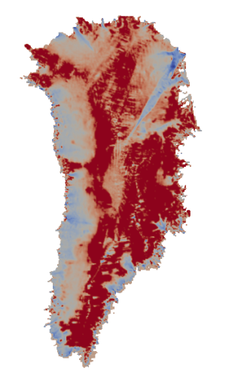
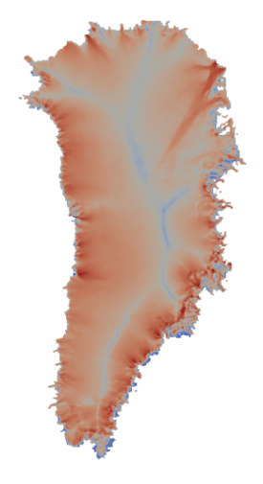
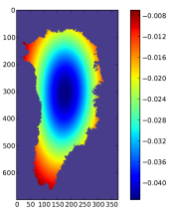
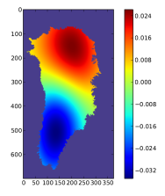
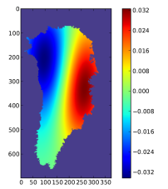
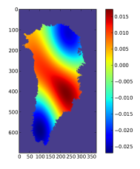
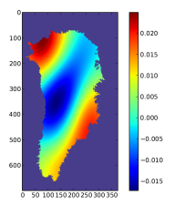
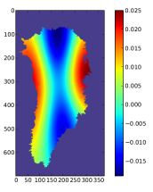
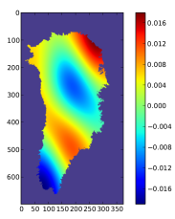
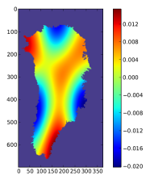
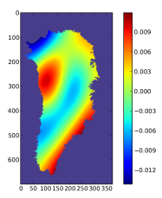
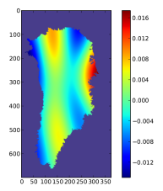
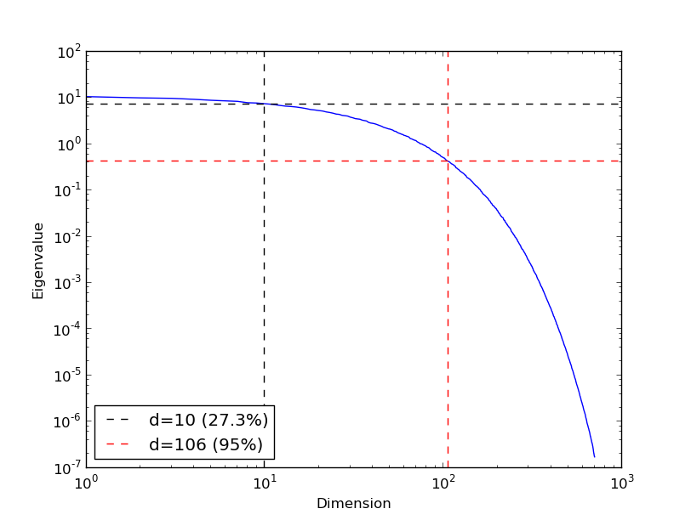
Initial Demonstration: Bayesian
Calibration for 4km GIS Problem
Mean $\overline{β}$ field obtained through spin-up over 100 years (cheaper than inversion, gives reasonable agreement with present-day velocity field).
Correlation length $L$ ($L2$=0.05) selected s.t. slow decay of KLE eigenvalues to enable refinement (left): 10 KLE modes capture 27.3% of covariance energy.
$$\overline{β}$$
$\left|u\right|$ computed with $\overline{β}$
Modes 1-5:
Below: decay of KLE eigenvalues
Modes 6-10:
Mismatch function (calculated in Albany/FELIX):
$$J\left(β\right)=\int_{Γtop}{\frac{1}{σu2}\left|u−uobs\right|2ds}$$
PCE emulator was formed for the mismatch $J\left(β\right)$ using uniform $[−1,1]$prior distributions and 286 high-fidelity runs on Hopper (286 points = 3rd degree polynomial in 10D).

Slide 31
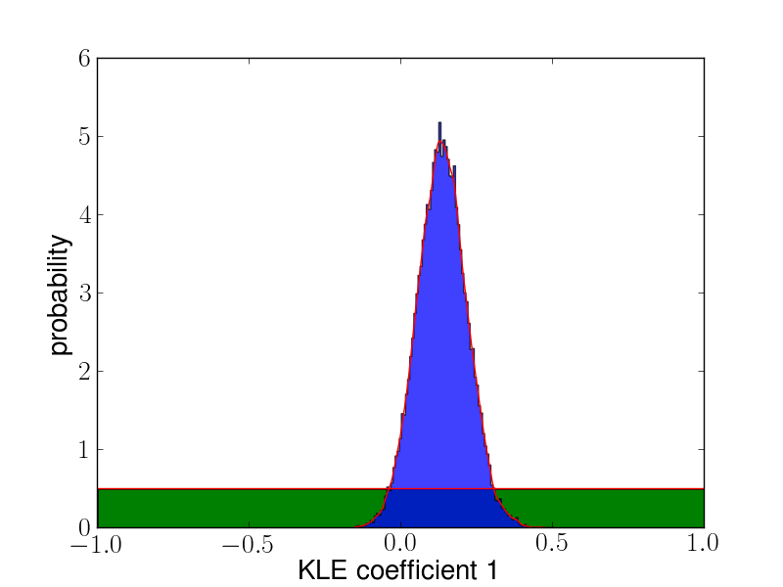
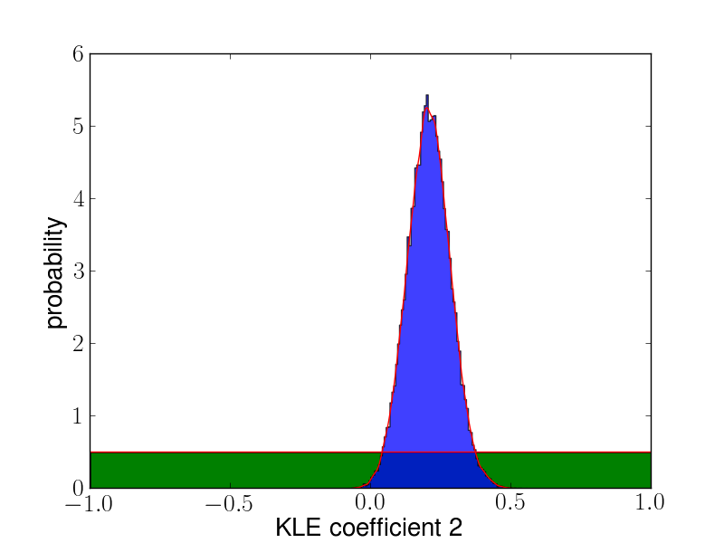
Initial Demonstration: Bayesian
Calibration for 4km GIS Problem
For calibration, MCMC (Delayed Rejection Adaptive Metropolis – DRAM) was performed on the PCE with 2K samples.
Posterior distributions for 10 KLE coefficients:
Mode 1
Mode 2
…
Green = prior (uniform [-1,1])
Blue = posterior
Distributions are peaked rather than uniform $⇒$ data informed the posteriors.
MAP point: $ξ=(\text{0.}\text{372}\text{, }\text{−}\text{0.}\text{679}\text{, }\text{−}\text{0.}\text{4}\text{20, }\text{−}\text{0.}\text{18}\text{9, }\text{−7.38}\text{e}\text{−2, −0.255}$, $0.\text{449}$, $\text{−}\text{0.}\text{75}\text{7}$, $0.\text{84}\text{7,}\text{−}\text{0.}\text{44}\text{7}\text{)}$

Slide 32
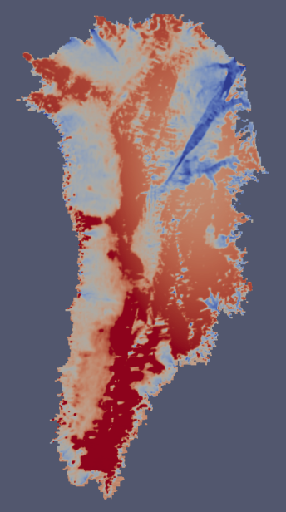
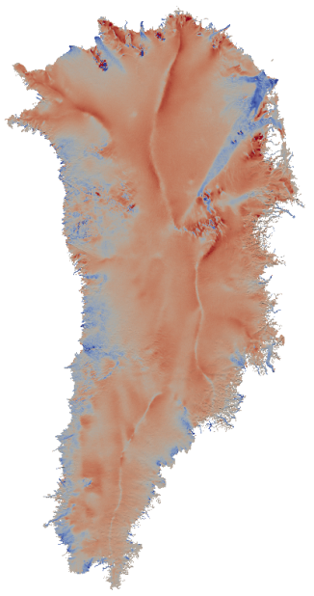
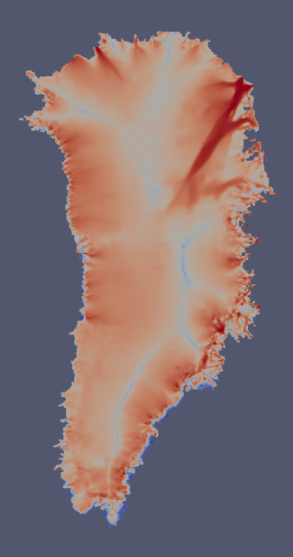
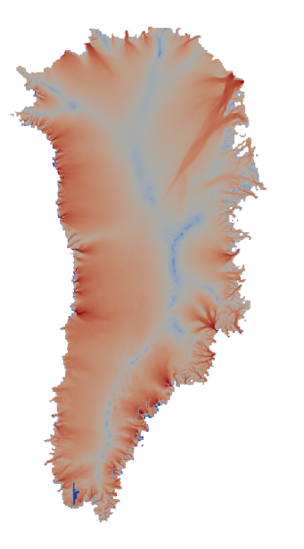
Initial Demonstration: Bayesian
Calibration for 4km GIS Problem
$|u|$ computed with $β$ at MAP point
$β$ from deterministic inversion
$β$ field at MAP point
$$\overline{β}$$
$$|uobs|$$
Ice is too fast at MAP point. Possible explanations:
Surrogate error (based on cross-validation).
Mean field error.
Bad modes (modes lack fine scale features).
Mismatch $J\left(β\right)$ at MAP point: $1.87×$ mismatch at $\overline{β}$

Slide 33
Next Step: Bayesian Calibration of
$β, h$ for 8km, 16km GIS Problems
Mean $\overline{β}$ , $\overline{h}$ fields obtained deterministic inversion minimizing
$$J\left(β,h\right)=αv\int_{Γtop}{\left|u−uobs\right|2ds}+α\int_{Γ}{\left|div\left(uH\right)−SMB\right|2ds+}αH\int_{Γtop}{\left|h−hobs\right|2ds}$$

Slide 34
Next Step: Bayesian Calibration of
$β, h$ for 8km, 16km GIS Problems
Mean $\overline{β}$ , $\overline{h}$ fields obtained deterministic inversion minimizing
$$J\left(β,h\right)=αv\int_{Γtop}{\left|u−uobs\right|2ds}+α\int_{Γ}{\left|div\left(uH\right)−SMB\right|2ds+}αH\int_{Γtop}{\left|h−hobs\right|2ds}$$
Prior and expected variation in $β,h$ is unknown…

Slide 35
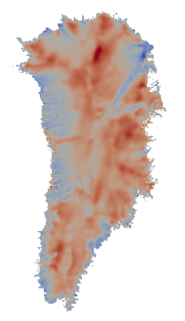
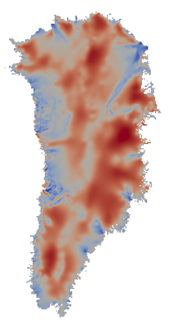
Next Step: Bayesian Calibration of
$β, h$ for 8km, 16km GIS Problems
Mean $\overline{β}$ , $\overline{h}$ fields obtained deterministic inversion minimizing
$$J\left(β,h\right)=αv\int_{Γtop}{\left|u−uobs\right|2ds}+α\int_{Γ}{\left|div\left(uH\right)−SMB\right|2ds+}αH\int_{Γtop}{\left|h−hobs\right|2ds}$$
Prior and expected variation in $β,h$ is unknown…
Idea to estimate K and L: solve LLS problem
$$\min_{L,K}\left|\left|exp⁡\left(\overline{β}opt(\min{J(β))−\overline{β}opt(\min{J(β,h))}−}\sum_{k=1}^{K}{\sqrt{λkβ}φk}{ξk}_{}^{β}\left(ω\right)\right)\right|\right|$$
$\overline{β}opt$ (min $J\left(β,h\right)$)
$$\overline{β}opt(\min{J(β))}$$

Slide 36
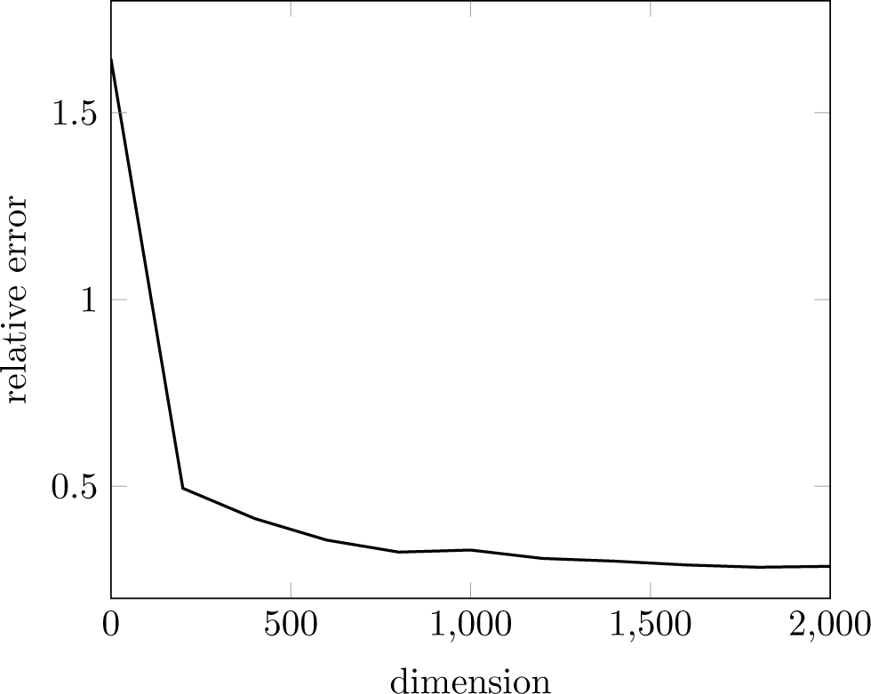
Next Step: Bayesian Calibration of
$β, h$ for 8km, 16km GIS Problems
Mean $\overline{β}$ , $\overline{h}$ fields obtained deterministic inversion minimizing
$$J\left(β,h\right)=αv\int_{Γtop}{\left|u−uobs\right|2ds}+α\int_{Γ}{\left|div\left(uH\right)−SMB\right|2ds+}αH\int_{Γtop}{\left|h−hobs\right|2ds}$$
Prior and expected variation in $β,h$ is unknown…
Idea to estimate K and L: solve LLS problem
$$\min_{L,K}\left|\left|exp⁡\left(\overline{β}opt(\min{J(β))−\overline{β}opt(\min{J(β,h))}−}\sum_{k=1}^{K}{\sqrt{λkβ}φk}{ξk}_{}^{β}\left(ω\right)\right)\right|\right|$$
$\overline{β}opt$ (min $J\left(β,h\right)$)
$$\overline{β}opt(\min{J(β))}$$
$$⇒$$
LLS representation relative error
LLS representation error decay is independent of L
K

Slide 37
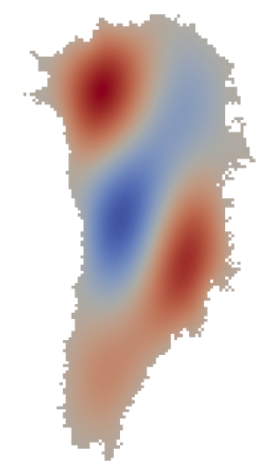
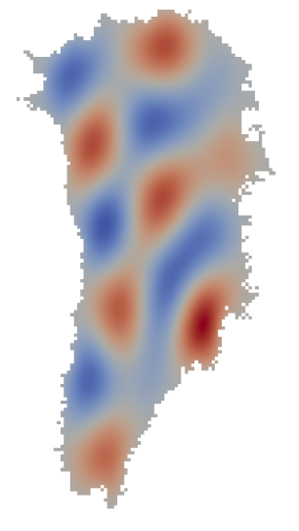
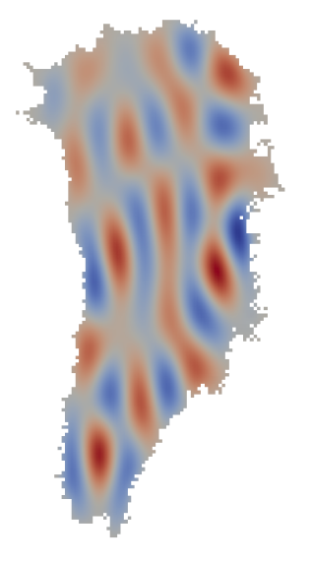
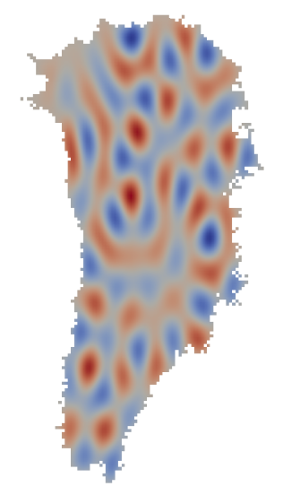
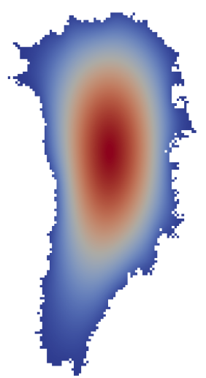
Next Step: Bayesian Calibration of
$β, h$ for 8km, 16km GIS Problems
Conclusion 1: use more modes (O(100), O(1000)).
$β$ field at MAP point
Mode 1
Mode 5
Mode 20
Mode 50
Mode 100
Notes:
Insert new results

Slide 38
Next Step: Bayesian Calibration of
$β, h$ for 8km, 16km GIS Problems
Conclusion 1: use more modes (O(100), O(1000)).
$β$ field at MAP point
Mode 1
Mode 5
Mode 20
Mode 50
Mode 100
Conclusion 2: L does not affect LLS reconstruction because representation error decay is independent of L.
Coefficients in LLS fitting were of the same order.
$⟹$ We can assume every random variable has the same variance:
$β\left(ω\right)=\overline{β}+\sum_{k=1}^{K}{\sqrt{λkβ}φk}{ξk}_{}^{β}(ω)$, $h\left(ω\right)=\overline{h}+\sum_{k=1}^{K}{\sqrt{λkh}φk{ξk}_{}^{h}(ω)}$
Notes:
Insert new results

Slide 39
Next Step: Bayesian Calibration of
$β, h$ for 8km, 16km GIS Problems
Conclusion 1: use more modes (O(100), O(1000)).
$β$ field at MAP point
Mode 1
Mode 5
Mode 20
Mode 50
Mode 100
Conclusion 2: L does not affect LLS reconstruction because representation error decay is independent of L.
Coefficients in LLS fitting were of the same order.
$⟹$ We can assume every random variable has the same variance:
$β\left(ω\right)=\overline{β}+\sum_{k=1}^{K}{φk}{ξk}_{}^{β}(ω)$, $h\left(ω\right)=\overline{h}+\sum_{k=1}^{K}{φk{ξk}_{}^{h}(ω)}$
Notes:
Insert new results

Slide 40
Next Step: Improve Efficiency of
MCMC Using Gradient/Hessian Information
MCMC with active subspaces using gradient information
Gradients (${d(mismatch)}/{dβ},{d(mismatch)}/{dh}$) can be used to identify subspace that controls variation in likelihood function → this info can improve MCMC performance by reducing correlation between samples.
Surrogates (to reduce sampling cost) are feasible for high-dimensional parameter spaces with active subspaces.
Plan: combine MCMC in active subspaces with surrogates that adaptively target regions of high probability.
Exploit Hessian structure
Improve MCMC by informing proposal covariance by structure of Hessian → posterior Hessian-based proposal distribution properly balances likelihood and prior, performing better than either alone.
Leverage analytic emulator gradients for QOI → full or Gauss-Newton misfit Hessian.
Stochastic Newton: low rank approximation for prior-preconditioned misfit Hessian → multivariate normal proposal covariance for MCMC.
Gauss-Newton approx

Slide 41
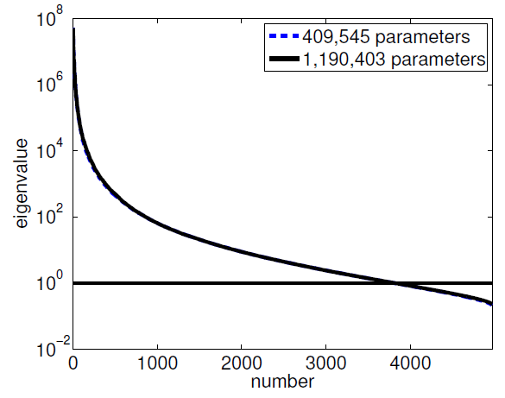
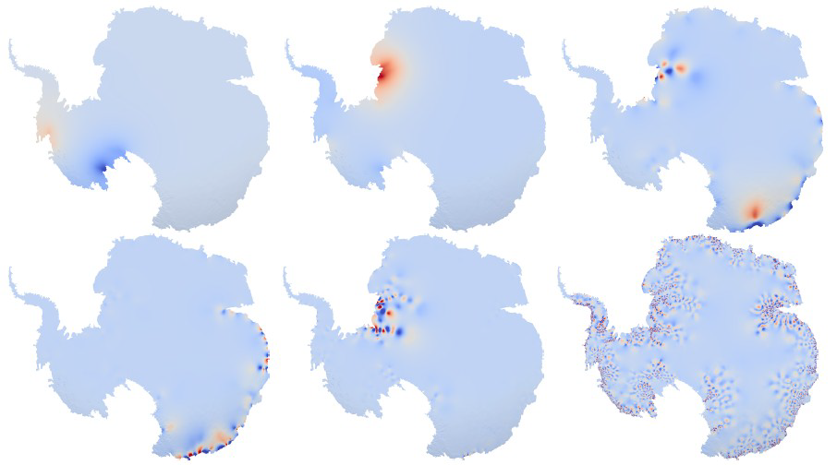
Next Step: Better Reduced Bases for Bayesian Calibration using Hessian Info
Hessian of the merit (mismatch) functional can provide a way to compute the covariance of a Gaussian posterior:
$$Cpost={\left(CpriorHmisfit+I\right)}^{−1}Cprior$$
We want to limit only the most important directions (eigenvectors) of $Cpost$.
evec 1
evec 2
evec 100
Figures courtesy of O. Ghattas’ group (Isaac et al., 2004)
# significant eigenvalues does not depend on # DOFs in grid
evec 200
evec 500
evec 4000
Right: log-linear plot of the spectra of a prior-preconditioned data misfit Hessian at the MAP point for two successively finer parameter/state meshes of the inverse ice sheet problem.

Slide 42
Outline
The PISCEES project, land-ice equations and relevant codes (Albany/FELIX, CISM-Albany, MPAS-Albany).
Uncertainty Quantification Problem Definition.
Bayesian Calibration.
Methodology.
Demonstrations.
Forward Propagation of Uncertainty.
Methodology.
Demonstrations.
Summary and Future Work.

Slide 43
Forward Propagation
PCE Emulator
$$β\left(ω\right)=\overline{β}+\sum_{k=1}^{K}{\sqrt{λkβ}φk}{ξk}_{}^{β}(ω)$$
Model realizations
Forward propagation
(e.g., 2000-2050)
DAKOTA, Albany/FELIX
QoI$(β)$
(total ice mass loss)
Albany/FELIX
Parameter ($β$) distribution can either be assumed to be Gaussian (based on Hessian information) or can be the result of Bayesian calibration.
Emulator is built using DAKOTA coupled with CISM-Albany for forward runs.
MCMC (Delayed Rejection Adaptive Metropolis – DRAM) was used to perform uncertainty propagation (QUESO).

Slide 44
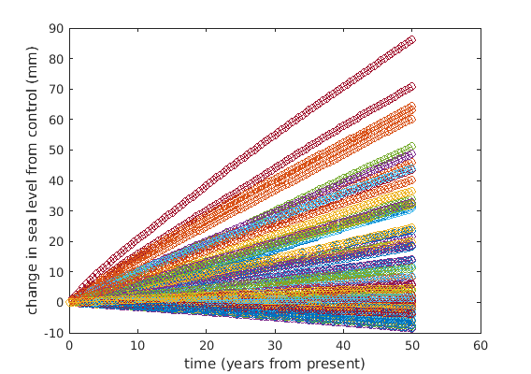
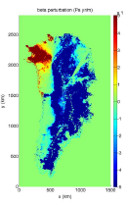
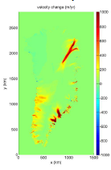
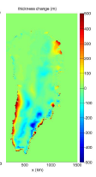
Initial Demonstration: Forward
Propagation for 4km GIS Problem
Procedure:
We first ran 66* CISM-Albany high-fidelity simulations on Hopper with $β$ sampled from a uniform $[−1,1]$ distribution and no forcing for 50 years.
Left: SLR distribution from ensemble of 66 high-fidelity simulations (differenced against control run using the $\overline{β}$ distribution). All 66 runs ran to completion out-of-the-box on Hopper!
Above: $β$, velocity and thickness perturbations. Ice thickness changed > 500m in some places.
We then used the results of these runs to create a PCE emulator for the SLR.
Using emulator, propagated posterior distributions computed in Bayesian calibration (using KLE) through the model to get posteriors on SLR (MCMC on PCE emulator with 2K samples).
*66 points = 2D polynomial in 10D.

Slide 45
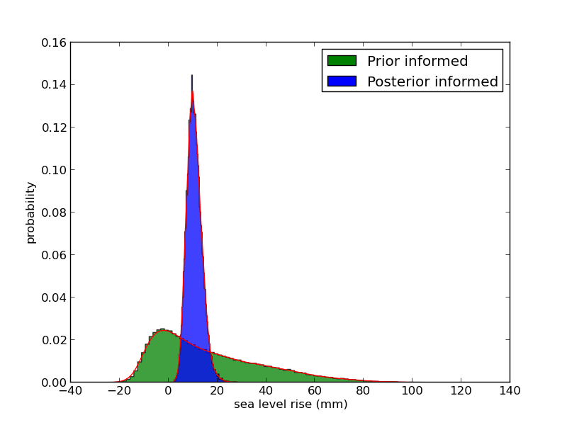
Initial Demonstration: Forward
Propagation for 4km GIS Problem
Disclaimer: these results illustrate that we have in place all steps of our UQ workflow. They are NOT yet actual uncertainty bounds for sea-level rise.
Expected PDF of SLR: normal distribution centered around 0 SLR since no forcing.
PDF of SLR
Prior informed (green): uniform distribution translates to distribution skewed w.r.t. model outputs.
Larger fraction of the ice sheet currently has a $β$ value that forces no (or slow) basal sliding.
Areas with little sliding: not affected by increase in $β$, but greatly affected by decrease in $β$ (velocity in these regions will change significantly from initial condition).
Since we sample from a uniform distribution when perturbing $β$, we expect to see a disproportionately large signal when reducing $β$ vs. increasing it.
Posterior informed (blue): centered on positive tail of prior – not consistent with observations.
Could be due to “ad hoc” $β$ used as mean field (spin-up over 100 years).
May be that emulator was been built with a (non-physical) positive mass balance while calibration was done on present-day observations (consistent with ice losing mass).

Slide 46
Outline
The PISCEES project, land-ice equations and relevant codes (Albany/FELIX, CISM-Albany, MPAS-Albany).
Uncertainty Quantification Problem Definition.
Bayesian Calibration.
Methodology.
Demonstrations.
Forward Propagation of Uncertainty.
Methodology.
Demonstrations.
Summary and Future Work.

Slide 47
Summary and Ongoing Work
This talk described our workflow for quantifying uncertainties in expected aggregate ice sheet mass loss and its demonstration on some Greenland ice sheet problems.
Our choice of prior is somewhat arbitrary; however it is possible to build an informed Gaussian distribution using the Hessian of the deterministic inversion.
We plan to use gradient information to combine MCMC in active subspaces with surrogates.
We might use techniques such as the compressed sensing technique to adaptively select significant modes and the basis for the parameter space. The hope is that only few modes affect the low dimensional QoI (e.g., sea level rise).
We might use cheap physical models (e.g., the shallow ice model or SIA) or low resolution solves to reduce the cost of building the emulator.
In future work, we plan to look at effects of other sources of uncertainty, e.g., surface mass balance.

Slide 48
Funding/Acknowledgements
Support for this work was provided through Scientific Discovery through Advanced Computing (SciDAC) projects funded by the U.S. Department of Energy, Office of Science (OSCR), Advanced Scientific Computing Research and Biological and Environmental Research (BER) $→$PISCEES SciDAC Application Partnership.
PISCEES team members: K. Evans, M. Gunzburger, M. Hoffman, C. Jackson, P. Jones, W. Lipscomb, M. Perego, S. Price, A. Salinger, I. Tezaur, R. Tuminaro, P. Worley.
Trilinos/DAKOTA collaborators: M. Eldred, J. Jakeman, E. Phipps, L. Swiler.
Computing resources: NERSC, OLCF.
Thank you! Questions?

Slide 49
References
[1] M.A. Heroux et al. “An overview of the Trilinos project.” ACM Trans. Math. Softw. 31(3) (2005).
[2] A.G. Salinger et al. "Albany: Using Agile Components to Develop a Flexible, Generic Multiphysics Analysis Code", Comput. Sci. Disc. (submitted, 2015).
[3] I. Tezaur, M. Perego, A. Salinger, R. Tuminaro, S. Price. "Albany/FELIX: A Parallel, Scalable and Robust Finite Element Higher-Order Stokes Ice Sheet Solver Built for Advanced Analysis", Geosci. Model Develop. 8 (2015) 1-24.
[4] I. Tezaur, R. Tuminaro, M. Perego, A. Salinger, S. Price. "On the scalability of the Albany/FELIX first-order Stokes approximation ice sheet solver for large-scale simulations of the Greenland and Antarctic ice sheets", MSESM/ICCS15, Reykjavik, Iceland (June 2014).
[5] R.S. Tuminaro, I. Tezaur, M. Perego, A.G. Salinger. "A Hybrid Operator Dependent Multi-Grid/Algebraic Multi-Grid Approach: Application to Ice Sheet Modeling", SIAM J. Sci. Comput. (in prep).
[6] R. Tuminaro. “ML’s SemiCoarsening Feature, Addition to ML 5.0 Smoothed Aggregation User’s Guide” , Sandia National Laboratories Report, SAND2006-2649, Sandia National Laboratories, Albuquerque, NM, 2014.

Slide 50
References (cont’d)
[7] S. Shannon, et al. “Enhanced basal lubrication and the contribution of the Greenland ice sheet to future sea-level rise”, P. Natl. Acad. Sci., 110 (2013) 14156-14161.
[8] P. Fretwell, et al. “BEDMAP2: Improved ice bed, surface, and thickness datasets for Antarctica”, The Cryosphere 7(1) (2013) 375-393.
[9] F. Pattyn. “Antarctic subglacial conditions inferred from a hybrid ice sheet/ice stream model”, Earth and Planetary Science Letters 295 (2010).
[10] M. Perego, S. Price, G. Stadler. “Optimal Initial Conditions for Coupling Ice Sheet Models to Earth System Models”, J. Geophys. Res. 119 (2014) 1894-1917.
[11] J. Jakeman, M. Eldred, K. Sargsyan. “Enhancing l1-minimization estimates of polynomial chaos expansions using basis selection”, J. Comp. Phys. 289 (2015) 18-34.

Slide 51
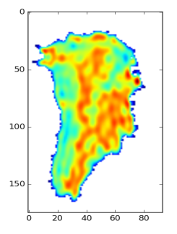
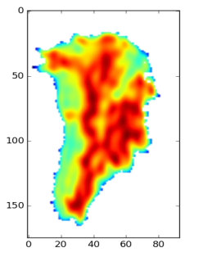
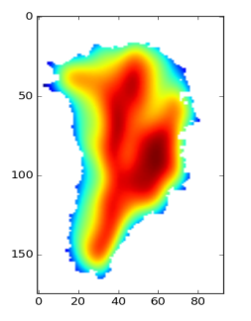
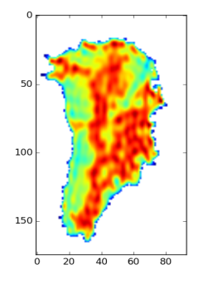
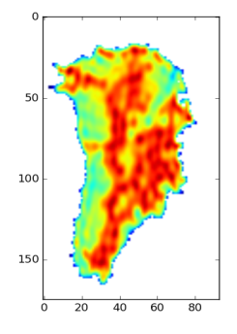
Appendix: Bayesian Calibration
of $β, h$ for 8km, 16km GIS Problems
Length scale L and dimension size K can be fine-tuned by looking at reconstruction of $β$ using the KLE modes.
Larger L $⇒$ smoother (too diffusive) reconstruction.
High dimension K in plots due to omitting $\overline{β}$ from reconstruction:
$β=\sum_{k=1}^{K}{akφk}$
K=300
L²=0.005
L²=0.05
L²=0.5
K=500
L²=0.001
L²=0.005
L²=0.05
Left: $\overline{β}$ for 16km GIS
Right: $\overline{β}$ reconstructed with K KLE modes as a function of length scale L for 16km GIS
K=1000
L²=0.001
L²=0.005
L²=0.01

