Slide 1
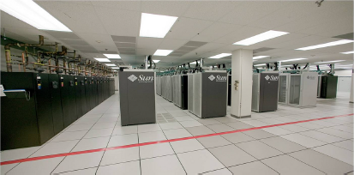
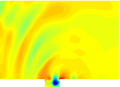
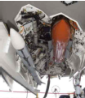
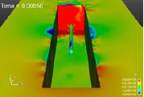
A minimal subspace rotation approach for extreme model reduction in fluid mechanics
Irina Tezaur¹, Maciej Balajewicz²
¹ Extreme Scale Data Science & Analytics Department, Sandia National Laboratories
² Aerospace Engineering Department, University of Illinois Urbana-Champaign
Recent Developments MOR 2016 Paris, France November 7-10, 2016
SAND2016-10461C

Slide 2
Outline
Introduction
  Targeted application
  POD/Galerkin approach to MOR
  Extreme model reduction
  Mode truncation instability in MOR
2. Accounting for modal truncation
  Traditional linear eddy-viscosity approach
  New proposed approach via subspace rotation
3. Applications
  Low Reynolds (Re) number channel driven cavity
  Moderate Reynolds (Re) number channel driven cavity
4. Extension to Least-Squares Petrov-Galerkin (LSPG) ROMs
5. Summary & future work

Slide 3
Outline
Introduction
  Targeted application
  POD/Galerkin approach to MOR
  Extreme model reduction
  Mode truncation instability in MOR
2. Accounting for modal truncation
  Traditional linear eddy-viscosity approach
  New proposed approach via subspace rotation
3. Applications
  Low Reynolds (Re) number channel driven cavity
  Moderate Reynolds (Re) number channel driven cavity
4. Extension to Least-Squares Petrov-Galerkin (LSPG) ROMs
5. Summary & future work

Slide 4
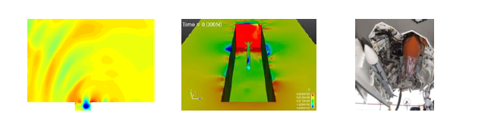
Targeted Application: Compressible Flow
We are interested in the compressible captive-carry problem.

Slide 5
Targeted Application: Compressible Flow
We are interested in the compressible captive-carry problem.
Of primary interest are long-time predictive simulations: ROM run at same parameters as FOM but much longer in time.

Slide 6
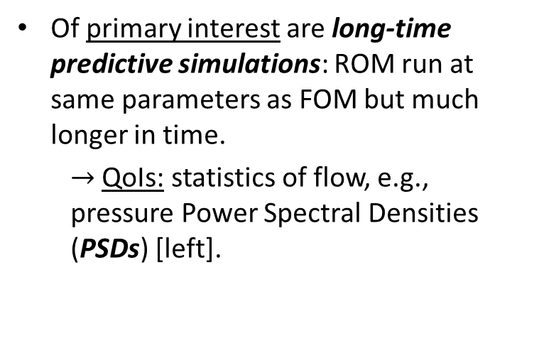
Targeted Application: Compressible Flow
We are interested in the compressible captive-carry problem.
Of primary interest are long-time predictive simulations: ROM run at same parameters as FOM but much longer in time.
  $→$ QoIs: statistics of flow, e.g., pressure Power Spectral Densities (PSDs) [left].

Slide 7
Targeted Application: Compressible Flow
We are interested in the compressible captive-carry problem.
Of primary interest are long-time predictive simulations: ROM run at same parameters as FOM but much longer in time.
  $→$ QoIs: statistics of flow, e.g., pressure Power Spectral Densities (PSDs) [left].
Secondary interest: ROMs robust w.r.t. parameter changes (e.g., Reynolds, Mach number) for enabling uncertainty quantification.

Slide 8
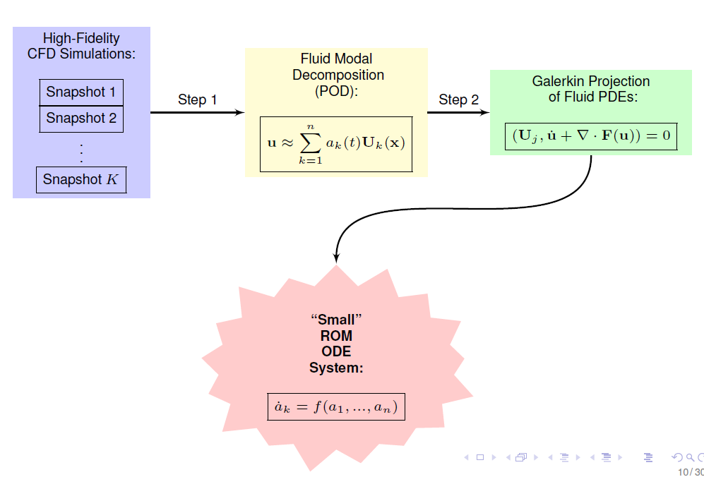
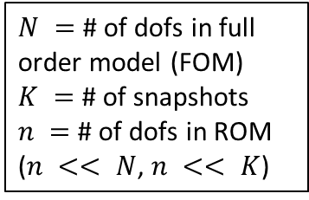
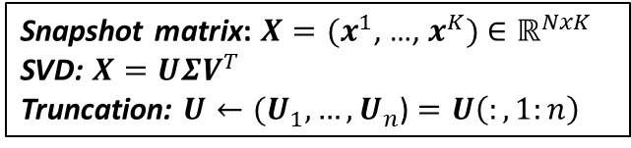
POD/Galerkin Method to MOR
Snapshot matrix: $X=(x^{1}$, …, $x^{K})$ $∈ℝ^{NxK}$
SVD: $X=UΣV^{T}$
Truncation: $U←(U_{1}, …, U_{n}$) $=U\left(:,1:n\right)$
$N =$ # of dofs in full order model (FOM)
$K =$ # of snapshots
$n =$ # of dofs in ROM
($n << N$, $n << K$)
Our focus has been primarily on POD/Galerkin ROMs
Notes:
Add equation numbers (1) and (2)!

Slide 9
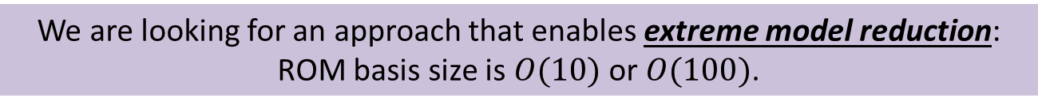
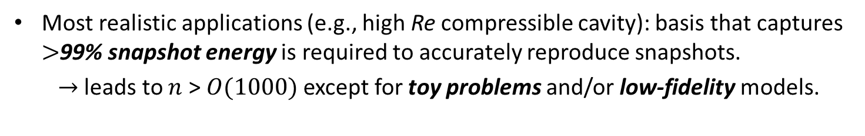
Extreme Model Reduction
Most realistic applications (e.g., high Re compressible cavity): basis that captures $>$99% snapshot energy is required to accurately reproduce snapshots.
  $→$ leads to $n$ >$O(1000)$except for toy problems and/or low-fidelity models.
Higher order modes are in general unreliable for prediction, so including them in the basis is unlikely to improve the predictive capabilities of a ROM.
Figure (right) shows projection error for POD basis constructed using 800 snapshots for cavity problem.
Dashed line = end of snapshot collection period.
We are looking for an approach that enables extreme model reduction:
ROM basis size is $O(10)$ or $O(100)$.

Slide 10
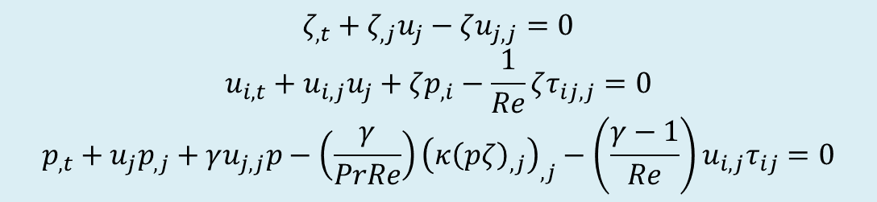
3D Compressible Navier-Stokes Equations
We start with the 3D compressible Navier-Stokes equations in primitive specific volume form:
$$ζ_{,t}+ζ_{,j}u_{j}−ζu_{j,j}=0$$
$$u_{i,t}+u_{i,j}u_{j}+ζp_{,i}−\frac{1}{Re}ζτ_{ij,j}=0$$
$$p_{,t}+u_{j}p_{,j}+γu_{j,j}p−\left(\frac{γ}{PrRe}\right){\left(κ{\left(pζ\right)}_{,j}\right)}_{,j}−\left(\frac{γ−1}{Re}\right)u_{i,j}τ_{ij}=0$$
[PDEs]
(1)
Notes:
Add equation numbers (1) and (2)!

Slide 11
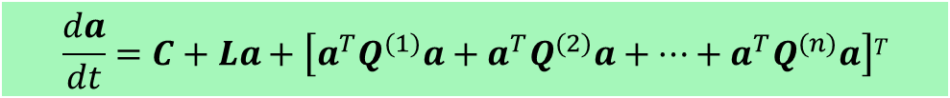
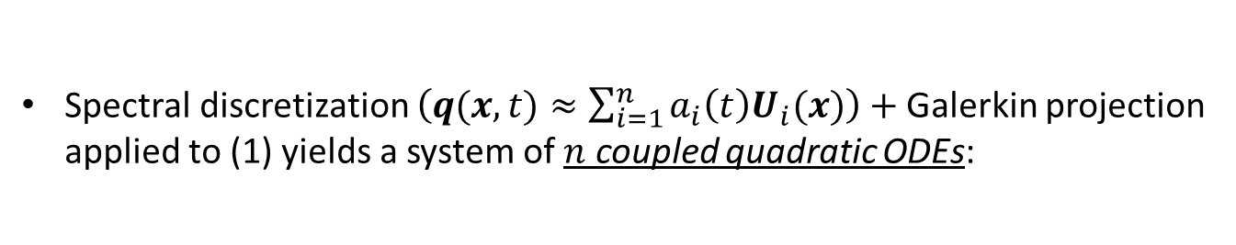
3D Compressible Navier-Stokes Equations
We start with the 3D compressible Navier-Stokes equations in primitive specific volume form:
$$ζ_{,t}+ζ_{,j}u_{j}−ζu_{j,j}=0$$
$$u_{i,t}+u_{i,j}u_{j}+ζp_{,i}−\frac{1}{Re}ζτ_{ij,j}=0$$
$$p_{,t}+u_{j}p_{,j}+γu_{j,j}p−\left(\frac{γ}{PrRe}\right){\left(κ{\left(pζ\right)}_{,j}\right)}_{,j}−\left(\frac{γ−1}{Re}\right)u_{i,j}τ_{ij}=0$$
[PDEs]
(1)
Spectral discretization $\left(q(x,t)≈\sum_{i=1}^{n}{a_{i}\left(t\right)U_{i}(x)}\right)+$Galerkin projection applied to (1) yields a system of $n$ coupled quadratic ODEs:
[ROM]
$$\frac{da}{dt}=C+La+\left[a^{T}Q^{(1)}a+a^{T}Q^{(2)}a+⋯+a^{T}Q^{(n)}a\right]T$$
(2)
where $C∈ℝ^{n}, L∈ℝ^{n×n}$ and $Q^{(i)}$ $∈ℝ^{n×n}$ for all $i=1,…,n.$
Notes:
Add equation numbers (1) and (2)!

Slide 12
ROM Instability Problem
Stability can be a real problem for compressible flow ROMs!

Slide 13
ROM Instability Problem
Stability can be a real problem for compressible flow ROMs!
A compressible fluid POD/Galerkin ROM might be stable for a given number of modes, but unstable for other choices of basis size (Bui-Tanh et al. 2007).

Slide 14
ROM Instability Problem
Stability can be a real problem for compressible flow ROMs!
A compressible fluid POD/Galerkin ROM might be stable for a given number of modes, but unstable for other choices of basis size (Bui-Tanh et al. 2007).
Instability can be due to:

Slide 15
ROM Instability Problem
Stability can be a real problem for compressible flow ROMs!
A compressible fluid POD/Galerkin ROM might be stable for a given number of modes, but unstable for other choices of basis size (Bui-Tanh et al. 2007).
Instability can be due to:
  1. Choice of inner product: Galerkin projection + L2 inner product is unstable.

Slide 16
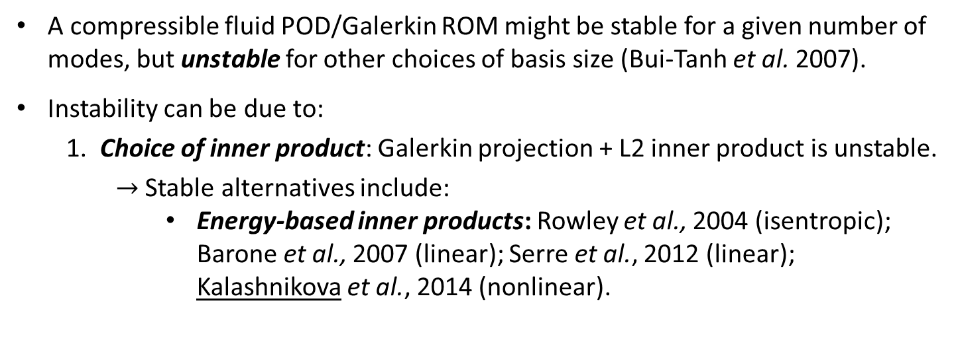
ROM Instability Problem
Stability can be a real problem for compressible flow ROMs!
A compressible fluid POD/Galerkin ROM might be stable for a given number of modes, but unstable for other choices of basis size (Bui-Tanh et al. 2007).
Instability can be due to:
  1. Choice of inner product: Galerkin projection + L2 inner product is unstable.
    $→$ Stable alternatives include:
      Energy-based inner products: Rowley et al., 2004 (isentropic); Barone et al., 2007 (linear); Serre et al., 2012 (linear); Kalashnikova et al., 2014 (nonlinear).

Slide 17
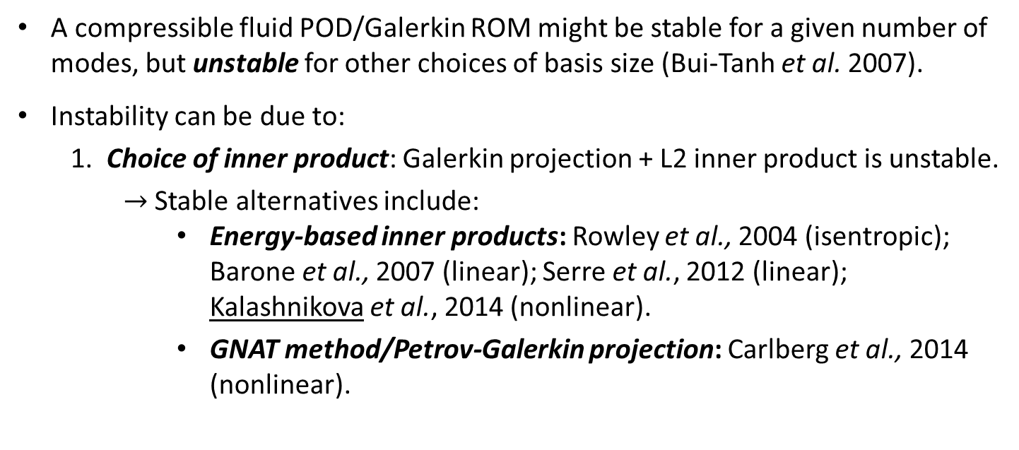
ROM Instability Problem
Stability can be a real problem for compressible flow ROMs!
A compressible fluid POD/Galerkin ROM might be stable for a given number of modes, but unstable for other choices of basis size (Bui-Tanh et al. 2007).
Instability can be due to:
  1. Choice of inner product: Galerkin projection + L2 inner product is unstable.
    $→$ Stable alternatives include:
      Energy-based inner products: Rowley et al., 2004 (isentropic); Barone et al., 2007 (linear); Serre et al., 2012 (linear); Kalashnikova et al., 2014 (nonlinear).
      GNAT method/Petrov-Galerkin projection: Carlberg et al., 2014 (nonlinear).

Slide 18
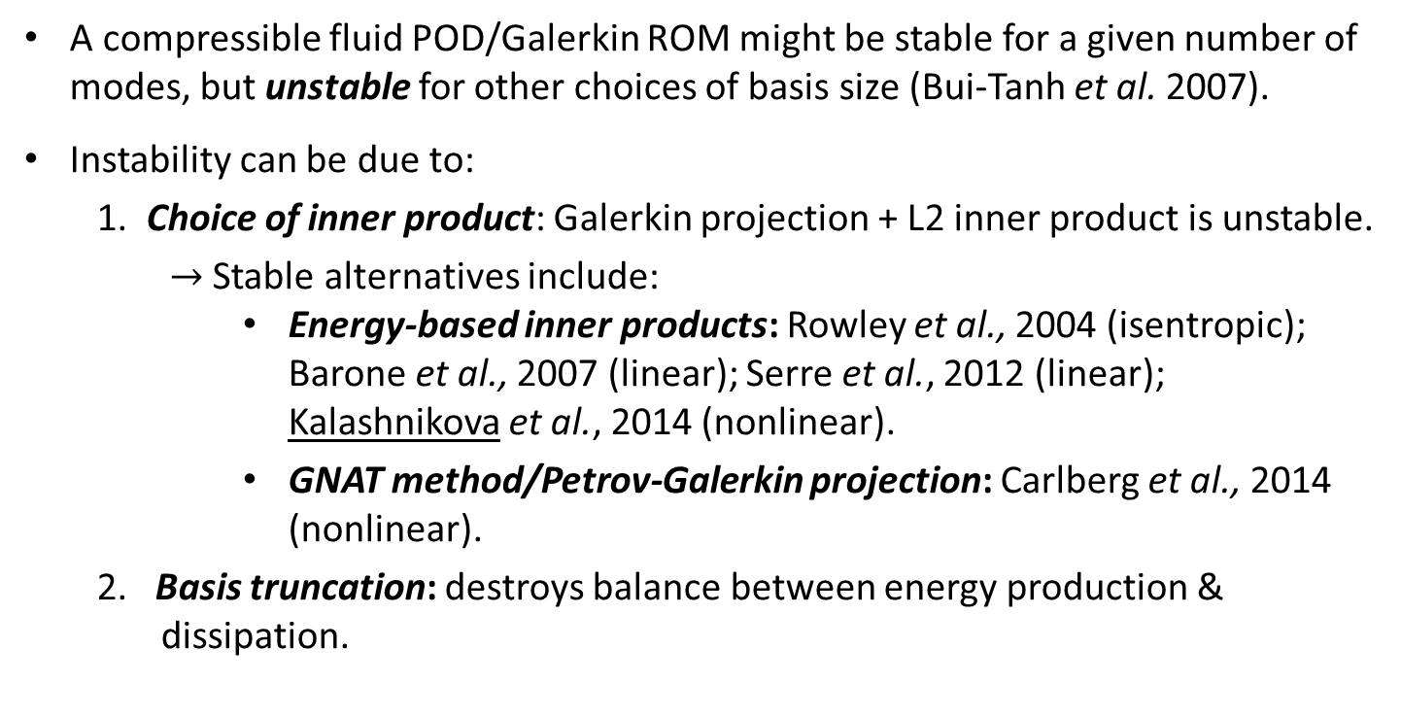
ROM Instability Problem
Stability can be a real problem for compressible flow ROMs!
A compressible fluid POD/Galerkin ROM might be stable for a given number of modes, but unstable for other choices of basis size (Bui-Tanh et al. 2007).
Instability can be due to:
  1. Choice of inner product: Galerkin projection + L2 inner product is unstable.
    $→$ Stable alternatives include:
      Energy-based inner products: Rowley et al., 2004 (isentropic); Barone et al., 2007 (linear); Serre et al., 2012 (linear); Kalashnikova et al., 2014 (nonlinear).
      GNAT method/Petrov-Galerkin projection: Carlberg et al., 2014 (nonlinear).
  2. Basis truncation: destroys balance between energy production & nnndissipation.

Slide 19
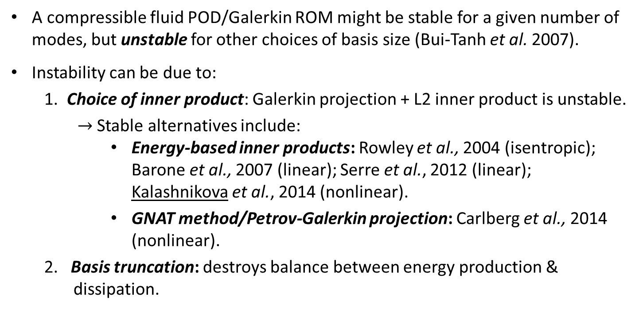
ROM Instability Problem
Stability can be a real problem for compressible flow ROMs!
A compressible fluid POD/Galerkin ROM might be stable for a given number of modes, but unstable for other choices of basis size (Bui-Tanh et al. 2007).
Instability can be due to:
  1. Choice of inner product: Galerkin projection + L2 inner product is unstable.
    $→$ Stable alternatives include:
      Energy-based inner products: Rowley et al., 2004 (isentropic); Barone et al., 2007 (linear); Serre et al., 2012 (linear); Kalashnikova et al., 2014 (nonlinear).
      GNAT method/Petrov-Galerkin projection: Carlberg et al., 2014 (nonlinear).
  2. Basis truncation: destroys balance between energy production & hhhdissipation.
This talk focuses on remedying “mode truncation instability” problem for projection-based (POD/Galerkin) compressible flow ROMs.

Slide 20
Mode Truncation Instability
Projection-based MOR necessitates truncation.

Slide 21
Mode Truncation Instability
Projection-based MOR necessitates truncation.
POD is, by definition and design, biased towards the large, energy producing scales of the flow (i.e., modes with large POD eigenvalues).

Slide 22
Mode Truncation Instability
Projection-based MOR necessitates truncation.
POD is, by definition and design, biased towards the large, energy producing scales of the flow (i.e., modes with large POD eigenvalues).
Truncated/unresolved modes are negligible from a data compression point of view (i.e., small POD eigenvalues) but are crucial for the dynamical equations.

Slide 23
Mode Truncation Instability
Projection-based MOR necessitates truncation.
POD is, by definition and design, biased towards the large, energy producing scales of the flow (i.e., modes with large POD eigenvalues).
Truncated/unresolved modes are negligible from a data compression point of view (i.e., small POD eigenvalues) but are crucial for the dynamical equations.
For fluid flow applications, higher-order modes are associated with energy dissipation

Slide 24
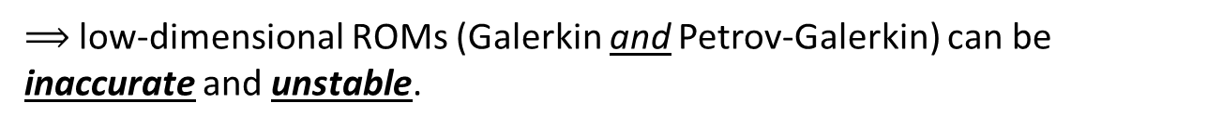
Mode Truncation Instability
Projection-based MOR necessitates truncation.
POD is, by definition and design, biased towards the large, energy producing scales of the flow (i.e., modes with large POD eigenvalues).
Truncated/unresolved modes are negligible from a data compression point of view (i.e., small POD eigenvalues) but are crucial for the dynamical equations.
For fluid flow applications, higher-order modes are associated with energy dissipation
$⟹$ low-dimensional ROMs (Galerkin and Petrov-Galerkin) can be inaccurate and unstable.

Slide 25
Mode Truncation Instability
Projection-based MOR necessitates truncation.
POD is, by definition and design, biased towards the large, energy producing scales of the flow (i.e., modes with large POD eigenvalues).
Truncated/unresolved modes are negligible from a data compression point of view (i.e., small POD eigenvalues) but are crucial for the dynamical equations.
For fluid flow applications, higher-order modes are associated with energy dissipation
$⟹$ low-dimensional ROMs (Galerkin and Petrov-Galerkin) can be inaccurate and unstable.
For a low-dimensional ROM to be stable and accurate, the truncated/unresolved subspace must be accounted for.

Slide 26
Mode Truncation Instability
Projection-based MOR necessitates truncation.
POD is, by definition and design, biased towards the large, energy producing scales of the flow (i.e., modes with large POD eigenvalues).
Truncated/unresolved modes are negligible from a data compression point of view (i.e., small POD eigenvalues) but are crucial for the dynamical equations.
For fluid flow applications, higher-order modes are associated with energy dissipation
$⟹$ low-dimensional ROMs (Galerkin and Petrov-Galerkin) can be inaccurate and unstable.
For a low-dimensional ROM to be stable and accurate, the truncated/unresolved subspace must be accounted for.
Turbulence Modeling
(traditional approach)
Subspace Rotation
(our approach)

Slide 27
Outline
Introduction
  Targeted application
  POD/Galerkin approach to MOR
  Extreme model reduction
  Mode truncation instability in MOR
2. Accounting for modal truncation
  Traditional linear eddy-viscosity approach
  New proposed approach via subspace rotation
3. Applications
  Low Reynolds (Re) number channel driven cavity
  Moderate Reynolds (Re) number channel driven cavity
4. Extension to Least-Squares Petrov-Galerkin (LSPG) ROMs
5. Summary & future work

Slide 28
Traditional Linear Eddy-Viscosity Approach
Dissipative dynamics of truncated higher-order modes are modeled using an additional linear term:
$$\frac{da}{dt}=C+La+\left[a^{T}Q^{\left(1\right)}a+a^{T}Q^{\left(2\right)}a+⋯+a^{T}Q^{\left(n\right)}a\right]T$$

Slide 29
Traditional Linear Eddy-Viscosity Approach
Dissipative dynamics of truncated higher-order modes are modeled using an additional linear term:
$$\frac{da}{dt}=C+\left(L+L_{ν}\right)a+\left[a^{T}Q^{\left(1\right)}a+a^{T}Q^{\left(2\right)}a+⋯+a^{T}Q^{\left(n\right)}a\right]T$$

Slide 30
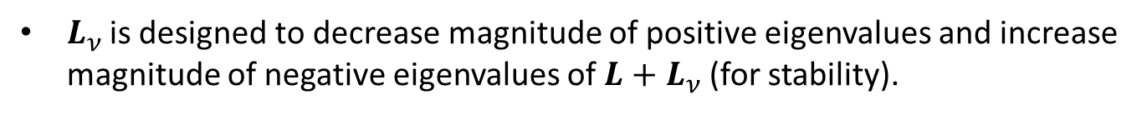
Traditional Linear Eddy-Viscosity Approach
Dissipative dynamics of truncated higher-order modes are modeled using an additional linear term:
$$\frac{da}{dt}=C+\left(L+L_{ν}\right)a+\left[a^{T}Q^{\left(1\right)}a+a^{T}Q^{\left(2\right)}a+⋯+a^{T}Q^{\left(n\right)}a\right]T$$
$L_{ν }$is designed to decrease magnitude of positive eigenvalues and increase magnitude of negative eigenvalues of $L+L_{ν}$(for stability).

Slide 31
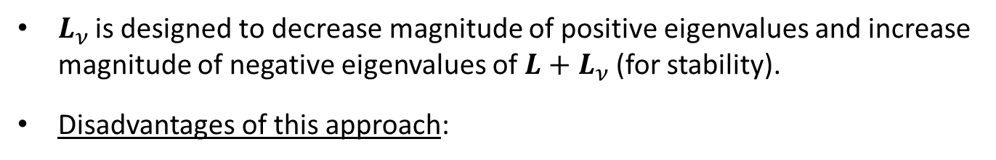
Traditional Linear Eddy-Viscosity Approach
Dissipative dynamics of truncated higher-order modes are modeled using an additional linear term:
$$\frac{da}{dt}=C+\left(L+L_{ν}\right)a+\left[a^{T}Q^{\left(1\right)}a+a^{T}Q^{\left(2\right)}a+⋯+a^{T}Q^{\left(n\right)}a\right]T$$
$L_{ν }$is designed to decrease magnitude of positive eigenvalues and increase magnitude of negative eigenvalues of $L+L_{ν}$(for stability).
Disadvantages of this approach:

Slide 32
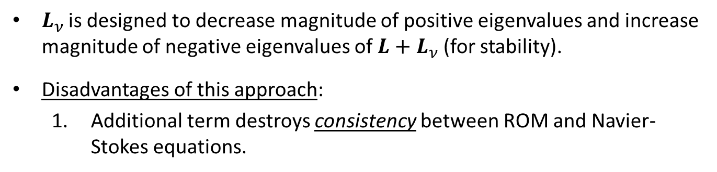
Traditional Linear Eddy-Viscosity Approach
Dissipative dynamics of truncated higher-order modes are modeled using an additional linear term:
$$\frac{da}{dt}=C+\left(L+L_{ν}\right)a+\left[a^{T}Q^{\left(1\right)}a+a^{T}Q^{\left(2\right)}a+⋯+a^{T}Q^{\left(n\right)}a\right]T$$
$L_{ν }$is designed to decrease magnitude of positive eigenvalues and increase magnitude of negative eigenvalues of $L+L_{ν}$(for stability).
Disadvantages of this approach:
  Additional term destroys consistency between ROM and Navier-Stokes equations.

Slide 33
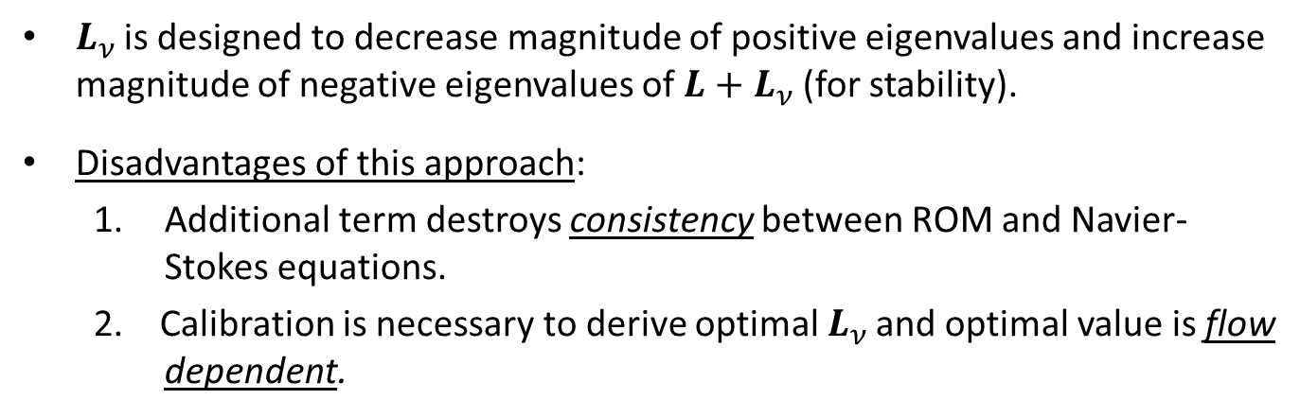
Traditional Linear Eddy-Viscosity Approach
Dissipative dynamics of truncated higher-order modes are modeled using an additional linear term:
$$\frac{da}{dt}=C+\left(L+L_{ν}\right)a+\left[a^{T}Q^{\left(1\right)}a+a^{T}Q^{\left(2\right)}a+⋯+a^{T}Q^{\left(n\right)}a\right]T$$
$L_{ν }$is designed to decrease magnitude of positive eigenvalues and increase magnitude of negative eigenvalues of $L+L_{ν}$(for stability).
Disadvantages of this approach:
  Additional term destroys consistency between ROM and Navier-Stokes equations.
  2. Calibration is necessary to derive optimal $L_{ν }$and optimal value is flow dependent.

Slide 34

Traditional Linear Eddy-Viscosity Approach
Dissipative dynamics of truncated higher-order modes are modeled using an additional linear term:
$$\frac{da}{dt}=C+\left(L+L_{ν}\right)a+\left[a^{T}Q^{\left(1\right)}a+a^{T}Q^{\left(2\right)}a+⋯+a^{T}Q^{\left(n\right)}a\right]T$$
$L_{ν }$is designed to decrease magnitude of positive eigenvalues and increase magnitude of negative eigenvalues of $L+L_{ν}$(for stability).
Disadvantages of this approach:
  Additional term destroys consistency between ROM and Navier-Stokes equations.
  2. Calibration is necessary to derive optimal $L_{ν }$and optimal value is flow dependent.
  3. Inherently a linear model $→$cannot be expected to perform well for all classes of problems (e.g., nonlinear).

Slide 35
Proposed new approach: basis rotation
Instead of modeling truncation via additional linear term, model the truncation a priori by “rotating” the projection subspace into a more dissipative regime

Slide 36
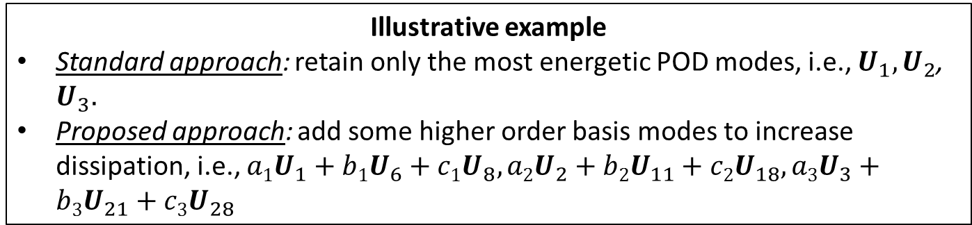
Proposed new approach: basis rotation
Instead of modeling truncation via additional linear term, model the truncation a priori by “rotating” the projection subspace into a more dissipative regime
Illustrative example
Standard approach: retain only the most energetic POD modes, i.e., $U_{1},U_{2}$, $U_{3}.$
Proposed approach: add some higher order basis modes to increase dissipation, i.e., ${a1U}_{1}+{b1U}_{6}+{c1U}_{8},{a2U}_{2}+{b2U}_{11}+{c2U}_{18},a3U_{3}+{b3U}_{21}+{c3U}_{28}$

Slide 37
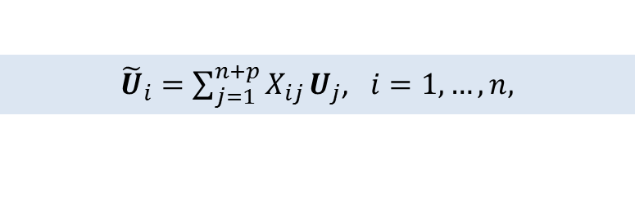
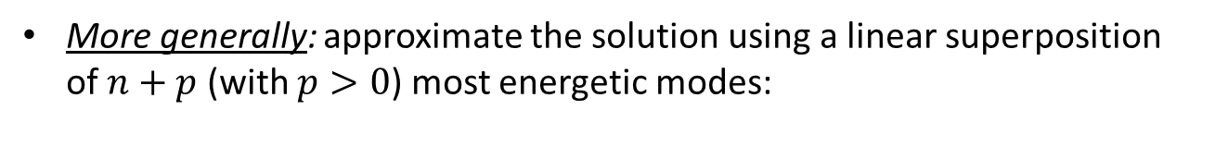
Proposed new approach: basis rotation
Instead of modeling truncation via additional linear term, model the truncation a priori by “rotating” the projection subspace into a more dissipative regime
Illustrative example
Standard approach: retain only the most energetic POD modes, i.e., $U_{1},U_{2}$, $U_{3}.$
Proposed approach: add some higher order basis modes to increase dissipation, i.e., ${a1U}_{1}+{b1U}_{6}+{c1U}_{8},{a2U}_{2}+{b2U}_{11}+{c2U}_{18},a3U_{3}+{b3U}_{21}+{c3U}_{28}$
More generally: approximate the solution using a linear superposition of $n+p$ (with $p>0$) most energetic modes:
${\tilde{U}}_{i}=\sum_{j=1}^{n+p}{X_{ij}}U_{j}$, $i=1,…,n,$
(3)
where $X∈ℝ^{\left(n+p\right)×n}$is an orthonormal ($X^{T}X=I_{n×n}$) “rotation” matrix.

Slide 38
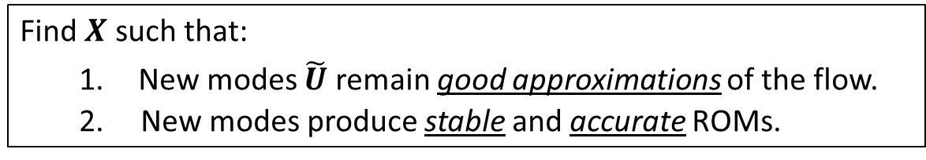
Goals of proposed new approach
Find $X$ such that:
  New modes $\tilde{U}$ remain good approximations of the flow.
  2. New modes produce stable and accurate ROMs.

Slide 39

Goals of proposed new approach
Find $X$ such that:
  New modes $\tilde{U}$ remain good approximations of the flow.
  2. New modes produce stable and accurate ROMs.
We formulate and solve a constrained optimization problem for $X$:
$${minimize}_{X∈𝒱_{\left(n+p\right),n}} f(X)$$
$$subject to g\left(X,L\right)=0$$
where$𝒱_{\left(n+p\right),n}∈\left\{X∈ℝ^{\left(n+p\right)×n}:X^{T}X=I_{n}, p>0\right\}$ is the Stiefel manifold.

Slide 40
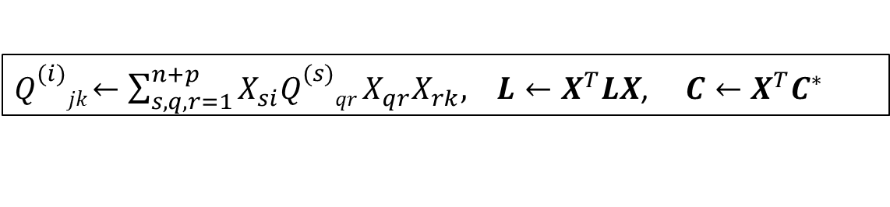
Goals of proposed new approach
Find $X$ such that:
  New modes $\tilde{U}$ remain good approximations of the flow.
  2. New modes produce stable and accurate ROMs.
We formulate and solve a constrained optimization problem for $X$:
$${minimize}_{X∈𝒱_{\left(n+p\right),n}} f(X)$$
$$subject to g\left(X,L\right)=0$$
where$𝒱_{\left(n+p\right),n}∈\left\{X∈ℝ^{\left(n+p\right)×n}:X^{T}X=I_{n}, p>0\right\}$ is the Stiefel manifold.
Once $X$ is found, the result is a system of the form:
$$\frac{da}{dt}=C+La+\left[a^{T}Q^{\left(1\right)}a+a^{T}Q^{\left(2\right)}a+⋯+a^{T}Q^{\left(n\right)}a\right]T$$
with:
$Q_{}^{(i)}jk$ $←\sum_{s,q,r=1}^{n+p}{X_{si}Q_{}^{(s)}qr}X_{qr}X_{rk}, L$ $←X^{T}LX$, $C$ $←X^{T}C^{∗}$
(4)

Slide 41

Objective function
$${minimize}_{X∈𝒱_{\left(n+p\right),n}} f(X)$$
$$subject to g\left(X,L\right)=0$$
(5)
We have considered two objectives $f(X)$ in (5):

Slide 42
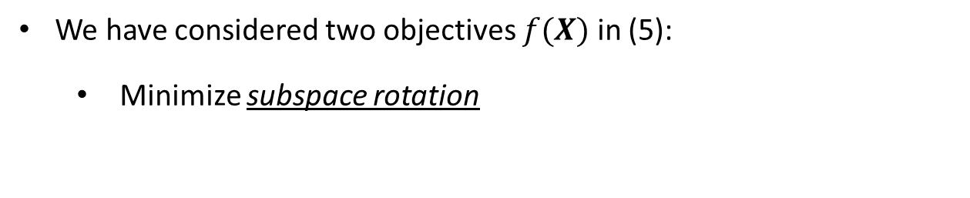
Objective function
$${minimize}_{X∈𝒱_{\left(n+p\right),n}} f(X)$$
$$subject to g\left(X,L\right)=0$$
(5)
We have considered two objectives $f(X)$ in (5):
  Minimize subspace rotation
$$f\left(X\right)= \left\|X−I_{\left(n+p\right),n}\right\|F= −tr\left(X^{T}I_{\left(n+p\right)×n}\right)$$
(6)

Slide 43

Objective function
$${minimize}_{X∈𝒱_{\left(n+p\right),n}} f(X)$$
$$subject to g\left(X,L\right)=0$$
(5)
We have considered two objectives $f(X)$ in (5):
  Minimize subspace rotation
$$f\left(X\right)= \left\|X−I_{\left(n+p\right),n}\right\|F= −tr\left(X^{T}I_{\left(n+p\right)×n}\right)$$
(6)
Maximize resolved turbulent kinetic energy (TKE)
$$f\left(X\right)=−|\left|Σ−XXTΣ\right||F$$
(7)

Slide 44
Objective function
$${minimize}_{X∈𝒱_{\left(n+p\right),n}} f(X)$$
$$subject to g\left(X,L\right)=0$$
(5)
We have considered two objectives $f(X)$ in (5):
  Minimize subspace rotation
$$f\left(X\right)= \left\|X−I_{\left(n+p\right),n}\right\|F= −tr\left(X^{T}I_{\left(n+p\right)×n}\right)$$
(6)
Maximize resolved turbulent kinetic energy (TKE)
$$f\left(X\right)=−|\left|Σ−XXTΣ\right||F$$
(7)
TKE objective (7) comes from earlier work (Balajewicz et al., 2013) involving stabilization of incompressible flow ROMs
  POD modes associated with low KE are important dynamically even though they contribute little to overall energy of the fluid flow.
* In (7), $Σ$ denotes the square of second moments of ROM modal coefficients (Balajewicz et al., 2013).

Slide 45

Objective function
$${minimize}_{X∈𝒱_{\left(n+p\right),n}} f(X)$$
$$subject to g\left(X,L\right)=0$$
(5)
We have considered two objectives $f(X)$ in (5):
  Minimize subspace rotation
$$f\left(X\right)= \left\|X−I_{\left(n+p\right),n}\right\|F= −tr\left(X^{T}I_{\left(n+p\right)×n}\right)$$
(6)
Maximize resolved turbulent kinetic energy (TKE)
$$f\left(X\right)=−|\left|Σ−XXTΣ\right||F$$
(7)
Numerical experiments reveal objective (6) produces better results than objective (7) for compressible flow.

Slide 46
Constraint
$${minimize}_{X∈𝒱_{\left(n+p\right),n}} f(X)$$
$$subject to g\left(X,L\right)=0$$
(5)

Slide 47
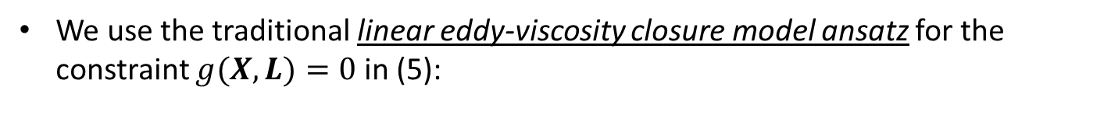

Constraint
$${minimize}_{X∈𝒱_{\left(n+p\right),n}} f(X)$$
$$subject to g\left(X,L\right)=0$$
(5)
We use the traditional linear eddy-viscosity closure model ansatz for the constraint $g(X,L)=0$ in (5):
$$g\left(X,L\right)=tr\left(X^{T}LX\right)−η$$
(8)

Slide 48
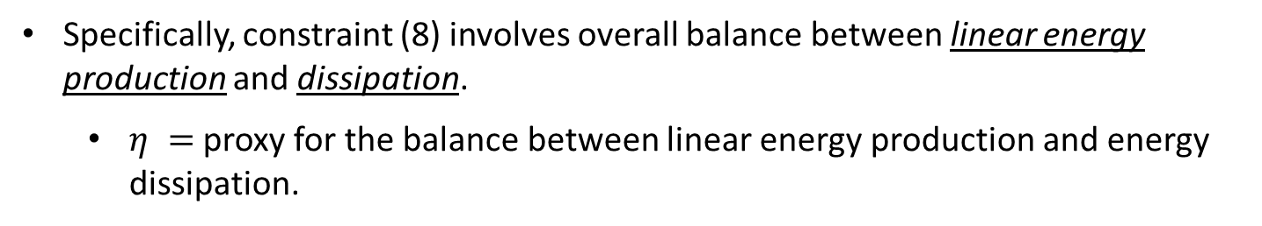
Constraint
$${minimize}_{X∈𝒱_{\left(n+p\right),n}} f(X)$$
$$subject to g\left(X,L\right)=0$$
(5)
We use the traditional linear eddy-viscosity closure model ansatz for the constraint $g(X,L)=0$ in (5):
$$g\left(X,L\right)=tr\left(X^{T}LX\right)−η$$
(8)
Specifically, constraint (8) involves overall balance between linear energy production and dissipation.
  $η =$ proxy for the balance between linear energy production and energy dissipation.

Slide 49
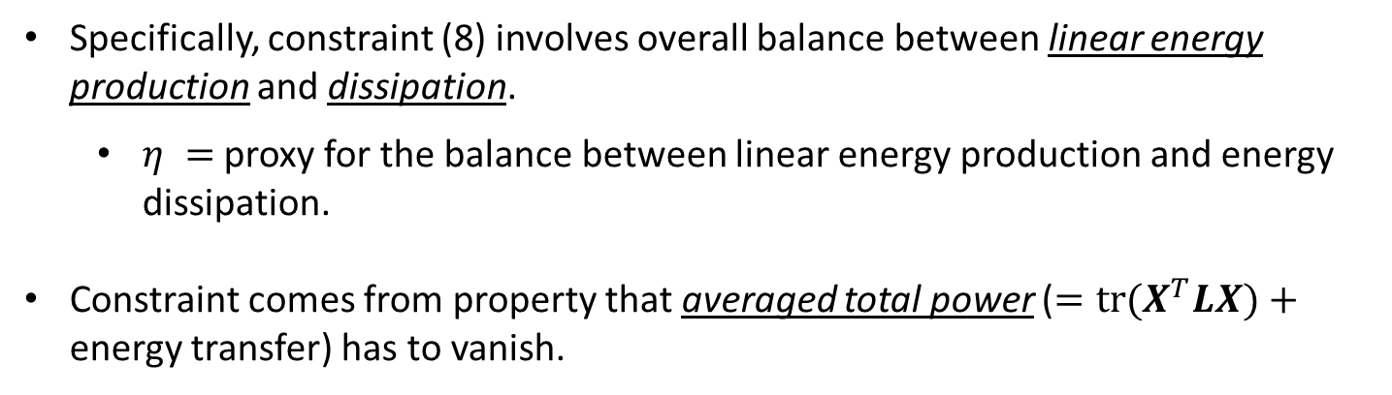
Constraint
$${minimize}_{X∈𝒱_{\left(n+p\right),n}} f(X)$$
$$subject to g\left(X,L\right)=0$$
(5)
We use the traditional linear eddy-viscosity closure model ansatz for the constraint $g(X,L)=0$ in (5):
$$g\left(X,L\right)=tr\left(X^{T}LX\right)−η$$
(8)
Specifically, constraint (8) involves overall balance between linear energy production and dissipation.
  $η =$ proxy for the balance between linear energy production and energy dissipation.
Constraint comes from property that averaged total power ($=tr(X^{T}LX)$ $+$ energy transfer) has to vanish.

Slide 50

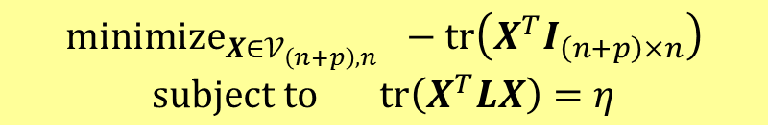
Optimization problem summary
Minimal subspace rotation: trace minimization on Stiefel manifold
$${minimize}_{X∈𝒱_{\left(n+p\right),n}} −tr\left(X^{T}I_{\left(n+p\right)×n}\right)$$
$$subject to tr\left(X^{T}LX\right)=η$$
(9)
  $η∈ℝ$: proxy for the balance between linear energy production and energy dissipation (calculated iteratively using modal energy).
$𝒱_{\left(n+p\right),n}∈\left\{X∈ℝ^{\left(n+p\right)×n}:X^{T}X=I_{n}, p>0\right\}$ is the Stiefel manifold.
Equation (9) is solved efficiently offline using the method of Lagrange multipliers (Manopt MATLAB toolbox).
See (Balajewicz, Tezaur, Dowell, 2016) and Appendix slide for Algorithm.

Slide 51
Remarks on proposed approach
Proposed approach may be interpreted as an a priori consistent formulation of the eddy-viscosity turbulence modeling approach.

Slide 52
Remarks on proposed approach
Proposed approach may be interpreted as an a priori consistent formulation of the eddy-viscosity turbulence modeling approach.
Advantages of proposed approach:

Slide 53
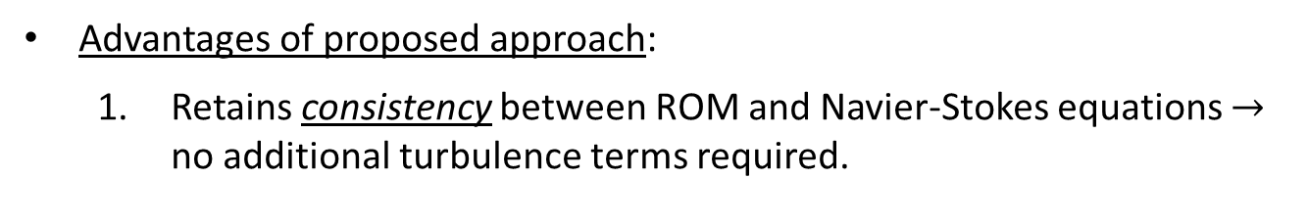
Remarks on proposed approach
Proposed approach may be interpreted as an a priori consistent formulation of the eddy-viscosity turbulence modeling approach.
Advantages of proposed approach:
  Retains consistency between ROM and Navier-Stokes equations $→$ no additional turbulence terms required.

Slide 54
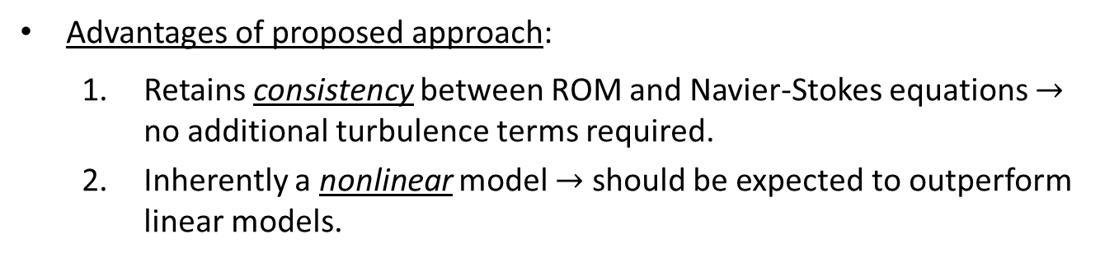
Remarks on proposed approach
Proposed approach may be interpreted as an a priori consistent formulation of the eddy-viscosity turbulence modeling approach.
Advantages of proposed approach:
  Retains consistency between ROM and Navier-Stokes equations $→$ no additional turbulence terms required.
  Inherently a nonlinear model $→$ should be expected to outperform linear models.

Slide 55
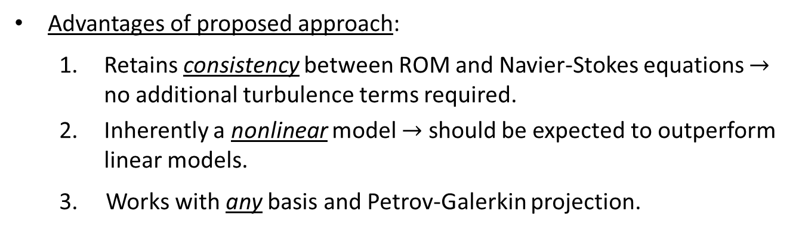
Remarks on proposed approach
Proposed approach may be interpreted as an a priori consistent formulation of the eddy-viscosity turbulence modeling approach.
Advantages of proposed approach:
  Retains consistency between ROM and Navier-Stokes equations $→$ no additional turbulence terms required.
  Inherently a nonlinear model $→$ should be expected to outperform linear models.
  3. Works with any basis and Petrov-Galerkin projection.

Slide 56
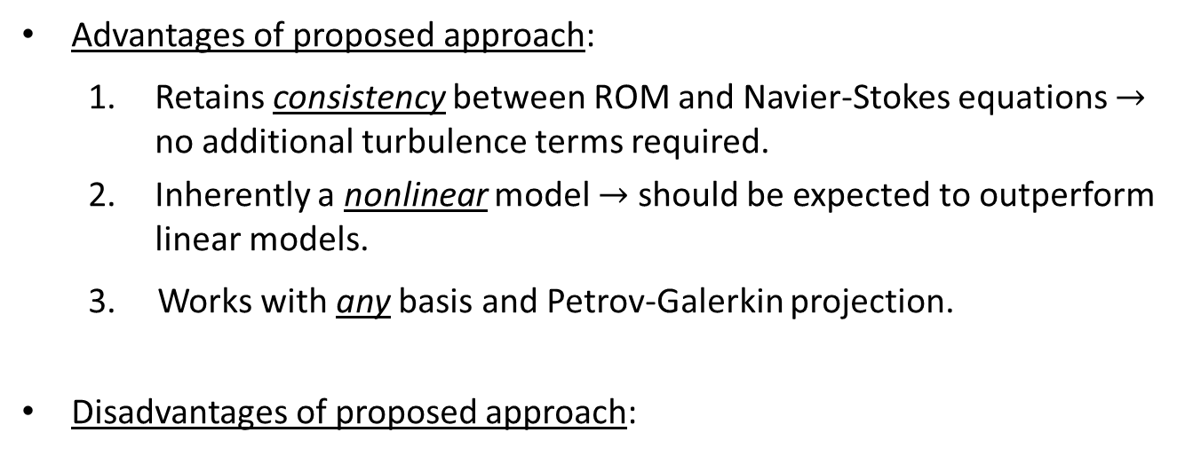
Remarks on proposed approach
Proposed approach may be interpreted as an a priori consistent formulation of the eddy-viscosity turbulence modeling approach.
Advantages of proposed approach:
  Retains consistency between ROM and Navier-Stokes equations $→$ no additional turbulence terms required.
  Inherently a nonlinear model $→$ should be expected to outperform linear models.
  3. Works with any basis and Petrov-Galerkin projection.
Disadvantages of proposed approach:

Slide 57
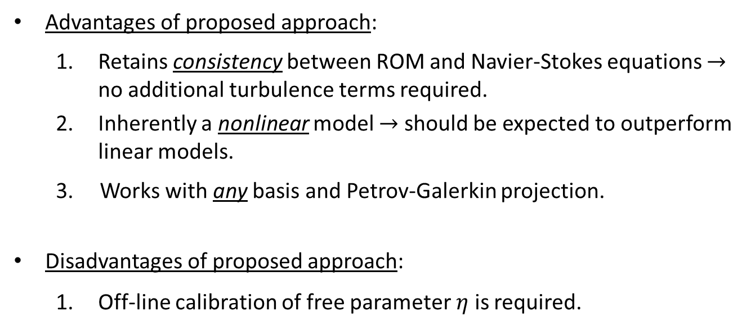
Remarks on proposed approach
Proposed approach may be interpreted as an a priori consistent formulation of the eddy-viscosity turbulence modeling approach.
Advantages of proposed approach:
  Retains consistency between ROM and Navier-Stokes equations $→$ no additional turbulence terms required.
  Inherently a nonlinear model $→$ should be expected to outperform linear models.
  3. Works with any basis and Petrov-Galerkin projection.
Disadvantages of proposed approach:
  Off-line calibration of free parameter $η$ is required.

Slide 58
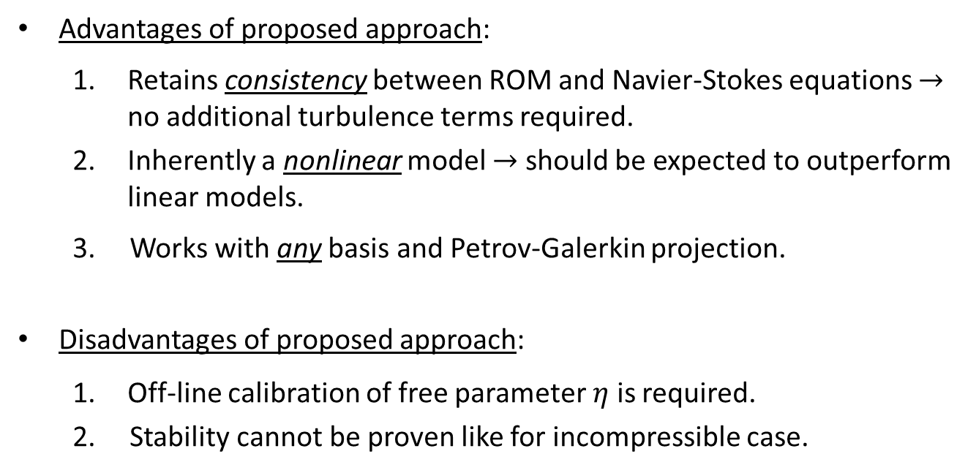
Remarks on proposed approach
Proposed approach may be interpreted as an a priori consistent formulation of the eddy-viscosity turbulence modeling approach.
Advantages of proposed approach:
  Retains consistency between ROM and Navier-Stokes equations $→$ no additional turbulence terms required.
  Inherently a nonlinear model $→$ should be expected to outperform linear models.
  3. Works with any basis and Petrov-Galerkin projection.
Disadvantages of proposed approach:
  Off-line calibration of free parameter $η$ is required.
  2. Stability cannot be proven like for incompressible case.

Slide 59
Outline
Introduction
  Targeted application
  POD/Galerkin approach to MOR
  Extreme model reduction
  Mode truncation instability in MOR
2. Accounting for modal truncation
  Traditional linear eddy-viscosity approach
  New proposed approach via subspace rotation
3. Applications
  Low Reynolds (Re) number channel driven cavity
  Moderate Reynolds (Re) number channel driven cavity
4. Extension to Least-Squares Petrov-Galerkin (LSPG) ROMs
5. Summary & future work

Slide 60
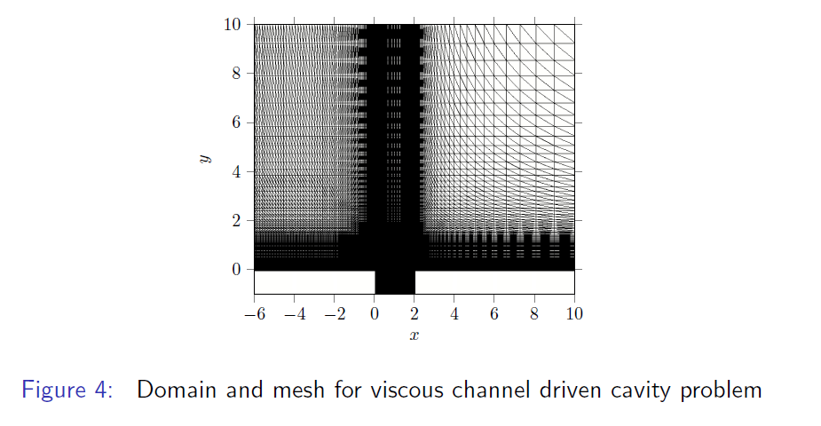
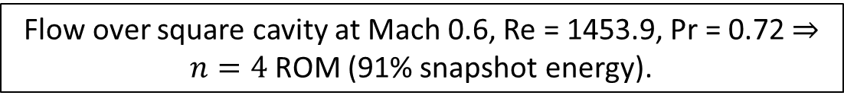
Low Re Channel Driven Cavity
Flow over square cavity at Mach 0.6, Re = 1453.9, Pr = 0.72 $⇒n=4$ ROM (91% snapshot energy).
Figure 1: Domain and mesh for viscous channel driven cavity problem.

Slide 61
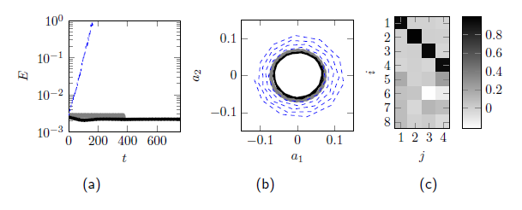
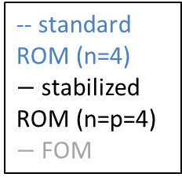
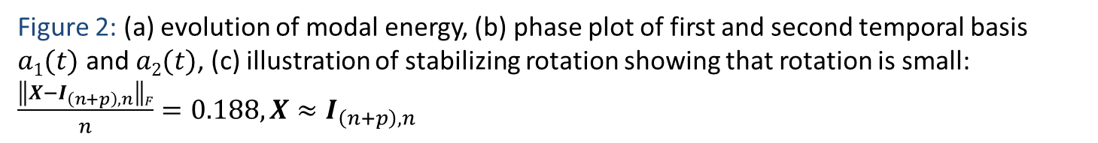
Low Re Channel Driven Cavity
Minimizing subspace rotation:
$$f\left(X\right)= \left\|X−I_{\left(n+p\right),n}\right\|F= −tr\left(X^{T}I_{\left(n+p\right)×n}\right)$$
-- standard ROM (n=4)
$−$stabilized ROM (n=p=4)
$−$FOM
Figure 2: (a) evolution of modal energy, (b) phase plot of first and second temporal basis $a1(t)$ and $a2(t)$, (c) illustration of stabilizing rotation showing that rotation is small: $\frac{\left\|X−I_{\left(n+p\right),n}\right\|F}{n}=0.188, X≈I_{\left(n+p\right),n}$

Slide 62
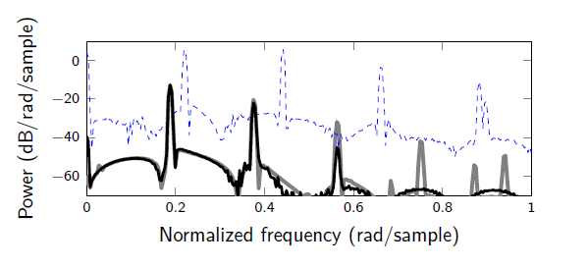
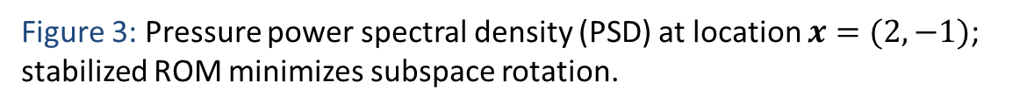

Low Re Channel Driven Cavity
Minimizing subspace rotation:
$$f\left(X\right)= \left\|X−I_{\left(n+p\right),n}\right\|F= −tr\left(X^{T}I_{\left(n+p\right)×n}\right)$$
-- standard ROM (n=4)
$−$stabilized ROM (n=p=4)
$−$FOM
Figure 3: Pressure power spectral density (PSD) at location $x=(2,−1)$; stabilized ROM minimizes subspace rotation.

Slide 63
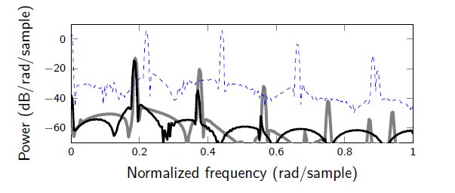
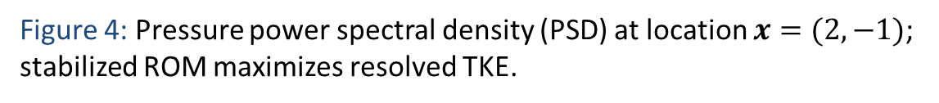


Low Re Channel Driven Cavity
Maximizing resolved TKE:
$$f\left(X\right)=−|\left|Σ−XXTΣ\right||F$$
-- standard ROM (n=4)
$−$stabilized ROM (n=p=4)
$−$FOM
Figure 4: Pressure power spectral density (PSD) at location $x=(2,−1)$; stabilized ROM maximizes resolved TKE.

Slide 64



Low Re Channel Driven Cavity
Minimizing subspace rotation:
$$f\left(X\right)= \left\|X−I_{\left(n+p\right),n}\right\|F= −tr\left(X^{T}I_{\left(n+p\right)×n}\right)$$
Standard ROM ($n=4$)
Stabilized ROM ($n=p=4$)
FOM
Figure 5: Channel driven cavity Re $≈$ 1500 contours of $u$-velocity at time of final snapshot.

Slide 65

Moderate Re Channel Driven Cavity
Flow over square cavity at Mach 0.6, Re = 5452.1, Pr = 0.72 $⇒n=20$ ROM (71.8% snapshot energy).
Figure 6: Domain and mesh for viscous channel driven cavity problem.

Slide 66



Moderate Re Channel Driven Cavity
Minimizing subspace rotation:
$$f\left(X\right)= \left\|X−I_{\left(n+p\right),n}\right\|F= −tr\left(X^{T}I_{\left(n+p\right)×n}\right)$$
-- standard ROM (n=20)
$−$stabilized ROM (n=p=20)
$−$FOM
Figure 7: (a) evolution of modal energy, (b) illustration of stabilizing rotation showing that rotation is small: $\frac{\left\|X−I_{\left(n+p\right),n}\right\|F}{n}=0.038, X≈I_{\left(n+p\right),n}$

Slide 67



Moderate Re Channel Driven Cavity
Minimizing subspace rotation:
$−$stabilized ROM (n=p=20)
$−$FOM
$$f\left(X\right)= \left\|X−I_{\left(n+p\right),n}\right\|F= −tr\left(X^{T}I_{\left(n+p\right)×n}\right)$$
Figure 8: Pressure cross PSD of of $p(x1,t)$ and $p(x2,t)$ where $x1=\left(2,−0.5\right),$ $x2=(0,−0.5)$
Power and phase lag at fundamental frequency, and first two super harmonics are predicted accurately using the fine-tuned ROM ($∆ =$ stabilized ROM, $=$FOM)

Slide 68



Moderate Re Channel Driven Cavity
Minimizing subspace rotation:
$$f\left(X\right)= \left\|X−I_{\left(n+p\right),n}\right\|F= −tr\left(X^{T}I_{\left(n+p\right)×n}\right)$$
Standard ROM ($n=20$)
Stabilized ROM ($n=p=$20)
FOM
Figure 9: Channel driven cavity Re $≈$ 5500 contours of $u$-velocity at time of final snapshot.

Slide 69

CPU times (CPU-hours) for offline and online computations*
Procedure | Low Re Cavity | Moderate Re Cavity
FOM # of DOF | 288,250 | 243,750
Time-integration of FOM | 72 hrs | 179 hrs
Basis construction (size $n+p$ ROM) | 0.88 hrs | 3.44 hrs
Galerkin projection (size $n+p$ ROM) | 5.44 hrs | 14.8 hrs
Stabilization | 14 sec | 170 sec
ROM # of DOF | 4 | 20
Time-integration of ROM | 0.16 sec | 0.83 sec
Online computational speed-up | 1.6e6 | 7.8e5
offline
online
* For minimizing subspace rotation.

Slide 70

CPU times (CPU-hours) for offline and online computations*
Procedure | Low Re Cavity | Moderate Re Cavity
FOM # of DOF | 288,250 | 243,750
Time-integration of FOM | 72 hrs | 179 hrs
Basis construction (size $n+p$ ROM) | 0.88 hrs | 3.44 hrs
Galerkin projection (size $n+p$ ROM) | 5.44 hrs | 14.8 hrs
Stabilization | 14 sec | 170 sec
ROM # of DOF | 4 | 20
Time-integration of ROM | 0.16 sec | 0.83 sec
Online computational speed-up | 1.6e6 | 7.8e5
offline
online
Stabilization is fast ($O$(sec) or $O$(min)).
* For minimizing subspace rotation.

Slide 71


CPU times (CPU-hours) for offline and online computations*
Procedure | Low Re Cavity | Moderate Re Cavity
FOM # of DOF | 288,250 | 243,750
Time-integration of FOM | 72 hrs | 179 hrs
Basis construction (size $n+p$ ROM) | 0.88 hrs | 3.44 hrs
Galerkin projection (size $n+p$ ROM) | 5.44 hrs | 14.8 hrs
Stabilization | 14 sec | 170 sec
ROM # of DOF | 4 | 20
Time-integration of ROM | 0.16 sec | 0.83 sec
Online computational speed-up | 1.6e6 | 7.8e5
offline
online
Stabilization is fast ($O$(sec) or $O$(min)).
Significant online computational speed-up!
* For minimizing subspace rotation.

Slide 72
Outline
Introduction
  Targeted application
  POD/Galerkin approach to MOR
  Extreme model reduction
  Mode truncation instability in MOR
2. Accounting for modal truncation
  Traditional linear eddy-viscosity approach
  New proposed approach via subspace rotation
3. Applications
  Low Reynolds (Re) number channel driven cavity
  Moderate Reynolds (Re) number channel driven cavity
4. Extension to Least-Squares Petrov-Galerkin (LSPG) ROMs
5. Summary & future work

Slide 73
Extensions to Least-Squares Petrov-Galerkin (LSPG) ROMs
Stabilization/enhancement of LSPG ROMs is parallel effort to implementation of LSPG minimal-residual ROMs (GNAT method of Carlberg et al.) in our in-house flow solver, SPARC (see poster by Jeff Fike)

Slide 74

Extensions to Least-Squares Petrov-Galerkin (LSPG) ROMs
Stabilization/enhancement of LSPG ROMs is parallel effort to implementation of LSPG minimal-residual ROMs (GNAT method of Carlberg et al.) in our in-house flow solver, SPARC (see poster by Jeff Fike)
FOM is a nonlinear system of the form $r(w)$ = $0$ (Navier-Stokes discretized in space and in time).

Slide 75


Extensions to Least-Squares Petrov-Galerkin (LSPG) ROMs
Stabilization/enhancement of LSPG ROMs is parallel effort to implementation of LSPG minimal-residual ROMs (GNAT method of Carlberg et al.) in our in-house flow solver, SPARC (see poster by Jeff Fike)
FOM is a nonlinear system of the form $r(w)$ = $0$ (Navier-Stokes discretized in space and in time).
Solving ROM amounts to solving non-linear least-squares problem:
$\hat{w}PG=$ ${\arg{min}}_{y∈ℝn}||r(\overline{w}+$ $ΦM y$)||₂²$⁡$

Slide 76

Extensions to Least-Squares Petrov-Galerkin (LSPG) ROMs
Stabilization/enhancement of LSPG ROMs is parallel effort to implementation of LSPG minimal-residual ROMs (GNAT method of Carlberg et al.) in our in-house flow solver, SPARC (see poster by Jeff Fike)
FOM is a nonlinear system of the form $r(w)$ = $0$ (Navier-Stokes discretized in space and in time).
Solving ROM amounts to solving non-linear least-squares problem:
$\hat{w}PG=$ ${\arg{min}}_{y∈ℝn}||r(\overline{w}+$ $ΦM y$)||₂²$⁡$
Equivalent to Petrov-Galerkin projection with test basis $ΨM=JΦM,$where $J$ is the Jacobian of $r(w)$.

Slide 77


Extensions to Least-Squares Petrov-Galerkin (LSPG) ROMs
Stabilization/enhancement of LSPG ROMs is parallel effort to implementation of LSPG minimal-residual ROMs (GNAT method of Carlberg et al.) in our in-house flow solver, SPARC (see poster by Jeff Fike)
FOM is a nonlinear system of the form $r(w)$ = $0$(Navier-Stokes discretized in space and in time).
Solving ROM amounts to solving non-linear least-squares problem:
$\hat{w}PG=$ ${\arg{min}}_{y∈ℝn}||r(\overline{w}+$ $ΦM y$)||₂²$⁡$
Equivalent to Petrov-Galerkin projection with test basis $ΨM=JΦM,$where $J$ is the Jacobian of $r(w)$.
POD/LSPG ROMs are more stable than POD/Galerkin ROMs.

Slide 78

Extensions to Least-Squares Petrov-Galerkin (LSPG) ROMs
Stabilization/enhancement of LSPG ROMs is parallel effort to implementation of LSPG minimal-residual ROMs (GNAT method of Carlberg et al.) in our in-house flow solver, SPARC (see poster by Jeff Fike)
FOM is a nonlinear system of the form $r(w)$ = $0$ (Navier-Stokes discretized in space and in time).
Solving ROM amounts to solving non-linear least-squares problem:
$\hat{w}PG=$ ${\arg{min}}_{y∈ℝn}||r(\overline{w}+$ $ΦM y$)||₂²$⁡$
Equivalent to Petrov-Galerkin projection with test basis $ΨM=JΦM,$where $J$ is the Jacobian of $r(w)$.
POD/LSPG ROMs are more stable than POD/Galerkin ROMs.
  $→$Nevertheless, low-dimensional LSPG ROMs can benefit from basis stabilization.

Slide 79

Stabilization of Inviscid Pulse in Uniform Flow Low Order LSPG ROM
Preliminary Workflow
Run LSPG ROM in SPARC $→$ output POD basis.
Use POD/Galerkin ROM code Spirit to produce $C$, $L$, and $Q^{\left(i\right)}$matrices in (2).
Stabilize POD basis using stabilization approach described in this talk.
Run LSPG ROM in SPARC with stabilized basis.

Slide 80
Stabilization of Inviscid Pulse in Uniform Flow Low Order LSPG ROM
Preliminary Workflow
Run LSPG ROM in SPARC $→$ output POD basis.
Use POD/Galerkin ROM code Spirit to produce $C$, $L$, and $Q^{\left(i\right)}$matrices in (2).
Stabilize POD basis using stabilization approach described in this talk.
Run LSPG ROM in SPARC with stabilized basis.
Figure (left) shows generalized coordinates for mode 2 compared to FOM projection.
Our approach effectively stabilizes LSPG ROM.

Slide 81
Stabilization of Inviscid Pulse in Uniform Flow Low Order LSPG ROM
Preliminary Workflow
Run LSPG ROM in SPARC $→$ output POD basis.
Use POD/Galerkin ROM code Spirit to produce $C$, $L$, and $Q^{\left(i\right)}$matrices in (2).
Stabilize POD basis using stabilization approach described in this talk.
Run LSPG ROM in SPARC with stabilized basis.
Figure (left) shows generalized coordinates for mode 2 compared to FOM projection.
Our approach effectively stabilizes LSPG ROM.
Preliminary approach needs improvement, as there are inconsistencies between SPARC and Spirit codes.
We are currently working on extending our stabilization/enhancement approach to ROMs with generic nonlinearities.

Slide 82
Outline
Introduction
  Targeted application
  POD/Galerkin approach to MOR
  Extreme model reduction
  Mode truncation instability in MOR
2. Accounting for modal truncation
  Traditional linear eddy-viscosity approach
  New proposed approach via subspace rotation
3. Applications
  Low Reynolds (Re) number channel driven cavity
  Moderate Reynolds (Re) number channel driven cavity
4. Extension to Least-Squares Petrov-Galerkin (LSPG) ROMs
5. Summary & future work

Slide 83
Summary
We have developed a non-intrusive approach for stabilizing and fine-tuning projection-based ROMs for compressible flows.
The standard POD modes are “rotated” into a more dissipative regime to account for the dynamics in the higher order modes truncated by the standard POD method.
The new approach is consistent and does not require the addition of empirical turbulence model terms unlike traditional approaches.
Mathematically, the approach is formulated as a quadratic matrix program on the Stiefel manifold.
The constrained minimization problem is solved offline and small enough to be solved in MATLAB.
The method is demonstrated on several compressible flow problems and shown to deliver stable and accurate ROMs.

Slide 84
Future work

Slide 85
Future work
Application to higher Reynolds number problems.

Slide 86
Future work
Application to higher Reynolds number problems.
Extension of the proposed approach to problems with generic nonlinearities, where the ROM involves some form of hyper-reduction (e.g., DEIM, gappy POD).

Slide 87
Future work
Application to higher Reynolds number problems.
Extension of the proposed approach to problems with generic nonlinearities, where the ROM involves some form of hyper-reduction (e.g., DEIM, gappy POD).
Extension of the method to minimal-residual-based nonlinear ROMs.

Slide 88
Future work
Application to higher Reynolds number problems.
Extension of the proposed approach to problems with generic nonlinearities, where the ROM involves some form of hyper-reduction (e.g., DEIM, gappy POD).
Extension of the method to minimal-residual-based nonlinear ROMs.
Extension of the method to predictive applications, e.g., problems with varying Reynolds number and/or Mach number.

Slide 89


Future work
Application to higher Reynolds number problems.
Extension of the proposed approach to problems with generic nonlinearities, where the ROM involves some form of hyper-reduction (e.g., DEIM, gappy POD).
Extension of the method to minimal-residual-based nonlinear ROMs.
Extension of the method to predictive applications, e.g., problems with varying Reynolds number and/or Mach number.
Selecting different goal-oriented objectives and constraints in our optimization problem:
$${minimize}_{X∈𝒱_{\left(n+p\right),n}} f(X)$$
$$subject to g(X,L)=0$$
e.g.,
  Maximize parametric robustness: $f=\sum_{i=1}^{k}{β_{i}\left\|U^{∗}\left(μ_{i}\right)X−U^{∗}\left(μ_{i}\right)\right\|}F$.
  ODE constraints: $g= \left\|a\left(t\right)−a^{∗}(t)\right\|.$

Slide 90
References
[1] M. Balajewicz, E. Dowell. Stabilization of projection-based reduced order models of the Navier-Stokes equation. Nonlinear Dynamics 70(2),1619-1632, 2012.
[2] M. Balajewicz, E. Dowell, B. Noack. Low-dimensional modelling of high-Reynolds-number shear flows incorporating constraints from the Navier-Stokes equation. Journal of Fluid Mechanics 729, 285-308, 2013.
[3] M. Balajewicz, I. Tezaur, E. Dowell. Minimal subspace rotation on the Stiefel manifold for stabilization and enhancement of projection-based reduced order models for the compressible Navier-Stokes equations. J. Comput. Phys., 321, 224–241, 2016.
[4] M. Barone, I. Kalashnikova, D. Segalman, H. Thornquist. Stable Galerkin reduced order models for linearized compressible flow. J. Computat. Phys. 228(6), 1932-1946, 2009.
[5] K. Carlberg, C. Farhat, J. Cortial, D. Amsallem. The GNAT method for nonlinear model reduction: effective implementation and application to computational fluid dynamics and turbulent flows. J. Computat. Phys. 242, 623-647, 2013.
[6] I. Kalashnikova, S. Arunajatesan, M. Barone, B. van Bloemen Waanders, J. Fike. Reduced order modeling for prediction and control of large-scale systems. Sandia Tech. Report, 2014.
[7] C. Rowley, T. Colonius, R. Murray. Model reduction for compressible flows using POD and Galerkin projection. Physica D: Nonlinear Phenomena. 189(1) 115-129, 2004.
[8] G. Serre, P. Lafon, X. Gloerfelt, C. Bailly. Reliable reduced-order models for timedependentlinearized euler equations. J. Computat. Phys. 231(15) 5176-5194, 2012.
[9] N. Aubry, P. Holmes, J. Lumley, E. Stone The dynamics of coherent structures in the wall region of a
turbulent boundary layer. J. Fluid Mech. 192(115) 115-173, 1988.
[10] J. Osth, B. Noack, R. Krajnovic, D. Barros, J. Boree. On the need for a nonlinear subscale turbulence term in POD
models as exemplified for a high Reynolds number flow over an Ahmed body. J. Fluid Mech. 747 518-544, 2004.
[11] T. Bui-Thanh, K. Willcox, O. Ghattas, and B. van Bloemen Waanders. Goal-oriented, model
constrained optimization for reduction of large-scale systems. J. Comput. Phys., 224, 880–896, 2007.

Slide 91


Appendix: Accounting for modal truncation
Stabilization algorithm: returns stabilizing rotation matrix $X$.

Slide 92
Targeted Application: Compressible Flow
We are interested in the compressible captive-carry problem.
Majority of fluid MOR approaches in the literature are for incompressible flow.

Slide 93
Targeted Application: Compressible Flow
We are interested in the compressible captive-carry problem.
Majority of fluid MOR approaches in the literature are for incompressible flow.
Desired numerical properties of ROMs:
  Consistency (w.r.t. the continuous PDEs).
  Stability: if full order model (FOM) is stable, ROM should be stable.
  Convergence: requires consistency and stability.
  Accuracy (w.r.t. FOM).
  Efficiency.
  Robustness (w.r.t. time or parameter changes).

Slide 94
Targeted Application: Compressible Flow
We are interested in the compressible captive-carry problem.
Majority of fluid MOR approaches in the literature are for incompressible flow.
Desired numerical properties of ROMs:
  Consistency (w.r.t. the continuous PDEs).
  Stability: if full order model (FOM) is stable, ROM should be stable.
  Convergence: requires consistency and stability.
  Accuracy (w.r.t. FOM).
  Efficiency.
  Robustness (w.r.t. time or parameter changes).
Stability can be a real problem for compressible flow ROMs!

