Slide 1
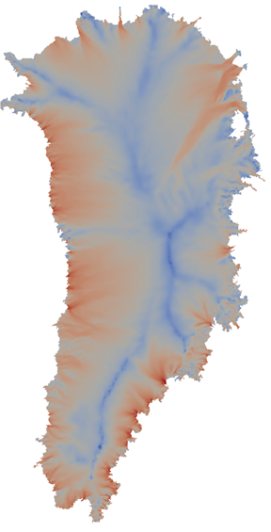
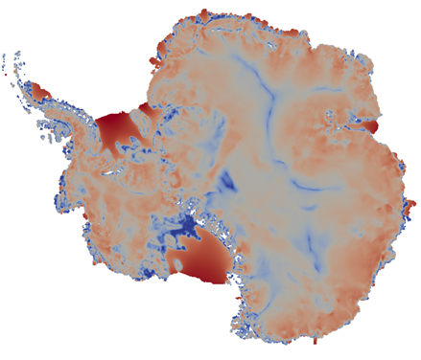
Albany/FELIX: A Robust & Scalable Trilinos-Based Finite-Element Ice Flow Dycore Built for Advanced Architectures & Analysis
I. Tezaur¹, A. Salinger¹, M. Perego¹, J. Jakeman¹, M. Eldred¹,
I. Demeshko¹, R. Tuminaro¹, S. Price²
¹ Sandia National Laboratories
Livermore, CA and Albuquerque, NM, USA
² Los Alamos National Laboratory
Los Alamos, NM, USA
8th International Congress on Industrial and Applied Mathematics (ICIAM 2015)
August 10-14, 2015
Beijing, China
SAND2015-6419C

Slide 2
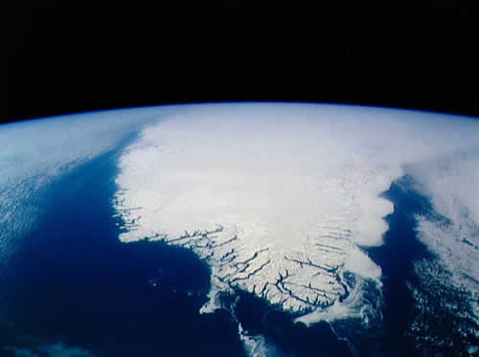
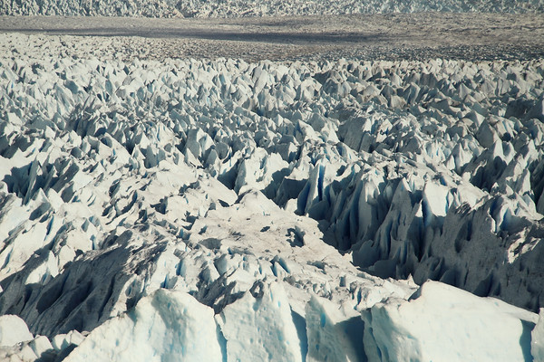
Outline
Albany/FELIX = new land-ice solver with next-generation capabilities.
Overview:
  First Order (FO) Stokes model.
  Albany/FELIX First-Order (FO) Stokes diagnostic solver.
  CISM-Albany and MPAS-Albany codes for prognostic simulations of the ice sheet evolution.
Uncertainty Quantification (UQ):
  Deterministic inversion.
  Bayesian calibration.
  Forward propagation of uncertainty.
Performance portability.
Summary and ongoing work.
Questions?

Slide 3
Outline
Albany/FELIX = new land-ice solver with next-generation capabilities.
Overview:
  First Order (FO) Stokes model.
  Albany/FELIX First-Order (FO) Stokes diagnostic solver.
  CISM-Albany and MPAS-Albany codes for prognostic simulations of the ice sheet evolution.
Uncertainty Quantification (UQ):
  Deterministic inversion.
  Bayesian calibration.
  Forward propagation of uncertainty.
Performance portability.
Summary and ongoing work.
Questions?

Slide 4

The PISCEES Project and the Albany/FELIX Solver
  “PISCEES” = Predicting Ice Sheet Climate & Evolution at Extreme Scales
  5 year project funded by SciDAC, which began in June 2012
  Sandia’s Role in the PISCEES Project: to develop and support a robust and scalable land ice solver based on the “First-Order” (FO) Stokes approximation
Steady-state stress-velocity solver based on FO Stokes physics is known as Albany/FELIX*.
Requirements for Albany/FELIX:
  Scalable, fast, robust.
  Dynamical core (dycore) when coupled to codes that solve thickness and temperature evolution equations (CISM/MPAS LI codes).
  Advanced analysis capabilities (adjoint-based deterministic inversion, Bayesian calibration, UQ, sensitivity analysis).
  Performance-portability.
Dycore will provide actionable predictions of 21st century sea-level rise (including uncertainty).
This talk
*FELIX=“Finite Elements for Land Ice eXperiments”
Albany/FELIX Solver (steady):
Ice Sheet PDEs (First Order Stokes)
(stress-velocity solve)
CISM/MPAS Land Ice Codes (dynamic):
Ice Sheet Evolution PDEs
(thickness, temperature evolution)

Slide 5
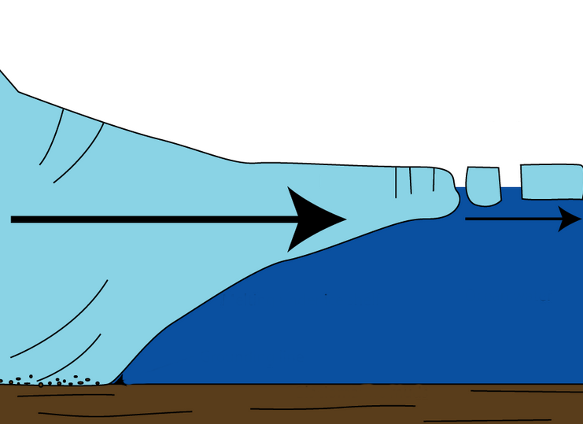
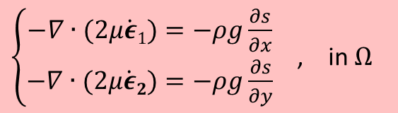



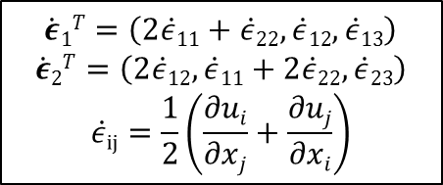

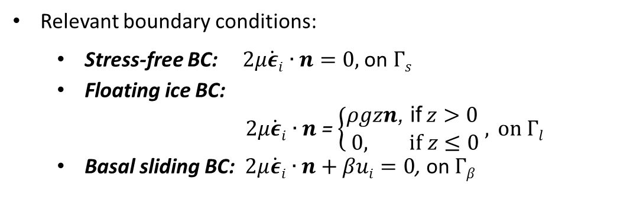
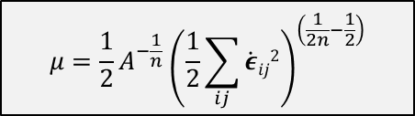

The First-Order Stokes Model
for Ice Sheets & Glaciers
Ice sheet dynamics are given by the “First-Order” Stokes PDEs: approximation* to viscous incompressible quasi-static Stokes flow with power-law viscosity.
$\left\{\begin{aligned}−∇∙(2μ\dot{ε}1)=−ρg\frac{∂s}{∂x} \\ −∇∙(2μ\dot{ε}2)=−ρg\frac{∂s}{∂y}\end{aligned}\right.$ , in $Ω$
$$\dot{ε}1T=\left(2\dot{ε}11+\dot{ε}22,\dot{ε}12,\dot{ε}13\right)$$
$$\dot{ε}2T=\left(2\dot{ε}12, \dot{ε}11+2\dot{ε}22,\dot{ε}23\right)$$
$$\dot{ε}ij=\frac{1}{2}\left(\frac{∂ui}{∂xj}+\frac{∂uj}{∂xi}\right)$$
Viscosity $μ$ is nonlinear function given by “Glen’s law”:
$$μ=\frac{1}{2}{A^{−\frac{1}{n}}\left(\frac{1}{2}\sum_{ij}{\dot{ε}ij2}\right)}^{\left(\frac{1}{2n}−\frac{1}{2}\right)}$$
  Surface boundary $Γs$
Albany/FELIX
$$(n=3)$$
Ice sheet
Relevant boundary conditions:
  Stress-free BC: $2μ\dot{ε}i∙n=0,$ on $Γs$
  Floating ice BC:
  $2μ\dot{ε}i∙n$ = $\left\{\begin{aligned}ρgzn\text{, }\text{if} z>0 \\ 0, if z≤0\end{aligned}, \right.on Γl$
  Basal sliding BC: $2μ\dot{ε}i∙n+βui=0$, on $Γβ$
Lateral boundary $Γl$
  Basal boundary $Γβ$
)
$$β=sliding coefficient≥0$$
*Assumption: aspect ratio $δ$is small and normals to upper/lower surfaces are almost vertical.

Slide 6
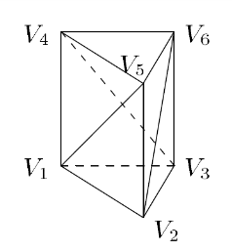
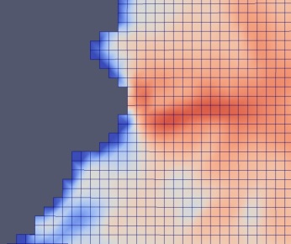
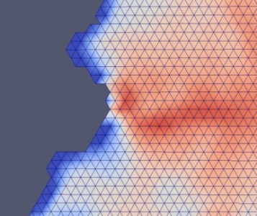
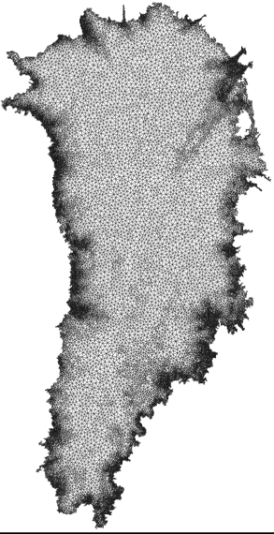
Algorithmic Choices for Albany/FELIX: Discretization & Meshes
  Discretization: unstructured grid finite element method (FEM)
    Can handle readily complex geometries.
    Natural treatment of stress boundary conditions.
    Enables regional refinement/unstructured meshes.
    Wealth of software and algorithms.
  Meshes: can use any mesh but interested specifically in
    Structured hexahedral meshes (compatible with CISM).
    Tetrahedral meshes (compatible with MPAS LI)
    Unstructured Delaunay triangle meshes with regional refinement based on gradient of surface velocity.
    All meshes are extruded (structured) in vertical direction as tetrahedra or hexahedra.

Slide 7
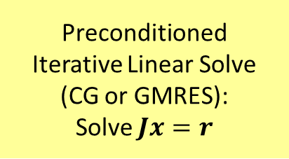
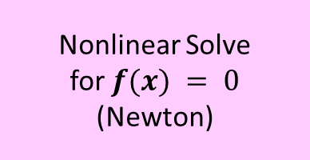

Algorithmic Choices for Albany/FELIX: Nonlinear & Linear Solver
  Nonlinear solver: full Newton with analytic (automatic differentiation) derivatives and homotopy continuation
    Most robust and efficient for steady-state solves.
    Jacobian available for preconditioners and matrix-vector products.
    Analytic sensitivity analysis.
    Analytic gradients for inversion.
  Linear solver: preconditioned iterative method
    Solvers: Conjugate Gradient (CG) or GMRES
    Preconditioners: ILU or algebraic multi-grid (AMG)
Automatic Differentiation Jacobian:
$$J = \frac{∂f}{∂x}$$
Preconditioned
Iterative Linear Solve
(CG or GMRES):
Solve $Jx=r$
Nonlinear Solve
for $f(x) = 0$
(Newton)

Slide 8



The Albany/FELIX Solver:
Implementation in Albany using Trilinos
The Albany/FELIX First Order Stokes solver is implemented in a Sandia parallel C++ finite element code called…
“Agile Components”
Discretizations/meshes
Solver libraries
Preconditioners
Automatic differentiation
Many others!
Started by A. Salinger
Parameter estimation
Uncertainty quantification
Optimization
Bayesian inference
Land Ice Physics Set (Albany/FELIX code)
Other Albany Physics Sets
Configure/build/test/documentation
Use of Trilinos components has enabled the rapid development of the Albany/FELIX First Order Stokes dycore!

Slide 9
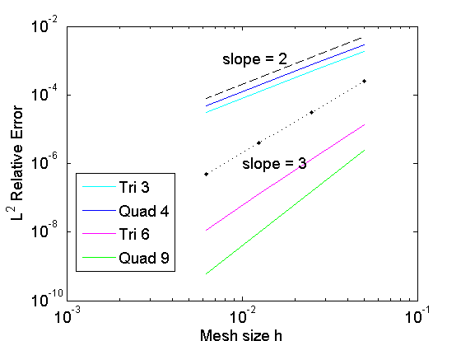
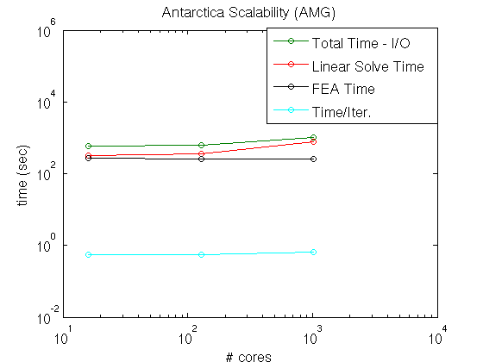
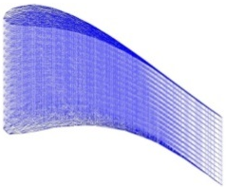
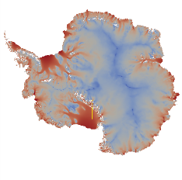
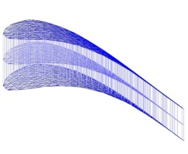
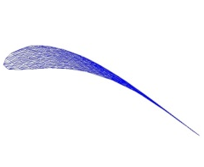
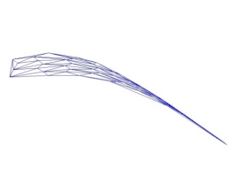
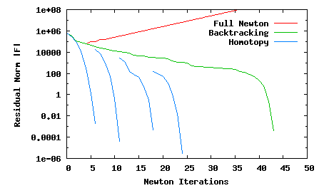
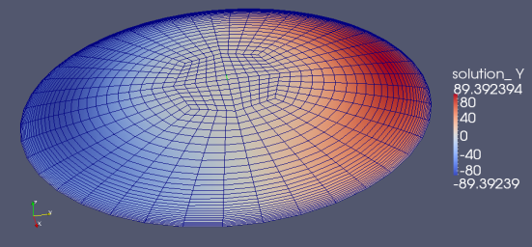
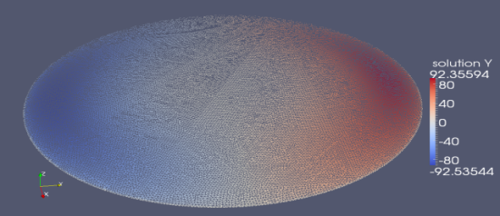

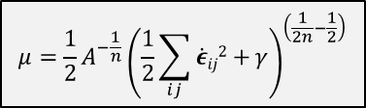


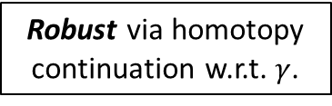



The Albany/FELIX Solver is Verified, Scalable, Fast and Robust!
Scalable via algebraic multi-grid (AMG) preconditioning
Algebraic Structured MG
Algebraic Structured MG
Verified via MMS and code-to-code comparisons.
Unstructured AMG
Albany/FELIX
$γ$=10⁻¹⁰
$$μ=\frac{1}{2}{A^{−\frac{1}{n}}\left(\frac{1}{2}\sum_{ij}{\dot{ε}ij2+}γ\right)}^{\left(\frac{1}{2n}−\frac{1}{2}\right)}$$
$γ$=10⁻¹⁰
Robust via homotopy continuation w.r.t. $γ$.
LifeV
$γ$=10^{-1.0}
$γ$=10^{-6.0}
$γ$=10⁻¹⁰
$γ$=10^{-2.5}

Slide 10
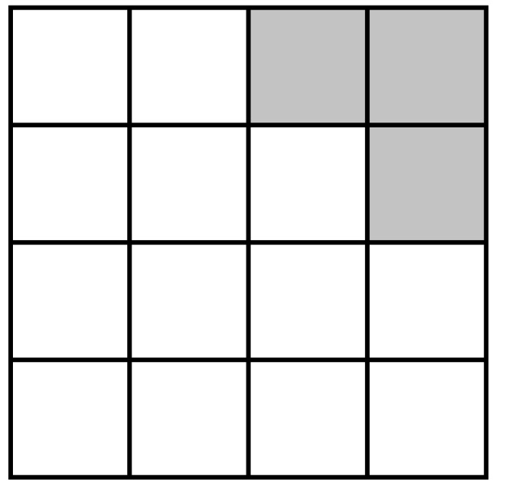
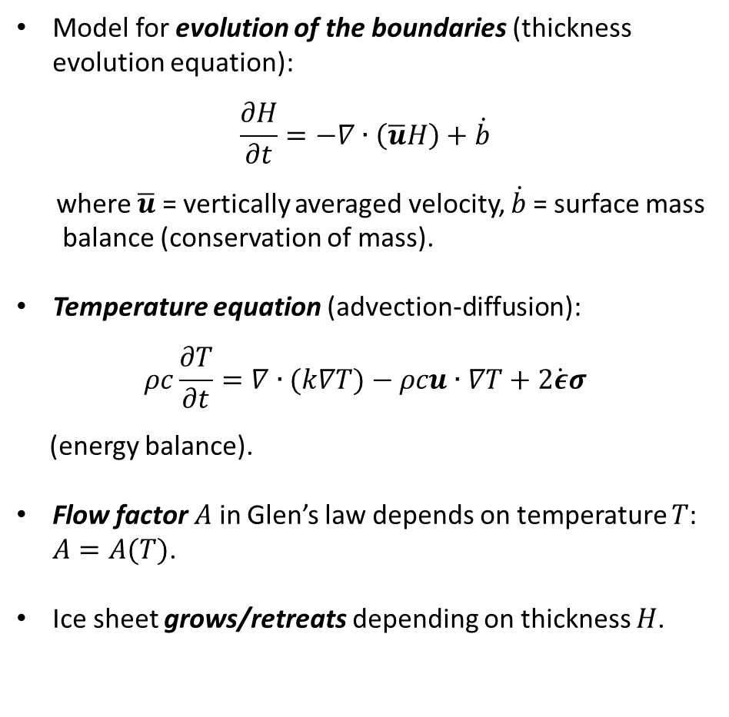
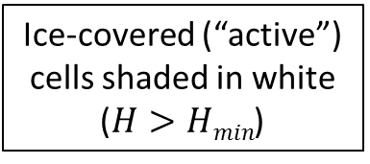

Ice Sheet Evolution Models
Model for evolution of the boundaries (thickness evolution equation):
$$\frac{∂H}{∂t}=−∇∙\left(\overline{u}H\right)+\dot{b}$$
where $\overline{u}$ = vertically averaged velocity, $\dot{b}$= surface mass
balance (conservation of mass).
Temperature equation (advection-diffusion):
$$ρc\frac{∂T}{∂t}=∇∙(k∇T)−ρcu∙∇T+2\dot{ε}σ$$
(energy balance).
Flow factor $A$ in Glen’s law depends on temperature $T$: $A=A(T)$.
Ice sheet grows/retreats depending on thickness $H$.
time $t0$
Ice-covered (“active”) cells shaded in white ($H>Hmin$)

Slide 11
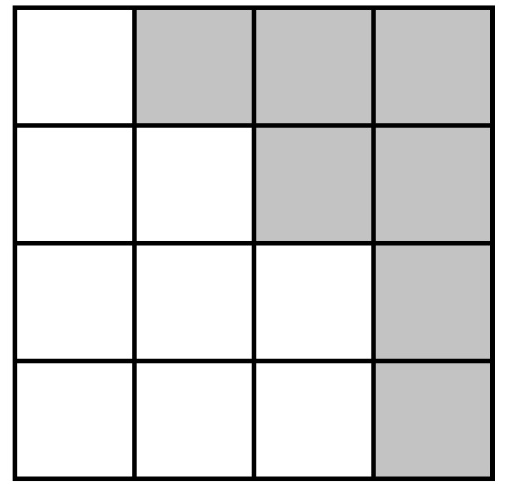
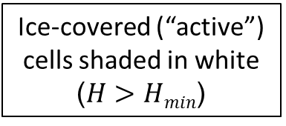
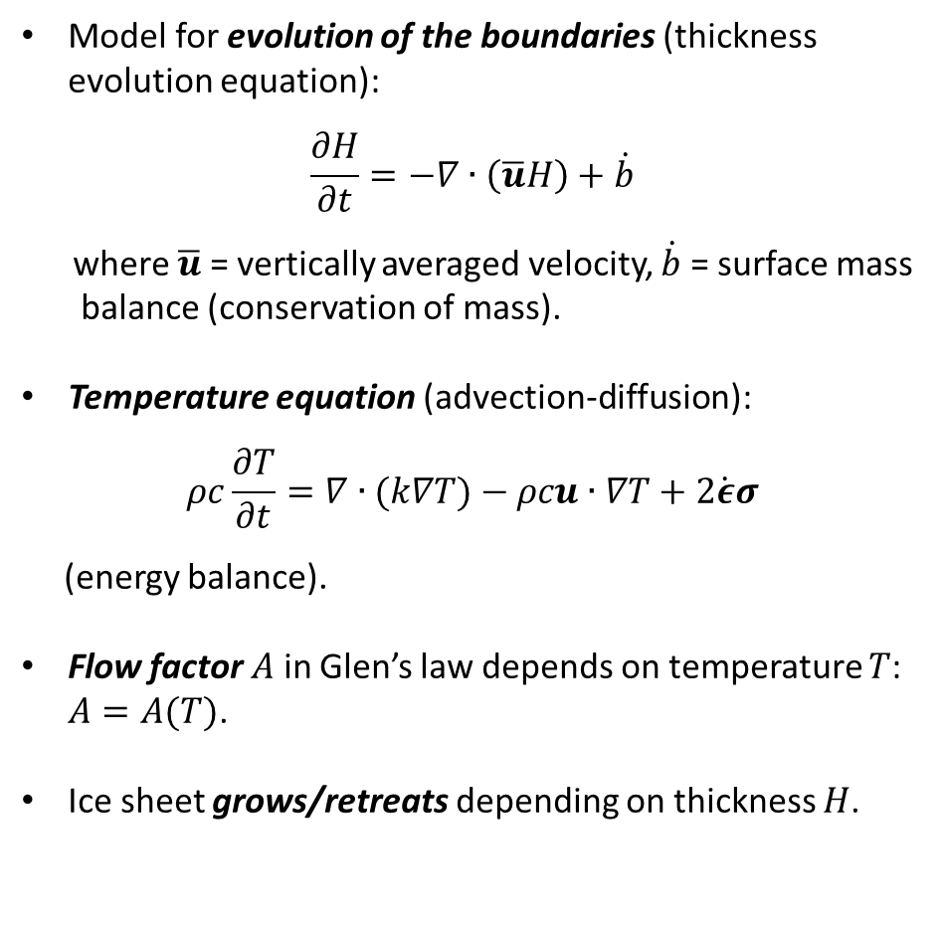

Ice Sheet Evolution Models
Model for evolution of the boundaries (thickness evolution equation):
$$\frac{∂H}{∂t}=−∇∙\left(\overline{u}H\right)+\dot{b}$$
where $\overline{u}$ = vertically averaged velocity, $\dot{b}$ = surface mass
balance (conservation of mass).
Temperature equation (advection-diffusion):
$$ρc\frac{∂T}{∂t}=∇∙(k∇T)−ρcu∙∇T+2\dot{ε}σ$$
(energy balance).
Flow factor $A$ in Glen’s law depends on temperature $T$: $A=A(T)$.
Ice sheet grows/retreats depending on thickness $H$.
time $t0$
time $t1$
Ice-covered (“active”) cells shaded in white ($H>Hmin$)

Slide 12
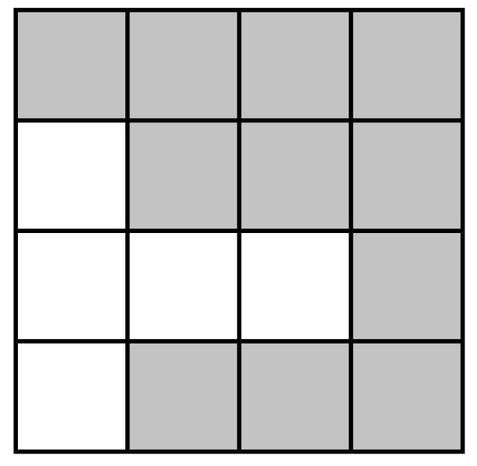

Ice Sheet Evolution Models
Model for evolution of the boundaries (thickness evolution equation):
$$\frac{∂H}{∂t}=−∇∙\left(\overline{u}H\right)+\dot{b}$$
where $\overline{u}$ = vertically averaged velocity, $\dot{b}$= surface mass
balance (conservation of mass).
Temperature equation (advection-diffusion):
$$ρc\frac{∂T}{∂t}=∇∙(k∇T)−ρcu∙∇T+2\dot{ε}σ$$
(energy balance).
Flow factor $A$ in Glen’s law depends on temperature $T$: $A=A(T)$.
Ice sheet grows/retreats depending on thickness $H$.
time $t$₂
time $t0$
time $t1$
Ice-covered (“active”) cells shaded in white ($H>Hmin$)

Slide 13

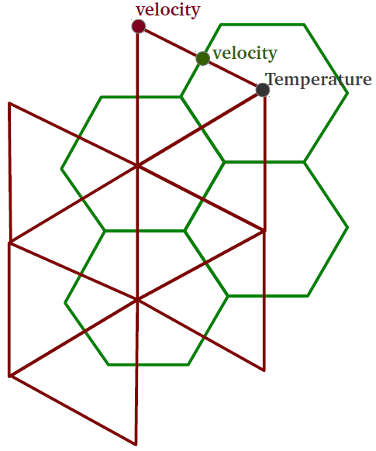

Interfaces to CISM and MPAS LI for Transient Simulations
CISM-Albany
MPAS LI-Albany
cism_driver
Albany/FELIX (C++)
velocity solve
LandIce_model
MPAS Land-Ice (Fortran)
Thickness evolution,
temperature solve,
coupling to DOE-ESM
CISM (Fortran)
Thickness evolution, temperature solve, coupling to CESM
C++/Fortran Interface, Mesh Conversion
C++/Fortran Interface, Mesh Conversion
Tetrahedral meshes (dual of hexaganonal mesh, extruded to tets).
output file
output file
Structured hexahedral meshes (rectangles extruded to hexes).
Albany/FELIX has been coupled to two land ice dycores: Community Ice Sheet Model (CISM) and Model for Prediction Across Scales for Land Ice (MPAS LI)
7/20

Slide 14
Outline
Albany/FELIX = new land-ice solver with next-generation capabilities.
Overview:
  First Order (FO) Stokes model.
  Albany/FELIX First-Order (FO) Stokes diagnostic solver.
  CISM-Albany and MPAS-Albany codes for prognostic simulations of the ice sheet evolution.
Uncertainty Quantification (UQ):
  Deterministic inversion.
  Bayesian calibration.
  Forward propagation of uncertainty.
Performance portability.
Summary and ongoing work.
Questions?

Slide 15
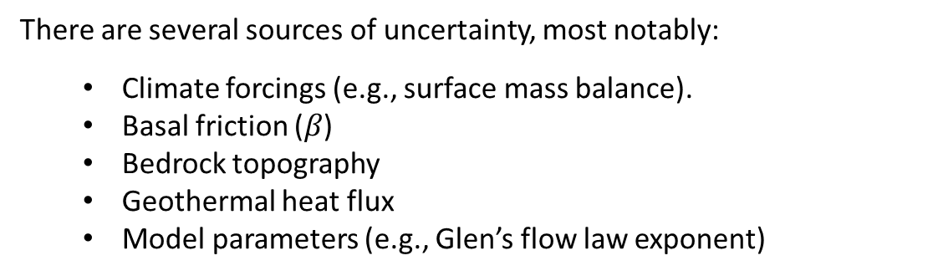



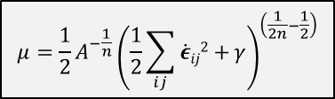
Uncertainty Quantification (UQ)
Problem Definition
Quantity of Interest (QoI) in Ice Sheet Modeling:
total ice mass loss/gain during 21st century
$→$ sea level rise prediction.
$$μ=\frac{1}{2}{A^{−\frac{1}{n}}\left(\frac{1}{2}\sum_{ij}{\dot{ε}ij2+}γ\right)}^{\left(\frac{1}{2n}−\frac{1}{2}\right)}$$
There are several sources of uncertainty, most notably:
  Climate forcings (e.g., surface mass balance).
  Basal friction ($β$)
  Bedrock topography
  Geothermal heat flux
  Model parameters (e.g., Glen’s flow law exponent)
$n$ = Glen’s law exponent
Ice sheet
  Basal boundary $Γβ$
)
  Basal sliding BC:
  $2μ\dot{ε}i∙n+βui=0$, on $Γβ$

Slide 16
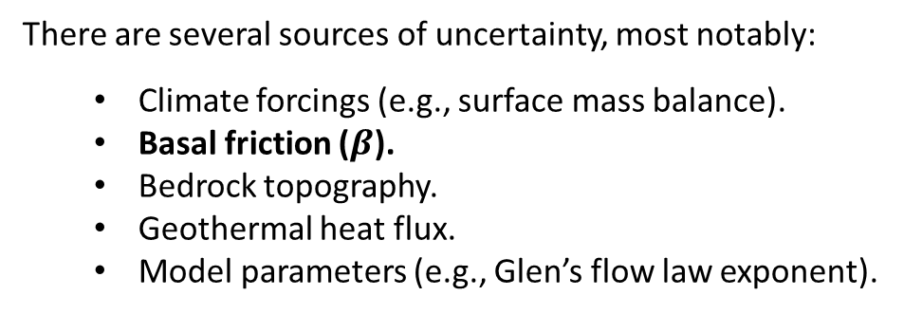
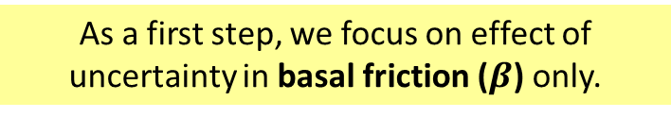
Uncertainty Quantification (UQ)
Problem Definition
Quantity of Interest (QoI) in Ice Sheet Modeling:
total ice mass loss/gain during 21st century
$→$ sea level rise prediction.
$$μ=\frac{1}{2}{A^{−\frac{1}{n}}\left(\frac{1}{2}\sum_{ij}{\dot{ε}ij2+}γ\right)}^{\left(\frac{1}{2n}−\frac{1}{2}\right)}$$
There are several sources of uncertainty, most notably:
  Climate forcings (e.g., surface mass balance).
  Basal friction ($β$).
  Bedrock topography.
  Geothermal heat flux.
  Model parameters (e.g., Glen’s flow law exponent).
There are several sources of uncertainty, most notably:
  Climate forcings (e.g., surface mass balance).
  Basal friction ($β$)
  Bedrock topography
  Geothermal heat flux
  Model parameters (e.g., Glen’s flow law exponent)
$n$ = Glen’s law exponent
Ice sheet
  Basal boundary $Γβ$
)
  As a first step, we focus on effect of uncertainty in basal friction ($β$) only.
  Basal sliding BC:
  $2μ\dot{ε}i∙n+βui=0$, on $Γβ$

Slide 17
Uncertainty Quantification
Workflow
Goal: Uncertainty Quantification in 21st century sea level (QoI)
Deterministic inversion: perform adjoint-based deterministic inversion to estimate initial ice sheet state (i.e., characterize the present state of the ice sheet to be used for performing prediction runs).
Bayesian calibration: construct the posterior distribution using Markov Chain Monte Carlo (MCMC) run on an emulator of the forward model.
Forward propagation: sample the obtained distribution and perform ensemble of forward propagation runs to compute the uncertainty in the QoI.
What are the parameters that render a given set of observations?
What is the impact of uncertain parameters in the model on quantities of interest (QoI)?

Slide 18
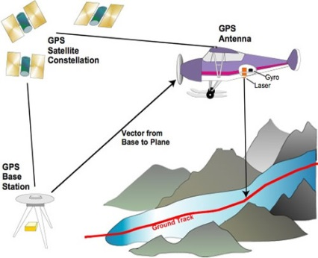
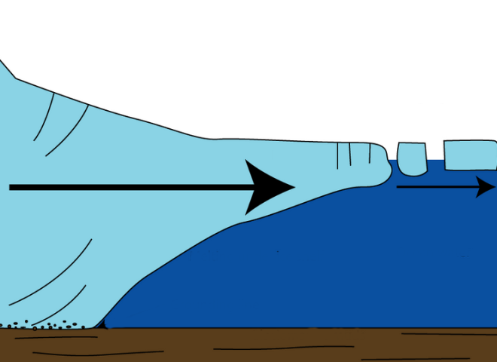
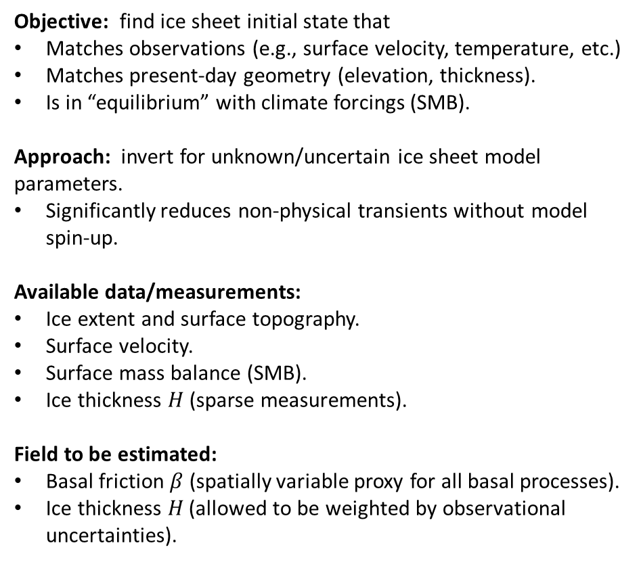



Deterministic Inversion: Estimation of Ice Sheet Initial State
Objective: find ice sheet initial state that
Matches observations (e.g., surface velocity, temperature, etc.)
Matches present-day geometry (elevation, thickness).
Is in “equilibrium” with climate forcings (SMB).
Approach: invert for unknown/uncertain ice sheet model parameters.
Significantly reduces non-physical transients without model spin-up.
Available data/measurements:
Ice extent and surface topography.
Surface velocity.
Surface mass balance (SMB).
Ice thickness $H$ (sparse measurements).
Field to be estimated:
Basal friction $β$ (spatially variable proxy for all basal processes).
Ice thickness $H$ (allowed to be weighted by observational uncertainties).
Assumptions:
Ice flow described by FO Stokes equations.
Ice is close to mechanical equilibrium.
Temperature field is given.
  Basal sliding BC:
  $2μ\dot{ε}i∙n+βui=0$, on $Γβ$
$$H$$
Ice sheet
$$β$$

Slide 19
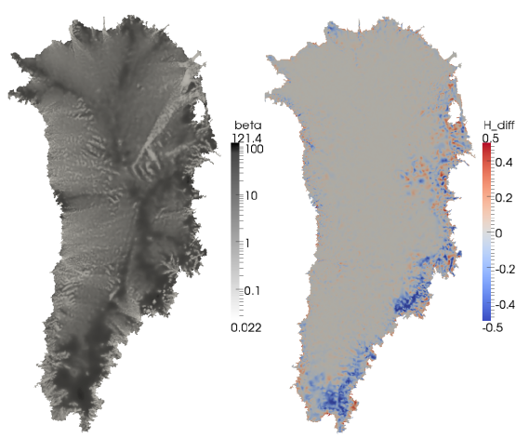
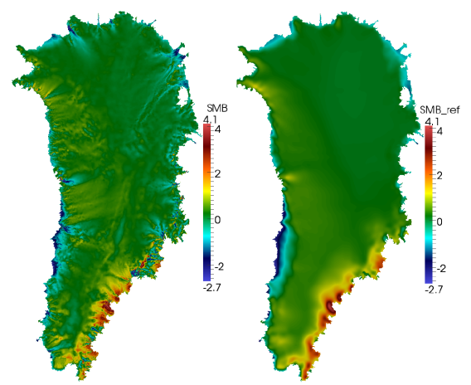
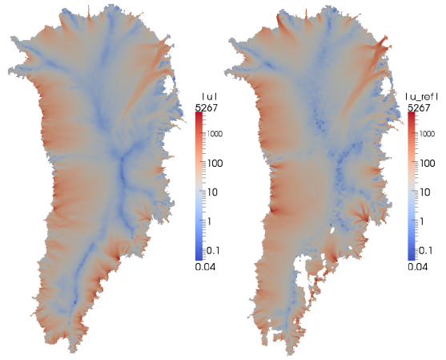

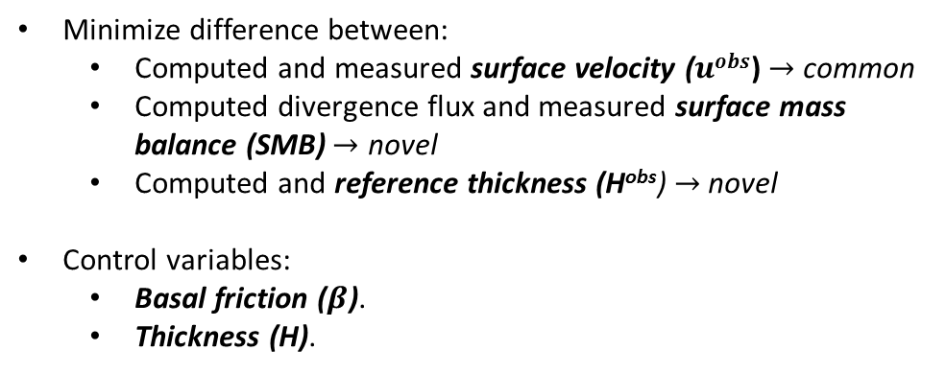

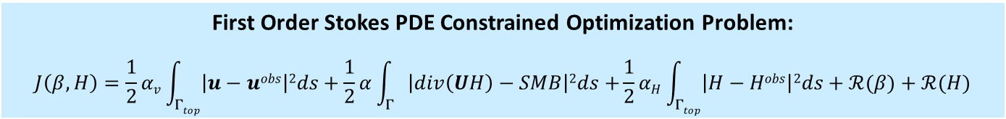
Deterministic Inversion:
Greenland
First Order Stokes PDE Constrained Optimization Problem:
$$J\left(β,H\right)=\frac{1}{2}αv\int_{Γtop}{\left|u−uobs\right|2ds}+\frac{1}{2}α\int_{Γ}{\left|div\left(UH\right)−SMB\right|2ds+}\frac{1}{2}αH\int_{Γtop}{\left|H−Hobs\right|2ds+ℛ(β)+ℛ(H)}$$
Minimize difference between:
    Computed and measured surface velocity ($uobs$) $→$ common
  Computed divergence flux and measured surface mass balance (SMB)$→$ novel
  Computed and reference thickness (H^{obs}) $→$ novel
Control variables:
  Basal friction ($β$).
  Thickness (H).
Estimated $β$
$$H−Hobs$$
Estimated divergence (left) vs. reference SMB (right)
Estimated (left) vs. reference surface velocity (right)
Software for adjoint-based inversion:
Albany/FELIX (assembly)
Trilinos (linear/nonlinear solvers)
ROL (gradient-based optimization)
  Limited memory BFGS.
  Backtrack line-search.

Slide 20
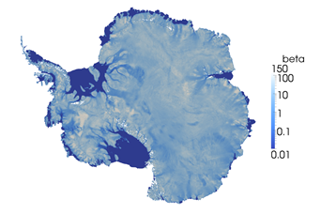
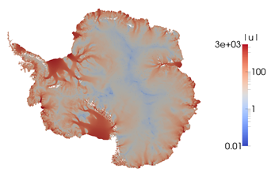





Deterministic Inversion:
Antarctica (basal friction only)
FO Stokes PDE Constrained Optimization Problem:
$J\left(β\right)=\frac{1}{2}\int_{Γtop}{α\left|u−uobs\right|2ds}+ℛ(β$)
Geometry: Cornford, Martin et al. (in prep.)
Bedmap2: Fretwell et al., 2013
Temperature: Pattyn, 2010.
$β$ (kPa y/m) obtained through inversion
$\left|u\right|$ (m/yr) computed with estimated $β$
$\left|u\right|$ (m/yr) for observed surface velocity
Antarctic ice sheet inversion performed on 700K parameters

Slide 21

Bayesian Calibration: Demonstration of Workflow using KLE
Albany/FELIX has been hooked up to DAKOTA (in “black-box” mode) for UQ/ Bayesian calibration.
Difficulty in UQ: “Curse of Dimensionality”
The $β$-field inversion problem has $O(100K)$ dimensions!

Slide 22
Bayesian Calibration: Demonstration of Workflow using KLE
Albany/FELIX has been hooked up to DAKOTA (in “black-box” mode) for UQ/ Bayesian calibration.
Difficulty in UQ: “Curse of Dimensionality”
The $β$-field inversion problem has $O(100K)$ dimensions!
Approach: Reduce $O(100K)$ dimensional problem to $O(10)$ dimensional problem.

Slide 23

Bayesian Calibration: Demonstration of Workflow using KLE
Albany/FELIX has been hooked up to DAKOTA (in “black-box” mode) for UQ/ Bayesian calibration.
Difficulty in UQ: “Curse of Dimensionality”
The $β$-field inversion problem has $O(100K)$ dimensions!
Approach: Reduce $O(100K)$ dimensional problem to $O(10)$ dimensional problem.
For initial demonstration of workflow, we use the Karhunen-Loeve Expansion (KLE):

Slide 24

Bayesian Calibration: Demonstration of Workflow using KLE
Albany/FELIX has been hooked up to DAKOTA (in “black-box” mode) for UQ/ Bayesian calibration.
Difficulty in UQ: “Curse of Dimensionality”
The $β$-field inversion problem has $O(100K)$ dimensions!
Approach: Reduce $O(100K)$ dimensional problem to $O(10)$ dimensional problem.
For initial demonstration of workflow, we use the Karhunen-Loeve Expansion (KLE):
  Assume analytic covariance kernel $C\left(r1,r2\right)=exp\left(−\frac{\left(r1−r2\right)2}{L2}\right)$.

Slide 25

Bayesian Calibration: Demonstration of Workflow using KLE
Albany/FELIX has been hooked up to DAKOTA (in “black-box” mode) for UQ/ Bayesian calibration.
Difficulty in UQ: “Curse of Dimensionality”
The $β$-field inversion problem has $O(100K)$ dimensions!
Approach: Reduce $O(100K)$ dimensional problem to $O(10)$ dimensional problem.
For initial demonstration of workflow, we use the Karhunen-Loeve Expansion (KLE):
  Assume analytic covariance kernel $C\left(r1,r2\right)=exp\left(−\frac{\left(r1−r2\right)2}{L2}\right)$.
  Perform eigenvalue decomposition of $C$.

Slide 26




Bayesian Calibration: Demonstration of Workflow using KLE
Albany/FELIX has been hooked up to DAKOTA (in “black-box” mode) for UQ/ Bayesian calibration.
Difficulty in UQ: “Curse of Dimensionality”
The $β$-field inversion problem has $O(100K)$ dimensions!
Approach: Reduce $O(100K)$ dimensional problem to $O(10)$ dimensional problem.
For initial demonstration of workflow, we use the Karhunen-Loeve Expansion (KLE):
  Assume analytic covariance kernel $C\left(r1,r2\right)=exp\left(−\frac{\left(r1−r2\right)2}{L2}\right)$.
  Perform eigenvalue decomposition of $C$.
  Expand* $β−\overline{β}$ in basis of eigenvectors $\{φk\}$ of $C$, with random variables $\{ξk\}$:
$$β\left(ω\right)=\overline{β}+\sum_{k=1}^{K}{\sqrt{λk}φkξk(ω)}$$
$\overline{β}$ = initial condition for $β$ (result of deterministic inversion or spin-up)
*In practice, expansion is done on $log(β$) to avoid negative values of $β$.

Slide 27
Bayesian Calibration: Demonstration of Workflow using KLE
Albany/FELIX has been hooked up to DAKOTA (in “black-box” mode) for UQ/ Bayesian calibration.
Difficulty in UQ: “Curse of Dimensionality”
The $β$-field inversion problem has $O(100K)$ dimensions!
Approach: Reduce $O(100K)$ dimensional problem to $O(10)$ dimensional problem.
For initial demonstration of workflow, we use the Karhunen-Loeve Expansion (KLE):
  Assume analytic covariance kernel $C\left(r1,r2\right)=exp\left(−\frac{\left(r1−r2\right)2}{L2}\right)$.
  Perform eigenvalue decomposition of $C$.
  Expand* $β−\overline{β}$ in basis of eigenvectors $\{φk\}$ of $C$, with random variables $\{ξk\}$:
Offline
$$β\left(ω\right)=\overline{β}+\sum_{k=1}^{K}{\sqrt{λk}φkξk(ω)}$$
$\overline{β}$ = initial condition for $β$ (result of deterministic inversion or spin-up)
*In practice, expansion is done on $log(β$) to avoid negative values of $β$.

Slide 28

Bayesian Calibration: Demonstration of Workflow using KLE
Albany/FELIX has been hooked up to DAKOTA (in “black-box” mode) for UQ/ Bayesian calibration.
Difficulty in UQ: “Curse of Dimensionality”
The $β$-field inversion problem has $O(100K)$ dimensions!
Approach: Reduce $O(100K)$ dimensional problem to $O(10)$ dimensional problem.
For initial demonstration of workflow, we use the Karhunen-Loeve Expansion (KLE):
  Assume analytic covariance kernel $C\left(r1,r2\right)=exp\left(−\frac{\left(r1−r2\right)2}{L2}\right)$.
  Perform eigenvalue decomposition of $C$.
  Expand* $β−\overline{β}$ in basis of eigenvectors $\{φk\}$ of $C$, with random variables $\{ξk\}$:
Offline
Online
$$β\left(ω\right)=\overline{β}+\sum_{k=1}^{K}{\sqrt{λk}φkξk(ω)}$$
$\overline{β}$ = initial condition for $β$ (result of deterministic inversion or spin-up)
*In practice, expansion is done on $log(β$) to avoid negative values of $β$.
Inference/calibration is for coefficients of KLE
$⇒$ significant dimension reduction.

Slide 29





















Bayesian Calibration: Illustration
on 4km GIS Problem
Disclaimer: results presented demonstrate that we have UQ workflow in place; quantifying uncertainty in $β$ and SLR will require re-running with better data.
Mean $\overline{β}$ field obtained through spin-up over 100 years (cheaper than inversion, gives reasonable agreement with present-day velocity field).
Correlation length $L$ selected s.t. slow decay of KLE eigenvalues to enable refinement (left): 10 KLE modes capture 27.3% of covariance energy.
$$\overline{β}$$
$\left|u\right|$ computed with $\overline{β}$
Modes 1-5:
Below: decay of KLE eigenvalues
Modes 6-10:
Mismatch function (calculated in Albany/FELIX):
$$J\left(β\right)=\int_{Γtop}{\frac{1}{σu2}\left|u−uobs\right|2ds}$$
PCE emulator was formed for the mismatch $J\left(β\right)$ using uniform $[−1,1]$prior distributions and 286* high-fidelity runs on Hopper (DAKOTA).
For calibration, MCMC was performed on the PCE with 2K samples (QUESO).
*286 points = 3rd degree polynomial in 10D

Slide 30











Bayesian Calibration: Illustration
on 4km GIS Problem (cont’d)
Posterior distributions for 10 KLE coefficients:
Mode 1
Mode 2
Mode 3
Mode 4
Mode 5
Mode 6
Mode 7
Mode 8
Mode 9
Mode 10
Distributions are peaked rather than uniform $⇒$ data informed the posteriors.
MAP point: $ξ=(\text{0.}\text{372}\text{, }\text{−}\text{0.}\text{679}\text{, }\text{−}\text{0.}\text{4}\text{20, }\text{−}\text{0.}\text{18}\text{9, }\text{−7.38}\text{e}\text{−2, −0.255}$, $0.\text{449}$, $\text{−}\text{0.}\text{75}\text{7}$, $0.\text{84}\text{7,}\text{−}\text{0.}\text{44}\text{7}\text{)}$

Slide 31










Bayesian Calibration: Illustration
on 4km GIS Problem (cont’d)
$|u|$ computed with $β$ at MAP point
$β$ from deterministic inversion
$β$ field at MAP point
$$\overline{β}$$
$$|uobs|$$
Ice is too fast at MAP point. Possible explanations:
  Surrogate error (based on cross-validation).
  Mean field error.
  Bad modes and/or not enough modes.
Mismatch $J\left(β\right)$ at MAP point: $1.87×$ mismatch at $\overline{β}$

Slide 32



Bayesian Calibration: Building
Gaussian Distribution using Hessian
Hessian of the merit functional (velocity mismatch) can provide a way to compute the covariance of a Gaussian posterior:
$$Cpost={\left(CpriorHmisfit+I\right)}^{−1}Cprior$$
We want to limit only the most important directions (eigenvectors) of $Cpost$.
evec 1
evec 2
evec 100
Figures courtesy of O. Ghattas’ group (Isaac et al., 2004)
# significant eigenvalues does not depend on # DOFs in grid
evec 200
evec 500
evec 4000
Issue: there are too many (~1000) significant eigenvalues
Right: log-linear plot of the spectra of a prior-preconditioned data misfit Hessian at the MAP point for two successively finer parameter/state meshes of the inverse ice sheet problem.

Slide 33




Forward Propagation
PCE Emulator
$$β\left(ω\right)=\overline{β}+\sum_{k=1}^{K}{\sqrt{λk}φkξk(ω)}$$
DAKOTA, Albany/FELIX
QoI$(β)$
(total ice mass loss)
Model realizations
Forward propagation
(e.g., 2000-2050)
Parameter ($β$) distribution can either be assumed to be Gaussian (based on Hessian information) or can be the result of Bayesian calibration.
Emulator is built using DAKOTA coupled with CISM-Albany for forward runs.
  Use compressed sensing to adaptively select significant modes that affect QoI. The hope is that only a few modes affect the QoI.
  Could use cheaper physical models to reduce computational time of forward model.
MCMC (QUESO) used to perform uncertainty propagation.
Albany/FELIX

Slide 34








Disclaimer: results presented demonstrate that we have UQ workflow in place; quantifying uncertainty in $β$ and SLR will require re-running with better data.
Forward Propagation:
Illustration on 4km GIS Problem
Procedure:
  We first ran 66* CISM-Albany high-fidelity simulations on Hopper with $β$ sampled from a uniform $[−1,1]$ distribution and no forcing for 50 years.
Left: SLR distribution from ensemble of 66 high-fidelity simulations (differenced against control run using the $\overline{β}$ distribution). All 66 runs ran to completion out-of-the-box on Hopper!
Above: $β$, velocity and thickness perturbations. Ice thickness changed > 500m in some places.
  We then used the results of these runs to create a PCE emulator for the SLR.
  Using emulator, propagated posterior distributions computed in Bayesian calibration (using KLE) through the model to get posteriors on SLR (MCMC on PCE emulator with 2K samples).
*66 points = 2D polynomial in 10D.

Slide 35



Forward Propagation:
Illustration on 4km GIS Problem (cont’d)
Expected (black): normal distribution centered around 0 SLR since no forcing.
PDF of SLR
Prior informed (green): uniform distribution translates to distribution skewed w.r.t. model outputs.
Larger fraction of the ice sheet currently has a $β$ value that forces no (or slow) basal sliding.
Areas with little sliding: not affected by increase in $β$, but greatly affected by decrease in $β$ (velocity in these regions will change significantly from initial condition).
Since we sample from a uniform distribution when perturbing $β$, we expect to see a disproportionately large signal when reducing $β$ vs. increasing it.
Posterior informed (blue): centered on positive tail of prior – not consistent with observations.
Could be due to “ad hoc” $β$ used as mean field (spin-up over 100 years).
May be that emulator was been built with a (non-physical) positive mass balance while calibration was done on present-day observations (consistent with ice losing mass).

Slide 36

Forward Propagation:
Illustration on 4km GIS Problem (cont’d)
Expected (black): normal distribution centered around 0 SLR since no forcing.
PDF of SLR
Prior informed (green): uniform distribution translates to distribution skewed w.r.t. model outputs.
Larger fraction of the ice sheet currently has a $β$ value that forces no (or slow) basal sliding.
Areas with little sliding: not affected by increase in $β$, but greatly affected by decrease in $β$ (velocity in these regions will change significantly from initial condition).
Since we sample from a uniform distribution when perturbing $β$, we expect to see a disproportionately large signal when reducing $β$ vs. increasing it.
Posterior informed (blue): centered on positive tail of prior – not consistent with observations.
Could be due to “ad hoc” $β$ used as mean field (spin-up over 100 years).
May be that emulator was been built with a (non-physical) positive mass balance while calibration was done on present-day observations (consistent with ice losing mass).
Results illustrate that we have in place all steps of our UQ workflow;
they are NOT yet actual uncertainty bounds for sea-level rise.
Next step: repeat UQ procedure with better modes, surrogates and $\overline{β}$.

Slide 37
Outline
Albany/FELIX = new land-ice solver with next-generation capabilities.
Overview:
  First Order (FO) Stokes model.
  Albany/FELIX First-Order (FO) Stokes diagnostic solver.
  CISM-Albany and MPAS-Albany codes for prognostic simulations of the ice sheet evolution.
Uncertainty Quantification (UQ):
  Deterministic inversion.
  Bayesian calibration.
  Forward propagation of uncertainty.
Performance portability.
Summary and ongoing work.
Questions?

Slide 38


Performance-Portability via
Kokkos
We need to be able to run Albany/FELIX on new architecture machines (hybrid systems) and manycore devices (multi-core CPU, NVIDIA GPU, Intel Xeon Phi, etc.) .
Kokkos: Trilinos library that provides performance portability across diverse devises with different memory models.
  A programming model as much as a software library.
  Provides automatic access to OpenMP, CUDA, Pthreads, etc.
  Templated meta-programming: parallel_for, parallel_reduce (templated on an execution space).
  Memory layout abstraction (“array of structs” vs. “struct of arrays”, locality).
With Kokkos, you write an algorithm once, and just change a template parameter to get the optimal data layout for your hardware.

Slide 39
Performance-Portability via
Kokkos
We need to be able to run Albany/FELIX on new architecture machines (hybrid systems) and manycore devices (multi-core CPU, NVIDIA GPU, Intel Xeon Phi, etc.) .
Kokkos: Trilinos library that provides performance portability across diverse devises with different memory models.
  A programming model as much as a software library.
  Provides automatic access to OpenMP, CUDA, Pthreads, etc.
  Templated meta-programming: parallel_for, parallel_reduce (templated on an execution space).
  Memory layout abstraction (“array of structs” vs. “struct of arrays”, locality).
With Kokkos, you write an algorithm once, and just change a template parameter to get the optimal data layout for your hardware.
Finite element assembly in Albany has recently been rewritten using Kokkos functors.

Slide 40

Kokkos-ification of Finite Element Assembly
ExecutionSpace parameter tailors code for device (e.g., OpenMP, CUDA, etc.)

Slide 41


Performance-Portability via
Kokkos: 20km GIS Problem
Shannon: 32 nodes
Two 8-core Sandy Bridge Xeon E5-2670 @ 2.6GHz (HT deactivated) per node.
128GB DDR3 memory per node
2x NVIDIA K20x per node.
FEA Residual: less work done by GPU, so kernel launch overhead becomes significant.
  “# of elements/workset” = threading index (allows for on-node parallelism)

Slide 42


Performance-Portability via
Kokkos: Weak Scalability for GIS on Titan
Increasing # OpenMP threads can increase thread synchronization overheads.
Titan: 18,688 AMD Opteron nodes
16 cores per node
1 K20X Kepler GPUs per node
32GB + 6GB memory per node
MPI+CUDA results on Titan coming soon! (waiting for gcc 4.7.2 compiler support for Cray)

Slide 43
Outline
Albany/FELIX = new land-ice solver with next-generation capabilities.
Overview:
  First Order (FO) Stokes model.
  Albany/FELIX First-Order (FO) Stokes diagnostic solver.
  CISM-Albany and MPAS-Albany codes for prognostic simulations of the ice sheet evolution.
Uncertainty Quantification (UQ):
  Deterministic inversion.
  Bayesian calibration.
  Forward propagation of uncertainty.
Performance portability.
Summary and ongoing work.
Questions?

Slide 44

Summary and Ongoing Work
Summary: this talk described…
The development of a finite element land ice solver known as Albany/FELIX written using the Trilinos libraries.
Coupling of Albany/FELIX to the CISM and MPAS LI codes for transient simulations of ice sheet evolution.
Advanced, next generation capabilities (UQ, performance portability) of Albany//FELIX.
Ongoing/future work:
Science runs using CISM-Albany and MPAS-Albany.
Deploy UQ workflow with better basis than KLE (e.g., Hessian eigenvectors).
Continued porting of code to new architecture supercomputers (GPUs on Titan, Summit, Cori Phase I).
Delivering code to climate community and coupling to earth system models.

Slide 45










Funding/Acknowledgements
Support for this work was provided through Scientific Discovery through Advanced Computing (SciDAC) projects funded by the U.S. Department of Energy, Office of Science (OSCR), Advanced Scientific Computing Research and Biological and Environmental Research (BER) $→$PISCEES SciDAC Application Partnership.
PISCEES team members: K. Evans, M. Gunzburger, M. Hoffman, C. Jackson, P. Jones, W. Lipscomb, M. Perego, S. Price, A. Salinger, I. Tezaur, R. Tuminaro, P. Worley.
Trilinos/DAKOTA collaborators: M. Eldred, J. Jakeman, E. Phipps, L. Swiler.
  Computing resources: NERSC, OLCF.
Thank you! Questions?

Slide 46
References
[1] M.A. Heroux et al. “An overview of the Trilinos project.” ACM Trans. Math. Softw. 31(3) (2005).
[2] A.G. Salinger et al. "Albany: Using Agile Components to Develop a Flexible, Generic Multiphysics Analysis Code", Comput. Sci. Disc. (submitted, 2015).
[3] I. Tezaur, M. Perego, A. Salinger, R. Tuminaro, S. Price. "Albany/FELIX: A Parallel, Scalable and Robust Finite Element Higher-Order Stokes Ice Sheet Solver Built for Advanced Analysis", Geosci. Model Develop. 8 (2015) 1-24.
[4] I. Tezaur, R. Tuminaro, M. Perego, A. Salinger, S. Price. "On the scalability of the Albany/FELIX first-order Stokes approximation ice sheet solver for large-scale simulations of the Greenland and Antarctic ice sheets", MSESM/ICCS15, Reykjavik, Iceland (June 2014).
[5] R.S. Tuminaro, I. Tezaur, M. Perego, A.G. Salinger. "A Hybrid Operator Dependent Multi-Grid/Algebraic Multi-Grid Approach: Application to Ice Sheet Modeling", SIAM J. Sci. Comput. (in prep).
[6] R. Tuminaro. “ML’s SemiCoarsening Feature, Addition to ML 5.0 Smoothed Aggregation User’s Guide” , Sandia National Laboratories Report, SAND2006-2649, Sandia National Laboratories, Albuquerque, NM, 2014.

Slide 47
References (cont’d)
[7] S. Shannon, et al. “Enhanced basal lubrication and the contribution of the Greenland ice sheet to future sea-level rise”, P. Natl. Acad. Sci., 110 (2013) 14156-14161.
[8] P. Fretwell, et al. “BEDMAP2: Improved ice bed, surface, and thickness datasets for Antarctica”, The Cryosphere 7(1) (2013) 375-393.
[9] F. Pattyn. “Antarctic subglacial conditions inferred from a hybrid ice sheet/ice stream model”, Earth and Planetary Science Letters 295 (2010).
[10] M. Perego, S. Price, G. Stadler. “Optimal Initial Conditions for Coupling Ice Sheet Models to Earth System Models”, J. Geophys. Res. 119 (2014) 1894-1917.

Slide 48






Appendix: Preliminary Results for GIS Bayesian Inference
5 KLE modes capture 95% of covariance energy $→$ parallel C++/Trilinos code (Anasazi).
Mode 1
Mode 2
Mode 3
Mode 4
Mode 5
Mismatch = sum of squares of surface velocity discrepancy $→$ Albany.
Polynomial chaos expansion (PCE) was formed for the mismatch over ξ_{k} using uniform prior distributions and isotropic sparse grid level = 3 $→$ DAKOTA.
Markov Chain Monte Carlo (MCMC) was performed on the PCE with 100K samples $→$ QUESO.
16/18
Collaborators: M. Perego, J. Jakeman, M. Eldred, L. Swiler (SNL)

Slide 49





Appendix: Preliminary Results for GIS Bayesian Inference (cont’d)
Posterior distributions for the 5 KLE coefficients:
MAP solution:
$$x = (−0.16, −0.08, 0, 0, 0)$$
Coefficient 1
Coefficient 2
Coefficient 3
Coefficient 4
Coefficient 5
Inference of KLE random field:
Left: true $β$ field
Right: reconstructed $β$ field
Good agreement between true and reconstructed $β$ field!
17/18
True $β$ field
Reconstructed $β$ field
Notes:
Analytic covariance kernel would normally be computed from ensemble averaging (or numerical integration) applied to a set of (X_i - mu_i)(X_j – mu_j) snapshots.

