Slide 1
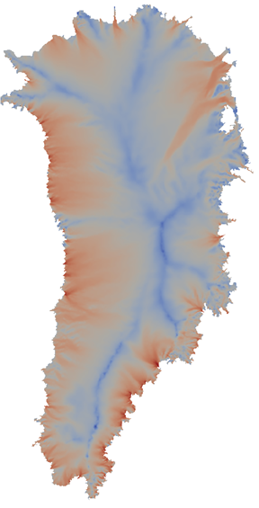
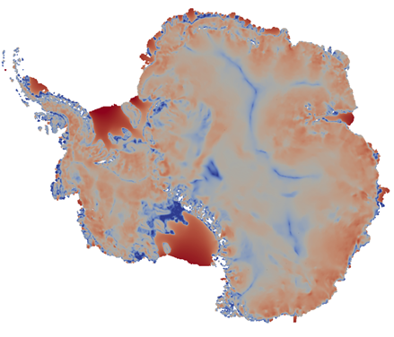
On the Scalability of the Albany/FELIX First-Order Stokes Approximation Ice Sheet Solver for Large-Scale Simulations of the Greenland and Antarctic Ice Sheets
I. Tezaur¹, R. Tuminaro¹, M. Perego¹, A. Salinger¹, S. Price²
¹ Sandia National Laboratories
Livermore, CA and Albuquerque, NM, USA
² Los Alamos National Laboratory
Los Alamos, NM, USA
Numerical and Computational Developments to Advance Multiscale Earth System Models (MSESM)
International Conference on Computational Science (ICCS) 2015
June 1-3, 2015
Reykjavik, Iceland
SAND2015-3862C

Slide 2
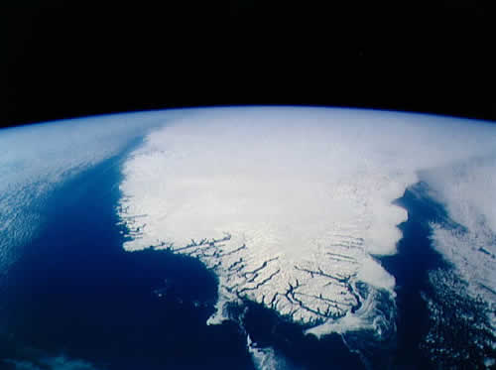
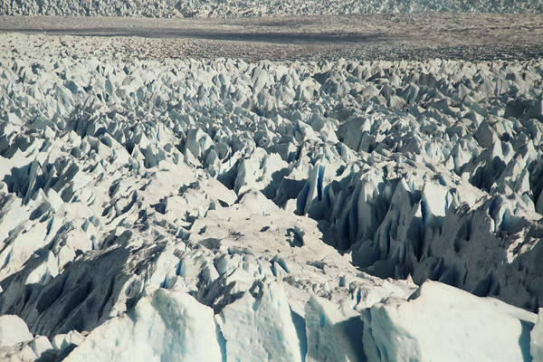
Outline
Overview: the PISCEES project, the First Order (FO) Stokes model for ice sheets and the Albany/FELIX finite element solver.
Definitions: Strong vs. Weak Scalability.
Algebraic multi-grid (AMG) preconditioner based on aggressive semi-coarsening.
Importance of node ordering and mesh partitioning.
Strong scaling study for a fine-resolution Greenland Ice Sheet (GIS) problem.
Weak scaling study for a moderate-resolution Antarctic Ice Sheet (AIS) problem.
Summary and ongoing work.
Questions?

Slide 3
The PISCEES Project and the Albany/FELIX Solver
“PISCEES” = Predicting Ice Sheet Climate & Evolution at Extreme Scales
5 Year Project funded by SciDAC, which began in June 2012
Sandia’s Role in the PISCEES Project: to develop and support a robust and scalable land ice solver based on the “First-Order” (FO) Stokes physics

Slide 4
The PISCEES Project and the Albany/FELIX Solver
“PISCEES” = Predicting Ice Sheet Climate & Evolution at Extreme Scales
5 Year Project funded by SciDAC, which began in June 2012
Sandia’s Role in the PISCEES Project: to develop and support a robust and scalable land ice solver based on the “First-Order” (FO) Stokes physics
Steady-state stress-velocity solver based on FO Stokes physics is known as Albany/FELIX*.
*FELIX=“Finite Elements for Land Ice eXperiments”
Albany/FELIX Solver (steady):
Ice Sheet PDEs (First Order Stokes)
(stress-velocity solve)

Slide 5
The PISCEES Project and the Albany/FELIX Solver
“PISCEES” = Predicting Ice Sheet Climate & Evolution at Extreme Scales
5 Year Project funded by SciDAC, which began in June 2012
Sandia’s Role in the PISCEES Project: to develop and support a robust and scalable land ice solver based on the “First-Order” (FO) Stokes physics
Steady-state stress-velocity solver based on FO Stokes physics is known as Albany/FELIX*.
Requirements for Albany/FELIX:
*FELIX=“Finite Elements for Land Ice eXperiments”
Albany/FELIX Solver (steady):
Ice Sheet PDEs (First Order Stokes)
(stress-velocity solve)

Slide 6
The PISCEES Project and the Albany/FELIX Solver
“PISCEES” = Predicting Ice Sheet Climate & Evolution at Extreme Scales
5 Year Project funded by SciDAC, which began in June 2012
Sandia’s Role in the PISCEES Project: to develop and support a robust and scalable land ice solver based on the “First-Order” (FO) Stokes physics
Steady-state stress-velocity solver based on FO Stokes physics is known as Albany/FELIX*.
Requirements for Albany/FELIX:
Scalable, fast, robust.
*FELIX=“Finite Elements for Land Ice eXperiments”
Albany/FELIX Solver (steady):
Ice Sheet PDEs (First Order Stokes)
(stress-velocity solve)

Slide 7
The PISCEES Project and the Albany/FELIX Solver
“PISCEES” = Predicting Ice Sheet Climate & Evolution at Extreme Scales
5 Year Project funded by SciDAC, which began in June 2012
Sandia’s Role in the PISCEES Project: to develop and support a robust and scalable land ice solver based on the “First-Order” (FO) Stokes physics
Steady-state stress-velocity solver based on FO Stokes physics is known as Albany/FELIX*.
Requirements for Albany/FELIX:
Scalable, fast, robust.
Dynamical core (dycore) when coupled to codes that solve thickness and temperature evolution equations (CISM/MPAS codes).
Dycore will provide actionable predictions of 21st century sea-level rise (including uncertainty).
*FELIX=“Finite Elements for Land Ice eXperiments”
Albany/FELIX Solver (steady):
Ice Sheet PDEs (First Order Stokes)
(stress-velocity solve)
CISM/MPAS Land Ice Codes (dynamic):
Ice Sheet Evolution PDEs
(thickness, temperature evolution)

Slide 8
The PISCEES Project and the Albany/FELIX Solver
“PISCEES” = Predicting Ice Sheet Climate & Evolution at Extreme Scales
5 Year Project funded by SciDAC, which began in June 2012
Sandia’s Role in the PISCEES Project: to develop and support a robust and scalable land ice solver based on the “First-Order” (FO) Stokes physics
Steady-state stress-velocity solver based on FO Stokes physics is known as Albany/FELIX*.
Requirements for Albany/FELIX:
Scalable, fast, robust.
Dynamical core (dycore) when coupled to codes that solve thickness and temperature evolution equations (CISM/MPAS codes).
Advanced analysis capabilities (adjoint-based deterministic inversion, Bayesian calibration, UQ, sensitivity analysis).
Dycore will provide actionable predictions of 21st century sea-level rise (including uncertainty).
*FELIX=“Finite Elements for Land Ice eXperiments”
Albany/FELIX Solver (steady):
Ice Sheet PDEs (First Order Stokes)
(stress-velocity solve)
CISM/MPAS Land Ice Codes (dynamic):
Ice Sheet Evolution PDEs
(thickness, temperature evolution)

Slide 9
The PISCEES Project and the Albany/FELIX Solver
“PISCEES” = Predicting Ice Sheet Climate & Evolution at Extreme Scales
5 Year Project funded by SciDAC, which began in June 2012
Sandia’s Role in the PISCEES Project: to develop and support a robust and scalable land ice solver based on the “First-Order” (FO) Stokes physics
Steady-state stress-velocity solver based on FO Stokes physics is known as Albany/FELIX*.
Requirements for Albany/FELIX:
Scalable, fast, robust.
Dynamical core (dycore) when coupled to codes that solve thickness and temperature evolution equations (CISM/MPAS codes).
Advanced analysis capabilities (adjoint-based deterministic inversion, Bayesian calibration, UQ, sensitivity analysis).
Performance-portability.
Dycore will provide actionable predictions of 21st century sea-level rise (including uncertainty).
*FELIX=“Finite Elements for Land Ice eXperiments”
Albany/FELIX Solver (steady):
Ice Sheet PDEs (First Order Stokes)
(stress-velocity solve)
CISM/MPAS Land Ice Codes (dynamic):
Ice Sheet Evolution PDEs
(thickness, temperature evolution)

Slide 10
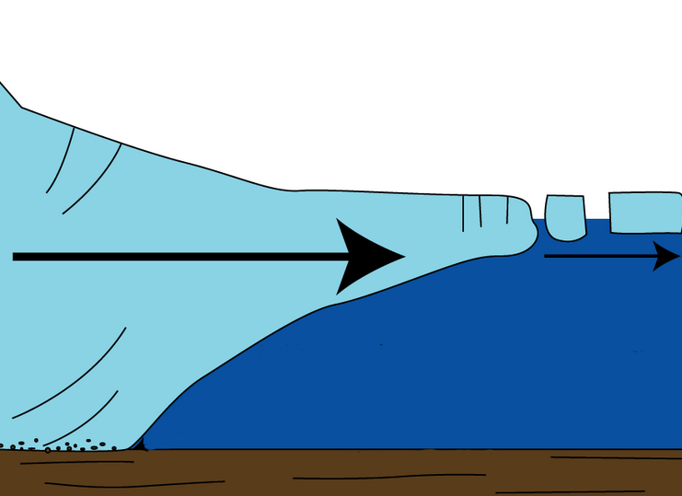
The First-Order Stokes Model
for Ice Sheets & Glaciers
Ice sheet dynamics are given by the “First-Order” Stokes PDEs: approximation* to viscous incompressible quasi-static Stokes flow with power-law viscosity.
$\left\{\begin{aligned}−∇∙(2μ\dot{ε}1)=−ρg\frac{∂s}{∂x} \\ −∇∙(2μ\dot{ε}2)=−ρg\frac{∂s}{∂y}\end{aligned}\right.$ , in $Ω$
$$\dot{ε}1T=\left(2\dot{ε}11+\dot{ε}22,\dot{ε}12,\dot{ε}13\right)$$
$$\dot{ε}2T=\left(2\dot{ε}12, \dot{ε}11+2\dot{ε}22,\dot{ε}23\right)$$
$$\dot{ε}ij=\frac{1}{2}\left(\frac{∂ui}{∂xj}+\frac{∂uj}{∂xi}\right)$$
Viscosity $μ$ is nonlinear function given by “Glen’s law”:
$$μ=\frac{1}{2}{A^{−\frac{1}{n}}\left(\frac{1}{2}\sum_{ij}{\dot{ε}ij2}\right)}^{\left(\frac{1}{2n}−\frac{1}{2}\right)}$$
Albany/FELIX
$$(n=3)$$
Ice sheet
Relevant boundary conditions:
*Assumption: aspect ratio $δ$is small and normals to upper/lower surfaces are almost vertical.

Slide 11
The First-Order Stokes Model
for Ice Sheets & Glaciers
Ice sheet dynamics are given by the “First-Order” Stokes PDEs: approximation* to viscous incompressible quasi-static Stokes flow with power-law viscosity.
$\left\{\begin{aligned}−∇∙(2μ\dot{ε}1)=−ρg\frac{∂s}{∂x} \\ −∇∙(2μ\dot{ε}2)=−ρg\frac{∂s}{∂y}\end{aligned}\right.$ , in $Ω$
$$\dot{ε}1T=\left(2\dot{ε}11+\dot{ε}22,\dot{ε}12,\dot{ε}13\right)$$
$$\dot{ε}2T=\left(2\dot{ε}12, \dot{ε}11+2\dot{ε}22,\dot{ε}23\right)$$
$$\dot{ε}ij=\frac{1}{2}\left(\frac{∂ui}{∂xj}+\frac{∂uj}{∂xi}\right)$$
Viscosity $μ$ is nonlinear function given by “Glen’s law”:
$$μ=\frac{1}{2}{A^{−\frac{1}{n}}\left(\frac{1}{2}\sum_{ij}{\dot{ε}ij2}\right)}^{\left(\frac{1}{2n}−\frac{1}{2}\right)}$$
Surface boundary $Γs$
Albany/FELIX
$$(n=3)$$
Ice sheet
Relevant boundary conditions:
Stress-free BC: $2μ\dot{ε}i∙n=0,$ on $Γs$
*Assumption: aspect ratio $δ$is small and normals to upper/lower surfaces are almost vertical.

Slide 12
The First-Order Stokes Model
for Ice Sheets & Glaciers
Ice sheet dynamics are given by the “First-Order” Stokes PDEs: approximation* to viscous incompressible quasi-static Stokes flow with power-law viscosity.
$\left\{\begin{aligned}−∇∙(2μ\dot{ε}1)=−ρg\frac{∂s}{∂x} \\ −∇∙(2μ\dot{ε}2)=−ρg\frac{∂s}{∂y}\end{aligned}\right.$ , in $Ω$
$$\dot{ε}1T=\left(2\dot{ε}11+\dot{ε}22,\dot{ε}12,\dot{ε}13\right)$$
$$\dot{ε}2T=\left(2\dot{ε}12, \dot{ε}11+2\dot{ε}22,\dot{ε}23\right)$$
$$\dot{ε}ij=\frac{1}{2}\left(\frac{∂ui}{∂xj}+\frac{∂uj}{∂xi}\right)$$
Viscosity $μ$ is nonlinear function given by “Glen’s law”:
$$μ=\frac{1}{2}{A^{−\frac{1}{n}}\left(\frac{1}{2}\sum_{ij}{\dot{ε}ij2}\right)}^{\left(\frac{1}{2n}−\frac{1}{2}\right)}$$
Surface boundary $Γs$
Albany/FELIX
$$(n=3)$$
Ice sheet
Relevant boundary conditions:
Stress-free BC: $2μ\dot{ε}i∙n=0,$ on $Γs$
Floating ice BC:
$2μ\dot{ε}i∙n$ = $\left\{\begin{aligned}ρgzn\text{, }\text{if} z>0 \\ 0, if z≤0\end{aligned}, \right.on Γl$
Lateral boundary $Γl$
*Assumption: aspect ratio $δ$is small and normals to upper/lower surfaces are almost vertical.

Slide 13
The First-Order Stokes Model
for Ice Sheets & Glaciers
Ice sheet dynamics are given by the “First-Order” Stokes PDEs: approximation* to viscous incompressible quasi-static Stokes flow with power-law viscosity.
$\left\{\begin{aligned}−∇∙(2μ\dot{ε}1)=−ρg\frac{∂s}{∂x} \\ −∇∙(2μ\dot{ε}2)=−ρg\frac{∂s}{∂y}\end{aligned}\right.$ , in $Ω$
$$\dot{ε}1T=\left(2\dot{ε}11+\dot{ε}22,\dot{ε}12,\dot{ε}13\right)$$
$$\dot{ε}2T=\left(2\dot{ε}12, \dot{ε}11+2\dot{ε}22,\dot{ε}23\right)$$
$$\dot{ε}ij=\frac{1}{2}\left(\frac{∂ui}{∂xj}+\frac{∂uj}{∂xi}\right)$$
Viscosity $μ$ is nonlinear function given by “Glen’s law”:
$$μ=\frac{1}{2}{A^{−\frac{1}{n}}\left(\frac{1}{2}\sum_{ij}{\dot{ε}ij2}\right)}^{\left(\frac{1}{2n}−\frac{1}{2}\right)}$$
Surface boundary $Γs$
Albany/FELIX
$$(n=3)$$
Ice sheet
Relevant boundary conditions:
Stress-free BC: $2μ\dot{ε}i∙n=0,$ on $Γs$
Floating ice BC:
$2μ\dot{ε}i∙n$ = $\left\{\begin{aligned}ρgzn\text{, }\text{if} z>0 \\ 0, if z≤0\end{aligned}, \right.on Γl$
Basal sliding BC: $2μ\dot{ε}i∙n+βui=0$, on $Γβ$
Lateral boundary $Γl$
Basal boundary $Γβ$
)
$$β=sliding coefficient≥0$$
*Assumption: aspect ratio $δ$is small and normals to upper/lower surfaces are almost vertical.

Slide 14
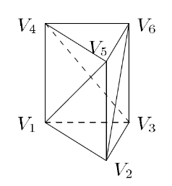
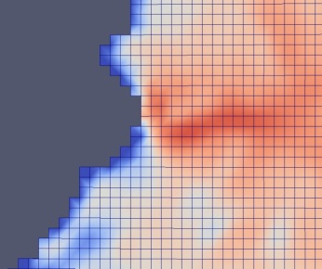
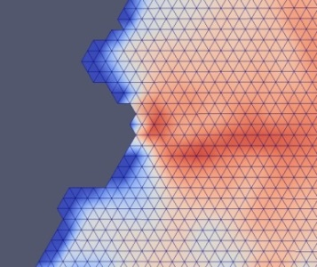
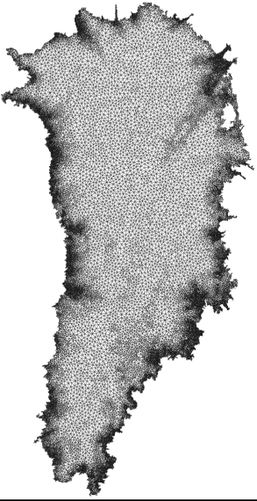
Algorithmic Choices for Albany/FELIX: Discretization & Meshes
Discretization: unstructured grid finite element method (FEM)
Can handle readily complex geometries.
Natural treatment of stress boundary conditions.
Enables regional refinement/unstructured meshes.
Wealth of software and algorithms.
Meshes: can use any mesh but interested specifically in
Structured hexahedral meshes (compatible with CISM).
Structured tetrahedral meshes (compatible with MPAS)
Unstructured Delaunay triangle meshes with regional refinement based on gradient of surface velocity.
All meshes are extruded (structured) in vertical direction as tetrahedra or hexahedra.

Slide 15
Algorithmic Choices for Albany/FELIX: Nonlinear & Linear Solver
Nonlinear solver: full Newton with analytic (automatic differentiation) derivatives and homotopy continuation
Most robust and efficient for steady-state solves.
Jacobian available for preconditioners and matrix-vector products.
Analytic sensitivity analysis.
Analytic gradients for inversion.
Linear solver: preconditioned iterative method
Solvers: Conjugate Gradient (CG) or GMRES
Preconditioners: ILU or algebraic multi-grid (AMG)
Automatic Differentiation Jacobian:
$$J = \frac{∂f}{∂x}$$
Preconditioned
Iterative Linear Solve
(CG or GMRES):
Solve $Jx=r$
Nonlinear Solve
for $f(x) = 0$
(Newton)

Slide 16
The Albany/FELIX Solver:
Implementation in Albany using Trilinos
*Available on github: https://github.com/gahansen/Albany
(Salinger et al., 2015).
The Albany/FELIX First Order Stokes solver is implemented in a Sandia (open-source*) parallel C++ finite element code called…
“Agile Components”
Discretizations/meshes
Solver libraries
Preconditioners
Automatic differentiation
Many others!
Started by A. Salinger
Parameter estimation
Uncertainty quantification
Optimization
Bayesian inference
Land Ice Physics Set (Albany/FELIX code)
Other Albany Physics Sets
Configure/build/test/documentation
Use of Trilinos components has enabled the rapid development of the Albany/FELIX First Order Stokes dycore!

Slide 17
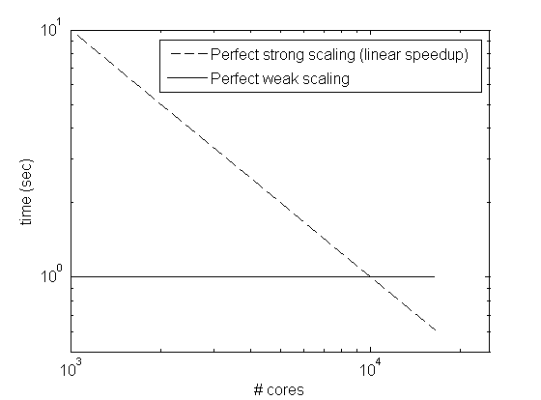
Definitions: Strong vs. Weak Scaling
Scalability (a.k.a. Scaling Efficiency) = measure of the efficiency of a code when increasing numbers of parallel processing elements (CPUs, cores, processes, threads, etc.).
Strong scaling: how the solution time varies with the number of cores for a fixed total problem size.
Fix problem size, increase # cores.
Ideal: linear speed-up with increase in # cores.
Weak scaling: how the solution time varies with the number of cores for a fixed problem size per core.
Increase problem size and # cores s.t. # dofs/core is approximately constant.
Ideal: solution time remains constant as problem size and # cores increases.

Slide 18
Scalability via Algebraic Multi-Grid
Preconditioning with Semi-Coarsening
Bad aspect ratios ruin classical AMG convergence rates!
relatively small horizontal coupling terms, hard to smooth horizontal errors
⇒ Solvers (AMG and ILU) must take aspect ratios into account
We developed a new AMG solver based on aggressive semi-coarsening (figure below)
Algebraic Structured MG ( ≡ matrix depend. MG) used with vertical line relaxation on
finest levels + traditional AMG on 1 layer problem
…
Algebraic Structured MG
Algebraic Structured MG
Unstructured AMG
Unstructured AMG

Slide 19
Scalability via Algebraic Multi-Grid
Preconditioning with Semi-Coarsening
Bad aspect ratios ruin classical AMG convergence rates!
relatively small horizontal coupling terms, hard to smooth horizontal errors
⇒ Solvers (AMG and ILU) must take aspect ratios into account
We developed a new AMG solver based on aggressive semi-coarsening (figure below)
Algebraic Structured MG ( ≡ matrix depend. MG) used with vertical line relaxation on
finest levels + traditional AMG on 1 layer problem
New AMG preconditioner is available in ML package of Trilinos!
…
Algebraic Structured MG
Algebraic Structured MG
Unstructured AMG
Unstructured AMG
See (Tuminaro, 2014), (Tezaur et al., 2015), (Tuminaro et al., 2015).

Slide 20
Scalability via Algebraic Multi-Grid
Preconditioning with Semi-Coarsening
Bad aspect ratios ruin classical AMG convergence rates!
relatively small horizontal coupling terms, hard to smooth horizontal errors
⇒ Solvers (AMG and ILU) must take aspect ratios into account
We developed a new AMG solver based on aggressive semi-coarsening (figure below)
Algebraic Structured MG ( ≡ matrix depend. MG) used with vertical line relaxation on
finest levels + traditional AMG on 1 layer problem
New AMG preconditioner is available in ML package of Trilinos!
…
Algebraic Structured MG
Algebraic Structured MG
Unstructured AMG
Unstructured AMG
Scaling studies (next slides):
New AMG preconditioner vs. ILU
See (Tuminaro, 2014), (Tezaur et al., 2015), (Tuminaro et al., 2015).

Slide 21
Importance of Node Ordering & Mesh Partitioning
Our studies revealed that node ordering and mesh partitioning matters for linear solver performance, especially for the ILU preconditioner!
It is essential that incomplete factorization accurately captures vertical coupling, which is dominant due to anisotropic mesh.

Slide 22
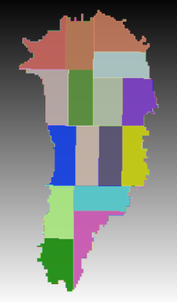
Importance of Node Ordering & Mesh Partitioning
Our studies revealed that node ordering and mesh partitioning matters for linear solver performance, especially for the ILU preconditioner!
It is essential that incomplete factorization accurately captures vertical coupling, which is dominant due to anisotropic mesh.
This is accomplished by:
Ensuring all points along a vertically extruded grid line reside within a single processor (“2D mesh partitioning”; top right).
6

Slide 23
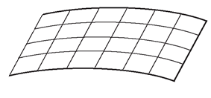
Importance of Node Ordering & Mesh Partitioning
Our studies revealed that node ordering and mesh partitioning matters for linear solver performance, especially for the ILU preconditioner!
It is essential that incomplete factorization accurately captures vertical coupling, which is dominant due to anisotropic mesh.
This is accomplished by:
Ensuring all points along a vertically extruded grid line reside within a single processor (“2D mesh partitioning”; top right).
Ordering the equations such that grid layer $k$’s nodes are ordered before all dofs associated with grid layer $k+1$ (“row-wise ordering”; bottom right).
28
29
$$⋯$$
$$⋯$$
$$⋯$$
34
0
1
$$⋯$$
$$⋯$$
$$⋯$$
6

Slide 24
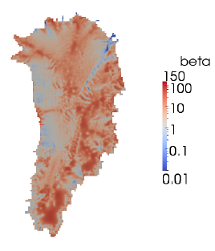
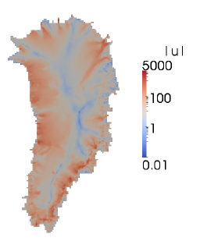
Strong Scaling Study for a Fine-Resolution GIS Problem
Uniform quadrilateral mesh with 1 km horizontal resolution, extruded vertically using 40 layers (69.8M hex elements, 143M dofs).
Run on 1024$→$16,384 cores of Hopper (16-fold increase).
Realistic basal friction coefficient and bed topographies calculated by solving a deterministic inversion problem that minimized modeled and observed surface velocity mismatch (Perego et al., 2014; top right).
Realistic 3D temperature field calculated in CISM (Shannon et al.)
Preconditioner: ILU vs. new AMG (with aggressive semi-coarsening).
Iterative linear solver: Conjugate Gradient (CG).

Slide 25
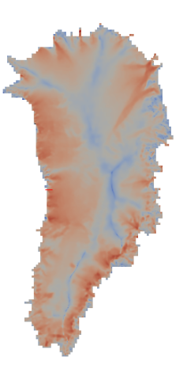
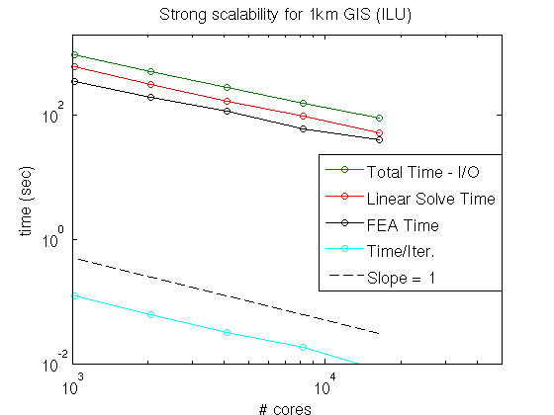
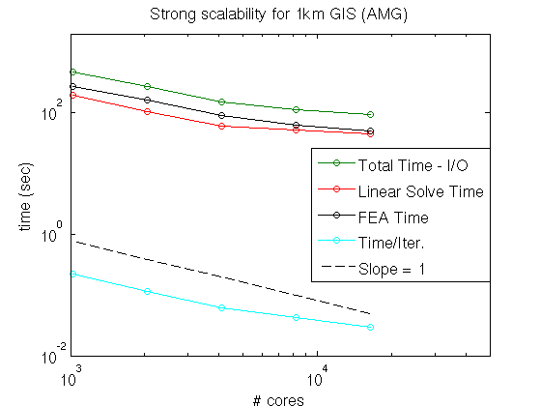
Strong Scaling Study for a Fine-Resolution GIS Problem (cont’d)
ILU
AMG
1024 cores
16,384 cores
1024 cores
16,384 cores
1024 core run:
AMG preconditioner solves are much faster than ILU (e.g., 194.3 sec for AMG vs. 607.9 sec for ILU).
Primarily due to better convergence rate obtained with AMG vs. ILU.

Slide 26
Strong Scaling Study for a Fine-Resolution GIS Problem (cont’d)
ILU
AMG
1024 cores
16,384 cores
1024 cores
16,384 cores
16,384 core run:
ILU preconditioner fairly effective relative to AMG when # dofs/core is modest (e.g., 10K dofs/core).
ILU requires slightly more iterations/linear solve but cost/iteration is higher for AMG.
AMG solver is very inefficient when # dofs/core is small; communication costs in coarse level processing dominate.

Slide 27
Strong Scaling Study for a Fine-Resolution GIS Problem (cont’d)
ILU
AMG
1024 cores
16,384 cores
1024 cores
16,384 cores
Summary:
ILU preconditioner scales better in the strong sense than AMG.
However, ILU-preconditioned solve is slower for lower #s of cores (more dofs/core).

Slide 28
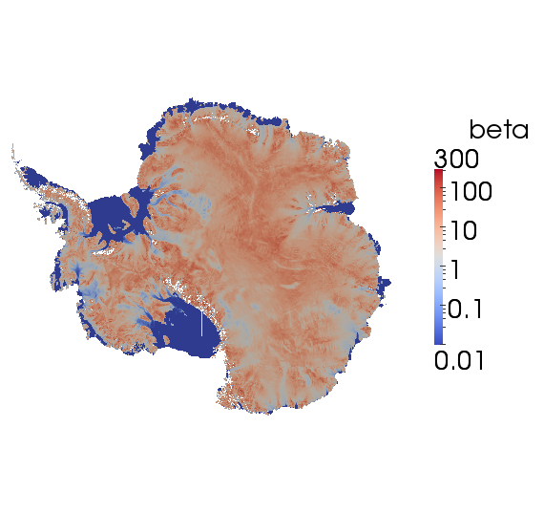
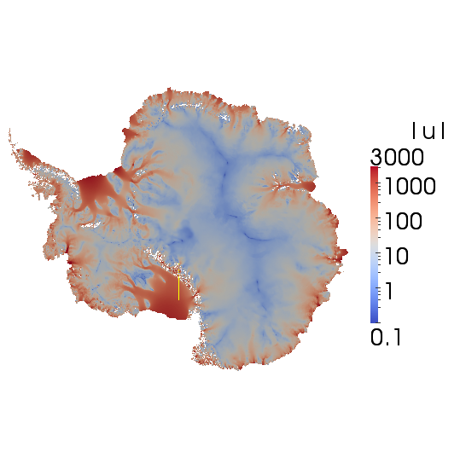
Weak Scaling Study for a Moderate-Resolution AIS Problem
3 hexahedral meshes considered:
8 km horizontal resolution + 5 vertical layers (2.52M dofs) $→$ 16 cores of Hopper.
4 km horizontal resolution + 10 vertical layers (18.5M dofs) $→$ 128 cores of Hopper.
2 km horizontal resolution + 20 vertical layers (141.5M dofs) $→$ 1024 cores of Hopper.
Ice sheet geometry based on BEDMAP2 (Fretwell et al., 2013) and 3D temperature field from (Pattyn, 2010)
Realistic regularized* basal friction coefficient and bed topographies calculated by solving a deterministic inversion problem that minimizes modeled and observed surface velocity mismatch on finest (2km) resolution geometry (Perego et al., 2014; top right).
Preconditioner: ILU vs. new AMG (with aggressive semi-coarsening).
Iterative linear solver: GMRES.
*Setting $β=δ>0$, with $δ≪1$ under ice shelves.

Slide 29
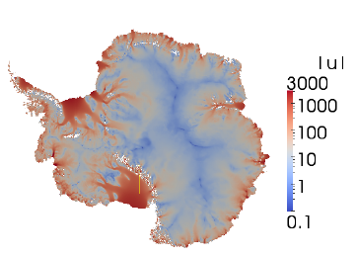
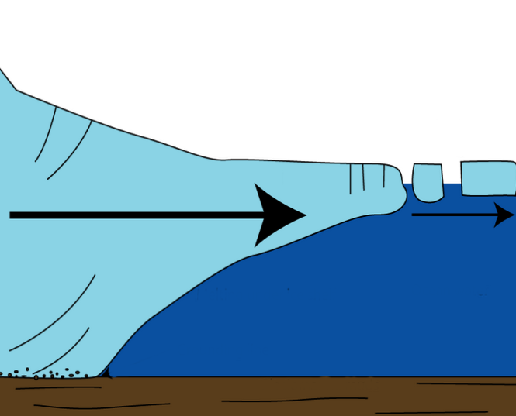
Weak Scaling Study for a Moderate-Resolution AIS Problem (cont’d)
Antarctica is fundamentally different than Greenland:
AIS contains large ice shelves (floating extensions of land ice).
Along ice shelf front: open-ocean BC (Neumann).
Along ice shelf base: zero traction BC (Neumann).
$⇒$ For vertical grid lines that lie within ice shelves, top and bottom BCs resemble Neumann BCs so sub-matrix associated with one of these lines is almost* singular.
Albany/FELIX
Glimmer/CISM
Surface boundary $Γs$
(vertical > horizontal coupling)
+
Neumann BCs
$=$
nearly singular submatrix associated with vertical lines
Ice sheet
Lateral boundary $Γl$
Basal boundary $Γβ$
)
*Completely singular in the presence of islands and some ice tongues.
Notes:
- AMG: Gauss-Seidel smoothing on finest level (where lines are defined in mesh extruded direction), Chebyshev smoothing on coarser levels.
- ILU: ordering is important to maintain acceptable convergence rates (need row-wise ordering)!
- GMRES less sensitive than CG to rounding errors associated w/ severe ill-conditioning introduced by presence of ice shelves.
- CG and GMRES minimize different norms.
- Floating ice shelves: matrix entries corresponding to vertical coupling are much stronger than entries corresponding to horizontal coupling. Vertical grid lines lie within ice shelves, top/bottom BCs resemble Neumann conditions and so the submatrix associated with the vertical lines is nearly singular. Ill-conditioning creates challenges for solver.

Slide 30
Weak Scaling Study for a Moderate-Resolution AIS Problem (cont’d)
Antarctica is fundamentally different than Greenland:
AIS contains large ice shelves (floating extensions of land ice).
Along ice shelf front: open-ocean BC (Neumann).
Along ice shelf base: zero traction BC (Neumann).
$⇒$ For vertical grid lines that lie within ice shelves, top and bottom BCs resemble Neumann BCs so sub-matrix associated with one of these lines is almost* singular.
Albany/FELIX
Glimmer/CISM
Surface boundary $Γs$
(vertical > horizontal coupling)
+
Neumann BCs
$=$
nearly singular submatrix associated with vertical lines
Ice sheet
Lateral boundary $Γl$
$⇒$Ice shelves give rise to severe ill-conditioning of linear systems!
Basal boundary $Γβ$
)
*Completely singular in the presence of islands and some ice tongues.
Notes:
- AMG: Gauss-Seidel smoothing on finest level (where lines are defined in mesh extruded direction), Chebyshev smoothing on coarser levels.
- ILU: ordering is important to maintain acceptable convergence rates (need row-wise ordering)!
- GMRES less sensitive than CG to rounding errors associated w/ severe ill-conditioning introduced by presence of ice shelves.
- CG and GMRES minimize different norms.
- Floating ice shelves: matrix entries corresponding to vertical coupling are much stronger than entries corresponding to horizontal coupling. Vertical grid lines lie within ice shelves, top/bottom BCs resemble Neumann conditions and so the submatrix associated with the vertical lines is nearly singular. Ill-conditioning creates challenges for solver.

Slide 31
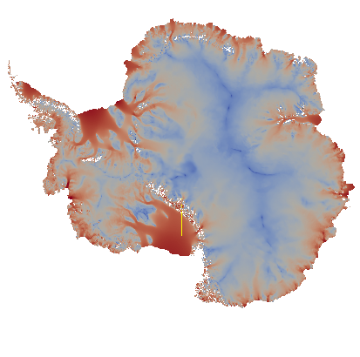
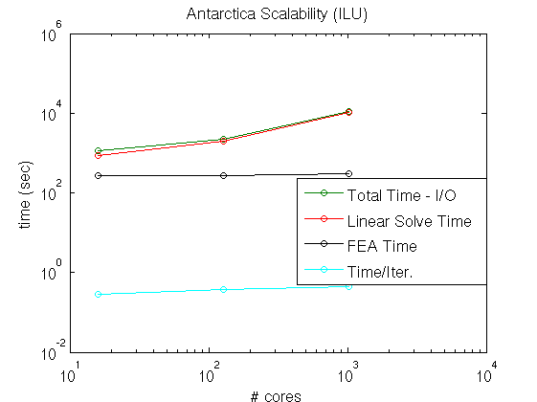
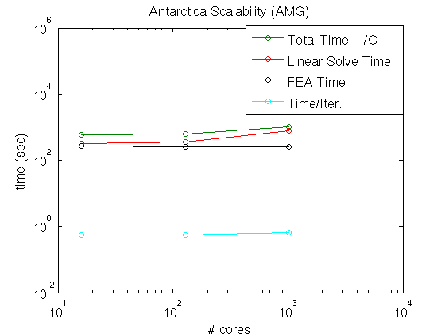
Weak Scaling Study for a Fine-Resolution AIS Problem (cont’d)
ILU
AMG
16 cores
1024 cores
16 cores
1024 cores
ILU vs. AMG:
ILU solver > 10$×$ slower than AMG solver on 1024 core problem.
Due to extremely poor convergence of ILU solver (~700 iterations/solve) $→$ resulting from ill-conditioning of underlying linear systems.
AMG iterations do grow as problem refined (14.4 iterations/solve on 16 cores vs. 35.5 iterations/solve on 1024 cores), but it is better suited to linear systems associated with AIS.

Slide 32
Weak Scaling Study for a Fine-Resolution AIS Problem (cont’d)
ILU
AMG
16 cores
1024 cores
16 cores
1024 cores
GMRES vs. CG:
GMRES solver found to be more effective than CG, even though problem is symmetric.
We believe GMRES is somewhat less sensitive to rounding errors associated with the severe ill-conditioning induced by the presence of ice shelves.
GMRES and CG minimize different norms.

Slide 33
Weak Scaling Study for a Fine-Resolution AIS Problem (cont’d)
ILU
AMG
16 cores
1024 cores
16 cores
1024 cores
Summary:
Severe ill-conditioning caused by ice shelves!
GMRES less sensitive than CG to rounding errors from ill-conditioning [also minimizes different norm].
AMG preconditioner less sensitive than ILU to ill-conditioning.
(vertical > horizontal coupling)
+
Neumann BCs
$=$
nearly singular submatrix associated with vertical lines

Slide 34
Summary and Ongoing Work
Summary:
This talk described the development of a finite element land ice solver known as Albany/FELIX written using the libraries of the Trilinos libraries.
Strong and weak scaling studies on GIS and AIS problems revealed good overall scalability can be achieved by using a new AMG preconditioner based on aggressive semi-coarsening.
I. Tezaur, R. Tuminaro, M. Perego, A. Salinger, S. Price. "On the scalability of the Albany/FELIX first-order Stokes approximation ice sheet solver for large-scale simulations of the Greenland and Antarctic ice sheets", MSESM/ICCS, Reykjavik, Iceland (June 2015).
Ongoing/future work:
Dynamic simulations of ice evolution using CISM-Albany and MPAS-Albany.
Deterministic and stochastic initialization runs.
Porting of code to new architecture supercomputers.
Journal article on AMG preconditioner in preparation for SISC (Tuminaro et. al, 2015)
Delivering code to climate community and coupling to earth system models.

Slide 35
Funding/Acknowledgements
Support for this work was provided through Scientific Discovery through Advanced Computing (SciDAC) projects funded by the U.S. Department of Energy, Office of Science (OSCR), Advanced Scientific Computing Research and Biological and Environmental Research (BER) $→$PISCEES SciDAC Application Partnership.
PISCEES team members: W. Lipscomb, S. Price, M. Hoffman, A. Salinger, M. Perego, I. Tezaur, R. Tuminaro, P. Jones, K. Evans, P. Worley, M. Gunzburger, C. Jackson;
Trilinos/DAKOTA collaborators: E. Phipps, M. Eldred, J. Jakeman, L. Swiler.
Thank you! Questions?

Slide 36
References
[1] M.A. Heroux et al. “An overview of the Trilinos project.” ACM Trans. Math. Softw. 31(3) (2005).
[2] A.G. Salinger et al. "Albany: Using Agile Components to Develop a Flexible, Generic Multiphysics Analysis Code", Comput. Sci. Disc. (submitted, 2015).
[3] I. Tezaur, M. Perego, A. Salinger, R. Tuminaro, S. Price. "Albany/FELIX: A Parallel, Scalable and Robust Finite Element Higher-Order Stokes Ice Sheet Solver Built for Advanced Analysis", Geosci. Model Develop. 8 (2015) 1-24.
[4] I. Tezaur, R. Tuminaro, M. Perego, A. Salinger, S. Price. "On the scalability of the Albany/FELIX first-order Stokes approximation ice sheet solver for large-scale simulations of the Greenland and Antarctic ice sheets", MSESM/ICCS15, Reykjavik, Iceland (June 2014).
[5] R.S. Tuminaro, I. Tezaur, M. Perego, A.G. Salinger. "A Hybrid Operator Dependent Multi-Grid/Algebraic Multi-Grid Approach: Application to Ice Sheet Modeling", SIAM J. Sci. Comput. (in prep).
[6] R. Tuminaro. “ML’s SemiCoarsening Feature, Addition to ML 5.0 Smoothed Aggregation User’s Guide” , Sandia National Laboratories Report, SAND2006-2649, Sandia National Laboratories, Albuquerque, NM, 2014.

Slide 37
References (cont’d)
[7] S. Shannon, et al. “Enhanced basal lubrication and the contribution of the Greenland ice sheet to future sea-level rise”, P. Natl. Acad. Sci., 110 (2013) 14156-14161.
[8] P. Fretwell, et al. “BEDMAP2: Improved ice bed, surface, and thickness datasets for Antarctica”, The Cryosphere 7(1) (2013) 375-393.
[9] F. Pattyn. “Antarctic subglacial conditions inferred from a hybrid ice sheet/ice stream model”, Earth and Planetary Science Letters 295 (2010).
[10] M. Perego, S. Price, G. Stadler. “Optimal Initial Conditions for Coupling Ice Sheet Models to Earth System Models”, J. Geophys. Res. 119 (2014) 1894-1917.

Slide 38
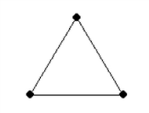
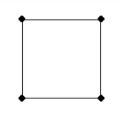
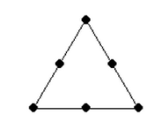
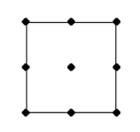
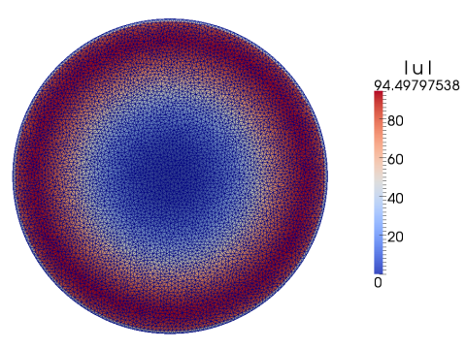
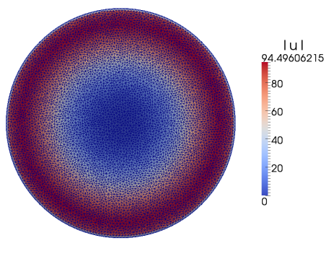
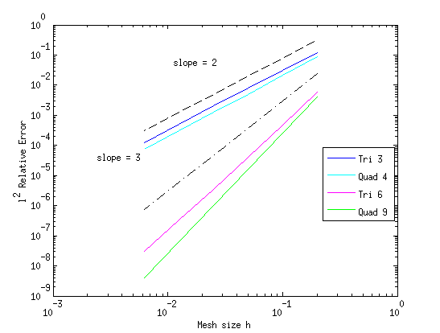
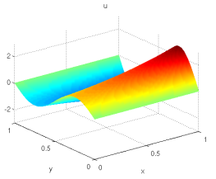
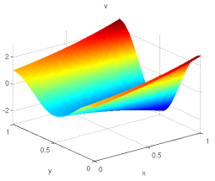
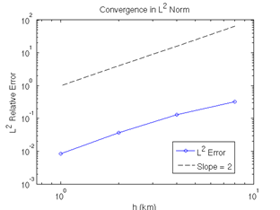
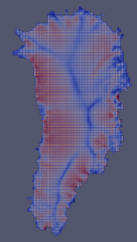
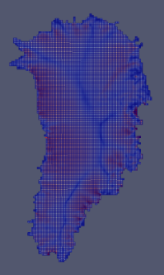
Appendix: Verification/Mesh Convergence Studies
Stage 1: solution verification on 2D MMS problems we derived.
Stage 2: code-to-code comparisons on canonical ice sheet problems.
Albany/FELIX
LifeV
Stage 3: full 3D mesh convergence study on Greenland w.r.t. reference solution.
Are the Greenland problems resolved?
Is theoretical convergence rate achieved?

Slide 39
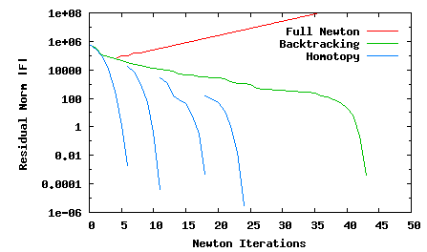
Appendix: Robustness of Newton’s Method via Homotopy Continuation (LOCA)
$$\dot{ε}1T=\left(2\dot{ε}11+\dot{ε}22,\dot{ε}12,\dot{ε}13\right)$$
$$\dot{ε}2T=\left(2\dot{ε}12, \dot{ε}11+2\dot{ε}22,\dot{ε}23\right)$$
$$\dot{ε}ij=\frac{1}{2}\left(\frac{∂ui}{∂xj}+\frac{∂uj}{∂xi}\right)$$
$γ$=10⁻¹⁰
Glen’s Law Viscosity:
$γ$=10⁻¹⁰
$$μ=\frac{1}{2}{A^{−\frac{1}{n}}\left(\frac{1}{2}\sum_{ij}{\dot{ε}ij2}\right)}^{\left(\frac{1}{2n}−\frac{1}{2}\right)}$$
$γ$=10^{-1.0}
$γ$=10^{-6.0}
$γ$=10⁻¹⁰
$γ$=10^{-2.5}
$$n=3$$
(Glen’s law exponent)

Slide 40
Appendix: Robustness of Newton’s Method via Homotopy Continuation (LOCA)
$$\dot{ε}1T=\left(2\dot{ε}11+\dot{ε}22,\dot{ε}12,\dot{ε}13\right)$$
$$\dot{ε}2T=\left(2\dot{ε}12, \dot{ε}11+2\dot{ε}22,\dot{ε}23\right)$$
$$\dot{ε}ij=\frac{1}{2}\left(\frac{∂ui}{∂xj}+\frac{∂uj}{∂xi}\right)$$
$γ$=10⁻¹⁰
Glen’s Law Viscosity:
$$μ=\frac{1}{2}{A^{−\frac{1}{n}}\left(\frac{1}{2}\sum_{ij}{\dot{ε}ij2+}γ\right)}^{\left(\frac{1}{2n}−\frac{1}{2}\right)}$$
$γ$=10⁻¹⁰
$$μ=\frac{1}{2}{A^{−\frac{1}{n}}\left(\frac{1}{2}\sum_{ij}{\dot{ε}ij2}\right)}^{\left(\frac{1}{2n}−\frac{1}{2}\right)}$$
$γ$=10^{-1.0}
$γ=$regularization parameter
$γ$=10^{-6.0}
$γ$=10⁻¹⁰
$γ$=10^{-2.5}
$$n=3$$
(Glen’s law exponent)

Slide 41
Appendix: Robustness of Newton’s Method via Homotopy Continuation (LOCA)
$$\dot{ε}1T=\left(2\dot{ε}11+\dot{ε}22,\dot{ε}12,\dot{ε}13\right)$$
$$\dot{ε}2T=\left(2\dot{ε}12, \dot{ε}11+2\dot{ε}22,\dot{ε}23\right)$$
$$\dot{ε}ij=\frac{1}{2}\left(\frac{∂ui}{∂xj}+\frac{∂uj}{∂xi}\right)$$
$γ$=10⁻¹⁰
Glen’s Law Viscosity:
$$μ=\frac{1}{2}{A^{−\frac{1}{n}}\left(\frac{1}{2}\sum_{ij}{\dot{ε}ij2+}γ\right)}^{\left(\frac{1}{2n}−\frac{1}{2}\right)}$$
$γ$=10⁻¹⁰
$$μ=\frac{1}{2}{A^{−\frac{1}{n}}\left(\frac{1}{2}\sum_{ij}{\dot{ε}ij2}\right)}^{\left(\frac{1}{2n}−\frac{1}{2}\right)}$$
$γ$=10^{-1.0}
$γ=$regularization parameter
$γ$=10^{-6.0}
$γ$=10⁻¹⁰
$γ$=10^{-2.5}
$$n=3$$
(Glen’s law exponent)
Newton’s method most robust with full step + homotopy continuation of $γ→{10}^{−10}$: converges out-of-the-box!

