Slide 1
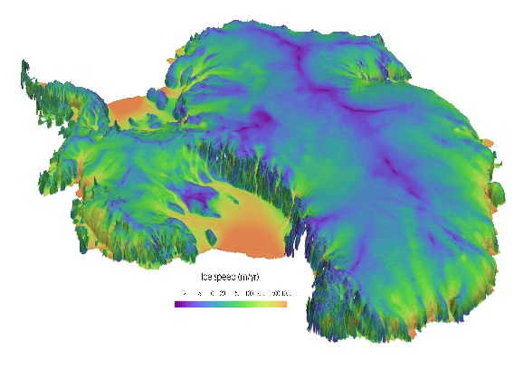
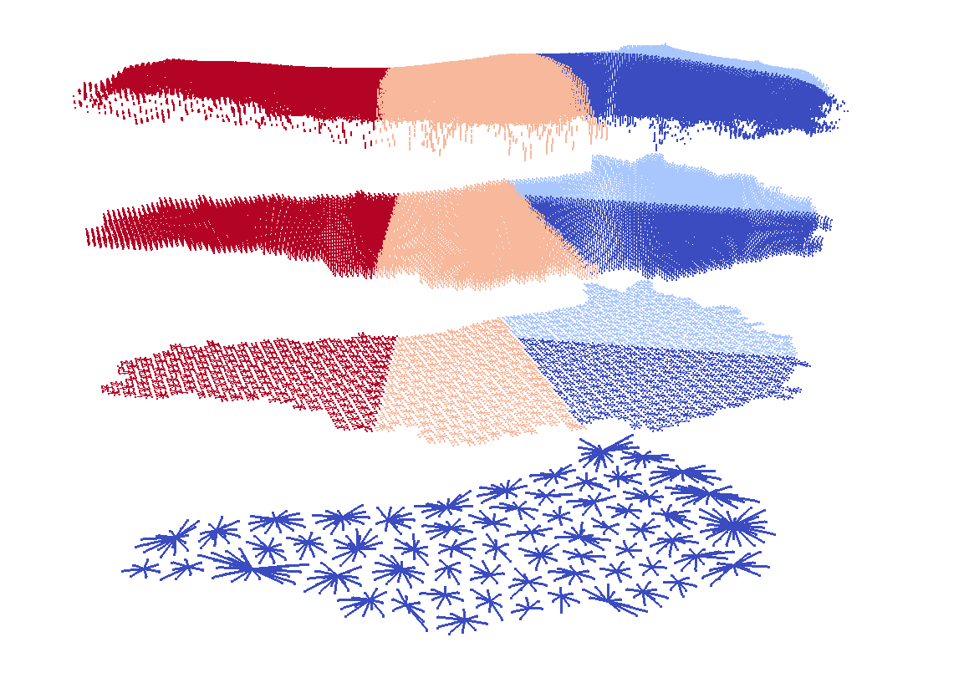
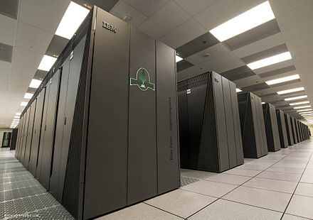
Towards Performance-Portability of the Albany Land-Ice Solver to New and Emerging Architectures Using Kokkos
Jerry Watkins¹, Irina Tezaur¹, Irina Demeshko²
¹ Sandia National Laboratories, Livermore, CA, USA.
² Los Alamos National Laboratory, Los Alamos, NM, USA.
ESCO 2018 Pilsen, Czech Republic June 4-8, 2018
Sandia National Laboratories is a multi-mission laboratory managed and operated by National Technology and Engineering Solutions of Sandia, LLC., a wholly owned subsidiary of Honeywell International, Inc., for the U.S. Department of Energy’s National Nuclear Security Administration under contract DE-NA0003525.
SAND2018-4907 C

Slide 2
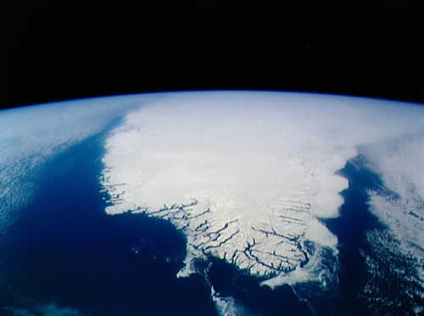
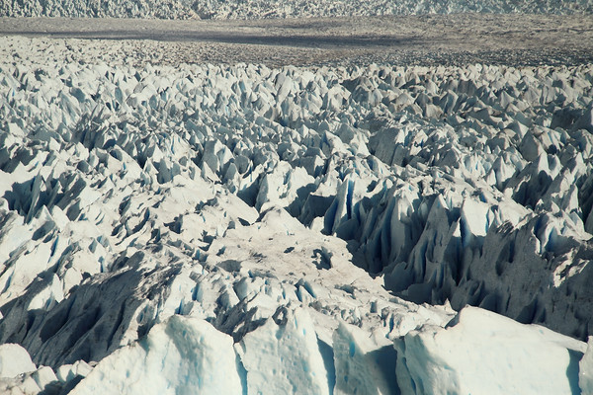
Outline
Background
  Motivation
  ProSPect Project for Land-ice Modeling & Albany Land-Ice Solver
Performance-Portability of Finite Element Assembly via Kokkos
Performance Results
  Architecture Comparison
  Scaling Study
  Preliminary Results on Volta GPU
Summary & Future Work.

Slide 3
Outline
Background
  Motivation
  ProSPect Project for Land-ice Modeling & Albany Land-Ice Solver
Performance-Portability of Finite Element Assembly via Kokkos
Performance Results
  Architecture Comparison
  Scaling Study
  Preliminary Results on Volta GPU
Summary & Future Work.

Slide 4
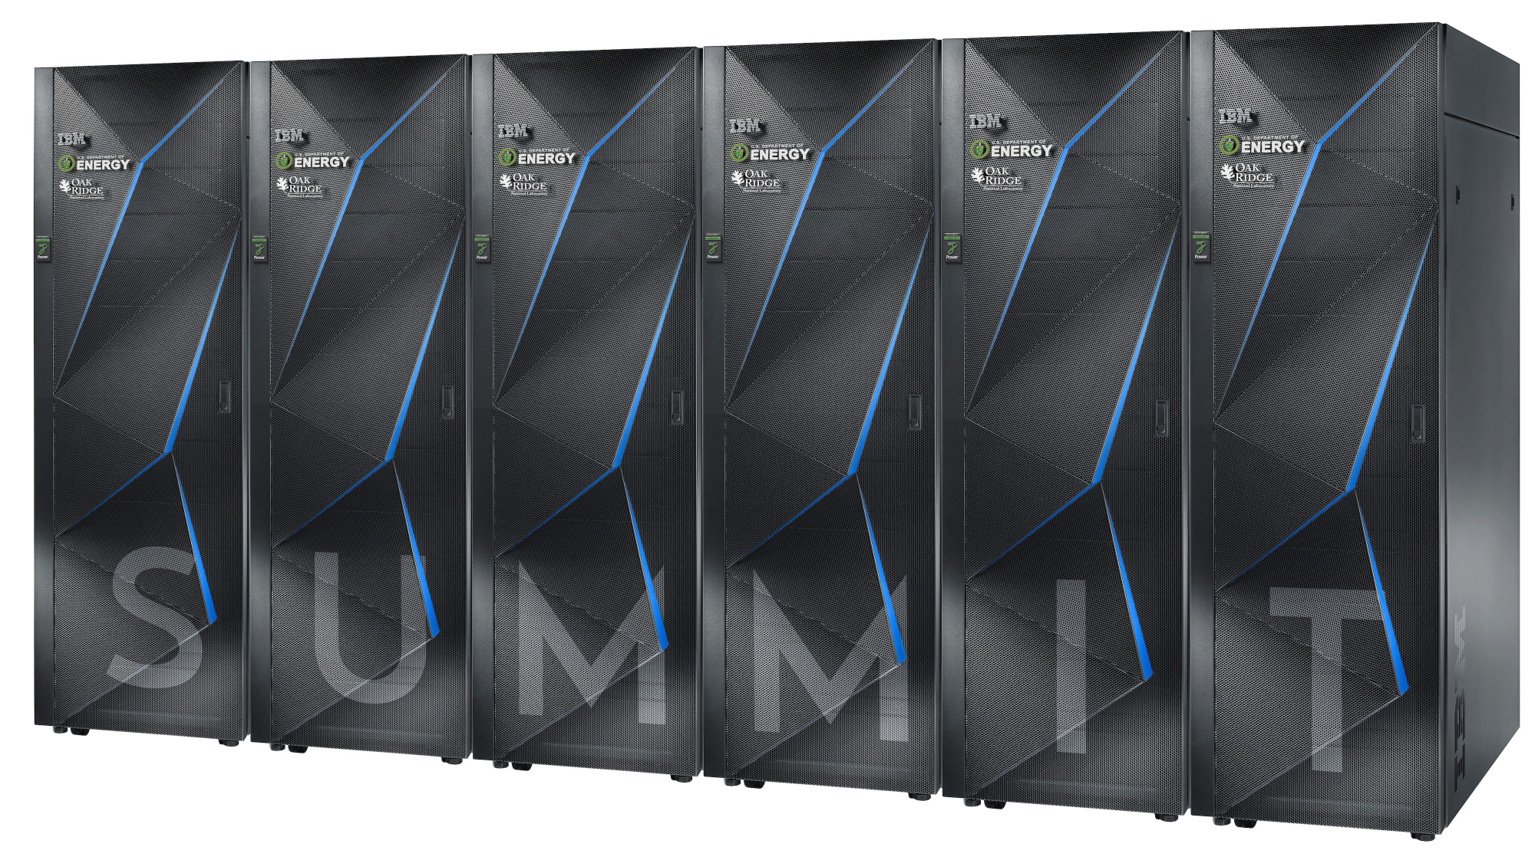
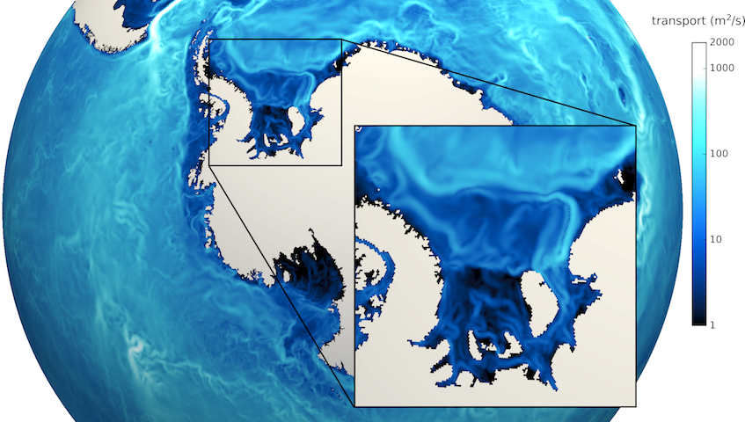
Motivation
Scientific models (e.g., climate models) need more computational power to achieve higher resolutions.
High performance computing (HPC) architectures are becoming increasingly more heterogeneous in a move towards exascale.
Climate models need to adapt to execute correctly & efficiently on new HPC architectures with drastically different memory models.

Slide 5
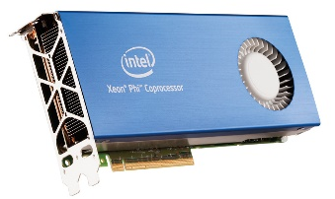
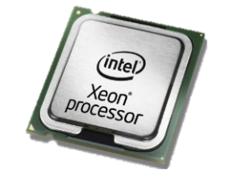
MPI+X Programming Model
HPC architectures are rapidly changing, but trends remain the same.
  Computations are cheap, memory transfer is expensive.
  Single core cycle time has improved but stagnated.
  Increased computational power achieved through manycore architectures.
  → MPI-only is not enough to exploit emerging massively parallel architectures.
Year | Memory Access Time | Single Core Cycle Time
1980s | ~100 ns | ~100 ns
Today | ~50-100 ns | ~1 ns
Approach: MPI+X Programming Model
MPI: inter-node parallelism.
X: intra-node parallelism.
  → Examples: X = OpenMP, CUDA, Pthreads, etc.

Slide 6
Outline
Background
  Motivation
  ProSPect Project for Land-ice Modeling & Albany Land-Ice Solver
Performance-Portability of Finite Element Assembly via Kokkos
Performance Results
  Architecture Comparison
  Scaling Study
  Preliminary Results on Volta GPU
Summary & Future Work.

Slide 7

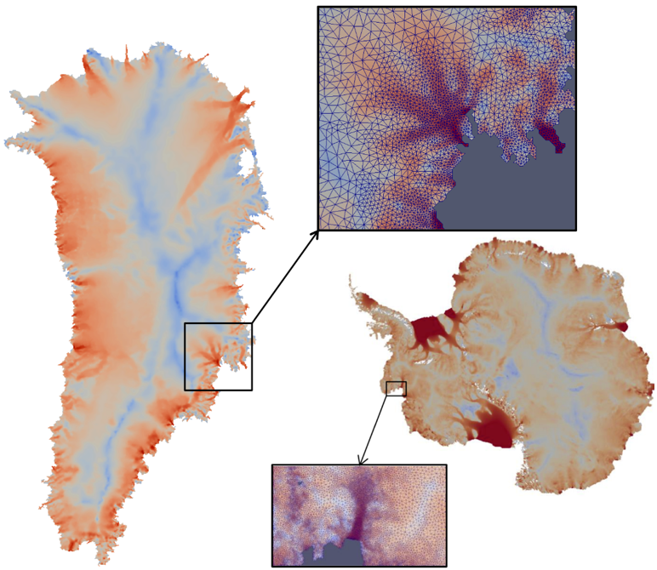
ProSPect Project for Land-Ice Modeling
  “ProSPect” = Probabilistic Sea Level Projections from Ice Sheet and Earth System Models
  5 year SciDAC4 project (2017-2022).
  Sandia’s Role in the ProSPect Project: to develop and support a robust and scalable land ice solver based on the “First-Order” (FO) Stokes equations $→$Albany Land-Ice
Requirements for Albany Land-Ice:
  Unstructured grid meshes.
  Scalable, fast and robust.
  Verified and validated.
  Portable to new architecture machines.
  Advanced analysis capabilities: deterministic inversion, calibration, uncertainty quantification.
As part of DOE E3SM* Earth System Model, solver will provide actionable predictions of 21st century sea-level change (including uncertainty bounds).
* Energy Exascale Earth System Model.

Slide 8
ProSPect Project for Land-Ice Modeling
  “ProSPect” = Probabilistic Sea Level Projections from Ice Sheet and Earth System Models
  5 year SciDAC4 project (2017-2022).
  Sandia’s Role in the ProSPect Project: to develop and support a robust and scalable land ice solver based on the “First-Order” (FO) Stokes equations $→$Albany Land-Ice
Requirements for Albany Land-Ice:
  Unstructured grid meshes.
  Scalable, fast and robust.
  Verified and validated.
  Portable to new architecture machines.
  Advanced analysis capabilities: deterministic inversion, calibration, uncertainty quantification.
As part of DOE E3SM* Earth System Model, solver will provide actionable predictions of 21st century sea-level change (including uncertainty bounds).
* Energy Exascale Earth System Model.

Slide 9
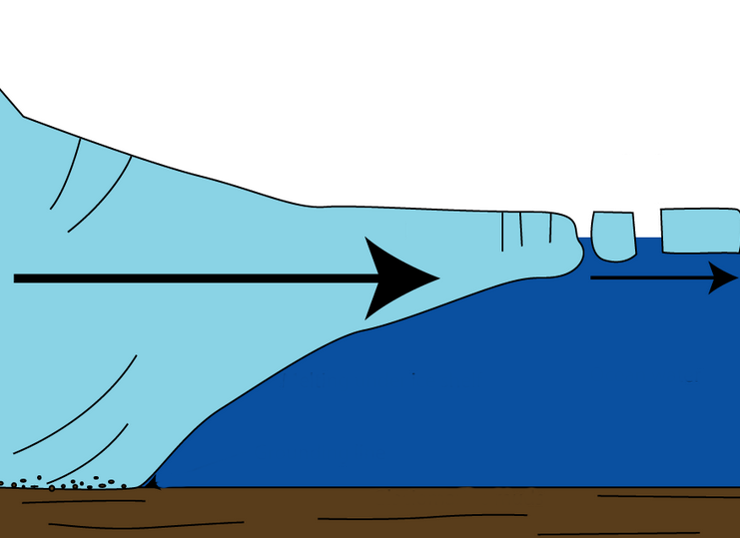
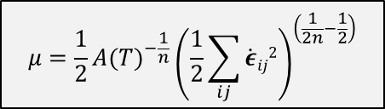

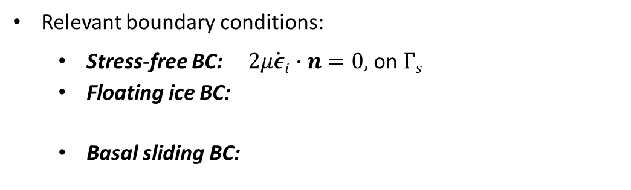
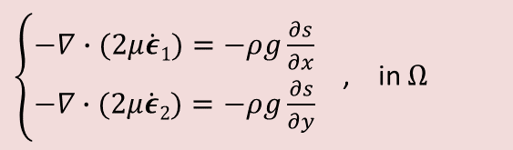
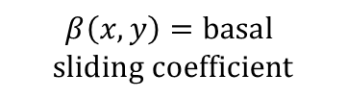




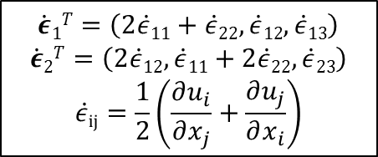

First-Order (FO) Stokes Model
Ice behaves like a very viscous shear-thinning fluid (similar to lava flow).
Quasi-static model with momentum balance given by “First-Order” Stokes PDEs: “nice” elliptic approximation* to Stokes’ flow equations.
$$\dot{ε}1T=\left(2\dot{ε}11+\dot{ε}22,\dot{ε}12,\dot{ε}13\right)$$
$$\dot{ε}2T=\left(2\dot{ε}12, \dot{ε}11+2\dot{ε}22,\dot{ε}23\right)$$
$$\dot{ε}ij=\frac{1}{2}\left(\frac{∂u_{i}}{∂x_{j}}+\frac{∂u_{j}}{∂x_{i}}\right)$$
$\left\{\begin{aligned}−∇∙(2μ\dot{ε}1)=−ρg\frac{∂s}{∂x} \\ −∇∙(2μ\dot{ε}2)=−ρg\frac{∂s}{∂y}\end{aligned}\right.$ , in $Ω$
Viscosity $μ$ is nonlinear function given by “Glen’s law”:
  Surface boundary $Γs$
$$μ=\frac{1}{2}{{A(T)}^{−\frac{1}{n}}\left(\frac{1}{2}\sum_{ij}{\dot{ε}ij2}\right)}^{\left(\frac{1}{2n}−\frac{1}{2}\right)}$$
$$(n=3)$$
Ice sheet
Albany/FELIX
Relevant boundary conditions:
  Stress-free BC: $2μ\dot{ε}i∙n=0,$ on $Γs$
  Floating ice BC:
  Basal sliding BC:
Lateral boundary $Γl$
  $2μ\dot{ε}i∙n$ = $\left\{\begin{aligned}ρgzn\text{, }\text{if} z>0 \\ 0, if z≤0\end{aligned}, \right.on Γl$
  Basal boundary $Γβ$
)
$$β\left(x,y\right)=basal$$
$$sliding coefficient$$
  $2μ\dot{ε}i∙n+β(x,y)u_{i}=0$, on $Γβ$
*Assumption: aspect ratio $δ$is small and normals to upper/lower surfaces are almost vertical.

Slide 10

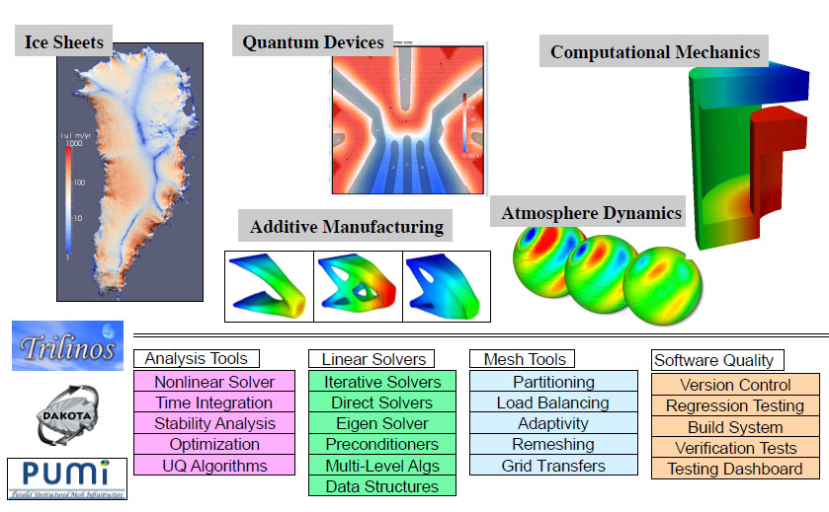
Albany Code Base and Albany Land-Ice Solver
Albany Land-Ice implemented in open-source* C++ multi-physics finite element Trilinos-based code:
* https://github.com/gahansen/Albany.

Slide 11
Outline
Background
  Motivation
  ProSPect Project for Land-ice Modeling & Albany Land-Ice Solver
Performance-Portability of Finite Element Assembly via Kokkos
Performance Results
  Architecture Comparison
  Scaling Study
  Preliminary Results on Volta GPU
Summary & Future Work.

Slide 12
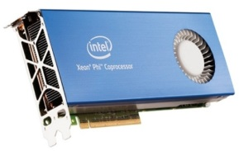
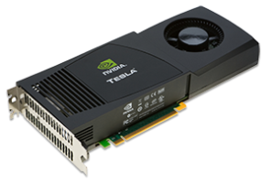
Performance-portability via Kokkos
We need to be able to run climate models on new architecture machines (hybrid systems) and manycore devices (multi-core CPU, NVIDIA GPU, Intel Xeon Phi, etc.) .
In Albany Land-Ice, we achieve performance-portability via Kokkos.
  Kokkos: C++ library and programming model that provides performance portability across multiple computing architectures.
    → Examples: Multicore CPU, NVIDIA GPU, Intel Xeon Phi, and more.
  Provides automatic access to OpenMP, CUDA, Pthreads, etc.
  Designed to work with the MPI+X programming model.
  Abstracts data layouts for optimal performance (“array of strucs” vs. struct of arrays”, locality).
With Kokkos, you write an algorithm once, and just change a template parameter to get the optimal data layout for your hardware.
→ Allows researcher to focus on application development for large heterogeneous architectures.

Slide 13
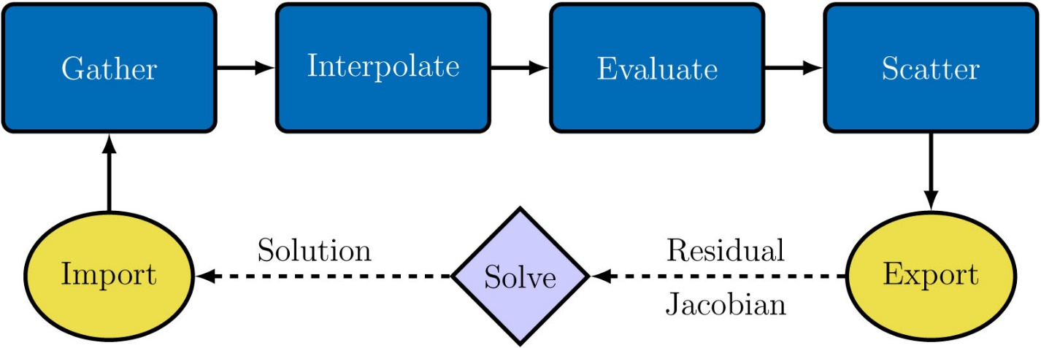
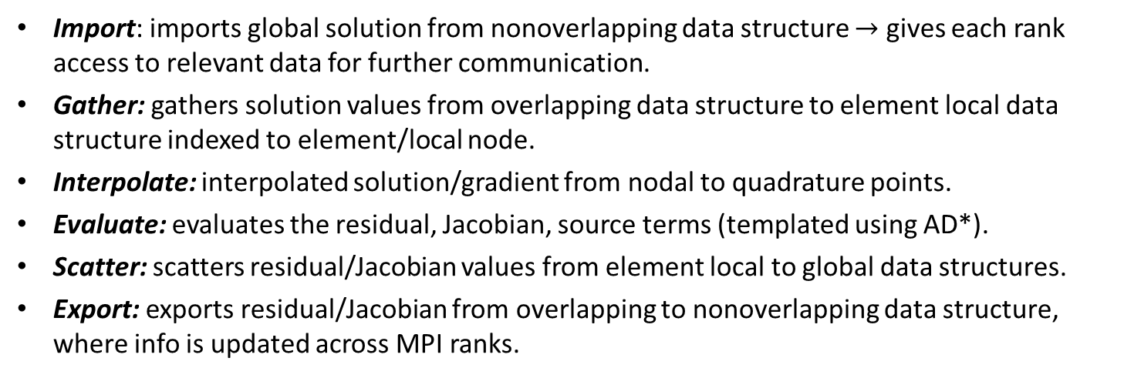
Albany Finite Element Assembly (FEA)
Performance-portability work has focused on Finite Element Assembly (FEA).
Problem Type | % CPU time for FEA
Implicit | 50%
Explicit | 99%
FEA
Shared Memory Assembly
Distributed Memory Assembly
Import: imports global solution from nonoverlapping data structure $→$ gives each rank access to relevant data for further communication.
Gather: gathers solution values from overlapping data structure to element local data structure indexed to element/local node.
Interpolate: interpolated solution/gradient from nodal to quadrature points.
Evaluate: evaluates the residual, Jacobian, source terms (templated using AD*).
Scatter: scatters residual/Jacobian values from element local to global data structures.
Export: exports residual/Jacobian from overlapping to nonoverlapping data structure, where info is updated across MPI ranks.
* Automatic differentiation.

Slide 14

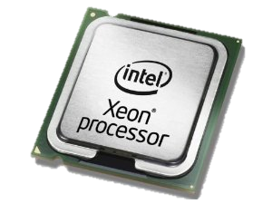
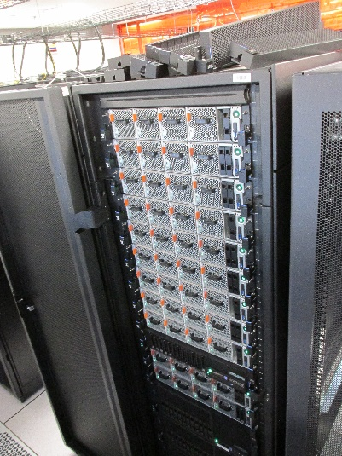
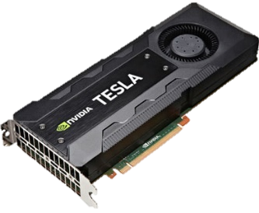
Performance-portability of FEA via Kokkos
MPI-only FEA
MPI+X FEA
MPI-only FEA:
  Each MPI process has workset of cells, computes nested parallel for loops.
MPI+X FEA:
  Each MPI process has workset of cells.
  Multi-dimensional parallelism with +X (X=OpenMP, CUDA) for nested parallel for loops.
Parallelism over all elements (element local data structure)
  Kokkos::parallel_for
Multidimensional parallelism for nested for loops
  Kokkos::Experimental::md_parallel_for
Atomics used to scatter local data to global data structures
  Kokkos::atomic_fetch_add (Tpetra)
Data transfer from host to device handled by CUDA UVM*
* Unified Virtual Memory.

Slide 15
MPI+X FEA via Kokkos
MPI-only nested for loop:
for (int cell=0; cell<numCells; ++cell)
for (int node=0; node<numNodes; ++node)
for (int qp=0; qp<numQPs; ++qp)
compute A;
MPI process n

Slide 16

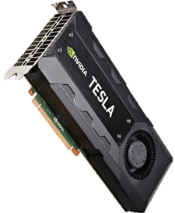
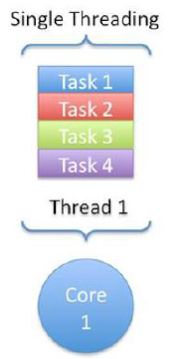

MPI+X FEA via Kokkos
Thread 1 computes A for
(cell,node,qp)=(0,0,0)
Multi-dimensional parallelism for nested for loops via Kokkos:
Thread 2 computes A for
(cell,node,qp)=(0,0,1)
for (int cell=0; cell<numCells; ++cell)
for (int node=0; node<numNodes; ++node)
for (int qp=0; qp<numQPs; ++qp)
compute A;
Thread N computes A for
(cell,node,qp)=(numCells,numNodes,numQPs)
MPI process n

Slide 17
MPI+X FEA via Kokkos
Thread 1 computes A for
(cell,node,qp)=(0,0,0)
Multi-dimensional parallelism for nested for loops via Kokkos:
Thread 2 computes A for
(cell,node,qp)=(0,0,1)
for (int cell=0; cell<numCells; ++cell)
for (int node=0; node<numNodes; ++node)
for (int qp=0; qp<numQPs; ++qp)
compute A;
Thread N computes A for
(cell,node,qp)=(numCells,numNodes,numQPs)
MPI process n
computeA_Policy range({0,0,0},{(int)numCells,(int)numNodes,(int)numQPs});
Kokkos::Experimental::md_parallel_for<ExecutionSpace>(range,*this);
* Unified Virtual Memory.
* Unified Virtual Memory.

Slide 18
MPI+X FEA via Kokkos
Thread 1 computes A for
(cell,node,qp)=(0,0,0)
Multi-dimensional parallelism for nested for loops via Kokkos:
Thread 2 computes A for
(cell,node,qp)=(0,0,1)
for (int cell=0; cell<numCells; ++cell)
for (int node=0; node<numNodes; ++node)
for (int qp=0; qp<numQPs; ++qp)
compute A;
Thread N computes A for
(cell,node,qp)=(numCells,numNodes,numQPs)
MPI process n
computeA_Policy range({0,0,0},{(int)numCells,(int)numNodes,(int)numQPs});
Kokkos::Experimental::md_parallel_for<ExecutionSpace>(range,*this);
ExecutionSpace defined at compile time, e.g.
  typedef Kokkos::OpenMP ExecutionSpace; //MPI+OpenMP
  typedef Kokkos::CUDA ExecutionSpace; //MPI+CUDA
  typedef Kokkos::Serial ExecutionSpace; //MPI-only

Slide 19
MPI+X FEA via Kokkos
Thread 1 computes A for
(cell,node,qp)=(0,0,0)
Multi-dimensional parallelism for nested for loops via Kokkos:
Thread 2 computes A for
(cell,node,qp)=(0,0,1)
for (int cell=0; cell<numCells; ++cell)
for (int node=0; node<numNodes; ++node)
for (int qp=0; qp<numQPs; ++qp)
compute A;
Thread N computes A for
(cell,node,qp)=(numCells,numNodes,numQPs)
MPI process n
computeA_Policy range({0,0,0},{(int)numCells,(int)numNodes,(int)numQPs});
Kokkos::Experimental::md_parallel_for<ExecutionSpace>(range,*this);
ExecutionSpace defined at compile time, e.g.
  typedef Kokkos::OpenMP ExecutionSpace; //MPI+OpenMP
  typedef Kokkos::CUDA ExecutionSpace; //MPI+CUDA
  typedef Kokkos::Serial ExecutionSpace; //MPI-only
Kokkos parallelization in Albany Land-Ice is only over cells.

Slide 20
Outline
Background
  Motivation
  ProSPect Project for Land-ice Modeling & Albany Land-Ice Solver
Performance-Portability of Finite Element Assembly via Kokkos
Performance Results
  Architecture Comparison
  Scaling Study
  Preliminary Results on Volta GPU
Summary & Future Work.

Slide 21
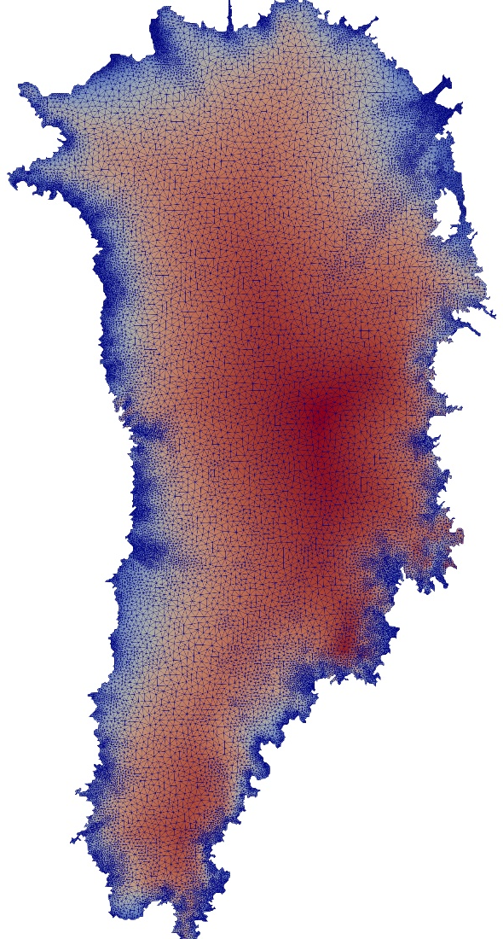
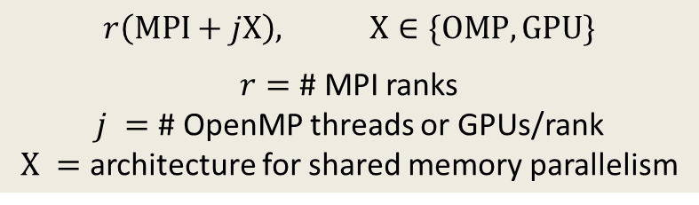
Performance Study*: Greenland Ice Sheet (GIS)
Mesh | Resolution | # Elements
Case 1 | 4km-20km | 1.51 million
Case 2 | 1km-7km | 14.4 million
Unstructured tetrahedral element meshes
Wall-clock time averaged over 100 global assembly evaluations (residual + Jacobian)
Performance analysis focuses on finite element assembly
No-slip boundary condition at bedrock
3 devices considered: Haswell, KNL, P100 GPU
Notation for performance results:
$r\left(MPI+jX\right),$ $X∈\{OMP,GPU\}$
$r=$ # MPI ranks
$j =$ # OpenMP threads or GPUs/rank
$X =$ architecture for shared memory parallelism
* See J. Watkins, I. Tezaur, I. Demeshko. Lecture Notes in Computational Science & Engineering, 2018 (accepted).

Slide 22
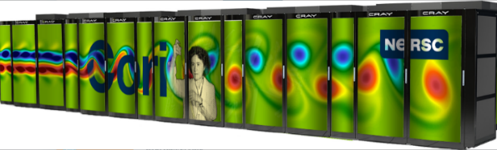
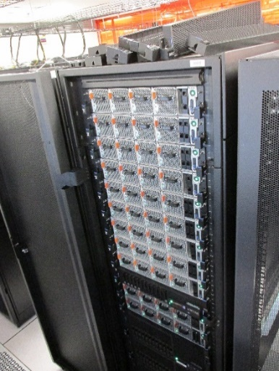
Computer Architectures
Performance-portability of FEA in Albany has been tested across multiple architectures: Intel Sandy Bridge, IBM POWER8, IBM POWER9, Keplar/Pascal/Volta GPUs, KNL Xeon Phi
Architectures:
Ride (SNL): 12 nodes [2 POWER8 (16 cores) + P100 (4 GPUs)]
Cori (NERSC): 2,388 Haswell nodes [2 Haswell (32 cores)] 9,688 KNL nodes [1 Xeon Phi KNL (68 cores)]
Quetzal (SNL): Workstation [Titan V GV100 (1 GPU)]
Models:
3 models tested: MPI-only, MPI+OpenMP, MPI+CUDA
MPI+OpenMP: MPI ranks are mapped to cores, OpenMP threads are mapped to hardware-threads*
  Each Haswell core has 2 256-bit-wide vector processing units
  Each KNL core has 2 512-bit-wide vector processing units
MPI+GPU: MPI ranks assigned a single core per GPU
  CUDA-Aware MPI (direct GPU communication)
Ride
* Alternatives are sub-optimal, e.g., mapping MPI ranks to hardware threads $⇒$ slower runs (ranks compete for resources).

Slide 23
Outline
Background
  Motivation
  ProSPect Project for Land-ice Modeling & Albany Land-Ice Solver
Performance-Portability of Finite Element Assembly via Kokkos
Performance Results
  Architecture Comparison
  Scaling Study
  Preliminary Results on Volta GPU
Summary & Future Work.

Slide 24
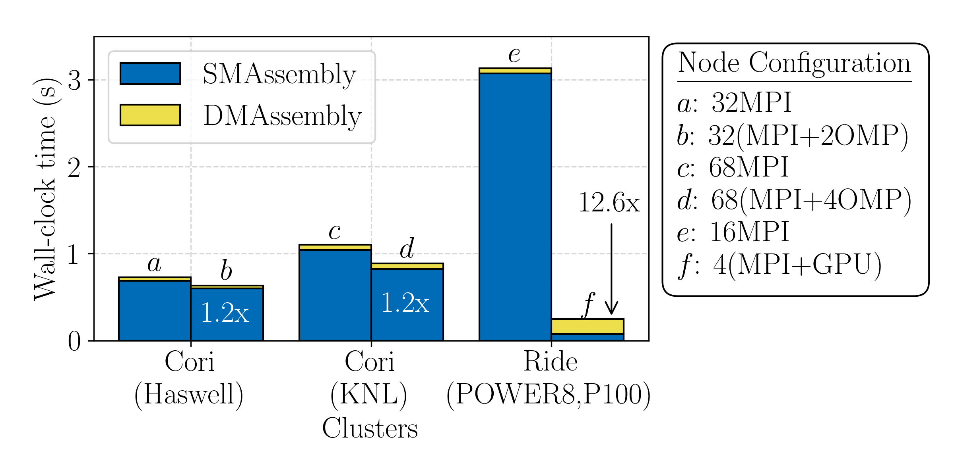
Wall-Clock Time on Single Node
Given access to a single node of Cori Haswell, Cori KNL, and Ride P100, where should 4km-20km GIS problem be run?
SM = Shared Memory
DM = Distributed Memory
Speedup is achieved across all execution spaces.
  Ride node performs best in this case (because of the 4 GPUs)
SMAssembly dominates on CPU
  Possible improvement: explicit vectorization to utilize VPUs.
DMAssembly is a factor on GPU
  Tpetra routines (50% CPU time spent in Tpetra) are not fully optimized
Notes:
Ask Jerry: what is difference b/w this slide and next slide? This one maxes out node, the next one maxes out proc?
Someone may want to maximize performance on a cluster – where should I run my code? -> maximize performance based on single node – want to use maximal resources
MPI ranks map to cores, OMP threads map to hardware threads (for FEA) -> make coarse grain parallelism as efficient as possible
- other configuration: but then ranks start competing for resources on single core -> can overwrite memory on cache rank
- if map MPI ranks to hardware threads, code runs slower b/c ranks compete for resources

Slide 25
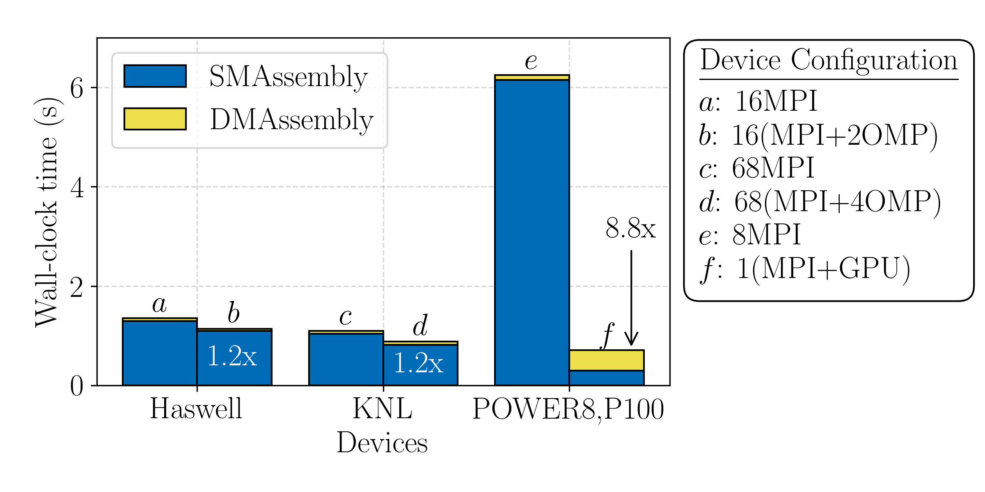
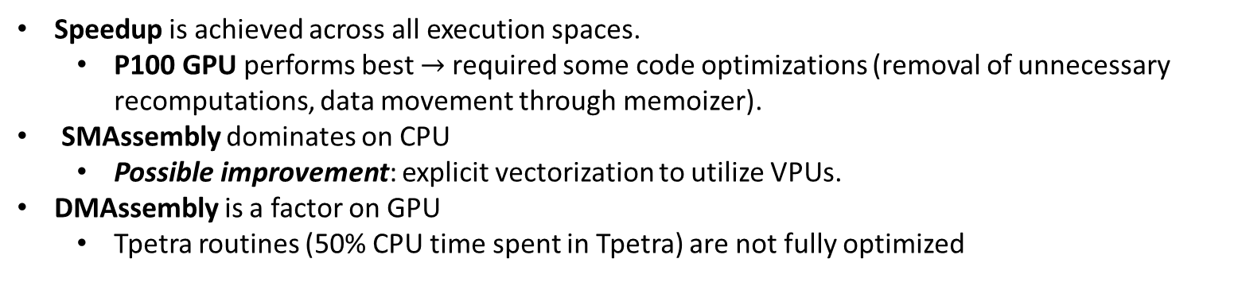
Wall-Clock Time on Single Device
What single device is best investment (Haswell, KNL, POWER8, P100) for running 4km-20km GIS problem?
SM = Shared Memory
DM = Distributed Memory
Speedup is achieved across all execution spaces.
  P100 GPU performs best $→$required some code optimizations (removal of unnecessary recomputations, data movement through memoizer).
SMAssembly dominates on CPU
  Possible improvement: explicit vectorization to utilize VPUs.
DMAssembly is a factor on GPU
  Tpetra routines (50% CPU time spent in Tpetra) are not fully optimized
Similar conclusions as for single node.
Notes:
Ask Jerry: what is difference b/w this slide and next slide? This one maxes out node, the next one maxes out proc?
Someone may want to maximize performance on a cluster – where should I run my code? -> maximize performance based on single node – want to use maximal resources
MPI ranks map to cores, OMP threads map to hardware threads (for FEA) -> make coarse grain parallelism as efficient as possible
- other configuration: but then ranks start competing for resources on single core -> can overwrite memory on cache rank
- if map MPI ranks to hardware threads, code runs slower b/c ranks compete for resources

Slide 26
Outline
Background
  Motivation
  ProSPect Project for Land-ice Modeling & Albany Land-Ice Solver
Performance-Portability of Finite Element Assembly via Kokkos
Performance Results
  Architecture Comparison
  Scaling Study
  Preliminary Results on Volta GPU
Summary & Future Work.

Slide 27
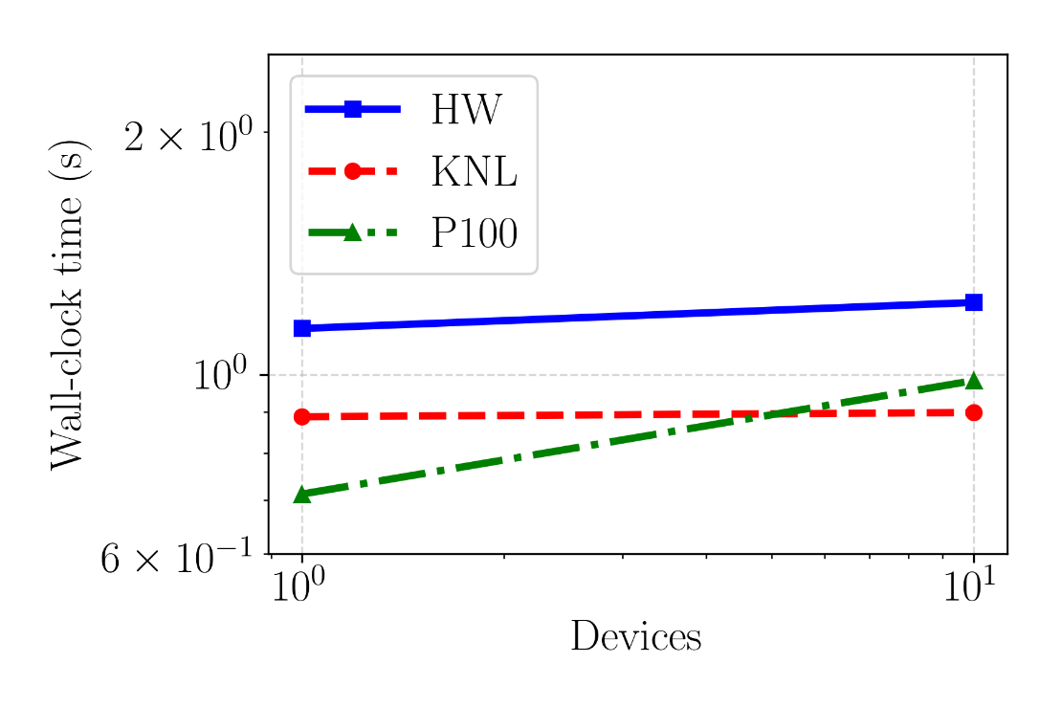
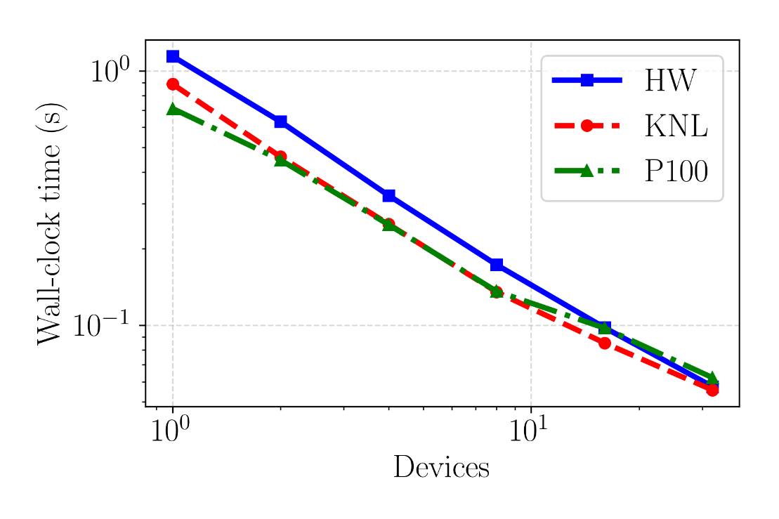
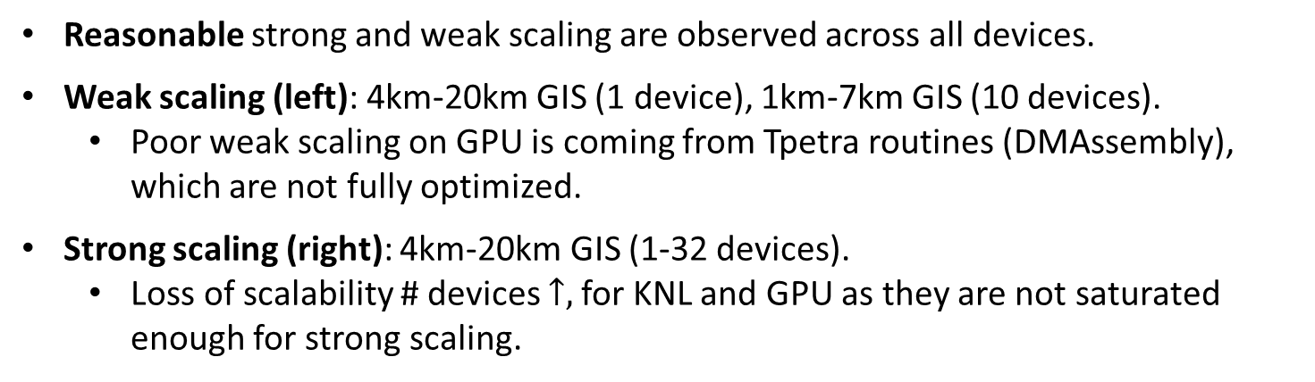
Scalability Study
Weak Scaling
Strong Scaling
Reasonable strong and weak scaling are observed across all devices.
Weak scaling (left): 4km-20km GIS (1 device), 1km-7km GIS (10 devices).
  Poor weak scaling on GPU is coming from Tpetra routines (DMAssembly), which are not fully optimized.
Strong scaling (right): 4km-20km GIS (1-32 devices).
  Loss of scalability # devices $↑,$for KNL and GPU as they are not saturated enough for strong scaling.
Notes:
What is “reasonably close” to each other? Why is performance the way it is?
GPU will not scale strongly – GPU not fully being occupied for smaller workset sizes -> GPU is not expected to strong scale as well as CPU
Same for KNL compared to traditional GPU -> many MPI ranks – start to deal with distributed memory connectivity -> overhead associated with MPI
KNL and GPU not saturated enough for strong scaling
- How well are we scaling? Hard to answer, problem dependent

Slide 28
Outline
Background
  Motivation
  ProSPect Project for Land-ice Modeling & Albany Land-Ice Solver
Performance-Portability of Finite Element Assembly via Kokkos
Performance Results
  Architecture Comparison
  Scaling Study
  Preliminary Results on Volta GPU
Summary & Future Work.

Slide 29
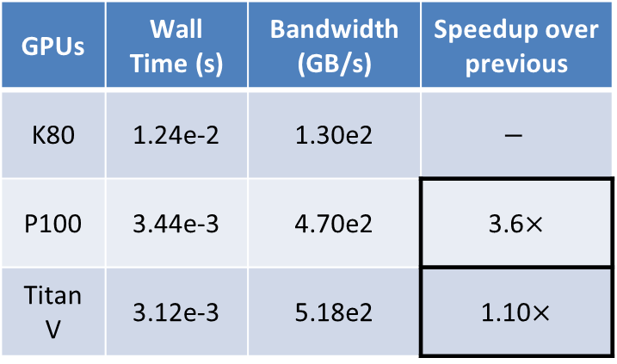
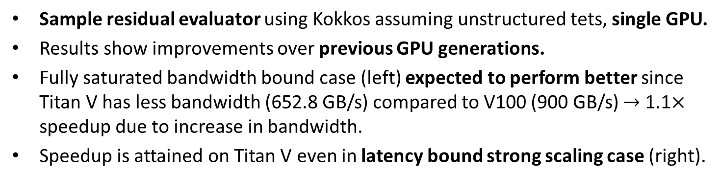
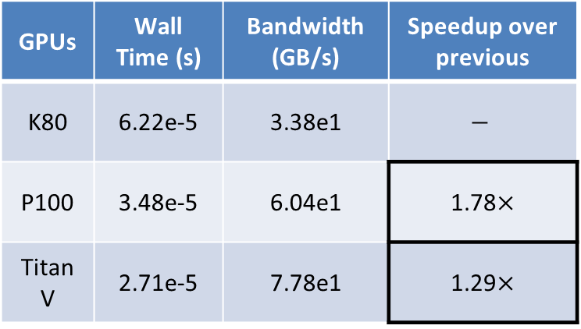
Preliminary Results on Volta GPU
1.51M Elements/GPU:
bandwidth bound case
1961 Elements/GPU (768 GPUs):
latency bound case
GPUs | Wall Time (s) | Bandwidth (GB/s) | Speedup over previous
K80 | 1.24e-2 | 1.30e2 | $$−$$
P100 | 3.44e-3 | 4.70e2 | 3.6$×$
Titan V | 3.12e-3 | 5.18e2 | 1.10$×$
GPUs | Wall Time (s) | Bandwidth (GB/s) | Speedup over previous
K80 | 6.22e-5 | 3.38e1 | $$−$$
P100 | 3.48e-5 | 6.04e1 | 1.78$×$
Titan V | 2.71e-5 | 7.78e1 | 1.29$×$
Sample residual evaluator using Kokkos assuming unstructured tets, single GPU.
Results show improvements over previous GPU generations.
Fully saturated bandwidth bound case (left) expected to perform better since Titan V has less bandwidth (652.8 GB/s) compared to V100 (900 GB/s) $→$ 1.1$×$ speedup due to increase in bandwidth.
Speedup is attained on Titan V even in latency bound strong scaling case (right).
Notes:
Ask Jerry re: details.
Right strong scaling -> less elements/GPU -> latency bound case
Left: want to be bandwidth bound, as strong scaling, will be latency bound -> do we get latency improvement due to how GPU is structured?
1.1x speedup due to increase in bandwidth
Bandwidth not fully saturated even for P100 -> not hitting max bandwidth for P100 or volta

Slide 30
Outline
Background
  Motivation
  ProSPect Project for Land-ice Modeling & Albany Land-Ice Solver
Performance-Portability of Finite Element Assembly via Kokkos
Performance Results
  Architecture Comparison
  Scaling Study
  Preliminary Results on Volta GPU
Summary & Future Work.

Slide 31
Summary & Future Work
Summary
Performance portability is achieved across a wide variety of HPC architectures using a single code base through Kokkos
  Multicore and manycore processors (POWER8, Haswell, KNL)
  NVIDIA GPUs (P100, Titan V)
We can use heterogeneous HPC architectures for climate research using Albany Land-Ice.
  Target: Cori (Haswell, KNL), Aurora (new Xeon Phi), Summit (POWER9+V100)
The open-source Albany multi-physics finite element code is available here:
  https://github.com/gahansen/Albany
Performance studies show that further optimization is needed to fully utilize resources
Future Work
Code optimizations for FEA:
  Introduction of hierarchical parallelism, GEMMS.
  Explicit vectorization on CPUs.
  Multiple CUDA instances on GPUs for better node utilization.
  Explicit data management to minimize memory transfers.
Performance portability for linear solvers is an ongoing research topic within Trilinos.

Slide 32










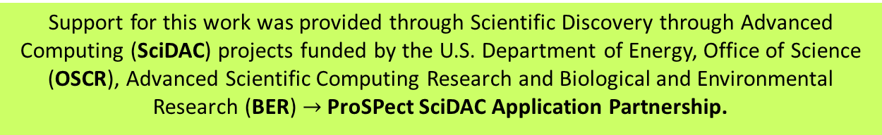
Funding/Acknowledgements
Support for this work was provided through Scientific Discovery through Advanced Computing (SciDAC) projects funded by the U.S. Department of Energy, Office of Science (OSCR), Advanced Scientific Computing Research and Biological and Environmental Research (BER) $→$ProSPect SciDAC Application Partnership.
ProSPect team members: K. Evans, M. Hoffman, C. Jackson, W. Lipscomb, M. Perego, S. Price, A. Salinger, I. Tezaur, R. Tuminaro, J. Bassis, G. Stadler, M. Eldred, J. Jakeman.
  Computing resources: NERSC, OLCF.

Slide 33
References
[1] M.A. Heroux et al. “An overview of the Trilinos project.” ACM Trans. Math. Softw. 31(3) (2005).
[2] A. Salinger, et al. "Albany: Using Agile Components to Develop a Flexible, Generic Multiphysics Analysis Code", Int. J. Multiscale Comput. Engng. 14(4) (2016) 415-438.
[3] I. Tezaur, M. Perego, A. Salinger, R. Tuminaro, S. Price. "Albany/FELIX: A Parallel, Scalable and Robust Finite Element Higher-Order Stokes Ice Sheet Solver Built for Advanced Analysis", Geosci. Model Develop. 8 (2015) 1-24.
[4] C. Edwards, C. Trott, D. Sunderland. “Kokkos: Enabling manycore performance portability through
polymorphic memory access patterns”, J. Par. & Distr. Comput. 74 (12) (2014) 3202-3216.
[5] I. Demeshko, J. Watkins, I. Tezaur, O. Guba, W. Spotz, A. Salinger, R. Pawlowski, M. Heroux. "Towards performance-portability of the Albany finite element analysis code using the Kokkos library", J. HPC Appl. (2018) 1-23.
[6] J. Watkins, I. Tezaur, I. Demeshko. "A study on the performance portability of the finite element assembly process within the Albany land ice solver", Lecture Notes in Computational Science and Engineering (accepted).
[7] S. Price, M. Hoffman, J. Bonin, T. Neumann, I. Howat, J. Guerber, I. Tezaur, J. Saba, J. Lanaerts, D. Chambers, W. Lipscomb, M. Perego, A. Salinger, R. Tuminaro. "An ice sheet model validation framework for the Greenland ice sheet", Geosci. Model Dev. 10 (2017) 255-270

Slide 34
Appendix: Parallelism on Modern Hardware
Year | Memory Access Time | Single Core Cycle Time
1980s | ~100 ns | ~100 ns
Today | ~50-100 ns | ~1 ns
Memory access time has remained the same.
Single core performance has improved but stagnated.
Computations are cheap, memory transfer is expensive.
More performance from multicore/manycore processors.

Slide 35
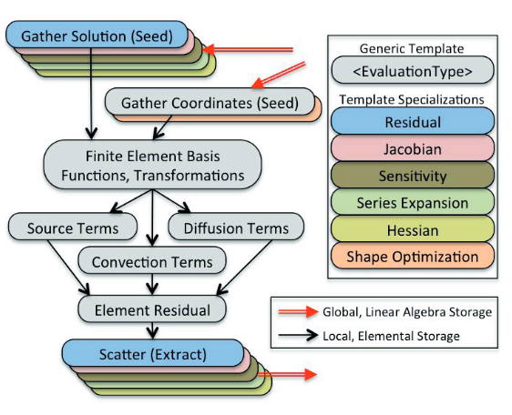
Appendix: Albany FEA
Gather operation extracts solution values out of global solution vector.
Physics evaluator functions operate on workset of elements, store evaluated quantities in local field arrays.
FEA relies on template based generic programming + automatic differentiation for Jacobians, tangents, etc.
Scatter operation adds local residual, Jacobian to global residual, Jacobian.
Performance-portability: focus on FEA.
MPI-only FEA:
  Each MPI process has workset of cells & computes nested parallel for loops.
MPI+X FEA:
  Each MPI process has workset of cells.
  Multi-dimensional parallelism with +X (X=OpenMP, CUDA) for nested parallel for loops.
Problem Type | % CPU time for FEA
Implicit | 50%
Explicit | 99%

Slide 36

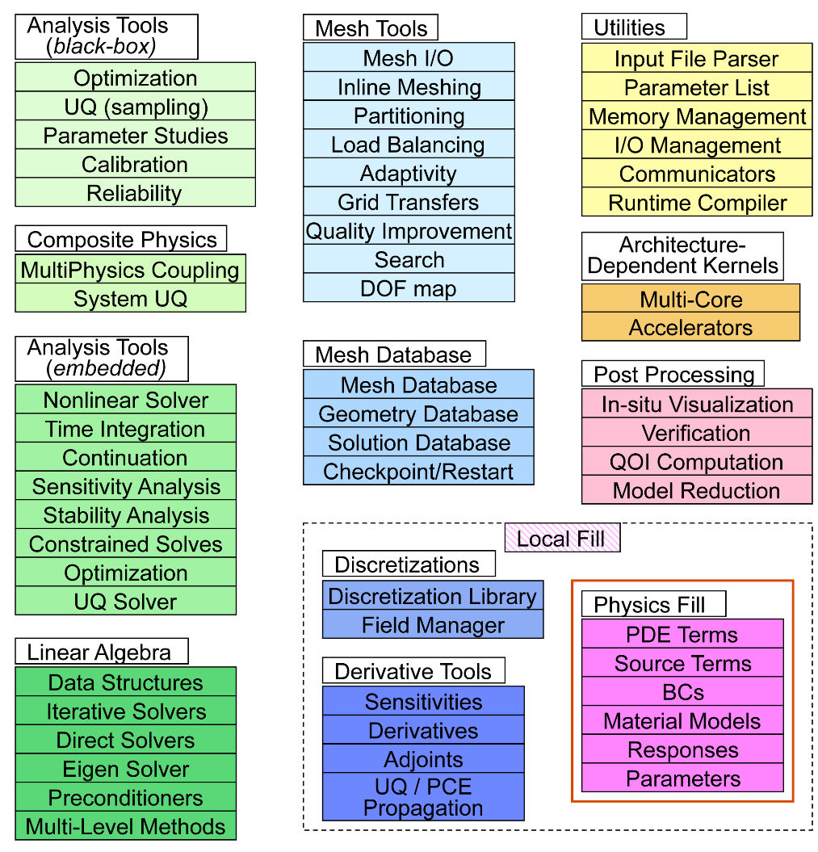
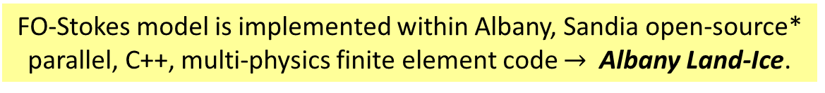
Appendix:
Multiphysics Code
FO-Stokes model is implemented within Albany, Sandia open-source* parallel, C++, multi-physics finite element code $→$ Albany Land-Ice.
Component-based design for rapid development of new physics & capabilities.
Extensive use of libraries from the open-source Trilinos project:
  Automatic differentiation.
  Discretizations/meshes, mesh adaptivity.
  Solvers, preconditioners.
  Performance-portable kernels.
Advanced analysis capabilities:
  Parameter estimation.
  Uncertainty quantification (DAKOTA).
  Optimization.
  Sensitivity analysis.
40+ packages; 120+ libraries
* https://github.com/gahansen/Albany.

Slide 37
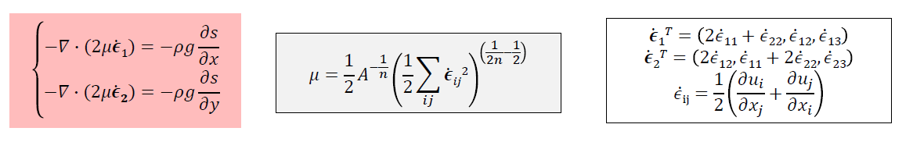
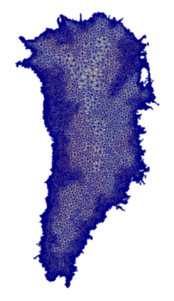
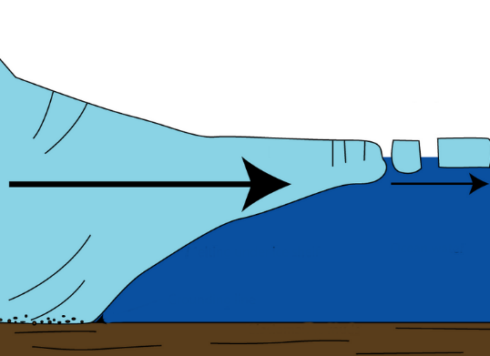
Appendix: First-Order (FO) Stokes Model
Ice velocities given by the “First-Order” Stokes PDEs with nonlinear viscosity:
Algorithmic choices for Albany Land-Ice:
3D unstructured grid FEM discretization.
Newton method nonlinear solver with automatic differentiation Jacobians.
Preconditioned Krylov iterative linear solvers.
Advanced analysis capabilities: deterministic inversion, calibration, UQ.
Implicit solver:
FEA** = 50% CPU-time
Linear solve = 50% CPU-time
Albany Land-Ice implemented in open-source* multi-physics FE Trilinos-based code:
Ice sheet
* https://github.com/gahansen/Albany. **Finite Element Assembly

Slide 38
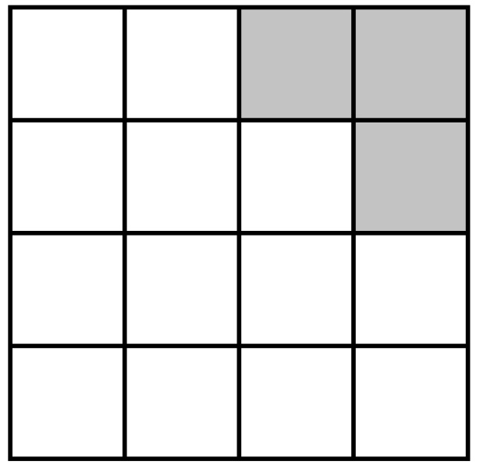
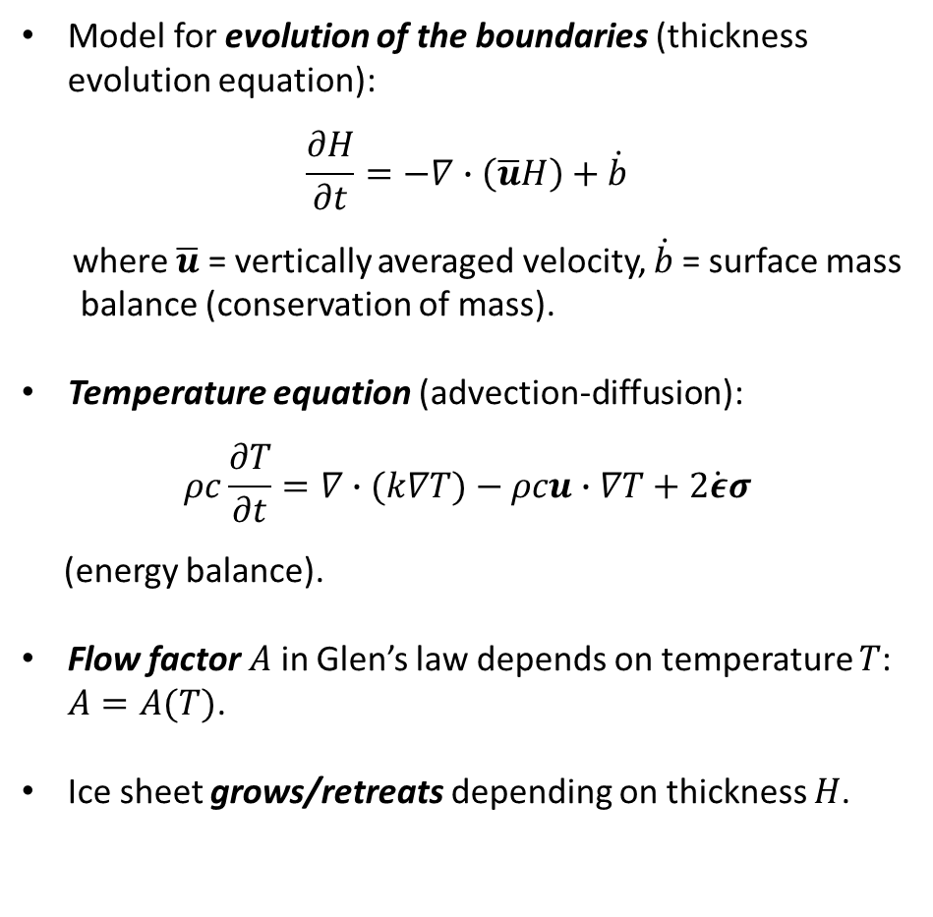
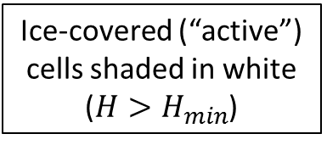
Appendix: Ice Sheet Dynamic Equations
Model for evolution of the boundaries (thickness evolution equation):
$$\frac{∂H}{∂t}=−∇∙\left(\overline{u}H\right)+\dot{b}$$
where $\overline{u}$ = vertically averaged velocity, $\dot{b}$= surface mass
balance (conservation of mass).
Temperature equation (advection-diffusion):
$$ρc\frac{∂T}{∂t}=∇∙(k∇T)−ρcu∙∇T+2\dot{ε}σ$$
(energy balance).
Flow factor $A$ in Glen’s law depends on temperature $T$: $A=A(T)$.
Ice sheet grows/retreats depending on thickness $H$.
Ice-covered (“active”) cells shaded in white
($H>H_{min}$)

Slide 39
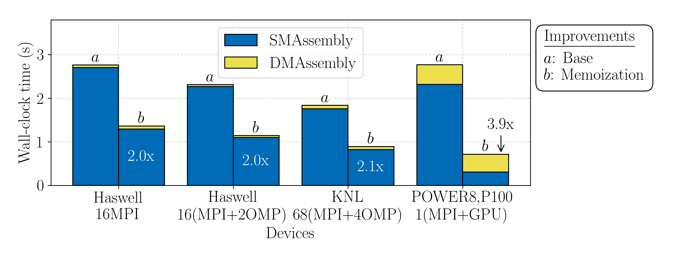

Appendix: Performance Improvements from Introduction of Memoizer
Approximately 2-4$×$ improvement on finite element assembly (FEA) using memorization.

Slide 40

Single GPU Profile (4km-20km GIS)
Profile includes shared memory local/global assembly (assembly & computation)
Wall-clock time dominated by Interpolation and ALI kernels
Future Work:
  Improve Interpolation and ALI kernels
  Begin profiling solver performance
ALI

