Slide 1
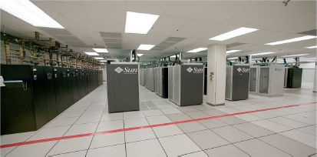
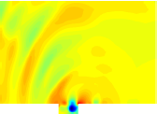
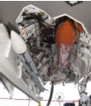
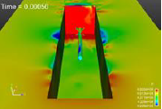
A minimal subspace rotation approach for obtaining stable & accurate low-order projection-based reduced order models for nonlinear compressible flow
I. Tezaur¹, M. Balajewicz²
¹ Quantitative Modeling & Analysis Department, Sandia National Laboratories
² Aerospace Engineering Department, University of Illinois Urbana-Champaign
ECCOMAS 2016 Crete, Greece June 6-10, 2016
SAND2016-4892C

Slide 2
Outline
Motivation
2. Projection-based model order reduction
3. Accounting for modal truncation
Traditional linear eddy-viscosity approach
New proposed approach via subspace rotation
Applications
High angle of attack laminar airfoil
Low Reynolds number channel driven cavity
Moderate Reynolds number channel driven cavity
Summary
6. Future work
7. References
SAND2016-4892C

Slide 3
Outline
Motivation
2. Projection-based model order reduction
3. Accounting for modal truncation
Traditional linear eddy-viscosity approach
New proposed approach via subspace rotation
Applications
High angle of attack laminar airfoil
Low Reynolds number channel driven cavity
Moderate Reynolds number channel driven cavity
Summary
6. Future work
7. References
SAND2016-4892C

Slide 4
Motivation
Targeted application: compressible fluid flow (e.g., captive-carry)
SAND2016-4892C

Slide 5
Motivation
Targeted application: compressible fluid flow (e.g., captive-carry)
Majority of fluid MOR approaches in the literature are for incompressible flow.
SAND2016-4892C

Slide 6
Motivation
Targeted application: compressible fluid flow (e.g., captive-carry)
Majority of fluid MOR approaches in the literature are for incompressible flow.
There has been some on MOR for compressible flows.
SAND2016-4892C

Slide 7
Motivation
Targeted application: compressible fluid flow (e.g., captive-carry)
Majority of fluid MOR approaches in the literature are for incompressible flow.
There has been some on MOR for compressible flows.
Energy-based inner products: Rowley et al., 2004 (isentropic); Barone et al., 2007 (linear); Serre et al., 2012 (linear); Kalashnikova et al., 2014 (nonlinear).
SAND2016-4892C

Slide 8
Motivation
Targeted application: compressible fluid flow (e.g., captive-carry)
Majority of fluid MOR approaches in the literature are for incompressible flow.
There has been some on MOR for compressible flows.
Energy-based inner products: Rowley et al., 2004 (isentropic); Barone et al., 2007 (linear); Serre et al., 2012 (linear); Kalashnikova et al., 2014 (nonlinear).
GNAT method/Petrov-Galerkin projection: Carlberg et al., 2014 (nonlinear).
SAND2016-4892C

Slide 9
Motivation
Targeted application: compressible fluid flow (e.g., captive-carry)
Majority of fluid MOR approaches in the literature are for incompressible flow.
There has been some on MOR for compressible flows.
Energy-based inner products: Rowley et al., 2004 (isentropic); Barone et al., 2007 (linear); Serre et al., 2012 (linear); Kalashnikova et al., 2014 (nonlinear).
GNAT method/Petrov-Galerkin projection: Carlberg et al., 2014 (nonlinear).
MOR for nonlinear, compressible fluid flows is still in its infancy!
SAND2016-4892C

Slide 10
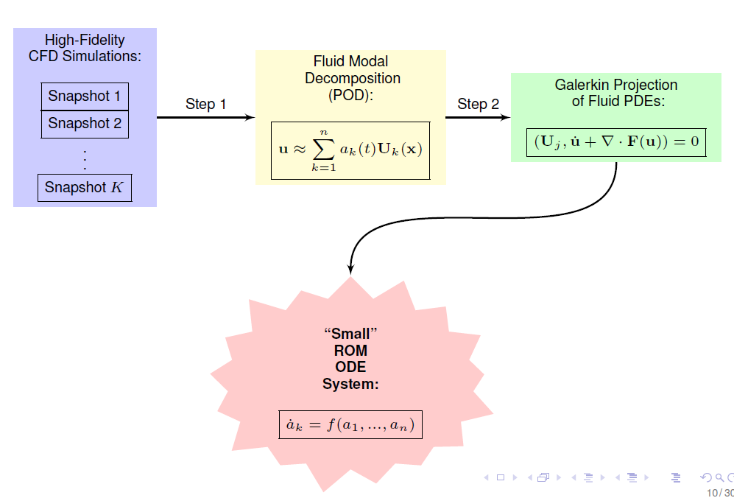
Projection-based model order reduction
Snapshot matrix: $X=(x^{1}$, …, $x^{K})$ $∈ℝ^{NxK}$
SVD: $X=UΣV^{T}$
Truncation: $U←(U_{1}, …, U_{n}$) $=U\left(:,1:n\right)$
$N =$ # of dofs in high-fidelity simulation
$K =$ # of snapshots
$n =$ # of dofs in ROM
($n << N$, $n << K$)
POD/Galerkin Method to Model Order Reduction
SAND2016-4892C
Notes:
Add equation numbers (1) and (2)!

Slide 11
Projection-based model order reduction
Governing equations
3D compressible Navier-Stokes equations in primitive specific volume form:
$$ζ_{,t}+ζ_{,j}u_{j}−ζu_{j,j}=0$$
$$u_{i,t}+u_{i,j}u_{j}+ζp_{,i}−\frac{1}{Re}ζτ_{ij,j}=0$$
$$p_{,t}+u_{j}p_{,j}+γu_{j,j}p−\left(\frac{γ}{PrRe}\right){\left(κ{\left(pζ\right)}_{,j}\right)}_{,j}−\left(\frac{γ−1}{Re}\right)u_{i,j}τ_{ij}=0$$
[PDEs]
(1)
SAND2016-4892C
Notes:
Add equation numbers (1) and (2)!

Slide 12
Projection-based model order reduction
Governing equations
3D compressible Navier-Stokes equations in primitive specific volume form:
$$ζ_{,t}+ζ_{,j}u_{j}−ζu_{j,j}=0$$
$$u_{i,t}+u_{i,j}u_{j}+ζp_{,i}−\frac{1}{Re}ζτ_{ij,j}=0$$
$$p_{,t}+u_{j}p_{,j}+γu_{j,j}p−\left(\frac{γ}{PrRe}\right){\left(κ{\left(pζ\right)}_{,j}\right)}_{,j}−\left(\frac{γ−1}{Re}\right)u_{i,j}τ_{ij}=0$$
[PDEs]
(1)
Spectral discretization $\left(q(x,t)≈\sum_{i=1}^{n}{a_{i}\left(t\right)U_{i}(x)}\right)+$Galerkin projection applied to (1) yields a system of $n$ coupled quadratic ODEs:
[ROM]
$$\frac{da}{dt}=C+La+\left[a^{T}Q^{(1)}a+a^{T}Q^{(2)}a+⋯+a^{T}Q^{(n)}a\right]T$$
(2)
where $C∈ℝ^{n}, L∈ℝ^{n×n}$ and $Q^{(i)}$ $∈ℝ^{n×n}$ for all $i=1,…,n.$
SAND2016-4892C
Notes:
Add equation numbers (1) and (2)!

Slide 13
Projection-based model order reduction
Summary of technical challenges
Projection-based MOR necessitates truncation.
SAND2016-4892C

Slide 14
Projection-based model order reduction
Summary of technical challenges
Projection-based MOR necessitates truncation.
POD is, by definition and design, biased towards the large, energy producing scales of the flow (i.e., modes with large POD eigenvalues).
SAND2016-4892C

Slide 15
Projection-based model order reduction
Summary of technical challenges
Projection-based MOR necessitates truncation.
POD is, by definition and design, biased towards the large, energy producing scales of the flow (i.e., modes with large POD eigenvalues).
Truncated/unresolved modes are negligible form a data compression point of view (i.e., small POD eigenvalues) but are crucial for the dynamical equations.
SAND2016-4892C

Slide 16
Projection-based model order reduction
Summary of technical challenges
Projection-based MOR necessitates truncation.
POD is, by definition and design, biased towards the large, energy producing scales of the flow (i.e., modes with large POD eigenvalues).
Truncated/unresolved modes are negligible form a data compression point of view (i.e., small POD eigenvalues) but are crucial for the dynamical equations.
For fluid flow applications, higher-order modes are associated with energy dissipation $⟹$ low-dimensional ROMs are often inaccurate and sometimes unstable.
SAND2016-4892C

Slide 17
Projection-based model order reduction
Summary of technical challenges
Projection-based MOR necessitates truncation.
POD is, by definition and design, biased towards the large, energy producing scales of the flow (i.e., modes with large POD eigenvalues).
Truncated/unresolved modes are negligible form a data compression point of view (i.e., small POD eigenvalues) but are crucial for the dynamical equations.
For fluid flow applications, higher-order modes are associated with energy dissipation $⟹$ low-dimensional ROMs are often inaccurate and sometimes unstable.
For a ROM to be stable and accurate, the truncated/unresolved subspace must be accounted for.
SAND2016-4892C

Slide 18
Projection-based model order reduction
Summary of technical challenges
Projection-based MOR necessitates truncation.
POD is, by definition and design, biased towards the large, energy producing scales of the flow (i.e., modes with large POD eigenvalues).
Truncated/unresolved modes are negligible form a data compression point of view (i.e., small POD eigenvalues) but are crucial for the dynamical equations.
For fluid flow applications, higher-order modes are associated with energy dissipation $⟹$ low-dimensional ROMs are often inaccurate and sometimes unstable.
For a ROM to be stable and accurate, the truncated/unresolved subspace must be accounted for.
Turbulence Modeling
(traditional approach)
Subspace Rotation
(our approach)
SAND2016-4892C

Slide 19
Outline
Motivation
2. Projection-based model order reduction
3. Accounting for modal truncation
Traditional linear eddy-viscosity approach
New proposed approach via subspace rotation
Applications
High angle of attack laminar airfoil
Low Reynolds number channel driven cavity
Moderate Reynolds number channel driven cavity
Summary
6. Future work
7. References
SAND2016-4892C

Slide 20
Outline
Motivation
2. Projection-based model order reduction
3. Accounting for modal truncation
Traditional linear eddy-viscosity approach
New proposed approach via subspace rotation
Applications
High angle of attack laminar airfoil
Low Reynolds number channel driven cavity
Moderate Reynolds number channel driven cavity
Summary
6. Future work
7. References
SAND2016-4892C

Slide 21
Accounting for modal truncation
Traditional linear eddy-viscosity approach
Dissipative dynamics of truncated higher-order modes are modeled using an additional linear term:
$$\frac{da}{dt}=C+La+\left[a^{T}Q^{\left(1\right)}a+a^{T}Q^{\left(2\right)}a+⋯+a^{T}Q^{\left(n\right)}a\right]T$$
SAND2016-4892C

Slide 22
Accounting for modal truncation
Traditional linear eddy-viscosity approach
Dissipative dynamics of truncated higher-order modes are modeled using an additional linear term:
$$\frac{da}{dt}=C+\left(L+L_{ν}\right)a+\left[a^{T}Q^{\left(1\right)}a+a^{T}Q^{\left(2\right)}a+⋯+a^{T}Q^{\left(n\right)}a\right]T$$
SAND2016-4892C

Slide 23
Accounting for modal truncation
Traditional linear eddy-viscosity approach
Dissipative dynamics of truncated higher-order modes are modeled using an additional linear term:
$$\frac{da}{dt}=C+\left(L+L_{ν}\right)a+\left[a^{T}Q^{\left(1\right)}a+a^{T}Q^{\left(2\right)}a+⋯+a^{T}Q^{\left(n\right)}a\right]T$$
$L_{ν }$is designed to decrease magnitude of positive eigenvalues and increase magnitude of negative eigenvalues of $L+L_{ν}$(for stability).
SAND2016-4892C

Slide 24
Accounting for modal truncation
Traditional linear eddy-viscosity approach
Dissipative dynamics of truncated higher-order modes are modeled using an additional linear term:
$$\frac{da}{dt}=C+\left(L+L_{ν}\right)a+\left[a^{T}Q^{\left(1\right)}a+a^{T}Q^{\left(2\right)}a+⋯+a^{T}Q^{\left(n\right)}a\right]T$$
$L_{ν }$is designed to decrease magnitude of positive eigenvalues and increase magnitude of negative eigenvalues of $L+L_{ν}$(for stability).
Disadvantages of this approach:
SAND2016-4892C

Slide 25
Accounting for modal truncation
Traditional linear eddy-viscosity approach
Dissipative dynamics of truncated higher-order modes are modeled using an additional linear term:
$$\frac{da}{dt}=C+\left(L+L_{ν}\right)a+\left[a^{T}Q^{\left(1\right)}a+a^{T}Q^{\left(2\right)}a+⋯+a^{T}Q^{\left(n\right)}a\right]T$$
$L_{ν }$is designed to decrease magnitude of positive eigenvalues and increase magnitude of negative eigenvalues of $L+L_{ν}$(for stability).
Disadvantages of this approach:
Additional term destroys consistency between ROM and Navier-Stokes equations.
SAND2016-4892C

Slide 26
Accounting for modal truncation
Traditional linear eddy-viscosity approach
Dissipative dynamics of truncated higher-order modes are modeled using an additional linear term:
$$\frac{da}{dt}=C+\left(L+L_{ν}\right)a+\left[a^{T}Q^{\left(1\right)}a+a^{T}Q^{\left(2\right)}a+⋯+a^{T}Q^{\left(n\right)}a\right]T$$
$L_{ν }$is designed to decrease magnitude of positive eigenvalues and increase magnitude of negative eigenvalues of $L+L_{ν}$(for stability).
Disadvantages of this approach:
Additional term destroys consistency between ROM and Navier-Stokes equations.
Calibration is necessary to derive optimal $L_{ν }$and optimal value is flow dependent.
SAND2016-4892C

Slide 27
Accounting for modal truncation
Traditional linear eddy-viscosity approach
Dissipative dynamics of truncated higher-order modes are modeled using an additional linear term:
$$\frac{da}{dt}=C+\left(L+L_{ν}\right)a+\left[a^{T}Q^{\left(1\right)}a+a^{T}Q^{\left(2\right)}a+⋯+a^{T}Q^{\left(n\right)}a\right]T$$
$L_{ν }$is designed to decrease magnitude of positive eigenvalues and increase magnitude of negative eigenvalues of $L+L_{ν}$(for stability).
Disadvantages of this approach:
Additional term destroys consistency between ROM and Navier-Stokes equations.
Calibration is necessary to derive optimal $L_{ν }$and optimal value is flow dependent.
Inherently a linear model $→$cannot be expected to perform well for all classes of problems (e.g., nonlinear).
SAND2016-4892C

Slide 28
Outline
Motivation
2. Projection-based model order reduction
3. Accounting for modal truncation
Traditional linear eddy-viscosity approach
New proposed approach via subspace rotation
Applications
High angle of attack laminar airfoil
Low Reynolds number channel driven cavity
Moderate Reynolds number channel driven cavity
Summary
6. Future work
7. References
SAND2016-4892C

Slide 29
Accounting for modal truncation
Proposed new approach
Instead of modeling truncation via additional linear term, model the truncation a priori by “rotating” the projection subspace into a more dissipative regime
SAND2016-4892C

Slide 30
Accounting for modal truncation
Proposed new approach
Instead of modeling truncation via additional linear term, model the truncation a priori by “rotating” the projection subspace into a more dissipative regime
Illustrative example
Standard approach: retain only the most energetic POD modes, i.e., $U_{1},U_{2}$, $U_{3}$, $U_{4},…$
Proposed approach: choose some higher order basis modes to increase dissipation, i.e., $U_{1},U_{2}$, $U_{6}$, $U_{8},…$
SAND2016-4892C

Slide 31
Accounting for modal truncation
Proposed new approach
Instead of modeling truncation via additional linear term, model the truncation a priori by “rotating” the projection subspace into a more dissipative regime
Illustrative example
Standard approach: retain only the most energetic POD modes, i.e., $U_{1},U_{2}$, $U_{3}$, $U_{4},…$
Proposed approach: choose some higher order basis modes to increase dissipation, i.e., $U_{1},U_{2}$, $U_{6}$, $U_{8},…$
More generally: approximate the solution using a linear superposition of $n+p$ (with $p>0$) most energetic modes:
${\tilde{U}}_{i}=\sum_{j=1}^{n+p}{X_{ij}}U_{j}$, $i=1,…,n,$
(3)
where $X∈ℝ^{\left(n+p\right)×n}$is an orthonormal ($X^{T}X=I_{n×n}$) “rotation” matrix.
SAND2016-4892C

Slide 32
Accounting for modal truncation
Goals of proposed new approach
Find $X$ such that:
New modes $\tilde{U}$ remain good approximations of the flow.
2. New modes produce stable and accurate ROMs.
SAND2016-4892C

Slide 33
Accounting for modal truncation
Goals of proposed new approach
Find $X$ such that:
New modes $\tilde{U}$ remain good approximations of the flow.
2. New modes produce stable and accurate ROMs.
We formulate and solve a constrained optimization problem for $X$:
$${minimize}_{X∈𝒱_{\left(n+p\right),n}} f(X)$$
$$subject to g\left(X,L\right)=0$$
where$𝒱_{\left(n+p\right),n}∈\left\{X∈ℝ^{\left(n+p\right)×n}:X^{T}X=I_{n}, p>0\right\}$ is the Stiefel manifold.
SAND2016-4892C

Slide 34
Accounting for modal truncation
Goals of proposed new approach
Find $X$ such that:
New modes $\tilde{U}$ remain good approximations of the flow.
2. New modes produce stable and accurate ROMs.
We formulate and solve a constrained optimization problem for $X$:
$${minimize}_{X∈𝒱_{\left(n+p\right),n}} f(X)$$
$$subject to g\left(X,L\right)=0$$
where$𝒱_{\left(n+p\right),n}∈\left\{X∈ℝ^{\left(n+p\right)×n}:X^{T}X=I_{n}, p>0\right\}$ is the Stiefel manifold.
Once $X$ is found, the result is a system of the form (2) with:
$Q_{}^{(i)}jk$ $←\sum_{s,q,r=1}^{n+p}{X_{si}Q_{}^{(s)}qr}X_{qr}X_{rk}, L$ $←X^{T}LX$, $C$ $←X^{T}C^{∗}$
SAND2016-4892C

Slide 35
Accounting for modal truncation
Objective function
$${minimize}_{X∈𝒱_{\left(n+p\right),n}} f(X)$$
$$subject to g\left(X,L\right)=0$$
(5)
We have considered two objectives $f(X)$ in (5):
SAND2016-4892C

Slide 36
Accounting for modal truncation
Objective function
$${minimize}_{X∈𝒱_{\left(n+p\right),n}} f(X)$$
$$subject to g\left(X,L\right)=0$$
(5)
We have considered two objectives $f(X)$ in (5):
Minimize subspace rotation
$$f\left(X\right)= \left\|X−I_{\left(n+p\right),n}\right\|F= −tr\left(X^{T}I_{\left(n+p\right)×n}\right)$$
(6)
SAND2016-4892C

Slide 37
Accounting for modal truncation
Objective function
$${minimize}_{X∈𝒱_{\left(n+p\right),n}} f(X)$$
$$subject to g\left(X,L\right)=0$$
(5)
We have considered two objectives $f(X)$ in (5):
Minimize subspace rotation
$$f\left(X\right)= \left\|X−I_{\left(n+p\right),n}\right\|F= −tr\left(X^{T}I_{\left(n+p\right)×n}\right)$$
(6)
Maximize resolved turbulent kinetic energy (TKE)
$$f\left(X\right)=−|\left|Σ−XXTΣ\right||F$$
(7)
SAND2016-4892C

Slide 38
Accounting for modal truncation
Objective function
$${minimize}_{X∈𝒱_{\left(n+p\right),n}} f(X)$$
$$subject to g\left(X,L\right)=0$$
(5)
We have considered two objectives $f(X)$ in (5):
Minimize subspace rotation
$$f\left(X\right)= \left\|X−I_{\left(n+p\right),n}\right\|F= −tr\left(X^{T}I_{\left(n+p\right)×n}\right)$$
(6)
Maximize resolved turbulent kinetic energy (TKE)
$$f\left(X\right)=−|\left|Σ−XXTΣ\right||F$$
(7)
TKE objective (7) comes from earlier work (Balajewicz et al., 2013) involving stabilization of incompressible flow ROMs
POD modes associated with low KE are important dynamically even though they contribute little to overall energy of the fluid flow.
SAND2016-4892C

Slide 39
Accounting for modal truncation
Objective function
$${minimize}_{X∈𝒱_{\left(n+p\right),n}} f(X)$$
$$subject to g\left(X,L\right)=0$$
(5)
We have considered two objectives $f(X)$ in (5):
Minimize subspace rotation
$$f\left(X\right)= \left\|X−I_{\left(n+p\right),n}\right\|F= −tr\left(X^{T}I_{\left(n+p\right)×n}\right)$$
(6)
Maximize resolved turbulent kinetic energy (TKE)
$$f\left(X\right)=−|\left|Σ−XXTΣ\right||F$$
(7)
Numerical experiments reveal objective (6) produces better results than objective (7) for compressible flow.
SAND2016-4892C

Slide 40
Accounting for modal truncation
Constraint
$${minimize}_{X∈𝒱_{\left(n+p\right),n}} f(X)$$
$$subject to g\left(X,L\right)=0$$
(5)
We use the traditional linear eddy-viscosity closure model ansatz for the constraint $g(X,L)=0$ in (5):
$$g\left(X,L\right)=tr\left(X^{T}LX\right)−η$$
(8)
SAND2016-4892C

Slide 41
Accounting for modal truncation
Constraint
$${minimize}_{X∈𝒱_{\left(n+p\right),n}} f(X)$$
$$subject to g\left(X,L\right)=0$$
(5)
We use the traditional linear eddy-viscosity closure model ansatz for the constraint $g(X,L)=0$ in (5):
$$g\left(X,L\right)=tr\left(X^{T}LX\right)−η$$
(8)
Specifically, constraint (8) involves overall balance between linear energy production and dissipation.
$η =$ proxy for the balance between linear energy production and energy dissipation.
SAND2016-4892C

Slide 42
Accounting for modal truncation
Constraint
$${minimize}_{X∈𝒱_{\left(n+p\right),n}} f(X)$$
$$subject to g\left(X,L\right)=0$$
(5)
We use the traditional linear eddy-viscosity closure model ansatz for the constraint $g(X,L)=0$ in (5):
$$g\left(X,L\right)=tr\left(X^{T}LX\right)−η$$
(8)
Specifically, constraint (8) involves overall balance between linear energy production and dissipation.
$η =$ proxy for the balance between linear energy production and energy dissipation.
Constraint comes from property that averaged total power ($=tr(X^{T}LX)$ $+$ energy transfer) has to vanish.
SAND2016-4892C

Slide 43
Accounting for modal truncation
Minimal subspace rotation: trace minimization on Stiefel manifold
$${minimize}_{X∈𝒱_{\left(n+p\right),n}} −tr\left(X^{T}I_{\left(n+p\right)×n}\right)$$
$$subject to tr\left(X^{T}LX\right)=η$$
(9)
$η∈ℝ$: proxy for the balance between linear energy production and energy dissipation (calculated iteratively using modal energy).
$𝒱_{\left(n+p\right),n}∈\left\{X∈ℝ^{\left(n+p\right)×n}:X^{T}X=I_{n}, p>0\right\}$ is the Stiefel manifold.
Equation (9) is solved efficiently offline using the method of Lagrange multipliers (Manopt MATLAB toolbox).
See (Balajewicz, Tezaur, Dowell, 2016) and Appendix slide for Algorithm.
SAND2016-4892C

Slide 44
Accounting for modal truncation
Remarks
Proposed approach may be interpreted as an a priori consistent formulation of the eddy-viscosity turbulence modeling approach.
SAND2016-4892C

Slide 45
Accounting for modal truncation
Remarks
Proposed approach may be interpreted as an a priori consistent formulation of the eddy-viscosity turbulence modeling approach.
Advantages of proposed approach:
SAND2016-4892C

Slide 46
Accounting for modal truncation
Remarks
Proposed approach may be interpreted as an a priori consistent formulation of the eddy-viscosity turbulence modeling approach.
Advantages of proposed approach:
Retains consistency between ROM and Navier-Stokes equations $→$ no additional turbulence terms required.
SAND2016-4892C

Slide 47
Accounting for modal truncation
Remarks
Proposed approach may be interpreted as an a priori consistent formulation of the eddy-viscosity turbulence modeling approach.
Advantages of proposed approach:
Retains consistency between ROM and Navier-Stokes equations $→$ no additional turbulence terms required.
Inherently a nonlinear model $→$ should be expected to outperform linear models.
SAND2016-4892C

Slide 48
Accounting for modal truncation
Remarks
Proposed approach may be interpreted as an a priori consistent formulation of the eddy-viscosity turbulence modeling approach.
Advantages of proposed approach:
Retains consistency between ROM and Navier-Stokes equations $→$ no additional turbulence terms required.
Inherently a nonlinear model $→$ should be expected to outperform linear models.
Works with any basis and Petrov-Galerkin projection.
SAND2016-4892C

Slide 49
Accounting for modal truncation
Remarks
Proposed approach may be interpreted as an a priori consistent formulation of the eddy-viscosity turbulence modeling approach.
Advantages of proposed approach:
Retains consistency between ROM and Navier-Stokes equations $→$ no additional turbulence terms required.
Inherently a nonlinear model $→$ should be expected to outperform linear models.
Works with any basis and Petrov-Galerkin projection.
Disadvantages of proposed approach:
SAND2016-4892C

Slide 50
Accounting for modal truncation
Remarks
Proposed approach may be interpreted as an a priori consistent formulation of the eddy-viscosity turbulence modeling approach.
Advantages of proposed approach:
Retains consistency between ROM and Navier-Stokes equations $→$ no additional turbulence terms required.
Inherently a nonlinear model $→$ should be expected to outperform linear models.
Works with any basis and Petrov-Galerkin projection.
Disadvantages of proposed approach:
Off-line calibration of free parameter $η$ is required.
SAND2016-4892C

Slide 51
Accounting for modal truncation
Remarks
Proposed approach may be interpreted as an a priori consistent formulation of the eddy-viscosity turbulence modeling approach.
Advantages of proposed approach:
Retains consistency between ROM and Navier-Stokes equations $→$ no additional turbulence terms required.
Inherently a nonlinear model $→$ should be expected to outperform linear models.
Works with any basis and Petrov-Galerkin projection.
Disadvantages of proposed approach:
Off-line calibration of free parameter $η$ is required.
Stability cannot be proven like for incompressible case.
SAND2016-4892C

Slide 52
Outline
Motivation
2. Projection-based model order reduction
3. Accounting for modal truncation
Traditional linear eddy-viscosity approach
New proposed approach via subspace rotation
Applications
High angle of attack laminar airfoil
Low Reynolds number channel driven cavity
Moderate Reynolds number channel driven cavity
Summary
6. Future work
7. References
SAND2016-4892C

Slide 53
Outline
Motivation
2. Projection-based model order reduction
3. Accounting for modal truncation
Traditional linear eddy-viscosity approach
New proposed approach via subspace rotation
Applications
High angle of attack laminar airfoil
Low Reynolds number channel driven cavity
Moderate Reynolds number channel driven cavity
Summary
6. Future work
7. References
SAND2016-4892C

Slide 54
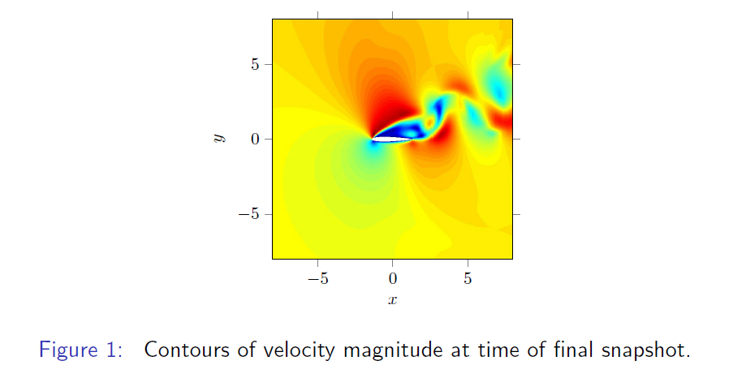
Applications
High angle of attack laminar airfoil
2D flow around an inclined NACA0012 airfoil at Mach 0.7,
Re = 500, Pr = 0.72, AOA = 20° $⟹$ $n=4$ ROM (86% snapshot energy).
Figure 1: Contours of velocity magnitude at time of final snapshot.
SAND2016-4892C

Slide 55
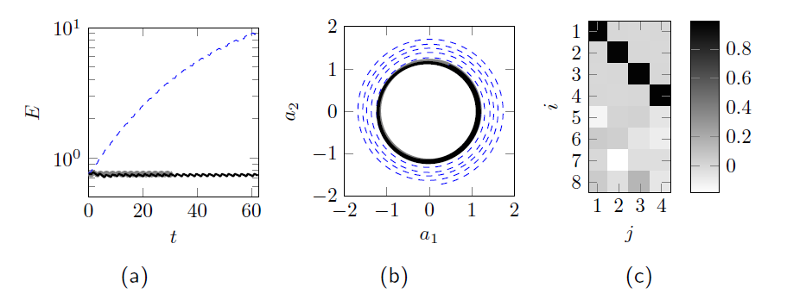
Applications
High angle of attack laminar airfoil
Minimizing subspace rotation:
$$f\left(X\right)= \left\|X−I_{\left(n+p\right),n}\right\|F= −tr\left(X^{T}I_{\left(n+p\right)×n}\right)$$
-- standard ROM (n=4)
$−$stabilized ROM (n=p=4)
$−$DNS
Figure 2: (a) evolution of modal energy, (b) phase plot of first and second temporal basis $a1(t)$ and $a2(t)$, (c) illustration of stabilizing rotation showing that rotation is small: $\frac{\left\|X−I_{\left(n+p\right),n}\right\|F}{n}=0.083, X≈I_{\left(n+p\right),n}$
SAND2016-4892C

Slide 56
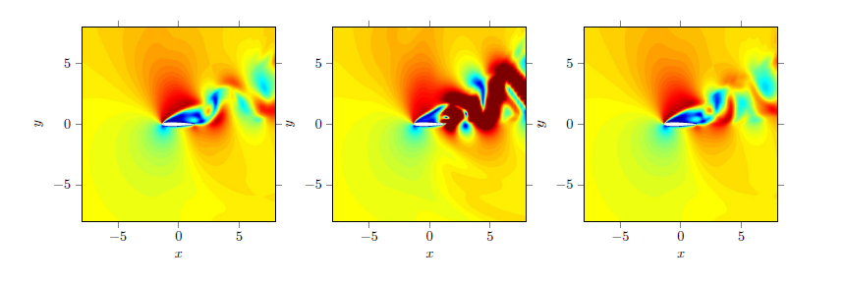
Applications
High angle of attack laminar airfoil
Minimizing subspace rotation:
$$f\left(X\right)= \left\|X−I_{\left(n+p\right),n}\right\|F= −tr\left(X^{T}I_{\left(n+p\right)×n}\right)$$
Standard ROM ($n=4$)
Stabilized ROM ($n=p=4$)
DNS
Figure 3: High angle of attack laminar airfoil contours of velocity magnitude at time of final snapshot.
SAND2016-4892C

Slide 57
Outline
Motivation
2. Projection-based model order reduction
3. Accounting for modal truncation
Traditional linear eddy-viscosity approach
New proposed approach via subspace rotation
Applications
High angle of attack laminar airfoil
Low Reynolds number channel driven cavity
Moderate Reynolds number channel driven cavity
Summary
6. Future work
7. References
SAND2016-4892C

Slide 58
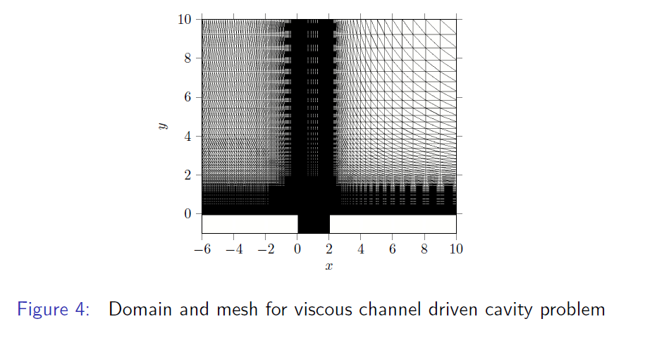
Applications
Channel driven cavity: low Reynolds number case
Flow over square cavity at Mach 0.6, Re = 1453.9, Pr = 0.72 $⇒n=4$ ROM (91% snapshot energy).
Figure 4: Domain and mesh for viscous channel driven cavity problem.
SAND2016-4892C

Slide 59
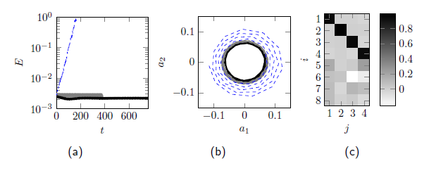
Applications
Channel driven cavity: low Reynolds number case
Minimizing subspace rotation:
$$f\left(X\right)= \left\|X−I_{\left(n+p\right),n}\right\|F= −tr\left(X^{T}I_{\left(n+p\right)×n}\right)$$
-- standard ROM (n=4)
$−$stabilized ROM (n=p=4)
$−$DNS
Figure 5: (a) evolution of modal energy, (b) phase plot of first and second temporal basis $a1(t)$ and $a2(t)$, (c) illustration of stabilizing rotation showing that rotation is small: $\frac{\left\|X−I_{\left(n+p\right),n}\right\|F}{n}=0.188, X≈I_{\left(n+p\right),n}$
SAND2016-4892C

Slide 60
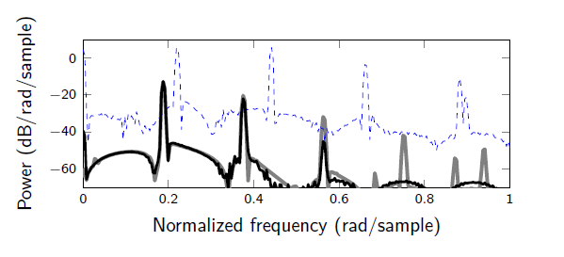
Applications
Channel driven cavity: low Reynolds number case
Minimizing subspace rotation:
$$f\left(X\right)= \left\|X−I_{\left(n+p\right),n}\right\|F= −tr\left(X^{T}I_{\left(n+p\right)×n}\right)$$
-- standard ROM (n=4)
$−$stabilized ROM (n=p=4)
$−$DNS
Figure 6: Pressure power spectral density (PSD) at location $x=(2,−1)$; stabilized ROM minimizes subspace rotation.
SAND2016-4892C

Slide 61
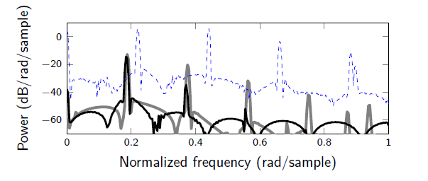
Applications
Channel driven cavity: low Reynolds number case
Maximizing resolved TKE:
$$f\left(X\right)=−|\left|Σ−XXTΣ\right||F$$
-- standard ROM (n=4)
$−$stabilized ROM (n=p=4)
$−$DNS
Figure 7: Pressure power spectral density (PSD) at location $x=(2,−1)$; stabilized ROM maximizes resolved TKE.
SAND2016-4892C

Slide 62
Applications
Channel driven cavity: low Reynolds number case
Minimizing subspace rotation:
$$f\left(X\right)= \left\|X−I_{\left(n+p\right),n}\right\|F= −tr\left(X^{T}I_{\left(n+p\right)×n}\right)$$
Standard ROM ($n=4$)
Stabilized ROM ($n=p=4$)
DNS
Figure 8: Channel driven cavity Re $≈$ 1500 contours of $u$-velocity at time of final snapshot.
SAND2016-4892C

Slide 63
Outline
Motivation
2. Projection-based model order reduction
3. Accounting for modal truncation
Traditional linear eddy-viscosity approach
New proposed approach via subspace rotation
Applications
High angle of attack laminar airfoil
Low Reynolds number channel driven cavity
Moderate Reynolds number channel driven cavity
Summary
6. Future work
7. References
SAND2016-4892C

Slide 64
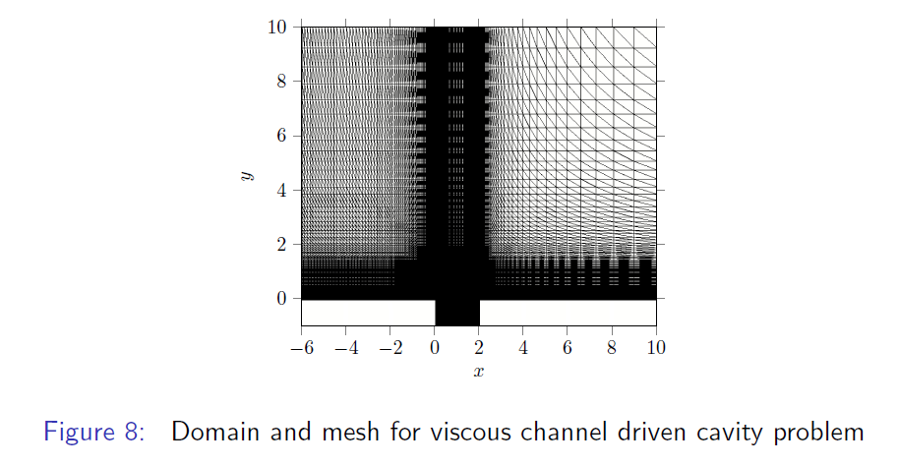
Applications
Channel driven cavity: moderate Reynolds number case
Flow over square cavity at Mach 0.6, Re = 5452.1, Pr = 0.72 $⇒n=20$ ROM (71.8% snapshot energy).
Figure 9: Domain and mesh for viscous channel driven cavity problem.
SAND2016-4892C

Slide 65
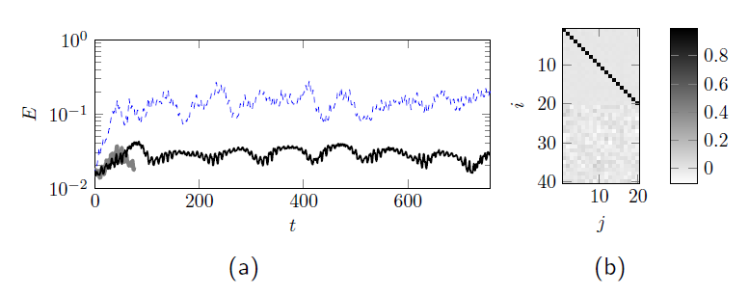
Applications
Channel driven cavity: moderate Reynolds number case
Minimizing subspace rotation:
$$f\left(X\right)= \left\|X−I_{\left(n+p\right),n}\right\|F= −tr\left(X^{T}I_{\left(n+p\right)×n}\right)$$
-- standard ROM (n=20)
$−$stabilized ROM (n=p=20)
$−$DNS
Figure 10: (a) evolution of modal energy, (b) illustration of stabilizing rotation showing that rotation is small: $\frac{\left\|X−I_{\left(n+p\right),n}\right\|F}{n}=0.038, X≈I_{\left(n+p\right),n}$
SAND2016-4892C

Slide 66
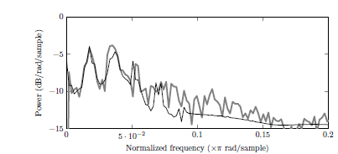
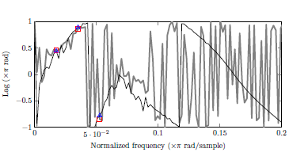
Applications
Channel driven cavity: moderate Reynolds number case
Minimizing subspace rotation:
$−$stabilized ROM (n=p=20)
$−$DNS
$$f\left(X\right)= \left\|X−I_{\left(n+p\right),n}\right\|F= −tr\left(X^{T}I_{\left(n+p\right)×n}\right)$$
Figure 11: Pressure cross PSD of of $p(x1,t)$ and $p(x2,t)$ where $x1=\left(2,−0.5\right),$ $x2=(0,−0.5)$
Power and phase lag at fundamental frequency, and first two super harmonics are predicted accurately using the fine-tuned ROM ($∆ =$ stabilized ROM, $=$DNS)
SAND2016-4892C

Slide 67
Applications
Channel driven cavity: moderate Reynolds number case
Minimizing subspace rotation:
$$f\left(X\right)= \left\|X−I_{\left(n+p\right),n}\right\|F= −tr\left(X^{T}I_{\left(n+p\right)×n}\right)$$
Standard ROM ($n=20$)
Stabilized ROM ($n=p=$20)
DNS
Figure 12: Channel driven cavity Re $≈$ 5500 contours of $u$-velocity at time of final snapshot.
SAND2016-4892C

Slide 68
Applications
CPU times (CPU-hours) for offline and online computations*
Procedure | Airfoil | Low Re Cavity | Moderate Re Cavity
FOM # of DOF | 360,000 | 288,250 | 243,750
Time-integration of FOM | 7.8 hrs | 72 hrs | 179 hrs
Basis construction (size $n+p$ ROM) | 0.16 hrs | 0.88 hrs | 3.44 hrs
Galerkin projection (size $n+p$ ROM) | 0.74 hrs | 5.44 hrs | 14.8 hrs
Stabilization | 28 sec | 14 sec | 170 sec
ROM # of DOF | 4 | 4 | 20
Time-integration of ROM | 0.31 sec | 0.16 sec | 0.83 sec
Online computational speed-up | 9.1e4 | 1.6e6 | 7.8e5
offline
online
* For minimizing subspace rotation.
SAND2016-4892C

Slide 69
Applications
CPU times (CPU-hours) for offline and online computations*
Procedure | Airfoil | Low Re Cavity | Moderate Re Cavity
FOM # of DOF | 360,000 | 288,250 | 243,750
Time-integration of FOM | 7.8 hrs | 72 hrs | 179 hrs
Basis construction (size $n+p$ ROM) | 0.16 hrs | 0.88 hrs | 3.44 hrs
Galerkin projection (size $n+p$ ROM) | 0.74 hrs | 5.44 hrs | 14.8 hrs
Stabilization | 28 sec | 14 sec | 170 sec
ROM # of DOF | 4 | 4 | 20
Time-integration of ROM | 0.31 sec | 0.16 sec | 0.83 sec
Online computational speed-up | 9.1e4 | 1.6e6 | 7.8e5
offline
online
Stabilization is fast ($O$(sec) or $O$(min)).
* For minimizing subspace rotation.
SAND2016-4892C

Slide 70
Applications
CPU times (CPU-hours) for offline and online computations*
Procedure | Airfoil | Low Re Cavity | Moderate Re Cavity
FOM # of DOF | 360,000 | 288,250 | 243,750
Time-integration of FOM | 7.8 hrs | 72 hrs | 179 hrs
Basis construction (size $n+p$ ROM) | 0.16 hrs | 0.88 hrs | 3.44 hrs
Galerkin projection (size $n+p$ ROM) | 0.74 hrs | 5.44 hrs | 14.8 hrs
Stabilization | 28 sec | 14 sec | 170 sec
ROM # of DOF | 4 | 4 | 20
Time-integration of ROM | 0.31 sec | 0.16 sec | 0.83 sec
Online computational speed-up | 9.1e4 | 1.6e6 | 7.8e5
offline
online
Stabilization is fast ($O$(sec) or $O$(min)).
Significant online computational speed-up!
* For minimizing subspace rotation.
SAND2016-4892C

Slide 71
Outline
Motivation
2. Projection-based model order reduction
3. Accounting for modal truncation
Traditional linear eddy-viscosity approach
New proposed approach via subspace rotation
Applications
High angle of attack laminar airfoil
Low Reynolds number channel driven cavity
Moderate Reynolds number channel driven cavity
Summary
6. Future work
7. References
SAND2016-4892C

Slide 72
Summary
We have developed a non-intrusive approach for stabilizing and fine-tuning projection-based ROMs for compressible flows.
The standard POD modes are “rotated” into a more dissipative regime to account for the dynamics in the higher order modes truncated by the standard POD method.
The new approach is consistent and does not require the addition of empirical turbulence model terms unlike traditional approaches.
Mathematically, the approach is formulated as a quadratic matrix program on the Stiefel manifold.
The constrained minimization problem is solved offline and small enough to be solved in MATLAB.
The method is demonstrated on several compressible flow problems and shown to deliver stable and accurate ROMs.
SAND2016-4892C

Slide 73
Outline
Motivation
2. Projection-based model order reduction
3. Accounting for modal truncation
Traditional linear eddy-viscosity approach
New proposed approach via subspace rotation
Applications
High angle of attack laminar airfoil
Low Reynolds number channel driven cavity
Moderate Reynolds number channel driven cavity
Summary
6. Future work
7. References
SAND2016-4892C

Slide 74
Future work
Application to higher Reynolds number problems.
Extension of the proposed approach to problems with generic nonlinearities, where the ROM involves some form of hyper-reduction (e.g., DEIM, gappy POD).
Extension of the method to minimal-residual-based nonlinear ROMs.
Extension of the method to predictive applications, e.g., problems with varying Reynolds number and/or Mach number.
Selecting different goal-oriented objectives and constraints in our optimization problem:
$${minimize}_{X∈𝒱_{\left(n+p\right),n}} f(X)$$
$$subject to g(X,L)=0$$
e.g.,
Maximize parametric robustness: $f=\sum_{i=1}^{k}{β_{i}\left\|U^{∗}\left(μ_{i}\right)X−U^{∗}\left(μ_{i}\right)\right\|}F$.
ODE constraints: $g= \left\|a\left(t\right)−a^{∗}(t)\right\|.$
SAND2016-4892C

Slide 75
Outline
Motivation
2. Projection-based model order reduction
3. Accounting for modal truncation
Traditional linear eddy-viscosity approach
New proposed approach via subspace rotation
Applications
High angle of attack laminar airfoil
Low Reynolds number channel driven cavity
Moderate Reynolds number channel driven cavity
Summary
6. Future work
7. References
SAND2016-4892C

Slide 76
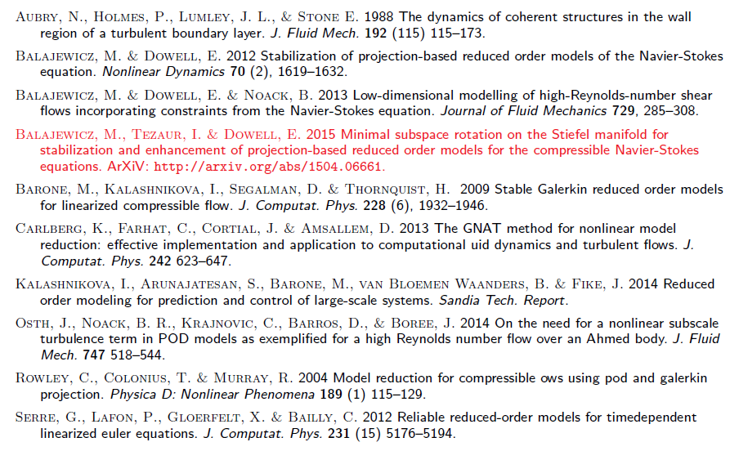
References
SAND2016-4892C

Slide 77
Outline
Motivation
2. Projection-based model order reduction
3. Accounting for modal truncation
Traditional linear eddy-viscosity approach
New proposed approach via subspace rotation
4. Applications
Low Reynolds number channel driven cavity
Moderate Reynolds number channel driven cavity
Summary
6. Future work
7. References
8. Appendix
SAND2016-4892C

Slide 78
Appendix: Accounting for modal truncation
Stabilization algorithm: returns stabilizing rotation matrix $X$.
SAND2016-4892C

