Slide 1
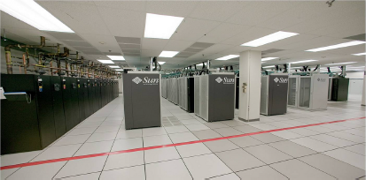
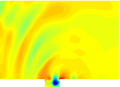
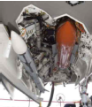
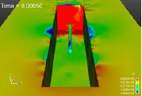
Proper Orthogonal Decomposition (POD) Closure Models for Turbulent Flows
Irina K. Tezaur
Extreme Scale Data Science & Analytics Department, Sandia National Laboratories, Livermore CA
Data Science Reading Group Seminar
Thursday, May 18, 2017
Sandia National Laboratories is a multi-mission laboratory managed and operated by National Technology and Engineering Solutions of Sandia, LLC., a wholly owned subsidiary of Honeywell International, Inc., for the U.S. Department of Energy’s National Nuclear Security Administration under contract DE-NA0003525.
SAND2017-5377 PE

Slide 2
Paper

Slide 3
Paper
My interest in this work:

Slide 4
Paper
My interest in this work:
  I am interested in stable POD-Galerkin ROMs for fluid problems (next slides).

Slide 5
Paper
My interest in this work:
  I am interested in stable POD-Galerkin ROMs for fluid problems (next slides).
  Authors of this paper have similar requirements for ROMs as me: use ROMs for long-time integration, “extreme model reduction”, QoI = statistics of flow, etc.

Slide 6
Paper
My interest in this work:
  I am interested in stable POD-Galerkin ROMs for fluid problems (next slides).
  Authors of this paper have similar requirements for ROMs as me: use ROMs for long-time integration, “extreme model reduction”, QoI = statistics of flow, etc.
  Methods in this paper are alternatives to my work on basis rotation¹.
¹ M. Balajewicz, I. Tezaur, E. Dowell. "Minimal subspace rotation on the Stiefel manifold for stabilization and enhancement of projection-based reduced order models for the compressible Navier-Stokes equations", JCP 321 (2016) 224-241.

Slide 7
Paper
My interest in this work:
  I am interested in stable POD-Galerkin ROMs for fluid problems (next slides).
  Authors of this paper have similar requirements for ROMs as me: use ROMs for long-time integration, “extreme model reduction”, QoI = statistics of flow, etc.
  Methods in this paper are alternatives to my work on basis rotation¹.
  I am working with T. Iliescu to try to understand how to extend methods such as those in the paper to compressible flow problems and to make them more rigorous.
¹ M. Balajewicz, I. Tezaur, E. Dowell. "Minimal subspace rotation on the Stiefel manifold for stabilization and enhancement of projection-based reduced order models for the compressible Navier-Stokes equations", JCP 321 (2016) 224-241.

Slide 8
Outline
Motivation/Background
Section 2: POD/Galerkin ROMs for Incompressible Flows
Background on Turbulence Modeling/Large Eddy Simulation
4. Section 3: POD Closure Models
  Mixing Length (ML)
  Smagorinsky (S)
  Variational Multi-Scale (VMS)
  Dynamic Subgrid (DS)
Section 4.1: Computational Efficiency
6. Section 4.2: Numerical Results for 3D Flow Around Cylinder
7. Section 5 and Beyond: Future/Follow-Up Work
[8. Basis Rotation (My Work – an Alternative Approach)]

Slide 9
Outline
Motivation/Background
Section 2: POD/Galerkin ROMs for Incompressible Flows
Background on Turbulence Modeling/Large Eddy Simulation
4. Section 3: POD Closure Models
  Mixing Length (ML)
  Smagorinsky (S)
  Variational Multi-Scale (VMS)
  Dynamic Subgrid (DS)
Section 4.1: Computational Efficiency
6. Section 4.2: Numerical Results for 3D Flow Around Cylinder
7. Section 5 and Beyond: Future/Follow-Up Work
[8. Basis Rotation (My Work – an Alternative Approach)]

Slide 10
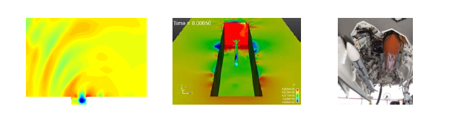
Motivation
We are interested in the compressible captive-carry problem.

Slide 11
Motivation
We are interested in the compressible captive-carry problem.
Of primary interest are long-time predictive simulations: ROM run at same parameters as FOM but much longer in time.

Slide 12
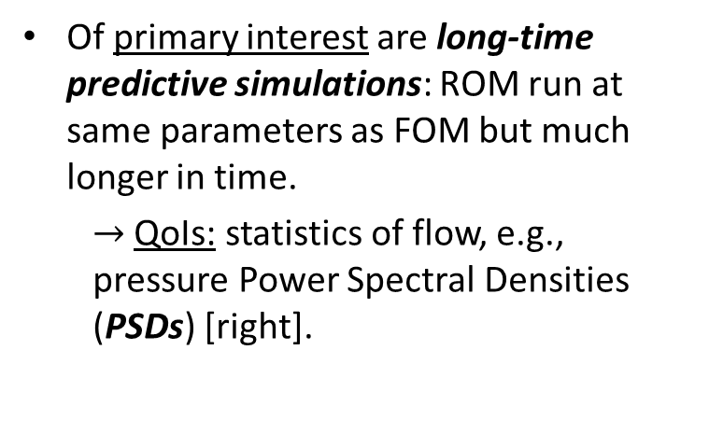
Motivation
We are interested in the compressible captive-carry problem.
Of primary interest are long-time predictive simulations: ROM run at same parameters as FOM but much longer in time.
  $→$ QoIs: statistics of flow, e.g., pressure Power Spectral Densities (PSDs) [right].

Slide 13
Motivation
We are interested in the compressible captive-carry problem.
Of primary interest are long-time predictive simulations: ROM run at same parameters as FOM but much longer in time.
  $→$ QoIs: statistics of flow, e.g., pressure Power Spectral Densities (PSDs) [right].
Secondary interest: ROMs robust w.r.t. parameter changes (e.g., Reynolds, Mach number) for enabling uncertainty quantification.

Slide 14
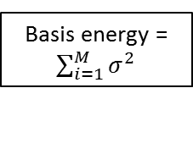
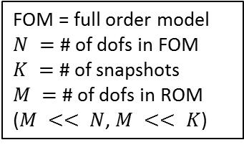
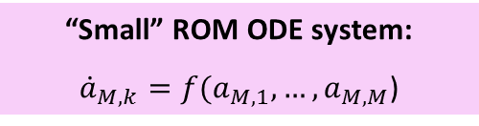
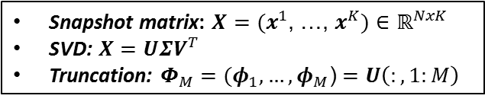
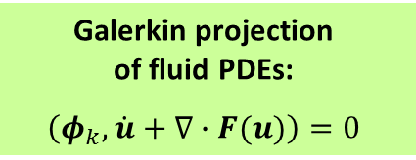
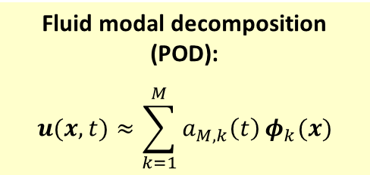
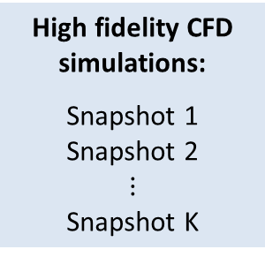
Proper Orthogonal Decomposition (POD)/
Galerkin method to model reduction
High fidelity CFD simulations:
Snapshot 1
Snapshot 2
$$⋮$$
Snapshot K
Fluid modal decomposition (POD):
$$u(x,t)≈\sum_{k=1}^{M}{a_{M,k}\left(t\right)}φ_{k}(x)$$
Galerkin projection
of fluid PDEs:
$$\left(φ_{k},\dot{u}+∇∙F(u)\right)=0$$
Step 1
Step 2
Snapshot matrix: $X=(x^{1}$, …, $x^{K})$ $∈ℝ^{NxK}$
SVD: $X=UΣV^{T}$
Truncation: $Φ_{M}=(φ_{1}, …, φ_{M}$) $=U\left(:,1:M\right)$
Basis energy = $\sum_{i=1}^{M}{σ^{2}}$
FOM = full order model
$N =$ # of dofs in FOM
$K =$ # of snapshots
$M =$ # of dofs in ROM
($M << N$, $M << K$)
“Small” ROM ODE system:
${\dot{a}}_{M,k}=f(a_{M,1},…,a_{M,M}$)

Slide 15
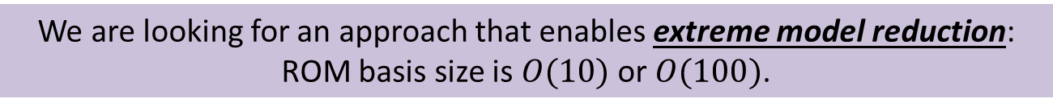
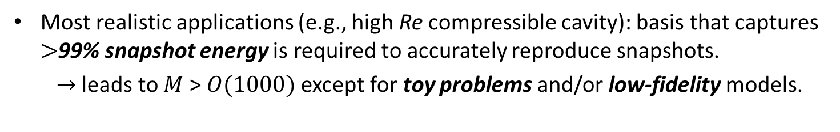
Extreme Model Reduction
Most realistic applications (e.g., high Re compressible cavity): basis that captures $>$99% snapshot energy is required to accurately reproduce snapshots.
  $→$ leads to $M$>$O(1000)$except for toy problems and/or low-fidelity models.
Higher order modes are in general unreliable for prediction, so including them in the basis is unlikely to improve the predictive capabilities of a ROM.
Figure (right) shows projection error for POD basis constructed using 800 snapshots for cavity problem.
Dashed line = end of snapshot collection period.
We are looking for an approach that enables extreme model reduction:
ROM basis size is $O(10)$ or $O(100)$.

Slide 16
Mode truncation instability
Projection-based MOR necessitates truncation.

Slide 17
Mode truncation instability
Projection-based MOR necessitates truncation.
POD is, by definition and design, biased towards the large, energy producing scales of the flow (i.e., modes with large POD eigenvalues).

Slide 18
Mode truncation instability
Projection-based MOR necessitates truncation.
POD is, by definition and design, biased towards the large, energy producing scales of the flow (i.e., modes with large POD eigenvalues).
Truncated/unresolved modes are negligible from a data compression point of view (i.e., small POD eigenvalues) but are crucial for the dynamical equations.

Slide 19
Mode truncation instability
Projection-based MOR necessitates truncation.
POD is, by definition and design, biased towards the large, energy producing scales of the flow (i.e., modes with large POD eigenvalues).
Truncated/unresolved modes are negligible from a data compression point of view (i.e., small POD eigenvalues) but are crucial for the dynamical equations.
For fluid flow applications, higher-order modes are associated with energy dissipation

Slide 20
Mode truncation instability
Projection-based MOR necessitates truncation.
POD is, by definition and design, biased towards the large, energy producing scales of the flow (i.e., modes with large POD eigenvalues).
Truncated/unresolved modes are negligible from a data compression point of view (i.e., small POD eigenvalues) but are crucial for the dynamical equations.
For fluid flow applications, higher-order modes are associated with energy dissipation
$⟹$ low-dimensional ROMs can be inaccurate and unstable.

Slide 21
Mode truncation instability
Projection-based MOR necessitates truncation.
POD is, by definition and design, biased towards the large, energy producing scales of the flow (i.e., modes with large POD eigenvalues).
Truncated/unresolved modes are negligible from a data compression point of view (i.e., small POD eigenvalues) but are crucial for the dynamical equations.
For fluid flow applications, higher-order modes are associated with energy dissipation
$⟹$ low-dimensional ROMs can be inaccurate and unstable.
For a low-dimensional ROM to be stable and accurate, the truncated/unresolved subspace must be accounted for.

Slide 22
Mode truncation instability
Projection-based MOR necessitates truncation.
POD is, by definition and design, biased towards the large, energy producing scales of the flow (i.e., modes with large POD eigenvalues).
Truncated/unresolved modes are negligible from a data compression point of view (i.e., small POD eigenvalues) but are crucial for the dynamical equations.
For fluid flow applications, higher-order modes are associated with energy dissipation
$⟹$ low-dimensional ROMs can be inaccurate and unstable.
For a low-dimensional ROM to be stable and accurate, the truncated/unresolved subspace must be accounted for.
Turbulence Modeling
(this paper)
Subspace Rotation
(our approach)

Slide 23
Outline
Motivation/Background
Section 2: POD/Galerkin ROMs for Incompressible Flows
Background on Turbulence Modeling/Large Eddy Simulation
4. Section 3: POD Closure Models
  Mixing Length (ML)
  Smagorinsky (S)
  Variational Multi-Scale (VMS)
  Dynamic Subgrid (DS)
Section 4.1: Computational Efficiency
6. Section 4.2: Numerical Results for 3D Flow Around Cylinder
7. Section 5 and Beyond: Future/Follow-Up Work
[8. Basis Rotation (My Work – an Alternative Approach)]

Slide 24
Section 2: POD-Galerkin-ROM (POD-G-ROM) for Incompressible Flow
Governing equations of incompressible flow:

Slide 25
Section 2: POD-Galerkin-ROM (POD-G-ROM) for Incompressible Flow
Governing equations of incompressible flow:
POD approximation of velocity solution² $u$:
where $U(x)$ = base flow, $φ_{j}(x)$ = POD modes.
² Pressure ROM can be obtained by solving pressure-Poisson equation. Pressure term drops out from (1) following projection due to BCs. See [36,56].

Slide 26
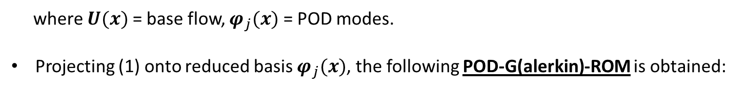
Section 2: POD-Galerkin-ROM (POD-G-ROM) for Incompressible Flow
Governing equations of incompressible flow:
POD approximation of velocity solution² $u$:
where $U(x)$ = base flow, $φ_{j}(x)$ = POD modes.
Projecting (1) onto reduced basis $φ_{j}(x)$, the following POD-G(alerkin)-ROM is obtained:
where $X^{r}$ = reduced subspace, $𝔻\left(u_{r}\right)=\frac{1}{2}∇u_{r}+\frac{1}{2}\left(∇u_{r}\right)T$ = deformation tensor of $u_{r}$.
² Pressure ROM can be obtained by solving pressure-Poisson equation. Pressure term drops out from (1) following projection due to BCs. See [36,56].

Slide 27
Section 2: POD-G-ROM for Incompressible Flow
POD-G-ROM algebraic system:
where:

Slide 28
Section 2: POD-G-ROM for Incompressible Flow
POD-G-ROM algebraic system:
where:
POD-G-ROM in matrix form:
$\dot{a}=b+Aa+a^{T}Ba$
(8)

Slide 29
Section 2: POD-G-ROM for Incompressible Flow
POD-G-ROM algebraic system:
where:
POD-G-ROM in matrix form:
$\dot{a}=b+Aa+a^{T}Ba$
(8)
POD-G-ROM (8) has been successfully used for laminar flows.

Slide 30
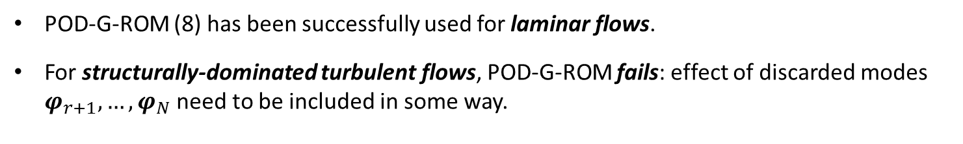
Section 2: POD-G-ROM for Incompressible Flow
POD-G-ROM algebraic system:
where:
POD-G-ROM in matrix form:
$\dot{a}=b+Aa+a^{T}Ba$
(8)
POD-G-ROM (8) has been successfully used for laminar flows.
For structurally-dominated turbulent flows, POD-G-ROM fails: effect of discarded modes $φ_{r+1}, …,φ_{N}$need to be included in some way.

Slide 31
Section 2: POD-G-ROM for Incompressible Flow
POD-G-ROM algebraic system:
where:
POD-G-ROM in matrix form:
$\dot{a}=b+Aa+a^{T}Ba$
(8)
POD-G-ROM (8) has been successfully used for laminar flows.
For structurally-dominated turbulent flows, POD-G-ROM fails: effect of discarded modes $φ_{r+1}, …,φ_{N}$need to be included in some way.
“POD closure problem”

Slide 32
Outline
Motivation/Background
Section 2: POD/Galerkin ROMs for Incompressible Flows
Background on Turbulence Modeling/Large Eddy Simulation
4. Section 3: POD Closure Models
  Mixing Length (ML)
  Smagorinsky (S)
  Variational Multi-Scale (VMS)
  Dynamic Subgrid (DS)
Section 4.1: Computational Efficiency
6. Section 4.2: Numerical Results for 3D Flow Around Cylinder
7. Section 5 and Beyond: Future/Follow-Up Work
[8. Basis Rotation (My Work – an Alternative Approach)]

Slide 33
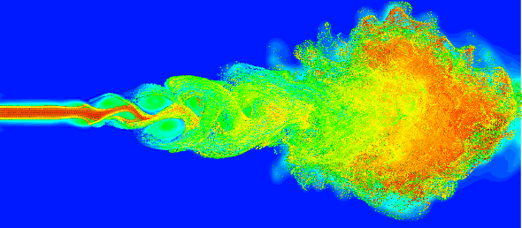
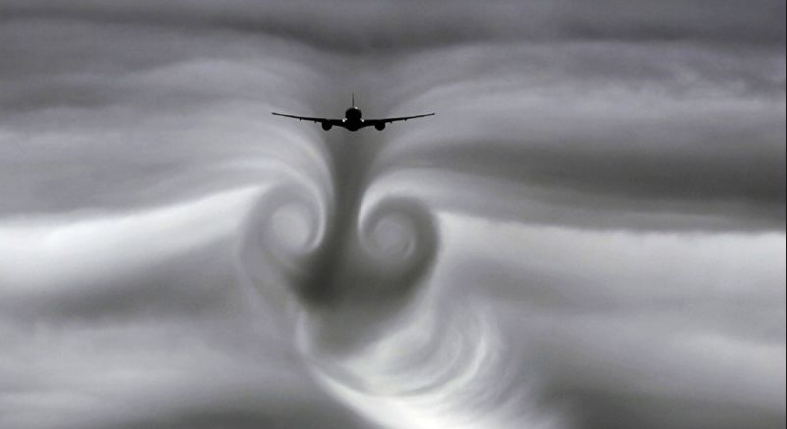
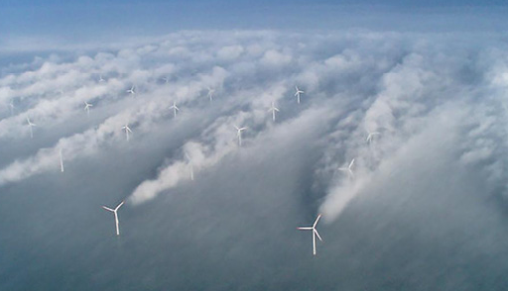
Turbulence
For sufficiently high Reynolds number, flow becomes turbulent.
Notes:
TODO: add background on turbulence modeling, LES.

Slide 34
Turbulence
For sufficiently high Reynolds number, flow becomes turbulent.
Turbulence is nonlinear, chaotic, 3D phenomenon.
Notes:
TODO: add background on turbulence modeling, LES.

Slide 35
Turbulence
For sufficiently high Reynolds number, flow becomes turbulent.
Turbulence is nonlinear, chaotic, 3D phenomenon.
Kolmogorov hypothesis / energy cascade:
  Kinetic energy enters the turbulence through the production mechanism at largest scales of motion.
  Energy is transferred (by inviscid processes) to smaller and smaller scales.
  At smallest scales, energy is dissipated by viscous action.

Slide 36

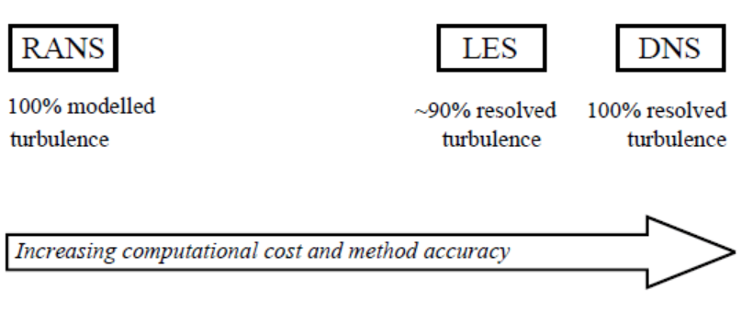
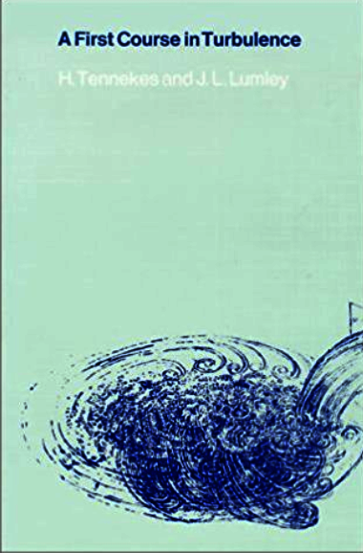

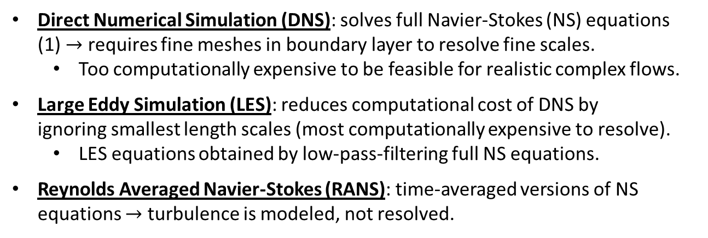
Turbulence Modeling
Direct Numerical Simulation (DNS): solves full Navier-Stokes (NS) equations (1) $→$ requires fine meshes in boundary layer to resolve fine scales.
  Too computationally expensive to be feasible for realistic complex flows.
Large Eddy Simulation (LES): reduces computational cost of DNS by ignoring smallest length scales (most computationally expensive to resolve).
  LES equations obtained by low-pass-filtering full NS equations.
Reynolds Averaged Navier-Stokes (RANS): time-averaged versions of NS equations $→$ turbulence is modeled, not resolved.
Notes:
TODO: add background on turbulence modeling, LES.

Slide 37
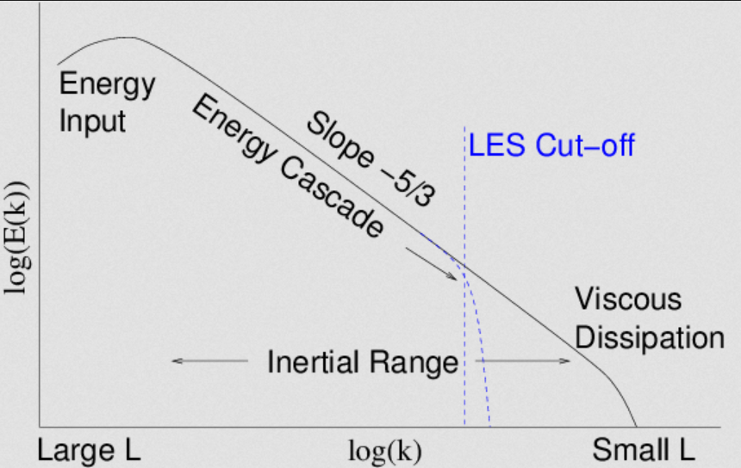
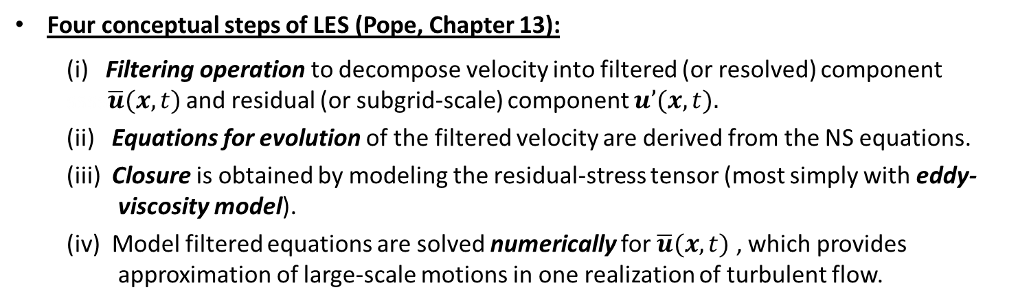
Large Eddy Simulation (LES)
E(k) = energy spectrum
Left: energy cascade / “Kolmogorov spectrum” (energy transfer from large to small scales); LES filter filters out small scales.
Four conceptual steps of LES (Pope, Chapter 13):
  (i) Filtering operation to decompose velocity into filtered (or resolved) component ssss$\overline{u}(x,t)$ and residual (or subgrid-scale) component $u’(x,t).$
  (ii) Equations for evolution of the filtered velocity are derived from the NS equations.
  (iii) Closure is obtained by modeling the residual-stress tensor (most simply with eddy- viscosity model).
  (iv) Model filtered equations are solved numerically for $\overline{u}(x,t)$ , which provides approximation of large-scale motions in one realization of turbulent flow.

Slide 38
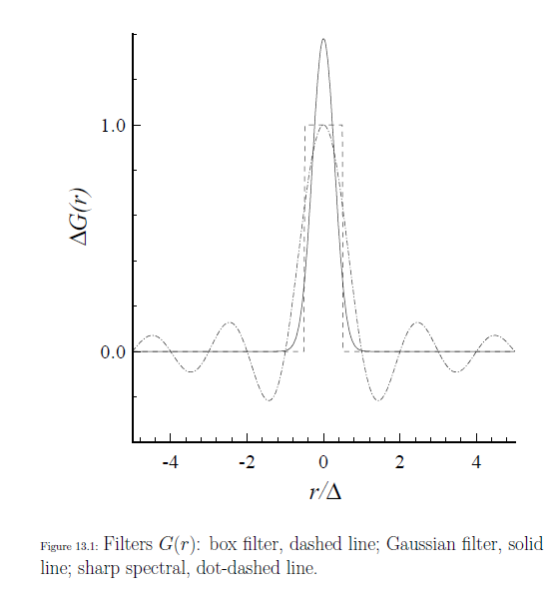

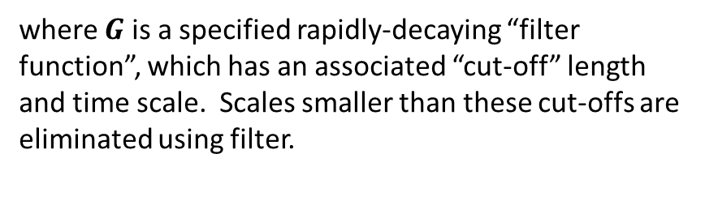
LES Filtering
General filtering operation defined by:
$$\overline{u}\left(x,t\right)= \int{G\left(r,x\right)u\left(x−r,t\right)dr}$$
where $G$ is a specified rapidly-decaying “filter function”, which has an associated “cut-off” length and time scale. Scales smaller than these cut-offs are eliminated using filter.

Slide 39
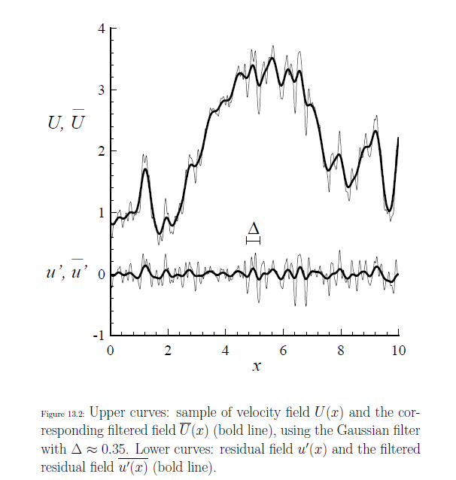
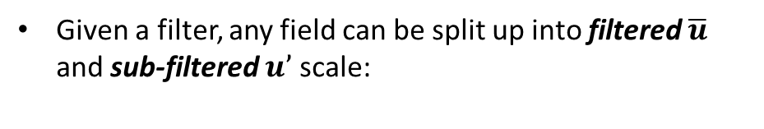

LES Filtering
General filtering operation defined by:
$$\overline{u}\left(x,t\right)= \int{G\left(r,x\right)u\left(x−r,t\right)dr}$$
where $G$ is a specified rapidly-decaying “filter function”, which has an associated “cut-off” length and time scale. Scales smaller than these cut-offs are eliminated using filter.
Bold: filtered signal
Given a filter, any field can be split up into filtered $\overline{u}$ and sub-filtered $u’$ scale:
$u(x,t) = \overline{u}\left(x,t\right)+u′(x,t)$

Slide 40
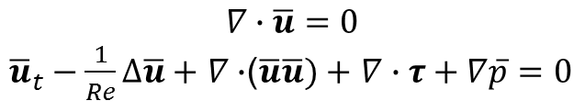

LES Filtered Governing Equations
Applying filtering operation to (1) gives the following equations for the filtered variables:
$$∇∙\overline{u}=0$$
${\overline{u}}_{t}−\frac{1}{Re}∆\overline{u}+$ $∇∙$($\overline{u}\overline{u})+$ $∇∙τ+∇\overline{p}=0$
where $τ$ is the subfilter-scale stress tensor:
$$τ=\overline{uu}−\overline{u}\overline{u}$$

Slide 41
LES Filtered Governing Equations
Applying filtering operation to (1) gives the following equations for the filtered variables:
$$∇∙\overline{u}=0$$
${\overline{u}}_{t}−\frac{1}{Re}∆\overline{u}+$ $∇∙$($\overline{u}\overline{u})+$ $∇∙τ+∇\overline{p}=0$
where $τ$ is the subfilter-scale stress tensor:
$$τ=\overline{uu}−\overline{u}\overline{u}$$
$\overline{uu}$is most difficult term to model, as it requires knowledge of unfiltered velocity field, which is unknown.

Slide 42
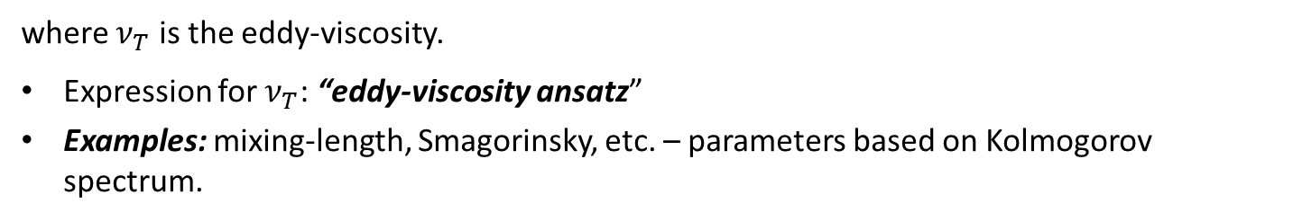
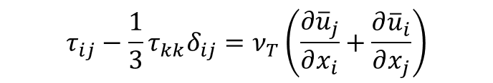
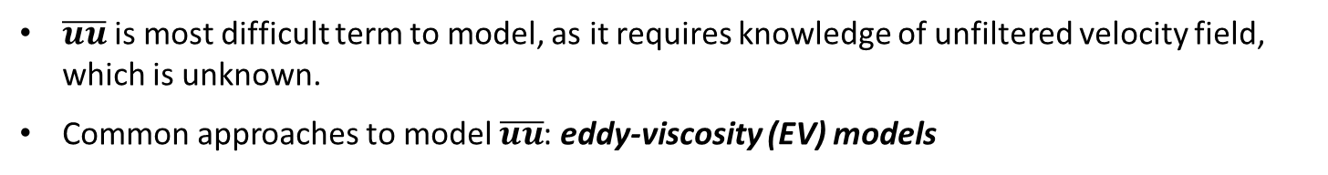
LES Filtered Governing Equations
Applying filtering operation to (1) gives the following equations for the filtered variables:
$$∇∙\overline{u}=0$$
${\overline{u}}_{t}−\frac{1}{Re}∆\overline{u}+$ $∇∙$($\overline{u}\overline{u})+$ $∇∙τ+∇\overline{p}=0$
where $τ$ is the subfilter-scale stress tensor:
$$τ=\overline{uu}−\overline{u}\overline{u}$$
$\overline{uu}$is most difficult term to model, as it requires knowledge of unfiltered velocity field, which is unknown.
Common approaches to model $\overline{uu}$: eddy-viscosity (EV) models
$$τ_{ij}−\frac{1}{3}τ_{kk}δ_{ij}=ν_{T}\left(\frac{∂{\overline{u}}_{j}}{∂x_{i}}+\frac{∂{\overline{u}}_{i}}{∂x_{j}}\right)$$
where $ν_{T}$ is the eddy-viscosity.
Expression for $ν_{T}$: “eddy-viscosity ansatz”
Examples: mixing-length, Smagorinsky, etc. – parameters based on Kolmogorov spectrum.

Slide 43
Outline
Motivation/Background
Section 2: POD/Galerkin ROMs for Incompressible Flows
Background on Turbulence Modeling/Large Eddy Simulation
4. Section 3: POD Closure Models
  Mixing Length (ML)
  Smagorinsky (S)
  Variational Multi-Scale (VMS)
  Dynamic Subgrid (DS)
Section 4.1: Computational Efficiency
6. Section 4.2: Numerical Results for 3D Flow Around Cylinder
7. Section 5 and Beyond: Future/Follow-Up Work
[8. Basis Rotation (My Work – an Alternative Approach)]

Slide 44
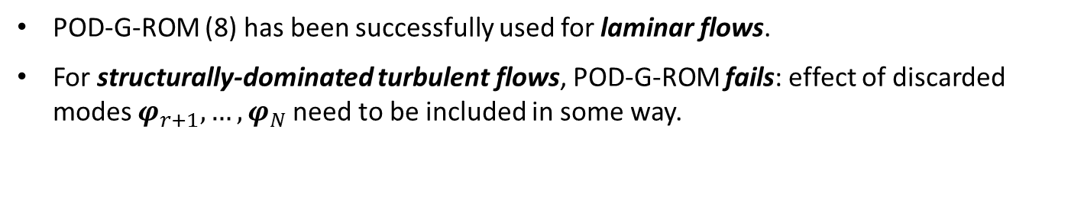
Section 3.3: POD Closure Models
POD-G-ROM (8) has been successfully used for laminar flows.
For structurally-dominated turbulent flows, POD-G-ROM fails: effect of discarded modes $φ_{r+1}, …,φ_{N}$need to be included in some way.
“POD closure problem”

Slide 45
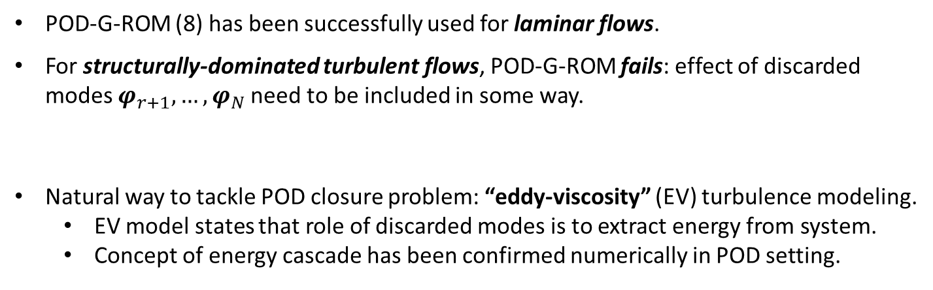
Section 3.3: POD Closure Models
POD-G-ROM (8) has been successfully used for laminar flows.
For structurally-dominated turbulent flows, POD-G-ROM fails: effect of discarded modes $φ_{r+1}, …,φ_{N}$need to be included in some way.
Natural way to tackle POD closure problem: “eddy-viscosity” (EV) turbulence modeling.
  EV model states that role of discarded modes is to extract energy from system.
  Concept of energy cascade has been confirmed numerically in POD setting.
“POD closure problem”

Slide 46
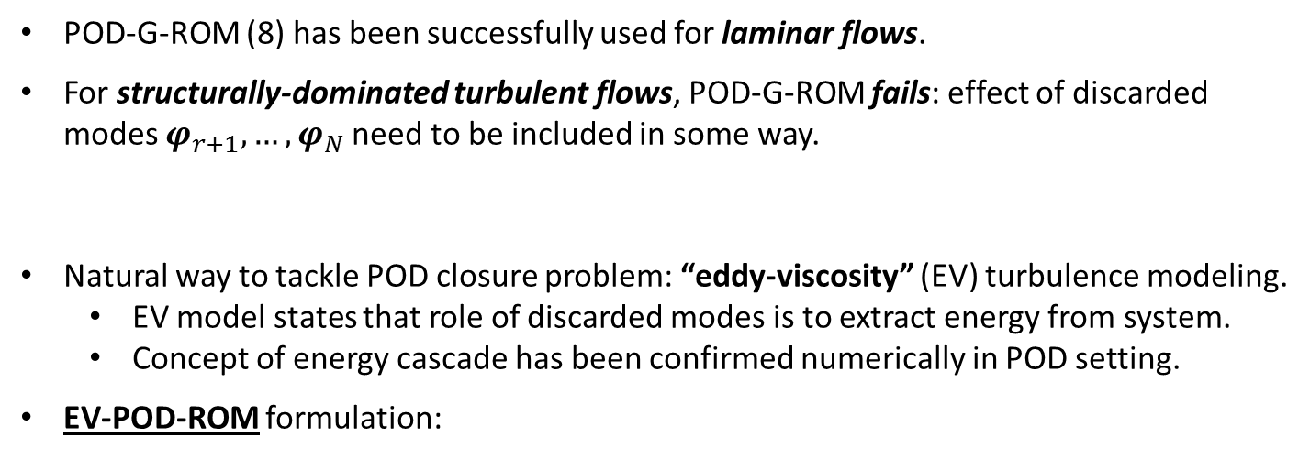
Section 3.3: POD Closure Models
POD-G-ROM (8) has been successfully used for laminar flows.
For structurally-dominated turbulent flows, POD-G-ROM fails: effect of discarded modes $φ_{r+1}, …,φ_{N}$need to be included in some way.
Natural way to tackle POD closure problem: “eddy-viscosity” (EV) turbulence modeling.
  EV model states that role of discarded modes is to extract energy from system.
  Concept of energy cascade has been confirmed numerically in POD setting.
EV-POD-ROM formulation:
“POD closure problem”
$\dot{a}=(b+\tilde{b}\left(a\right))+(A+\tilde{A}\left(a\right))a+a^{T}Ba$
(24)
where $\tilde{b}\left(a\right)$ and $\tilde{A}\left(a\right)$ correspond to numerical discretization of EV closure model.

Slide 47
Section 3.3: POD Closure Models
POD-G-ROM (8) has been successfully used for laminar flows.
For structurally-dominated turbulent flows, POD-G-ROM fails: effect of discarded modes $φ_{r+1}, …,φ_{N}$need to be included in some way.
Natural way to tackle POD closure problem: “eddy-viscosity” (EV) turbulence modeling.
  EV model states that role of discarded modes is to extract energy from system.
  Concept of energy cascade has been confirmed numerically in POD setting.
EV-POD-ROM formulation:
“POD closure problem”
$\dot{a}=(b+\tilde{b}\left(a\right))+(A+\tilde{A}\left(a\right))a+a^{T}Ba$
(24)
where $\tilde{b}\left(a\right)$ and $\tilde{A}\left(a\right)$ correspond to numerical discretization of EV closure model.
(24) is equivalent to adding $ν_{T}\left(\frac{∂{\overline{u}}_{j}}{∂x_{i}}+\frac{∂{\overline{u}}_{i}}{∂x_{j}}\right)$ to equations (1) and projecting.

Slide 48
Section 3.3: POD Closure Models
POD-G-ROM (8) has been successfully used for laminar flows.
For structurally-dominated turbulent flows, POD-G-ROM fails: effect of discarded modes $φ_{r+1}, …,φ_{N}$need to be included in some way.
Natural way to tackle POD closure problem: “eddy-viscosity” (EV) turbulence modeling.
  EV model states that role of discarded modes is to extract energy from system.
  Concept of energy cascade has been confirmed numerically in POD setting.
EV-POD-ROM formulation:
“POD closure problem”
$\dot{a}=(b+\tilde{b}\left(a\right))+(A+\tilde{A}\left(a\right))a+a^{T}Ba$
(24)
where $\tilde{b}\left(a\right)$ and $\tilde{A}\left(a\right)$ correspond to numerical discretization of EV closure model.
(24) is equivalent to adding $ν_{T}\left(\frac{∂{\overline{u}}_{j}}{∂x_{i}}+\frac{∂{\overline{u}}_{i}}{∂x_{j}}\right)$ to equations (1) and projecting.
Four EV-POD-ROMs of the form (24) proposed/evaluated:
1. ML-POD-ROM (ML = mixing length). 3. VMS-POD-ROM (VMS = variational multi-scale)
2. S-POD-ROM (S = Smagorinsky). 4. DS-POD-ROM (DS = dynamic subgrid)

Slide 49
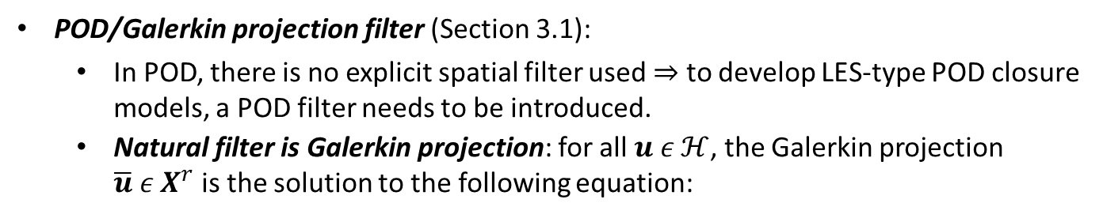
POD Filter and Lengthscale (Section 3.1-3.2)
POD/Galerkin projection filter (Section 3.1):
  In POD, there is no explicit spatial filter used $⇒$ to develop LES-type POD closure models, a POD filter needs to be introduced.
  Natural filter is Galerkin projection: for all $u ε ℋ$, the Galerkin projection $\overline{u} ε X^{r}$is the solution to the following equation:
By doing POD/Galerkin projection to build the ROM, one is applying a filter. In the context of LES, filtered equations require introduction of closure model to model effect of neglected POD modes. This is where idea of adding EV models to ROM equations comes from.

Slide 50
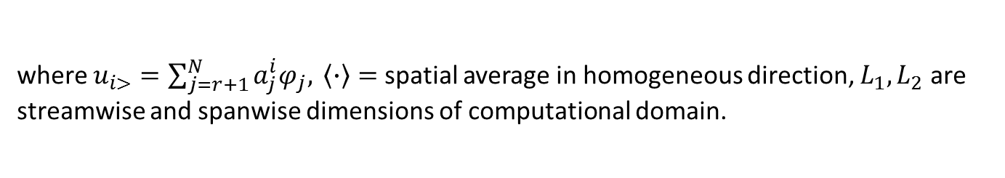
POD Filter and Lengthscale (Section 3.1-3.2)
POD/Galerkin projection filter (Section 3.1):
  In POD, there is no explicit spatial filter used $⇒$ to develop LES-type POD closure models, a POD filter needs to be introduced.
  Natural filter is Galerkin projection: for all $u ε ℋ$, the Galerkin projection $\overline{u} ε X^{r}$is the solution to the following equation:
By doing POD/Galerkin projection to build the ROM, one is applying a filter. In the context of LES, filtered equations require introduction of closure model to model effect of neglected POD modes. This is where idea of adding EV models to ROM equations comes from.
POD lengthscale (Section 3.2): implicitly defined by neglected modes ${\left\{φ_{j}\right\}}_{j=r+1}^{N}$
where $u_{i>}=\sum_{j=r+1}^{N}{a_{j}^{i}φ_{j}, }\left\langle ∙\right\rangle =$ spatial average in homogeneous direction, $L_{1}, L_{2}$are streamwise and spanwise dimensions of computational domain.

Slide 51
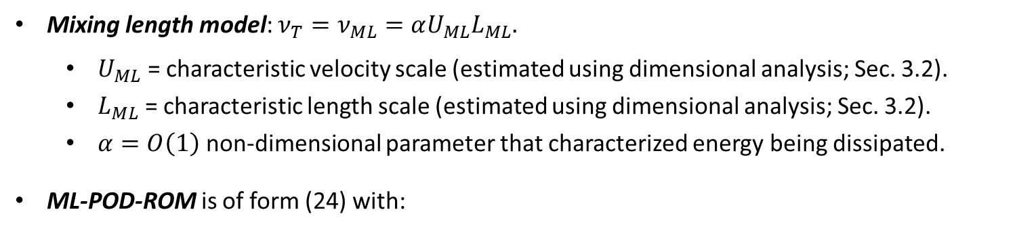
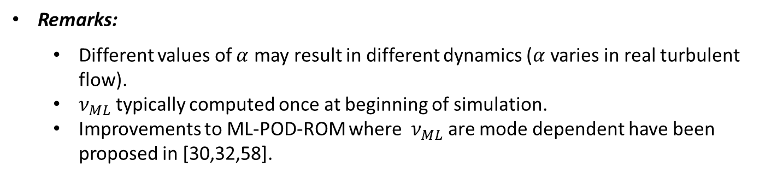
Section 3.3.1: ML*-POD-ROM
Mixing length model: $ν_{T}=ν_{ML}=αU_{ML}L_{ML}.$
  $U_{ML}$ = characteristic velocity scale (estimated using dimensional analysis; Sec. 3.2).
  $L_{ML}$ = characteristic length scale (estimated using dimensional analysis; Sec. 3.2).
  $α=O\left(1\right)$ non-dimensional parameter that characterized energy being dissipated.
ML-POD-ROM is of form (24) with:
Remarks:
  Different values of $α$ may result in different dynamics ($α$ varies in real turbulent flow).
  $ν_{ML}$ typically computed once at beginning of simulation.
  Improvements to ML-POD-ROM where $ν_{ML}$ are mode dependent have been proposed in [30,32,58].
* ML = Mixing Length
Notes:
TODO: look at references [30,32,58] and see what happens there, namely if \nu \to 0 as basis size increases.

Slide 52
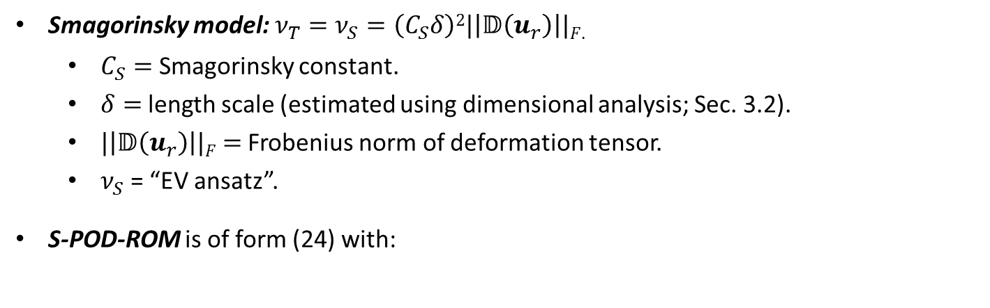
Section 3.3.2: S*-POD-ROM
Smagorinsky model:${ ν}_{T} =ν_{S}=\left(C_{S}δ\right)2|\left|𝔻\left(u_{r}\right)\right||F$.
  $C_{S}=$ Smagorinsky constant.
  $δ=$length scale (estimated using dimensional analysis; Sec. 3.2).
  $|\left|𝔻\left(u_{r}\right)\right||F$ $=$ Frobenius norm of deformation tensor.
  $ν_{S}$ = “EV ansatz”.
S-POD-ROM is of form (24) with:
Remarks:
  Main advantage over ML-POD-ROM: EV coefficient recomputed at every time-step.
  EV terms are nonlinear and need to be handled efficiently – discussed in Section 4.
* S = Smagorinsky
Notes:
TODO: define “ansatz”. How is C_s chosen?

Slide 53
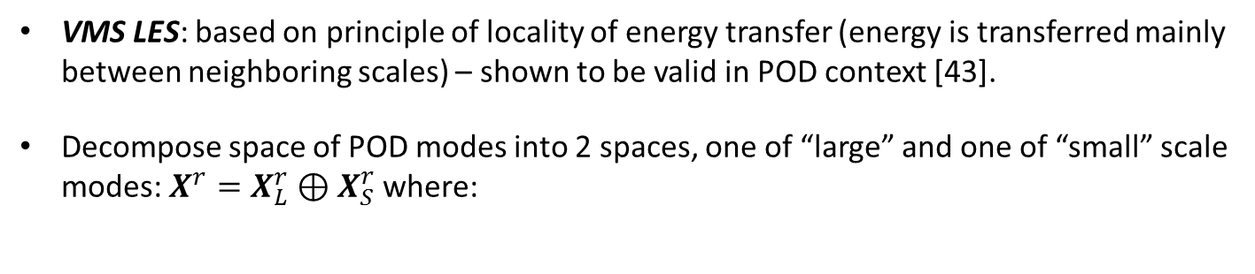
Section 3.3.3: VMS*-POD-ROM
VMS LES: based on principle of locality of energy transfer (energy is transferred mainly between neighboring scales) – shown to be valid in POD context [43].
Decompose space of POD modes into 2 spaces, one of “large” and one of “small” scale modes: $X^{r}=X_{L}^{r}⊕X_{S}^{r}$ where:
Decompose ROM solution into “large resolved” and “small resolved” scales: $u_{r}=u_{r}^{L}+u_{r}^{S}$where:
VMS-POD-ROM has the form:
* VMS = Variational Multi-Scale
Notes:
TODO: how is r_L defined?

Slide 54
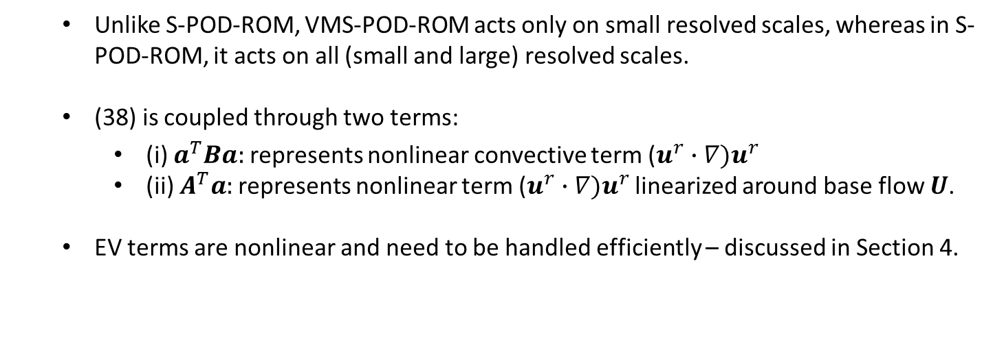
Section 3.3.3: VMS-POD-ROM
VMS-POD-ROM has the form:
Remarks:
  EV term applied to small scales only, following principle of energy transfer locality:
  Unlike S-POD-ROM, VMS-POD-ROM acts only on small resolved scales, whereas in S-POD-ROM, it acts on all (small and large) resolved scales.
  (38) is coupled through two terms:
    (i) $a^{T}Ba:$represents nonlinear convective term ($u^{r}∙∇)u^{r}$
    (ii) $A^{T}a:$represents nonlinear term ($u^{r}∙∇)u^{r}$ linearized around base flow $U$.
  EV terms are nonlinear and need to be handled efficiently – discussed in Section 4.
Notes:
TODO: how is r_L defined?

Slide 55
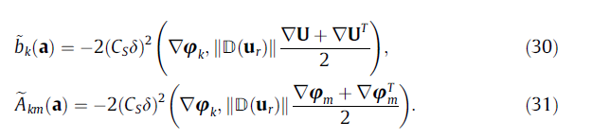
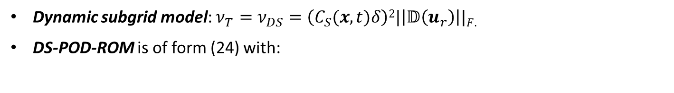

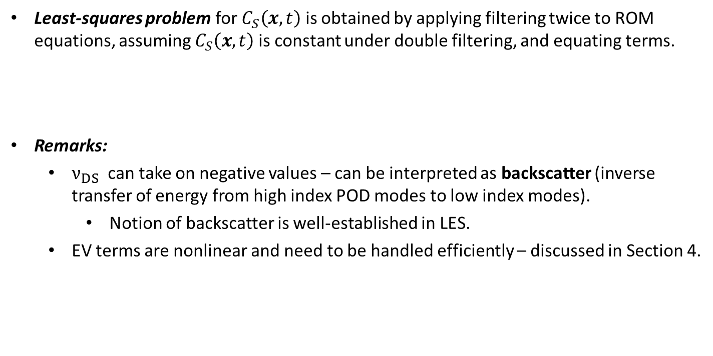
Section 3.3.4 : DS*-POD-ROM
Dynamic subgrid model: $ν_{T}=ν_{DS}=\left(C_{S}(x,t)δ\right)2|\left|𝔻\left(u_{r}\right)\right||F$.
DS-POD-ROM is of form (24) with:
Least-squares problem for $C_{S}\left(x,t\right)$ is obtained by applying filtering twice to ROM equations, assuming $C_{S}\left(x,t\right)$is constant under double filtering, and equating terms.
Remarks:
  $ν_{DS}$can take on negative values – can be interpreted as backscatter (inverse transfer of energy from high index POD modes to low index modes).
    Notion of backscatter is well-established in LES.
  EV terms are nonlinear and need to be handled efficiently – discussed in Section 4.
$$⇒$$
* DS = Dynamic Subgrid

Slide 56
Outline
Motivation/Background
Section 2: POD/Galerkin ROMs for Incompressible Flows
Background on Turbulence Modeling/Large Eddy Simulation
4. Section 3: POD Closure Models
  Mixing Length (ML)
  Smagorinsky (S)
  Variational Multi-Scale (VMS)
  Dynamic Subgrid (DS)
Section 4.1: Computational Efficiency
6. Section 4.2: Numerical Results for 3D Flow Around Cylinder
7. Section 5 and Beyond: Future/Follow-Up Work
[8. Basis Rotation (My Work – an Alternative Approach)]

Slide 57
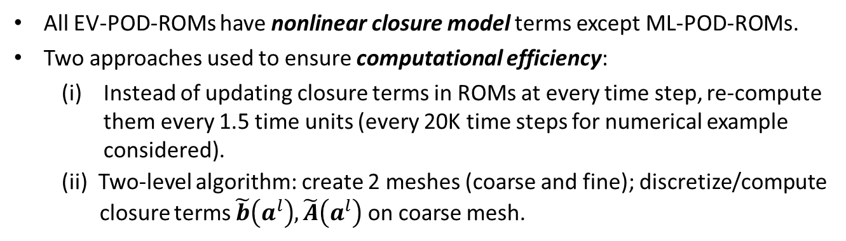
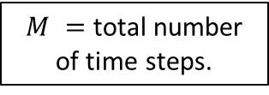
Ensuring Computational Efficiency (Section 4.1)
All EV-POD-ROMs have nonlinear closure model terms except ML-POD-ROMs.
Two approaches used to ensure computational efficiency:
  Instead of updating closure terms in ROMs at every time step, re-compute them every 1.5 time units (every 20K time steps for numerical example considered).
  (ii) Two-level algorithm: create 2 meshes (coarse and fine); discretize/compute ssssclosure terms $\tilde{b}\left(a^{l}\right),\tilde{A}\left(a^{l}\right)$ on coarse mesh.
$M =$ total number of time steps.
Both (i) and (ii) were applied to all ROMs for fair comparison (even ML-POD-ROM).
In [50], it was shown that two-level algorithm achieves same level of accuracy as one-level algorithm while decreasing computational cost by order of magnitude.
Notes:
Could do DEIM, or gappy POD. Why not do?

Slide 58
Outline
Motivation/Background
Section 2: POD/Galerkin ROMs for Incompressible Flows
Background on Turbulence Modeling/Large Eddy Simulation
4. Section 3: POD Closure Models
  Mixing Length (ML)
  Smagorinsky (S)
  Variational Multi-Scale (VMS)
  Dynamic Subgrid (DS)
Section 4.1: Computational Efficiency
6. Section 4.2: Numerical Results for 3D Flow Around Cylinder
7. Section 5 and Beyond: Future/Follow-Up Work
[8. Basis Rotation (My Work – an Alternative Approach)]

Slide 59
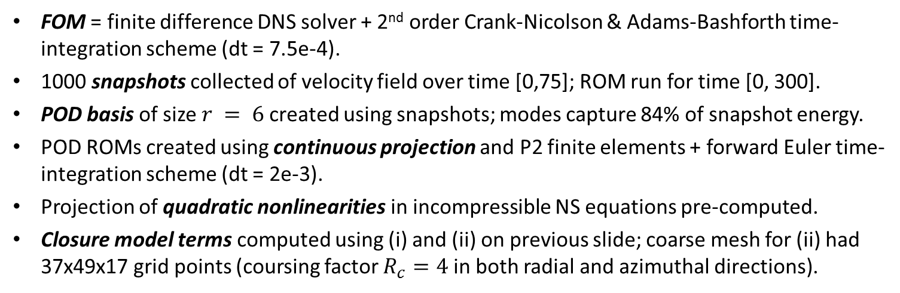
Numerical Example: 3D Flow Past Re = 1000 Cylinder (Section 4.1)
FOM = finite difference DNS solver + 2nd order Crank-Nicolson & Adams-Bashforth time-integration scheme (dt = 7.5e-4).
1000 snapshots collected of velocity field over time [0,75]; ROM run for time [0, 300].
POD basis of size $r = 6$created using snapshots; modes capture 84% of snapshot energy.
POD ROMs created using continuous projection and P2 finite elements + forward Euler time-integration scheme (dt = 2e-3).
Projection of quadratic nonlinearities in incompressible NS equations pre-computed.
Closure model terms computed using (i) and (ii) on previous slide; coarse mesh for (ii) had 37x49x17 grid points (coursing factor $R_{c}=4$ in both radial and azimuthal directions).

Slide 60
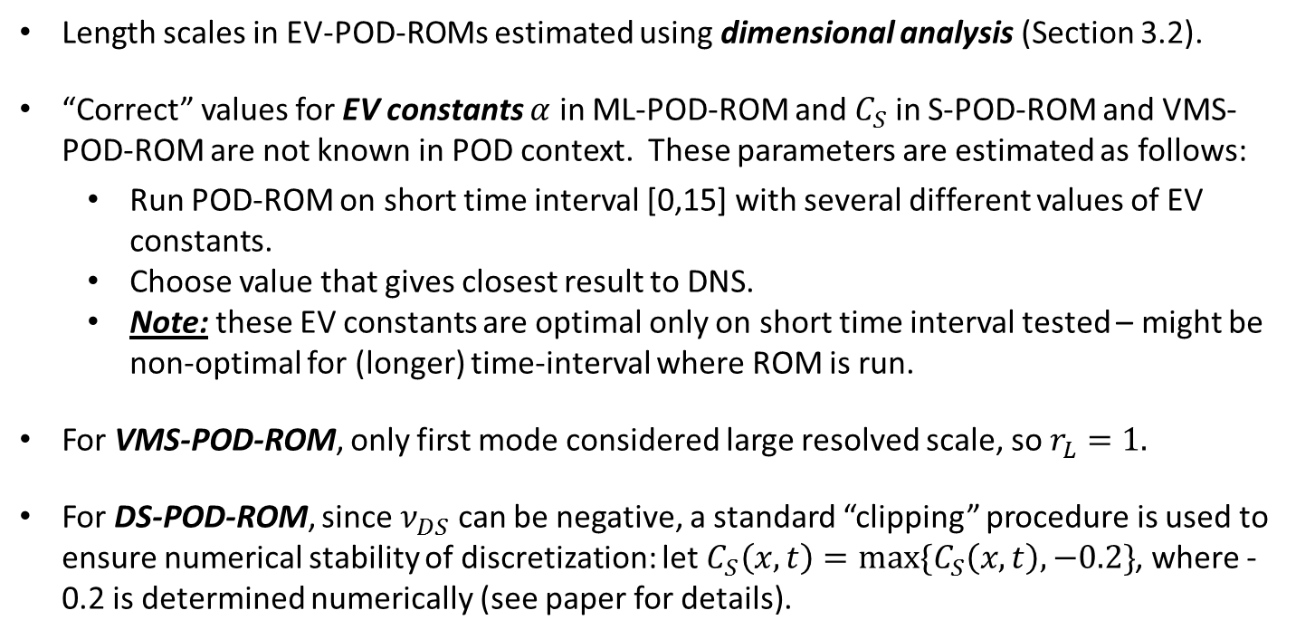
Numerical Example: Estimation of Parameters (Section 4.1)
Length scales in EV-POD-ROMs estimated using dimensional analysis (Section 3.2).
“Correct” values for EV constants $α$ in ML-POD-ROM and $C_{S}$ in S-POD-ROM and VMS-POD-ROM are not known in POD context. These parameters are estimated as follows:
  Run POD-ROM on short time interval [0,15] with several different values of EV constants.
  Choose value that gives closest result to DNS.
  Note: these EV constants are optimal only on short time interval tested – might be non-optimal for (longer) time-interval where ROM is run.
For VMS-POD-ROM, only first mode considered large resolved scale, so $r_{L}=1.$
For DS-POD-ROM, since $ν_{DS}$ can be negative, a standard “clipping” procedure is used to ensure numerical stability of discretization: let $C_{S}\left(x,t\right)=max⁡\{C_{S}\left(x,t\right), −0.2\}$, where -0.2 is determined numerically (see paper for details).

Slide 61

Numerical Example: Estimation of Parameters (Section 4.1)
Length scales in EV-POD-ROMs estimated using dimensional analysis (Section 3.2).
“Correct” values for EV constants $α$ in ML-POD-ROM and $C_{S}$ in S-POD-ROM and VMS-POD-ROM are not known in POD context. These parameters are estimated as follows:
  Run POD-ROM on short time interval [0,15] with several different values of EV constants.
  Choose value that gives closest result to DNS.
  Note: these EV constants are optimal only on short time interval tested – might be non-optimal for (longer) time-interval where ROM is run.
For VMS-POD-ROM, only first mode considered large resolved scale, so $r_{L}=1.$
For DS-POD-ROM, since $ν_{DS}$ can be negative, a standard “clipping” procedure is used to ensure numerical stability of discretization: let $C_{S}\left(x,t\right)=max⁡\{C_{S}\left(x,t\right), −0.2\}$, where -0.2 is determined numerically (see paper for details).
Comment: authors consider one basis size $r$. Approach could be modified so $ν_{T}→0$ as $r→K$ for consistency.

Slide 62
Criteria for Evaluating ROMs
(Section 4.1)
Five criteria are used for evaluating ROMs:
  Kinetic energy spectrum.
  Mean velocity.
  Reynolds stresses.
  Root mean square (rms) values of velocity and fluctuations.
  (v) Time-evolution of POD coefficients.

Slide 63
Criteria for Evaluating ROMs
(Section 4.1)
Five criteria are used for evaluating ROMs:
  Kinetic energy spectrum.
  Mean velocity.
  Reynolds stresses.
  Root mean square (rms) values of velocity and fluctuations.
  (v) Time-evolution of POD coefficients.
Comment: These are similar criteria to those we are interested in!

Slide 64
Kinetic Energy Spectrum (Section 4.1)
All energy spectra calculated from average kinetic energy (KE) at a single point.
POD-G-ROM: over-estimates energy spectrum.
ML-POD-ROM: underestimates energy spectrum, especially at higher frequencies.
S-POD-ROM: more accurate than ML-POD-ROM, but displays high oscillations at higher frequencies.
VMS-POD-ROM: improvement over S-POD-ROM, with smaller oscillations at higher frequencies.
DS-POD-ROM and VMS-POD-ROM yield most accurate energy spectra, with DS-POD-ROM slightly better than VMS-POD-ROM.

Slide 65

Mean Velocity Components (Section 4.1)
$\left\langle u\right\rangle =$mean streamwise velocity
$\left\langle v\right\rangle =$mean normal velocity
$\left\langle w\right\rangle =$ mean spanwise velocity
$\left\langle ⋅\right\rangle$denotes time-averaging for t=[0,300] and spatial averaging performed in $yz$-direction.
Mean streamwise velocity computed accurately by all POD-ROMs.
POD-G-ROM yields inaccurate results for mean normal velocity; all other POD-ROMs performed significantly better.
Mean spanwise velocity results similar for all EV-ROMs; POD-G-ROM performed better than all EV-ROMs over certain regions worse over others.

Slide 66

Reynolds Stresses (Section 4.1)
$\left\langle u−\left\langle u\right\rangle , v−\left\langle v\right\rangle \right\rangle : xy$-component of Reynolds stress.
$\left\langle u−\left\langle u\right\rangle , w−\left\langle w\right\rangle \right\rangle : xz$-component of Reynolds stress.
$\left\langle v−\left\langle v\right\rangle , w−\left\langle w\right\rangle \right\rangle : yz$-component of Reynolds stress.
POD-G-ROM Reynolds stresses are consistently most inaccurate.
EV-ROMs have similar behaviors; no clear “winner”.

Slide 67

Root Mean Square Values (Section 4.1)
${\left\langle u\right\rangle }_{rms}=\left\langle u−\left\langle u\right\rangle , u−\left\langle u\right\rangle \right\rangle :$rms of streamwise velocity fluctuations.
${\left\langle v\right\rangle }_{rms}=\left\langle v−\left\langle v\right\rangle , v−\left\langle v\right\rangle \right\rangle :$rms of normal velocity fluctuations.
${\left\langle w\right\rangle }_{rms}=\left\langle w−\left\langle w\right\rangle , w−\left\langle w\right\rangle \right\rangle :$rms of spanwise velocity fluctuations.
POD-G-ROM rms values of velocity fluctuations are consistently the most inaccurate.
DS-POD-ROM and VMS-POD-ROMs consistently outperformed other two EV-ROMs.
S-POD-ROM consistently performs worse than DS-POD-ROM and VMS-POD-ROM, but is clearly more accurate than ML-POD-ROM.

Slide 68

Time Evolution of POD Coefficients (Section 4.1)
Left: $a_{1},$ right: $a_{4}$.
POD-G-ROM’s time evolutions of $a_{1}$ and $a_{4}$ are clearly inaccurate.
ML-POD-ROMs time evolutions also inaccurate.
S-POD-ROM more accurate than ML-POD-ROM.
VMS-POD-ROM more accurate than S-POD-ROM.
DS-POD-ROM yields accurate results.
More variability in coefficients for DS-POD-ROM due to $C_{S}$ varying with space and time.
VMS-POD-ROM and DS-POD-ROM perform best.

Slide 69
CPU Times (Section 4.1)
To measure computational efficiency of the four POD-ROMs, define speed-up factor:
Table 1 gives speed-up factors for POD-ROMs:
POD-G-ROM is most efficient; as sophistication of turbulence model increases, model becomes more expensive, not surprisingly.

Slide 70
CPU Times (Section 4.1)
To measure computational efficiency of the four POD-ROMs, define speed-up factor:
Table 1 gives speed-up factors for POD-ROMs:
POD-G-ROM is most efficient; as sophistication of turbulence model increases, model becomes more expensive, not surprisingly.
Comment: it may be possible to improve these speed-up factors using hyper-reduction to handle non-linear terms (e.g., DEIM, gappy POD).

Slide 71

Summary of Results (Section 4.1)
VMS and DS approaches yield most accurate POD closure models (i.e., give most accurate average and instantaneous numerical results):
  Best energy spectra.
  Best rms values.
  Best time evolution of POD coefficients $a_{1}$ and $a_{4}$.
  With respect to other criteria (mean velocity components, Reynolds stresses), DS-POD-ROM and VMS-POD-ROM perform at least as well as other POD-ROMs.

Slide 72
Summary of Results (Section 4.1)
VMS and DS approaches yield most accurate POD closure models (i.e., give most accurate average and instantaneous numerical results):
  Best energy spectra.
  Best rms values.
  Best time evolution of POD coefficients $a_{1}$ and $a_{4}$.
  With respect to other criteria (mean velocity components, Reynolds stresses), DS-POD-ROM and VMS-POD-ROM perform at least as well as other POD-ROMs.
Comment: one cannot make these definitive conclusions from data presented because all the ROMs do not have the same computational cost (see previous slide)… but it is possible to improve computational efficiency of EV-ROMs using hyper-reduction like DEIM or gappy POD.

Slide 73
Outline
Motivation/Background
Section 2: POD/Galerkin ROMs for Incompressible Flows
Background on Turbulence Modeling/Large Eddy Simulation
4. Section 3: POD Closure Models
  Mixing Length (ML)
  Smagorinsky (S)
  Variational Multi-Scale (VMS)
  Dynamic Subgrid (DS)
Section 4.1: Computational Efficiency
6. Section 4.2: Numerical Results for 3D Flow Around Cylinder
7. Section 5 and Beyond: Future/Follow-Up Work
[8. Basis Rotation (My Work – an Alternative Approach)]

Slide 74

Future Work (Section 5)
Study more efficient time-discretization approaches and take advantage of parallel computing in POD-ROMs.
Investigate hybrid approach: using DS-POD-ROM to calculate $α$ only when flow displays high level of variability, use this value in ML-POD-ROM (linear) as long as flow does not experience sudden transitions.
Higher Reynolds number structurally dominated turbulent flows.
Combining two-level algorithms in conjunction with EIM and DEIM to handle efficiently nonlinearities in turbulence models.
Application to problems in optimal control, optimization, data assimilation.

Slide 75



Follow Up Work by Iliescu et al.
Filtered ROMs (F-ROMs)
  ROM terms are explicitly filtered using projection or differential filter.
    E.g., “Evolve-then-filter” approach: do one step of ROM, filter ROM amplitudes $a_{i}(t)$, repeat.
Calibrated ROMs (C-ROMs)
  Turbulence model terms, e.g., $\tilde{A}$, are obtained by solving optimization problem.
$$\min_{\tilde{A}}\sum_{j=1}^{M}{|\left|a\left(t_{j}\right)−a^{snap}\left(t_{j}\right)\right||2}$$
Unlike LES-ROMs, F-ROMs and C-ROMs are consistent and more computationally efficient (no nonlinear turbulence model terms to compute).
References:
  D. Wells, Z. Wang, X. Xie, T. Iliescu, “An Evolve-Then-Filter Regularized Reducer Order Model for Convection-Dominated Flows”, https://arxiv.org/abs/1506.07555 .
  X. Xie, M. Mohebujjaman, L.G. Rebholz, T. Iliescu, “Calibrated Filtered Reduced Order Modeling”, https://arxiv.org/abs/1702.06886 .
  Technical seminar by X. Xie in March 2017: “LES ROMs”.

Slide 76
Other Follow Up Work
Closure models with auto-tuned data-driven coefficients:
  Free parameters in closure models are “learned” online using data-driven multi-parameter extremum seeking (MES) algorithm.
    Takes into account parametric uncertainties
    Employs robust Lyapunov control theory.
M. Benosman, J. Borggaard, O. San, B. Kramer. “Learning-based robust stabilization for reduced-order models of 2D and 3D Boussinesq equations”, Applied Mathematical Modelling 49 (2017) 162–181.

Slide 77
Outline
Motivation/Background
Section 2: POD/Galerkin ROMs for Incompressible Flows
Background on Turbulence Modeling/Large Eddy Simulation
4. Section 3: POD Closure Models
  Mixing Length (ML)
  Smagorinsky (S)
  Variational Multi-Scale (VMS)
  Dynamic Subgrid (DS)
Section 4.1: Computational Efficiency
6. Section 4.2: Numerical Results for 3D Flow Around Cylinder
7. Section 5 and Beyond: Future/Follow-Up Work
[8. Basis Rotation (My Work – an Alternative Approach)]

Slide 78

3D Compressible Navier-Stokes Equations
We start with the 3D compressible Navier-Stokes equations in primitive specific volume form:
$$ζ_{,t}+ζ_{,j}u_{j}−ζu_{j,j}=0$$
$$u_{i,t}+u_{i,j}u_{j}+ζp_{,i}−\frac{1}{Re}ζτ_{ij,j}=0$$
$$p_{,t}+u_{j}p_{,j}+γu_{j,j}p−\left(\frac{γ}{PrRe}\right){\left(κ{\left(pζ\right)}_{,j}\right)}_{,j}−\left(\frac{γ−1}{Re}\right)u_{i,j}τ_{ij}=0$$
[PDEs]
(1)
Notes:
Add equation numbers (1) and (2)!

Slide 79


3D Compressible Navier-Stokes Equations
We start with the 3D compressible Navier-Stokes equations in primitive specific volume form:
$$ζ_{,t}+ζ_{,j}u_{j}−ζu_{j,j}=0$$
$$u_{i,t}+u_{i,j}u_{j}+ζp_{,i}−\frac{1}{Re}ζτ_{ij,j}=0$$
$$p_{,t}+u_{j}p_{,j}+γu_{j,j}p−\left(\frac{γ}{PrRe}\right){\left(κ{\left(pζ\right)}_{,j}\right)}_{,j}−\left(\frac{γ−1}{Re}\right)u_{i,j}τ_{ij}=0$$
[PDEs]
(1)
Spectral discretization $\left(q(x,t)≈\sum_{i=1}^{n}{a_{i}\left(t\right)U_{i}(x)}\right)+$Galerkin projection applied to (1) yields a system of $n$ coupled quadratic ODEs:
[ROM]
$$\frac{da}{dt}=C+La+\left[a^{T}Q^{(1)}a+a^{T}Q^{(2)}a+⋯+a^{T}Q^{(n)}a\right]T$$
(2)
where $C∈ℝ^{n}, L∈ℝ^{n×n}$ and $Q^{(i)}$ $∈ℝ^{n×n}$ for all $i=1,…,n.$
Notes:
Add equation numbers (1) and (2)!

Slide 80
ROM Instability Problem
Stability can be a real problem for compressible flow ROMs!
A compressible fluid POD/Galerkin ROM might be stable for a given number of modes, but unstable for other choices of basis size (Bui-Tanh et al. 2007).
Some* remedies:
 | Continuous Projection | Discrete Projection
Change projection (a priori) | Energy inner products (Rowley et al., Serre et al., IKT et al.) | Energy inner products (Rowley, et al.), Petrov-Galerkin Projection (Carlberg et al.)
Change ROM equations (a posteriori) | Linear/nonlinear turbulence modeling (Iliescu, Borggaard, Xie, Wang, …) | Eigenvalue reassignment (IKT et al.)
Change ROM basis (a posteriori) | Basis rotation (Balajewicz, IKT, et al.) | Optimization-based right basis modification (Amsallem et al.)

Slide 81
ROM Instability Problem
Stability can be a real problem for compressible flow ROMs!
A compressible fluid POD/Galerkin ROM might be stable for a given number of modes, but unstable for other choices of basis size (Bui-Tanh et al. 2007).
Some* remedies:
 | Continuous Projection | Discrete Projection
Change projection (a priori) | Energy inner products (Rowley et al., Serre et al., IKT et al.) | Energy inner products (Rowley, et al.), Petrov-Galerkin Projection (Carlberg et al.)
Change ROM equations (a posteriori) | Linear/nonlinear turbulence modeling (Iliescu, Borggaard, Xie, Wang, …) | Eigenvalue reassignment (IKT et al.)
Change ROM basis (a posteriori) | Basis rotation (Balajewicz, IKT, et al.) | Optimization-based right basis modification (Amsallem et al.)
Yellow box: Wang, Akhtar, Borggaard, Iliescu.
Blue box: Balajewicz, Tezaur, Dowell.

Slide 82
ROM Instability Problem
Stability can be a real problem for compressible flow ROMs!
A compressible fluid POD/Galerkin ROM might be stable for a given number of modes, but unstable for other choices of basis size (Bui-Tanh et al. 2007).
Some* remedies:
 | Continuous Projection | Discrete Projection
Change projection (a priori) | Energy inner products (Rowley et al., Serre et al., IKT et al.) | Energy inner products (Rowley, et al.), Petrov-Galerkin Projection (Carlberg et al.)
Change ROM equations (a posteriori) | Linear/nonlinear turbulence modeling (Iliescu, Borggaard, Xie, Wang, …) | Eigenvalue reassignment (IKT et al.)
Change ROM basis (a posteriori) | Basis rotation (Balajewicz, IKT, et al.) | Optimization-based right basis modification (Amsallem et al.)
Yellow box: Wang, Akhtar, Borggaard, Iliescu.
Blue box: Balajewicz, Tezaur, Dowell.
Aimed at remedying mode truncation instability.

Slide 83

Mode Truncation Instability
Projection-based MOR necessitates truncation.
POD is, by definition and design, biased towards the large, energy producing scales of the flow (i.e., modes with large POD eigenvalues).
Truncated/unresolved modes are negligible from a data compression point of view (i.e., small POD eigenvalues) but are crucial for the dynamical equations.
For fluid flow applications, higher-order modes are associated with energy dissipation
$⟹$ low-dimensional ROMs (Galerkin and Petrov-Galerkin) can be inaccurate and unstable.
For a low-dimensional ROM to be stable and accurate, the truncated/unresolved subspace must be accounted for.
Turbulence Modeling
(traditional approach)
Subspace Rotation
(our approach)

Slide 84
Proposed new approach*: basis rotation
Instead of modeling truncation via additional linear term, model the truncation a priori by “rotating” the projection subspace into a more dissipative regime
*M. Balajewicz, E. Dowell. Stabilization of projection-based reduced order models of the Navier-Stokes equation. Nonlinear Dynamics 70 (2), 1619-1632 (2012).

Slide 85

Proposed new approach*: basis rotation
Instead of modeling truncation via additional linear term, model the truncation a priori by “rotating” the projection subspace into a more dissipative regime
Illustrative example
Standard approach: retain only the most energetic POD modes, i.e., $U_{1},U_{2}$, $U_{3}.$
Proposed approach: add some higher order basis modes to increase dissipation, i.e., ${a1U}_{1}+{b1U}_{6}+{c1U}_{8},{a2U}_{2}+{b2U}_{11}+{c2U}_{18},a3U_{3}+{b3U}_{21}+{c3U}_{28}$
*M. Balajewicz, E. Dowell. Stabilization of projection-based reduced order models of the Navier-Stokes equation. Nonlinear Dynamics 70 (2), 1619-1632 (2012).

Slide 86


Proposed new approach*: basis rotation
Instead of modeling truncation via additional linear term, model the truncation a priori by “rotating” the projection subspace into a more dissipative regime
Illustrative example
Standard approach: retain only the most energetic POD modes, i.e., $U_{1},U_{2}$, $U_{3}.$
Proposed approach: add some higher order basis modes to increase dissipation, i.e., ${a1U}_{1}+{b1U}_{6}+{c1U}_{8},{a2U}_{2}+{b2U}_{11}+{c2U}_{18},a3U_{3}+{b3U}_{21}+{c3U}_{28}$
More generally: approximate the solution using a linear superposition of $n+p$ (with $p>0$) most energetic modes:
${\tilde{U}}_{i}=\sum_{j=1}^{n+p}{X_{ij}}U_{j}$, $i=1,…,n,$
(3)
where $X∈ℝ^{\left(n+p\right)×n}$is an orthonormal ($X^{T}X=I_{n×n}$) “rotation” matrix.
*M. Balajewicz, E. Dowell. Stabilization of projection-based reduced order models of the Navier-Stokes equation. Nonlinear Dynamics 70 (2), 1619-1632 (2012).

Slide 87

Goals of proposed new approach to account for modal truncation
Find $X$ such that:
  New modes $\tilde{φ}$ remain good approximations of the flow
  $→$ minimize the “rotation” angle, i.e., minimize $\left\|X−I_{\left(M+P\right),M}\right\|F$
  New modes produce stable and accurate ROMs.
    $→$ ensure appropriate balance between energy production and energy dissipation.

Slide 88

Goals of proposed new approach to account for modal truncation
Find $X$ such that:
  New modes $\tilde{φ}$ remain good approximations of the flow
  $→$ minimize the “rotation” angle, i.e., minimize $\left\|X−I_{\left(M+P\right),M}\right\|F$
  New modes produce stable and accurate ROMs.
    $→$ ensure appropriate balance between energy production and energy dissipation.

Slide 89

Goals of proposed new approach to account for modal truncation
Find $X$ such that:
  New modes $\tilde{φ}$ remain good approximations of the flow
  $→$ minimize the “rotation” angle, i.e., minimize $\left\|X−I_{\left(M+P\right),M}\right\|F$
  New modes produce stable and accurate ROMs.
    $→$ ensure appropriate balance between energy production and energy dissipation.

Slide 90

Goals of proposed new approach to account for modal truncation
Find $X$ such that:
  New modes $\tilde{φ}$ remain good approximations of the flow
  $→$ minimize the “rotation” angle, i.e., minimize $\left\|X−I_{\left(M+P\right),M}\right\|F$
  New modes produce stable and accurate ROMs.
    $→$ ensure appropriate balance between energy production and energy dissipation.
Once $X$ is found, the result is a system of the form (3) with:
$Q_{}^{(i)}jk$ $←\sum_{s,q,r=1}^{M+P}{X_{si}Q_{}^{(s)}qr}X_{qr}X_{rk}, L$ $←X^{T}LX$, $C$ $←X^{T}C^{∗}$

Slide 91


Minimal subspace rotation
Trace minimization problem on the Stiefel manifold:
$${minimize}_{X∈𝒱_{\left(M+P\right),M}} −tr\left(X^{T}I_{\left(M+P\right)×M}\right)$$
$$subject to tr\left(X^{T}LX\right)=η$$
(5)
$𝒱_{\left(M+P\right),M}∈\left\{X∈ℝ^{\left(M+P\right)×M}:X^{T}X=I_{M}, P>0\right\}$ is the Stiefel manifold.
  Constraint is traditional linear eddy-viscosity closure model ansatz $→$ involves overall balance between linear energy production and dissipation / vanishing of averaged total power ($=tr(X^{T}LX)$ $+$ energy transfer).
    $η∈ℝ$: proxy for the balance between linear energy production and energy dissipation (calculated iteratively using modal energy).
Equation (5) is solved efficiently offline using the method of Lagrange multipliers (Manopt MATLAB toolbox).
See (Balajewicz, IKT, Dowell, 2016) and Appendix slide for Algorithm.

Slide 92
Basis rotation: remarks
Proposed approach may be interpreted as an a priori consistent formulation of the eddy-viscosity turbulence modeling approach.

Slide 93

Basis rotation: remarks
Proposed approach may be interpreted as an a priori consistent formulation of the eddy-viscosity turbulence modeling approach.
Advantages of proposed approach:
  Retains consistency between ROM and Navier-Stokes equations $→$ no additional turbulence terms required.

Slide 94

Basis rotation: remarks
Proposed approach may be interpreted as an a priori consistent formulation of the eddy-viscosity turbulence modeling approach.
Advantages of proposed approach:
  Retains consistency between ROM and Navier-Stokes equations $→$ no additional turbulence terms required.
  Inherently a nonlinear model $→$ should be expected to outperform linear models.

Slide 95

Basis rotation: remarks
Proposed approach may be interpreted as an a priori consistent formulation of the eddy-viscosity turbulence modeling approach.
Advantages of proposed approach:
  Retains consistency between ROM and Navier-Stokes equations $→$ no additional turbulence terms required.
  Inherently a nonlinear model $→$ should be expected to outperform linear models.
  Works with any basis and Petrov-Galerkin projection.

Slide 96

Basis rotation: remarks
Proposed approach may be interpreted as an a priori consistent formulation of the eddy-viscosity turbulence modeling approach.
Advantages of proposed approach:
  Retains consistency between ROM and Navier-Stokes equations $→$ no additional turbulence terms required.
  Inherently a nonlinear model $→$ should be expected to outperform linear models.
  Works with any basis and Petrov-Galerkin projection.
Disadvantages of proposed approach:
  Off-line calibration of free parameter $η$ is required.

Slide 97

Basis rotation: remarks
Proposed approach may be interpreted as an a priori consistent formulation of the eddy-viscosity turbulence modeling approach.
Advantages of proposed approach:
  Retains consistency between ROM and Navier-Stokes equations $→$ no additional turbulence terms required.
  Inherently a nonlinear model $→$ should be expected to outperform linear models.
  Works with any basis and Petrov-Galerkin projection.
Disadvantages of proposed approach:
  Off-line calibration of free parameter $η$ is required.
  Stability cannot be proven like for incompressible case.

Slide 98


Numerical results: low Re number cavity
Flow over square cavity at Mach 0.6, Re = 1453.9, Pr = 0.72 $⇒M=4$ ROM (91% snapshot energy).
Above: domain and mesh for viscous channel driven cavity problem.

Slide 99



Numerical results: low Re number cavity
-- standard ROM (M=4)
$−$stabilized ROM (M=P=4)
$−$DNS
Figure (a) shows evolution of modal energy. Standard ROM is unstable.
Figure (b) shows phase plot of first and second temporal basis $a1(t)$ and $a2\left(t\right).$Stabilized ROM computes stable limit cycle; standard ROM computes unstable spiral.
Figure (c) is an illustration of the stabilizing rotation matrix. Rotation is small: $\frac{\left\|X−I_{\left(M+P\right),M}\right\|F}{M}=0.188, X≈I_{\left(M+P\right),M}$

Slide 100


Numerical results: low Re number cavity
-- standard ROM (M=4)
$−$stabilized ROM (M=P=4)
$−$DNS
Pressure power spectral density (PSD) at location $x=\left(2,−1\right).$

Slide 101

Numerical results: moderate Re number cavity
Flow over square cavity at Mach 0.6, Re = 5452.1, Pr = 0.72 $⇒M=20$ ROM (71.8% snapshot energy).
Above: domain and mesh for viscous channel driven cavity problem.

Slide 102



Numerical results: moderate Re number cavity
-- standard ROM (M=20)
$−$stabilized ROM (M=P=20)
$−$DNS
Figure (a) shows evolution of modal energy. Stabilized ROM energy closer to FOM.
Figure (b) illustrates stabilizing rotation matrix. Rotation is small:$\frac{\left\|X−I_{\left(M+P\right),M}\right\|F}{M}=0.038, X≈I_{\left(M+P\right),M}$

Slide 103



Numerical results: moderate Re number cavity
$−$stabilized ROM (M=P=20)
$−$DNS
Figures show pressure cross PSD of of $p(x1,t)$ and $p(x2,t)$ where $x1=\left(2,−0.5\right),$ $x2=\left(0,−0.5\right).$ Left: power; right: phase lag.
Power and phase lag at fundamental frequency, and first two super harmonics are predicted accurately using the fine-tuned ROM ($∆ =$ stabilized ROM, $=$DNS)

Slide 104


Future work (basis rotation)
Application to higher Reynolds number problems.
Extension of the proposed approach to problems with generic nonlinearities, where the ROM involves some form of hyper-reduction (e.g., DEIM, gappy POD).
Extension of the method to minimal-residual-based nonlinear ROMs.
Extension of the method to predictive applications, e.g., problems with varying Reynolds number and/or Mach number.
Selecting different goal-oriented objectives and constraints in our optimization problem:
$${minimize}_{X∈𝒱_{\left(M+P\right),M}} f(X)$$
$$subject to g(X,L)=0$$
e.g.,
  Maximize parametric robustness:
        $f=\sum_{i=1}^{k}{β_{i}\left\|U^{∗}\left(μ_{i}\right)X−U^{∗}\left(μ_{i}\right)\right\|}F$.
  ODE constraints: $g= \left\|a\left(t\right)−a^{∗}(t)\right\|.$

Slide 105








Appendix: Continuous vs. discrete Galerkin projection
Continuous Projection
Discrete Projection
Governing PDEs
$$\dot{q}=ℒq$$
Governing PDEs
$$\dot{q}=ℒq$$
If PDEs are linear or have polynomial non-linearities, projection can be calculated in offline stage of MOR.
High-fidelity model
$$\dot{q}N=ANqN$$
High-fidelity model
$$\dot{q}N=ANqN$$
Continuous modal basis* $φj(x)$
Discrete modal basis $Φ$
Projection of governing PDEs (numerical integration)
Projection of FOM
(matrix operation)
ROM
$$\dot{a}j=\left(φj,ℒφk\right)ak$$
ROM
$$\dot{a}M=ΦTANΦaM$$
* Continuous function space defined using e.g., finite elements.

Slide 106

Appendix: Section 3.3.4 : DS*-POD-ROM
Original DS models are in LES, where it is considered state-of-the-art.
Derivation requires precise definition of filtering operation, unlike other models, which were phenomenological.
  LES: filtering operation effected by convolving flow variables with a rapidly-decaying spatial filter.
  POD: filtering operation is effected by using the POD Galerkin projection (Sec. 3.1).
Apply filtering operation (14) to:
((49) is equivalent to momentum equation (1) since $∇∙u_{r}=0)$, one obtains:
(assuming differentiation and POD filtering commute).
Remarks:
  If filtering and differentiation do not commute, one has to estimate commutation error [67-69].
  Since POD filtering is Galerkin projection (14), we have that ${\overline{u}}_{r}=$ $u_{r}.$
* DS = Dynamic Subgrid

