Slide 1
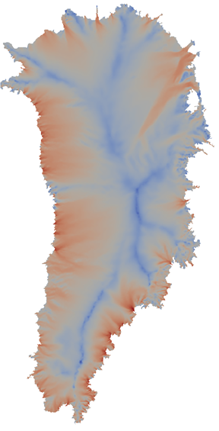
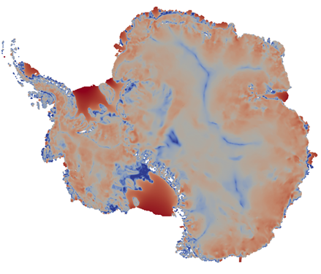
On the Development & Performance of a First Order Stokes Finite Element Ice Sheet Dycore Built Using Trilinos Software Components
I. Tezaur*, A. Salinger, M. Perego, R. Tuminaro
Sandia National Laboratories
Livermore, CA and Albuquerque, NM
With contributions from: I. Demeshko (SNL), S. Price (LANL) and M. Hoffman (LANL)
Saturday, March 14, 2015
SIAM Conference on Computational Science & Engineering (CS&E) 2015
Salt Lake City, UT
*Formerly I. Kalashnikova.
SAND2015-1599 C

Slide 2
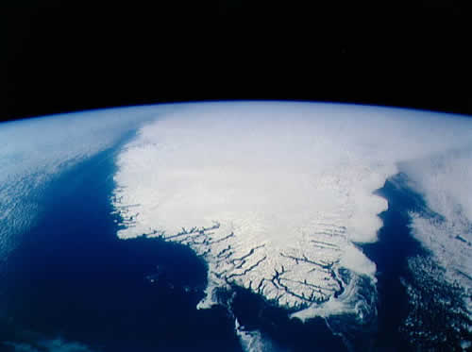
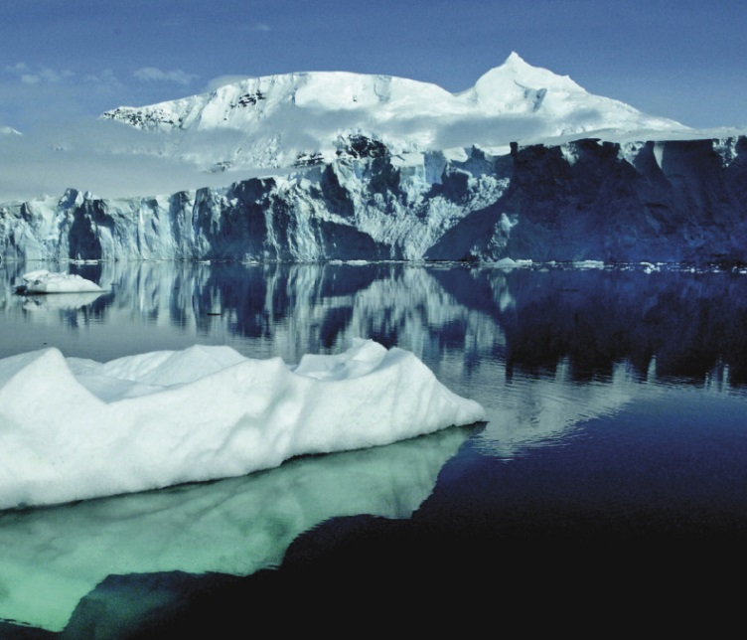
Outline
The First Order Stokes model for ice sheets and the Albany/FELIX finite element solver.
Verification and mesh convergence.
Effect of partitioning and vertical refinement.
Nonlinear solver robustness.
Linear solver scalability.
Performance-portability.
Summary and ongoing work.

Slide 3
Outline
The First Order Stokes model for ice sheets and the Albany/FELIX finite element solver.
Verification and mesh convergence.
Effect of partitioning and vertical refinement.
Nonlinear solver robustness.
Linear solver scalability.
Performance-portability.
Summary and ongoing work.
For non-ice sheet modelers, this talk will show:
How one can rapidly develop a production-ready scalable and robust code using open-source libraries.
Recommendations based on numerical lessons learned.
New algorithms / numerical techniques.

Slide 4
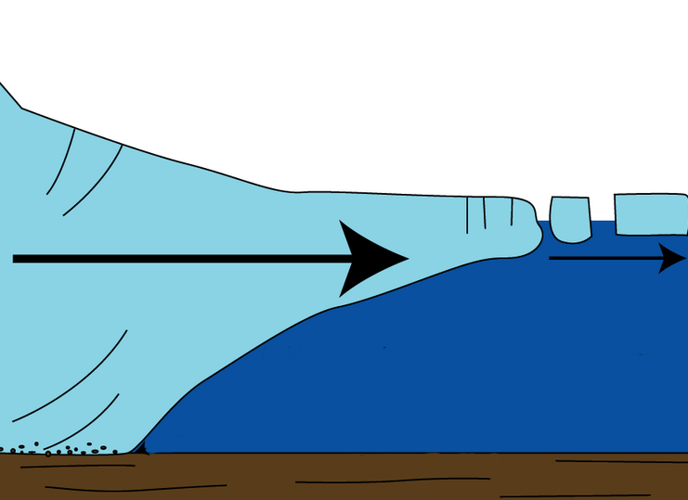
The First-Order Stokes Model
for Ice Sheets & Glaciers
Ice sheet dynamics are given by the “First-Order” Stokes PDEs: approximation* to viscous incompressible quasi-static Stokes flow with power-law viscosity.
$\left\{\begin{aligned}−∇∙(2μ\dot{ε}1)=−ρg\frac{∂s}{∂x} \\ −∇∙(2μ\dot{ε}2)=−ρg\frac{∂s}{∂y}\end{aligned}\right.$ , in $Ω$
$$\dot{ε}1T=\left(2\dot{ε}11+\dot{ε}22,\dot{ε}12,\dot{ε}13\right)$$
$$\dot{ε}2T=\left(2\dot{ε}12, \dot{ε}11+2\dot{ε}22,\dot{ε}23\right)$$
$$\dot{ε}ij=\frac{1}{2}\left(\frac{∂ui}{∂xj}+\frac{∂uj}{∂xi}\right)$$
Viscosity $μ$ is nonlinear function given by “Glen’s law”:
$$μ=\frac{1}{2}{A^{−\frac{1}{n}}\left(\frac{1}{2}\sum_{ij}{\dot{ε}ij2}\right)}^{\left(\frac{1}{2n}−\frac{1}{2}\right)}$$
Albany/FELIX
$$(n=3)$$
Ice sheet
Relevant boundary conditions:
*Assumption: aspect ratio $δ$is small and normals to upper/lower surfaces are almost vertical.

Slide 5
The First-Order Stokes Model
for Ice Sheets & Glaciers
Ice sheet dynamics are given by the “First-Order” Stokes PDEs: approximation* to viscous incompressible quasi-static Stokes flow with power-law viscosity.
$\left\{\begin{aligned}−∇∙(2μ\dot{ε}1)=−ρg\frac{∂s}{∂x} \\ −∇∙(2μ\dot{ε}2)=−ρg\frac{∂s}{∂y}\end{aligned}\right.$ , in $Ω$
$$\dot{ε}1T=\left(2\dot{ε}11+\dot{ε}22,\dot{ε}12,\dot{ε}13\right)$$
$$\dot{ε}2T=\left(2\dot{ε}12, \dot{ε}11+2\dot{ε}22,\dot{ε}23\right)$$
$$\dot{ε}ij=\frac{1}{2}\left(\frac{∂ui}{∂xj}+\frac{∂uj}{∂xi}\right)$$
Viscosity $μ$ is nonlinear function given by “Glen’s law”:
$$μ=\frac{1}{2}{A^{−\frac{1}{n}}\left(\frac{1}{2}\sum_{ij}{\dot{ε}ij2}\right)}^{\left(\frac{1}{2n}−\frac{1}{2}\right)}$$
Surface boundary $Γs$
Albany/FELIX
$$(n=3)$$
Ice sheet
Relevant boundary conditions:
Stress-free BC: $2μ\dot{ε}i∙n=0,$ on $Γs$
*Assumption: aspect ratio $δ$is small and normals to upper/lower surfaces are almost vertical.

Slide 6
The First-Order Stokes Model
for Ice Sheets & Glaciers
Ice sheet dynamics are given by the “First-Order” Stokes PDEs: approximation* to viscous incompressible quasi-static Stokes flow with power-law viscosity.
$\left\{\begin{aligned}−∇∙(2μ\dot{ε}1)=−ρg\frac{∂s}{∂x} \\ −∇∙(2μ\dot{ε}2)=−ρg\frac{∂s}{∂y}\end{aligned}\right.$ , in $Ω$
$$\dot{ε}1T=\left(2\dot{ε}11+\dot{ε}22,\dot{ε}12,\dot{ε}13\right)$$
$$\dot{ε}2T=\left(2\dot{ε}12, \dot{ε}11+2\dot{ε}22,\dot{ε}23\right)$$
$$\dot{ε}ij=\frac{1}{2}\left(\frac{∂ui}{∂xj}+\frac{∂uj}{∂xi}\right)$$
Viscosity $μ$ is nonlinear function given by “Glen’s law”:
$$μ=\frac{1}{2}{A^{−\frac{1}{n}}\left(\frac{1}{2}\sum_{ij}{\dot{ε}ij2}\right)}^{\left(\frac{1}{2n}−\frac{1}{2}\right)}$$
Surface boundary $Γs$
Albany/FELIX
$$(n=3)$$
Ice sheet
Relevant boundary conditions:
Stress-free BC: $2μ\dot{ε}i∙n=0,$ on $Γs$
Floating ice BC:
$2μ\dot{ε}i∙n$ = $\left\{\begin{aligned}ρgzn\text{, }\text{if} z>0 \\ 0, if z≤0\end{aligned}, \right.on Γl$
Lateral boundary $Γl$
*Assumption: aspect ratio $δ$is small and normals to upper/lower surfaces are almost vertical.

Slide 7
The First-Order Stokes Model
for Ice Sheets & Glaciers
Ice sheet dynamics are given by the “First-Order” Stokes PDEs: approximation* to viscous incompressible quasi-static Stokes flow with power-law viscosity.
$\left\{\begin{aligned}−∇∙(2μ\dot{ε}1)=−ρg\frac{∂s}{∂x} \\ −∇∙(2μ\dot{ε}2)=−ρg\frac{∂s}{∂y}\end{aligned}\right.$ , in $Ω$
$$\dot{ε}1T=\left(2\dot{ε}11+\dot{ε}22,\dot{ε}12,\dot{ε}13\right)$$
$$\dot{ε}2T=\left(2\dot{ε}12, \dot{ε}11+2\dot{ε}22,\dot{ε}23\right)$$
$$\dot{ε}ij=\frac{1}{2}\left(\frac{∂ui}{∂xj}+\frac{∂uj}{∂xi}\right)$$
Viscosity $μ$ is nonlinear function given by “Glen’s law”:
$$μ=\frac{1}{2}{A^{−\frac{1}{n}}\left(\frac{1}{2}\sum_{ij}{\dot{ε}ij2}\right)}^{\left(\frac{1}{2n}−\frac{1}{2}\right)}$$
Surface boundary $Γs$
Albany/FELIX
$$(n=3)$$
Ice sheet
Relevant boundary conditions:
Stress-free BC: $2μ\dot{ε}i∙n=0,$ on $Γs$
Floating ice BC:
$2μ\dot{ε}i∙n$ = $\left\{\begin{aligned}ρgzn\text{, }\text{if} z>0 \\ 0, if z≤0\end{aligned}, \right.on Γl$
Basal sliding BC: $2μ\dot{ε}i∙n+βui=0$, on $Γβ$
Lateral boundary $Γl$
Basal boundary $Γβ$
)
$$β=sliding coefficient≥0$$
*Assumption: aspect ratio $δ$is small and normals to upper/lower surfaces are almost vertical.

Slide 8
The PISCEES Project and the Albany/FELIX Solver
“PISCEES” = Predicting Ice Sheet Climate & Evolution at Extreme Scales
5 Year Project funded by SciDAC, which began in June 2012
Sandia’s Role in the PISCEES Project: to develop and support a robust and scalable land ice solver based on the “First-Order” (FO) Stokes physics

Slide 9
The PISCEES Project and the Albany/FELIX Solver
“PISCEES” = Predicting Ice Sheet Climate & Evolution at Extreme Scales
5 Year Project funded by SciDAC, which began in June 2012
Sandia’s Role in the PISCEES Project: to develop and support a robust and scalable land ice solver based on the “First-Order” (FO) Stokes physics
Steady-state stress-velocity solver based on FO Stokes physics is known as Albany/FELIX*.
*FELIX=“Finite Elements for Land Ice eXperiments”
Albany/FELIX Solver (steady):
Ice Sheet PDEs (First Order Stokes)
(stress-velocity solve)

Slide 10
The PISCEES Project and the Albany/FELIX Solver
“PISCEES” = Predicting Ice Sheet Climate & Evolution at Extreme Scales
5 Year Project funded by SciDAC, which began in June 2012
Sandia’s Role in the PISCEES Project: to develop and support a robust and scalable land ice solver based on the “First-Order” (FO) Stokes physics
Steady-state stress-velocity solver based on FO Stokes physics is known as Albany/FELIX*.
Requirements for Albany/FELIX:
*FELIX=“Finite Elements for Land Ice eXperiments”
Albany/FELIX Solver (steady):
Ice Sheet PDEs (First Order Stokes)
(stress-velocity solve)

Slide 11
The PISCEES Project and the Albany/FELIX Solver
“PISCEES” = Predicting Ice Sheet Climate & Evolution at Extreme Scales
5 Year Project funded by SciDAC, which began in June 2012
Sandia’s Role in the PISCEES Project: to develop and support a robust and scalable land ice solver based on the “First-Order” (FO) Stokes physics
Steady-state stress-velocity solver based on FO Stokes physics is known as Albany/FELIX*.
Requirements for Albany/FELIX:
Scalable, fast, robust.
*FELIX=“Finite Elements for Land Ice eXperiments”
Albany/FELIX Solver (steady):
Ice Sheet PDEs (First Order Stokes)
(stress-velocity solve)

Slide 12
The PISCEES Project and the Albany/FELIX Solver
“PISCEES” = Predicting Ice Sheet Climate & Evolution at Extreme Scales
5 Year Project funded by SciDAC, which began in June 2012
Sandia’s Role in the PISCEES Project: to develop and support a robust and scalable land ice solver based on the “First-Order” (FO) Stokes physics
Steady-state stress-velocity solver based on FO Stokes physics is known as Albany/FELIX*.
Requirements for Albany/FELIX:
Scalable, fast, robust.
Dynamical core (dycore) when coupled to codes that solve thickness and temperature evolution equations (CISM/MPAS codes).
Dycore will provide actionable predictions of 21st century sea-level rise (including uncertainty).
*FELIX=“Finite Elements for Land Ice eXperiments”
Albany/FELIX Solver (steady):
Ice Sheet PDEs (First Order Stokes)
(stress-velocity solve)
CISM/MPAS Land Ice Codes (dynamic):
Ice Sheet Evolution PDEs
(thickness, temperature evolution)

Slide 13
The PISCEES Project and the Albany/FELIX Solver
“PISCEES” = Predicting Ice Sheet Climate & Evolution at Extreme Scales
5 Year Project funded by SciDAC, which began in June 2012
Sandia’s Role in the PISCEES Project: to develop and support a robust and scalable land ice solver based on the “First-Order” (FO) Stokes physics
Steady-state stress-velocity solver based on FO Stokes physics is known as Albany/FELIX*.
Requirements for Albany/FELIX:
Scalable, fast, robust.
Dynamical core (dycore) when coupled to codes that solve thickness and temperature evolution equations (CISM/MPAS codes).
Advanced analysis capabilities (deterministic inversion**, Bayesian calibration, UQ, sensitivity analysis).
Dycore will provide actionable predictions of 21st century sea-level rise (including uncertainty).
**See M. Perego’s talk today@ 5:25PM in MS71: “Advances on Ice-Sheet Model Initialization using the First Order Model”
*FELIX=“Finite Elements for Land Ice eXperiments”
Albany/FELIX Solver (steady):
Ice Sheet PDEs (First Order Stokes)
(stress-velocity solve)
CISM/MPAS Land Ice Codes (dynamic):
Ice Sheet Evolution PDEs
(thickness, temperature evolution)

Slide 14
The PISCEES Project and the Albany/FELIX Solver
“PISCEES” = Predicting Ice Sheet Climate & Evolution at Extreme Scales
5 Year Project funded by SciDAC, which began in June 2012
Sandia’s Role in the PISCEES Project: to develop and support a robust and scalable land ice solver based on the “First-Order” (FO) Stokes physics
Steady-state stress-velocity solver based on FO Stokes physics is known as Albany/FELIX*.
Requirements for Albany/FELIX:
Scalable, fast, robust.
Dynamical core (dycore) when coupled to codes that solve thickness and temperature evolution equations (CISM/MPAS codes).
Advanced analysis capabilities (deterministic inversion**, Bayesian calibration, UQ, sensitivity analysis).
Performance-portability.
Dycore will provide actionable predictions of 21st century sea-level rise (including uncertainty).
**See M. Perego’s talk today@ 5:25PM in MS71: “Advances on Ice-Sheet Model Initialization using the First Order Model”
*FELIX=“Finite Elements for Land Ice eXperiments”
Albany/FELIX Solver (steady):
Ice Sheet PDEs (First Order Stokes)
(stress-velocity solve)
CISM/MPAS Land Ice Codes (dynamic):
Ice Sheet Evolution PDEs
(thickness, temperature evolution)

Slide 15
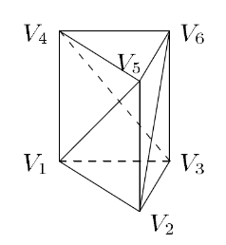
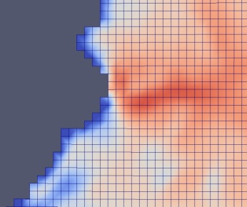
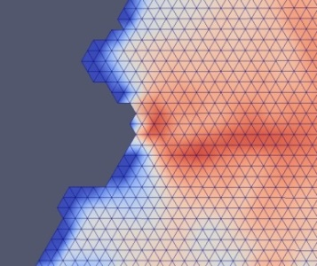
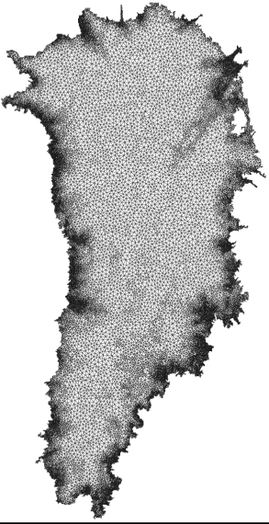
Algorithmic Choices for Albany/FELIX: Discretization & Meshes
Discretization: unstructured grid finite element method (FEM)
Can handle readily complex geometries.
Natural treatment of stress boundary conditions.
Enables regional refinement/unstructured meshes.
Wealth of software and algorithms.
Meshes: can use any mesh but interested specifically in
Structured hexahedral meshes (compatible with CISM).
Structured tetrahedral meshes (compatible with MPAS)
Unstructured Delaunay triangle meshes with regional refinement based on gradient of surface velocity.
All meshes are extruded (structured) in vertical direction as tetrahedra or hexahedra.

Slide 16
Algorithmic Choices for Albany/FELIX: Nonlinear & Linear Solver
Nonlinear solver: full Newton with analytic (automatic differentiation) derivatives
Most robust and efficient for steady-state solves.
Jacobian available for preconditioners and matrix-vector products.
Analytic sensitivity analysis.
Analytic gradients for inversion.
Linear solver: preconditioned iterative method
Solvers: Conjugate Gradient (CG) or GMRES
Preconditioners: ILU or algebraic multi-grid (AMG)
Automatic Differentiation Jacobian:
$$J = \frac{∂f}{∂x}$$
Preconditioned
Iterative Linear Solve
(CG or GMRES):
Solve $Jx=r$
Nonlinear Solve
for $f(x) = 0$
(Newton)

Slide 17
The Albany/FELIX Solver:
Implementation in Albany using Trilinos
*Available on github: https://github.com/gahansen/Albany.
The Albany/FELIX First Order Stokes solver is implemented in a Sandia (open-source*) parallel C++ finite element code called…
“Agile Components”
Discretizations/meshes
Solver libraries
Preconditioners
Automatic differentiation
Many others!
Started by A. Salinger
Parameter estimation
Uncertainty quantification
Optimization
Bayesian inference
Land Ice Physics Set (Albany/FELIX code)
Other Albany Physics Sets
Configure/build/test/documentation
Use of Trilinos components has enabled the rapid development of the Albany/FELIX First Order Stokes dycore!
See A. Salinger’s talk on Tuesday @ 2:40PM in MS225
“Albany: A Trilinos-based code for Ice Sheet Simulations and other Applications”

Slide 18
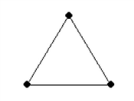
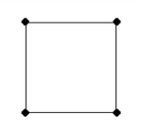
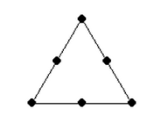
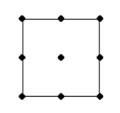
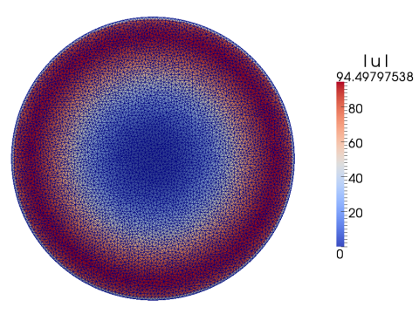
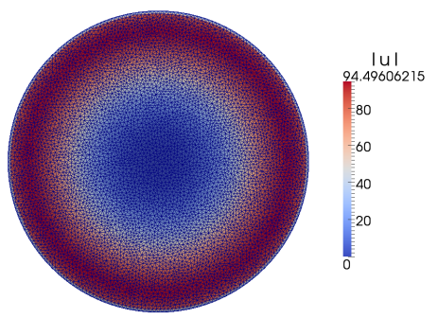
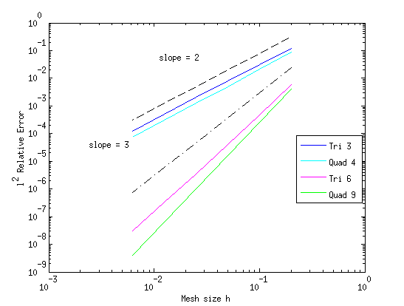
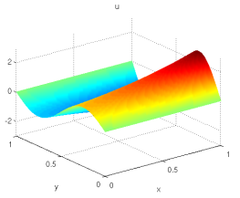
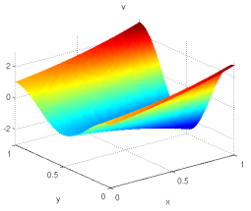
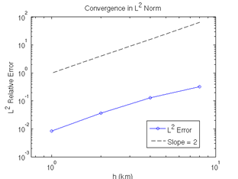
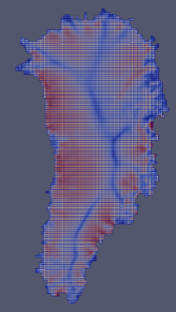
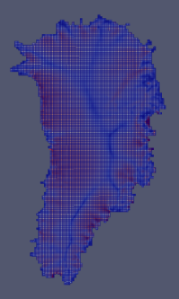
Verification/Mesh Convergence Studies
Stage 1: solution verification on 2D MMS problems we derived.
Stage 2: code-to-code comparisons on canonical ice sheet problems.
Albany/FELIX
LifeV
Stage 3: full 3D mesh convergence study on Greenland w.r.t. reference solution.
Are the Greenland problems resolved?
Is theoretical convergence rate achieved?

Slide 19
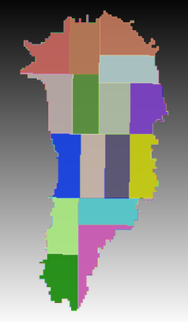
Mesh Partitioning & Vertical
Refinement
Mesh convergence studies led to some useful practical recommendations
(for ice sheet modelers and geo-scientists)!
Partitioning matters: good solver performance obtained with 2D partition of mesh (all elements with same $x,y$coordinates on same processor - right).
Number of vertical layers matters: more gained in refining # vertical layers than horizontal resolution (below – relative errors for Greenland).
Horiz. res.\vert. layers | 5 | 10 | 20 | 40 | 80
8km | 2.0e-1
4km | 9.0e-2 | 7.8e-2
2km | 4.6e-2 | 2.4e-2 | 2.3e-2
1km | 3.8e-2 | 8.9e-3 | 5.5e-3 | 5.1e-3
500m | 3.7e-2 | 6.7e-3 | 1.7e-3 | 3.9e-4 | 8.1e-5

Slide 20
Mesh Partitioning & Vertical
Refinement
Mesh convergence studies led to some useful practical recommendations
(for ice sheet modelers and geo-scientists)!
Partitioning matters: good solver performance obtained with 2D partition of mesh (all elements with same $x,y$coordinates on same processor - right).
Number of vertical layers matters: more gained in refining # vertical layers than horizontal resolution (below – relative errors for Greenland).
Horiz. res.\vert. layers | 5 | 10 | 20 | 40 | 80
8km | 2.0e-1
4km | 9.0e-2 | 7.8e-2
2km | 4.6e-2 | 2.4e-2 | 2.3e-2
1km | 3.8e-2 | 8.9e-3 | 5.5e-3 | 5.1e-3
500m | 3.7e-2 | 6.7e-3 | 1.7e-3 | 3.9e-4 | 8.1e-5

Slide 21
Mesh Partitioning & Vertical
Refinement
Mesh convergence studies led to some useful practical recommendations
(for ice sheet modelers and geo-scientists)!
Partitioning matters: good solver performance obtained with 2D partition of mesh (all elements with same $x,y$coordinates on same processor - right).
Number of vertical layers matters: more gained in refining # vertical layers than horizontal resolution (below – relative errors for Greenland).
Horiz. res.\vert. layers | 5 | 10 | 20 | 40 | 80
8km | 2.0e-1
4km | 9.0e-2 | 7.8e-2
2km | 4.6e-2 | 2.4e-2 | 2.3e-2
1km | 3.8e-2 | 8.9e-3 | 5.5e-3 | 5.1e-3
500m | 3.7e-2 | 6.7e-3 | 1.7e-3 | 3.9e-4 | 8.1e-5
Vertical refinement to 20 layers recommended for 1km resolution over horizontal refinement.

Slide 22
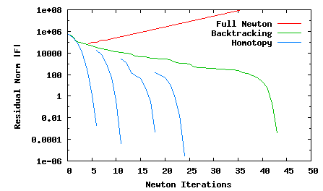
Robustness of Newton’s Method via Homotopy Continuation (LOCA)
$$\dot{ε}1T=\left(2\dot{ε}11+\dot{ε}22,\dot{ε}12,\dot{ε}13\right)$$
$$\dot{ε}2T=\left(2\dot{ε}12, \dot{ε}11+2\dot{ε}22,\dot{ε}23\right)$$
$$\dot{ε}ij=\frac{1}{2}\left(\frac{∂ui}{∂xj}+\frac{∂uj}{∂xi}\right)$$
$γ$=10⁻¹⁰
Glen’s Law Viscosity:
$γ$=10⁻¹⁰
$$μ=\frac{1}{2}{A^{−\frac{1}{n}}\left(\frac{1}{2}\sum_{ij}{\dot{ε}ij2}\right)}^{\left(\frac{1}{2n}−\frac{1}{2}\right)}$$
$γ$=10^{-1.0}
$γ$=10^{-6.0}
$γ$=10⁻¹⁰
$γ$=10^{-2.5}
$$n=3$$
(Glen’s law exponent)

Slide 23
Robustness of Newton’s Method via Homotopy Continuation (LOCA)
$$\dot{ε}1T=\left(2\dot{ε}11+\dot{ε}22,\dot{ε}12,\dot{ε}13\right)$$
$$\dot{ε}2T=\left(2\dot{ε}12, \dot{ε}11+2\dot{ε}22,\dot{ε}23\right)$$
$$\dot{ε}ij=\frac{1}{2}\left(\frac{∂ui}{∂xj}+\frac{∂uj}{∂xi}\right)$$
$γ$=10⁻¹⁰
Glen’s Law Viscosity:
$$μ=\frac{1}{2}{A^{−\frac{1}{n}}\left(\frac{1}{2}\sum_{ij}{\dot{ε}ij2+}γ\right)}^{\left(\frac{1}{2n}−\frac{1}{2}\right)}$$
$γ$=10⁻¹⁰
$$μ=\frac{1}{2}{A^{−\frac{1}{n}}\left(\frac{1}{2}\sum_{ij}{\dot{ε}ij2}\right)}^{\left(\frac{1}{2n}−\frac{1}{2}\right)}$$
$γ$=10^{-1.0}
$γ=$regularization parameter
$γ$=10^{-6.0}
$γ$=10⁻¹⁰
$γ$=10^{-2.5}
$$n=3$$
(Glen’s law exponent)

Slide 24
Robustness of Newton’s Method via Homotopy Continuation (LOCA)
$$\dot{ε}1T=\left(2\dot{ε}11+\dot{ε}22,\dot{ε}12,\dot{ε}13\right)$$
$$\dot{ε}2T=\left(2\dot{ε}12, \dot{ε}11+2\dot{ε}22,\dot{ε}23\right)$$
$$\dot{ε}ij=\frac{1}{2}\left(\frac{∂ui}{∂xj}+\frac{∂uj}{∂xi}\right)$$
$γ$=10⁻¹⁰
Glen’s Law Viscosity:
$$μ=\frac{1}{2}{A^{−\frac{1}{n}}\left(\frac{1}{2}\sum_{ij}{\dot{ε}ij2+}γ\right)}^{\left(\frac{1}{2n}−\frac{1}{2}\right)}$$
$γ$=10⁻¹⁰
$$μ=\frac{1}{2}{A^{−\frac{1}{n}}\left(\frac{1}{2}\sum_{ij}{\dot{ε}ij2}\right)}^{\left(\frac{1}{2n}−\frac{1}{2}\right)}$$
$γ$=10^{-1.0}
$γ=$regularization parameter
$γ$=10^{-6.0}
$γ$=10⁻¹⁰
$γ$=10^{-2.5}
$$n=3$$
(Glen’s law exponent)
Newton’s method most robust with full step + homotopy continuation of $γ→{10}^{−10}$: converges out-of-the-box!

Slide 25
Scalability via Algebraic Multi-Grid
Preconditioning
With R. Tuminaro (SNL)
Bad aspect ratios ruin classical AMG convergence rates!
relatively small horizontal coupling terms, hard to smooth horizontal errors
⇒ Solvers (even ILU) must take aspect ratios into account
We developed a new AMG solver based on semi-coarsening (figure below)
Algebraic Structured MG ( ≡ matrix depend. MG) used with vertical line relaxation on
finest levels + traditional AMG on 1 layer problem
…
Algebraic Structured MG
Algebraic Structured MG
Unstructured AMG
Unstructured AMG
*With 2D partitioning and layer-wise node ordering, required for best performance of ILU.

Slide 26
Scalability via Algebraic Multi-Grid
Preconditioning
With R. Tuminaro (SNL)
Bad aspect ratios ruin classical AMG convergence rates!
relatively small horizontal coupling terms, hard to smooth horizontal errors
⇒ Solvers (even ILU) must take aspect ratios into account
We developed a new AMG solver based on semi-coarsening (figure below)
Algebraic Structured MG ( ≡ matrix depend. MG) used with vertical line relaxation on
finest levels + traditional AMG on 1 layer problem
New AMG preconditioner is available in ML package of Trilinos!
…
Algebraic Structured MG
Algebraic Structured MG
Unstructured AMG
Unstructured AMG
*With 2D partitioning and layer-wise node ordering, required for best performance of ILU.

Slide 27
Scalability via Algebraic Multi-Grid
Preconditioning
With R. Tuminaro (SNL)
Bad aspect ratios ruin classical AMG convergence rates!
relatively small horizontal coupling terms, hard to smooth horizontal errors
⇒ Solvers (even ILU) must take aspect ratios into account
We developed a new AMG solver based on semi-coarsening (figure below)
Algebraic Structured MG ( ≡ matrix depend. MG) used with vertical line relaxation on
finest levels + traditional AMG on 1 layer problem
New AMG preconditioner is available in ML package of Trilinos!
…
Algebraic Structured MG
Algebraic Structured MG
Unstructured AMG
Unstructured AMG
Scaling studies (next 3 slides):
New AMG preconditioner vs. ILU*
*With 2D partitioning and layer-wise node ordering, required for best performance of ILU.

Slide 28
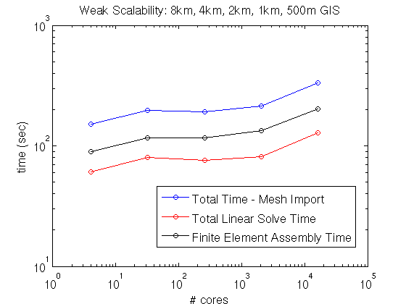
Greenland Controlled Weak Scalability Study
Weak scaling study with fixed dataset, 4 mesh bisections.
~70-80K dofs/core.
Conjugate Gradient (CG) iterative method for linear solves (faster convergence than GMRES).
New AMG preconditioner developed by R. Tuminaro based on semi-coarsening (coarsening in $z$-direction only).
Significant improvement in scalability with new AMG preconditioner over ILU preconditioner!
4 cores
334K dofs
8 km Greenland,
5 vertical layers
16,384 cores
1.12B dofs(!)
0.5 km Greenland,
80 vertical layers
$×84$
scale up

Slide 29
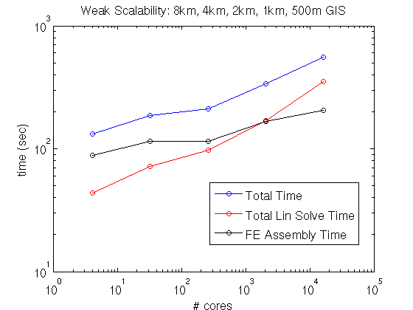
Greenland Controlled Weak Scalability Study
New AMG preconditioner preconditioner
ILU preconditioner
Weak scaling study with fixed dataset, 4 mesh bisections.
~70-80K dofs/core.
Conjugate Gradient (CG) iterative method for linear solves (faster convergence than GMRES).
New AMG preconditioner developed by R. Tuminaro based on semi-coarsening (coarsening in $z$-direction only).
Significant improvement in scalability with new AMG preconditioner over ILU preconditioner!
4 cores
334K dofs
8 km Greenland,
5 vertical layers
16,384 cores
1.12B dofs(!)
0.5 km Greenland,
80 vertical layers
$×84$
scale up

Slide 30
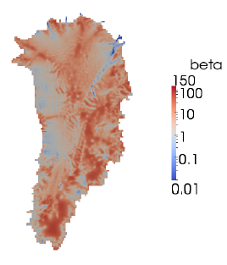
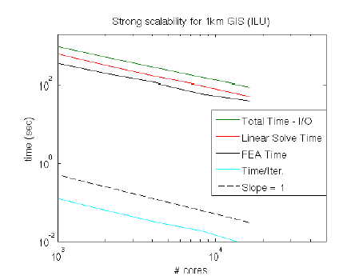
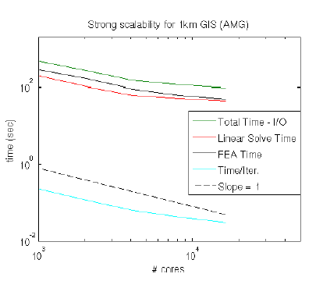
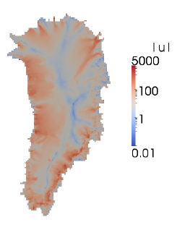
Fine-Resolution Greenland Strong
Scaling Study
Strong scaling on 1km Greenland with 40 vertical layers (143M dofs, hex elements).
Initialized with realistic basal friction (from deterministic inversion) and temperature fields $→$ interpolated from coarser to fine mesh.
Iterative linear solver: CG.
Preconditioner: ILU vs. new AMG (based on aggressive semi-coarsening).
ILU
AMG
Albany/FELIX
Glimmer/CISM
1024 cores
16,384 cores
1024 cores
16,384 cores
# cores
# cores
ILU preconditioner scales better than AMG but ILU-preconditioned solve is slightly slower
(see Kalashnikova et al ICCS 2015).

Slide 31
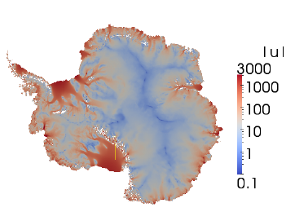
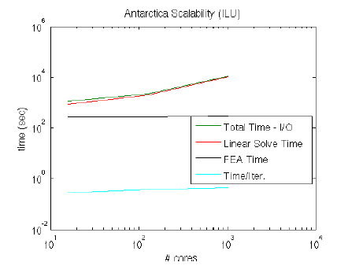
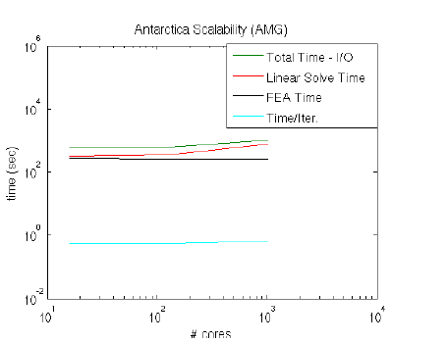
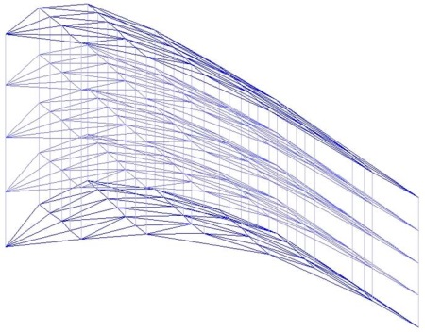
Moderate Resolution Antarctica
Weak Scaling Study
Weak scaling study on Antarctic problem (8km w/ 5 layers $→$ 2km with 20 layers).
Initialized with realistic basal friction (from deterministic inversion) and temperature field from BEDMAP2.
Iterative linear solver: GMRES.
Preconditioner: ILU vs. new AMG based on aggressive semi-coarsening (Kalashnikova et al GMD 2014, Kalashnikova et al ICCS 2015, Tuminaro et al SISC 2015).
ILU
Severe ill-conditioning caused by ice shelves!
AMG
Albany/FELIX
Glimmer/CISM
AMG preconditioner
(vertical > horizontal coupling)
+
Neumann BCs
$=$
nearly singular submatrix associated with vertical lines
16 cores
1024 cores
16 cores
1024 cores
# cores
# cores
GMRES less sensitive than CG to rounding errors from ill-conditioning [also minimizes different norm].
AMG preconditioner less sensitive than ILU to ill-conditioning.
Notes:
- AMG: Gauss-Seidel smoothing on finest level (where lines are defined in mesh extruded direction), Chebyshev smoothing on coarser levels.
- ILU: ordering is important to maintain acceptable convergence rates (need row-wise ordering)!
- GMRES less sensitive than CG to rounding errors associated w/ severe ill-conditioning introduced by presence of ice shelves.
- CG and GMRES minimize different norms.
- Floating ice shelves: matrix entries corresponding to vertical coupling are much stronger than entries corresponding to horizontal coupling. Vertical grid lines lie within ice shelves, top/bottom BCs resemble Neumann conditions and so the submatrix associated with the vertical lines is nearly singular. Ill-conditioning creates challenges for solver.

Slide 32
Performance-Portability via
Kokkos
With I. Demeshko (SNL)
We need to be able to run Albany/FELIX on new architecture machines (hybrid systems) and manycore devices (multi-core CPU, NVIDIA GPU, Intel Xeon Phi, etc.) .
Kokkos: Trilinos library and programming model that provides performance portability across diverse devises with different memory models.
With Kokkos, you write an algorithm once, and just change a template parameter to get the optimal data layout for your hardware.
See I. Demeshko’s talk today @ 3:40PM in MS43
“A Kokkos Implementation of Albany: A Performance Portable Multiphysics Simulation Code”

Slide 33
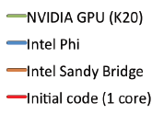
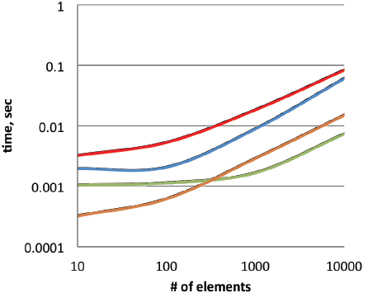
Performance-Portability via
Kokkos (continued)
Right: results for a mini-app that uses finite element kernels from Albany/FELIX but none of the surrounding infrastructure.
“# of elements” = threading index (allows for on-node parallelism).
# of threads required before the Phi and GPU accelerators start to get enough work to warrant overhead: ~100 for the Phi and ~1000 for the GPU.
Below: preliminary results for 3 of the finite element assembly kernels, as part of full Albany/FELIX code run.
Kernel | Serial | 16 OpenMP Threads | GPU
Viscosity Jacobian | 20.39 s | 2.06 s | 0.54 s
Basis Functions w/ FE Transforms | 8.75 s | 0.94 s | 1.23 s
Gather Coordinates | 0.097 s | 0.107 s | 5.77 s
Note: Gather Coordinates routine requires copying data from host to GPU.

Slide 34
Summary and Ongoing Work
Summary:
This talk described the development of a finite element land ice solver known as Albany/FELIX written using the libraries of the Trilinos libraries.
The code is verified, scalable, robust, and portable to new-architecture machines! This is thanks to:
Some new algorithms (e.g., AMG preconditioner) and numerical techniques (e.g., homotopy continuation).
The Trilinos software stack.
Use of Trilinos libraries has enabled the rapid development of this code!
Ongoing/future work:
Dynamic simulations of ice evolution.
Deterministic and stochastic initialization runs (see M. Perego’s talk).
Porting of code to new architecture supercomputers (see I. Demeshko’s talk).
Articles on Albany/FELIX [GMD, ICCS 2015], Albany [J. Engng.] (see A. Salinger’s talk), AMG preconditioner (SISC).
Delivering code to climate community and coupling to earth system models.

Slide 35
Funding/Acknowledgements
Support for this work was provided through Scientific Discovery through Advanced Computing (SciDAC) projects funded by the U.S. Department of Energy, Office of Science (OSCR), Advanced Scientific Computing Research and Biological and Environmental Research (BER) $→$PISCEES SciDAC Application Partnership.
PISCEES team members: W. Lipscomb, S. Price, M. Hoffman, A. Salinger, M. Perego, I. Kalashnikova, R. Tuminaro, P. Jones, K. Evans, P. Worley, M. Gunzburger, C. Jackson;
Trilinos/DAKOTA collaborators: E. Phipps, M. Eldred, J. Jakeman, L. Swiler.
Thank you! Questions?

Slide 36
References
[1] M.A. Heroux et al. “An overview of the Trilinos project.” ACM Trans. Math. Softw. 31(3) (2005).
[2] A.G. Salinger et al. "Albany: Using Agile Components to Develop a Flexible, Generic Multiphysics Analysis Code", Comput. Sci. Disc. (submitted, 2015).
[3] I. Kalashnikova, M. Perego, A. Salinger, R. Tuminaro, S. Price. "Albany/FELIX: A Parallel, Scalable and Robust Finite Element Higher-Order Stokes Ice Sheet Solver Built for Advanced Analysis", Geosci. Model Develop. Discuss. 7 (2014) 8079-8149 (under review for GMD).
[4] I. Kalashnikova, R. Tuminaro, M. Perego, A. Salinger, S. Price. "On the scalability of the Albany/FELIX first-order Stokes approximation ice sheet solver for large-scale simulations of the Greenland and Antarctic ice sheets", MSESM/ICCS15, Reykjavik, Iceland (June 2014).
[5] R.S. Tuminaro, I. Tezaur, M. Perego, A.G. Salinger. "A Hybrid Operator Dependent Multi-Grid/Algebraic Multi-Grid Approach: Application to Ice Sheet Modeling", SIAM J. Sci. Comput. (in prep).

