Slide 1
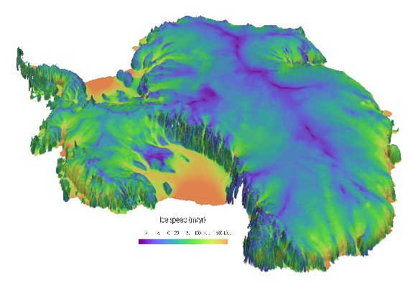
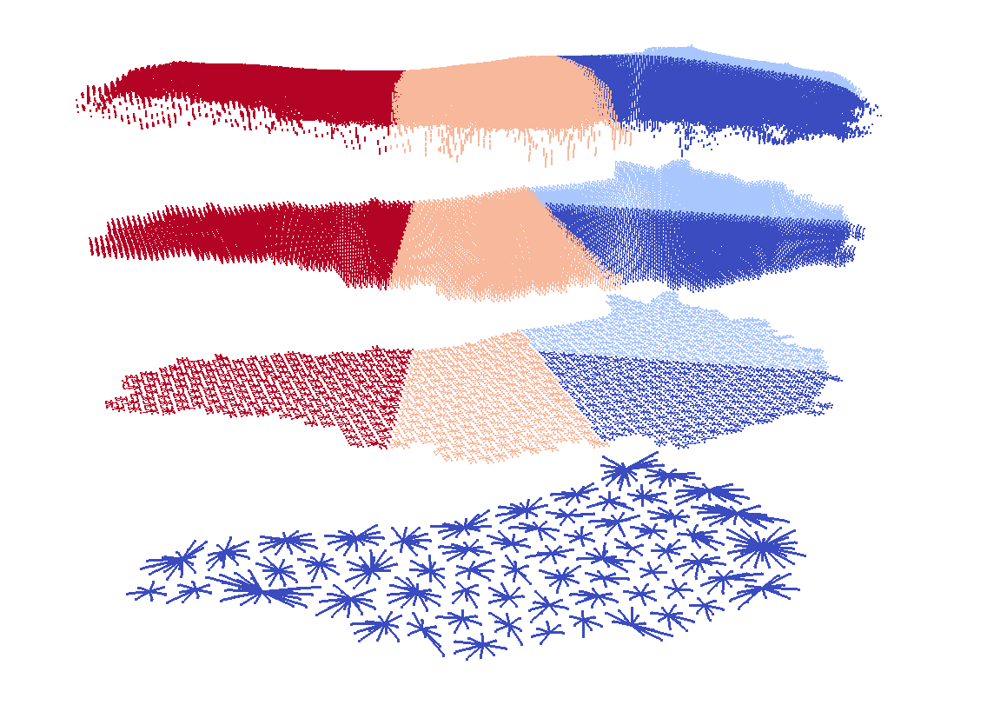
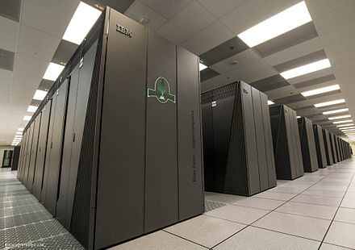
Trilinos/Kokkos-based strategy towards achieving a performance portable land-ice model
Irina Tezaur¹, Jerry Watkins¹, Ray Tuminaro¹, Mauro Perego¹, Andy Salinger¹, Steve Price²
¹Sandia National Laboratories. ²Los Alamos National Laboratory.
BiRS Workshop: Math. Model. in Glaciology Banff, AB, Canada January 13-17, 2020
Sandia National Laboratories is a multi-mission laboratory managed and operated by National Technology and Engineering Solutions of Sandia, LLC., a wholly owned subsidiary of Honeywell International, Inc., for the U.S. Department of Energy’s National Nuclear Security Administration under contract DE-NA0003525.
SAND2020-0015C

Slide 2
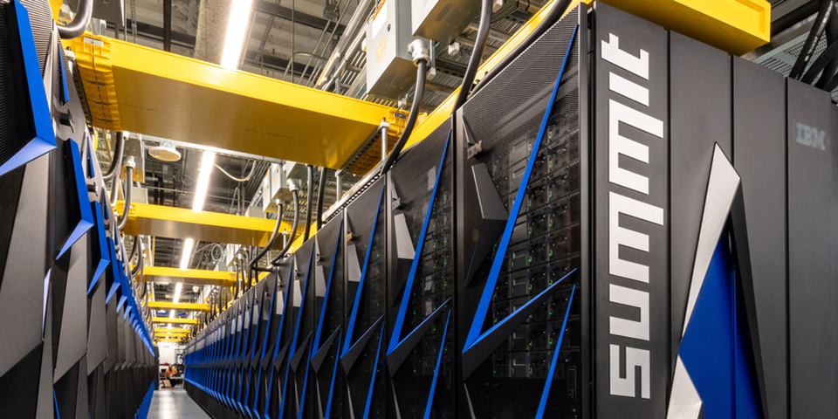
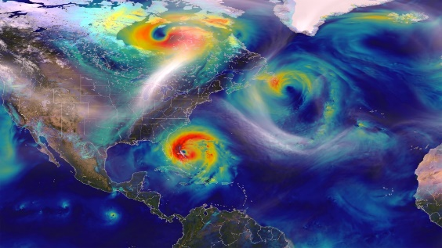
Motivation for performance portability
Earth system models (ESMs) and ice sheet models (ISMs) need more computational power to achieve higher resolutions.
High performance computing (HPC) architectures are becoming increasingly more heterogeneous in a move towards exascale.
Climate models need to adapt to execute correctly & efficiently on new HPC architectures with drastically different memory models.
An application is “performance portable” if it achieves a consistent level of performance across a variety of computer architectures.

Slide 3
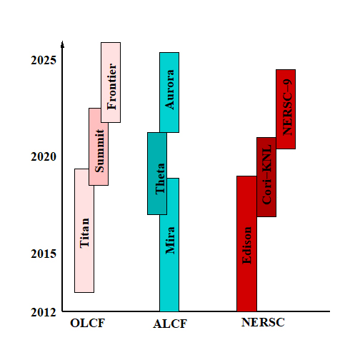
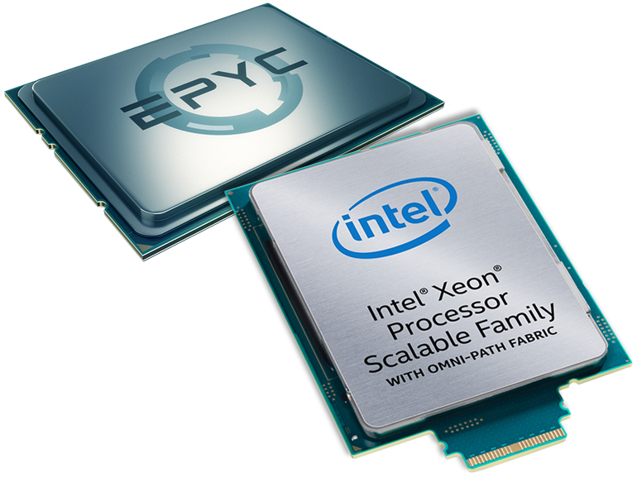
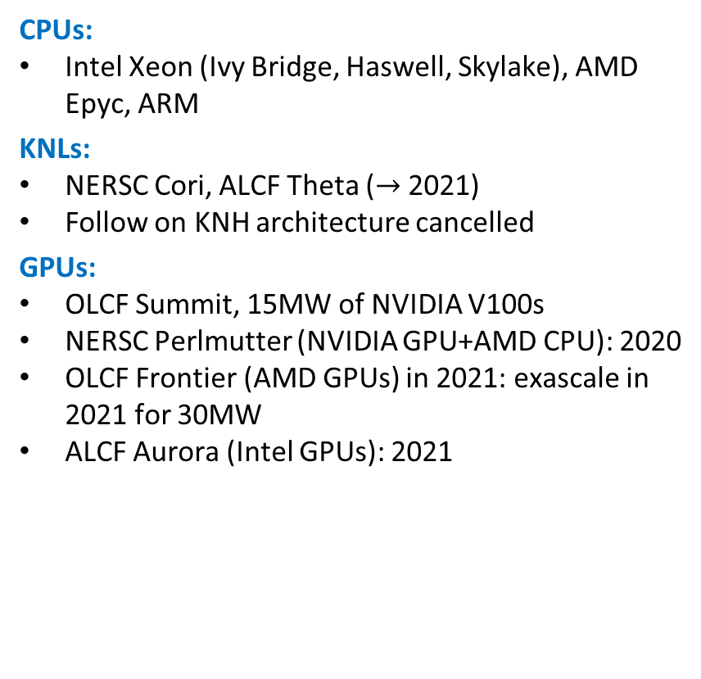
Trends in HPC architectures
CPUs:
Intel Xeon (Ivy Bridge, Haswell, Skylake), AMD Epyc, ARM
KNLs:
  NERSC Cori, ALCF Theta ($→$ 2021)
  Follow on KNH architecture cancelled
GPUs:
  OLCF Summit, 15MW of NVIDIA V100s
  NERSC Perlmutter (NVIDIA GPU+AMD CPU): 2020
  OLCF Frontier (AMD GPUs) in 2021: exascale in 2021 for 30MW
  ALCF Aurora (Intel GPUs): 2021
GPU and heterogeneous (CPU+GPU) architectures seem to be the future in moving towards exascale.
  Computations are cheap, memory transfer is expensive.
  MPI alone is not enough to exploit available parallelism.

Slide 4
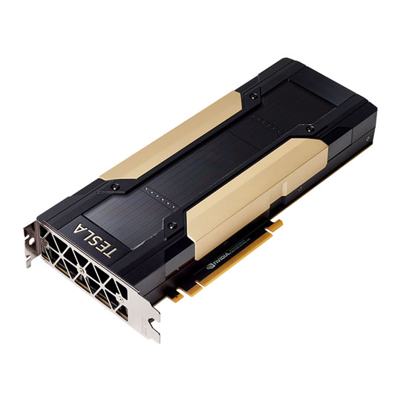
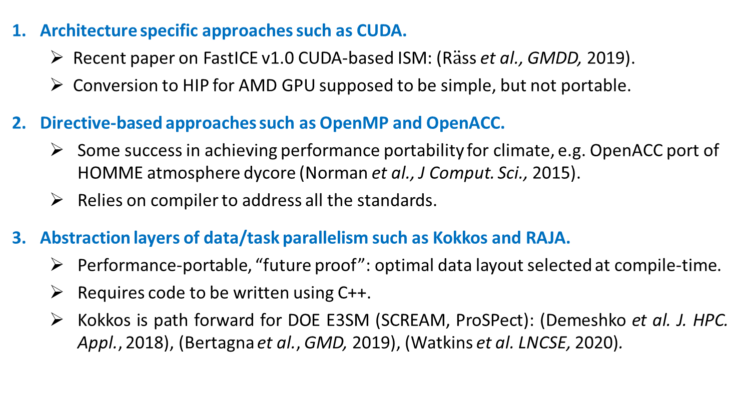
MPI+X programming model/approaches
MPI+X Approach: two levels of parallelism for CPU+accelerator
  MPI for inter-node parallelism (for CPU)
  X for intra-node parallelism (for accelerator, e.g. GPU)
Architecture specific approaches such as CUDA.
  Recent paper on FastICE v1.0 CUDA-based ISM: (R$\ddot{a}$ss et al., GMDD, 2019).
  Conversion to HIP for AMD GPU supposed to be simple, but not portable.
Directive-based approaches such as OpenMP and OpenACC.
  Some success in achieving performance portability for climate, e.g. OpenACC port of HOMME atmosphere dycore (Norman et al., J Comput. Sci., 2015).
  Relies on compiler to address all the standards.
Abstraction layers of data/task parallelism such as Kokkos and RAJA.
  Performance-portable, “future proof”: optimal data layout selected at compile-time.
  Requires code to be written using C++.
  Kokkos is path forward for DOE E3SM (SCREAM, ProSPect): (Demeshko et al. J. HPC. Appl., 2018), (Bertagna et al., GMD, 2019), (Watkins et al. LNCSE, 2020).

Slide 5

MPI+X programming model/approaches
MPI+X Approach: two levels of parallelism for CPU+accelerator
  MPI for inter-node parallelism (for CPU)
  X for intra-node parallelism (for accelerator, e.g. GPU)
Architecture specific approaches such as CUDA.
  Recent paper on FastICE v1.0 CUDA-based ISM: (R$\ddot{a}$ss et al., GMDD, 2019).
  Conversion to HIP for AMD GPU supposed to be simple, but not portable.
Directive-based approaches such as OpenMP and OpenACC.
  Some success in achieving performance portability for climate, e.g. OpenACC port of HOMME atmosphere dycore (Norman et al., J Comput. Sci., 2015).
  Relies on compiler to address all the standards.
Abstraction layers of data/task parallelism such as Kokkos and RAJA.
  Performance-portable, “future proof”: optimal data layout selected at compile-time.
  Requires code to be written using C++.
  Kokkos is path forward for DOE E3SM (SCREAM, ProSPect): (Demeshko et al. J. HPC. Appl., 2018), (Bertagna et al., GMD, 2019), (Watkins et al. LNCSE, 2020).
Our strategy and this talk!

Slide 6
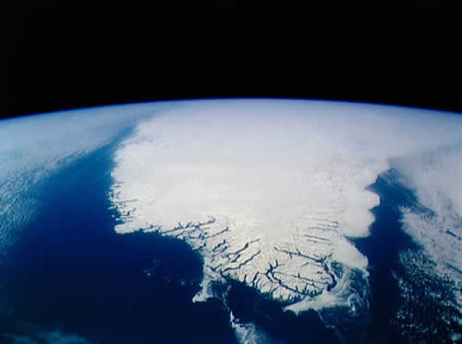
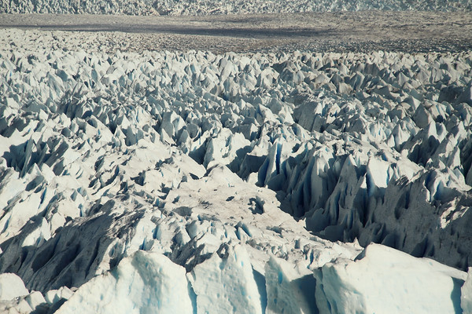
Outline
This talk describes our efforts towards creating a performance portable implementation of the Albany/Land Ice (ALI) model using the Kokkos programming model and Trilinos libraries.
Overview of the Albany/Land Ice (ALI) model/code developed under ProSPect SciDAC.
Performance portability of the finite element assembly in ALI using Kokkos.
Performant algebraic multi-grid linear solvers implemented in Trilinos.
Summary and discussion

Slide 7
Outline
This talk describes our efforts towards creating a performance portable implementation of the Albany/Land Ice (ALI) model using the Kokkos programming model and Trilinos libraries.
Overview of the Albany/Land Ice (ALI) model/code developed under ProSPect SciDAC.
Performance portability of the finite element assembly in ALI using Kokkos.
Performant algebraic multi-grid linear solvers implemented in Trilinos.
Summary and discussion

Slide 8

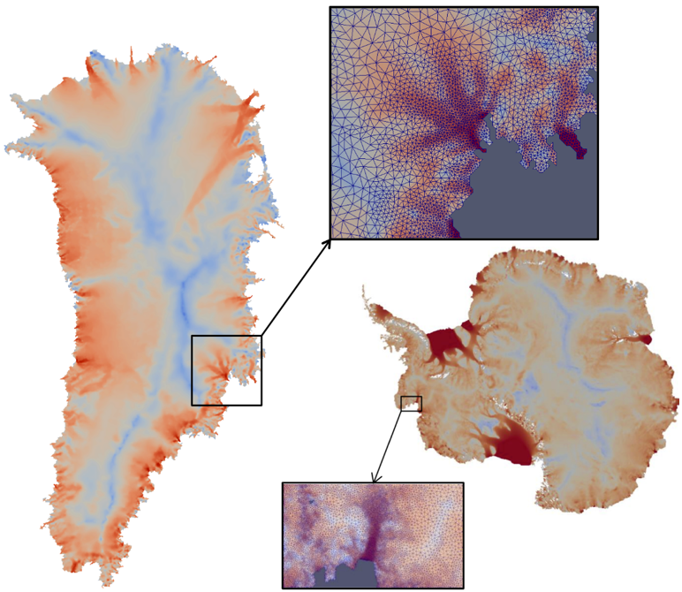
ProSPect project for land-ice modeling
  “ProSPect” = Probabilistic Sea Level Projections from ISMs and ESMs
  5 year SciDAC4 project (2017-2022), https://doe-prospect.github.io/
  Sandia’s Role in the ProSPect Project: to develop and support a robust and scalable land ice solver based on the “First-Order” (FO) Stokes equations $→$Albany/Land Ice (ALI)*
Requirements for Albany/Land Ice (ALI)*:
  Unstructured grid meshes.
  Scalable, fast and robust.
  Verified and validated.
  Portable to new architecture machines.
  Advanced analysis capabilities: deterministic inversion, calibration, uncertainty quantification.
Hooked up to DOE’s E3SM Earth System Model through MPAS
(MPAS + ALI = MALI)
* Formerly Albany/FELIX.

Slide 9
ProSPect project for land-ice modeling
  “ProSPect” = Probabilistic Sea Level Projections from ISMs and ESMs
  5 year SciDAC4 project (2017-2022), https://doe-prospect.github.io/
  Sandia’s Role in the ProSPect Project: to develop and support a robust and scalable land ice solver based on the “First-Order” (FO) Stokes equations $→$Albany/Land Ice (ALI)*
Requirements for Albany/Land Ice (ALI)*:
  Unstructured grid meshes.
  Scalable, fast and robust.
  Verified and validated.
  Portable to new architecture machines.
  Advanced analysis capabilities: deterministic inversion, calibration, uncertainty quantification.
Hooked up to DOE’s E3SM Earth System Model through MPAS
(MPAS + ALI = MALI)
* Formerly Albany/FELIX.

Slide 10



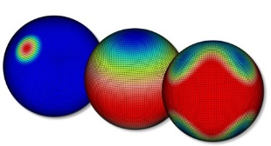
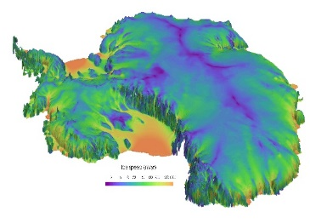
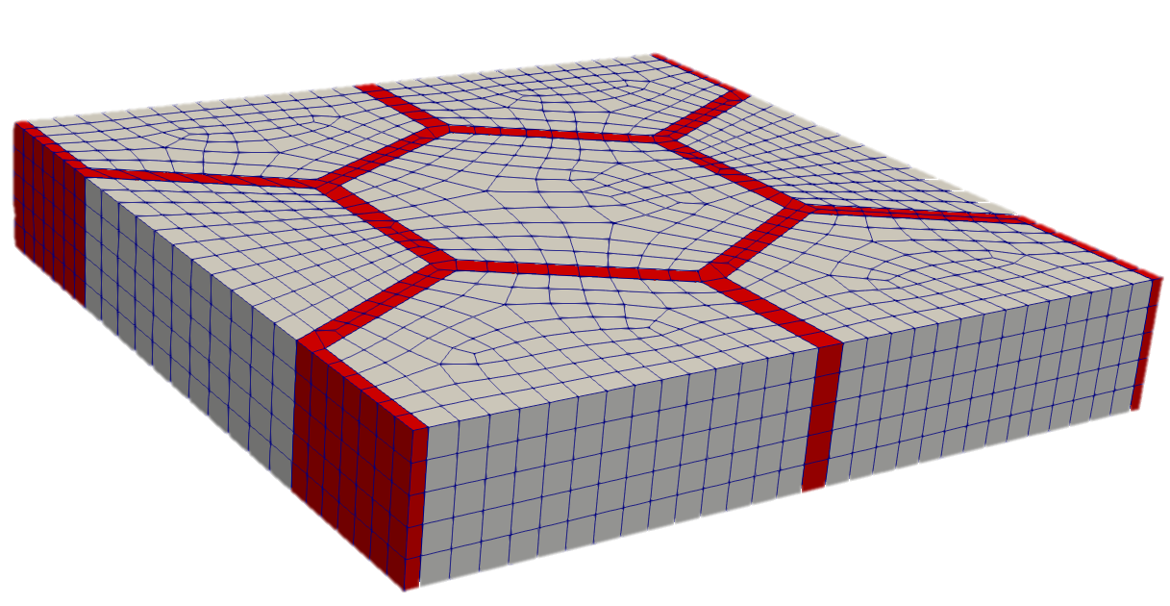
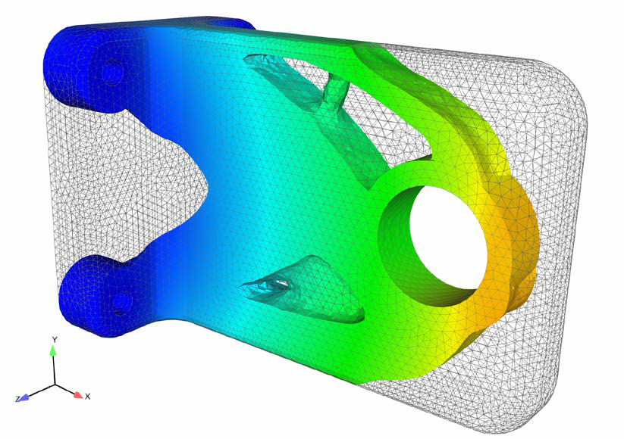
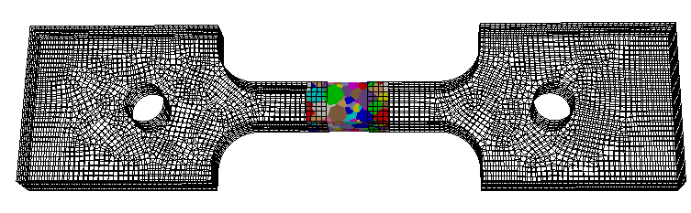
Albany finite element C++ code base
“Agile Components”
The Albany/Land Ice First Order Stokes solver is implemented in a Sandia open-source parallel C++ multi-physics finite element code known as…
Discretizations/meshes
Solver libraries
Preconditioners
Automatic differentiation
Performance portable kernels
Many others!
Parameter estimation
Uncertainty quantification
Optimization
Bayesian inference
Land Ice Equation Set (ALI)
Other Equation Sets
By using software components, we have been able to leverage years of R&D in algorithms, software, and performance portability!
Albany: https://github.com/SNLComputation/Albany
Trilinos: https://github.com/trilinos/Trilinos
Dakota: https://dakota.sandia.gov/

Slide 11
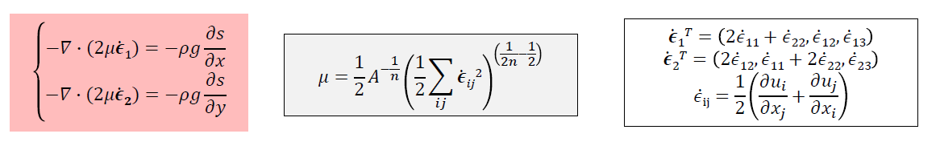
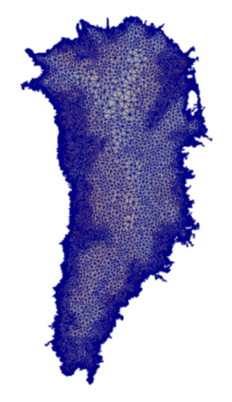
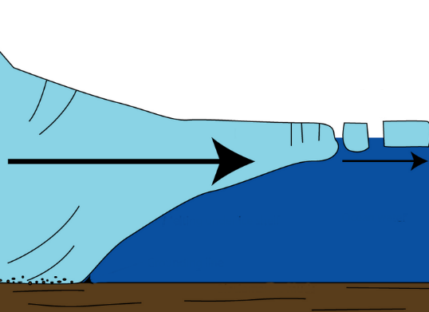

First-Order (FO) Stokes model
Ice velocities given by the “First-Order” Stokes PDEs with nonlinear viscosity:
Algorithmic choices for ALI:
3D unstructured grid FEM discretization.
Newton method nonlinear solver with automatic differentiation Jacobians.
Preconditioned Krylov iterative linear solvers.
Advanced analysis capabilities: deterministic inversion, calibration, UQ.
Ice sheet

Slide 12
First-Order (FO) Stokes model
Ice velocities given by the “First-Order” Stokes PDEs with nonlinear viscosity:
Algorithmic choices for ALI:
3D unstructured grid FEM discretization.
Newton method nonlinear solver with automatic differentiation Jacobians.
Preconditioned Krylov iterative linear solvers.
Advanced analysis capabilities: deterministic inversion, calibration, UQ.
Implicit solver:
FEA* = 50% CPU-time
Linear solve = 50% CPU-time
Ice sheet
* Finite Element Assembly

Slide 13
First-Order (FO) Stokes model
Ice velocities given by the “First-Order” Stokes PDEs with nonlinear viscosity:
Algorithmic choices for ALI:
3D unstructured grid FEM discretization.
Newton method nonlinear solver with automatic differentiation Jacobians.
Preconditioned Krylov iterative linear solvers.
Advanced analysis capabilities: deterministic inversion, calibration, UQ.
Implicit solver:
FEA* = 50% CPU-time
Performance-portable
Linear solve = 50% CPU-time
Performant (towards portability)
Ice sheet
* Finite Element Assembly

Slide 14
Outline
This talk describes our experience in creating a performance portable implementation of the Albany/Land Ice (ALI) model using the Kokkos programming model and Trilinos libraries.
Overview of the Albany/Land Ice (ALI) model/code developed under ProSPect SciDAC.
Performance portability of the finite element assembly in ALI using Kokkos.
Performant algebraic multi-grid linear solvers implemented in Trilinos.
Summary and discussion

Slide 15
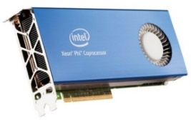
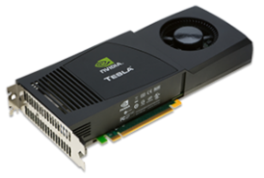
Performance portability via Kokkos
We need to be able to run ALI/E3SM on new architecture machines (GPUs, KNLs) and hybrid (CPU+GPU) systems.
Kokkos* is a C++ library that provides performance portability across multiple shared memory computing architectures using the MPI+X programming model
  A programming model as much as a software library.
  Provides automatic access to OpenMP, CUDA, Pthreads, ...
  Templated meta-programming: parallel_for, parallel_reduce
  Memory layout abstraction (“array of structs” vs. “struct of arrays”, locality).
With Kokkos, you write an algorithm once, and just change a template parameter to get the optimal data layout for your hardware.
Allows researchers to focus on application development instead of architecture specific programming.
Finite element assembly in ALI has been rewritten using Kokkos functors.
* https://github.com/kokkos/kokkos

Slide 16

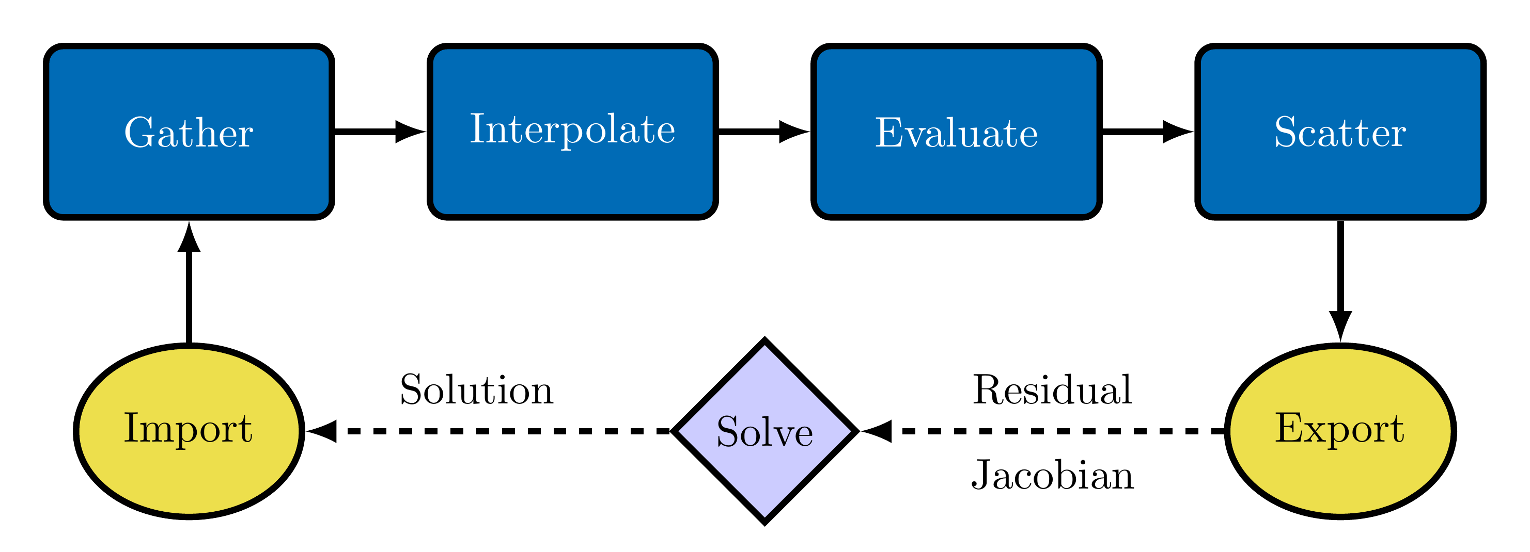
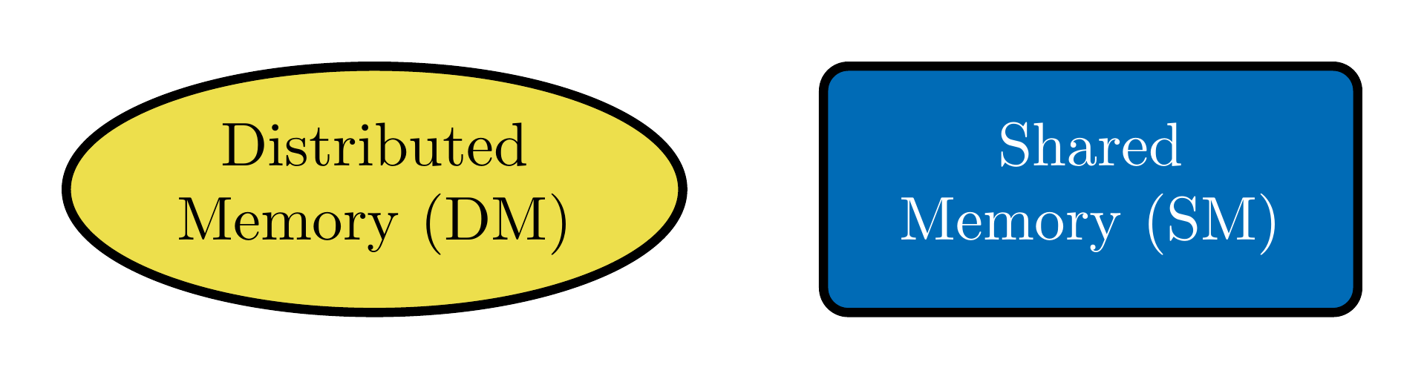
ALI Finite Element Assembly (FEA)
Albany Land Ice performance is split between the linear solve (50%) and FEA (50%)
Trilinos Packages
Piro manages the nonlinear solve
Tpetra manages distributed memory linear algebra (MPI+X)
Phalanx manages shared memory computations (X)
  Gather fills element local solution
  Interpolate solution/gradient to quadrature points
  Evaluate residual/Jacobian
  Scatter fills global residual/Jacobian
Jacobians (+ sensitivities, Hessians, ...) obtained via automatic differentiation (Sacado).
FEA Overview
Memory Model

Slide 17

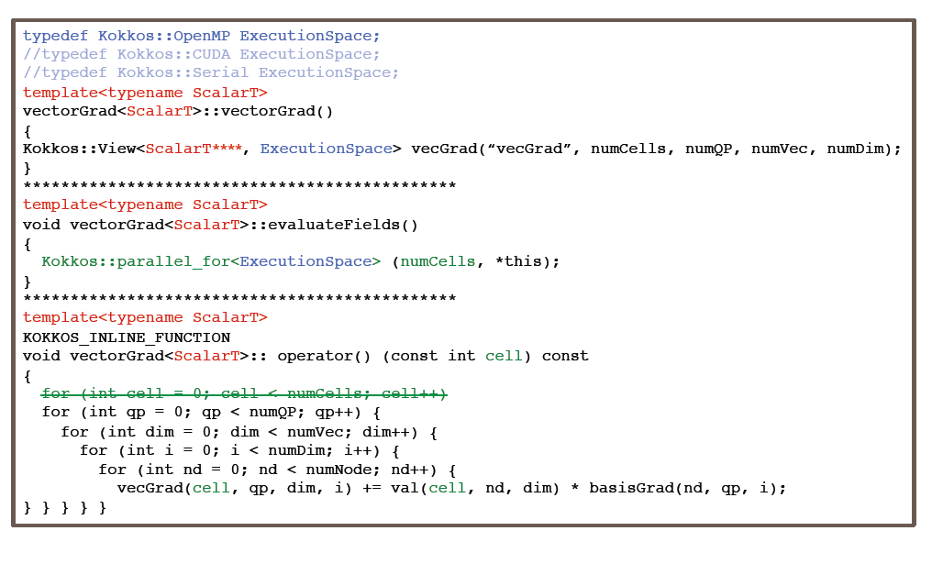
MPI+X FEA via Kokkos
MPI-only FEA
MPI+X FEA
ExecutionSpace parameter tailors code for device (e.g., OpenMP, CUDA, etc.)

Slide 18
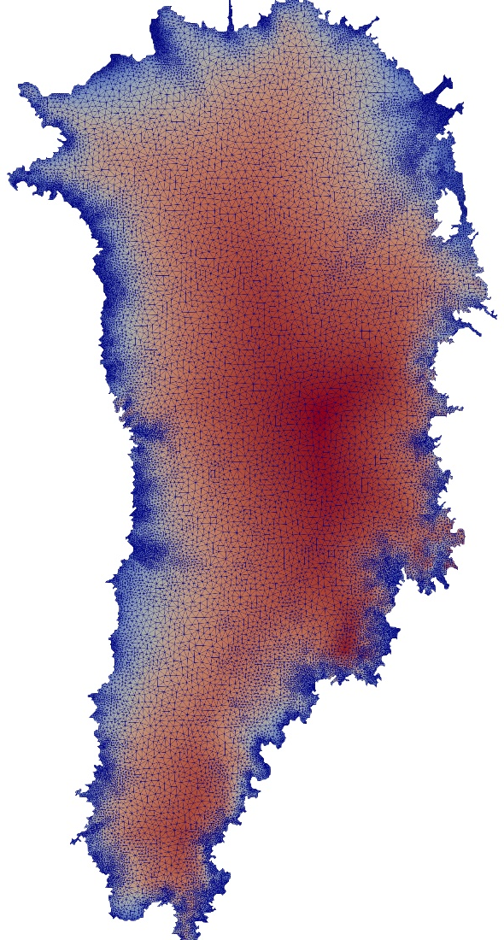
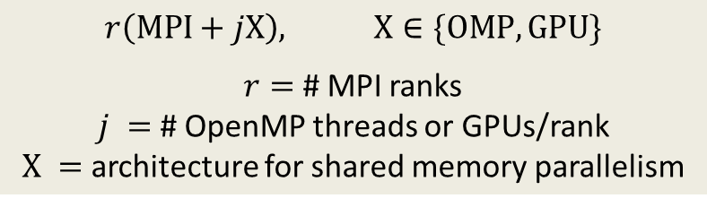
Performance study: Greenland Ice Sheet (GIS)
Mesh | Resolution | # Elements
GIS4k-20k | 4km-20km | 1.51 million
GIS1k-7k | 1km-7km | 14.4 million
Unstructured tetrahedral element meshes
Wall-clock time averaged over 100 global assembly evaluations (residual + Jacobian)
Performance analysis focuses on finite element assembly
Notation for performance results:
$r\left(MPI+jX\right),$ $X∈\{OMP,GPU\}$
$r=$ # MPI ranks
$j =$ # OpenMP threads or GPUs/rank
$X =$ architecture for shared memory parallelism
Notes:
Ask Jerry: is this still accurate?

Slide 19
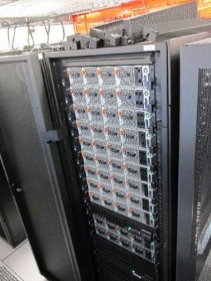
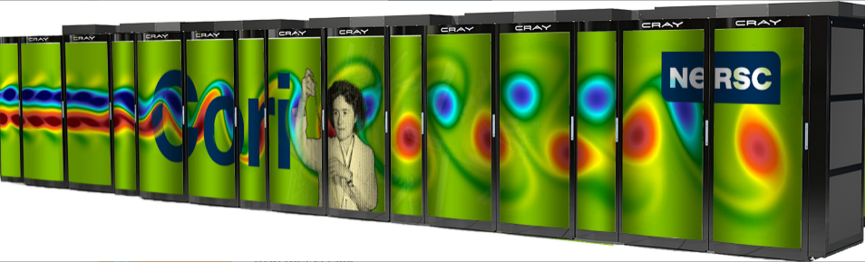

Performance study: Architectures
Performance-portability of FEA in Albany has been tested across multiple architectures: Intel Sandy Bridge, Intel Skylake, IBM Power8/9, Keplar/Pascal/Volta GPUs, KNL Xeon Phi
Architectures:
Cori (NERSC): 2,388 Haswell nodes [2 Haswell (32 cores)] 9,688 KNL nodes [1 Xeon Phi KNL (68 cores)] (Cray Aries)
Blake (SNL): 40 nodes [2 Skylake (48 cores)] (Intel OmniPath Gen-1)
Mayer (SNL): 43 nodes [2 ARM64 Cavium ThunderX2 (56 cores)] (Mx EDR IB)
Ride (SNL): 12 nodes [2 POWER8 (16 cores) + P100 (4 GPUs)] (Mx C-X4 IB)
Waterman (SNL): 10 nodes [2 POWER9 (40 cores) + V100 (4 GPUs)] (Mx EDR IB)
Compilers: gcc/icpc/xlC
Models:
3 models: MPI-only, MPI+OpenMP, MPI+CUDA
MPI+OpenMP: MPI ranks are mapped to cores, OpenMP threads are mapped to hardware-threads
MPI+GPU: MPI ranks assigned a single core per GPU
  CUDA UVM used for host to device communication
Ride

Slide 20
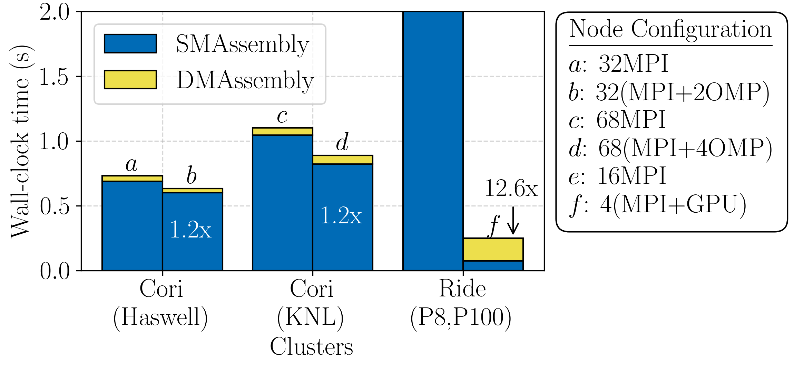
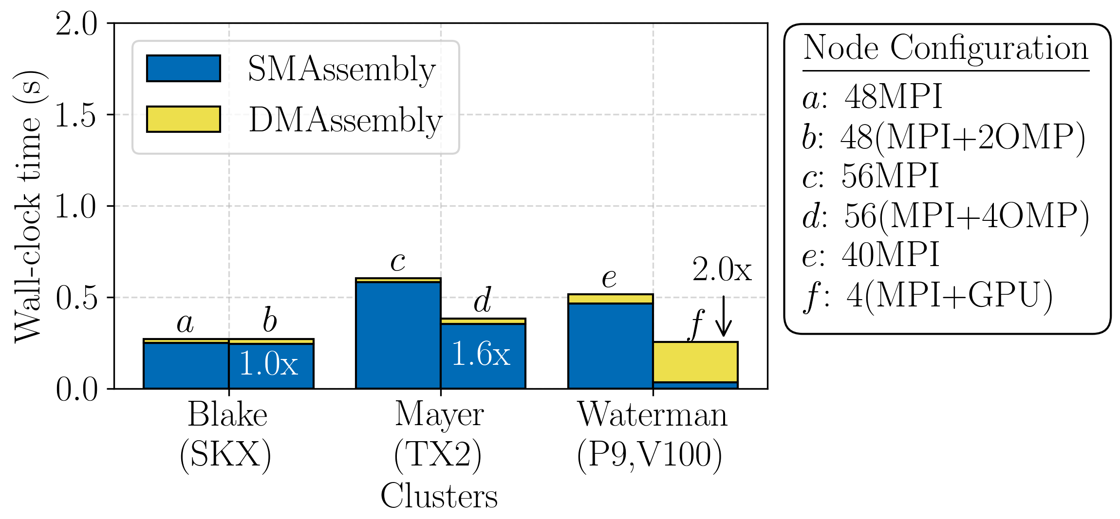
Performance results: Node utilization
Node: Single dual-socket CPU or quad-GPU
Speedup achieved across most execution spaces
  Kokkos Serial vs. OpenMP or CUDA
  12.6x speedup on POWER8+P100, 2.0x speedup on POWER9+V100 (~16x speedup would be expected if memory bound, but we are latency bound due to Export/Import).
  In general, should expect no speedup with MPI+OpenMP – slight speedups on Mayer and Cori may be due to thread caching.
Tpetra Export poor on GPU machines (WIP within Albany and GPUDirect issue on POWER systems: CUDA does not play well with MPI!)
Blue (SMAssembly): shared memory local/global assembly (assembly/computation)
Yellow (DMAssembly): distributed memory global assembly handled by Tpetra (mostly communication)
Notes:
2x is not superb for Waterman – 16x expected if memory bound; we’re latency bound -> if fix yellow, will be closer to 16x speedup (blue is probably 16x speedup; blue is latency bound + bandwidth bound)
Ride +X is faster b/c Power8 is known to be slow
In general, should expect no speedup with +X and OpenMP – what we see for blake
- other platforms: extra threads shouldn’t help, but they do; caching with threads may be helping
Yellow running only on host – export of matrix -> need to switch to FECrsMatrix
GPUDirect has to do with CUDA-aware MPI -> multi-lab system with POWER systems (multi-year issue)
- one of the reasons next system is Cray! Next systems will be Cray with AMD GPUs.
- has to do with CUDA not playing well with MPI on power systems

Slide 21
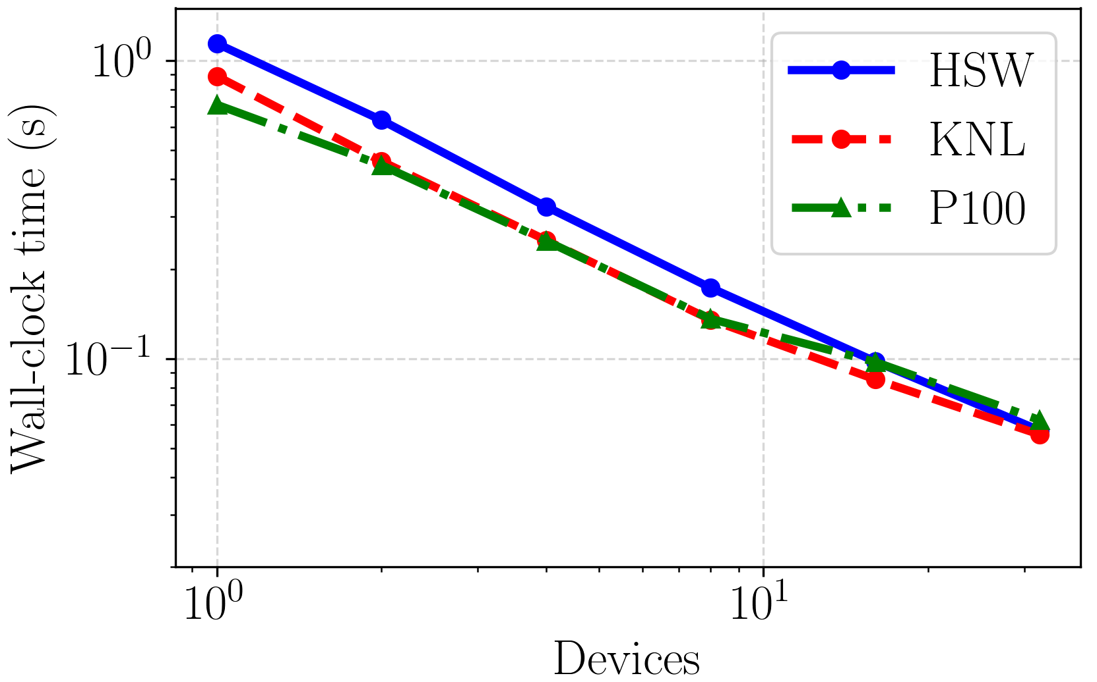
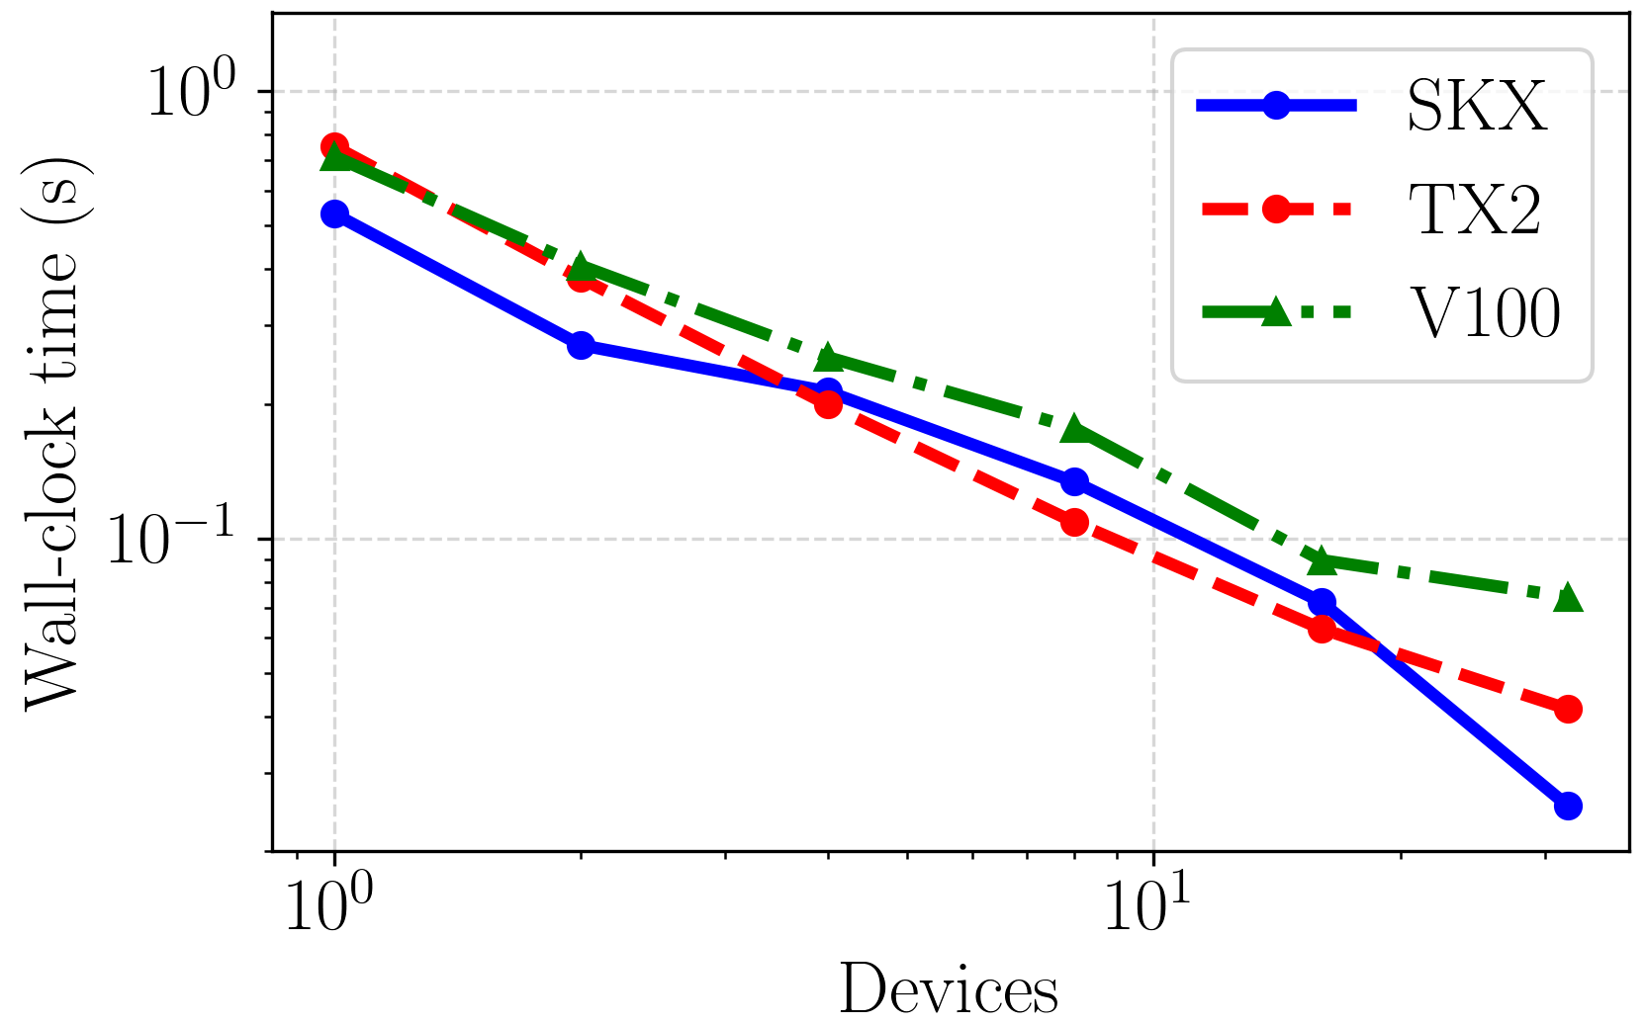
Performance results: Strong scalability
Legend: HSW, SKX=Haswell, Skylake CPU; KNL=Xeon Phi; TX2=ThunderX2; P100,V100=GPU
Reasonable scaling across all devices without machine-specific optimization in Albany
  Poor GPU scaling (Export WIP within Albany and GPUDirect issue on POWER)
  Best case: Skylake at 32 devices (768 cores)
Notes:
- We haven’t updated results if POWER

Slide 22
Outline
This talk describes our efforts towards creating a performance portable implementation of the Albany/Land Ice (ALI) model using the Kokkos programming model and Trilinos libraries.
Overview of the Albany/Land Ice (ALI) model/code developed under ProSPect SciDAC.
Performance portability of the finite element assembly in ALI using Kokkos.
Performant algebraic multi-grid linear solvers implemented in Trilinos.
Summary and discussion

Slide 23
Motivation for linear solvers work
Linear solver takes ~50% of total CPU time for ALI diagnostic solve
  FEA is only half the story: we need to make linear solver performant (and ultimately performance portable)

Slide 24
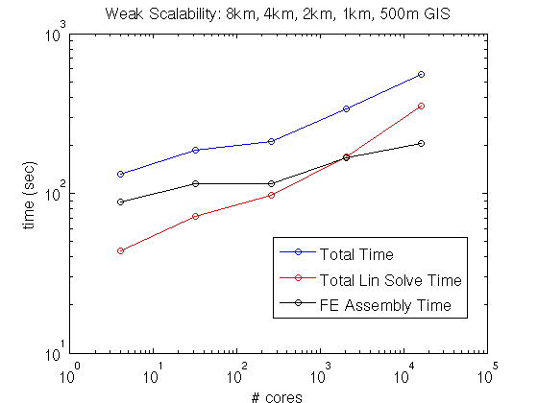
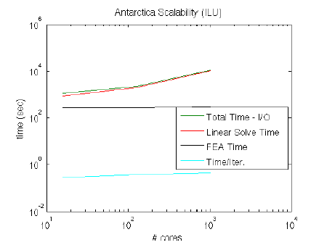
Motivation for linear solvers work
Greenland Ice Sheet
Antarctic Ice Sheet
Off-the-shelf linear solvers (ILU, AMG*) do not always work that well!
* Algebraic Multi-Grid.

Slide 25
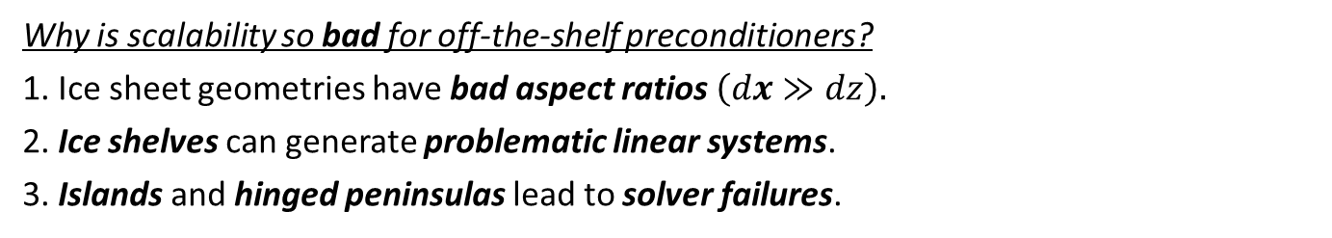
Motivation for linear solvers work
Greenland Ice Sheet
Antarctic Ice Sheet
Off-the-shelf linear solvers (ILU, AMG*) do not always work that well!
Why is scalability so bad for off-the-shelf preconditioners?
1. Ice sheet geometries have bad aspect ratios $\left(dx≫dz\right).$
2. Ice shelves can generate problematic linear systems.
3. Islands and hinged peninsulas lead to solver failures.
* Algebraic Multi-Grid.

Slide 26
Motivation for linear solvers work
Greenland Ice Sheet
Antarctic Ice Sheet
Off-the-shelf linear solvers (ILU, AMG*) do not always work that well!
We mitigate these difficulties through the development of:
New AMG* preconditioner based on semi-coarsening.
Island/hinge removal algorithm.
Why is scalability so bad for off-the-shelf preconditioners?
1. Ice sheet geometries have bad aspect ratios $\left(dx≫dz\right).$
2. Ice shelves can generate problematic linear systems.
3. Islands and hinged peninsulas lead to solver failures.
* Algebraic Multi-Grid.

Slide 27
Motivation for linear solvers work
Greenland Ice Sheet
Antarctic Ice Sheet
Off-the-shelf linear solvers (ILU, AMG*) do not always work that well!
We mitigate these difficulties through the development of:
New AMG* preconditioner based on semi-coarsening.
Island/hinge removal algorithm.
Why is scalability so bad for off-the-shelf preconditioners?
1. Ice sheet geometries have bad aspect ratios $\left(dx≫dz\right).$
2. Ice shelves can generate problematic linear systems.
3. Islands and hinged peninsulas lead to solver failures.
* Algebraic Multi-Grid.

Slide 28
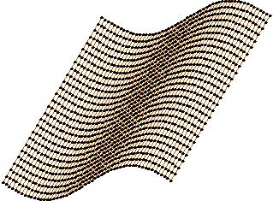
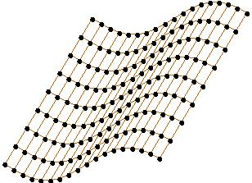
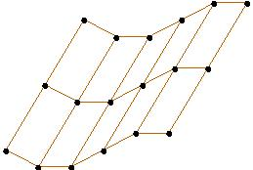
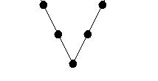








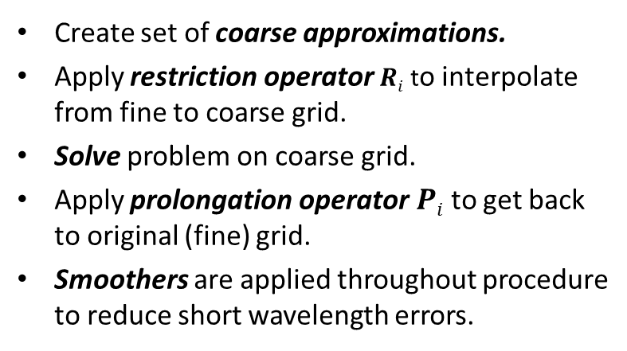
How Does Multi-Grid Work?
Basic idea: accelerate convergence of an iterative method on a given grid by solving a series of (cheaper) problems on coarser grids.
Create set of coarse approximations.
Apply restriction operator $Ri$ to interpolate from fine to coarse grid.
Solve problem on coarse grid.
Apply prolongation operator $Pi$ to get back to original (fine) grid.
Smoothers are applied throughout procedure to reduce short wavelength errors.
$P2$ $R2$
$P1$ $R1$
Solve $A3u3=f3$
Smooth $A3u3=f3.$Set $f2 = R2r3.$
Set $u3= u3 + P2u2$. Smooth $A3u3=f3$.
Smooth $A2u2=f2$. Set $f1=R1r2$.
Set $u2 = u2 + P1u1$. Smooth $A2u2=f2$.
Solve $A1u1=f1$directly.

Slide 29


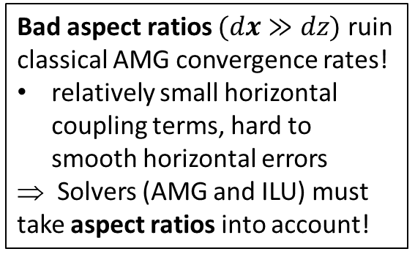
Scalable Algebraic Multi-Grid (AMG) Preconditioners
Bad aspect ratios $(dx≫dz)$ ruin classical AMG convergence rates!
relatively small horizontal coupling terms, hard to smooth horizontal errors
⇒ Solvers (AMG and ILU) must take aspect ratios into account!
Algebraic Structured MG
Algebraic Structured MG
We developed a new AMG solver based on aggressive semi-coarsening (available in ML/MueLu packages of Trilinos)
Unstructured AMG
See (Tezaur et al., Procedia CS, 2015),
(Tuminaro et al., SISC, 2016).

Slide 30
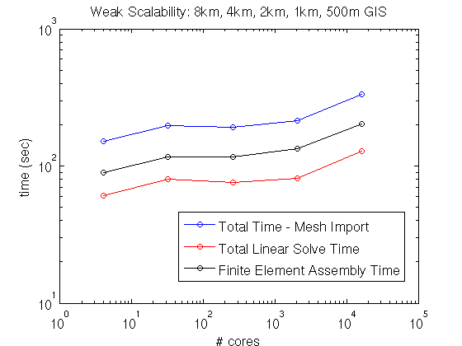
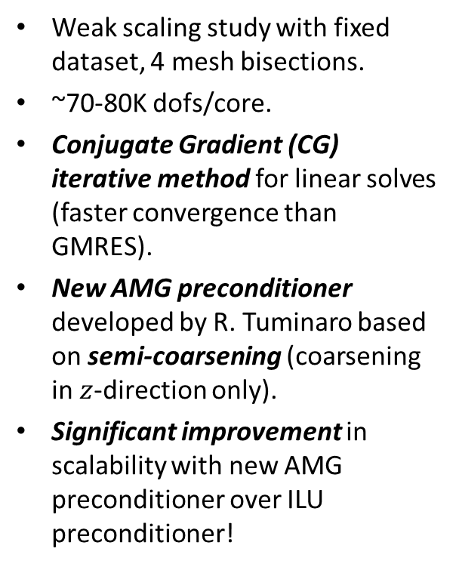

Weak scalability: Greenland
Weak scaling study with fixed dataset, 4 mesh bisections.
~70-80K dofs/core.
Conjugate Gradient (CG) iterative method for linear solves (faster convergence than GMRES).
New AMG preconditioner developed by R. Tuminaro based on semi-coarsening (coarsening in $z$-direction only).
Significant improvement in scalability with new AMG preconditioner over ILU preconditioner!
4 cores
334K dofs
8 km Greenland,
5 vertical layers
16,384 cores
1.12B dofs(!)
0.5 km Greenland,
80 vertical layers
$×84$
scale up

Slide 31
Weak scalability: Greenland
New AMG preconditioner preconditioner
ILU preconditioner
Weak scaling study with fixed dataset, 4 mesh bisections.
~70-80K dofs/core.
Conjugate Gradient (CG) iterative method for linear solves (faster convergence than GMRES).
New AMG preconditioner developed by R. Tuminaro based on semi-coarsening (coarsening in $z$-direction only).
Significant improvement in scalability with new AMG preconditioner over ILU preconditioner!
4 cores
334K dofs
8 km Greenland,
5 vertical layers
16,384 cores
1.12B dofs(!)
0.5 km Greenland,
80 vertical layers
$×84$
scale up

Slide 32
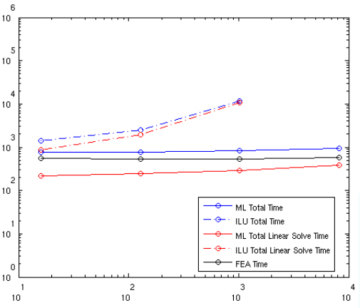
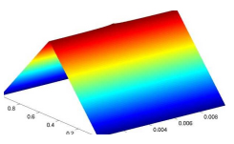
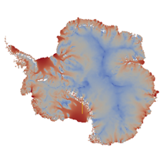
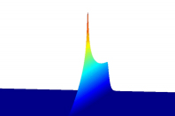

Weak scalability: Antarctica
ILU solver does not converge for finest mesh resolution!
Thin floating ice: ILU will not work well! Green’s function ~ constant in thin direction*
time (sec)
Thin grounded ice: ILU can work well w/ proper ordering
# cores
Weak scaling study: 2.5M $→$ 1.1B dofs, 16 $→$8192 cores
Initialized with realistic basal friction (from deterministic inversion) and temperature field from BEDMAP2.
Iterative linear solver: GMRES.
Preconditioner: ILU vs. new AMG based on aggressive semi-coarsening.
See (Tuminaro et al., SISC, 2016).
* $A^{−1}$ will have large number of non-zeroes, so approximate inverse ILU preconditioner is ineffective.
Notes:
See: https://pdfs.semanticscholar.org/280a/1f2f3fa5aea7d2fd380a408512b40a871be6.pdf (R. Bridson, W.-P. Tang, Multi-resolution approximate inverse preconditioners.
Condition number = 9.5364e+12 for FO_AIS problem in tests/small/LandIce directory num_nodes = 314,724 , num_elem = 255,465 (hex)
Condition number = 9.8492e+08 for FO_GIS unstruct problem in tests/small/LandIce directory num_nodes = 12522, num_elem = 55350 (tet)
Condition number = 2.6254e+11 for gis-1-7km unstruct problem num_nodes = 2,760,230, num_elem = 4,799,300 (tet)
- AMG: Gauss-Seidel smoothing on finest level (where lines are defined in mesh extruded direction), Chebyshev smoothing on coarser levels.
- ILU: ordering is important to maintain acceptable convergence rates (need row-wise ordering)!
- GMRES less sensitive than CG to rounding errors associated w/ severe ill-conditioning introduced by presence of ice shelves.
- CG and GMRES minimize different norms.
- Floating ice shelves: matrix entries corresponding to vertical coupling are much stronger than entries corresponding to horizontal coupling. Vertical grid lines lie within ice shelves, top/bottom BCs resemble Neumann conditions and so the submatrix associated with the vertical lines is nearly singular. Ill-conditioning creates challenges for solver.

Slide 33

Towards linear solver performance portability
Trilinos templated software stack for sparse algebra interfaces/linear solvers (Tpetra, Belos, MueLu, Ifpack2) integrates Kokkos for performance portability.
MueLu_CoarseMapFactory.hpp $→$ MueLu_CoordinatesTransferFactory_kokkos.hpp
MueLu_CoordinatesTransferFactory.hpp $→$ MueLu_CoarseMapFactory_kokkos.hpp
MueLu_NullspaceFactory.hpp $→$ MueLu_NullspaceFactory_kokkos.hpp
…
Semi-coarsening algorithm need not be redesigned for GPUs.
Performance portability of MueLu solvers on advanced architectures including GPUs has been demonstrated for Maxwell and compressible flow equations.
  Mat/vecs, orthogonalizations in Belos done on GPU.
  Smoothers in Ifpack2 created/applied on GPU.
  ☑ Coarse grid solve performed on host (direct solvers on GPUs is R&D topic).
Evaluating the performance portability of our AMG semi-coarsening-based solver in ALI is in the project plan for FY20 – all necessary pieces are in Trilinos!
Notes:
shouldn’t be too bad to port MG – relies on FEA
Researchers are working on
Tridiags may not be there in Ifpack2 – ask Luc

Slide 34
Towards linear solver performance portability
Trilinos templated software stack for sparse algebra interfaces/linear solvers (Tpetra, Belos, MueLu, Ifpack2) integrates Kokkos for performance portability.
MueLu_CoarseMapFactory.hpp $→$ MueLu_CoordinatesTransferFactory_kokkos.hpp
MueLu_CoordinatesTransferFactory.hpp $→$ MueLu_CoarseMapFactory_kokkos.hpp
MueLu_NullspaceFactory.hpp $→$ MueLu_NullspaceFactory_kokkos.hpp
…
Semi-coarsening algorithm need not be redesigned for GPUs.
Performance portability of MueLu solvers on advanced architectures including GPUs has been demonstrated for Maxwell and compressible flow equations.
  Mat/vecs, orthogonalizations in Belos done on GPU.
  Smoothers in Ifpack2 created/applied on GPU.
  ☑ Coarse grid solve performed on host (direct solvers on GPUs is R&D topic).
Evaluating the performance portability of our AMG semi-coarsening-based solver in ALI is in the project plan for FY20 – all necessary pieces are in Trilinos!
We will be looking to hire a summer intern in SNL/CA to help with this task! Posting coming soon!
Notes:
shouldn’t be too bad to port MG – relies on FEA
Researchers are working on

Slide 35


Advertisement: Climate MS at
European Seminar on COmputing (ESCO) 2020
June 8-12, 2020 (abstracts due Feb. 14, 2020)
Pilsen, Czech Republic
https://www.esco2020.femhub.com/

Slide 36
Outline
This talk describes our efforts towards creating a performance portable implementation of the Albany/Land Ice (ALI) model using the Kokkos programming model and Trilinos libraries.
Overview of the Albany/Land Ice (ALI) model/code developed under ProSPect SciDAC.
Performance portability of the finite element assembly in ALI using Kokkos.
Performant algebraic multi-grid linear solvers implemented in Trilinos.
Summary and discussion

Slide 37
Summary and discussion points
We are making progress towards running Albany/Land Ice on heterogeneous HPC architectures with the help of Kokkos and Trilinos!
  Comments/discussion points:
  Kokkos (and similar libraries) not a magic bullet!
    Some algorithms need to be redesigned substantially to be efficient on GPUs/hybrid architectures (e.g. ILU), and Kokkos will not circumvent this fact.
  How feasible is it to port non-C++/Sandia codes to Kokkos?
    E3SM seems to support C++/Kokkos route: BER-funded SCREAM project is aimed at rewriting (Fortran) HOMME atmospheric dycore using C++/Kokkos.
  There is always some tradeoff between portability and performance.
    Getting the best possible performance on GPUs using Kokkos may require some platform-specific optimizations.
  Relying on libraries can be a blessing and a curse.
    Code can speed up and slow down with no changes on your side!
  Regression/performance testing is critical when targeting multiple architectures!
  Other solvers besides MG for GPUs worth considering (e.g. hierarchical solvers).

Slide 38










Funding/Acknowledgements
Support for this work was provided through Scientific Discovery through Advanced Computing (SciDAC) projects funded by the U.S. Department of Energy, Office of Science (OSCR), Advanced Scientific Computing Research and Biological and Environmental Research (BER) $→$ProSPect SciDAC Application Partnership.
ProSPect team members: K. Evans, M. Hoffman, M. Perego, S. Price, A. Salinger, I. Tezaur, R. Tuminaro, C. Sockwell, J. Watkins, L. Bertagna, T. Zhang.
Trilinos/DAKOTA collaborators: M. Eldred, J. Jakeman, G. Stadler.
  Computing resources: NERSC, OLCF.

Slide 39
References
[1] M.A. Heroux et al. “An overview of the Trilinos project.” ACM Trans. Math. Softw. 31(3) (2005).
[2] A. Salinger, et al. "Albany: Using Agile Components to Develop a Flexible, Generic Multiphysics Analysis Code", Int. J. Multiscale Comput. Engng. 14(4) (2016) 415-438.
[3] I. Tezaur, M. Perego, A. Salinger, R. Tuminaro, S. Price. "Albany/FELIX: A Parallel, Scalable and Robust Finite Element Higher-Order Stokes Ice Sheet Solver Built for Advanced Analysis", Geosci. Model Develop. 8 (2015) 1-24.
[4] C. Edwards, C. Trott, D. Sunderland. “Kokkos: Enabling manycore performance portability through
polymorphic memory access patterns”, J. Par. & Distr. Comput. 74 (12) (2014) 3202-3216.
[5] R. Tuminaro, M. Perego, I. Tezaur, A. Salinger, S. Price. "A matrix dependent/algebraic multigrid approach for extruded meshes with applications to ice sheet modeling", SIAM J. Sci. Comput. 38(5) (2016) C504-C532.
[6] I. Tezaur, R. Tuminaro, M. Perego, A. Salinger, S. Price. "On the scalability of the Albany/FELIX first-order Stokes approximation ice sheet solver for large-scale simulations of the Greenland and Antarctic ice sheets", Procedia Computer Science, 51 (2015) 2026-2035.
[7] I. Demeshko, J. Watkins, I. Tezaur, O. Guba, W. Spotz, A. Salinger, R. Pawlowski, M. Heroux. "Towards performance-portability of the Albany finite element analysis code using the Kokkos library", E. van Brummelen, A. Corsini, S. Perotto, G. Rozza, eds. Numerical Methods for Flows: FEF 2017 Selected Contributions, Elsevier, 2019.
[8] S. Price, M. Hoffman, J. Bonin, T. Neumann, I. Howat, J. Guerber, I. Tezaur, J. Saba, J. Lanaerts, D. Chambers, W. Lipscomb, M. Perego, A. Salinger, R. Tuminaro. "An ice sheet model validation framework for the Greenland ice sheet", Geosci. Model Dev. 10 (2017) 255-270

Slide 40
Start of Backup Slides

Slide 41

Albany/Land Ice Finite Element Assembly (FEA)
Gather operation extracts solution values out of global solution vector.
Physics evaluator functions operate on workset of elements, store evaluated quantities in local field arrays.
FEA relies on template based generic programming + automatic differentiation for Jacobians, tangents, etc.
Scatter operation adds local residual, Jacobian to global residual, Jacobian.
Performance-portability: focus on FEA.
MPI-only FEA:
  Each MPI process has workset of cells & computes nested parallel for loops.
MPI+X FEA:
  Each MPI process has workset of cells.
  Multi-dimensional parallelism with +X (X=OpenMP, CUDA) for nested parallel for loops.
Problem Type | % CPU time for FEA
Implicit | 50%
Explicit | 99%

Slide 42
MPI+X FEA via Kokkos
MPI-only nested for loop:
for (int cell=0; cell<numCells; ++cell)
for (int node=0; node<numNodes; ++node)
for (int qp=0; qp<numQPs; ++qp)
compute A;
MPI process n

Slide 43




MPI+X FEA via Kokkos
Thread 1 computes A for
(cell,node,qp)=(0,0,0)
Multi-dimensional parallelism for nested for loops via Kokkos:
Thread 2 computes A for
(cell,node,qp)=(0,0,1)
for (int cell=0; cell<numCells; ++cell)
for (int node=0; node<numNodes; ++node)
for (int qp=0; qp<numQPs; ++qp)
compute A;
Thread N computes A for
(cell,node,qp)=(numCells,numNodes,numQPs)
MPI process n

Slide 44
MPI+X FEA via Kokkos
Thread 1 computes A for
(cell,node,qp)=(0,0,0)
Multi-dimensional parallelism for nested for loops via Kokkos:
Thread 2 computes A for
(cell,node,qp)=(0,0,1)
for (int cell=0; cell<numCells; ++cell)
for (int node=0; node<numNodes; ++node)
for (int qp=0; qp<numQPs; ++qp)
compute A;
Thread N computes A for
(cell,node,qp)=(numCells,numNodes,numQPs)
MPI process n
computeA_Policy range({0,0,0},{(int)numCells,(int)numNodes,(int)numQPs});
Kokkos::Experimental::md_parallel_for<ExecutionSpace>(range,*this);
* Unified Virtual Memory.
* Unified Virtual Memory.

Slide 45
MPI+X FEA via Kokkos
Thread 1 computes A for
(cell,node,qp)=(0,0,0)
Multi-dimensional parallelism for nested for loops via Kokkos:
Thread 2 computes A for
(cell,node,qp)=(0,0,1)
for (int cell=0; cell<numCells; ++cell)
for (int node=0; node<numNodes; ++node)
for (int qp=0; qp<numQPs; ++qp)
compute A;
Thread N computes A for
(cell,node,qp)=(numCells,numNodes,numQPs)
MPI process n
computeA_Policy range({0,0,0},{(int)numCells,(int)numNodes,(int)numQPs});
Kokkos::Experimental::md_parallel_for<ExecutionSpace>(range,*this);
ExecutionSpace defined at compile time, e.g.
  typedef Kokkos::OpenMP ExecutionSpace; //MPI+OpenMP
  typedef Kokkos::CUDA ExecutionSpace; //MPI+CUDA
  typedef Kokkos::Serial ExecutionSpace; //MPI-only

Slide 46
MPI+X FEA via Kokkos
Thread 1 computes A for
(cell,node,qp)=(0,0,0)
Multi-dimensional parallelism for nested for loops via Kokkos:
Thread 2 computes A for
(cell,node,qp)=(0,0,1)
for (int cell=0; cell<numCells; ++cell)
for (int node=0; node<numNodes; ++node)
for (int qp=0; qp<numQPs; ++qp)
compute A;
Thread N computes A for
(cell,node,qp)=(numCells,numNodes,numQPs)
MPI process n
computeA_Policy range({0,0,0},{(int)numCells,(int)numNodes,(int)numQPs});
Kokkos::Experimental::md_parallel_for<ExecutionSpace>(range,*this);
ExecutionSpace defined at compile time, e.g.
  typedef Kokkos::OpenMP ExecutionSpace; //MPI+OpenMP
  typedef Kokkos::CUDA ExecutionSpace; //MPI+CUDA
  typedef Kokkos::Serial ExecutionSpace; //MPI-only
Atomics used to scatter local data to global data structures
  Kokkos::atomic_fetch_add

Slide 47
MPI+X FEA via Kokkos
Thread 1 computes A for
(cell,node,qp)=(0,0,0)
Multi-dimensional parallelism for nested for loops via Kokkos:
Thread 2 computes A for
(cell,node,qp)=(0,0,1)
for (int cell=0; cell<numCells; ++cell)
for (int node=0; node<numNodes; ++node)
for (int qp=0; qp<numQPs; ++qp)
compute A;
Thread N computes A for
(cell,node,qp)=(numCells,numNodes,numQPs)
MPI process n
computeA_Policy range({0,0,0},{(int)numCells,(int)numNodes,(int)numQPs});
Kokkos::Experimental::md_parallel_for<ExecutionSpace>(range,*this);
ExecutionSpace defined at compile time, e.g.
  typedef Kokkos::OpenMP ExecutionSpace; //MPI+OpenMP
  typedef Kokkos::CUDA ExecutionSpace; //MPI+CUDA
  typedef Kokkos::Serial ExecutionSpace; //MPI-only
Atomics used to scatter local data to global data structures
  Kokkos::atomic_fetch_add
For MPI+CUDA, data transfer from host to device handled by CUDA UVM*.
* Unified Virtual Memory.

Slide 48
MPI+X FEA via Kokkos
Thread 1 computes A for
(cell,node,qp)=(0,0,0)
Multi-dimensional parallelism for nested for loops via Kokkos:
Thread 2 computes A for
(cell,node,qp)=(0,0,1)
Kokkos parallelization in ALI master is only over cells**.
for (int cell=0; cell<numCells; ++cell)
for (int node=0; node<numNodes; ++node)
for (int qp=0; qp<numQPs; ++qp)
compute A;
Thread N computes A for
(cell,node,qp)=(numCells,numNodes,numQPs)
MPI process n
computeA_Policy range({0,0,0},{(int)numCells,(int)numNodes,(int)numQPs});
Kokkos::Experimental::md_parallel_for<ExecutionSpace>(range,*this);
ExecutionSpace defined at compile time, e.g.
  typedef Kokkos::OpenMP ExecutionSpace; //MPI+OpenMP
  typedef Kokkos::CUDA ExecutionSpace; //MPI+CUDA
  typedef Kokkos::Serial ExecutionSpace; //MPI-only
Atomics used to scatter local data to global data structures
  Kokkos::atomic_fetch_add
For MPI+CUDA, data transfer from host to device handled by CUDA UVM*.
* Unified Virtual Memory. **Hierarchical parallelism can be up to 2x faster on GPU but adds code bloat & requires padding.

Slide 49



Phalanx: DAG*-based assembly
DAG Example
Advantages:
Increased flexibility, extensibility, usability
Arbitrary data type support
Potential for task parallelism
Disadvantage:
Performance loss through fragmentation
Extension:
Performance gain through memoization
DAG Example (memoization)
Single CPU socket or GPU
* Directed acyclic graph.

Slide 50
Phalanx Evaluator: templated Phalanx node
A Phalanx node (evaluator) is constructed as a C++ class
Each evaluator is templated on an evaluation type (e.g. residual, Jacobian)
The evaluation type is used to determine the data type (e.g. double, Sacado data types)
Kokkos RangePolicy is used to parallelize over cells over an ExeSpace (e.g. Serial, OpenMP, CUDA)
Inline functors are used as kernels
MDField data layouts
  Serial/OpenMP – LayoutRight (row-major)
  CUDA – LayoutLeft (col-major)
template<typename EvalT, typename Traits>
void StokesFOResid<EvalT, Traits>::
evaluateFields(typename Traits::EvalData workset) {
Kokkos::parallel_for(
Kokkos::RangePolicy<ExeSpace>(0,workset.numCells),
*this);
}
template<typename EvalT, typename Traits>
KOKKOS_INLINE_FUNCTION
void StokesFOResid<EvalT, Traits>::
operator() (const int& cell) const{
for (int node=0; node<numNodes; ++node){
Residual(cell,node,0)=0.;
}
for (int node=0; node < numNodes; ++node) {
for (int qp=0; qp < numQPs; ++qp) {
Residual(cell,node,0) +=
Ugrad(cell,qp,0,0)*wGradBF(cell,node,qp,0) +
Ugrad(cell,qp,0,1)*wGradBF(cell,node,qp,1) +
force(cell,qp,0)*wBF(cell,node,qp);
}
}
}

Slide 51



Sacado – Automatic Differentiation (AD)
Sacado data types are used for derivative components (ND = # components)
DFad (most flexible) – ND is set at run-time
SLFad (flexible/efficient) – maximum ND set at compile-time
SFad (most efficient) – ND set at compile-time
ND Size Example: Tetrahedral elements (4 nodes), 2 equations, ND = 4*2 = 8
Fad Type Comparison for StokesFO<Jacobian> (Serial, OpenMP (12 threads), CUDA)

Slide 52



Performance Portability: a response to heterogeneity
Generic Definition: For an application, a reasonable level of performance is achieved across a wide variety of computing architectures with the same source code.
Let’s be more specific:
Performance quantified by application execution time while strong/weak scaling.
Portability includes conventional CPU, Intel KNL, NVIDIA GPU.
Approach: MPI+X Programming Model
MPI: distributed memory parallelism – Tpetra
X: shared memory parallelism – Kokkos
  Examples: OpenMP, CUDA
Minimize data movement (efficient programming)
Increase arithmetic intensity (improve compute to memory transfer ratio)
Saturate memory bandwidth (expose more parallelism)

Slide 53


Single CPU/GPU shared memory profile
SKX: 24-core
V100: 1 GPU
Residual/Jacobian Evaluation most expensive
Gather/Scatter becoming increasingly important…
Other: some auxiliary routines are still expensive on the GPU (~10%)
Notes:
As we move towards systems with more flops and higher costs of memory mgt, gather/scatter becomes more important -> go “matrix-free”

Slide 54

Hierarchical Parallelism
Hierarchical parallelism is used to expose more parallelism when strong scaling
Kokkos TeamPolicy, TeamThreadRange is used to parallelize over cells and nodes
Kokkos scratch space is used to store node/quadrature values in shared memory
~2x speedup for small problem sizes on GPU (need padding for large problem sizes)
Slowdown for all problem sizes on CPU (need different layout)
template<typename EvalT, typename Traits>
void StokesFOResid<EvalT, Traits>::
evaluateFields(typename Traits::EvalData workset) {
Kokkos::parallel_for(
Kokkos::TeamPolicy<ExeSpace>(workset.numCells,Kokkos::AUTO()),
*this);
}
template<typename EvalT, typename Traits>
KOKKOS_INLINE_FUNCTION
void StokesFOResid<EvalT, Traits>::
operator() (const Member& teamMember) const{
const Index cell = teamMember.league_rank();
// Allocate shared memory
ScratchView qpVals(teamMember.team_shmem(), numQPs, fadSize);
ScratchView nodeVals(teamMember.team_shmem(), numNodes, fadSize);
// Zero nodeVals
Kokkos::parallel_for(
Kokkos::TeamThreadRange(teamMember, numNodes), [&] (const Index& node) {
nodeVals(node) = 0; });
// Fill Ugrad00
Kokkos::parallel_for(
Kokkos::TeamThreadRange(teamMember, numQPs), [&] (const Index& qp) {
qpVals(qp) = Ugrad(cell,qp,0,0); });
// Calc Ugrad00 contribution
for (Index qp=0; qp < numQPs; ++qp) {
Kokkos::parallel_for(
Kokkos::TeamThreadRange(teamMember, numNodes), [&] (const Index& node) {
nodeVals(node) += qpVals(qp) * wGradBF(cell,node,qp,0); }); }
…
// Copy to Residual0
Kokkos::parallel_for(
Kokkos::TeamThreadRange(teamMember, numNodes), [&] (const Index& node) {
Residual(cell,node,0) = nodeVals(node); });
}
CUDA70
Residual
Jacobian

Slide 55


Performance results: weak scalability
Legend: HSW, SKX=Haswell, Skylake CPU; KNL=Xeon Phi; TX2=ThunderX2; P100,V100=GPU
Reasonable scaling across all devices w/o machine-specific optimization in Albany
Poor GPU scaling (Export WIP within Tpetra)
Best case: Skylake at 10 devices (280 cores)

Slide 56

Single GPU: full profile

Slide 57


Single GPU: Kokkos and non-Kokkos

Slide 58





Solver challenge: Thin meshes
Meshes with anisotropy/bad aspect ratios: ice sheets are thin (thickness up to 4 km, horizontal extension of thousands km)
  Problem for multi-grid solvers: if coarsening equally in all three coordinate directions, horizontal/vertical info gets “jumbled” and it is hard to smooth horizontal errors.
    Point relaxation is inefficient in reducing errors in weak direction.
Right: point Jacobi error after 30 iterations. Errors are oscillatory in x-dimension. y-dimension is analogous to thin dimension in 3D land ice mesh.
$P2$ $R2$
$P1$ $R1$
Above left: illustration of multi-grid solver (V-cycle). Above right: thin extruded meshes

Slide 59



Antarctica solver challenge: Floating ice
Ill-conditioning associated with floating ice boundary condition.
  Grounded ice (GIS): Green’s function shows rapid decay in horizontal direction $⟹$preconditioner need not approximate long distance horizontal couplings
    Vertical line solvers or ILU w/ layer-wise ordering + 2D parallel DD (right) can work well (vertical coupling accurately captured)
  Floating ice (AIS): Green’s function is nearly constant in thin direction
    ILU will not work well: large Krylov space is needed to capture Green’s function, preconditioner with spatially global character is insufficient
Horizontal Green’s function decay
(Tuminaro et al., SISC 2016)
Thin grounded ice: ILU can work well with proper ordering
Notes:
FIXME: is “thin direction” correct for floating ice?

Slide 60





Solver challenge: Islands hinged peninsulas
Islands and certain hinged peninsulas lead to solver failures
Rigid body translations and $x$-$y$ plane rotations of islands/ peninsulas are correspond to nullspace components.
We have developed an algorithm to detect/remove problematic hinged peninsulas & islands based on coloring and repeated use of connected component algorithms (Tuminaro et al. SISC, 2016).
Solves are ~2x faster with hinges removed.
WIP: C++ implementation within Trilinos for integration into dycores.
Greenland Problem
Resolu-tion | ILU – hinges | ILU – no hinges | ML – hinges | ML – no hinges
8km/5 layers | 878 sec, 84 iter/solve | 693 sec, 71 iter/solve | 254 sec, 11 iter/solve | 220 sec, 9 iter/solve
4km/10 layers | 1953 sec, 160 iter/solve | 1969 sec, 160 iter/solve | 285 sec, 13 iter/solve | 245 sec, 12 iter/solve
2km/20 layers | 10942 sec, 710 iter/solve | 5576 sec, 426 iter/solve | 482 sec, 24 iter/solve | 294 sec, 15 iter/solve
1km/40 layers | -- | 15716 sec, 881 iter/solve | 668 sec, 34 iter/solve | 378 sec, 20 iter/solve
Notes:
TODO: ask Mauro regarding status of this.

Slide 61
Summary and outlook
A performance portable implementation of the FEA in the ALI model was created using Kokkos within the Albany code base.
  With this implementation, the same code can run on devices with drastically different memory models (many-core CPU, GPU, Intel Xeon Phi, etc.).
    Only “optimization” we have done for portability involved minimizing data movement (via memoization), which improved code performance on all architectures.
    Further optimization can be done to improve resource utilization.
See (Demeshko et al., J. HPC. Appl., 2018) and (Watkins et al., LNCSE, 2020) for more details on our performance portability efforts in Albany using Kokkos.
Scalable, fast and robust linear solve is achieved via algebraic multigrid (AMG) preconditioner that takes advantage of layered nature of meshes.
  Performance portability of linear solve is work in progress.
See (Tezaur et al., Procedia CS, 2015) and (Tuminaro et al., SISC, 2016) for more details on our AMG preconditioner/linear solver work.
We are making progress towards running Albany/Land Ice on heterogeneous HPC architectures with the help of Kokkos and Trilinos!

Slide 62




Ongoing and future work
Finite Element Assembly (FEA):
Profiling on CPUs and GPUs.
Methods for improving performance:
        - Reduce excess memory usage.
        - Replace CUDA UVM with manual memory transfer.
  - Further research into portable hierarchical parallelism.
  - Improve matrix export (FECrsMatrix in Tpetra).
  Large-scale runs on Cori and Summit.
Linear Solve:
Performance-portability of preconditioned iterative linear solve using Kokkos for implicit problems in Albany (e.g., ALI).
  - All the pieces are there in Belos/Ifpack2/MueLu for us to try running on GPUs and aaaaother advanced architectures
  - We are also looking at other solvers, e.g., hierarchical solvers, Shylu (FAST-ILU, multi- cccccthreaded GS).
Notes:
Heirarchical parallelism was slower on CPU
Bloated code – not path forward for research code
TODO: talk to Jonathan re: MueLu/Ifpack2 status

