Slide 1
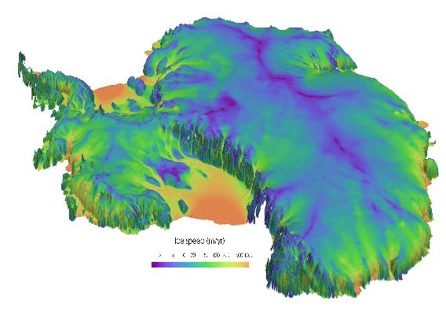
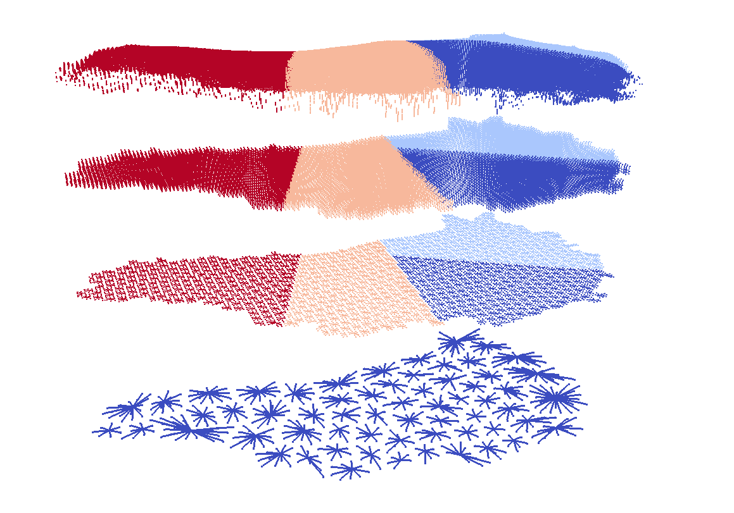
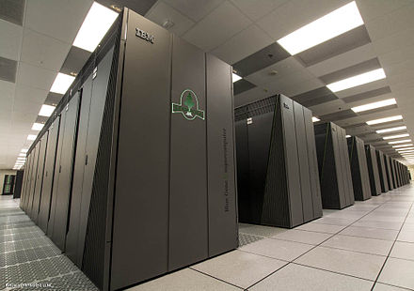
The Albany/FELIX Land-Ice Dynamical Core
I. Tezaur¹, A. Salinger¹, M. Perego¹, R. Tuminaro¹, J. Jakeman¹, M. Eldred¹, J. Watkins¹,
S. Price², I. Demeshko²
¹ Sandia National Laboratories, Albuquerque, NM and Livermore, CA, USA.
² Los Alamos National Laboratory, Los Alamos, NM, USA.
AUG 2017 Livermore, CA Jan. 17-18, 2017
SAND2017-0029 PE

Slide 2
The PISCEES Project
* Proposal for follow-up funding under SciDaC4 in preparation.
FSU FELIX
FSU
Finite Element
Full Stokes Model
PISCEES
SciDaC3 Application Partnership
(DOE’s BER + ASCR divisions)
June 2012 – 2017*
3 land-ice dycores developed under PISCEES
Albany/FELIX
SNL
Finite Element
First-Order Stokes Model
Increased fidelity
BISICLES
LBNL
Finite Volume
L1L2 Model
PISCEES: Predicting Ice Sheet Climate Evolution at Extreme Scales
FELIX: Finite Elements for Land Ice eXperiments
BISICLES: Berkeley Ice Sheet Initiative for Climate at Extreme Scales

Slide 3
The PISCEES Project
* Proposal for follow-up funding under SciDaC4 in preparation.
FSU FELIX
FSU
Finite Element
Full Stokes Model
PISCEES
SciDaC3 Application Partnership
(DOE’s BER + ASCR divisions)
June 2012 – 2017*
3 land-ice dycores developed under PISCEES
Albany/FELIX
SNL
Finite Element
First-Order Stokes Model
Increased fidelity
BISICLES
LBNL
Finite Volume
L1L2 Model
Goal: support DOE climate missions
PISCEES: Predicting Ice Sheet Climate Evolution at Extreme Scales
FELIX: Finite Elements for Land Ice eXperiments
BISICLES: Berkeley Ice Sheet Initiative for Climate at Extreme Scales

Slide 4
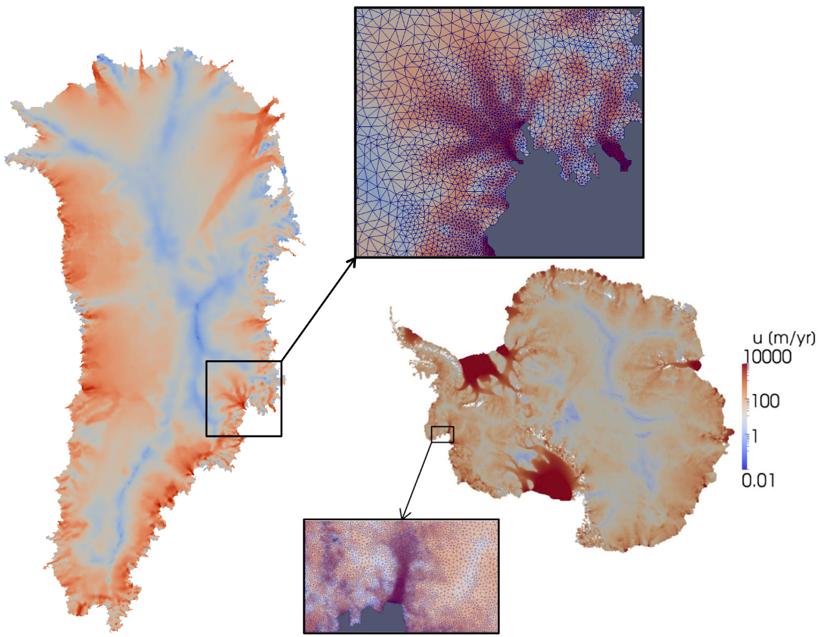
Sandia’s Role in PISCEES
Sandia’s Role in the PISCEES Project: to develop and support a robust and scalable land ice solver based on the “First-Order” (FO) Stokes equations $→$Albany/FELIX*
Requirements for Albany/FELIX:
Unstructured grid finite elements.
Scalable, fast and robust.
Verified and validated.
Portable to new/emerging architecture machines (multi-core, many-core, GPU).
Advanced analysis capabilities: deterministic inversion, calibration, uncertainty quantification.
*Finite Elements for Land Ice eXperiments

Slide 5
Sandia’s Role in PISCEES
Albany/FELIX = production code!
Sandia’s Role in the PISCEES Project: to develop and support a robust and scalable land ice solver based on the “First-Order” (FO) Stokes equations $→$Albany/FELIX*
Requirements for Albany/FELIX:
Unstructured grid finite elements.
Scalable, fast and robust.
Verified and validated.
Portable to new/emerging architecture machines (multi-core, many-core, GPU).
Advanced analysis capabilities: deterministic inversion, calibration, uncertainty quantification.
As part of ACME DOE earth system model, solver will provide actionable predictions of 21st century sea-level rise (including uncertainty).
*Finite Elements for Land Ice eXperiments

Slide 6
The First-Order Stokes Model
Ice behaves like a very viscous shear-thinning fluid (similar to lava flow).

Slide 7
The First-Order Stokes Model
Ice behaves like a very viscous shear-thinning fluid (similar to lava flow).
Quasi-static model with momentum balance given by “First-Order” Stokes PDEs: “nice” elliptic approximation* to Stokes’ flow equations.
$$\dot{ε}1T=\left(2\dot{ε}11+\dot{ε}22,\dot{ε}12,\dot{ε}13\right)$$
$$\dot{ε}2T=\left(2\dot{ε}12, \dot{ε}11+2\dot{ε}22,\dot{ε}23\right)$$
$$\dot{ε}ij=\frac{1}{2}\left(\frac{∂u_{i}}{∂x_{j}}+\frac{∂u_{j}}{∂x_{i}}\right)$$
$\left\{\begin{aligned}−∇∙(2μ\dot{ε}1)=−ρg\frac{∂s}{∂x} \\ −∇∙(2μ\dot{ε}2)=−ρg\frac{∂s}{∂y}\end{aligned}\right.$ , in $Ω$
Viscosity $μ$ is nonlinear function given by “Glen’s law”:
$$μ=\frac{1}{2}{{A(T)}^{−\frac{1}{n}}\left(\frac{1}{2}\sum_{ij}{\dot{ε}ij2}\right)}^{\left(\frac{1}{2n}−\frac{1}{2}\right)}$$
$$(n=3)$$
Albany/FELIX
*Assumption: aspect ratio $δ$is small and normals to upper/lower surfaces are almost vertical.

Slide 8
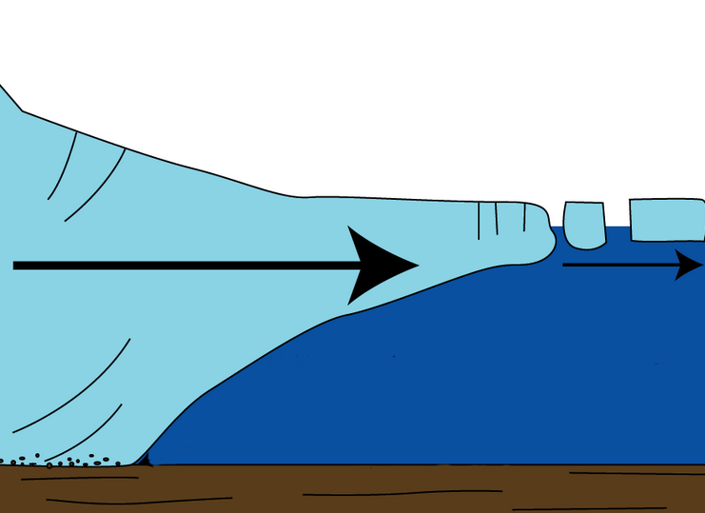
The First-Order Stokes Model
Ice behaves like a very viscous shear-thinning fluid (similar to lava flow).
Quasi-static model with momentum balance given by “First-Order” Stokes PDEs: “nice” elliptic approximation* to Stokes’ flow equations.
$$\dot{ε}1T=\left(2\dot{ε}11+\dot{ε}22,\dot{ε}12,\dot{ε}13\right)$$
$$\dot{ε}2T=\left(2\dot{ε}12, \dot{ε}11+2\dot{ε}22,\dot{ε}23\right)$$
$$\dot{ε}ij=\frac{1}{2}\left(\frac{∂u_{i}}{∂x_{j}}+\frac{∂u_{j}}{∂x_{i}}\right)$$
$\left\{\begin{aligned}−∇∙(2μ\dot{ε}1)=−ρg\frac{∂s}{∂x} \\ −∇∙(2μ\dot{ε}2)=−ρg\frac{∂s}{∂y}\end{aligned}\right.$ , in $Ω$
Viscosity $μ$ is nonlinear function given by “Glen’s law”:
$$μ=\frac{1}{2}{{A(T)}^{−\frac{1}{n}}\left(\frac{1}{2}\sum_{ij}{\dot{ε}ij2}\right)}^{\left(\frac{1}{2n}−\frac{1}{2}\right)}$$
$$(n=3)$$
Ice sheet
Albany/FELIX
Relevant boundary conditions:
*Assumption: aspect ratio $δ$is small and normals to upper/lower surfaces are almost vertical.

Slide 9
The First-Order Stokes Model
Ice behaves like a very viscous shear-thinning fluid (similar to lava flow).
Quasi-static model with momentum balance given by “First-Order” Stokes PDEs: “nice” elliptic approximation* to Stokes’ flow equations.
$$\dot{ε}1T=\left(2\dot{ε}11+\dot{ε}22,\dot{ε}12,\dot{ε}13\right)$$
$$\dot{ε}2T=\left(2\dot{ε}12, \dot{ε}11+2\dot{ε}22,\dot{ε}23\right)$$
$$\dot{ε}ij=\frac{1}{2}\left(\frac{∂u_{i}}{∂x_{j}}+\frac{∂u_{j}}{∂x_{i}}\right)$$
$\left\{\begin{aligned}−∇∙(2μ\dot{ε}1)=−ρg\frac{∂s}{∂x} \\ −∇∙(2μ\dot{ε}2)=−ρg\frac{∂s}{∂y}\end{aligned}\right.$ , in $Ω$
Viscosity $μ$ is nonlinear function given by “Glen’s law”:
Surface boundary $Γs$
$$μ=\frac{1}{2}{{A(T)}^{−\frac{1}{n}}\left(\frac{1}{2}\sum_{ij}{\dot{ε}ij2}\right)}^{\left(\frac{1}{2n}−\frac{1}{2}\right)}$$
$$(n=3)$$
Ice sheet
Albany/FELIX
Relevant boundary conditions:
Stress-free BC: $2μ\dot{ε}i∙n=0,$ on $Γs$
*Assumption: aspect ratio $δ$is small and normals to upper/lower surfaces are almost vertical.

Slide 10
The First-Order Stokes Model
Ice behaves like a very viscous shear-thinning fluid (similar to lava flow).
Quasi-static model with momentum balance given by “First-Order” Stokes PDEs: “nice” elliptic approximation* to Stokes’ flow equations.
$$\dot{ε}1T=\left(2\dot{ε}11+\dot{ε}22,\dot{ε}12,\dot{ε}13\right)$$
$$\dot{ε}2T=\left(2\dot{ε}12, \dot{ε}11+2\dot{ε}22,\dot{ε}23\right)$$
$$\dot{ε}ij=\frac{1}{2}\left(\frac{∂u_{i}}{∂x_{j}}+\frac{∂u_{j}}{∂x_{i}}\right)$$
$\left\{\begin{aligned}−∇∙(2μ\dot{ε}1)=−ρg\frac{∂s}{∂x} \\ −∇∙(2μ\dot{ε}2)=−ρg\frac{∂s}{∂y}\end{aligned}\right.$ , in $Ω$
Viscosity $μ$ is nonlinear function given by “Glen’s law”:
Surface boundary $Γs$
$$μ=\frac{1}{2}{{A(T)}^{−\frac{1}{n}}\left(\frac{1}{2}\sum_{ij}{\dot{ε}ij2}\right)}^{\left(\frac{1}{2n}−\frac{1}{2}\right)}$$
$$(n=3)$$
Ice sheet
Albany/FELIX
Relevant boundary conditions:
Stress-free BC: $2μ\dot{ε}i∙n=0,$ on $Γs$
Floating ice BC:
$2μ\dot{ε}i∙n$ = $\left\{\begin{aligned}ρgzn\text{, }\text{if} z>0 \\ 0, if z≤0\end{aligned}, \right.on Γl$
Lateral boundary $Γl$
*Assumption: aspect ratio $δ$is small and normals to upper/lower surfaces are almost vertical.

Slide 11
The First-Order Stokes Model
Ice behaves like a very viscous shear-thinning fluid (similar to lava flow).
Quasi-static model with momentum balance given by “First-Order” Stokes PDEs: “nice” elliptic approximation* to Stokes’ flow equations.
$$\dot{ε}1T=\left(2\dot{ε}11+\dot{ε}22,\dot{ε}12,\dot{ε}13\right)$$
$$\dot{ε}2T=\left(2\dot{ε}12, \dot{ε}11+2\dot{ε}22,\dot{ε}23\right)$$
$$\dot{ε}ij=\frac{1}{2}\left(\frac{∂u_{i}}{∂x_{j}}+\frac{∂u_{j}}{∂x_{i}}\right)$$
$\left\{\begin{aligned}−∇∙(2μ\dot{ε}1)=−ρg\frac{∂s}{∂x} \\ −∇∙(2μ\dot{ε}2)=−ρg\frac{∂s}{∂y}\end{aligned}\right.$ , in $Ω$
Viscosity $μ$ is nonlinear function given by “Glen’s law”:
Surface boundary $Γs$
$$μ=\frac{1}{2}{{A(T)}^{−\frac{1}{n}}\left(\frac{1}{2}\sum_{ij}{\dot{ε}ij2}\right)}^{\left(\frac{1}{2n}−\frac{1}{2}\right)}$$
$$(n=3)$$
Ice sheet
Albany/FELIX
Relevant boundary conditions:
Stress-free BC: $2μ\dot{ε}i∙n=0,$ on $Γs$
Floating ice BC:
$2μ\dot{ε}i∙n$ = $\left\{\begin{aligned}ρgzn\text{, }\text{if} z>0 \\ 0, if z≤0\end{aligned}, \right.on Γl$
Basal sliding BC: $2μ\dot{ε}i∙n+β(x,y)u_{i}=0$, on $Γβ$
Lateral boundary $Γl$
Basal boundary $Γβ$
)
$$β\left(x,y\right)=basal sliding coefficient$$
*Assumption: aspect ratio $δ$is small and normals to upper/lower surfaces are almost vertical.

Slide 12
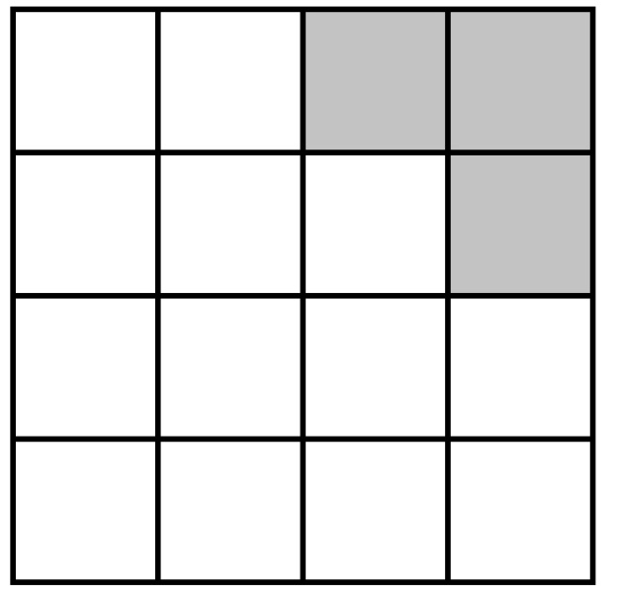
Thickness & Temperature Equations
Model for evolution of the boundaries (thickness evolution equation):
$$\frac{∂H}{∂t}=−∇∙\left(\overline{u}H\right)+\dot{b}$$
where $\overline{u}$ = vertically averaged velocity, $\dot{b}$= surface mass
balance (conservation of mass).
Temperature equation (advection-diffusion):
$$ρc\frac{∂T}{∂t}=∇∙(k∇T)−ρcu∙∇T+2\dot{ε}σ$$
(energy balance).
Flow factor $A$ in Glen’s law depends on temperature $T$: $A=A(T)$.
Ice sheet grows/retreats depending on thickness $H$.
time $t0$
Ice-covered (“active”) cells shaded in white
($H>H_{min}$)

Slide 13
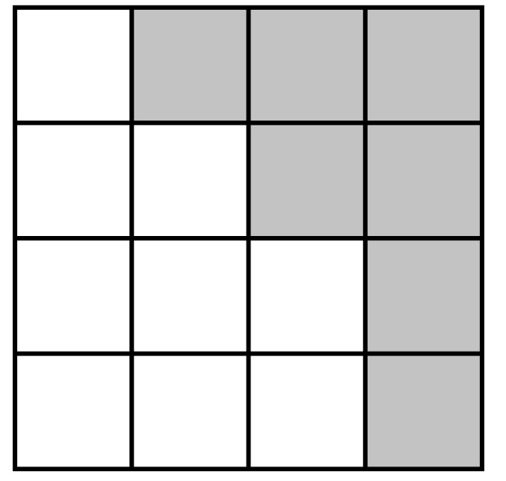
Thickness & Temperature Equations
Model for evolution of the boundaries (thickness evolution equation):
$$\frac{∂H}{∂t}=−∇∙\left(\overline{u}H\right)+\dot{b}$$
where $\overline{u}$ = vertically averaged velocity, $\dot{b}$= surface mass
balance (conservation of mass).
Temperature equation (advection-diffusion):
$$ρc\frac{∂T}{∂t}=∇∙(k∇T)−ρcu∙∇T+2\dot{ε}σ$$
(energy balance).
Flow factor $A$ in Glen’s law depends on temperature $T$: $A=A(T)$.
Ice sheet grows/retreats depending on thickness $H$.
time $t$₁
Ice-covered (“active”) cells shaded in white
($H>H_{min}$)

Slide 14
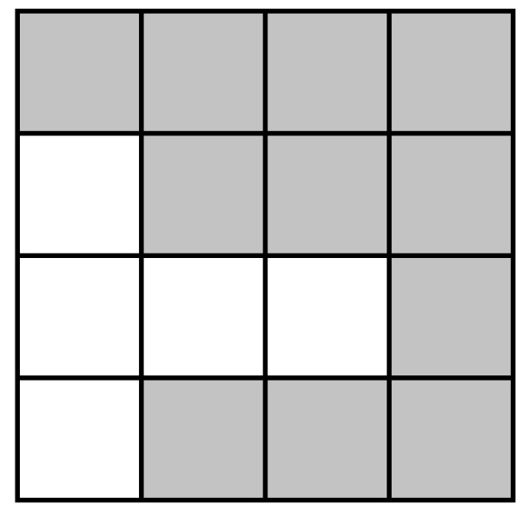
Thickness & Temperature Equations
Model for evolution of the boundaries (thickness evolution equation):
$$\frac{∂H}{∂t}=−∇∙\left(\overline{u}H\right)+\dot{b}$$
where $\overline{u}$ = vertically averaged velocity, $\dot{b}$= surface mass
balance (conservation of mass).
Temperature equation (advection-diffusion):
$$ρc\frac{∂T}{∂t}=∇∙(k∇T)−ρcu∙∇T+2\dot{ε}σ$$
(energy balance).
Flow factor $A$ in Glen’s law depends on temperature $T$: $A=A(T)$.
Ice sheet grows/retreats depending on thickness $H$.
time $t2$
Ice-covered (“active”) cells shaded in white
($H>H_{min}$)

Slide 15
Summary of Ice Sheet Equations & Codes
Code:
Momentum Balance: First-Order Stokes PDEs
C++
$\left\{\begin{aligned}−∇∙(2μ\dot{ε}1)=−ρg\frac{∂s}{∂x} \\ −∇∙(2μ\dot{ε}2)=−ρg\frac{∂s}{∂y}\end{aligned}\right.$ , in $Ω$
Albany/FELIX
with Glen’s law viscosity $μ=\frac{1}{2}{{A(T)}^{−\frac{1}{3}}\left(\frac{1}{2}\sum_{ij}{\dot{ε}ij2}\right)}^{\left(−\frac{2}{3}\right)}$.
Conservation of Mass: thickness evolution PDE
Albany/FELIX
$$\frac{∂h}{∂t}=−∇∙\left(\overline{u}h\right)+\dot{b}$$
CISM/Albany
MPAS/Albany
Energy Balance: temperature advection-diffusion PDE
$$ρc\frac{∂T}{∂t}=∇∙(k∇T)−ρcu∙∇T+2\dot{ε}σ$$
Fortran

Slide 16
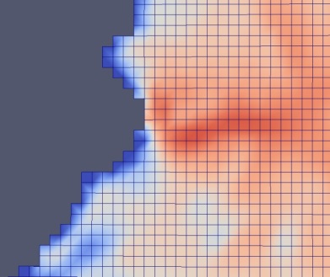
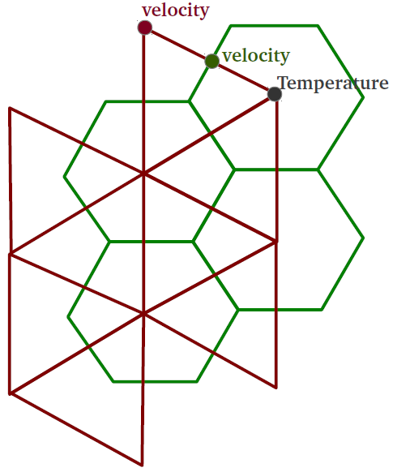
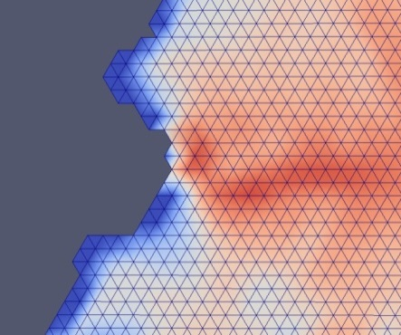
CISM-Albany and MPAS-Albany
CISM-Albany
MPAS-Albany
cism_driver
Albany/FELIX (C++)
velocity solve
LandIce_model
MPAS Land-Ice (Fortran)
Thickness evolution,
temperature solve,
coupling to DOE-ESM
CISM (Fortran)
Thickness evolution, temperature solve, coupling to CESM
C++/Fortran Interface, Mesh Conversion
C++/Fortran Interface, Mesh Conversion
Tetrahedral meshes (dual of hexaganonal mesh, extruded to tets).
output file
output file
Structured hexahedral meshes (rectangles extruded to hexes).
Albany/FELIX has been coupled to two land ice dycores: Community Ice Sheet Model (CISM) and Model for Prediction Across Scales for Land-Ice (MPAS)
7/20

Slide 17
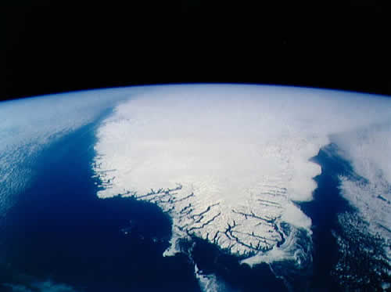
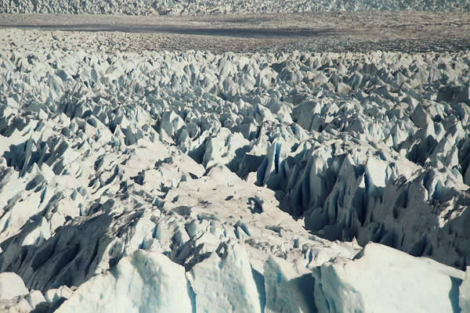
Meshes and Data

Slide 18
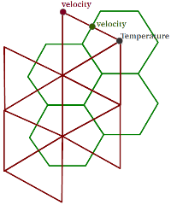
Meshes and Data
Meshes: can use any mesh but interested specifically in
CISM-Albany: structured hexahedral meshes
MPAS-Albany: tetrahedral meshes (Delaunay triangle mesh = dual of hexaganonal mesh, extruded to tets).
Unstructured Delaunay triangle meshes w/ regional refinement based on gradient of surface velocity.
Unstructured adaptively-refined meshes generated in memory using PAALS* (Parallel Albany Adaptive Loop w/ SCOREC).
*See talks by RPI folks and Glen Hansen.
Notes:
To ask: is my workflow description correct?
What is SPR-based error estimator?
Why prism elements and not tets?

Slide 19
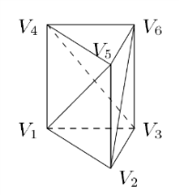
Meshes and Data
Meshes: can use any mesh but interested specifically in
CISM-Albany: structured hexahedral meshes
MPAS-Albany: tetrahedral meshes (Delaunay triangle mesh = dual of hexaganonal mesh, extruded to tets).
Unstructured Delaunay triangle meshes w/ regional refinement based on gradient of surface velocity.
Unstructured adaptively-refined meshes generated in memory using PAALS* (Parallel Albany Adaptive Loop w/ SCOREC).
All meshes are extruded (structured) in vertical direction as tetrahedra or hexahedra.
*See talks by RPI folks and Glen Hansen.
Notes:
To ask: is my workflow description correct?
What is SPR-based error estimator?
Why prism elements and not tets?

Slide 20
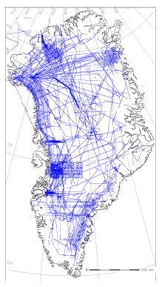
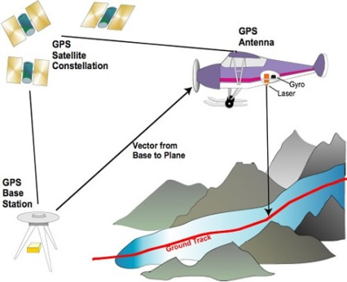
Meshes and Data
Meshes: can use any mesh but interested specifically in
CISM-Albany: structured hexahedral meshes
MPAS-Albany: tetrahedral meshes (Delaunay triangle mesh = dual of hexaganonal mesh, extruded to tets).
Unstructured Delaunay triangle meshes w/ regional refinement based on gradient of surface velocity.
Unstructured adaptively-refined meshes generated in memory using PAALS* (Parallel Albany Adaptive Loop w/ SCOREC).
All meshes are extruded (structured) in vertical direction as tetrahedra or hexahedra.
Data: needs to be imported into code to run “real” problems (Greenland, Antarctica).
Surface data are available from measurements (satellite infrarometry, radar, altimetry): ice extent, surface topography, surface velocity, surface mass balance.
Interior ice data (ice thickness, basal friction) cannot be measured; estimated by solving an inverse problem.
*See talks by RPI folks and Glen Hansen.
Notes:
To ask: is my workflow description correct?
What is SPR-based error estimator?
Why prism elements and not tets?

Slide 21
Performance: Robustness and Scalability

Slide 22
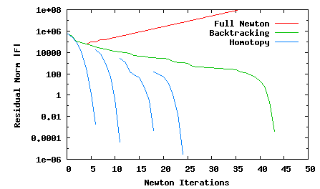
Robustness of Newton’s Method via Homotopy Continuation (LOCA)
$$\dot{ε}1T=\left(2\dot{ε}11+\dot{ε}22,\dot{ε}12,\dot{ε}13\right)$$
$$\dot{ε}2T=\left(2\dot{ε}12, \dot{ε}11+2\dot{ε}22,\dot{ε}23\right)$$
$$\dot{ε}ij=\frac{1}{2}\left(\frac{∂u_{i}}{∂x_{j}}+\frac{∂u_{j}}{∂x_{i}}\right)$$
$γ$=10⁻¹⁰
Glen’s Law Viscosity:
$γ$=10⁻¹⁰
$$μ=\frac{1}{2}{A^{−\frac{1}{3}}\left(\frac{1}{2}\sum_{ij}{\dot{ε}ij2}\right)}^{−\frac{2}{3}}$$
$γ$=10^{-1.0}
$γ$=10^{-6.0}
$γ$=10⁻¹⁰
$γ$=10^{-2.5}

Slide 23
Robustness of Newton’s Method via Homotopy Continuation (LOCA)
$$\dot{ε}1T=\left(2\dot{ε}11+\dot{ε}22,\dot{ε}12,\dot{ε}13\right)$$
$$\dot{ε}2T=\left(2\dot{ε}12, \dot{ε}11+2\dot{ε}22,\dot{ε}23\right)$$
$$\dot{ε}ij=\frac{1}{2}\left(\frac{∂u_{i}}{∂x_{j}}+\frac{∂u_{j}}{∂x_{i}}\right)$$
$γ$=10⁻¹⁰
Glen’s Law Viscosity:
$γ$=10⁻¹⁰
$$μ=\frac{1}{2}{A^{−\frac{1}{3}}\left(\frac{1}{2}\sum_{ij}{\dot{ε}ij2}+γ\right)}^{−\frac{2}{3}}$$
$γ$=10^{-1.0}
$γ=$regularization parameter
$γ$=10^{-6.0}
$γ$=10⁻¹⁰
$γ$=10^{-2.5}

Slide 24
Robustness of Newton’s Method via Homotopy Continuation (LOCA)
$$\dot{ε}1T=\left(2\dot{ε}11+\dot{ε}22,\dot{ε}12,\dot{ε}13\right)$$
$$\dot{ε}2T=\left(2\dot{ε}12, \dot{ε}11+2\dot{ε}22,\dot{ε}23\right)$$
$$\dot{ε}ij=\frac{1}{2}\left(\frac{∂u_{i}}{∂x_{j}}+\frac{∂u_{j}}{∂x_{i}}\right)$$
$γ$=10⁻¹⁰
Glen’s Law Viscosity:
$γ$=10⁻¹⁰
$$μ=\frac{1}{2}{A^{−\frac{1}{3}}\left(\frac{1}{2}\sum_{ij}{\dot{ε}ij2}+γ\right)}^{−\frac{2}{3}}$$
$γ$=10^{-1.0}
$γ=$regularization parameter
$γ$=10^{-6.0}
$γ$=10⁻¹⁰
$γ$=10^{-2.5}
Newton most robust with full step + homotopy
continuation of $γ→{10}^{−10}$: converges out-of-the-box!

Slide 25
Scalability via Algebraic Multi-Grid
Preconditioning with Semi-Coarsening
Bad aspect ratios $(dx≫dz)$ ruin classical AMG convergence rates!
relatively small horizontal coupling terms, hard to smooth horizontal errors
⇒ Solvers (AMG and ILU) must take aspect ratios into account
Algebraic Structured MG
Algebraic Structured MG
New AMG solver based on aggressive semi-coarsening has been developed by R. Tuminaro (available in ML/MueLu packages of Trilinos)
Unstructured AMG
See (Tezaur et al., 2015),
(Tuminaro et al., 2016).
Scalability studies (next slides):
New AMG preconditioner vs. ILU

Slide 26
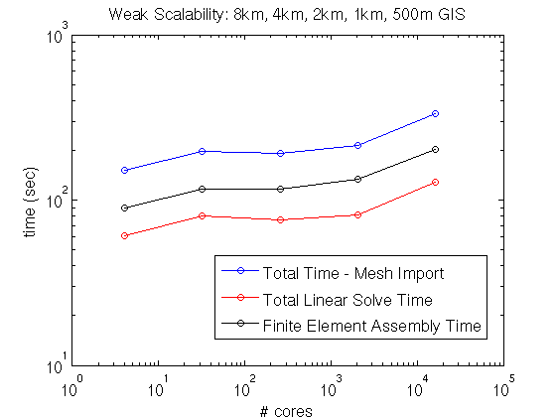
Greenland Controlled Weak Scalability Study
New AMG preconditioner preconditioner
Weak scaling study with fixed dataset, 4 mesh bisections.
~70-80K dofs/core.
Conjugate Gradient (CG) iterative method for linear solves (faster convergence than GMRES).
New AMG preconditioner developed by R. Tuminaro based on semi-coarsening (coarsening in $z$-direction only).
Significant improvement in scalability with new AMG preconditioner over ILU preconditioner!
4 cores
334K dofs
8 km Greenland,
5 vertical layers
16,384 cores
1.12B dofs(!)
0.5 km Greenland,
80 vertical layers
$×84$
scale up

Slide 27
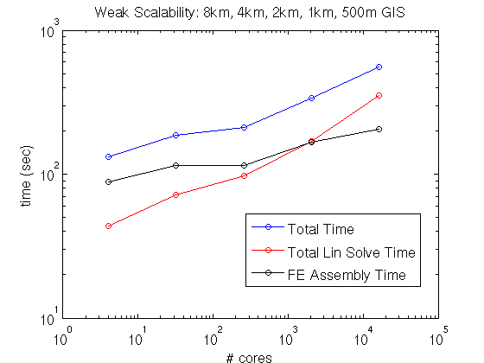
Greenland Controlled Weak Scalability Study
New AMG preconditioner preconditioner
ILU preconditioner
Weak scaling study with fixed dataset, 4 mesh bisections.
~70-80K dofs/core.
Conjugate Gradient (CG) iterative method for linear solves (faster convergence than GMRES).
New AMG preconditioner developed by R. Tuminaro based on semi-coarsening (coarsening in $z$-direction only).
Significant improvement in scalability with new AMG preconditioner over ILU preconditioner!
4 cores
334K dofs
8 km Greenland,
5 vertical layers
16,384 cores
1.12B dofs(!)
0.5 km Greenland,
80 vertical layers
$×84$
scale up

Slide 28
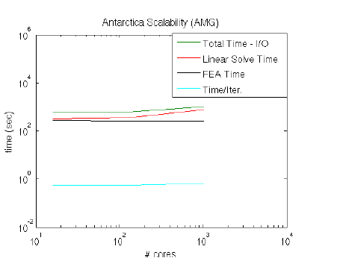
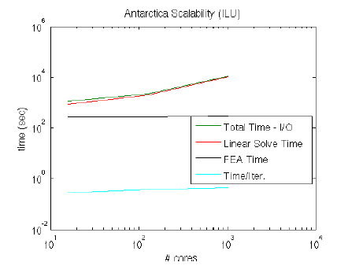
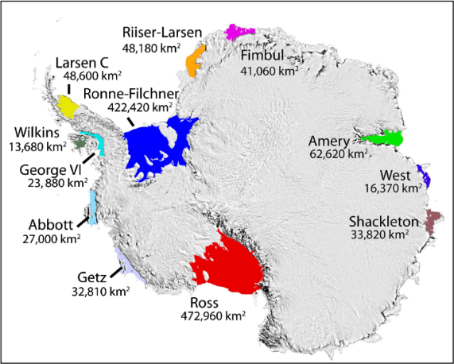
Antarctica Weak Scalability Study
ILU preconditioner
New AMG preconditioner
Severe ill-conditioning caused by ice shelves!
Albany/FELIX
Glimmer/CISM
16 cores
1024 cores
16 cores
1024 cores
# cores
# cores
AMG preconditioner less sensitive to
ill-conditioning caused by ice shelves than ILU
(ice shelves $→$ Green’s function with modest horizontal decay $→$ ILU is less effective).
Notes:
- AMG: Gauss-Seidel smoothing on finest level (where lines are defined in mesh extruded direction), Chebyshev smoothing on coarser levels.
- ILU: ordering is important to maintain acceptable convergence rates (need row-wise ordering)!
- GMRES less sensitive than CG to rounding errors associated w/ severe ill-conditioning introduced by presence of ice shelves.
- CG and GMRES minimize different norms.
- Floating ice shelves: matrix entries corresponding to vertical coupling are much stronger than entries corresponding to horizontal coupling. Vertical grid lines lie within ice shelves, top/bottom BCs resemble Neumann conditions and so the submatrix associated with the vertical lines is nearly singular. Ill-conditioning creates challenges for solver.

Slide 29
Performance Portability

Slide 30
Performance Portability via Kokkos
We need to be able to run Albany/FELIX on new architecture machines (hybrid systems) and manycore devices (multi-core CPU, NVIDIA GPU, Intel Xeon Phi, etc.)

Slide 31
Performance Portability via Kokkos
We need to be able to run Albany/FELIX on new architecture machines (hybrid systems) and manycore devices (multi-core CPU, NVIDIA GPU, Intel Xeon Phi, etc.)
$→$ achieved using the Kokkos library/programming model.

Slide 32
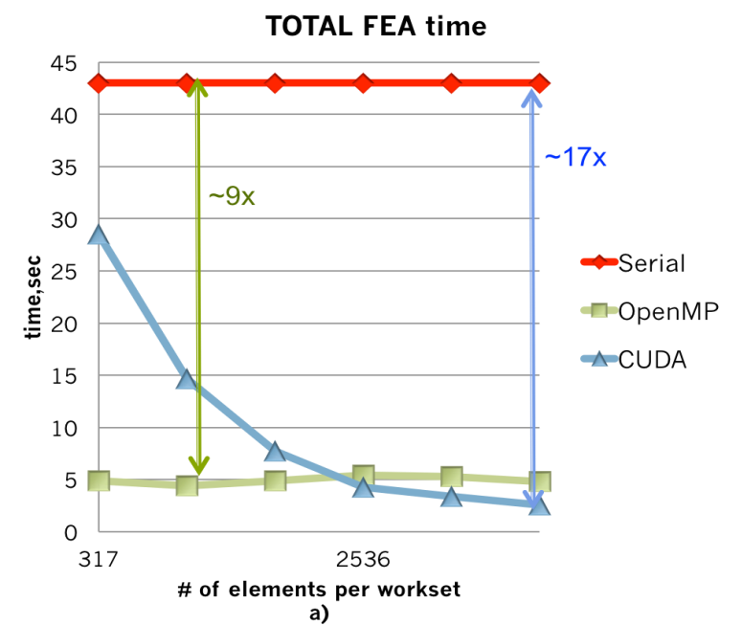
Performance Portability via Kokkos
We need to be able to run Albany/FELIX on new architecture machines (hybrid systems) and manycore devices (multi-core CPU, NVIDIA GPU, Intel Xeon Phi, etc.)
$→$ achieved using the Kokkos library/programming model.
Finite element assembly (FEA) in Albany/FELIX has been rewritten using Kokkos functors*.
Linear solvers in Belos package of Trilinos can run on next-generation platforms with simple preconditioners (Jacobi, Gauss-Seidel, Chebyshev, ILU).
FEA Time (Greenland, on Shannon)
Compute Time (Greenland, on Titan)
time (sec)
time (sec)
# elements/workset
# nodes
*See talk by Jerry Watkins.

Slide 33
Performance Portability via Kokkos
We need to be able to run Albany/FELIX on new architecture machines (hybrid systems) and manycore devices (multi-core CPU, NVIDIA GPU, Intel Xeon Phi, etc.)
$→$ achieved using the Kokkos library/programming model.
Finite element assembly (FEA) in Albany/FELIX has been rewritten using Kokkos functors*.
Jerry Watkins currently working on code profiling and optimizations to get the best possible performance on GPUs and Intel Xeon Phis.
FEA Time (Greenland, on Shannon)
Compute Time (Greenland, on Titan)
time (sec)
time (sec)
# elements/workset
# nodes
*See talk by Jerry Watkins.

Slide 34
Deterministic Inversion

Slide 35
Deterministic Inversion: Estimation of Ice Sheet Initial State
Objective: find ice sheet initial state that
Matches observations (e.g., surf. vel., temp., etc.)
Matches present-day geometry (elevation, thickness).
Is in “equilibrium” with climate forcings (SMB).
Unknown/uncertain variables:
Basal friction ($β$).
Thickness (H).

Slide 36
Deterministic Inversion: Estimation of Ice Sheet Initial State
Objective: find ice sheet initial state that
Matches observations (e.g., surf. vel., temp., etc.)
Matches present-day geometry (elevation, thickness).
Is in “equilibrium” with climate forcings (SMB).
Approach: invert for unknown/uncertain parameters by minimizing difference between
Computed and measured surface velocity ($uobs$)
Computed divergence flux and measured surface mass balance (SMB)
Computed and reference thickness (H^{obs})
Unknown/uncertain variables:
Basal friction ($β$).
Thickness (H).
First-Order Stokes PDE Constrained Optimization Problem:
min $J\left(β,H\right)$ s.t. FO Stokes PDEs where
$$J\left(β,H\right)=\frac{1}{2}αv\int_{Γtop}{\left|u−uobs\right|2ds}+\frac{1}{2}α\int_{Γ}{\left|div\left(UH\right)−SMB\right|2ds+}\frac{1}{2}αH\int_{Γtop}{\left|H−Hobs\right|2ds+ℛ(β)+ℛ(H)}$$

Slide 37
Deterministic Inversion: Estimation of Ice Sheet Initial State
Software for Adjoint-Based Deterministic Inversion*:
Albany/FELIX (FE assembly)
Trilinos (linear/nonlinear solvers)
ROL (gradient-based optimization)
Limited memory BFGS.
Backtrack line-search.
Objective: find ice sheet initial state that
Matches observations (e.g., surf. vel., temp., etc.)
Matches present-day geometry (elevation, thickness).
Is in “equilibrium” with climate forcings (SMB).
Approach: invert for unknown/uncertain parameters by minimizing difference between
Computed and measured surface velocity ($uobs$)
Computed divergence flux and measured surface mass balance (SMB)
Computed and reference thickness (H^{obs})
Unknown/uncertain variables:
Basal friction ($β$).
Thickness (H).
First-Order Stokes PDE Constrained Optimization Problem:
min $J\left(β,H\right)$ s.t. FO Stokes PDEs where
$$J\left(β,H\right)=\frac{1}{2}αv\int_{Γtop}{\left|u−uobs\right|2ds}+\frac{1}{2}α\int_{Γ}{\left|div\left(UH\right)−SMB\right|2ds+}\frac{1}{2}αH\int_{Γtop}{\left|H−Hobs\right|2ds+ℛ(β)+ℛ(H)}$$
*See talk by Mauro Perego.

Slide 38
Deterministic Inversion: Estimation of Ice Sheet Initial State
Software for Adjoint-Based Deterministic Inversion*:
Albany/FELIX (FE assembly)
Trilinos (linear/nonlinear solvers)
ROL (gradient-based optimization)
Limited memory BFGS.
Backtrack line-search.
Objective: find ice sheet initial state that
Matches observations (e.g., surf. vel., temp., etc.)
Matches present-day geometry (elevation, thickness).
Is in “equilibrium” with climate forcings (SMB).
Approach: invert for unknown/uncertain parameters by minimizing difference between
Computed and measured surface velocity ($uobs$)
Computed divergence flux and measured surface mass balance (SMB)
Computed and reference thickness (H^{obs})
Unknown/uncertain variables:
Basal friction ($β$).
Thickness (H).
First-Order Stokes PDE Constrained Optimization Problem:
min $J\left(β,H\right)$ s.t. FO Stokes PDEs where
$$J\left(β,H\right)=\frac{1}{2}αv\int_{Γtop}{\left|u−uobs\right|2ds}+\frac{1}{2}α\int_{Γ}{\left|div\left(UH\right)−SMB\right|2ds+}\frac{1}{2}αH\int_{Γtop}{\left|H−Hobs\right|2ds+ℛ(β)+ℛ(H)}$$
$→$ significantly reduces non-physical model transients
*See talk by Mauro Perego.

Slide 39
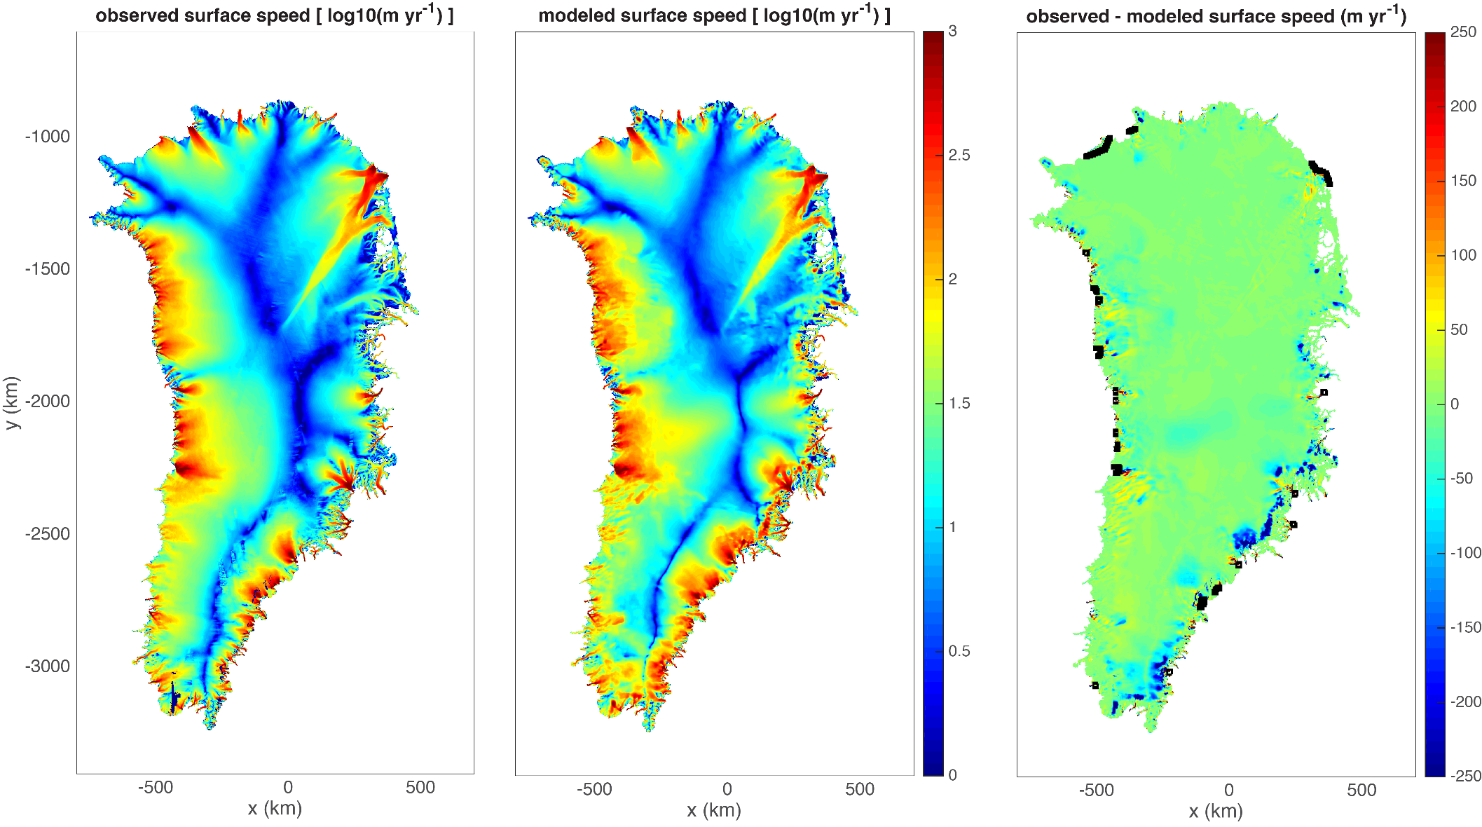
Deterministic Inversion: 1km Greenland Initial Condition*
*This initial condition was used for validation study, discussed later in the talk.

Slide 40
Uncertainty Quantification

Slide 41
Uncertainty Quantification Workflow
Goal: Uncertainty Quantification in 21st century sea level (QoI)

Slide 42
Uncertainty Quantification Workflow
Goal: Uncertainty Quantification in 21st century sea level (QoI)
Sources of uncertainty: climate forcings (e.g., surface mass balance), basal friction ($β$), bedrock topography, geothermal heat flux, model parameters (e.g., Glen’s law exponent).

Slide 43
Uncertainty Quantification Workflow
Goal: Uncertainty Quantification in 21st century sea level (QoI)
Sources of uncertainty: climate forcings (e.g., surface mass balance), basal friction ($β$), bedrock topography, geothermal heat flux, model parameters (e.g., Glen’s law exponent).
As a first step, we focus on effect of uncertainty in basal friction ($β$) only.

Slide 44
Uncertainty Quantification Workflow
Goal: Uncertainty Quantification in 21st century sea level (QoI)
3 Stage UQ Workflow Process:
Deterministic inversion: perform adjoint-based deterministic inversion to estimate initial ice sheet state (i.e., characterize the present state of the ice sheet to be used for performing prediction runs).
Bayesian calibration: construct the posterior distribution using Markov Chain Monte Carlo (MCMC) run on an emulator of the forward model.
Forward propagation: sample the obtained distribution and perform ensemble of forward propagation runs to compute the uncertainty in the QoI.
Sources of uncertainty: climate forcings (e.g., surface mass balance), basal friction ($β$), bedrock topography, geothermal heat flux, model parameters (e.g., Glen’s law exponent).
As a first step, we focus on effect of uncertainty in basal friction ($β$) only.
What are the parameters that render a given set of observations?
What is the impact of uncertain parameters in the model on quantities of interest (QoI)?

Slide 45
Uncertainty Quantification Workflow
Goal: Uncertainty Quantification in 21st century sea level (QoI)
3 Stage UQ Workflow Process:
Deterministic inversion: perform adjoint-based deterministic inversion to estimate initial ice sheet state (i.e., characterize the present state of the ice sheet to be used for performing prediction runs).
Bayesian calibration: construct the posterior distribution using Markov Chain Monte Carlo (MCMC) run on an emulator of the forward model.
Forward propagation: sample the obtained distribution and perform ensemble of forward propagation runs to compute the uncertainty in the QoI.
Sources of uncertainty: climate forcings (e.g., surface mass balance), basal friction ($β$), bedrock topography, geothermal heat flux, model parameters (e.g., Glen’s law exponent).
As a first step, we focus on effect of uncertainty in basal friction ($β$) only.
What are the parameters that render a given set of observations?
What is the impact of uncertain parameters in the model on quantities of interest (QoI)?

Slide 46
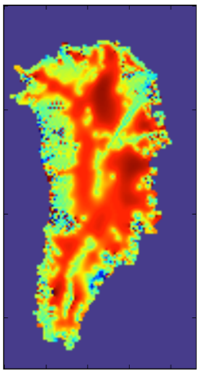
Bayesian Calibration
Difficulty in UQ: “Curse of Dimensionality”
The unknown/uncertain fields have $O(100K)$ dimensions!
Notes:
To ask: is my workflow description correct?
What is SPR-based error estimator?
Why prism elements and not tets?

Slide 47
Bayesian Calibration
Difficulty in UQ: “Curse of Dimensionality”
The unknown/uncertain fields have $O(100K)$ dimensions!
Approach:
Notes:
To ask: is my workflow description correct?
What is SPR-based error estimator?
Why prism elements and not tets?

Slide 48
Bayesian Calibration
Difficulty in UQ: “Curse of Dimensionality”
The unknown/uncertain fields have $O(100K)$ dimensions!
Approach:
Reduce $O(100K)$ dimensional problem to $O(10)$ dimensional problem using, e.g., Karhunen-Loeve Expansion (KLE), Hessian eigenvectors, etc. [Trilinos].
Dimension reduction:
$β=\overline{β}$ $+\sum_{i}{αi}βi$
Best fit: $\overline{β}$
$αi$: random samples from prior distribution
Basis perturbations: $β$_{i}
Data-informed directions
Notes:
To ask: is my workflow description correct?
What is SPR-based error estimator?
Why prism elements and not tets?

Slide 49
Bayesian Calibration
Difficulty in UQ: “Curse of Dimensionality”
The unknown/uncertain fields have $O(100K)$ dimensions!
Approach:
Reduce $O(100K)$ dimensional problem to $O(10)$ dimensional problem using, e.g., Karhunen-Loeve Expansion (KLE), Hessian eigenvectors, etc. [Trilinos].
Form Polynomial Chaos Expansion (PCE) emulator for mismatch (over surface velocity, SMB, thickness) discrepancy [DAKOTA].
Dimension reduction:
$β=\overline{β}$ $+\sum_{i}{αi}βi$
Best fit: $\overline{β}$
$αi$: random samples from prior distribution
Basis perturbations: $β$_{i}
Data-informed directions
Notes:
To ask: is my workflow description correct?
What is SPR-based error estimator?
Why prism elements and not tets?

Slide 50
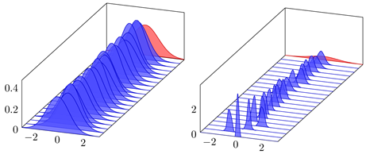
Bayesian Calibration
Difficulty in UQ: “Curse of Dimensionality”
The unknown/uncertain fields have $O(100K)$ dimensions!
Approach:
Reduce $O(100K)$ dimensional problem to $O(10)$ dimensional problem using, e.g., Karhunen-Loeve Expansion (KLE), Hessian eigenvectors, etc. [Trilinos].
Form Polynomial Chaos Expansion (PCE) emulator for mismatch (over surface velocity, SMB, thickness) discrepancy [DAKOTA].
Markov Chain Monte Carlo (MCMC) calibration using emulator [QUESO].
Dimension reduction:
$β=\overline{β}$ $+\sum_{i}{αi}βi$
Marginal distributions of Gaussian posterior
Best fit: $\overline{β}$
$αi$: random samples from prior distribution
Basis perturbations: $β$_{i}
Data-informed directions
Notes:
To ask: is my workflow description correct?
What is SPR-based error estimator?
Why prism elements and not tets?

Slide 51
Forward Propagation
Propagate distribution obtained in Bayesian calibration through the model to get distributions on total ice mass loss/gain during 21st century
Notes:
To ask: is my workflow description correct?
What is SPR-based error estimator?
Why prism elements and not tets?

Slide 52
Forward Propagation
Propagate distribution obtained in Bayesian calibration through the model to get distributions on total ice mass loss/gain during 21st century
Approach:
Notes:
To ask: is my workflow description correct?
What is SPR-based error estimator?
Why prism elements and not tets?

Slide 53
Forward Propagation
Propagate distribution obtained in Bayesian calibration through the model to get distributions on total ice mass loss/gain during 21st century
Approach:
Parameter distribution is the result of Bayesian calibration.
Notes:
To ask: is my workflow description correct?
What is SPR-based error estimator?
Why prism elements and not tets?

Slide 54
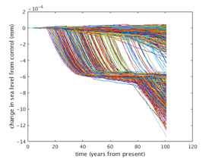
Forward Propagation
Propagate distribution obtained in Bayesian calibration through the model to get distributions on total ice mass loss/gain during 21st century
Approach:
Parameter distribution is the result of Bayesian calibration.
Run $M$ forward CISM/MPAS-Albany runs each for $N$ years w/ parameter sampled from its distribution and build emulator from these runs [DAKOTA].
Sea level time-history for 1000 50-year forward runs with steady state forcing
Notes:
To ask: is my workflow description correct?
What is SPR-based error estimator?
Why prism elements and not tets?

Slide 55
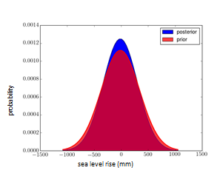
Forward Propagation
Propagate distribution obtained in Bayesian calibration through the model to get distributions on total ice mass loss/gain during 21st century
Approach:
Parameter distribution is the result of Bayesian calibration.
Run $M$ forward CISM/MPAS-Albany runs each for $N$ years w/ parameter sampled from its distribution and build emulator from these runs [DAKOTA].
Use MCMC and emulator to perform uncertainty propagation [QUESO].
Sea level time-history for 1000 50-year forward runs with steady state forcing
PDFs of SLR
Notes:
To ask: is my workflow description correct?
What is SPR-based error estimator?
Why prism elements and not tets?

Slide 56
Verification and Validation

Slide 57
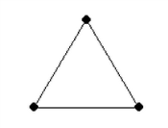
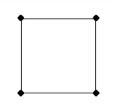
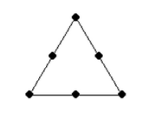
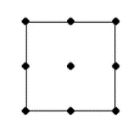
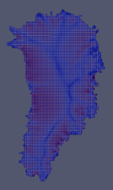
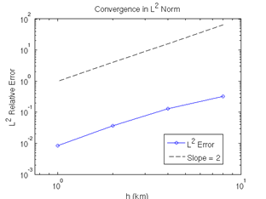
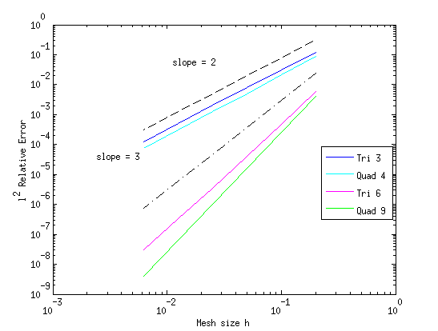
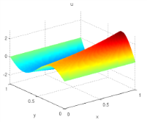
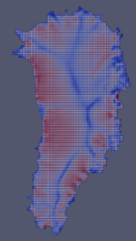
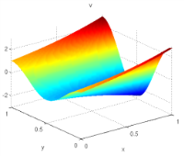
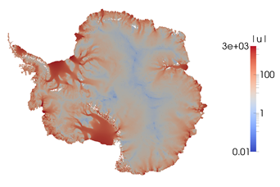
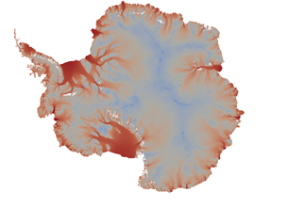
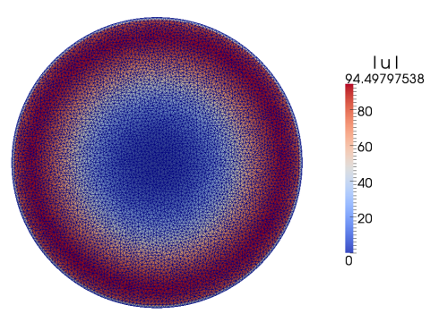
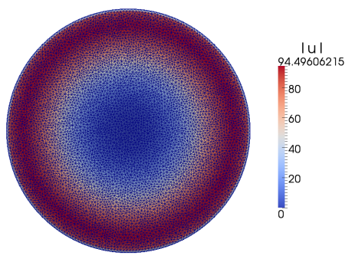
Verification
Is the code bug free?
Stage 1: solution verification on 2D MMS problems.
Stage 3: full 3D mesh convergence study on Greenland w.r.t. reference solution.
Stage 4: reasonable solutions for large-scale realistic GIS & AIS problems (Albany/FELIX – left; reference solution – right).
Stage 2: code-to-code comparisons on canonical ice sheet benchmarks (Albany/FELIX – left; LifeV – right).

Slide 58
Validation: Definition & Workflow
Validation: how well does model represent the real ice sheet?

Slide 59
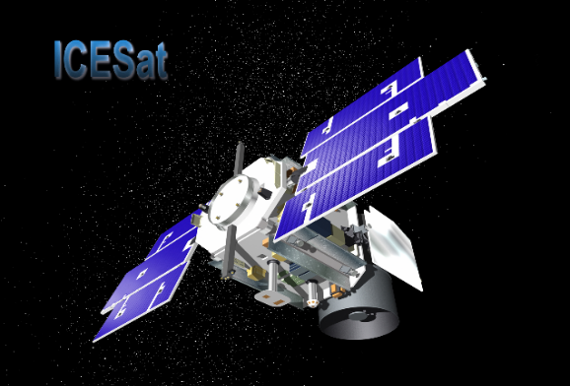
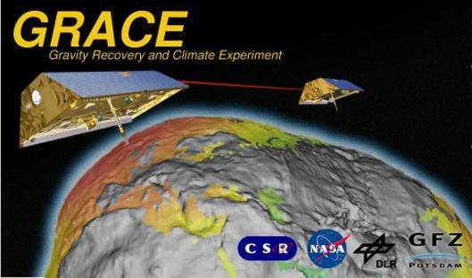
Validation: Definition & Workflow
Validation: how well does model represent the real ice sheet?
There are currently (up to) 2 decades of large-scale satellite observations of Greenland ice sheet geometry change:
ICESat1 | 2003 – 2009
GRACE | 2002 – 201? (ongoing)
Validation Workflow (with LANL & NASA):
Run CISM-Albany for period where observations exist.
Process model output and observations for comparison.
Evaluate model performance relative to observations.
ICESat: ice sheet surface elevation [state comparison]
GRACE: rate of mass change [trend comparison]
Validation time periods: 2003-2009 (IceSAT), 2003-2011 (GRACE)

Slide 60
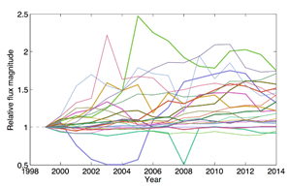
Validation: Definition & Workflow
Validation: how well does model represent the real ice sheet?
There are currently (up to) 2 decades of large-scale satellite observations of Greenland ice sheet geometry change:
ICESat1 | 2003 – 2009
GRACE | 2002 – 201? (ongoing)
Validation Workflow (with LANL & NASA):
Run CISM-Albany for period where observations exist.
Process model output and observations for comparison.
Evaluate model performance relative to observations.
ICESat: ice sheet surface elevation [state comparison]
GRACE: rate of mass change [trend comparison]
Validation time periods: 2003-2009 (IceSAT), 2003-2011 (GRACE)
Model forcing: monthly surface mass balance (SMB) anomalies from RACMO2 and/or outlet glacier flux-forcing (FF) at grounding line applied.

Slide 61
Validation: Definition & Workflow
Validation: how well does model represent the real ice sheet?
There are currently (up to) 2 decades of large-scale satellite observations of Greenland ice sheet geometry change:
ICESat1 | 2003 – 2009
GRACE | 2002 – 201? (ongoing)
Validation Workflow (with LANL & NASA):
Run CISM-Albany for period where observations exist.
Process model output and observations for comparison.
Evaluate model performance relative to observations.
ICESat: ice sheet surface elevation [state comparison]
GRACE: rate of mass change [trend comparison]
Validation time periods: 2003-2009 (IceSAT), 2003-2011 (GRACE)
Model forcing: monthly surface mass balance (SMB) anomalies from RACMO2 and/or outlet glacier flux-forcing (FF) at grounding line applied.
Initial condition (1km GIS) obtained through deterministic inversion (shown on earlier slide).

Slide 62
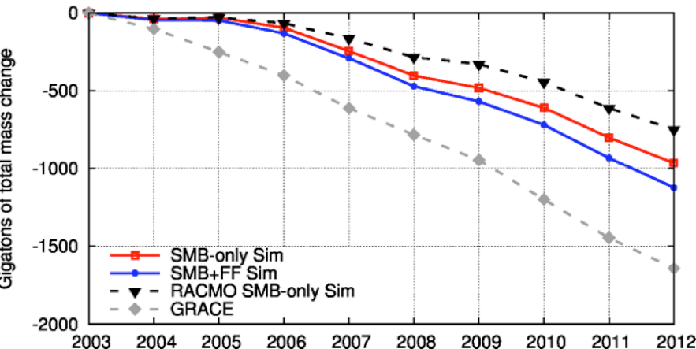
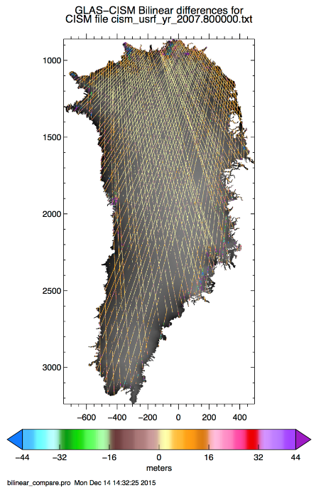
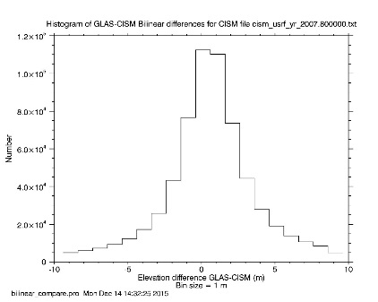
Validation Results
Surface Elevation Comparison [IceSAT]
Whole Ice Sheet Mass Trends [GRACE]
Oct. 07 bilinear differences
Surface elevation predictions (states) agree well with GLAS (Geoscience Laser Altimeter System aboard ICESat): mean differences are <1 m
Gigatons total mass change
Histogram of Oct. 07 bilinear differences
CISM-Albany results (blue, red lines) closer to observations (gray line) than older “idealized” simulations (black line).

Slide 63
Validation Results
Surface Elevation Comparison [IceSAT]
Whole Ice Sheet Mass Trends [GRACE]
Oct. 07 bilinear differences
Surface elevation predictions (states) agree well with GLAS (Geoscience Laser Altimeter System aboard ICESat): mean differences are <1 m
Gigatons total mass change
Histogram of Oct. 07 bilinear differences
CISM-Albany results (blue, red lines) closer to observations (gray line) than older “idealized” simulations (black line).
Main Takeaway from Validation Study
Current generation ice sheet models, when appropriately forced, show skill at mimicking ice sheet observations

Slide 64
Validation Results
Surface Elevation Comparison [IceSAT]
Whole Ice Sheet Mass Trends [GRACE]
Oct. 07 bilinear differences
Surface elevation predictions (states) agree well with GLAS (Geoscience Laser Altimeter System aboard ICESat): mean differences are <1 m
Gigatons total mass change
Histogram of Oct. 07 bilinear differences
CISM-Albany results (blue, red lines) closer to observations (gray line) than older “idealized” simulations (black line).
Main Takeaway from Validation Study
Current generation ice sheet models, when appropriately forced, show skill at mimicking ice sheet observations
Clear improvement over a decade ago: SLR projections from ice sheet models were not included in the IPCC’s AR4 b/c models could not explain observed ice dynamical behaviors.

Slide 65
Cool Movie of Validation Results
Video acknowledgement: B. Carvey (SNL)

Slide 66
Summary and Future Work
Summary:
We have developed the Albany/FELIX land-ice solver, which is:
Scalable, fast, robust.
Coupled to CISM and MPAS codes for dynamic runs and integration into ESMs.
Verified and validated.
Portable to new and emerging architecture machines.
Equipped with advanced analysis capabilities (deterministic inversion, UQ).
A production code in Albany.
Albany/FELIX work not covered in this talk:
Semi-implicit FO Stokes-thickness coupling methods.
Temperature solver in Albany/FELIX.
More sophisticated basal hydrology models.
FO Stokes model on spherical grids via stereographic projection.
Ongoing/future work:
Science runs using CISM-Albany and MPAS-Albany.
Code optimizations for new architecture machines (GPUs, Intel Xeon Phis).
Improving UQ workflow / algorithms, towards paper.
Proposal for follow-up funding (SciDaC4).
Delivering code to climate community and coupling to ESMs.

Slide 67
Funding/Acknowledgements
Support for this work was provided through Scientific Discovery through Advanced Computing (SciDAC) projects funded by the U.S. Department of Energy, Office of Science (OSCR), Advanced Scientific Computing Research and Biological and Environmental Research (BER) $→$PISCEES SciDAC Application Partnership.
PISCEES team members: K. Evans, M. Gunzburger, M. Hoffman, C. Jackson, P. Jones, W. Lipscomb, M. Perego, S. Price, A. Salinger, I. Tezaur, R. Tuminaro, P. Worley.
Trilinos/DAKOTA collaborators: M. Eldred, J. Jakeman, E. Phipps, L. Swiler.
Computing resources: NERSC, OLCF.

Slide 68
References
[1] M.A. Heroux et al. “An overview of the Trilinos project.” ACM Trans. Math. Softw. 31(3) (2005).
[2] A. Salinger, et al. "Albany: Using Agile Components to Develop a Flexible, Generic Multiphysics Analysis Code", Int. J. Multiscale Comput. Engng. 14(4) (2016) 415-438.
[3] I. Tezaur, M. Perego, A. Salinger, R. Tuminaro, S. Price. "Albany/FELIX: A Parallel, Scalable and Robust Finite Element Higher-Order Stokes Ice Sheet Solver Built for Advanced Analysis", Geosci. Model Develop. 8 (2015) 1-24.
[4] I. Tezaur, R. Tuminaro, M. Perego, A. Salinger, S. Price. "On the scalability of the Albany/FELIX first-order Stokes approximation ice sheet solver for large-scale simulations of the Greenland and Antarctic ice sheets", MSESM/ICCS15, Reykjavik, Iceland (June 2014).
[5] R.S. Tuminaro, I. Tezaur, M. Perego, A.G. Salinger. "A Hybrid Operator Dependent Multi-Grid/Algebraic Multi-Grid Approach: Application to Ice Sheet Modeling", SIAM J. Sci. Comput. 38(5) (2016) C504-C532.
[6] S. Price, M. Hoffman, J. Bonin, T. Neumann, I. Howat, J. Guerber, I. Tezaur, J. Saba, J. Lanaerts, D. Chambers, W. Lipscomb, M. Perego, A. Salinger, R. Tuminaro. "An ice sheet model validation framework for the Greenland ice sheet", Geoscientific Model Development (GMD) (in press).

Slide 69
References (cont’d)
[7] S. Shannon, et al. “Enhanced basal lubrication and the contribution of the Greenland ice sheet to future sea-level rise”, P. Natl. Acad. Sci., 110 (2013) 14156-14161.
[8] P. Fretwell, et al. “BEDMAP2: Improved ice bed, surface, and thickness datasets for Antarctica”, The Cryosphere 7(1) (2013) 375-393.
[9] F. Pattyn. “Antarctic subglacial conditions inferred from a hybrid ice sheet/ice stream model”, Earth and Planetary Science Letters 295 (2010).
[10] M. Perego, S. Price, G. Stadler. “Optimal Initial Conditions for Coupling Ice Sheet Models to Earth System Models”, J. Geophys. Res. 119 (2014) 1894-1917.
[11] J.H. van Angelen, M.R. Van Den Broeke, B. Wouters, J.T.M. Lenaerts, “Contemporary (1960–2012) Evolution of the Climate and Surface Mass Balance of the Greenland Ice Sheet”, Surveys in Geophysics, 35, 1155–1174, 2013.
[12] E.M. Enderlin, I.M. Howat, S. Jeong, M.J. Noh, J.H. Angelen, J. H., M.R. Broeke, “An improved mass budget for the Greenland ice sheet”, Geophysical Research Letters, 41, 866–872, 2014.
[13] I. Velicogna, J. Wahr, “Time-variable gravity observations of ice sheet mass balance: Precision and limitations of the GRACE satelliteData”, Geophysical Research Letters, 2013.

Slide 70
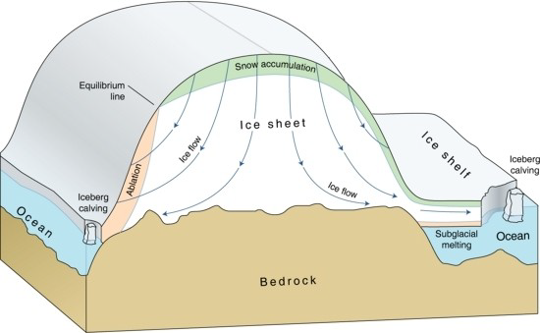
Stokes Ice Flow Equations
Ice behaves like a very viscous shear-thinning fluid (similar to lava flow) and is modeled using nonlinear incompressible Stokes’ equations.
Nonlinear incompressible Stokes’ ice flow equations (momentum balance):
$\left\{\begin{aligned}−∇∙σ=ρg \\ −∇∙u=0\end{aligned}\right.$ , in $Ω$
with
$σ = 2μ$ $\dot{ε}−pI$, $εij=\frac{1}{2}\left(\frac{∂ui}{∂xj}+\frac{∂uj}{∂xi}\right)$
and nonlinear “Glen’s law” viscosity
$μ=\frac{1}{2}{{A(T)}^{−\frac{1}{n}}\left(\frac{1}{2}\sum_{ij}{εij2}\right)}^{\left(\frac{1}{2n}−\frac{1}{2}\right)}$, $n=3$.

Slide 71
Stokes Ice Flow Equations
Ice behaves like a very viscous shear-thinning fluid (similar to lava flow) and is modeled using nonlinear incompressible Stokes’ equations.
Nonlinear incompressible Stokes’ ice flow equations (momentum balance):
$\left\{\begin{aligned}−∇∙σ=ρg \\ −∇∙u=0\end{aligned}\right.$ , in $Ω$
with
$σ = 2μ$ $\dot{ε}−pI$, $εij=\frac{1}{2}\left(\frac{∂ui}{∂xj}+\frac{∂uj}{∂xi}\right)$
and nonlinear “Glen’s law” viscosity
$μ=\frac{1}{2}{{A(T)}^{−\frac{1}{n}}\left(\frac{1}{2}\sum_{ij}{εij2}\right)}^{\left(\frac{1}{2n}−\frac{1}{2}\right)}$, $n=3$.
$→$“nasty” saddle point problem

