Slide 1
Stabilization of Projection-Based
Reduced Order Models via Optimization-Based Eigenvalue Reassignment
Irina K. Tezaur*, Bart G. van Bloemen Waanders,
Srinivasan Arunajatesan, Matthew F. Barone, Jeffrey A. Fike
Sandia National Laboratories
Livermore, CA and Albuquerque, NM, USA.
1st Pan-American Congress on Computational Mechanics (PANACM 2015)
Buenos Aires, Argentina
Mon. April 27– Wed. April 29, 2015
SAND2015-2795 C
*Formerly I. Kalashnikova.
Sandia National Laboratories is a multi-program laboratory managed and operated by Sandia Corporation, a wholly owned subsidiary of Lockheed Marin Corporation, for the U.S. Department of Energy’s National Security Administration under contract DE-AC04-94AL85000.

Slide 2
Motivation
Despite improved algorithms and powerful supercomputers, “high-fidelity” models are often too expensive for use in a design or analysis setting.

Slide 3
Motivation
Despite improved algorithms and powerful supercomputers, “high-fidelity” models are often too expensive for use in a design or analysis setting.
Example applications of interest to Sandia that could
benefit from ROMs:

Slide 4
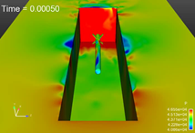
Motivation
Despite improved algorithms and powerful supercomputers, “high-fidelity” models are often too expensive for use in a design or analysis setting.
Example applications of interest to Sandia that could
benefit from ROMs:
Complex fluid dynamics problems, e.g., transonic compressible flow past a cavity: single LES simulation takes weeks even when run in parallel on state-of-the-art supercomputers.

Slide 5
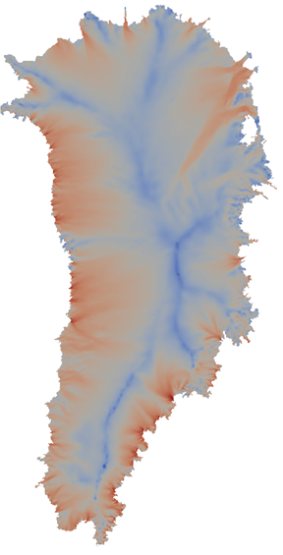
Motivation
Despite improved algorithms and powerful supercomputers, “high-fidelity” models are often too expensive for use in a design or analysis setting.
Example applications of interest to Sandia that could
benefit from ROMs:
Complex fluid dynamics problems, e.g., transonic compressible flow past a cavity: single LES simulation takes weeks even when run in parallel on state-of-the-art supercomputers.
Climate modeling, e.g., ice flow simulations for sea-level rise predictions: Bayesian inference tools cannot handle high-D parameter spaces, MCMC requires thousands of forward solves.

Slide 6
Motivation
Despite improved algorithms and powerful supercomputers, “high-fidelity” models are often too expensive for use in a design or analysis setting.
Example applications of interest to Sandia that could
benefit from ROMs:
Complex fluid dynamics problems, e.g., transonic compressible flow past a cavity: single LES simulation takes weeks even when run in parallel on state-of-the-art supercomputers.
Climate modeling, e.g., ice flow simulations for sea-level rise predictions: Bayesian inference tools cannot handle high-D parameter spaces, MCMC requires thousands of forward solves.
This talk presents a recent paper on ROM stabilization:
I. Kalashnikova, B.G. van Bloemen Waanders, S. Arunajatesan, M.F. Barone. "Stabilization of Projection-Based Reduced Order Models for Linear Time-Invariant Systems via Optimization-Based Eigenvalue Reassignment". Comput. Meth. Appl. Mech. Engng. 272 (2014) 251-270.

Slide 7
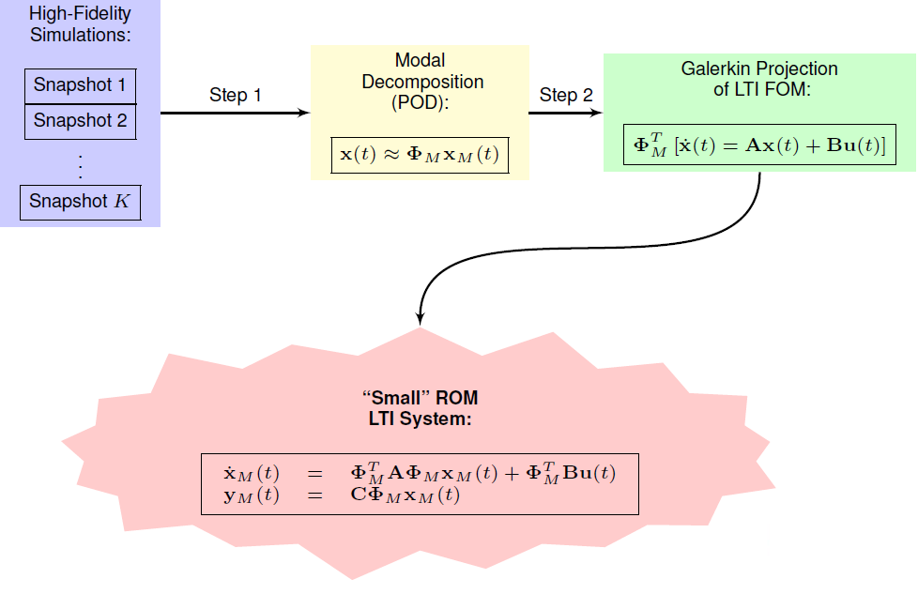
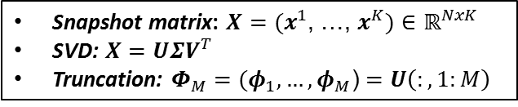
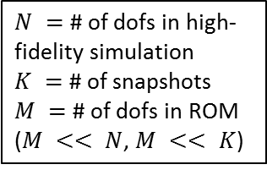
Proper Orthogonal Decomposition (POD)/
Galerkin Method to Model Reduction
Snapshot matrix: $X=(x^{1}$, …, $x^{K})$ $∈ℝ^{NxK}$
SVD: $X=UΣV^{T}$
Truncation: $Φ_{M}=(φ_{1}, …, φ_{M}$) $=U\left(:,1:M\right)$
$N =$ # of dofs in high-fidelity simulation
$K =$ # of snapshots
$M =$ # of dofs in ROM
($M << N$, $M << K$)
ROM = “Reduced Order Model”
FOM = “Full Order Model”
LTI = “Linear Time Invariant”

Slide 8
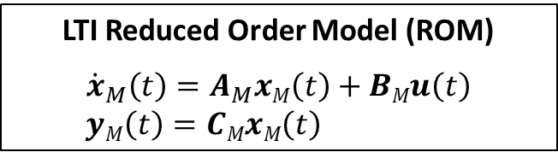
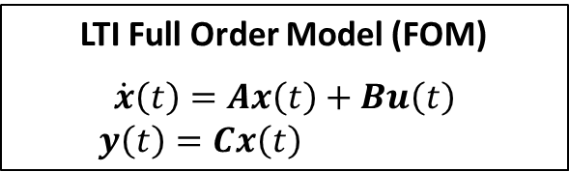

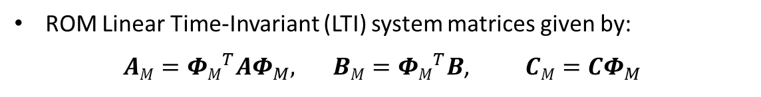
Stability Issues of POD/Galerkin ROMs
LTI Full Order Model (FOM)
$$\dot{x}\left(t\right)=Ax\left(t\right)+Bu\left(t\right)$$
$y\left(t\right)=Cx\left(t\right)$
LTI Reduced Order Model (ROM)
$${\dot{x}}_{M}\left(t\right)=A_{M}xM\left(t\right)+BMu\left(t\right)$$
$yM\left(t\right)=CMxM\left(t\right)$
ROM Linear Time-Invariant (LTI) system matrices given by:
${AM=ΦM}_{}^{T}AΦ_{M}, { BM=ΦM}_{}^{T}B$,$CM=$ $CΦ_{M}$
Problem: $A$ stable $⇏ AM$ stable!

Slide 9
Stability Issues of POD/Galerkin ROMs
LTI Full Order Model (FOM)
$$\dot{x}\left(t\right)=Ax\left(t\right)+Bu\left(t\right)$$
$y\left(t\right)=Cx\left(t\right)$
LTI Reduced Order Model (ROM)
$${\dot{x}}_{M}\left(t\right)=A_{M}xM\left(t\right)+BMu\left(t\right)$$
$yM\left(t\right)=CMxM\left(t\right)$
ROM Linear Time-Invariant (LTI) system matrices given by:
${AM=ΦM}_{}^{T}AΦ_{M}, { BM=ΦM}_{}^{T}B$,$CM=$ $CΦ_{M}$
Problem: $A$ stable $⇏ AM$ stable!
There is no a priori stability guarantee for POD/Galerkin ROMs.

Slide 10
Stability Issues of POD/Galerkin ROMs
LTI Full Order Model (FOM)
$$\dot{x}\left(t\right)=Ax\left(t\right)+Bu\left(t\right)$$
$y\left(t\right)=Cx\left(t\right)$
LTI Reduced Order Model (ROM)
$${\dot{x}}_{M}\left(t\right)=A_{M}xM\left(t\right)+BMu\left(t\right)$$
$yM\left(t\right)=CMxM\left(t\right)$
ROM Linear Time-Invariant (LTI) system matrices given by:
${AM=ΦM}_{}^{T}AΦ_{M}, { BM=ΦM}_{}^{T}B$,$CM=$ $CΦ_{M}$
Problem: $A$ stable $⇏ AM$ stable!
There is no a priori stability guarantee for POD/Galerkin ROMs.
Stability of a ROM is commonly evaluated a posteriori – RISKY!

Slide 11
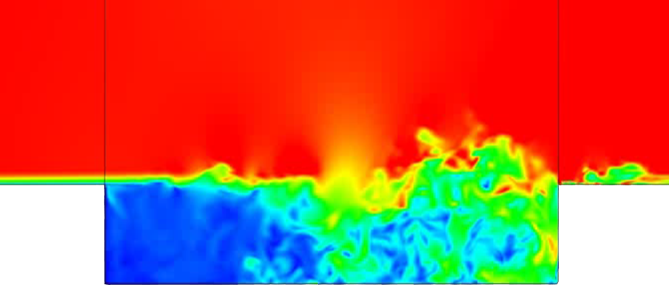
Stability Issues of POD/Galerkin ROMs
LTI Full Order Model (FOM)
$$\dot{x}\left(t\right)=Ax\left(t\right)+Bu\left(t\right)$$
$y\left(t\right)=Cx\left(t\right)$
LTI Reduced Order Model (ROM)
$${\dot{x}}_{M}\left(t\right)=A_{M}xM\left(t\right)+BMu\left(t\right)$$
$yM\left(t\right)=CMxM\left(t\right)$
ROM Linear Time-Invariant (LTI) system matrices given by:
${AM=ΦM}_{}^{T}AΦ_{M}, { BM=ΦM}_{}^{T}B$,$CM=$ $CΦ_{M}$
Problem: $A$ stable $⇏ AM$ stable!
There is no a priori stability guarantee for POD/Galerkin ROMs.
Stability of a ROM is commonly evaluated a posteriori – RISKY!
Instability of POD/Galerkin ROMs is a real problem in some applications…
…e.g., compressible cavity flows, high-Reynolds number flows, ...

Slide 12
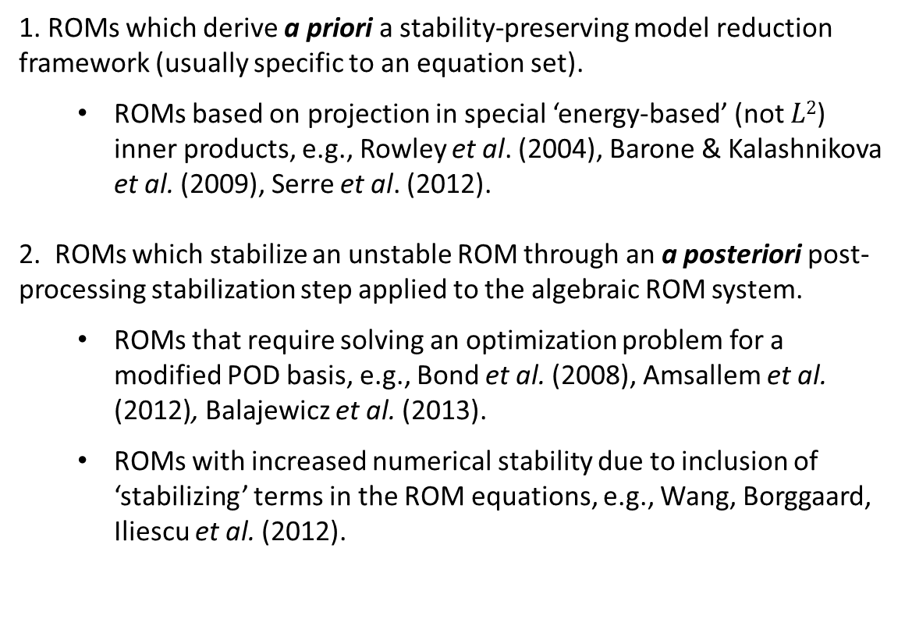
Stability Preserving ROM Approaches:
Literature Review
Approaches for building stability-preserving POD/Galerkin
ROMs found in the literature fall into two categories:
1. ROMs which derive a priori a stability-preserving model reduction framework (usually specific to an equation set).
  ROMs based on projection in special ‘energy-based’ (not $L2$) inner products, e.g., Rowley et al. (2004), Barone & Kalashnikova et al. (2009), Serre et al. (2012).
2. ROMs which stabilize an unstable ROM through an a posteriori post-processing stabilization step applied to the algebraic ROM system.
  ROMs that require solving an optimization problem for a modified POD basis, e.g., Bond et al. (2008), Amsallem et al. (2012), Balajewicz et al. (2013).
  ROMs with increased numerical stability due to inclusion of ‘stabilizing’ terms in the ROM equations, e.g., Wang, Borggaard, Iliescu et al. (2012).

Slide 13
Stability Preserving ROM Approaches:
Literature Review
Approaches for building stability-preserving POD/Galerkin
ROMs found in the literature fall into two categories:
1. ROMs which derive a priori a stability-preserving model reduction framework (usually specific to an equation set).
  ROMs based on projection in special ‘energy-based’ (not $L2$) inner products, e.g., Rowley et al. (2004), Barone & Kalashnikova et al. (2009), Serre et al. (2012).
2. ROMs which stabilize an unstable ROM through an a posteriori post-processing stabilization step applied to the algebraic ROM system.
  ROMs that require solving an optimization problem for a modified POD basis, e.g., Bond et al. (2008), Amsallem et al. (2012), Balajewicz et al. (2013).
  ROMs with increased numerical stability due to inclusion of ‘stabilizing’ terms in the ROM equations, e.g., Wang, Borggaard, Iliescu et al. (2012).
Can have an
intrusive implemetation
Can have
inconsistencies between ROM and FOM physics

Slide 14
ROM Stabilization via Optimization-Based
Eigenvalue Reassignment*
Approach falls in 2nd category of stabilization methods, but ensures stabilized ROM solution deviates minimally from FOM solution.
*I. Kalashnikova, B.G. van Bloemen Waanders, S. Arunajatesan, M.F. Barone. "Stabilization of Projection-Based Reduced Order Models for Linear Time-Invariant Systems via Optimization-Based Eigenvalue Reassignment". Comput. Meth. Appl. Mech. Engng. 272 (2014) 251-270.

Slide 15
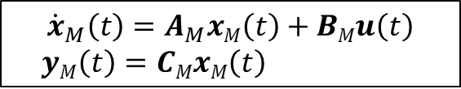
ROM Stabilization via Optimization-Based
Eigenvalue Reassignment*
Approach falls in 2nd category of stabilization methods, but ensures stabilized ROM solution deviates minimally from FOM solution.
Attention focused on LTI systems$:$
$${\dot{x}}_{M}\left(t\right)=A_{M}xM\left(t\right)+BMu\left(t\right)$$
$yM\left(t\right)=CMxM\left(t\right)$
(1)
*I. Kalashnikova, B.G. van Bloemen Waanders, S. Arunajatesan, M.F. Barone. "Stabilization of Projection-Based Reduced Order Models for Linear Time-Invariant Systems via Optimization-Based Eigenvalue Reassignment". Comput. Meth. Appl. Mech. Engng. 272 (2014) 251-270.

Slide 16

ROM Stabilization via Optimization-Based
Eigenvalue Reassignment*
Approach falls in 2nd category of stabilization methods, but ensures stabilized ROM solution deviates minimally from FOM solution.
Attention focused on LTI systems$:$
$${\dot{x}}_{M}\left(t\right)=A_{M}xM\left(t\right)+BMu\left(t\right)$$
$yM\left(t\right)=CMxM\left(t\right)$
(1)
Problem: $A$ stable $⇏ AM$ stable!
*I. Kalashnikova, B.G. van Bloemen Waanders, S. Arunajatesan, M.F. Barone. "Stabilization of Projection-Based Reduced Order Models for Linear Time-Invariant Systems via Optimization-Based Eigenvalue Reassignment". Comput. Meth. Appl. Mech. Engng. 272 (2014) 251-270.

Slide 17

ROM Stabilization via Optimization-Based
Eigenvalue Reassignment*
Approach falls in 2nd category of stabilization methods, but ensures stabilized ROM solution deviates minimally from FOM solution.
Attention focused on LTI systems$:$
$${\dot{x}}_{M}\left(t\right)=A_{M}xM\left(t\right)+BMu\left(t\right)$$
$yM\left(t\right)=CMxM\left(t\right)$
(1)
Problem: $A$ stable $⇏ AM$ stable!
Goal: modify ROM system s.t. $A_{M}$ is stable and discrepancy b/w ROM output $yM\left(t\right)$ and FOM output $y\left(t\right)$ is minimal.
*I. Kalashnikova, B.G. van Bloemen Waanders, S. Arunajatesan, M.F. Barone. "Stabilization of Projection-Based Reduced Order Models for Linear Time-Invariant Systems via Optimization-Based Eigenvalue Reassignment". Comput. Meth. Appl. Mech. Engng. 272 (2014) 251-270.

Slide 18
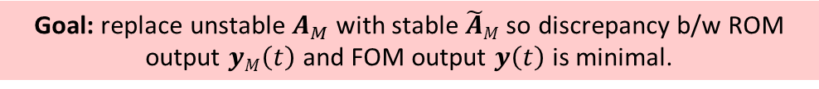
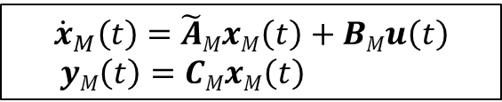
ROM Stabilization via Optimization-Based
Eigenvalue Reassignment*
Approach falls in 2nd category of stabilization methods, but ensures stabilized ROM solution deviates minimally from FOM solution.
Attention focused on LTI systems$:$
$${\dot{x}}_{M}\left(t\right)=A_{M}xM\left(t\right)+BMu\left(t\right)$$
$yM\left(t\right)=CMxM\left(t\right)$
$${\dot{x}}_{M}\left(t\right)=\tilde{A}MxM\left(t\right)+BMu\left(t\right)$$
$yM\left(t\right)=CMxM\left(t\right)$
(1)
Problem: $A$ stable $⇏ AM$ stable!
Goal: modify ROM system s.t. $A_{M}$ is stable and discrepancy b/w ROM output $yM\left(t\right)$ and FOM output $y\left(t\right)$ is minimal.
Goal: replace unstable $A_{M}$ with stable $\tilde{A}M$ so discrepancy b/w ROM output $yM\left(t\right)$ and FOM output $y\left(t\right)$ is minimal.
*I. Kalashnikova, B.G. van Bloemen Waanders, S. Arunajatesan, M.F. Barone. "Stabilization of Projection-Based Reduced Order Models for Linear Time-Invariant Systems via Optimization-Based Eigenvalue Reassignment". Comput. Meth. Appl. Mech. Engng. 272 (2014) 251-270.

Slide 19

ROM Stabilization via Optimization-Based
Eigenvalue Reassignment*
Approach falls in 2nd category of stabilization methods, but ensures stabilized ROM solution deviates minimally from FOM solution.
Attention focused on LTI systems$:$
$${\dot{x}}_{M}\left(t\right)=A_{M}xM\left(t\right)+BMu\left(t\right)$$
$yM\left(t\right)=CMxM\left(t\right)$
$${\dot{x}}_{M}\left(t\right)=\tilde{A}MxM\left(t\right)+BMu\left(t\right)$$
$yM\left(t\right)=CMxM\left(t\right)$
(1)
Problem: $A$ stable $⇏ AM$ stable!
Goal: modify ROM system s.t. $A_{M}$ is stable and discrepancy b/w ROM output $yM\left(t\right)$ and FOM output $y\left(t\right)$ is minimal.
Goal: replace unstable $A_{M}$ with stable $\tilde{A}M$ so discrepancy b/w ROM output $yM\left(t\right)$ and FOM output $y\left(t\right)$ is minimal.
$⟹$Optimization Problem
*I. Kalashnikova, B.G. van Bloemen Waanders, S. Arunajatesan, M.F. Barone. "Stabilization of Projection-Based Reduced Order Models for Linear Time-Invariant Systems via Optimization-Based Eigenvalue Reassignment". Comput. Meth. Appl. Mech. Engng. 272 (2014) 251-270.

Slide 20
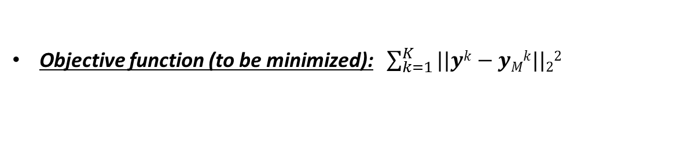
ROM Stabilization via Optimization-Based
Eigenvalue Reassignment*
Approach falls in 2nd category of stabilization methods, but ensures stabilized ROM solution deviates minimally from FOM solution.
Attention focused on LTI systems$:$
$${\dot{x}}_{M}\left(t\right)=A_{M}xM\left(t\right)+BMu\left(t\right)$$
$yM\left(t\right)=CMxM\left(t\right)$
$${\dot{x}}_{M}\left(t\right)=\tilde{A}MxM\left(t\right)+BMu\left(t\right)$$
$yM\left(t\right)=CMxM\left(t\right)$
(1)
Problem: $A$ stable $⇏ AM$ stable!
Goal: modify ROM system s.t. $A_{M}$ is stable and discrepancy b/w ROM output $yM\left(t\right)$ and FOM output $y\left(t\right)$ is minimal.
Goal: replace unstable $A_{M}$ with stable $\tilde{A}M$ so discrepancy b/w ROM output $yM\left(t\right)$ and FOM output $y\left(t\right)$ is minimal.
$⟹$Optimization Problem
Objective function (to be minimized): $\sum_{k=1}^{K}{||yk−yMk||22}$
*I. Kalashnikova, B.G. van Bloemen Waanders, S. Arunajatesan, M.F. Barone. "Stabilization of Projection-Based Reduced Order Models for Linear Time-Invariant Systems via Optimization-Based Eigenvalue Reassignment". Comput. Meth. Appl. Mech. Engng. 272 (2014) 251-270.

Slide 21
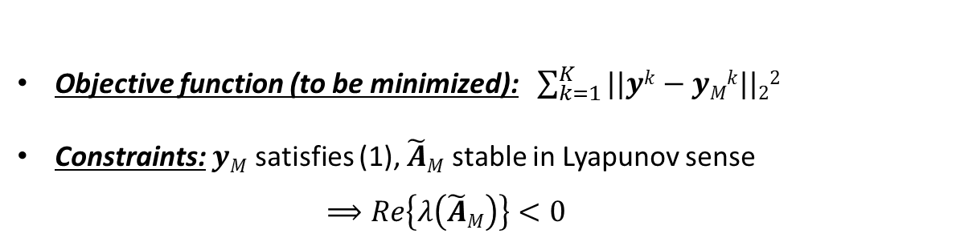
ROM Stabilization via Optimization-Based
Eigenvalue Reassignment*
Approach falls in 2nd category of stabilization methods, but ensures stabilized ROM solution deviates minimally from FOM solution.
Attention focused on LTI systems$:$
$${\dot{x}}_{M}\left(t\right)=A_{M}xM\left(t\right)+BMu\left(t\right)$$
$yM\left(t\right)=CMxM\left(t\right)$
$${\dot{x}}_{M}\left(t\right)=\tilde{A}MxM\left(t\right)+BMu\left(t\right)$$
$yM\left(t\right)=CMxM\left(t\right)$
(1)
Problem: $A$ stable $⇏ AM$ stable!
Goal: modify ROM system s.t. $A_{M}$ is stable and discrepancy b/w ROM output $yM\left(t\right)$ and FOM output $y\left(t\right)$ is minimal.
Goal: replace unstable $A_{M}$ with stable $\tilde{A}M$ so discrepancy b/w ROM output $yM\left(t\right)$ and FOM output $y\left(t\right)$ is minimal.
$⟹$Optimization Problem
Objective function (to be minimized): $\sum_{k=1}^{K}{||yk−yMk||22}$
Constraints: $yM$ satisfies (1), $\tilde{A}M$ stable in Lyapunov sense
$⟹Re\left\{λ\left(\tilde{A}M\right)\right\}<0$
*I. Kalashnikova, B.G. van Bloemen Waanders, S. Arunajatesan, M.F. Barone. "Stabilization of Projection-Based Reduced Order Models for Linear Time-Invariant Systems via Optimization-Based Eigenvalue Reassignment". Comput. Meth. Appl. Mech. Engng. 272 (2014) 251-270.

Slide 22
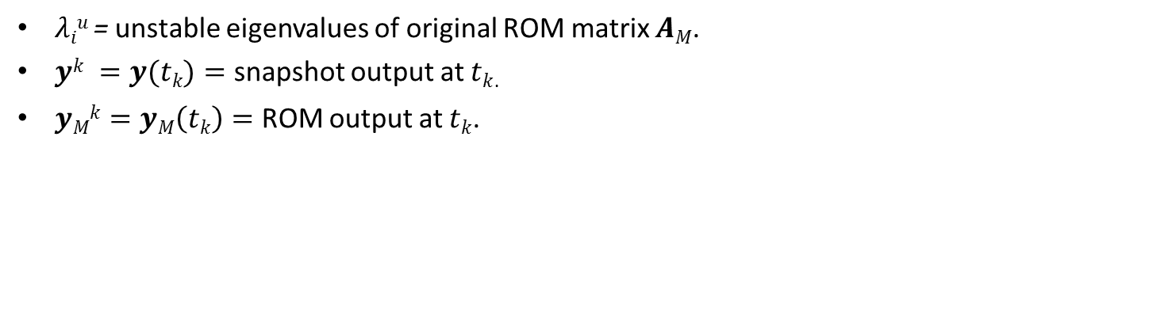
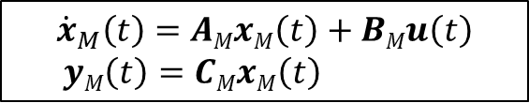
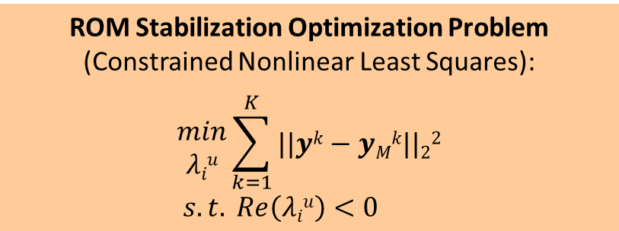
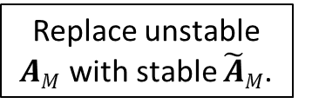
ROM Stabilization via Optimization-Based
Eigenvalue Reassignment (continued)
ROM Stabilization Optimization Problem
(Constrained Nonlinear Least Squares):
$$\begin{matrix}min \\ λiu\end{matrix}\sum_{k=1}^{K}{||yk−yMk||22}$$
$$s.t. Re\left(λiu\right)<0$$
$${\dot{x}}_{M}\left(t\right)=AMxM\left(t\right)+BMu\left(t\right)$$
$yM\left(t\right)=CMxM\left(t\right)$
(2)
Replace unstable
$AM$ with stable $\tilde{A}M$.
$λiu$ = unstable eigenvalues of original ROM matrix $AM$.
$yk =y(tk)=$ snapshot output at $tk$.
$yMk=yM\left(tk\right)=$ ROM output at $tk$.

Slide 23
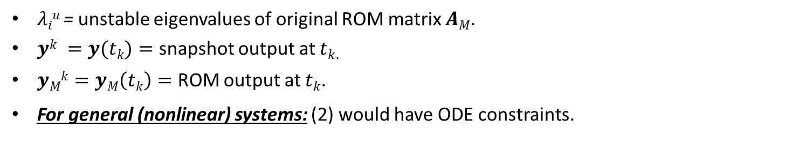
ROM Stabilization via Optimization-Based
Eigenvalue Reassignment (continued)
ROM Stabilization Optimization Problem
(Constrained Nonlinear Least Squares):
$$\begin{matrix}min \\ λiu\end{matrix}\sum_{k=1}^{K}{||yk−yMk||22}$$
$$s.t. Re\left(λiu\right)<0$$
$${\dot{x}}_{M}\left(t\right)=AMxM\left(t\right)+BMu\left(t\right)$$
$yM\left(t\right)=CMxM\left(t\right)$
(2)
Replace unstable
$AM$ with stable $\tilde{A}M$.
$λiu$ = unstable eigenvalues of original ROM matrix $AM$.
$yk =y(tk)=$ snapshot output at $tk$.
$yMk=yM\left(tk\right)=$ ROM output at $tk$.
For general (nonlinear) systems: (2) would have ODE constraints.

Slide 24

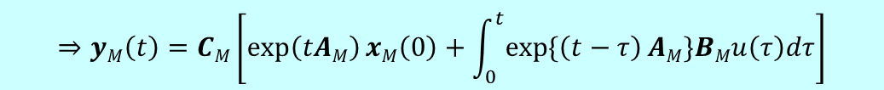
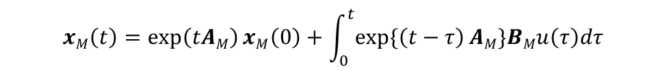
ROM Stabilization via Optimization-Based
Eigenvalue Reassignment (continued)
ROM Stabilization Optimization Problem
(Constrained Nonlinear Least Squares):
$$\begin{matrix}min \\ λiu\end{matrix}\sum_{k=1}^{K}{||yk−yMk||22}$$
$$s.t. Re\left(λiu\right)<0$$
$${\dot{x}}_{M}\left(t\right)=AMxM\left(t\right)+BMu\left(t\right)$$
$yM\left(t\right)=CMxM\left(t\right)$
(2)
Replace unstable
$AM$ with stable $\tilde{A}M$.
$λiu$ = unstable eigenvalues of original ROM matrix $AM$.
$yk =y(tk)=$ snapshot output at $tk$.
$yMk=yM\left(tk\right)=$ ROM output at $tk$.
For general (nonlinear) systems: (2) would have ODE constraints.
For LTI systems: the solution to (1) for the ROM output at $tk$ can be derived analytically!
$$xM\left(t\right)=\exp\left(tAM\right)xM\left(0\right)+\int_{0}^{t}{exp\{\left(t−τ\right)AM\}BMu\left(τ\right)dτ}$$
$$⇒yM\left(t\right)=CM\left[\exp\left(tAM\right)xM\left(0\right)+\int_{0}^{t}{exp\{\left(t−τ\right)AM\}BMu\left(τ\right)dτ}\right]$$

Slide 25
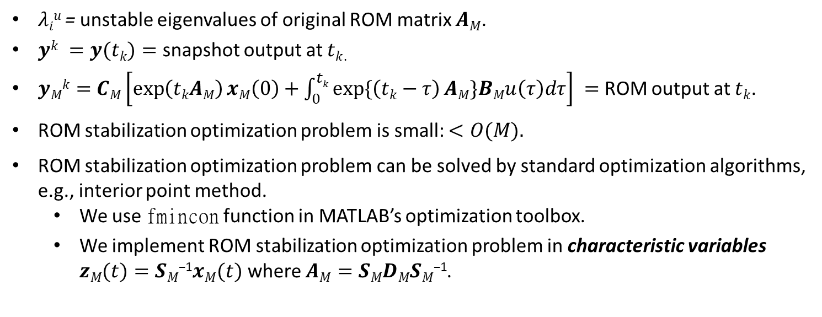
ROM Stabilization via Optimization-Based
Eigenvalue Reassignment (continued)
ROM Stabilization Optimization Problem
(Constrained Nonlinear Least Squares):
$$\begin{matrix}min \\ λiu\end{matrix}\sum_{k=1}^{K}{||yk−yMk||22}$$
$$s.t. Re\left(λiu\right)<0$$
$${\dot{x}}_{M}\left(t\right)=AMxM\left(t\right)+BMu\left(t\right)$$
$yM\left(t\right)=CMxM\left(t\right)$
(2)
Replace unstable
$AM$ with stable $\tilde{A}M$.
$λiu$ = unstable eigenvalues of original ROM matrix $AM$.
$yk =y(tk)=$ snapshot output at $tk$.
$yMk=$ $CM\left[\exp\left(tkAM\right)xM\left(0\right)+\int_{0}^{tk}{exp\{\left(tk−τ\right)AM\}BMu\left(τ\right)dτ}\right] =$ROM output at $tk$.
ROM stabilization optimization problem is small: $<O(M).$
ROM stabilization optimization problem can be solved by standard optimization algorithms, e.g., interior point method.
  We use fmincon function in MATLAB’s optimization toolbox.
  We implement ROM stabilization optimization problem in characteristic variables $zM(t)=SM\text{−1}xM(t)$ where $AM=SMDMSM\text{−1}$.

Slide 26
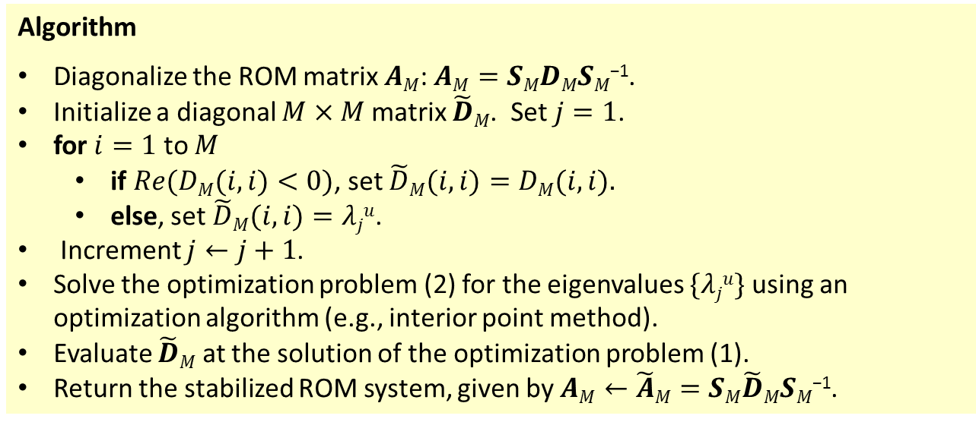
ROM Stabilization via Optimization-Based
Eigenvalue Reassignment (continued)
Algorithm
Diagonalize the ROM matrix $AM$: $AM=SMDMSM\text{−1}$.
Initialize a diagonal $M×M$ matrix $\tilde{D}M$. Set $j=1$.
for $i=1$ to $M$
  if $Re(DM(i,i)<0)$, set $\tilde{D}M(i,i)=DM(i,i).$
  else, set $\tilde{D}M(i,i)=λju$.
Increment $j←j+1$.
Solve the optimization problem (2) for the eigenvalues $\{λju\}$ using an optimization algorithm (e.g., interior point method).
Evaluate $\tilde{D}M$ at the solution of the optimization problem (1).
Return the stabilized ROM system, given by $AM←\tilde{A}M=SM\tilde{D}MSM\text{−1}$.

Slide 27
ROM Stabilization via Optimization-Based
Eigenvalue Reassignment (continued)
Algorithm
Diagonalize the ROM matrix $AM$: $AM=SMDMSM\text{−1}$.
Initialize a diagonal $M×M$ matrix $\tilde{D}M$. Set $j=1$.
for $i=1$ to $M$
  if $Re(DM(i,i)<0)$, set $\tilde{D}M(i,i)=DM(i,i).$
  else, set $\tilde{D}M(i,i)=λju$.
Increment $j←j+1$.
Solve the optimization problem (2) for the eigenvalues $\{λju\}$ using an optimization algorithm (e.g., interior point method).
Evaluate $\tilde{D}M$ at the solution of the optimization problem (1).
Return the stabilized ROM system, given by $AM←\tilde{A}M=SM\tilde{D}MSM\text{−1}$.
Existence of solution to (2) cannot be proven in general. Regularization may help.

Slide 28
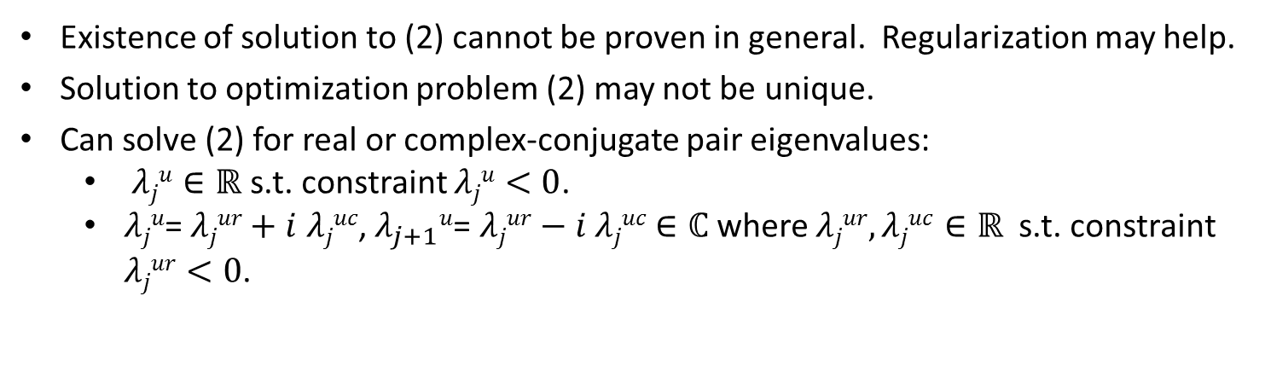
ROM Stabilization via Optimization-Based
Eigenvalue Reassignment (continued)
Algorithm
Diagonalize the ROM matrix $AM$: $AM=SMDMSM\text{−1}$.
Initialize a diagonal $M×M$ matrix $\tilde{D}M$. Set $j=1$.
for $i=1$ to $M$
  if $Re(DM(i,i)<0)$, set $\tilde{D}M(i,i)=DM(i,i).$
  else, set $\tilde{D}M(i,i)=λju$.
Increment $j←j+1$.
Solve the optimization problem (2) for the eigenvalues $\{λju\}$ using an optimization algorithm (e.g., interior point method).
Evaluate $\tilde{D}M$ at the solution of the optimization problem (1).
Return the stabilized ROM system, given by $AM←\tilde{A}M=SM\tilde{D}MSM\text{−1}$.
Existence of solution to (2) cannot be proven in general. Regularization may help.
Solution to optimization problem (2) may not be unique.
Can solve (2) for real or complex-conjugate pair eigenvalues:
  $λju∈ℝ$ s.t. constraint $λju<0$.
  $λju$= $λjur+i$ $λjuc$, $λ_{j+1}u$= $λjur−i$ $λjuc$ $∈ℂ$where $λjur,λjuc$ $∈ℝ$ s.t. constraint $λjur<0$.

Slide 29
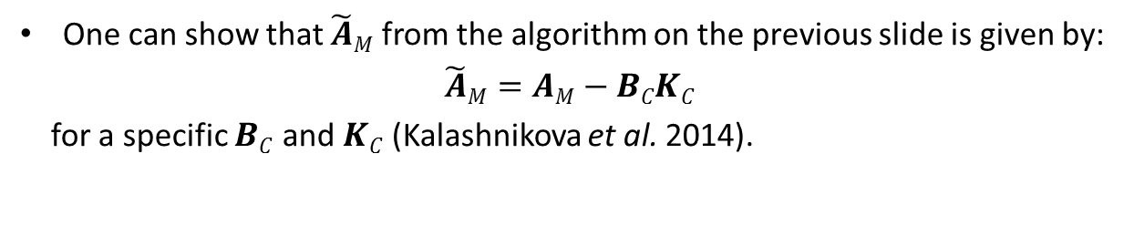
Consistency?
One can show that $\tilde{A}M$ from the algorithm on the previous slide is given by:
$$\tilde{A}M=AM−BCKC$$
for a specific $BC$ and $KC$ (Kalashnikova et al. 2014).

Slide 30
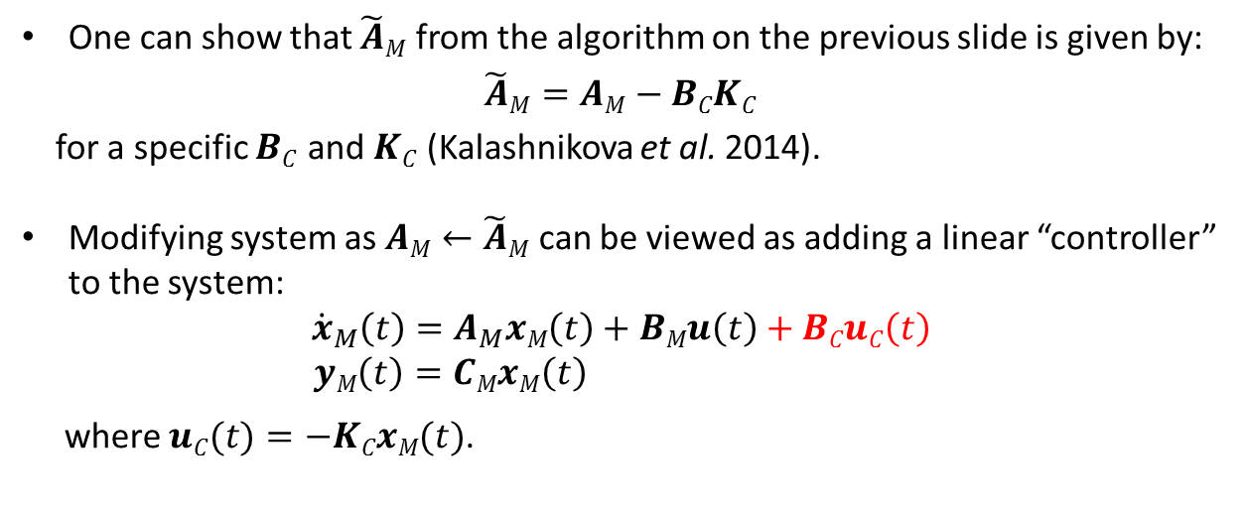
Consistency?
One can show that $\tilde{A}M$ from the algorithm on the previous slide is given by:
$$\tilde{A}M=AM−BCKC$$
for a specific $BC$ and $KC$ (Kalashnikova et al. 2014).
Modifying system as $AM←\tilde{A}M$ can be viewed as adding a linear “controller” to the system:
$${\dot{x}}_{M}\left(t\right)=A_{M}xM\left(t\right)+BMu\left(t\right)+BCuC\left(t\right)$$
$yM\left(t\right)=CMxM\left(t\right)$
where $uC(t)=−KCxM(t)$.

Slide 31
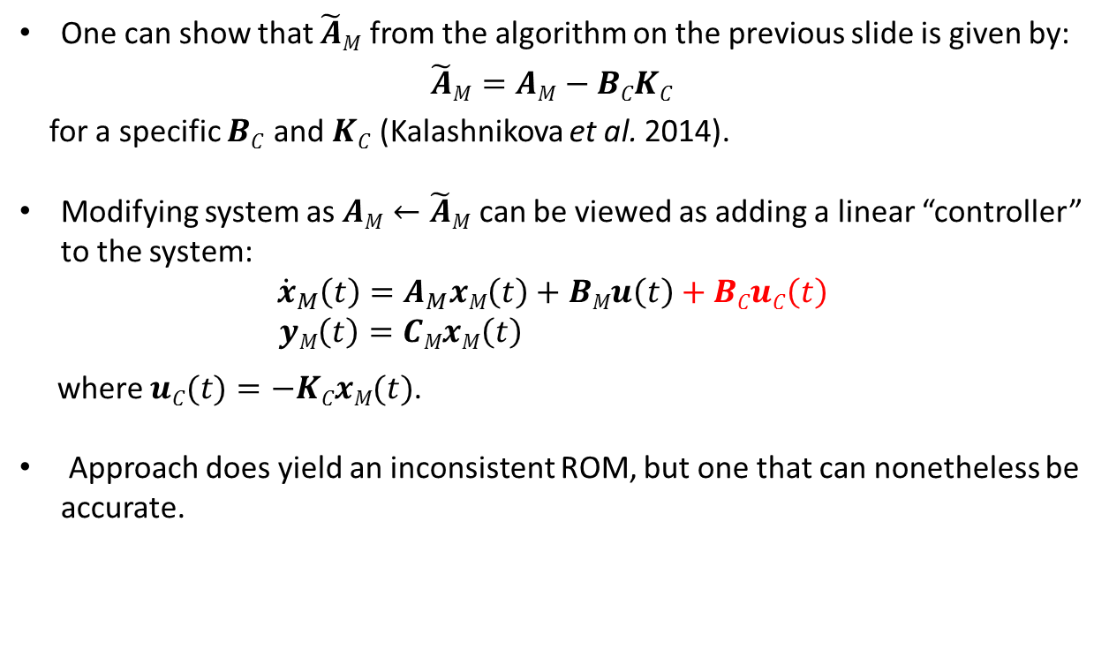
Consistency?
One can show that $\tilde{A}M$ from the algorithm on the previous slide is given by:
$$\tilde{A}M=AM−BCKC$$
for a specific $BC$ and $KC$ (Kalashnikova et al. 2014).
Modifying system as $AM←\tilde{A}M$ can be viewed as adding a linear “controller” to the system:
$${\dot{x}}_{M}\left(t\right)=A_{M}xM\left(t\right)+BMu\left(t\right)+BCuC\left(t\right)$$
$yM\left(t\right)=CMxM\left(t\right)$
where $uC(t)=−KCxM(t)$.
Approach does yield an inconsistent ROM, but one that can nonetheless be accurate.

Slide 32
Consistency?
One can show that $\tilde{A}M$ from the algorithm on the previous slide is given by:
$$\tilde{A}M=AM−BCKC$$
for a specific $BC$ and $KC$ (Kalashnikova et al. 2014).
Modifying system as $AM←\tilde{A}M$ can be viewed as adding a linear “controller” to the system:
$${\dot{x}}_{M}\left(t\right)=A_{M}xM\left(t\right)+BMu\left(t\right)+BCuC\left(t\right)$$
$yM\left(t\right)=CMxM\left(t\right)$
where $uC(t)=−KCxM(t)$.
Approach does yield an inconsistent ROM, but one that can nonetheless be accurate.
Ongoing work is to formulate ROM stabilization approaches that maintain consistency (last slide)

Slide 33
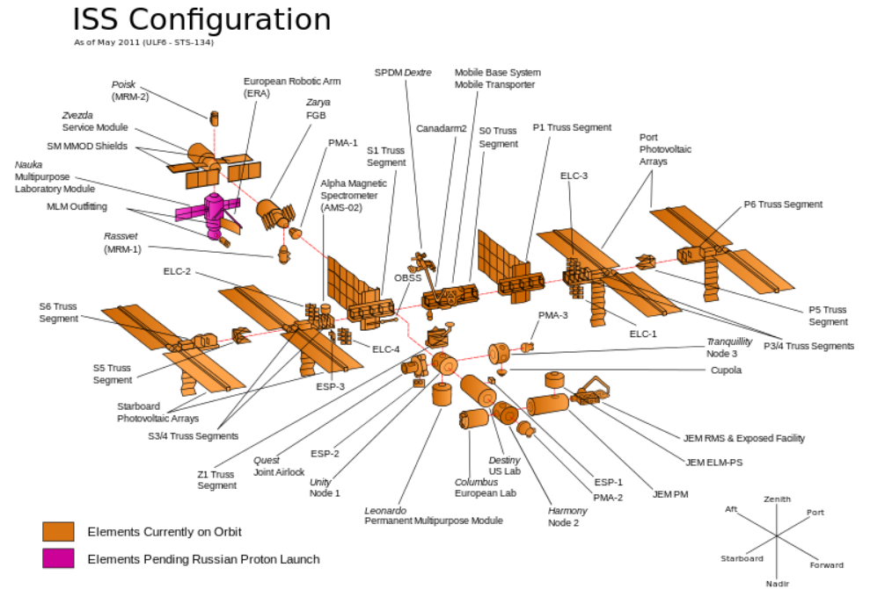
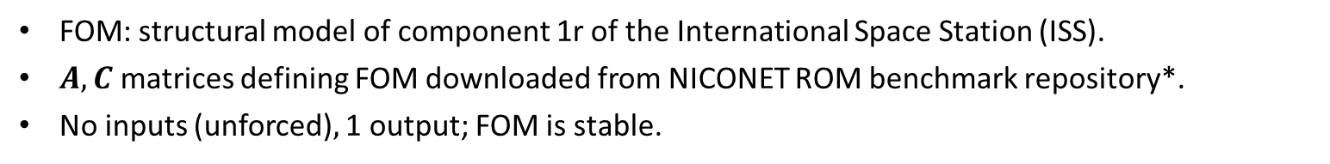
Numerical Results #1: International
Space Station (ISS) Benchmark
Component 1r
FOM: structural model of component 1r of the International Space Station (ISS).
$A,C$matrices defining FOM downloaded from NICONET ROM benchmark repository*.
No inputs (unforced)$,$ 1 output; FOM is stable.
*NICONET ROM benchmark repository: www.icm.tu-bs.de/NICONET/benchmodred.html.

Slide 34
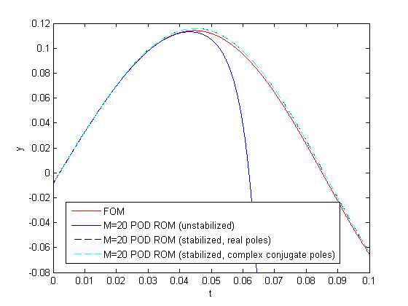
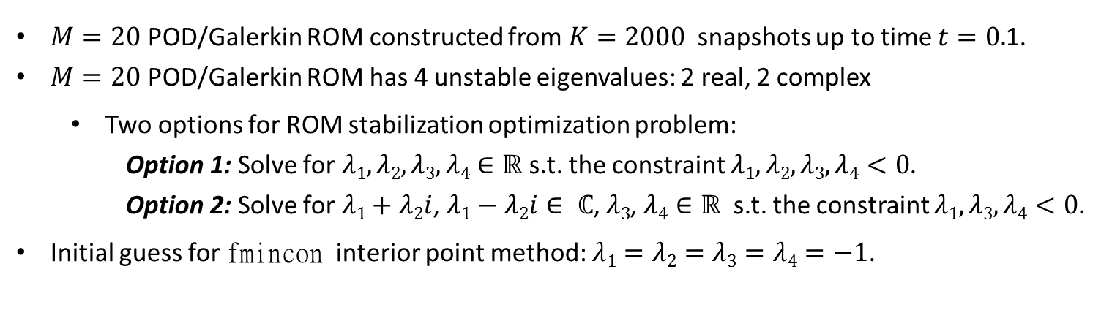
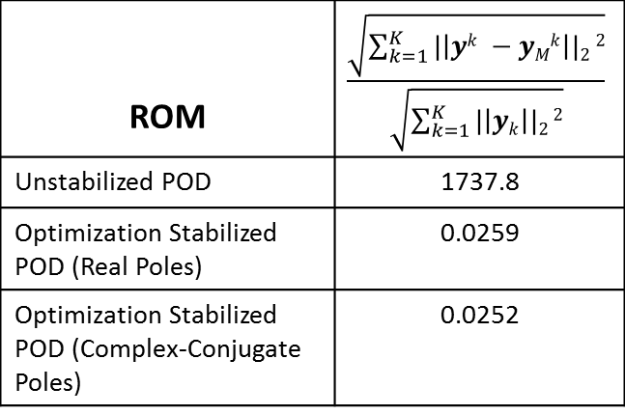
Numerical Results #1 : ISS Benchmark
(continued)
$M=20$ POD/Galerkin ROM constructed from $K=2000$snapshots up to time $t=0.$1.
$M=20$ POD/Galerkin ROM has 4 unstable eigenvalues: 2 real, 2 complex
  Two options for ROM stabilization optimization problem:
    Option 1: Solve for $λ1,λ2,λ3,λ4∈ℝ$ s.t. the constraint $λ1,λ2,λ3,λ4<0$.
    Option 2: Solve for $λ1+$ $λ2i$, $λ1−λ2i$ $∈ ℂ$, $λ3$, $λ4$ $∈ℝ$ s.t. the constraint $λ1,λ3,λ4<0.$
Initial guess for fmincon interior point method: $λ1=λ2=λ3=λ4=−1$.
ROM | $$\frac{\sqrt{\sum_{k=1}^{K}{|\left|yk −yMk\right||2}2}}{\sqrt{\sum_{k=1}^{K}{|\left|yk\right||2}2}}$$
Unstabilized POD | 1737.8
Optimization Stabilized POD (Real Poles) | 0.0259
Optimization Stabilized POD (Complex-Conjugate Poles) | 0.0252

Slide 35
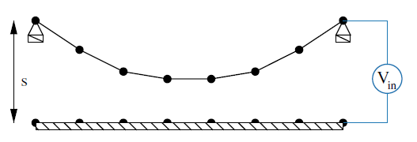
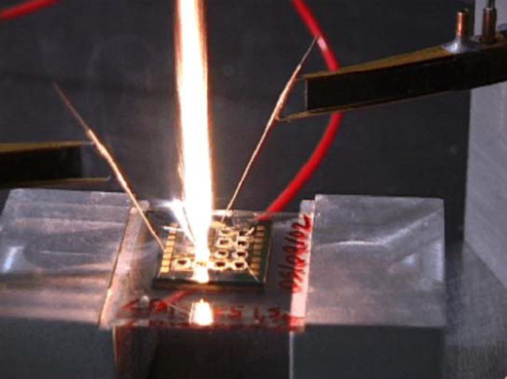
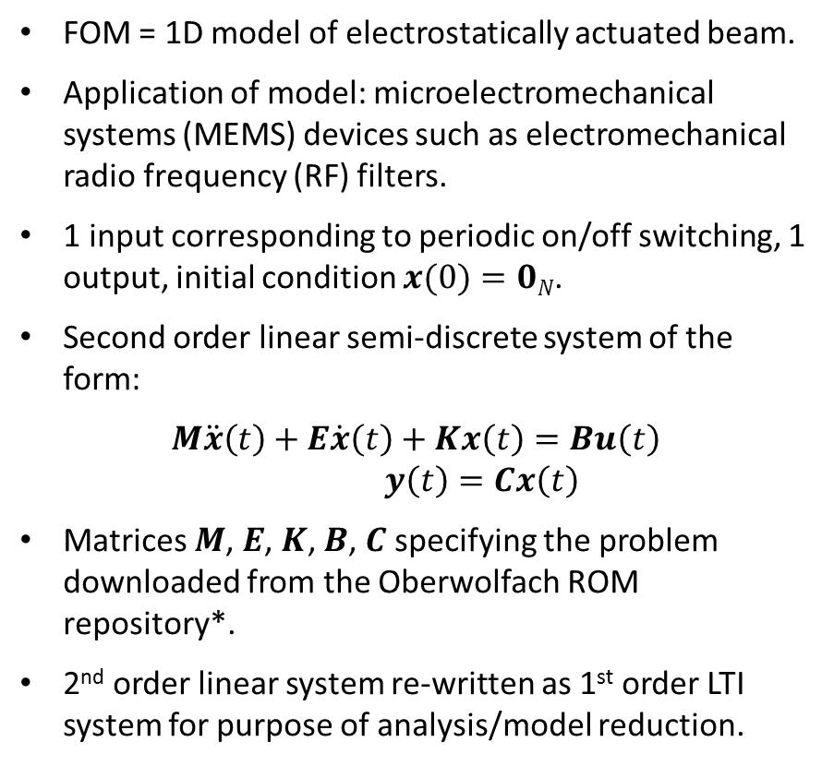
Numerical Results #2: Electrostatically
Actuated Beam Benchmark
FOM = 1D model of electrostatically actuated beam.
Application of model: microelectromechanical systems (MEMS) devices such as electromechanical radio frequency (RF) filters.
1 input corresponding to periodic on/off switching, 1 output, initial condition $x(0)=0N$.
Second order linear semi-discrete system of the form:
$$M\ddot{x}\left(t\right)+E\dot{x}\left(t\right)+Kx\left(t\right)=Bu\left(t\right)$$
$y\left(t\right)=Cx\left(t\right)$
Matrices $M$, $E$, $K$, $B$, $C$ specifying the problem downloaded from the Oberwolfach ROM repository*.
2nd order linear system re-written as 1st order LTI system for purpose of analysis/model reduction.
FOM is stable.
* Oberwolfach ROM benchmark repository: http://simulation.uni-freiburg.de/downloads/benchmark.

Slide 36
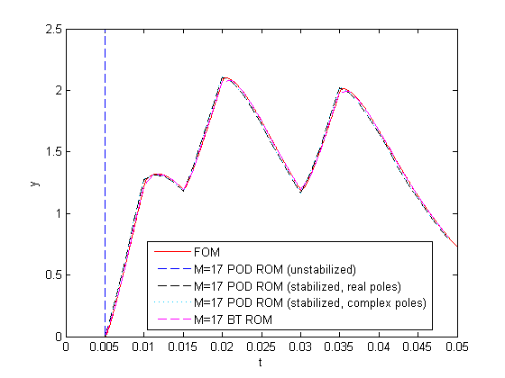
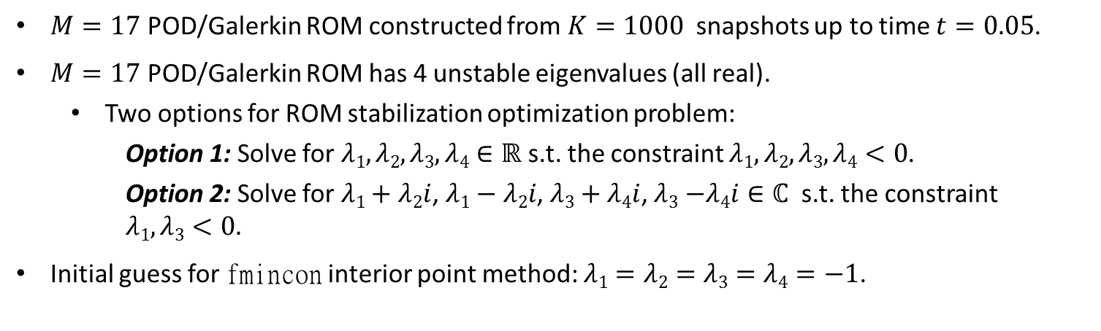
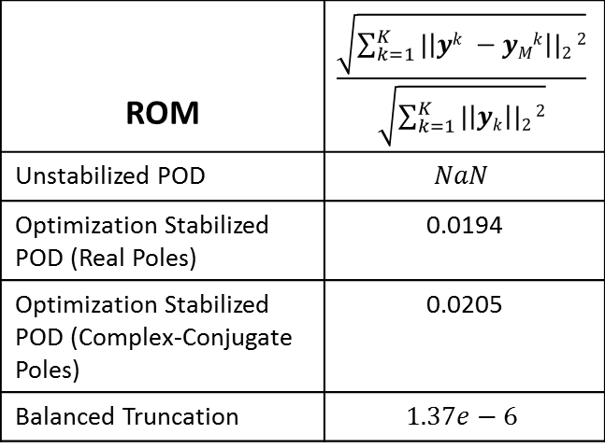
Numerical Results #2: Electrostatically
Actuated Beam Benchmark (continued)
$M=17$ POD/Galerkin ROM constructed from $K=1000$snapshots up to time $t=0.05$.
$M=17$ POD/Galerkin ROM has 4 unstable eigenvalues (all real).
  Two options for ROM stabilization optimization problem:
    Option 1: Solve for $λ1,λ2,λ3,λ4∈ℝ$ s.t. the constraint $λ1,λ2,λ3,λ4<0$.
    Option 2: Solve for $λ1+$ $λ2i$, $λ1−λ2i$, $λ3$ $+$ $λ4i$,$λ3$ $−λ4i∈ℂ$ s.t. the constraint
    $$λ1,λ3<0.$$
Initial guess for fmincon interior point method: $λ1=λ2=λ3=λ4=−1$.
ROM | $$\frac{\sqrt{\sum_{k=1}^{K}{|\left|yk −yMk\right||2}2}}{\sqrt{\sum_{k=1}^{K}{|\left|yk\right||2}2}}$$
Unstabilized POD | $$NaN$$
Optimization Stabilized POD (Real Poles) | 0.0194
Optimization Stabilized POD (Complex-Conjugate Poles) | 0.0205
Balanced Truncation | $$1.37e−6$$

Slide 37
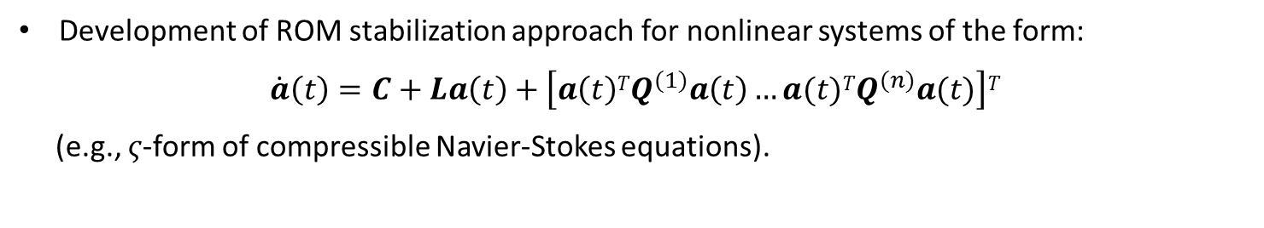
Ongoing Work: ROM Stabilization for
Nonlinear Problems (with M. Balajewicz)
Stabilization & enhancement of projection-based ROMs via minimal subspace rotation on the Stiefel manifold
Development of ROM stabilization approach for nonlinear systems of the form:
$$\dot{a}\left(t\right)=C+La\left(t\right)+\left[a\left(t\right)TQ^{(1)}a\left(t\right)…a(t)TQ^{(n)}a(t)\right]T$$
(e.g., $ς$-form of compressible Navier-Stokes equations).

Slide 38
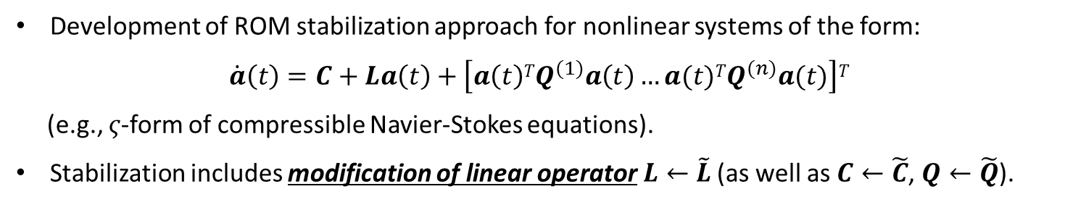
Ongoing Work: ROM Stabilization for
Nonlinear Problems (with M. Balajewicz)
Stabilization & enhancement of projection-based ROMs via minimal subspace rotation on the Stiefel manifold
Development of ROM stabilization approach for nonlinear systems of the form:
$$\dot{a}\left(t\right)=C+La\left(t\right)+\left[a\left(t\right)TQ^{(1)}a\left(t\right)…a(t)TQ^{(n)}a(t)\right]T$$
(e.g., $ς$-form of compressible Navier-Stokes equations).
Stabilization includes modification of linear operator$L←\tilde{L}$ (as well as $C←\tilde{C}$, $Q←\tilde{Q}$).

Slide 39
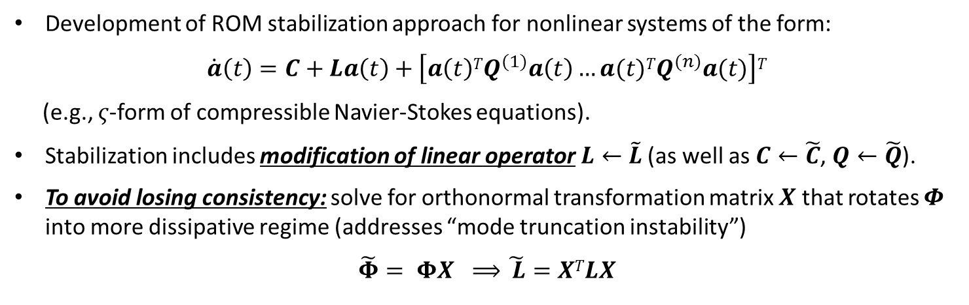
Ongoing Work: ROM Stabilization for
Nonlinear Problems (with M. Balajewicz)
Stabilization & enhancement of projection-based ROMs via minimal subspace rotation on the Stiefel manifold
Development of ROM stabilization approach for nonlinear systems of the form:
$$\dot{a}\left(t\right)=C+La\left(t\right)+\left[a\left(t\right)TQ^{(1)}a\left(t\right)…a(t)TQ^{(n)}a(t)\right]T$$
(e.g., $ς$-form of compressible Navier-Stokes equations).
Stabilization includes modification of linear operator$L←\tilde{L}$ (as well as $C←\tilde{C}$, $Q←\tilde{Q}$).
To avoid losing consistency: solve for orthonormal transformation matrix $X$ that rotates $Φ$ into more dissipative regime (addresses “mode truncation instability”)
$\tilde{Φ}= ΦX ⟹$ $\tilde{ L}=XTLX$

Slide 40
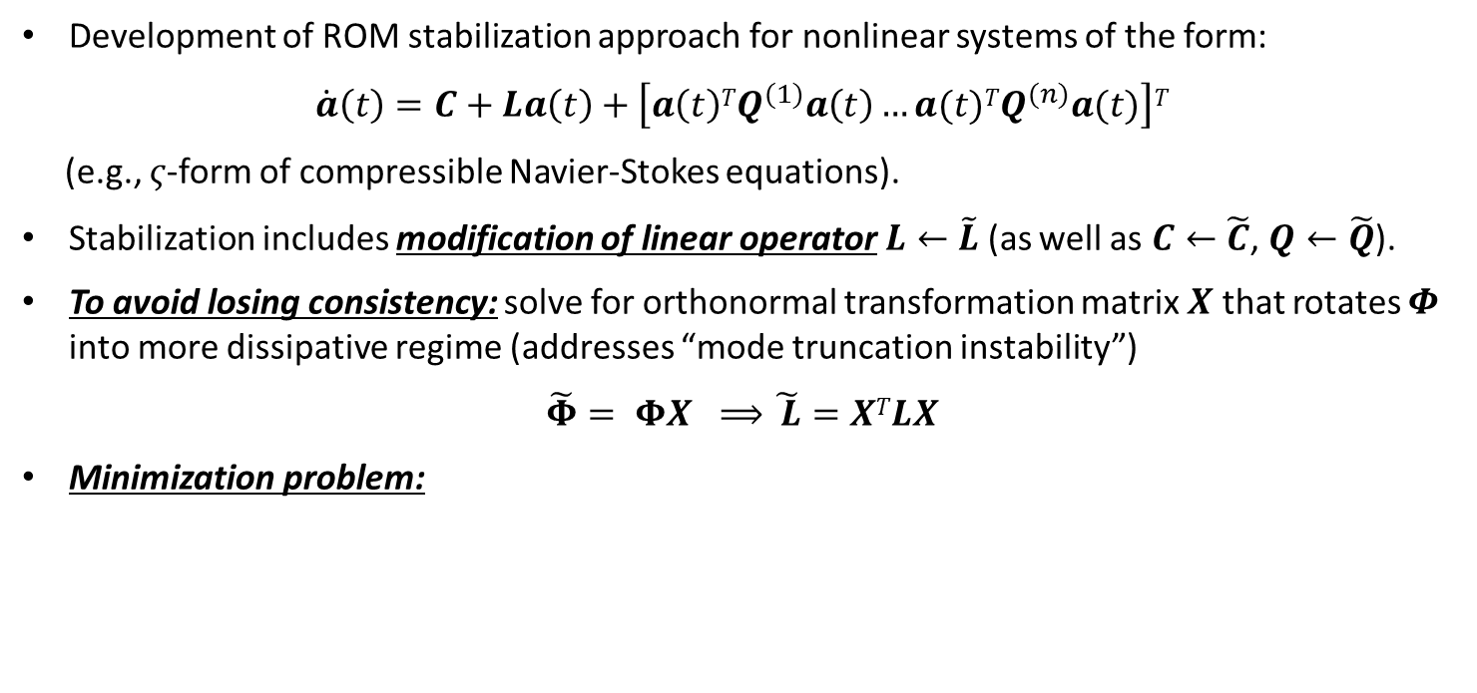
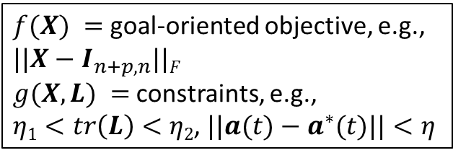
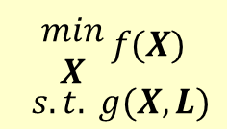
Ongoing Work: ROM Stabilization for
Nonlinear Problems (with M. Balajewicz)
Stabilization & enhancement of projection-based ROMs via minimal subspace rotation on the Stiefel manifold
Development of ROM stabilization approach for nonlinear systems of the form:
$$\dot{a}\left(t\right)=C+La\left(t\right)+\left[a\left(t\right)TQ^{(1)}a\left(t\right)…a(t)TQ^{(n)}a(t)\right]T$$
(e.g., $ς$-form of compressible Navier-Stokes equations).
Stabilization includes modification of linear operator$L←\tilde{L}$(as well as $C←\tilde{C}$, $Q←\tilde{Q}$).
To avoid losing consistency: solve for orthonormal transformation matrix $X$ that rotates $Φ$ into more dissipative regime (addresses “mode truncation instability”)
$\tilde{Φ}= ΦX ⟹$ $\tilde{ L}=XTLX$
Minimization problem:
$f(X) =$ goal-oriented objective, e.g., $||X−I_{n+p,n}||F$
$g(X,L) =$constraints, e.g.,
$η1<tr\left(L\right)<η2$, $||a(t)−a^{∗}(t)||<η$
$$\begin{matrix}min \\ X\end{matrix} f(X)$$
$$s.t. g(X,L)$$

Slide 41
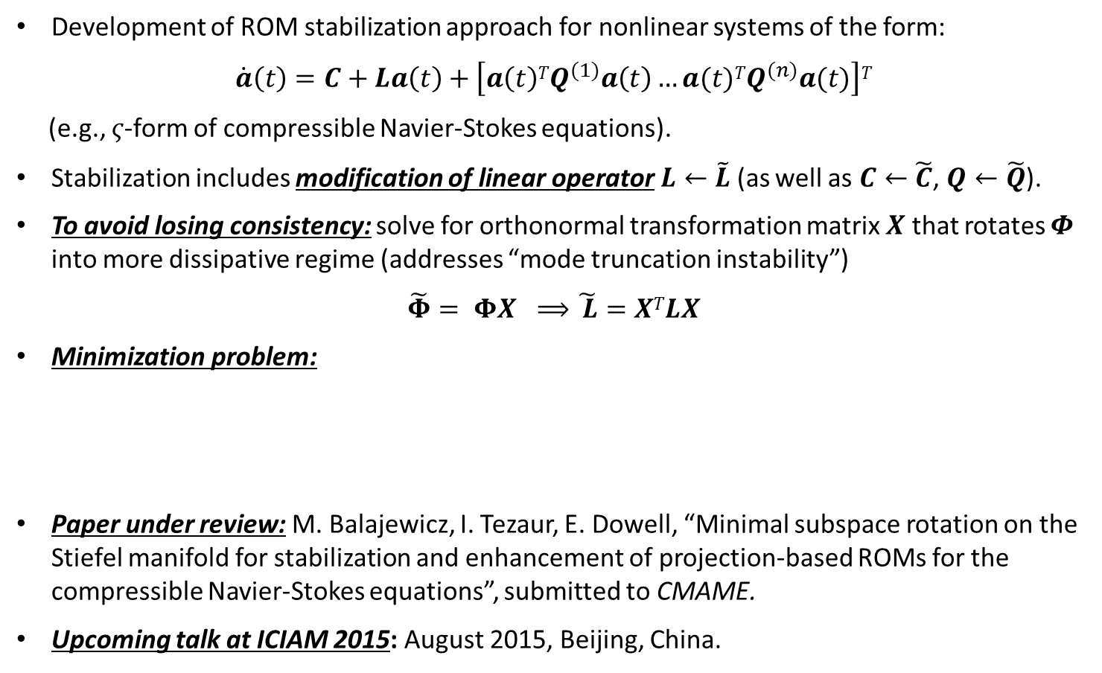
Ongoing Work: ROM Stabilization for
Nonlinear Problems (with M. Balajewicz)
Stabilization & enhancement of projection-based ROMs via minimal subspace rotation on the Stiefel manifold
Development of ROM stabilization approach for nonlinear systems of the form:
$$\dot{a}\left(t\right)=C+La\left(t\right)+\left[a\left(t\right)TQ^{(1)}a\left(t\right)…a(t)TQ^{(n)}a(t)\right]T$$
(e.g., $ς$-form of compressible Navier-Stokes equations).
Stabilization includes modification of linear operator$L←\tilde{L}$(as well as $C←\tilde{C}$, $Q←\tilde{Q}$).
To avoid losing consistency: solve for orthonormal transformation matrix $X$ that rotates $Φ$ into more dissipative regime (addresses “mode truncation instability”)
$\tilde{Φ}= ΦX ⟹$ $\tilde{ L}=XTLX$
Minimization problem:
Paper under review: M. Balajewicz, I. Tezaur, E. Dowell, “Minimal subspace rotation on the Stiefel manifold for stabilization and enhancement of projection-based ROMs for the compressible Navier-Stokes equations”, submitted to CMAME.
Upcoming talk at ICIAM 2015: August 2015, Beijing, China.
$f(X) =$ goal-oriented objective, e.g., $||X−I_{n+p,n}||F$
$g(X,L) =$constraints, e.g.,
$η1<tr\left(L\right)<η2$, $||a(t)−a^{∗}(t)||<η$
$$\begin{matrix}min \\ X\end{matrix} f(X)$$
$$s.t. g(X,L)$$

Slide 42
Summary & Acknowledgements
(www.sandia.gov/~ikalash)
A ROM stabilization approach that modifies a posteriori an unstable ROM LTI system by changing the system’s unstable eigenvalues is proposed.
In the proposed stabilization algorithm, a constrained nonlinear least squares optimization problem for the ROM eigenvalues is formulated to minimize error in ROM output.
Excellent performance of the proposed algorithm is evaluated on two benchmarks.
Stay tuned for extensions to nonlinear problems!
I. Kalashnikova, B.G. van Bloemen Waanders, S. Arunajatesan, M.F. Barone. "Stabilization of Projection-Based Reduced Order Models for Linear Time-Invariant Systems via Optimization-Based Eigenvalue Reassignment". Comput. Meth. Appl. Mech. Engng. 272 (2014) 251-270.
This work was funded by Laboratories’ Directed Research and Development (LDRD) Program at Sandia National Laboratories.
Special thanks to
  Prof. Lou Cattafesta (Florida State University)
  Prof. Karen Willcox (MIT)
for useful discussions that led to some of the ideas presented here.

Slide 43
References
I. Kalashnikova, B.G. van Bloemen Waanders, S. Arunajatesan, M.F. Barone. Stabilization of Projection-Based Reduced Order Models for Linear Time-Invariant Systems via Optimization-Based Eigenvalue Reassignment. Comput. Meth. Appl. Mech. Engng. 272: 251-270 (2014).
M.F. Barone, I. Kalashnikova, D.J. Segalman, H. Thornquist. Stable Galerkin reduced order models for linearized compressible flow. J. Comput. Phys. 288: 1932-1946, 2009.
M. Balajewicz, E. Dowell, B. Noack, Low-dimensional modeling of high-Reynolds number shear flows incorporating constraints from the Navier-Stokes equations, J. Fluid Mech. 729: 285-308, 2013.
M. Balajewicz, I. Tezaur, E. Dowell, Minimal subspace rotation on Stiefel manifold forstabilization and fine-tuning of projection-based ROMs of the compressible Navier-Stokes equations, under review for publication in CMAME.
C.W. Rowley, T. Colonius, R.M. Murray. Model reduction for compressible flows using POD and Galerkin projection. Physica D. 189: 115-129, 2004.
G. Serre, P. Lafon, X. Gloerfelt, C. Bailly. Reliable reduced-order models for time-dependent linearized Euler equations. J. Comput. Phys. 231(15): 5176-5194, 2012.

Slide 44
References (continued)
B. Bond, L. Daniel, Guaranteed stable projection-based model reduction for indefinite and unstable linear systems, In: Proceedings of the 2008 IEEE/ACM International Conference on Computer-Aided Design, 728–735, 2008.
D. Amsallem, C. Farhat. Stabilization of projection-based reduced order models. Int. J. Numer. Methods Engng. 91 (4) (2012) 358-377.
Z. Wang, I. Akhtar, J. Borggaard, T. Iliescu. Proper orthogonal decomposition closure models for turbulent flows: a numerical comparison. Comput. Methods Appl. Mech. Engrg. 237-240:10-26, 2012.
The MathWorks, Inc., Optimization Toolbox User’s Guide, 1990-2008.
NICONET ROM benchmark repository: www.icm.tu-bs.de/NICONET/benchmodred.html.
Oberwolfach ROM benchmark repository: http://simulation.uni-freiburg.de/downloads/benchmark.

Slide 45
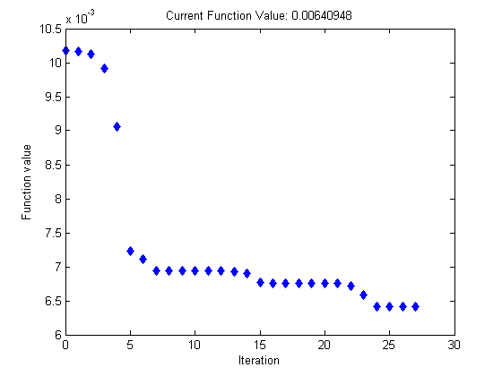
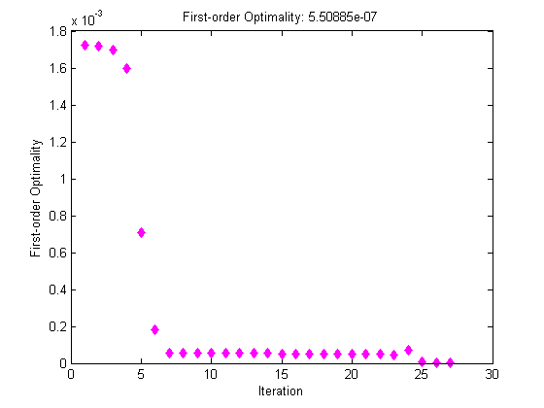
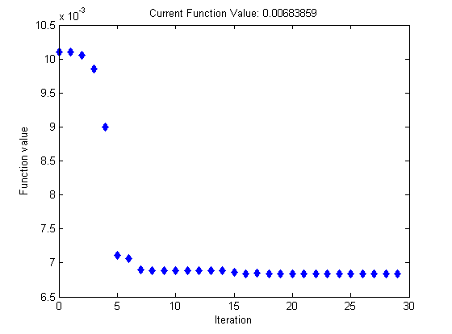


Appendix: ISS Benchmark (fmincon
performance)
Current Function Value
 | Real Poles | Complex-Conjugate Poles
# upper bound constraints | 4 | 3
# iterations | 29 | 27
# function evaluations | 30 | 30
$|∇L|$ at convergence (1st order optimality) | 4.00e-7 | 5.51e-7
0.00640948
First-Order Optimality
Current Function Value
First-Order Optimality
0.00683859
5.50885e-07
4.00842e-07

Slide 46
Appendix: ISS Benchmark
(CPU Times)
Model | Operations | CPU time (sec)
FOM | Time-Integration | 1.71e2
ROM – offline stage | Snapshot collection (FOM time-integration) | 1.71e2
 | Loading of matrices/snapshots | 6.99e-2
 | POD | 6.20
 | Projection | 8.18e-3
 | Optimization | 2.28e1
ROM – online stage | Time-integration | 3.77
To offset total pre-process time of ROM (time required to run FOM to collect snapshots, calculate the POD basis, perform the Galerkin projection, and solve the optimization problem (1)), the ROM would need to be run 53 times.
Solution of optimization problem is very fast: takes < 1 minute to complete.

Slide 47






Appendix: Electrostatically Actuated Beam
Benchmark (fmincon performance)
Current Function Value
 | Real Poles | Complex-Conjugate Poles
# upper bound constraints | 4 | 2
# iterations | 60 | 31
# function evaluations | 64 | 32
$|∇L|$ at convergence (1st order optimality) | 2.27e-7 | 8.43e-7
1.23598
Current Function Value
First-Order Optimality
First-Order Optimality
1.13229
2.26927e-07
8.43228e-07

Slide 48
Appendix: Electrostatically Actuated Beam Benchmark (CPU Times)
Model | Operations | CPU time (sec)
FOM | Time-Integration | 7.10e4
ROM – offline stage | Snapshot collection (FOM time-integration) | 7.10e4
 | Loading of matrices/snapshots | 5.17
 | POD | 1.09e1
 | Projection | 2.55e1
 | Optimization | 8.79e1
ROM – online stage | Time-integration | 6.78
To offset total pre-process time of ROM (time required to run FOM to collect snapshots, calculate the POD basis, perform the Galerkin projection, and solve the optimization problem (1)), the ROM would need to be run 1e4 times (due to large CPU time of FOM).
Solution of optimization problem is very fast: takes ~1.5 minute to complete.

Slide 49





Appendix: Electrostatically Actuated
Beam Benchmark (Eigenvalues)
Unstable Eigenvalues
$$λ6=16,053$$
$$λ12=48.985$$
$$λ14=12.650$$
$$λ17=0.05202$$
Stabilized Eigenvalues (Real) | Stabilized Eigenvalues (Complex Conjugates)
$$λ6=−7,043,505$$ | $$λ6=−106,976+551.77i$$
$$λ12=−35.364$$ | $$λ12=−106,976−551.77$$
$$λ14=−153,033$$ | $$λ14=−2954.1−1244.7i$$
$$λ17=−99,175$$ | $$λ17=−2954.1+1244.7i$$

