Slide 1
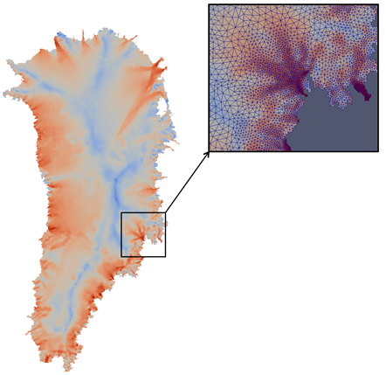
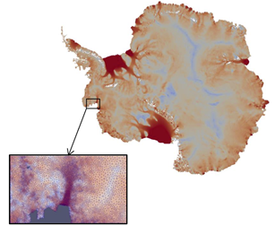
Update on Sandia Albany/FELIX First-Order Stokes (FELIX-FO) Solver
Irina K. Tezaur
Sandia National Laboratories
In collaboration with Mauro Perego, Andy Salinger, Ray Tuminaro, Steve Price, Matt Hoffman, Mike Eldred, John Jakeman, Irina Demeshko and Tobias Wiesner.
Thursday, November 5, 2015
PISCEES Project Meeting
Albuquerque, NM

Slide 2
FY15 Progress Highlights
Sandia’s Role in the PISCEES Project: to develop and support a robust and scalable unstructured grid finite element land ice solver based on the “First-Order” (FO) Stokes approximation$→$Albany/FELIX*
Albany/FELIX, CISM-Albany, MPAS-Albany Progress & Future Work (this talk):
Albany/FELIX is verified, scalable, robust.
Albany/FELIX is portable to next-generation machines via Kokkos.
We have written/are writing several journal articles on Albany/FELIX.
We have looked at the effect of earth curvature using stereographic projection.
Albany/FELIX is coupled to MPAS and CISM; mostly coupled to ACME (via MPAS).
$→$We have developed a stable semi-implicit coupling method for thickness-FO Stokes (implemented in MPAS-Albany).
Codes are running on Hopper, Edison, Titan, Mira.
Additional Progress & Future Work (other talks):
Deterministic inversion (talk by M. Perego).
Uncertainty quantification: Bayesian calibration, forward propagation of uncertainty (talk by J. Jakeman).
*FELIX = Finite Elements for Land Ice eXperiments

Slide 3
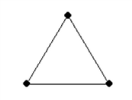
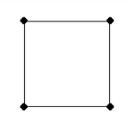
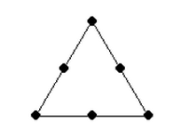
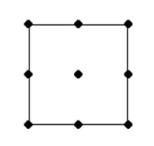
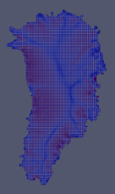
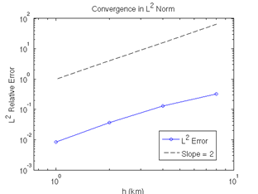
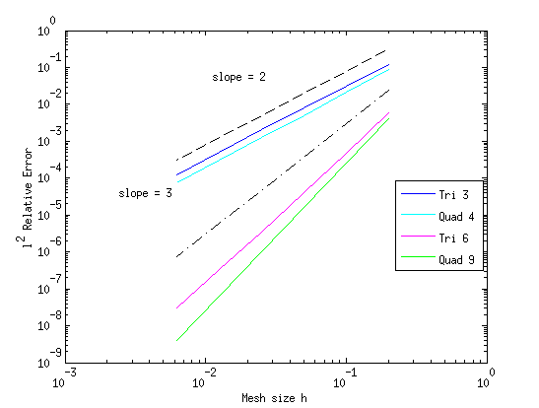
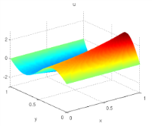
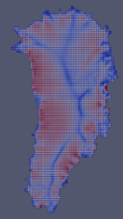
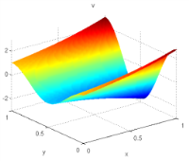
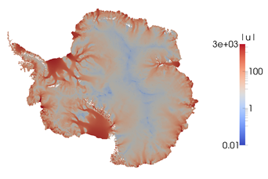
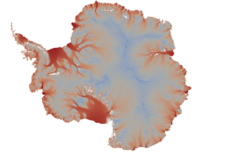
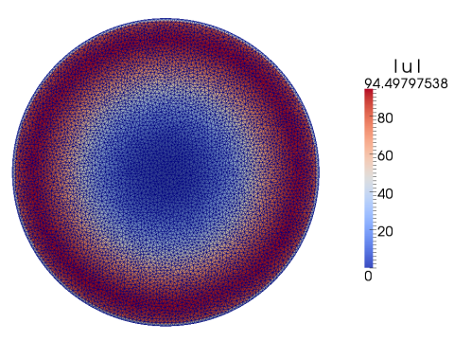
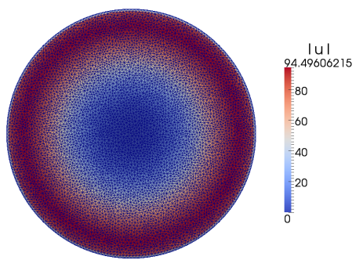
Verification of Albany/FELIX
Stage 1: solution verification on 2D MMS problems.
Stage 3: full 3D mesh convergence study on Greenland w.r.t. reference solution.
Stage 4: reasonable solutions for large-scale realistic GIS & AIS problems (Albany/FELIX – left; reference solution – right).
Stage 2: code-to-code comparisons on canonical ice sheet benchmarks (Albany/FELIX – left; LifeV – right).
This year

Slide 4
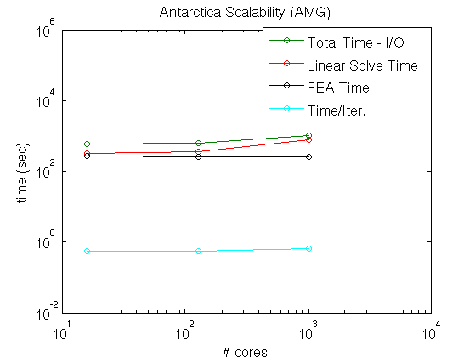
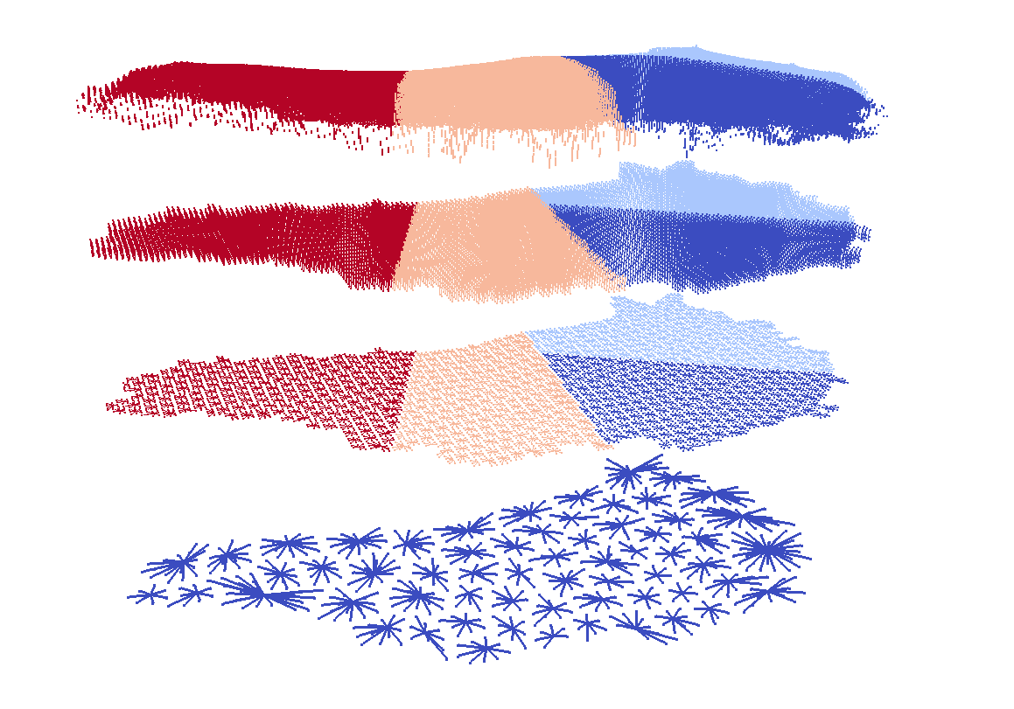
Scalability via Algebraic Multi-Grid
Preconditioning with Semi-Coarsening
We achieve excellent scalability (even with ice shelves!) via new algebraic multi-grid (AMG) preconditioner with semi-coarsening.
FY15 progress:
Demonstration of good scalability/ performance of AMG solver on Antarctica: > 30x faster than ILU solver!
3 papers featuring new AMG preconditioner.
New AMG preconditioner has been implemented in MueLu (T. Wiesner).
Planned work:
Speeding up MueLu AMG preconditioner (MueLu solver slower than ML).
Performance studies (optimizations?) on new architectures (template on 3rd dimension?) and/or with dynamical cores.
16 cores
1024 cores
with
R. Tuminaro,
T. Wiesner
I. Tezaur, M. Perego, A. Salinger, R. Tuminaro, and S. Price, GMD, 2015.
I. Tezaur, R. Tuminaro, M. Perego, A. Salinger, S. Price, Procedia CS, 2015.
R. Tuminaro, M. Perego, I. Tezaur, A. Salinger, S. Price, SISC, 2015.

Slide 5
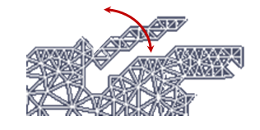
Improved Linear Solver Performance through Removal of Hinged Peninsulas
Islands/hinged peninsulas lead to solver failures
FY15 Progress:
An algorithm has been developed to detect/remove hinged peninsulas & islands based on coloring & repeated use of connected component algorithms.
Solves ~2x faster with hinges removed.
Planned work:
Integration of algorithm for hinge removal into dynamical cores?
Greenland Problem
Resolu-tion | ILU – hinges | ILU – no hinges | ML – hinges | ML – no hinges
8km/5 layers | 878 sec, 84 iter/solve | 693 sec, 71 iter/solve | 254 sec, 11 iter/solve | 220 sec, 9 iter/solve
4km/10 layers | 1953 sec, 160 iter/solve | 1969 sec, 160 iter/solve | 285 sec, 13 iter/solve | 245 sec, 12 iter/solve
2km/20 layers | 10942 sec, 710 iter/solve | 5576 sec, 426 iter/solve | 482 sec, 24 iter/solve | 294 sec, 15 iter/solve
1km/40 layers | -- | 15716 sec, 881 iter/solve | 668 sec, 34 iter/solve | 378 sec, 20 iter/solve
with R. Tuminaro

Slide 6
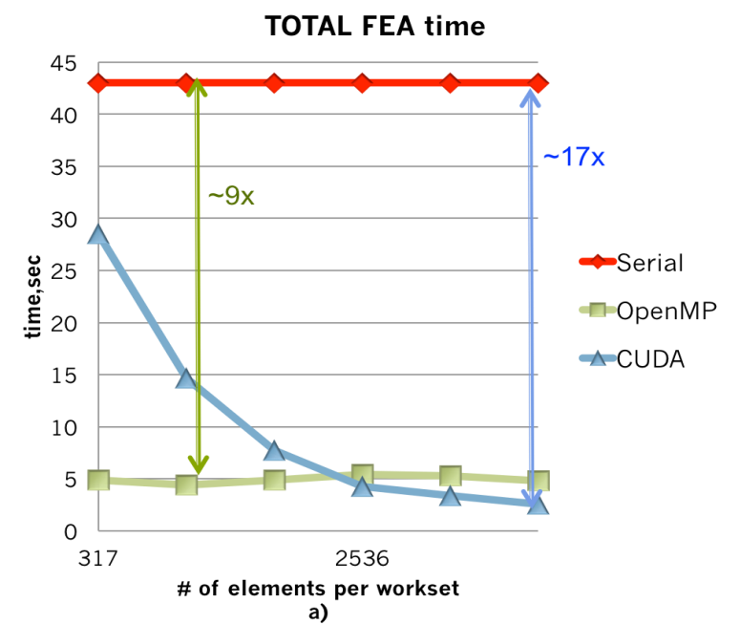
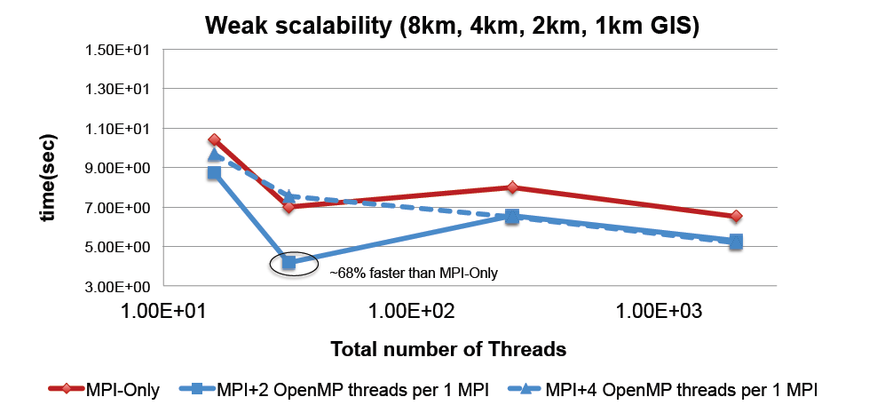
Performance Portability via Kokkos
Performance portability achieved through Kokkos programming model/Trilinos library.
Kokkos abstractions allow device-specific memory layout and parallel kernel launch$→$ same code can run on diverse devises with different memory models (multi-core, many-core, GPUs)
FY15 Progress:
Finite element assembly (FEA) in Albany has been converted to Kokkos.
Demonstrated performance portability with CUDA/OpenMP on Sandia clusters; with OpenMP on Titan.
Planned work:
Journal article in preparation (I. Demeshko).
Running on GPUs of Titan: awaiting gcc-4.7.2 compiler support from Cray.
with I. Demeshko
I. Demeshko, A. Salinger, W. Spotz, I. Tezaur, in prep for J. HPC Appl., 2015.

Slide 7
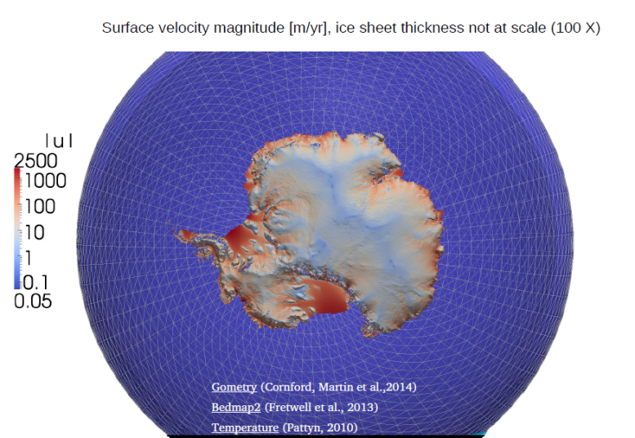
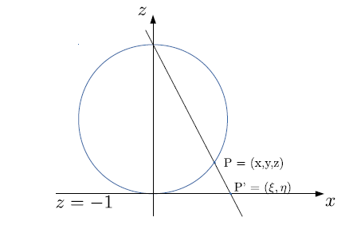
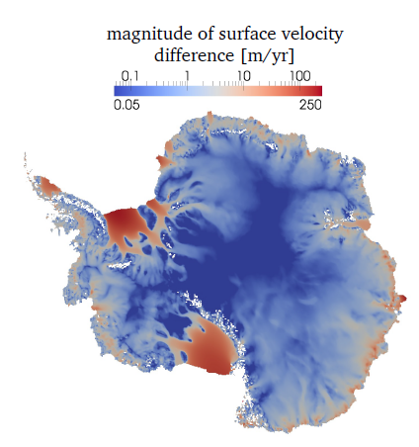
FO Stokes Equations on Spherical Grids
Current ice sheet models are derived using planar geometries (reasonable, especially for Greenland)…
The effect of Earth’s curvature is largely unknown and may be nontrivial for Antarctica!
FY15 Progress:
We have derived a FO Stokes model on sphere using stereographic projection and implemented it in Albany/FELIX.
Preliminary results: curvature has some effect on Antarctica simulations.
Planned work:
Verification.
Try transient simulations with dycores on curved geometry and investigate effect on quantities of interest (e.g., sea-level rise).
Journal article.
Curvilinear coordinate system
Relative difference in surface velocity magnitude is 10% in fast flow regions.
with
M. Perego

Slide 8
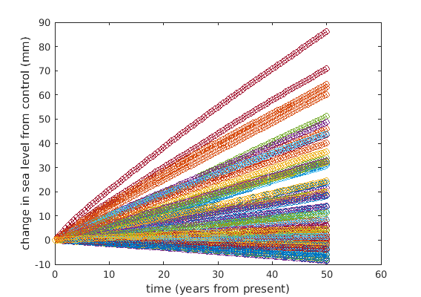
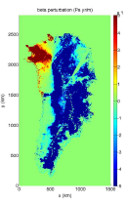
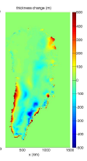
CISM-Albany Update
CISM-Albany dycore: Albany/FELIX has been coupled to CISM for transient simulations.
FY15 Progress:
Floating ice & kinematic Dirichlet BCs have been implemented in CISM-Albany for realistic problems.
CISM-Albany was used for 50 year UQ forward propagation study (see J. Jakeman’s talk)
$→$ demonstrated robustness of CISM-Albany: all 66 forward UQ runs with highly perturbed $β$ converged on Hopper out-of-the-box!
Planned work:
Fine-resolution GIS validation test case towards science runs using CISM-Albany (with S. Price).
Science paper using CISM-Albany (with S. Price).
Improved UQ demonstration (with J. Jakeman).
with S. Price,
J. Jakeman
$β$ perturbation
H perturbation

Slide 9
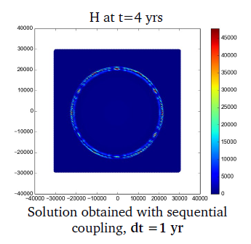
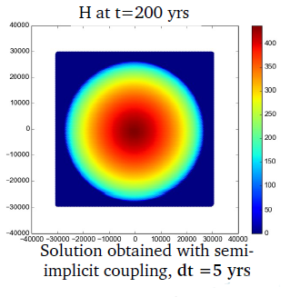
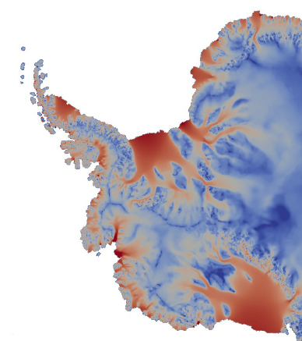
MPAS-Albany Update:
Semi-Implicit Thickness-FO Stokes Coupling
FY15 Progress:
Improved interface between MPAS and Albany.
Improved BCs (nonlinear basal BCs*/ grounding line parametrization**).
Developed and implemented semi-implicit*** thickness-FO Stokes discretization in MPAS-Albany: can use larger time steps (advective vs. diffusive CFL).
Planned work:
Continue investigating robustness/efficiency/ accuracy of the semi-implicit method and grounding line parametrization.
Coupled science simulations under ACME.
New GL parametrization
old
new
$$x1$$
GL
$x$₂
Dome test case: sequential approach unstable with dt = 1yr; semi-implicit approach stable with dt = 5yrs.
AIS prelim. result:
~4.5x speed-up
3km var. res.
* $β=C{|u|}^{m−1}, m=\frac{1}{n}.$
** Using high-order quadrature.
*** $u$ computed in Albany/FELIX with implicit solve; MPAS uses velocity to march in time explicitly.
w/ M. Perego, S. Price, M. Hoffman

Slide 10
Summary of Ongoing/Planned Work for FY16
Albany/FELIX:
MueLu speed-ups; optimizations for new architectures?
Continue porting to new architecture machines (e.g., GPUs on Titan), and performance-portability paper.
Testing under LIVV.
Finish optimization capabilities (see next talk by M. Perego).
Coupling with hydrology model (with L. Bertagna; see next talk by M. Perego).
Improved Bayesian calibration UQ demonstration (see J. Jakeman’s talk).
CISM-Albany:
Greenland validation test case.
Science runs using CISM-Albany, and science paper
Grounding line parametrization.
Improved forward propagation UQ demonstration (see J. Jakeman’s talk).
Testing under LIVV.
Linear solver performance studies/optimizations? Integration of hinge removal algorithm?
MPAS-Albany:
Coupled science simulations under ACME.
Continue investigating robustness/efficiency/accuracy of the semi-implicit method and grounding line parametrization.
Testing under LIVV.
Linear solver performance studies/optimizations? Integration of hinge removal algorithm?

