Slide 1
Model Reduction at Sandia National Laboratories
Irina Tezaur
Principal Member of Technical Staff
Quantitative Modeling & Analysis Department
Sandia National Laboratories, Livermore, CA
AIAA SciTech 2021
Jan. 20, 2021
SAND2021-0425C
Notes:
My name is Irina Tezaur. I am a staff scientist at Sandia National Laboratories, and I was asked to present more of an industry perspective on model order reduction.

Slide 2
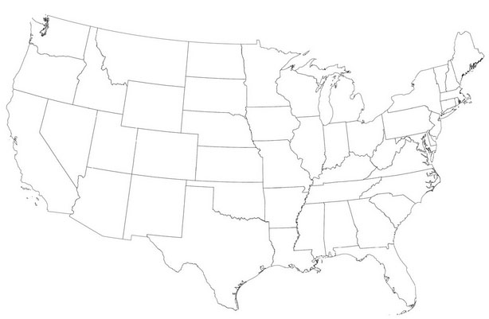

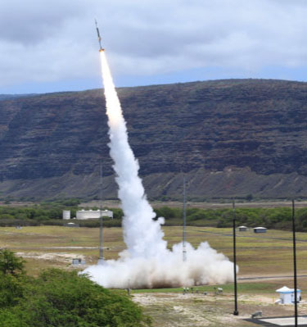

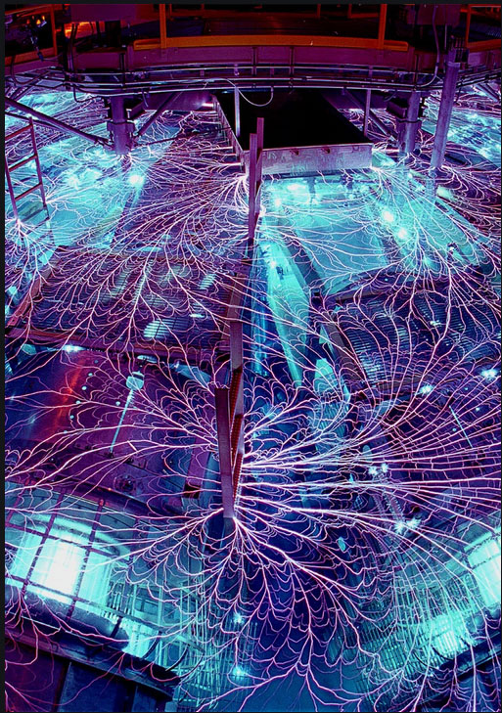
About Sandia National Labs (SNL)
Sandia’s primary mission is ensuring the U.S. nuclear arsenal is safe, secure and reliable, and can fully support our nation’s deterrence policy.
We have programs in the following areas:
2
Nuclear Deterrence
Defense Nuclear Nonproliferation
National Security
Global Security
Energy & Climate
Advanced Science & Technology
Sandia is a multidisciplinary national lab and Federally Funded Research & Development Center (FFRDC).
Contractor for the U.S. DOE’s National Nuclear Security Administration (NNSA).
Two main sites: Albuquerque, NM and Livermore, CA (above).
Notes:
Let me start by saying a few words about Sandia. We are a multidisciplinary national lab that operates as a contractor for the U.S. Department of Energy’s National Nuclear Security Administration of NNSA, with two main locations, one in Albuquerque, NM and one in Livermore, CA. Being a weapons lab, our primary mission is to support the nation’s nuclear deterrence and nonproliferation policies, but we also have research programs centered around national and global security, energy and climate and advanced science and technology. I think the best way to think of us is as being in between academia and industry – we do fundamental research including new methods development, but our ultimate goal is to apply these methods to mission-critical problems.
One of 17 DOE labs, 3 NNSA labs (SNL, LANL, LLNL).

Slide 3
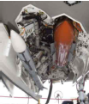
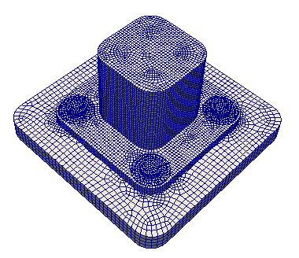
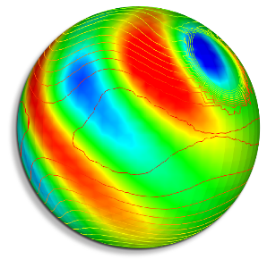
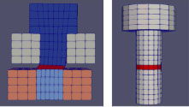
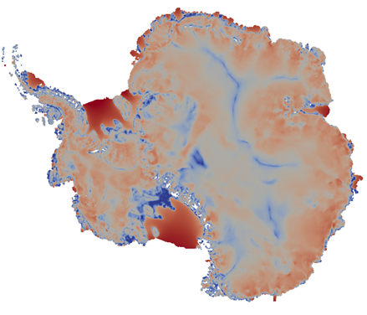
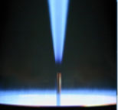
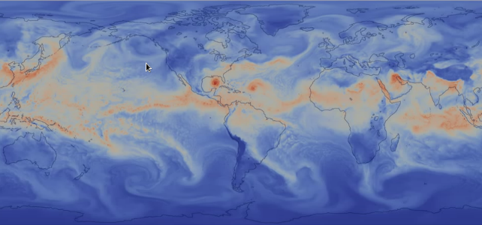
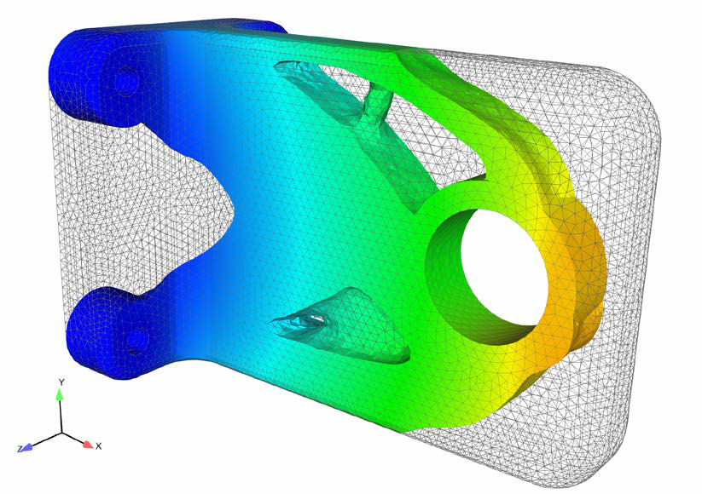
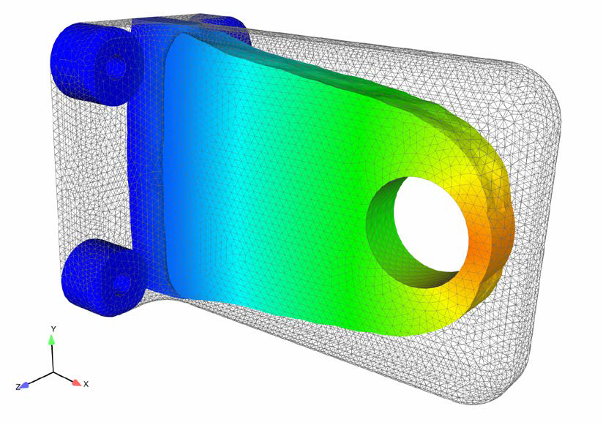
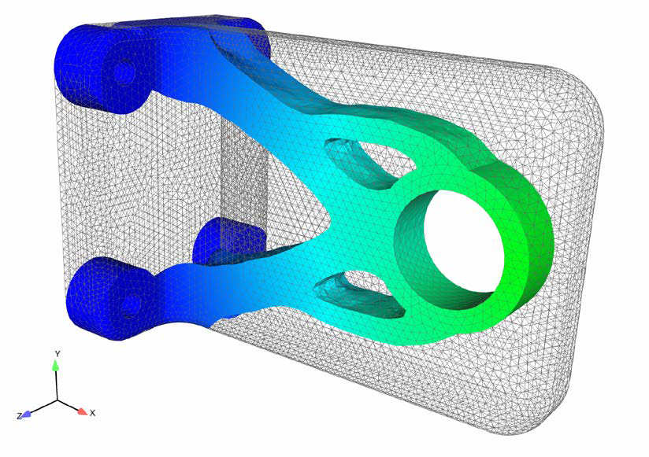
SNL Applications Requiring ROMs
Re-Entry/Captive-Carry Problems
Climate
Fastener Modeling
Heat Transfer/Turbulent Combustion
Topology Optimization/
Additive Manufacturing
Notes:
This next slide shows an example of some of the applications at Sandia where ROMs are sought, and these are also applications where we’ve looked at or started looking at using ROMs to some extent.

Slide 4
SNL Applications Requiring ROMs
Re-Entry/Captive-Carry Problems
Climate
Fastener Modeling
Heat Transfer/Turbulent Combustion
Topology Optimization/
Additive Manufacturing
These are not toy problems that are prevalent in the ROM literature!

Slide 5
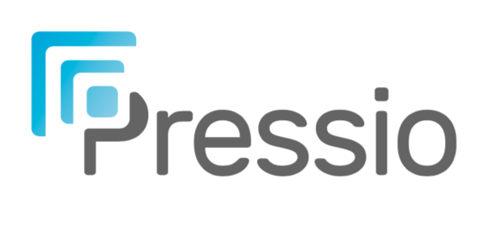
Sandia’s ROM Development/Deployment Strategy
Targeted problems present unique numerical challenges that you don’t run into with toy problems!
(e.g., strong nonlinearities, huge differences scales, turbulence/chaos, multiphysics, multi-D shocks, etc.)
Approach:
Step 1: New ideas/methods are first verified/prototyped on simple benchmarks (e.g., 1D Burgers).
New ROM Idea
New ROM Approach
Toy Problem
Publication
Step two is critical in determining whether ROMs are viable for realistic problems!
Realistic Targeted Problem
Publication
Step 2: Apply methods to targeted realistic problems – presents new challenges, requiring new R&D
  To facilitate step two, we have been developing an open-source tool called

Slide 6
An open-source* non-intrusive computational framework aimed at providing performant projection-based ROMs for generic application codes
Main idea:
  Separate the “application” and the ROM
  ROM methods are contained in the Pressio framework
  Pressio “plugs in” to an application code
Salient features:
  Header-only C++ library
  Supports HPC performance portability via Kokkos
  Supports Python API
  Supports Galerkin, LSPG, and WLS ROMs (with hyper-reduction)
  Pressio’s API requires application to expose two main routines: residual and applyJacobian
rom
* https://github.com/Pressio
Advantages:
  Pressio can be used to easily add ROM capabilities to any generic HPC code!
  Methods added to Pressio are at the fingertips of users of HPC codes hooked up to Pressio!

Slide 7
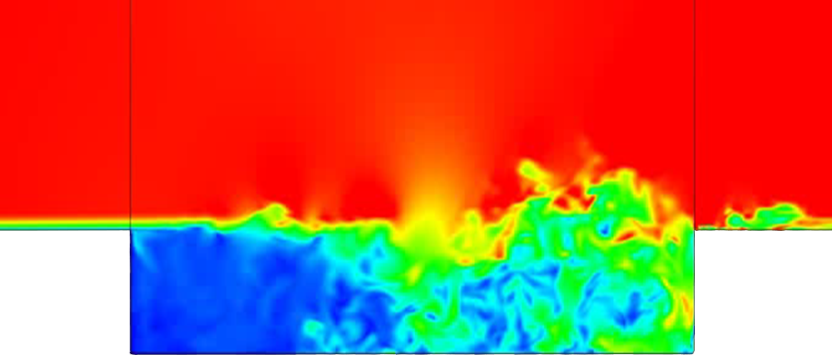
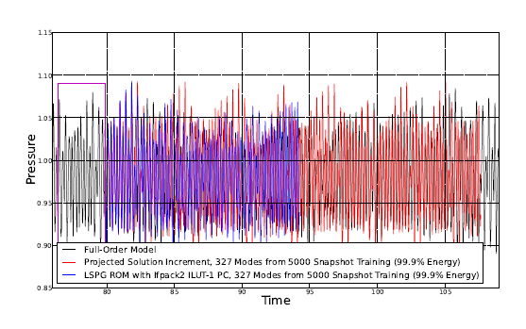
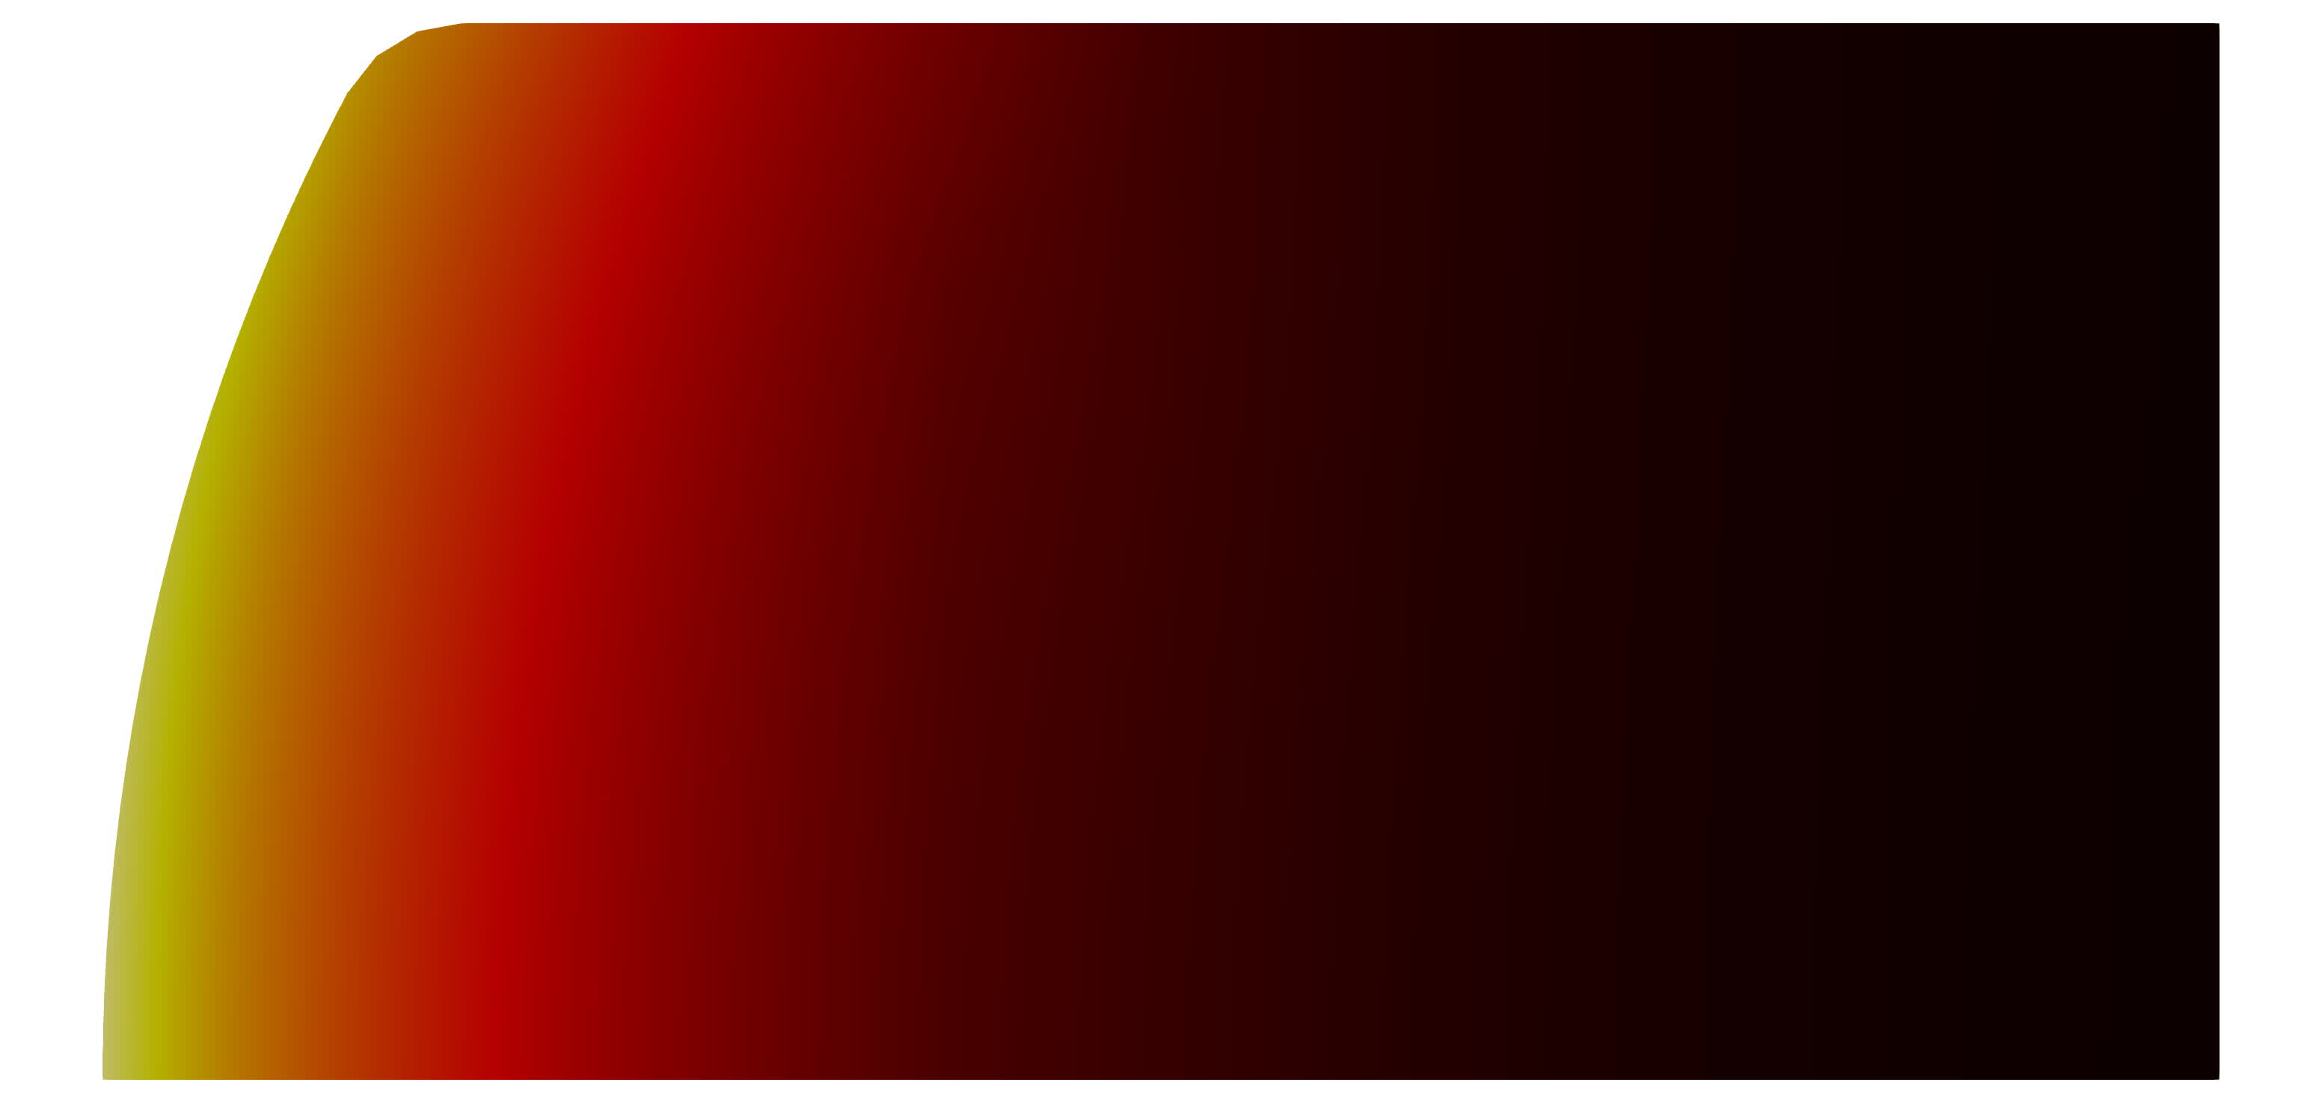
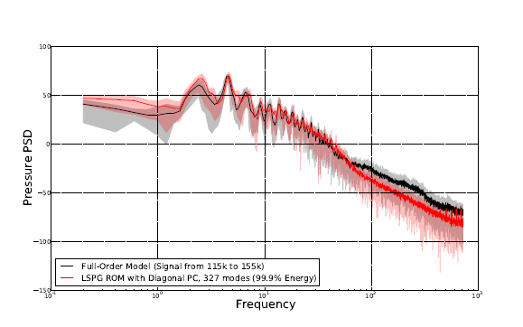
Recent ROM Successes at SNL
ROM accelerates ablation simulation with SPARC compressible flow solver
Time-predictive preconditioned captive-carry ROM in SPARC demonstrated to have sufficiently accurate pressure PSD
First applications of ROMs to ablation
Large differences in scales (7 orders of magnitude)
Iso-q with prescribed axisymmetric heat- and mass-transfer boundary conditions
Laminar compressible cavity problem (Ma = 0.6, Re = 3000).
Primarily interested in prediction in time.
High-fidelity
ROM
ROM PSD is within FOM PSD range!
~17x savings in core-hours
<0.1% error in temp, <4% error in disp
FOM
Preconditioned LSPG ROM
Notes:
QUES: what is iso-q?

Slide 8
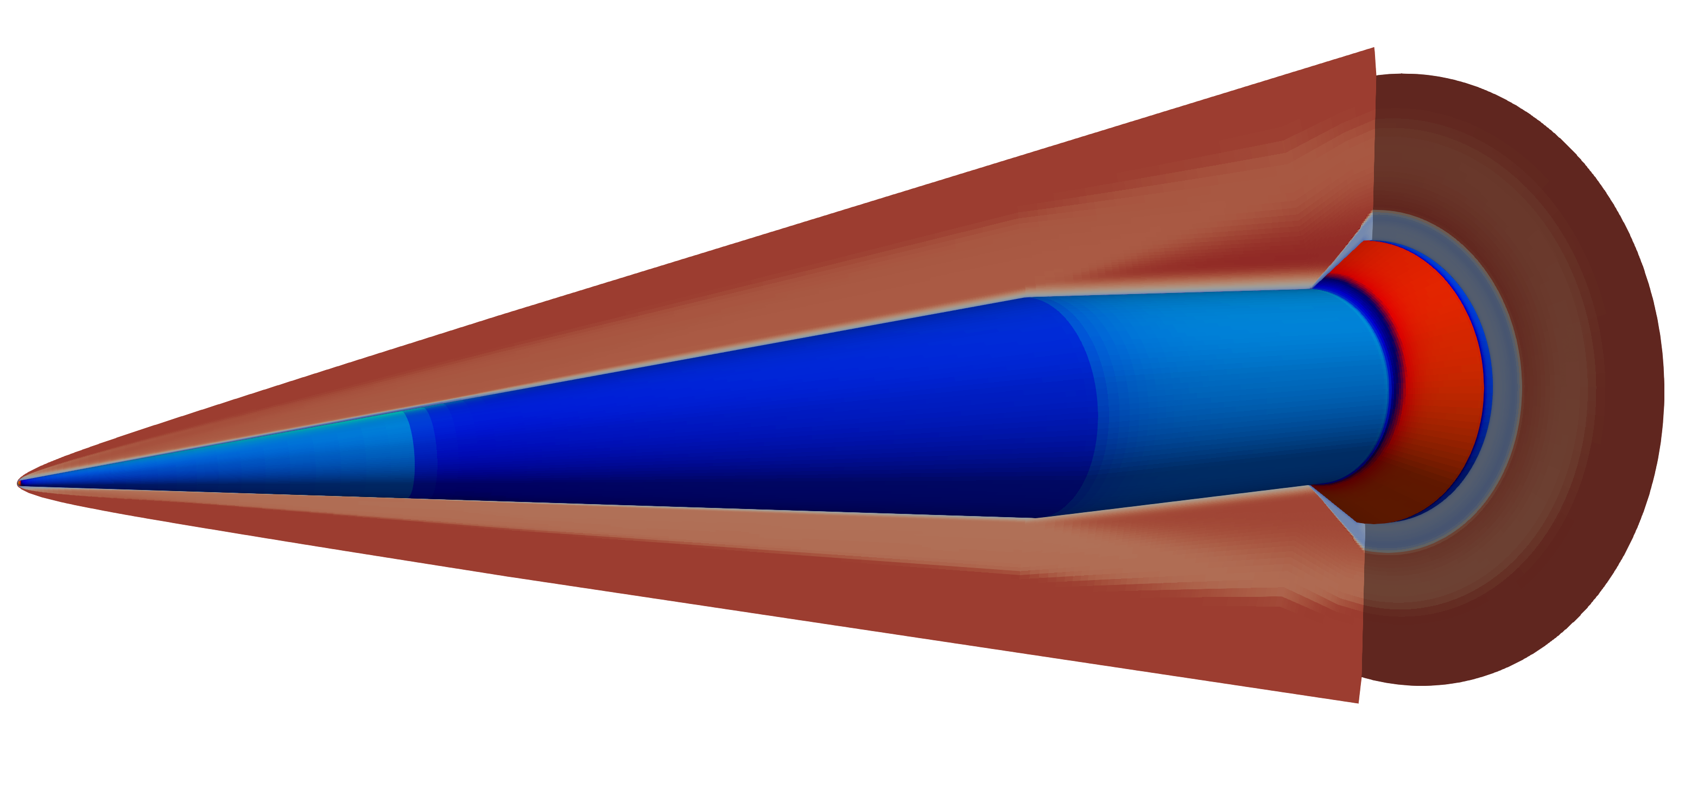
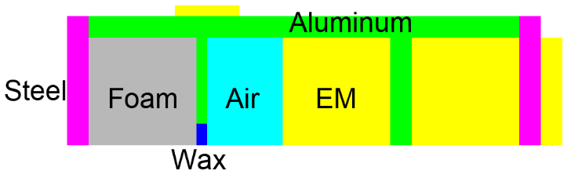
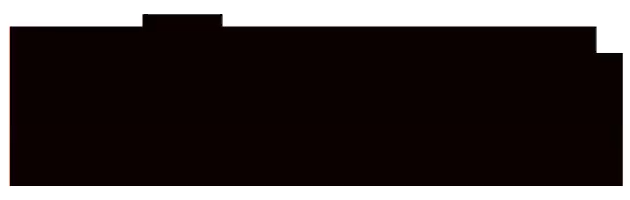
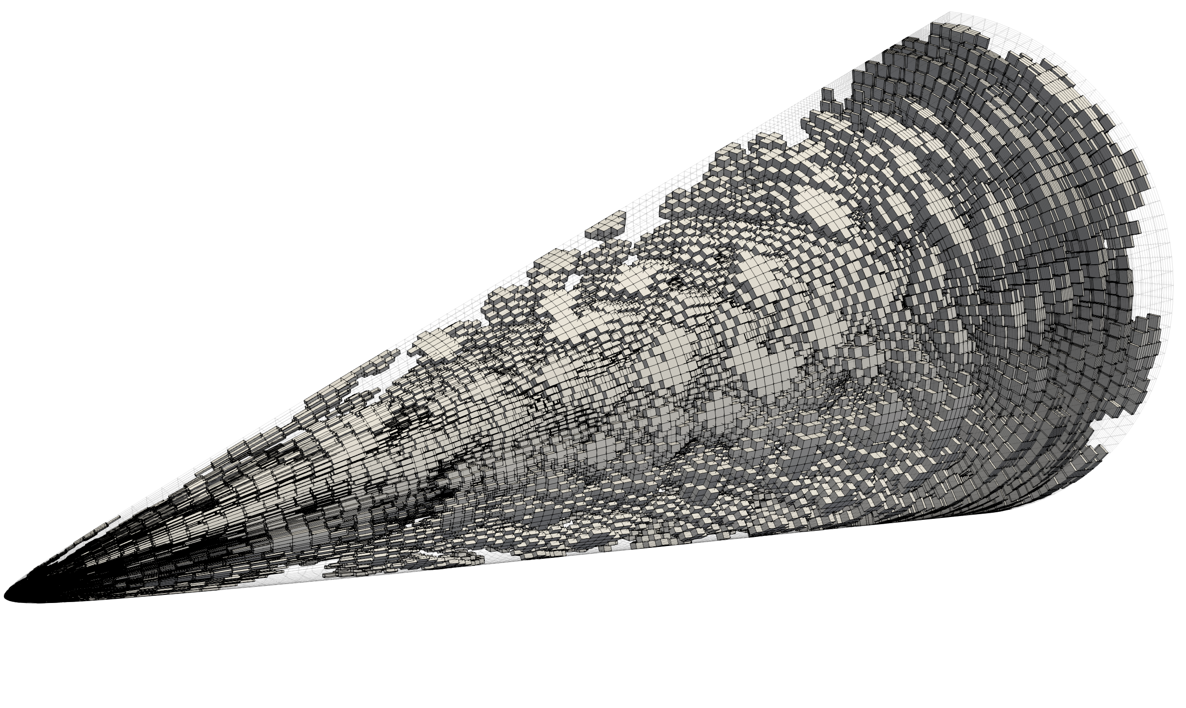
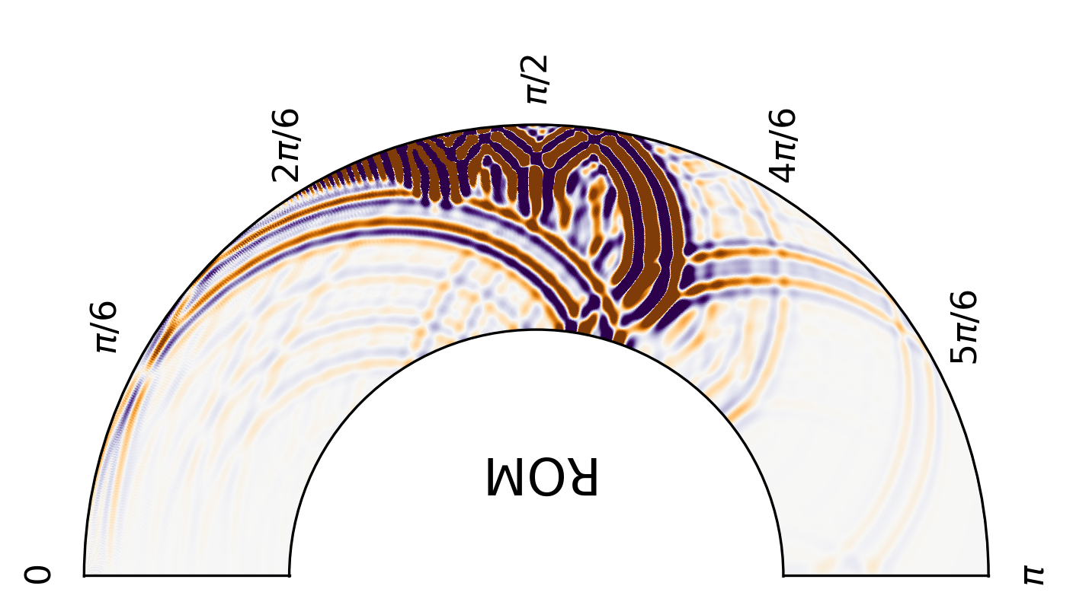
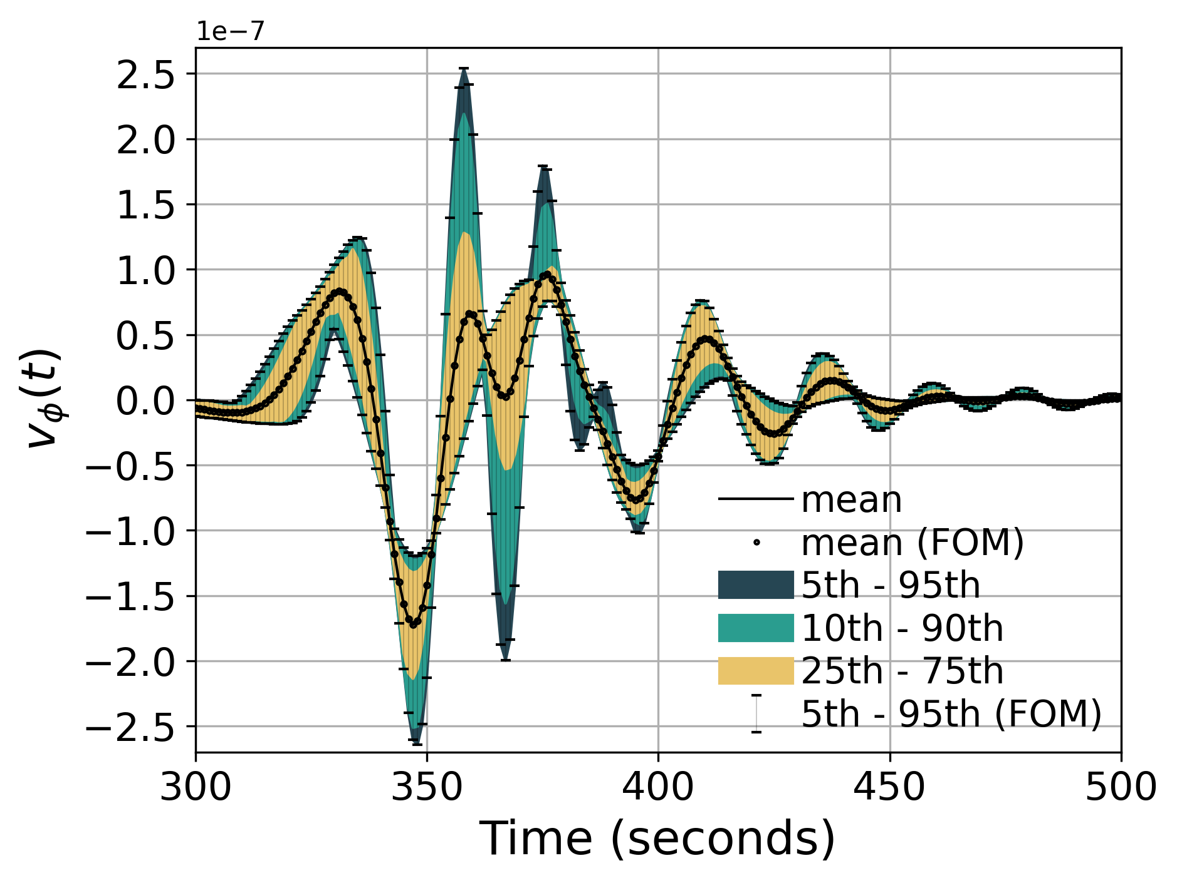


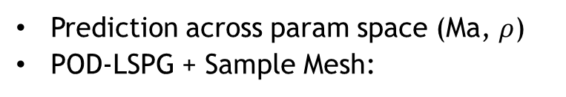



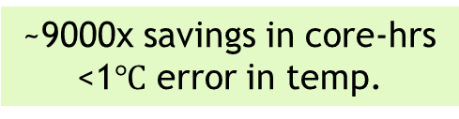


Recent ROM Successes at SNL (cont’d)
ROM accelerates transient conduction/thermochemistry in Aria
Transient thermochemistry test
  Foam decomposition
  Heat conduction
  Exothermic chemical reactions
ROM accelerates hypersonics simulation (HiFIRE-1 experiment) using in-house compressible flow solver (SPARC)
~9000x savings in core-hrs
<1$℃$ error in temp.
Re=10⁷
Ma ∞ =7.1
ROM accelerates seismic wave propagation
Prediction across param space (Ma, $ρ$)
POD-LSPG + Sample Mesh:
Synthetic seismogram data
One shot UQ: simultaneous simulation of many trajectories
$$\frac{π}{2}$$
$$\frac{2π}{3}$$
$$\frac{π}{3}$$
~300-1000x savings in core-hrs
<1% error in density, momentum, energy
~1-2% error in integrated wall heat flux
~950x savings in wall-time
<1% error
$$\frac{π}{6}$$
$$\frac{5π}{6}$$
[Blonigan, Carlberg, Rizzi, Howard, Fike, 2020]
$$0$$
$$π$$
Notes:
TODO: check if Ma and rho are correct params across which doing prediction for HiFIRE
QUES: for ARIA test, is this predictive? What are we predicting across – parameter space? Use POD-LSPG + sample mesh, I assume. Why is speed-up so large for ARIA test?
QUES: is wave propagation problem predictive? What code?

Slide 9
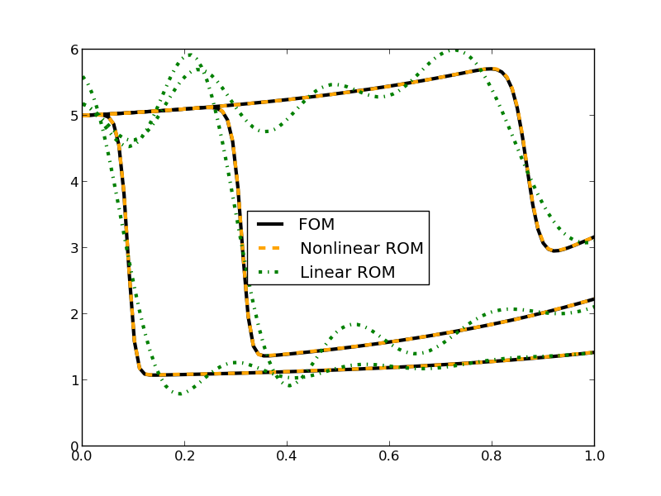
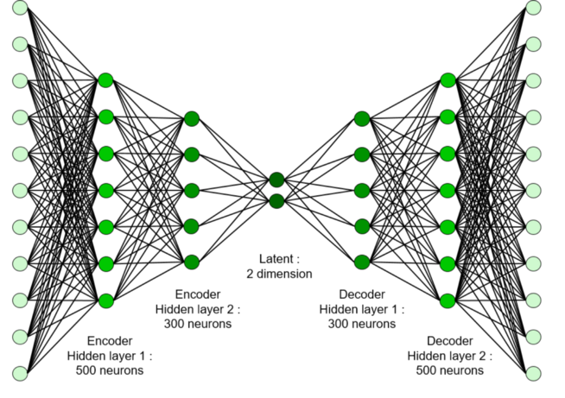
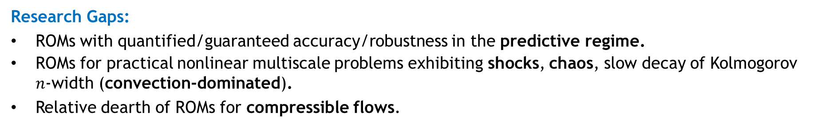
Research Gaps & Directions
Research Gaps:
ROMs with quantified/guaranteed accuracy/robustness in the predictive regime.
ROMs for practical nonlinear multiscale problems exhibiting shocks, chaos, slow decay of Kolmogorov $n$-width (convection-dominated).
Relative dearth of ROMs for compressible flows.
Current Research Directions at Sandia:
Windowed least-squares (WLS) ROMs [Parish, Carlberg, 2020; Shimizu, Parish, 2021].
ROM preconditioners to improve ROM predictability [Fike, Lindsay, Tezaur, Carlberg, 2021].
Domain decomposed ROMs for networks [Hoang, Choi, Carlberg, 2020].
Nonlinear manifold ROMs using autoencoders [Lee, Carlberg, 2020].
Notes:
QUES: Am I missing any refs? Gaps? Directions? - that we want to highlight

Slide 10
Suggestions for Benchmarks & ROM Evaluation Strategies
There should be benchmarks that go beyond simple 1D/2D toy problems.
  How to “release”/formulate these is a challenge, as high-fidelity code is likely required.
  Software like Pressio can help bridge the gap between ROM and application developers and give ROM developers access to more realistic problems to test their methods.
  Publishing problem formulations/datasets may help researchers set up more realistic tests in their own codes (“bake-of” problems or “model intercomparison” problems).
It’s important to evaluate ROMs in the predictive regime.
  Many researchers/authors never make it past reproductive regime.
In evaluating ROMs, one needs to carefully design relevant QOIs/metrics of success.
  Very application specific – e.g., for compressible flow ROM, analysts care about pressure PSD, not entire solution field.
  While ROMs cannot be expected to reproduce the entire solution field to a specified tolerance for an arbitrarily complex predictive problem, there is some hope of a ROM reproducing some relevant QOI.
Applying ROM to more realistic problems using appropriate QOIs/metrics will tell us how viable ROMs can be beyond the space of “toy” problems.
Notes:
QUES: ask team if anything to add.

Slide 11
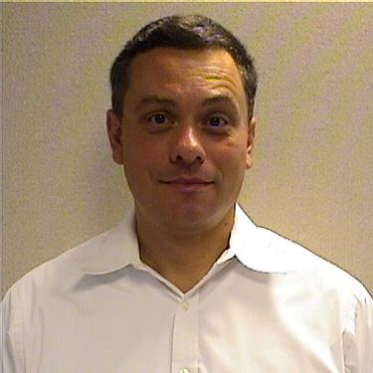
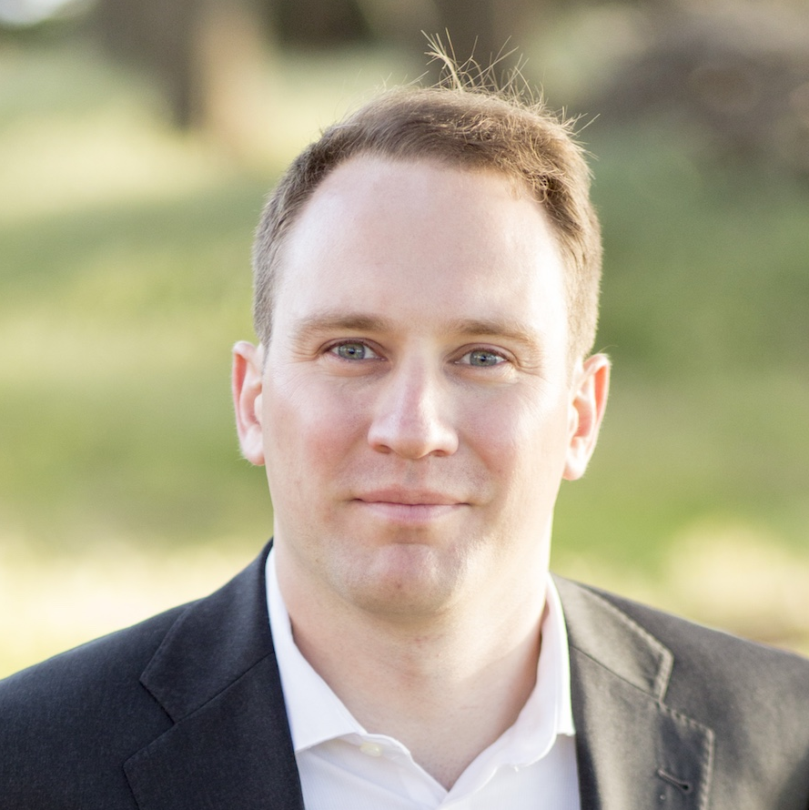
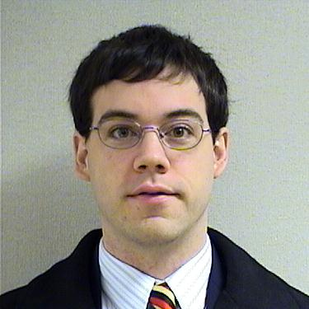
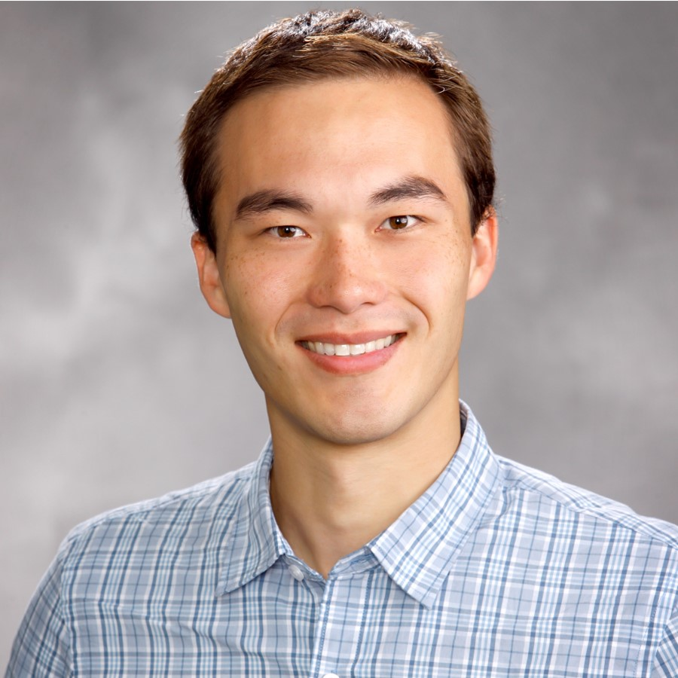
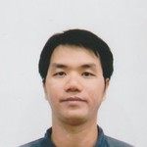


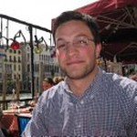


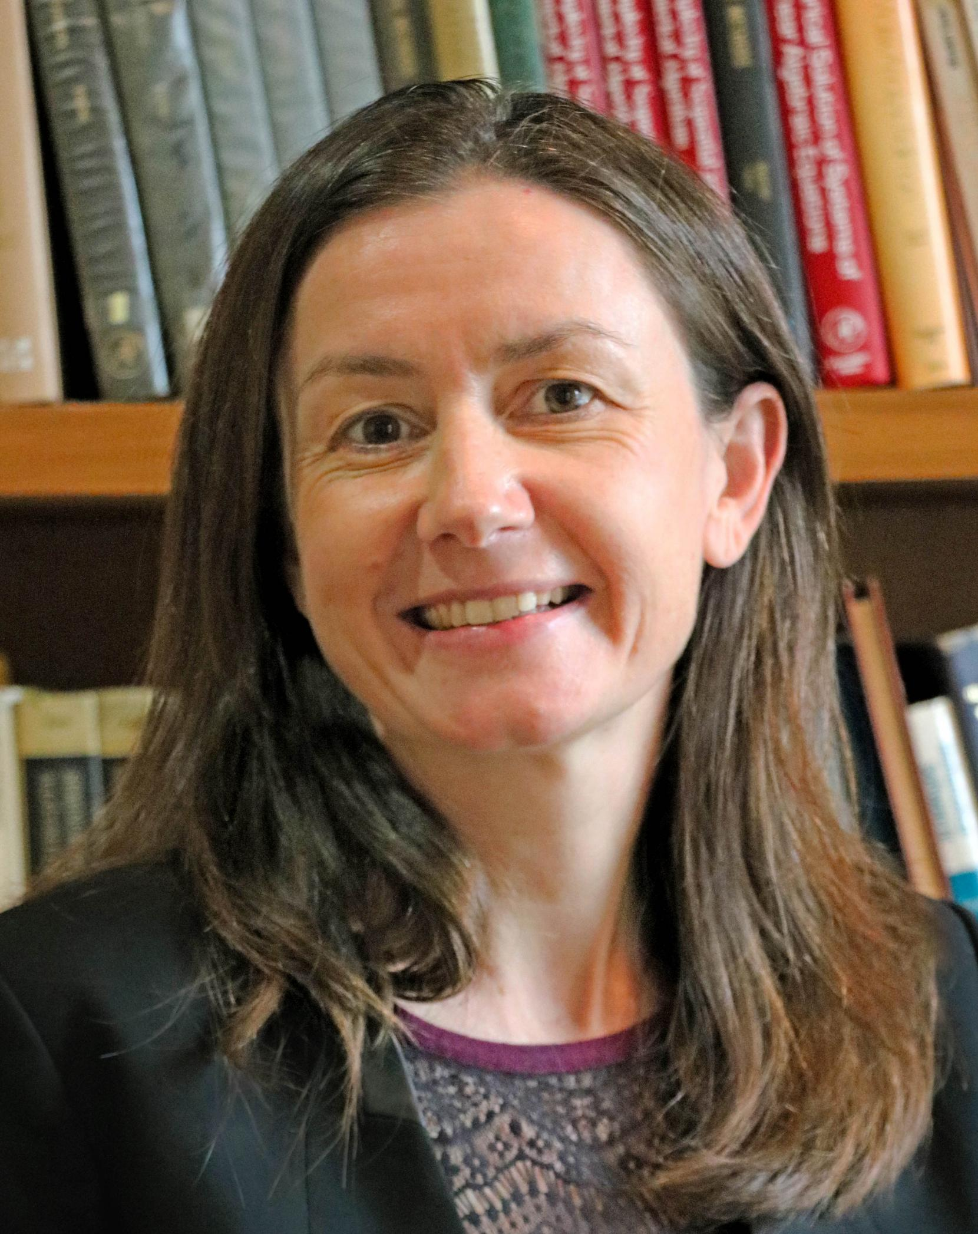
Research Team
Marco Arienti
Patrick Blonigan
Victor Brunini
David Ching
Jeff Fike
Chi Hoang
Micah Howard
Kookjin Lee
Samuel Majors
Eric Parish
Flint Pierce
Kevin Potter
Jaideep Ray
Francesco Rizzi
Yuki Shimizu
John Tencer
Irina Tezaur
Karen Willcox
Notes:
Kevin Carlberg, Philip Etter, Brian Freno, Kookjin Lee, Samuel Majors, Nirmal Nair, Eric Parish, Alex Schein, Yukiko Shimizu, Irina Tezaur, Karen Willcox
Francesco Rizzi
Marco Arienti, Patrick Blonigan, David Ching, Jeff Fike, Micah Howard, Flint Pierce, Jaideep Ray, John Tencer

